Slide 1




2021 Commissioning:
RF campaign in EAR1 with C₆D₆
V. Alcayne, A. Casanovas, F. García, J. Lerendegui,
E. Musacchio and J.A. Pavón

Slide 2
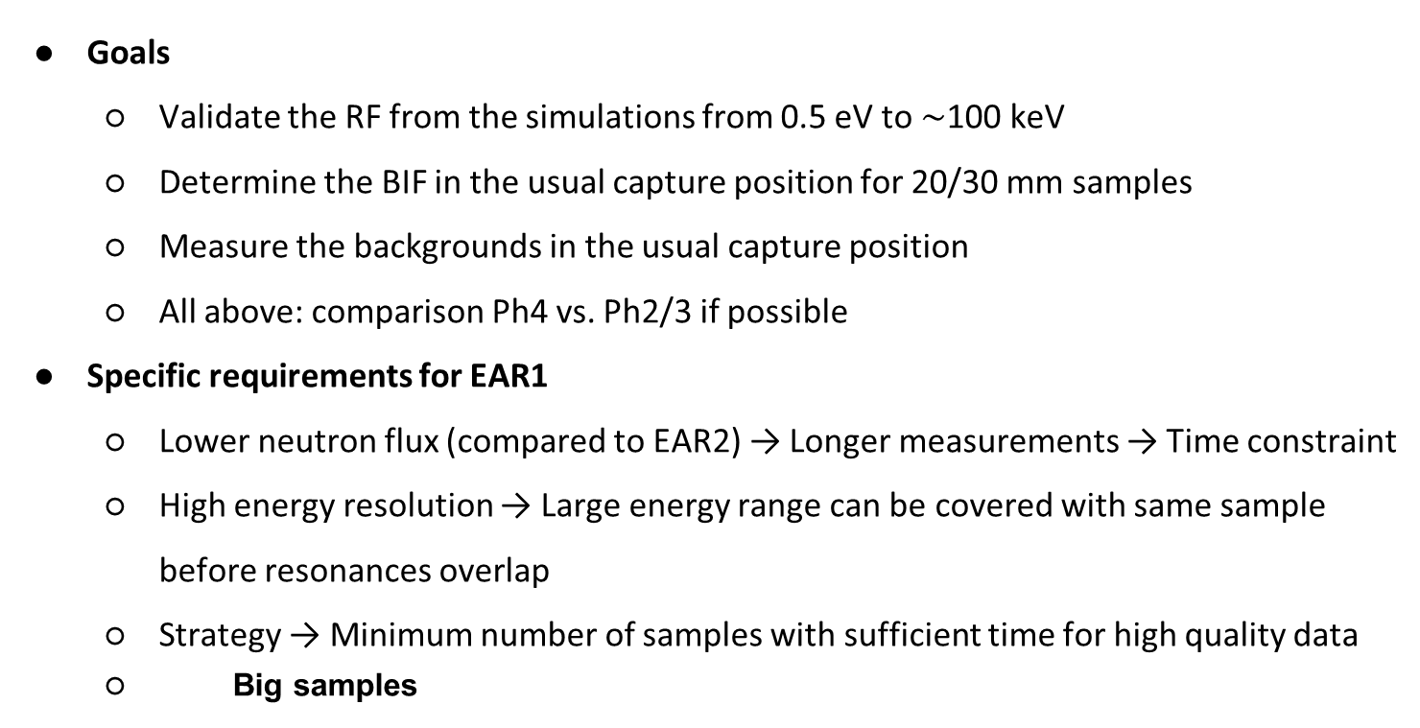
RF @ EAR1: Goals and planning
Goals
  Validate the RF from the simulations from 0.5 eV to $\sim$100 keV
  Determine the BIF in the usual capture position for 20/30 mm samples
  Measure the backgrounds in the usual capture position
  All above: comparison Ph4 vs. Ph2/3 if possible
Specific requirements for EAR1
  Lower neutron flux (compared to EAR2) → Longer measurements → Time constraint
  High energy resolution → Large energy range can be covered with same sample before resonances overlap
  Strategy → Minimum number of samples with sufficient time for high quality data
  Big samples

Slide 3
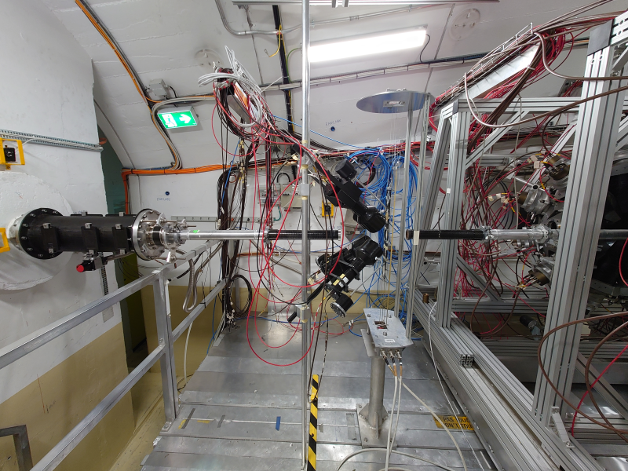
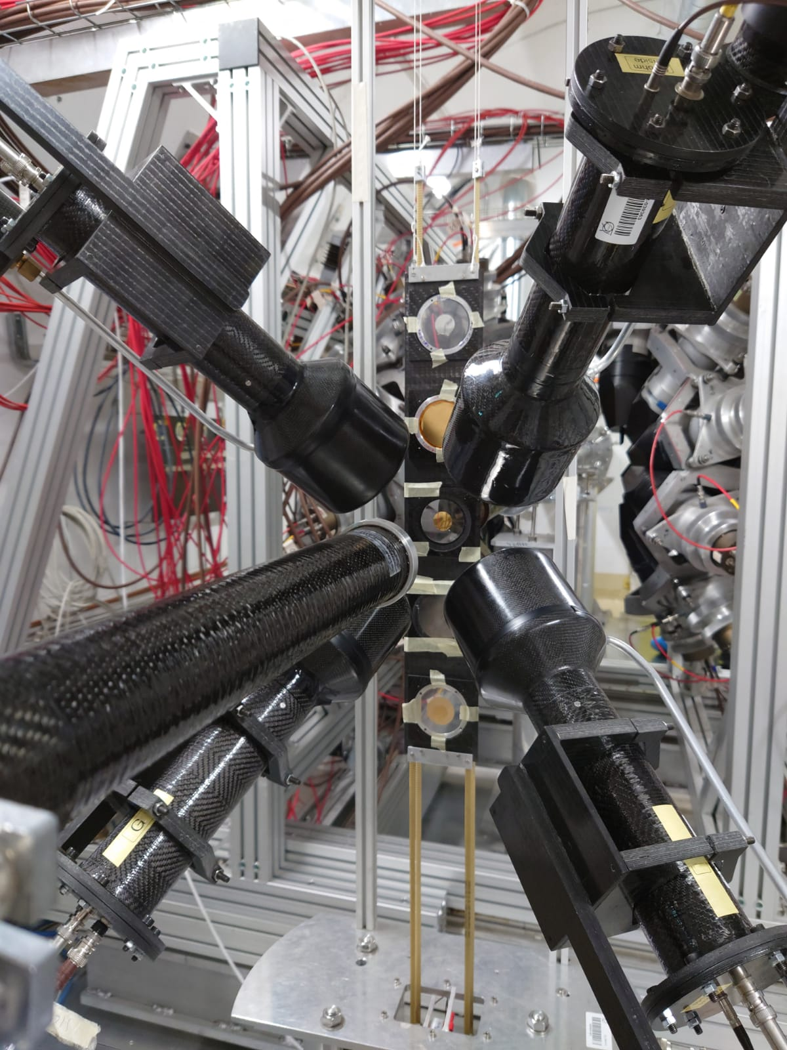
RF @ EAR1: Experimental Setup
Standard capture setup of SiMon + 4xL₆D₆ (D,E,G,L) + Sample Exchanger mounted on 27/28-9
L6D6 L
L6D6 D
L6D6 E
L6D6 G

Slide 4
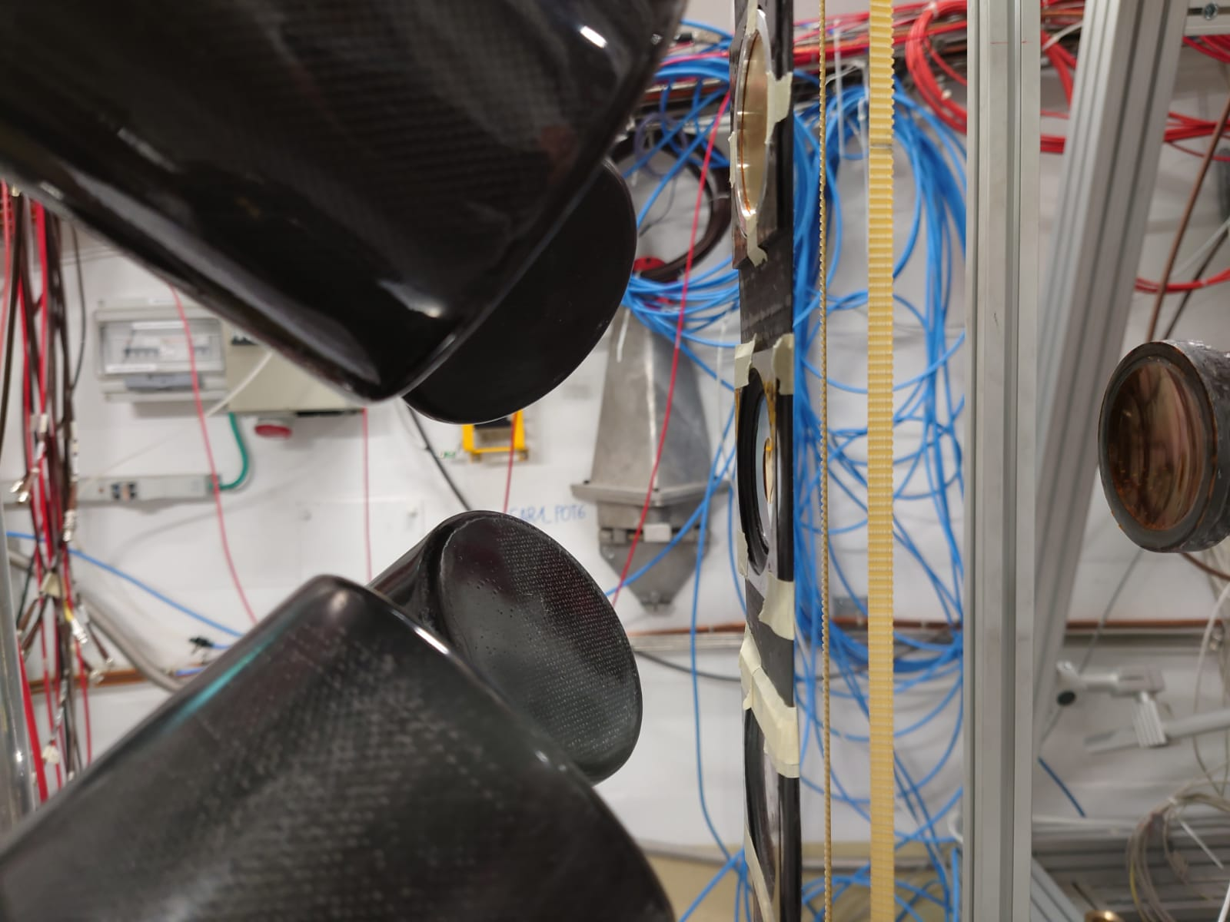
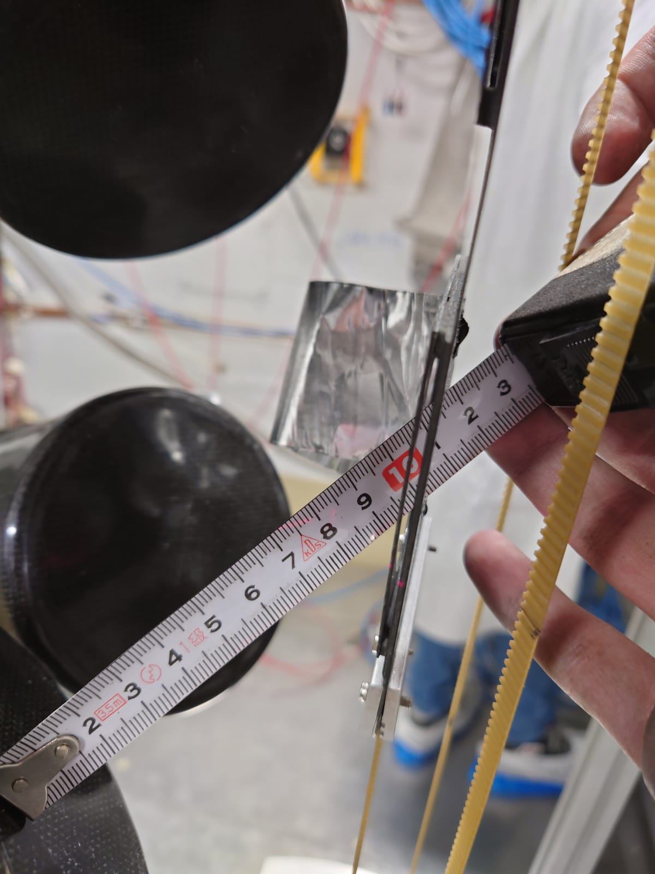
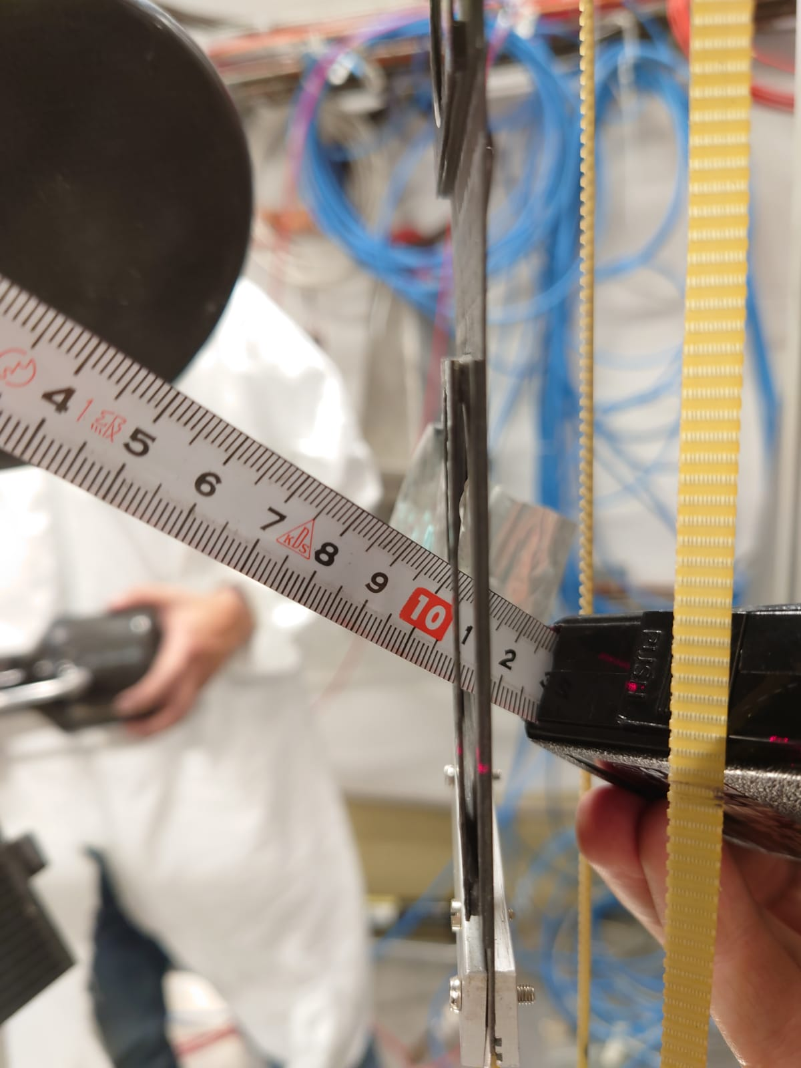
RF @ EAR1: Experimental Setup
Standard capture setup Simon + 4xL₆D₆ + Sample Exchanger mounted on 27/28-9
Detectors-sample distance: 10 cm, 125º from beam direction
PMT at 1500~1600 V

Slide 5
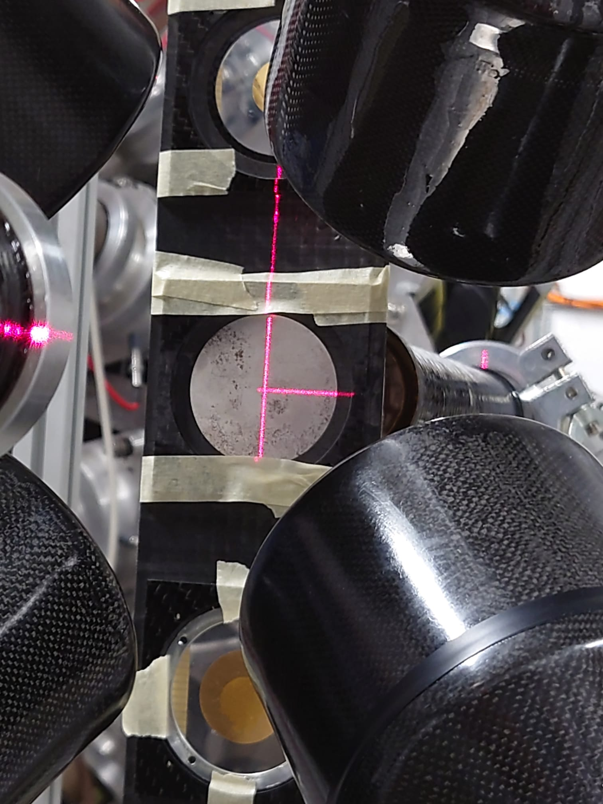
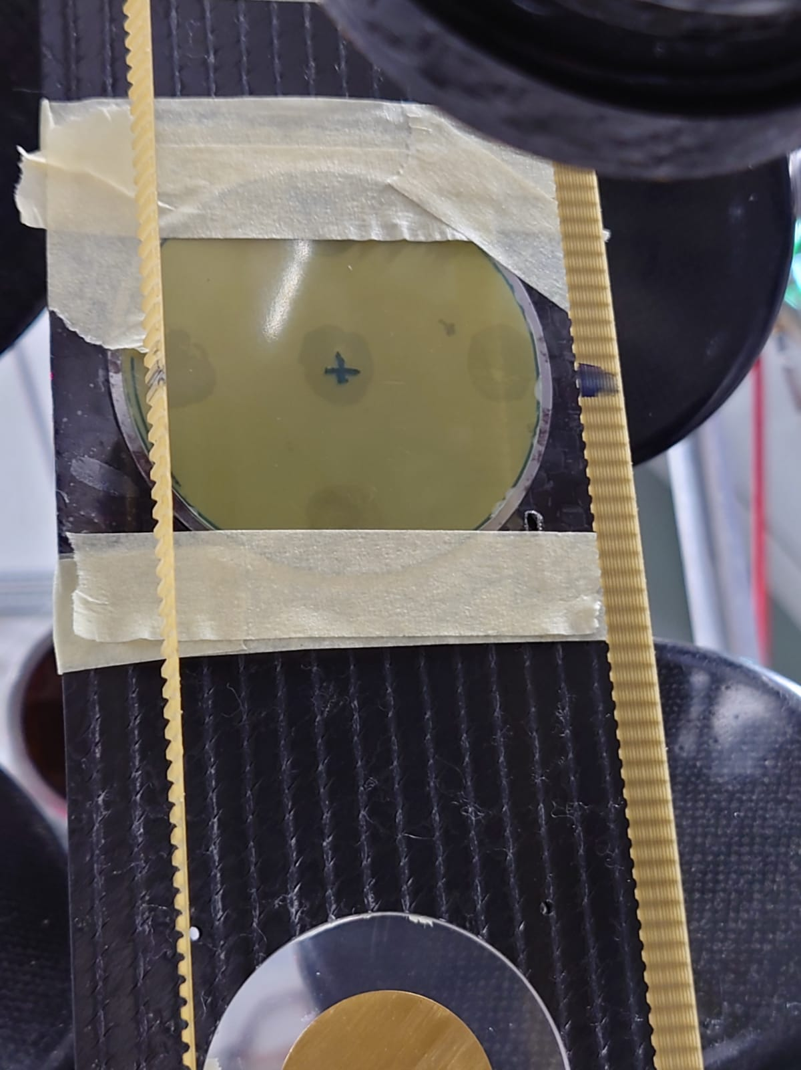
RF @ EAR1: Experimental Setup
Gafchromic foil inserted behind 65x2 mm ^{nat}Fe sample to check if alignment OK after change of collimator

Slide 6

RF @ EAR1: Summary
EAR1 RESOLUTION FUNCTION CAMPAIGN SUMMARY
ISOTOPE | DIMENSIONS / MASS | REF. | Protons | Goal
¹⁹⁷Au | 20 x 0.1 mm / 0.596 g | 101 | 1.05·10¹⁷ | RF @ 5eV- 1 keV, RF vs sample size, BIF
¹⁹⁷Au | 30 x 0.1 mm / 1.308 g | 228 | 8.60·10¹⁶ | RF @ 5eV- 1 keV, RF vs sample size, BIF
¹⁹⁷Au | 45x0.1 mm + 48x0.1 mm / 5.057 g | 22 | 1.76·10¹⁷ | RF @ 5eV- 1 keV, RF vs sample size, BIF, Activation
^{nat}Fe | 65 x 2 mm / 54.55 g | 153 | 5.01·10¹⁷ | RF @ keV – 100 keV and beyond
^{nat}Ir | 20 x 0.1 mm / 0.709 g | 369 | 9.01·10¹⁶ | RF < eV, flightpath vs E_{n}
^{nat}Si | 50.8 x 5 mm / 23.50 g | 629 | 2.97·10¹⁷ | RF @ keV – 100 keV and beyond
Empty |  |  | 1.48·10¹⁷ | Background
Lead* | 20 x 0.1 mm / 7.281 g | 184 | 1.51·10¹⁷ | Background, Ph2/Ph4 comparison
Carbon* | 20 x 6.6 mm / 0.596 g | 18 | 1.26·10¹⁷ | Background comparison Ph2/Ph4 comparison
28/9
to
16/10
10/11
to
14/11
*Peformed during ¹⁷⁶Yb(n,γ) campaign
Total RF samples: 1.26·10¹⁸ Backgrounds: 4.25·10¹⁷

Slide 7
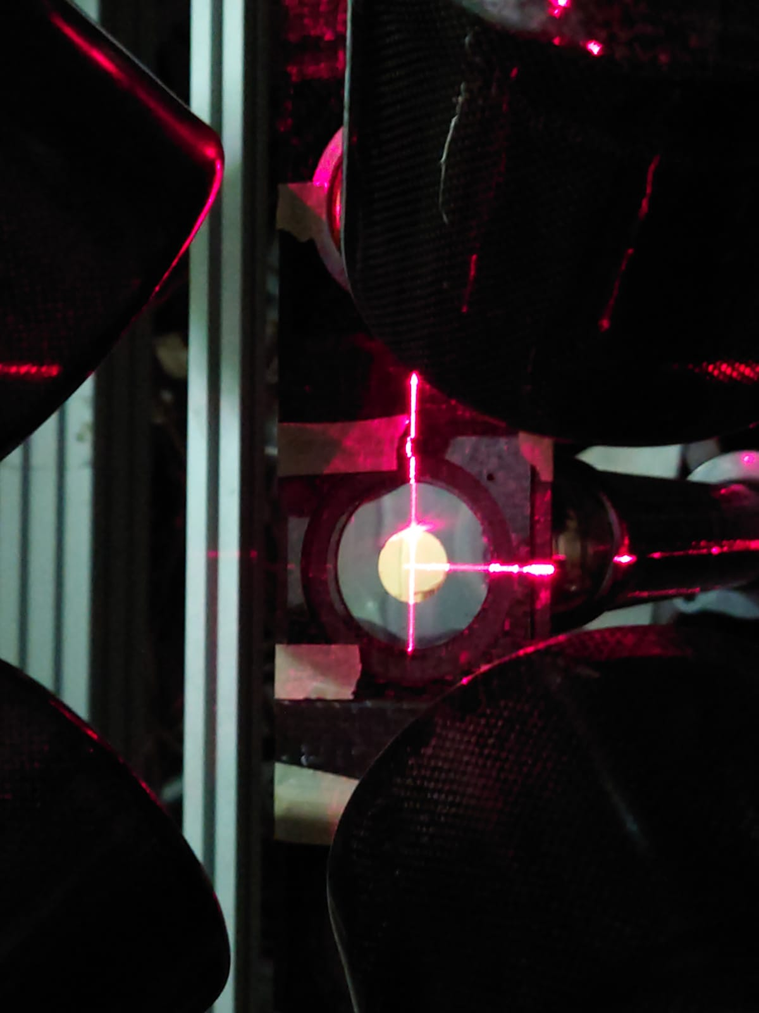
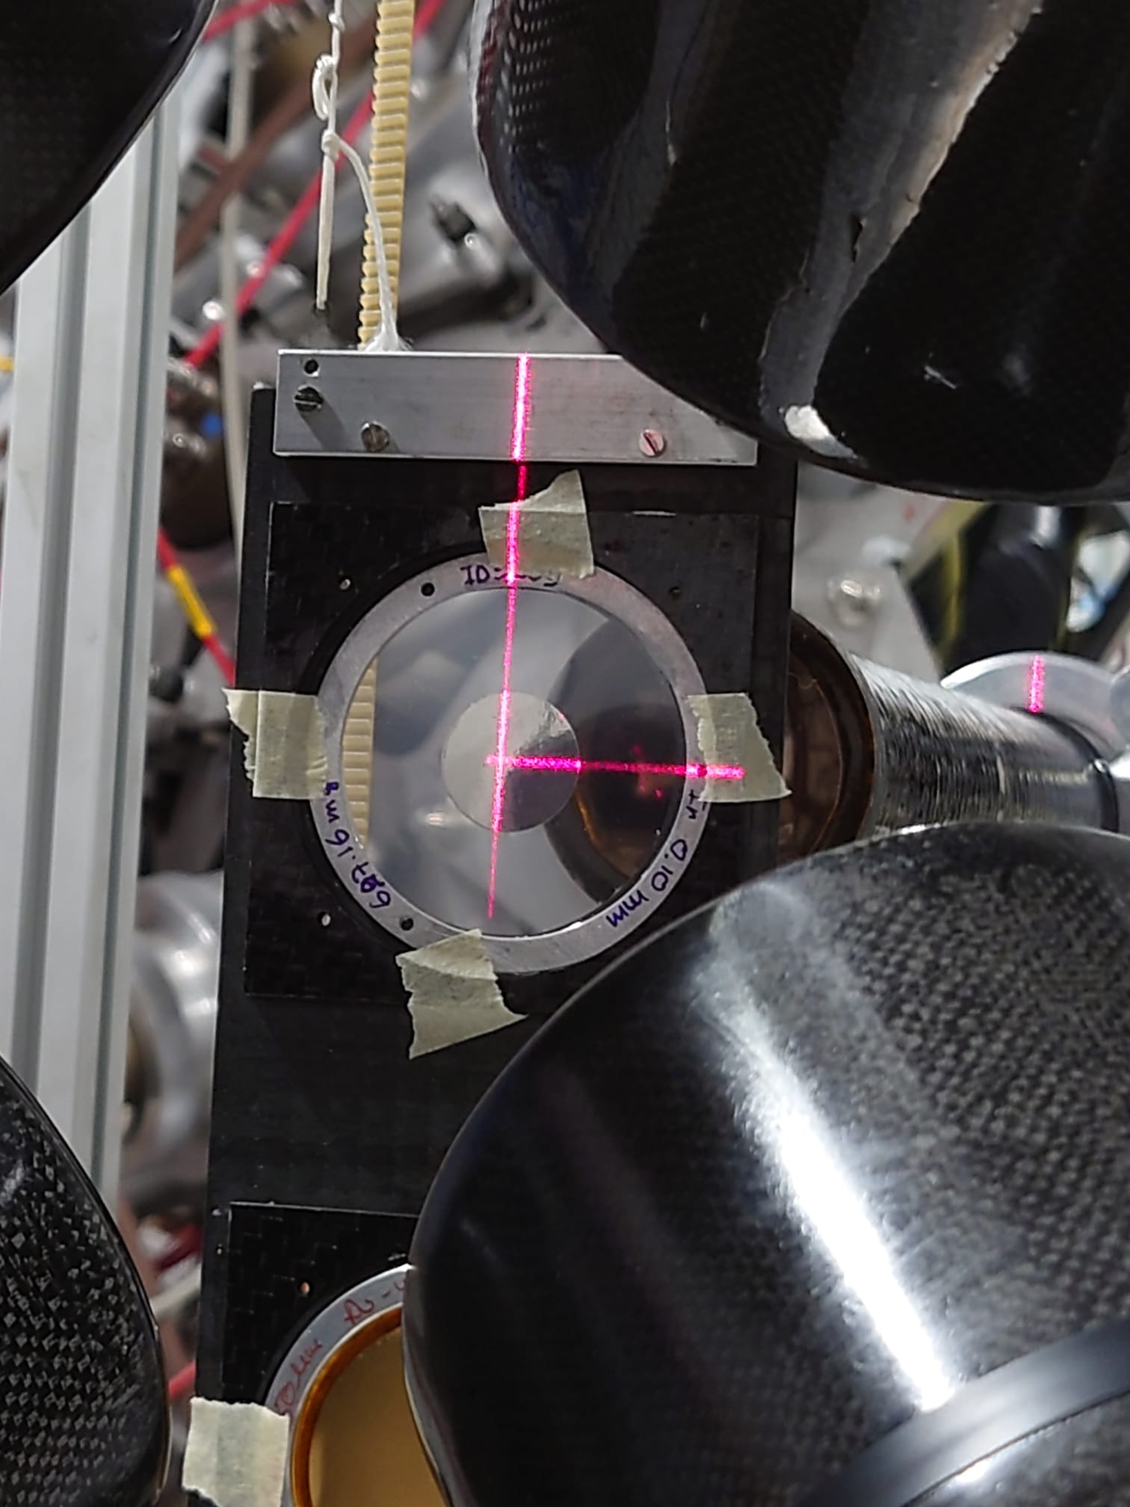
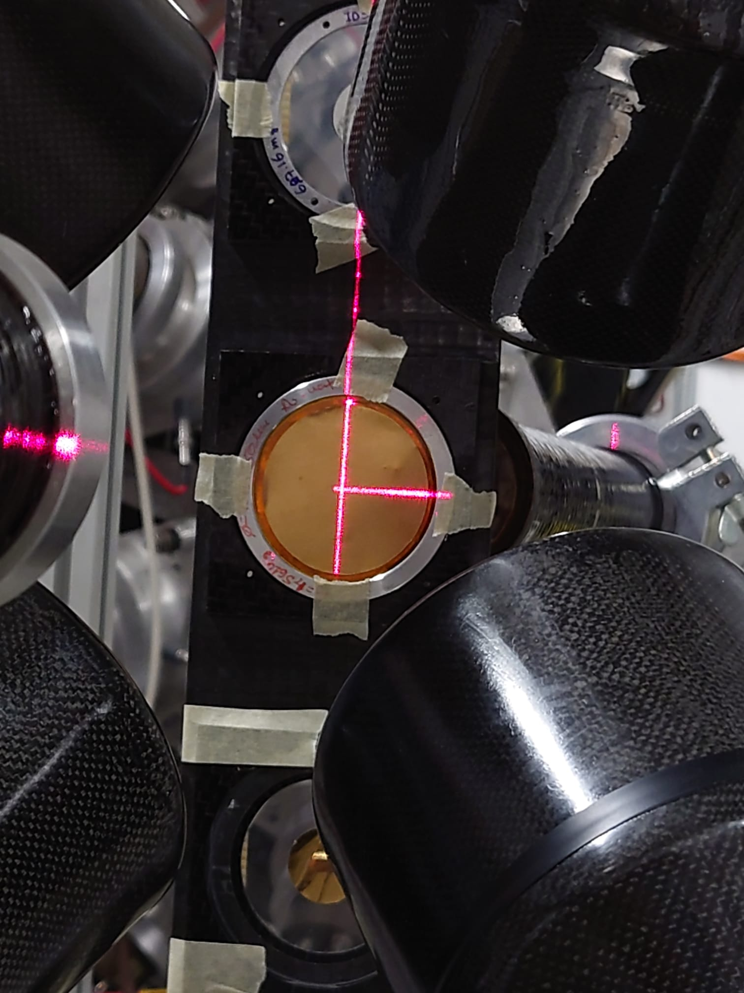

RF @ EAR1: Experimental Setup
Sample Exchanger in time for RF campaign! (Thanks Pino, Sylvain, Michi!!)
20x0.1 Au sample
20x0.1 mm ^{nat}Ir sample
45x0.1 mm Au sample
65x0.2 mm ^{nat}Fe sample

Slide 8
RF @ EAR1: Summary
EAR1 RESOLUTION FUNCTION CAMPAIGN SUMMARY
ISOTOPE | DIMENSIONS / MASS | REF. | Protons | Goal
¹⁹⁷Au | 20 x 0.1 mm / 0.596 g | 101 | 1.05·10¹⁷ | RF @ 5eV- 1 keV, RF vs sample size, BIF
¹⁹⁷Au | 30 x 0.1 mm / 1.308 g | 228 | 8.60·10¹⁶ | RF @ 5eV- 1 keV, RF vs sample size, BIF
¹⁹⁷Au | 45x0.1 mm + 48x0.1 mm / 5.057 g | 22 | 1.76·10¹⁷ | RF @ 5eV- 1 keV, RF vs sample size, BIF, Activation
^{nat}Fe | 65 x 2 mm / 54.55 g | 153 | 5.01·10¹⁷ | RF @ keV – 100 keV and beyond
^{nat}Ir | 20 x 0.1 mm / 0.709 g | 369 | 9.01·10¹⁶ | RF < eV, flightpath vs En
^{nat}Si | 50.8 x 5 mm / 23.50 g | 629 | 2.97·10¹⁷ | RF @ keV – 100 keV and beyond
Empty |  |  | 1.48·10¹⁷ | Background
Lead* | 20 x 0.1 mm / 7.281 g | 184 | 1.51·10¹⁷ | Background, Ph2/Ph4 comparison
Carbon* | 20 x 6.6 mm / 0.596 g | 18 | 1.26·10¹⁷ | Background comparison Ph2/Ph4 comparison
28/9
to
16/10
10/11
to
14/11
*Peformed during ¹⁷⁶Yb(n,γ) campaign
Total RF samples: 1.26·10¹⁸ Backgrounds: 4.25·10¹⁷

Slide 9
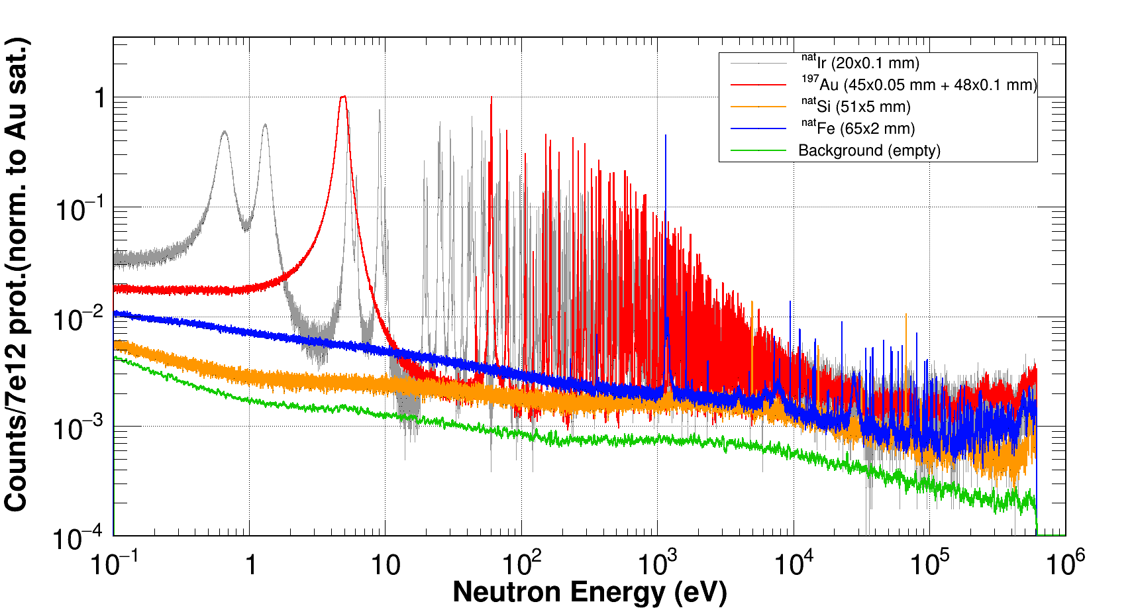
RF @ EAR1: Summary
EAR1 RESOLUTION FUNCTION CAMPAIGN SUMMARY
RF and flight path < 1eV
BIF and RF up to 1 keV
RF at 1 – 100 keV range and beyond

Slide 10
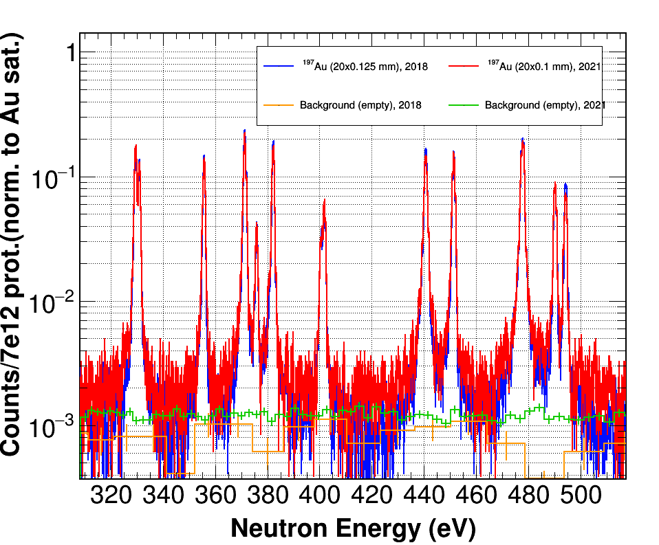
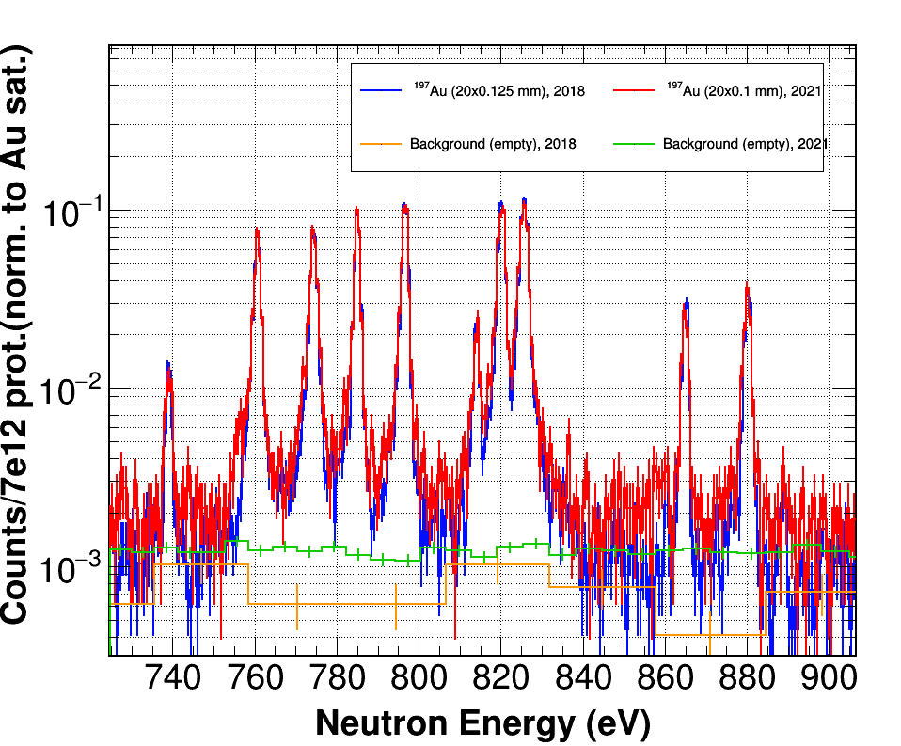
RF: First look at ¹⁹⁷Au, 2021 vs 2018
Au-197, 20x0.1 mm (2021) vs Au-197, 20x0.125 mm (2018)
Calib. in ToF to E_{n}: L₀=184.28 m (60 eV Au res.)

Slide 11
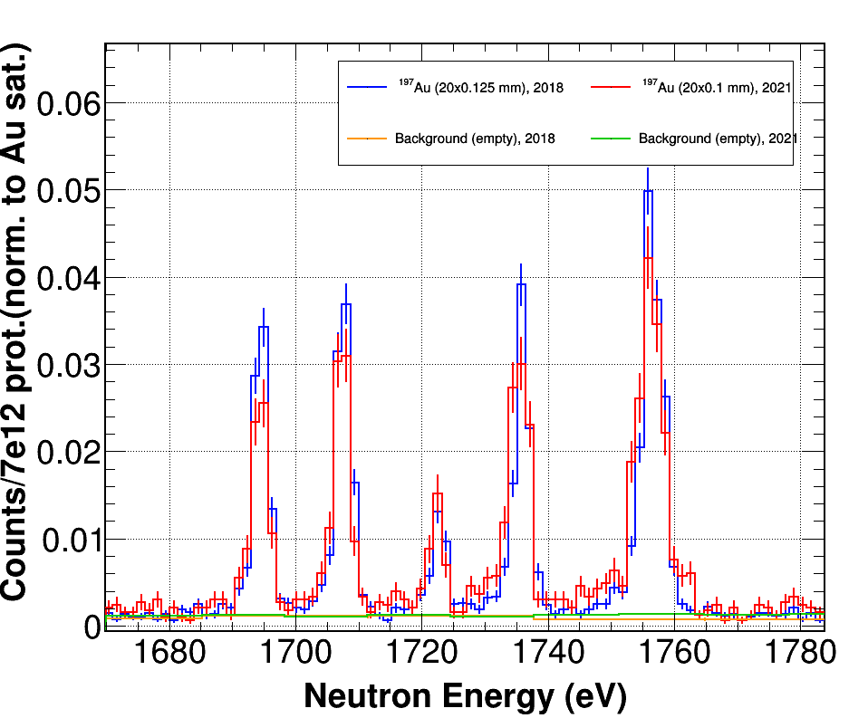
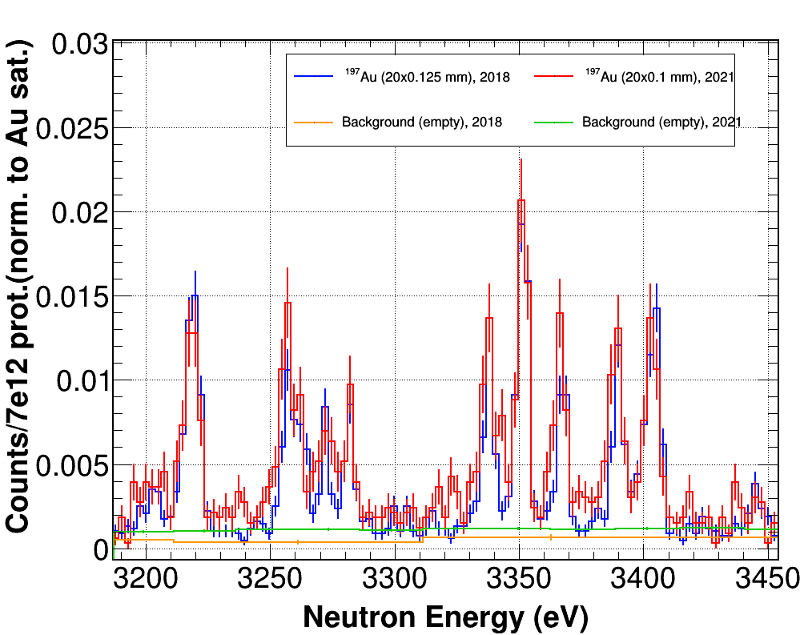
RF: First look at ¹⁹⁷Au, 2021 vs 2018
¹⁹⁷Au, 20x0.1 mm (2021) vs ¹⁹⁷Au, 20x0.125 mm (2018)
Calib. in ToF to E_{n}: L₀=184.28 m (60 eV Au res.)

Slide 12
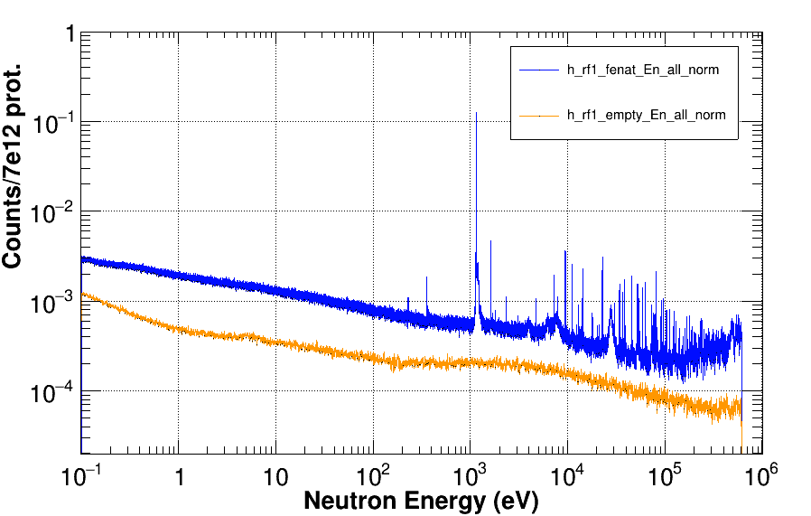
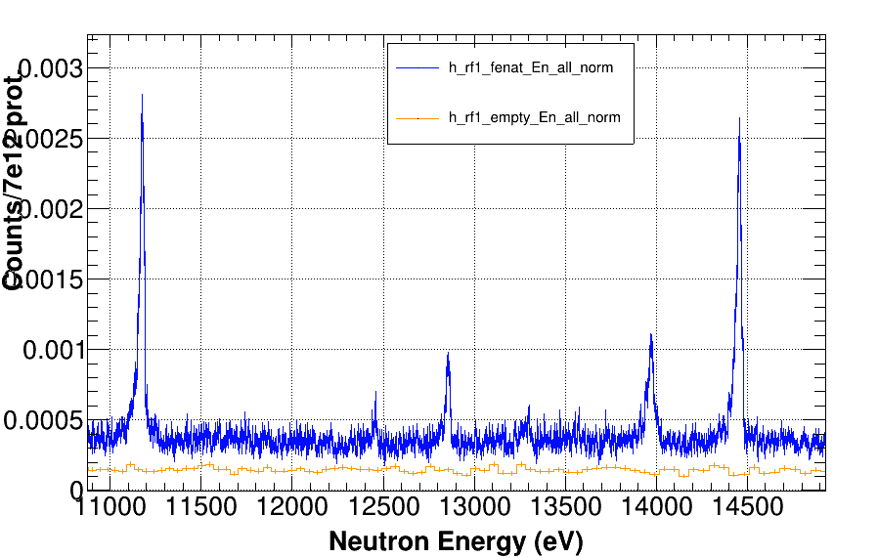
RF @ EAR1: ^{nat}Fe
^{nat}Fe, 65x0.2 mm (2021), 92% Fe-56, Fe-54 (5.85%), Fe-57 (2.1%)
Calib. in ToF to E_{n}: L₀=184.28 m
5x10¹⁷ protons

Slide 13
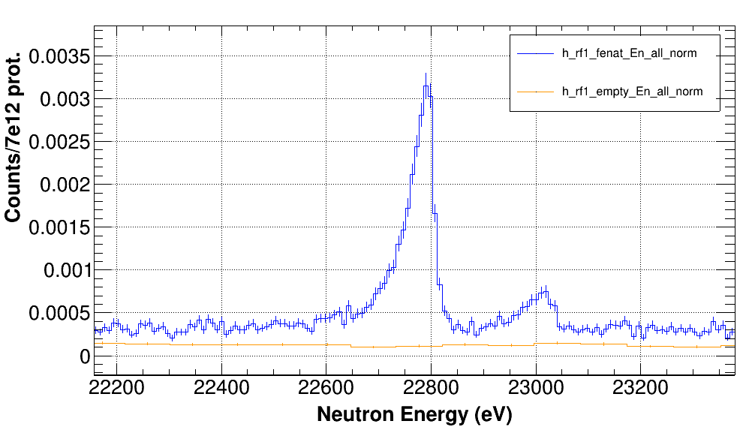
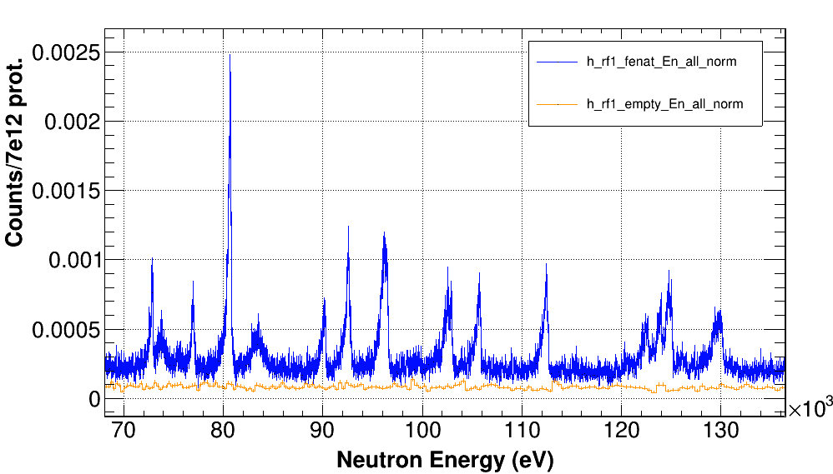
RF @ EAR1: ^{nat}Fe
^{nat}Fe, 65x0.2 mm (2021), 92% Fe-56, Fe-54 (5.85%), Fe-57 (2.1%)
Calib. in ToF to E_{n}: L₀=184.28 m
5x10¹⁷ protons

Slide 14
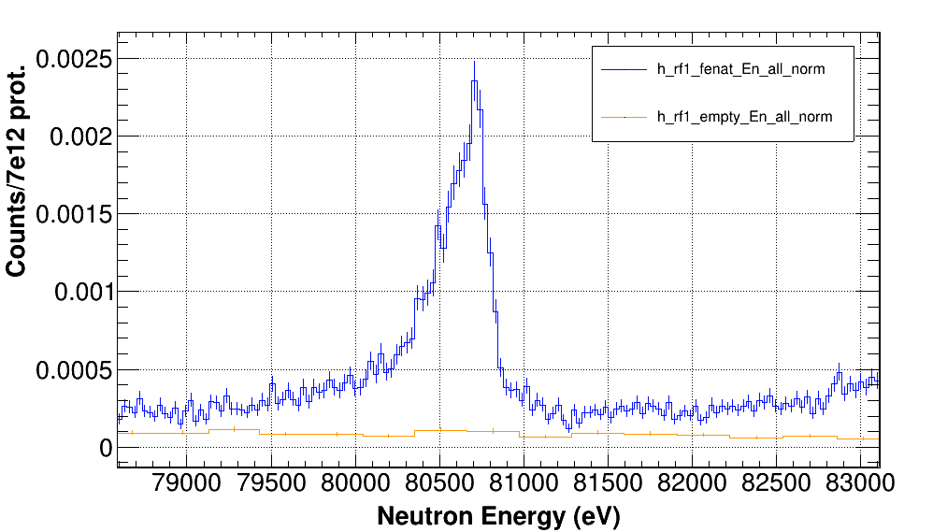
RF @ EAR1: ^{nat}Fe
^{nat}Fe, 65x0.2 mm (2021), 92% Fe-56, Fe-54 (5.85%), Fe-57 (2.1%)
Calib. in ToF to E_{n}: L₀=184.28 m
5x10¹⁷ protons

Slide 15
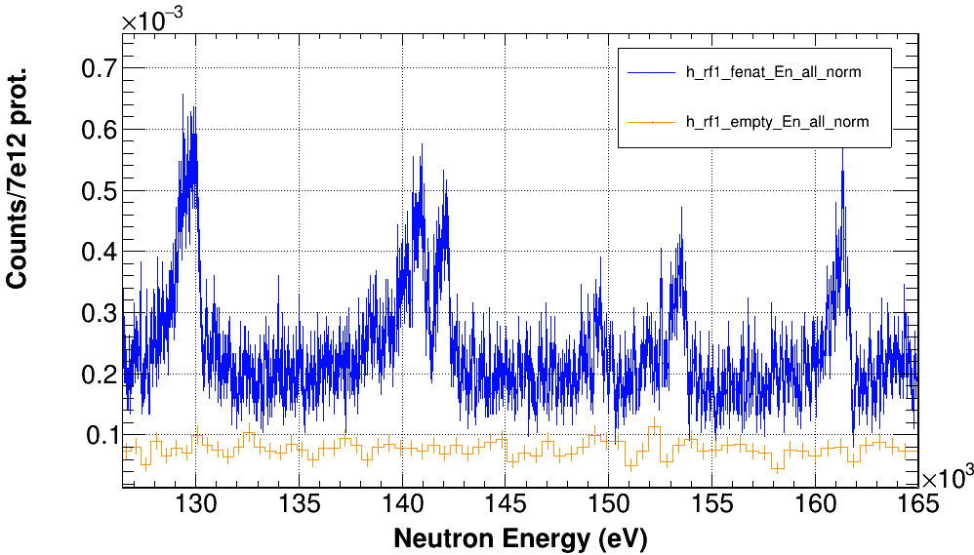
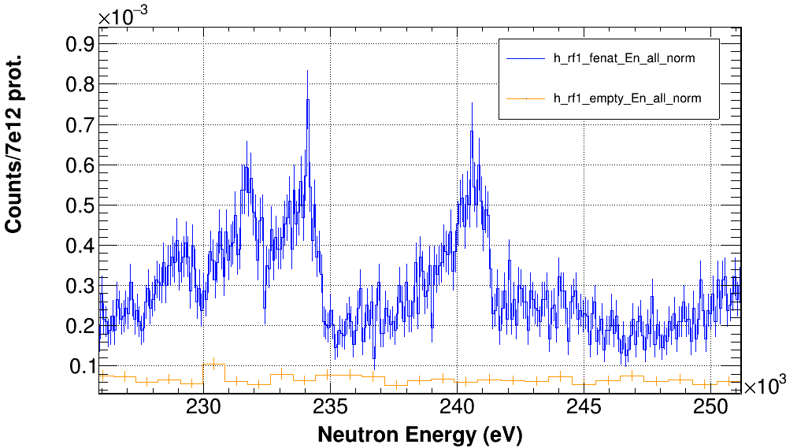
RF @ EAR1: ^{nat}Fe
^{nat}Fe, 65x0.2 mm (2021), 92% Fe-56, Fe-54 (5.85%), Fe-57 (2.1%)
Calib. in ToF to E_{n}: L₀=184.28 m
5x10¹⁷ protons

Slide 16
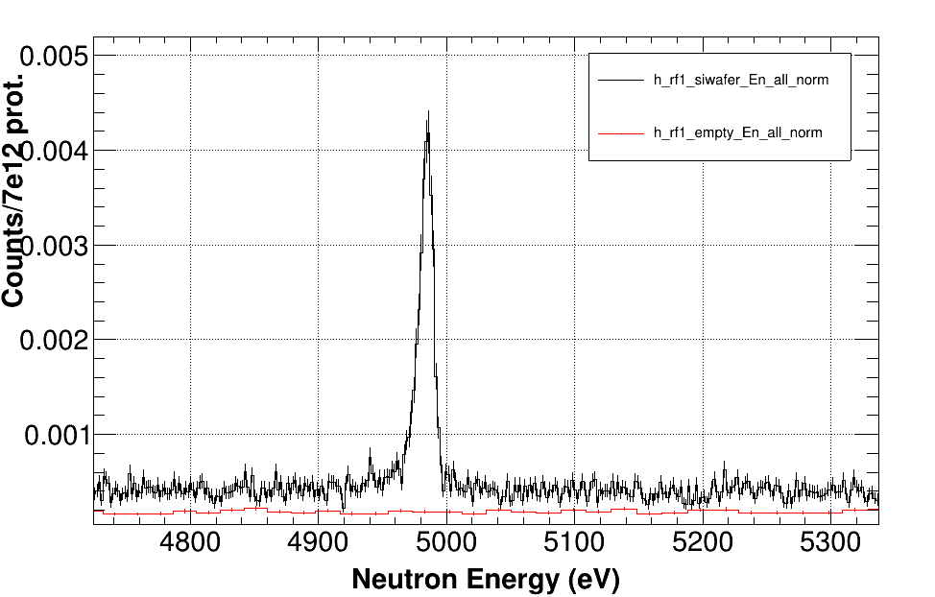
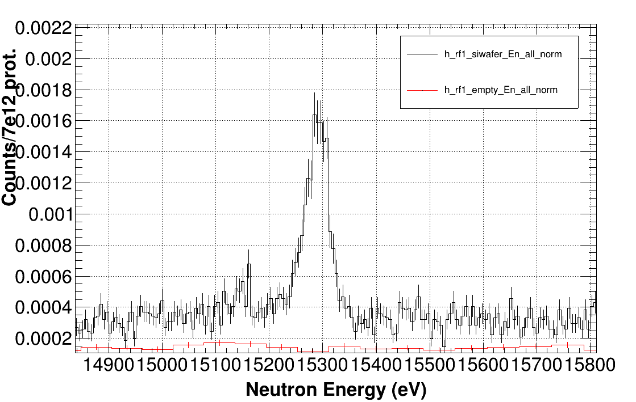
RF @ EAR1: ^{nat}Si
^{nat}Si (Si wafer), 50x0.5 mm (2021)
Calib. in ToF to E_{n}: L₀=184.28 m
2.87x10¹⁷ protons

Slide 17
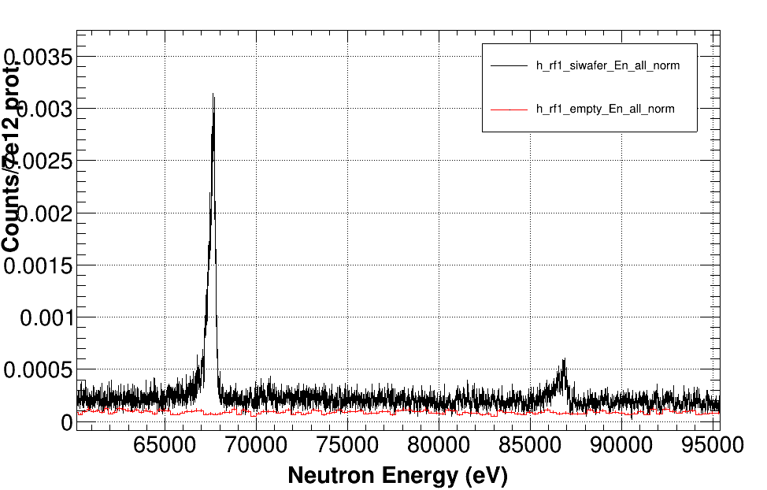
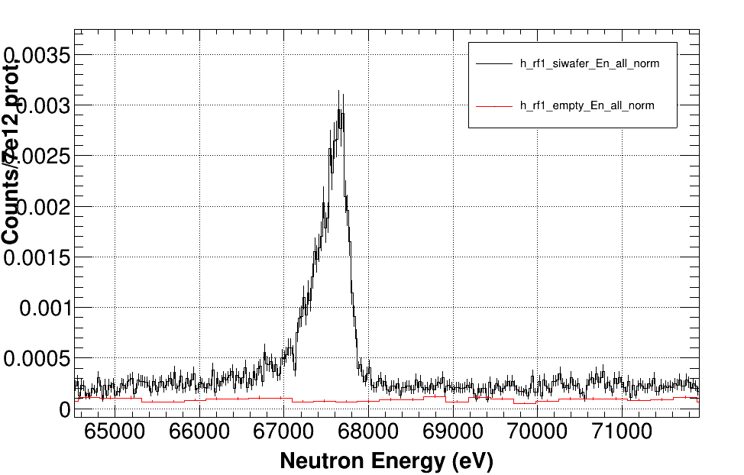
RF @ EAR1: ^{nat}Si
^{nat}Si (“Si “wafer”), 50x0.5 mm (2021)
Calib. in ToF to E_{n}: L₀=184.28
2.87x10¹⁷ protons

Slide 18
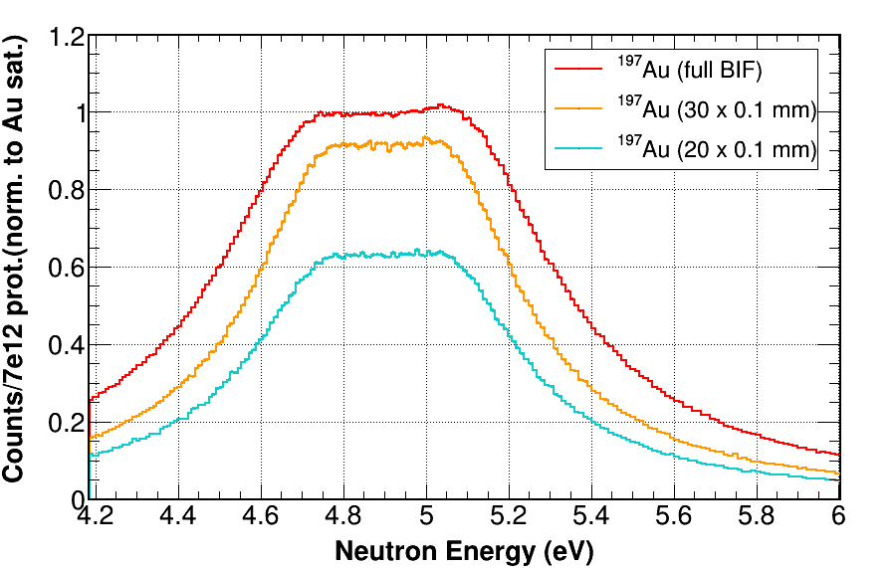
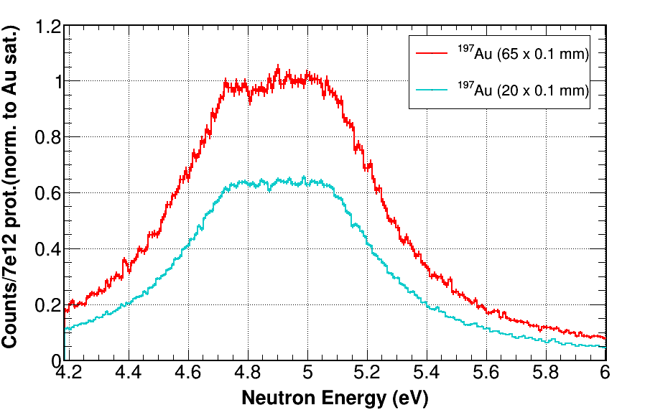
Beam interception factor: Phase4
20 mm and 30 mm BIF diameter calculated with gold samples from full intercepting 45mm + 48 mm samples: values inferior,although similar, to Phase3
(differences possibly to no WF applied -> No correction due to changes in det. eff.)
 | Ph4 (exp.) | Ph2 (simulations)
20 mm | 0.6312 | 0.68
20mm (¹⁷⁶Yb) | 0.6344 | 0.68
30 mm | 0.9168 | 0.96
Similar results in the posterior ¹⁷⁶Yb(n,γ) campaign
Pending: verification with simulations/TC once WF applied

Slide 19
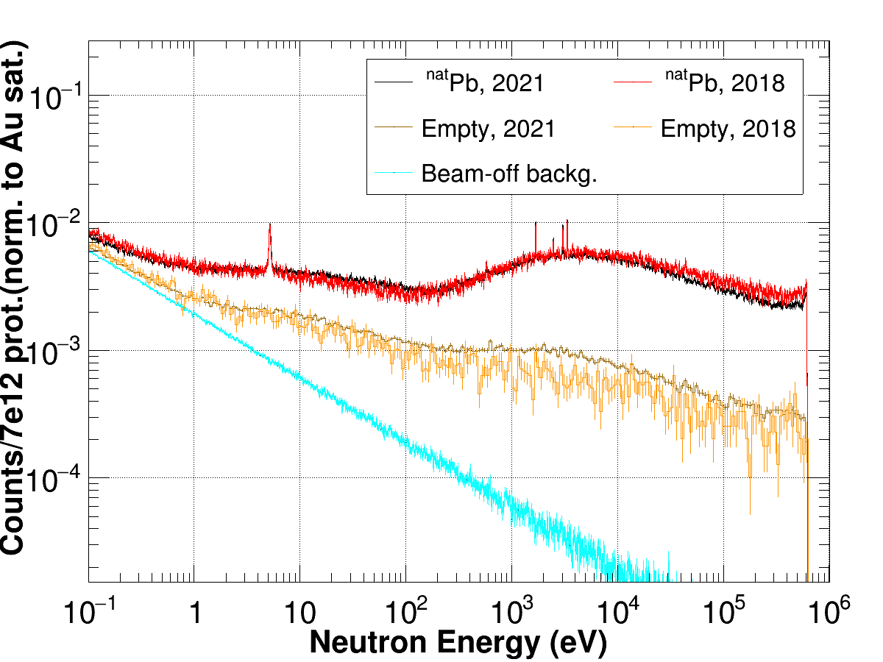
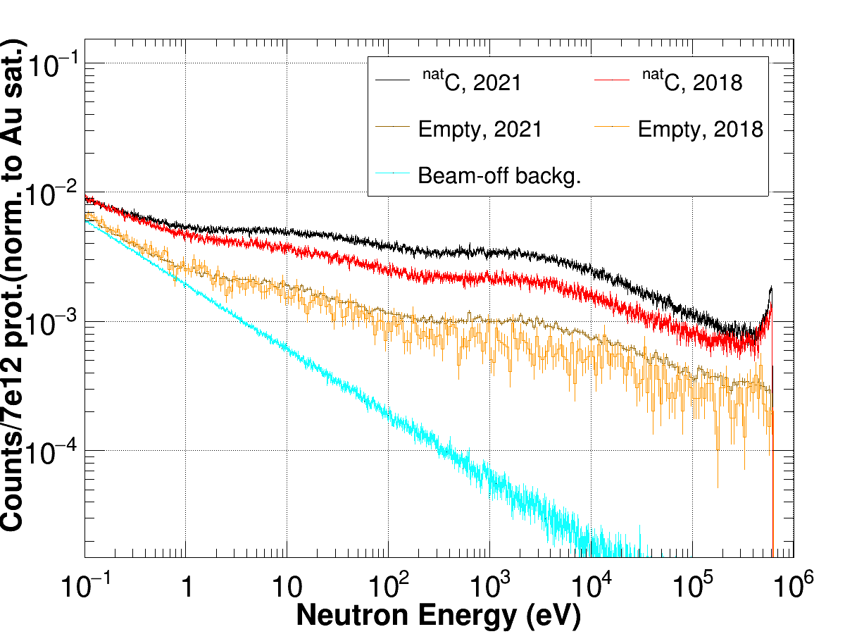
RF @ EAR1: Backgrounds
^{nat}Pb and ^{nat}C samples:
  ^{nat}Pb same sample as 2018; ^{nat}C 6.6 mm thickness (2021) vs 5 mm (2018)

Slide 20
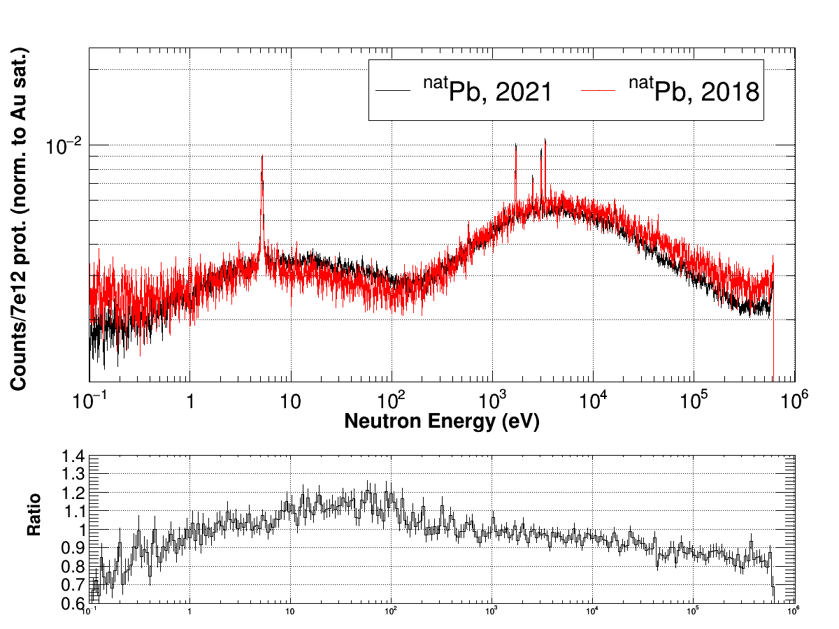
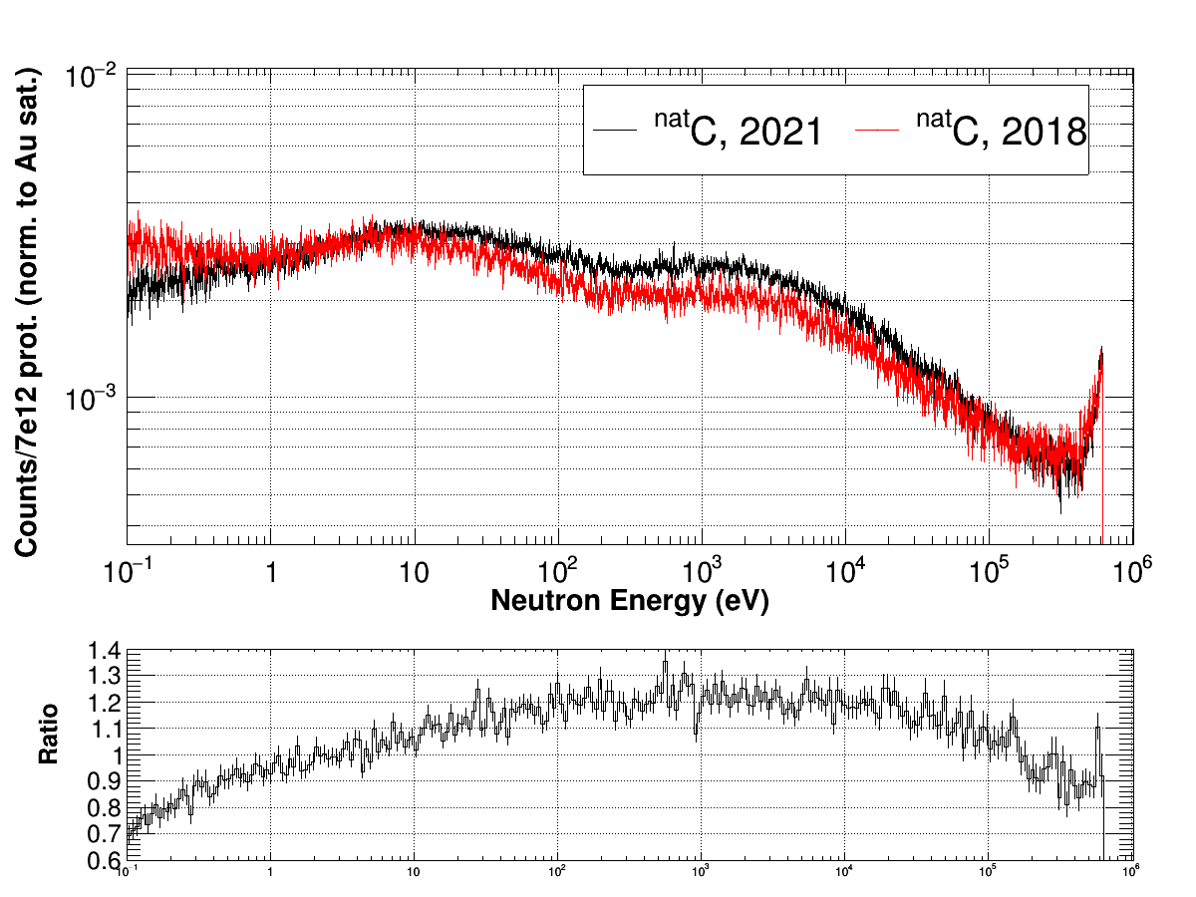
RF @ EAR1: Backgrounds
^{nat}Pb and ^{nat}C samples:
  Beam-off subtracted; ^{nat}C scaled by thickness ratio (6.6 mm vs 5 mm)
In-beam gamma rays reduction?
Neutron scattering scaling
with increasing neutron flux

Slide 21
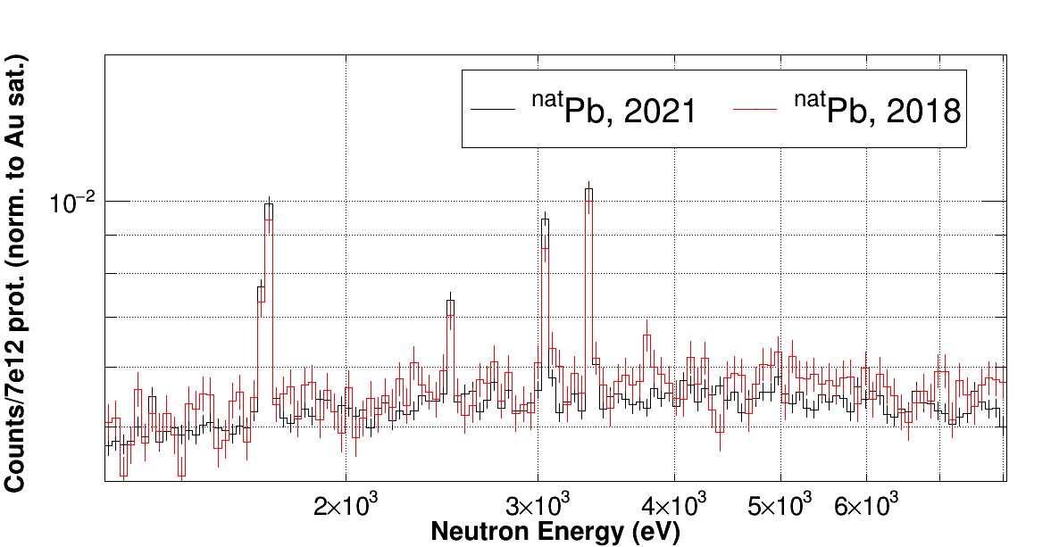
RF @ EAR1: Backgrounds
^{nat}Pb and ^{nat}C samples:
  Beam-off subtracted; ^{nat}C scaled by thickness ratio
Neutron scattering scaling
with increasing neutron flux (as expected)
In-beam gamma rays reduction?

Slide 22
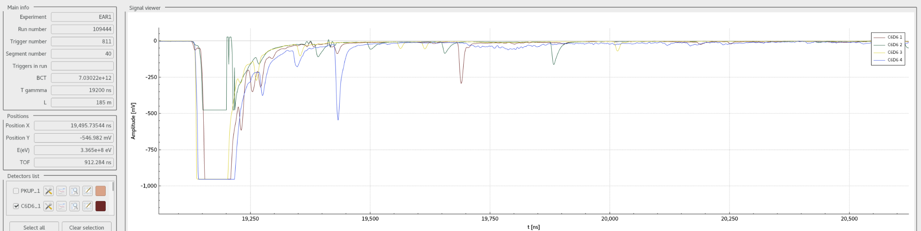
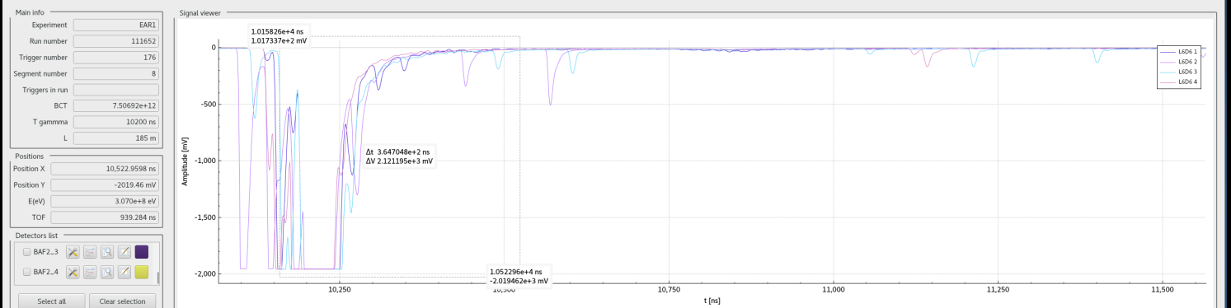
γ-Flash and prepulses
Au-197, 20x0.125 mm (2018)
Au-197, 20x0.1 mm (2021)

Slide 23
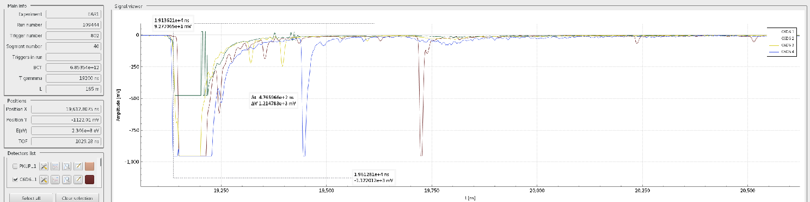
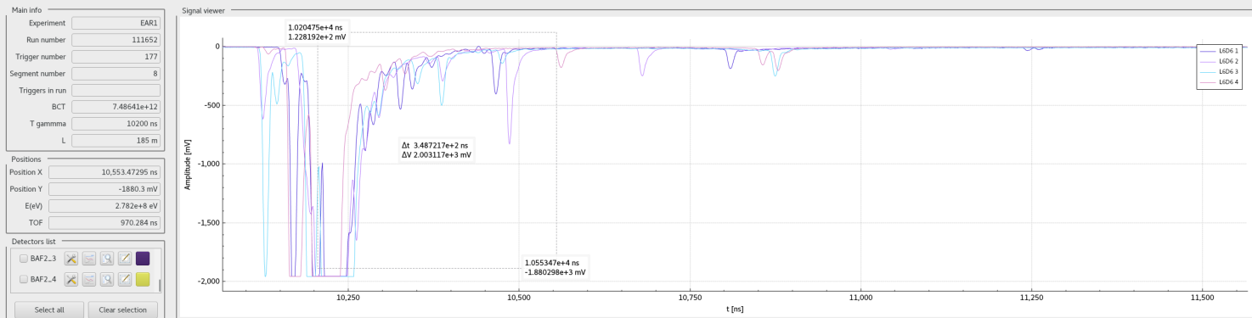
γ-Flash and prepulses
Au-197, 20x0.125 mm (2018)
Au-197, 20x0.1 mm (2021)

Slide 24
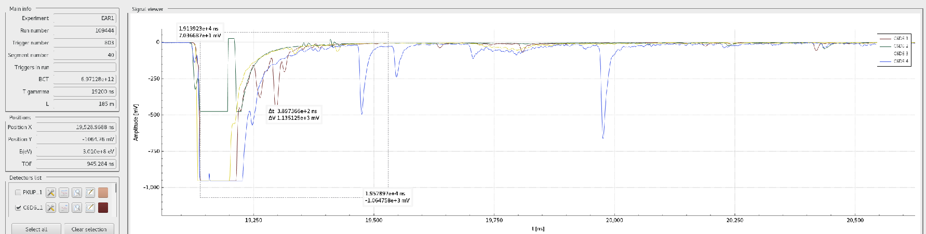
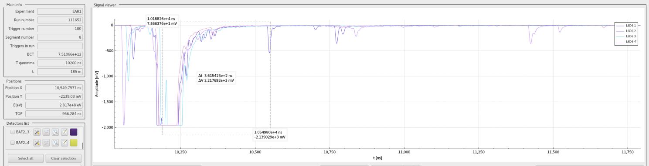
γ-Flash and prepulses
Au-197, 20x0.125 mm (2018)
Au-197, 20x0.1 mm (2021)

Slide 25
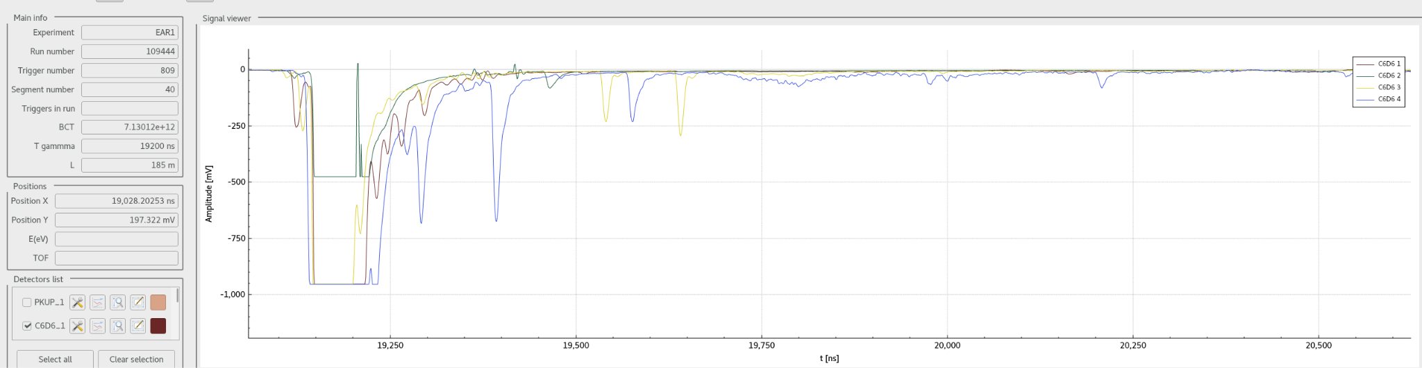
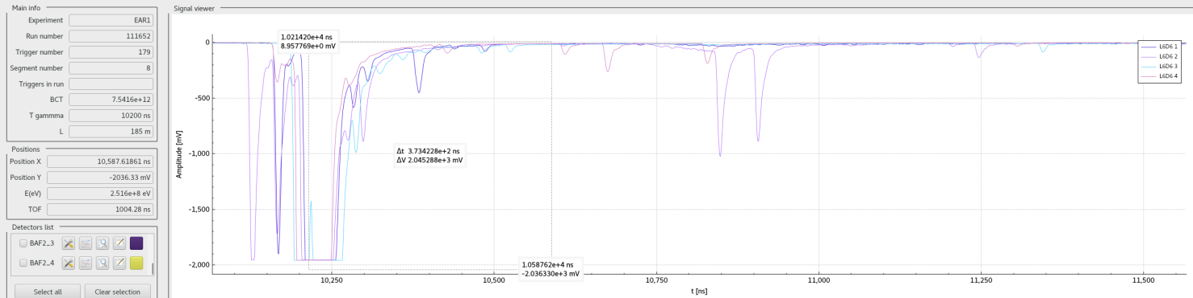
γ-Flash and prepulses
Au-197, 20x0.125 mm (2018)
Au-197, 20x0.1 mm (2021)

Slide 26
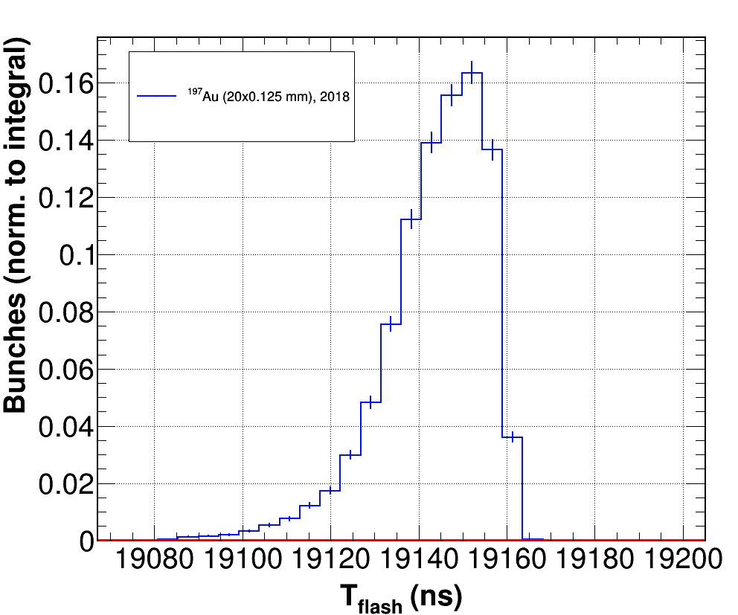
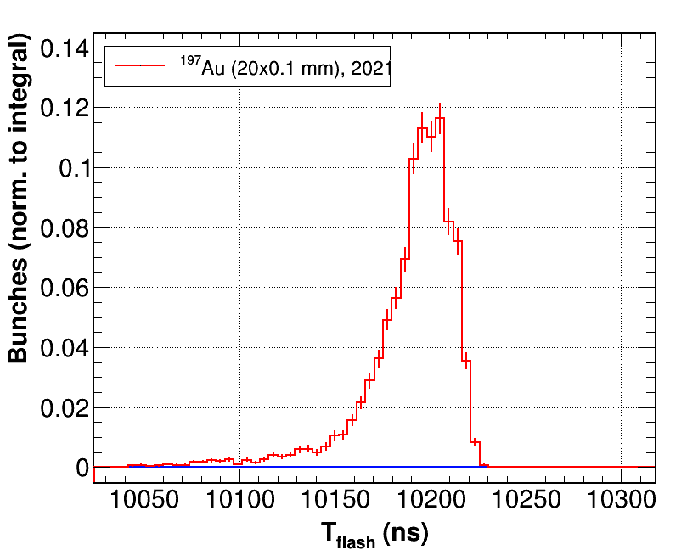
Preliminary: T_{γ-Flash} and prepulses
TFlash distribution time distribution in C6D6, 2018 vs 2021
Comparison dedicated vs parastic to see impact, ¹⁷⁶Yb(n,γ) campaign
Possible improvement in γ-Flash identification by PSA routine?
50 ns
50 ns
<1% of pulses
6.8% of pulses

Slide 27
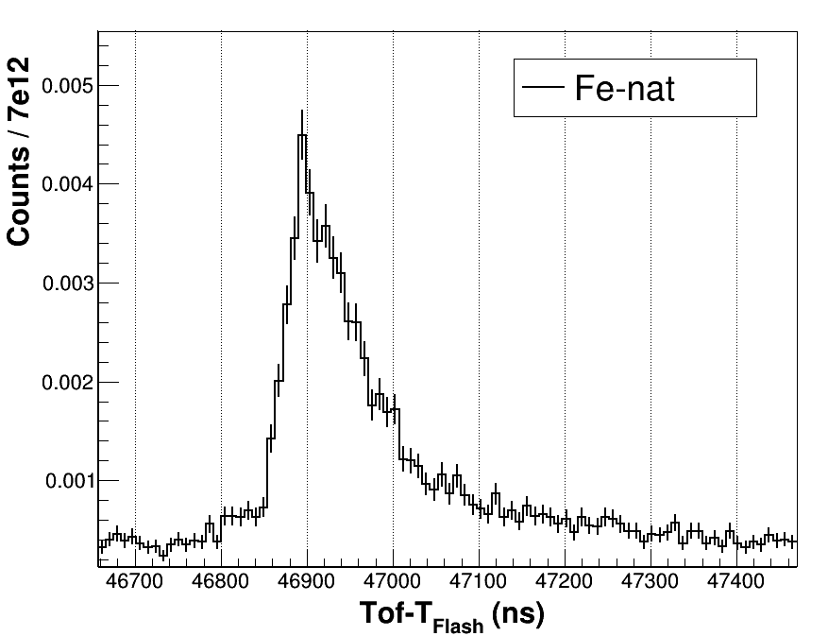
Preliminary: T_{γ-Flash} and prepulses
TFlash distribution time distribution in C6D6, 2018 vs 2021
Comparison dedicated vs parastic to see impact, ¹⁷⁶Yb(n,γ) campaign
natFe resonance at 80 keV: width ~300 ns
Possible improvement in γ-Flash identification by PSA routine?
50 ns
Effect on keV range resonances? To be studied…
6.8% of pulses

Slide 28
Summary and first conclusions
Measurements with big, massive samples allowed to gather useful capture resonance data up to 100 keV and beyond for EAR1 RF verification in the full capture energy range
  achieved in the limited amount of time availabe
  Natural samples, more complex analysis
Measurement of several ¹⁹⁷Au samples for verification of beam interception factor, and activation measurement of the flux absolute value at 4.9 eV sat. res.
Preliminary background comparison (lead and carbon): more flux but less (or similar) in-beam gamma rays
Next steps:
  Study of effect of prepulses in T_{Flash} identification and the possible effects in E_{n} resolution: PSA, Dedicated vs Parasitic
  Usual capture analysis (fine data sorting, WF, simulations, etc.) to extract yield / w. CR
  First comparison: Ph2 RF
  RF verification, and comparison with Ph3 RF, expected to be completed in the first half of 2022

Slide 29
Thank you for your attention!

