Slide 1
The NEAR Station irradiation activities n_TOF Collaboration meeting (25-26 of November 2021)
AP.Bernardes SY-STI on behalf of the n_TOF team
SY-STI: O. Aberle, Y.Aguiar, D.Baillard, M. Calviani, M.Ferrari, R.Garcia, K.Kershaw, M.Maeder, M.Sacristan Barbero, D.Senajova, G.Lerner, M.Cecchetto
EP-SME: M.Barbagallo, A.J.Praena Rodriguez
EP-UNT: A.Mengoni
BE-CEM: L.R.Buonocore, L.Barbosa Pina Pereira, E.Romagnoli, C.Veiga Almagro
HSE-RP: JF.Gruber, F.Pozzi, N.Conan
EDMS 2665621

Slide 2
Agenda
Introduction
NEAR irradiation station (NEAR IN)
NEAR experimental station (NEAR OUT)
Conclusion

Slide 3
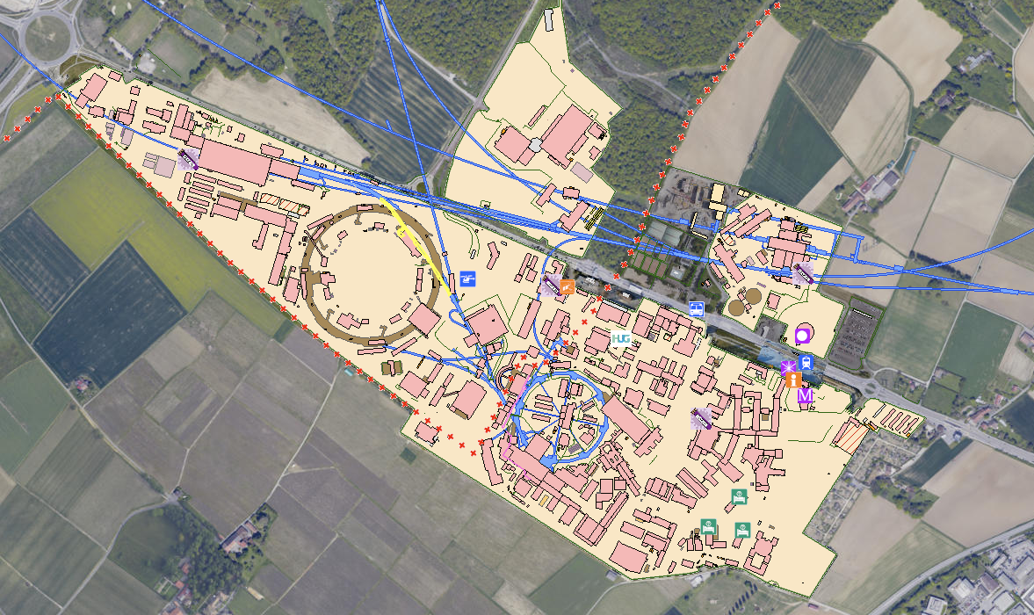
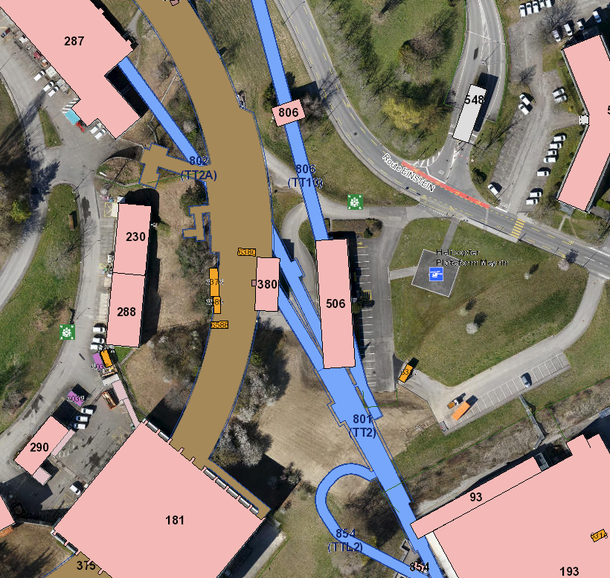
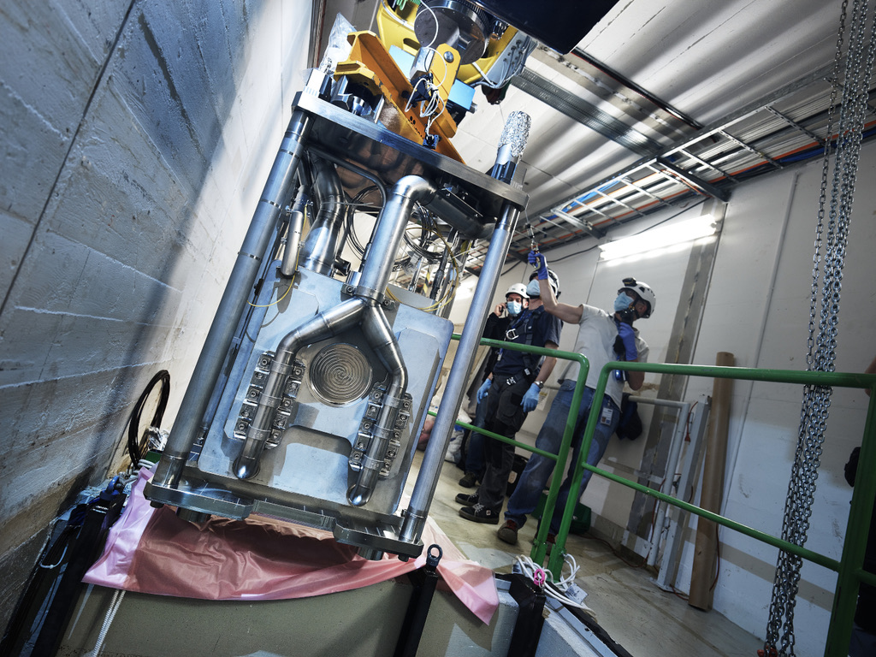
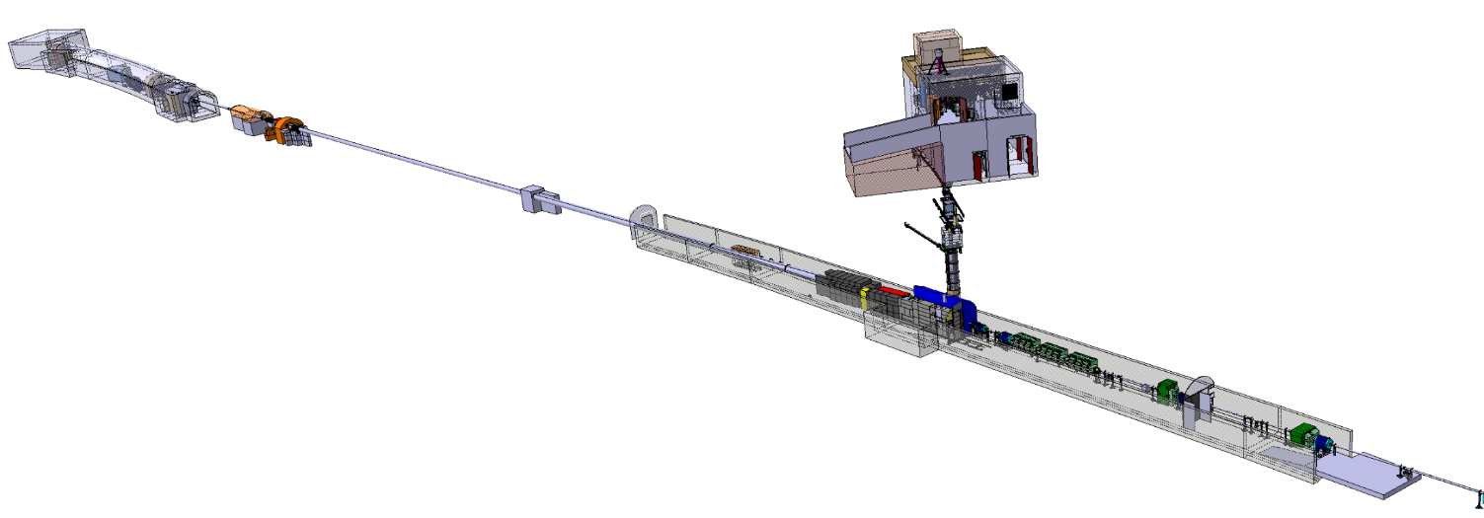
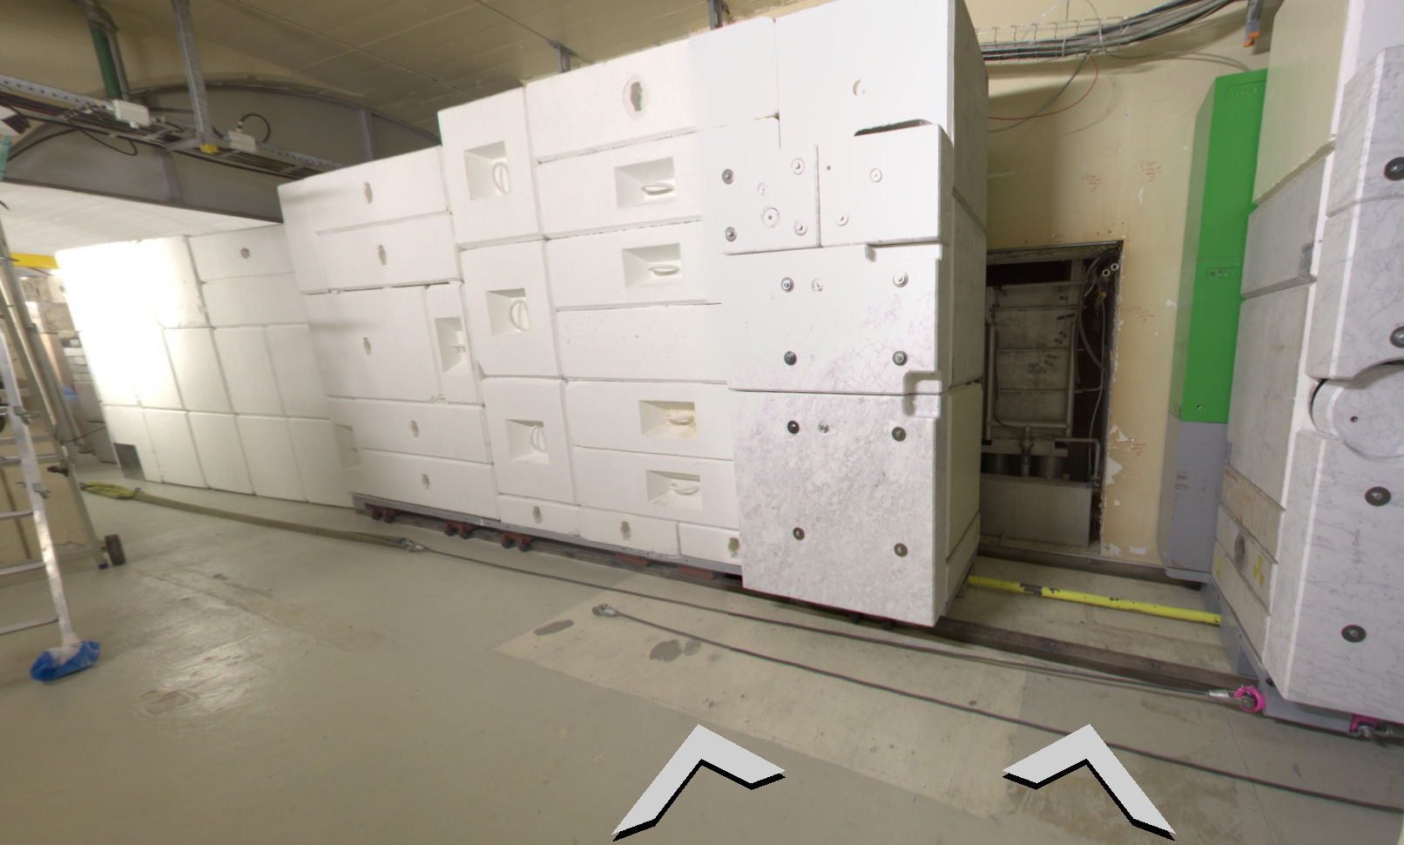

Introduction - NEAR at n_TOF
EAR2: Experimental area 2
EAR1: Experimental area 1
TT2A- 802
n_TOF target
Protons from PS
TT2 - 801
NEAR

Slide 4

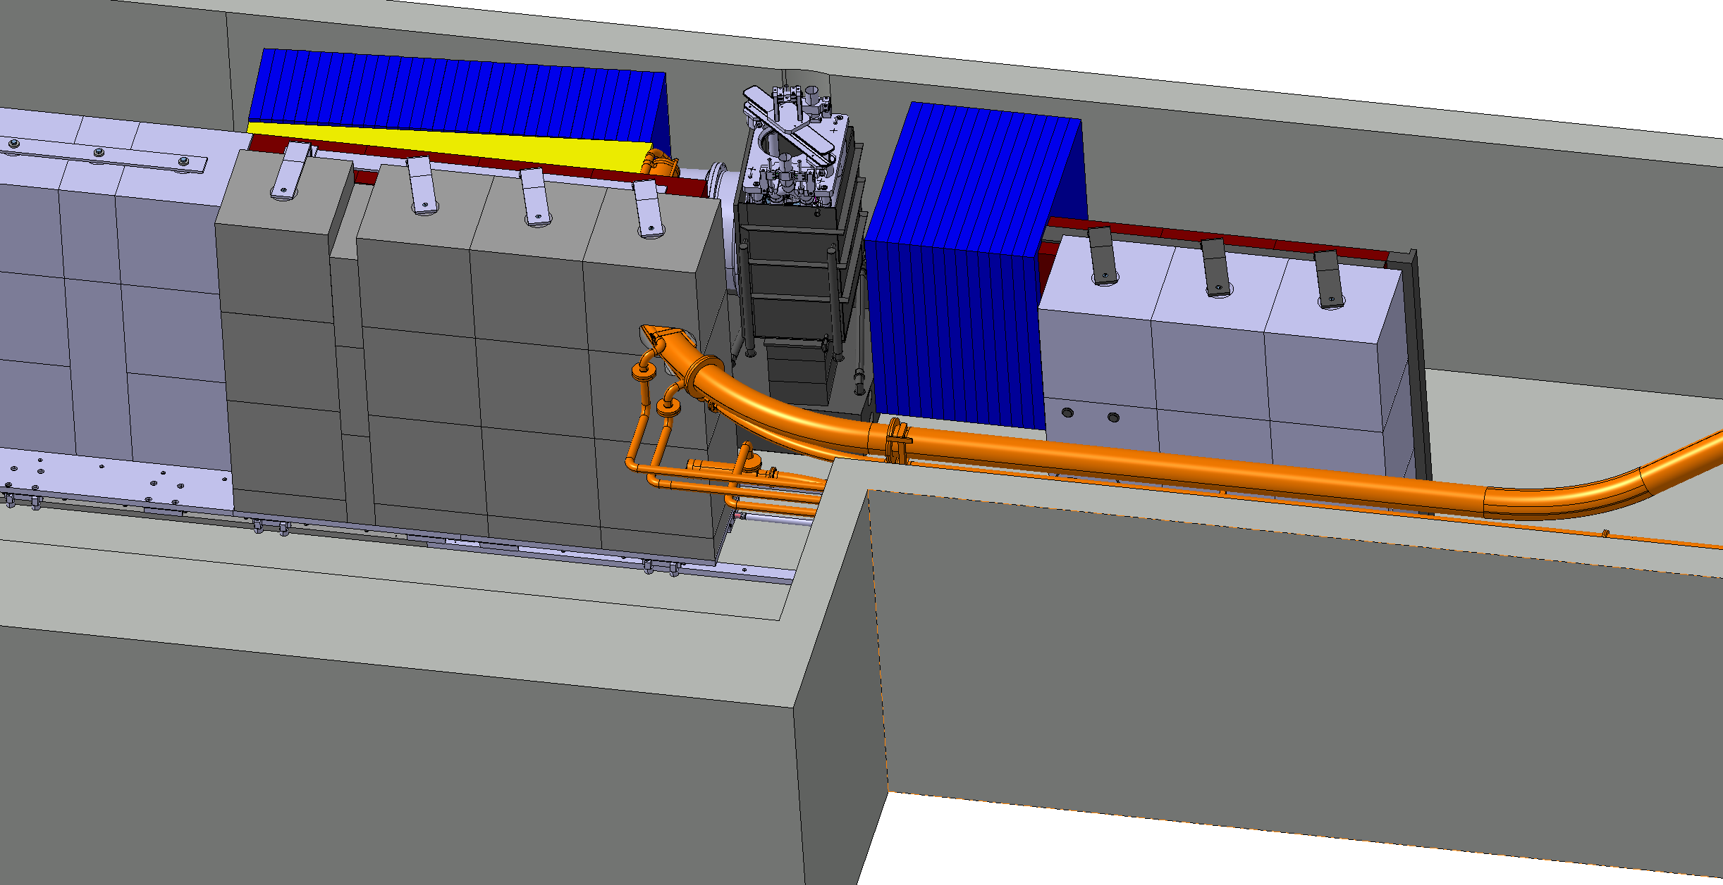
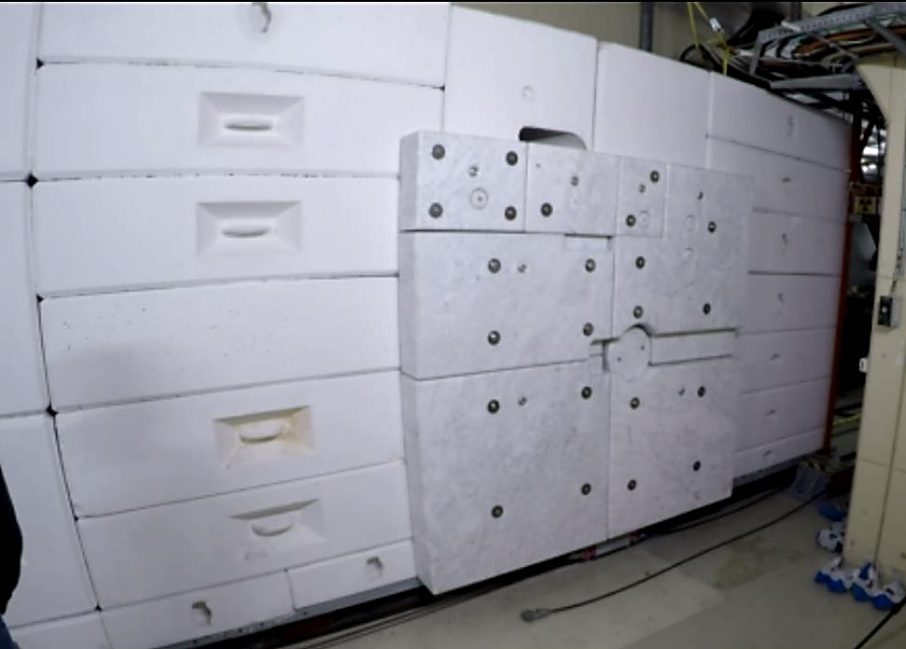
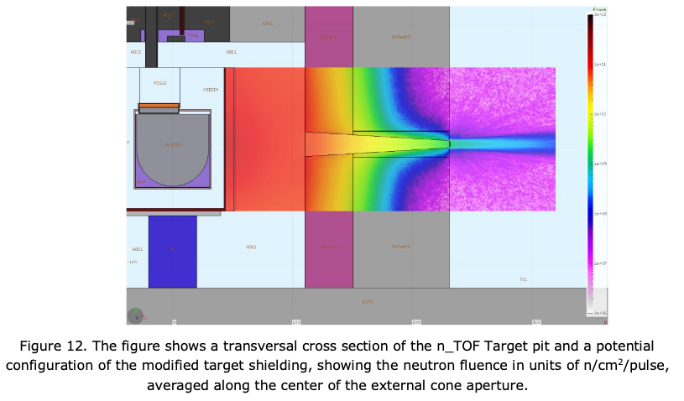
NEAR irradiation and experimental station
Roadmap for the Implementation of a New Target Mobile Shielding and a NEAR Experimental Station at the n_TOF Facility: EDMS 2158356 and associated ECR EDMS 2379173
Foreseen Yets 2021-2022 could be completed just before run3
Not financed
NEAR
Phase 3 – Pneumatic Rabbit System
Phase 1: New Target Mobile Shielding
Phase 2 – IMPLEMENTATION OF NEAR/R2E/M STATION
n_TOF mixed field irradiation places for R2M, R2E and n_TOF community applications – First irradiation in 2021 during run 3 – See E.Stamati, P.Torres Sanchez and P.Perez Maroto talks

Slide 5
Introduction - NEAR at n_TOF
n_TOF target area – Shielding OPEN
NEAR IN or
NEAR irradiation station
Pool where n_TOF target is located
Irradiation positions inside shielding - Close to the target

Slide 6
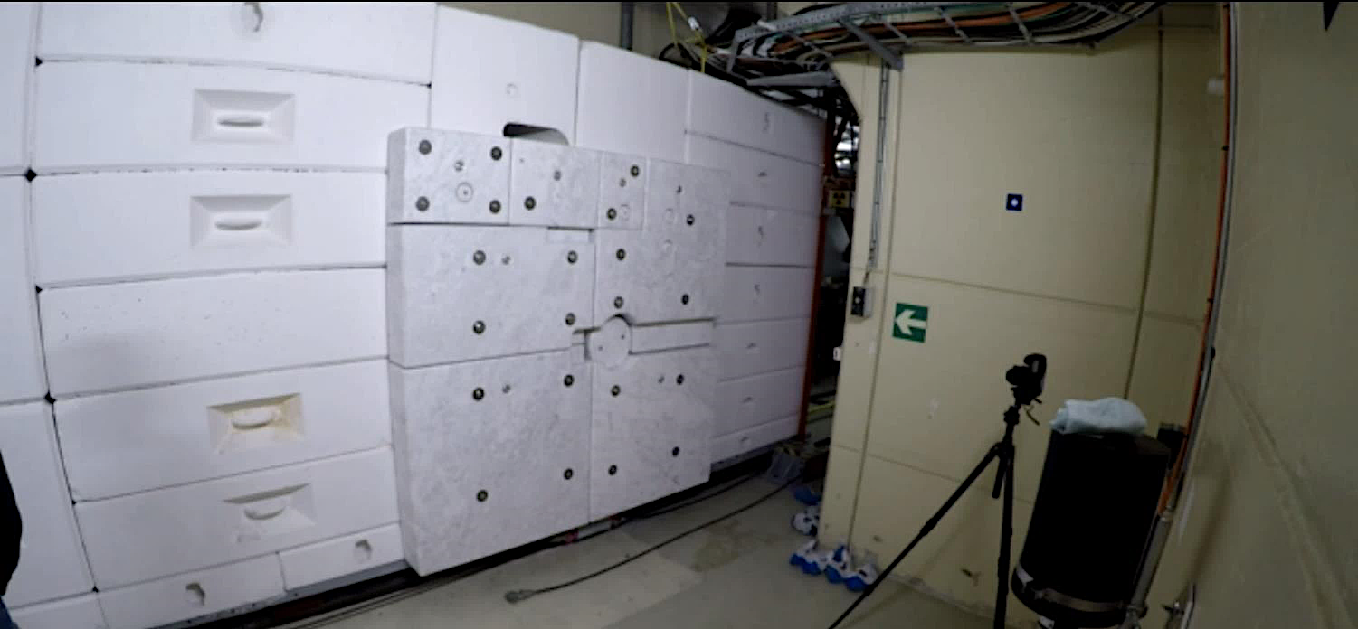
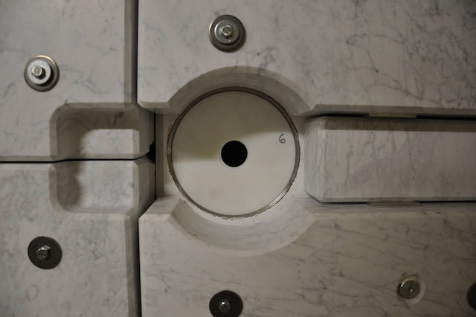
Introduction - NEAR at n_TOF
Acknowledgment: M.Barbagallo
n-TOF target area – Shielding CLOSED
NEAR OUT or
NEAR experimental station
Irradiation positions along the center of the external cone aperture

Slide 7
NEAR irradiation station (NEAR IN)

Slide 8
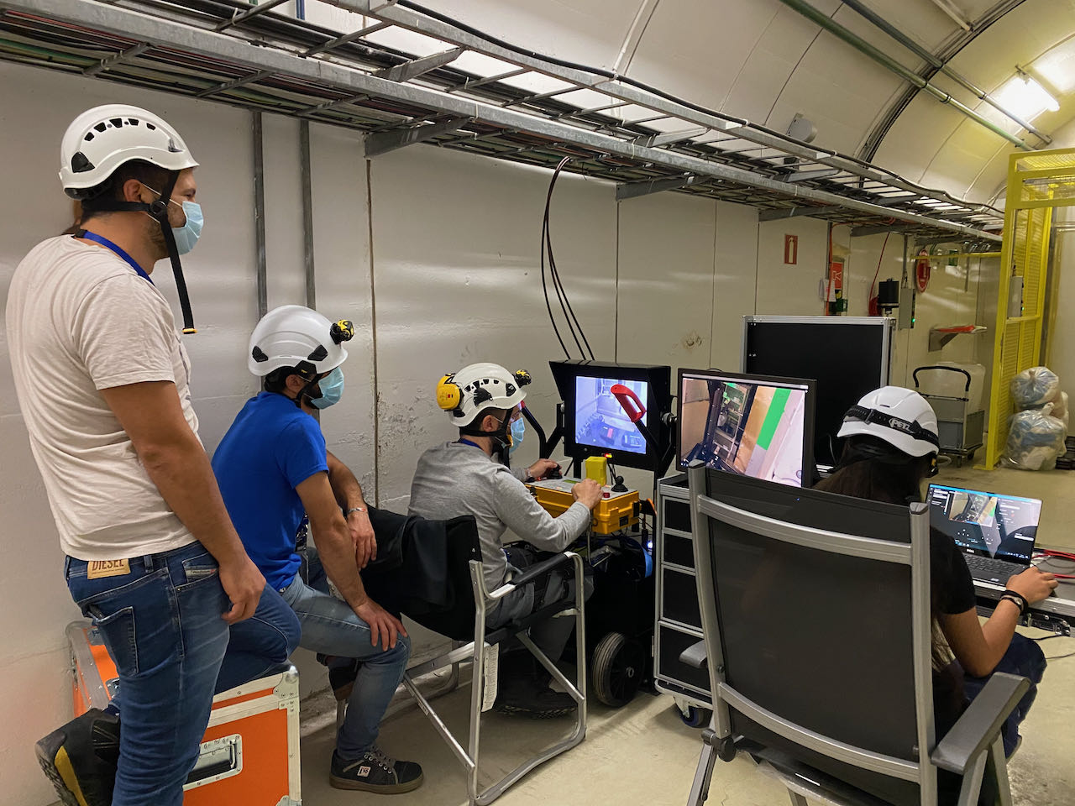
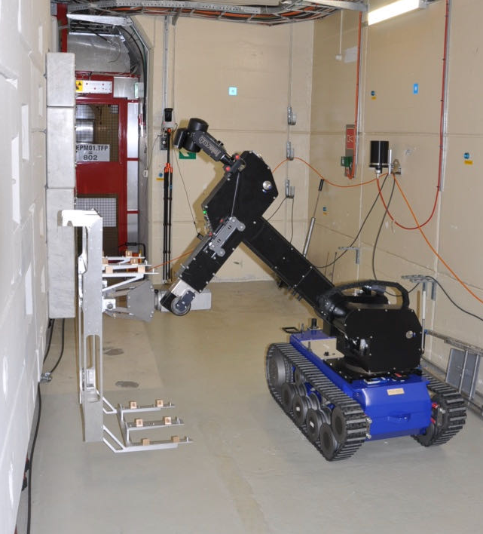
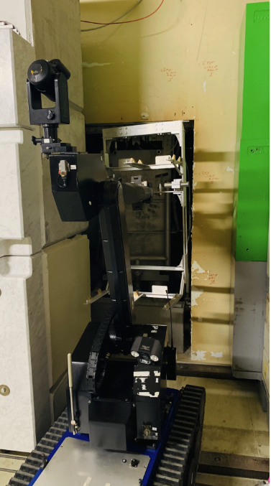
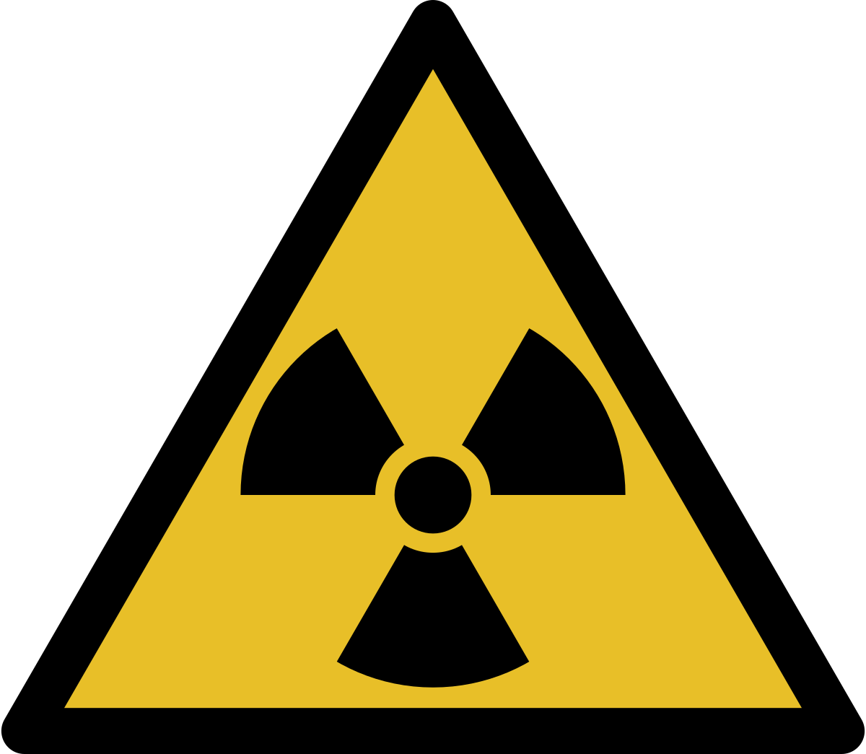
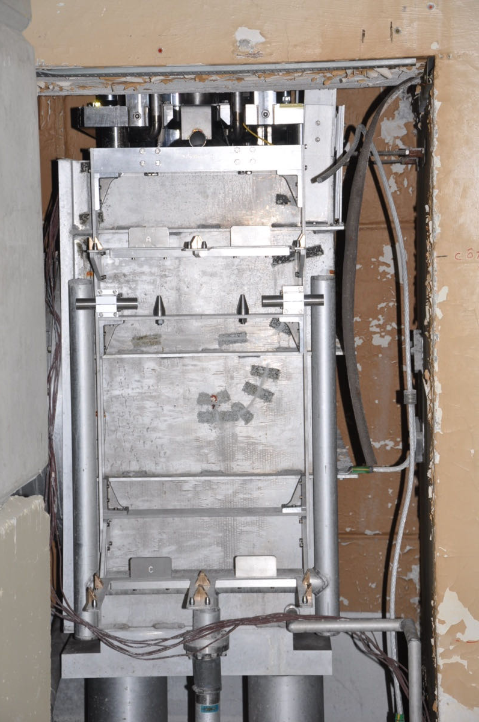
NEAR irradiation station (NEAR IN) - Shelve installation
Dose rate without target and after 2 years decay time 8 mSv/h
Acknowledgements
L.R.Buonocore, C.Veiga Almagro, E.Romagnoli, L.Barbosa Pina Pereira BE-CEM, JF.Gruber HSE-RP, D.Senajova SY-STI

Slide 9
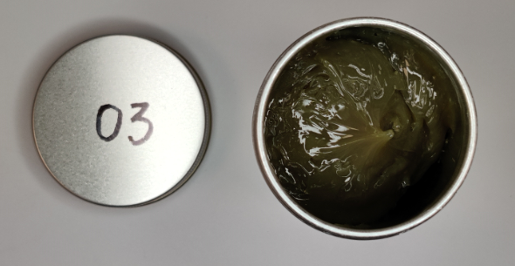
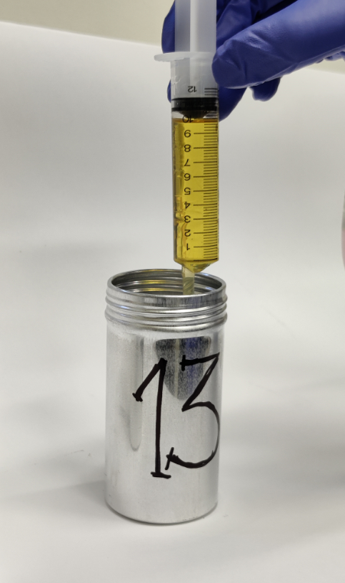
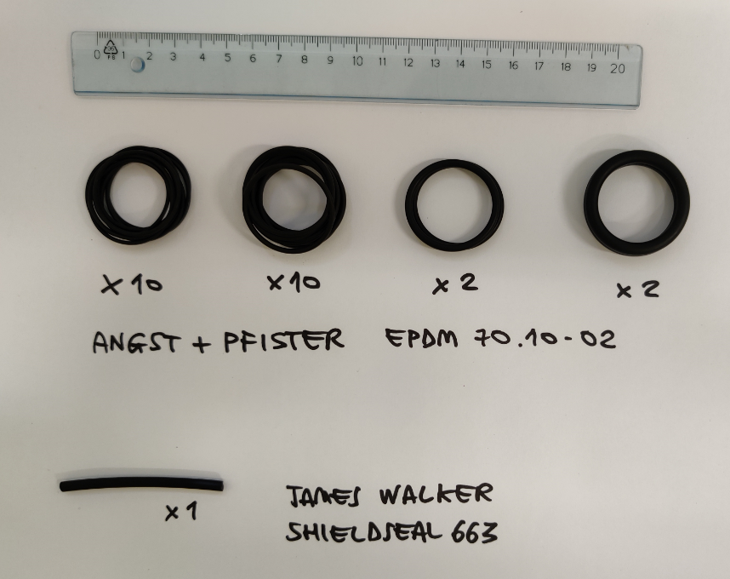
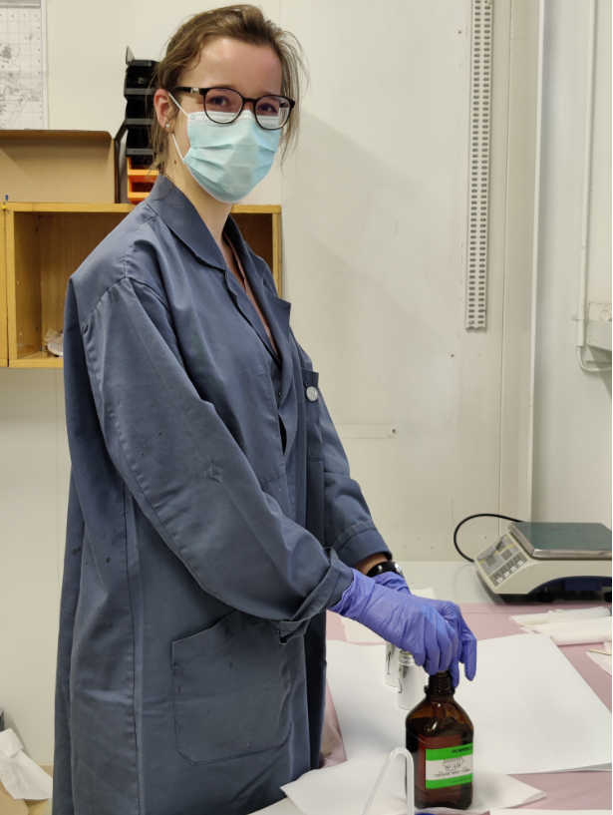
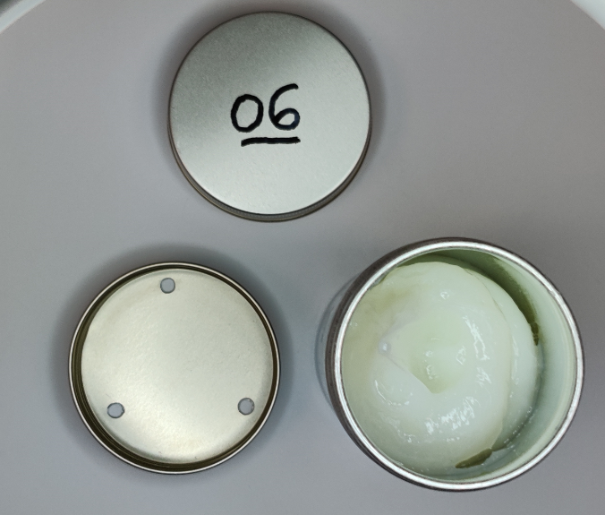
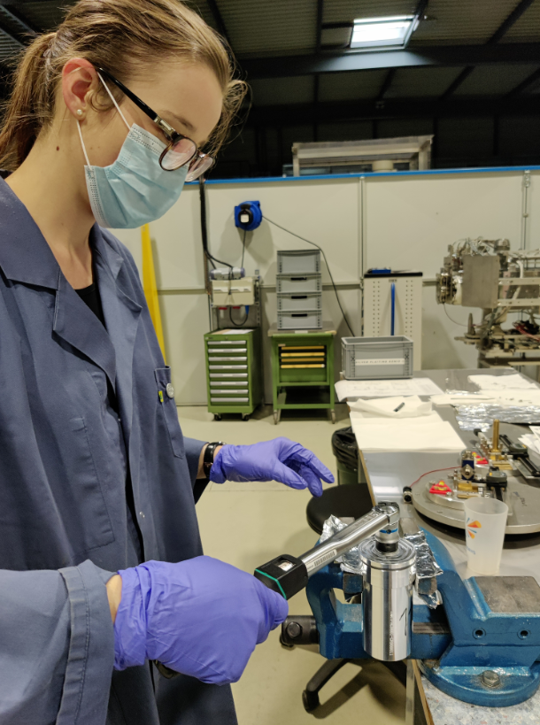
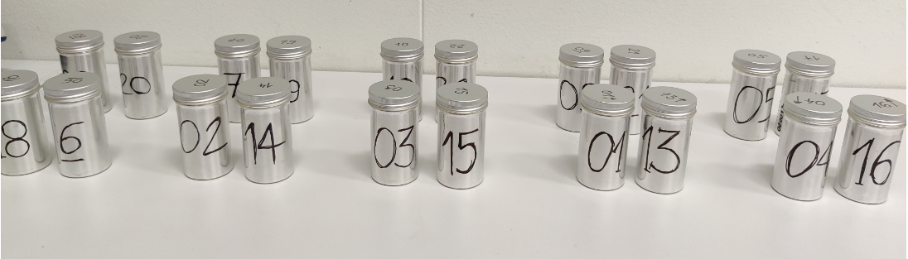
NEAR irradiation station (NEAR IN) - Samples preparation
Preparation
of samples in inner containers
MORESCO RG-42R-1 grease
LUBRILOG LX AGFA 2 grease
EPDM samples
Closing of outer containers
MORESCO RP-42R oil
22 samples prepared (11 materials) ✅
R2M samples for 2021 irradiation
Acknowledgements
M.Ferrari, D.Senajova SY-STI
Slide courtesy: D.Senajova (SY-STI) - July 2021

Slide 10
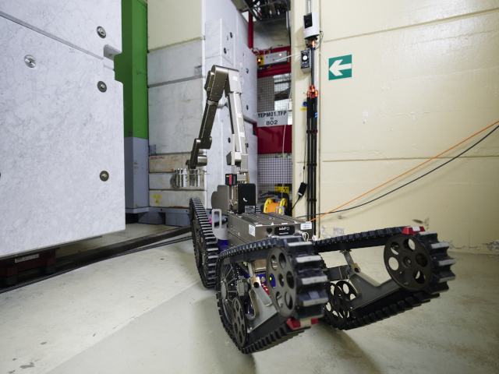
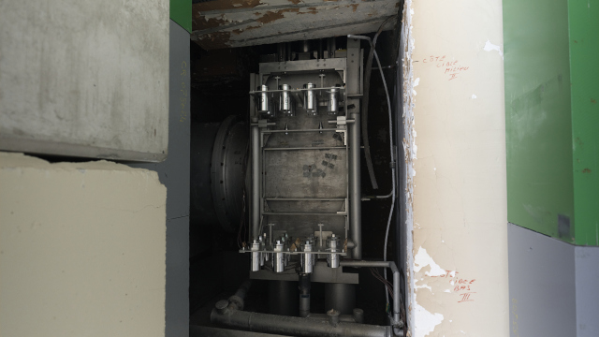
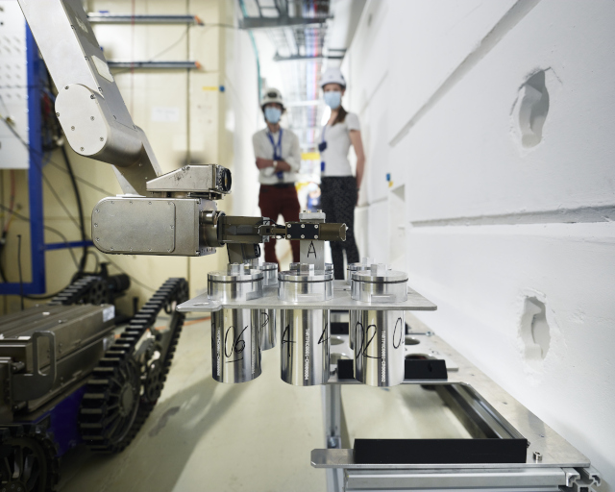
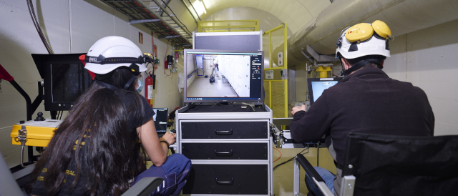
NEAR irradiation station (NEAR IN) – Samples installation
Acknowledgements
O.Aberle, O.Fjeld, M.Ferrari, D.Senajova SY-STI L.R.Buonocore, C.Veiga Almagro, E.Romagnoli, L.Barbosa Pina Pereira BE-CEM, JF.Gruber, D.Jaouen HSE-RP

Slide 11
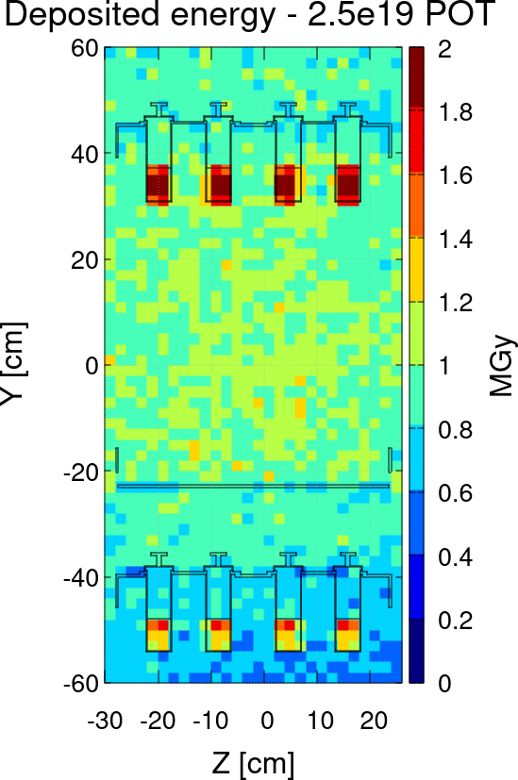
NEAR irradiation station (NEAR IN) – Irradiation parameters
IRRADIATION CONDITIONS
Neutron dose 80 to 85 % (in organic materials)
Neutrons in MeV range: dominant component
≈ 2 MGy/y – top shelf
≈ 1 MGy/y – bottom shelf
Satisfactory homogeneity
Total absorbed dose in the samples (FLUKA)
Top and bottom shelf
F.Pozzi, A. Makovec (HSE-RP), March 2021
Slide courtesy: M.Ferrari (SY-STI)
March 2021

Slide 12
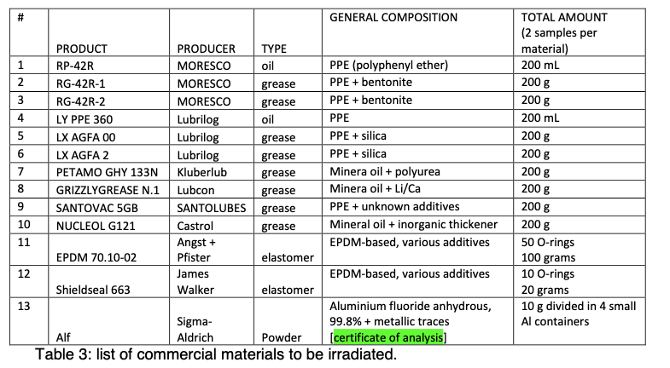
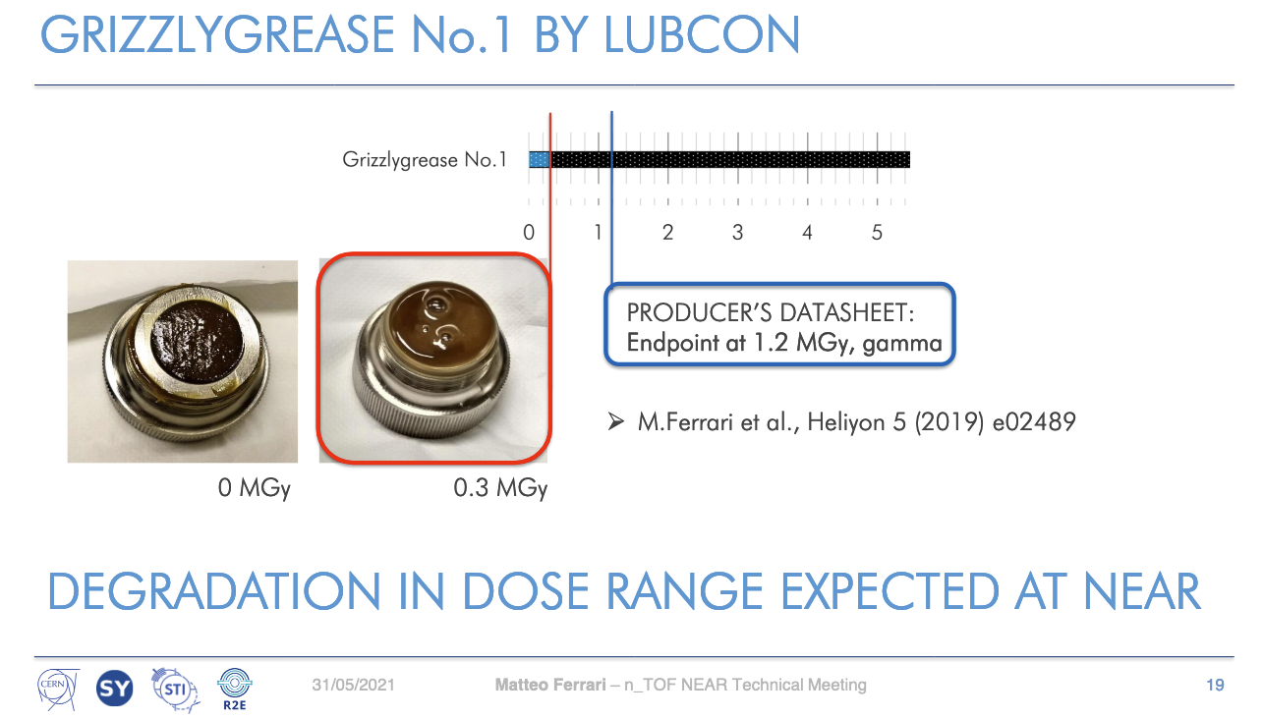
NEAR irradiation station (NEAR IN) – 2021 Samples
List of selected commercial Materials irradiated in 2021 at NEAR
Most of materials are used at CERN
Remote-handled recovery of irradiated samples planned in december 2021
Acknowledgements
M.Ferrari and D.Senajova
SY-STI-TCD

Slide 13
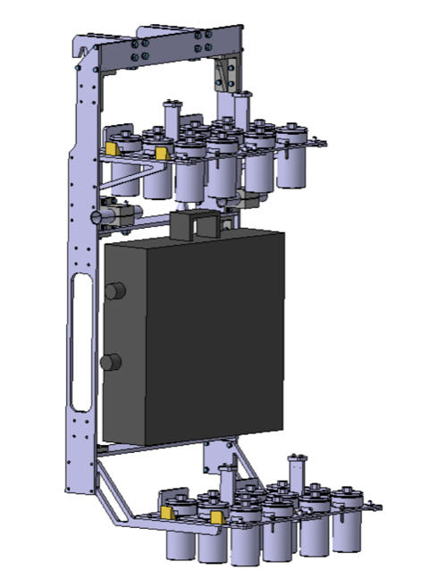
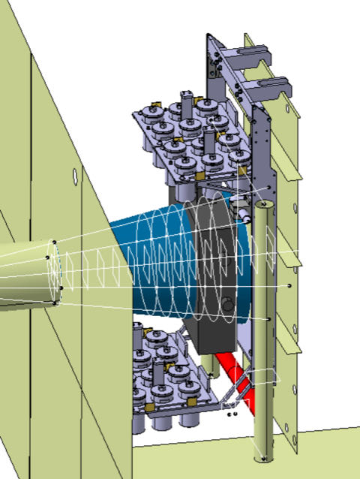
NEAR irradiation station - Moderator
Shelve
with 2 connection possibilities for the future moderator ✅
To be done:
- Selection of the moderator material
- Moderator design and production
- Moderator installation shut-down 2022-2023
Moderator independent from samples position
Moderator position covering the collimator aperture
Acknowledgements
D.Baillard, M.Maeder, D.Senajova SY-STI-TCD

Slide 14
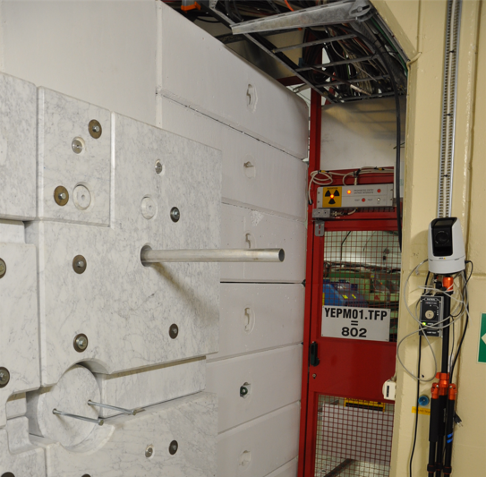
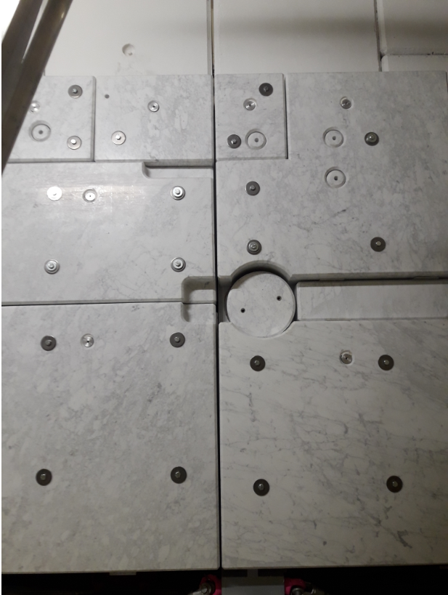
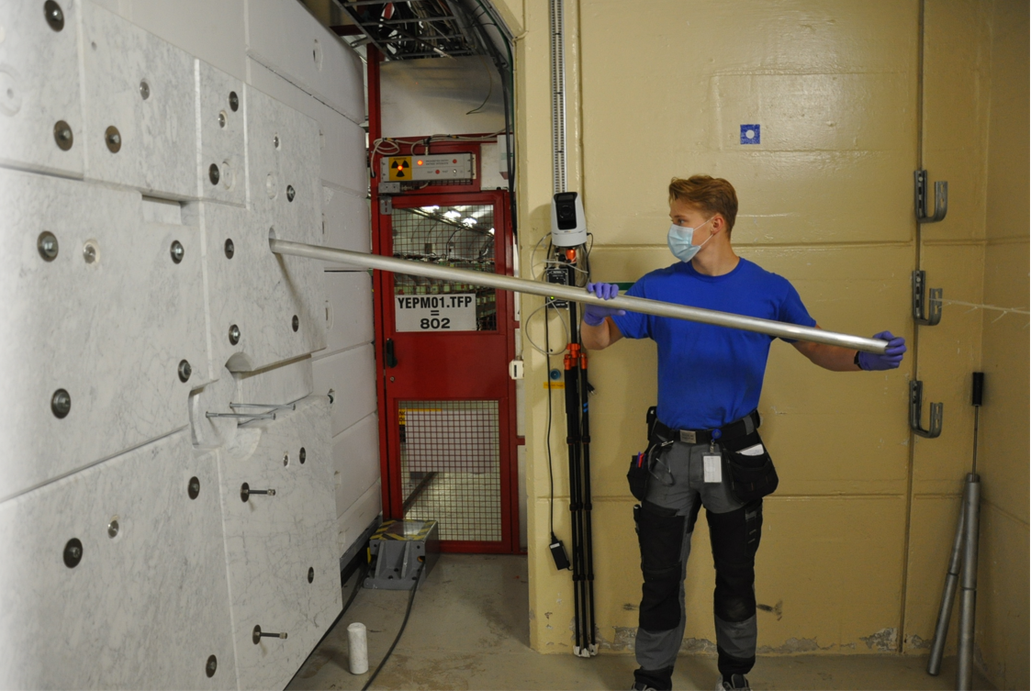
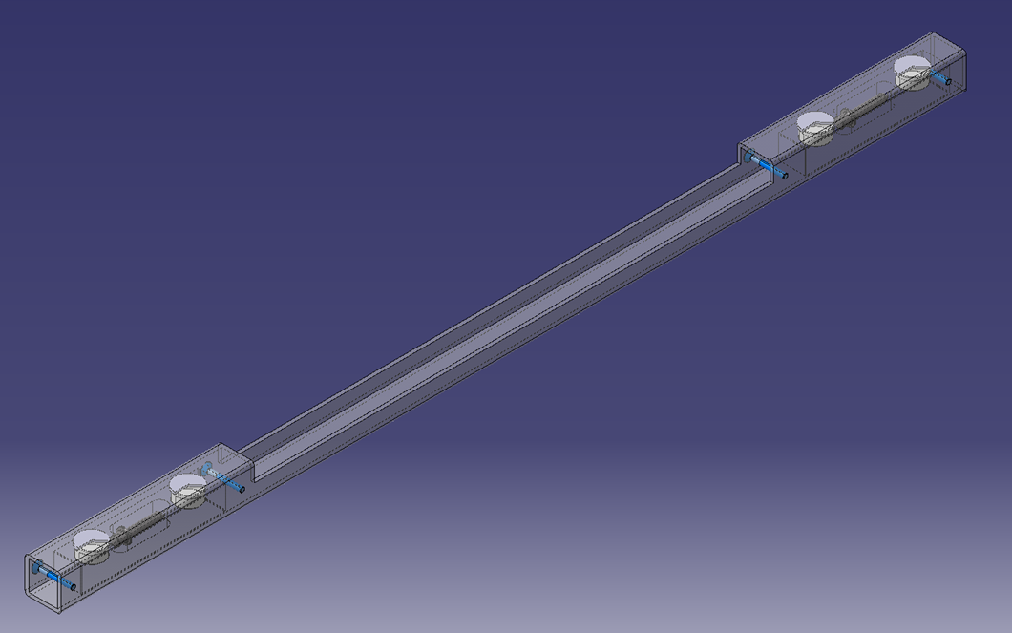
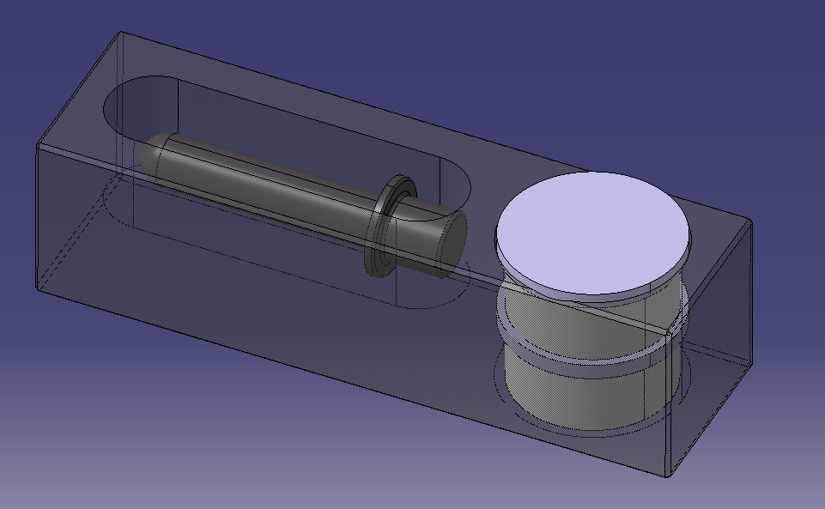
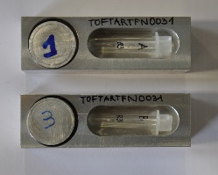
NEAR irradiation station (NEAR IN) – AlF₃
Aluminium Fluoride AlF3 samples irradiation for moderator development
HLD
Acknowledgements
O.Aberle, O.Fjeld, M.Ferrari, Y.Mucher, D.Senajova SY-STI-TCD
AlF₃ samples

Slide 15
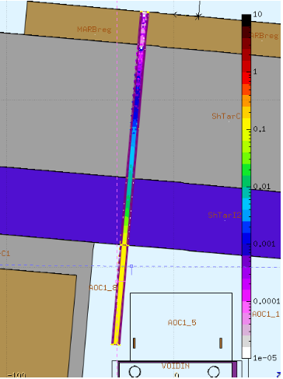
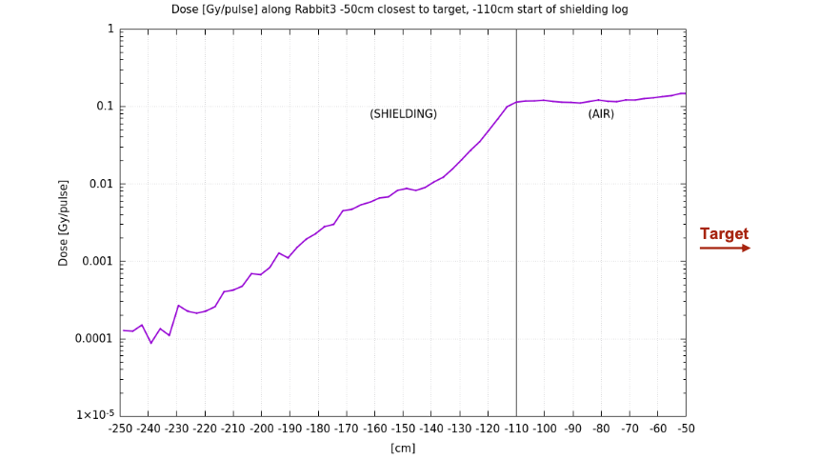
NEAR irradiation station (NEAR IN) – AlF₃
Dose scoring in Gy 7*10¹² POT/pulse
Tube with AlF₃ samples
Shielding
ALF3
0.12 Gy/pulse when the Rabbit is in air
Acknowledgements
G.Lerner and M.Cecchetto SY-STI-BMI
N_TOF Target

Slide 16
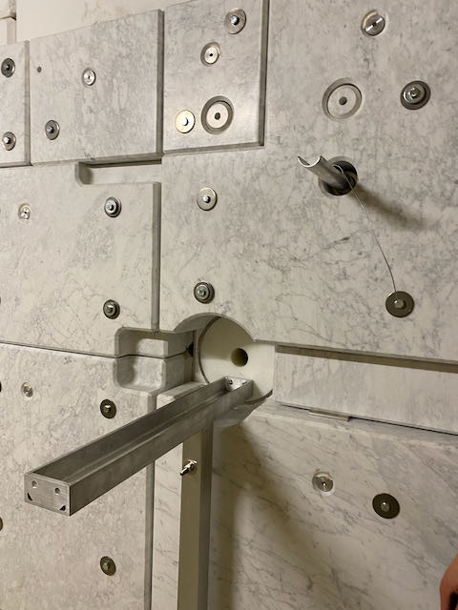
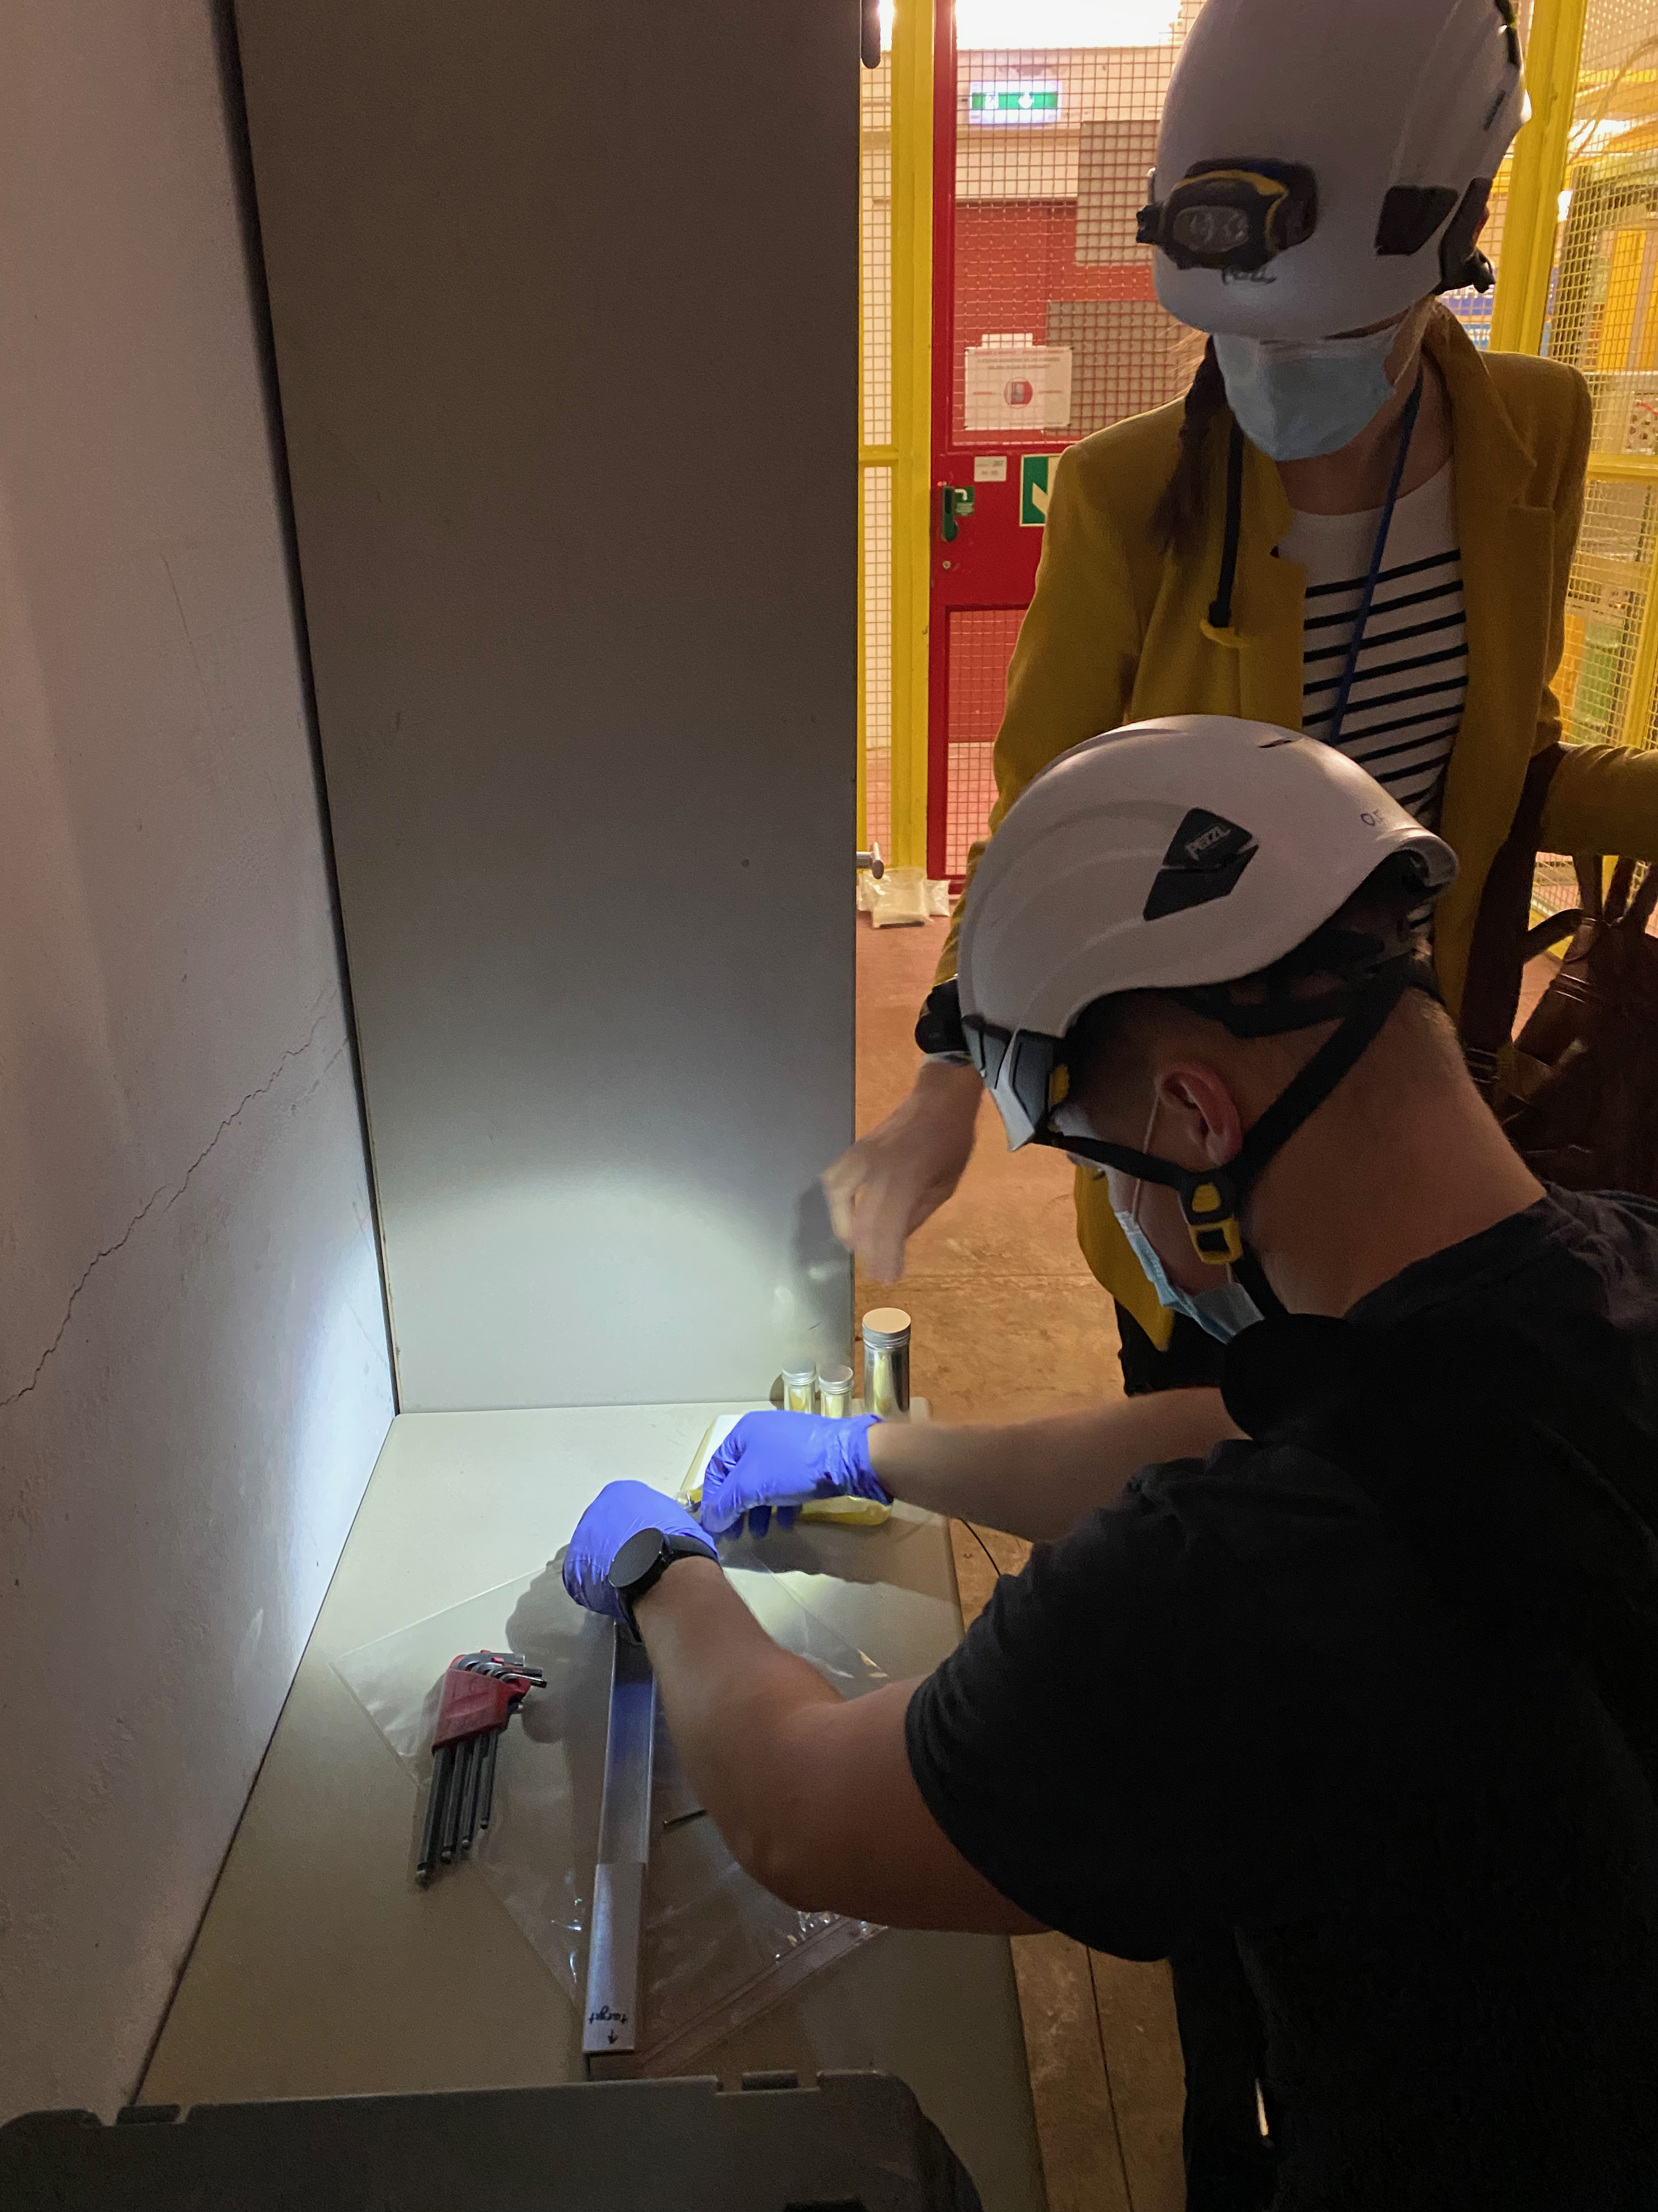
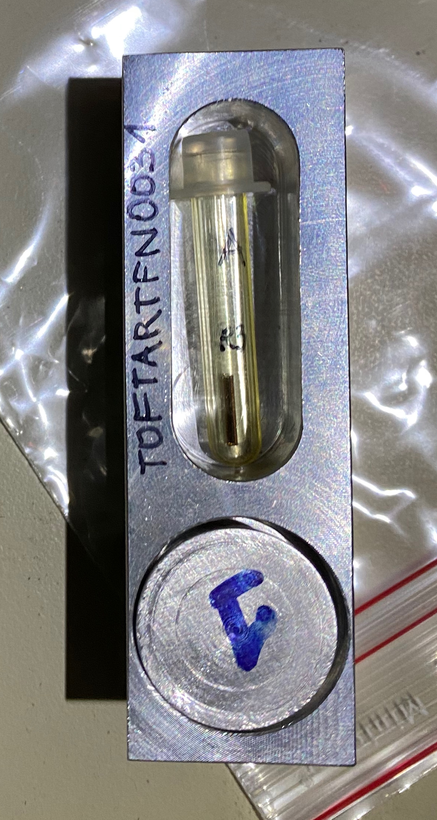
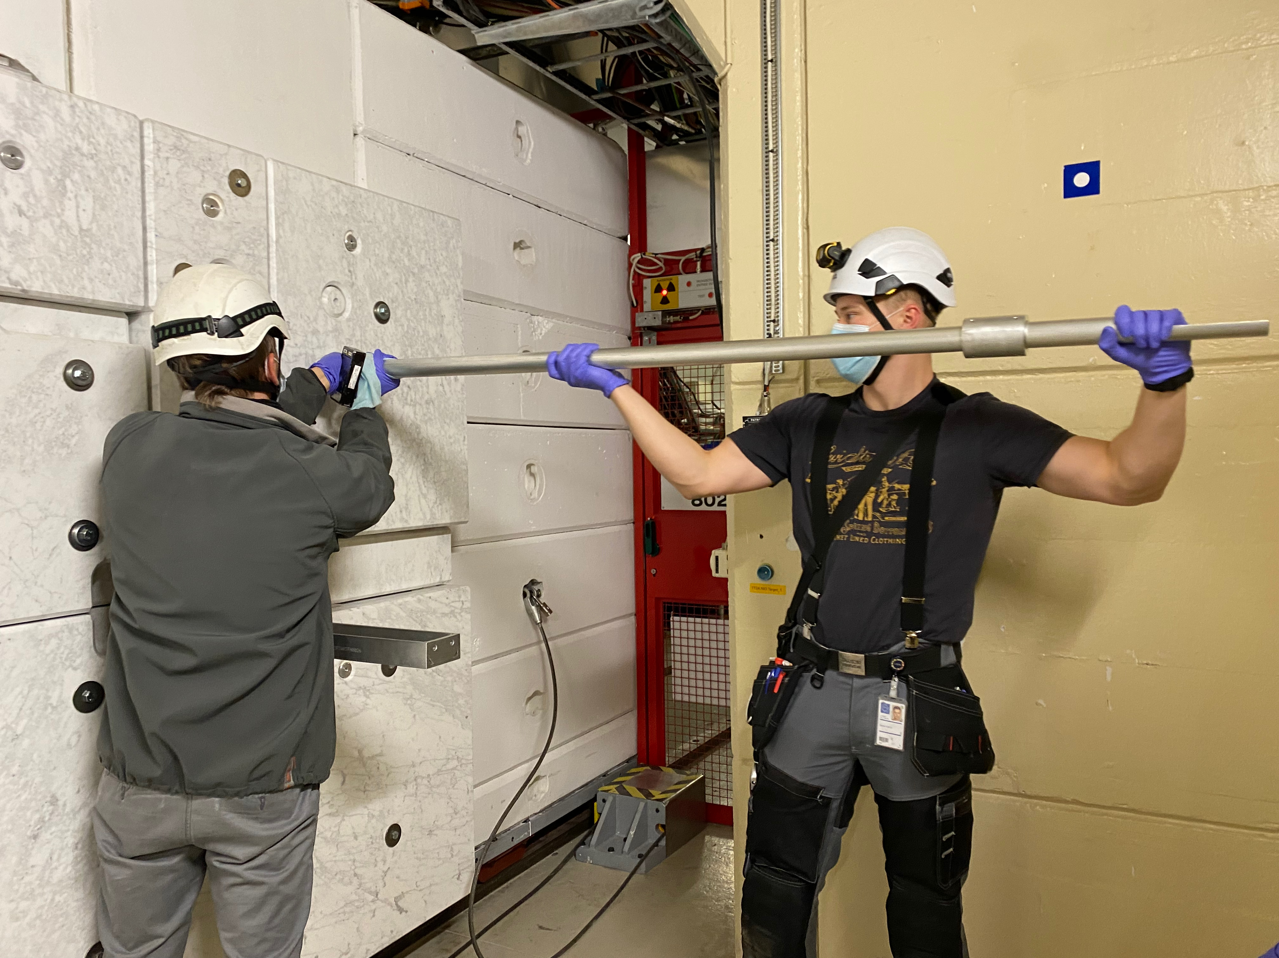
NEAR irradiation station (NEAR IN) – AlF₃
To be shipped to LENA
Acknowledgements
S.Altieri, N.Colonna, M.Ferrari, A.Mengoni, A.J.Praena Rodriguez, D.Senajova

Slide 17
NEAR experimental station (NEAR OUT)

Slide 18
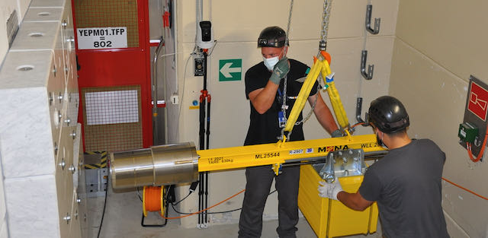
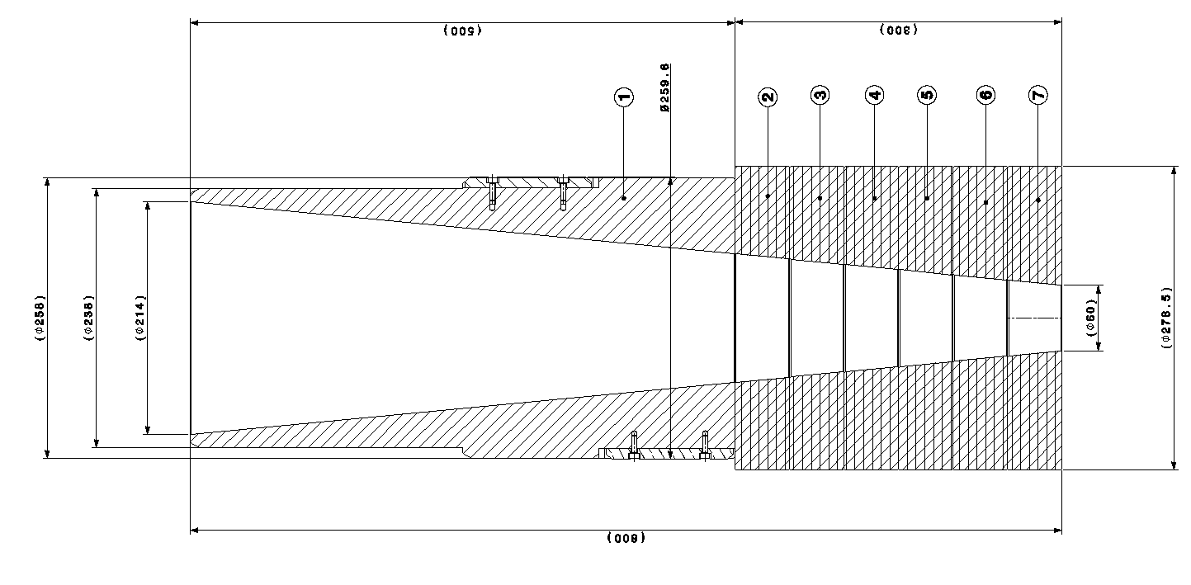
NEAR experimental station (NEAR OUT) – Collimator installation
3*10⁶ n/cm²/pulse at the wall (considering a pulse of 7*10¹² protons)
5*10⁸ n/cm²/pulse
After shielding
Acknowledgements
O.Aberle, J.Fermanel, F.Schneiter, D.Senajova
Acknowledgements: M.Barbagallo, G.Lerner, M.Cecchetto,

Slide 19
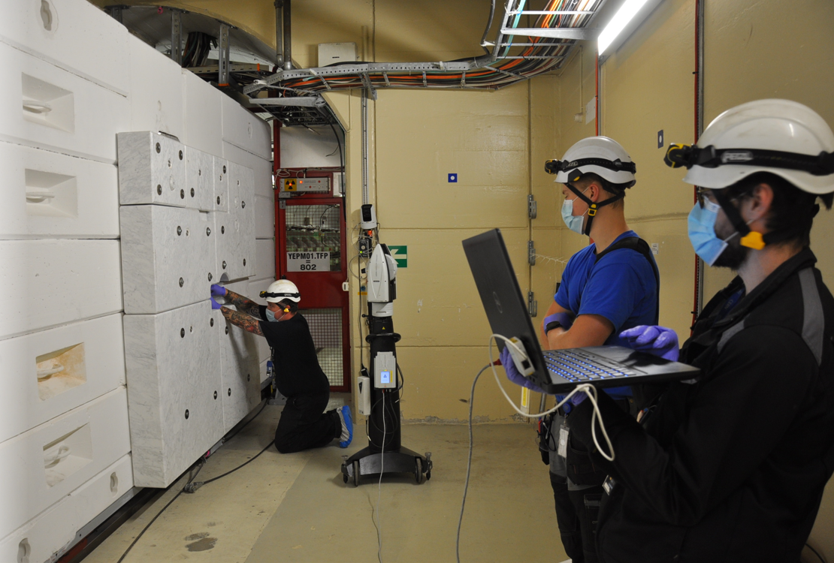
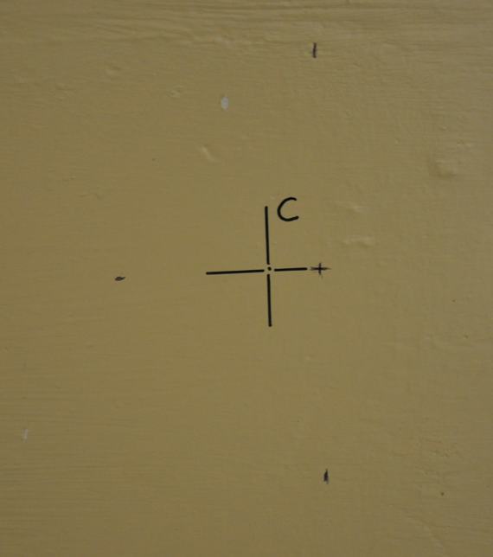
NEAR experimental station (NEAR OUT) – Support
Collimator projection on opposite wall
Acknowledgements
O.Aberle, D.Senajova, Survey team
Support along the center of the external cone aperture for samples irradiation

Slide 20
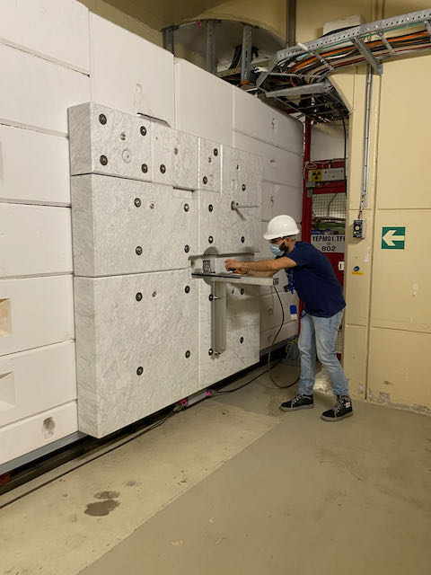
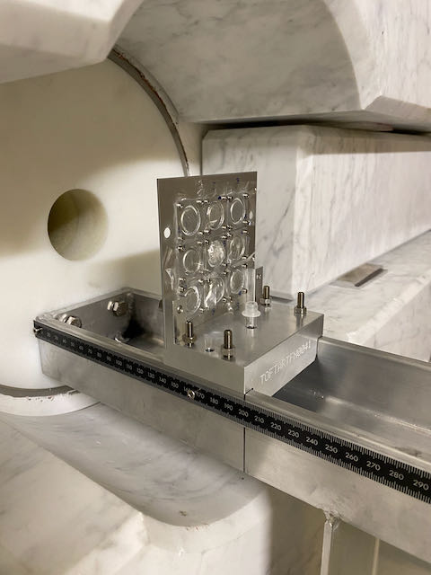
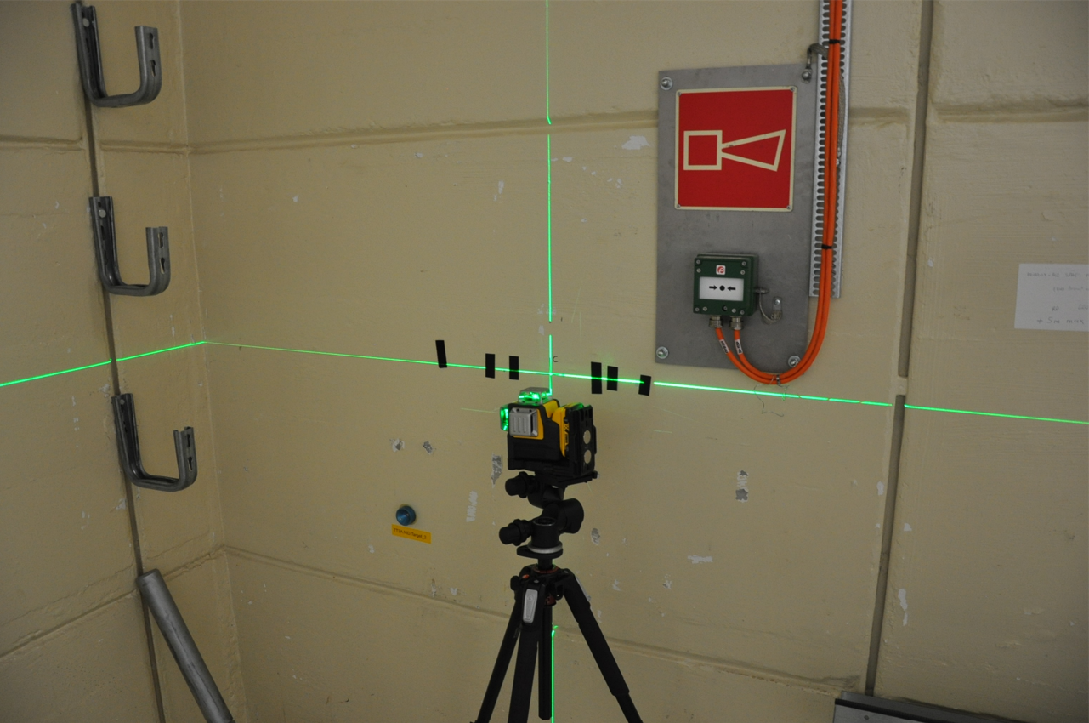

NEAR experimental station (NEAR OUT) – MAM-2 experiment
MAM-2 (multifoils activation) installation and alignement
Acknowledgements: O.Aberle, O.Fjeld, F.Garcia Infantes, F.Gruber, C.Y.Mucher, A.J.Praena Rodriguez, D.Senajova
→ See Pablo Torres Sanchez talk

Slide 21



NEAR experimental station (NEAR OUT) – MAM-1 experiment
MAM-1 (multifoils activation) installation and alignement
Acknowledgements: O.Aberle, O.Fjeld, F.Garcia Infantes, F.Gruber, C.Y.Mucher, A.J.Praena Rodriguez, D.Senajova, E.Stamati
→ See Elisso Stamati talk
MAM-1 iodine powder dispersion
MAM1 was open in EAR2 type A laboratory

Slide 22



NEAR experimental station (NEAR OUT) – EAR 2
Not financed
Existing connection for fumehood or Hot-cell
Type A ventilation operational
Not financed
EAR2 not well equipped for activities with contamination – Fumehood could be an asset for n_TOF
Racks taking too much space and too noisy – Building a new technical room to remove racks could open new possibilities (Fumehood, Hot-cell…)

Slide 23


NEAR experimental station (NEAR OUT) – ANTILoPE
20 Gold samples
Discrepancy between FLUKA simulation and measurements
Simulation ~2 uSv/h @40cm - Measured ~25 uSv/h @40cm
Due to change on mass of gold foils
Acknowledgements: O.Aberle, O.Fjeld, F.Gruber, C.Guerrero Sanchez, P.Perez Maroto, A.J.Praena Rodriguez, D.Senajova
→ See Pablo Perez Maroto talk

Slide 24



NEAR experimental station (NEAR OUT) – MAM-2 Shadow
MAM-2 (multifoils activation) Shadow Bar installation and alignement
Acknowledgements: O.Aberle, O.Fjeld, F.Garcia Infantes, F.Gruber, C.Y.Mucher, Pablo Torres Sanchez, A.J.Praena Rodriguez, D.Senajova

Slide 25


NEAR experimental station (NEAR OUT) – R2E
Measured Neutron flux
4*10⁶ HEH/cm²/pulse
Determine the High Energy Hadron fluence at NEAR by means of SRAM memories
Future neutron beam for Displacement Damage testing in electronics
Can take place in parallel of multifoils activation
Acknowledgements : M.Sacristan Barbero, M.Cecchetto SY-STI-BMI

Slide 26
Summary
Successful run at NEAR in 2021
Irradiation station for R2M (material irradiation) – 22 samples irradiated
AlF₃ samples irradiation for moderator study
4 n-TOF Multifoils activation experience at the collimator position
Irradiation station for R2E (irradiation of electronics) – several SRAM cards irradiation performed (in parallel of n-TOF experiment)

Slide 27
Thank you for
your attention!

