Slide 1
Target and first experiences after operation
R. Esposito (SY-STI-TCD)
n_TOF Collaboration meeting (25/11/2021)

Slide 2
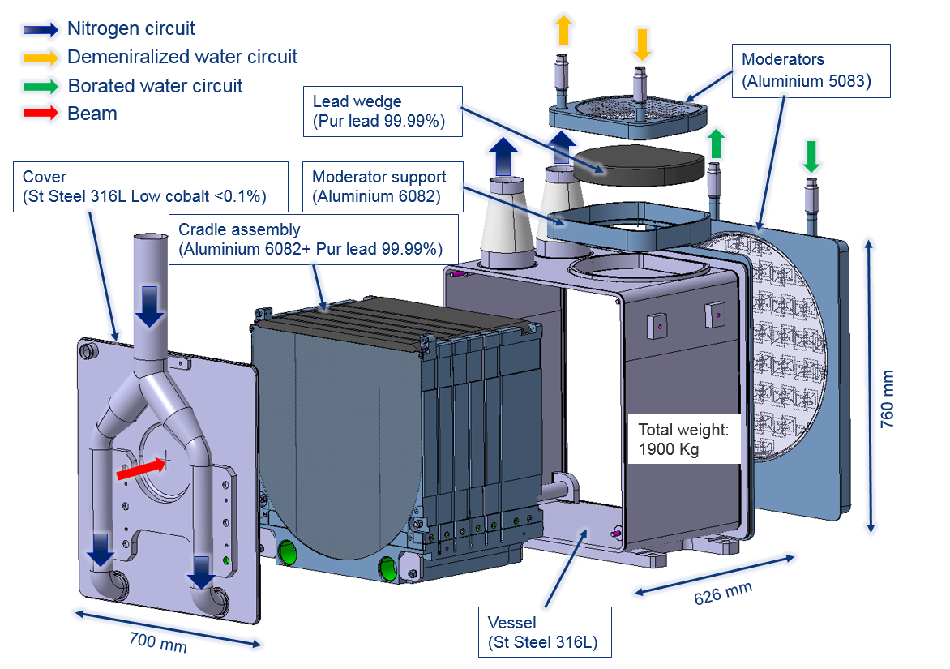
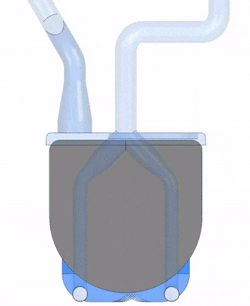
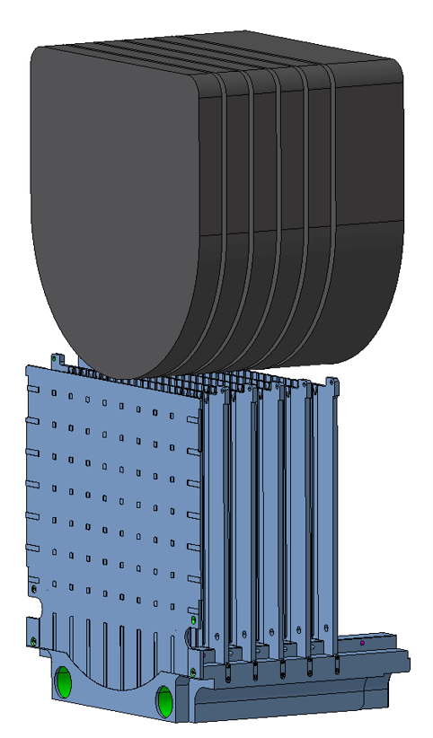
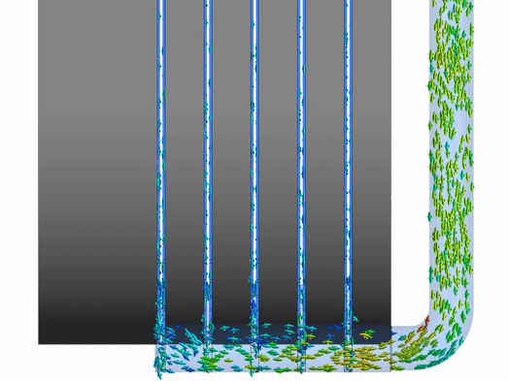
The n_TOF Target #3
More details: Phys. Rev. Accel. Beams 24, 093001 (2021)
50 mm
150 mm
N₂ gas cooling to avoid Pb corrosion and contamination of the cooling circuit
Al-6082-T6 supporting structure
(anti-creep and N₂ cooling channels)

Slide 3
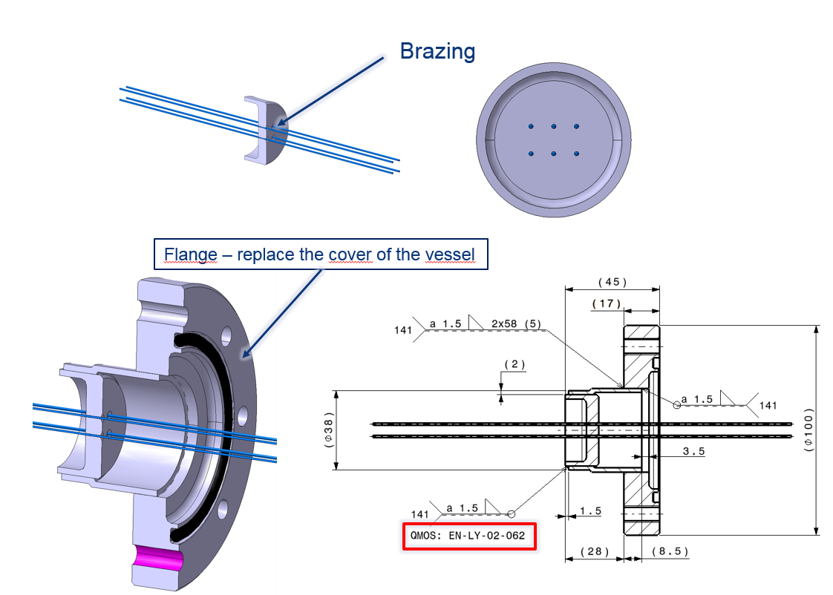
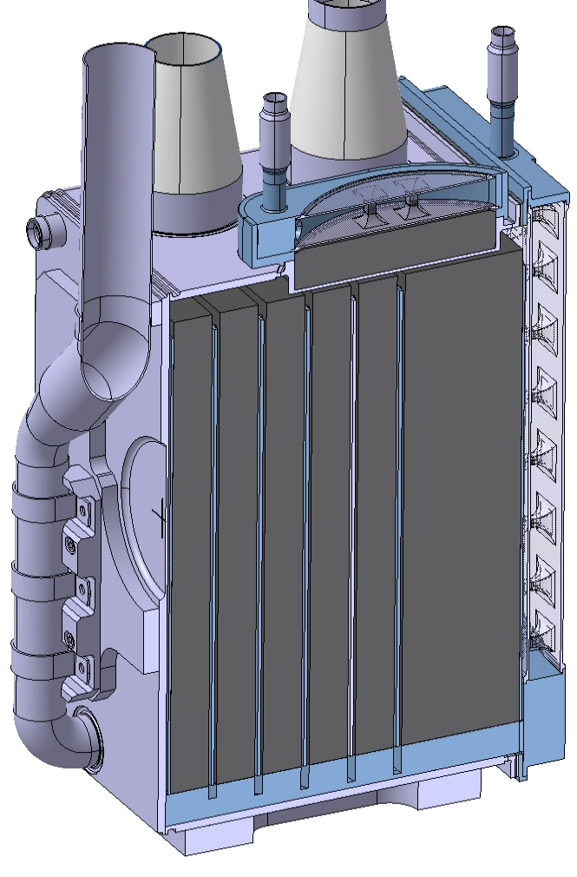
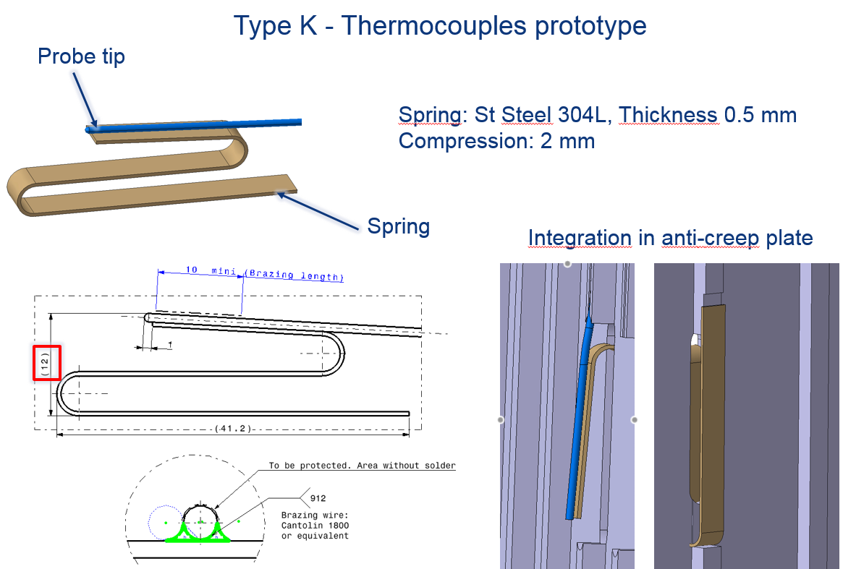
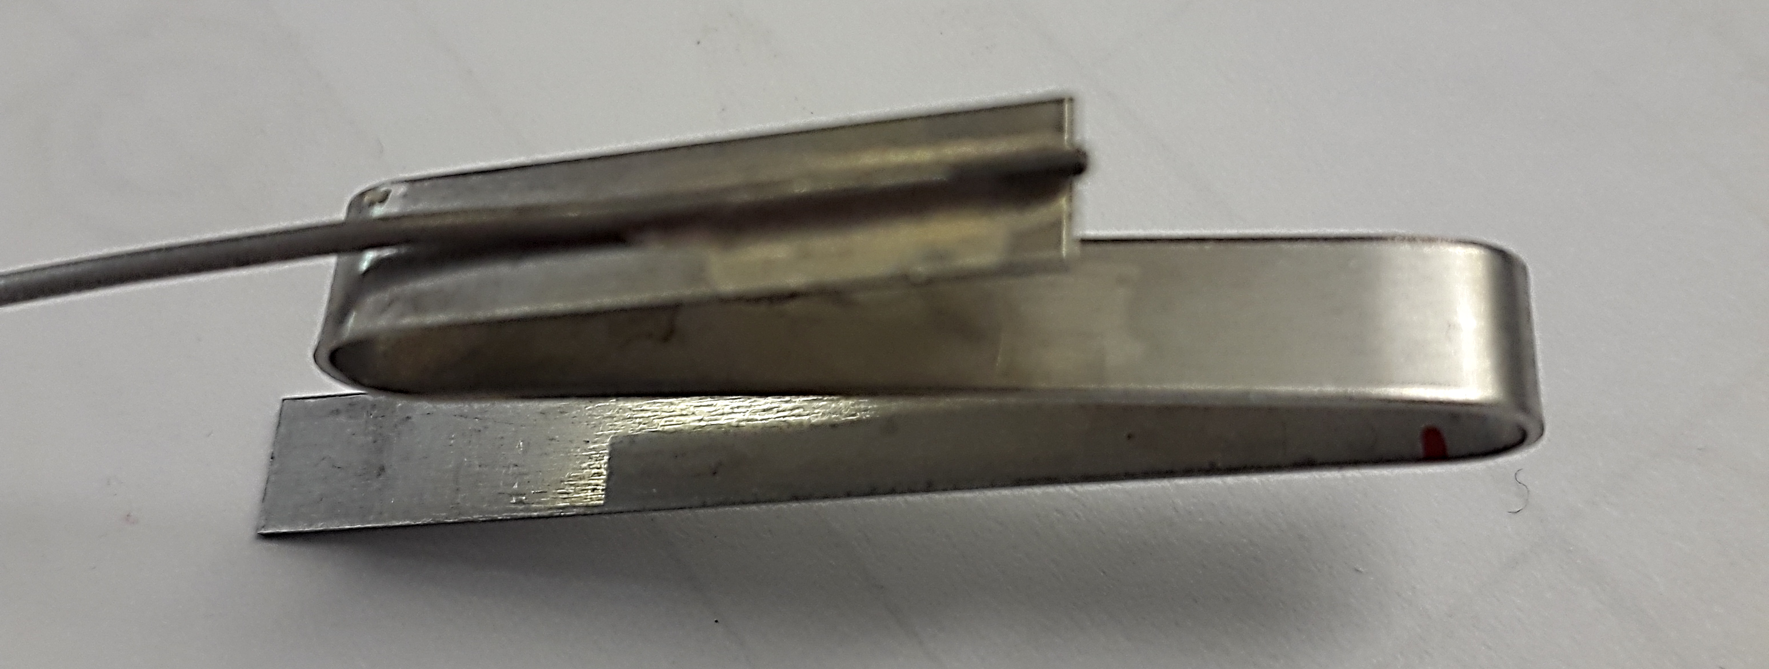
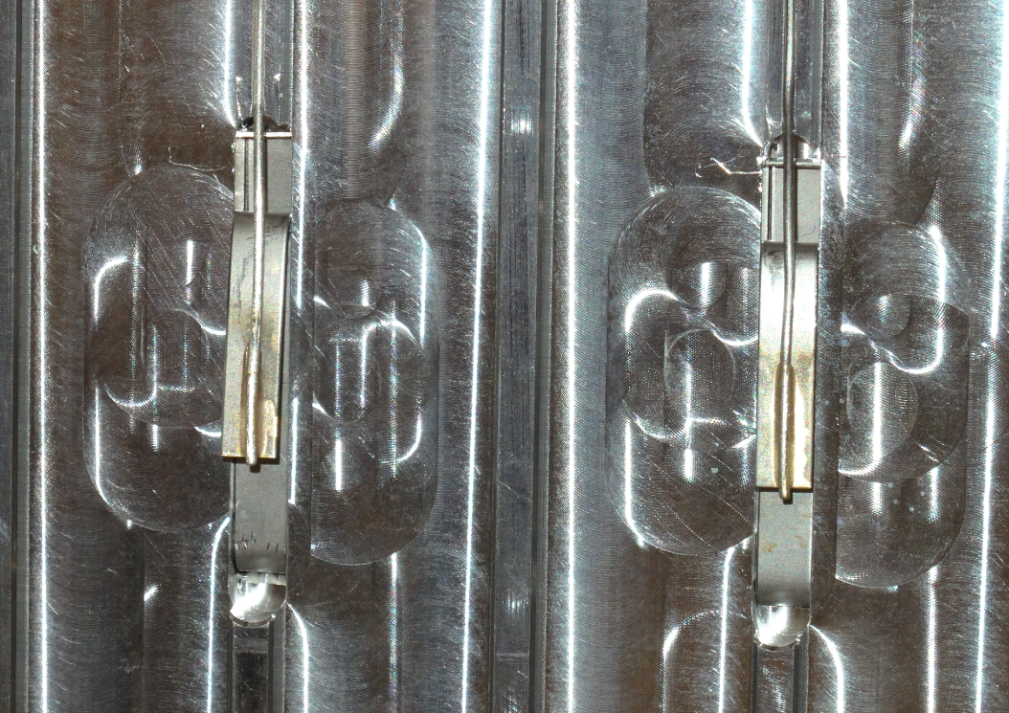
Target instrumentation
2 thermocouples × 3 points = 6 thermocouples to monitor Pb surface temperature

Slide 4
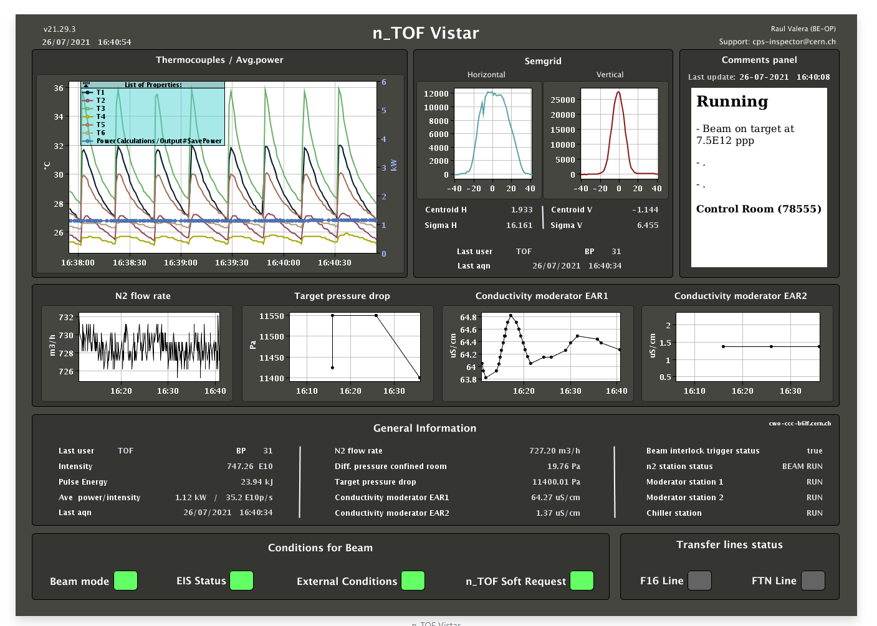
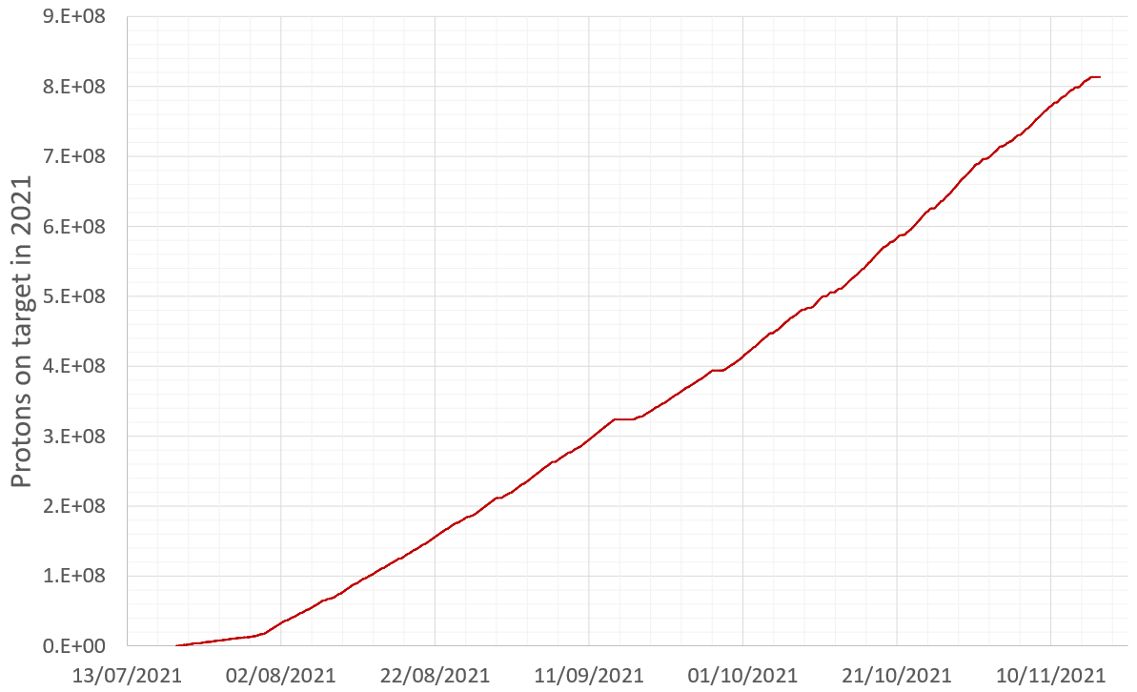
Target commissioning
n_TOF Vistar: https://insp.web.cern.ch/webviewer/application/CPS/n_TOF_Web_Vistar
First beam on target: July 19th 9:47 AM
Protons on target so far: ~8.1×10¹⁸ p⁺
All systems working correctly
Thermocouples
SEM grid
Nitrogen and moderator systems
Faraday cup

Slide 5
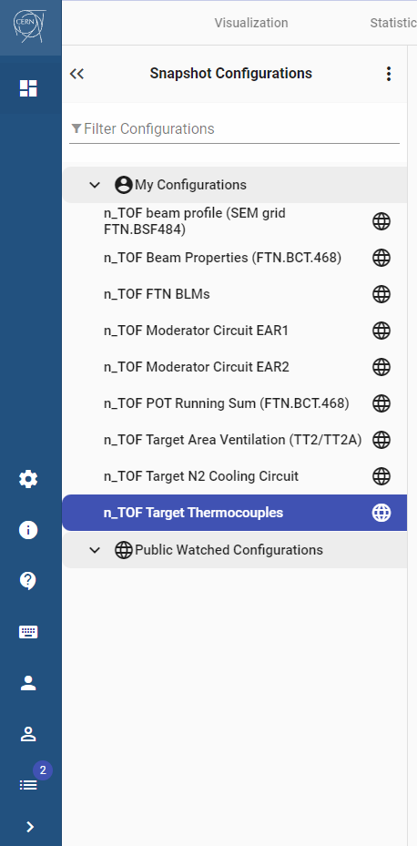
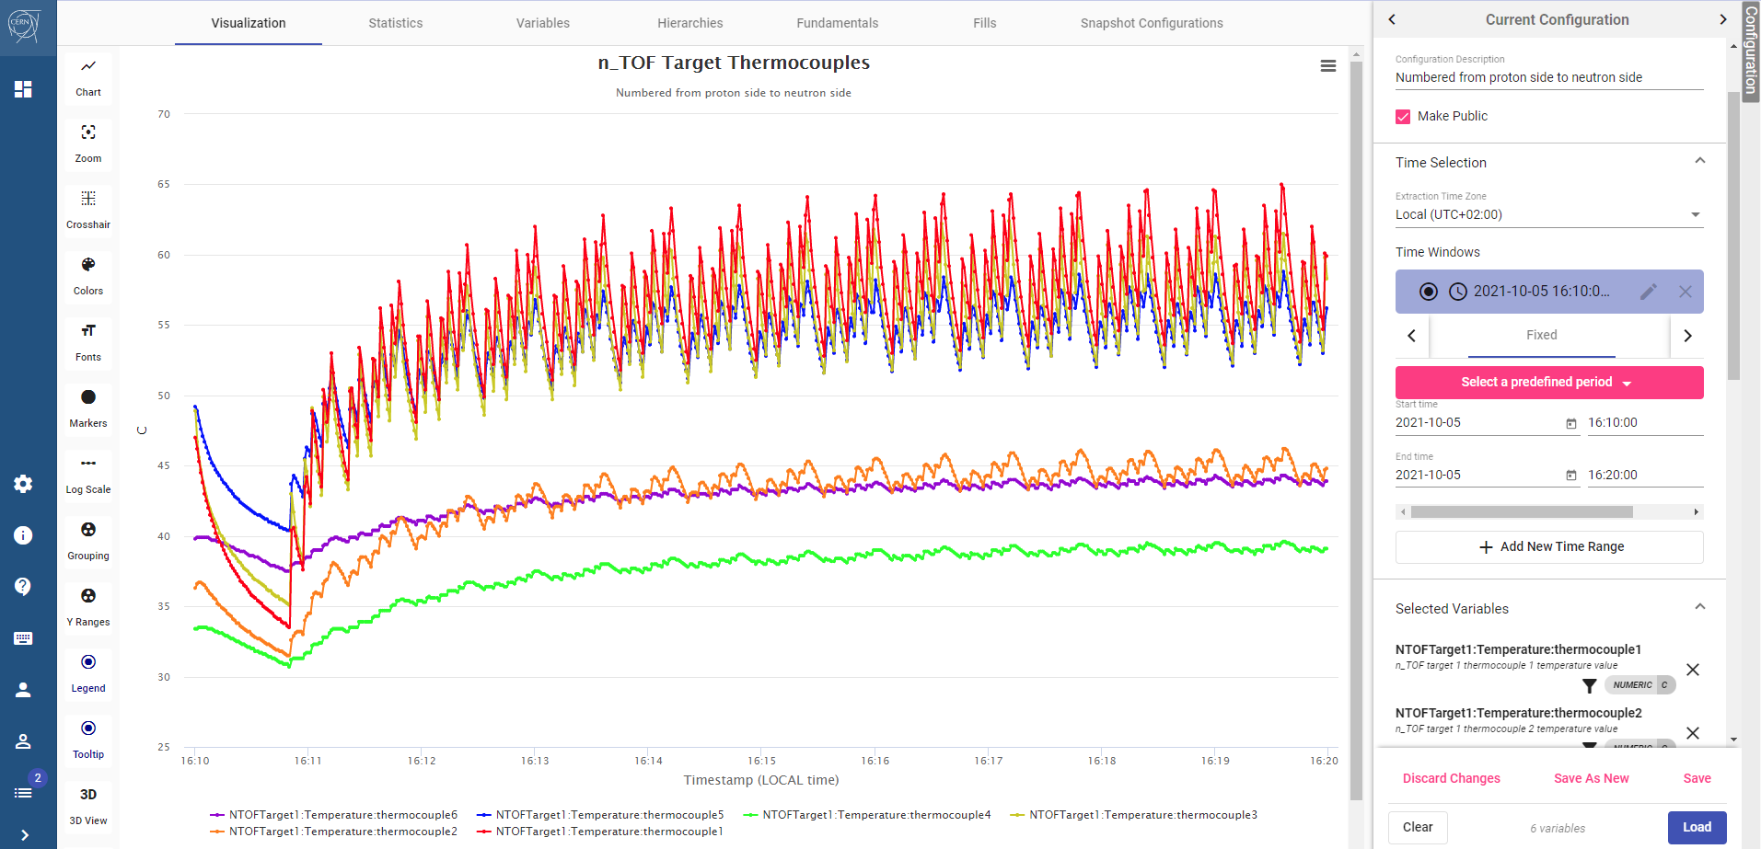
Target systems logging
All the monitored parameters are logged on NXCALS
Accessible from TIMBER
Snapshot configurations for each system

Slide 6
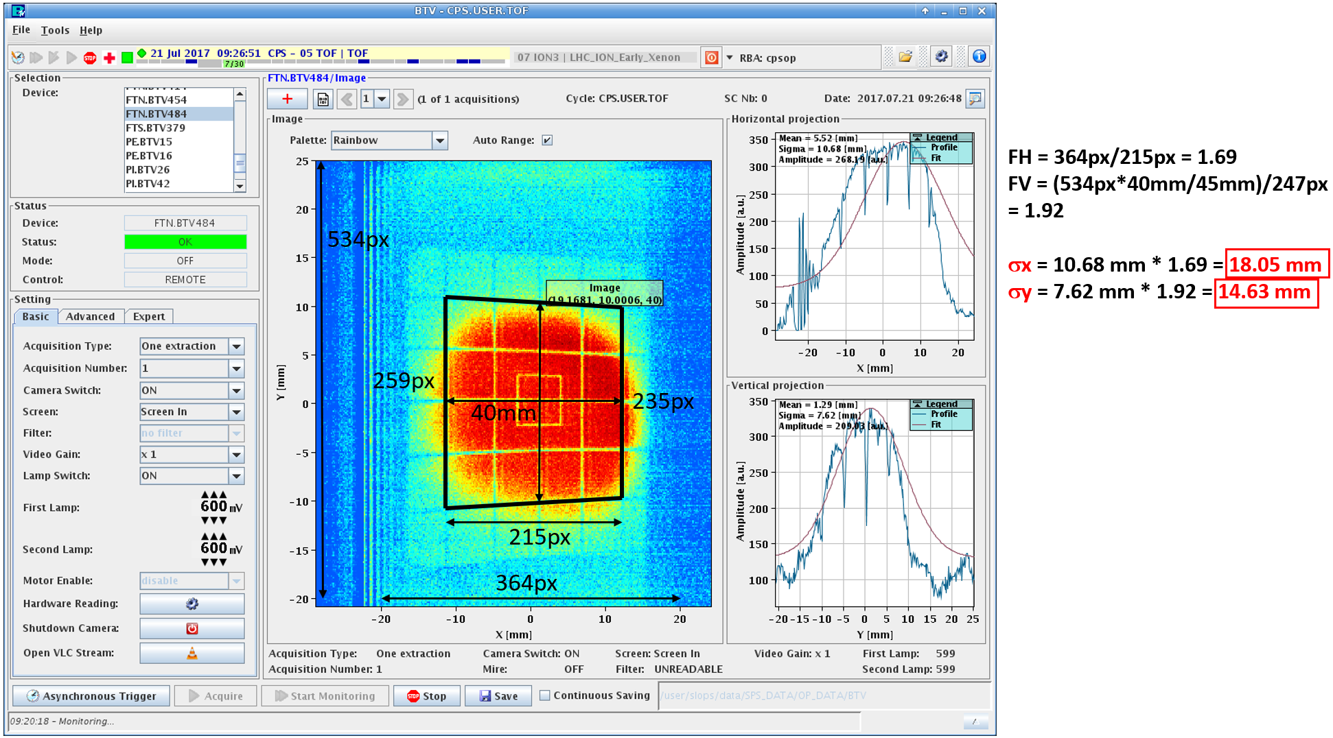
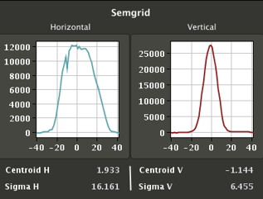
Target design parameters
SEM grid was not available before commissioning
BTV images (not reliable) compatible with 15×15mm² size
Design values
Bunch intensity: 10¹³ ppb
Average intensity: 1.67×10¹² p/s
1 pulse every 6 s on average
6 pulses in a 36 s supercycle
Beam size: 15 mm × 15 mm (RMS)
Momentum: 20 GeV/c
TOF-TAR-EP-0001 (EDMS 1581048), Beam Parameters for the n_TOF Spallation Target, 2016
TOF-TAR-EN-0001 (EDMS 1580996), Preliminary conceptual design of the n_TOF Spallation Target #3, 2016
TOF-TAR-ES-0003 (EDMS 2154581), n_TOF neutron spallation Target #3 – N₂ cooled bare Pb core, 2019
Esposito R. and Calviani M., J. Neutron Res., 22, 221, 2020
https://indico.cern.ch/event/696196/contributions/2949603/attachments/1649528/2637499/2018-05-15-Updated_Beam_parameters_for_n_TOF.pdf
SEM grid reveals beam size
16 mm × 7 mm

Slide 7
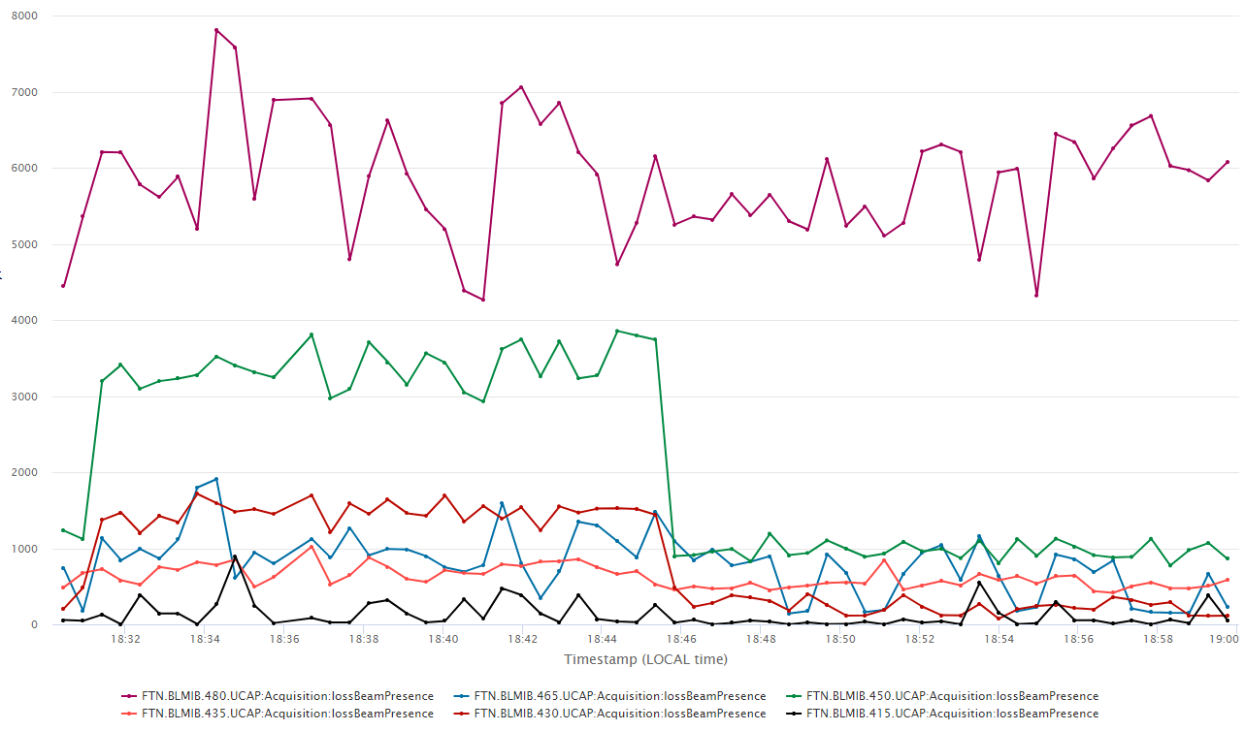
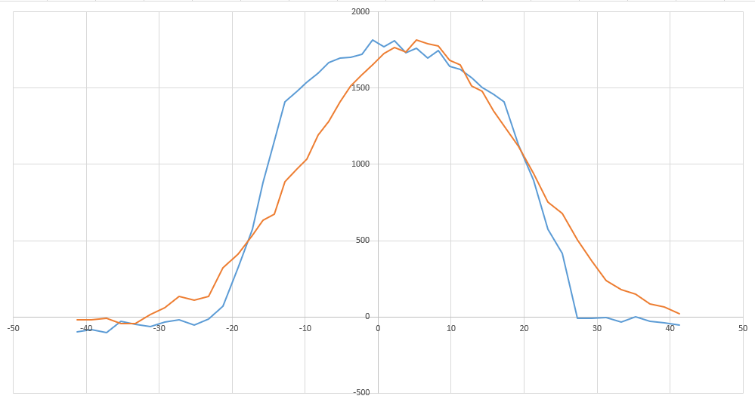
Test with new optics
Optics manipulation → Required beam
Up to factor 4 higher beam loss
15 mm × 15 mm 16 mm × 7 mm
⎯ H
⎯ V
mGy/s
mm
Test run with 15x15 beam during August until mid-September

Slide 8
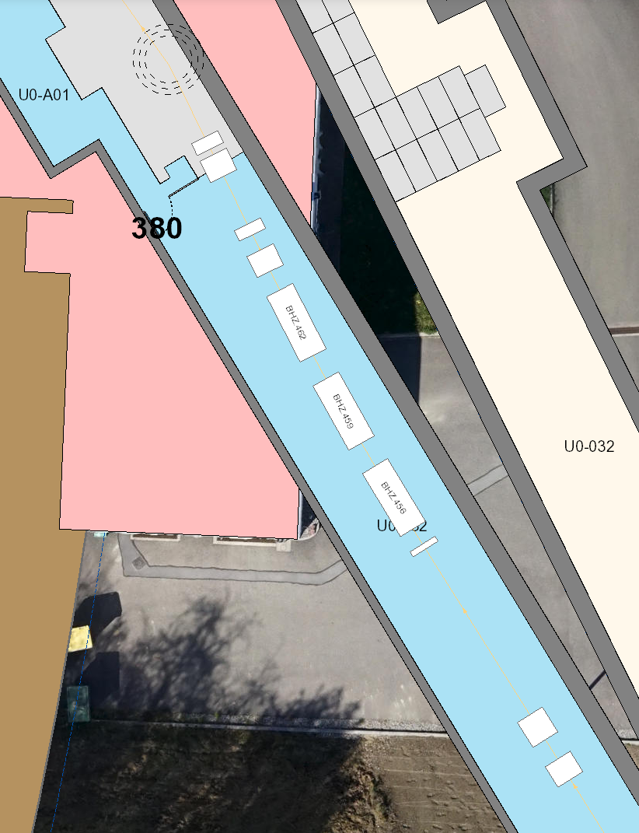
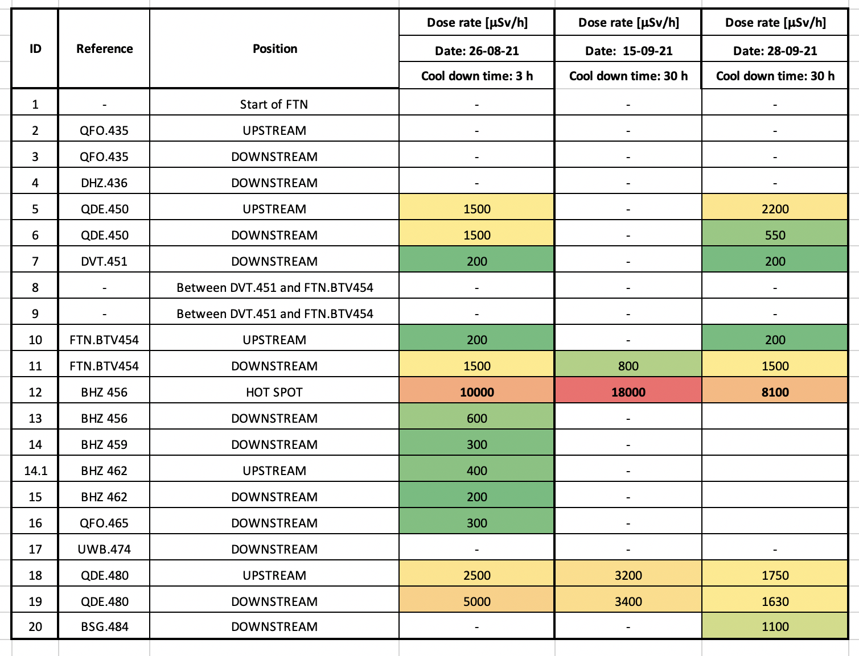
Dose rate in the FTN line after test
15mm×15mm 16mm×7mm
Target
Hot spot
PS beam

Slide 9
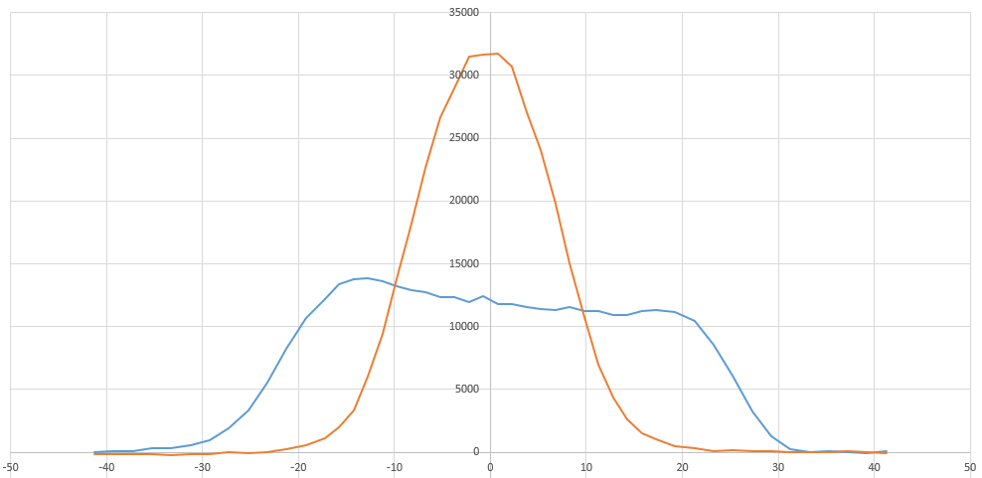
Back to pre-LS2 optics
High dose in FTN with 15x15mm beam size → spread on the horizontal axis keeping the limitation on the vertical axis
15x15 mm²
27x7 mm²
⎯ H
⎯ V
⎯ H
⎯ V
mm
mm
Comparison of peak energy density ongoing

Slide 10
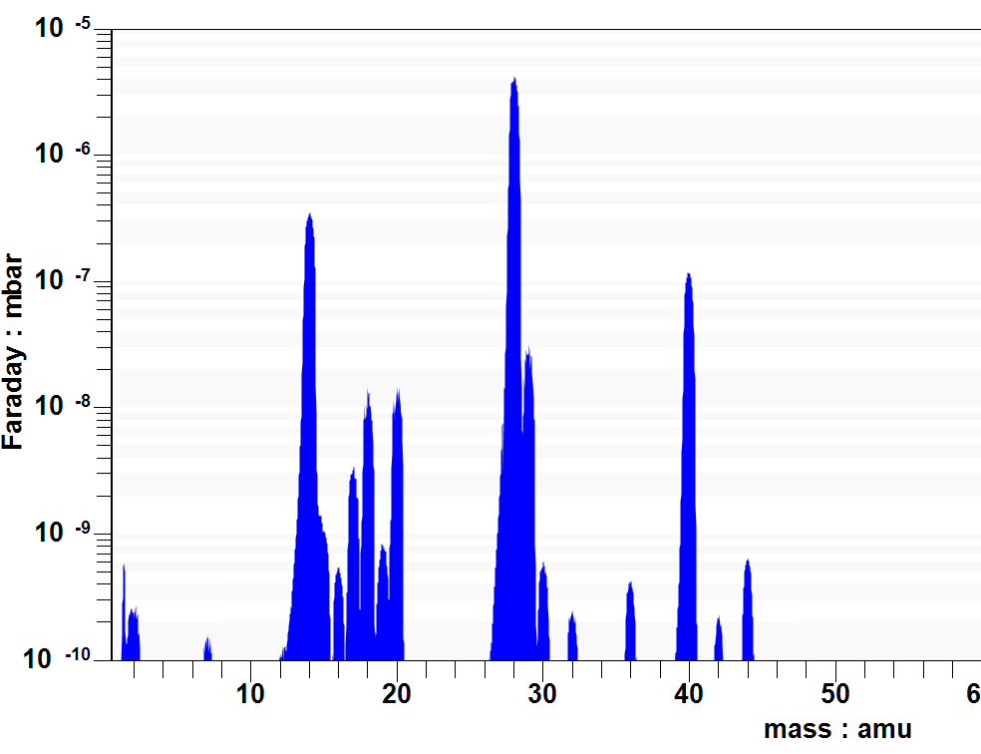
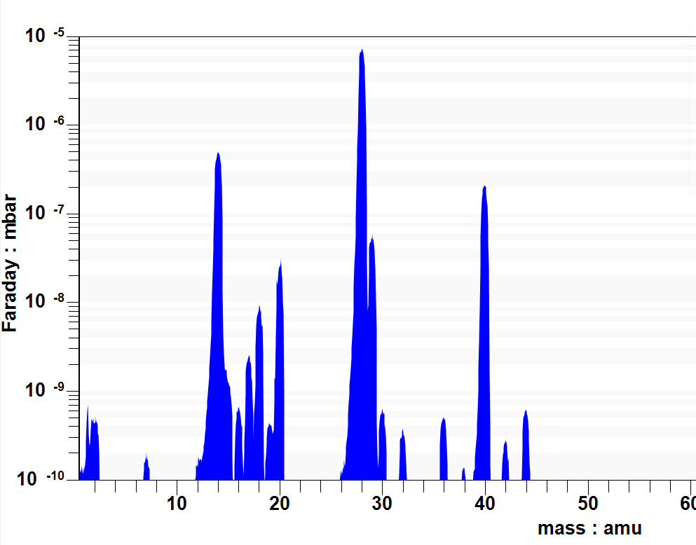
Gas analysis
N₂ (carrier gas) + Ar (2.7%)
H2O: this value is not accurate as H2O(g) is condensable and tends to accumulate in the mass spectrometer → H2O(g)= 1-2 ppm
Other impurities: O₂ (20 ppm), H₂ (20 ppm), CO₂ (60-80 ppm)
Before BEAM
After BEAM
N₂
Ar
H₂O
Faraday cup
Courtesy F. Dragoni

Slide 11
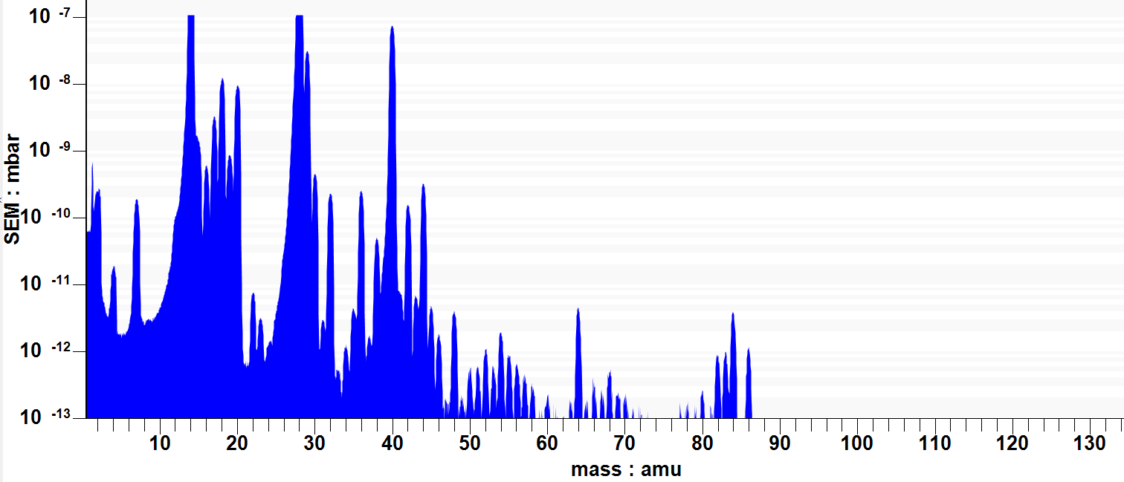
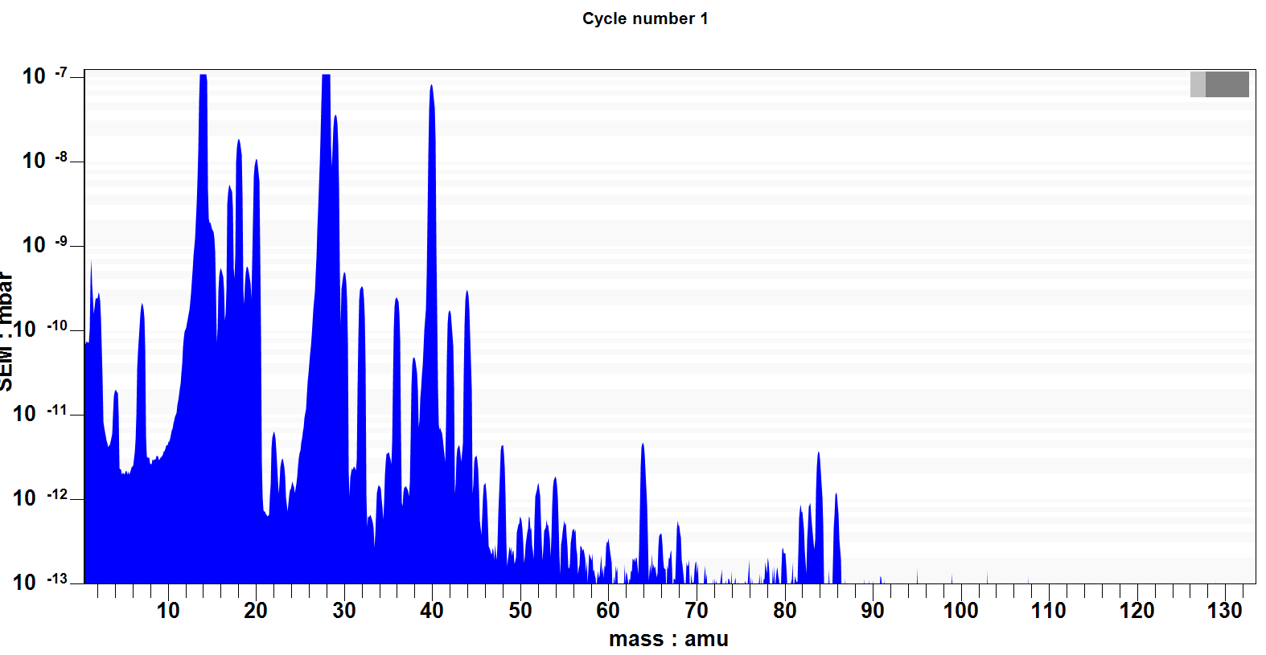
Gas analysis
Traces of organic components – 10-500 ppb
He
Before BEAM
Secondary Electron
Multiplier
After BEAM
Courtesy F. Dragoni

Slide 12
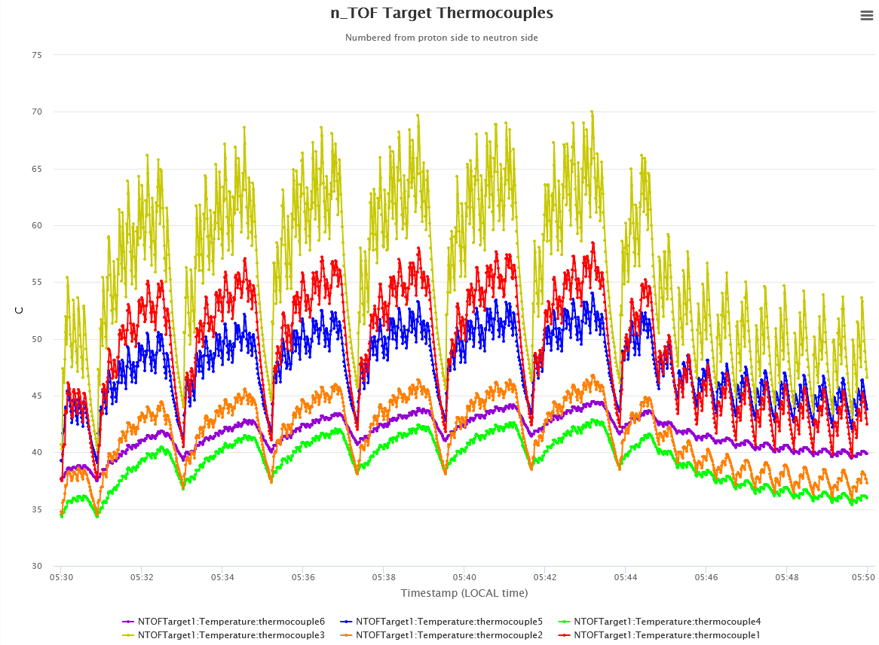
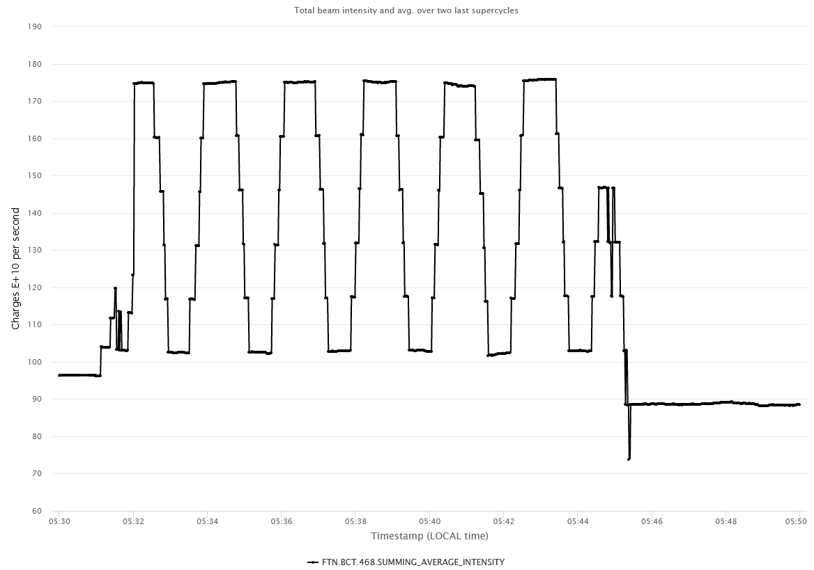
Beam interlocks
Beam interlocked if average intensity > than 1.67×10¹² p/s (computed over the last two supercycles)
If 3 high-intensity pulses (> 7.5×10¹² p⁺) have wrong size or position (x_{v} within +/- 3mm, σ_{v}< 5mm, σ_{H} < 25mm)
Number of pulses per supercycle accidentally high:
Beam interlock went off every time the average intensity increased too much

Slide 13
Conclusions
The n_TOF Target #3 and all the related systems worked well during commissioning:
Target instrumentation (thermocouples)
Cooling system (nitrogen and moderator station)
Beam size monitoring (SEM grid)
The target has already been impacted by ∼8.1×10¹⁸ p⁺ (∼ 1 million pulses).
The beam size assumed by design induces high dose in the beamline due to vertical aperture limitation: work ongoing to get the desired energy density by respecting the vertical limitation while spreading the energy along the horizontal axis.
The gas analyzer did not show variations in the cooling gas content so far.
Beam interlocks developed for beam size and position, in addition to pre-existing interlock on average intensity.

Slide 14
Thank you for your attention!

