Slide 1






Update on the X17 initiative
G. Gervino (UNITO)
P. Mastinu (INFN LNL)
C. Gustavino (INFN ROMA)
A. Mengoni (ENEA)
C. Massimi (UNIBOLOGNA)
N. Colonna (INFN BARI)
S. Fiore (ENEA ROMA)
A. Mazzone (CNR BARI)
M.C. Petrone (IFIN-HH BUCHAREST)
L. E. Marcucci (UNIPISA)
M. Viviani (INFN PISA)
A. Kievsky (INFN PISA)
L. Girlanda (UNISALENTO)
E. Cisbani (ISS)
F. Renga (INFN ROMA)
n_TOF
Theoretical group
Detector R&D
Working group (in evolution)
C.Gustavino, n_TOF meeting, 25 november 2021, CERN

Slide 2
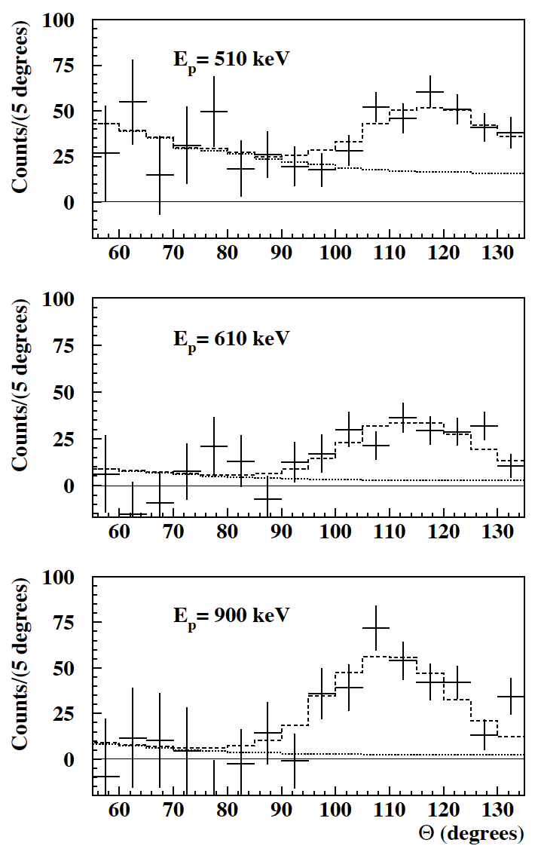
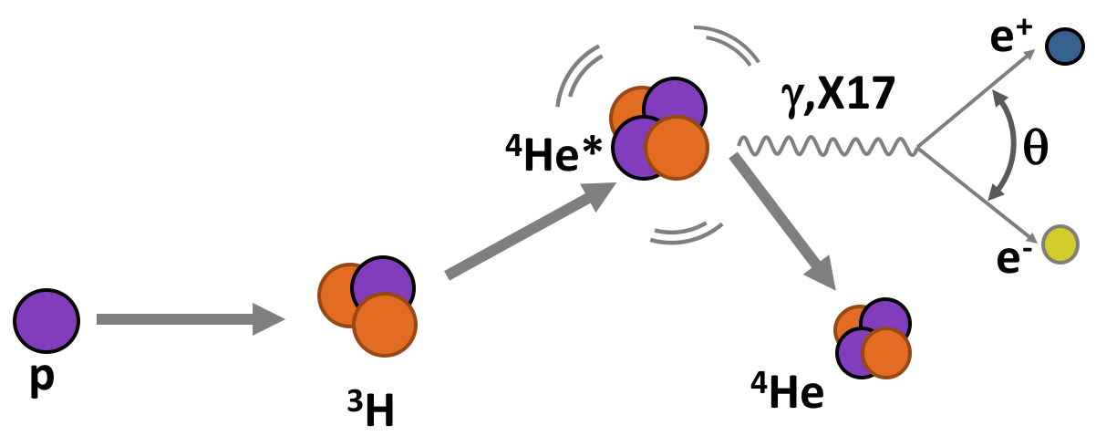
X17 ATOMKI RESULTS IN A NUTSHELL
-A significant anomaly has been recently observed in the emission of electron-positron pairs in the ⁷Li(p,e⁺e⁻)⁸Be and ³H(p,e⁺e⁻)⁴He reactions.
-This anomaly has been interpreted as the signature of a 17 MeV BOSON, not foreseen in the standard model of particle physics.
-The so called X17 boson could be a mediator of a fifth force, characterized by a strong coupling suppression of protons compared to neutrons.
-This evidence/scenario is presently not confirmed or excluded by other experiments or groups.
³H(p,e⁺e⁻)⁴He
Reaction | M_{X17}±ΔM_{stat}±ΔM_{syst} (MeV) | Statistical evidence
⁷Li(p,e⁺e⁻)⁸Be | 16.70±0.35±0,50 | >5 sigma
³H(p,e⁺e⁻)⁴He | 16.94±0.12±0.21 | >9 sigma
Krasznahorkay, A.J.; et al.: Physical Review Letters. 116 (42501): 042501 (2016).
Krasznahorkay, A.J.; et al.: arXiv:1910.10459v1 [nucl-ex] (23 October 2019).
Krasznahorkay, A.J.; et al.: arXiv:2104.10075v1 [nucl-ex] (20 April 2021).

Slide 3
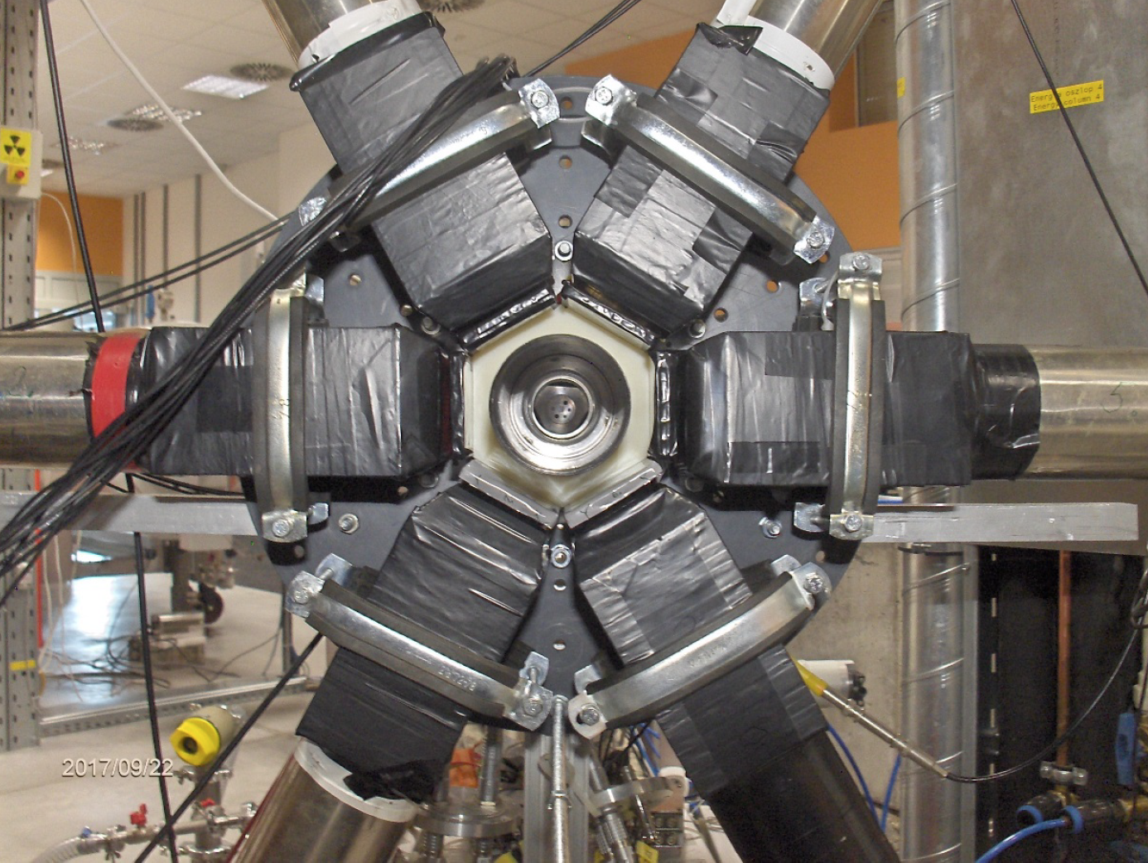
³H(p,e⁺e⁻)⁴He setup @ ATOMKI
³H adsorbed on Ti layer
6 plastic scintillator 82x86x80 mm³
6 double-sided silicon strip detector (3 mm wide strips, 0.5 mm thick)
1 mm thick carbon fiber tube
Detector acceptance only around 90° with respect to the beam axis
no tracking
Plastic scintillator
Carbon fiber tube
Target
e⁻
Silicon strips
e⁺

Slide 4
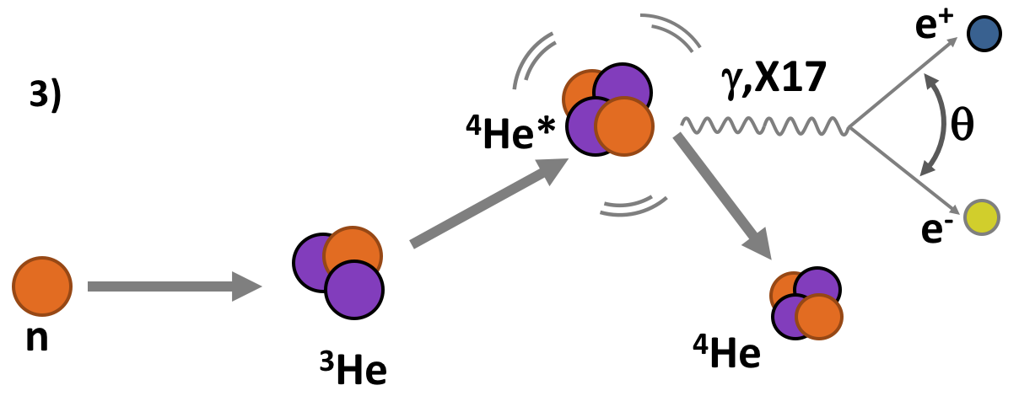
X17 @ nToF
Basic idea: new study of excited ⁴He
exploiting both the conjugated reactions:
³H(p,e⁺e⁻)⁴He
³He(n,e⁺e⁻)⁴He
ATOMKI REACTION
n_TOF REACTION
Physics:
Probing X17 existence
X17 Mass, quantic numbers, coupling, life time,..
proto-phobic nature of the fifth force.
First measurement of σ(E) ³He(n,e⁺e⁻)⁴He
Data Vs Theoretical nuclear physics

Slide 5
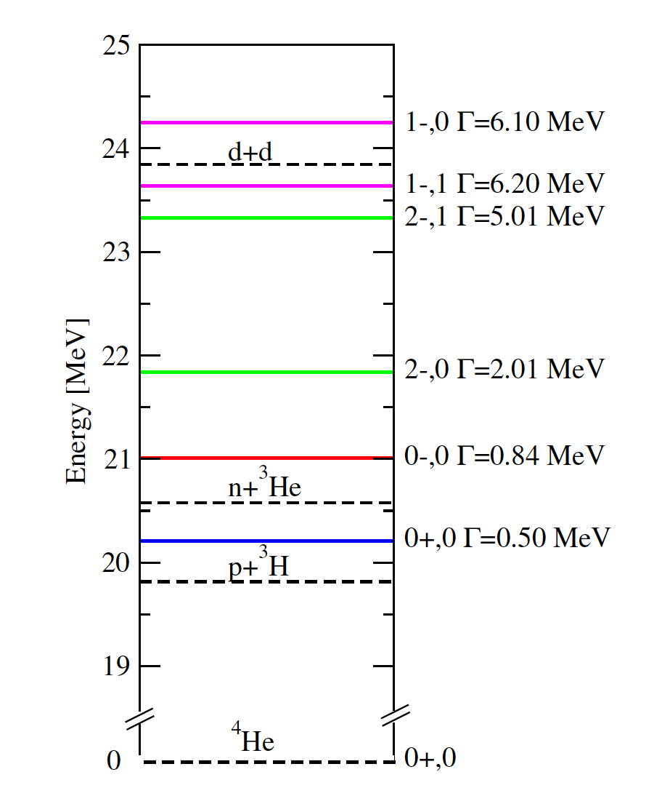


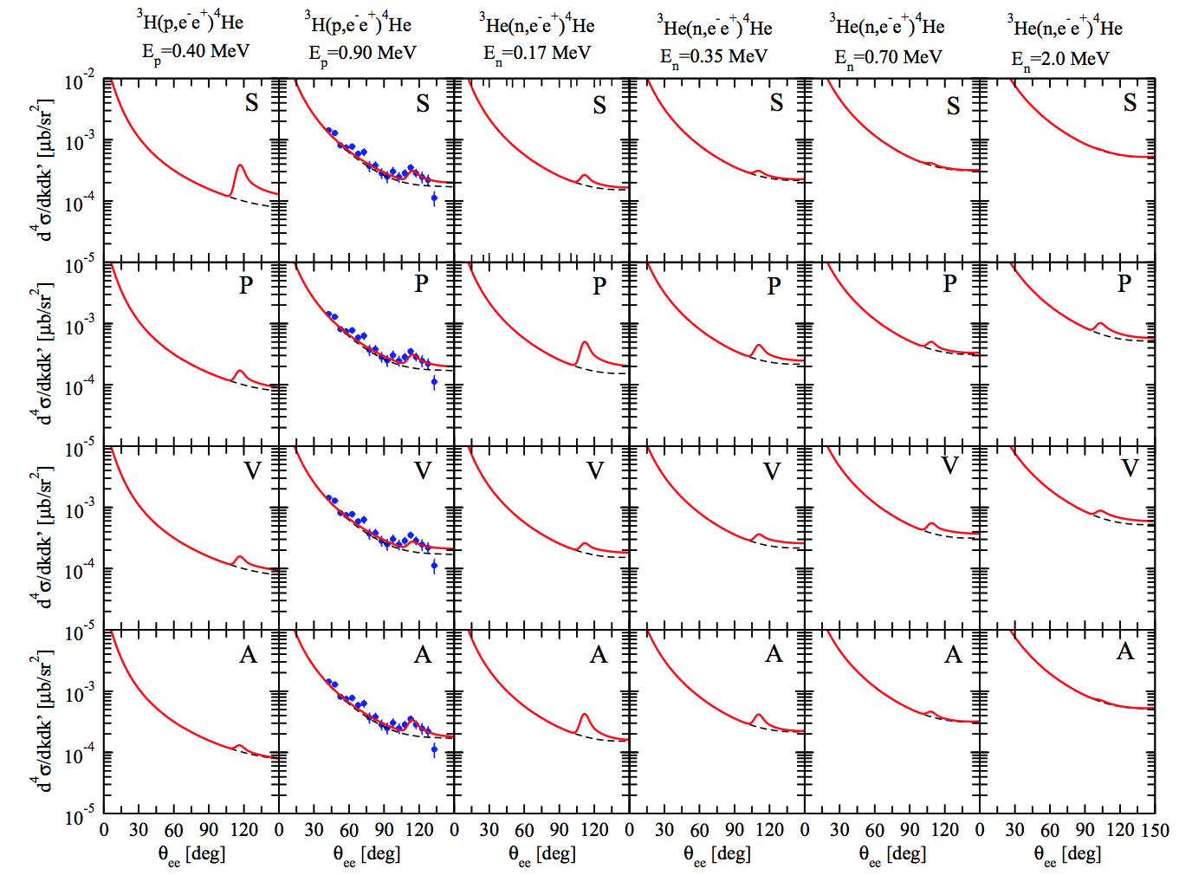
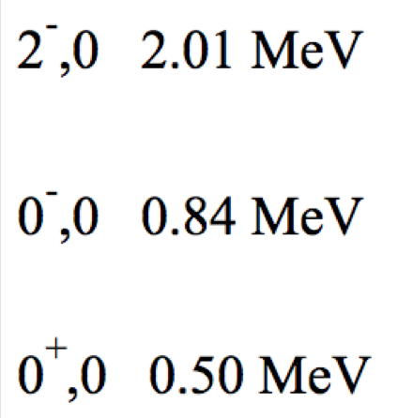
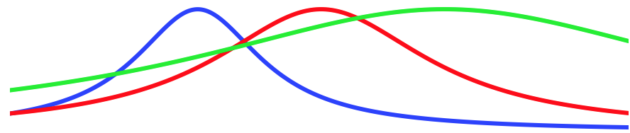
X17 @ nToF
ATOMKY
n_TOF
courtesy M. Viviani
Notes:
The low-energy spectrum of ⁴He. The dashed lines indicate the thresholds for the opening of the 1+3 channels, while the solid lines indicate the energies of
the various resonances with corresponding widths, J, and isospin assignments to the right. Blue area is investigated with a neutron beam, while thr green one is investigated with protons.

Slide 6
X17 @ nToF
ATOMKY data
ATOMKY
n_TOF
courtesy M. Viviani
Notes:
The low-energy spectrum of ⁴He. The dashed lines indicate the thresholds for the opening of the 1+3 channels, while the solid lines indicate the energies of
the various resonances with corresponding widths, J, and isospin assignments to the right. Blue area is investigated with a neutron beam, while thr green one is investigated with protons.

Slide 7
ATOMKY data
X17 @ nToF
ATOMKY
n_TOF
courtesy M. Viviani
Notes:
The low-energy spectrum of ⁴He. The dashed lines indicate the thresholds for the opening of the 1+3 channels, while the solid lines indicate the energies of
the various resonances with corresponding widths, J, and isospin assignments to the right. Blue area is investigated with a neutron beam, while thr green one is investigated with protons.

Slide 8
ATOMKY data
X17 @ nToF
ATOMKY
n_TOF
courtesy M. Viviani
Notes:
The low-energy spectrum of ⁴He. The dashed lines indicate the thresholds for the opening of the 1+3 channels, while the solid lines indicate the energies of
the various resonances with corresponding widths, J, and isospin assignments to the right. Blue area is investigated with a neutron beam, while thr green one is investigated with protons.

Slide 9
ATOMKY data
X17 @ nToF
ATOMKY
n_TOF
courtesy M. Viviani
Notes:
The low-energy spectrum of ⁴He. The dashed lines indicate the thresholds for the opening of the 1+3 channels, while the solid lines indicate the energies of
the various resonances with corresponding widths, J, and isospin assignments to the right. Blue area is investigated with a neutron beam, while thr green one is investigated with protons.

Slide 10
ATOMKY data
X17 @ nToF
ATOMKY
n_TOF
Wide energy range (proton and neutron beams) to explore all resonances with different J^{π}
courtesy M. Viviani
Notes:
The low-energy spectrum of ⁴He. The dashed lines indicate the thresholds for the opening of the 1+3 channels, while the solid lines indicate the energies of
the various resonances with corresponding widths, J, and isospin assignments to the right. Blue area is investigated with a neutron beam, while thr green one is investigated with protons.

Slide 11
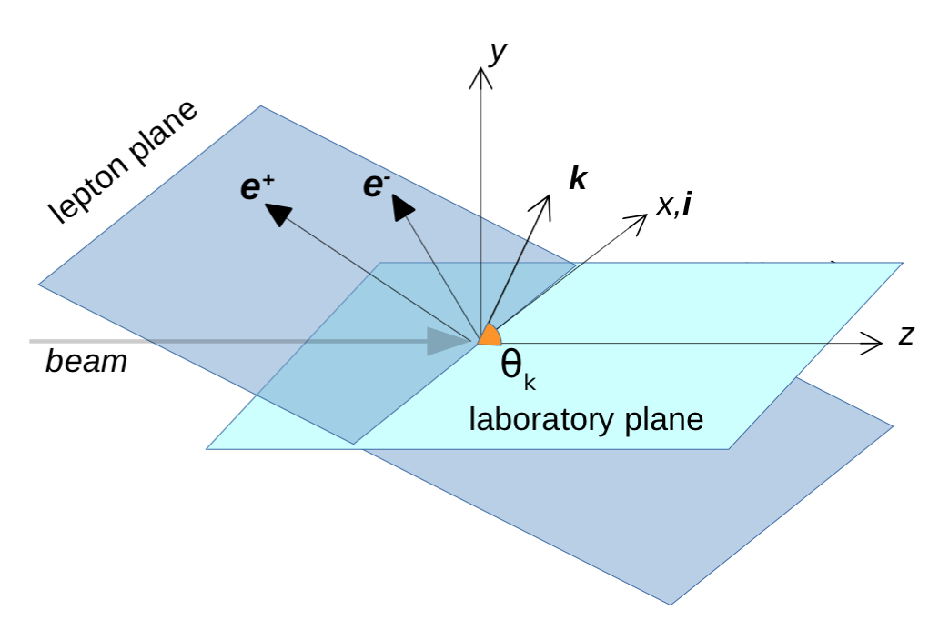
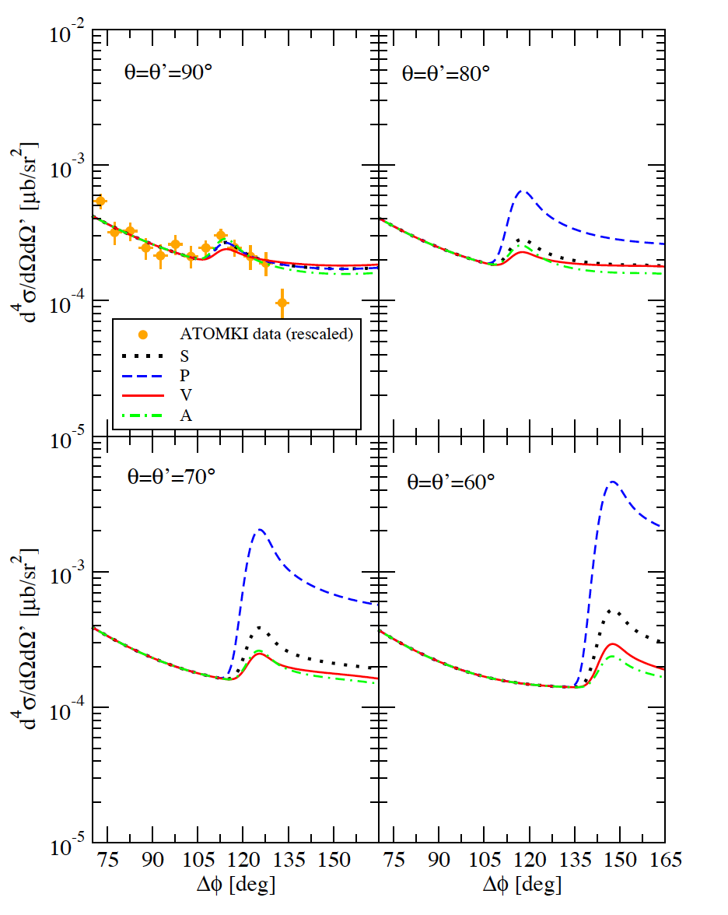
X17 @ nToF
ATOMKY data
Wide energy range (proton and neutron beams) to explore all resonances with different J^{π}
Large detector acceptance (statistics and kinematics)
M. Viviani et al.: arXiv:2104.07808 [nucl-th] , submitted to PRC
courtesy M. Viviani
Notes:
The low-energy spectrum of ⁴He. The dashed lines indicate the thresholds for the opening of the 1+3 channels, while the solid lines indicate the energies of
the various resonances with corresponding widths, J, and isospin assignments to the right. Blue area is investigated with a neutron beam, while thr green one is investigated with protons.

Slide 12
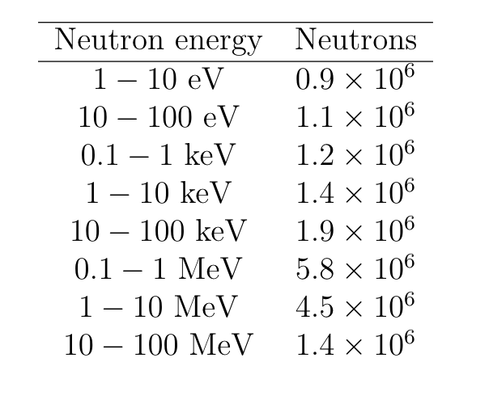
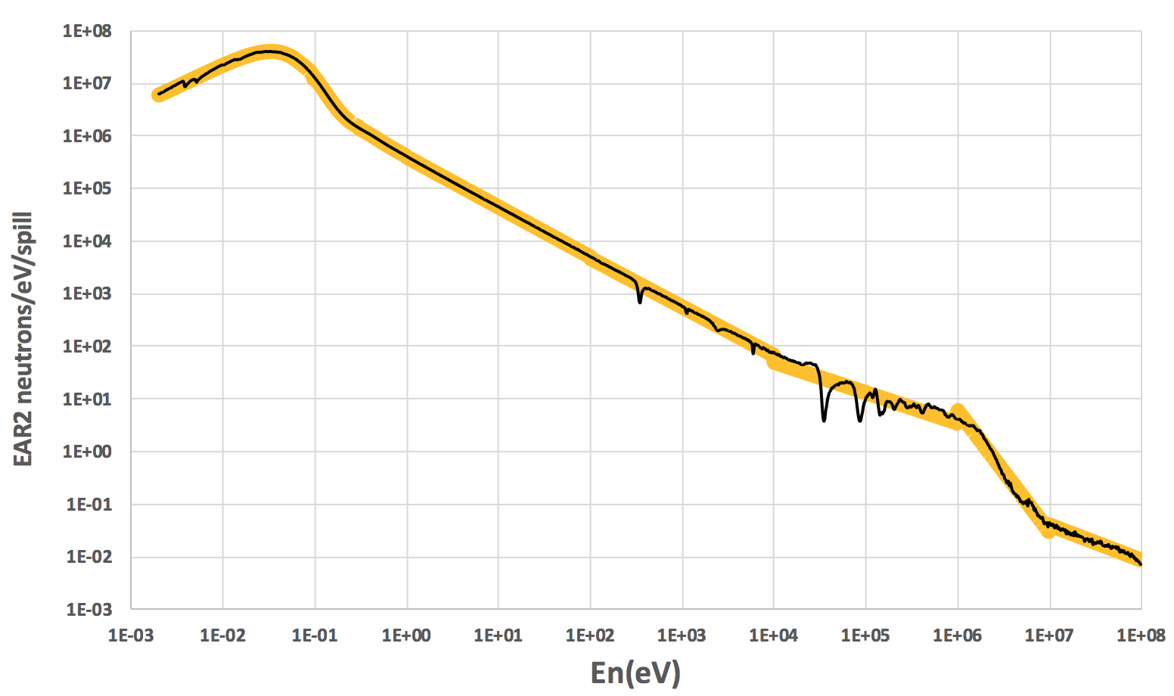
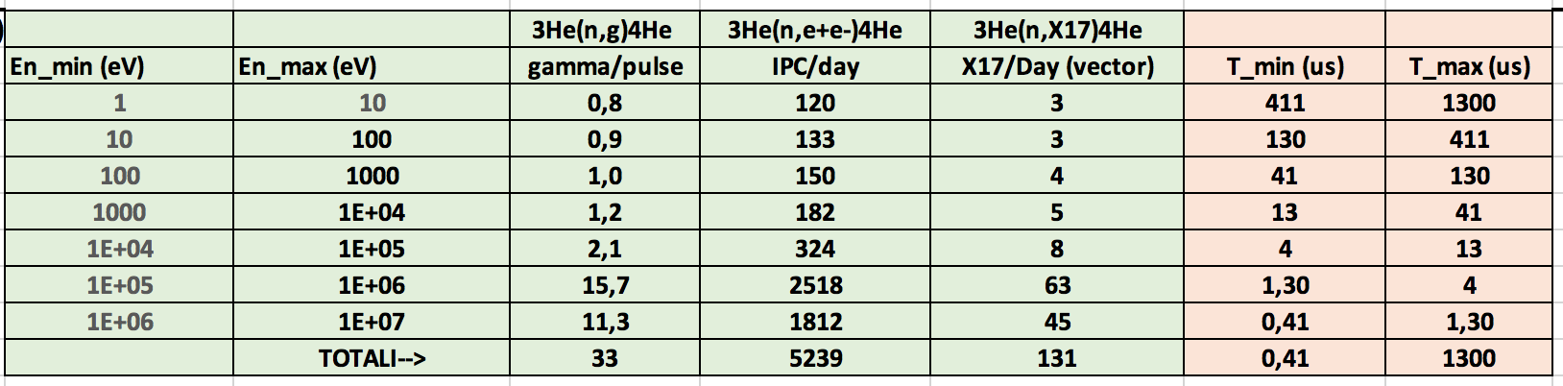
EAR2 @ n_ToF
Table and Figure: neutrons per pulse (frequency=1.2 sec)
Assuming:
ρ=8.21*10²¹ atoms/cm³
target lenght=10 cm
Duty Cycle=100%
efficiency=100%
acceptance=100%
Wide energy range for n_ToF neutrons
Under study (M. Calviani):
Moderator removal/change, to increase the abundance of neutrons in the MeV energy region

Slide 13
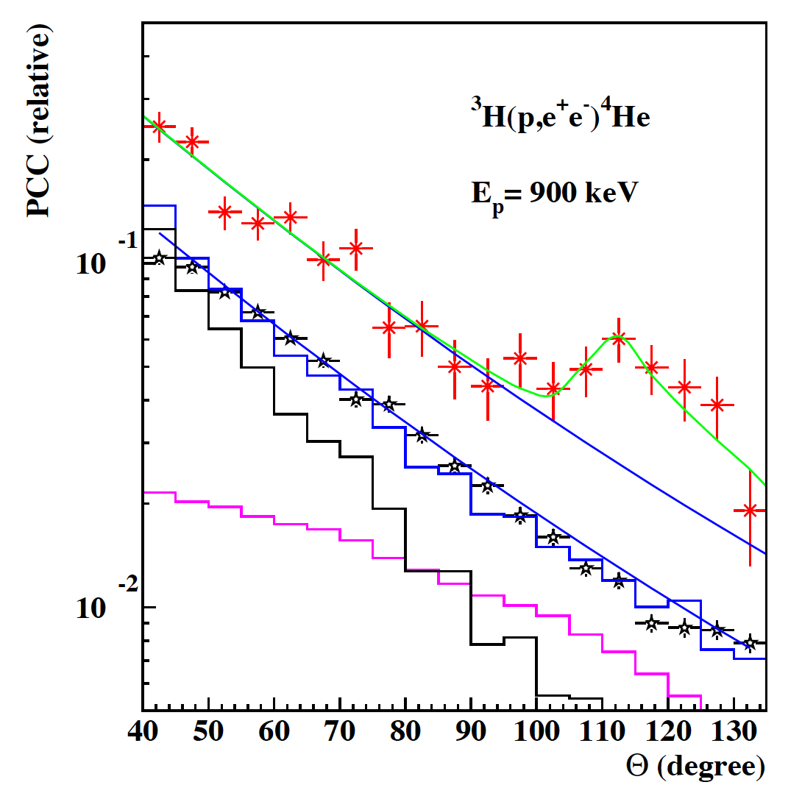
Backgrounds
Internal Pair Convertion (IPC) through the ³He(n,e+e-)⁴He process (virtual gammas convert into e+e- pairs). Most of the pairs can be cut off because of their small relative angle.
External Pair Convertion (EPC), i.e. ³He (n,γ)⁴He gammas converted into e+e- pairs in the material sorrounding the target. Also in this case, small relative angle between e+e- pairs.
Gammas from ³He (n,γ)⁴He.
protons from (n,p) reactions.
neutrons interacting with setup.
Picture from PRL 116 (42501): 042501 (2016)
X17→e+e-
EPC
IPC (irreducible background)

Slide 14
DETECTOR Conceptual design
e⁺
e⁻
e⁺
e⁻
beam
target
target
tracker (RICH/MPGD)
tracker (RICH/MPGD)
Ecal (Ej-200 or LYSO)
SIDE
FRONT
High intensity neutron beam 0<E_{n}[MeV]<3
High density target ρ=10²¹ atoms/cm³
Tracking (vertex and Pairs aperture angle energy)
4-momenta

Slide 15
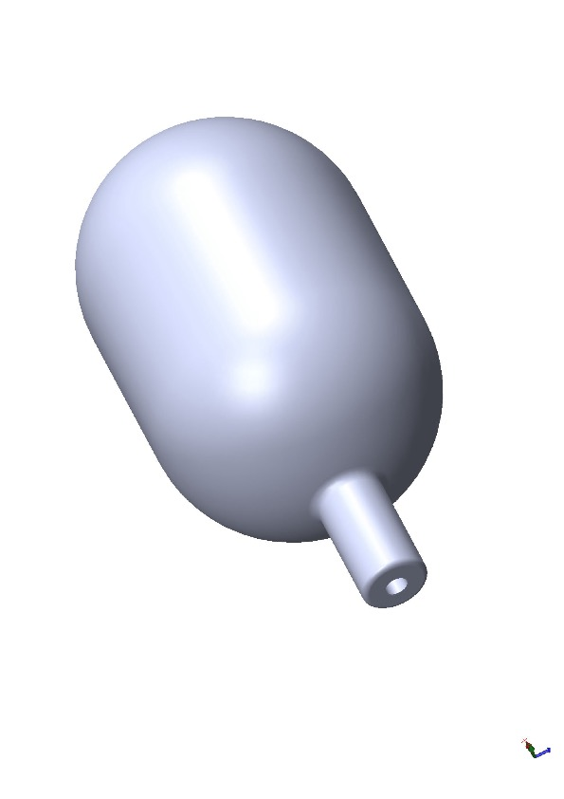
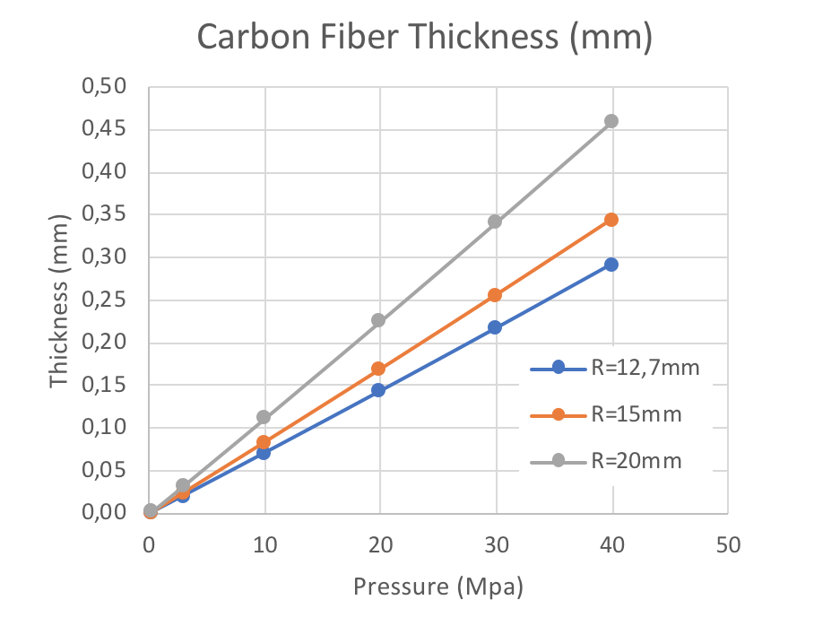
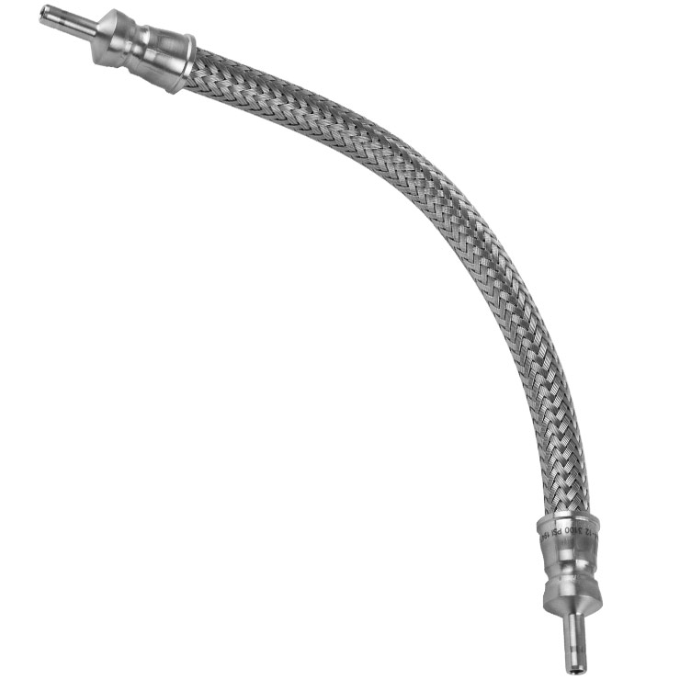
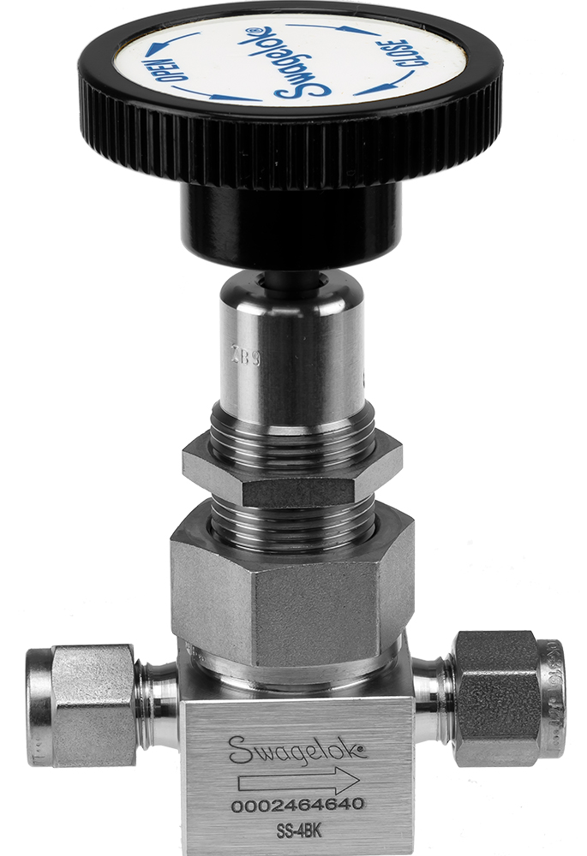

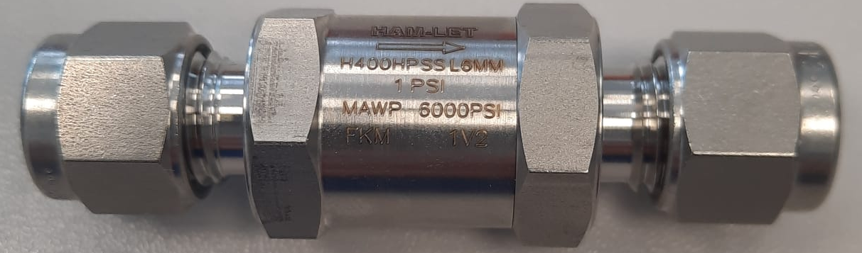
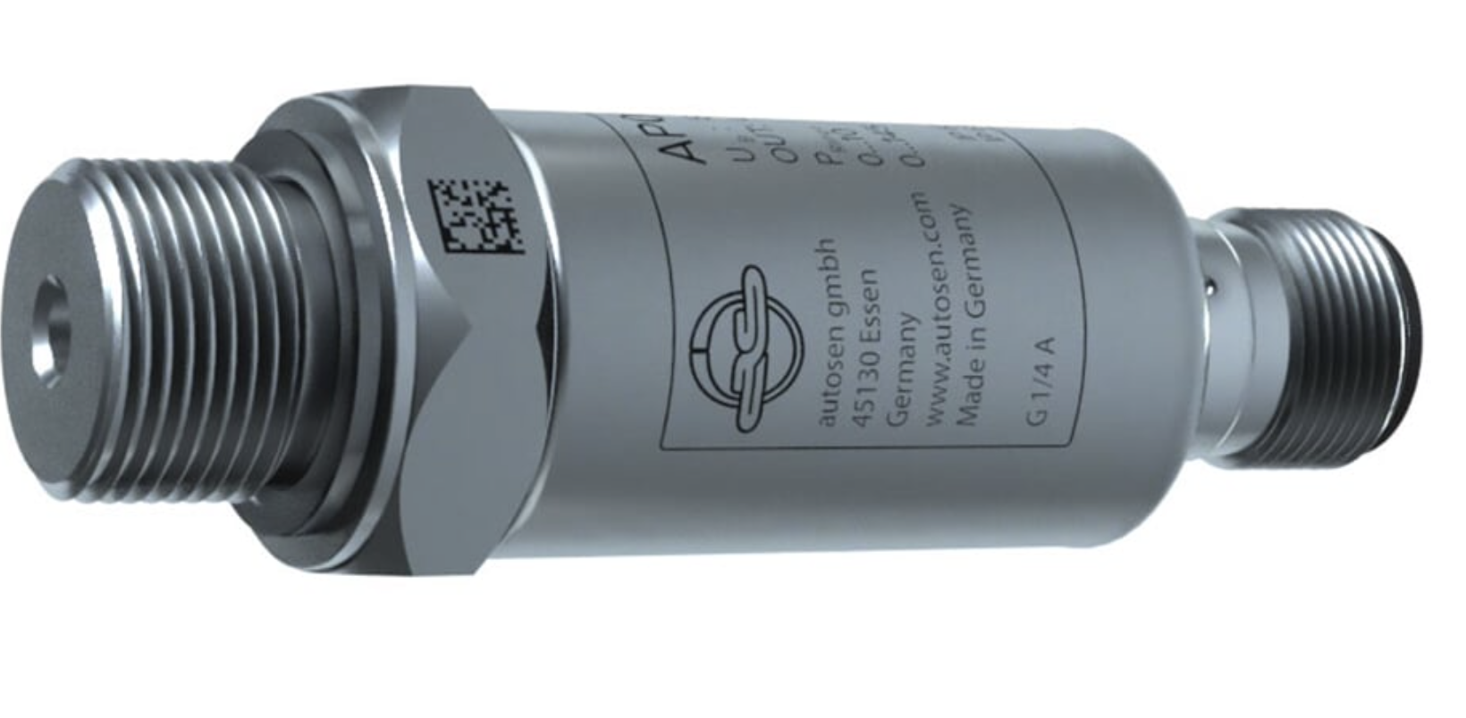
Target
0.6 mm thick envelope of Carbon Fibre will be tested to operate with ³He at 380 bar, 300 K. This pressure corresponds to 59 g/L (density of liquid ³He)
courtesy P. Mastinu

Slide 16
ROAD1: RICH (cfr. E. Cisbani)
aerogels
e⁻
Cherenkov light
neutron beam
³He target
SiPM
e⁺
β(e-,e+) @ 8 MeV = 0,993
β(p) @ 100 MeV = 0,42
→No signals due to the ³He(n,p)³H protons
Low ³He(n,γ)⁴He gamma background in the RICH
Standard Aerogels with n=1.05
Ellipse centers: e+/e- impact points
Ellipse shapes: e+/e- Directions

Slide 17
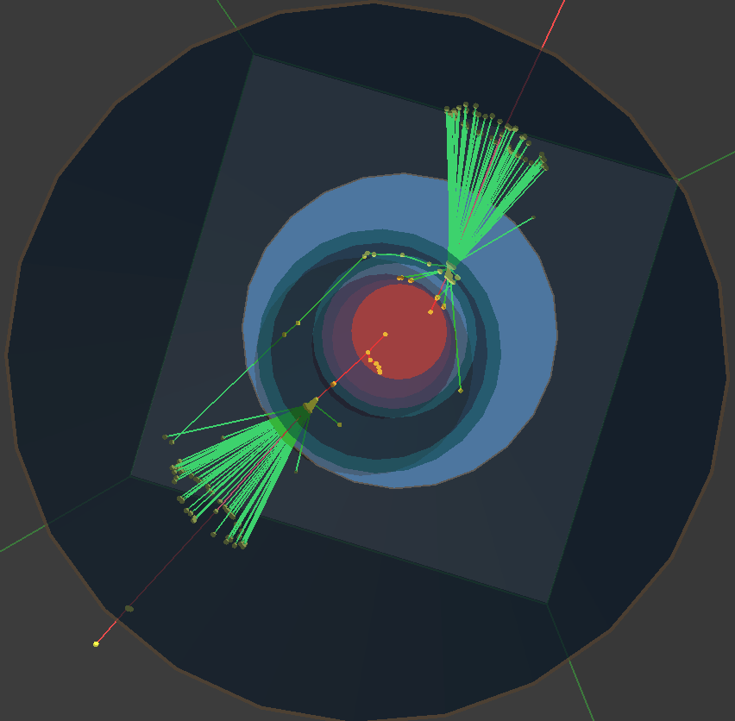
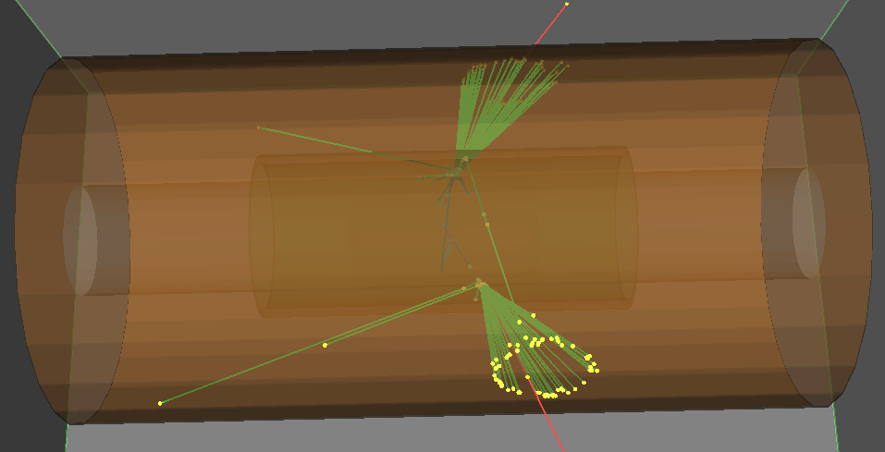
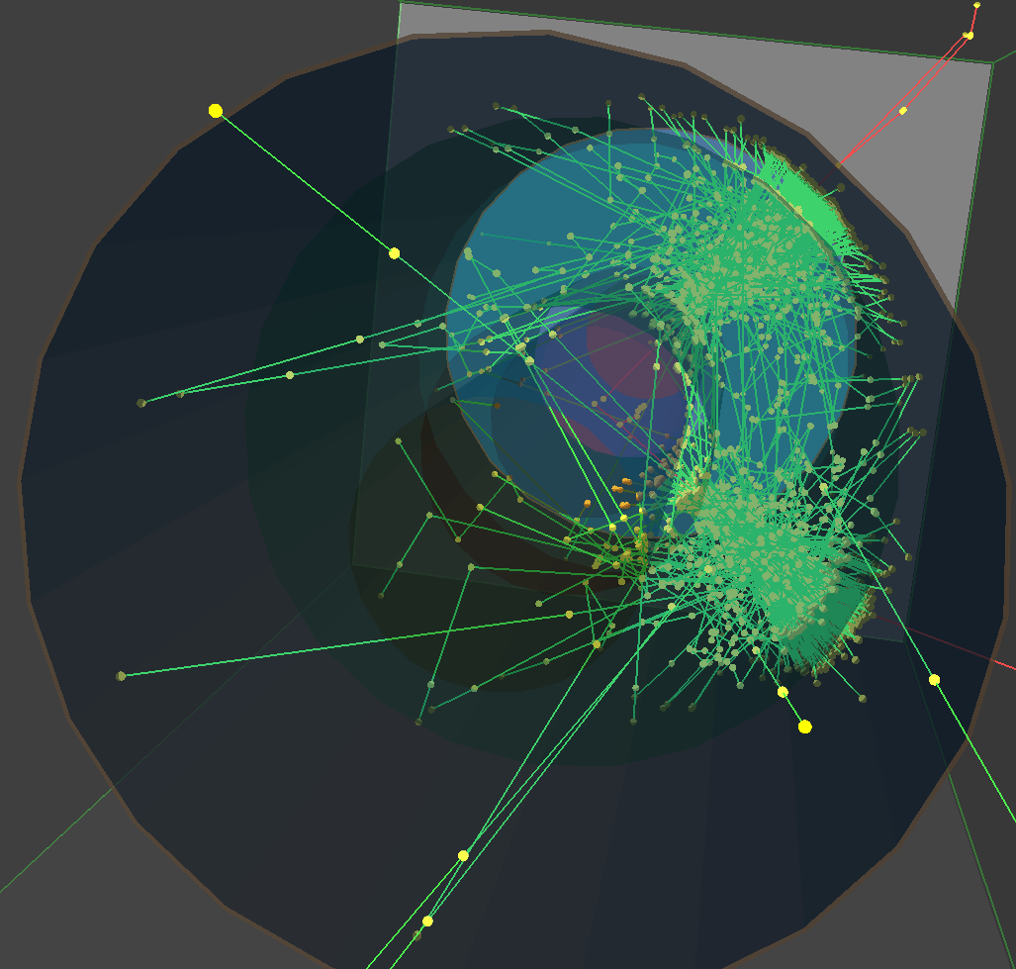
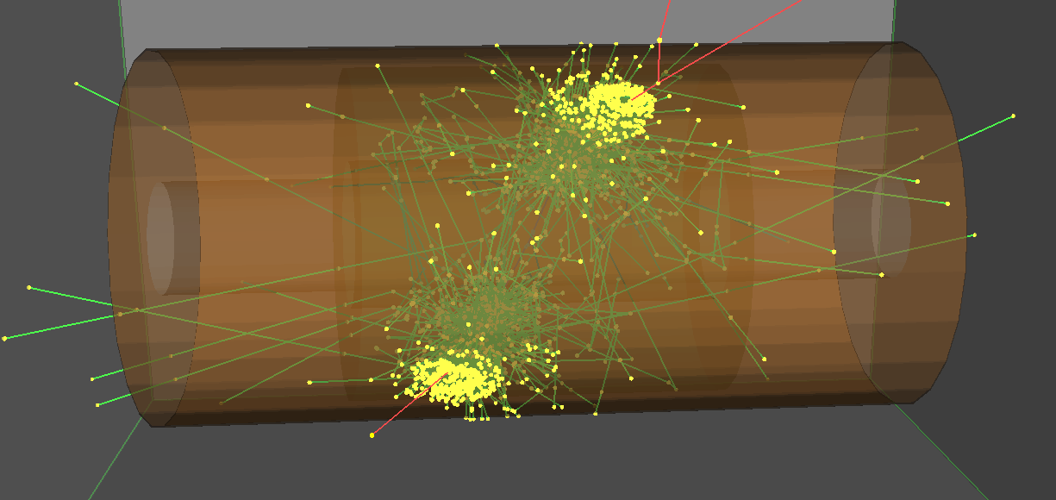
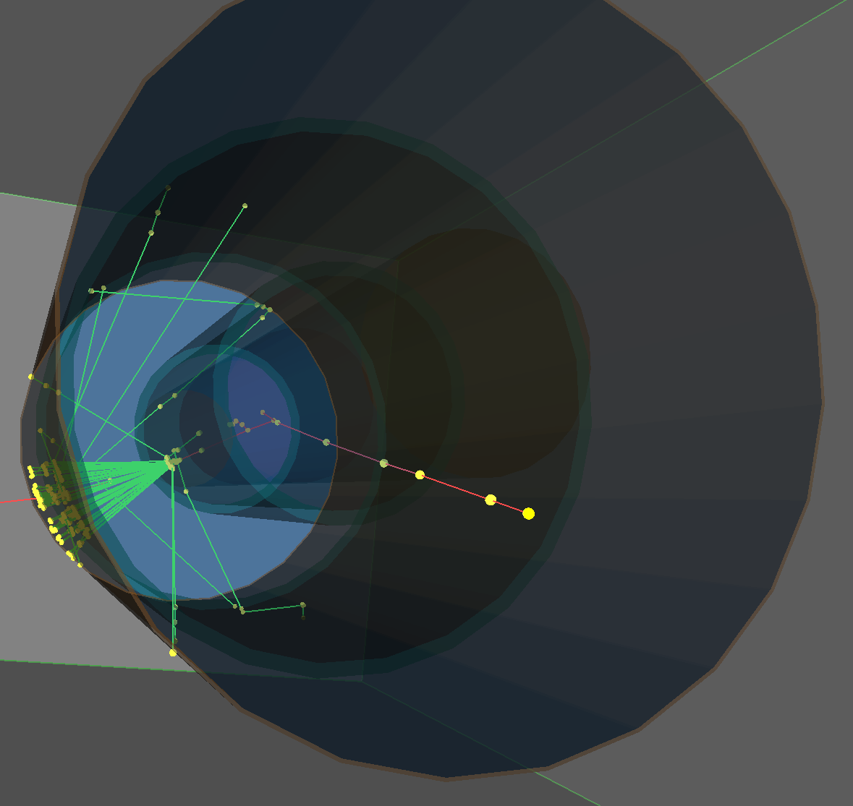
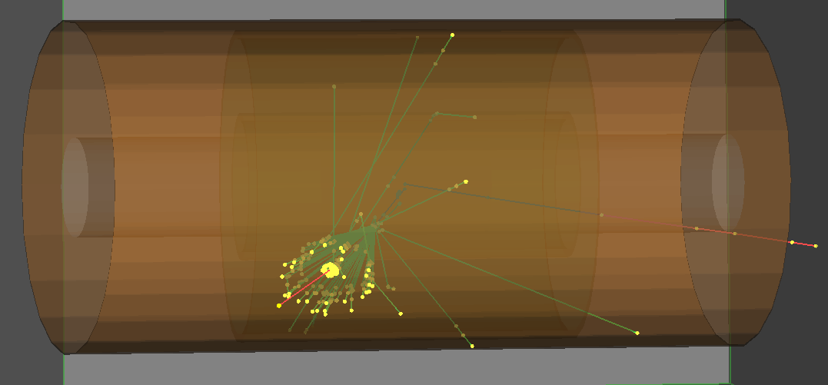
RICH simulation
Single Radiator inner radius = 4 cm, 5 mm thick
Single Radiator inner radius = 4 cm, 5 cm thick
p_{e} = 8 MeV
n=1.05
Sensor radius = 10 cm
no quantum efficiency applied
Dual Radiator inner radii = 4 and 9 cm, 5 mm thick
courtesy E. Cisbani

Slide 18
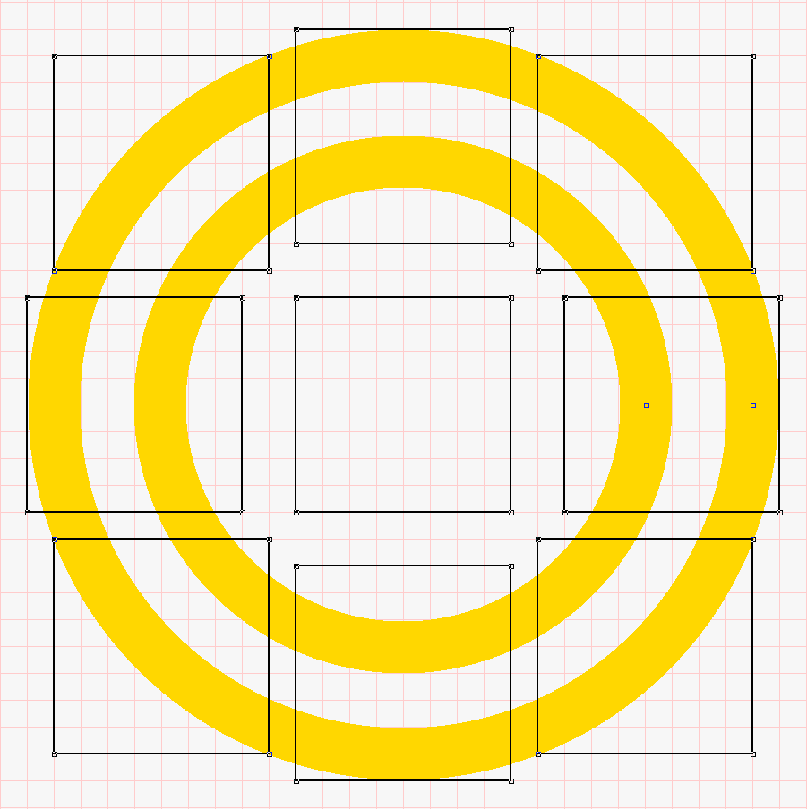
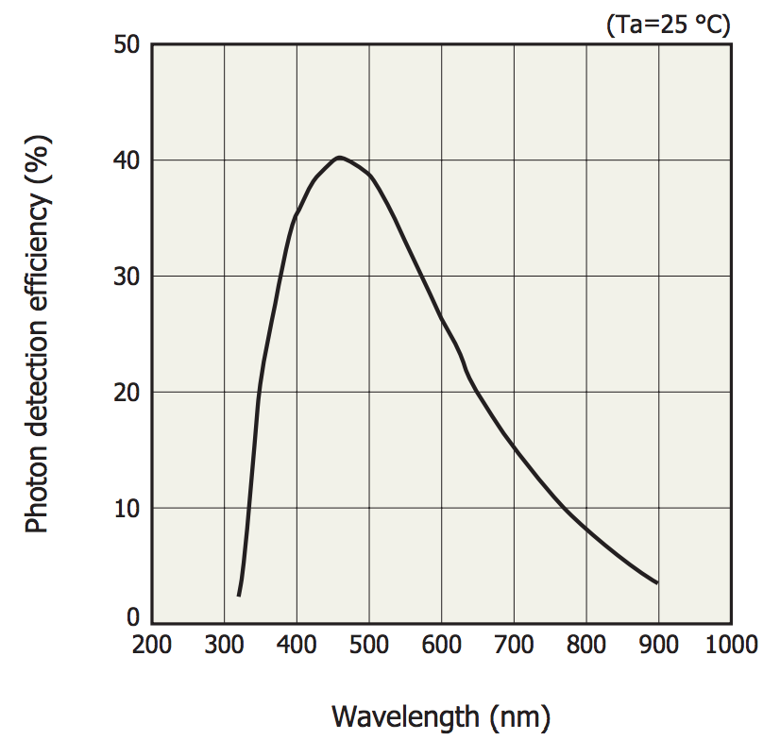
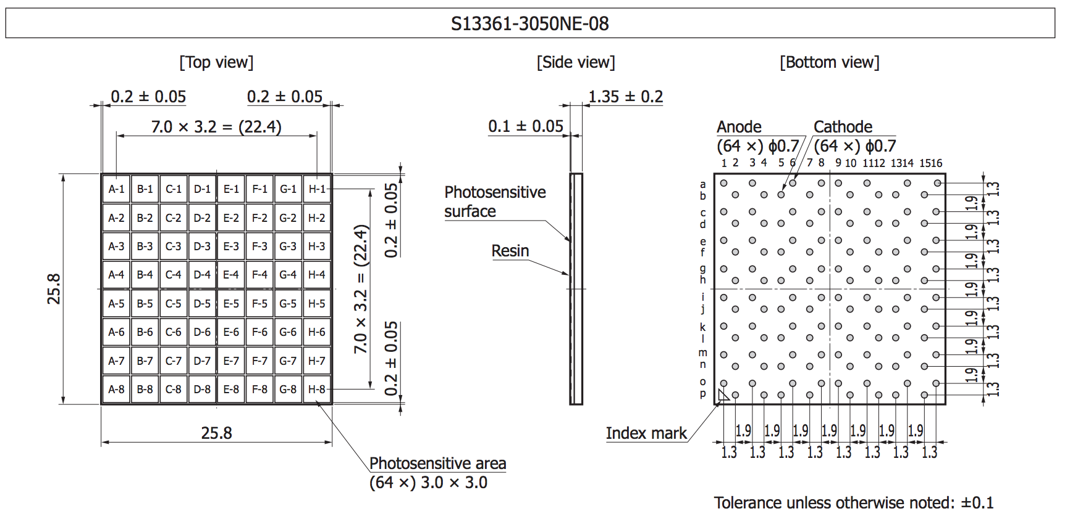
RICH prototype
-2 x Aerogel 1.05, 2 cm thick
-9 tile di Hamamatsu S13361-3050 8x8, 3x3 mm2
- <600 canali
-Peltier cooling
-Dark box
-possibility of changing positioning/angle with respect the beam
Partially funded by CSN3
x
courtesy E. Cisbani

Slide 19
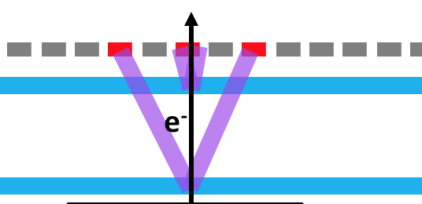
RICH: Test at n_ToF
ScintIllator
RICH
thin tube (Carbon fiber), "low" pressure
-Protons from ³He(n,p)⁴He
-gammas from ³He(n,γ)⁴He
-simoultaneous test with MPGD
neutron beam
³He/⁴He target
GOAL:
-Prove the RICH insensitivity to protons, γ's, neutrons
-gamma flash
-Comparison with MC
-Final design

Slide 20
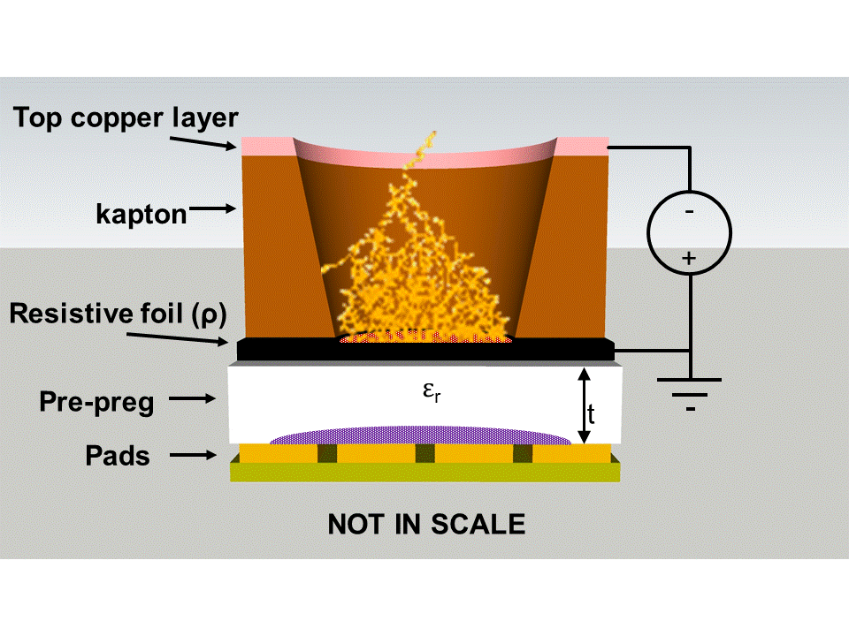
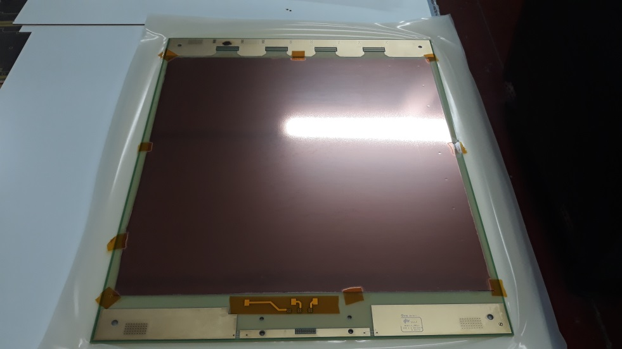
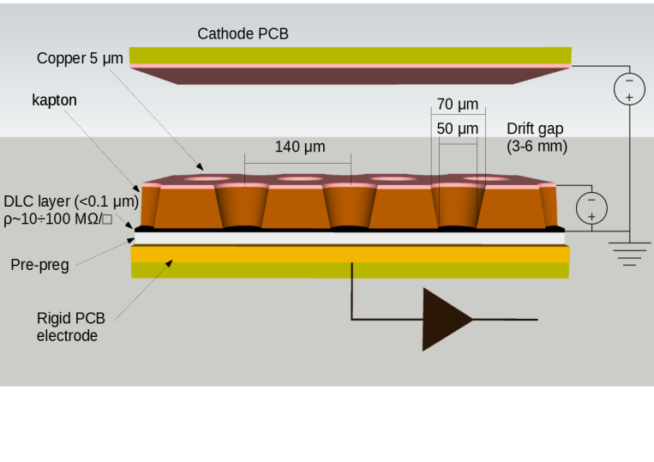
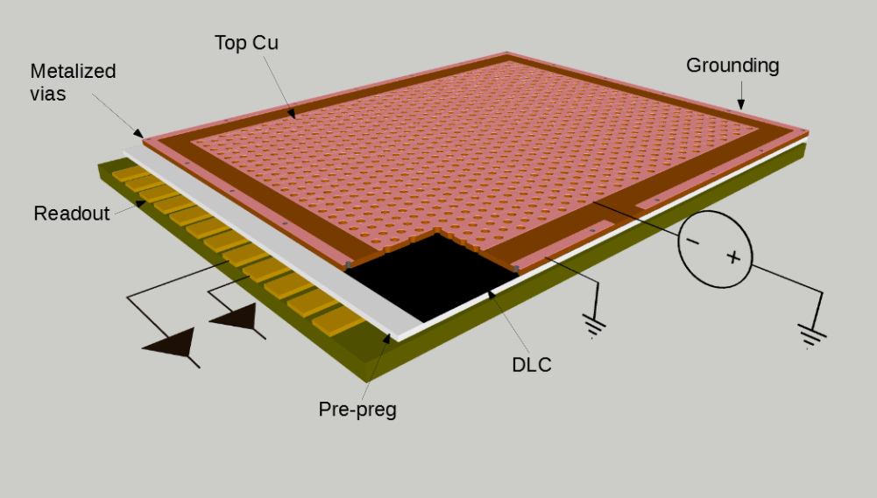
ROAD2: TPC with MPGD
307×307 mm² active area SRL - RWELL
Prototype (Design: LNF-INFN)
PCB production: ELTOS SpA
Detector manufacturing: CERN – PH dept. DT group (Rui de Oliveira)
PCB characteristics:
n.512 1-D strip, with 600 um pitch
30 mm gas gap
Gas mix → Ar/C0₂/CF₄ = 60/20/20
Delivery: end of November

Slide 21
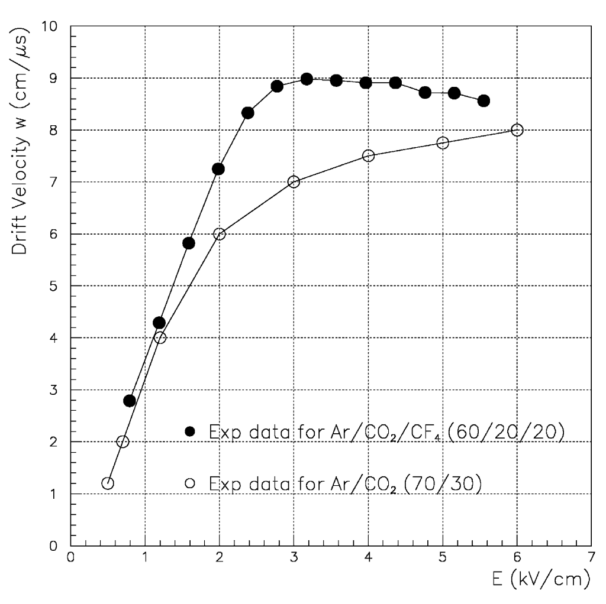
TPC: Test at EAR2
e⁻
with Ar/CO₂=/CF4=60/20/20
1/W_{drift} ~ 10 ns/mm
→300 ns signals (crossing e+e- pairs)
neutron beam
³He/⁴He
target
Goal of the test: Background evauation
³He(n,p)⁴He and E_{n}>10 MeV)
Gamma Flash
³He(n,γ)⁴He
³He(n,e+e-)⁴He
interactions with materials
Trigger/timing with pulsed beam
L=3 cm
ΔT=L/W_{drift}=300 ns
T₀=T_{tof}
e⁺

Slide 22
E.M CALORIMETER
Very preliminary design (simulation is in progress):
5 mm thick segmented composed by EJ-200 bars (X-view)
5 mm thick segmented composed by EJ-200 bars (Y-view)
8 cm thick Ej200 absorber (coarse segmentation)
8 cm
400 mm
30 mm
100 mm
5 mm
40 mm

Slide 23
Prototype for EAR2 TEST
Ej-200 bars 120 mm lonf and 10x10 mm² section
120 mm
50 mm
neutron Beam
30 mm
target ³He

Slide 24
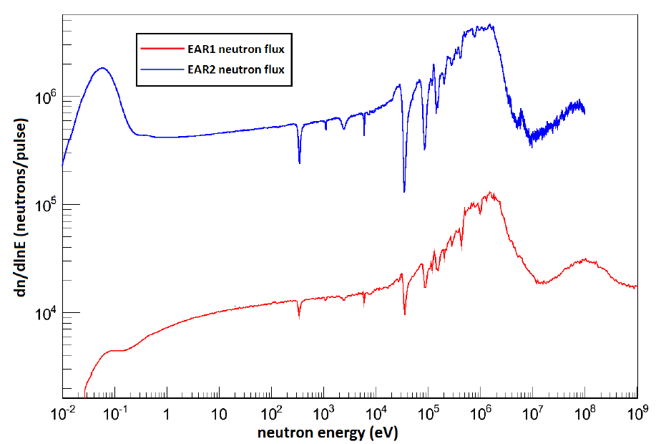
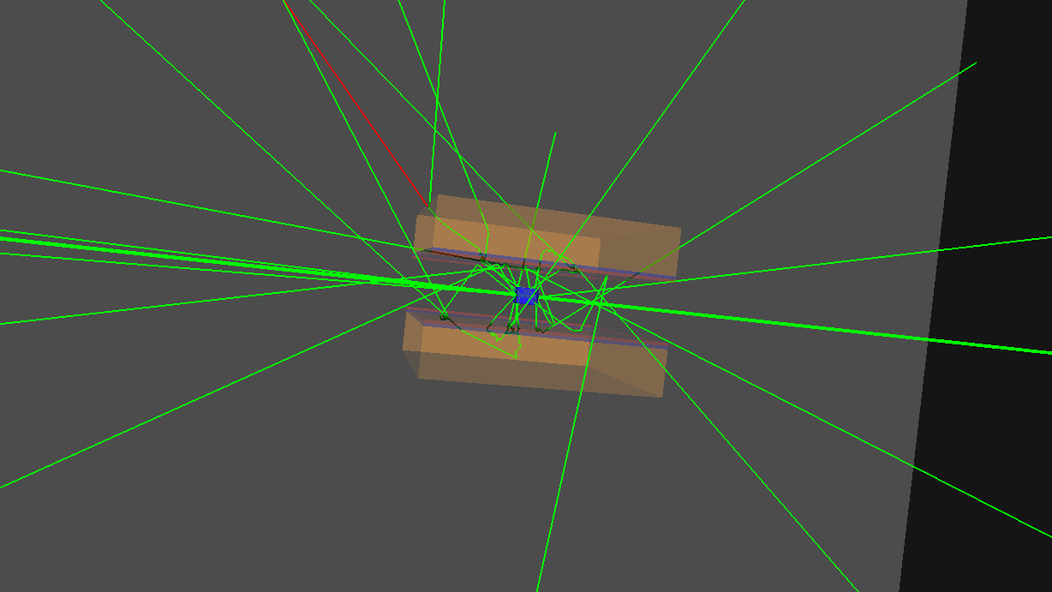
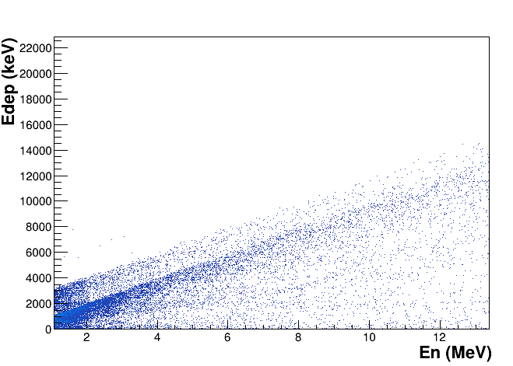
EJ200 neutron beam induced background
EAR2 neutron flux with the second-generation lead target
Shielding physics list
Two EJ-200 detectors 40x40x8 cm³ faced to the target
4x3x3 cm³ ³He target at T=300 k, P=200 bar and with a 0.8 mm Carbon Fibre envelope
Preliminary energy deposition as function of En
courtesy M.C. Petrone

Slide 25
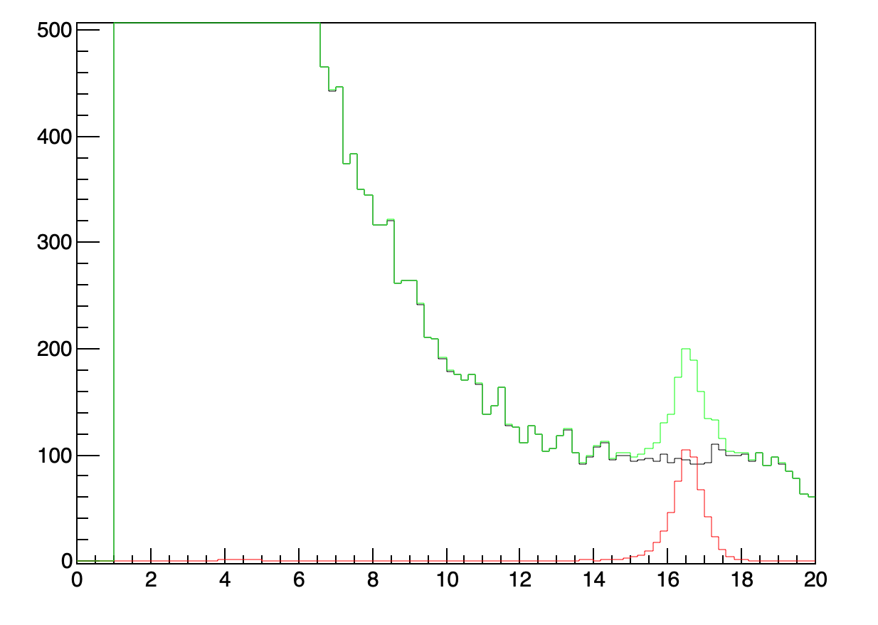
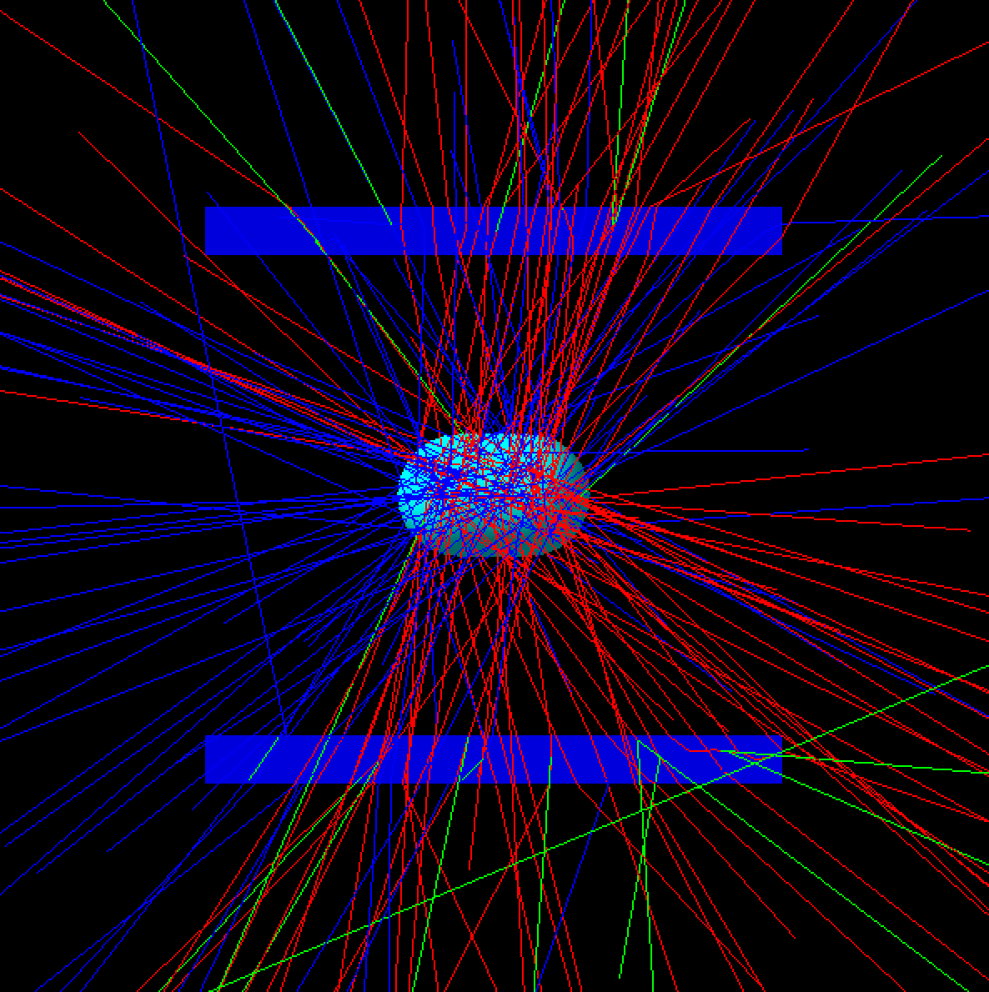
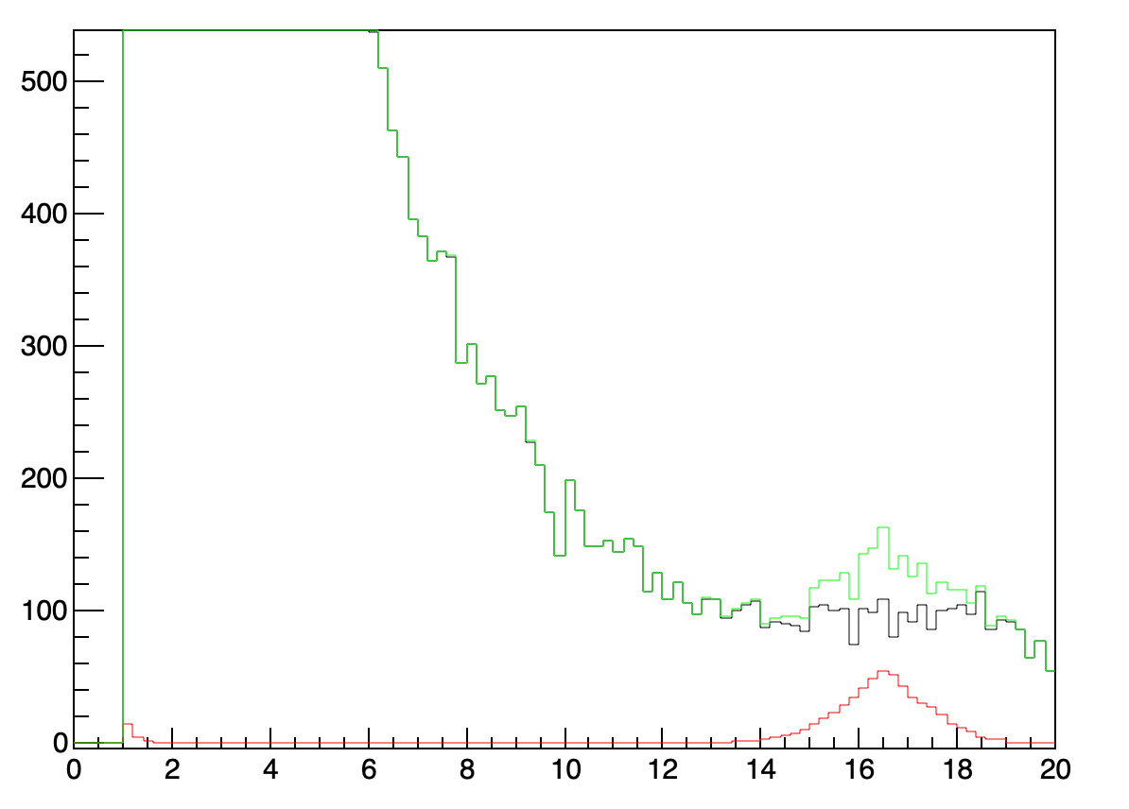
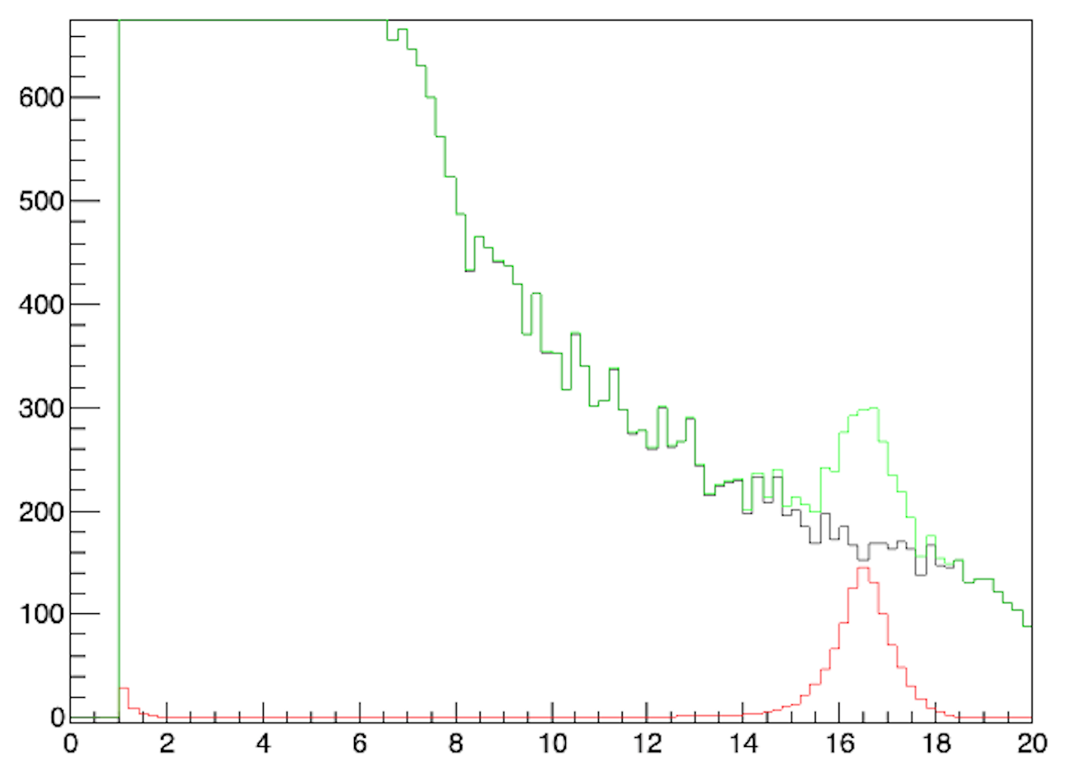
X17 Invariant mass
Ideal tracking
L=12 cm, H=5 cm
target: ³He at P=30 bar, T= 300 k
thickness of Carbon fibre= 1 mm
Multiple scattering included
IPC/EPC background included
L
No tracking
L=12 cm, H=5 cm
H
No tracking
L=40 cm, H=10 cm
courtesy A. Mazzone

Slide 26
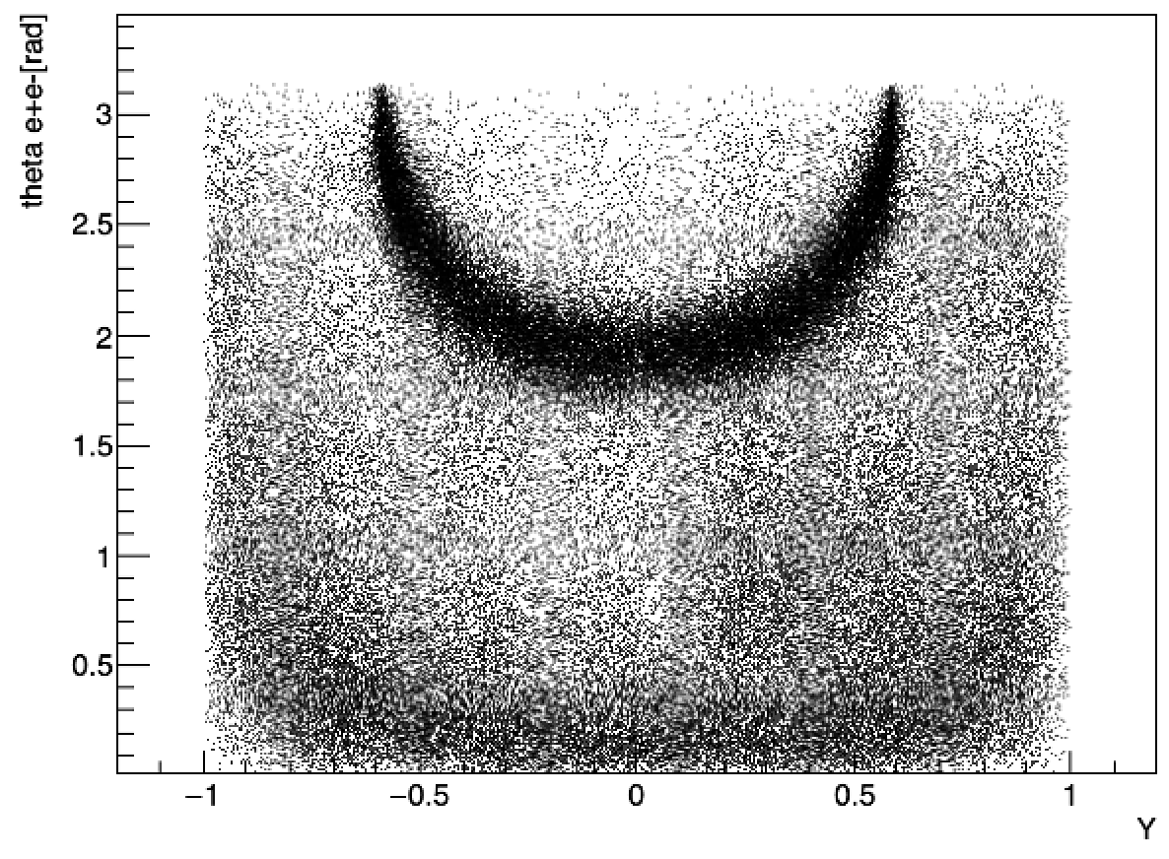
X17 SIGNAL AND (irreducible) BACKGROUND
target: ³He at P=30 bar, T= 300 k
thickness of Carbon fibre= 1 mm
Multiple scattering included
IPC background included
DATA From M. Viviani ab-initio calculations, normailzed to the ATOMKY results
L
Y=(E_{e-}—E_{e+})/(E_{e-}+ E_{e+})
θ_{ee}= aperture angle of e+e- pairs
X17 Signal
H
IPC background
courtesy A. Mazzone

Slide 27
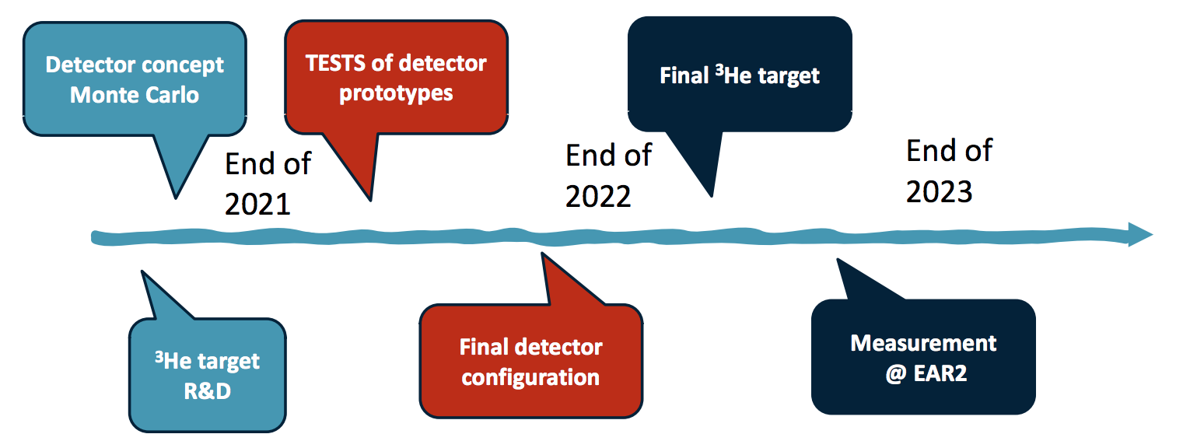
Conclusion
The ATOMKY anomaly has been interpreted as the signature of a particle (X17 boson) not foreseen in the standard model of particle physics.
A new measurement to confirm (or reject) the existence of X17 particle is mandatory.
With n_ToF it is possible to exploits the new reaction ³He(n,e+e-)⁴He in a wide energy range and using a dedicated setup, to probe the purpoted protophobic nature of fifth force and to measure X17 properties.
Standard ³He(n,e+e-)⁴He and ³H(p,γ)⁴He reactions are also of great interest in nuclear physics, providing an important experimental footing for "ab initio" calculations.
R&D, simulations and theoretical calculations are in progress. Feasibility tests are approved and funded by INFN.
Timeline of X17 @n_TOF
THANKS FOR THE ATTENTION

Slide 28
SPARES

Slide 29
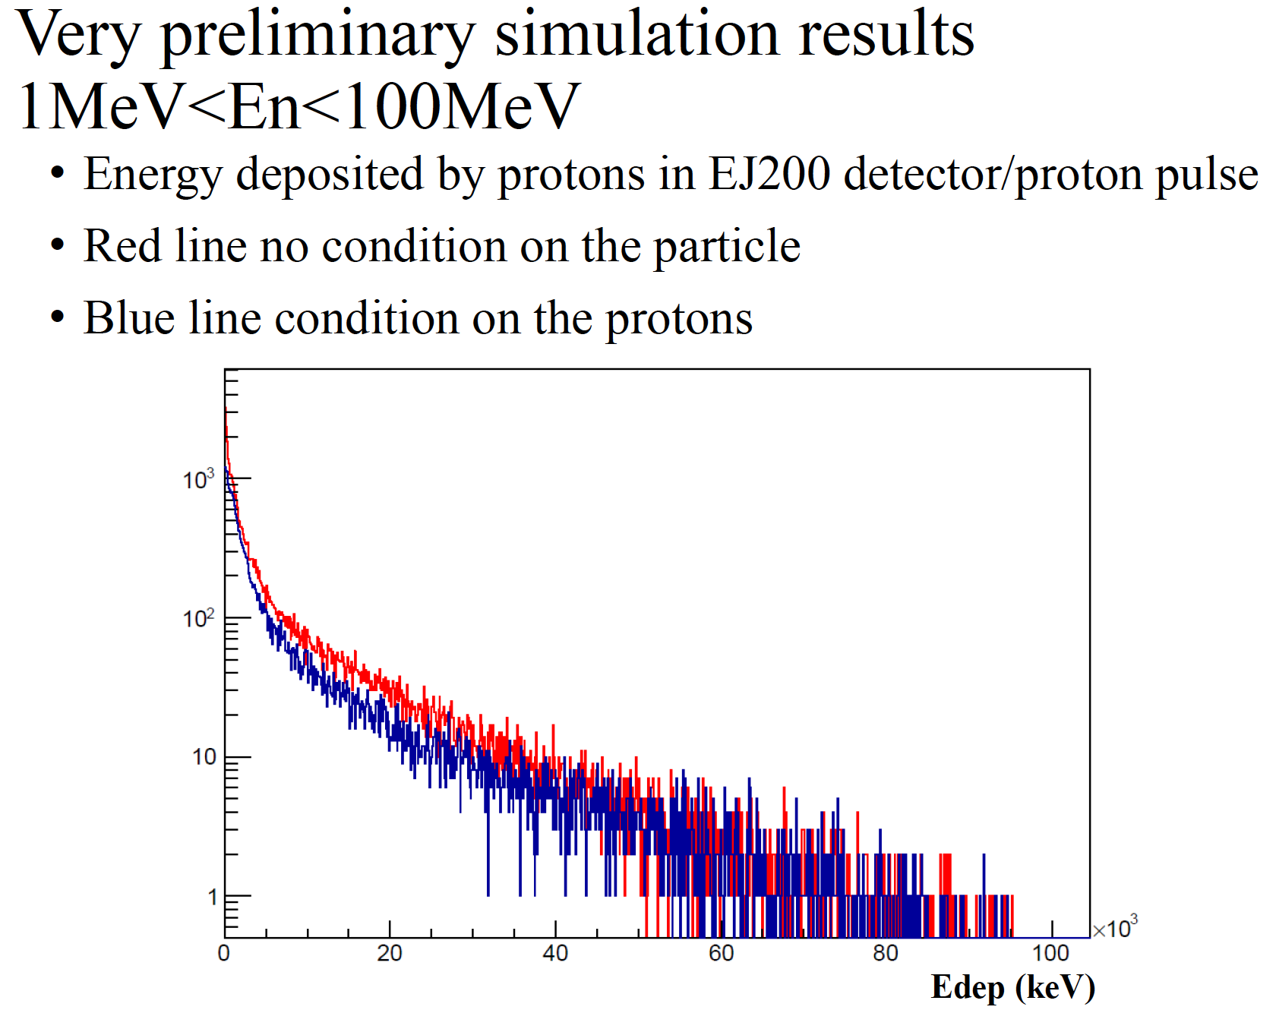
80 mm thick EJ-200 scintillator
courtesy M.C. Petrone

Slide 30
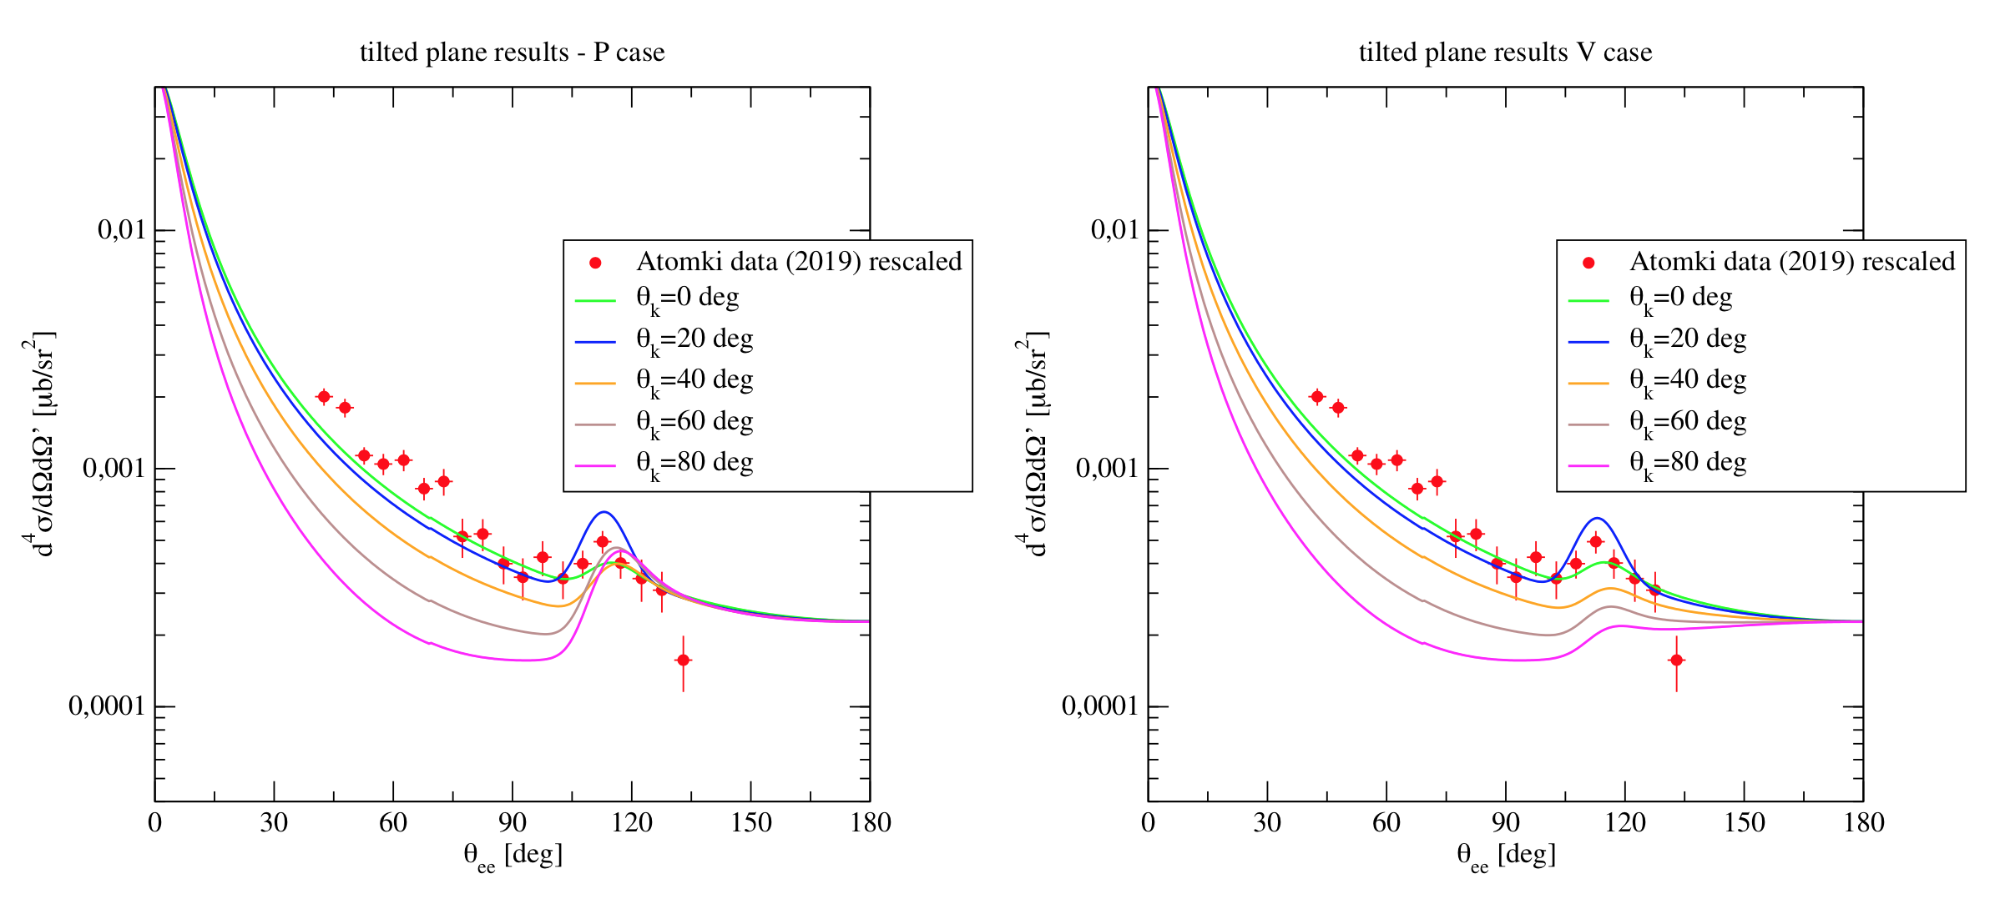
X17 @ nToF
Pseudoscalar X17
Vector X17
courtesy M. Viviani

Slide 31
TPC Prototype Electronics
APV
HDMI
SRU
M
S
PC
M
TPC
S
ADC
FEC
M
S
CERN STANDARD (RD51)

