Slide 1

Neutron and Femtsecond Infrared Laser
cross-calibration of a PIN detector
Francisco Rogelio Palomo Pintoª , Ricardo Ascazubiª , Jose M.Quesada-Molina^{b} fpalomo@us.es,
ª Electronic Engineering Dept. of School of Engineering, University of Seville, Spain
^{b} Nuclear Physics Dept. at Physics Faculty, University of Seville, Spain
Notes:
Para RD50 final: aumentar el número de autores, poner las diapositivas de puntería con el gadolinio, explicar las visualizaciones MCA y XY en una diapositiva adhoc, comparándolas con visualización de osciloscopio, establecer el valor de la ganancia final del DAQ para la comparativa. Dar una diapositiva de conclusiones

Slide 2
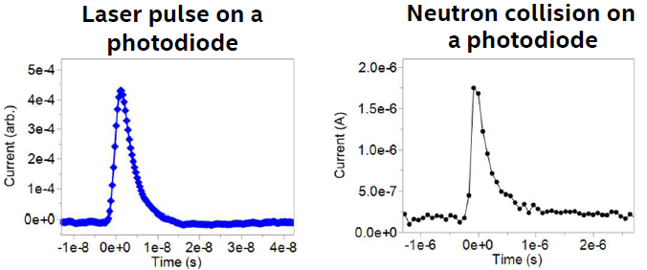
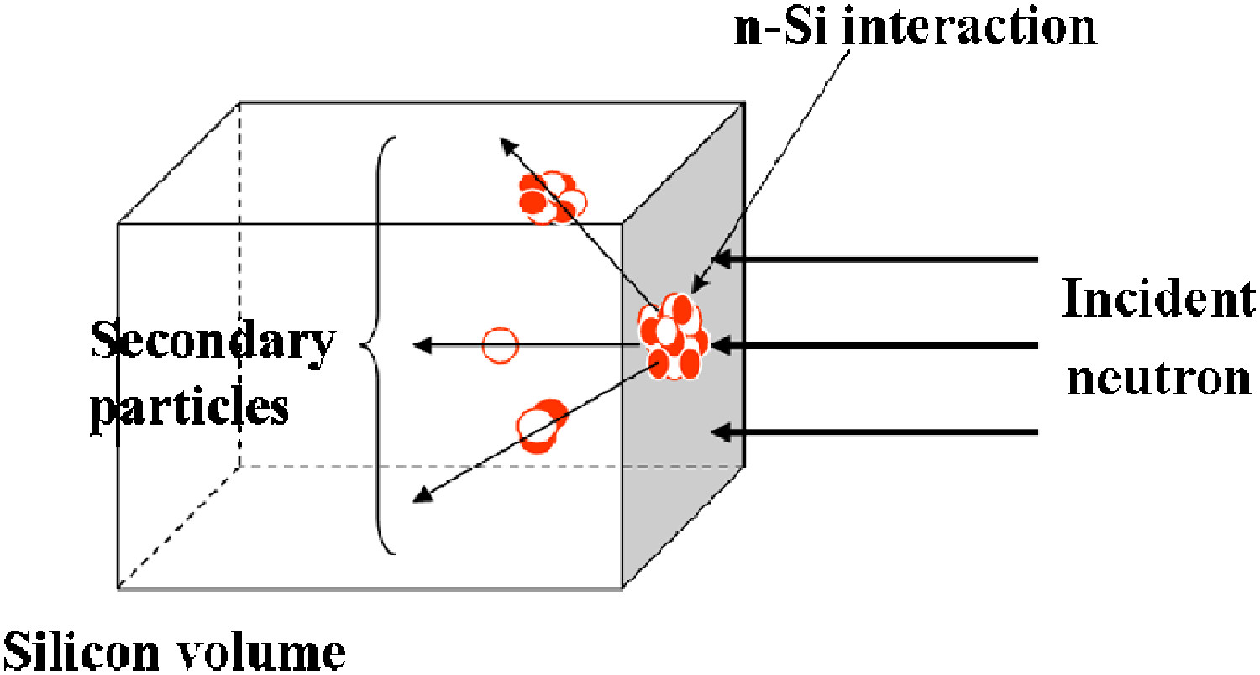
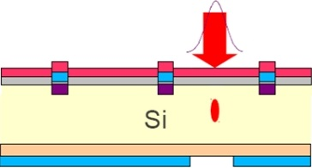

Neutron and Femtsecond Infrared Laser cross-calibration of a PIN detector
The main idea is very simple:
Neutron irradiation of semiconductors generates
recoil ions in the semiconductor bulk. Those secondary
ions have a short flight range in the device,
generating internal localized ionization volumes.
Solid State Detectors give a signal proportional
to the amount of electron-holes generated in the
ionization volume.
It is posible to generate photoionization localized
volumes inside a semiconductor detector using lasers
with wavelength λ>1200 nm (Two Photon Absorption).
Ultrashort laser pulses (<<1 ps) mimic the secondary
ion flight lapse.
We want to record a signal data set from neutrón
interaction inside a photodiode. We will also generate a
second signal data set illuminating the photodiode with
a femtosecond pulsed laser with a wavelength of 1500
nm (Two Photon Absorption regime). The purpose is to
cross calibrate neutron signals with laser signals.
Two Photon
Absorption
M.Wiehe; M.Fernández García; M.Moll; R.Montero; F.R.Palomo, I.Vila, H.Muñoz Marco, V.Otgón, P.Pérez-Millán; Development of a Tabletop Setup for the Transient Current Technique Using Two-Photon Absorption in Silicon Particle Detectors; IEEE Transactions on Nuclear Science 68 (2), (2021)
H. Chabane; J. R. Vaillé; T. Mérelle; F. Saigné; L. Dusseau; M. Dumas; J. M. Palau; B. Barelaud; J. L. Decossas; F. Wrobel; N. Buard; M. C. Palau; Determination of the deposited energy in a silicon volume by n-Si interaction Journal of Applied Physics 99, 124916 (2006)

Slide 3
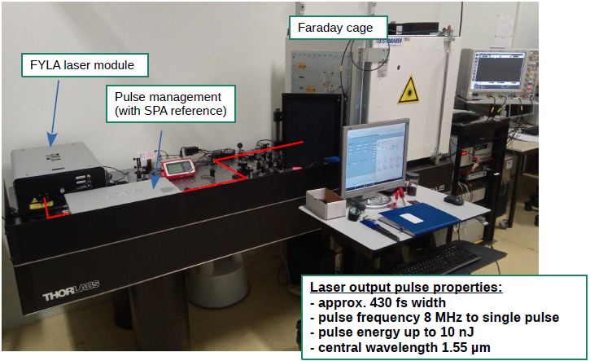
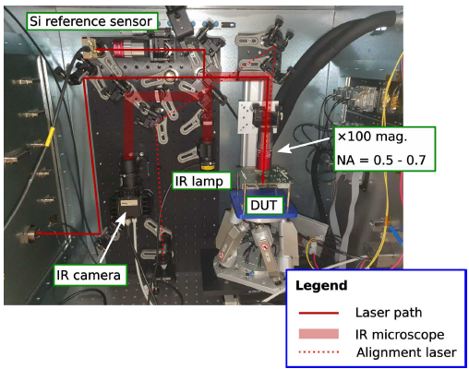
Neutron and Femtsecond Infrared Laser cross-calibration of a PIN detector
From 39th RD50 17th-19th Nov.2021
Sebastian Pape et al.
The laser facility is available at CERN, Building 28 basement, from the Solid State Detector Laboratory (EP-DT).

Slide 4

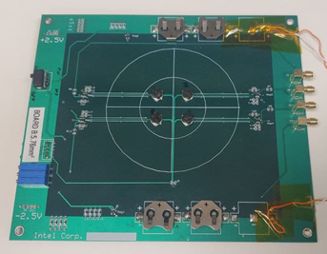
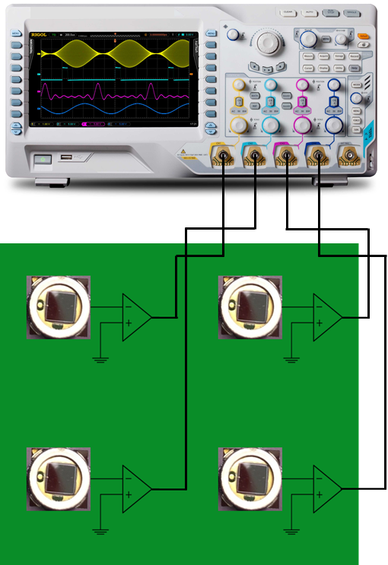
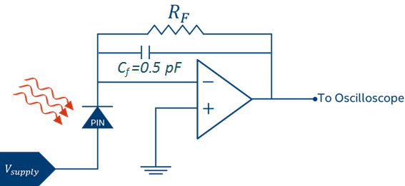
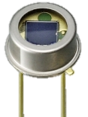
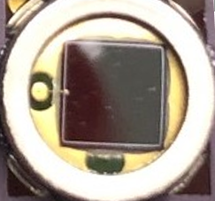
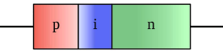

Neutron and Femtsecond Infrared Laser cross-calibration of a PIN detector
Key to successful result is to achieve a very low noise, high speed pre-amplifier.
Battery-powered pre-amp board (remove AC noise).
Single trans-impedance amplifier, 500MHz BW, femtoA input bias, femtoF input cap (from Analog Devices Inc.).
VREF-filtered voltage regulators for low noise (uV) high ripple rejection (68dB).
Custom board layout to minimize parasitic capacitances
Multiple diodes to maximize exposed cross section/oscilloscope channel usage.
Hamamatsu S1336 series PIN detectors
Neutron Beam
3.6 mm
3.6 mm
$$V_{OUT}=I_{photo}×R_{F}$$

Slide 5
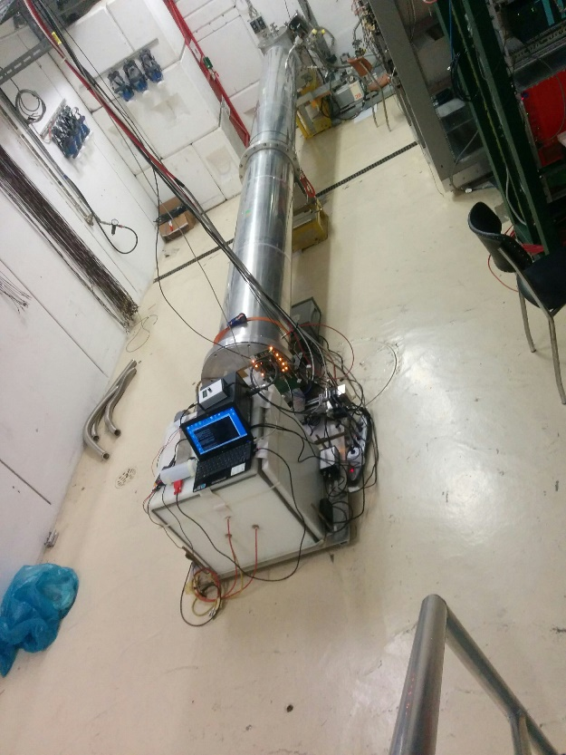
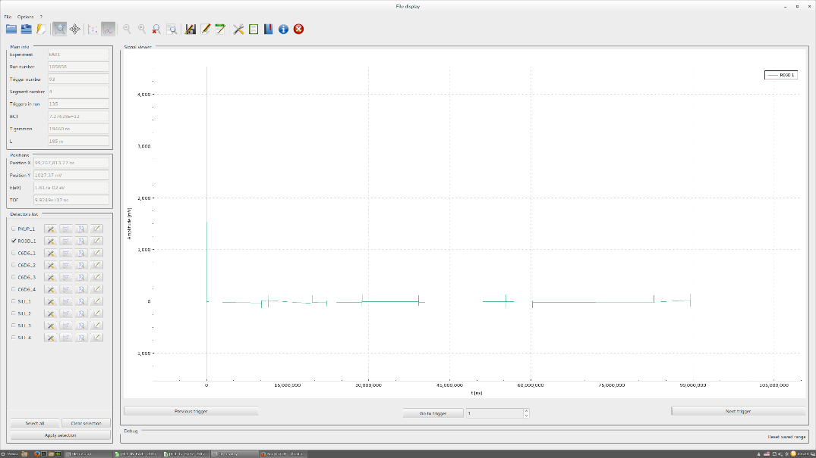
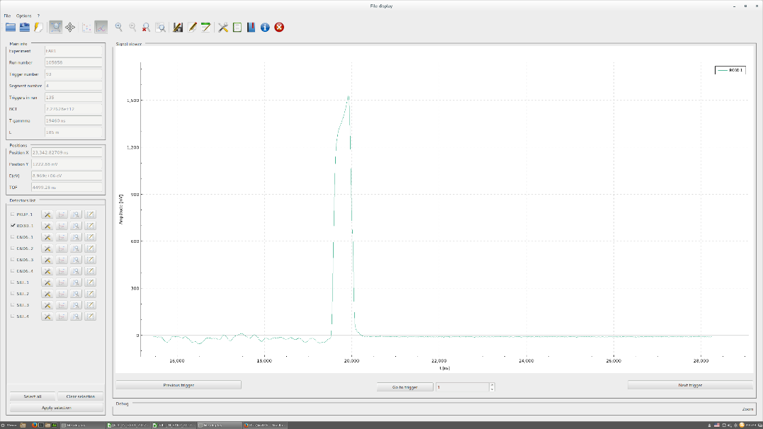
Neutron and Femtsecond Infrared Laser cross-calibration of a PIN detector
We need:
irradiation time at a nTOF dump (2 or 3 days of data acquisition)
we will record the photodiode signals
we will record the neutrón time of arrival (from nTOF DAQ)
the full dataset will be a collection of photodiode signals plus the neutron energy
We expect:
To cross-calibrate neutron and TPA laser interactions from PIN diode signals
If successful, the TPA calibration energy table will open us a method for fast analysis of neutron SEE (Single Event Effects)
in silicon devices
Images from a previous experiment (Nov 2017, M.Sabaté et al.
Testing of 3D detectors with time correlation from nTOF DAQ)

Slide 6
Neutron and Femtsecond Infrared Laser cross-calibration of a PIN detector
Thanks for your attention!
fpalomo@us.es

