Slide 1
Particle Detectors 2/2
Werner Riegler, CERN, werner.riegler@cern.ch

Slide 2
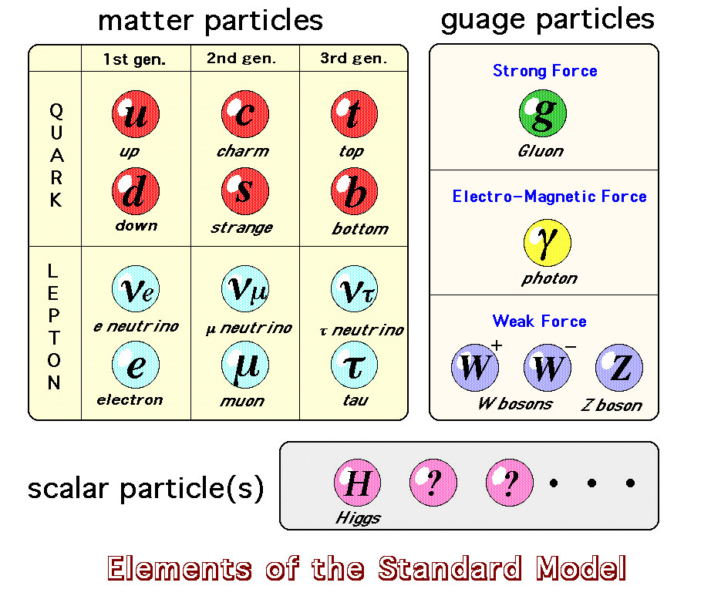
The ‘Standard Model’

Slide 3
The ‘Standard Model’

Slide 4
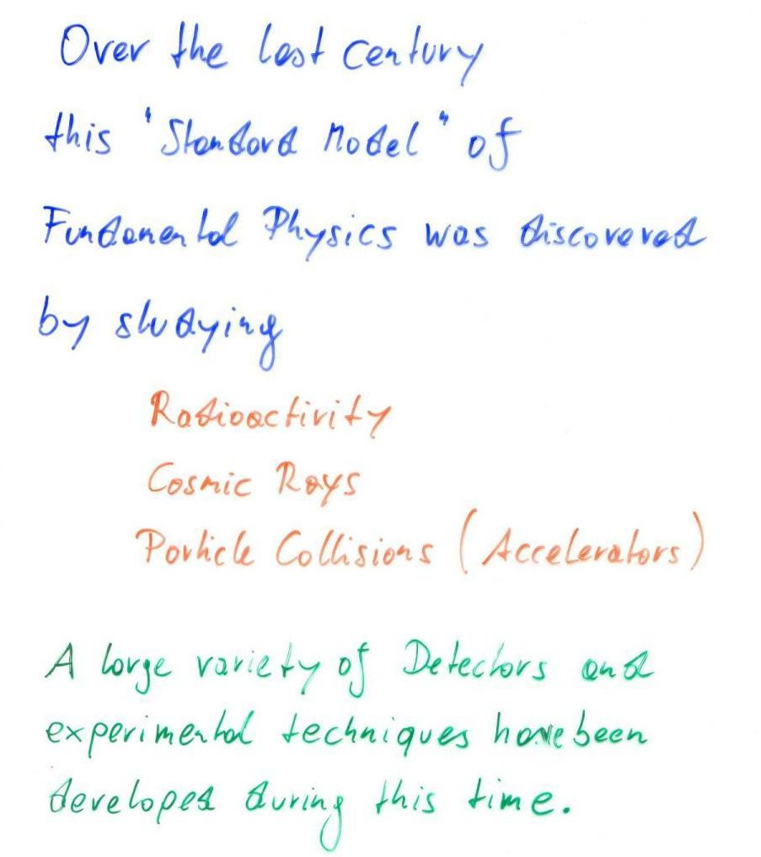

Slide 5
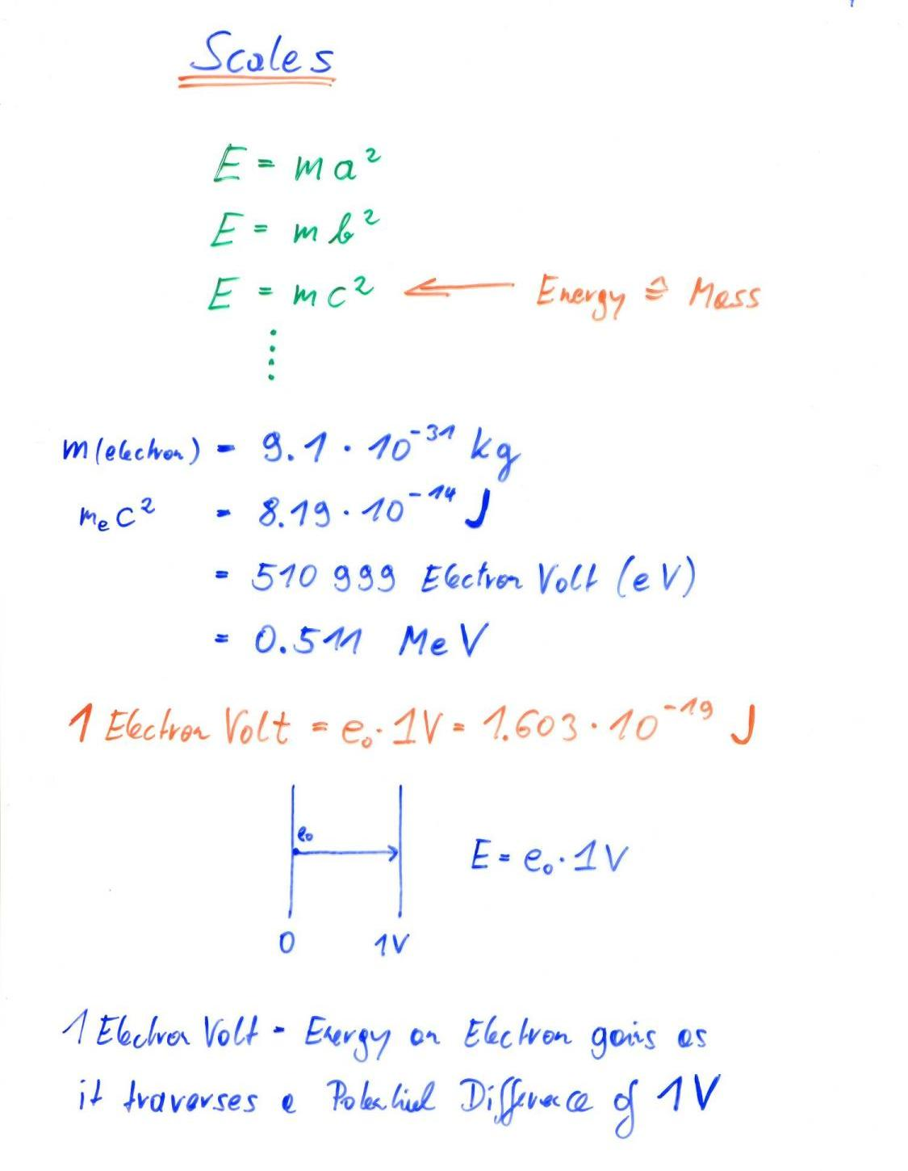

Slide 6
Build your own Accelerator
E_{kin}= 1.5eV =
2 615 596 km/h
+
1.5V
_
e⁻

Slide 7
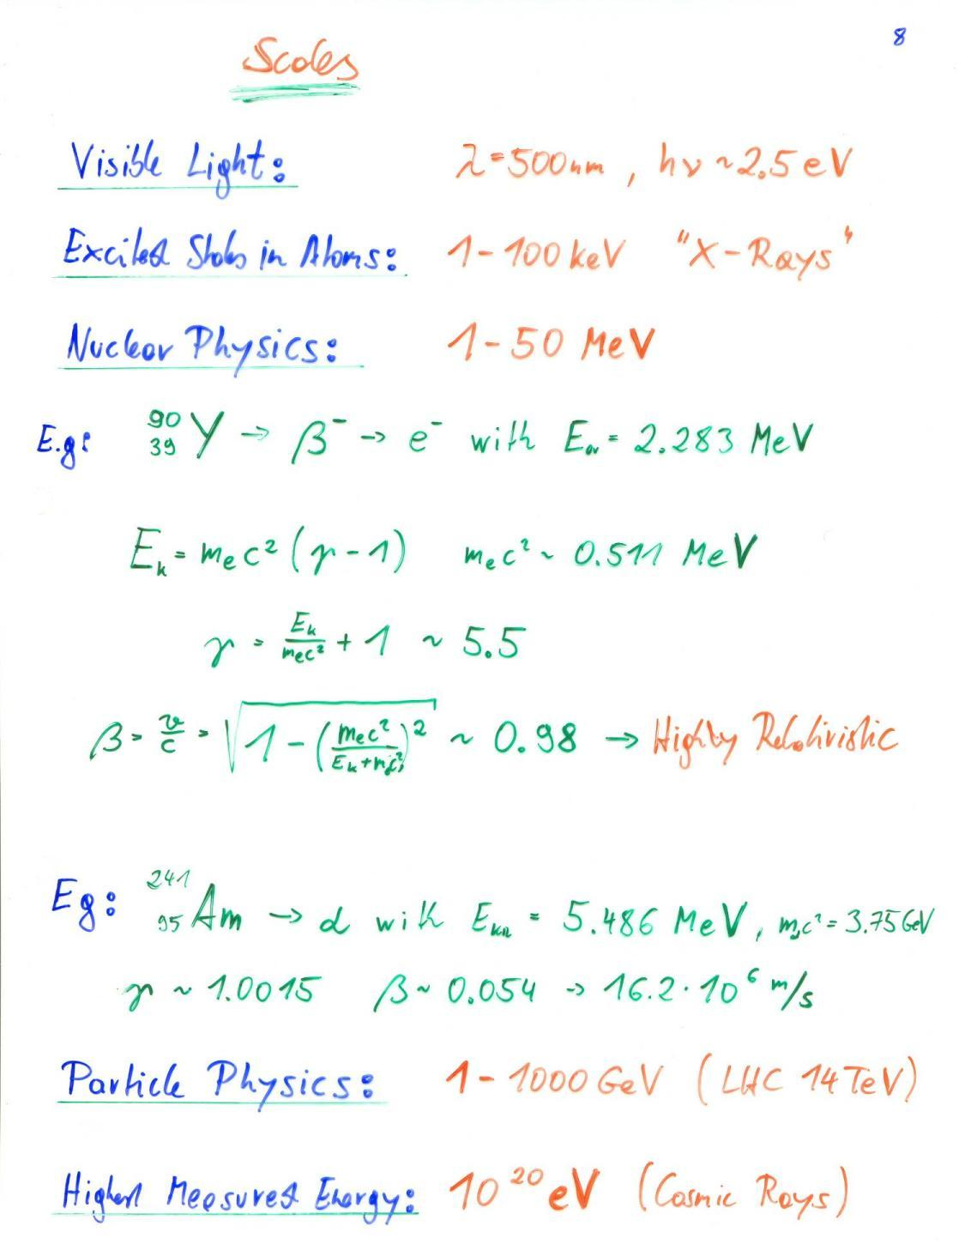

Slide 8
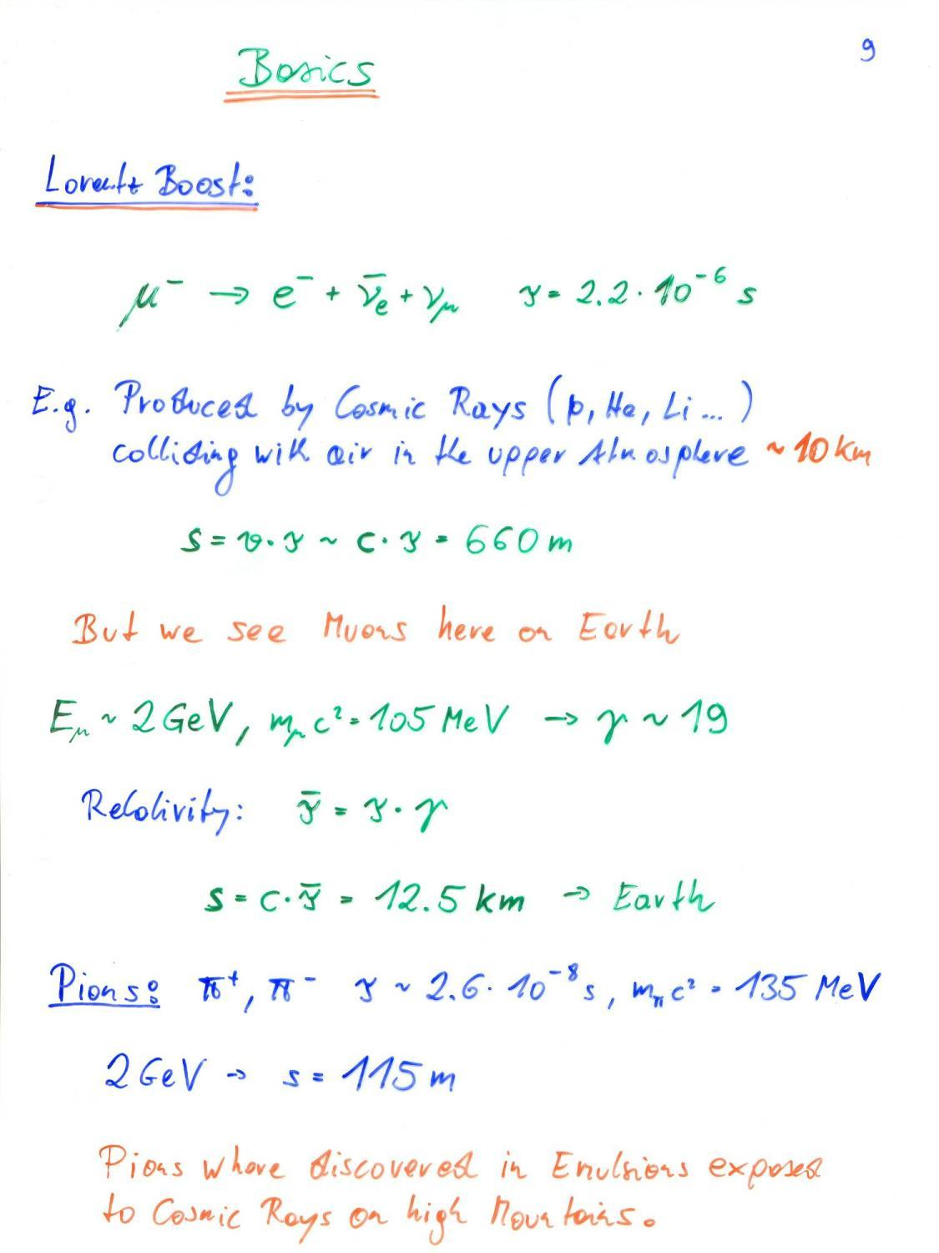

Slide 9
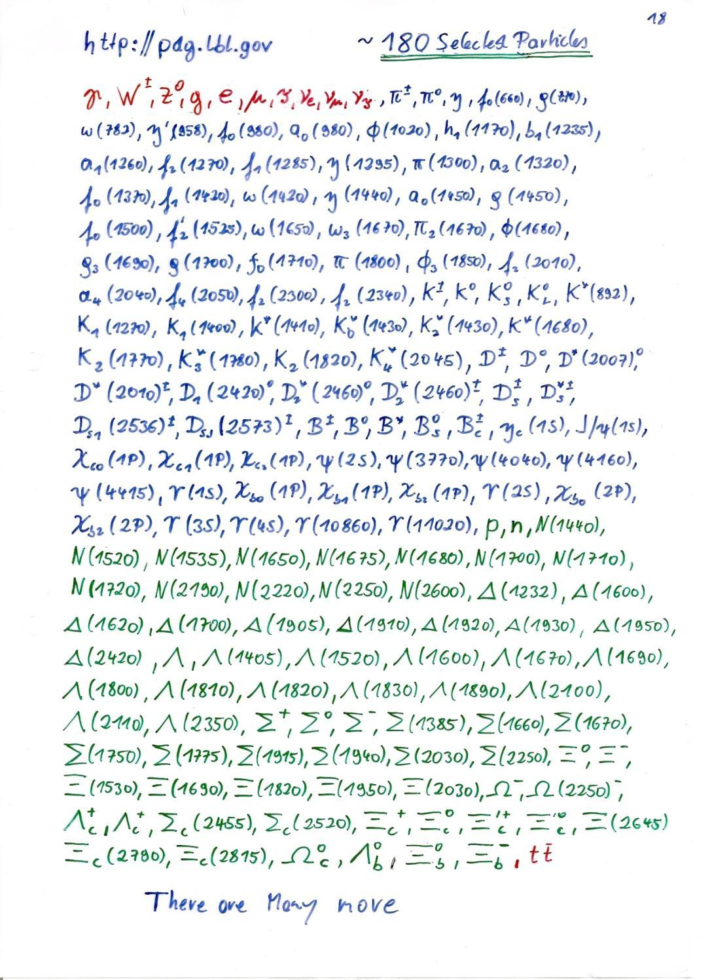

Slide 10
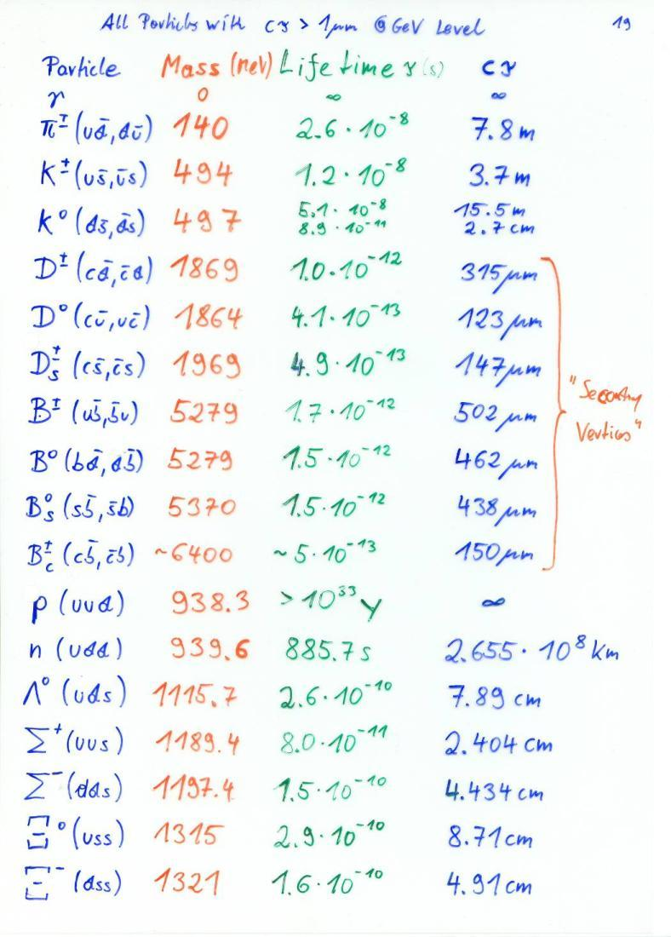
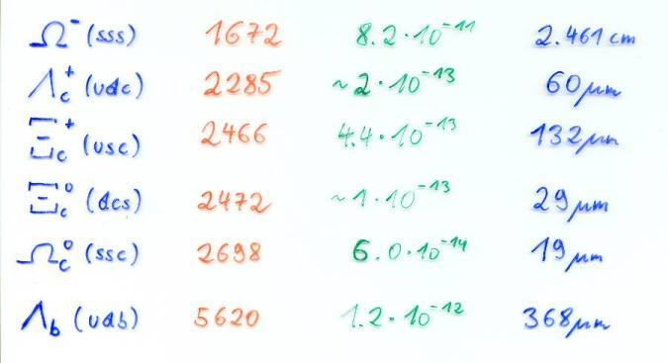

Slide 11
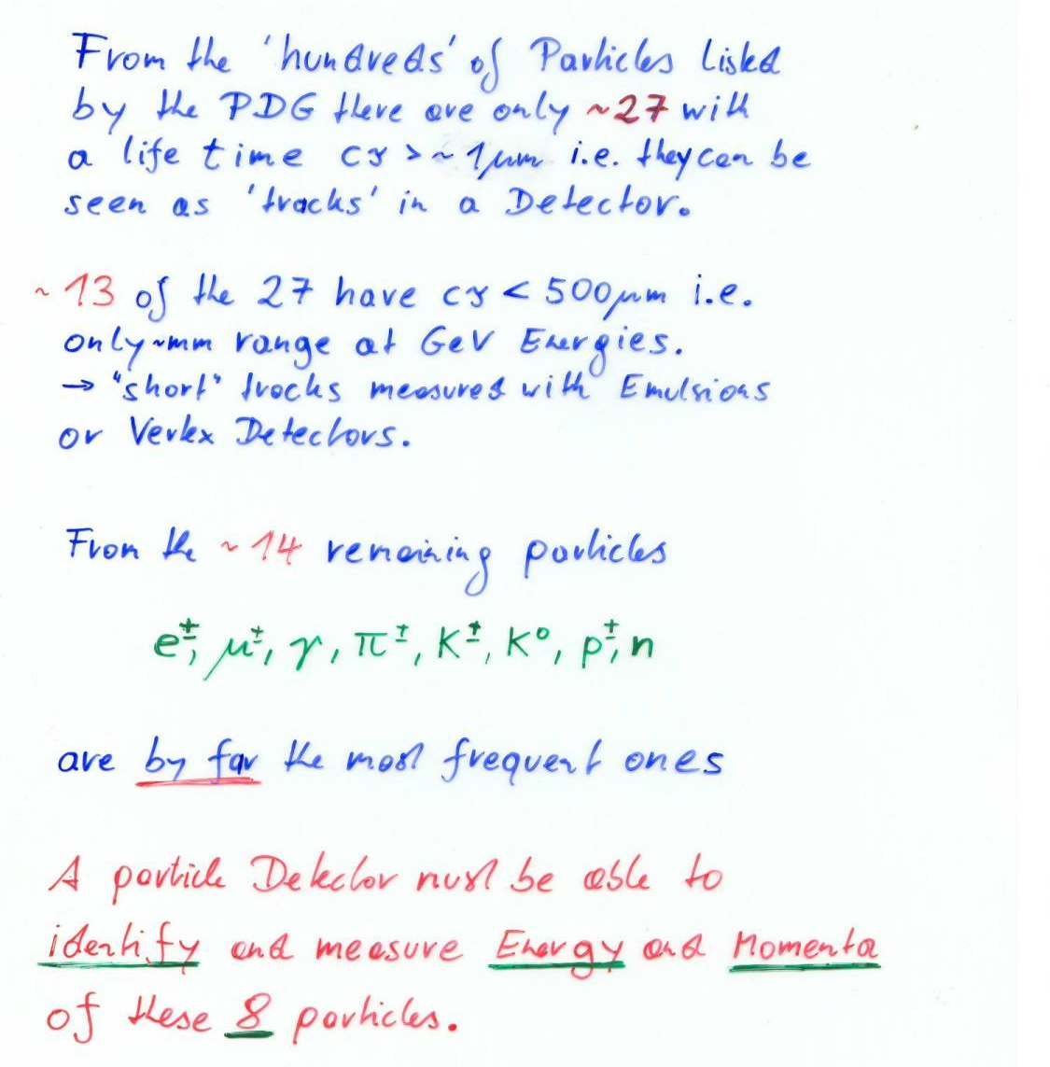

Slide 12
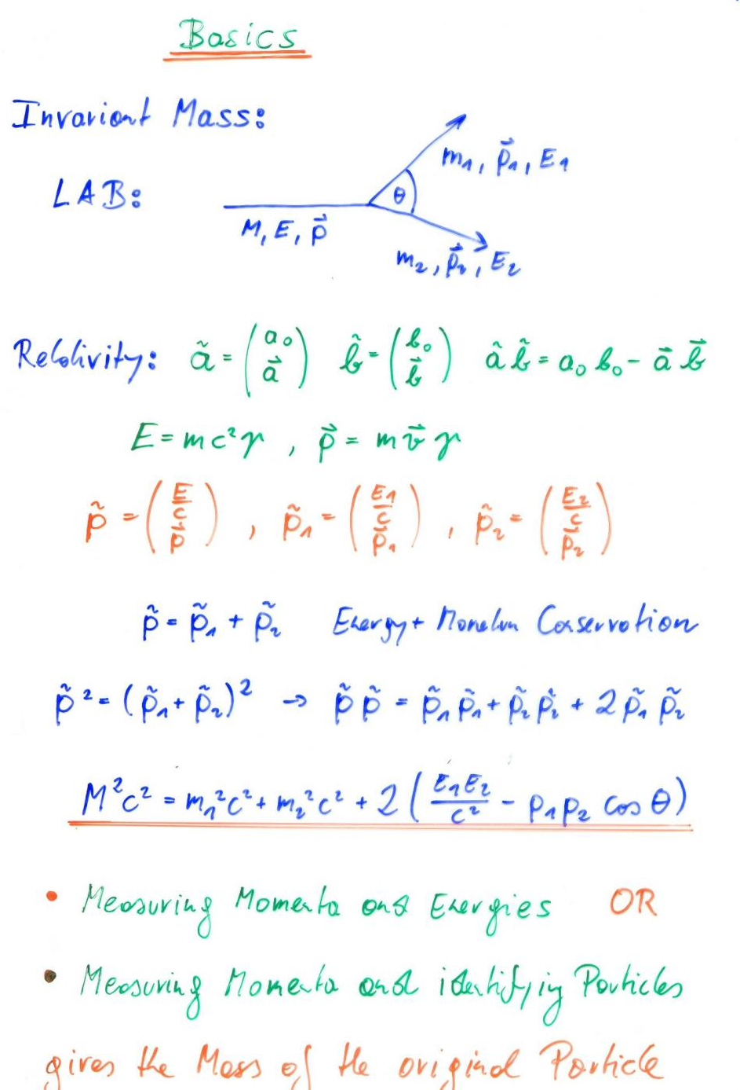

Slide 13
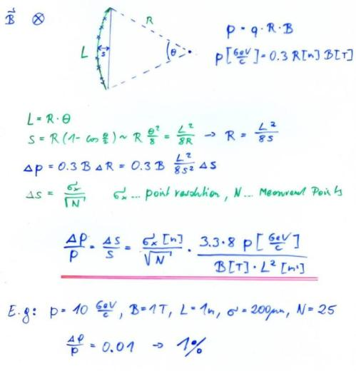
Momentum Measurement
Magnetic Spectrometer: A charged particle describes a circle in a magnetic field:
Limit → Multiple Scattering

Slide 14
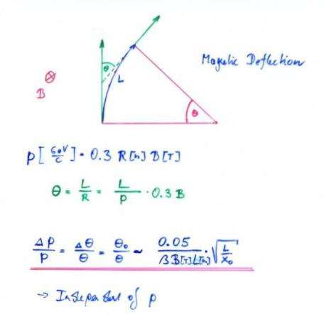
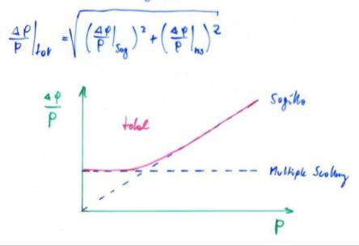
Multiple Scattering

Slide 15
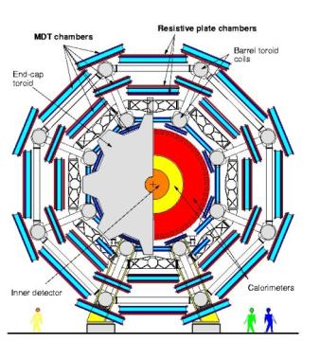
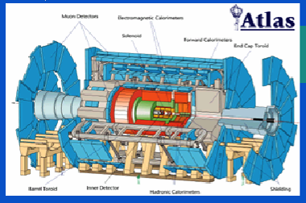
Multiple Scattering
ATLAS Muon Spectrometer:
N=3, sig=50um, P=1TeV,
L=5m, B=0.4T
∆p/p ~ 8% for the most energetic muons at LHC

Slide 16
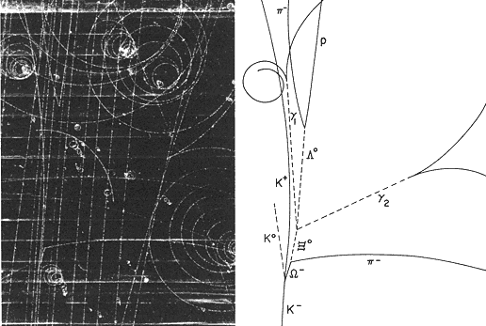

Slide 17
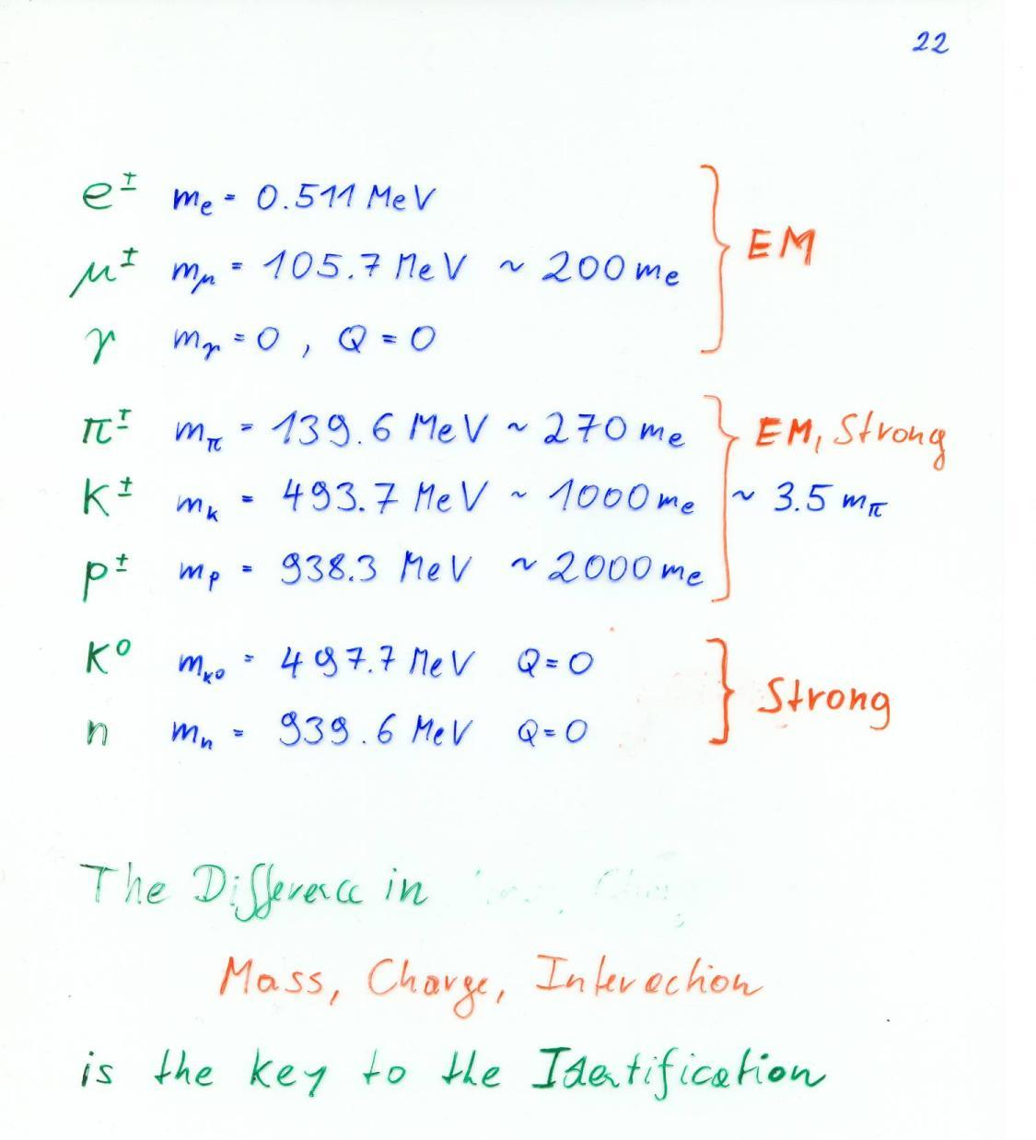

Slide 18
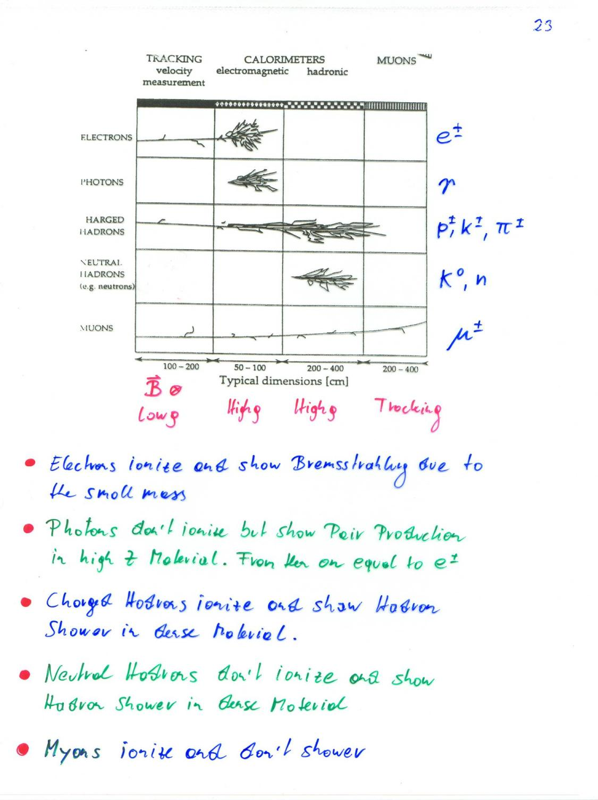
Tracking:
Momentum by bending in the B-field
Secondary vertices
Calorimeter:
Energy by absorption
Muons:
Only particles passing through calorimeters

Slide 19
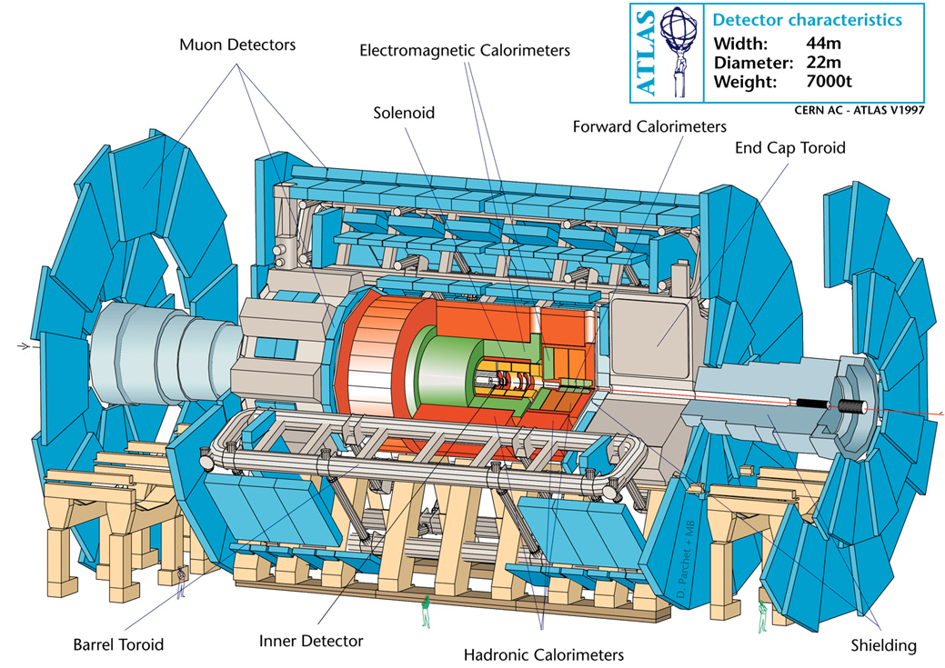
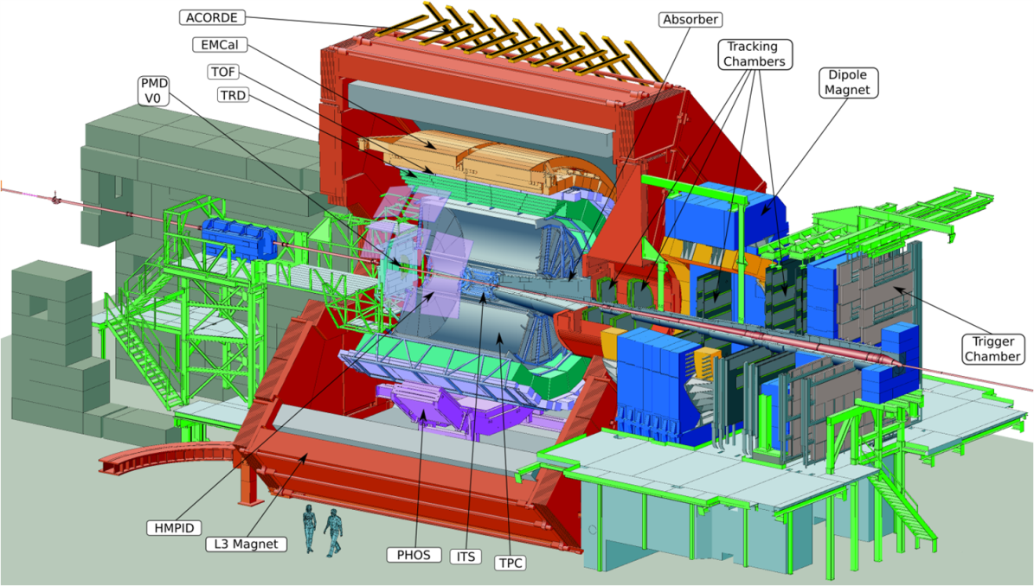
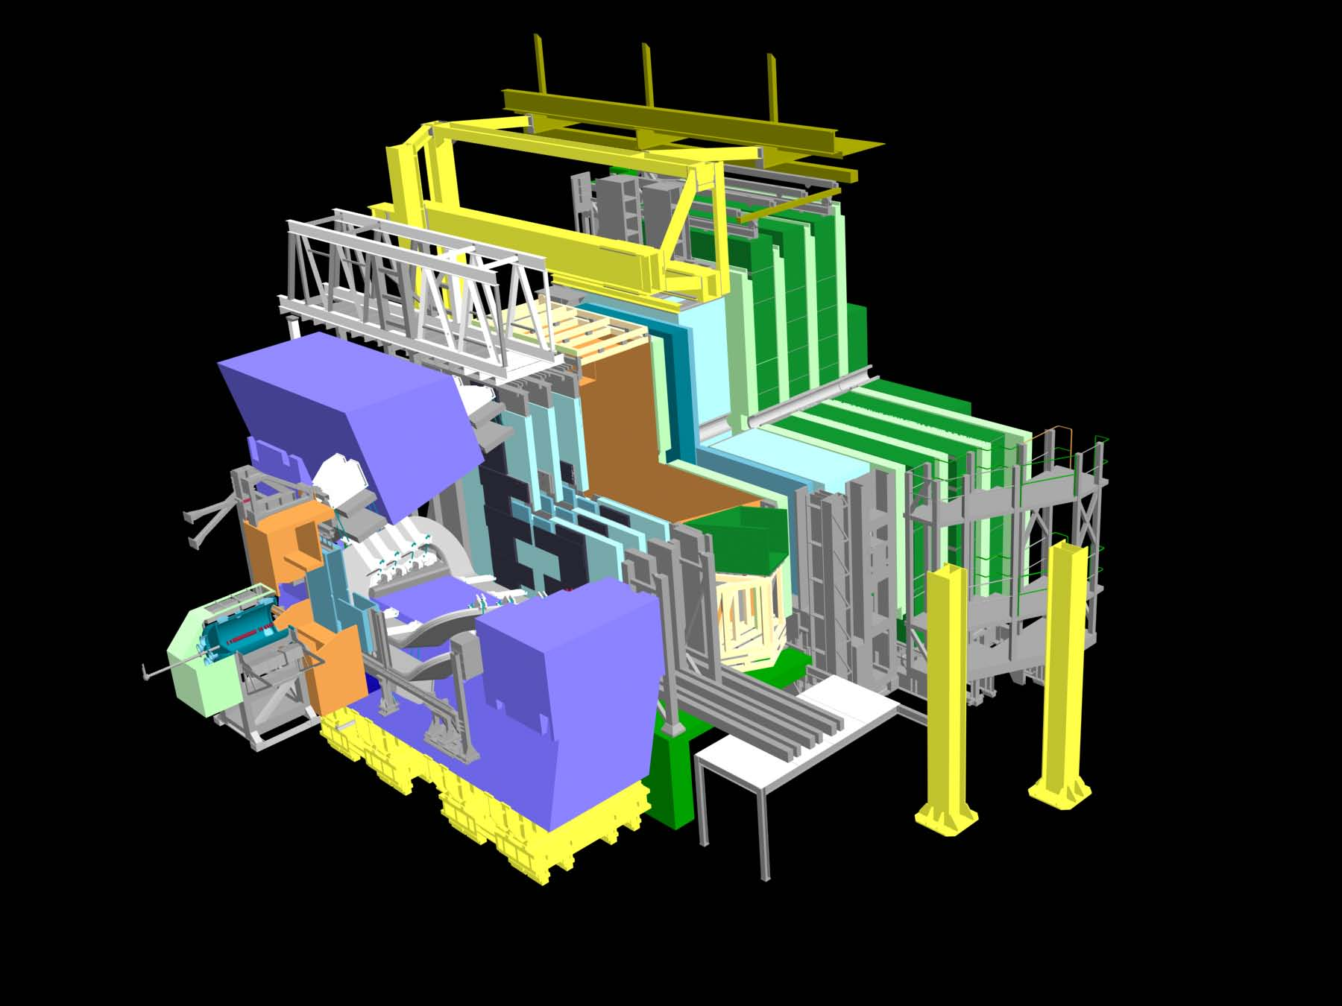
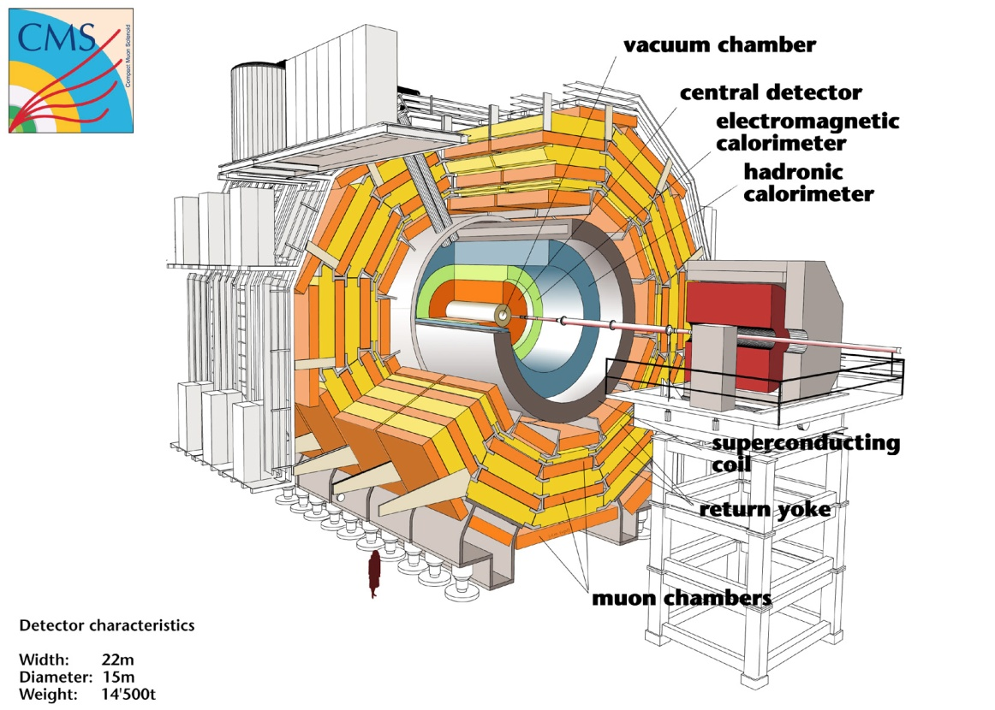

Slide 20
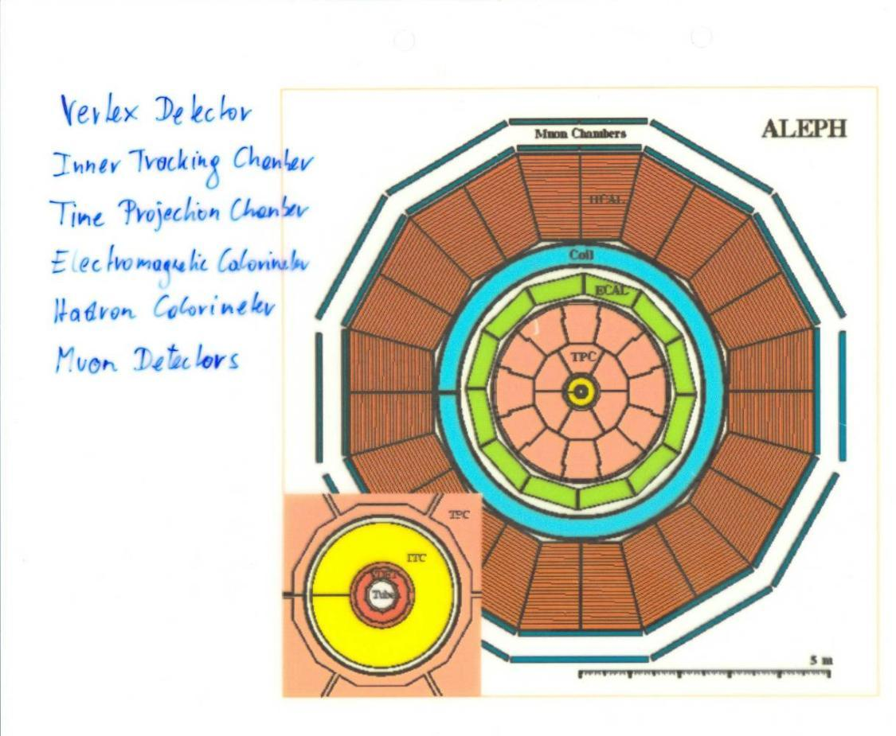

Slide 21
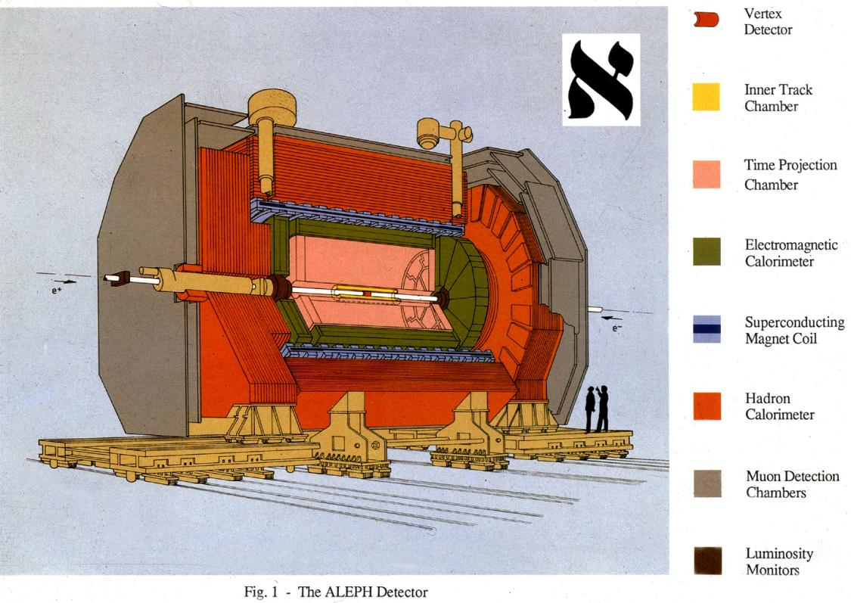

Slide 22
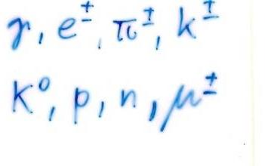
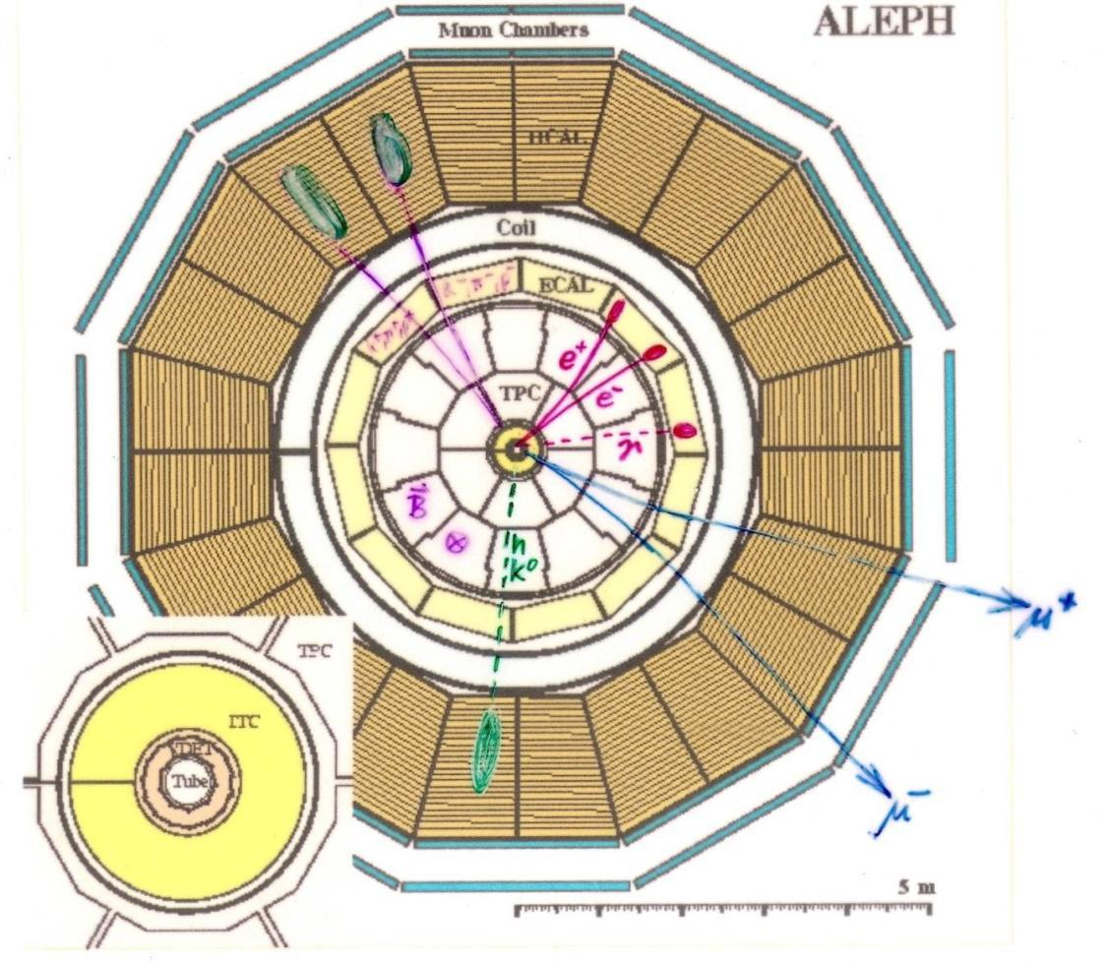

Slide 23
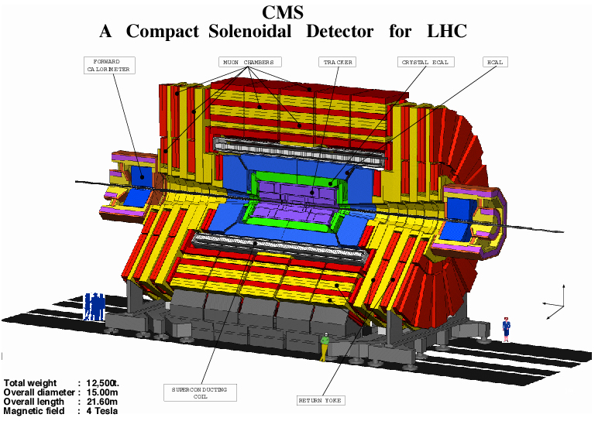
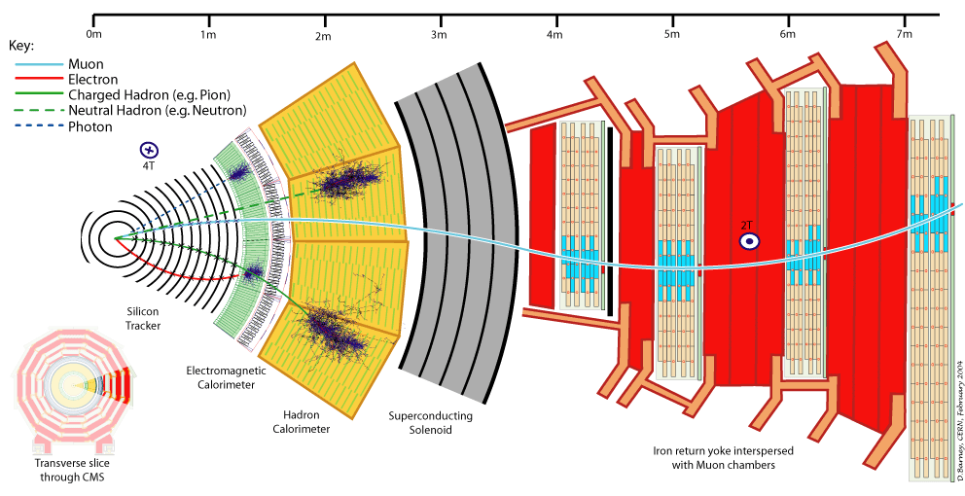

Slide 24
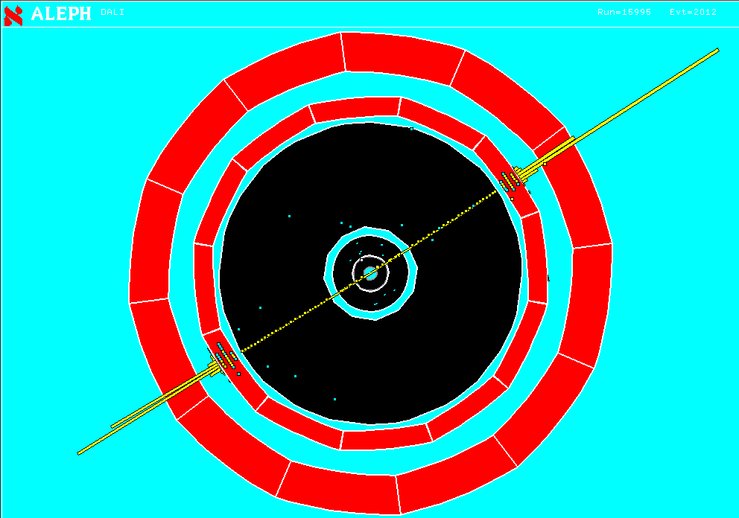
Z → e⁺ e⁻
Two high momentum charged particles depositing energy in the Electro Magnetic Calorimeter

Slide 25
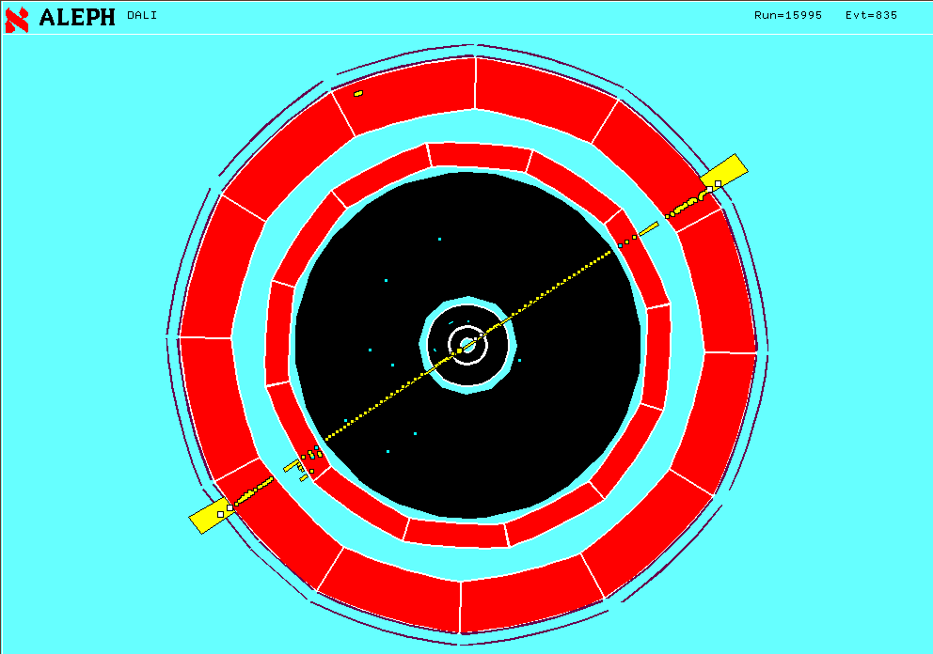
Z → μ⁺ μ⁻
Two high momentum charged particles traversing all calorimeters and leaving a signal in the muon chambers.

Slide 26
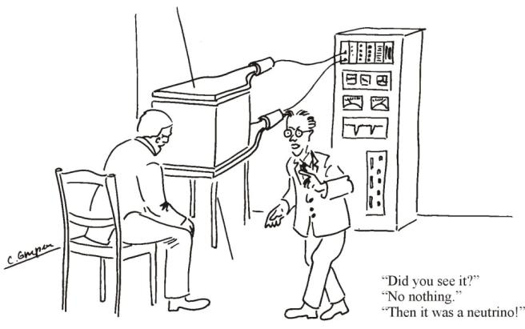
Interaction of Particles with Matter
Any device that is to detect a particle must interact with it in some way → almost …
In many experiments neutrinos are measured by missing transverse momentum.
E.g. e⁺e⁻ collider. P_{tot}=0,
If the Σ p_{i} of all collision products is ≠0 → neutrino escaped.
Claus Grupen, Particle Detectors, Cambridge University Press, Cambridge 1996 (455 pp. ISBN 0-521-55216-8)

Slide 27
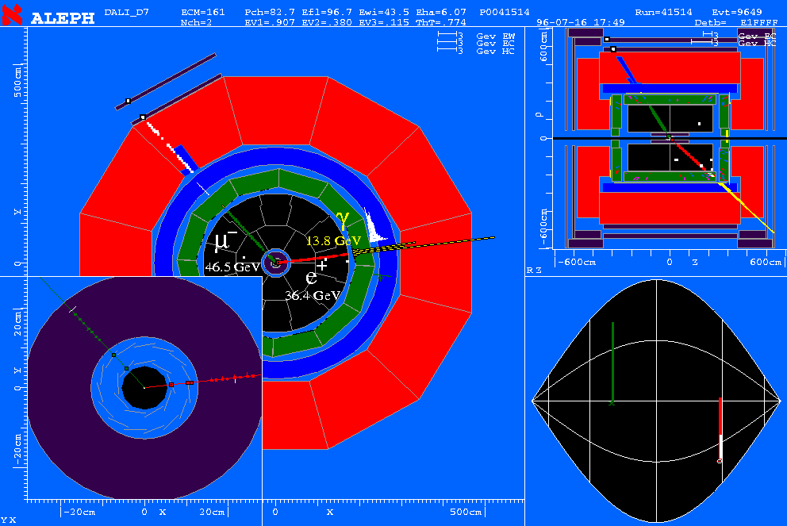
W⁺W⁻ → e+ m + n_{e}+n_{m}
Single electron, single Muon, Missing Momentum

Slide 28
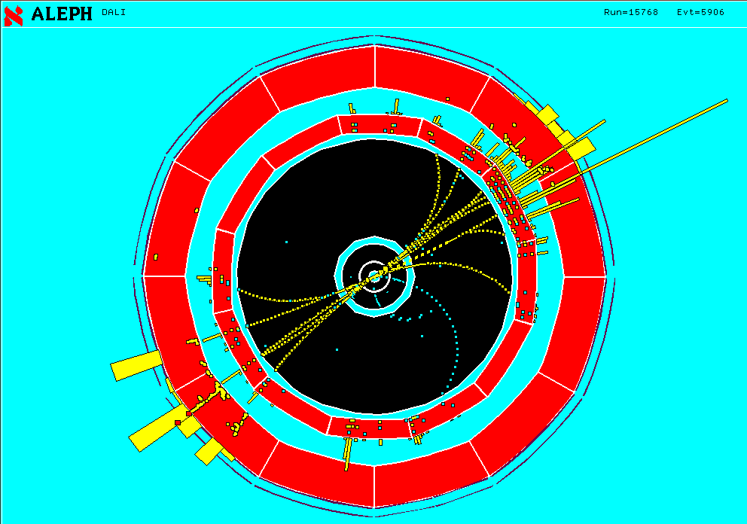
Z → q q
Two jets of particles

Slide 29
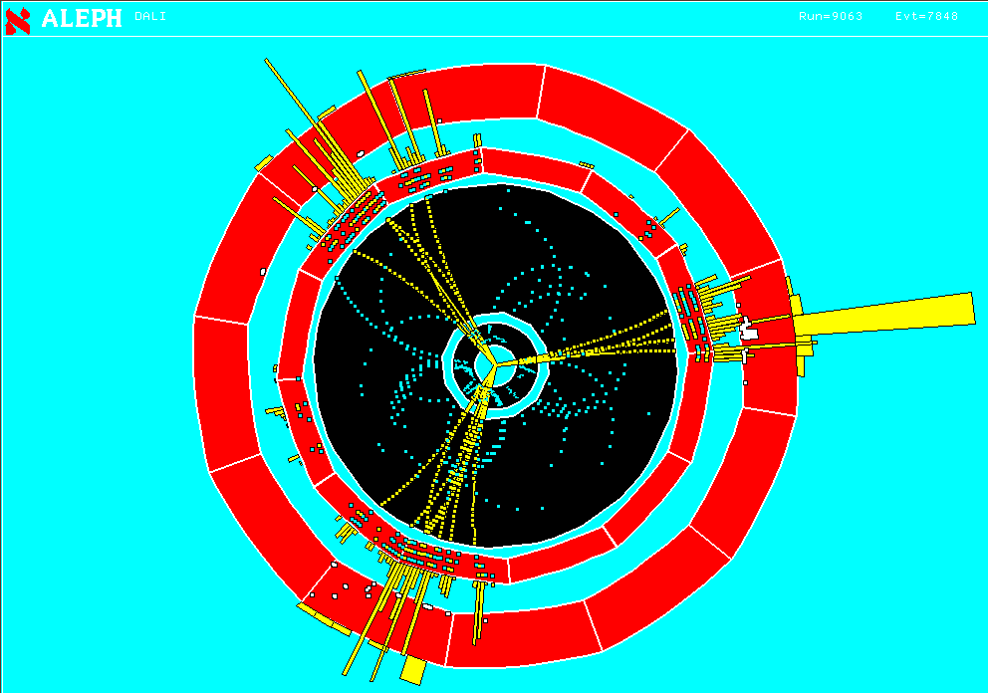
Z → q q g
Three jets of particles

Slide 30
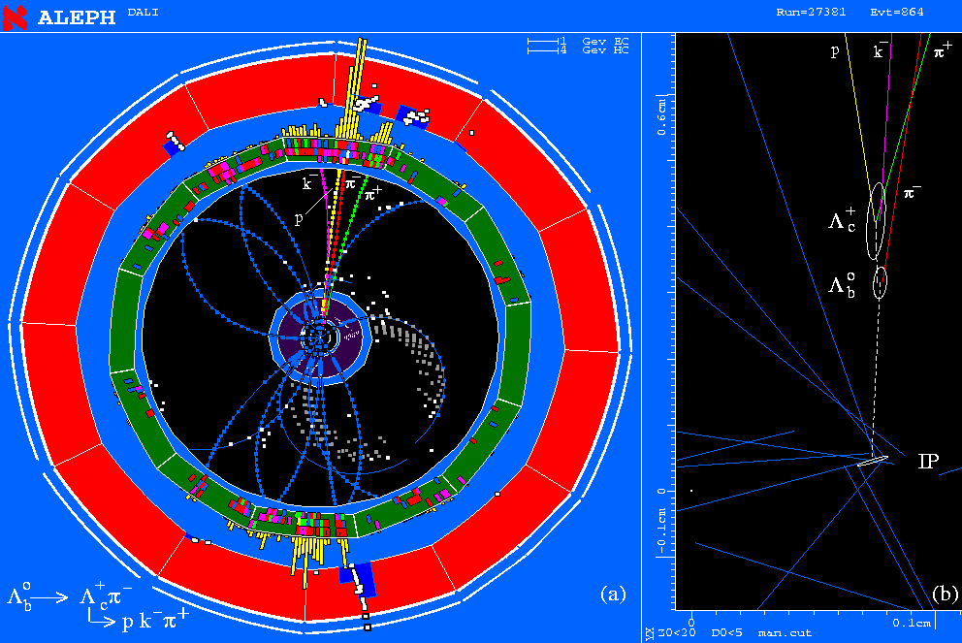
Two secondary vertices with characteristic decay particles giving invariant masses of known particles.
Bubble chamber like – a single event tells what is happening. Negligible background.

Slide 31
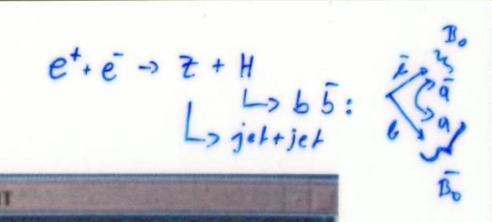
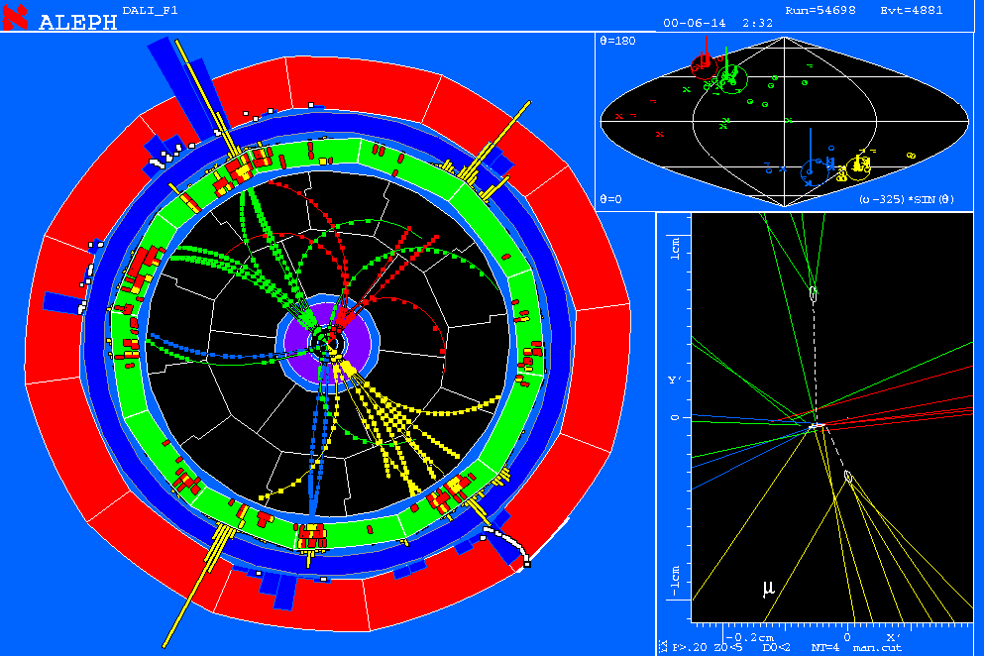
ALEPH Higgs Candidate
Undistinguishable background exists. Only statistical excess gives signature.

Slide 32
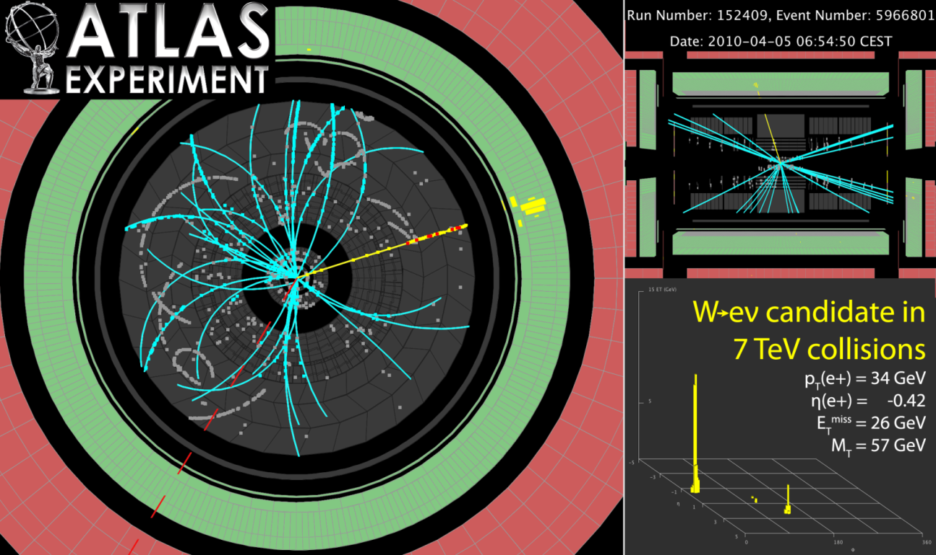
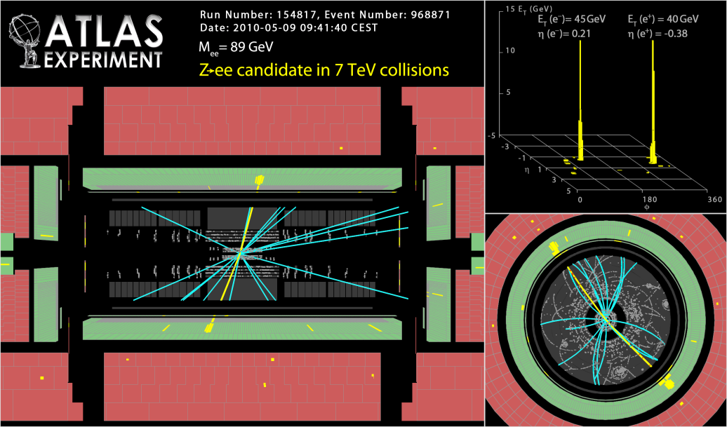
2010 ATLAS W, Z candidates !

Slide 33
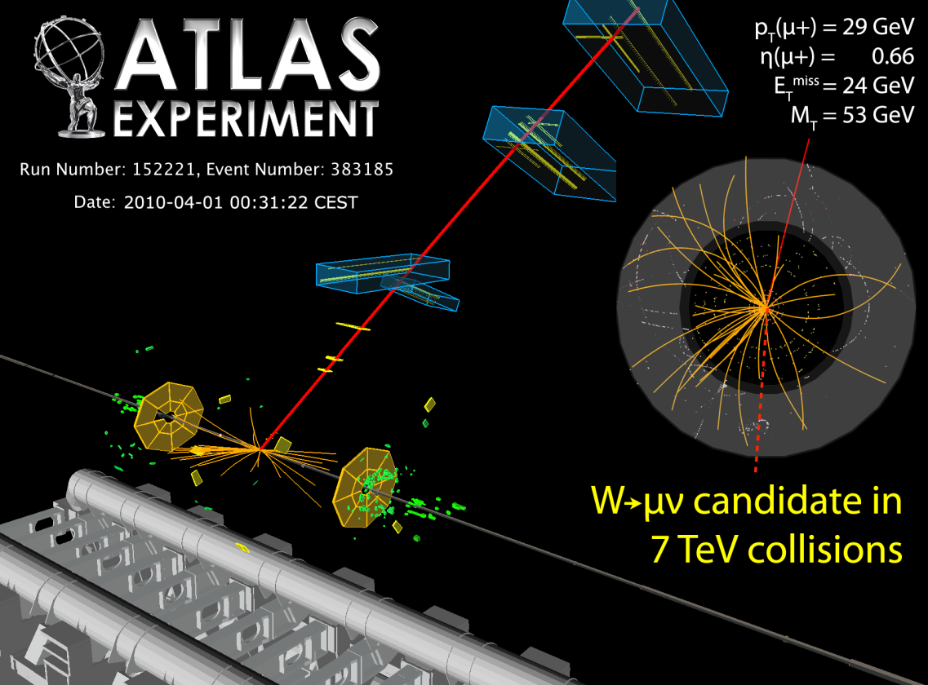
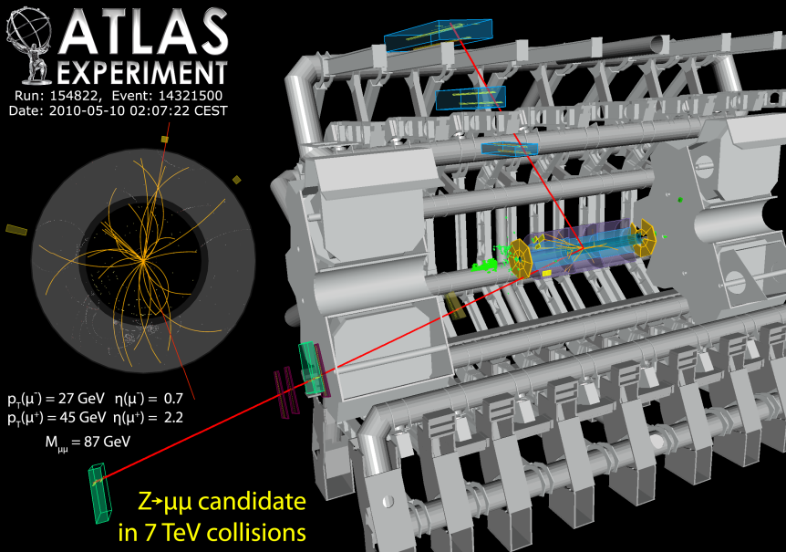
2010 ATLAS W, Z candidates !

Slide 34
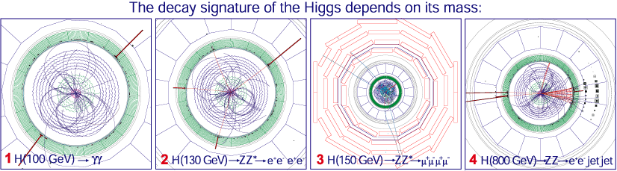
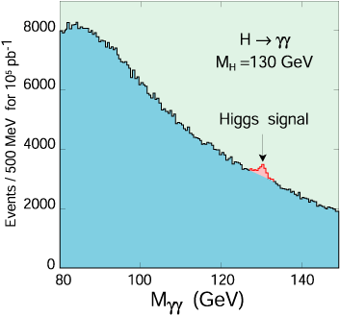
Higgs Boson at CMS
Particle seen as an excess of two photon events above the irreducible background.

Slide 35
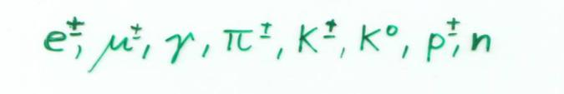
Principles:
Only a few of the numerous known particles have lifetimes that are long enough to leave tracks in a detector.
Most of the particles are measured though the decay products and their kinematic relations (invariant mass). Most particles are only seen as an excess over an irreducible background.
Some short lived particles (b,c –particles) reach lifetimes in the laboratory system that are sufficient to leave short tracks before decaying → identification by measurement of short tracks.
In addition to this, detectors are built to measure the
8 particles
Their difference in mass, charge and interaction is the key to their identification.

Slide 36
Detector Technologies
Solid state detectors close to the collision point for excellent position resolution to find vertices and secondary vertices → silicon pixel detectors.
Solid state detectors (silicon strip detectors) or gas detectors at larger distances for tracking and momentum measurement.
Massive calorimeters with alternating layers of passive absorber material and active detector material for measurement of particle energies.

Slide 37
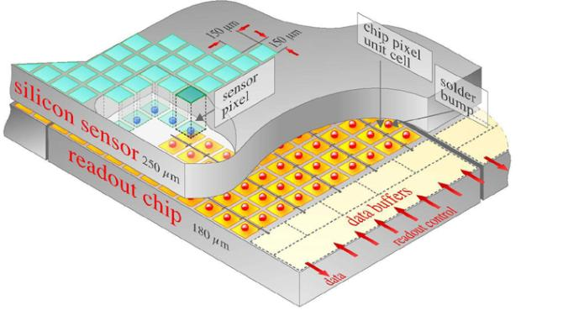
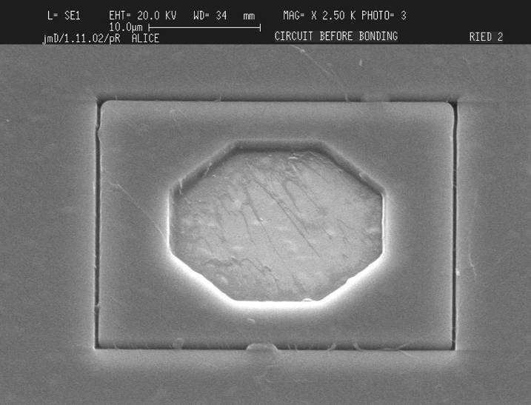
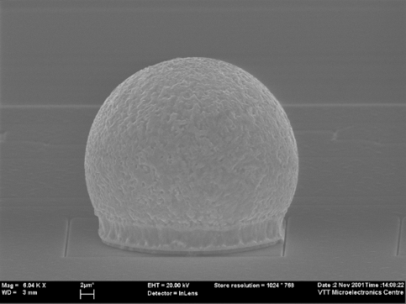
Silicon Pixel Detectors
ATLAS: 1.4x10⁸ pixels
40 000 000 ‘images’ per second.
Solid State Detectors

Slide 38
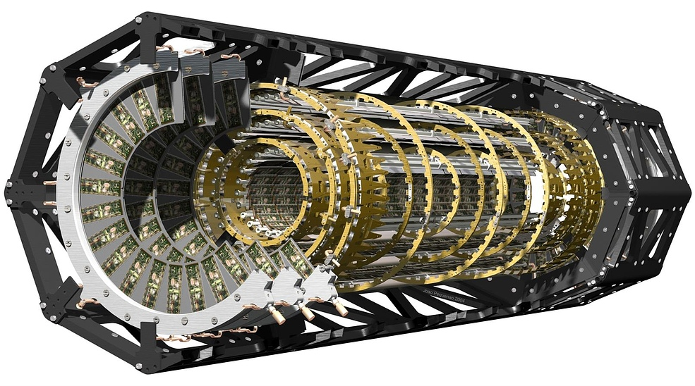
ATLAS Silicon Pixel Detector

Slide 39
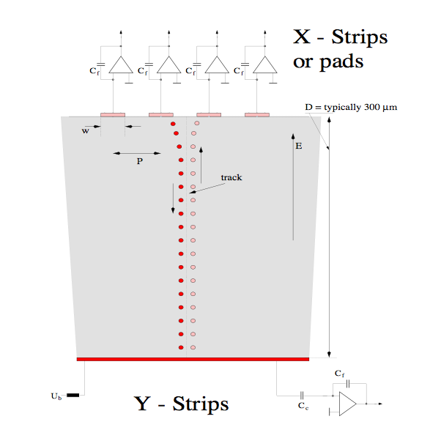
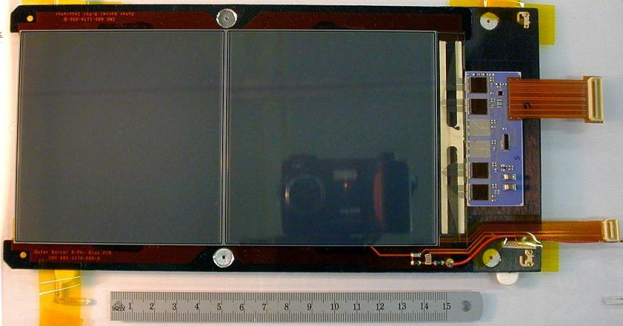
Silicon Strip Detectors
Every electrode is connected to an amplifier →
Highly integrated readout electronics.
Two dimensional readout is possible.
CMS Outer Barrel Module
Solid State Detectors

Slide 40


Silicon Strip Detectors

Slide 41


Time Projection Chamber (TPC):
Gas volume with parallel E and B Field.
B for momentum measurement. Positive effect: Diffusion is strongly reduced by E//B (up to a factor 5).
Drift Fields 100-400V/cm. Drift times 10-100 μs.
Distance up to 2.5m !
gas volume
B
drift
E
y
x
z
charged track
Wire Chamber to detect the tracks

Slide 42

ALICE TPC: Construction Parameters
Largest TPC:
  Length 5m
  Diameter 5m
  Volume 88m³
  Detector area 32m²
  Channels ~570 000
High Voltage:
  Cathode -100kV
Material X₀
  Cylinder from composite materials from airplane industry (X₀= ~3%)

Slide 43



ALICE TPC: Pictures of the Construction
Precision in z: 250μm End plates 250μm
Wire chamber: 40μm

Slide 44



ALICE TPC Construction
My personal contribution:
A visit inside the TPC.

Slide 45

TPC installed in the ALICE Experiment

Slide 46


First 7 TeV p-p Collisions in the ALICE TPC in March 2010 !

Slide 47

First Pb Pb Collisions in the ALICE TPC in Nov 2010 !

Slide 48



The Geiger Counter reloaded: Drift Tube
Primary electrons are drifting to the wire.
Electron avalanche at the wire.
The measured drift time is converted to a radius by a (calibrated) radius-time correlation.
Many of these circles define the particle track.
ATLAS MDT R(tube) =15mm
Calibrated Radius-Time correlation
ATLAS Muon Chambers
ATLAS MDTs, 80μm per tube

Slide 49


The Geiger counter reloaded: Drift Tube
Atlas Muon Spectrometer, 44m long, from r=5 to11m.
1200 Chambers
6 layers of 3cm tubes per chamber.
Length of the chambers 1-6m !
Position resolution: 80μm/tube, <50μm/chamber (3 bar)
Maximum drift time ≈700ns
Gas Ar/CO₂ 93/7

Slide 50
Detector Systems

Slide 51
CERN Neutrino Gran Sasso
(CNGS)

Slide 52

CNGS
If neutrinos have mass:
ν_{e}
Muon neutrinos produced at CERN.
See if tau neutrinos arrive in Italy.
ν_{μ}
ν_{τ}

Slide 53

CNGS Project
CNGS (CERN Neutrino Gran Sasso)
  A long base-line neutrino beam facility (732km)
  send ν_{μ} beam produced at CERN
  detect ν_{τ} appearance in OPERA experiment at Gran Sasso
➔ direct proof of ν_{μ} - ν_{τ} oscillation (appearance experiment)

Slide 54

CNGS

Slide 55

CNGS

Slide 56

CNGS

Slide 57

Radial Distribution of the ν_{μ}-Beam at GS
5 years CNGS operation, 1800 tons target:
30000 neutrino interactions
~150 ν_{τ} interactions
~15 ν_{τ} identified
< 1 event of background
Flat top: 500m
FWHM: 2800m
typical size of a detector at Gran Sasso
E. Gschwendtner, CERN

Slide 58
Neutrinos at CNGS: Some Numbers
For 1 year of CNGS operation, we expect:
protons on target 2 x 10¹⁹
pions / kaons at entrance to decay tunnel 3 x 10¹⁹
ν_{μ} in direction of Gran Sasso 10¹⁹
ν_{μ} in 100 m² at Gran Sasso 3 x 10¹⁴
ν_{μ} events per day in OPERA ≈ 2500
ν_{τ} events (from oscillation) ≈ 2

Slide 59


Opera Experiment at Gran Sasso
Basic unit: brick
56 Pb sheets + 56 photographic films (emulsion sheets)
Lead plates: massive target
Emulsions: micrometric precision
brick
Brick
1 mm
τ
8.3kg
ν
10.2 x 12.7 x 7.5 cm³
Pb
Couche de gélatine photographique 40 μm

Slide 60
Opera Experiment at Gran Sasso
31 target planes / supermodule
In total: 206336 bricks, 1766 tons
SM1
SM2
υ
Targets
Magnetic Spectrometers
First observation of CNGS beam neutrinos : August 18th, 2006
Notes:
Lead makes target mass, emulsions allows to see tracks!
Walls are made of bricks, bricks are made of sandwiches, sandwiches are made of lead and emulsion sheets. (type of photographic film)

Slide 61


Opera Experiment at Gran Sasso
Second Super-module
Details of the first spectrometer
Scintillator planes 5900 m²
8064 7m long drift tubes
3050 m² Resistive Plate Counters
2000 tons of iron for the two magnets
Notes:
2 photos of OPERA, so we see, experiment exists!

Slide 62

Opera Experiment at Gran Sasso

Slide 63

First Tau Candidate seen a few weeks ago !

Slide 64


AMANDA
Antarctic Muon And Neutrino Detector Array

Slide 65


AMANDA
South Pole

Slide 66




AMANDA
Photomultipliers in the Ice,
looking downwards.
Ice is the detecting medium.

Slide 67


AMANDA
Look for upwards going Muons from Neutrino Interactions.
Cherekov Light propagating through the ice.
Find neutrino point sources in the universe !

Slide 68



AMANDA
Event Display
Up to now: No significant point sources but just neutrinos from cosmic ray interactions in the atmosphere were found .
→ Ice Cube for more statistics !

Slide 69

AMS
Alpha Magnetic Spectrometer
Try to find Antimatter in the primary cosmic rays.
Study cosmic ray composition etc. etc.

Slide 70

AMS
Will be installed on the space station.

Slide 71

AMS

Slide 72

AMS

