Slide 1
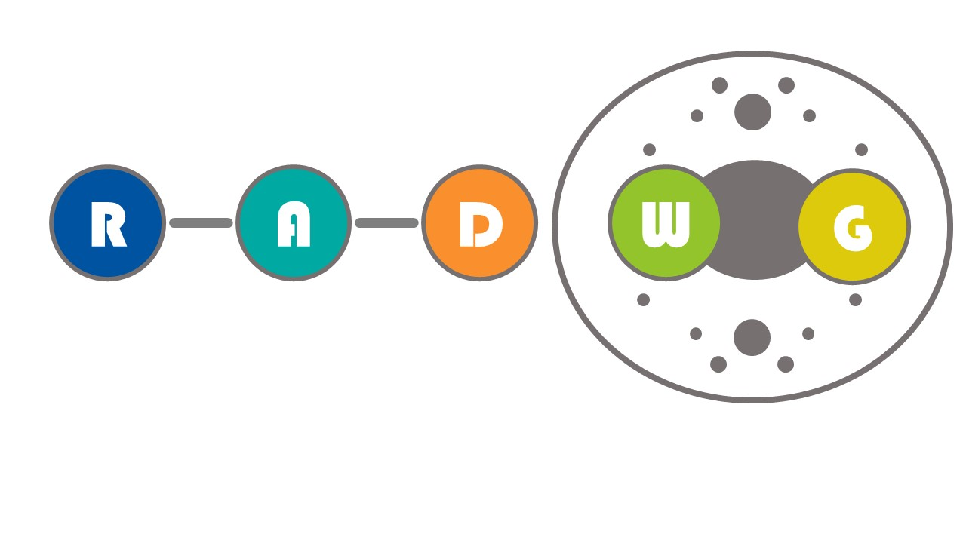
RADWG Meeting October 2021
Salvatore Danzeca BE-CEM-EPR
Manoel Barros Marin SY-BI-BP
on behalf of the RADWG

Slide 2
AGENDA
Introduction
Activities Overview by Rudy Ferraro
EP-ESE: Radiation-tolerant Optical Link Developments for HEP Experiments by Jan Troska
SY-BI : Current and future radiation-tolerant BPM electronics for the LHC and the SPS by Andrea Boccardi
TE-MPE: The QPS upgrade: radiation tolerant bus-bar detectors and field-bus clients by Jelena Spasic & Jens Steckert
EP-UCM: Radiation tolerant low voltage power supply for CMS detector by Krzysztof Stachon

Slide 3


RADWG Mandate
It provides support to the accelerator sector equipment groups for the assessment of radiation tolerance of electronic equipment to be installed in radiation exposed areas.
It is as a forum for electronic engineers to discuss
  design practices
  radiation tests
  radiation induced failures in the accelerators.
It coordinates radiation test campaigns inside and outside CERN
The RADWG is a pillar of the R2E Project

Slide 4
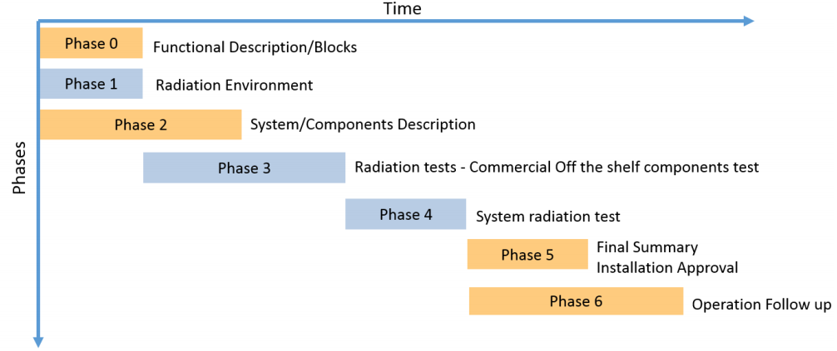
CERN RHA Guideline for COTS-based system
Within the R2E project we have defined the process for system qualification:
Provide advices and support for component type & technology choice
Collect Test request
Test & Reporting
Provide support on system failure analysis and mitigation
@ CERN RHA Guideline
Provide advices in early development stages for component choice
Help analyzing system failure observed in operation or during system-level test and propose mitigation techniques or part replacement candidates

Slide 5


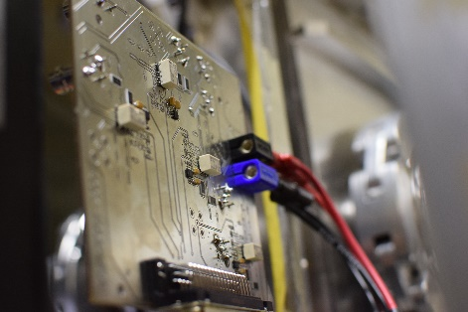
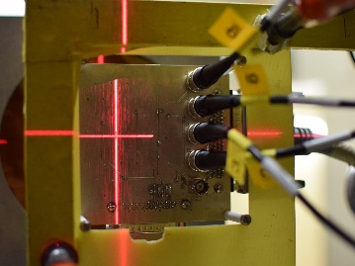
Radiation test service – BE-CEM-EPR
Request collection
The requests for radiation testing are collected and processed selecting the most suitable methodology and facilities
Database and Publication
The results are collected, stored and in EDMS and published in the RADWG database to allow an easy research of the best candidates for the new radiation tolerant designs
01
Test planning and structure
06
02
Each component/system is analyzed, and all the possible radiation effects are taken into account for planning the test and structure it
Result analysis
The results are analyzed during and after the tests for each component considering the end application and the possible operational issues
Board and instrumentation preparation
05
03
For each component a dedicated set of test board is prepared and the associated instrumentation is chosen to face the complexity of the radiation test
04
Testing
The test are carried out at CERN facilities such as CHARM or Co60 and in external facilities. The transport, personnel and instrumentation are selected considering the peculiar aspect of each facility

Slide 6
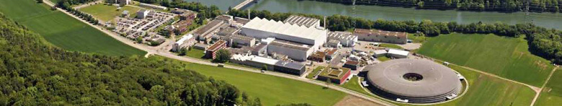

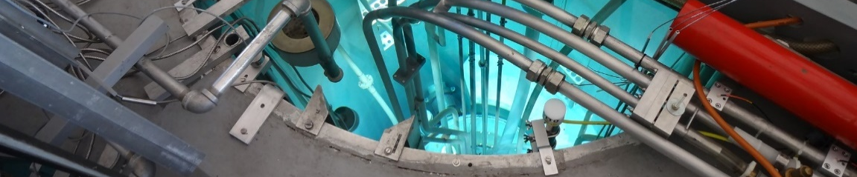

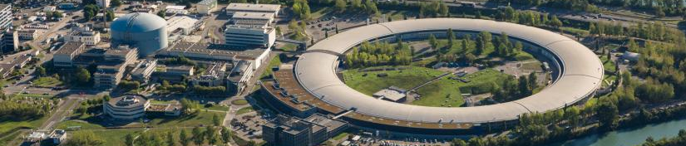

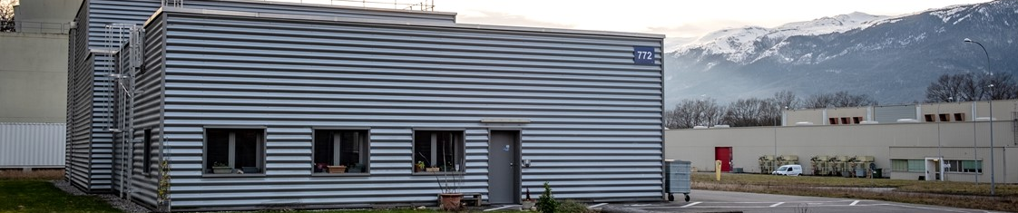

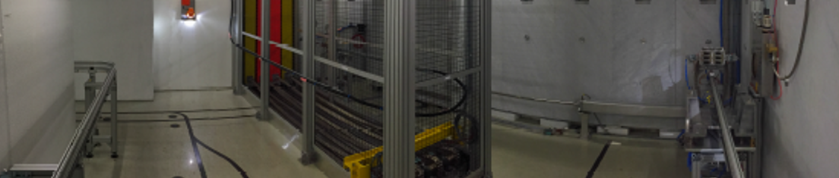

Where do we test: Key point is the facilities
PSI-PIF – Switzerland, Viligen
  30-220 MeV Proton beam
  Combined SEE, TID, DD Tests
  5 Years collaboration agreement with CERN
Paul Scherrer Institut
JSI – Slovenia, Ljubljana
  Triga Mark II Nuclear Reactor
  DD, TID
  Punctual use, possibility to make a contract
Jožef Stefan Institute
ILL – Genoble, France
  Thermal Neutron Beam
  Thermal neutron sensitivity Tests
  Punctual use, possibility to make a contract
Institut Laue-Langevin
CC60 – Switzerland, CERN
  10 Tb Cobalt 60 Source
  TID Tests
  Available all the year
CERN Cobalt 60 Facility
CHARM – Switzerland, CERN
  Representative LHC Radiation mixed-fields
  SEE, TID, DD
  Not available during technical stops
CERN High energy AcceleRator Mixed field

Slide 7
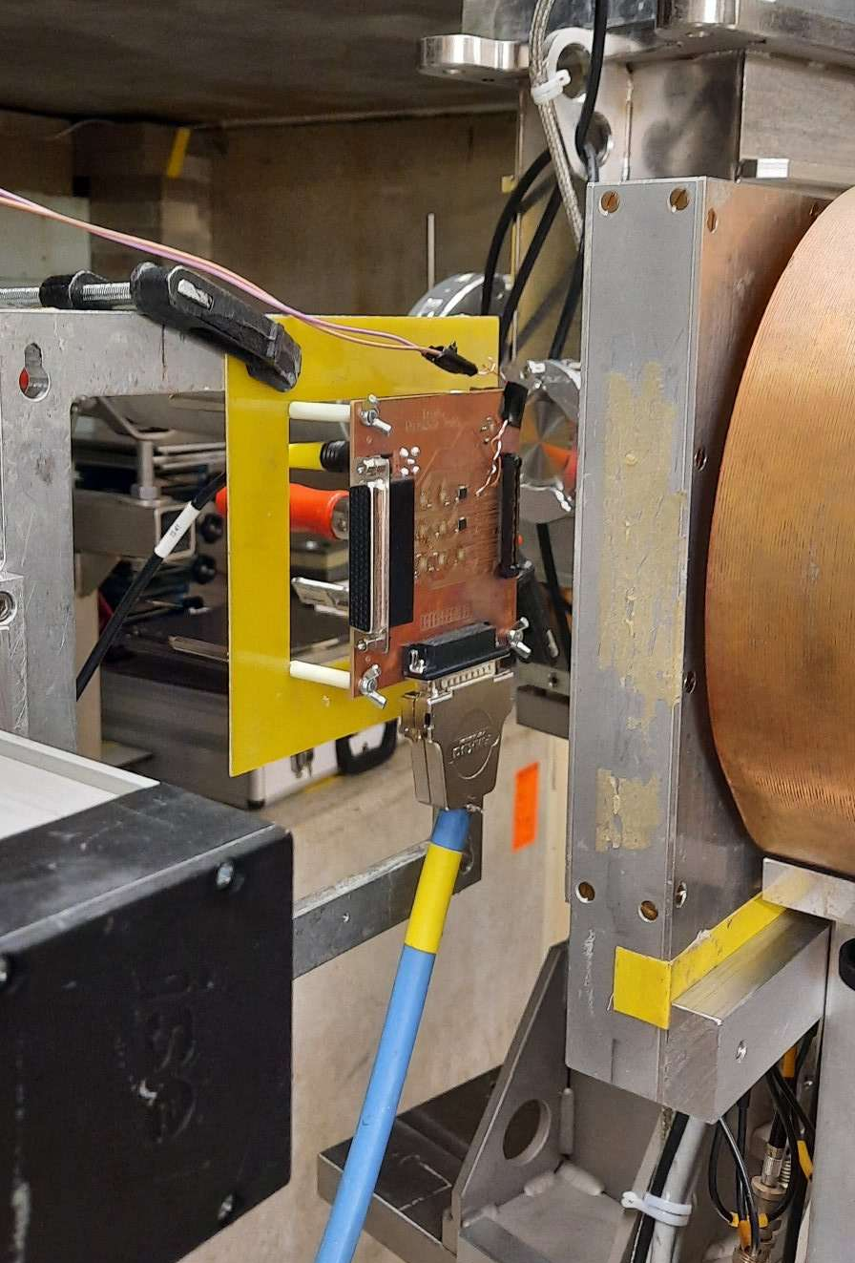
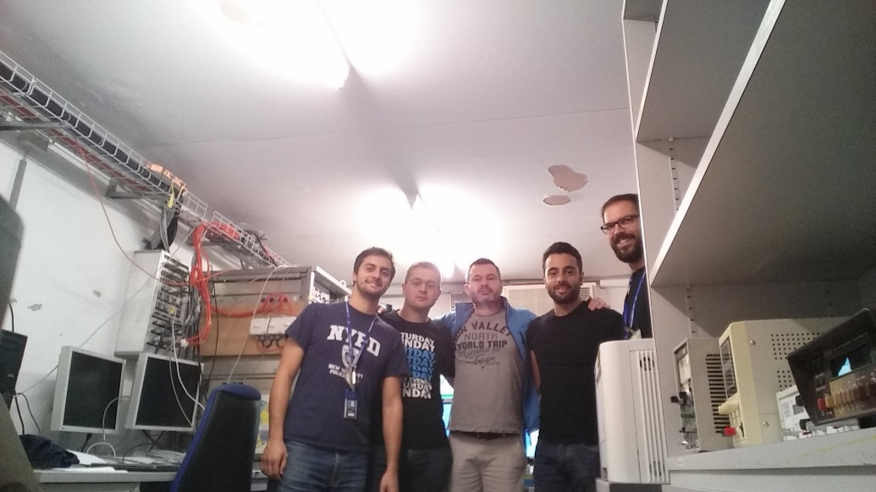
PSI Radiation test campaigns
PSI Facility Updates
  See next presentation from Rudy Ferraro
  Two slots left: October and December
  October slot : components from TE-MPE and SY-EPC tested by EPR
Today in 2015 at PSI

Slide 8

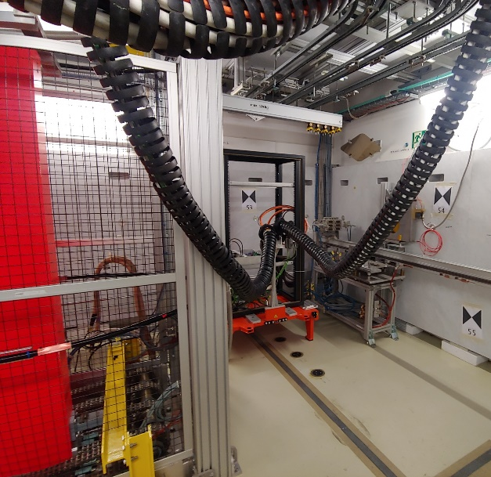
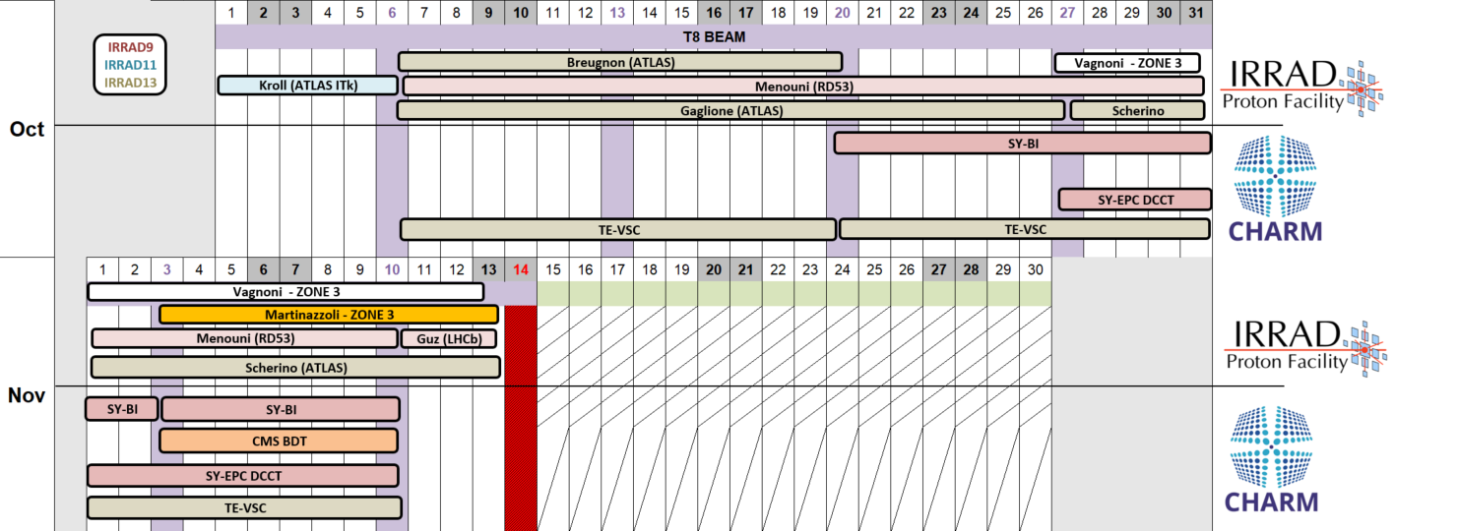
CHARM 2021
  First beam on target on the 4th of October
  Two days of facility commissioning and dosimetry assessment
  First user on the 6th of October TE-VSC
  3 users scheduled; 7 system level tests
    TE-VSC, SY-EPC, SY-BI, CMS BDT
  Several components testing by BE-CEM
  11 Users already booked for the 2021
  Registration for beam time for 2022 is available via the website charm.web.cern.ch

Slide 9

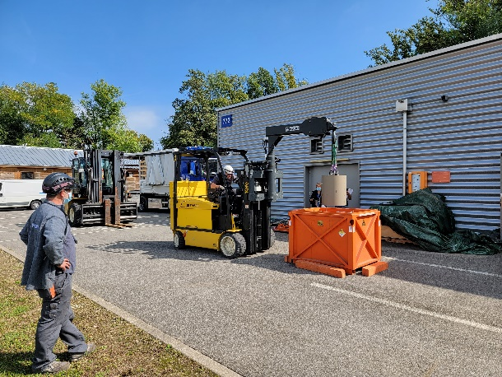
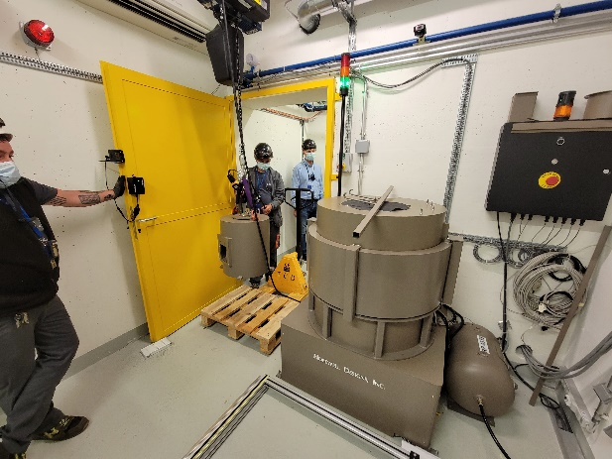
⁶⁰Co facility @ CERN
New Co60 source of 110TBq installed in the CC60 facility in September
The CC60 facility now hosts two Co60 source 4.6TBq and one of 110TBq (2019)
dose rates increased of factor 17x wrt the 4.6TBq source : from 464Gy/h up to 0.36Gy/h
  The installation procedure went smoothly and all the safety criteria have been applied
  The operation of the facility restarted this week

Slide 10
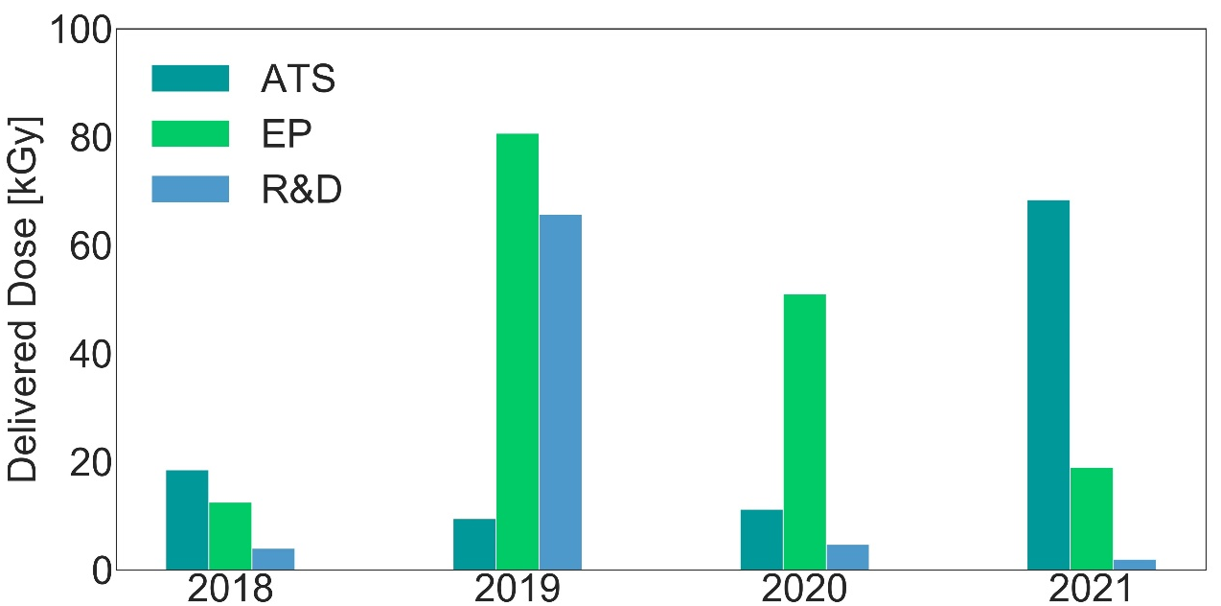
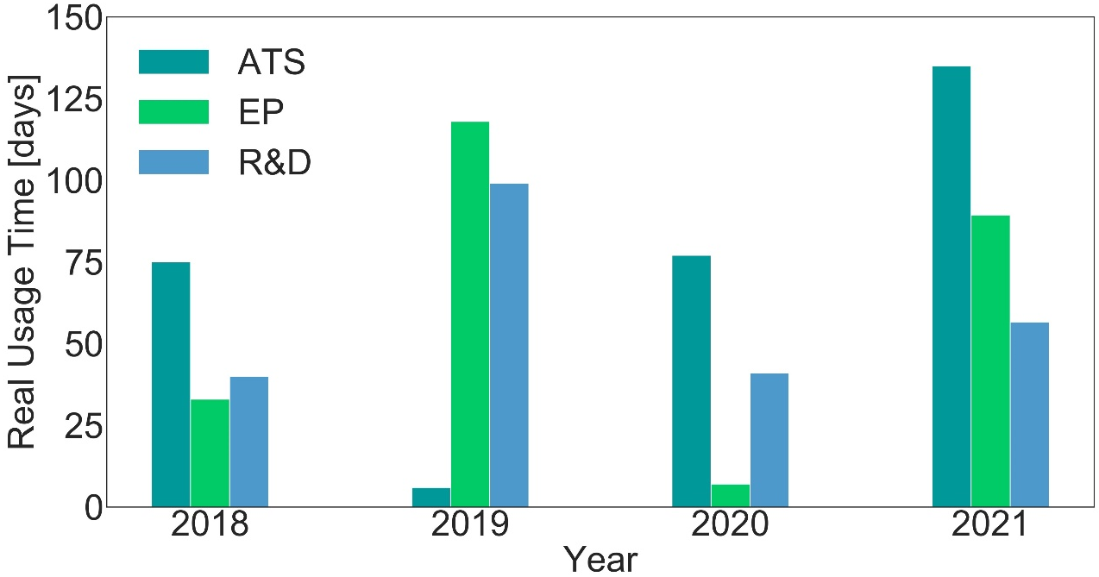
CC60 Statistics
Testing in 2021
Number of tests = 15
Total dose = 89 kGy
Usage time = 280 days
156 kGy
Users | Sector | Dose (Gy) | Time (days) | Experiment | Status
I. Ortega Ruiz | ATS | 60 k | ~100 | XBPF | Done
M. Rizzo | R&D | 2.5 k | ~50 | FGDOS | Done
M. Tornay | R&D | 2.4 k | ~15 | TC310 | Done
L. Marcon | EP | 10 k | 18 | CWDM Link | Done
L. Patnaik | EP | 30 | 1.9 k | Ratopus | Done
V. Ryjov | EP | 1.6 k | 32 | ELMB2 | Done
A. Tarek | EP | 100 | 0.3 | LVPS | Done
A. Miranda | ATS | 150 | 2.5 | WIC PLC | Done
D. Di Francesca | R&D | 1 | 1 | OFD | Done
V. Rieker | ATS | NA | 10 | HV Cables | Done
C. Clement | EP | ~220 | 10 | TileCal board | Done
S. Kundumattathil | R&D (RP) | ~10 | 1 | Ionization Chambers | Done
C. Baccigalupi | ATS | 6.6 k | 5 | Magnet Field Sensor | Done
G. Foucard | ATS (?) | 1 k | 13 | OpAmps | Done
J. Clar | ATS | 1.5 kGy | 5 | Mosfets | Done
89 kGy
67 kGy
35 kGy
280 days
223 days
148 days
125 days
13/10/2021
10

Slide 11
CC60 New Requests
Users | Sector | Dose (Gy) | Experiment | Status
V. Rieker | ATS | 1 k | HV Cables | Planned on 22nd Nov
I. Toccafondo | ATS | 100 k | Optical Fibers | To be planned
M. Seyedali | EP | 1 k (LDR) | - | To be planned
M. Corradi | EP | 300 | LDO | Planned in Oct
Greg Daniluk | EP | 500 | Ratopus | Planned in Oct
L. Martinazzoli | EP | 50 k | Samples for detectors | To be planned
Total |  | 153 k
13/10/2021
11

Slide 12
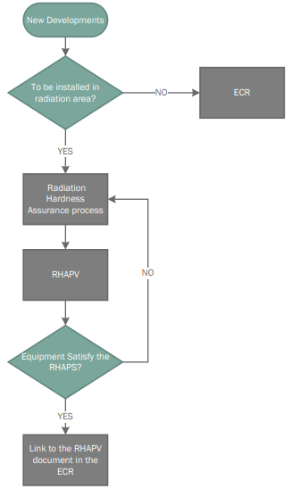
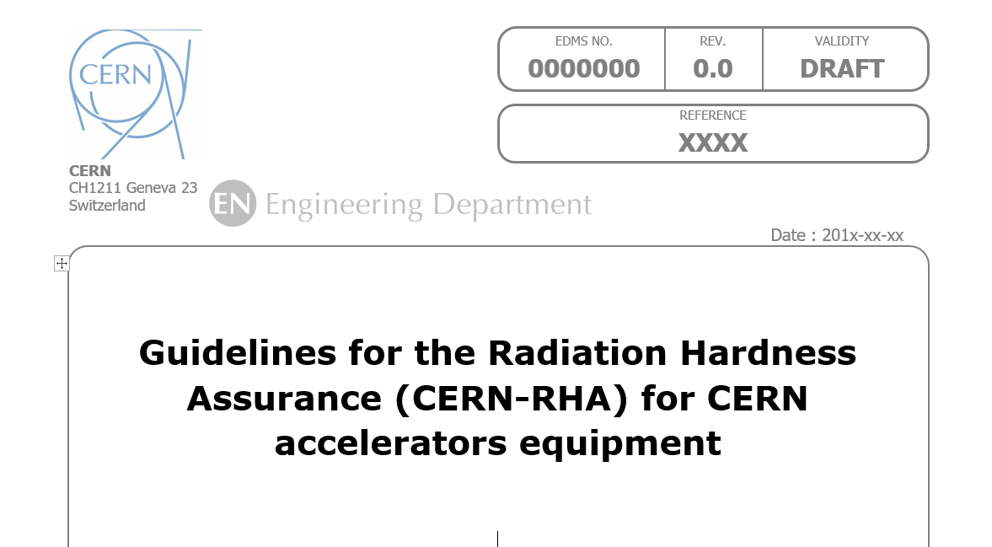
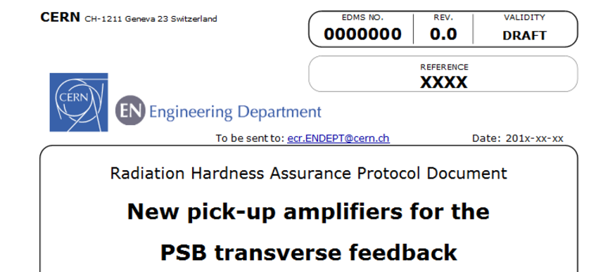
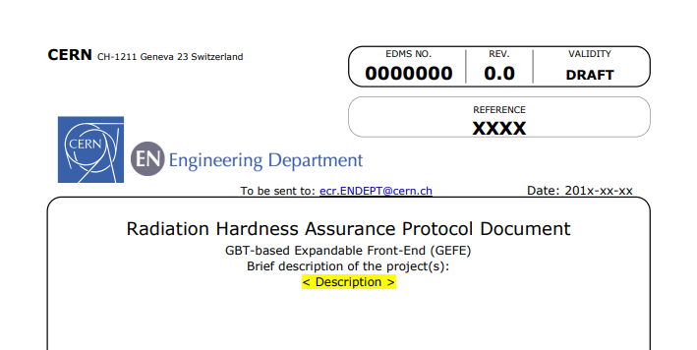
RHA validation procedure
A system radiation hardness assurance (HRA) procedure was developed within the R2E project:
Linked to the Engineering Change Request (ECR) as final validation
  Check-box in ECR template for electronics installed in possible radiation area
Contains the RHA Project Validation (RHAPV) document as cornerstone
  The RHA for the various developments is reviewed and approved by R2E project management, ensuring an independent check with respect to system developers and testing activity
Radiation Hardness Assurance Project Validation (RHAPV) document
Example of a filled document can be found here
Radiation Hardness Assurance Procedure (RHAP) document
GEFE RHAPV
Testing of electronic components by R. Ferraro (BE-CEM-EPR )

Slide 13
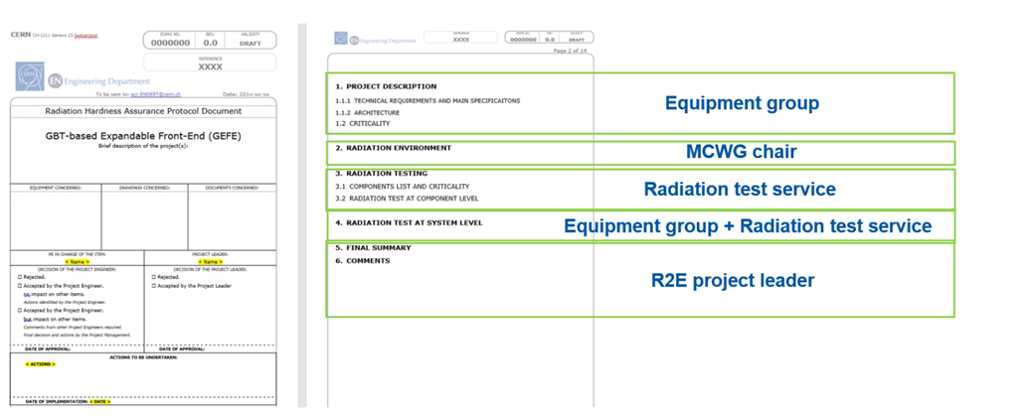
RHA Project Validation (RHAPV) details
Testing of electronic components by R. Ferraro (BE-CEM-EPR )

Slide 14
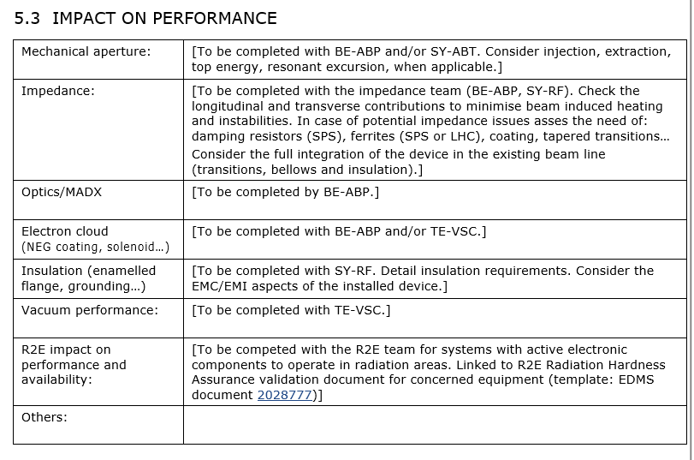
ECR Template

Slide 15
THANK YOU

