Slide 1
RADWG Activities Overview
Rudy Ferraro (BE-CEM-EPR)
RadWG Workshop – 13 October, 2021

Slide 2
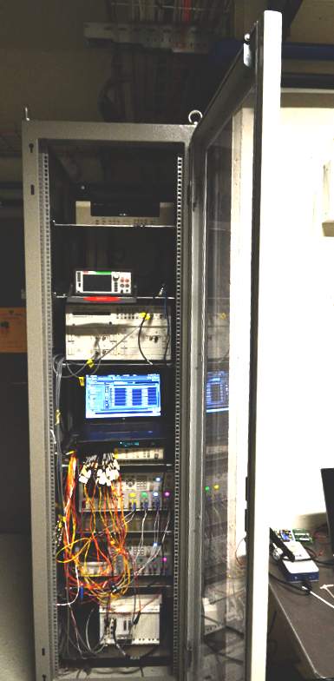
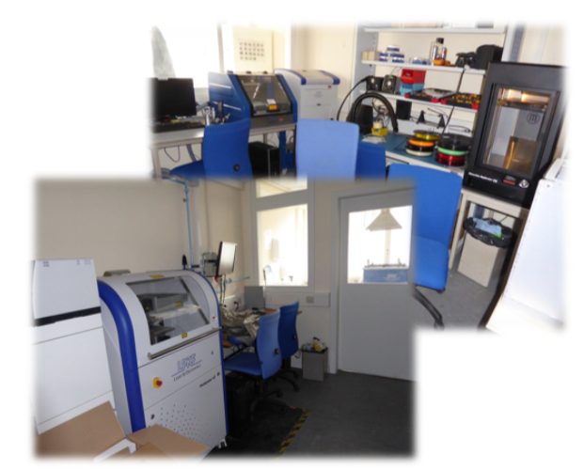
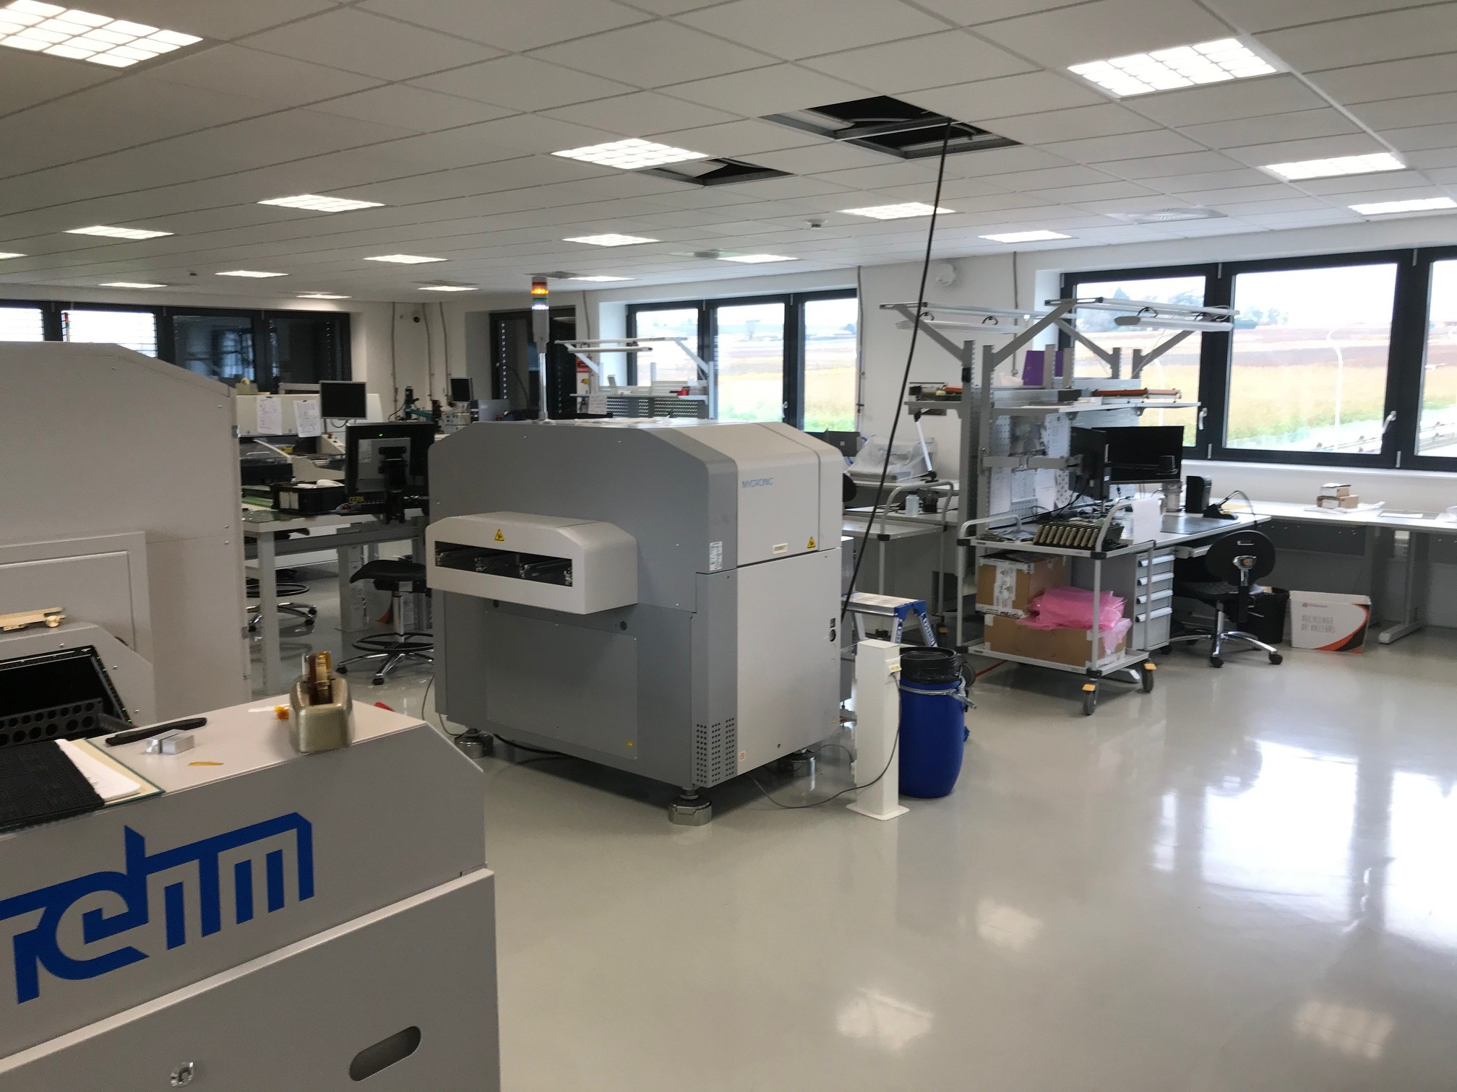
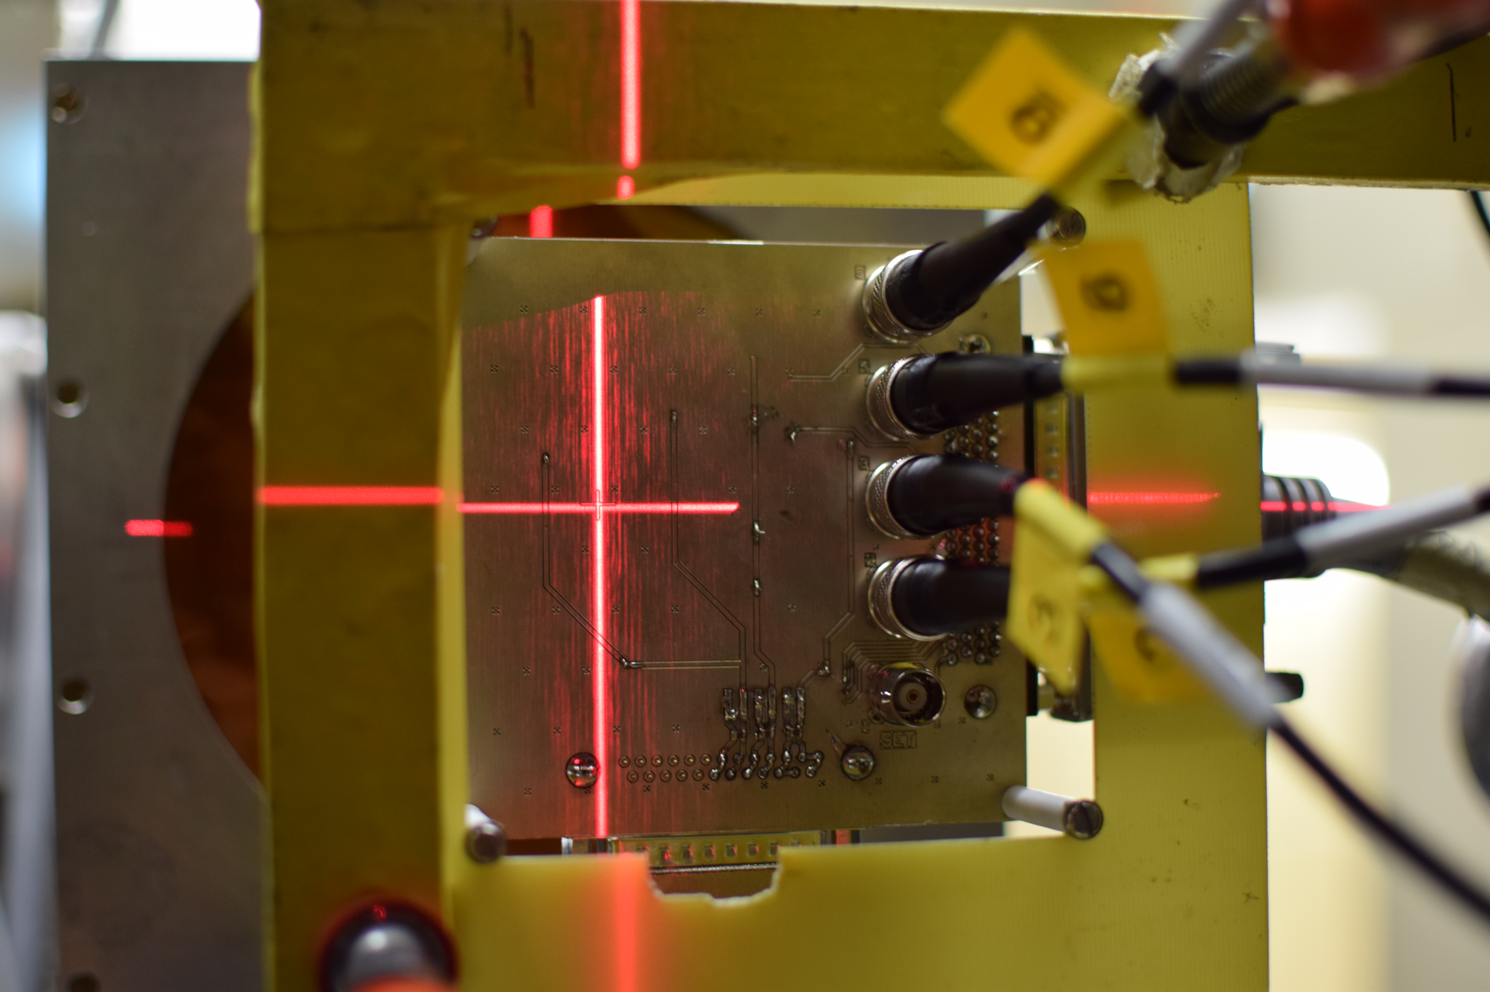
Radiation Test Service
BE-CEM-EPR provides, through R2E resources, the service of radiation testing of electronic components supporting the Radiation Working Group (RadWG)
19/1-019 Rapid Prototyping lab
107/1-A10 Main PCB Assembly Atelier
PSI Beam Line
CC60 Instrumentation
RADWG Activities Overview by R. Ferraro (BE-CEM-EPR )

Slide 3

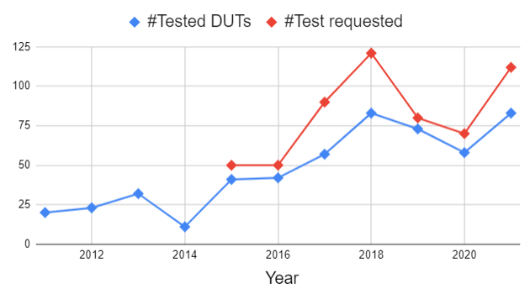
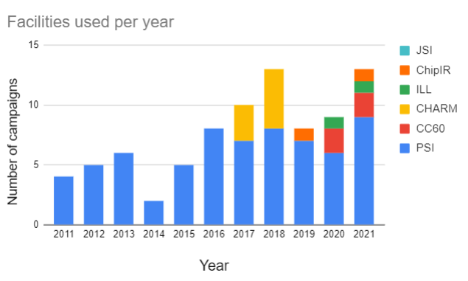
2021 in Numbers: Annual
112 requests collected
84 components & Systems tested
  New components but also a lot of system consolidation
12 Radiation campaigns done (9*PSI, 2*CC60, 1*ILL)
Other three planned: 1*PSI, 2*CHARM
Breaking records:
  Highest number of campaigns
  Highest number of DUTs
RADWG Activities Overview by R. Ferraro (BE-CEM-EPR )

Slide 4
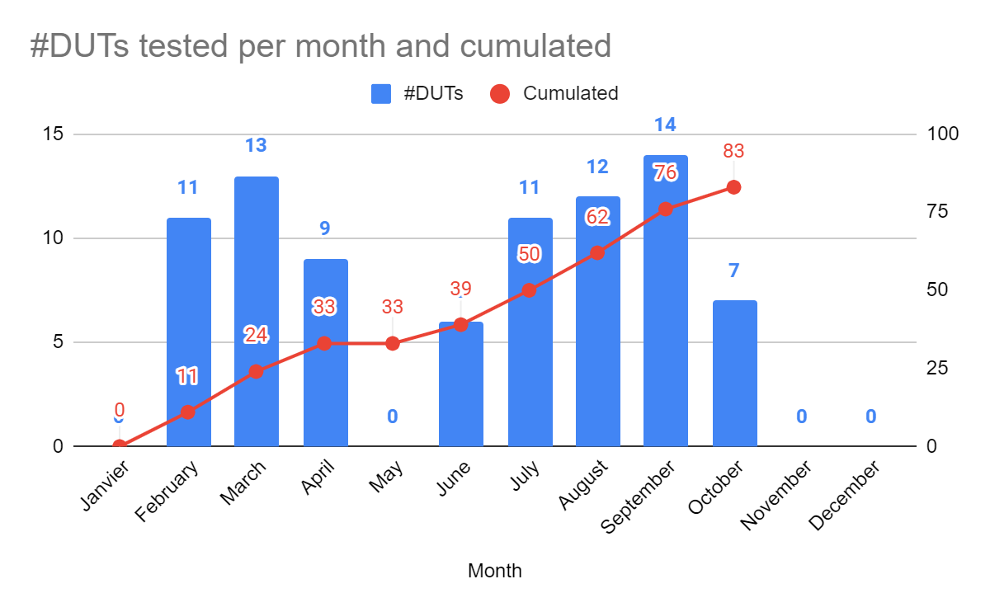
2021 in Numbers: Monthly
RADWG Activities Overview by R. Ferraro (BE-CEM-EPR )

Slide 5
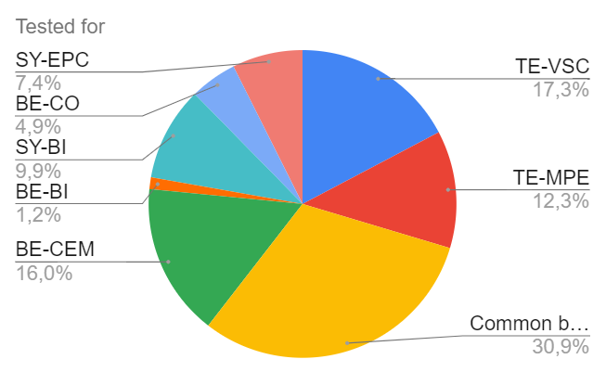
2021 in Numbers: User distribution
Basically the equipment groups in charge of new developments requested to qualify their selected components
  R2E-HL-LHC(60;120)A
  VSC Conditioning Electronics (Penning, log etc…)
  RaToPUS
  LHC BLM
  CIBU
  BLM Crate
  QPS
  LHC BPM
  DIOT Crate
  BATMON
  IOT Humidity Mon.
  Space RADMON
  Common building blocks
  FGPAs
  Opamps
  Regulators
  Etc…
RADWG Activities Overview by R. Ferraro (BE-CEM-EPR )

Slide 6
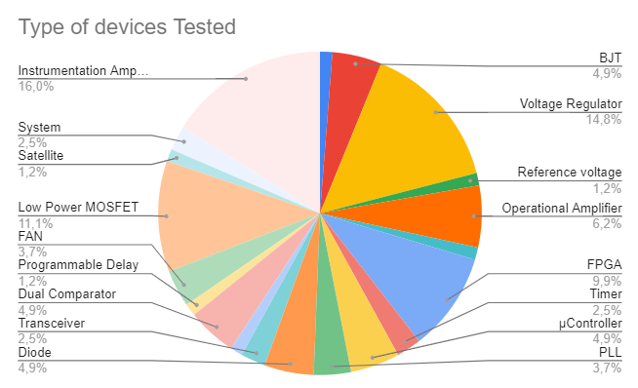



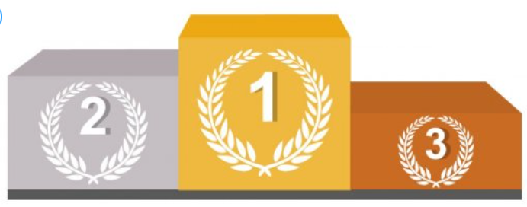
2021 in Numbers: DUT distribution
We tested from the simplest component (BJT) to the most complex ones (FPGAs) and even complete systems.
Opamps
Regulators
MOSFETs
Most Tested Devices
RADWG Activities Overview by R. Ferraro (BE-CEM-EPR )
Notes:
Link to the radWG database

Slide 7


2021 in Numbers: DUT distribution
We tested from the simplest component (BJT) to the most complex ones (FPGAs) and even complete systems.
Opamps
Regulators
MOSFETs
Opamps
Regulators
MOSFETs
FPGA
FPGAs
Most Tested Devices
Honorary title for FPGAs, which came in fourth place but represented a considerable effort.
RADWG Activities Overview by R. Ferraro (BE-CEM-EPR )

Slide 8
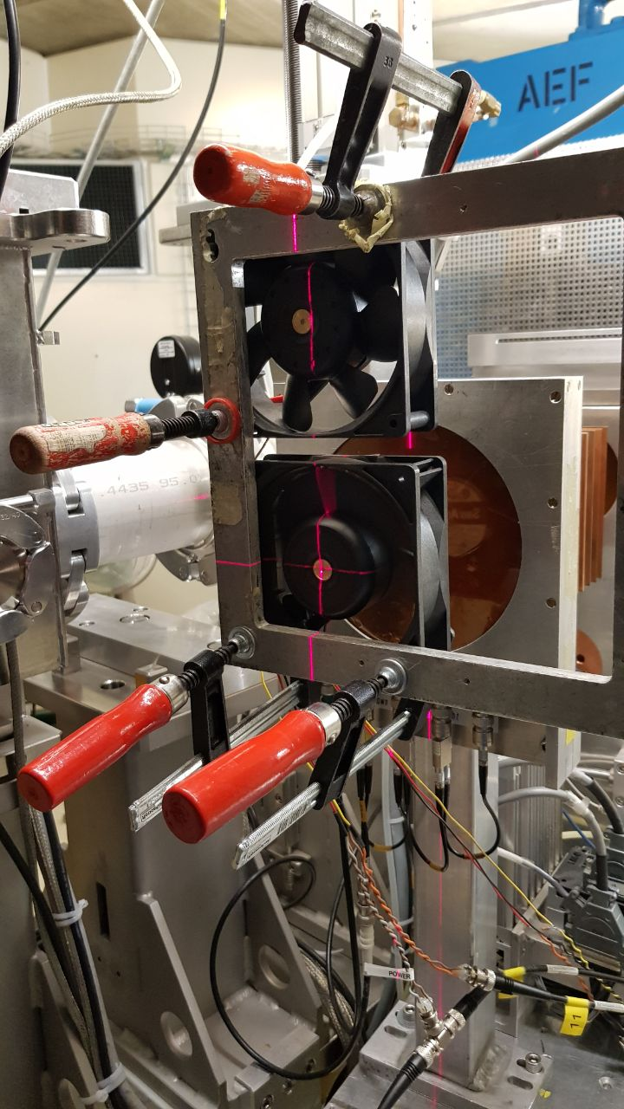
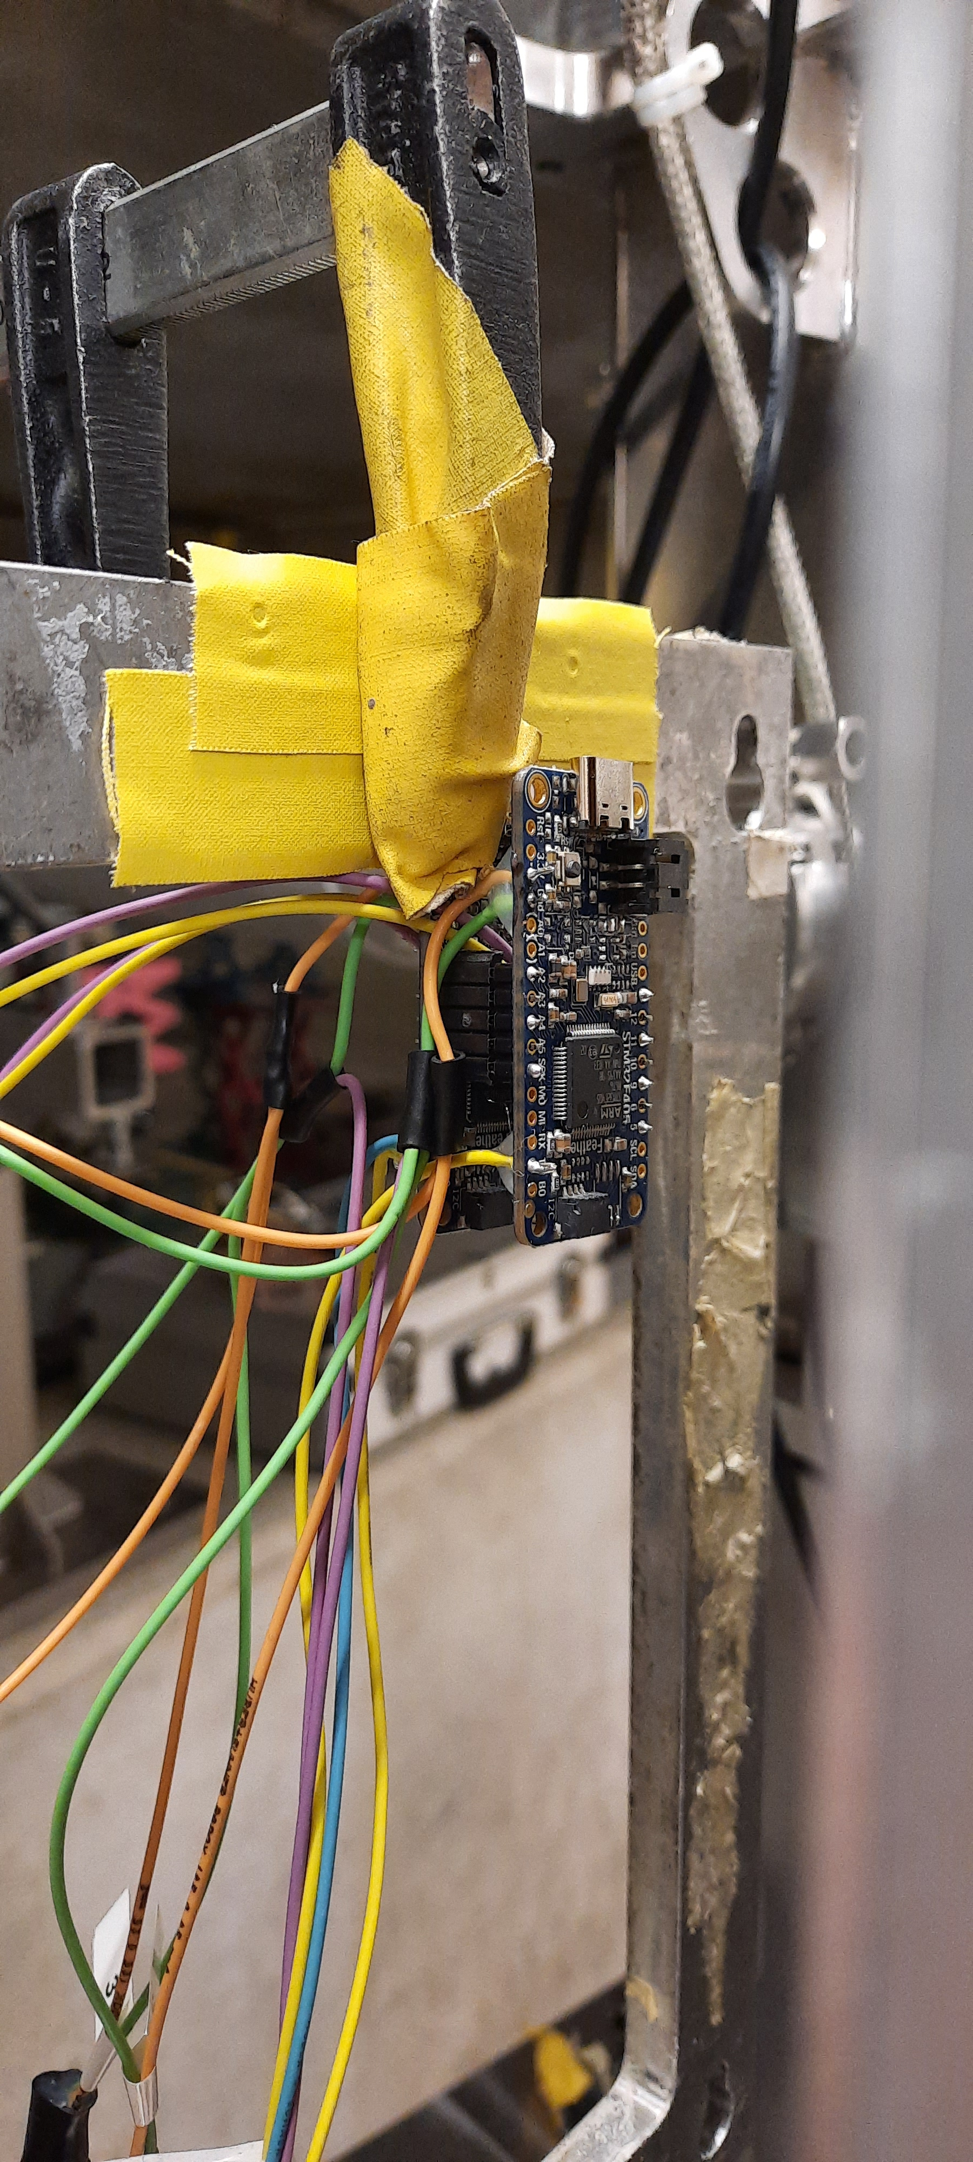
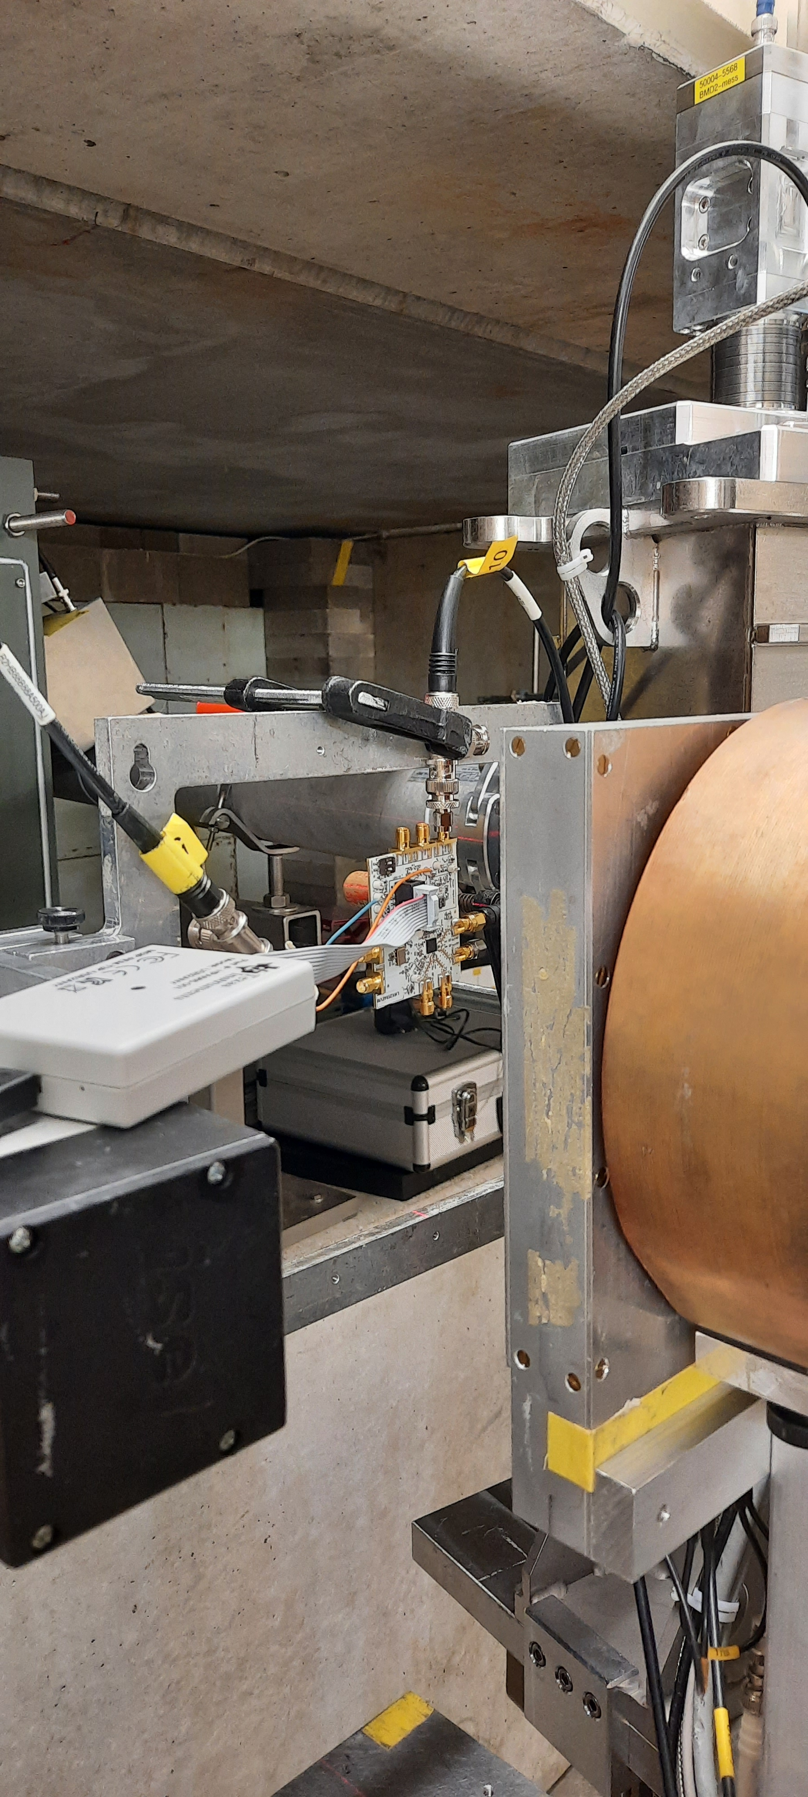
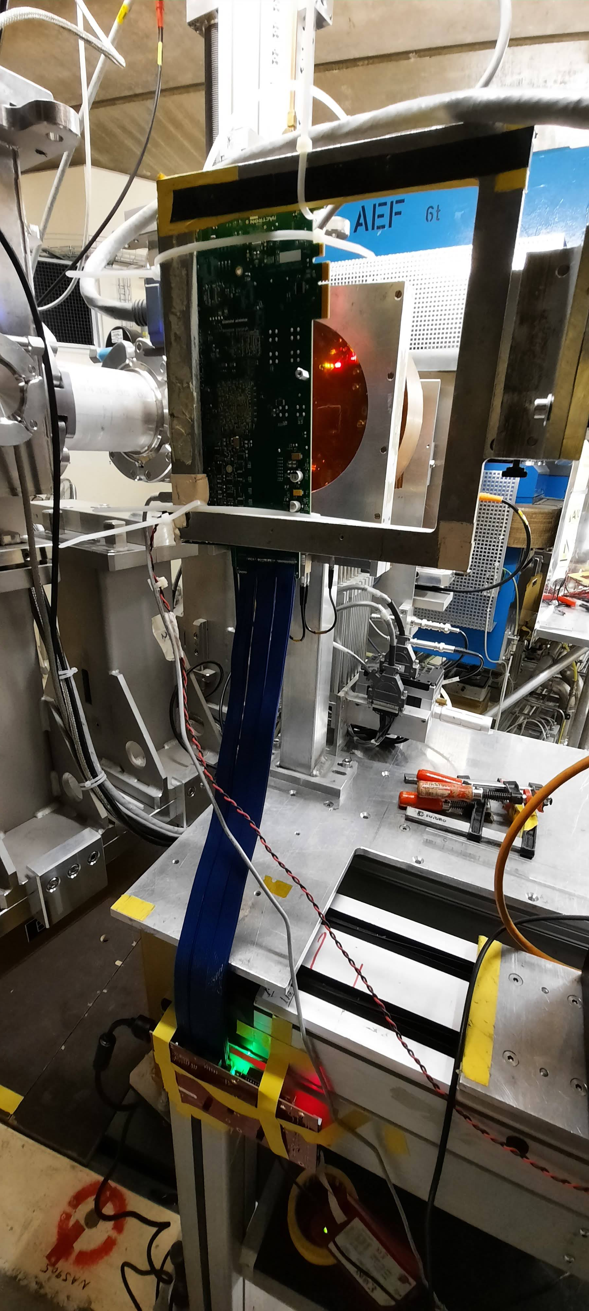
2020-2021 in pictures
FANS
uControllers
PLLs
FPGAs
RADWG Activities Overview by R. Ferraro (BE-CEM-EPR )

Slide 9
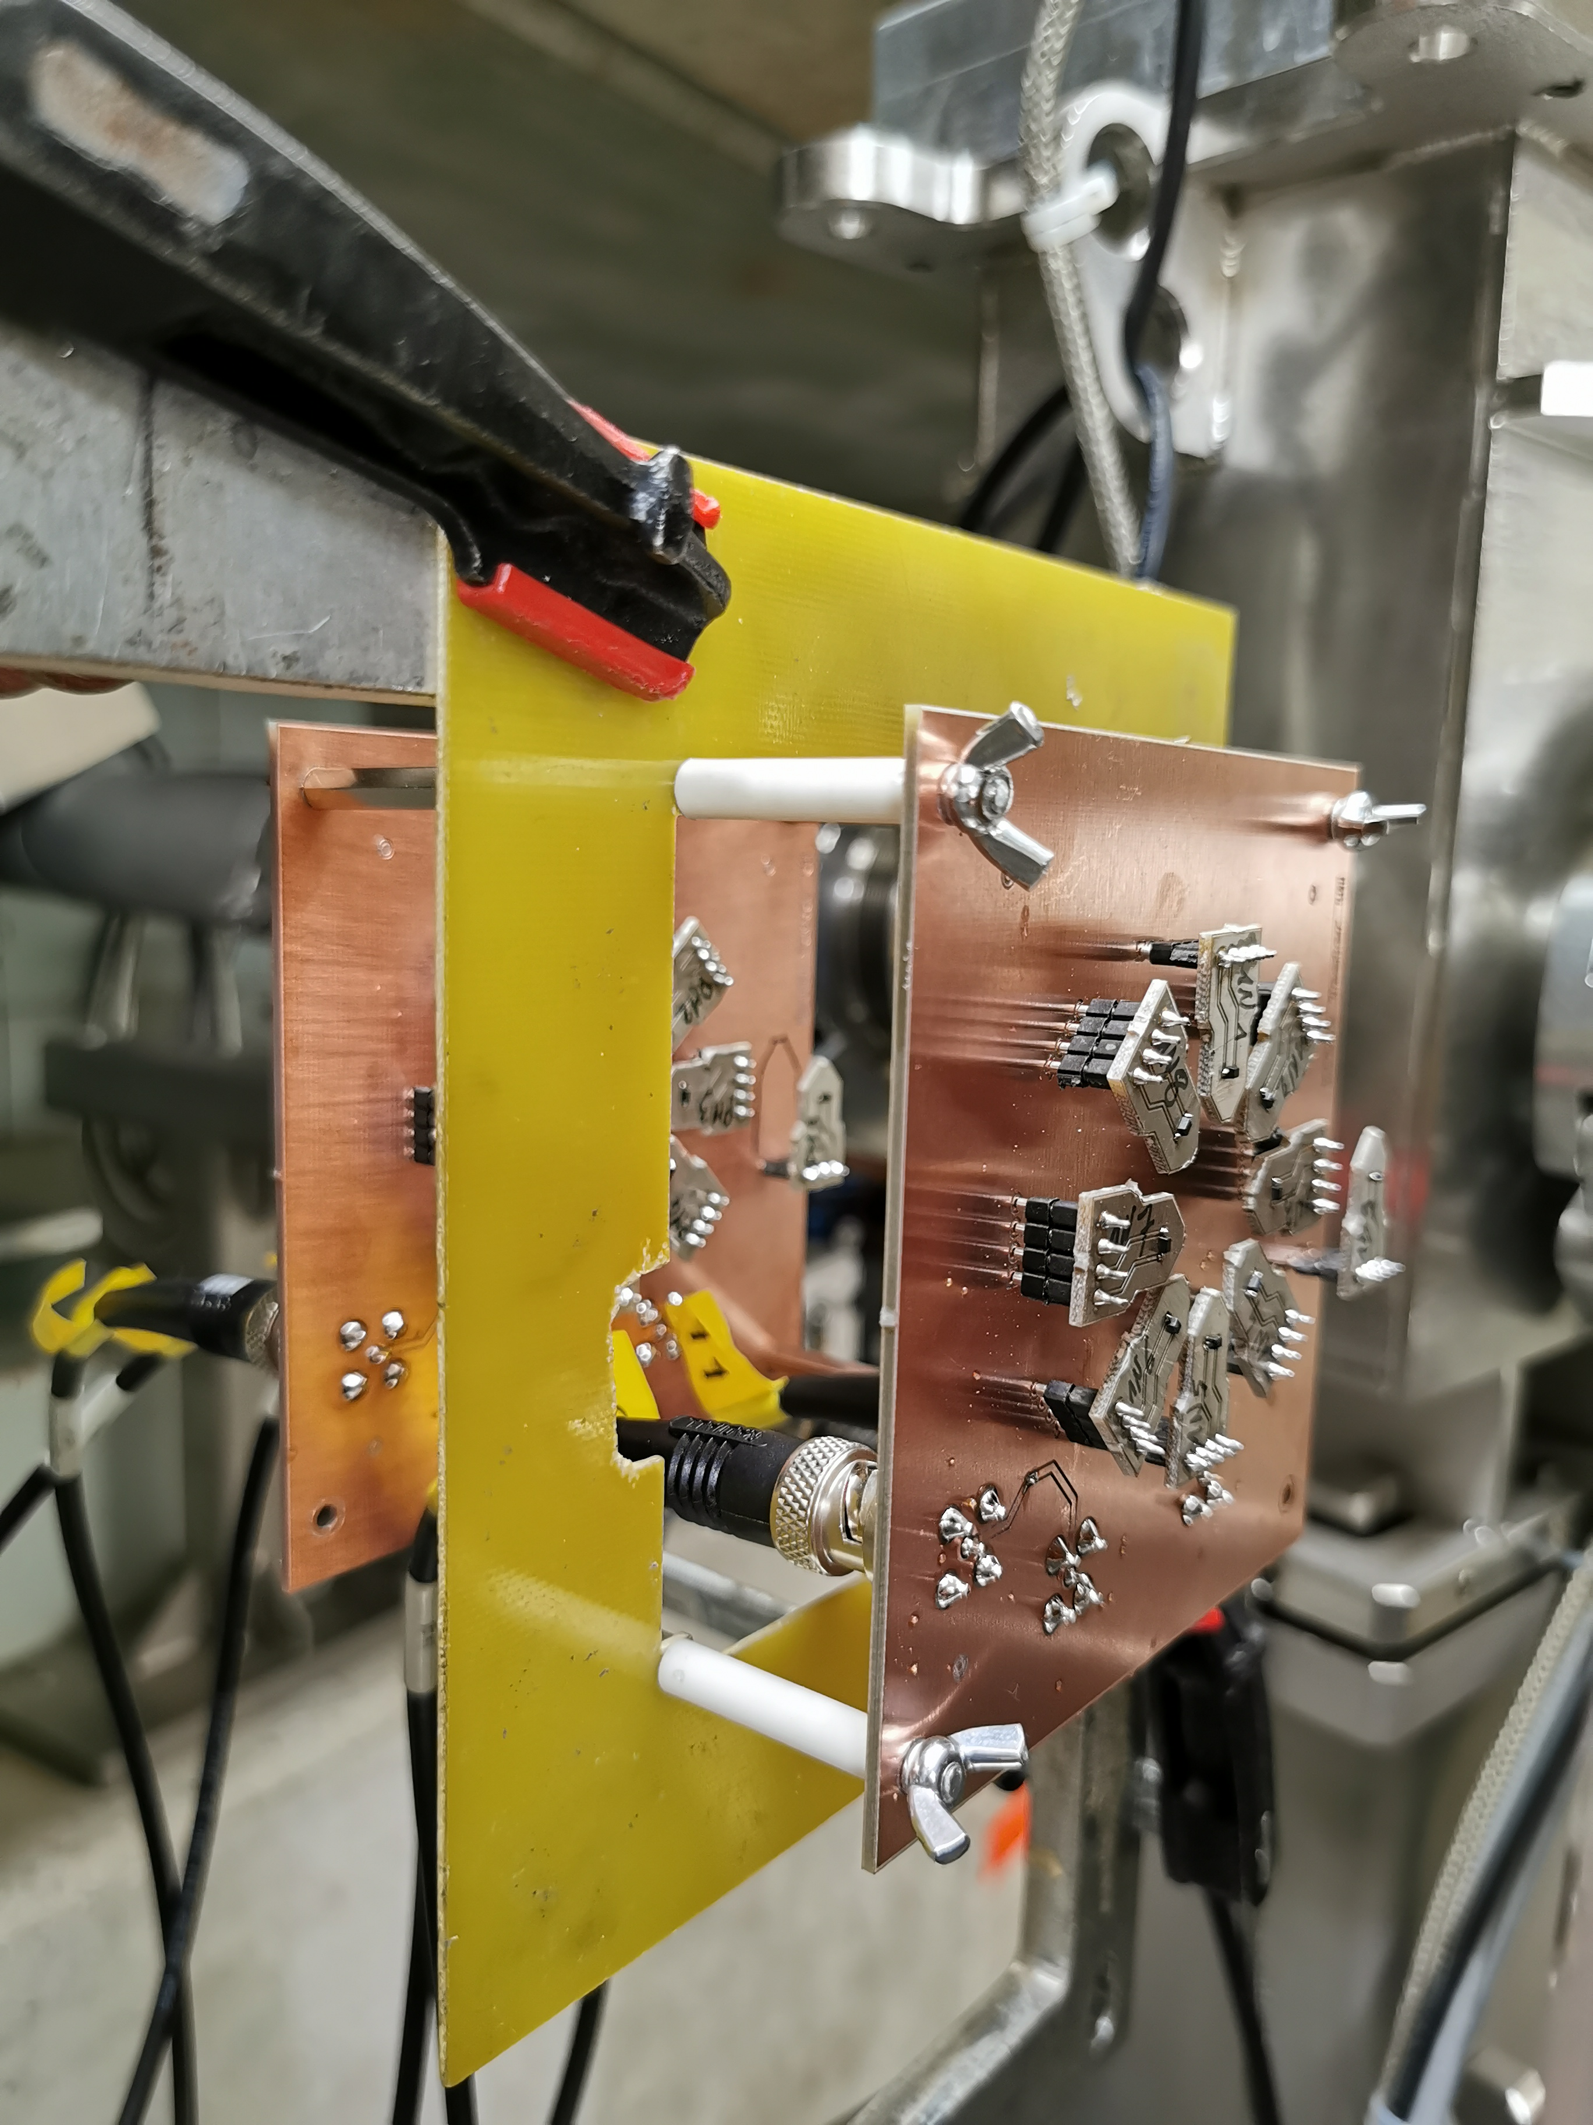
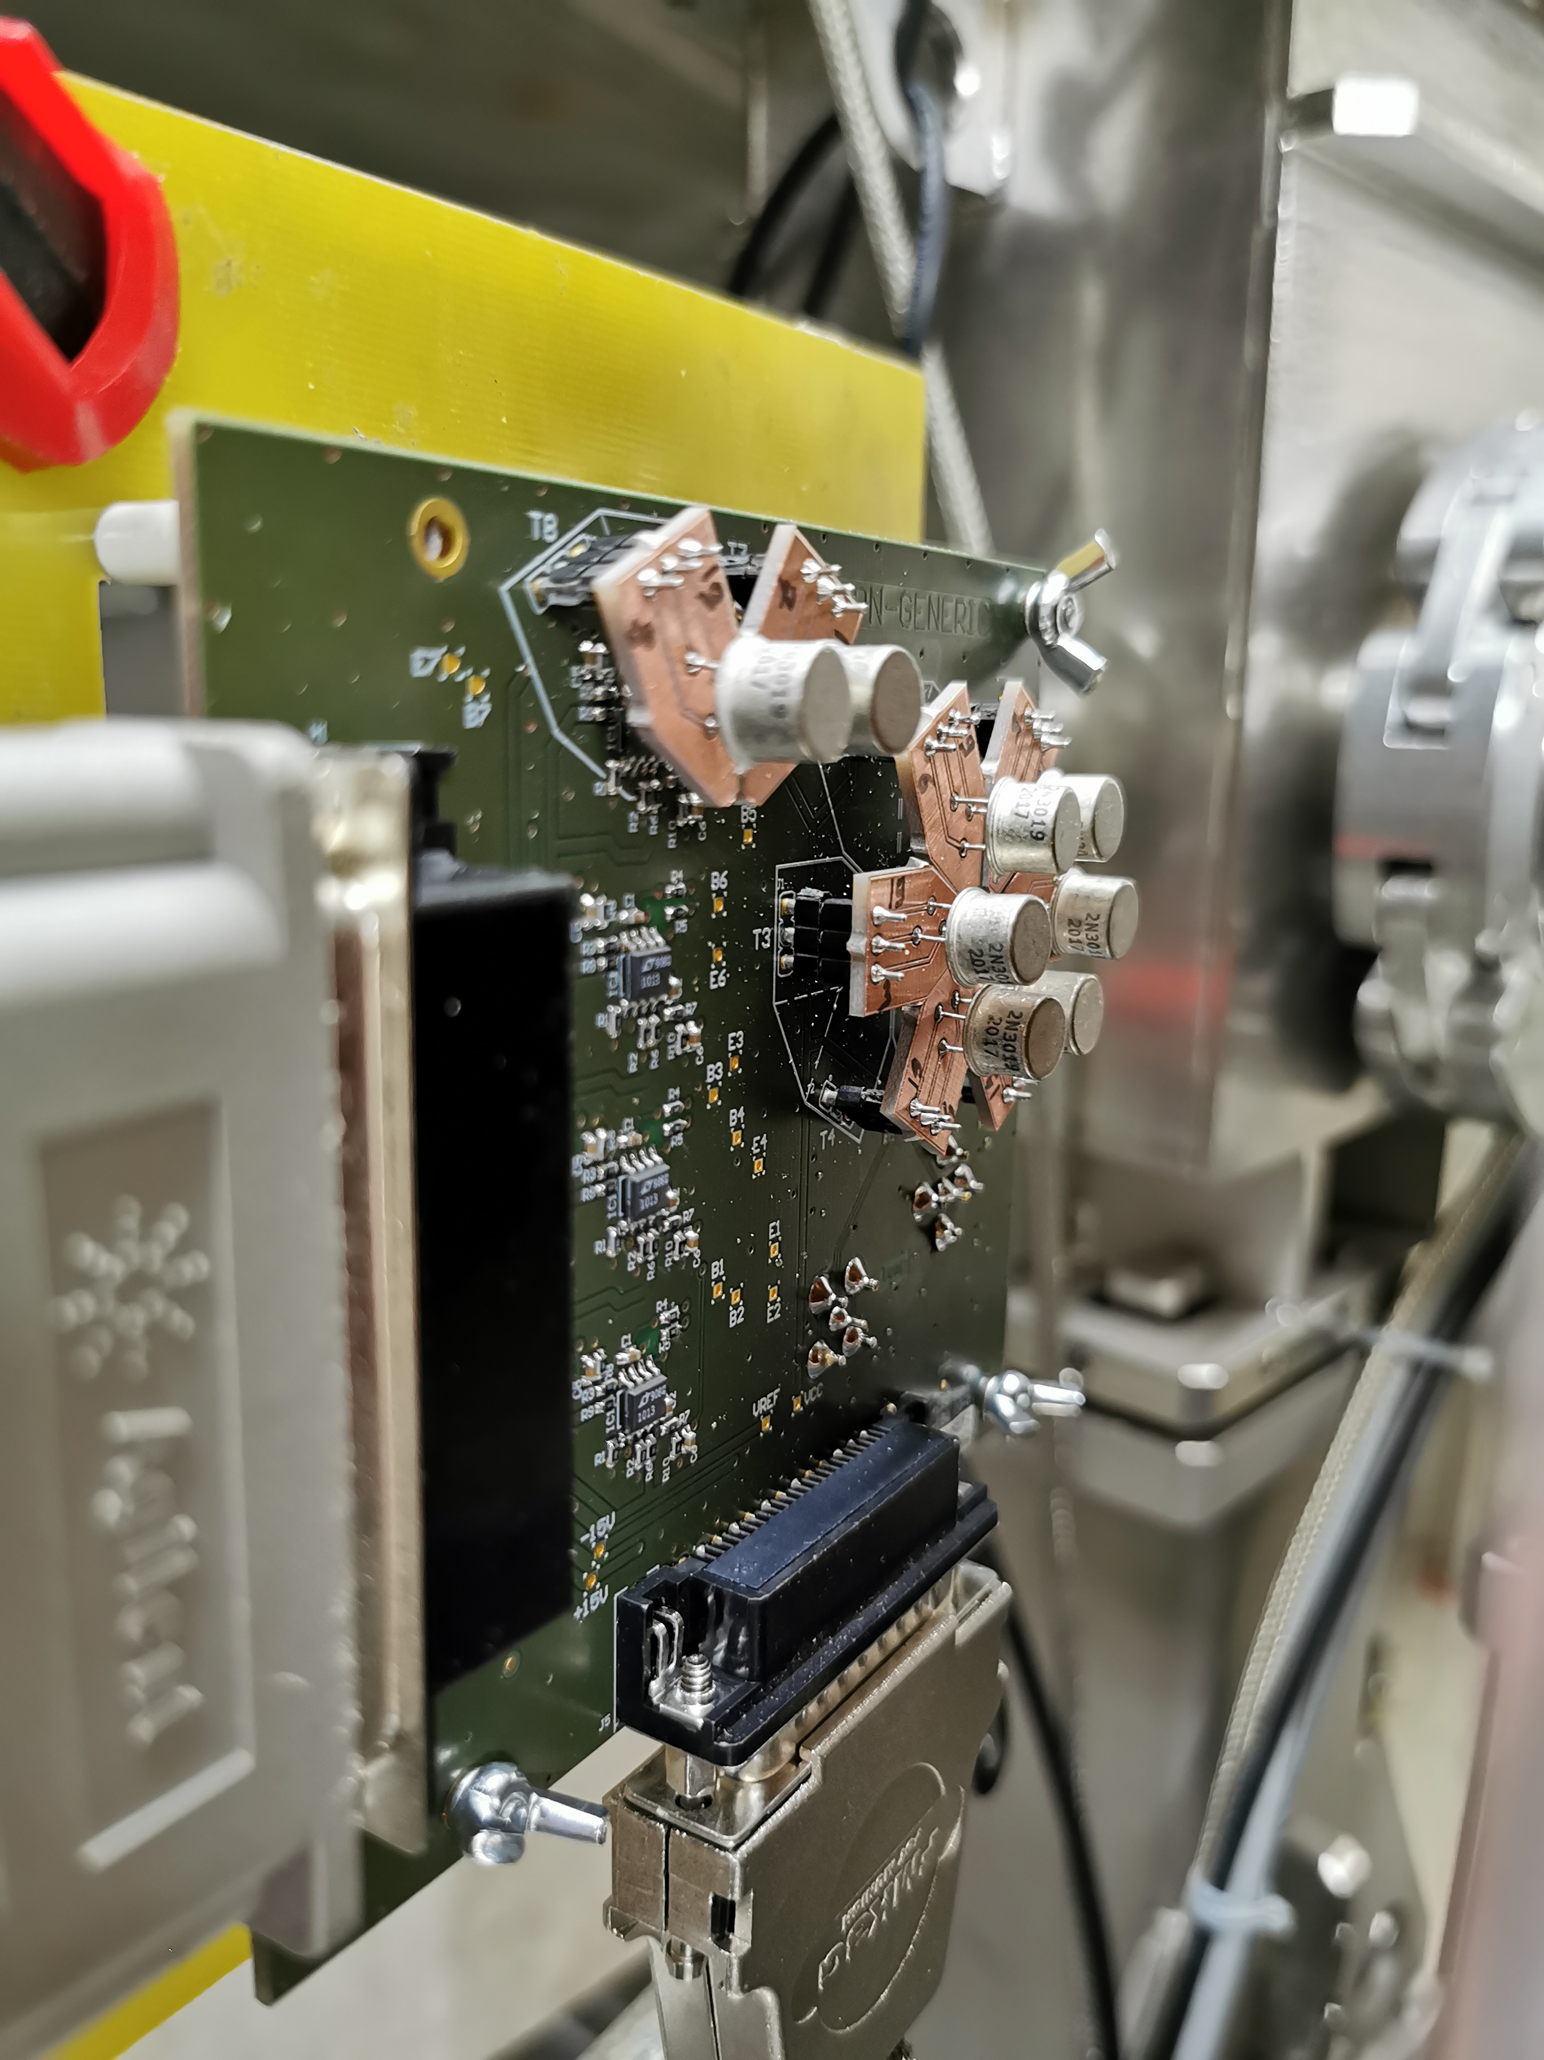
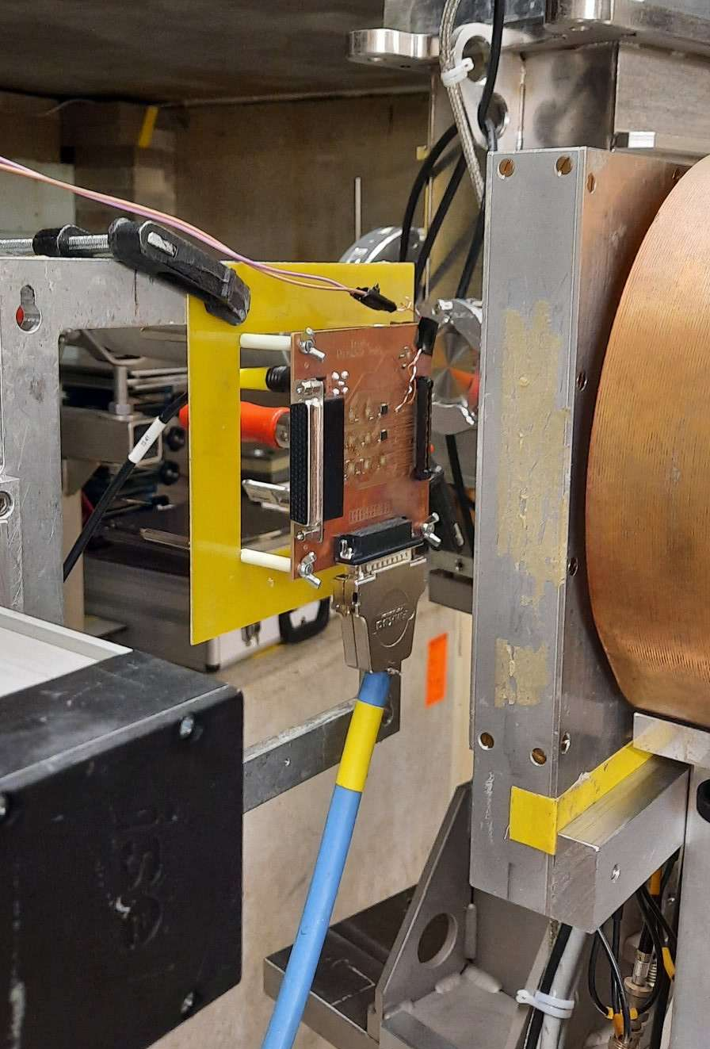
2020-2021 in pictures
BJTs
More BJTs
ADCs
RADWG Activities Overview by R. Ferraro (BE-CEM-EPR )

Slide 10
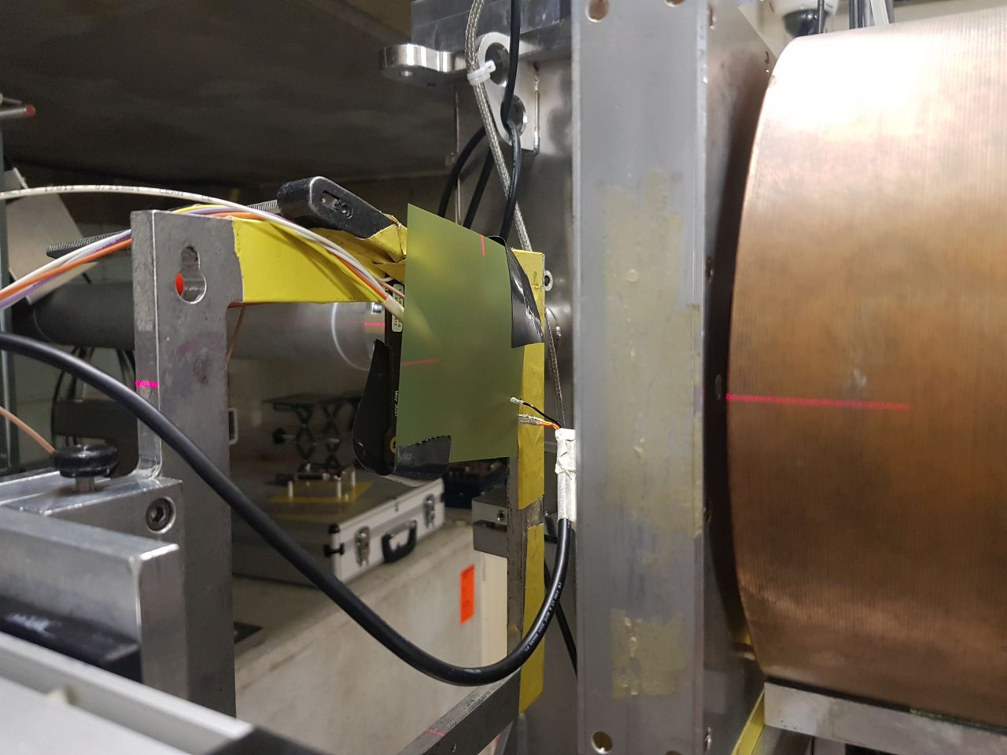
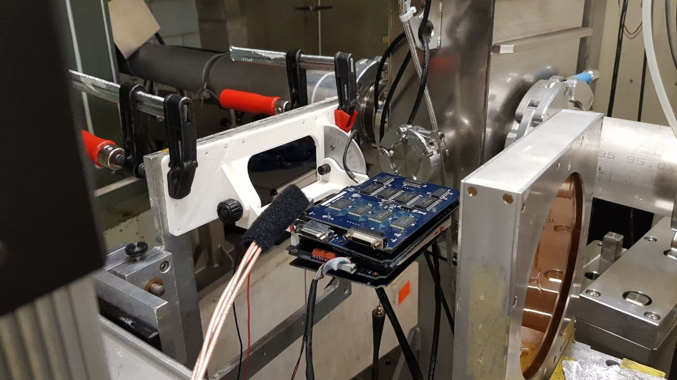
2020-2021 in pictures
PSI not meant for System level tests
But tests need due to urgency of the system qualification
Challenging due to size and setup limitations
“Nothing beats a CHARM Test”
Space RADMON
BATMON
BE-CEM
BE-BI
BE-CEM
RADWG Activities Overview by R. Ferraro (BE-CEM-EPR )

Slide 11
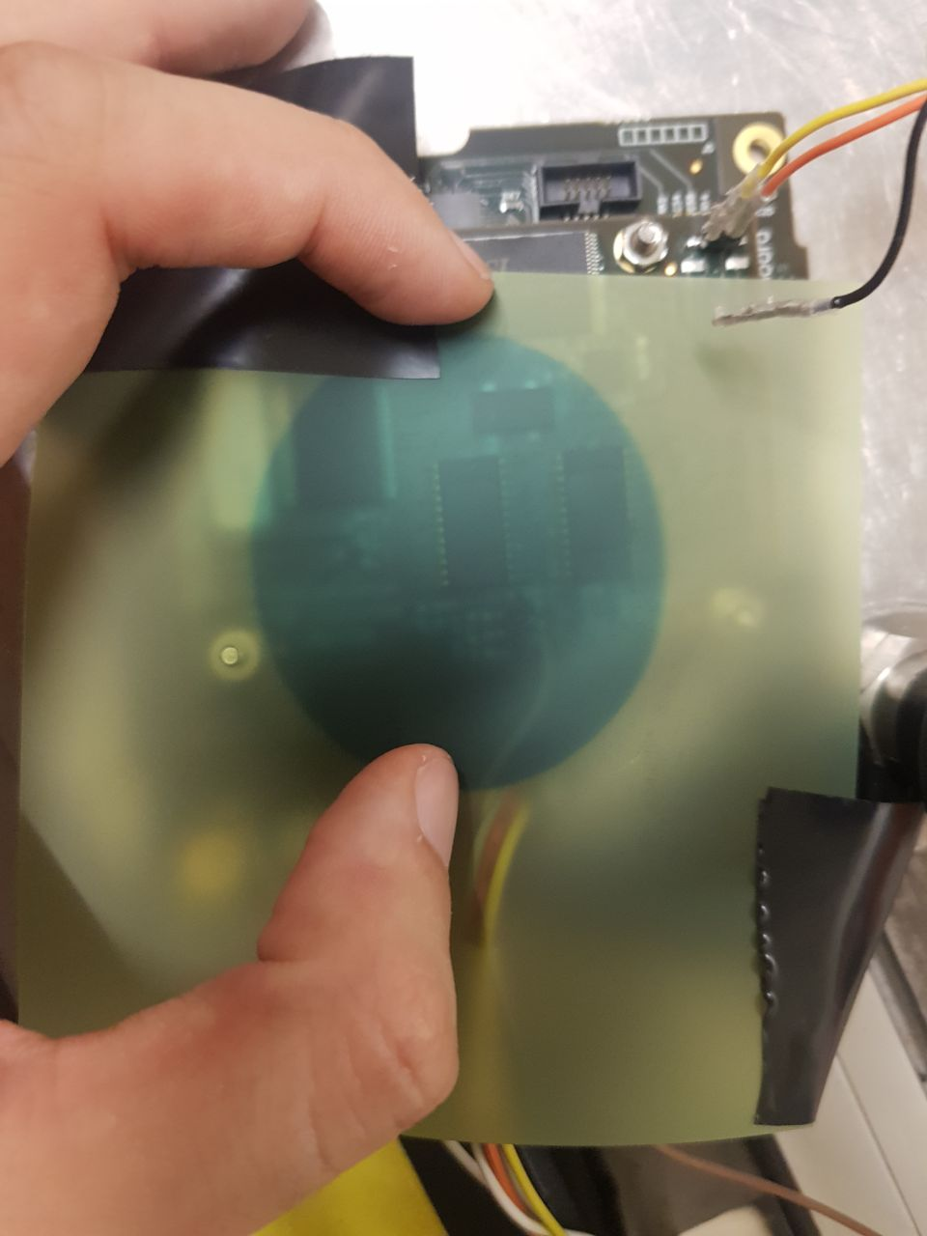
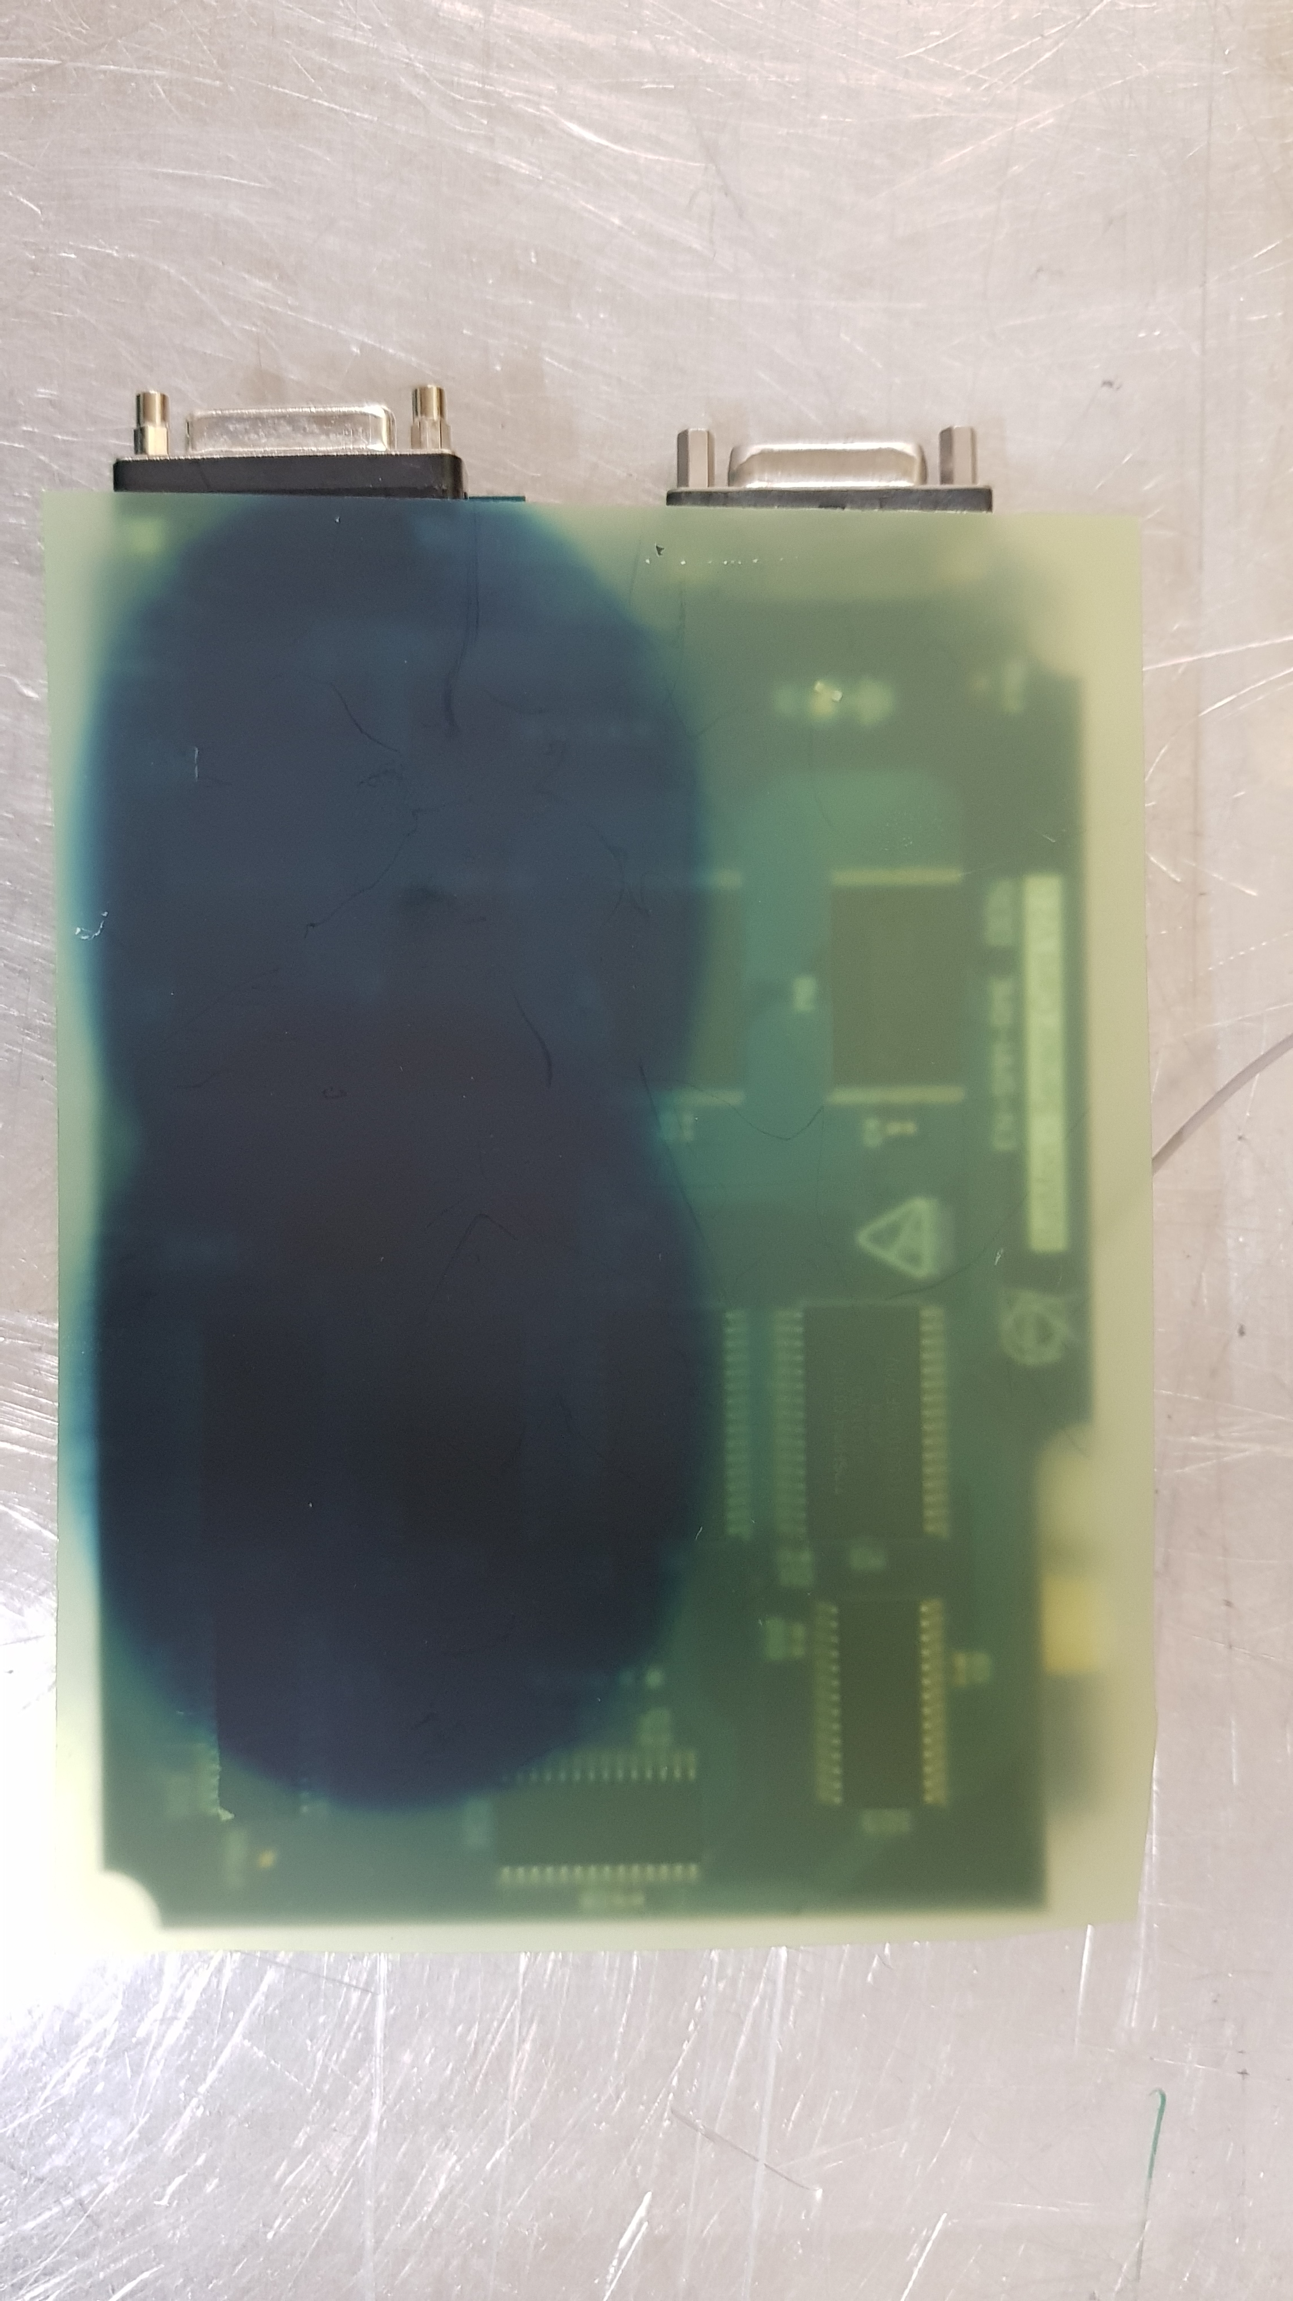
2020-2021 in pictures
In case of system testing we make use of Gafchromic film to cross-check the irradiated areas:
BATMON
Space RADMON
BE-CEM
BE-CEM
RADWG Activities Overview by R. Ferraro (BE-CEM-EPR )

Slide 12
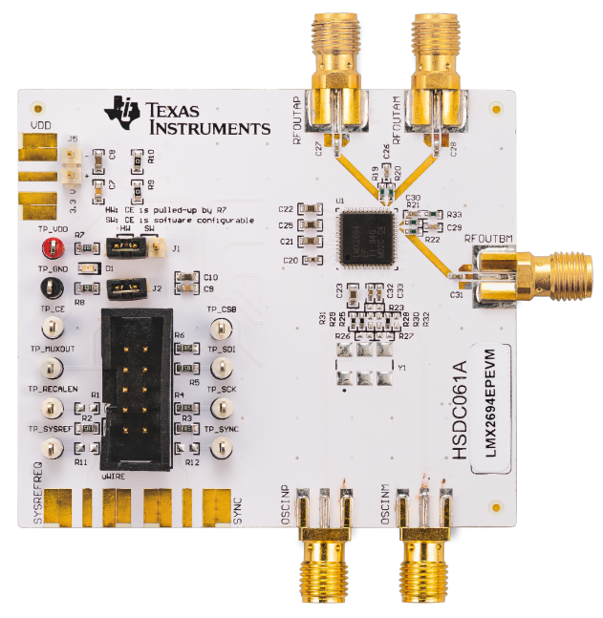
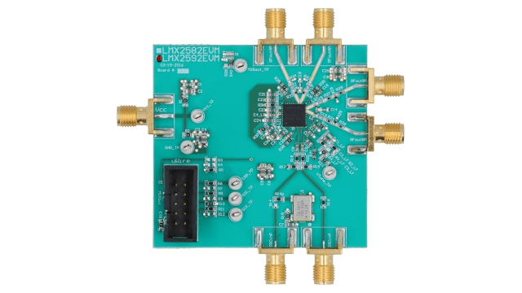
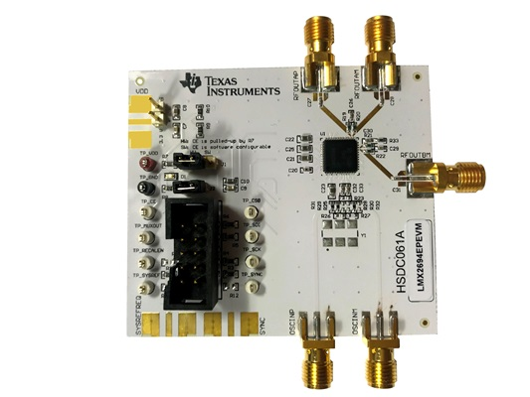
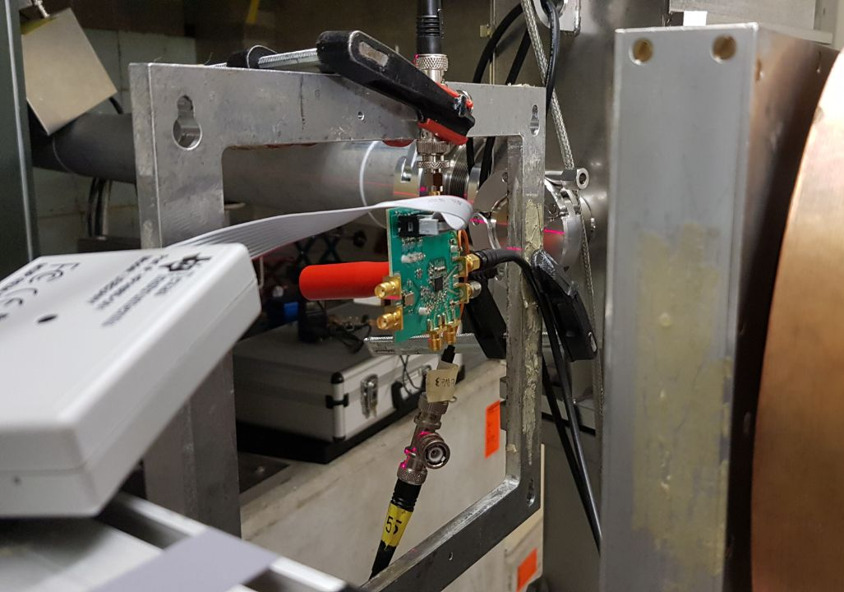
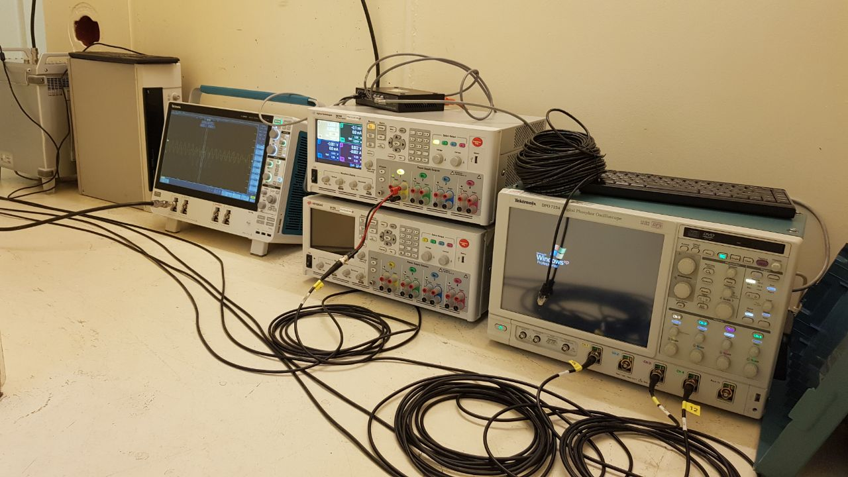
Recent outcomes: 5 GHz PLLs
5 GHz PLL testing in collaboration with SY-BI for new LHC BPM
  Challenging setup to keep signal integrity through 15 m of cables and multiples splitters
  Devices tested in active monitoring online SEE (SEU & Transients) and TID degradation (Phase Noise & Spectrum)
EDMS Reports: 2611501
RADWG Activities Overview by R. Ferraro (BE-CEM-EPR )

Slide 13
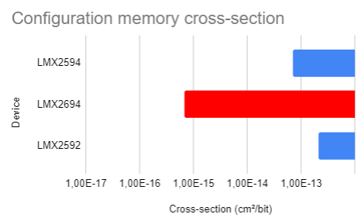
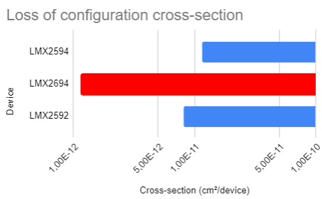
Recent outcomes: 5 GHz PLLs
5 GHz PLL testing in collaboration with SY-BI for new LHC BPS
  Challenging setup to keep signal integrity through 15 m of cables and multiples splitters
  Devices tested in active monitoring online SEE (SEU & Transients) and TID degradation (Phase Noise & Spectrum)
EDMS Reports: 2611501
Single Event Effects:
  No events observed
RADWG Activities Overview by R. Ferraro (BE-CEM-EPR )

Slide 14
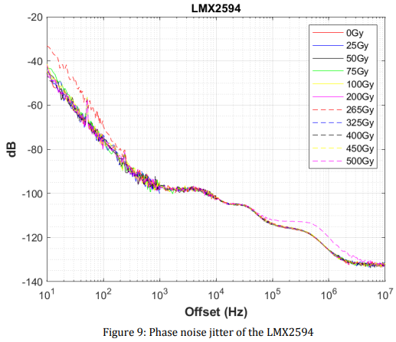
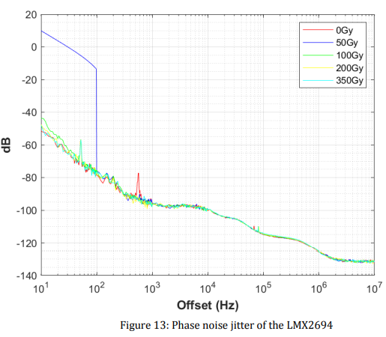
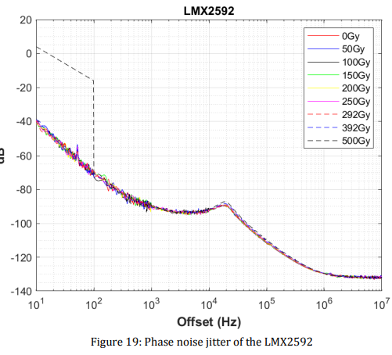
Recent outcomes: 5 GHz PLLs
5 GHz PLL testing in collaboration with SY-BI for new LHC BPS
  Challenging setup to keep signal integrity through 15 m of cables and multiples splitters
  Devices tested in active monitoring online SEE (SEU & Transients) and TID degradation (Phase Noise & Spectrum)
EDMS Reports: 2611501
Phase-Noise jitter:
LMX2694
RADWG Activities Overview by R. Ferraro (BE-CEM-EPR )

Slide 15
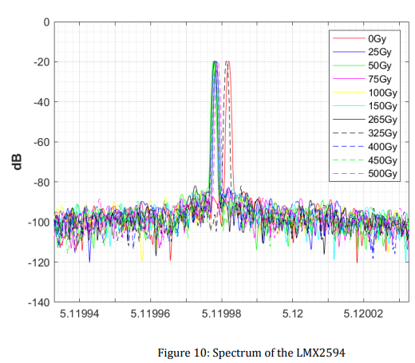
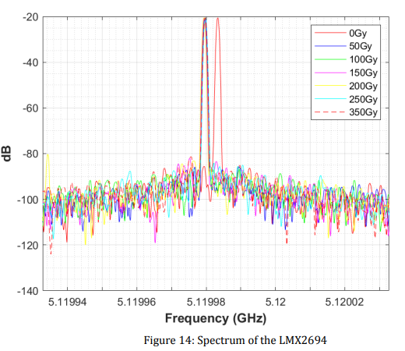
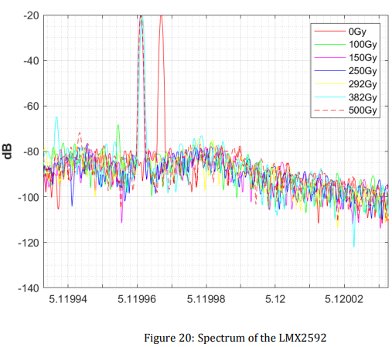
Recent outcomes: 5 GHz PLLs
5 GHz PLL testing in collaboration with SY-BI for new LHC BPS
  Challenging setup to keep signal integrity through 15 m of cables and multiples splitters
  Devices tested in active monitoring online SEE (SEU & Transients) and TID degradation (Phase Noise & Spectrum)
EDMS Reports: 2611501
Frequency Spectrum:
LMX2594
LMX2694
LMX2592
RADWG Activities Overview by R. Ferraro (BE-CEM-EPR )

Slide 16
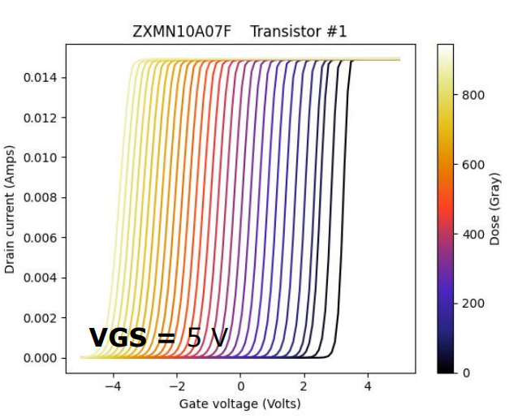
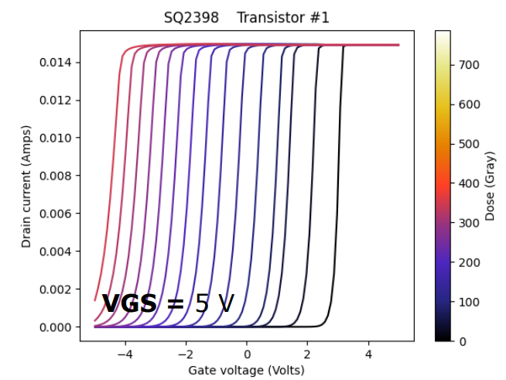
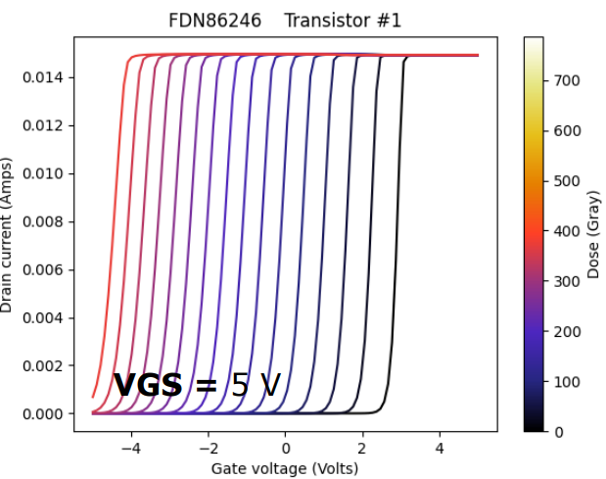
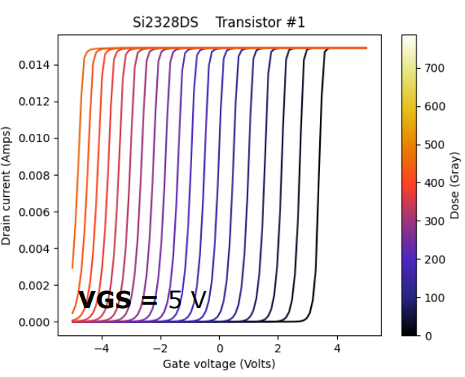
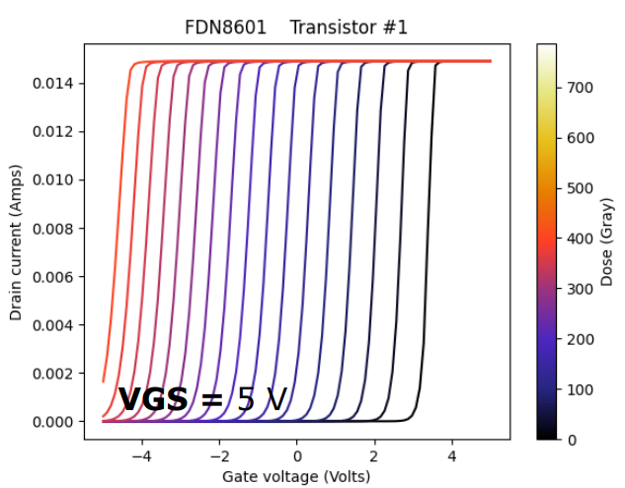
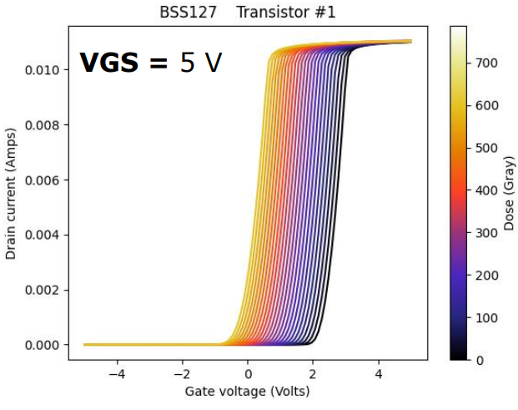
Recent outcomes: Low Power N-MOSFETs
MOSFETs tested at CC60 for SY-EPC (EDMS-2636745)
RADWG Activities Overview by R. Ferraro (BE-CEM-EPR )

Slide 17
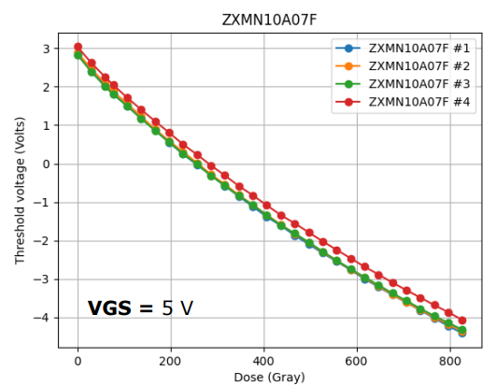
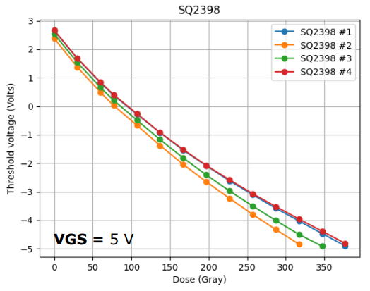
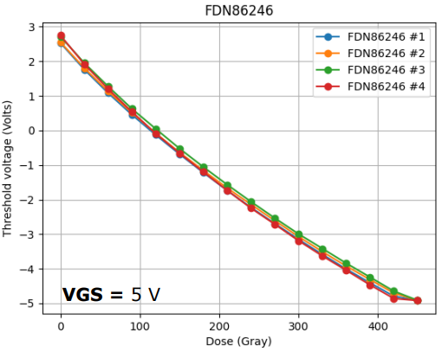
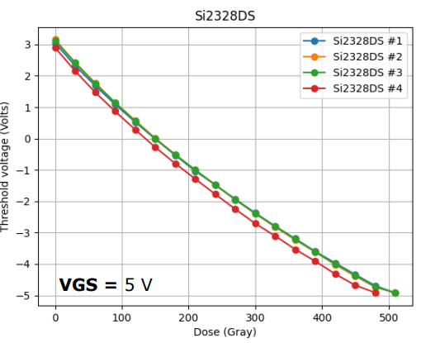
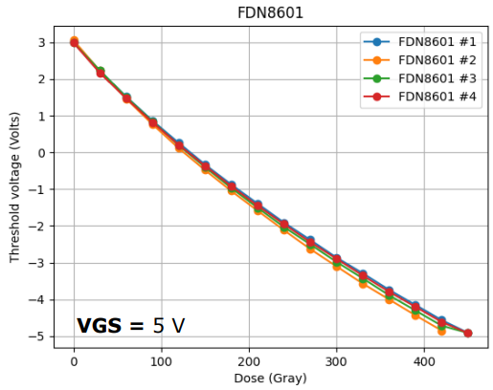
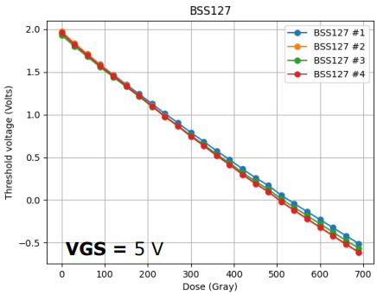
Recent outcomes: Low Power MOSFETs
RADWG Activities Overview by R. Ferraro (BE-CEM-EPR )

Slide 18
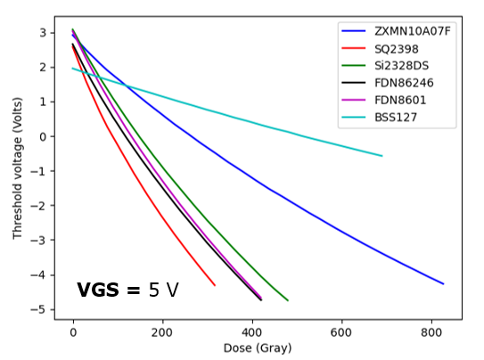
Recent outcomes: Low Power MOSFETs
BSS127 Best candidate from this campaign
While the SQ2398 can be used as ionizing dosimeter
RADWG Activities Overview by R. Ferraro (BE-CEM-EPR )

Slide 19
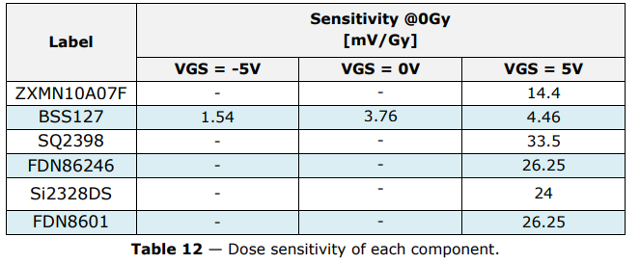
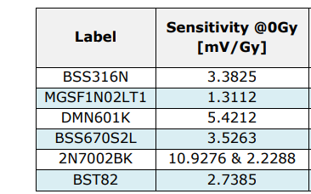
Recent outcomes: Low Power MOSFETs
2021 N-MOSFET campaign:
2016 N-MOSFET campaign:
From: EDMS-2636745
From: EDMS-1609725
Best component from 2021 (BSS127) still ~3 times more sensitive than the best one found in 2016 (MGSF1N01LT1)
The MGSF1N01LT1 remains the best option in terms of N-MOSFET used as switch.
RADWG Activities Overview by R. Ferraro (BE-CEM-EPR )

Slide 20
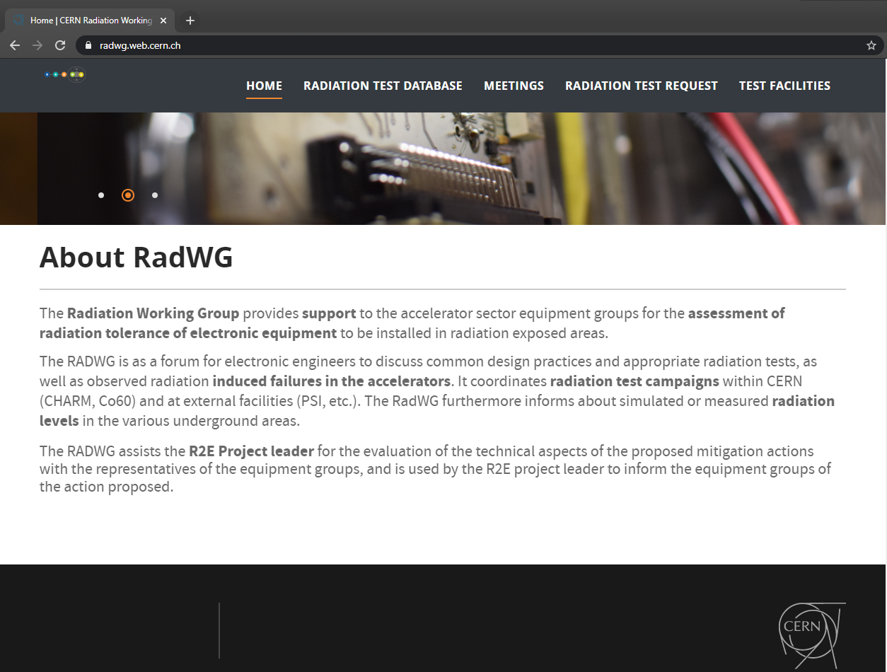
Test results analysis and reporting
The website https://radwg.web.cern.ch/ embeds an User-Friendly database
  More than 490 reports from the 2011 up to 2021
180 users subscribed to the mailing list lhc-proj-radwg-members
It embeds also the TE-EPC component list and tests
The service produces reports in a common template for all the components tested
  Test reports template ensure a coherent reporting
databases accessible by all the equipment groups
https://radwg.web.cern.ch
RADWG Activities Overview by R. Ferraro (BE-CEM-EPR )

Slide 21
Conclusions
BE-CEM-EPR provides the service of radiation testing of electronic components supporting the Radiation Working Group (RadWG)
Very intensive testing activity in 2021
  Highest number of test campaign
  Highest number of DUTs tested
CHARM restart this year, first component-level campaign planned next week!
Opamps and MOSFETs always among the three most tested components
  A lot of Instrumentation amplifier tested this year (report coming soon)
  No better N-MOSFET than the MGSF1N01LT1 found
Already preparing 2022 campaigns with SY-EPC and TE-MPE
RADWG Activities Overview by R. Ferraro (BE-CEM-EPR )

Slide 22
Thank you for your attention!

Slide 23


Recent outcomes
New FPGA qualifications: PolarFire & NanoXplore
  PolarFire SEE sensitivity one order less of magnitude wrt SmartFusion
  PolarFire programmability > 2.5 kGy !! (SmartFusion ~ 100 Gy)
  No increase of propagation delay up to 5 kGy !
  High sensitivity to thermal neutrons
  Reports: 2475661; 2319932; R2E presentation
  Research: Use of Benchmark test circuit for qualification
DFF
5 kGy
^{[cm²/FF]}
FF
FF Logic
FF_{TMR}
FF logic_{TMR}
PolarFire Propagation delay increase [%]
A.Scialdone ‘FPGA Qualification and Failure Rate estimation Methodology for LHC Environments Using Benchmarks Test Circuits’, oral RADECS2021
RADWG Activities Overview by R. Ferraro (BE-CEM-EPR )

