Slide 1
Radiation tolerant electronics for the Quench Detection System in HL-LHC: ongoing developments and challenges
Jens Steckert, Jelena Spasic, Tetiana Pridii, Guzman Martin, Dragos Vancea, Reiner Denz & colleagues – TE-MPE-EP

Slide 2
Outline
Hi-Lumi radiation levels in areas relevant for QDS
DS strategy
RR strategy
Common rad-tol designs in EP
Versatile quench detector DQQDV
Bus-Bar/Lead quench detector DQQDC002/DQQBS002
Communications controller DQAMN
Foreseen tests

Slide 3
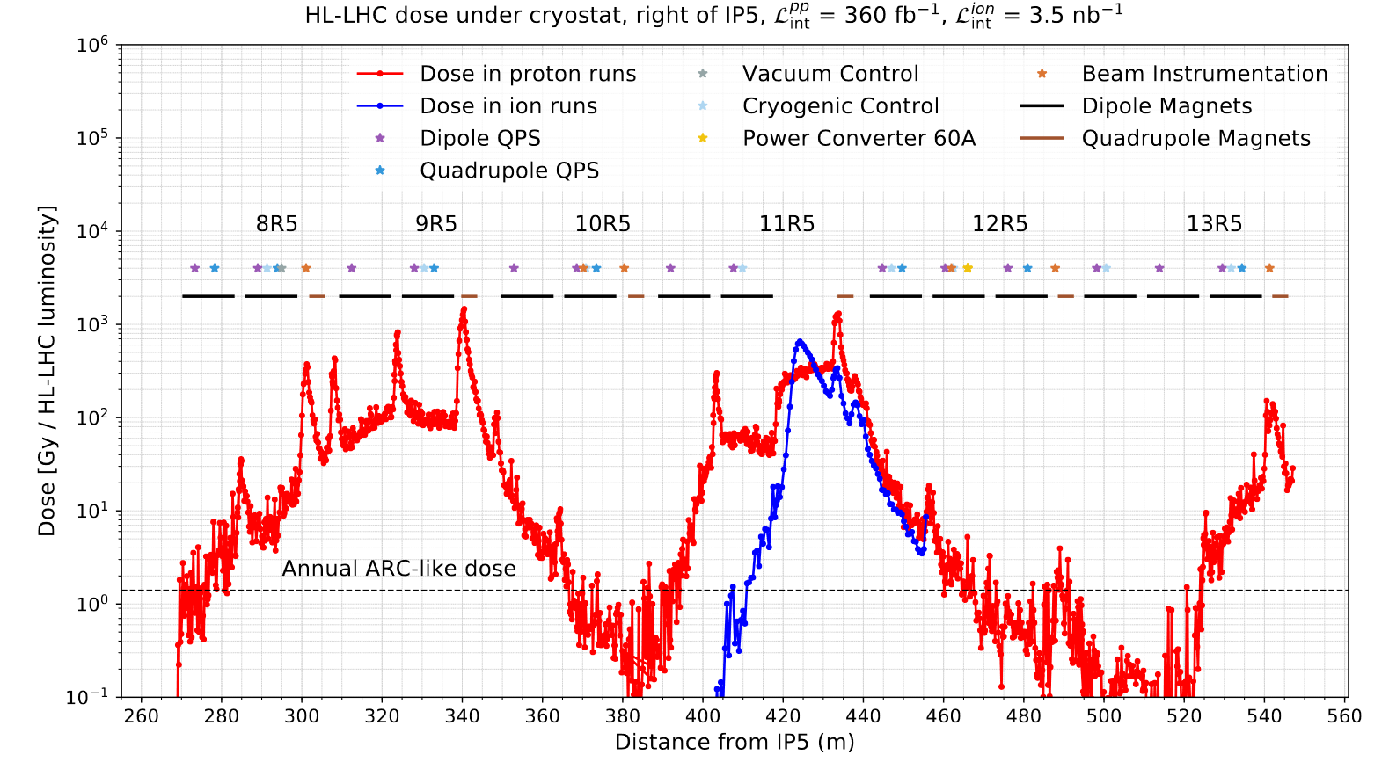
Radiation levels during Hi-Lumi operation
DS P1/P5:
up to 100 Gy/year
RR P1/P5:
25 Gy/year
Other RR:
<5 Gy/year
Arc: more or less the same as before
https://edms.cern.ch/ui/file/2302154/1.0/HLLHC_Specification_Document_v1.0.pdf

Slide 4
R2E strategies for HiLumi high radiation areas
Dispersion suppressor P1 & P5
RR areas P1 & P5
Devices need to stand dose rates of
100 Gy/year
→ Bullet proof SEU mitigation !
Periodic exchange of devices necessary due to dose effects: exchange or relocation every 2…5 years
Positioning is extremely important due to steep gradients in loss profile
Upgrade of DQQBS required
Re-test of DQQDS in CHARM
Devices need to stand dose rate of
25 Gy/year
→ Solid SEU mitigation required
Total dose of 500 Gy during expected lifetime of 20 years: within the limits of COTS, but DIFFICULT

Slide 5
Dispersion suppressor P1&P5 DQLPU(A/B/S)
Protection unit | Protected element | Quench detector | HDS supervision | Crate controller | Communications controller
DQLPU-A | Dipoles (MB) | DQQDL | DQHSU | DQCSU | DQAMC
DQLPU-B | Quadrupoles(MQ) | DQQDL003 | DQCSU002 |  | DQAMC
DQLPU-S | MB & MQ | DQQDS, DQQBS | - | - | DQAMGS
QDS installed below the magnets in DQLPU-A (Dipoles), -B(Quadrupoles), -S (nQPS)
Critical elements:
  DQQBS (uC with integrated sigma delta ADC): Spurious trips in PSI after a few Gy, trips in LHC ion runs
  DQAMx (world FIP couplers → uFIP): Failed in CHARM after ~60Gy
Replacement of these elements by upgraded versions
  DQQBS → DQQBS002 (Rad tol, SAR ADC + FPGA based)
  DQAMx → DQAMN (FPGA, nanoFIP, uC based)

Slide 6
RR in P1 & P5: DQGPU-A rad tol design
DQGPU-A: Global protection unit for 600A circuits
High integration density with 4-circuits in one chassis (as before)
New magnet quench detector boards type DQQDV
New lead detector boards DQQDC002
nanoFIP+ based communications controller DQAMN
2x Redundant 120 W linear power supplies
Cooling assured by fan tray
Linear
Power
Supply
Linear
Power
Supply
Midplane (passive)
DQQDV x2
DQAMN
DQQDCv2 x2
DQQDV x2
DQQDCv2 x2
DQQDV x2
DQQDCv2 x2
DQQDV x2
DQQDCv2 x2
17 circuit boards
24 Quench detectors

Slide 7
RR in P1 & P5: DQGPU-B rad tol design
DQGPU-B: Global detection unit for IPQ/IPD circuits
1-circuit per chassis design (2 before)
New magnet quench detector boards type DQQDV
New lead detector boards DQQDC002
DQQBS002 for bus-bar supervision
DQHSU board for precision heater supervision
nanoFIP+ based communications controller DQAMN
2x Redundant 120 W linear power supplies
Cooling assured by fan tray
Linear
Power
Supply
Linear
Power
Supply
Midplane (passive)
DQQDV x4
DQAMN
DQQDCv2 x3
DQHSU
DQQBSv2 x3
12 circuit boards

Slide 8
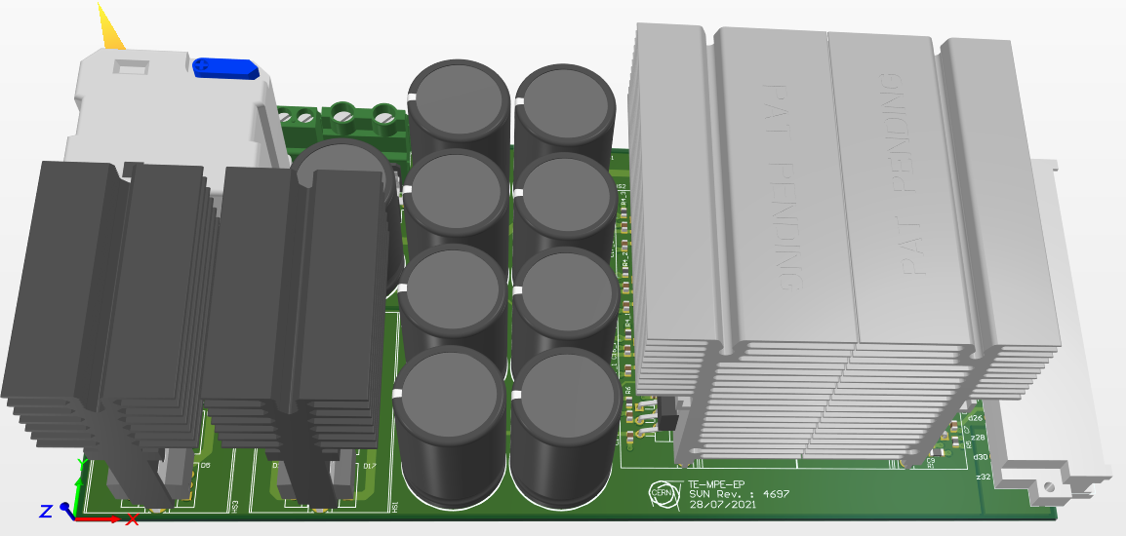
Rad tol linear power supply for DQGPU-A and B
Classical transformer, rectifier, linear regulator based power supply
Total output power per crate: 120W
  +5V: 15A, +15V: 2A, -15V: 0.5A
Very lean design based on tested COTS
  Linear regulator: LT3083, TID ~1kGy
  Schottky diode: STPS30M60S (30A, 60V) to be tested
  (but should not be an issue)
Efficient design (V_{dropLDO} ~0.4V, V_{Fdiode}~0.38V)
Two power supplies in redundant mode coupled by diodes
Cooling provided by external fan tray (230V AC fans)

Slide 9
Generic quench detector designs in MPE-EP

Slide 10
Generic digital quench detector design
LDO
DCDC
Tested parts:
SRAM
Good to 500Gy
Logic Device
Good to 500Gy (with care)
AMP
ADC
Interlock
Isolation
Relay
Good to 500Gy
(1 known part)
MUX
uC
FPGA
OptoCouples
PhotoMOS
No known ref up to 500Gy
Voltage
Reference
➔ For most of the ingredients we have good parts, but some areas are a bit weak

Slide 11
Tested good parts used in MPE-EP designs
Component Class | Component Model | Test | Comment
Op Amp | OPAx192 | Good up to 500Gy | More good references tested
ADC | LTC2378 | Good up to 500Gy | Not much alternatives
LDO | TPS7A4901 TPS7A3001 | Good up to 500Gy
DCDC, isol. 2W | MEJ2D0515 | Good up to 500Gy | TMV2 series of TRACO with same perf.
Voltage reference | ADR435-(EP) | Good to 90Gy (2mV deviation) | Does not break but shifts by 70mV @ 1kGy
Digital Isolator | ADuM263 ISO7842 | Good up to 500Gy (a few SEU) | SEU to be mitigated by higher level design
FPGA | Igloo2 | Good up to 400-500Gy
SRAM | CY62147GE | Good up to 500Gy

Slide 12
UQDS front end channel, used in new QD designs
Pos. rail
LDO generating local supplies
DC DC
MEJ2D0515SC
Broken wire detection
OPA192
OVP
+
TPS7A4901
TPS7A3001
V_{in+}
over voltage
protection
-
THS4521
LTC2378-20
Programmable
gain stage
G = 1..450
ADuM263
.
.
.
.
.
.
+2.5V
+
ADC
20-bit, 1Msps
+/-22.5 V
FDA
Digital
Isolator
No good part yet
Fixed gain only
-
SPI
SPI
.
.
.
.
.
.
Digital
Isolator
High precision matched resistor array
V_{in-}
-
Galvanic insulation
up to 5kV/1s
BSS126
OVP
+
Voltage Reference: ADR435-(EP)
Broken wire detection
Neg. rail

Slide 13
New quench detectors and communications/crate controllers

Slide 14
New magnet quench detector: DQQDV
Versatile board that can replace many quench detectors in LHC
Will replace existing DSP based boards for IPQ (DQQDI) and 600A circuits (DQQDG)
Software defined system
Based on proven designs and components
FPGA used for signal processing and quench detection algorithms
20-bit SAR 1 MSps ADC
Implements improved powering scheme
Baseline for P1/P5 RR upgrades
Target TID: 200 – 500 Gy (depends on components), SEU free

Slide 15
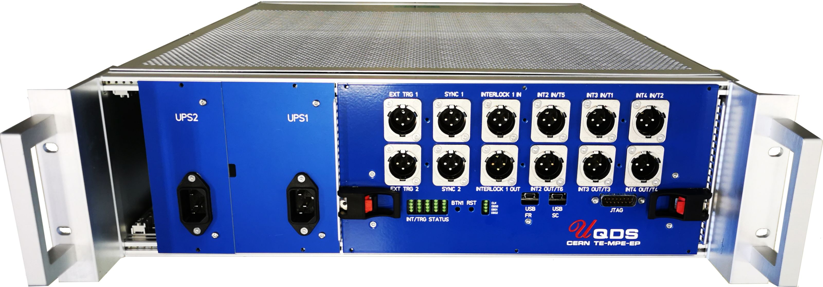
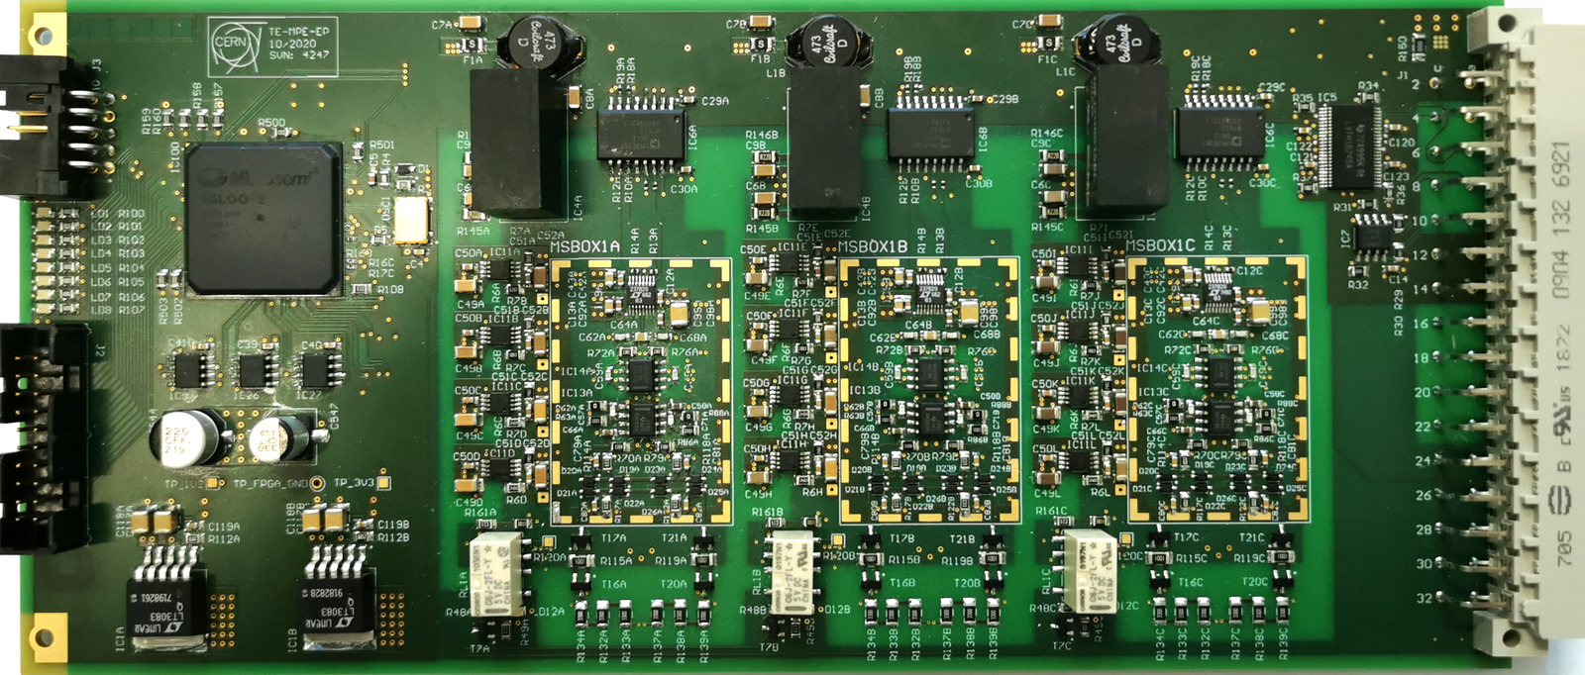
DQQDV overview
UQDS-in-a-pocket solution, very flexible
FPGA (M2GL060) & 3 UQDS channels on one board

Slide 16
New bus bar/lead quench detector: DQQBS/DQQDC
Two independent detector boards on one PCB
Replaces DQQBS and DQQDC board (uC with sigma delta ADC based)
Reuses proven designs and components
FPGA used for filtering and quench detection algorithms
Uses UQDS channel technology with 20-bit SAR ADC and digital filters
Configurable local SPI/I2C communication
Target TID: 200 – 500 Gy, SEU free
(depends on components)

Slide 17
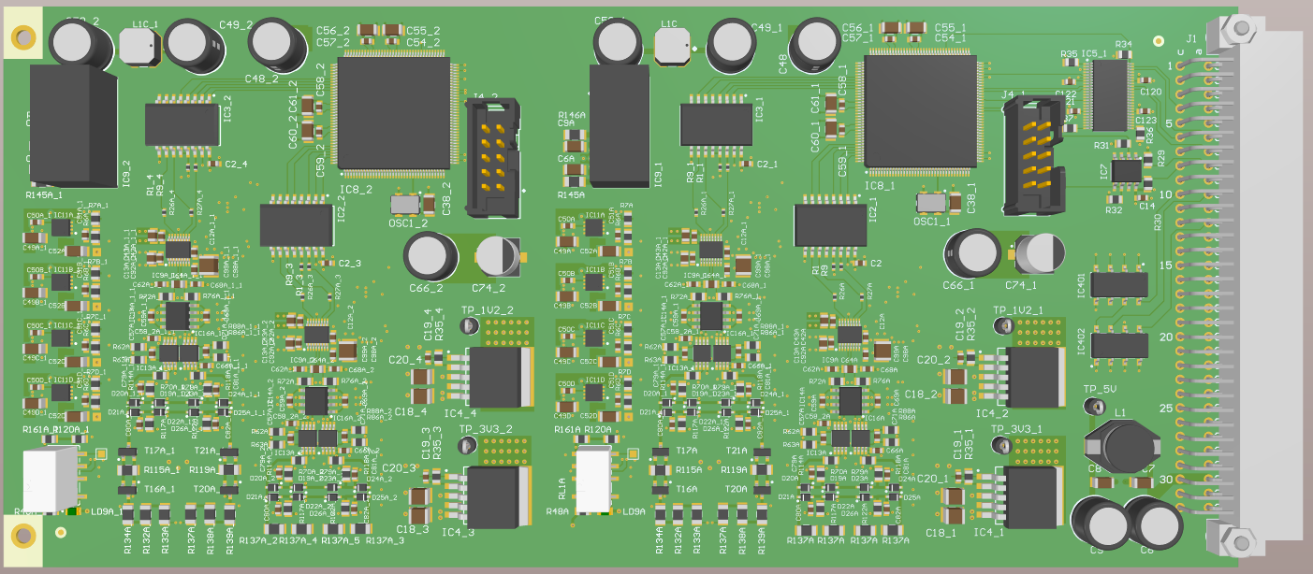
DQQBS/DQQDC overview
FPGA (M2GL010) & 2 double UQDS channels on one board

Slide 18
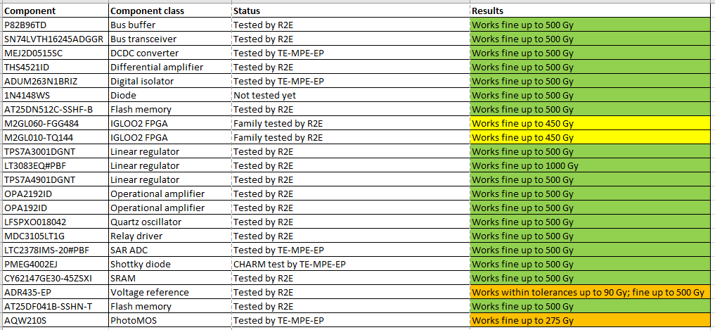
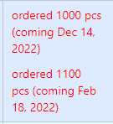
DQQDV & DQQBS/DQQDC components
Alternative references and PhotoMoses needed!

Slide 19
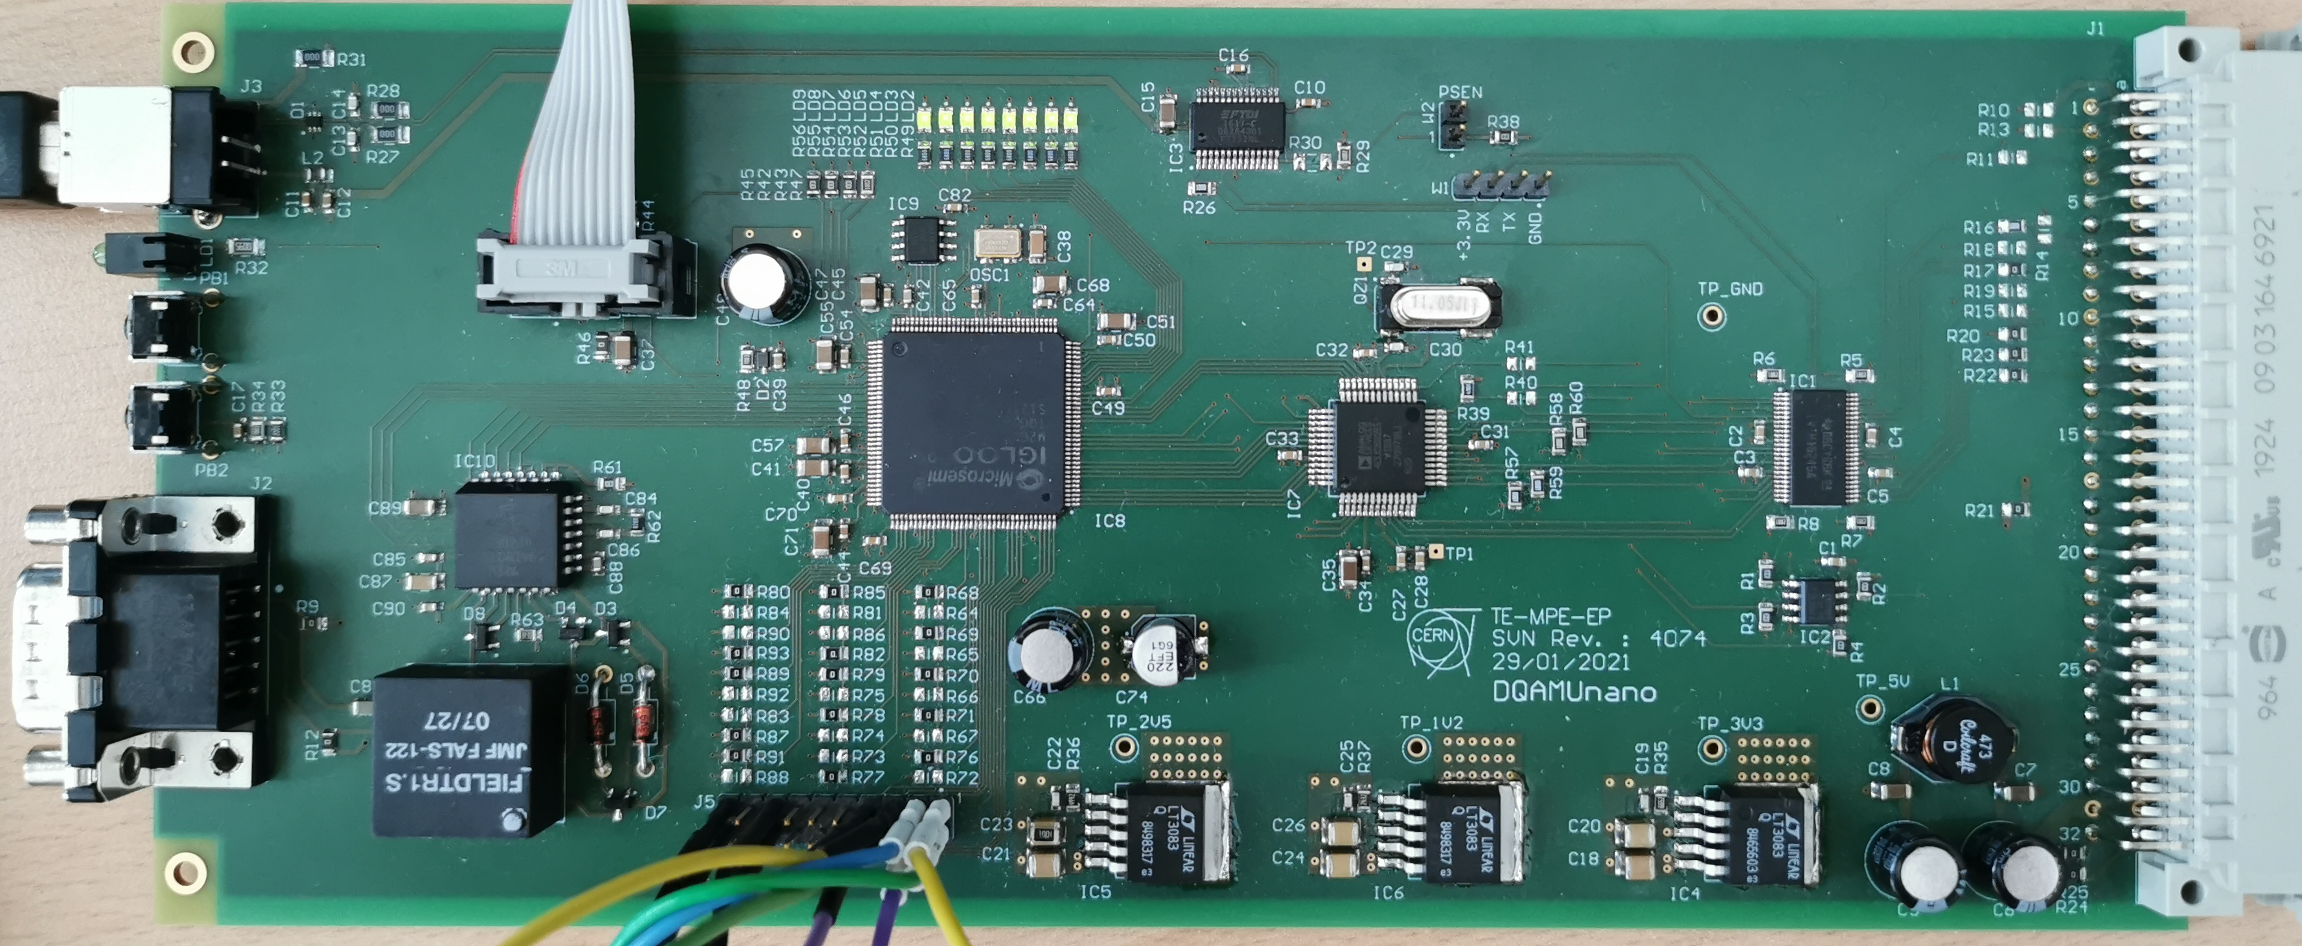
NanoFIP based crate controller: DQAMN
World-FIP based communications controller for areas with elevated radiation levels
NanoFIP IP-core + peripherals implemented in M2GL010 FPGA
ADuC 831 microcontroller
Plug-in replacement for uFIP based communications controllers type DQAMC/G/GS
Additional features like TTC and monitoring of crate power supplies and temperature
Targeted for DS and RR in P1&5

Slide 20
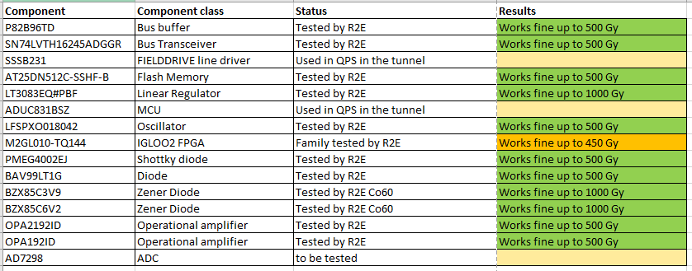
DQAMN components
SSSB231, ADUC831BSZ could be tested within system-level CHARM test

Slide 21
Radiation tests: Components
Component Class | Component Model | Comment
Analog Switch | ADG5209 ADG509 ADG5236 | Latch proof with trench isolation
Reference | LTC6655-5 | Precise
Reference | ADR445 | ADR441 already tested with good results
Reference | ISL21090bfb850 | Has rad-tol sibling
LDO | LT3042 | Similar to LT3083
PhotoMos | PVA1354NS PVA3354NS CPC1390
PhotoMos | AQW210S | Retest with higher forward current
ADC | AD7298 | AD7291 (I2C interface) tested and good up to 500 Gy
DCDC | LT1959 LT3845A | Have rad-tol siblings

Slide 22
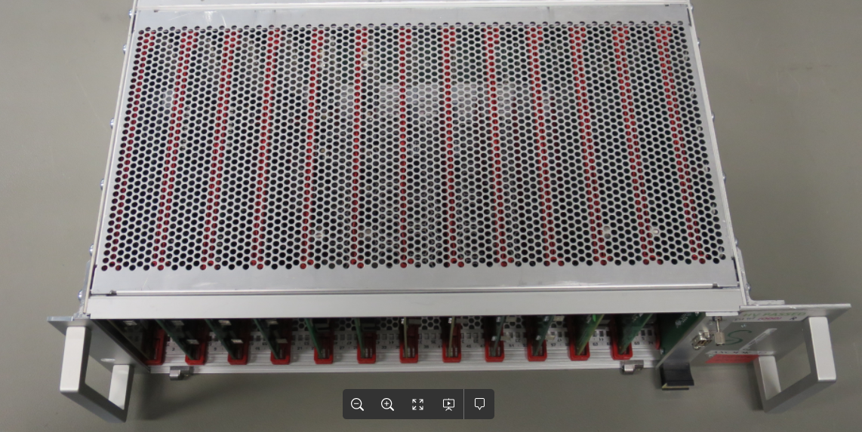
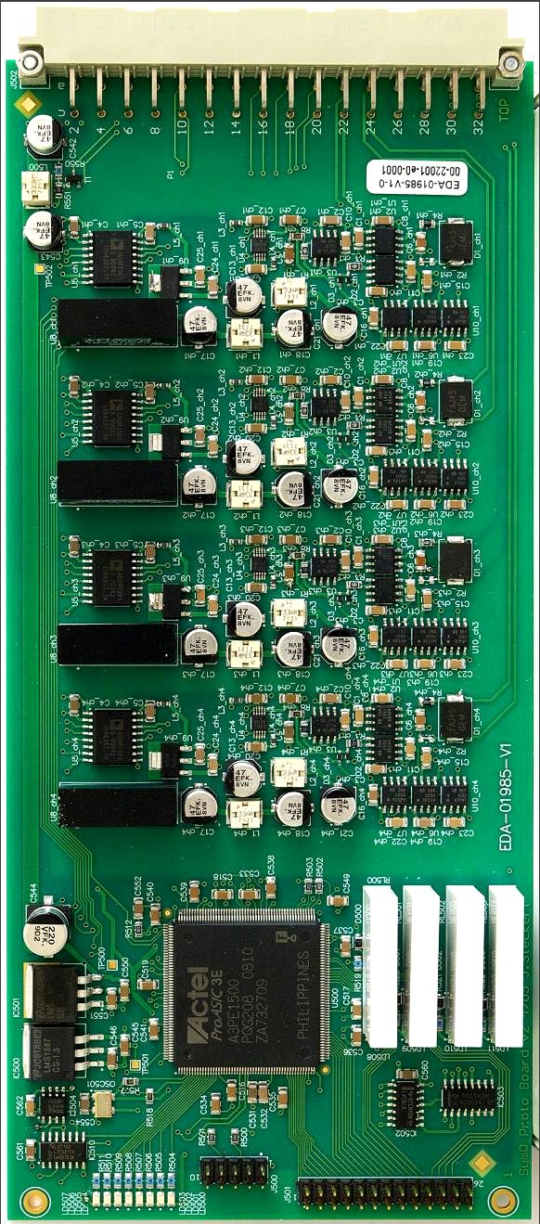
Radiation tests: Systems
System-level test planned to be done in CHARM in February up to 500 Gy
  For a modified DQLPU-S crate that hosts new DQQBS boards, DQQDS boards (symmetric quench detection for MB&MQ) and new nanoFIP field-bus clients
  For a new DQGPU-A/B crate that hosts new DQQDV boards, new DQQDC boards, DQHSU boards (heater supervision) and new nanoFIP field-bus clients

