Slide 1

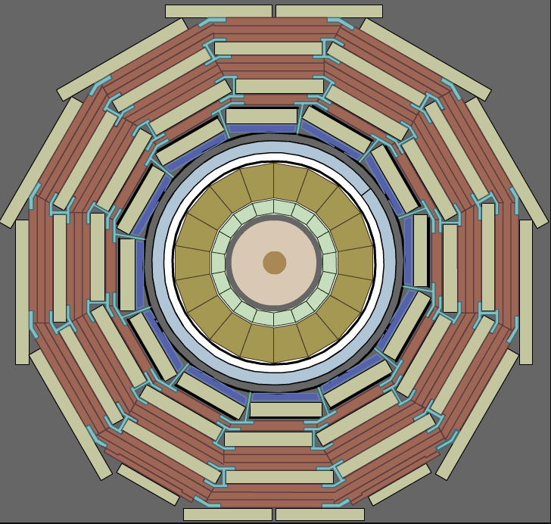
CMS Low Voltage Power Supplies (LVPS) Introduction to the power distribution and radiation testing.
+
-
Tomasz Gadek
Magnus Hansen
Werner Lustermann
Krzysztof Stachon
13/10/2021

Slide 2
Introduction
CMS upgrade phase II
In the coming years, a major CMS detector upgrade is planned to match the performance of the HL-LHC.
Low voltage power demand increases significantly
New subdetectors introduced – additional LV power needed.
Powering concept for the frontend electronics changed from linear regulators to switching converters.
Table 1: Channels and power need among subdetectors.
 | EB (configuration 1) | BTL (configuration 1) | ETL (configuration 2) | EC (configuration 3) | BTL TEC (conf. 1 variant a) | BTL BV (conf. 1 variant b)
Channel needs | 2448 x 50W channels | 432 x 50W channels | 700 x 200 W channels | 3600 x 100 W + 1008 x 50 W | 432 x 50 W channels | 432 x 100 W channels
Power needs | 122.4 kW | 21.6 kW | 140 kW | 410.4 kW | 21.6 kW | 43.2 kW
Total power need: 759.2 kW

Slide 3
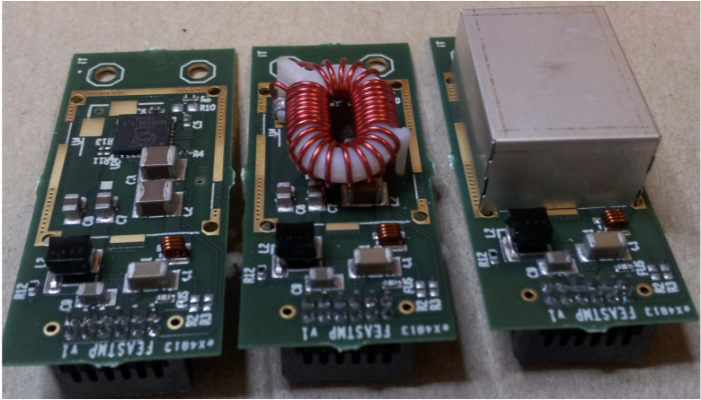
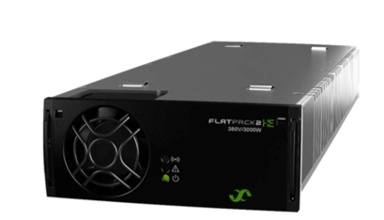
Powering concept overview
Power grid
AC
DC
DC
DC
DC
DC
Front-end electronics
DC
DC
DC
DC
DC
DC
DC
DC
First step conversion:
400 V AC => 380 V DC
Non-hazardous environment
Up to 150 m away from front-end electronics
Off-the-shelf solutions available
Second step conversion:
380 V DC => 11 - 12 V DC
Moderately hazardous environment
Up to 40 m away from front-end electronics.
Custom solution needed.
Third step conversion:
9 - 12 V DC => 1.2 – 2.5 V DC
Highly hazardous environment
Up to 0.3 m away from electronics.
Radiation-hard stepdown converters developed at CERN (bPOL12V)
?
An example AC/DC converter module.
Source: Eltek webpage.
FEASTMP – radiation hard DC-DC converters.
Source: FEASTMP datasheet

Slide 4
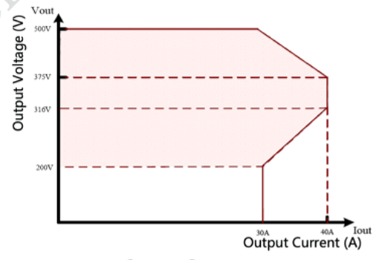
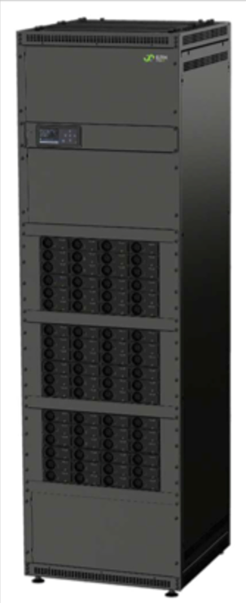
First step conversion in a non-hazardous area.
Power grid
AC
DC
There is a growing market for 380-400 V DC rectifier systems driven mainly by data centers.
Therefore, there are many off-the-shelf systems available on the market with hot-pluggable modules and conversion efficiencies above 95%.
Banks of paralleled high power-density bricks result in a highly-reliable fault-tolerant system that is easy to maintain.
Output voltages are not strictly limited to 380V.
Systems are typically provided with monitoring and communications.
Examples:
ELTEK Flatpack2 380V
VERTIV Netsure 9500
Huawei R50030G1
400 V AC => 380 V DC
First step conversion
Non-hazardous environment.
Up to 150 m away from electronics
Off-the-shelf solutions available
An example output voltage of an AC-DC rectifier.
ELTEK Flatpack2 380V module
An example AC/DC converter module.
Source: Eltek webpage.
72 rectifiers power cabinet

Slide 5
Second step conversion in the CMS cavern.
Upstream power source solution may be common for many subdetectors.
Shared system knowledge
Easier maintenance
Common spare parts
Lower cost
LVPS
(Low Voltage Power Supply)
Usage of DC-DC converters as a load for LVPS is common for many subdetectors, including:
ECAL Barrel (bPOL12V)
Barrel Timing Layer (bPOL12V)
HGCAL Endcap (bPOL12V)
Endcap Timing Layer (bPOL12V)
IN
OUT
380 V DC => 11 - 12 V DC
Second step conversion
Moderately hazardous environment.
Up to 40 m away from front-end electronics.
Need of a custom solution
Common solution for many subdetectors

Slide 6
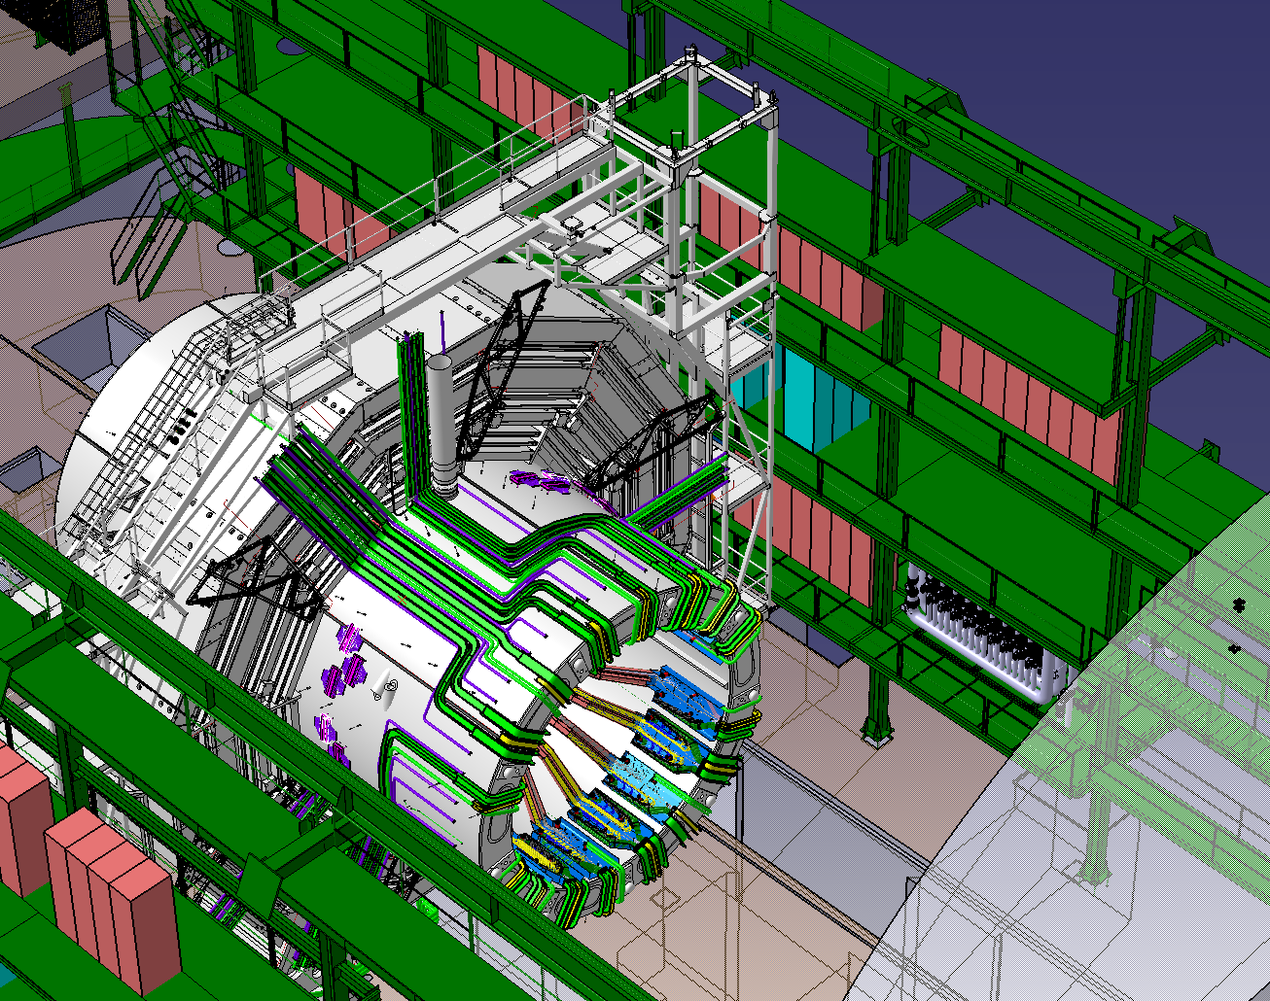
Location of the LVPS (Low Voltage Power Supply)
LVPS will be located on the towers attached to the CMS detector structure (YE1). There is remaining radiation and magnetic field present there.
Expected numbers for HL-LHC end of life (+ marigin, 4000 fb⁻¹ ) at LVPS location
TID: 30 Gy
1 MeV neutron eq: 1e13 cm-2
HEH (>20 MeV): 2e11 cm-2
Magnetic field: up to 120 mT
Space for the LVPS is very constrained, therefore a minimum power density of 1.2 kW / 19’’ RU (rack unit) is specified in requirements document.
High reliability is required – a minimum MTBF (Mean Time Between Failures) is defined as 300k hours. For this system, that corresponds to annual failure rate of 3%.
An overview of the CMS detector cable ducts and towers designated for low voltage power supplies. Credits: Axel Filenius.

Slide 7
Selected requirements
Parameter | Value | Comment
Input voltage | 380 V DC (+-10%) | May be lowered for reliability improvement
Minimum required power density | 1,2 kW / rack unit | Example: 10 modules of 12 channels in 5U chassis
Number of channels in module | 12
Output voltage | 9 – 14 V DC | Floating
Output power | 60 W (120, 180, 240) | Grouping possible
Conversion efficiency | > 90% | above 40% of nom. load
Ripple and noise | <10mV pp, <1mV RMS | 10 Hz to 30 MHz
Remote sense | NO
Protection | Over-temperature, over-current
Additional protection | Hardware-based overvoltage protection
Cooling | water cooling | no water fittings inside the power supply
Remote control | YES | all parameters remotely controlled and monitored using field bus (e.g. CAN).
Interlock | YES
Warranty | 2 years + up to 15 years extension 20 years maintenance support
Documentation | YES, full documentation of the design and tests carried, including detailed information about radiation and reliability qualification.

Slide 8
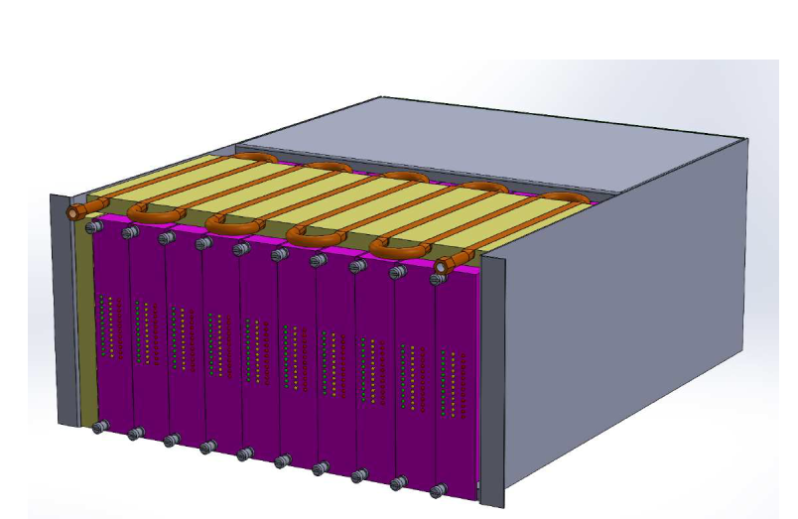
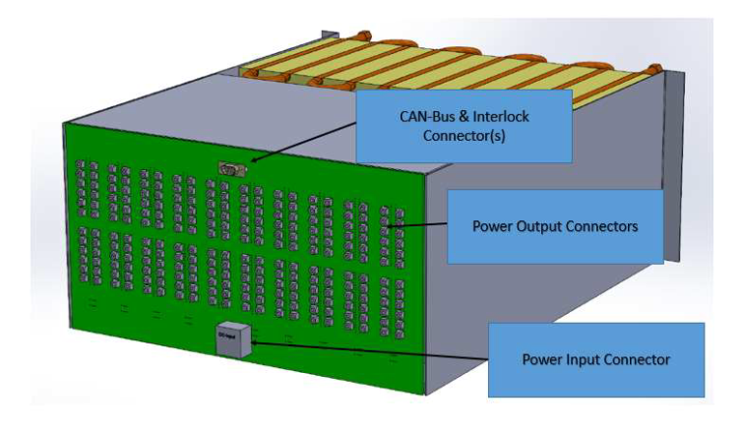
Power supply concept and system scale
Full CMS system size:
126 LVPS Chassis
1209 modules in total (each chassis up to 10 modules)
14508 channels (each module has 12 channels)
LVPS concept visualization

Slide 9
Timeline
Work on tendering strategy and other documents:
Tender form
Risk matrix
(Completed)
Contract signature (3.08.2021) (Completed)
Prototype verification
2020
2021
2022
2023
We are here
Work on common requirements specification document
(Completed)
Publish tender
(Completed)
Verification of design documentation and progress reports.
Support manufacturer in prototype development
Series produciton

Slide 10
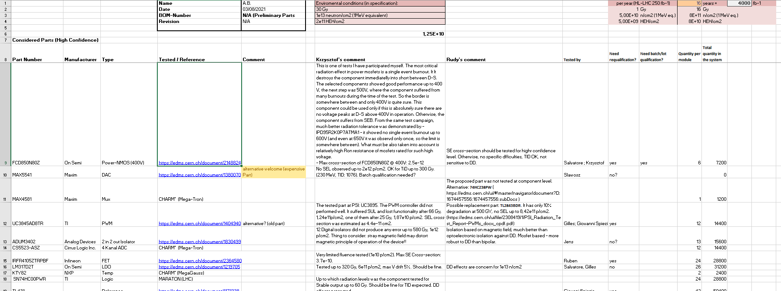
Prototype development phase
Support needed from CERN (RadWG)
  Access to radiation testing facilities through CERN
  Support concerning radiation qualification of electronic components
Big thanks to Rudy Ferraro and colleagues for preliminary feedback concerning selected components!

Slide 11

Challenges
Radiation environment
Large number of components (14500 individual channels)
Most of the components available in the database do not have enough confidence level to use them without further testing.
A lot of testing needed to ensure reliability!
 | Annual (250 fb-1) | Lifetime (4000 fb-1)
TID [Gy] | 2 | 32
Neutron fluence (1 MeV eq.) [n/cm2] | 6,25E+11 | 1,00E+13
HEH fluence [p/cm2] | 1,25E+11 | 2,00E+12
Update on radiation level estimates is ongoing. These values given here may be too conservative.
Expected radiation levels at the location of LVPS.

Slide 12
Example – test design to ensure SE tollerance
Use of reliability engineering in radiation test desing
    Testing n components in t time gives R reliability with certain CL when operating t_operation time
    Assumptions: weibull distribution with β = 1 (= exponential distribution, constant failure rate); no failures during the test observed.
    Reliability ensured from a standard PSI radiation test:
      testing n=10 components by t=1e12 HEH/cm2 gives R=0,9971 reliability with CL=90% when operating t_operation=1,25e10 HEH/cm2 (1 y of operation)
      If we use 14500 of these devices, we have annual failure rate of 14500*(1-R) ≈ 42 failures / year
    Sample size required to get sattysfying confidence level for a component that is present in each channel:
      Permitted annual failure rate for the entire system is 3%. If for a critical component that is present in every channel we permit a contribution to an annual failure rate of 1% for the whole system (that means 6,9e-5 for a single component) then we would need to test at least 417 devices and see no failures to have this reliability ensured with 90% CL.

Slide 13
Work is ongoing
Manufacturer has a list of promising components from the past developments and RadWG database
  Looking for a recommendation concerning microcontorller suitable for such application
    SAMD21 + watchdog
    https://edms.cern.ch/ui/#!master/navigator/document?D:100698304:100698304:subDocs
Radiation test plan is being developed by the manufacturer.

Slide 14
Thank you for your attention

