Slide 1

Super-FRS magnet testing at CERN: update of the status and resources situation
Haik Simon
CERN, November 25th, 2021

Slide 2
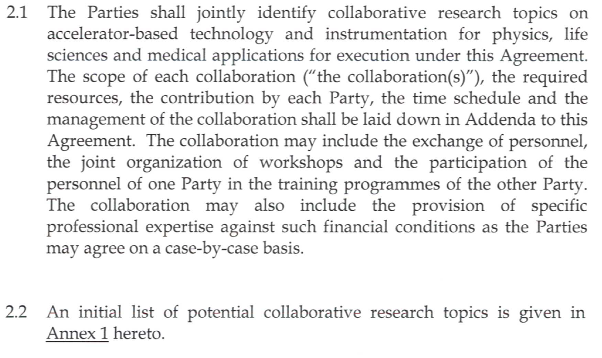
Current collaboration contracts
CERN-GSI/FAIR collaborations: superconducting magnets
all collaborations in the framework of the 2010 agreement K1727/DG
TITLE/SCOPE | Machine | Status | Addendum | Date
Cryogenic testing of the superconducting magnets for the Super-FRS | Super-FRS | active | #2 #4 #5 #12, KR3912 | 2012 2014 2016 2018
31/10/2023
Append Agreement to Amendment to #12 on
Multi Risk Insurance (12/2021)
  Last exchange insurance
  agents 20211109
➔ CERN to propose text.
Alternative means of compensation payments for enhanced living cost to GSI team.
Collaborative research topics !

Slide 3
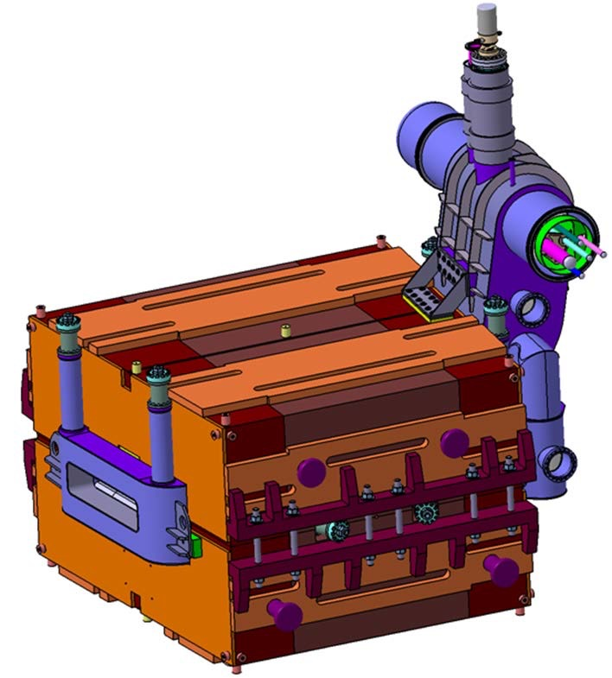
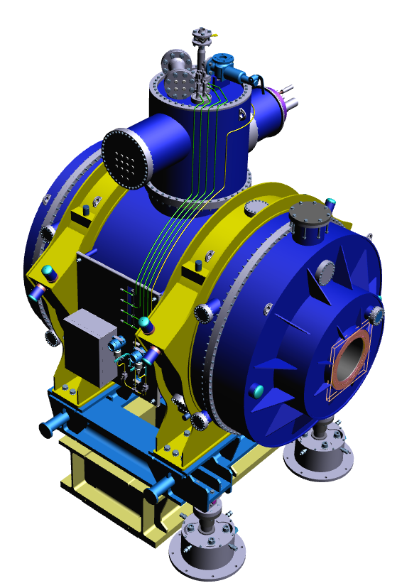
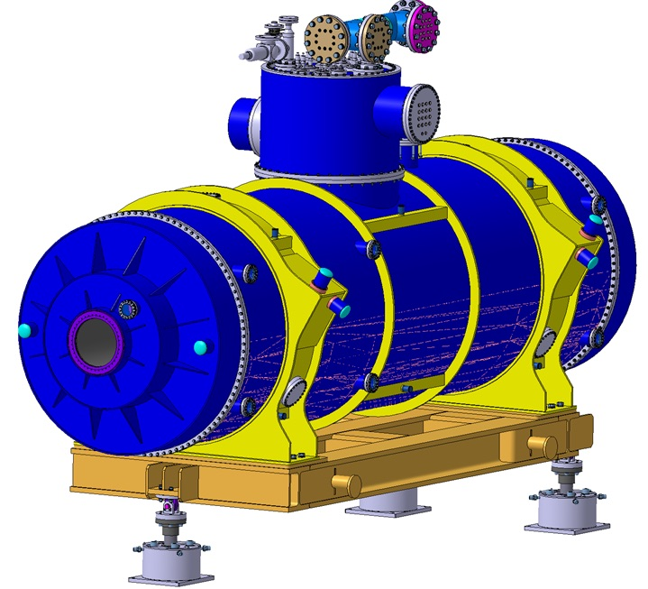
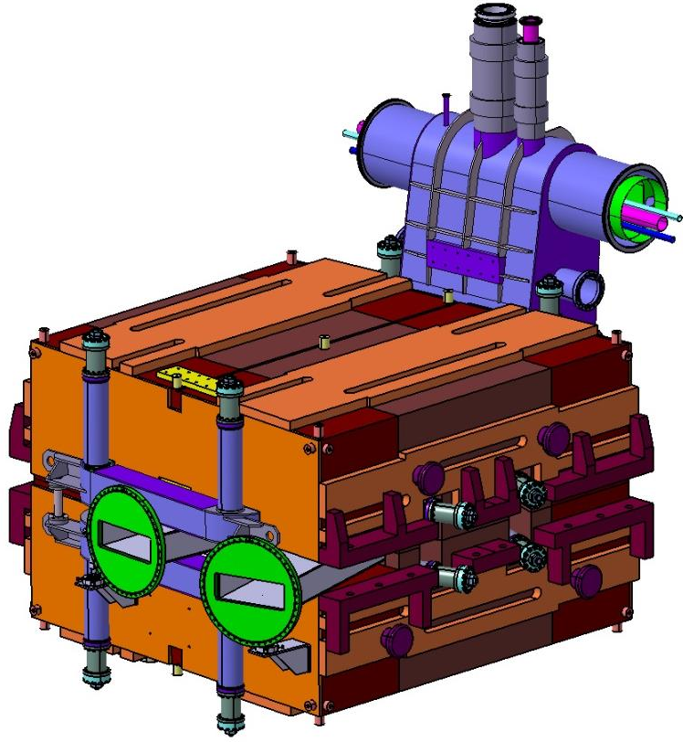
Super-FRS: testing of sc. magnets
K1727/DG (2010); Addendum #2 (2012), #4 (2014), #5 (2016) for infrastructure refurbishment + #12 (2018) for testing phase
purpose
refurbishment and adaption of the cryogenic test facility at B180/CERN (add. #2, #4, #5).
testing of all superconducting magnets for the Super-FRS depicting the SAT for acceptance (add. #12).
contribution
Add. | GSI |  |  | CERN
#2 | 5.000.000 € |  |  | Refurbishment of test facility B180
#4 | 1.860.000 CHF |  |  | Procurement of pre-cooler, QD-system, survey tooling
#5 | 210.000 CHF |  |  | Integration work, modification of cryo lines Implementation of preparation test bench and control room
#12 | Testing of the magnets 4 (/5) FTEs Further personnel if required Experts of survey at pre-series testing Cost-recovery for operational services | ongoing tbd ongoing ongoing |  | 1 FTE: test engineer to oversee functioning of test facility 0.4 FTE: support of equipment groups on best-effort basis Energy costs (no cryogenics) Office space and infrastructure | Ongoing (2022) tbd ongoing
facility will be made available for similar testing after Super-FRS activities

Slide 4
Resources
GSI
Replacement of the 4th member in March 2021 (hiring process completed in 4.5 months)
temporary secondment from GSI of a 5th member from February 2021 to August 2021. Definitive secondment starting from 2022; in preparation
travel arrangement for seconded members ends after 4y
CERN
Test facility coordinator selected; starting from January 2022

Slide 5
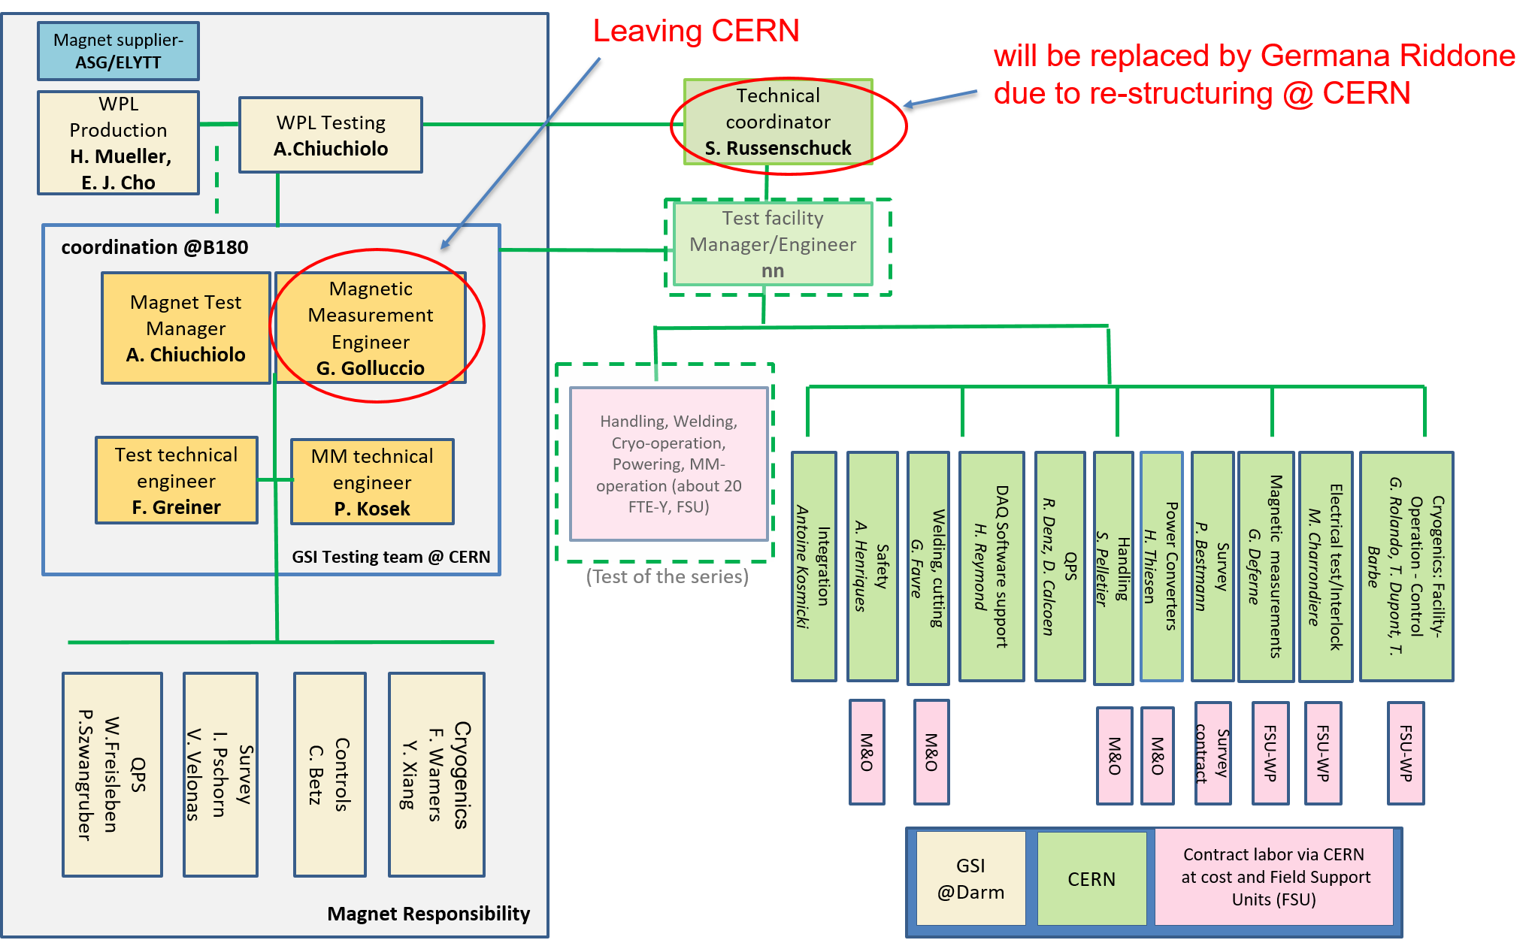
Team@CERN (2020)
Restaffing G.G.
ongoing
Replaced by Germana Riddone
(S. Russenschuck consultant
for magnet tests)
to be nominated

Slide 6
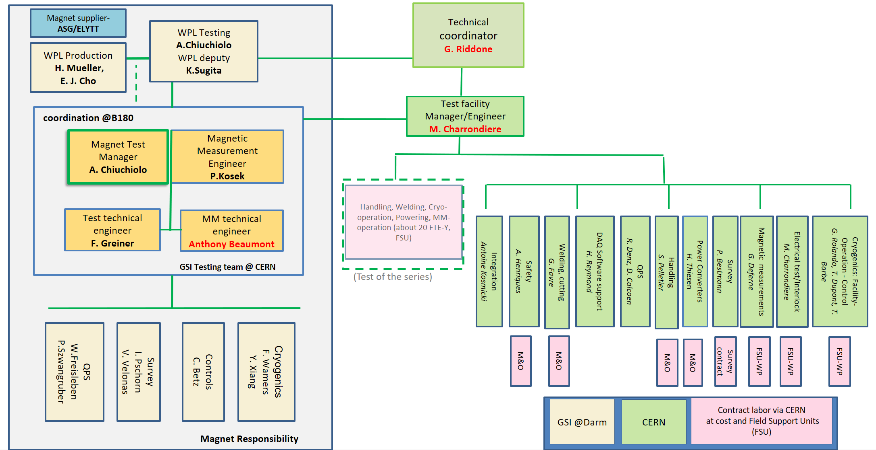
Team@CERN (2022)
Ressource management
Budget, harmonize CERN&GSI
schedule
Collaboration
matters
Daily
coordination
Daily: dashboards
Coordination on site
+ M. Michels

Slide 7
Roles and responsibilities
GSI executes the
testing
deploys 4/5 FTEs to work on site
further personnel if necessary
defines tests plan and procedures
gives support for operation, upgrade and maintenance of the interfaces
pays operation costs
CERN prepares and maintains the facility available
guarantees the functionally of the facility
contributes 1 FTE (test facility coordinator) + 0.4 FTEs
Coordinates Field Support Units (FSU paid by GSI)
supports GSI activities and training
offers standard offices and IT network
covers energy cost

Slide 8
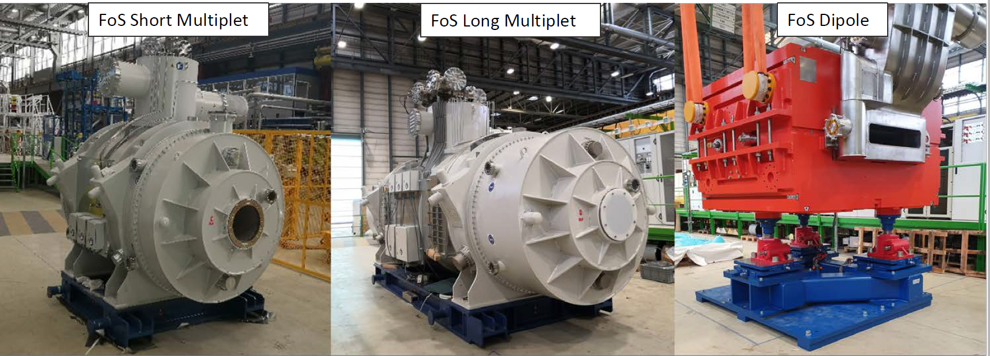
Status of testing
First of Series Magnets
Arrived on 20.02.2019
Tested in 2019-2020
on TB1 and TB2
Next SM expected next week.
Arrived on 24.11.2020
Tested from Q2 2020
Actual: warm up
2nd thermal cycle -03/2022
Arrived on 07.02.2021
Leakage issue → Elytt
→2nd FoS dipole in 2022

Slide 9
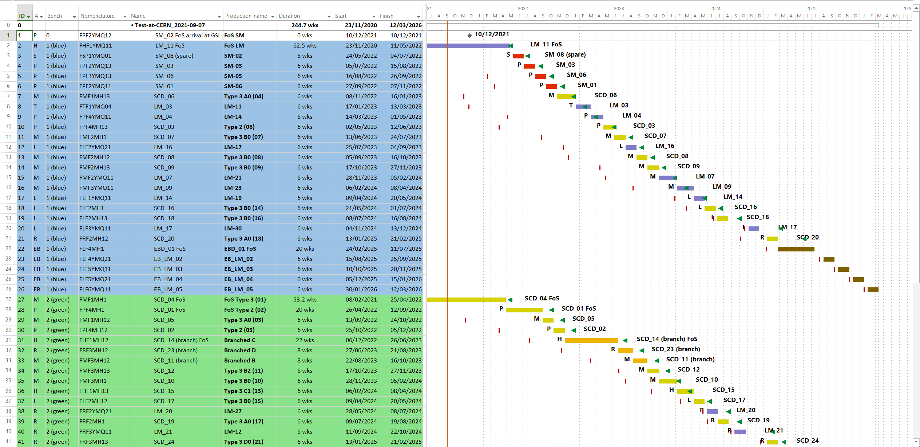
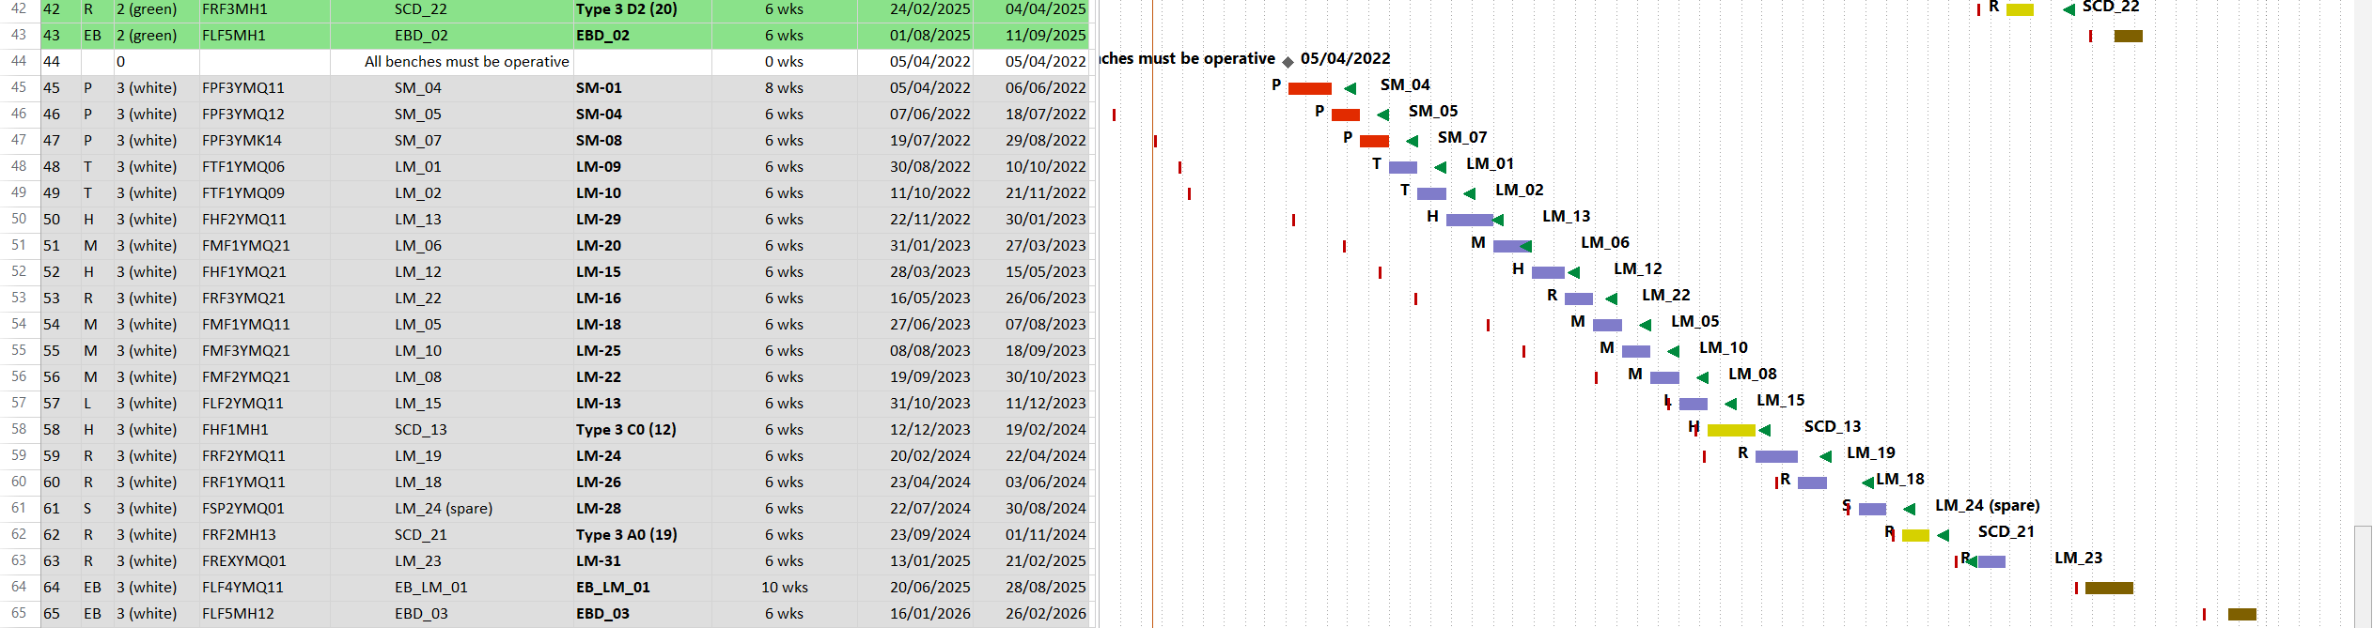
Testing project plan overview
3 benches:
(blue, green, white)
6 weeks testing during series
2022 2023 2024 2025
FoS LM
Buffer of already produced magnets is anticipated
for whole testing period !
FoS D3
EB magnets
| FAT dates
t baseline dates of SAT

Slide 10
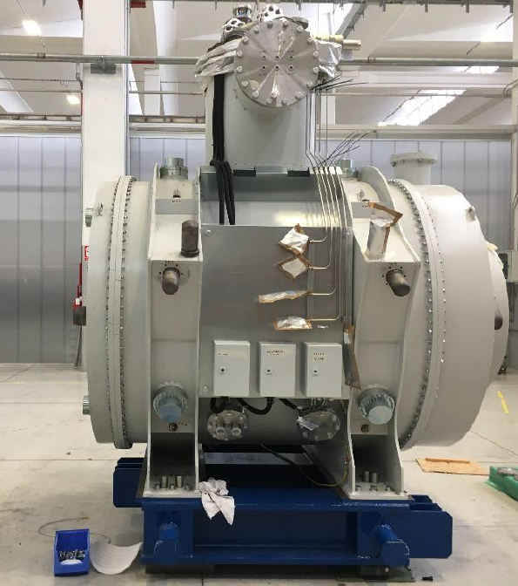
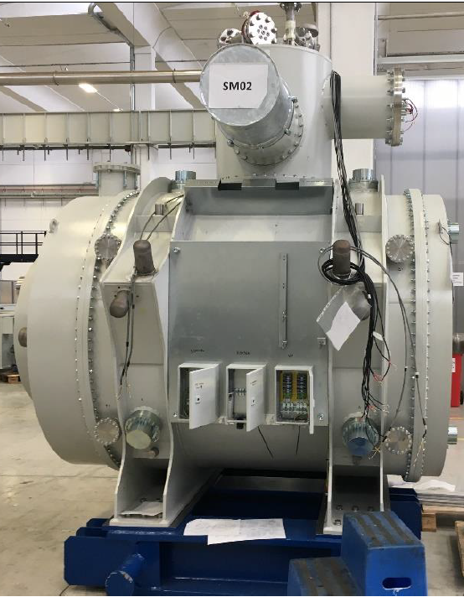
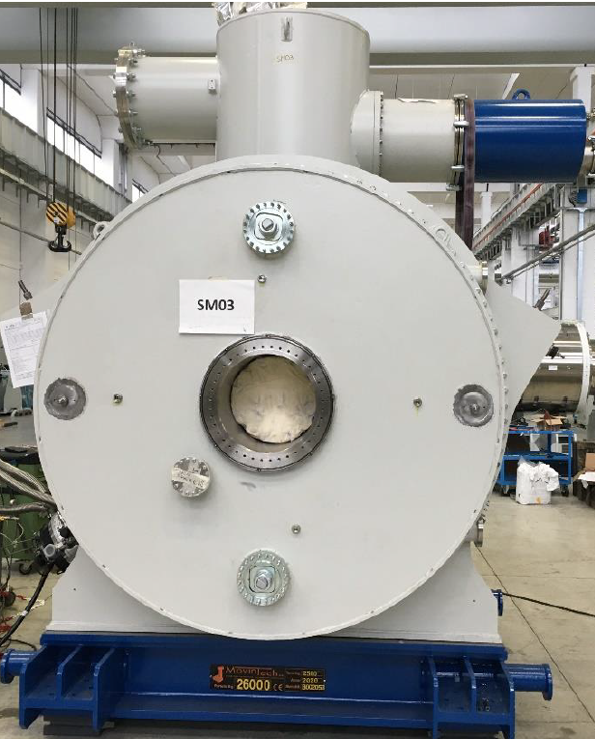
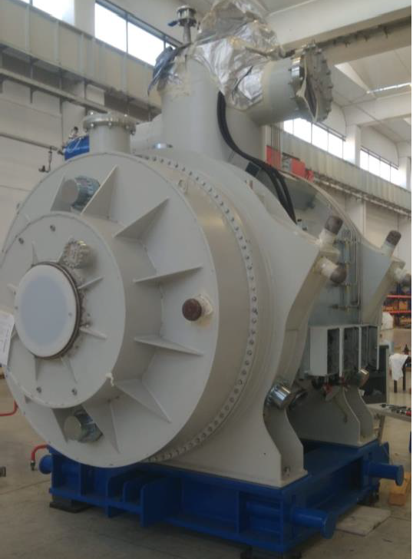
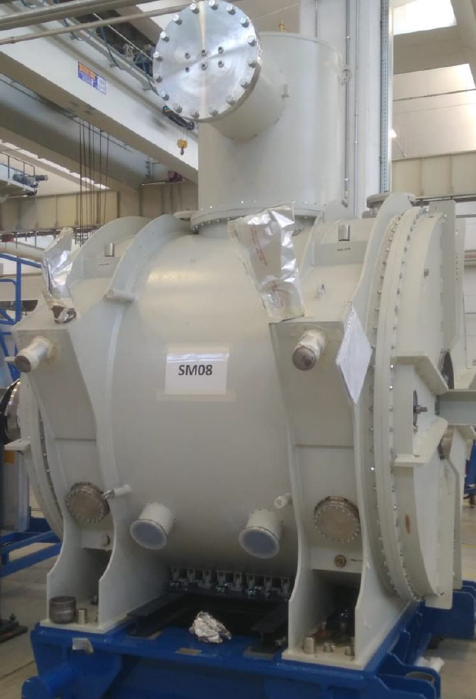
Multiplet production status
Production of series short multiplet (SM) is in progress
  FAT was completed for SM01, 02, 03, 04 (followed by GSI remotely)
  FAT for SM 08 in October (followed by GSI colleagues on site)
  FAT for the last two series SMs → March and April in 2022.
Production of series long multiplet (LM)
  FAT for two long multiplets → October ~ January 2022.
  FAT for about 7 multiplets per year from 2022 to 2024.
SM01
SM02
SM03
SM04
SM08

Slide 11
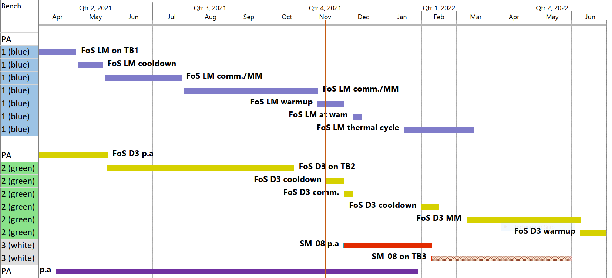
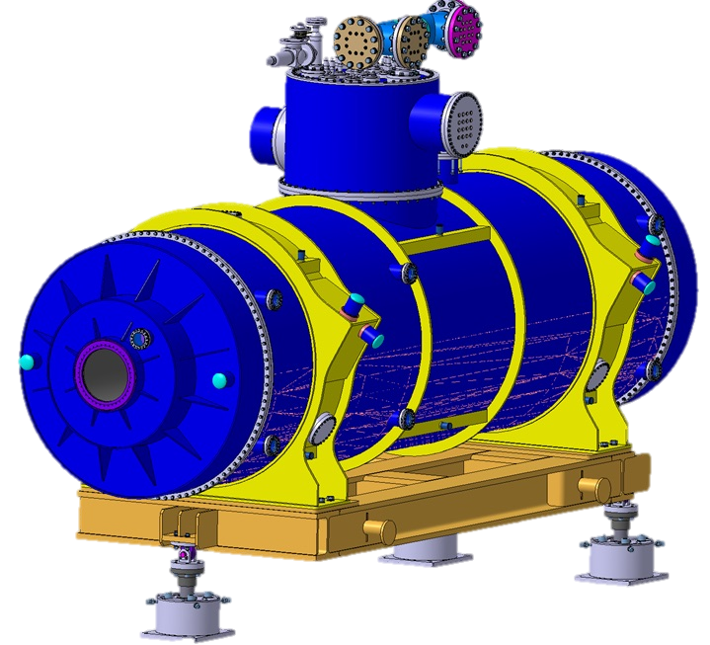
Timeline November ‘21 – June ’22
1st reschedule due to nc. FoS Dipole
1w cryo stop before expected
4 w cryo stop
Antonella Chiuchiolo / Super- FRS magnets testing: test plan 2021

Slide 12
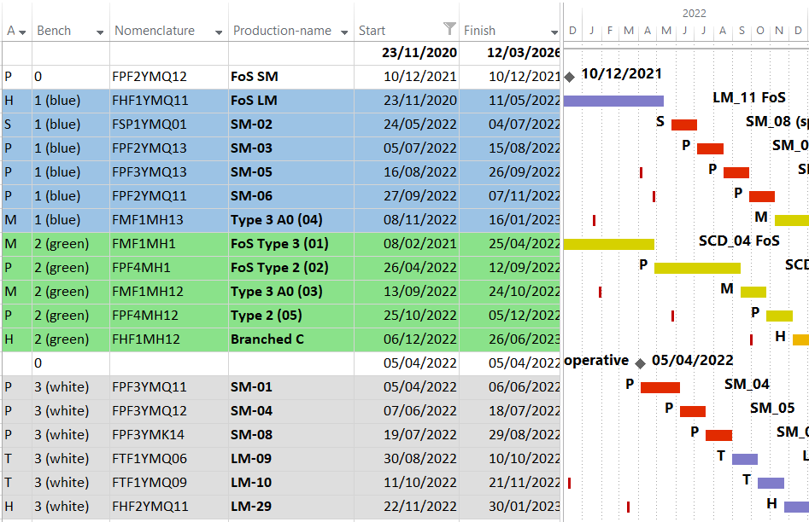
Test plan in 2022
New:
Original plan (February 2021)
FoS LM test finishes 2 months earlier
FoS Dipole Type 3: test stopped. (shield leak)
FoS Dipole Type 2: test will be anticipated
Outdated! Refinement needed
based on FoS experience
SM series multiplets: test starts 4 months earlier, includes bench 3 commissioning.
Schedule flexibility thanks to possible alternating test benches
and magnet production ahead testing
2022: Ramp up of necessary staff should be foreseen; include necessary training/hand over period

Slide 13
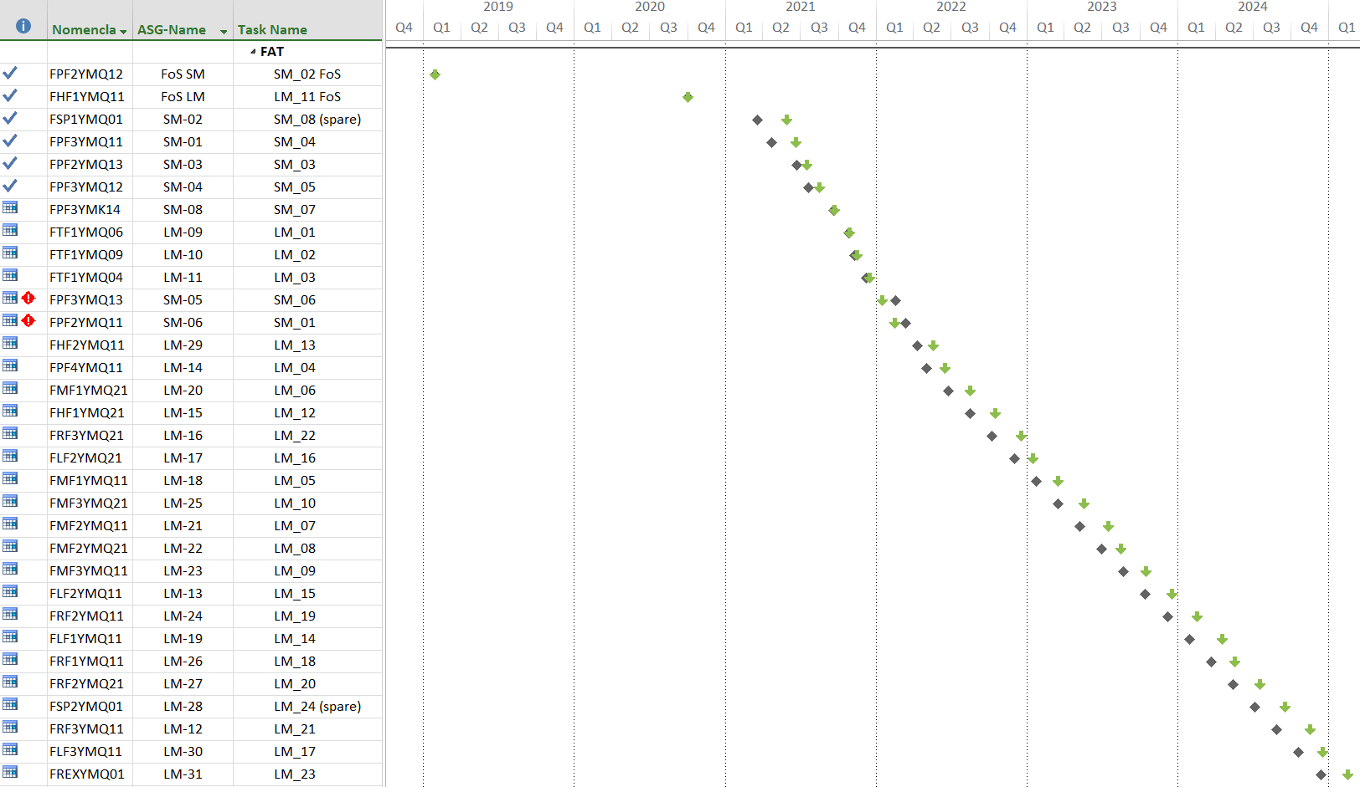
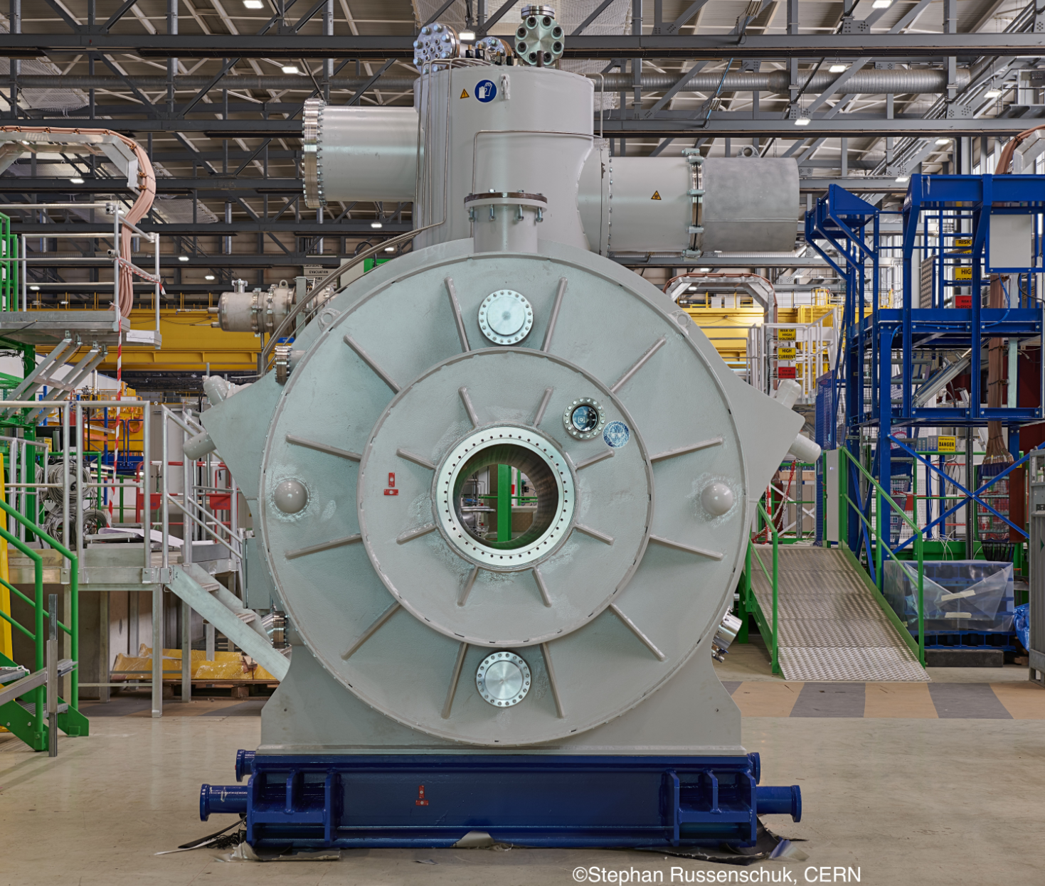
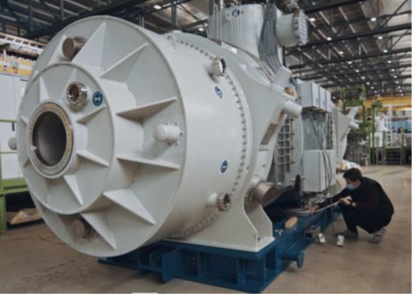
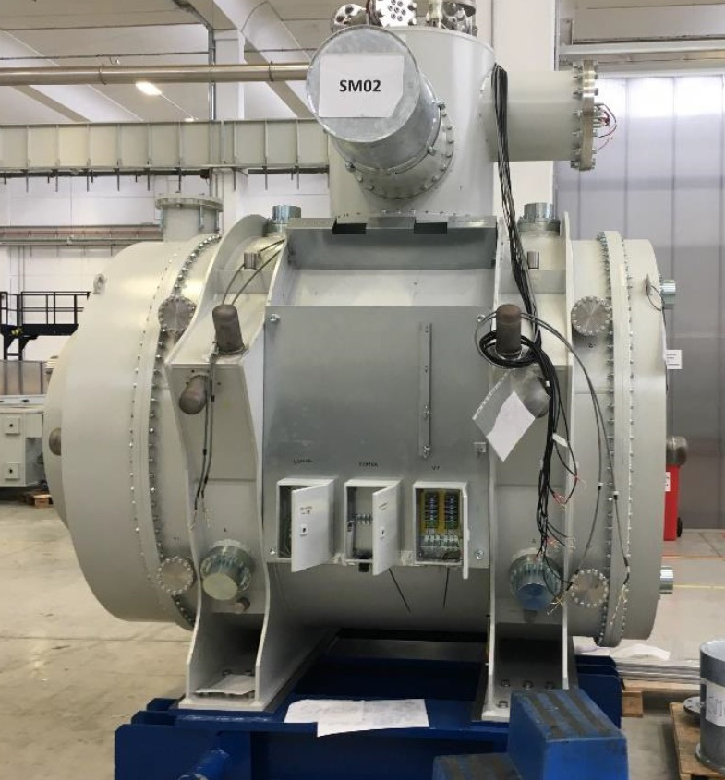
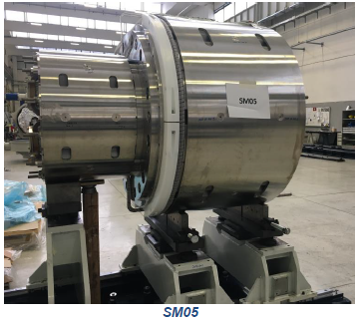
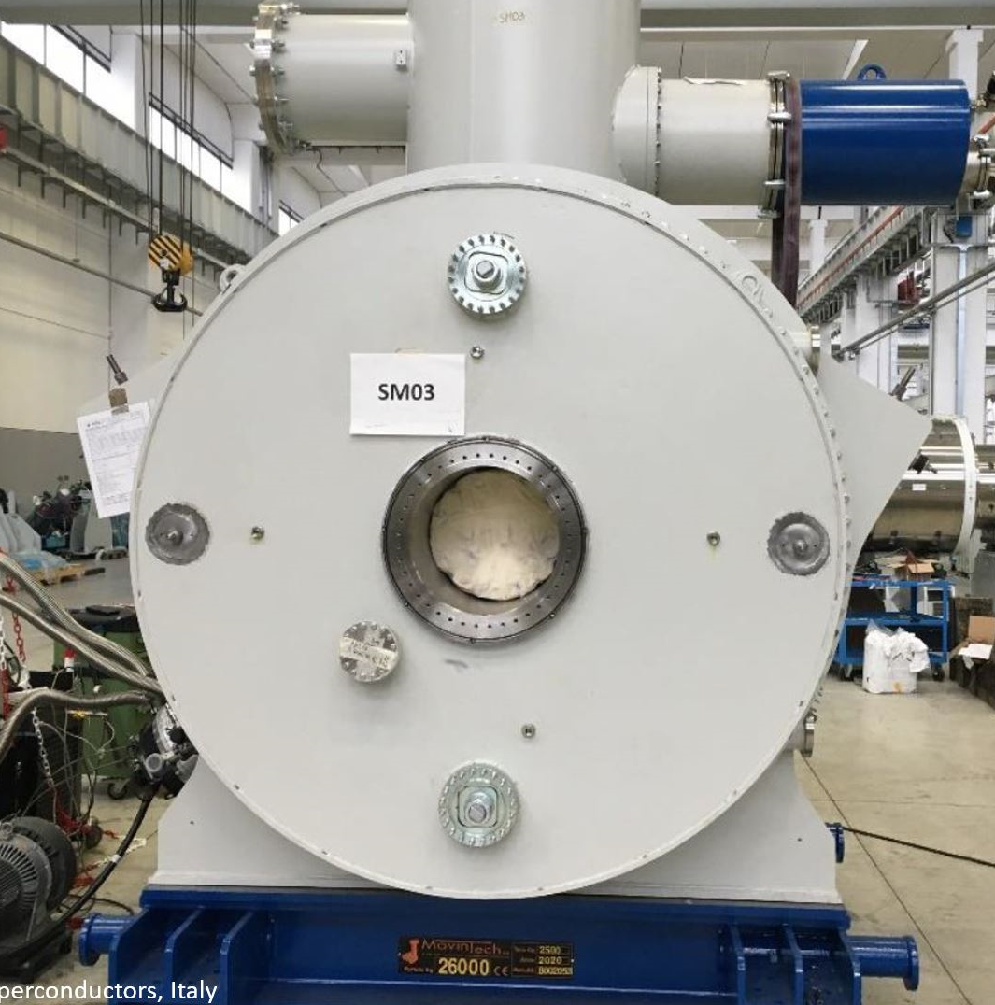
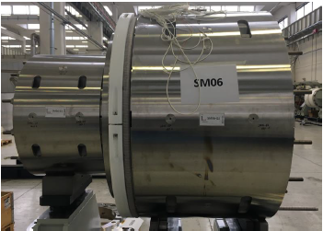
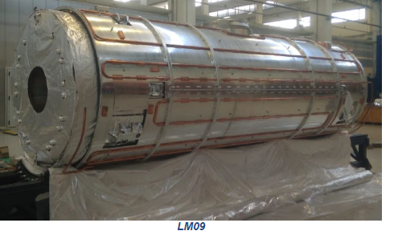
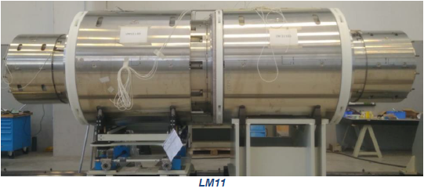
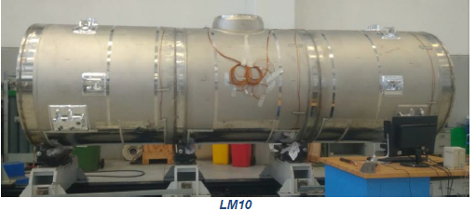
sc multiplets schedule
FoS SM
FoS LM
early science
(20 multiplets)
production ongoing at expected rate
(ASG production schedule 20210901)
LM-SM meanwhile mixed
baseline
actual
ASG: 01/09/2021

Slide 14
Dipole production status
Two production sites have been set up:
  Artea: Coil and Cryostat production
  Llodio: Yokes and Integration (+intermediate storage)
Production of series dipole is in progress.
  FAT was completed for FOS type 2, stored in Elytt.
  FAT for 8 Dipoles (3 branch type) foreseen from Nov. 2021 to Nov. 2022.
Half Yoke
Coil inside the coil casing
Cryostat
Dipole Magnet on stand

Slide 15
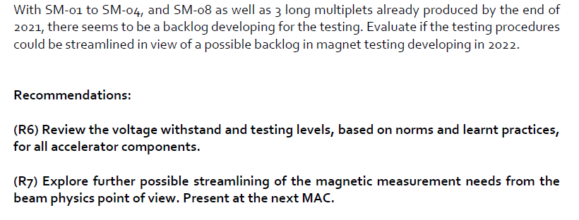
Test schedule
Experience based on FoS testing:
  For SM short cooldown time was achieved (7d vs. 14d)
  For LM cool down time slightly longer (16d vs. 14d)
  For SM warmup time (8d vs. 14d)
  For LM warmup time (prediction ~ 14d )
Backlog required to cope with
longer production times
MAC24

Slide 16
Test schedule
Non Conformities are addressed at producer
  2nd Dipole is free of dirt in pipes
  Piping issues (cauing leak) in ASG multipletts appears solved
  Assembly faults (octupole coils turned by 45°) are addressed
➔ Uncertainty in parallel Operation of several magents
on all benches!
  Mass flow that can nominally be achieved is ~20% below spec. (50g/s)
  Achieved currently is 26g/s, but still many unknowns.
  (max ΔT coil vs. plant, blocking issue at thermal shield)
Commissioning (Q1/2022) and parallel testing (03/2022 D3↓+LM↑) is key to understand achievable mass flow.
  Stable test at cold with warm up/cool down also

Slide 17
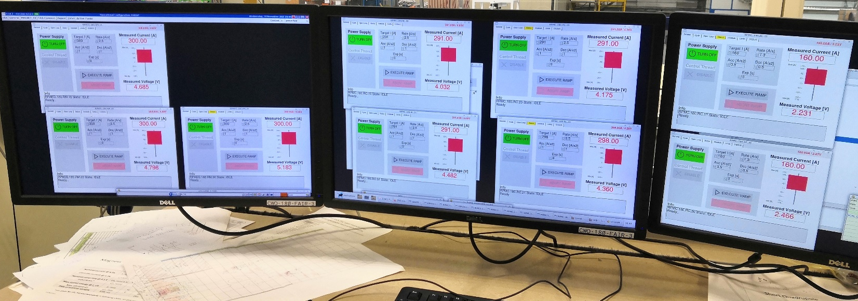
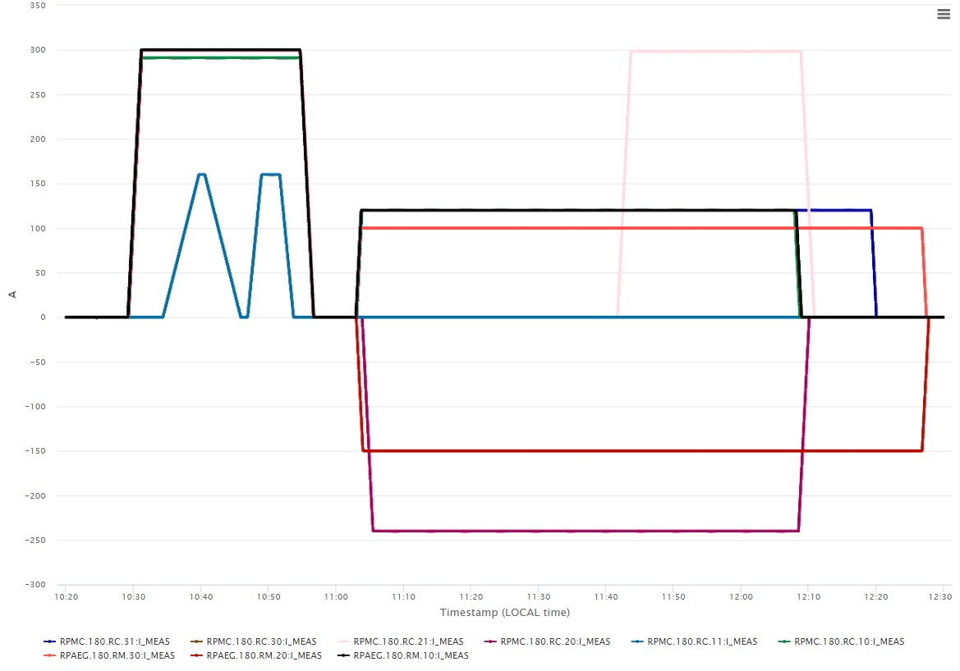
Achievments: FoS LM
  Powering
    9 magnets parallel operation validated for PC, QDS and power application
    All magnets powered with nominal ramp rate to nominal current
      Only the octupoles magnets powered first at intermediate ramp rate before nominal
      7 magnets over 9 powered with discordant current: octupole magnets operated only with positive current
  Cryogenic tests
    Static and dynamic (during magnet powering) heat load measurements. Analysis on going
  Dynamic warmup started
  work in progress

Slide 18
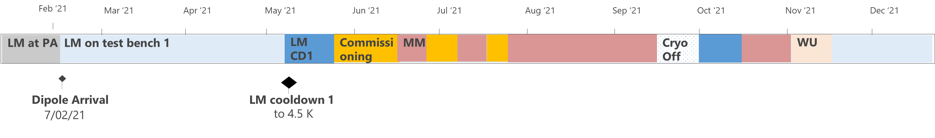
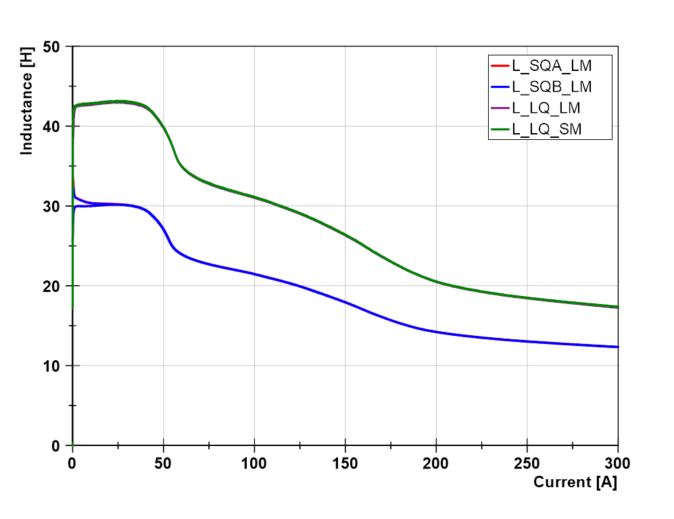
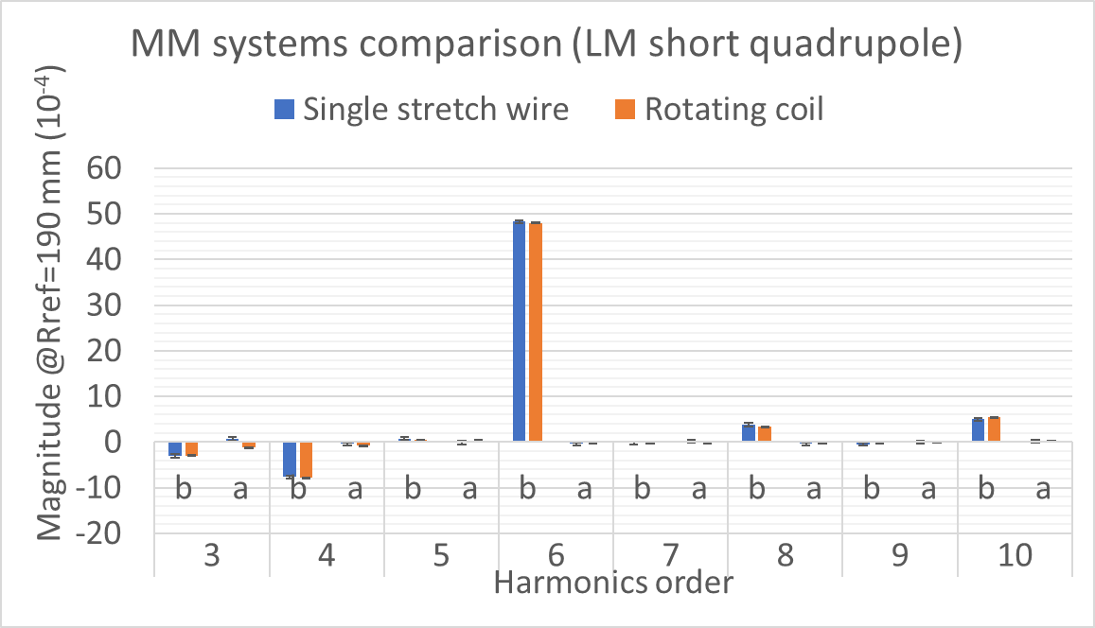
Achievments FoS LM
Powering commissioning:
  9 magnets tested individually and in cross talk configuration up to ultimate current levels
  Test bench 1 fully commissioned in 22 days
  (9 power circuits, quench protection, interlock)
  Inductance agreement of Long Quadrupoles in SM and LM
  Inductance agreement of 2 Short quadrupoles in LM
Magnetic measurements:
  Challenging especially for cross talk, alignment among 9 magnets and survey
  Test procedure improvement and optimization (11 weeks total measurements for 9 magnets vs. 6 weeks for 2 magnets in the SM)
  Validation of measurements system for series tests

Slide 19
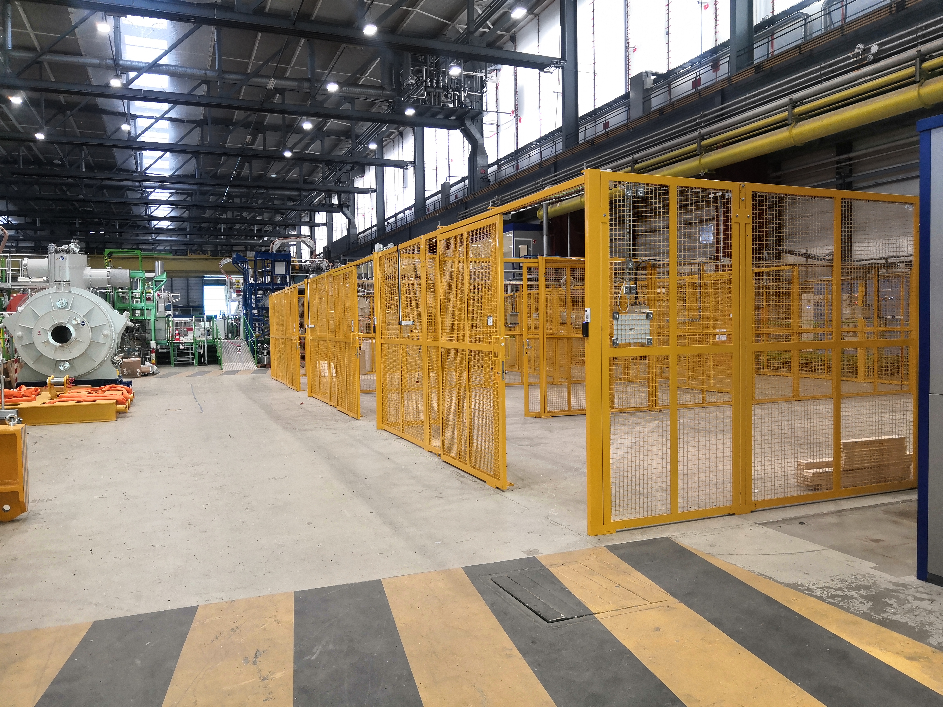
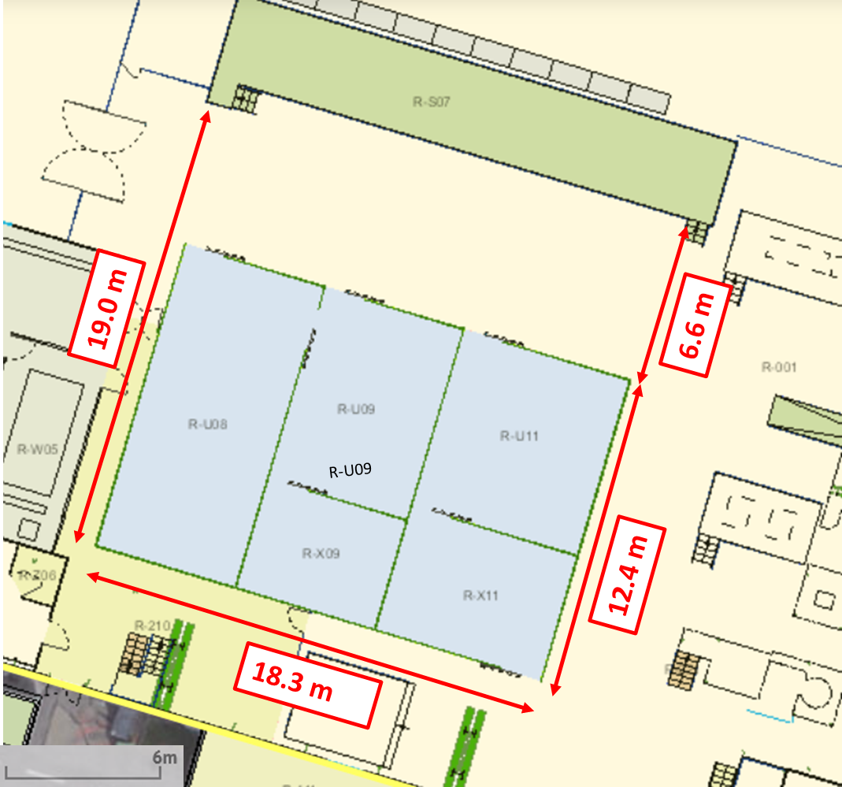
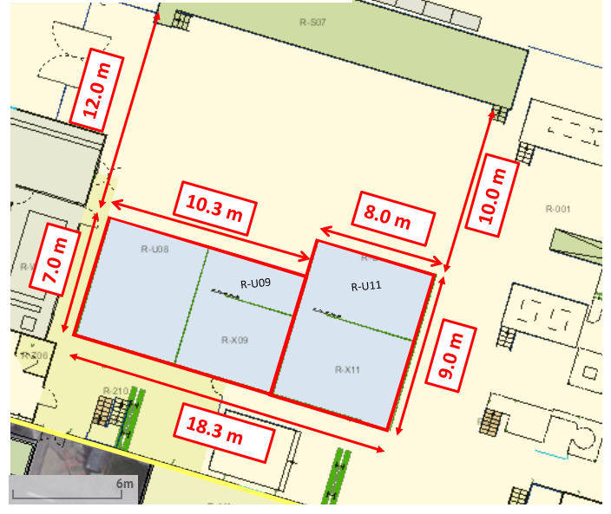
Logistics at CERN
Preparation Area increased
  Unloading and loading on the tracks (reception and departure)
  Preparation for integration in the test benches (heavy handling operation, electrical tests)
  Preparation for packaging (heavy handling operation, electrical tests)
FAIR PA
FAIR PA
FAIR Preparation Area
TE
TE
Aug.’21
From Oct.’21

Slide 20
Summary/Open issues
Very successful collaboration!
Many Milestones achieved –
now at the transition from FoS to series testing
Collaboration:
Rooms/integration with CERN collaborators
Contracts:
Additional agreement to amendment #12
  MRI separation from CERN insurance
  (from 12/21-01/22: div. handling)
  Alternative Compensation options for enhanced living cost at CERN
  Potential use of CERN budget code
Prepare new Amendment from 31/10/2023 including EB
Organisation:
Implement working scheme in series testing configuration of the org. chart.

