Slide 1

Synchrotron
Collaborations CERN – GSI/FAIR
P. Spiller
25.11.2021

Slide 2
TFS System/KO Exciter
R21.11 Continue to investigate technical details
of a transverse feedback system for SIS100, including reserving space in the ring for pickups and kickers for feedback systems with appropriate phase advances.
General (physical) Specification of TFS System completed by V. Kornilov 02.2020
Technical layout and design postponed because of priorisation on day-one items.
Presently, no WPL assignment yet.
TransFAIR FZJ ?
Start required in Q1/22.
Collaboration for technical specification with CERN (Wolfgang Höfle)
Requirements for SIS100 TFS system
Key parameters of SIS18 TFS system

Slide 3
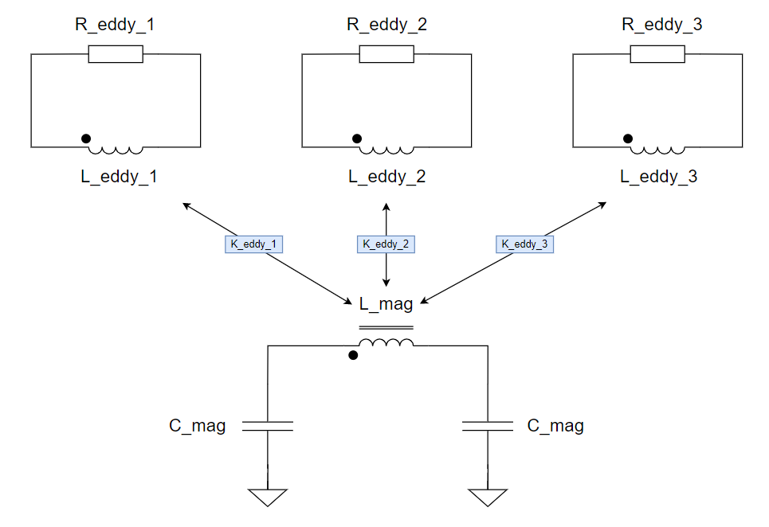
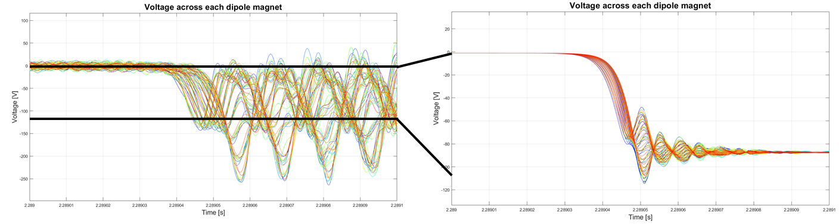
Transient Effects in SIS100
Simulation by STEAM Group
Collaboration duration: 2 years (1.03.2020 – 28.02.2022)
Resources: 1 FTE (Dr. Dimitri Delkov funded by GSI) + support of STEAM group
Scope and Status (simplified):
  Creating electrical models of the SIS100 main circuits including energy extraction circuits, grounding and simplified power converters (missing transfer function of the quadrupole magnet which will be measured in Dec. 2021) 80%
  SIS100 main dipole circuit transient simulation + case study 100%
  SIS100 main quadrupole circuits transient simulation + case study (waiting for the missing transfer function) 60%
  2D mutual inductance calculation for the main bus-bars in the dipole circuit 100%
Model of a vacuum chamber in the dipole magnet and effect on the oscillation limitation during energy extraction
Mayor results:
  DP circuit: initial study revealed high oscillation tendency → installation of parallel resistors across each dipole. After introduction of the vacuum chambers in the model, the oscillations are damped significantly → no R parallel required and no further mitigation action required
  Same is expected for the quadrupole circuits
  Case studies in DP: e.g. 1 Rd does not open → circuit asymmetry but within the voltage limits. Recommendation to introduce a controlled delay between turning on of energy extraction switches in order to always have an optimal order of turning on the 12 energy extraction resistors (circuit asymmetry reduction)
  2D mutual inductance simulation → very low coupling between the main bus-bars

Slide 4
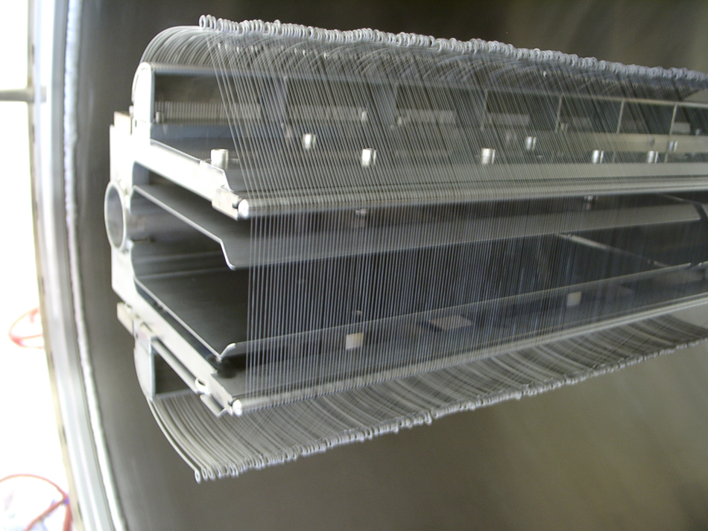
Radiation Hard Electrostatic Extraction Septa
The baseline SIS100 electrostatic extraction septum has a conventional design (wire septum).
However, the high specific energy deposition at full Uranium intensity can not be covered by this design.
Communication/exchange of concepts and idea for alternative E- septa designs.
CERN contact: Bruno Balhan, Jan Borburgh
U at 2.7 GeV/u, cycle 1+1s, 5x10¹¹ ions
Electrostatic wire septum
Wire Ø 25 μm
10 mm jump length
Wire Ø 25 μm
10 mm jump length
Heat load simulations for the W-Re wires

Slide 5
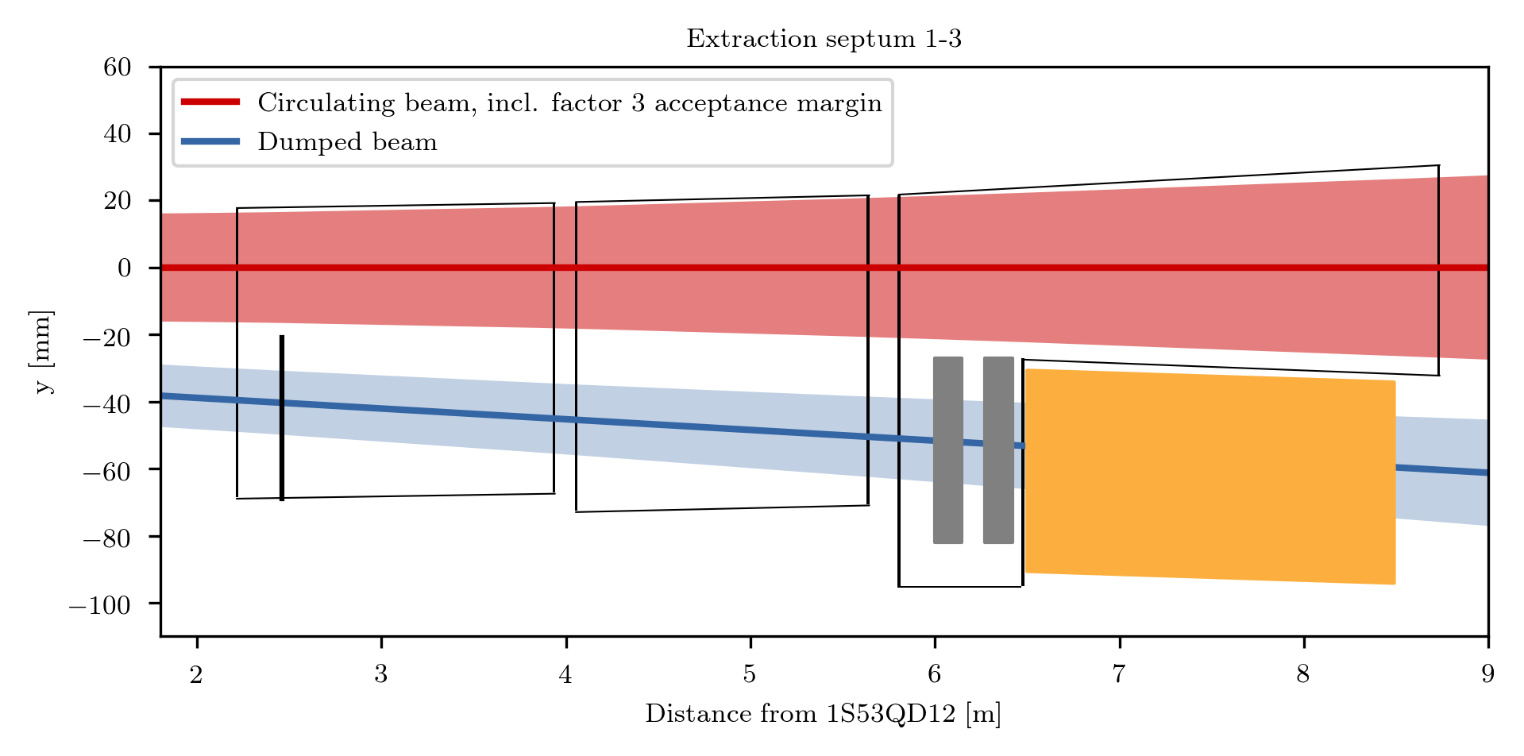
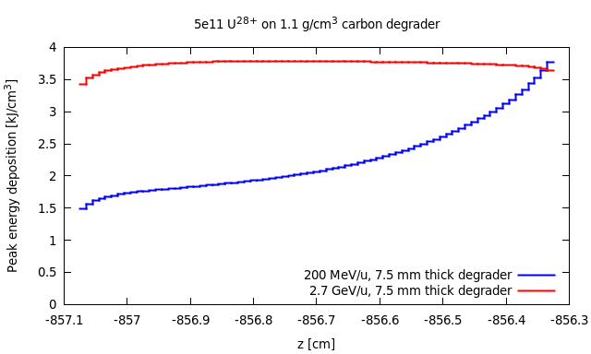
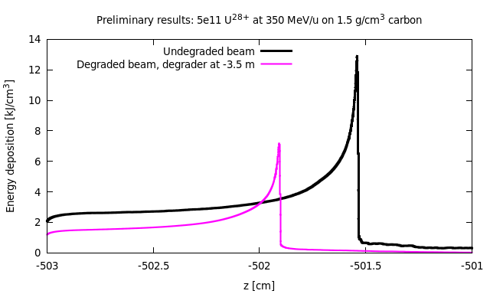
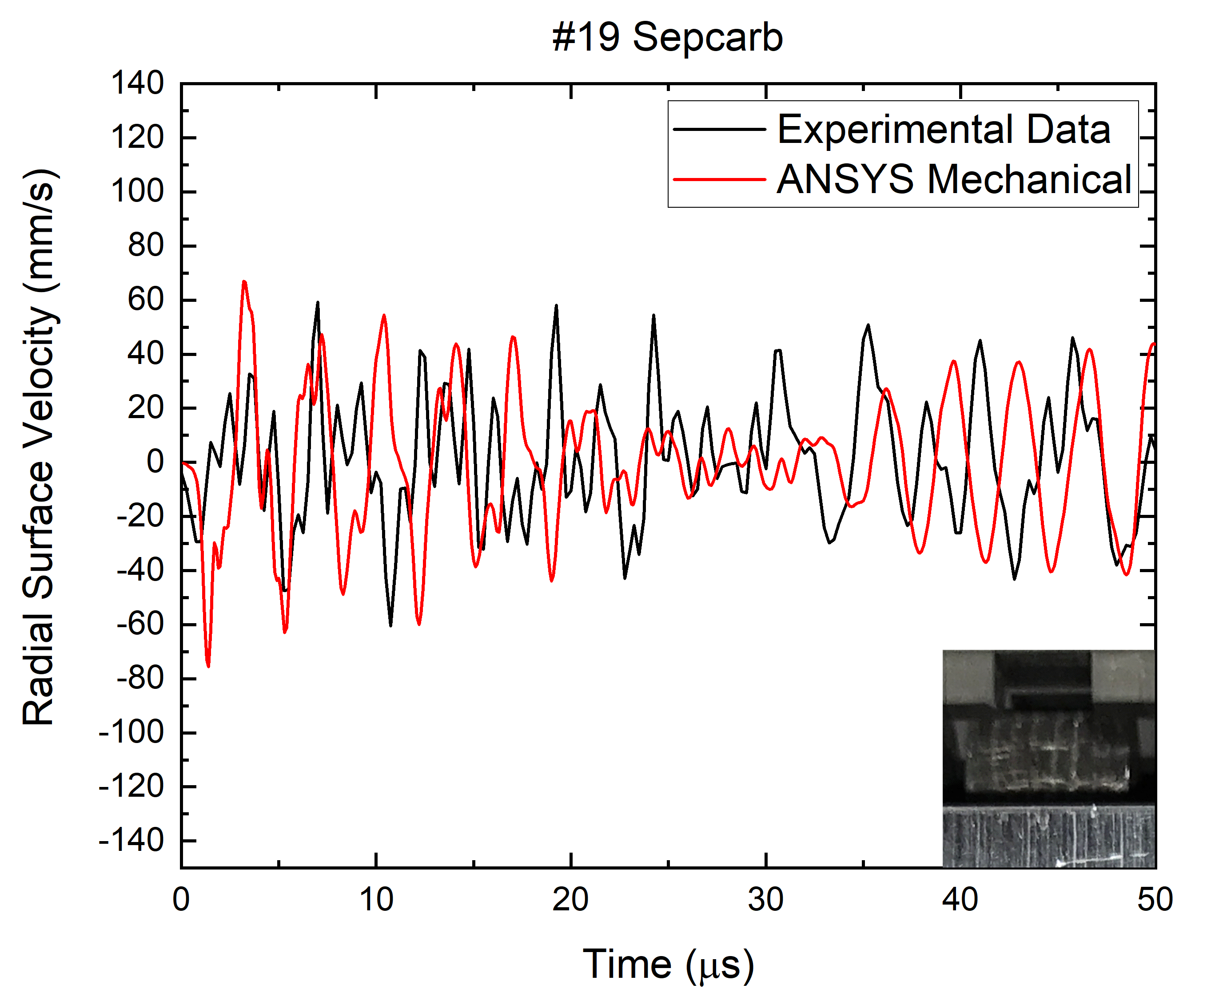
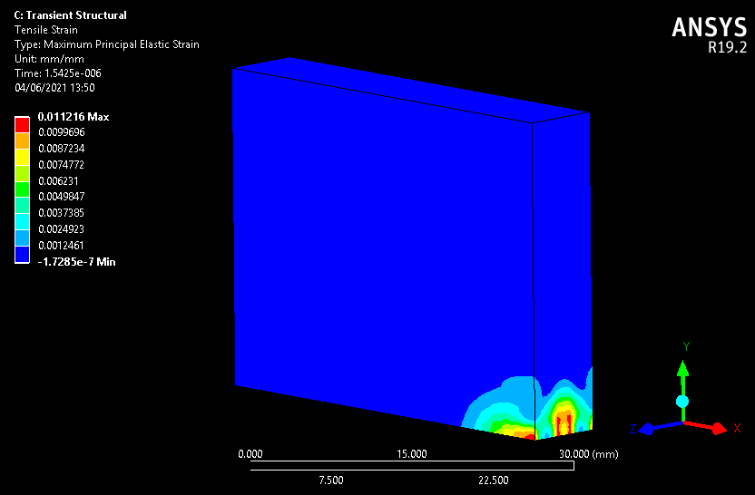
SIS100 Emergency Beam Dump
Function
  Protection of SIS100 machine and experimental equipment from damage by beam
  Essential part of Fast Beam Abort System (FBAS)
  Beam extraction during 50us by fast kickers
Main challenges
  Very different energy loss characteristics of protons and heavy ions (dE/dx ~ Z²)
  Peak energy deposition about 7 kJ/cm³
Design concept
  Split dump into low-Z and high-Z part for absorption of heaviest ions (U²⁸⁺) and protons
  Low-Z part in XHV beam vacuum, high-Z in air
  Degrader to increase beam size at dump
Collaboration interests
  Simulation tools and strategies for dump design
  Material properties of known low-density carbon materials for use in thermo-mechanical simulations
  Estimation of damage thresholds from simulations
  XHV properties of low-density carbon materials
  Material choice for beam exit windows
  CERN contact: M. Calviani (Head SY-STI-TCD)
Geometry of beam dump section
Degrader
Low-Z
High-Z
Courtesy R. Martin (GSI)
Energy deposition in degrader and low-Z part
peak: 7 kJ/cm³
density: 1.1 g/cm³
Courtesy R. Martin (GSI)
Thermo-mechanical simulations
Simulation for HIRADMAT experiment with CFC
Strain in degrader
Courtesy P. Drechsel (GSI)

Slide 6
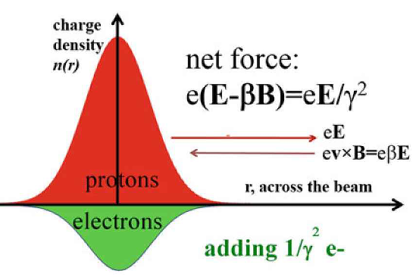
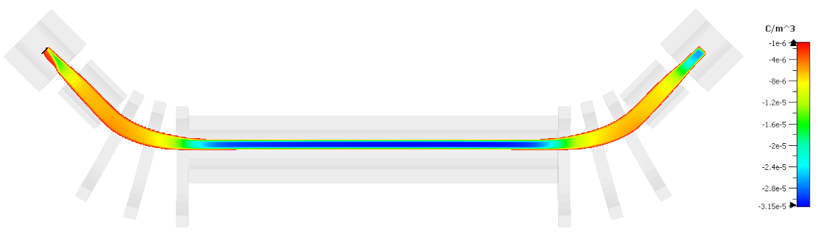
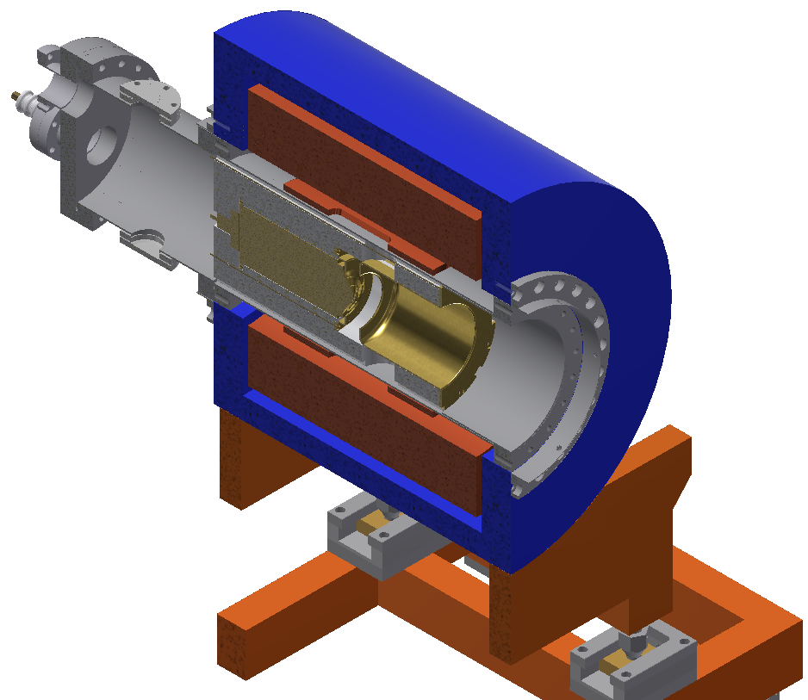
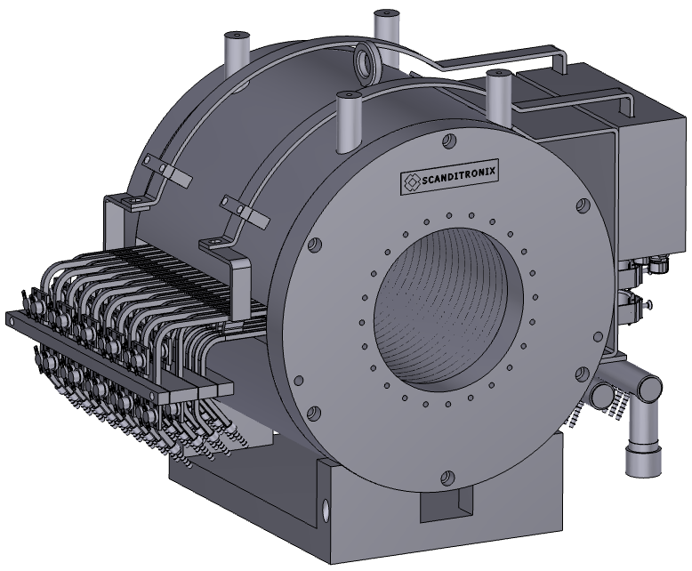
FP7- ARIES – Electron Lens for
Space Charge Compensation
ARIES workpackage (IAP, Frankfurt, Univ. Riga, GSI, CERN)
has been prolongated and shall be completed with all promissed deliveries until Dec. 31th 2021.
Bunch structure in SIS18 cycle
Modulation to match bunch
Motivation: Increasing heavy ion intensities beyond the space charge limit
  Light ions are space charge limited in SIS18 today
  Ion source and injector upgrades will push the limits
  Electron lenses allow to increase intensities by (partial) compensation of space charge
Roadmap: SC compensation lens for SIS18
  Requirements on lens
    Compensation of ΔQ_{sc} = 0.2 for A/Q ≤ 4
    3 Lenses with L = 3.3 m lead to 10 A peak current
    RF modulation to follow bunch structure
    Matching or flat transverse profile
  EU project for RF modulated electron gun
  (ARIES WP16, partners: CERN, IAP, RTU)
    Design of grid modulated gun finalized
    Gun and collector solenoids ordered
    Magnetic design of interaction solenoid done
    Preliminary layout of complete lens exists
  GSI project for manufacturing of prototype lens
    Required for benchmarking and optimization
    Ultimately at least three lenses necessary
Injection
Bunching
Accele-ration
t
Electron beam transport simulation
Mechanical gun design
3-D model of gun solenoid
CERN contact: Adriana Rossi
CERN contribution: Test stand for electron beam. Has been changed since test are conducted at IAP Frankfurt.

Slide 7
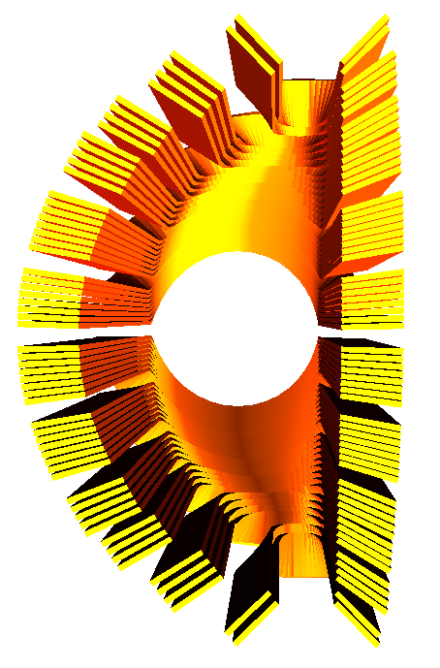
FCC: R&D high-field superconducting (extraction) septa
proposed
purpose/benefit
Contribution to FCC week 2015-2019
Conventional iron-dominated septa are limited to 2 T field strength. At GSI a cosine-theta septa magnet concept was developed enabling much higher field strength.
Superconducting cosine-theta septa might be used at future accelerators (e.g. FCC, SIS400, medical, …). For feasibility studies the concept must be transferred to an engineering design.
cosine-theta septa coil
magnetic field
contribution
Add. | GSI |  | CERN
#x | Septa concept expertise (comparison Nuclotron – Rutherford) |  | Consine-theta expertise (Rutherford cable)
 | Design studies: electromagnetic, cryogenic, mechanical R&D of critical parts Prototyping and testing
high interest from both sides (application in future projects)
benefit from complementary expertise
CERN contact: Jan Borburgh
7

Slide 8
Other Topics
Expert Reviews:
Design and Cold Testing of SIS100 Feed Boxes (28.4.2020) (CERN: Hans Quack)
Interconnection Region Design (Induction in LHe, Mutual Bus Bar Forces, Bus Bar Clamping, Forces by Process Line Bellow and Mechanical Fixations and Support)
(planned)

