Slide 1
FCCIS WP2 Hybrid meeting
Due to limited number of seats and travel restrictions,
plenaries will be held in a hybrid format
  Be kind to the remote colleagues and
  use the room microphones if you have questions
Also keep remote participants in mind for afternoon meetings

Slide 2
Room schedule
Day | Plenaries | Morning | Afternoon
Monday, Nov. 29th | Welcome, optics & corrections | 6/2-024 Be-Auditorium | 6/R-012
Tuesday, Nov. 30th | Codes | 6/2-024 Be-Auditorium | 6/R-012
Wednesday, Dec. 1st | Collimation, beam-beam | 6/2-024 Be-Auditorium | 6/R-012
Thursday, Dec. 2nd | ABP-Day | 222/R-001 | 6/R-012 / Dinner
Friday, Dec. 3rd | MDI | 40/S2-A01 | 40/S2-A01
Monday, Dec. 6th | Optics correction at existing facilities | 6/2-024 Be-Auditorium | SC Visits
Tuesday, Dec. 7th | Booster, injection & extraction | 40/S2-D01 | 104/R-A10
Wednesday, Dec. 8th | Collective effects, E-cloud | 6/2-024 Be-Auditorium | 6/R-012
Thursday, Dec. 9th | Vacuum, Fluka, Polarization | 6/2-024 Be-Auditorium | 6/R-012
Friday, Dec. 10th | Closing | 6/2-024 Be-Auditorium | 6/R-012
For finding rooms: https://maps.web.cern.ch

Slide 3
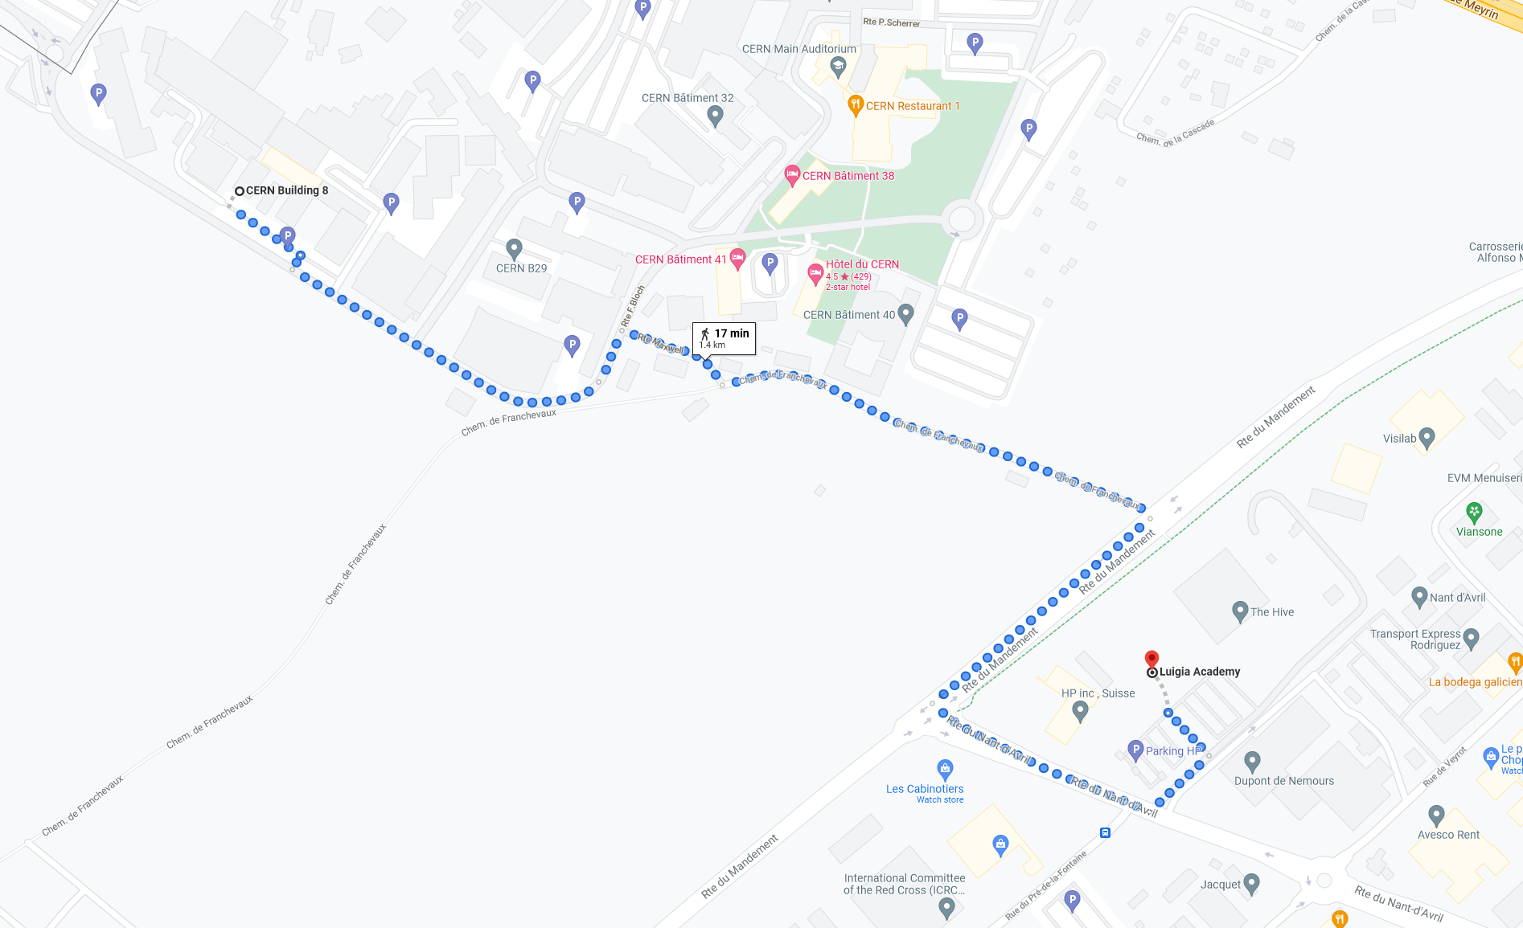
Locations, Luiga restaurant (outside CERN)

Slide 4
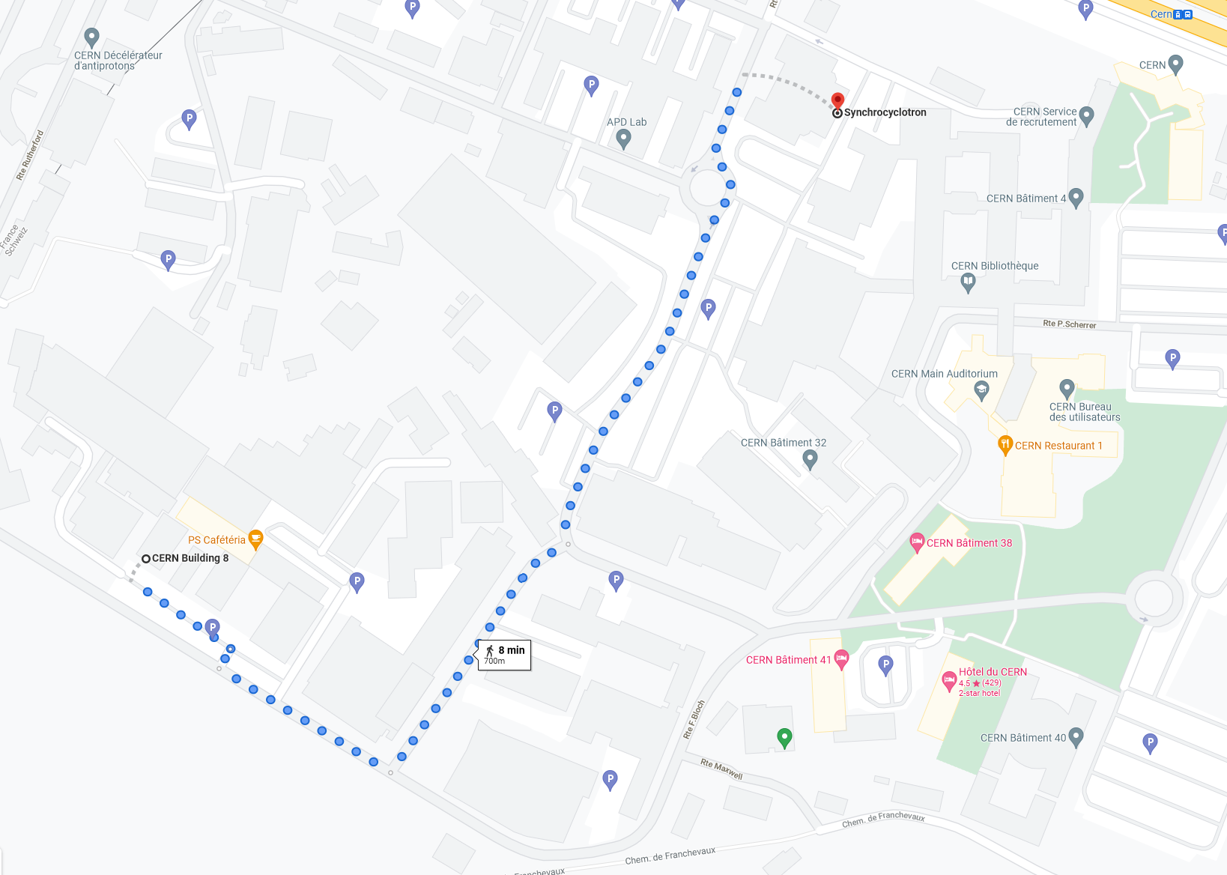
Locations, SC Visit

Slide 5
Communication
In case of any problem, send email an email to any of the organizers
Mattermost server (slack alternative at CERN)

Slide 6
Covid-matters
Masks when seated in the auditorium
  Speaker may remove their mask during the presentation
Only 21 persons allowed in BE-auditorium
  Priority will be given to speakers and externals
More information here and on https://hse.cern/covid-19-information

