Slide 1
Optics and Documentation
Repository for FCC
Ghislain ROY -- FCCIS WP2 Workshop 2021
30th November 2021

Slide 2
FCC Optics Repository
Repository : a place where we keep our common and valuable assets for FCC machine and optics design and development
Our assets are immaterial but very valuable given the efforts and work invested to ensure best performance and operability of the FCC.
Assets in the form of computer files and codes for now; later in databases…
Common assets implies that within the team
they can be shared;
they shall be easily understood and mastered;
and they shall be easily used further and built upon
Loop over many years between now and FCC operation
  Asset volume and value will grow
FCC Optics repository must be easy and useful
Valuable Common Assets
Collective efforts and work

Slide 3
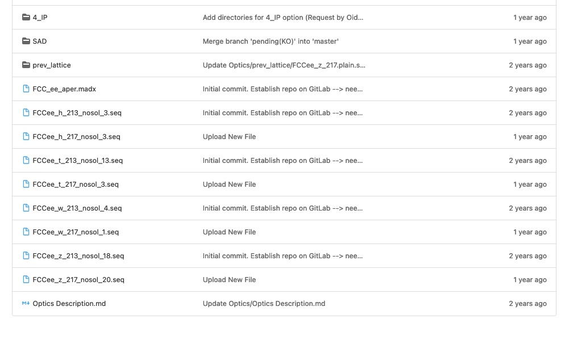
Legacy situation for FCC : own Gitlab instance
https://gitlab.cern.ch/fcc-optics
Hosts FCC-ee, FCC-ee-HEB, FCC-hh, FCC-eh
Master and few branches for FCC-ee
Several versions of the optics
  213 (CDR) and 217 (post CDR) at 4 energies each
  Optics in one single file
  301, a first 4-IP version, etc…

Slide 4
CERN Optics repository https://acc-models.web.cern.ch/acc-models/
Based on Gitlab
Documentation and website files also stored on Gitlab
Website generated from files on Gitlab, including MAD-X output files for plots…
Git clones of optics files are provided for easy linking through AFS and EOS:
  /afs/cern.ch/eng/acc-models/
  /eos/project/a/acc-models/public
  ‘Call, file=“/eos/project/a/acc-models/public/…’ in a MAD-X job
Most everybody probably goes to website for info and reference values,
and calls EOS files from their MAD-X jobs for their studies.
No Git cloning necessary unless you develop a new branch…

Slide 5
Migration to acc-models
After discussion, decision was taken to migrate the FCC Gitlab instance to acc-models
  Single place for all optics related files and documentation
  Tried and tested model for storage, documentation, tests, deployment
  Building upon the experience of acc-models maintainers; economy of resources, reusing recipes
Migration is ongoing… thanks to Alexander Huschauer and Riccardo De Maria
  FCC-eh already migrated; visible on Gitlab but not yet visible from website

Slide 6
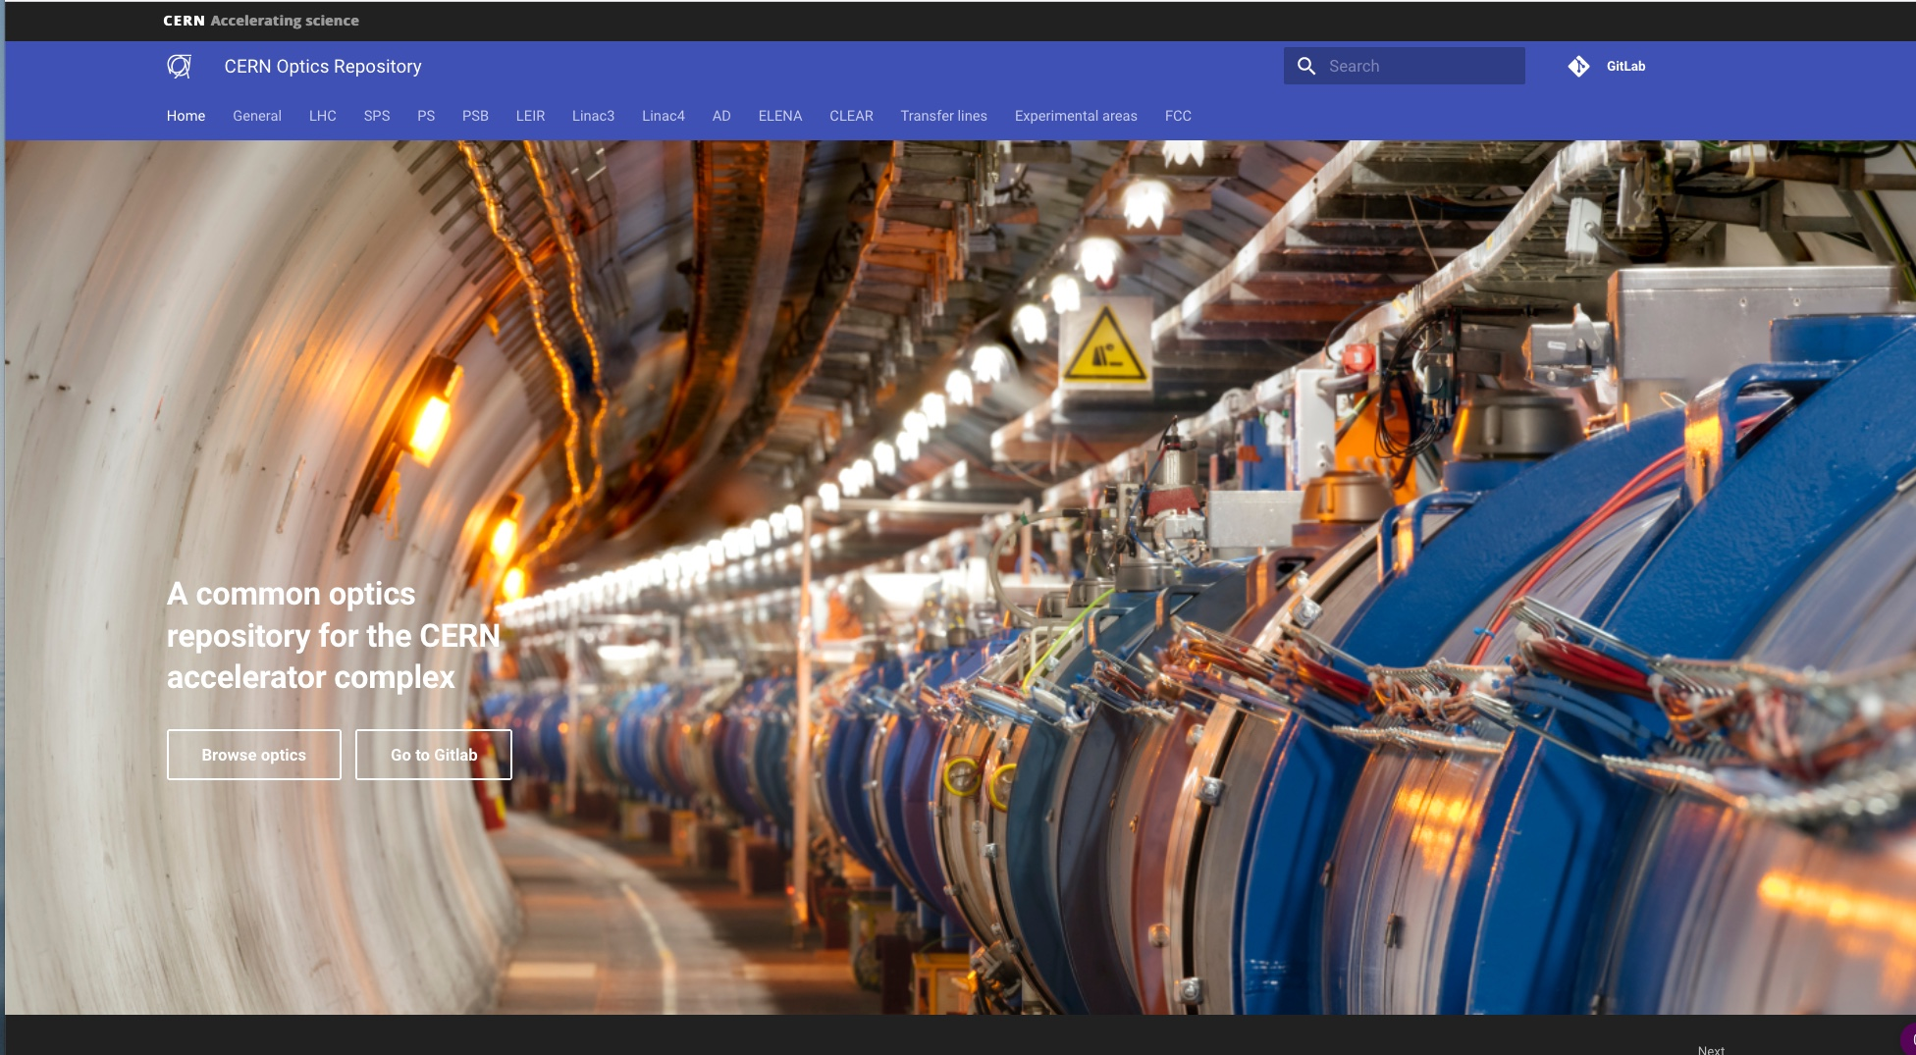
https://acc-models.web.cern.ch/acc-models/

Slide 7
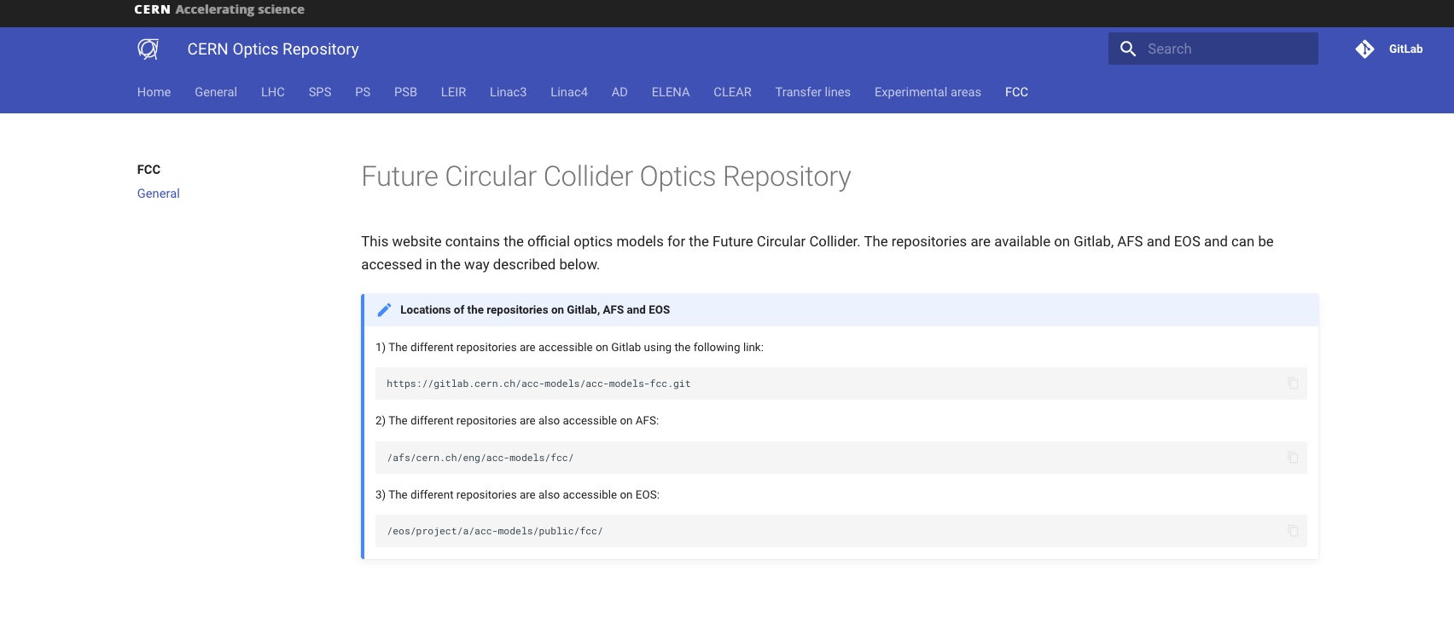
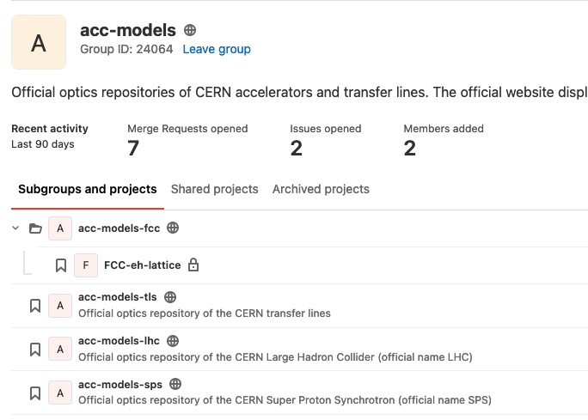

Slide 8
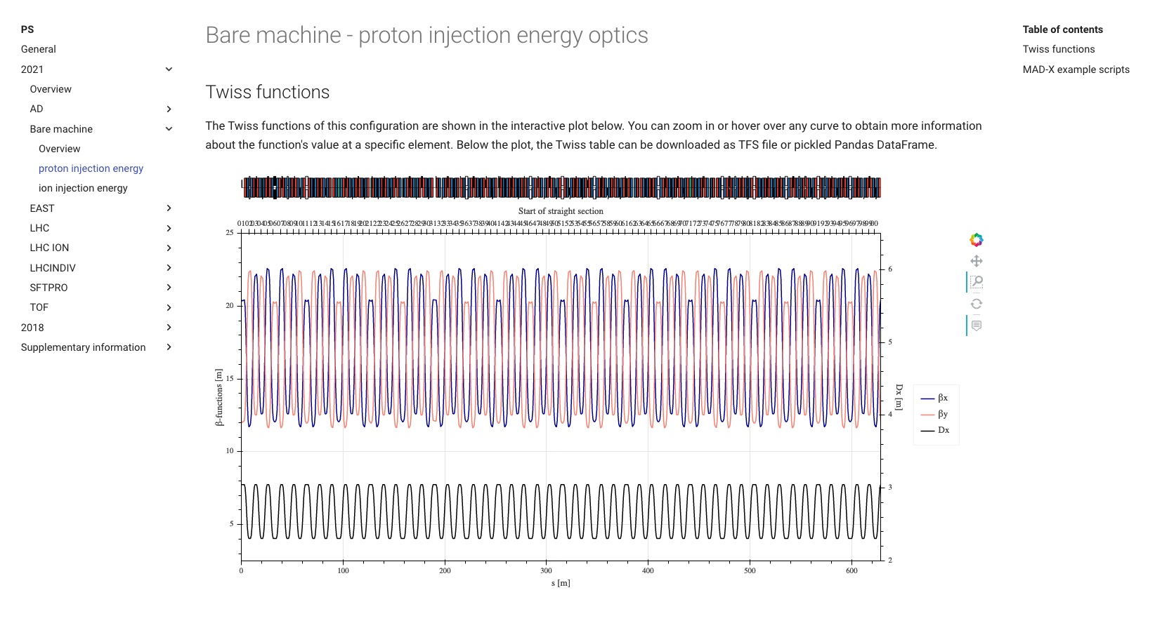

Slide 9
Optics Repository
Some pitfalls:
  Newcomers need to find their way through the data and its history; avoid losing time in induction,
  self-exploration, digging for information
  Avoid exploring a path already treaded ; document the loose ends and roadblocks
  Who remembers why we did it like this ?
  Using standardised version of the optics as firm ground for further studies (beam-beam, collimation,…) and for valid comparison between studies
Repository shall also hold pertinent documentation of the data files and the process that led to their development
  Documentation can be inline (comments to explain, guide, clarify…) or as extra files (or links)
  Documentation also needs structuring and discipline
    “JD: moved third collimator left of IP by 4cm”

Slide 10
How many reference optics do we need ?
Name versions with “publication friendly names”
proposal: V22.01 for the first reference version in 2022
  Can build forward and backward, eg version 213 by Oide-san can be tagged V18.01
Each reference version can have multiple filesets
  5 different energies (45.6, 80, 120, 175, 182.5 GeV)
  Multiple optics configurations ? Detuned/commissioning optics ? alignment optics ? …
  2 beams and therefore 2 sequences;
  but also two machines in some parts and different excitation sets.
  but avoid the beam2 paradigm of LHC !
  2 IP’s vs 4 IP’s
  Thick lenses vs thin lenses
  Study or MD optics
Define the mandatory sets and the optional parts
Define the directory tree.

Slide 11
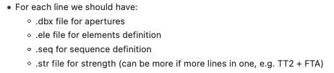
Good practice and return on experience
Avoid single file with everything
Split optics and machine description in several files with “engineering” view
  Element definitions ; “just the hardware”,
  with classes of elements and mechanical characteristics (length, basic aperture)
  QD: Quadrupole, L=1.6, apertype=ellipse, aperture={0.3,0.1};
  Symmetries of excitations; “no values, just logic”
  for example when two magnets are connected to the same bus-bar.
  KQS0.L2 := KQS0.2 ; KQSQ0.R2 := KQS0.2;
  Excitations of circuits; “Here be values !”
  KQS0.2 = 0.3792;
  Layout as LINE or SEQUENCE description; “only the geometry !”
    Line description for conceptual studies, exploiting repetitions and symmetries… but define drifts !
    Sequence descriptions have no drift but need to know precise positions; but can be nested and have relative positioning
  Specialised files: marker sets, instrumentation, detailed aperture models, solenoids, impedance…

Slide 12
Good practice and return on experience
Optics files must be complemented with
  Test jobs (madx | numdiff or other tools)
  Sample jobs (MAD-X or SAD)
Sample jobs
  are used for example to build special configurations,
  e.g. tapering, installing solenoids, loading imperfections, install specific observation points, etc…
  Can serve as “tutorial material” and are easily reused by cut and paste
  in MAD-X or SAD language ; but avoid the large macro libraries of LHC…

Slide 13
Good practice and return on experience
Tests are mandatory to evaluate the state of a development
and ensure quality control before a new version is officially released.
Provide specific MAD-X or SAD jobs with standardized results that can be validated, either internally or through post-processing. Automated process !
Examples:
  Closure of the ring, basic Q and Q’ values, optics functions at IP, optics functions at other specific locations (eg cavities, BI…), SR parameters at specific locations…
  e+ vs e- ; thin optics vs thick optics …
  Run SAD on translated MAD-X files; check results; run MAD-X on re-translated SAD files; check results
  Translate to SAD and optimise momentum acceptance; check results
Tests provided by you as well !!

Slide 14
Optics Repository
Holds a structured set of files including the documentation
Common approach to be decided together and then enforced collectively
Quality Control to be implemented as a set of tools, and a common mindset
Optics Repository is not a dump and shall only hold valuable data
Everybody in the team has access to website and afs/eos replicates
Few people, a team of librarians, have access to Gitlab as Developer or Maintainer

Slide 15
“Minor details…”
Next step is a link to layout databases
  Requires a change in naming conventions from “design” names to “engineering” names
  Experience of existing accelerators will also help
  Three prong asset management: DB, Git/Web, Filesystems
Custodian service accounts, not personal accounts. FCC.Optics@cern.ch
Egroups for maintenance and information sharing.

Slide 16
Timeline…
Given the “fluidity” of the FCC-ee study in 2021
  Optimisation of siting and layout;
  2IP’s vs 4IP’s;
  RF placement;
  Revisiting machine circumference for RF cogging;
  Injection scheme into HEB…
there was little point in moving towards a more “rigid” repository system with full documentation, but as soon as decisions are made on these major options, including circumference and machine layout, it will be time to produce a first reference, engineering-oriented version of the optics fileset and document it on acc-models
And thanks to Michael Hofer for setting up and testing the first workflows

