Slide 1
Code Comparison and Lattice Models
Leon van Riesen-Haupt
Many thanks to:
Rogelio Tomas, Tobias Persson, Tessa Charles, Katsunobu Oide, Helmut Burkhardt, Frank Zimmermann, Michael Hofer

Slide 2
Comparison Studies

Slide 3
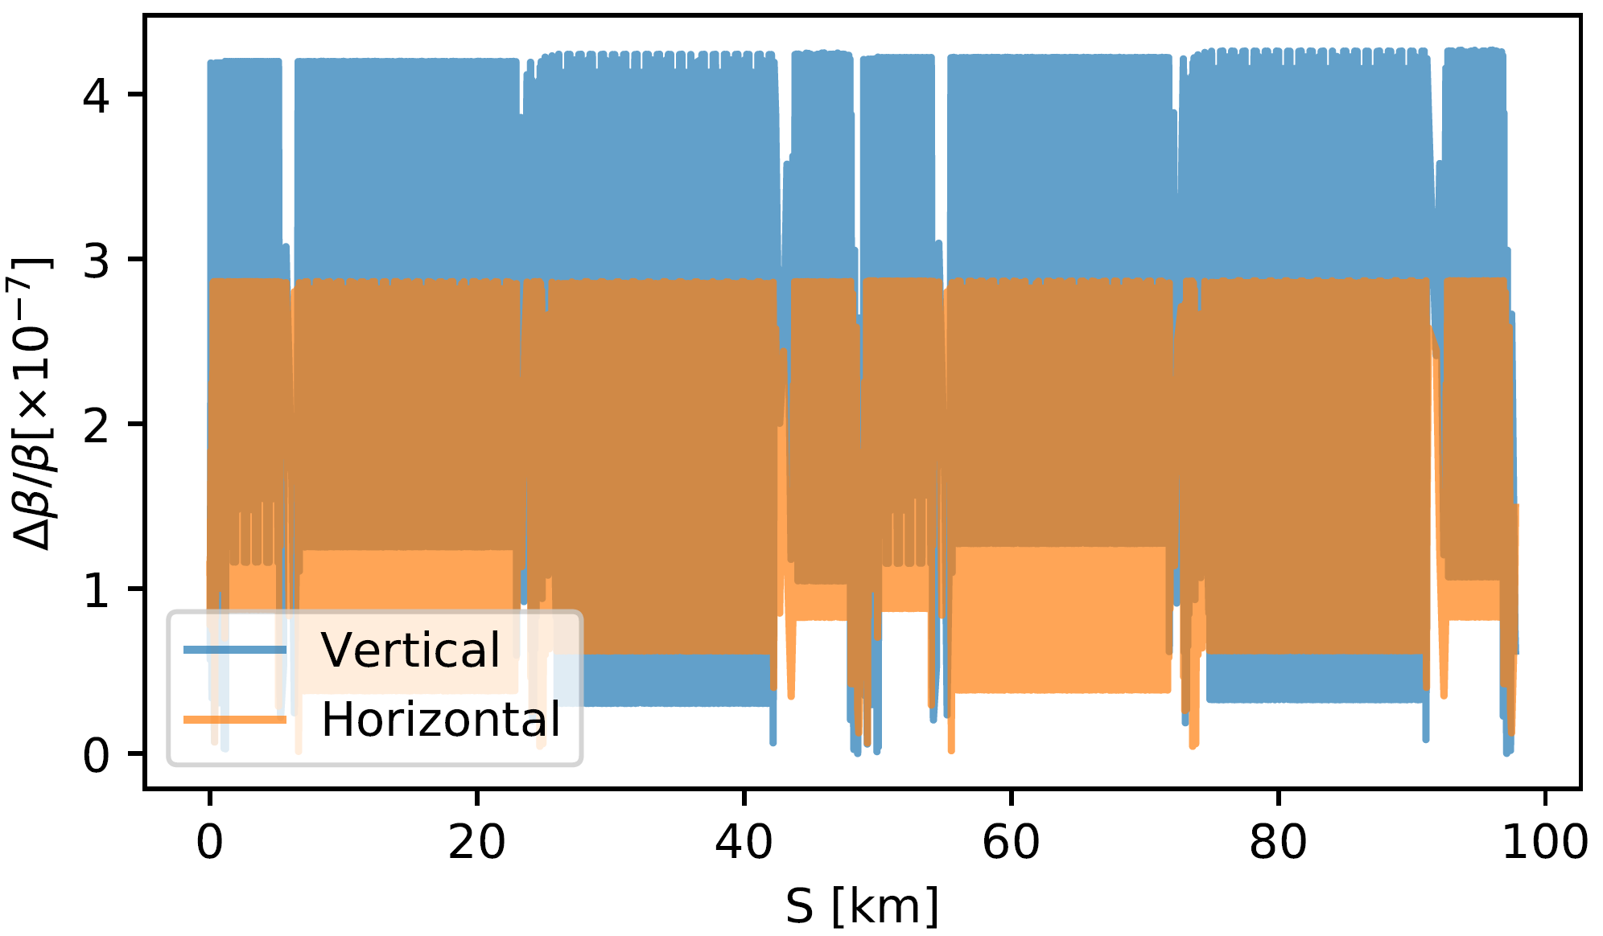
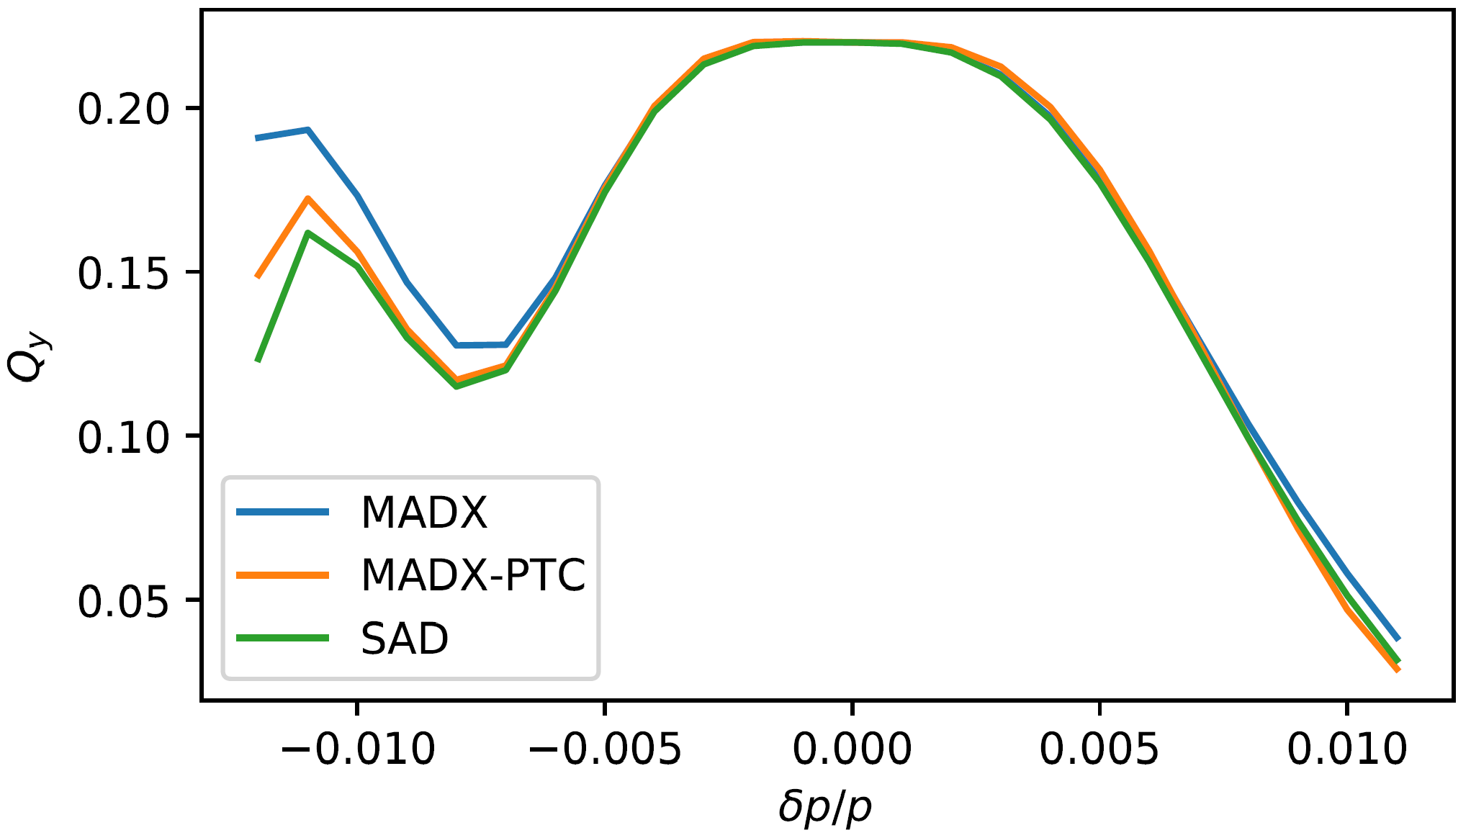

Comparison Studies – Optics
$β$-beating between MADX and SAD
Comprehensive comparison studies
  Beating between linear optics
  Momentum detuning
  Very good agreement between SAD, MADX, MADX-PTC
Presented during IPAC’21
  TUPAB004
Essential for ensuring optics studies in both codes are compatible
  Testing that translation is accurate
  Creating basic job files

Slide 4
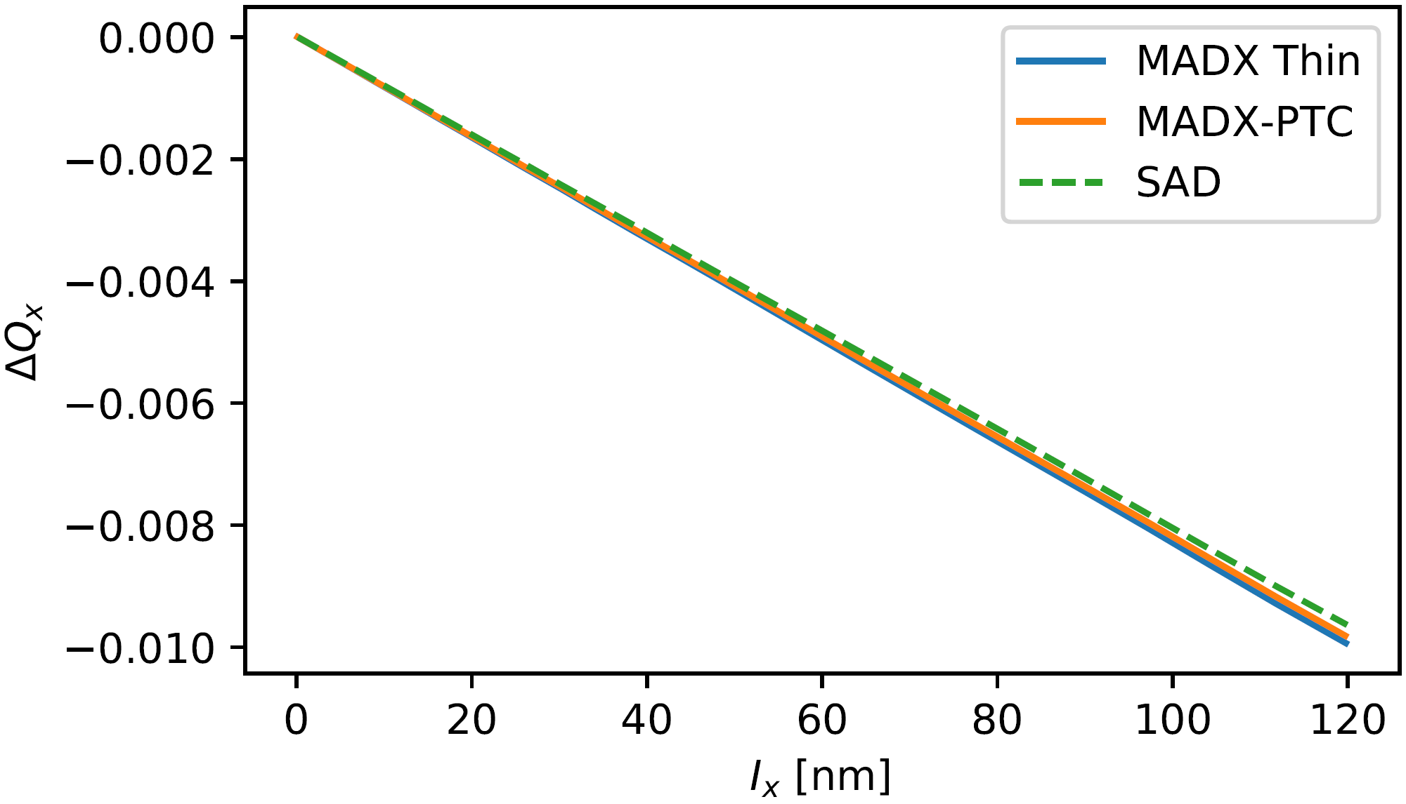
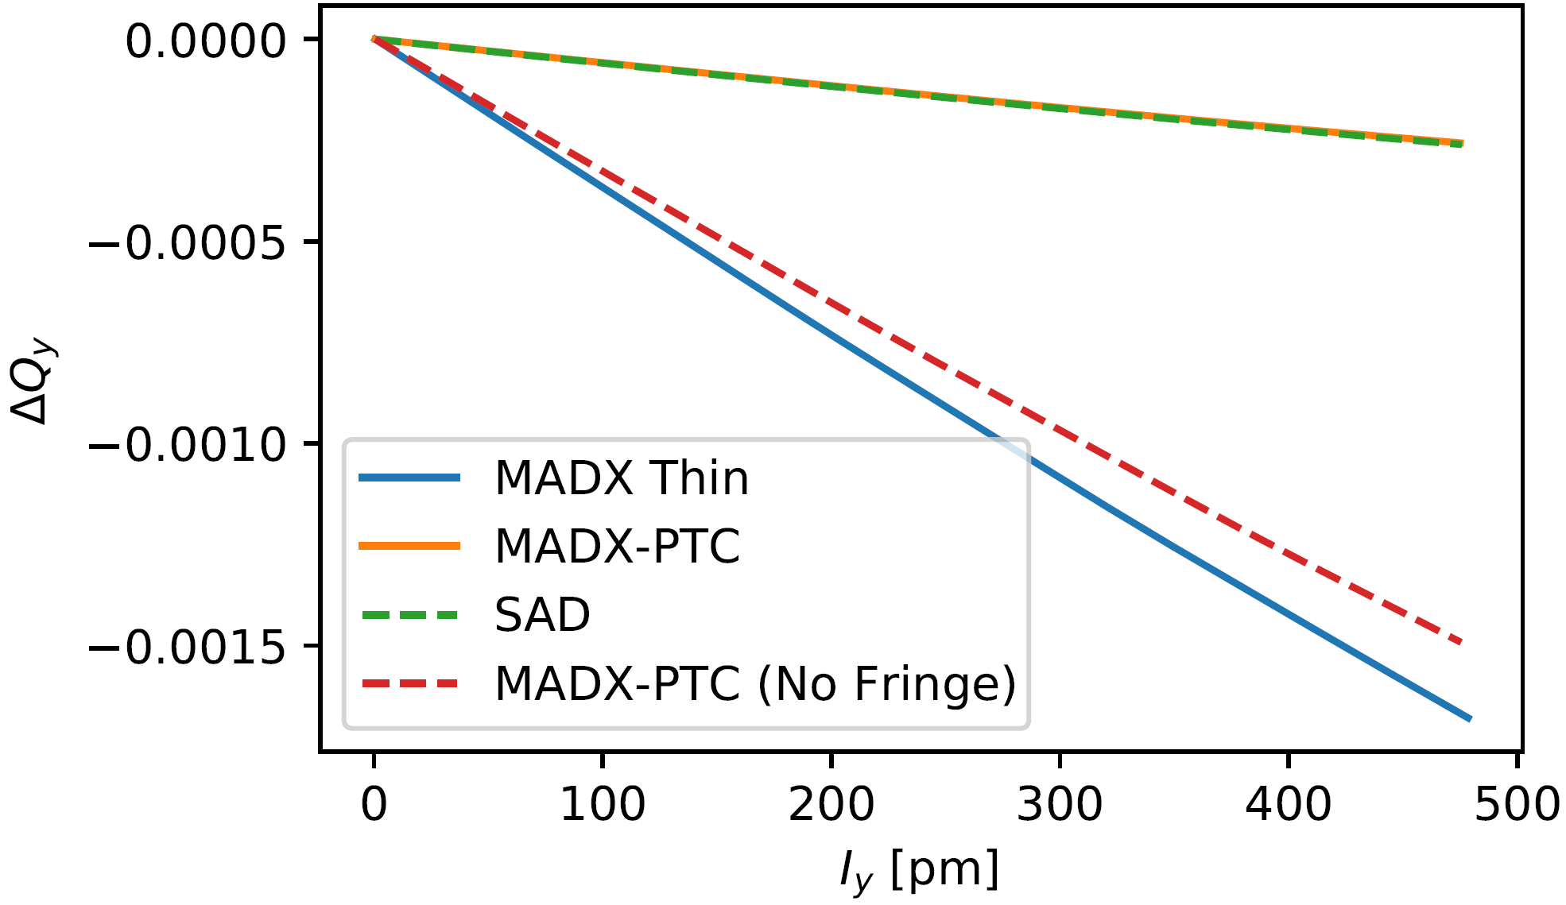
Comparison Studies – Tracking
Tracking to study amplitude detuning
  Also presented in IPAC’21 TUPAB004
  Good convergence when many integration steps are used in IR magnets
    Important information for DA tracking studies
    Setting essential in MADX and SAD

Slide 5
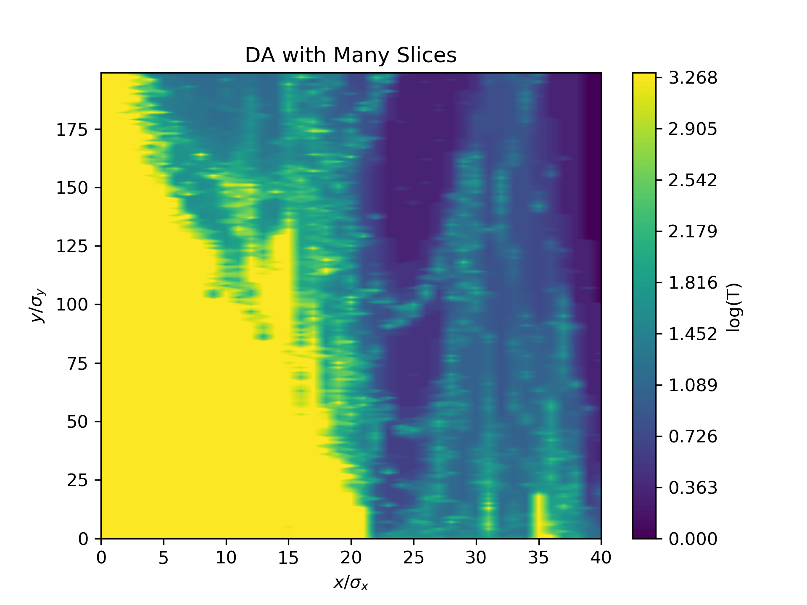
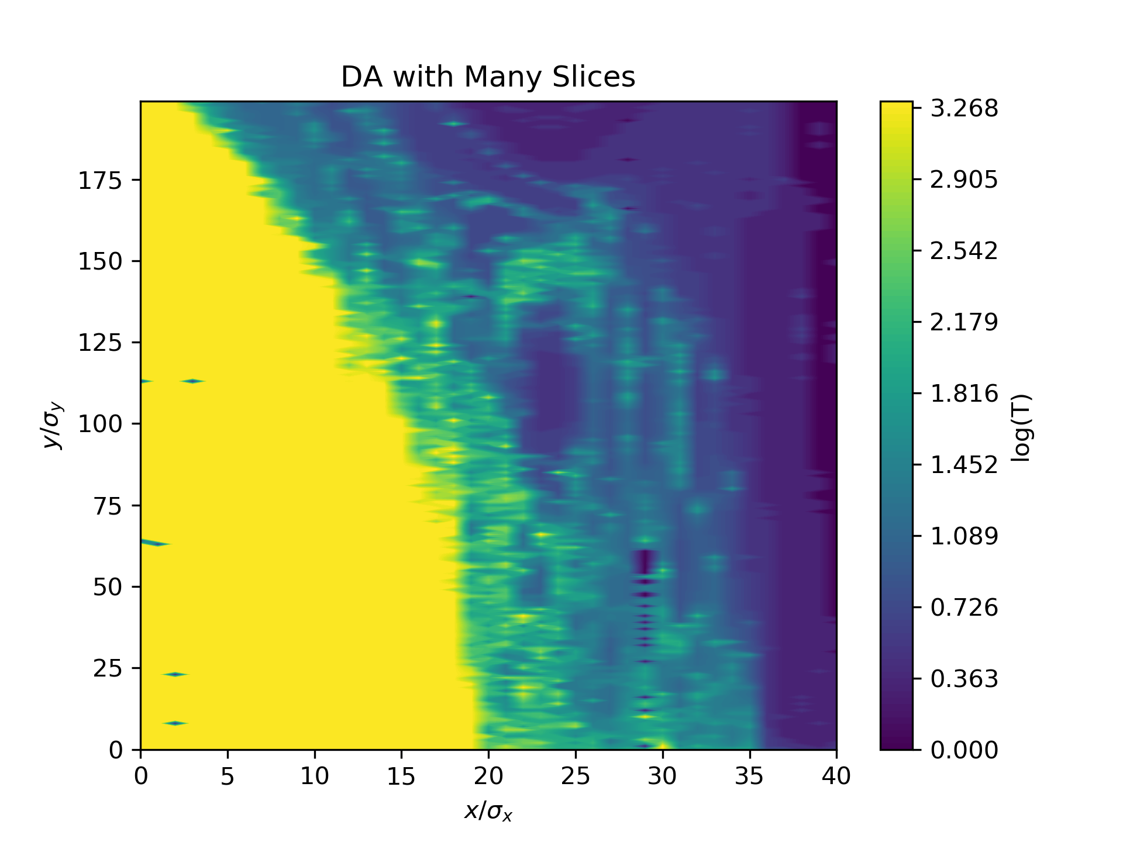
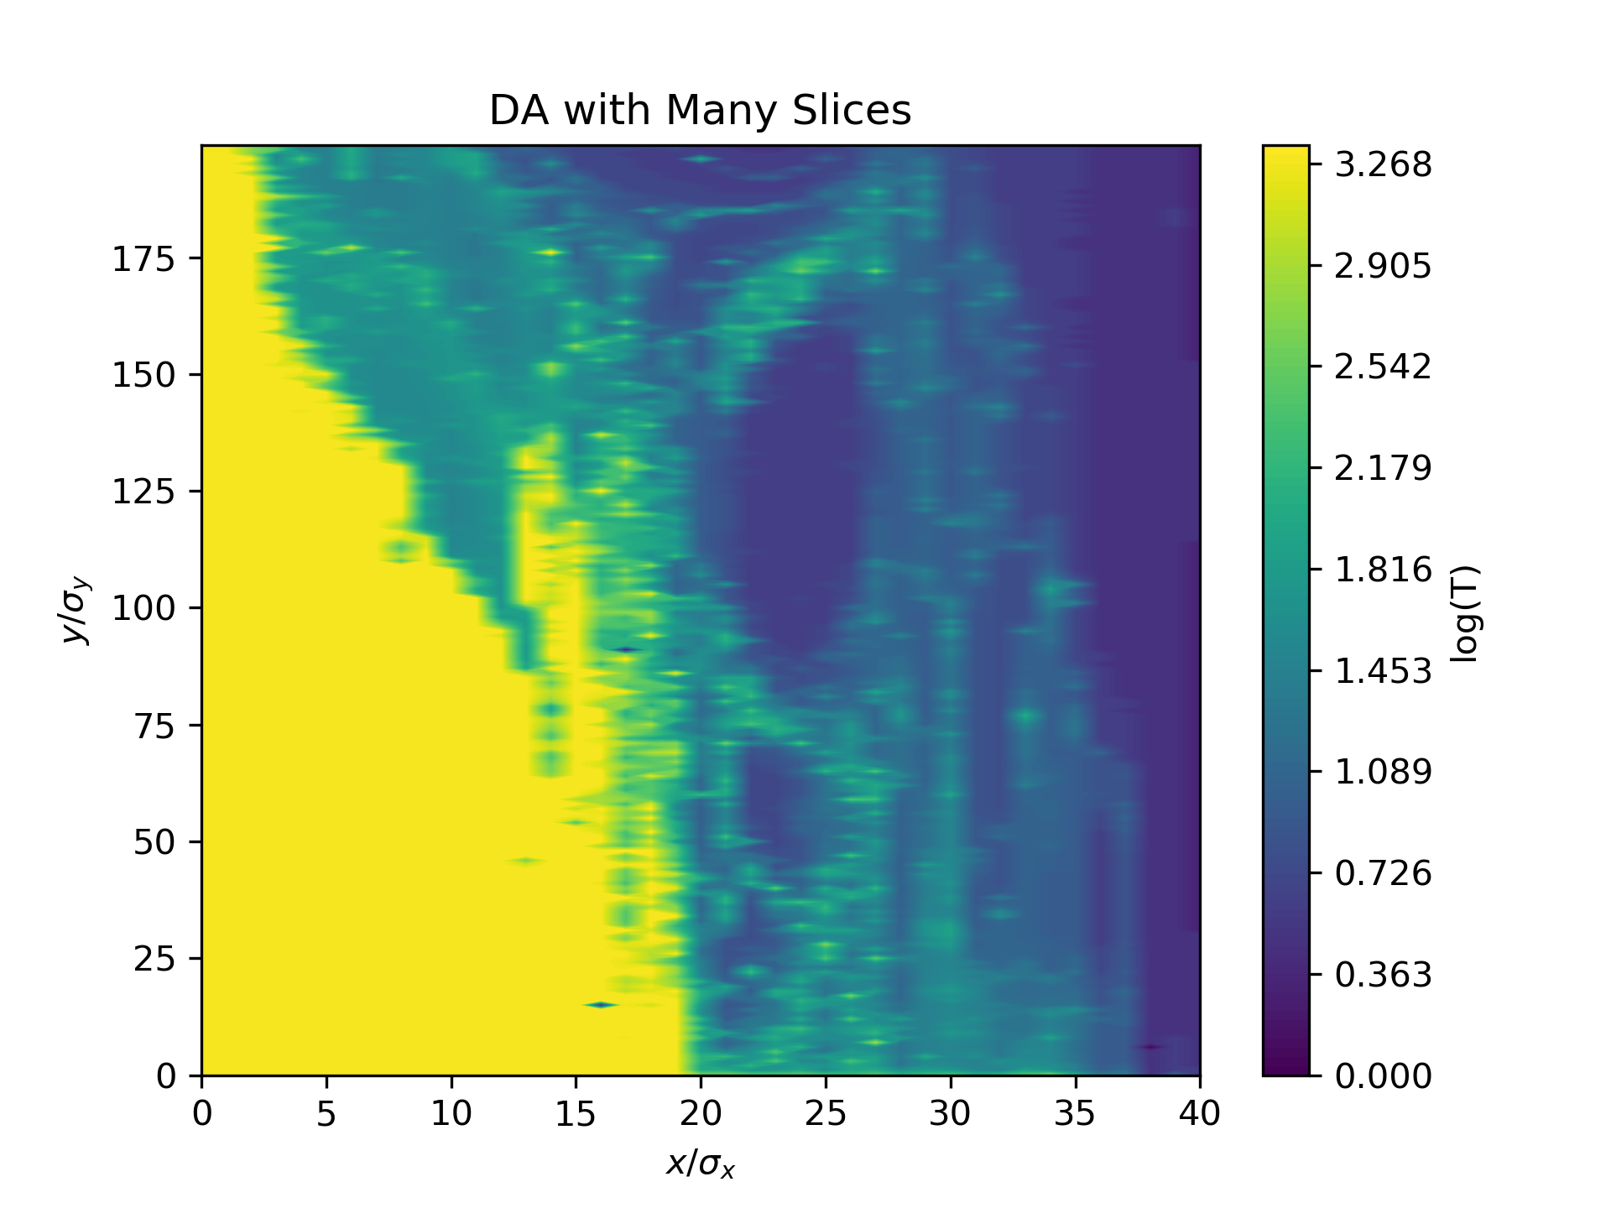
Comparison Studies – DA from Tracking
PTC
DA studies from tracking
  Using information and settings from amplitude detuning studies
  Radiation turned off
  Tracking acceptance
    On- and off-momentum
Relatively good agreement between all three codes
  Used as basic example for tracking studies
  Partially shown in FCC-ee optics meeting
MADX
SAD

Slide 6
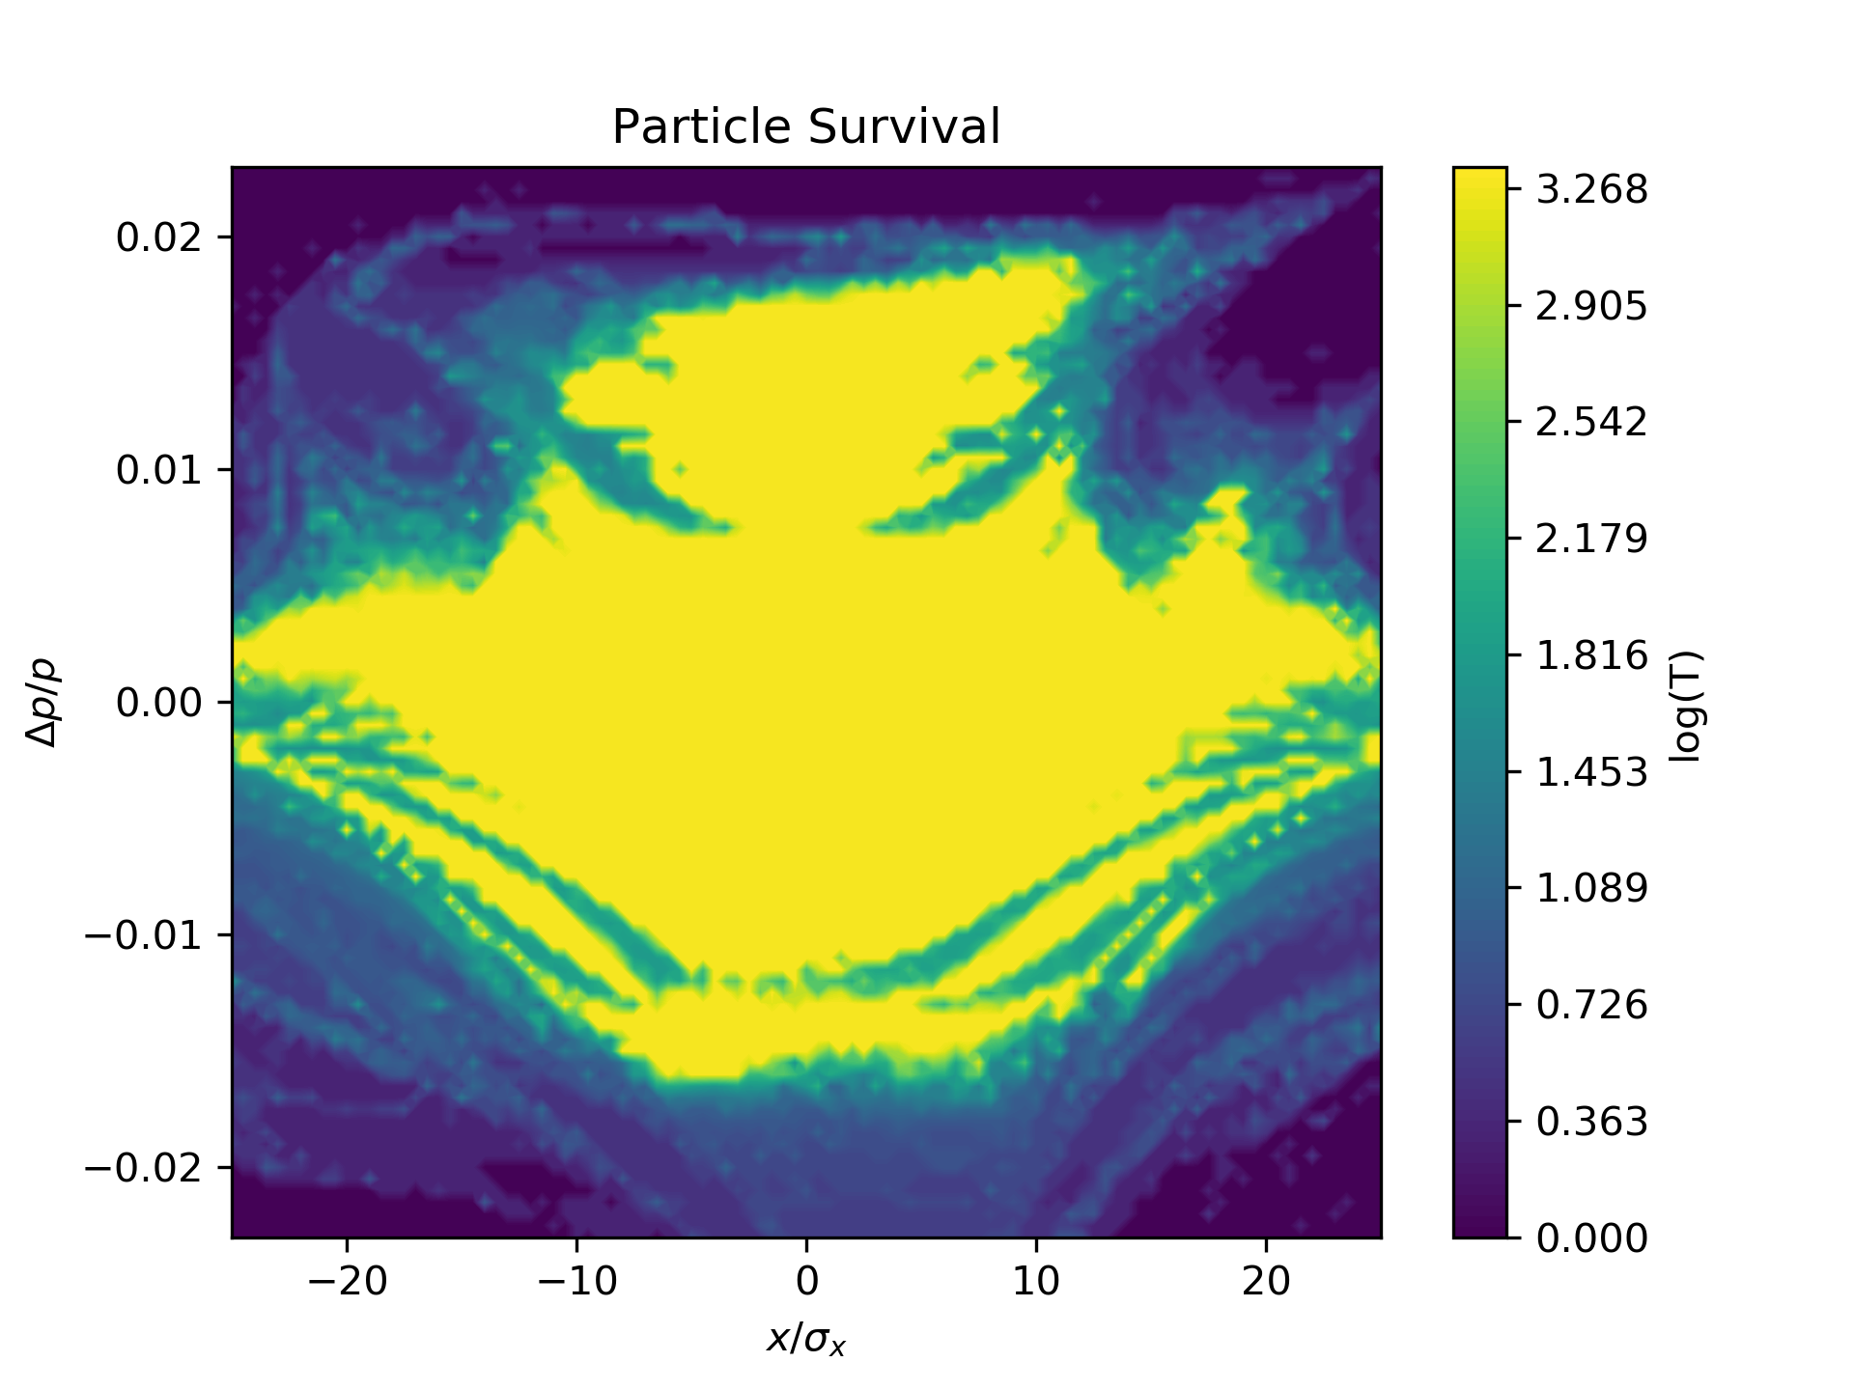
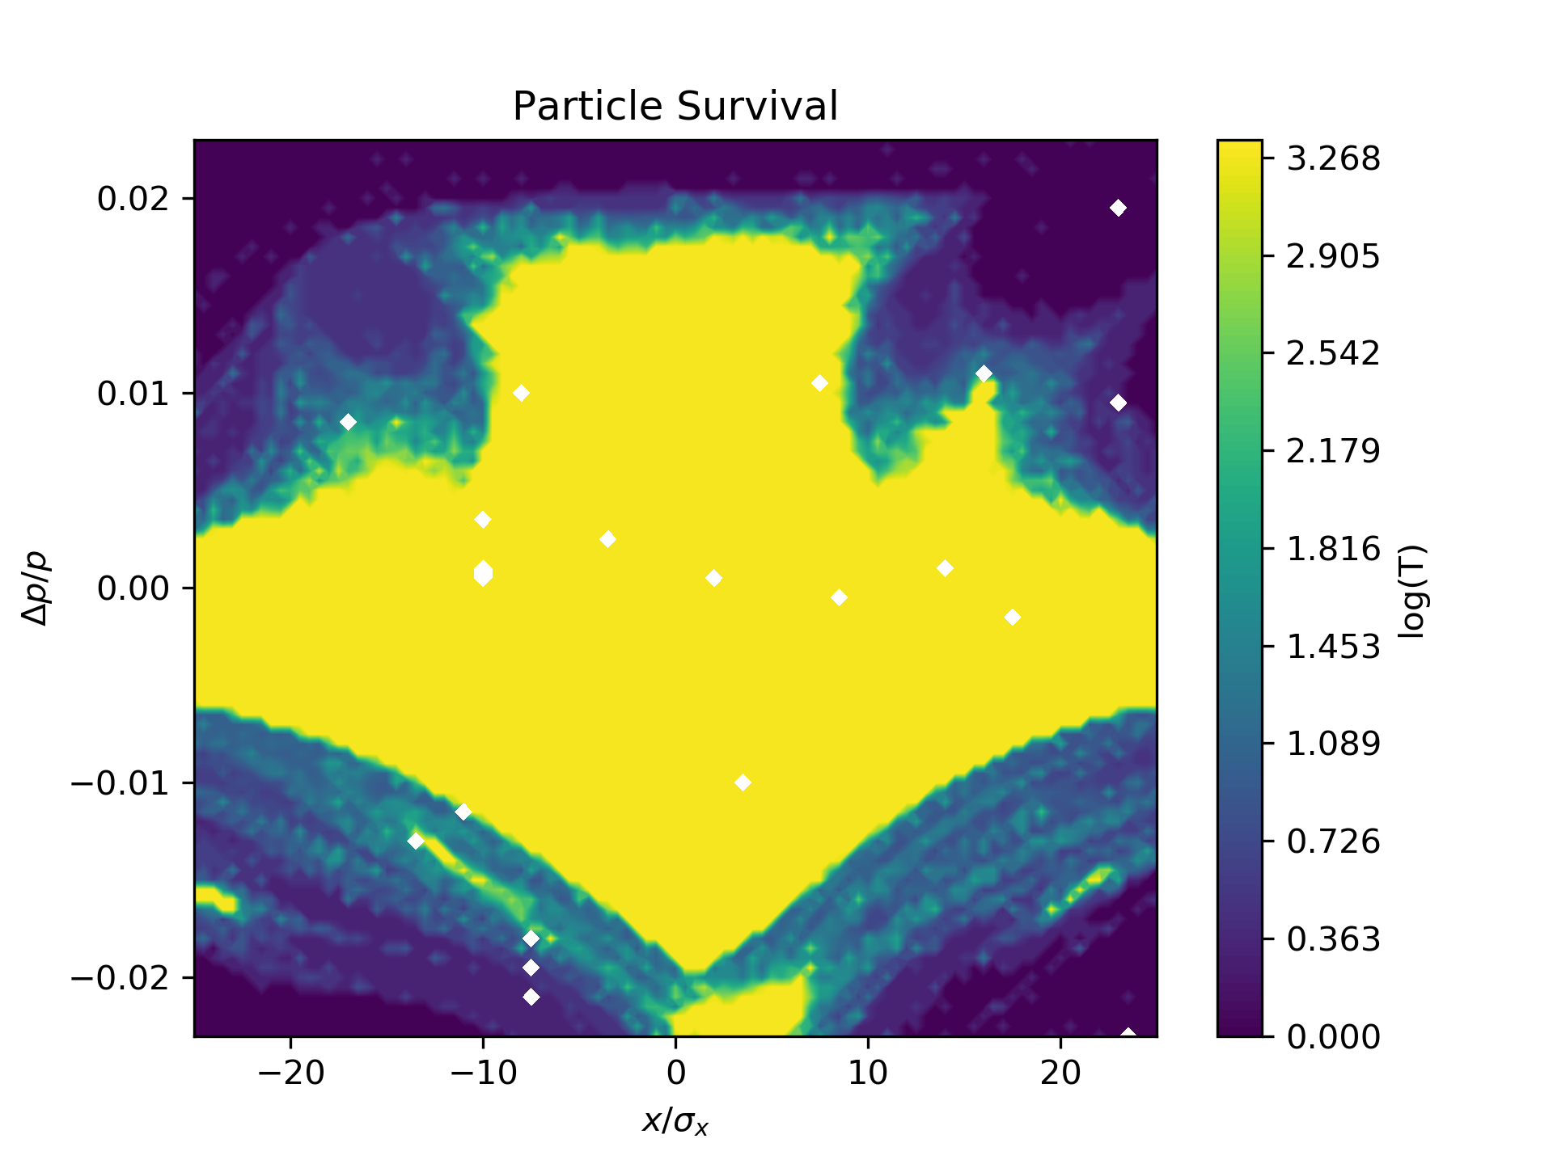
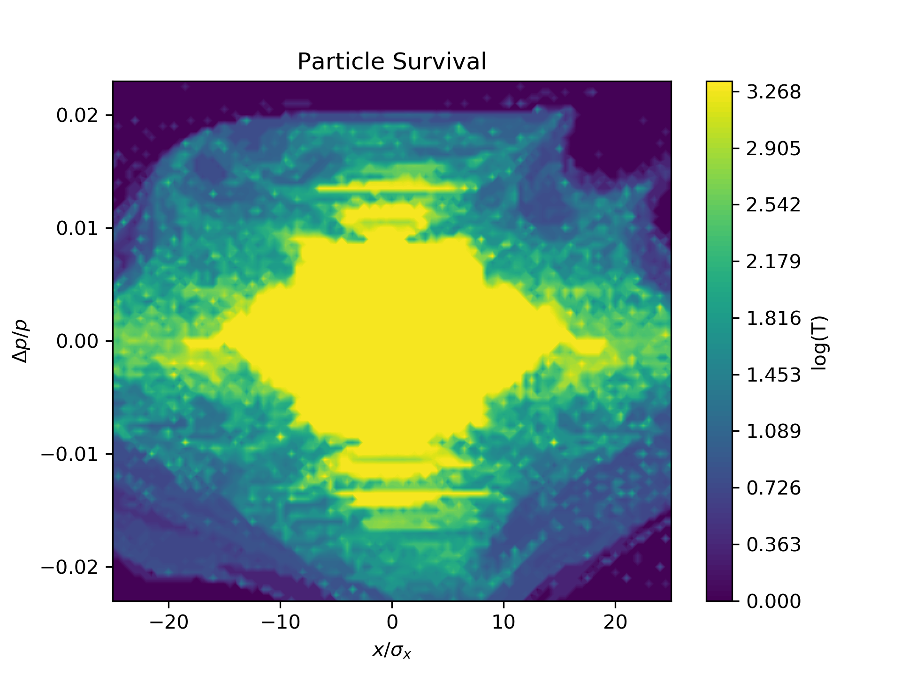
Comparison Studies – DA from Tracking
PTC
DA studies from tracking
  Using information and settings from amplitude detuning studies
  Radiation turned off
  Tracking acceptance
    On- and off-momentum
Relatively good agreement between all three codes
  Used as basic example for tracking studies
  Partially shown in FCC-ee optics meeting
MADX
SAD

Slide 7
MADX features

Slide 8
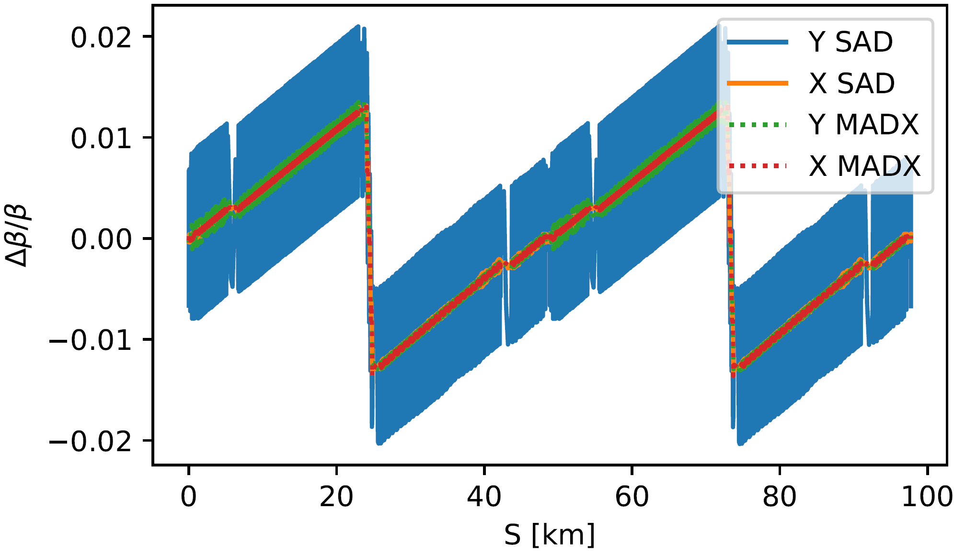
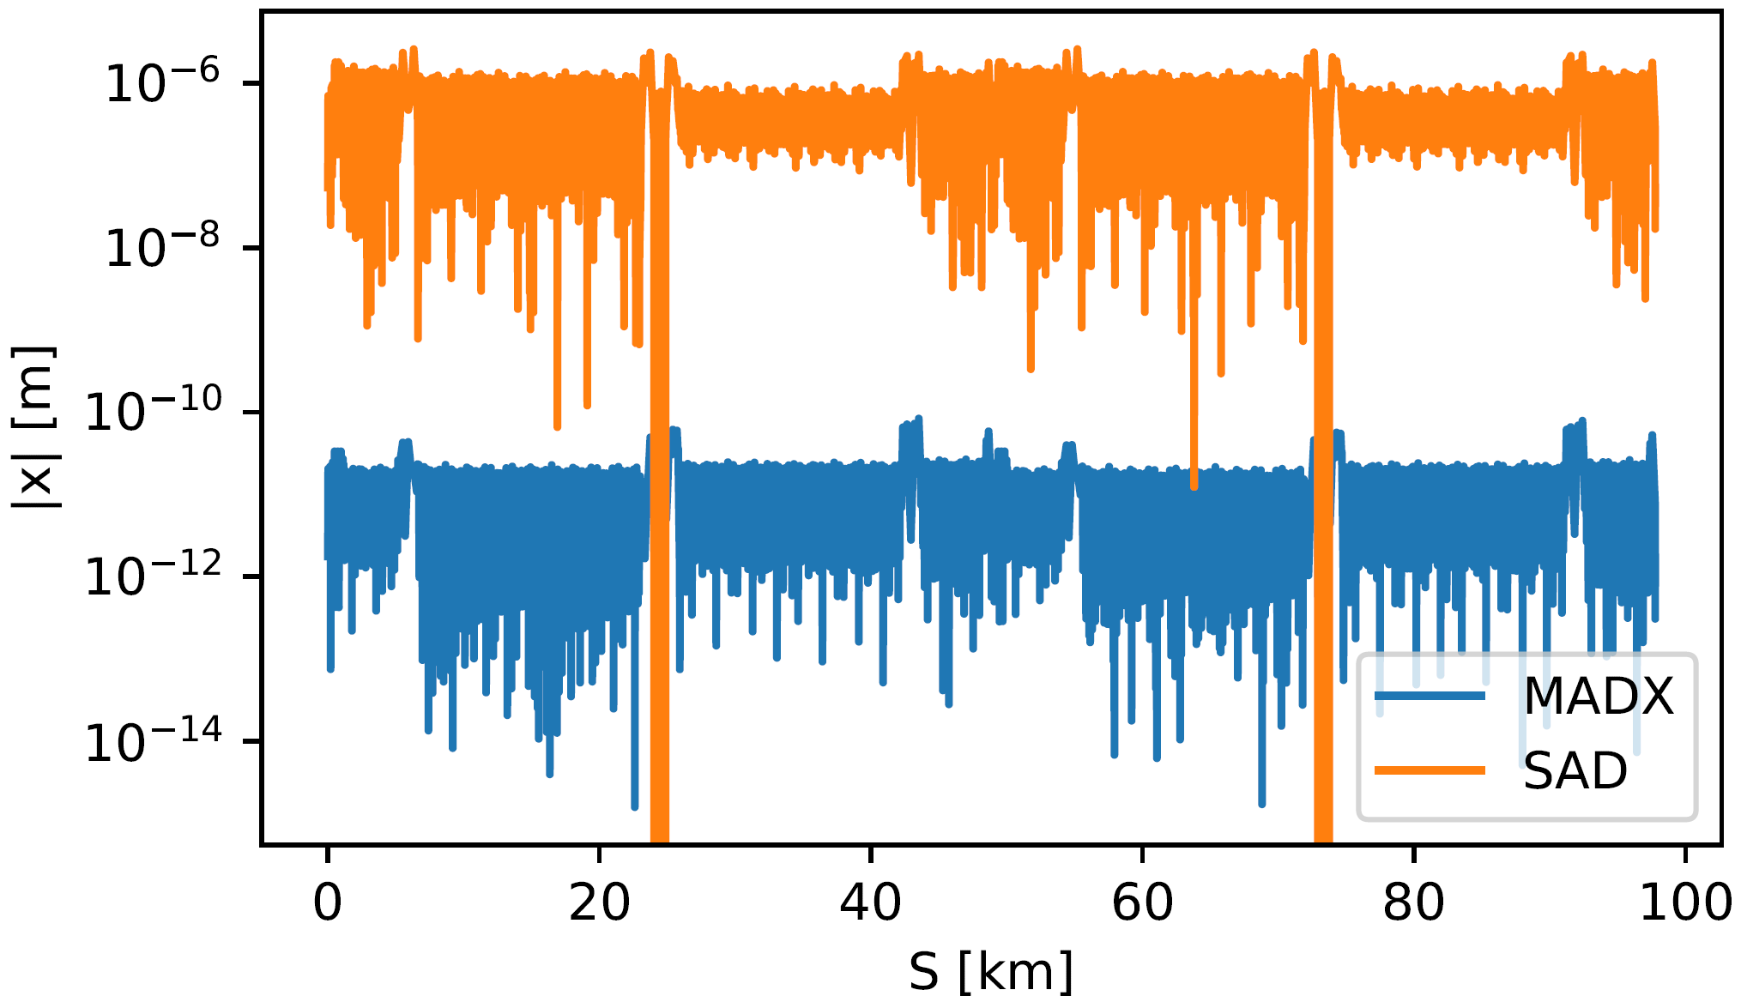
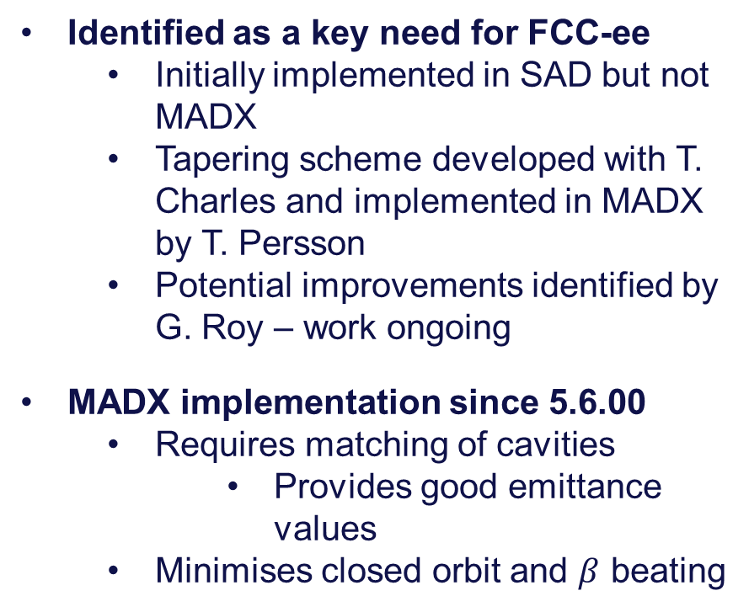
Tapering
Identified as a key need for FCC-ee
  Initially implemented in SAD but not MADX
  Tapering scheme developed with T. Charles and implemented in MADX by T. Persson
  Potential improvements identified by G. Roy – work ongoing
MADX implementation since 5.6.00
  Requires matching of cavities
    Provides good emittance values
  Minimises closed orbit and $β$ beating

Slide 9
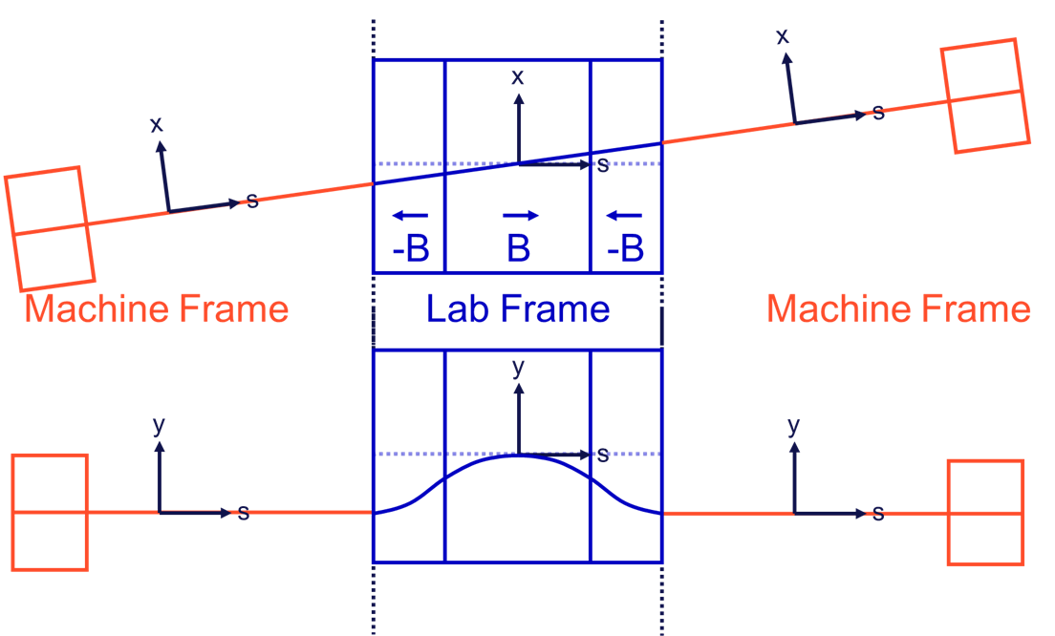
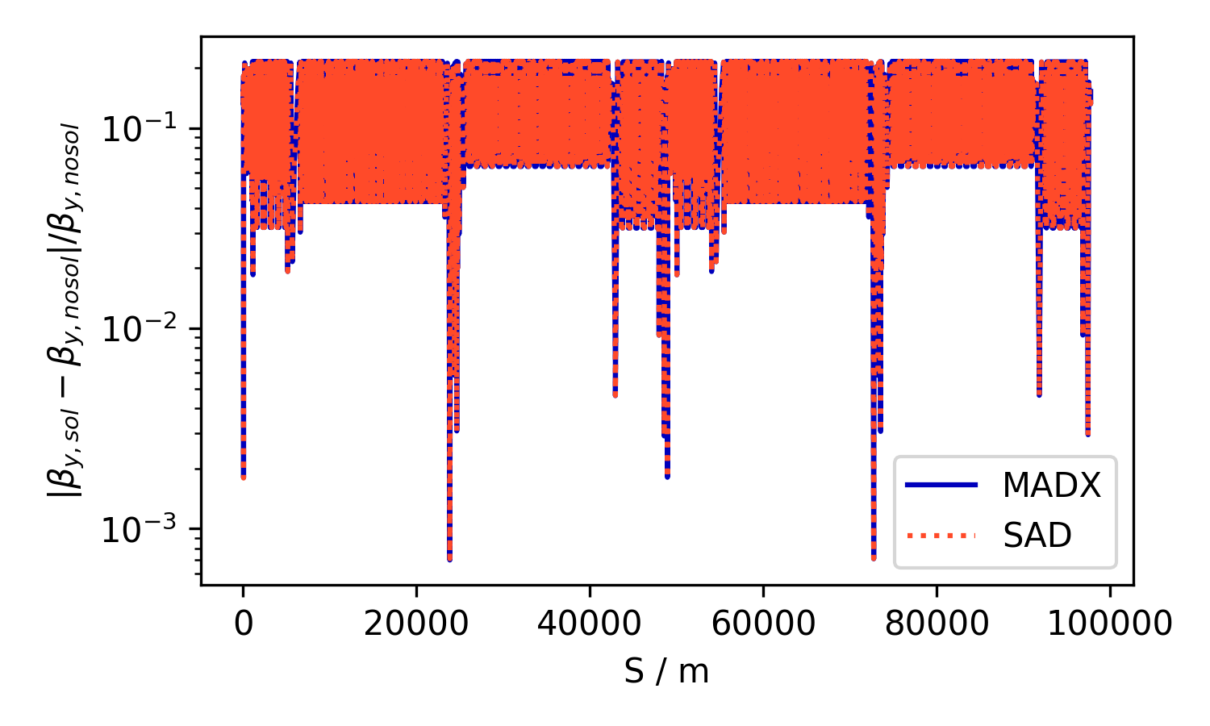
Tilted Solenoid
Different possibilities of how to implement Misaligned solenoid
  Misalign finite solenoid
  Sliced solenoid with interleaved bends
    Could interleave multipoles of “realistic solenoid”
  Tilt of coordinate system (SAD-like approach)
  (discussed in optics tuning meeting)
Able to reproduce SAD optics from SAD-like approach
  Presented in ABP meeting
Minor bugs due to rotation element and radiation in solenoid
  Actively investigated by T. Persson and A. Latina

Slide 10
Tilted Solenoid Strategies
Method | Benefits | Drawbacks | Example files
Misalignment of Solenoid Implemented like alignment errors | Very simple No need to change lattice file | Radiation in solenoid not correct Not SAD layout | /afs/cern.ch/work/l/lvanries/public/for_tuning_studies/Misaligned_Solenoid
Sliced Solenoid interleaved with vertical bends angle = vertical dipole field | Gives correct radiation | Lattice has to be heavily modified Not SAD layout | /afs/cern.ch/work/l/lvanries/public/for_tuning_studies/Interleaved_Solenoid
Tilt through change of coordinate system Rotations and translations at solenoid entrance/exit | Exact replication of SAD layout Exact agreement with SAD optics | Completely new lattice file from new translator Rotation causes strange dispersion | /afs/cern.ch/work/l/lvanries/public/for_tuning_studies/SAD_Style_Solenoid

Slide 11
Selected Applications

Slide 12
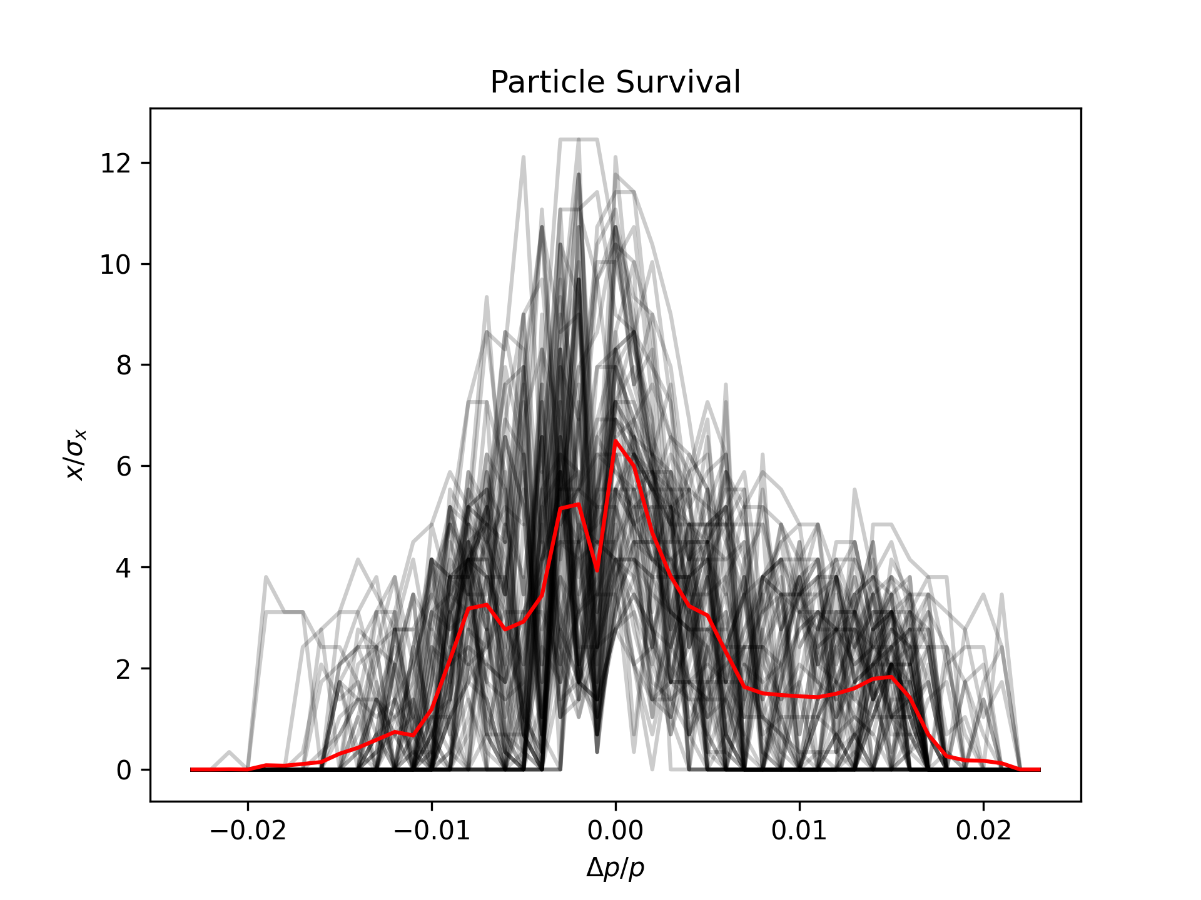
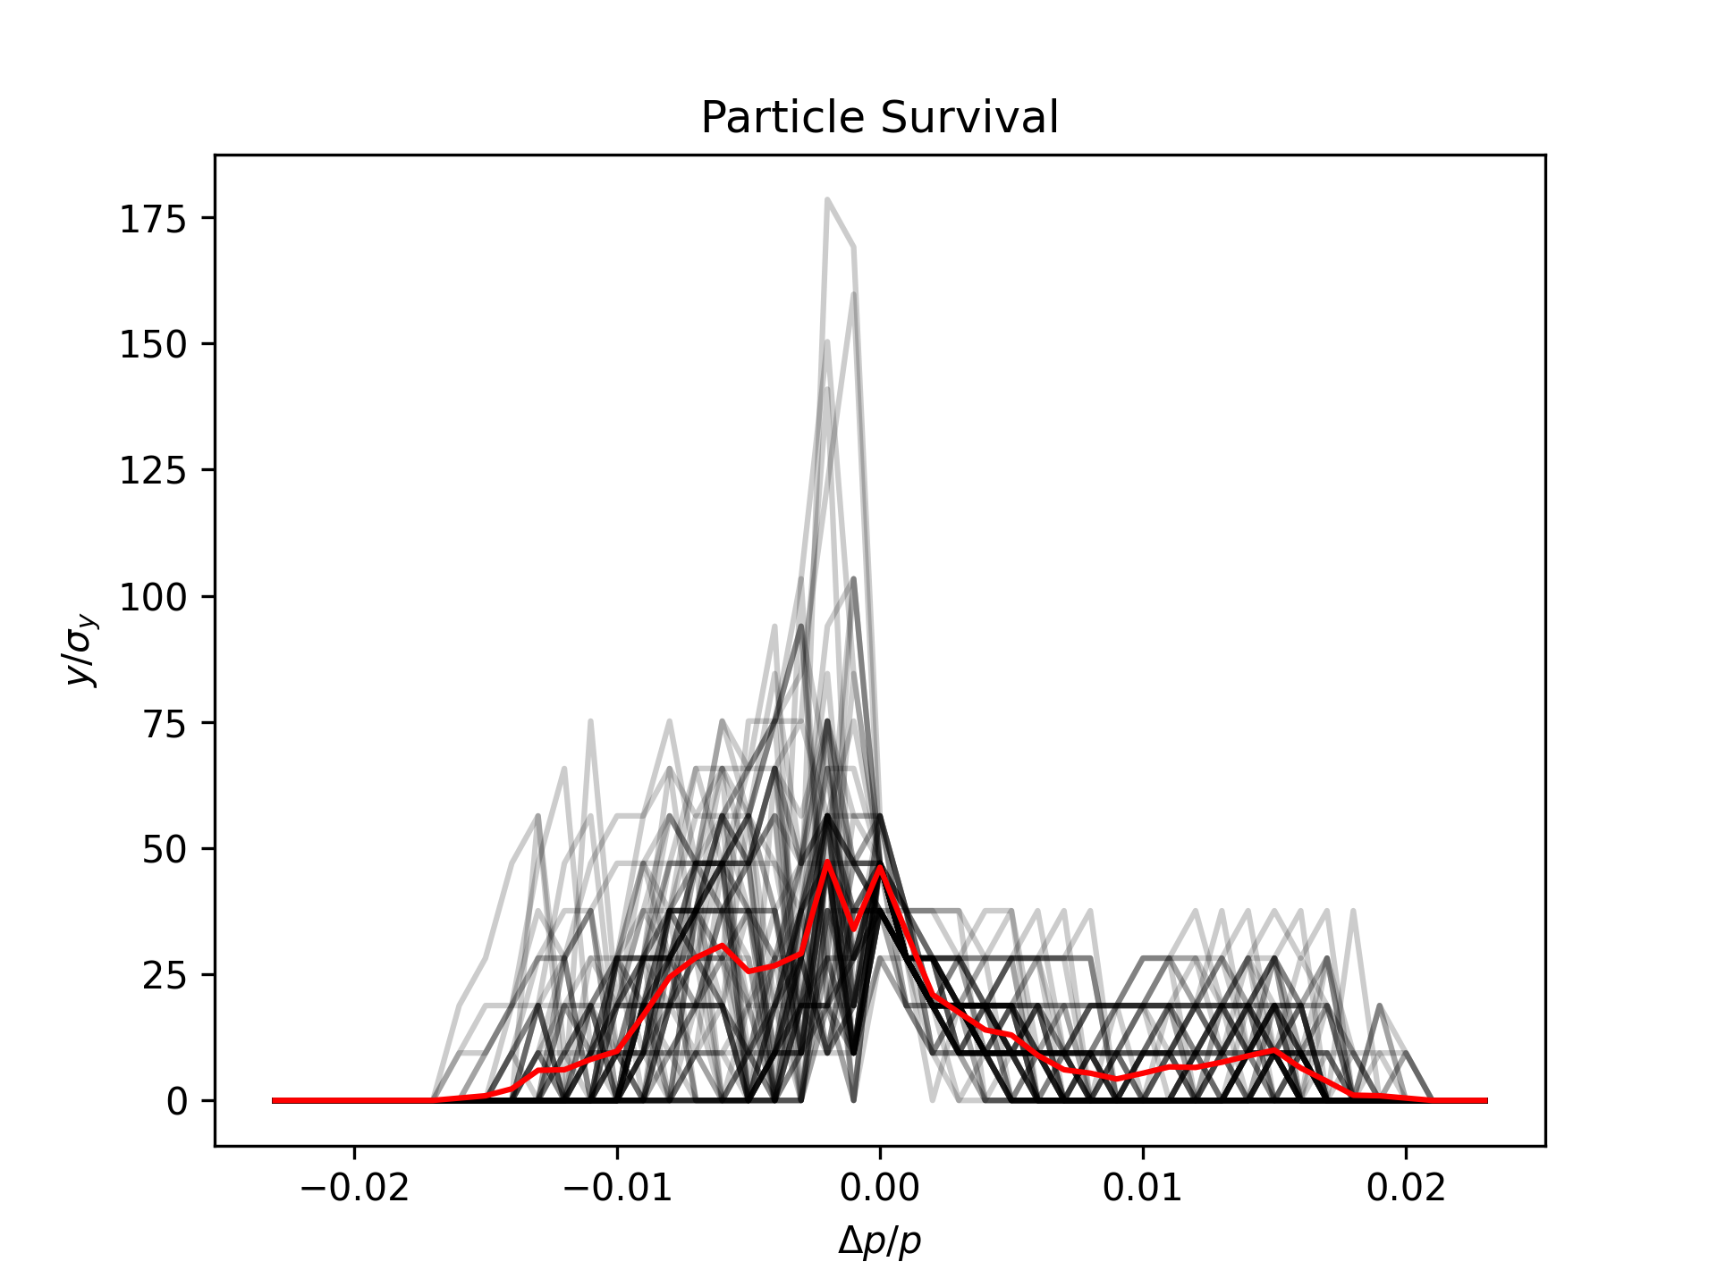
DA with Errors
Using lattices with errors and corrections by T. Charles
Using settings found during comparison studies
Without radiation and no minimum coupling
Results presented by T. Charles in FCC-ee Opitcs Meeting
  First iteration
  More in depth studies to follow, including studies with new corrections

Slide 13
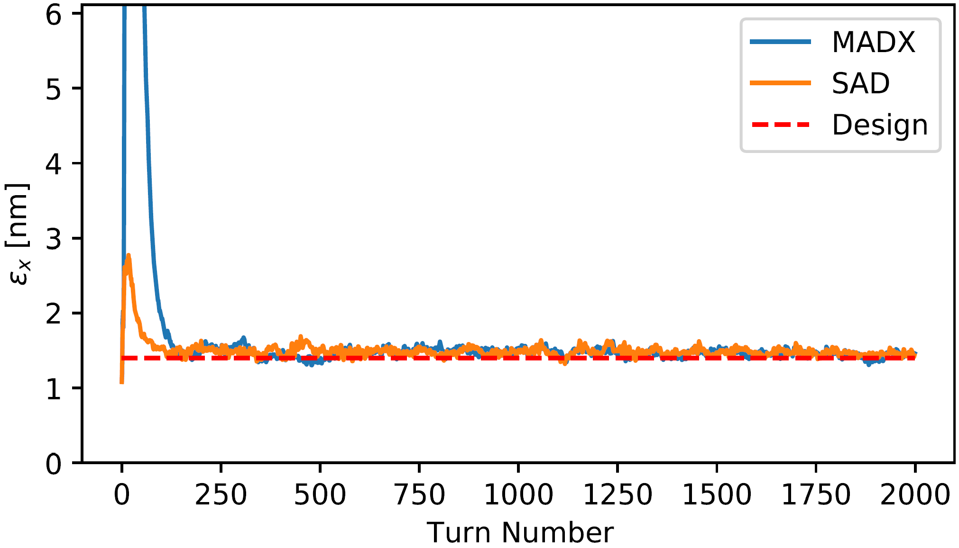
Tracking with Radiation
Tracking random particles to find emittance from tracking
  Using latticed tapered by MADX and SAD
  Simulating damping and quantum excitations
  Converges to design emittance
Presented in IPAC’21 TUPAB004
Can be used to verify emittance results for more complex lattices
  Errors and corrections
  Tilted solenoid

Slide 14
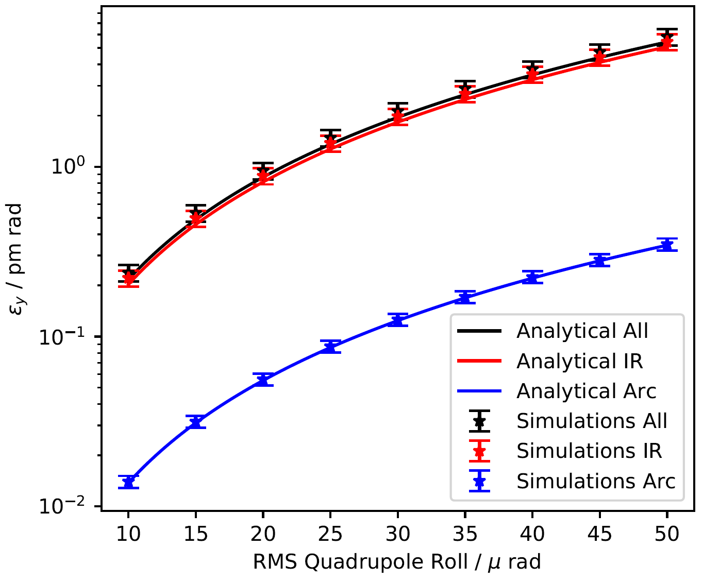
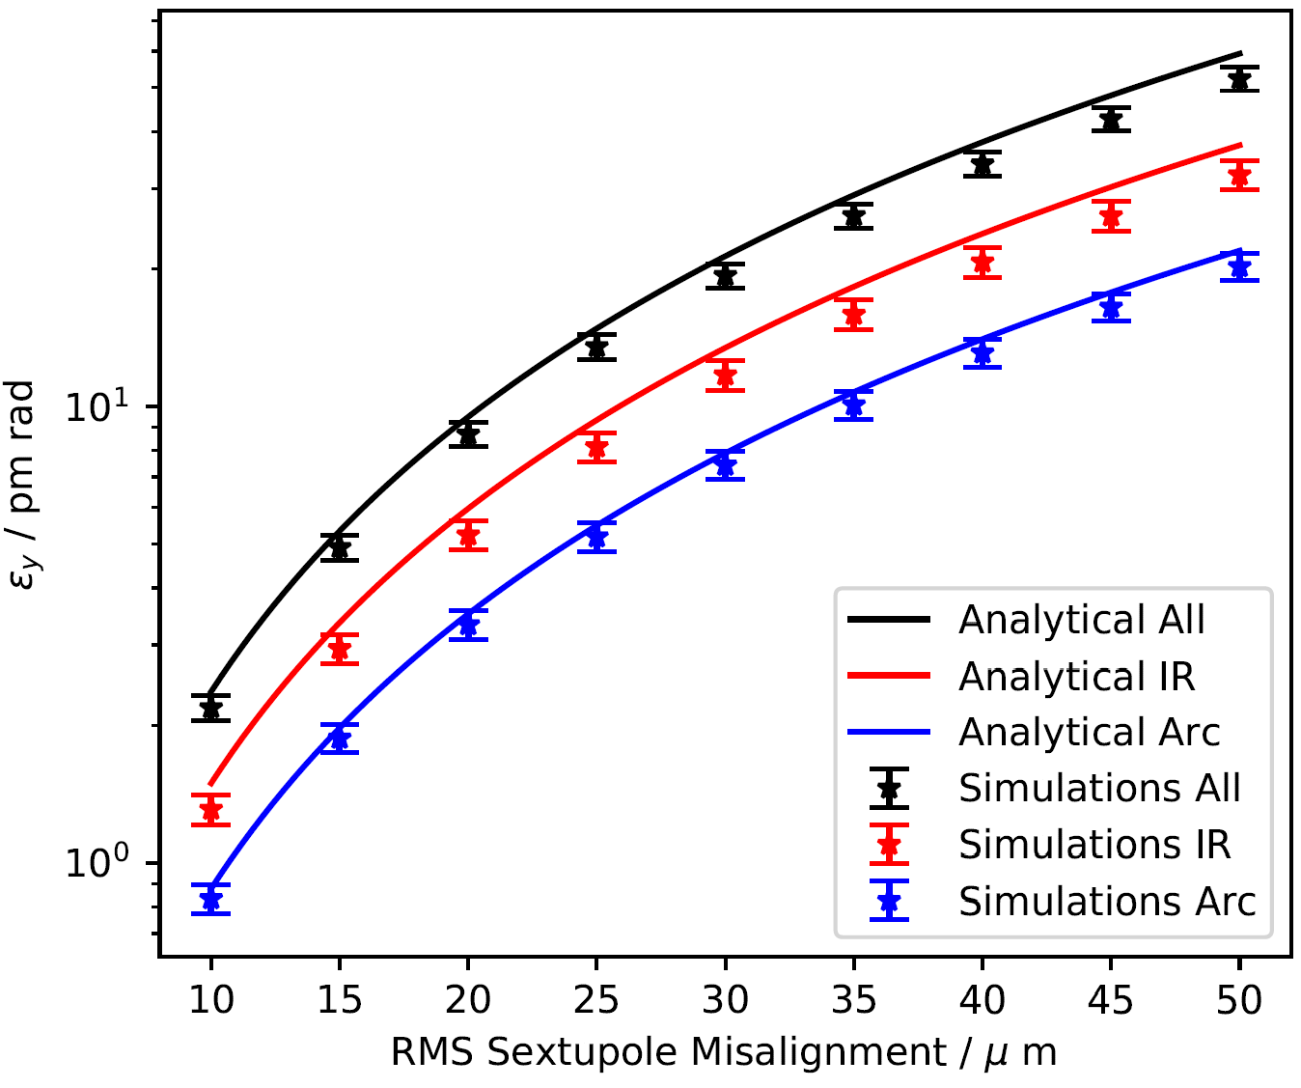
Analytical Emittance Estimates
Analytical emittance estimates
  Aim to identify magnets that need tighter tolerances
  Using well established analytical expressions
  Compared to simulations built on scripts by T. Charles
  Presented in IPAC’21 TUPAB006
Very good agreement for quadrupole rolls and sextupole misalignments
Effects of errors found to add linearly
  Investigation whether this applies to more complex configurations underway

Slide 15
Conclusions and Outlook

Slide 16
Conclusions and Outlook
Performed comprehensive comparison studies between MADX and SAD
  To establish baseline for further simulations
Important features brought to MADX
  E.g. tapering and tilted solenoid implementations
  By adding to MADX or finding ways to implement by hand
Studies using MADX features and findings from comparisons
  Dynamic aperture, tracking in tapered lattices, analaytical emittance estimates
Future work including:
  Model SKEKB IR in MADX
  Expand on analytical emittance studies by including other types of errors
  DA of new tuned lattices

