Slide 1

Status of collimation tracking code development for FCC-ee
A. Abramov, R. Bruce, F. Carlier, M. Hofer, L. Nevay, S. Redaelli
FCCIS WP2 Workshop - 01/12/2021
Many thanks for discussions and input to:
M. Boscolo, H. Burkhard, T. Charles, M. Hofer, G. Iadarola, M. Migliorati, J. Molson, M. Moudgalya, T. Persson, T. Pieloni, G. Roy, L. Van Riesen-Haupt, S. White, F. Zimmermann

Slide 2
Simulation tools
Tracking studies are essential for designing a collimation system
Effects such as synchrotron radiation and optics tapering make the tracking studies more challenging for the FCC-ee
The requirements for collimation simulation tools are:
  Tracking of beam electrons (and positrons) in the magnetic lattice
  Particle-matter interactions inside the collimators
  Accurate and efficient tracking over many turns
  Radiation damping and optics tapering
  Beam-beam effects
Studied several different simulation tools:
  MAD-X, SixTrack-FLUKA coupling, BDSIM, Merlin++, pyAT, Xtrack
  Alternatives not studied so far: SAD, BMAD, ELEGANT, MDISim, others…

Slide 3
Simulation tools
No framework that currently has the requirements for collimation
There is an EPFL-CERN collaboration (F. Carlier, T. Pieloni) to develop a comprehensive beam dynamics simulation framework for the FCC-ee (talk F. Carlier, talk T. Pieloni)
Collimation developments focus on a connection between a tracker and a physics engine
Code | 6D symplectic tracking | Synchrotron radiation | Tapering (lattice) | Geant4 integration | FLUKA integration | Speed | Aperture modelling
MAD-X
SixTrack
BDSIM
Merlin++
pyAT
xTrack
★
★
★
 | Not available |  | Partial availability |  | Available
★ = in development

Slide 4
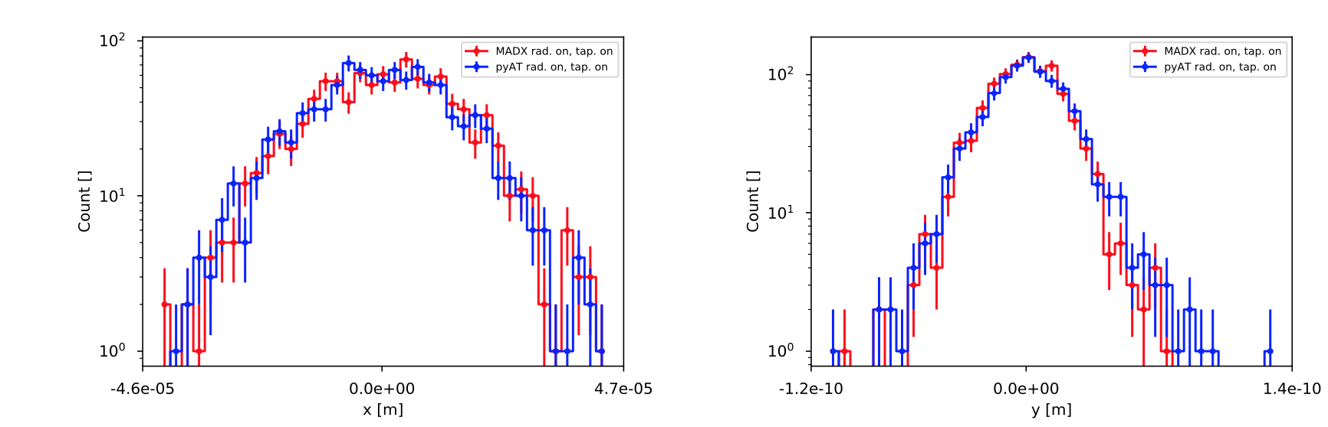
pyAT https://github.com/atcollab/at
PyAT is a promising tracking tool for the FCC-ee
  First used for FCC-ee by M. Rakic at EPFL
  Demonstrated tracking with radiation and tapering and an acceptable computational efficiency
  Straightforward to work with
Latest developments
  An option for per-element quantum excitation (S. White)
  Loss map features enabled – apertures and loss recording
  New features in MAD-X -> pyAT converter (F. Carlier)
    Apertures translated
    Collimator lattice element introduced
Developments for collimation
  Need to include scattering in the collimators
  Currently working on a connection to Geant4 for collimators
Distribution of 10³ particles after 10³ turns,
ideal Higgs lattice (120 GeV)

Slide 5
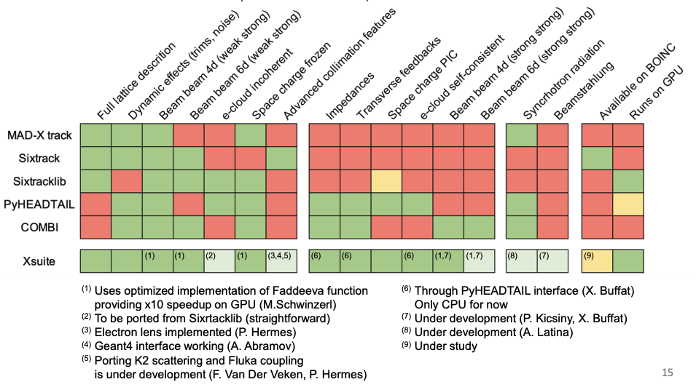
Xtrack
New tracking tool, part of the Xsuite project (talk by G. Iadarola) https://xsuite.readthedocs.io/en/latest/
  Developed by R. De Maria and G. Iadarola
  Designed to consolidate multiple beam dynamics studies at CERN
  Python on the top level, auto-generated C and extensions for performance-critical tasks
  Multi-platform, compatible with CPU and GPU
  Rapid development
  Documentation, tests
  Working with G. Iadarola on an interface to Geant4 for collimation
  Planned to also interface with K2 and FLUKA
G. Iadarola https://indico.cern.ch/event/1070294/contributions/4500628/attachments/2305233/3921762/021_Xsuite.pdf

Slide 6
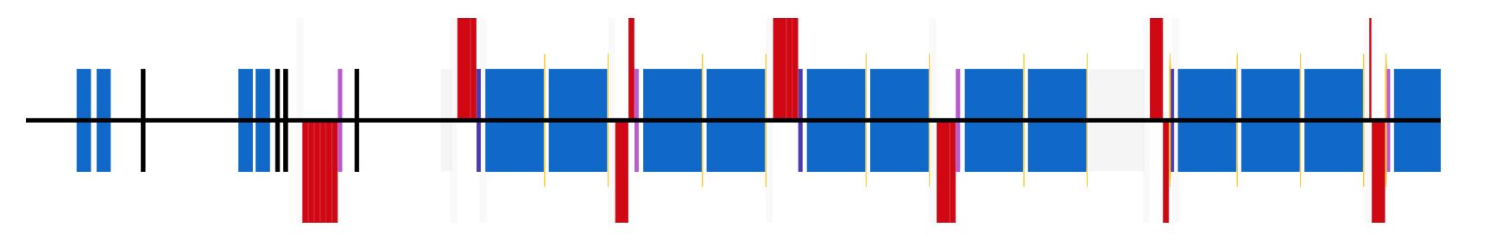
Collimation in Geant4 – general principle
collimators – Geant4
rest of the lattice – tracking code
example lattice section
Only collimators in the Geant4 world, with particle transfer mechanisms (like the SixTrack-FLUKA coupling)
Same general workflow, regardless of the tracking code connected:
  Define all collimators
  Select a collimator and add particles
  Run the physical interaction simulation
  Return eligible particles
Need to define interfaces for communication between the codes involved
Steps 2 – 4 are repeated for every collimator pass

Slide 7
Python bindings for Geant4
Existing general interface to Geant4 (BDSIM) for collimation (L. Nevay).
Build upon the existing code and add a Python wrapper
  Dedicated C++ classes for interfacing with tracking codes
  Python bindings via pybind11
  Direct and dynamic communication at runtime
The result is collimasim – a Python package running Geant4. https://gitlab.cern.ch/anabramo/collimasim
C++
Python
Geant4
pyAT
ROOT
BDSIM
collimasim
xtrack
CLHEP
…

Slide 8
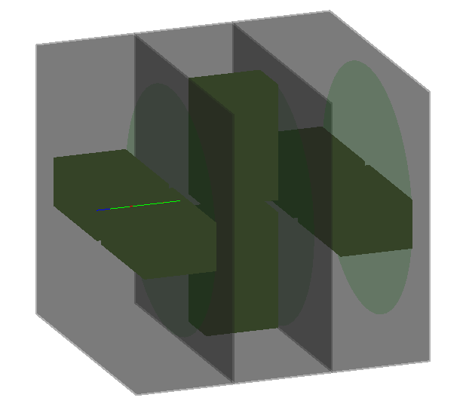
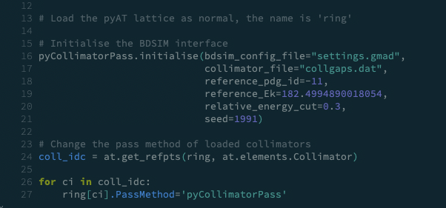
Integration with pyAT
particle interacting
Implemented a connection with pyAT
  Custom integrator (pass method) prepared for pyAT
  Workflow developed to prepare collimation studies
Current limitations
  Secondary particles are not tracked
  Only rectangular block jaw collimators supported
collimators
plane for
back-transfer
(green disk)
isolated cells

Slide 9
Testing the pyAT-Geant4 coupling
Use the collimation setup from FCC week 2021:
  ttbar mode (182.5 GeV), beam 1 (positron)
  Two-stage collimation system in IRF
  1 μm impact parameter pencil beam
  1 sigma beam in the vertical, nominal vertical emittance
  30 GeV energy cut
  No radiation and tapering
  Not the latest optics and aperture model
Compare against the SixTrack-FLUKA coupling
  The same beam distribution is used for both cases
  5e6 particles in SixTrack and 1e6 particles in pyAT
Halo collimation system in IRF
FCC week talk:
https://indico.cern.ch/event/995850/contributions/4410113/
Collimator settings

Slide 10
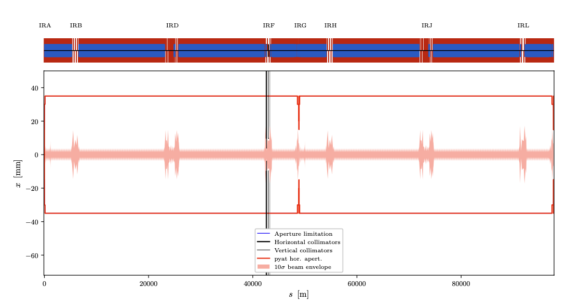
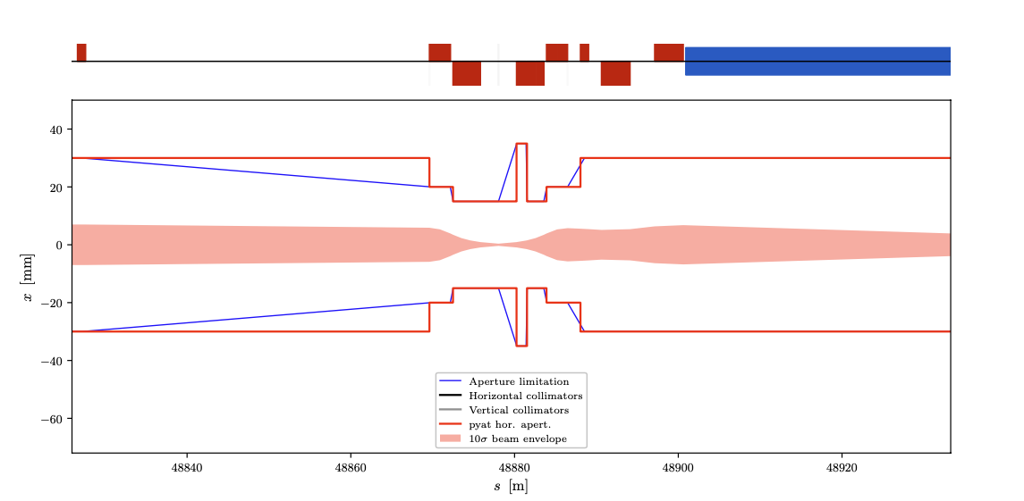
Aperture definition
Aperture model:
  FCC week (older) aperture model (M. Moudgalya)
  35 mm circular aperture in the arcs
  15 mm experimental beampipe, no SR masks
pyAT aperture
  Translated from MAD-X by F. Carlier’s converter.
  Nearest neighbour interpolation for all elements.
SixTrack aperture:
  Exported from MAD-X.
  Linear interpolation in 10 cm intervals.

Slide 11
Aperture definition caveats
pyAT
Thick elements in lattice – splitting only during integration
The aperture is defined as an element attribute and checked at entrance and exit
Only element id where the loss occurred is recoded
loss detected
element aperture
example track
aperture checks
SixTrack
Thin lenses and dedicated aperture markers in the lattice
Aperture can be interpolated – additional markers (usually every 10 cm)
Drift back-tracking for an improved loss precision
aperture check markers
thin lenses

Slide 12
New pyAT aperture definition
New method for splitting the lattice elements proposed by S. White
After a few manipulations, the aperture model is closer to SixTrack
Only nearest neighbour interpolation and no backtracking
loss detected
Starting lattice
aperture checks
element aperture
example track
Split every 10 cm
and interpolate
the aperture
New markers
inserted when splitting
Remove the
aperture from
magnetic elements
Similar to SixTrack!

Slide 13
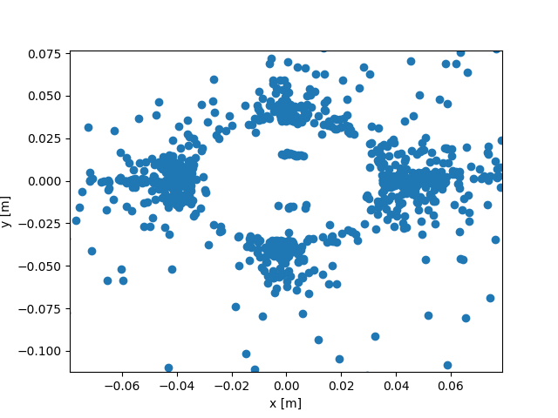
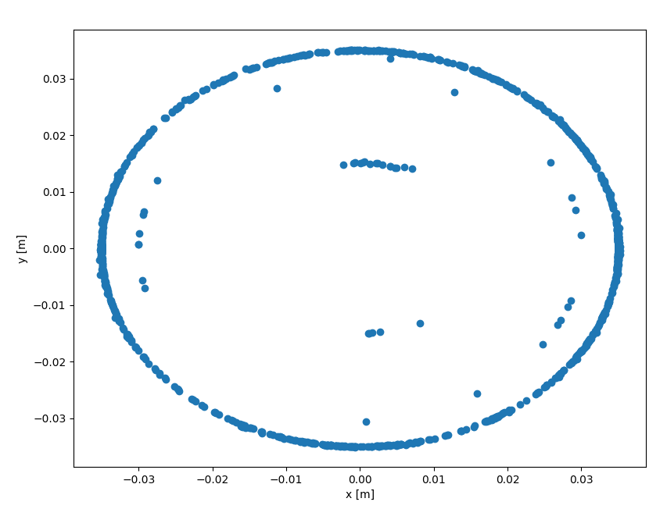
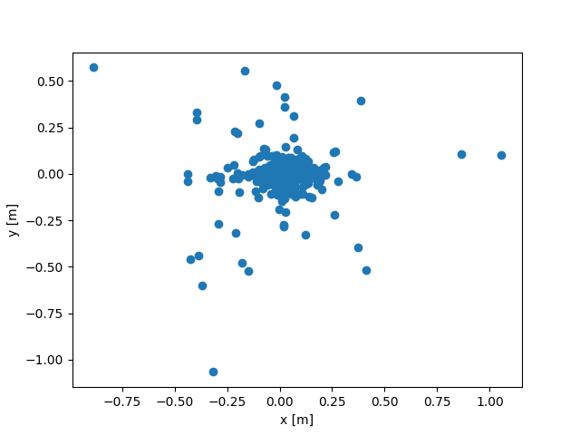
New pyAT aperture definition
The new aperture definition gives a much better resolution of the losses
The loss maps are directly comparable with ones from SixTrack
The tracking speed is severly impacted (factor 10 slower), but it is not a showstopper
Now
Before
Transverse loss coordinates along the whole ring for 10,000 particles

Slide 14
Collimator leakage comparison
*second jaw in overflow bin to improve visibility
Spectra of primary e+ and secondary e+/e- compared (no other secondary particles)
The leakage from BDSIM has no secondary e+/e- as pyAT can’t track them
Found good agreement between FLUKA and BDSIM for the 30 GeV cut used

Slide 15
Loss map comparison
SixTrack-FLUKA
pyAT-Geant4

Slide 16
Loss map comparison
The agreement between pyAT-Geant4 and SixTrack-FLUKA is significantly improved after the latest developments
Discrepancies still remain
  Large losses are observed in pyAT around IPG, which are not seen in SixTrack
  The losses around the ring are slightly higher in pyAT
To check:
  Investigate the effects of the different aperture interpolation
  Compare tracking and optical functions for the current model
  Check the loss map normalization in pyAT
Tracking studies with radiation and tapering to follow

Slide 17
Summary
Development of collimation simulations
  pyAT and Xtrack were selected as the most promising tracking codes
  Status of pyAT collimation developments
    A Python interface to BDSIM (Geant4) for particle-matter interactions inside the collimators was developed, to enable multi-turn tracking studies
    Testing and validation with comparisons to SixTrack-FLUKA
  Status of Xtrack collimation developments:
    Interface to Geant4 implemented, similar to pyAT
    Benchmarks being set up now
    Other developments in ABP, such as synchrotron radiation
Future work for the simulations
  Discussions between ABP collimation team and FLUKA team to develop a FLUKA integration with Xtrack and pyAT for collimation
  Integrate the collimation models with other studies, such as MDI-related activities
  Include errors, imperfections, and misalignments into the collimation models
  Investigate the options for including beam-beam effects, including Beamstrahlung (discussions ABP, EPFL, MDI team)

Slide 18
Thank you!

Slide 19
Collimator leakage comparison
*second jaw in overflow bin to improve visibility
Spectra of primary e+ and secondary e+/e- compared (no other particles)
Secondary e+/e- now included in BDSIM for comparison, although not tracked in pyAT

