Slide 1
Aperture STUDIES and
Layout for Collimation Insertion
A. Abramov, M. Boscolo, R. Bruce, M. Hofer, M. Moudgalya, K. Oide, F. Zimmermann

Slide 2
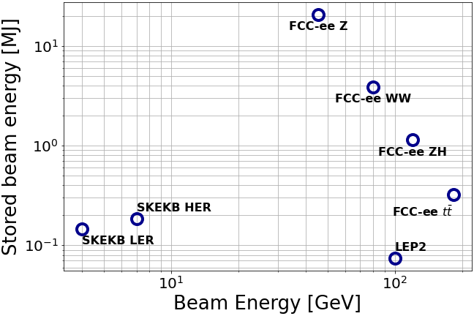
Motivation
Challenge of protecting machine elements from
unprecedented stored beam energy of 20MJ in FCC-ee at Z-operation mode
  Critical especially for superconducting final focus quadrupoles
Localize losses in one location far from experiments
  Layout permits to use one straight section for halo collimation system
Workflow:
  Establish aperture model of the machine and
  minimum aperture to protect
  Location and optics for halo collimation system
  Tracking studies to investigate losses for
  different beam loss scenarios
  Design iterations, Material, Collimator impedance,
  Energy deposition, …

Slide 3
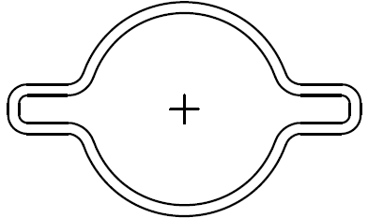

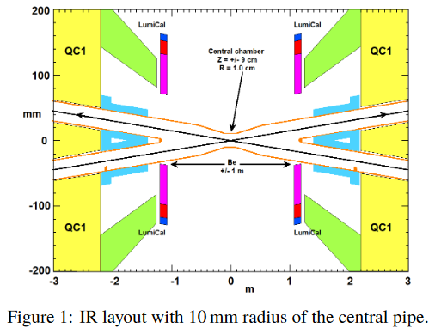
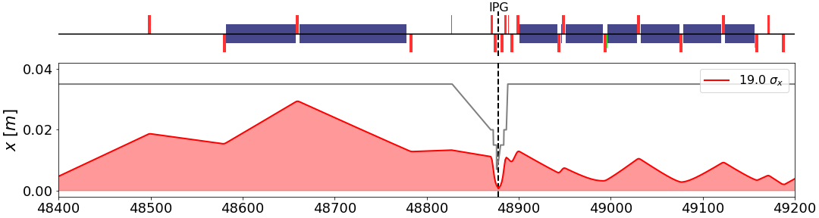
Aperture model
r=35mm
Need to establish aperture model to
find minimum aperture to protect and for loss studies:
  For most elements, a circular beam with r=35mm is used,
  only around IPs smaller beampipe and SR mask
  SR collimators upstream of IP not included
Stored in optics repository,
to keep track of changes over time and as common reference
Water-cooled SR absorber
Plot adapted from R. Kersevan,
“Vacuum system”, at FCC November Week 2020
From arXiv:2105.09698

Slide 4

Beam stay clear
Using MAD-X’s APERTURE command to calculate beam-stay-clear
(transverse distance in units of beam sigma between mechanical aperture and reference orbit)
  Using design emittances for different operations modes and
  including mechanical tolerances, radial closed orbit uncertainty, β-beating,
  no spurious dispersion (based on T. Charles’ error studies)
  Tilt applied as additional transverse offset of $∆x=l_{magnet}\sin{α_{tilt}}$
Element type | Transverse misalignment [μm] | Tilt [μrad]
Arc quadrupole and arc sextupole | 50 | 100
Dipoles | 1000 | 0
IR quadrupole and sextupoles | 100 | 100
Aperture parameter
Radial closed orbit uncertainty | 250 μm
β-beating | 20%
Parasitic dispersion | 0

Slide 5
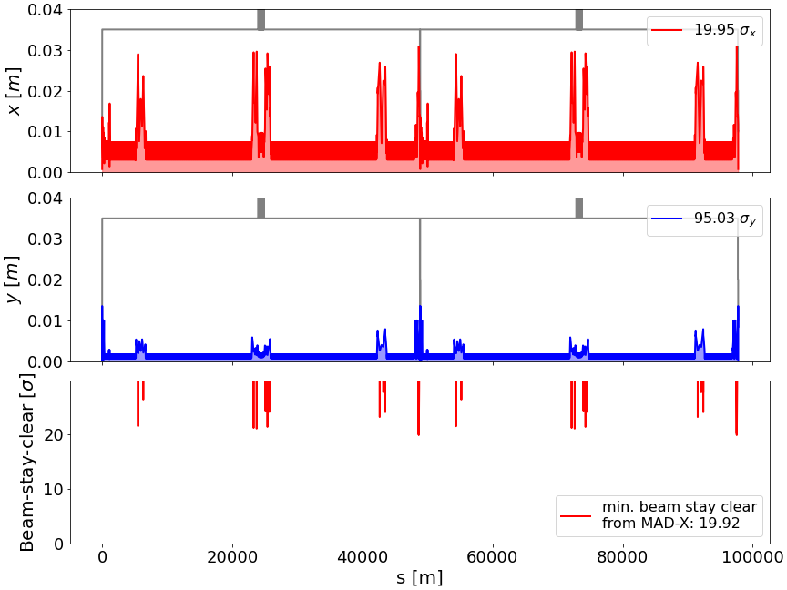
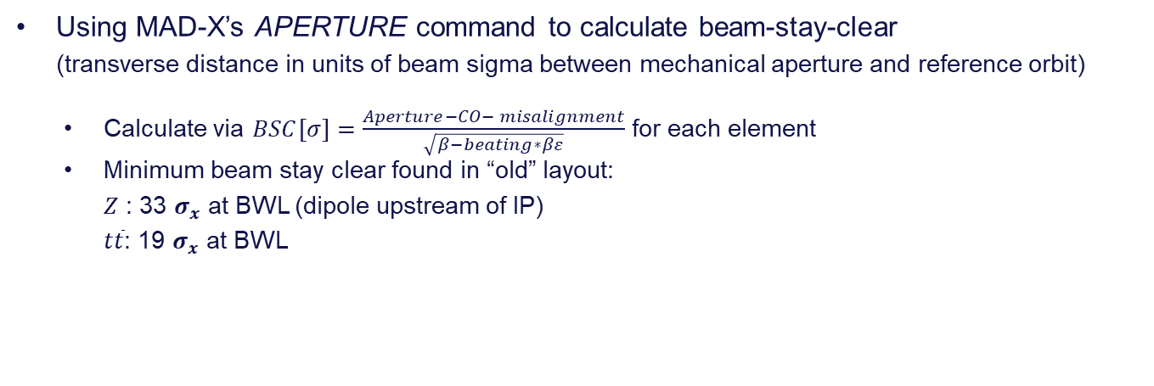
Beam stay clear
Using MAD-X’s APERTURE command to calculate beam-stay-clear
(transverse distance in units of beam sigma between mechanical aperture and reference orbit)
  Calculate via $BSC[σ]=\frac{Aperture−CO− misalignment}{\sqrt{β−beating∗βε}}$ for each element
  Minimum beam stay clear found in “old” layout:
  $Z$ : 33 $σ_{x}$ at BWL (dipole upstream of IP)
  $t\overline{t}$: 19 $σ_{x}$ at BWL

Slide 6
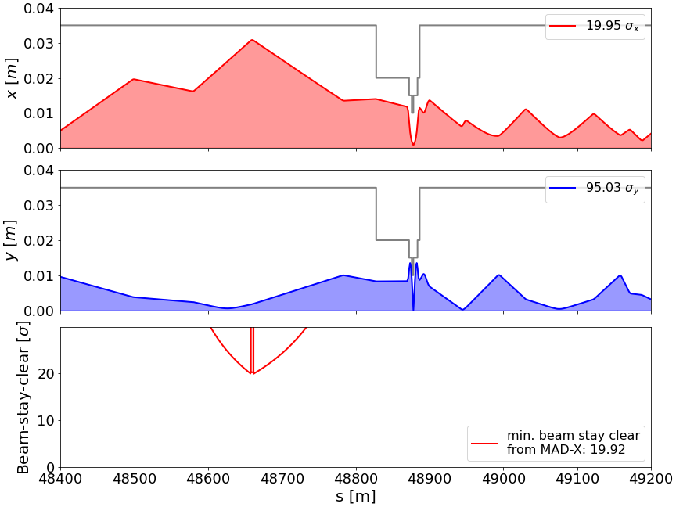
Beam stay clear
Using MAD-X’s APERTURE command to calculate beam-stay-clear
(transverse distance in units of beam sigma between mechanical aperture and reference orbit)
  Calculate via $BSC[σ]=\frac{Aperture−CO− misalignment}{\sqrt{β−beating∗βε}}$ for each element
  Minimum beam stay clear found in “old” layout:
  $Z$ : 33 $σ_{x}$ at BWL (dipole upstream of IP)
  $t\overline{t}$: 19 $σ_{x}$ at BWL

Slide 7
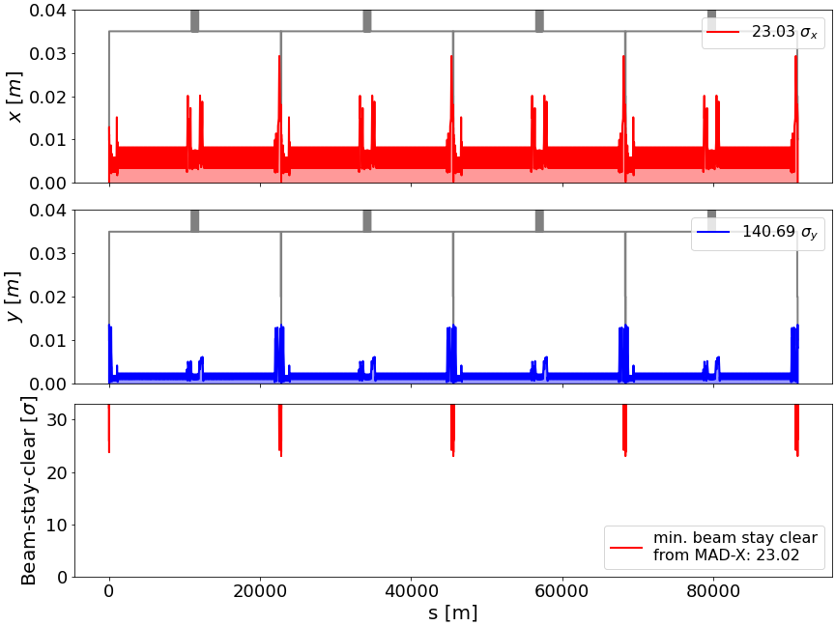
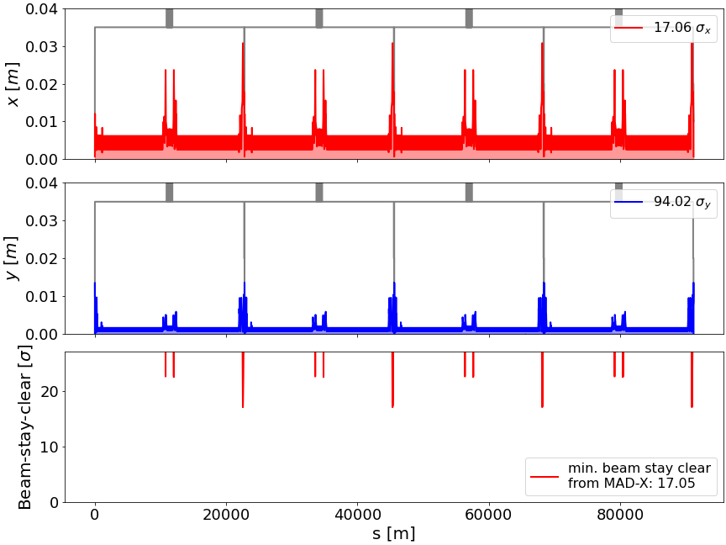


Beam stay clear in new layout
With new layout, switch to long and short 90/90 optics
  For Z mode, $ε_{x}$ increased from 0.27 nm to 0.71 nm
  Minimum beam stay clear found in new layout: $Z$ : 23 $σ_{x}$ at QC1 (final focus quadrupole)
  $t\overline{t}$: 17 $σ_{x}$ at BWL
Z operation mode
$t\overline{t}$ operation mode

Slide 8
Layout strategy
Initial strategy to dedicate (at least) on straight section to collimation
  Similar to LEP and PEP-II, and more recently (HL-)LHC
Two stage system (primary and secondary collimators in one straight section),
supplement with additional masks/collimators
Start with LHC β-collimation insertion, scale to available length,
and match to arc constraints
  Arc optics changes between operation modes,
  while (ideally) no change of collimation optics
Modified lattices are kept for now in a separate gitlab repository
  After first validation, to be merged into main FCC-ee lattice

Slide 9
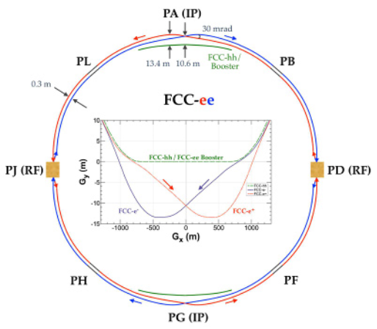
Layout – 2IP
So far, baseline for studies is 2IP
  4 straight sections available for technical systems
Start with dedicating PF for halo collimation
  Potential to add momentum collimation in PL later
  or use combined insertions

Slide 10
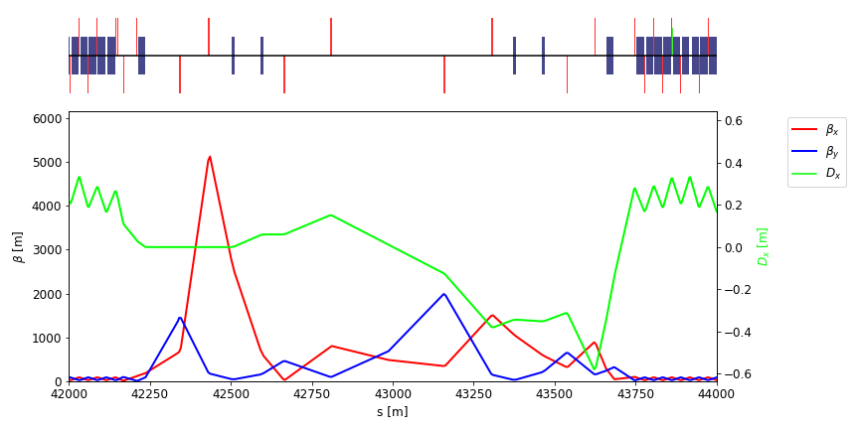
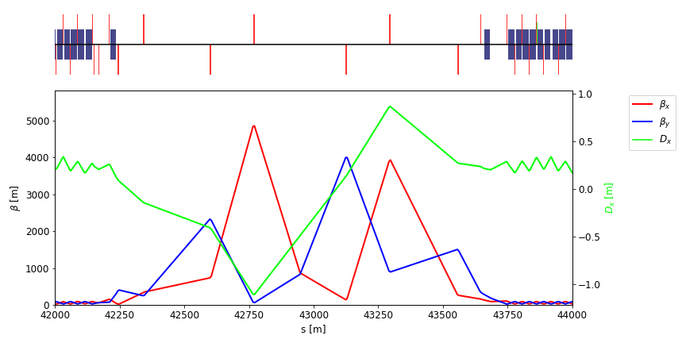
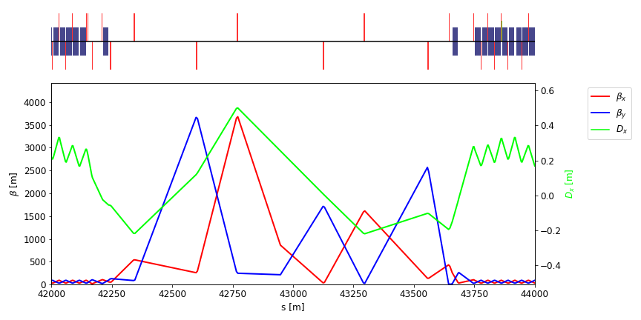
Layouts and optics for 2IP
1.)
Layouts integrated in the most recent 2IP lattice
(Version 217, based on
the “old” 97.75 km long layout)
Different options including:
  Layout with space for polarimeter
  High dispersion optics
  (momentum collimation)
  Low dispersion optics
  (β-collimation)
2.)
3.)

Slide 11
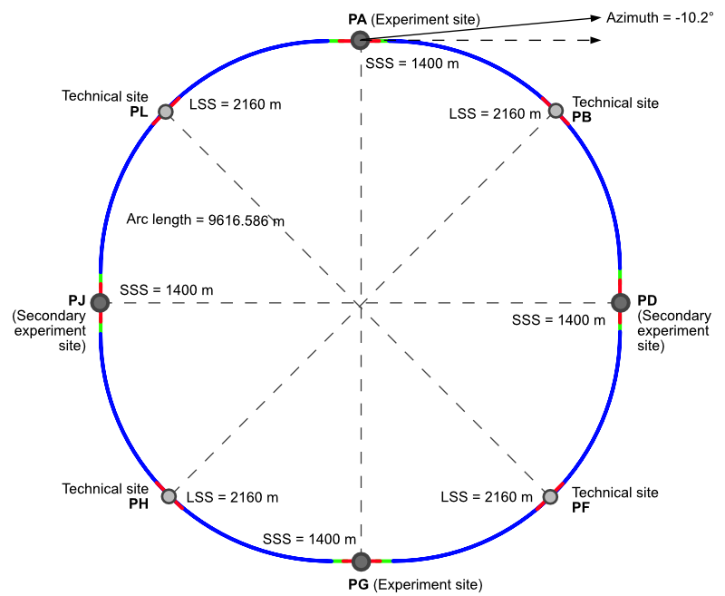
Layout – 4IP
Latest layout PA31-1.0 is compatible with 4IP operation
Collimation insertion in PF
  Preferred location for RF are PH and PL
  Beam crossing required in each
  straight section
  No obvious way to separate
  halo and momentum collimation in this layout
  → combined cleaning insertion

Slide 12
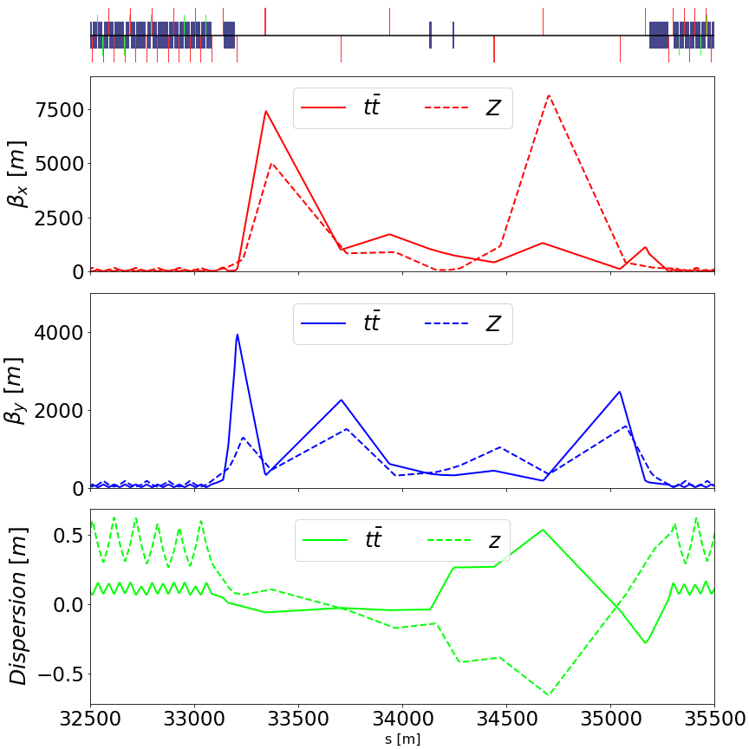

Potential layout and optics for 4IP
Based on preliminary lattice for new layout,
a 4IP compatible layout was developed
  With only one 2.1 km long straight section available,
  may serve as
  combined β– and momentum collimation
  Beam crossing at the center of insertion
  With different arc optics
  between Z and $t\overline{t}$ operation modes,
  no common solution found

Slide 13
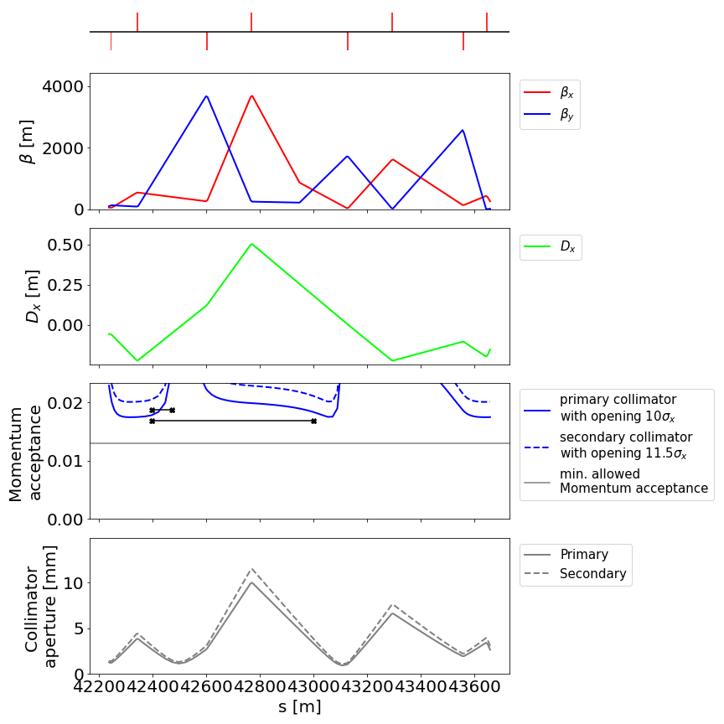
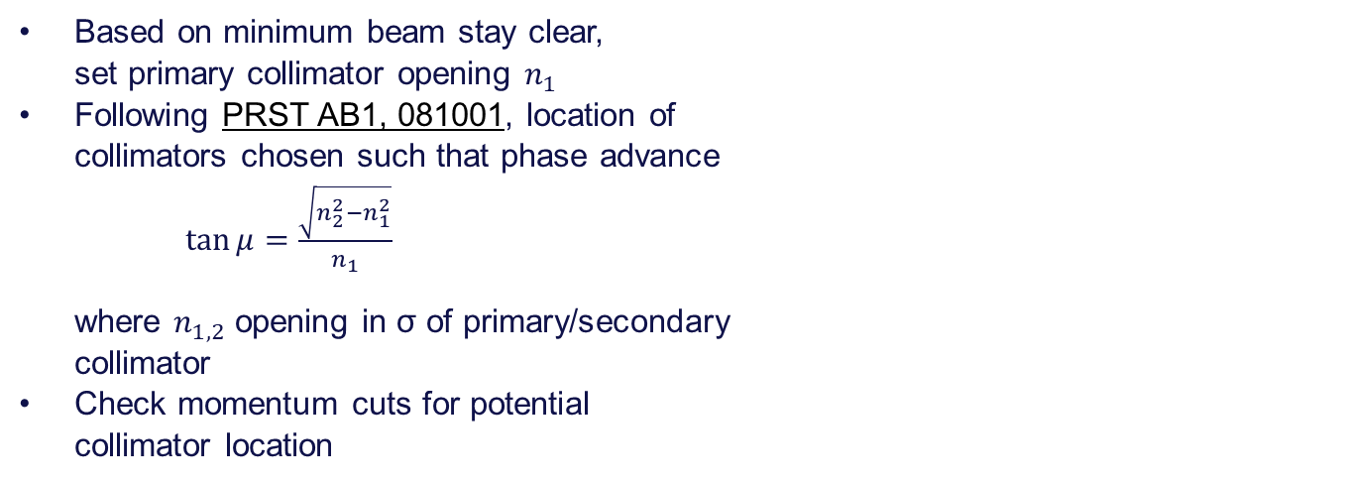
Collimator placement
Based on minimum beam stay clear,
set primary collimator opening $n_{1}$
Following PRST AB1, 081001, location of
collimators chosen such that phase advance
$\tan{μ}=\frac{\sqrt{n_{2}^{2}−n_{1}^{2}}}{n_{1}}$
where $n_{1,2}$ opening in σ of primary/secondary
collimator
Check momentum cuts for potential
collimator location

Slide 14
Conclusions
Aperture model for the whole FCC-ee ring available
  Implement missing elements (SR collimators) and keep updated
  Refine mechanical tolerances for elements
Minimum beam stay clear used to define primary collimator opening
  Based on input from studies on optics corrections
First collimation insertion layout implemented and matched
  For collimation, a 2IP layout provides more flexibility
Future work:
  Reimplement collimation insertion in new 2IP layout
  Ideally keep same optics between working points
  Refine optics based on input from tracking studies

Slide 15
Thanks for your attention!

