Slide 1
MAD-X SIMULATIONS OF VIBRATIONS IN THE MDI REGION
B. Aimard, G. Balik, L. Brunetti, J.P. Baud, A. Dominjon, S. Grabon, G. Lamanna, E. Montbarbon, F. Poirier
LAPP, IN2P3, CNRS
FCC IS WP2 Workshop
Friday, the 3rd of December 2021

Slide 2
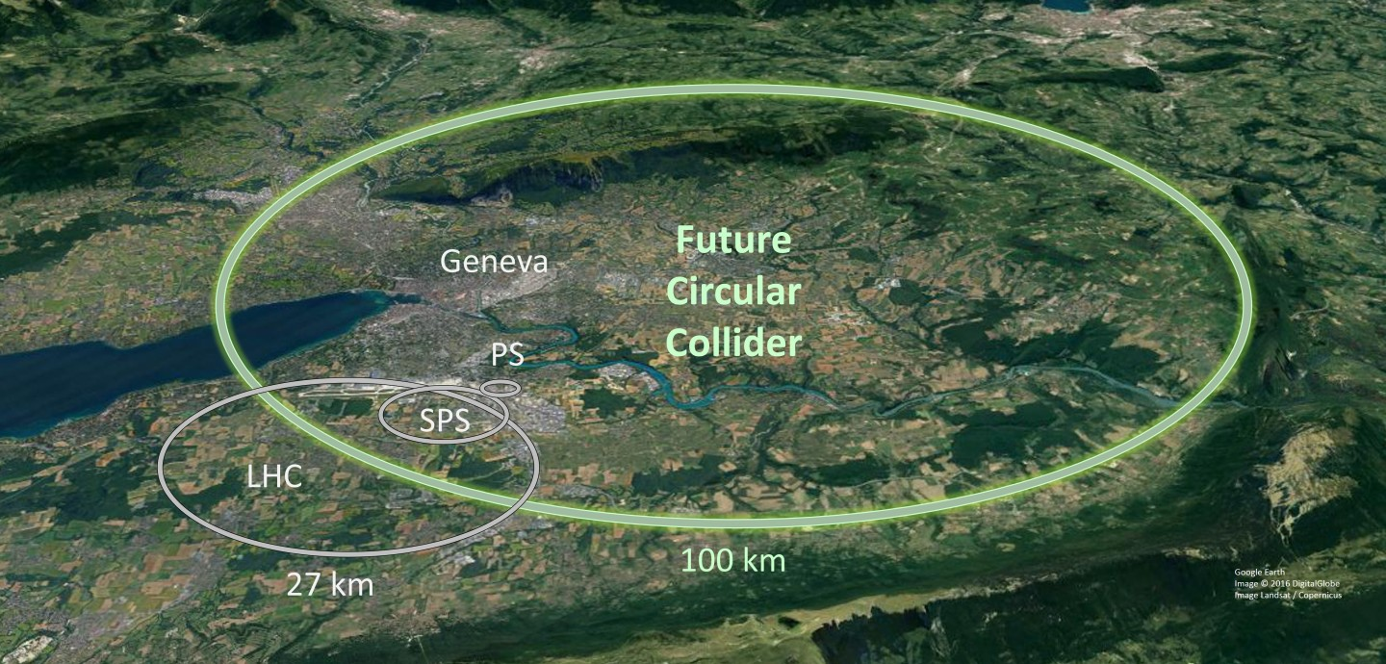

Table of contents
Context of vibrations studies
  Objectives
  Tools
  Challenges
First works
New procedure: methodology
Conclusions and perspectives

Slide 3
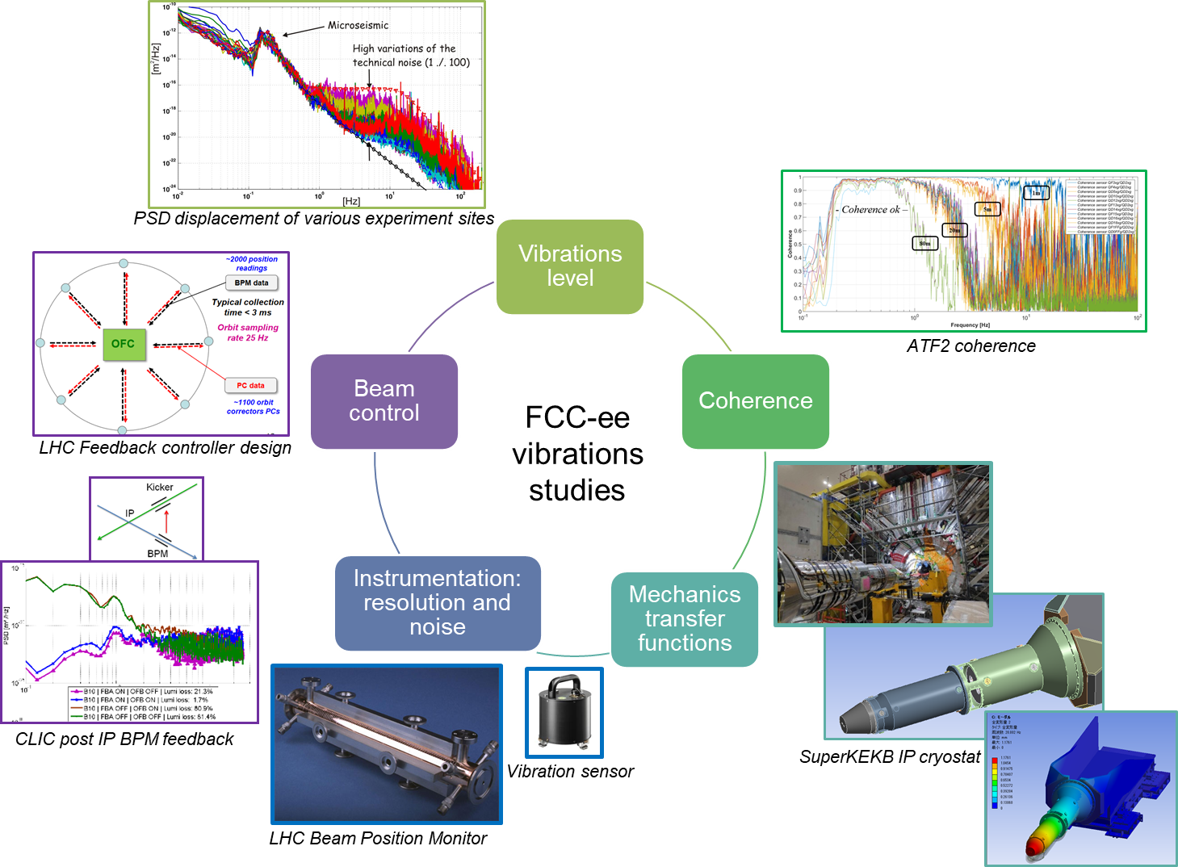
FCC-ee vibrations studies

Slide 4
Context
Objectives:
Vibrations study in the MDI region: dynamical misalignments study
Complementary study to the performed misalignments study (see Tessa Charles presentation)
  Difference with integration of static mechanics, with an alignment system
Integrate dynamics beam optics with the mechanical design
Tools:
  Optics simulation with MAD-X (5.07.00)
  Z lattice considered
  Latest layout used (09/2021)*, ∼91 km long
 | Z | W | H | ttbar
Energie (GeV) | 45,6 | 80 | 120 | 175 | 182,5
σ_{x}(IP) (μm) | 6,4 | 13 | 13,7 | 36,7 | 38,2
σ_{y}(IP) (nm) | 28 | 41 | 36 | 66 | 68
*PA31-1.0
FCC-ee CDR values

Slide 5
Challenges
3 requirements to perform the vibrations study in the MDI region:
  1. Magnets misalignments: representation of ground motion and/or cultural noise
  2. Iterative simulations:
    Reloaded lattice at each tour of the accelerator with the injection of offsets induced by the previous misalignments
  3. Evaluation of the impact of vibrations on emittance and/or beam size
Concerning the magnets misalignments model:
Fixed vertical misalignments
Level of complexity
Misalignments relative to frequency
Considering revolution frequency
Vib(t)
Ground motion
Mechanical transfer functions
Coherence
Vib(t)
?
t
t

Slide 6
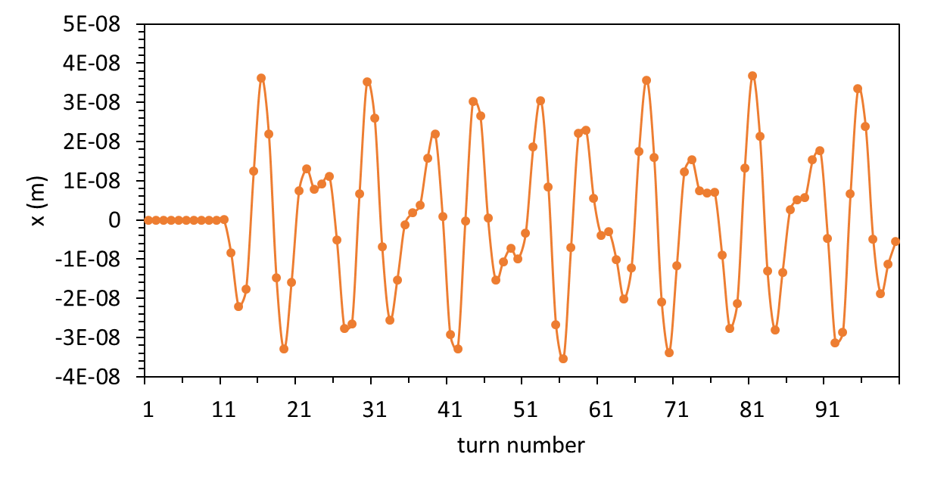
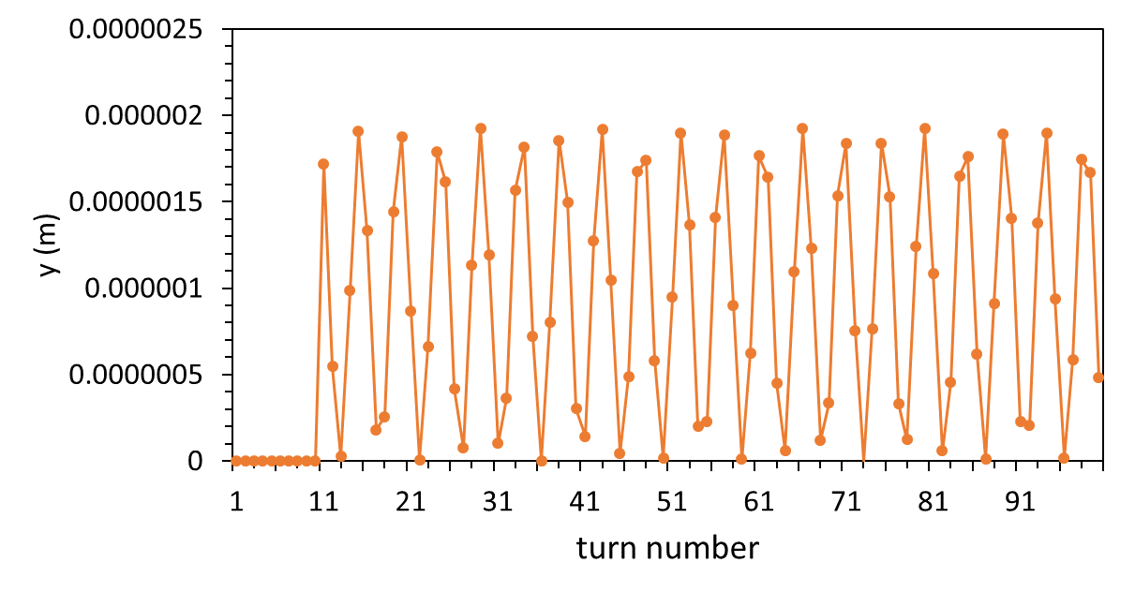
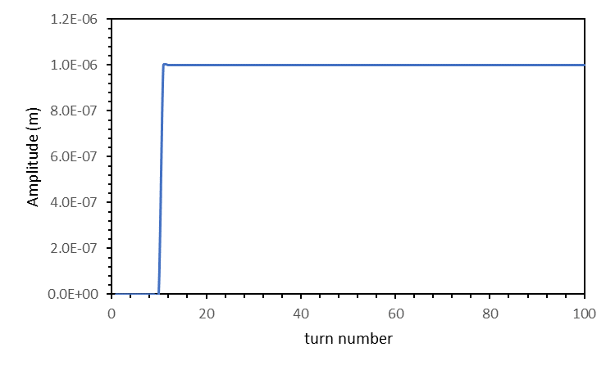
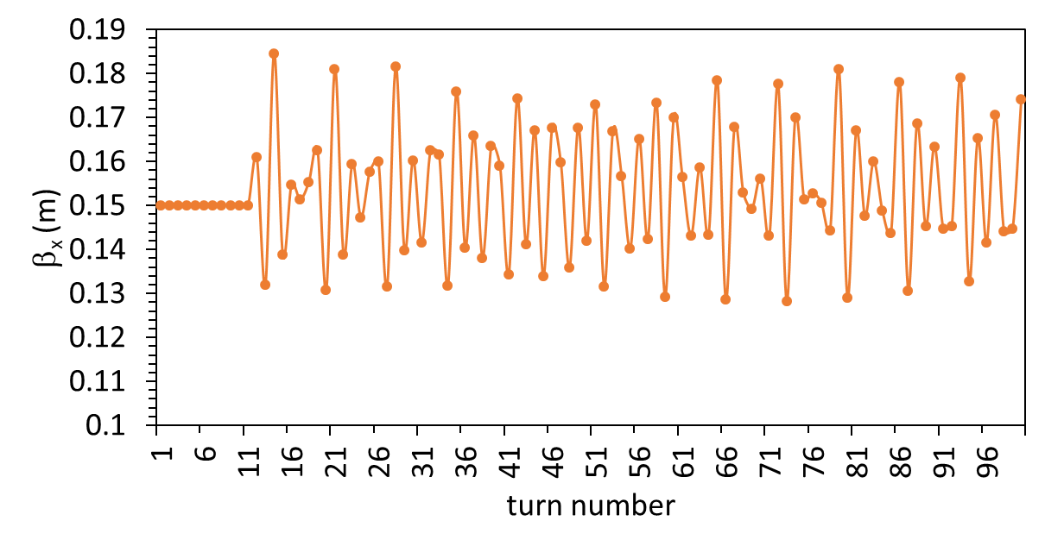
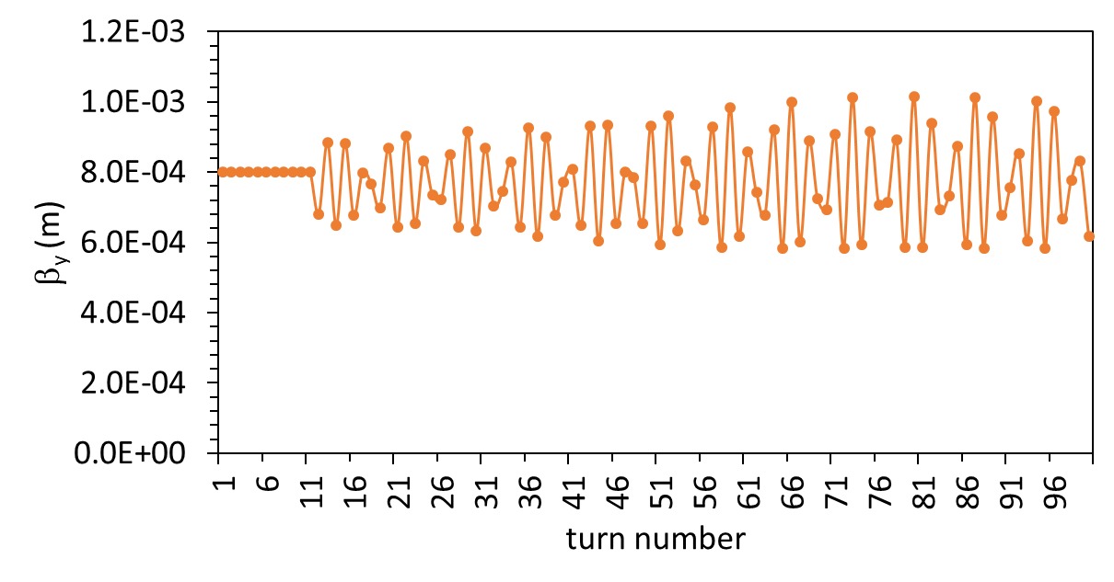
First works with MAD-X
Introduce static misalignments and perform iterative simulations:
TWISS module used
100 turns
No global correction considered
Observables @ IP2: β_{x}, β_{y} and x, y offsets
“Old” Z lattice, 2 IPs
Vertical misalignment of QC1

Slide 7
First works with MAD-X (2)
No divergence observed for x and y offsets
Orbit is closed at each turn
Not consistent with cumulative results

Slide 8
New procedure
Use MAD-X Tracking…
Aim: Simulate a bunch of particles and propagate misalignments over thousands of turns
(First) Initial conditions: RF off VOLTCA1 = 0
Calculation of nominal Twiss parameters
Slice the sequence to prepare for thin lenses tracking: differentiate arc cells and insertions (RF + experiments)
Start the sequence at a dedicated marker near the first RF cavities
Match the global tunes to the nominal ones
Track particles
1. TWISS
2. MAKETHIN
4. MATCH
5. TRACK
3. CYCLE

Slide 9
New procedure
1. TWISS
2. MAKETHIN
4. MATCH
5. TRACK
3. CYCLE
Use MAD-X Tracking…
Work in progress:
In 2. :
It seems that there is no need to slice quadrupoles, but only sextupoles, octupoles and crab-cavities.
When ready, use the standardized thin sequence (see Ghislain Roy’s talk).
In 5.:
Define a macro (tr$macro), which can apply misalignments relative to the number of turn (tr$turni)
Evaluate the beam size
Define misalignments depending to the number of turn, which is related to frequency

Slide 10
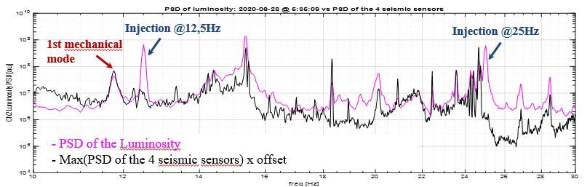
Work on SuperKEKB
Related optics simulations
Correlation of vibration and luminosity measurements (see Laurent’s talk):
Ongoing work: perform optics simulations to make the comparison with measurements
Induce vibrations of the cryostats in the simulations: PSD displacement measured
Evaluate luminosity losses
Work performed with SAD
Possibility to compare results with MAD-X when SAD/MAD-X converter available
(see Leon’s talk)
10
Frequency (Hz)
20
30

Slide 11
Summary and perspectives
Conclusions:
Ongoing work to define properly vibrations in MAD-X (PSD)
Integration of mechanical design in optics simulations
Complementary study to misalignments results
Parallel made with SuperKEKB vibrations studies
Gradually complexify vibrations simulations in MAD-X for MDI studies with the add of mechanical specifications check criticality of vibrations in FCC-ee

Slide 12
Summary and perspectives
Lots of things to do before getting and presenting numerical results…
Long-term perspectives:
Integrate mechanical transfer functions in the definitions of beam elements misalignments
Consider RF and Radiation (6D problem)
Test global and local corrections
Inclusion of previous misalignments and correction
Consideration of both e⁺ and e⁻ beams (2 different beam pipes)
…
  Many thanks to: M. Boscolo, T. Charles, M. Hofer, G. Roy, L. Van Riesen-Haupt, F. Zimmermann

Slide 13
Thank you for your attention!
13

