Slide 1


Impedance model
&
TMCI threshold
Emanuela Carideo
Acknowledegements: M. Migliorati, F. Zimmermann, D. Quartullo, M. Zobov, D. De Arcangelis

Slide 2
Outline
Wakefields and impedances evaluated so far: The method used to calculate the wakepotential
Repository
Longitudinal single beam instabilities: MI analysis
Transverse single beam instabilities : TMCI mode analysis
Collaboration with the Super KEKB : Collimators

Slide 3
Impedance Sources: CST and IW2D simulations
Longitudinal wake potentials for a Gaussian bunch with nominal bunch length σ_{z} = 3.5mm due to the main FCC-ee components, evaluated so far.
How did we do these simulations?

Slide 4
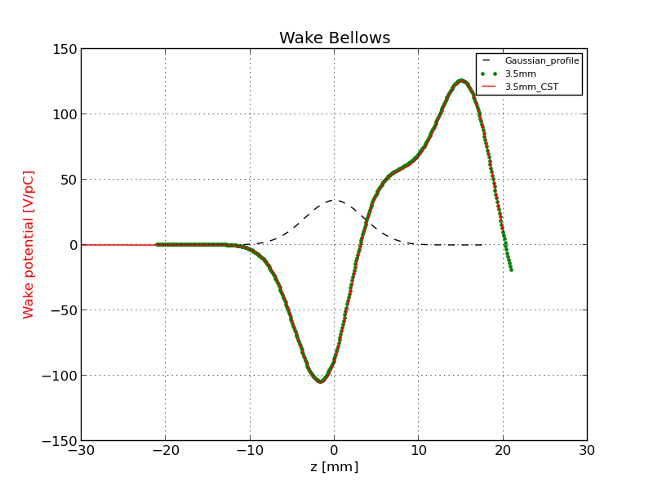
Method to calculate the Wake Potential by software simulation
Comparison of the wake potential of 3.5 mm bunch length between PyHT and CST: Bellows
Wake potential for a Bellow of a 3.5 mm Gaussian bunch obtained directly by CST (red curve) and with the convolution by using the wake potential of 0.4 mm Gaussian bunch (green dots).

Slide 5
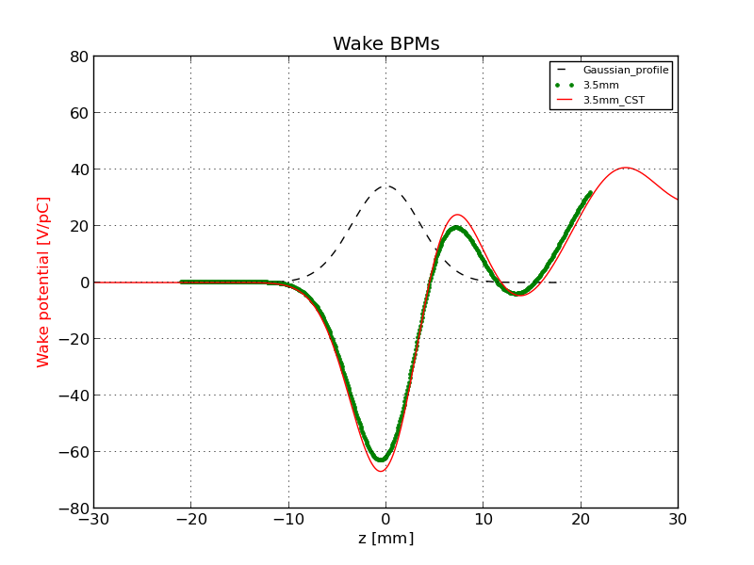
Comparison of the wake potential of 3.5 mm bunch length between PyHT and CST: BPMs

Slide 6
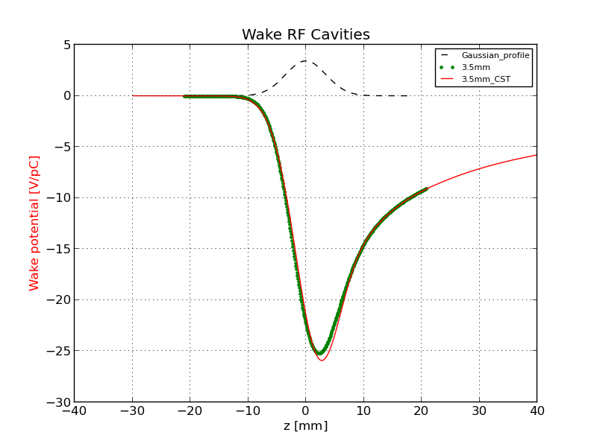
Comparison of the wake potential of 3.5 mm bunch length between PyHT and CST: RF Cavities

Slide 7
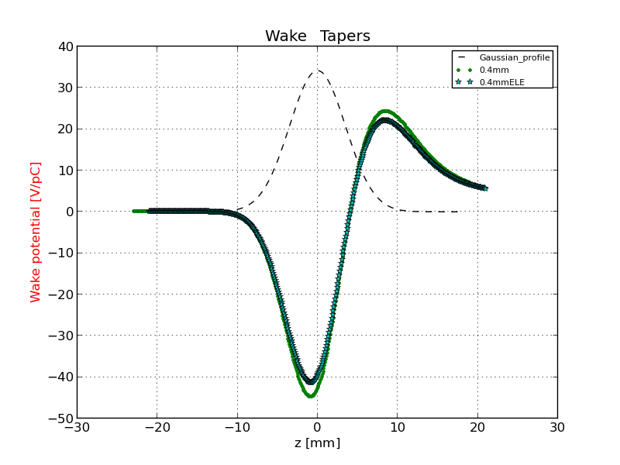
Comparison of the wake potential of 3.5 mm bunch length between PyHT and CST: RF double tapers
3.5 mm
3.5_ABCI

Slide 8
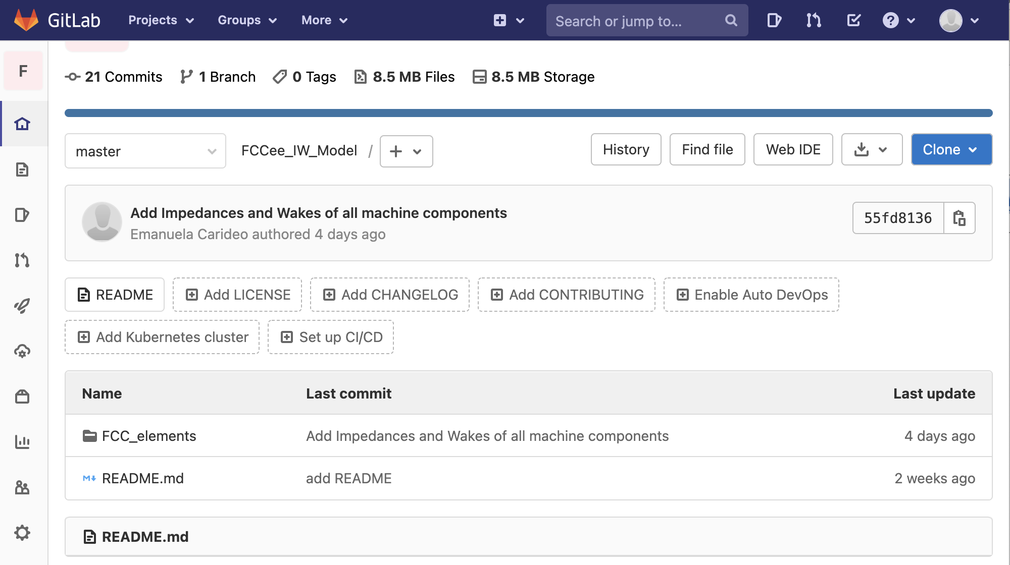
Wake and impedance repository for FCC-ee: https://gitlab.cern.ch/ecarideo/FCCee_IW_Model
A repository, or Git project, encompasses the entire collection of files and folders associated with a project. Working in repositories keeps development projects organized and organized and protected.
The Repository also provides more opportunities for project transparency and collaboration, working together to build the best possible final product.
How is it developed?
In this folder there are some of FCC-ee components and for each machine components the calculated impedance and wake

Slide 9
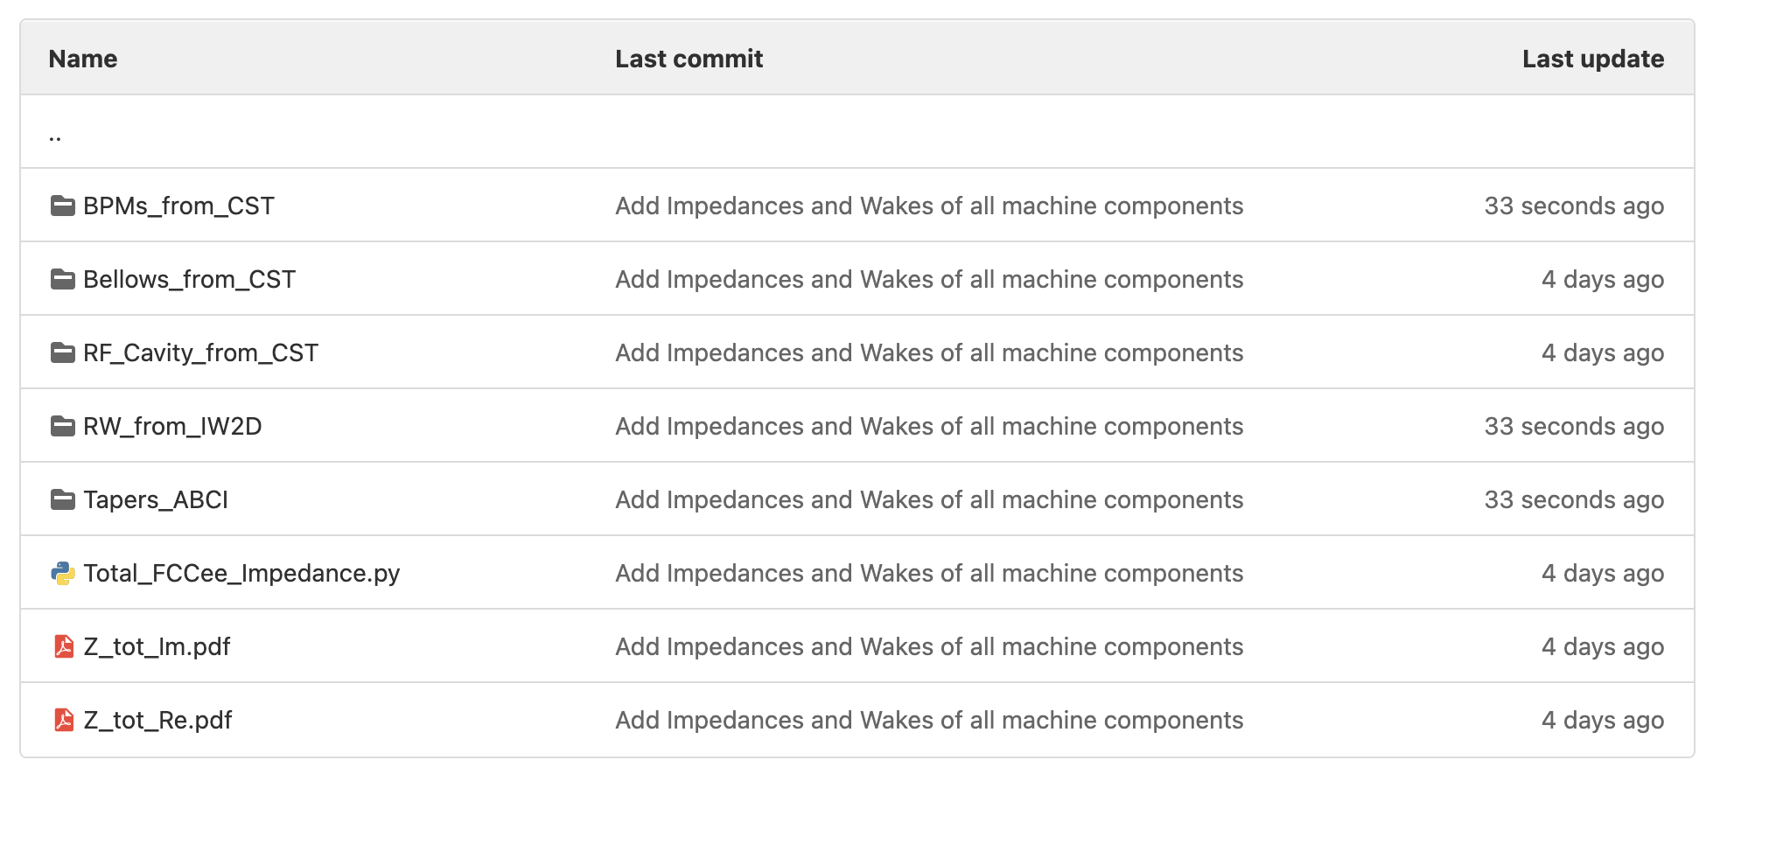
FCCee_IW_Model/FCC_elements/
The same procedure for every folders
The total FCCee Impedance comes from all machine components

Slide 10
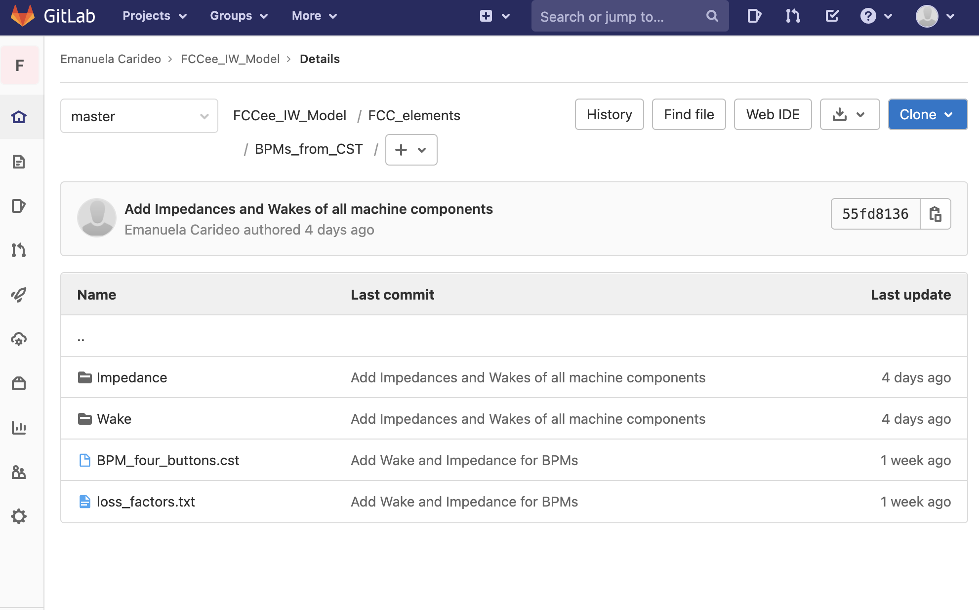
FCCee_IW_Model/FCC_elements/BPM_from_CST/
Real and Imaginary Longitudinal Impedance
Wake potential
Model used for CST simulation
Calculation of the loss factor

Slide 11
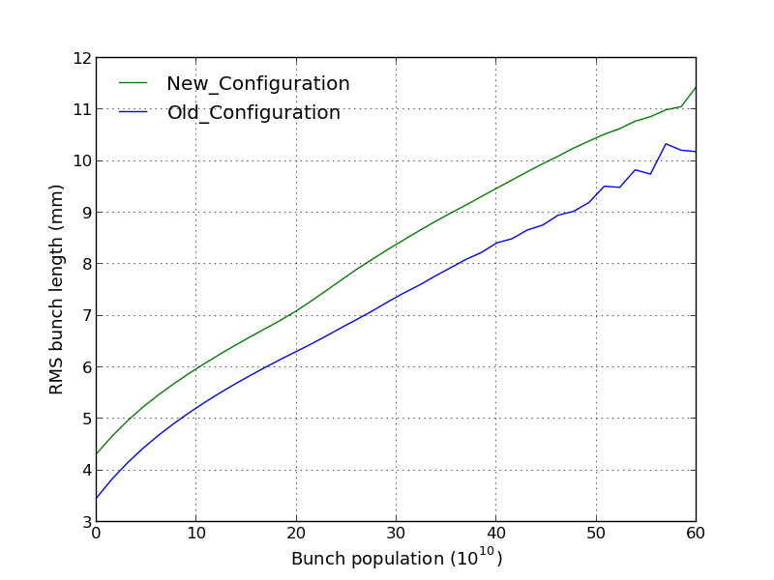
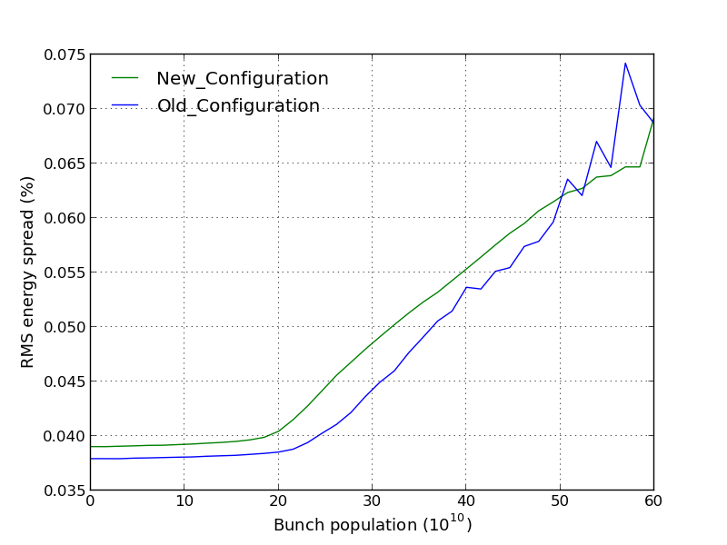
New Wakes with new machine parameters :
Longitudinal RW with 150nm of coating plus the Bellows without neglected the perturbation introduced by the lateral winglets used to place synchrotron radiation absorbers (Chiara Antuono)
https://indico.cern.ch/event/995850/contributions/4401571/attachments/2275135/3864813/FCCweek.pdf

Slide 12
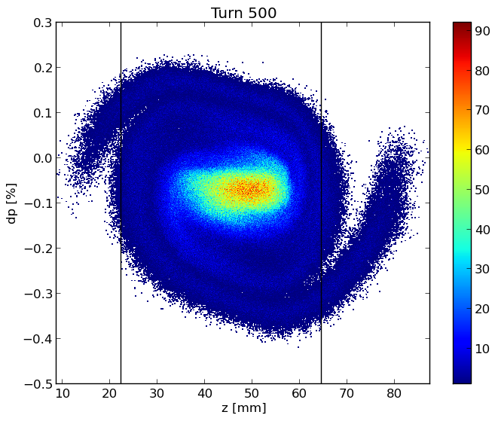
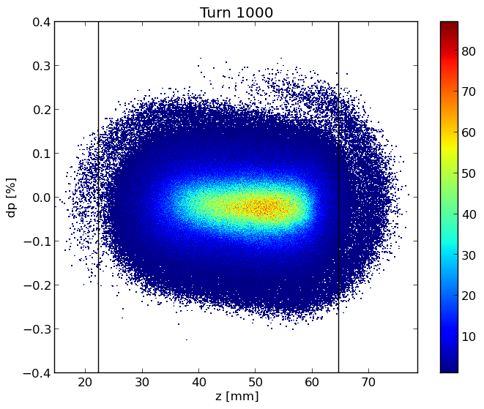
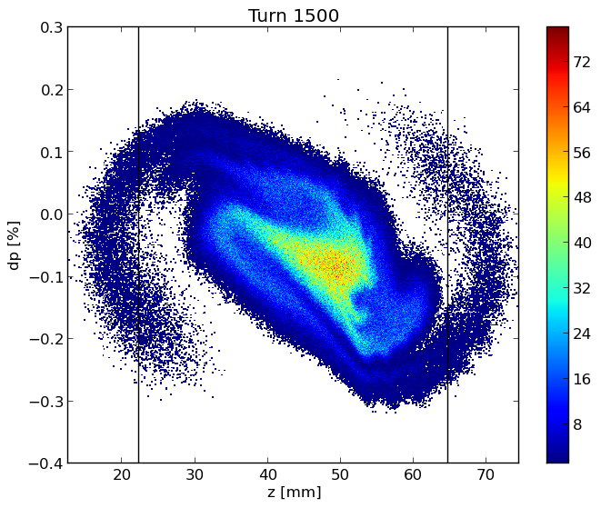
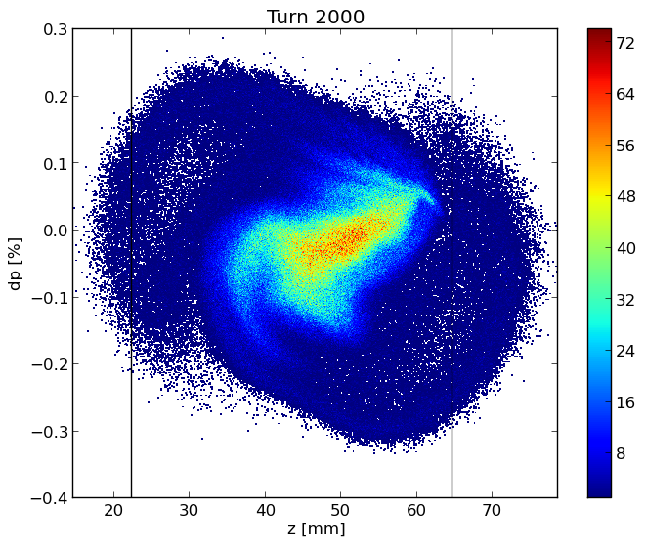
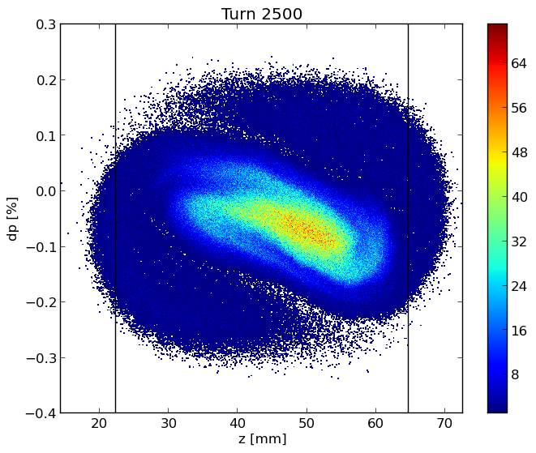
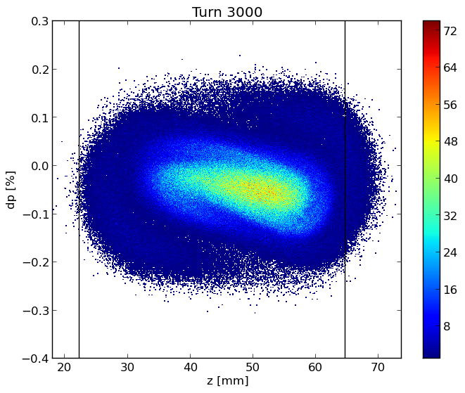
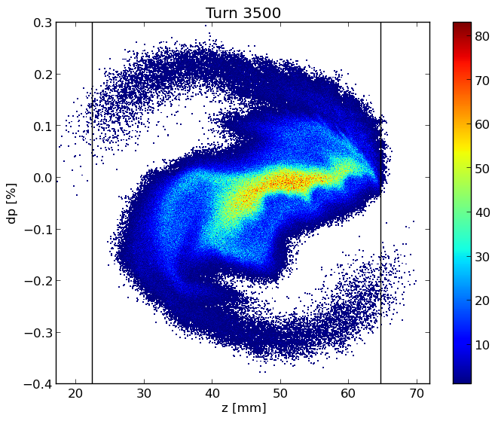
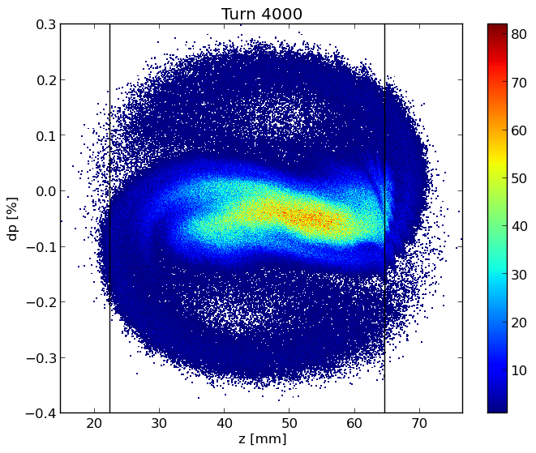
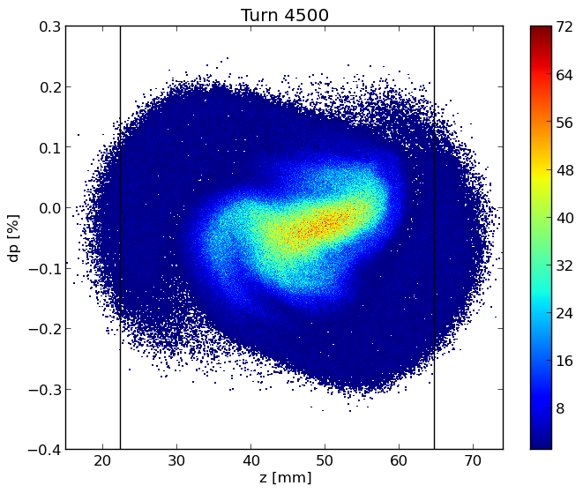
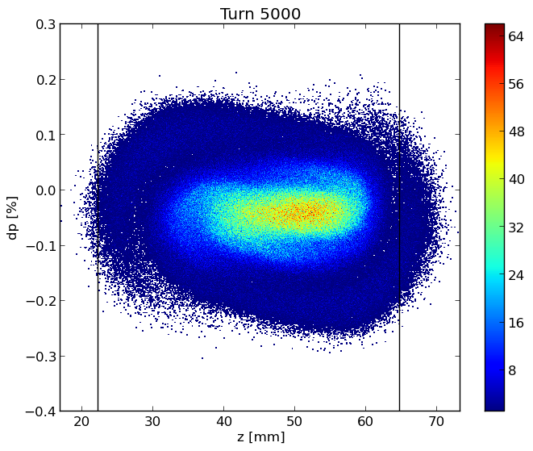
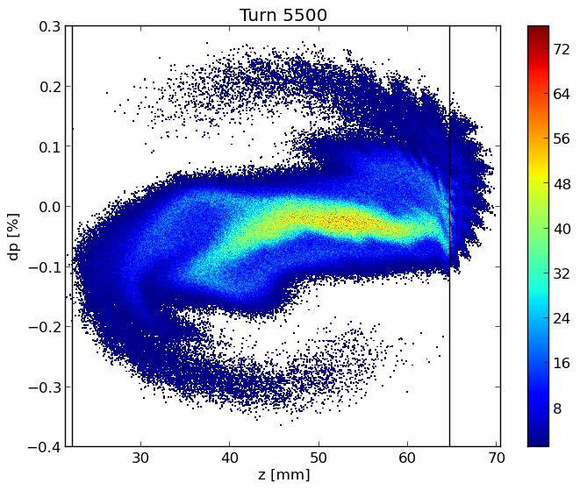
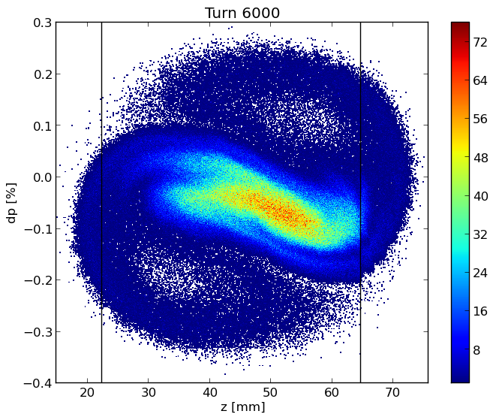
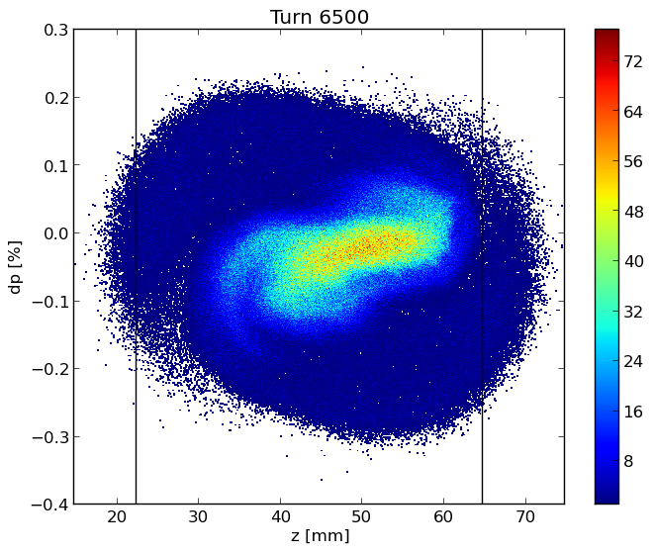
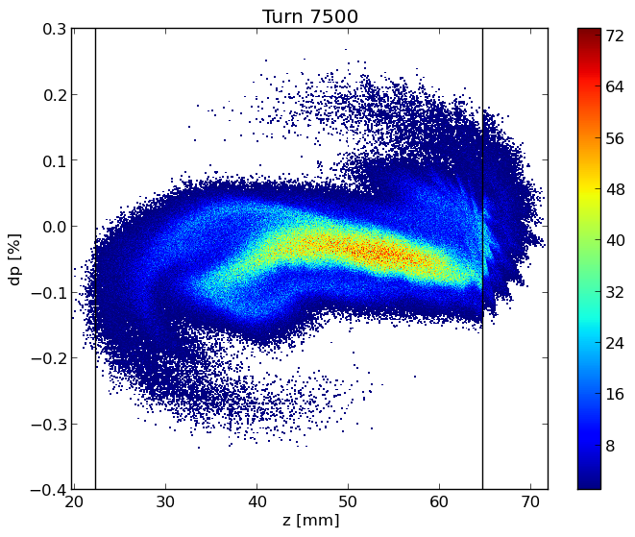
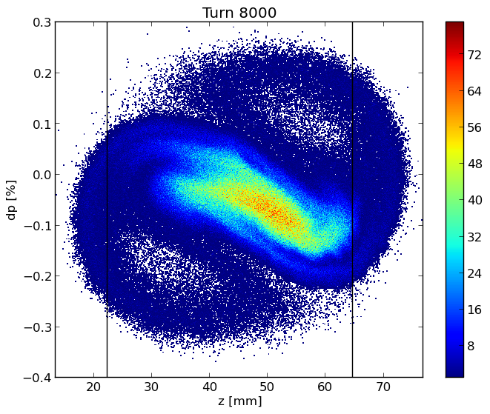
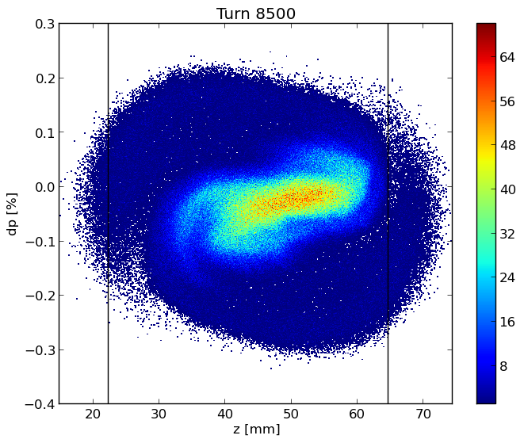
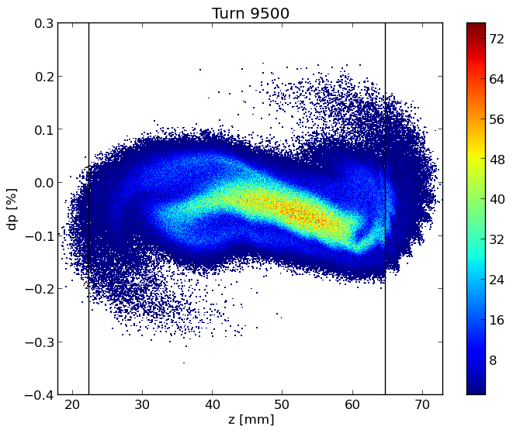
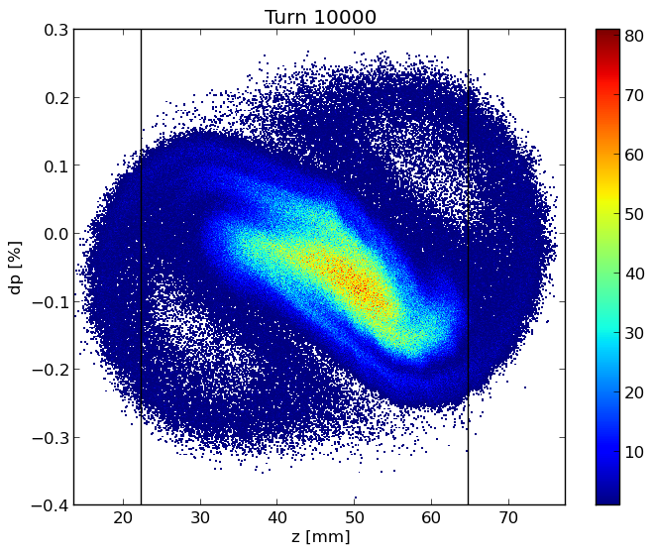
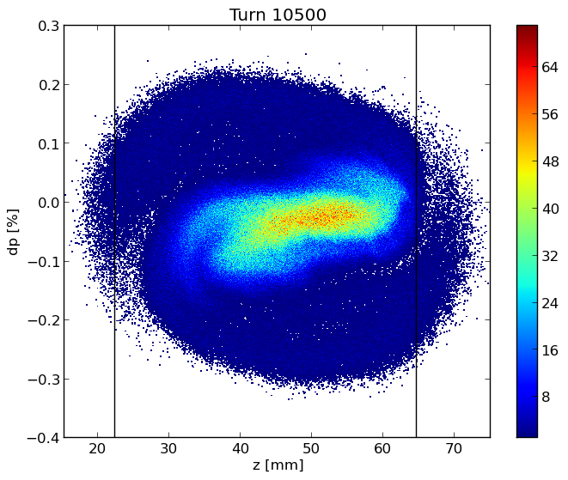
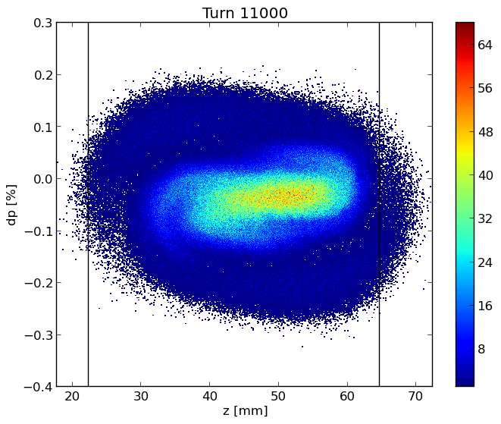
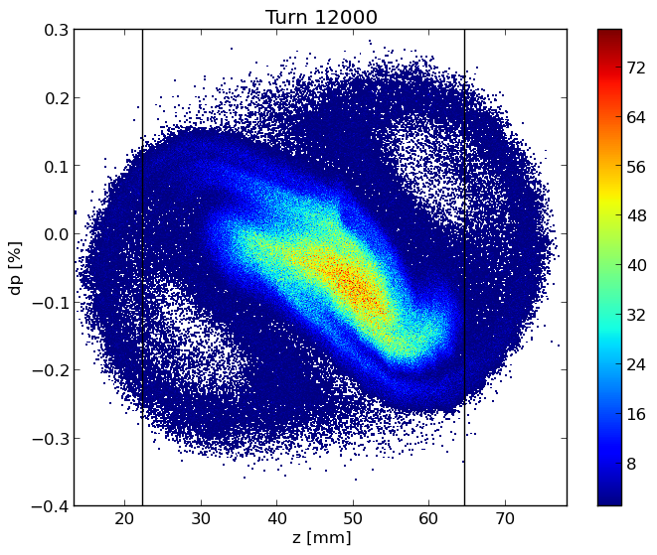

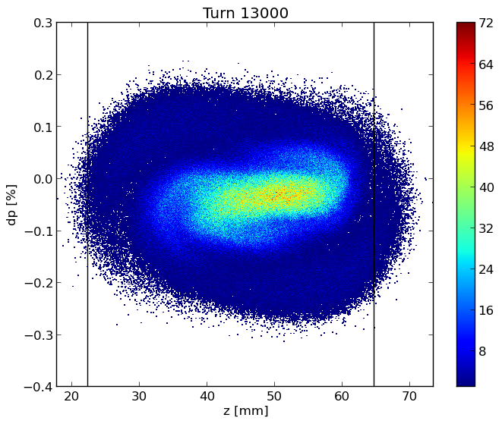
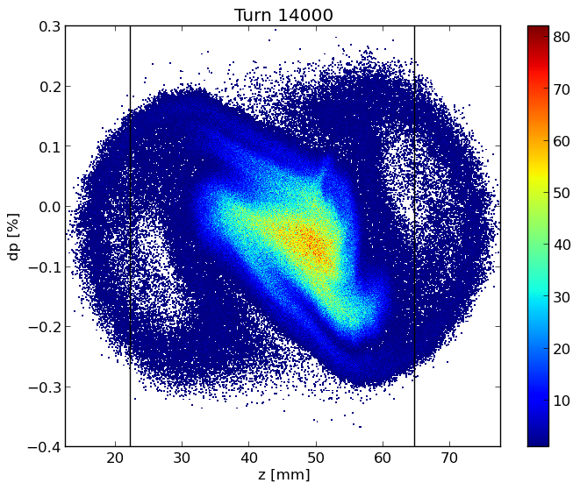
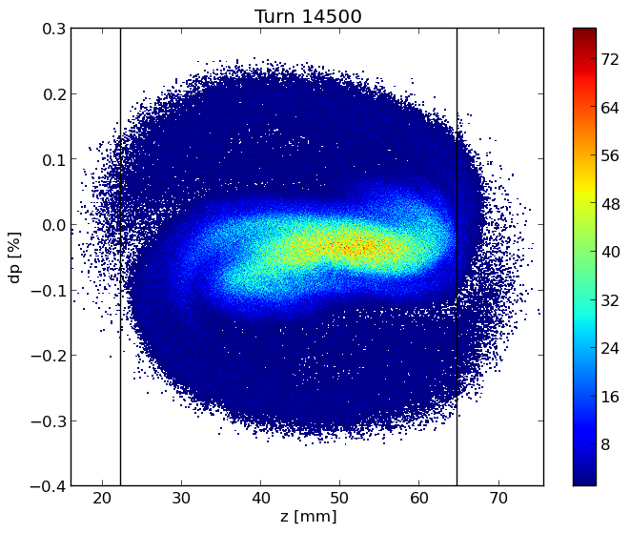
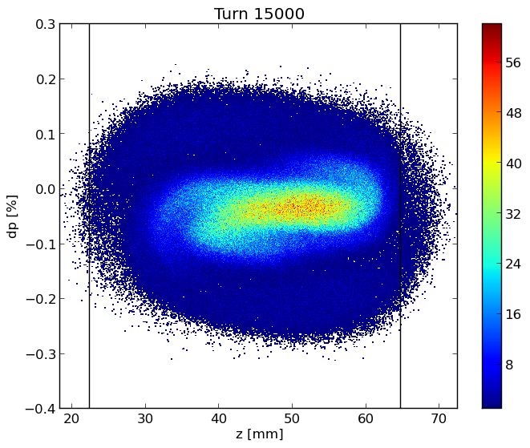
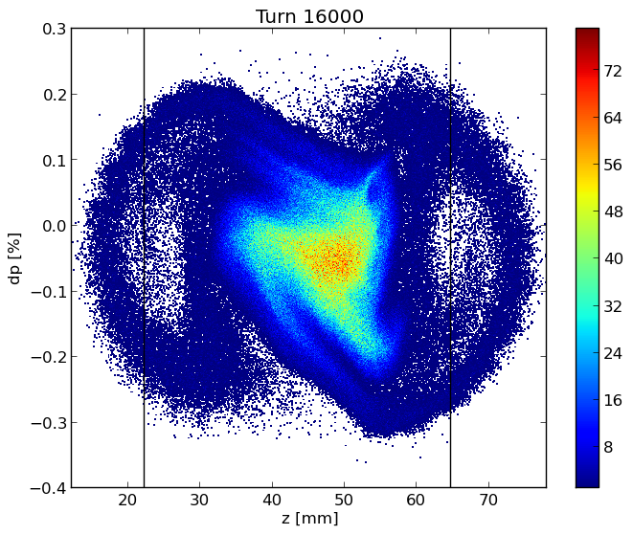
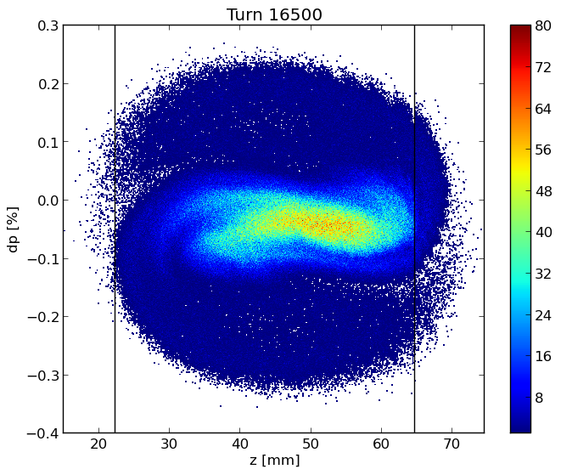

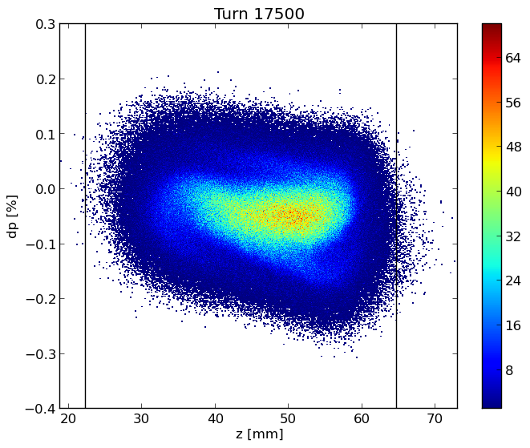
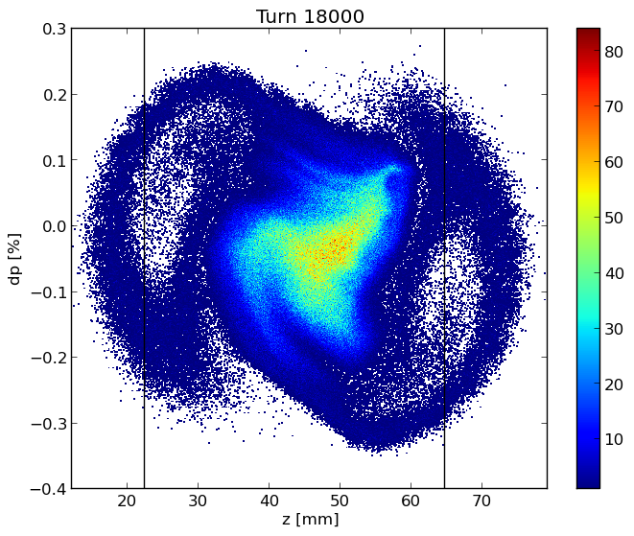
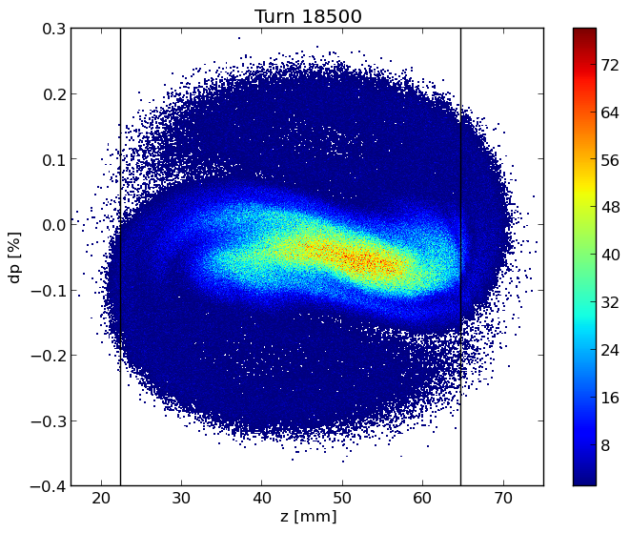
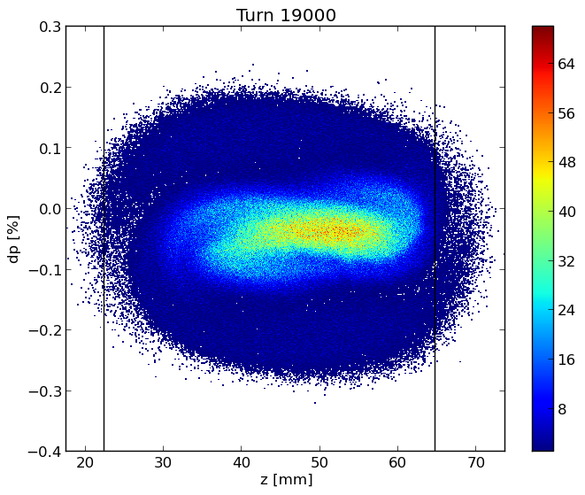
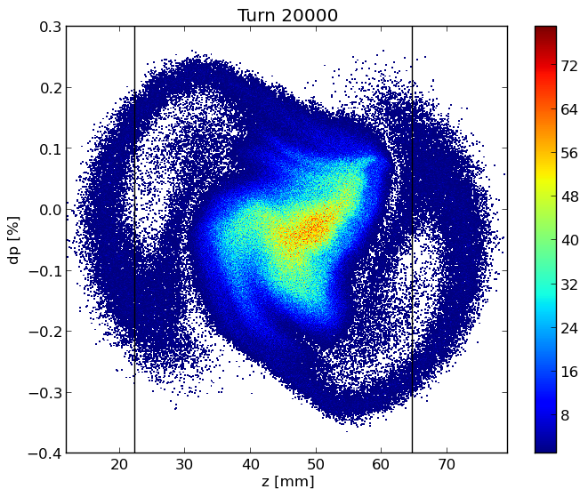
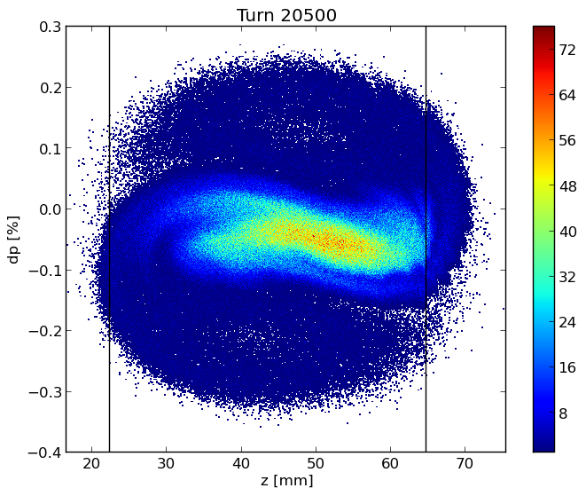
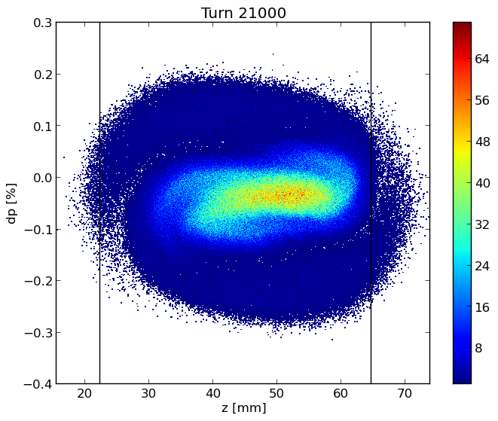
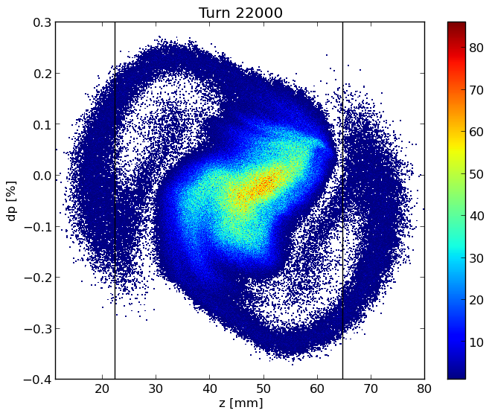
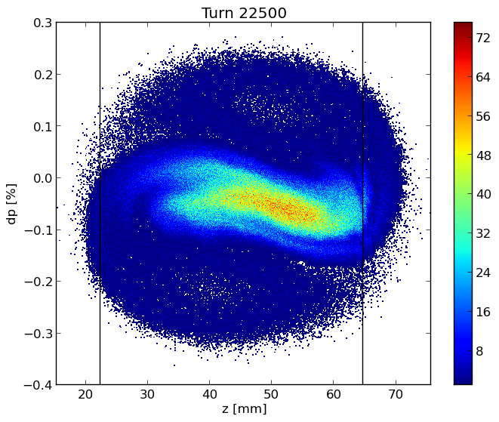
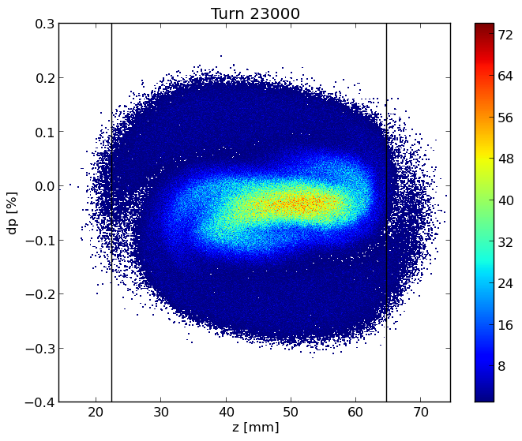
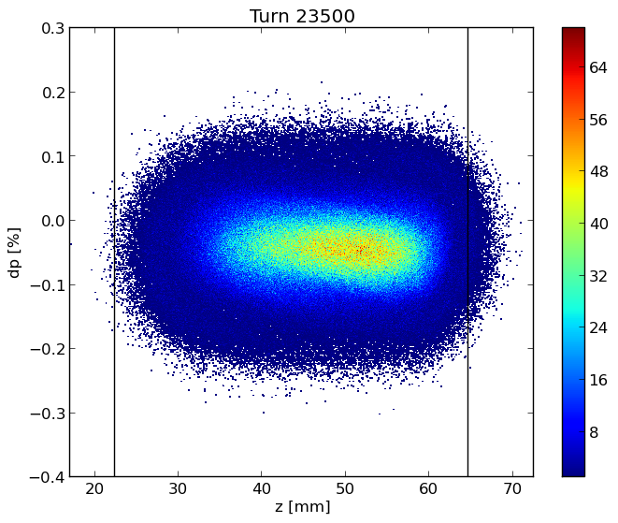
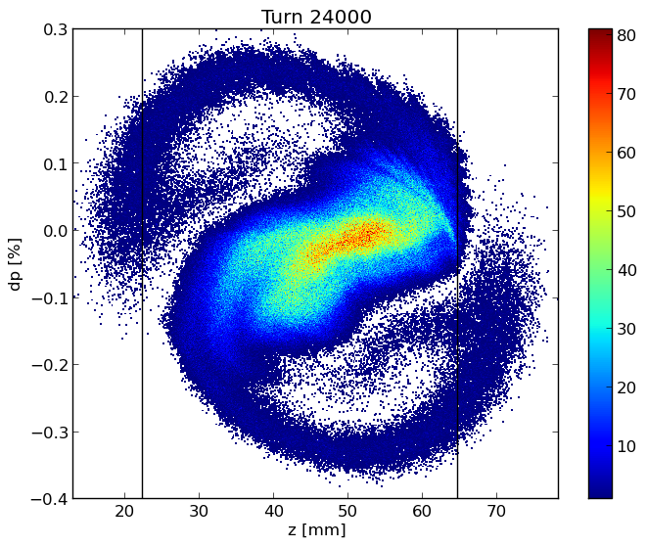
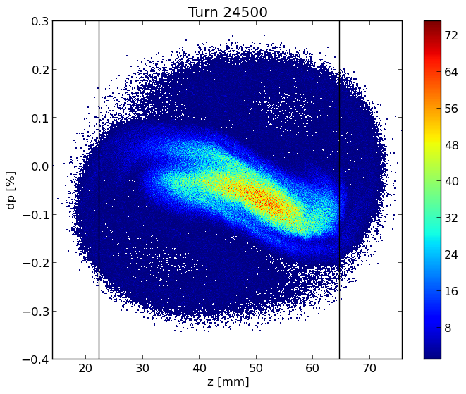
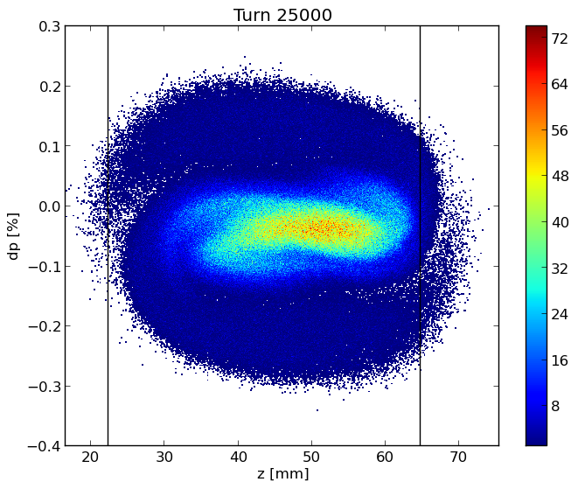











Longitudinal dynamics
Longitudinal phase
space
Bunch length (bottom) and RMS energy spread (top) as a function of bunch population in the case with (BS) and without (SR) beamstrahlung, which is considered here independent of the longitudinal impedance.
Bunch shape distortion at nominal intensity from the original Gaussian one.

Slide 13


Bunch length and energy spread for considered cases
The transverse impedance almost does not affect the longitudinal dynamics

Slide 14
Transverse Dynamics: Checked the method
In addition to simulations with the tracking code, the TMCI threshold has been also evaluated with the analytic Vlasov solver DELPHI. For PyHEADTAIL, we have used the RW wakefield of a short bunch with a length of 0.4 mm as Green function. DELPHI uses the impedance in frequency domain given directly by IW2D.
The green dots represent the DELPHI results, which well fit with the PyHEADTAIL simulations for which the colours are proportional to the amplitude of the frequency spectrum of the various moments of the distribution . Red corresponds to the largest amplitude, blue to the lack of signal.
There is an excellent agreement between the two methods up to the instability threshold

Slide 15

Transverse Dynamics
The TMCI, Transverse Mode Coupling Instability,
occurs when the frequencies of two neighboring coherent oscillation modes merge together. Above the transverse instability threshold the bunch is lost and this makes the TMCI very dangerous for the beam.
On the top, real part of the frequency shift of the first coherent oscillation modes as a function of the bunch population without beamstrahlung, by considering only the RW impedance produced by a NEG film with 150 nm thickness given by IW2D.
On the right, real part of the coherent tune shift as a function of intensity considering the longitudinal resistive wall wakefield, by using PyHEADTAIL.

Slide 16

TMCI
SR: Bunch length of 4.35 mm
Without longitudinal resistive wall wakefield
Considering the longitudinal resistive wall wakefield

Slide 17
TMCI: longitudinal and transverse wake with a bunch length of 15.2 mm (BS)
In the back-up slides (#37) you can find the other plots (transverse and longitudinal separately)

Slide 18


Variable Chromaticity
On the left, real part of the frequency shift of the first coherent oscillation modes as a function of the bunch population without beamstrahlung, so considering a bunch length of 4.32mm and a value of Chromaticity of +5
On the right, real part of the frequency shift of the first coherent oscillation modes as a function of the bunch population without beamstrahlung, so considering a bunch length of 4.32mm and a value of Chromaticity of -5

Slide 19
New evaluation of the impedances using different NEG coating : 100 nm 150 nm and 200 nm

Slide 20


Longitudinal dynamics

Slide 21


TMCI analyzes using wake with different NEGs : 100nm, 150 nm and 200 nm
On the letf the plot of the TMCI considering a wake with 100nm of NEG and a beam length of 3.5mm
On the right the plot of the TMCI considering a wake with 100nm of NEG and a beam length of 12.1mm

Slide 22


TMCI analyzes using wake with different NEGs :
100nm, 150 nm and 200 nm
On the letf the plot of the TMCI considering a wake with 150nm of NEG and a beam length of 3.5mm
On the right the plot of the TMCI considering a wake with 150nm of NEG and a beam length of 12.1mm

Slide 23


TMCI analyzes using wake with different NEGs : 100nm,150 nm and 200 nm
On the letf the plot of the TMCI considering a wake with 200nm of NEG and a beam length of 3.5mm
On the right the plot of the TMCI considering a wake with 200nm of NEG and a beam length of 12.1mm

Slide 24



Work in progress
Collaboration with Super KEKB
CST Studio Suite is a “high-performance 3D EM analysis software package for designing, analyzing and optimizing electromagnetic (EM) components and systems”
Which is the problem?
Vertical FCCee collimator

Slide 25





Preliminary work
Used a round taper model to calculate the transverse impedance
The approximate formula that I have used for the round taper is extrapolated from Stupakov1 ‘s paper :
$$Z_{⏊}^{round}=−\frac{iZ_{0}}{2π}\int{dz{\left(\frac{g^{′}}{g}\right)}^{2}}$$
Z₀=377 # Ohm
a, b₁, b₂ are gaps
α₁= 11.74*0.0174533 is the angle of the taper in radiant
α₂= 4.38*0.0174533 is the angle of the taper in radiant
Z₀=377 # Ohm
a and b are gaps
α= 11.74*0.0174533 is the angle of the taper in radiant
$$Z_{⏊1}^{round}=\frac{Z_{0}∗tan⁡(α1) }{2π}\left(\left(\frac{1}{a}\right)−\left(\frac{1}{b1}\right)\right)$$
$$Z_{⏊}^{round}=\frac{Z_{0}∗tan⁡(α) }{2π}\left(\left(\frac{1}{a}\right)−\left(\frac{1}{b}\right)\right)$$
α₁
$$Z_{⏊2}^{round}=\frac{Z_{0}∗tan⁡(α2) }{2π}\left(\left(\frac{1}{b1}\right)−\left(\frac{1}{b2}\right)\right)$$
At frequency [0-1.3] GHz the impedance
does not change much
α₂
$Z_{⏊}^{round}$=$Z_{⏊1}^{round}$+$Z_{⏊2}^{round}$
1: "Low frequency impedance of tapered transitions with arbitrary cross sections“ G. Stupakov, Stanford Linear Accelerator Center, Stanford University, Stanford, CA 94309

Slide 26


First result
We had the simulation data for some gaps.
Hence, we extrapolate the transverse impedance at different gaps by using a nonlinear fits in Python:
$$Z=A∗g^{−α}$$
Where:
Z - transverse impedance
g - gap
A and alpha - constants to be found during the fit.

Slide 27
Future Plan
Continue the work for the evaluation, reduction and optimization of the impedances of the main machine elements (e. g. flanges, collimators), and also implementing the FCC-ee repository.
In additionally to the bellows, update of some impedance sources (e. g., BPMs, RF tapers) with more realistic models.
Future investigations about the reduction of the TMCI threshold due to the longitudinal wake are required, as well as possible mitigation solutions.
Continue the work with the CST simulations and continue the “segments project” (splitting the accelerator ring in to segments) to study the effect of different distributed wake along the machine.

Slide 28
Any questions or suggestions?
Time for further discussion this afternoon in 6/R-012
Thanks for your attention!

Slide 29
Back-up Slides

Slide 30

Updated FCC-ee impedance model
Longitudinal wake potentials of some machine elements evaluated so far for a Gaussian bunch with a nominal bunch length of 3.5 mm, considering 8000 bellows.
Component | Number | K_{loss}(3.5mm)[V/pC] | K_{loss}(12.1mm)[V/pC]
Resistive Wall | 97.75 km | 210 | 33.1
RF cavities | 56 | 18.5 | 9.44
BPMs | 4000 | 40.1 | 4.81
Bellows | 8000 | 49 | 4.7e-5
RF double tapers | 14 | 26.6 | 2.5116

Slide 31
Impedance Sources: CST and IW2D simulations
Longitudinal wake potentials for a Gaussian bunch with nominal bunch length σ_{z} = 3.5mm due to the main FCC-ee components, evaluated so far.
Loss factor and Power loss contribution of FCC-ee devices at nominal intensity and bunch length of 12.1 mm, in the lowest energy case of 45.6 GeV
Component | Number | K_{loss}(12.1mm)[V/pC] | 𝑃_{𝑙𝑜𝑠𝑠} [𝑀𝑊]
Resistive Wall | 97.75 km | 33.1 | 1.21
RF cavities | 52 | 8.76 | 0.334
BPMs | 4000 | 4.81 | 0.180
Bellows | 20000 | 23.95 | 0.880
RF double tapers | 13 | 2.33 | 0.088

Slide 32

Updated FCC-ee impedance model: 20000 Bellows
We initially considered a number of 8000 Bellows
BUT
85% of arcs (~ 79 km)
Every arc is 8m long
X2 because we have another bellow before any quadrupole
12000-13000 but to be sure we are performing our calculations considering up to 20000 bellows

Slide 33

Method to calculate the Wake Potential by software simulation: Resistive Wall
Real and imaginary part of the resistive wall impedance calculated by using the code IW2D
Wake potential of a 0.4 mm Gaussian bunch convoluted with the nominal bunch length and compared with the wake potential obtained directly from the convolution of the wakefield with the 3.5 mm Gaussian bunch.

Slide 34

Longitudinal dynamics: OLD machine parameters
Bunch length (bottom) and RMS energy spread (top) as a function of bunch population in the case with (BS) and without (SR) beamstrahlung, which is considered here independent of the longitudinal impedance.

Slide 35


Bunch length and energy spread
(old machine parameters)

Slide 36
Transverse Dynamics
The TMCI occurs when the frequencies of two neighbouring coherent oscillation modes merge together. Above the transverse instability threshold the bunch is lost and this makes the TMCI very dangerous for the beam.
In addition to simulations with the tracking code, the TMCI threshold has been also evaluated with the analytic Vlasov solver DELPHI
On the top, real part of the frequency shift of the first coherent oscillation modes as a function of the bunch population without beamstrahlung, by considering only the RW impedance produced by a NEG film with 150 nm thickness given by IW2D.
On the right, real part of the coherent tune shift as a function of intensity considering the longitudinal resistive wall wakefield, by using PyHEADTAIL.

Slide 37
TMCI
Without longitudinal resistive wall wakefield
Considering the longitudinal resistive wall wakefield

Slide 38



Transverse RW for a beam length of 12.1mm:
TMCI analysis
Transverse RW: PyHT vs Delphi
Considering the longitudinal resistive wall wakefield
Without longitudinal resistive wall wakefield
Longitudinal RW

Slide 39
TMCI: longitudinal wake (on the right) and transverse wake (on the left) with a bunch length of 15.2 mm

