Slide 1


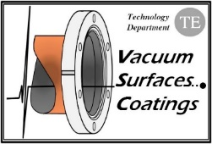
FCC-ee Vacuum System and Pressure Forecast
R. Kersevan, TE-VSC-VSM

Slide 2
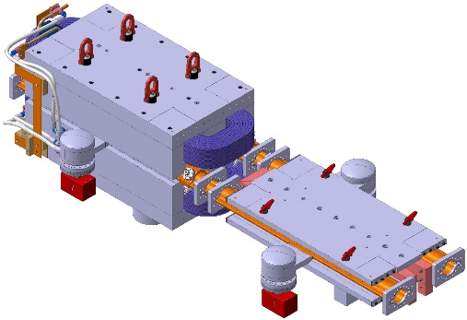
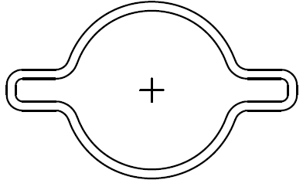

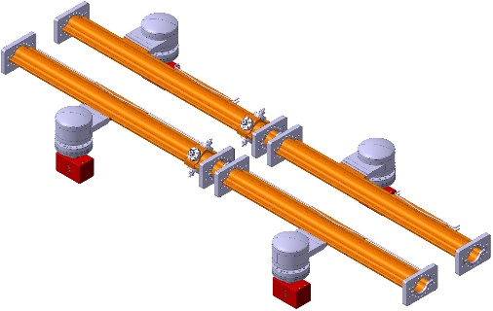
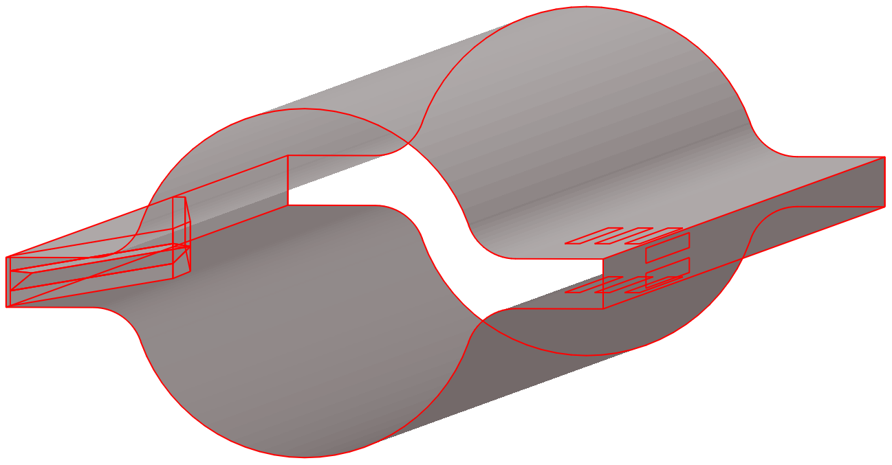
FCC-ee vacuum chamber cross-section and pumping concept (as per CDR)
Lumped SR absorbers, 300 mm long (~ 5.6 m spacing on average, in the arcs)
Vacuum chamber cross section: 70 mm ID with”winglets” in the plane of the orbit (SUPERKEKB-like);
Pumping slots
High-Z shielding_ around absorber
Water-cooled SR absorber
SR fan
R. Kersevan, FCC-ee Vacuum System and Pressure Forecast, FCCIS WP2 Workshop

Slide 3
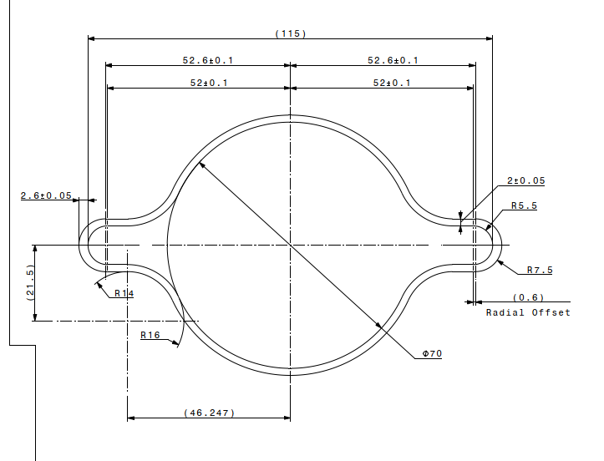
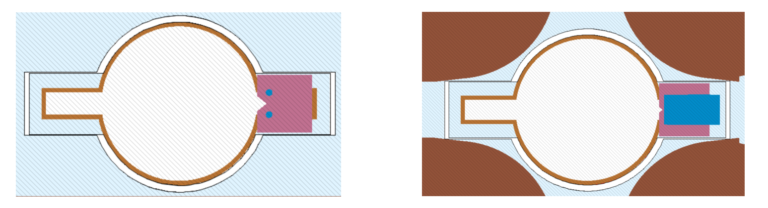
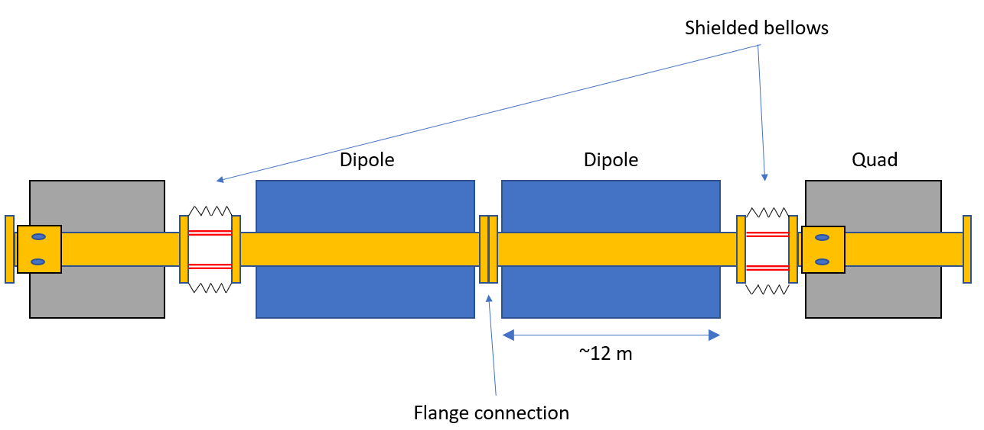
FLUKA model of vacuum chamber with ABS along dipole (left) and quadrupole (right). Quad ABS needs reduced vertical size, to avoid interference with magnet poles; Dipole has 90 mm vertical opening;
External beam: the SR absorber is placed AFTER the pump port, same side (not 1 pump port/ABS!)
(courtesy C. Garion)
Internal beam: the SR absorber is placed IN FRONT of the pump port (not 1 pump port/ABS!)

Slide 4
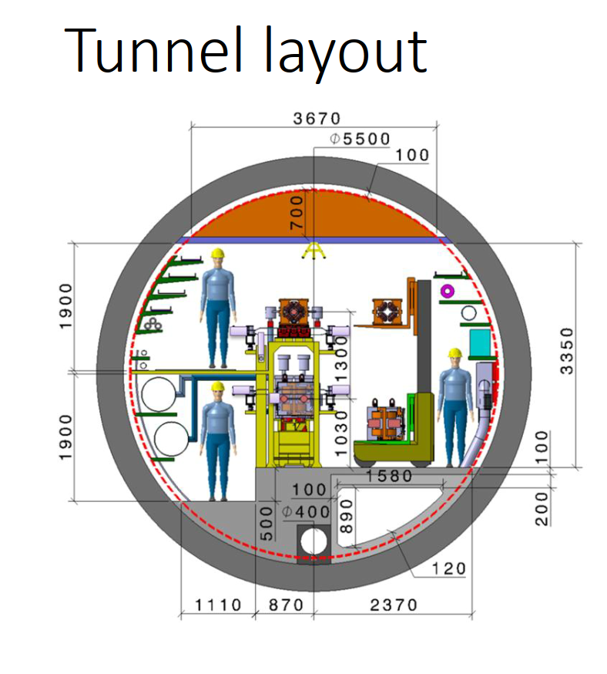
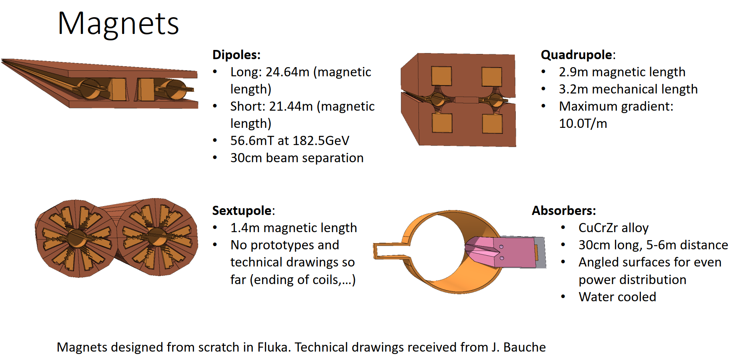
FCC-ee: Tunnel cross-section and magnet/vacuum chamber models
Tunnel layout (not up-to-date)
(courtesy F. Valchkova-Georgieva)
3D models for the magnets and the vacuum chamber
(courtesy B. Humann, FLUKA team)
R. Kersevan, FCC-ee Vacuum System and Pressure Forecast, FCCIS WP2 Workshop

Slide 5
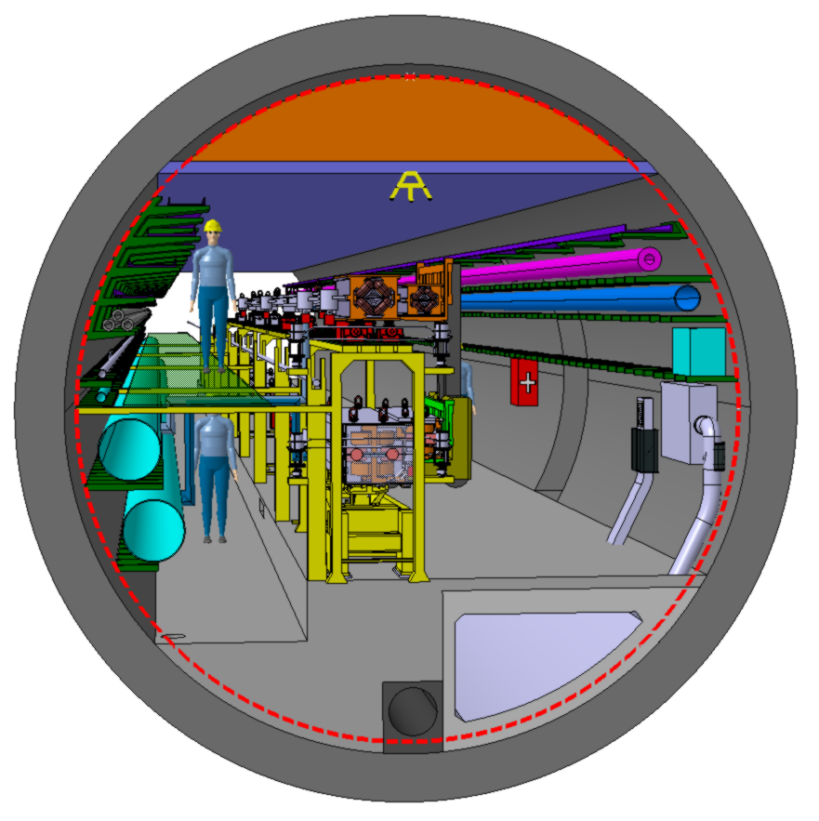
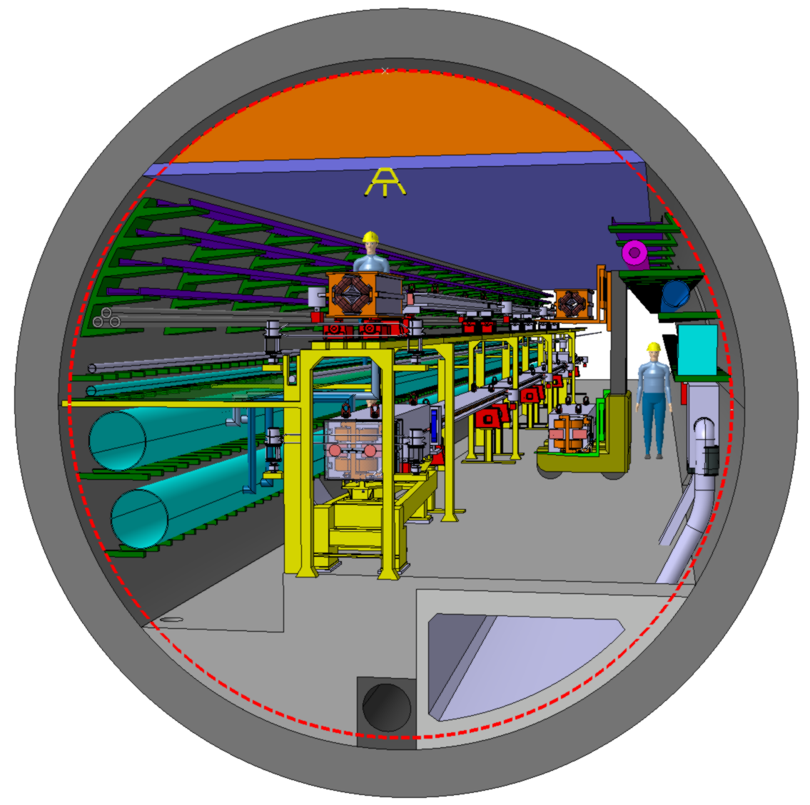
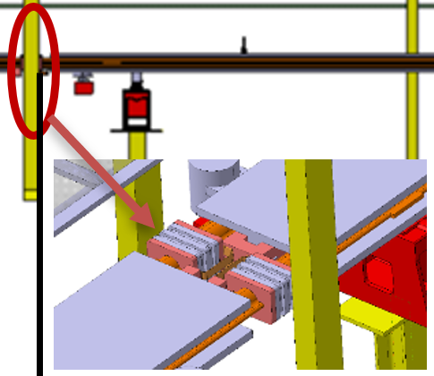
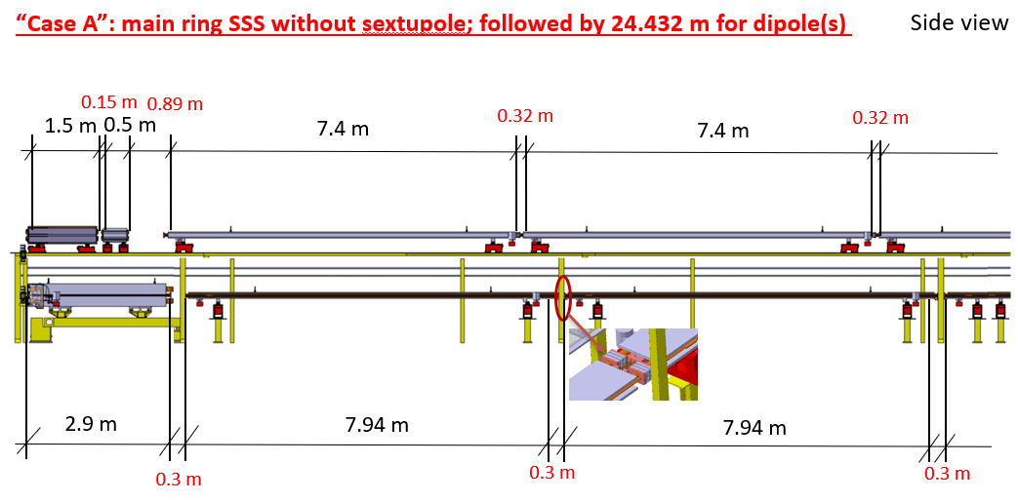
Tunnel layout and integration
(courtesy F. Valchkova-Georgieva)

Slide 6
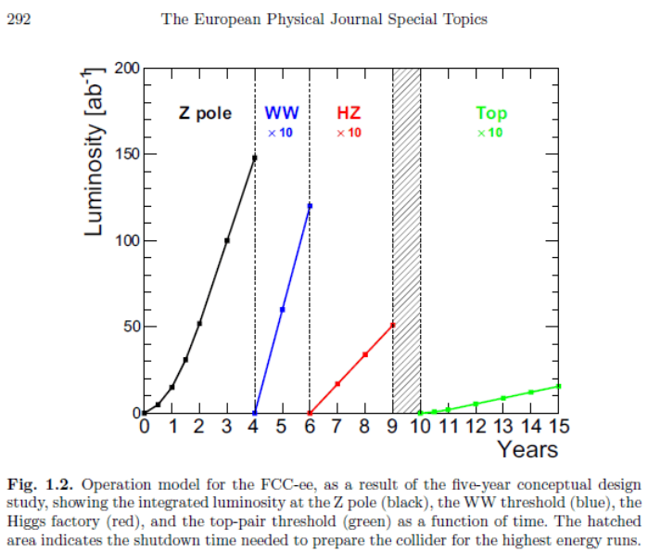
Timeline of experimental program, FCC-ee
Two years to start the machine and get up to nominal luminosity at the Z-pole energy
R. Kersevan, FCC-ee Vacuum System and Pressure Forecast, FCCIS WP2 Workshop

Slide 7
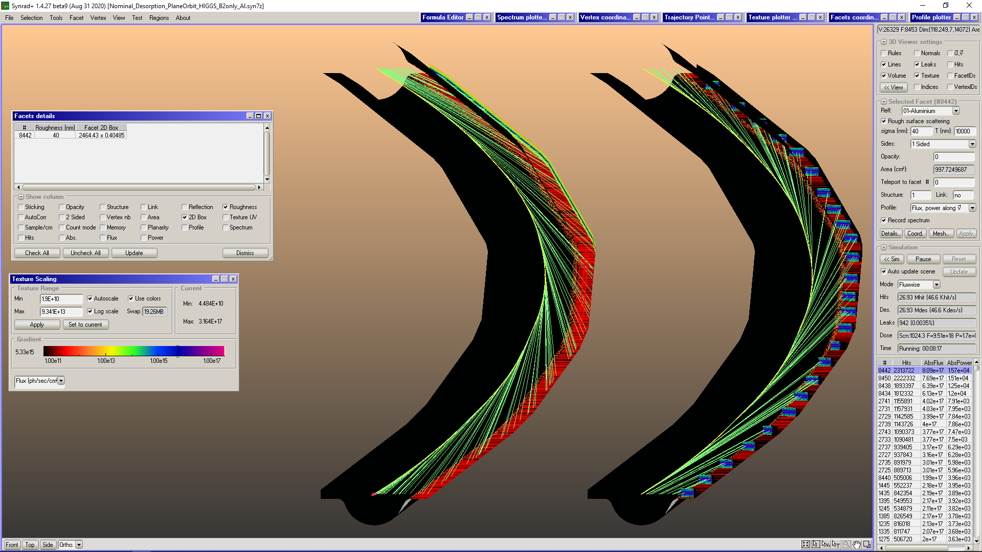
Modeling the FCC-ee Rings: Ray-Tracing
We have created a model of a ~140 m-long arc section of the FCC-ee, both beams, which is also being used by the FLUKA team to compute the beam losses and radiation leakage from the vacuum chambers, irradiating all machine and tunnel components; 5 dipoles and 5 quadrupoles, interleaved, for each beam
Beam 2 is coming from top to bottom, on the left, B1 reverse direction on the right; periodic boundary conditions apply
B2 has the vacuum chamber with NO photon absorbers, B2 has 25 photon absorbers placed to intercept ~ 100% power
Low energy photons strike outside of the 11 mm-high slot, see red-colored textures; 120 GeV, 29 mA Higgs-pole case
On average, each photon absorber in B1 intercepts the SR power impinging over 5.6 m of external wall length
We have also considered a new type of SR absorber: it implements the concept of the sawtooth profile similar to what is installed in the LHC beam-screen and also has been envisaged for the FCC-hh and HE-LHC beam-screens (with different pitch-height geometries though)
It turns out to be a very efficient way to keep scattered photons, and the related photoelectrons, away from the circular part of the chamber, where the beam runs, therefore minimizing the electron cloud issues
B2
B1
R. Kersevan, FCC-ee Vacuum System and Pressure Forecast, FCCIS WP2 Workshop

Slide 8
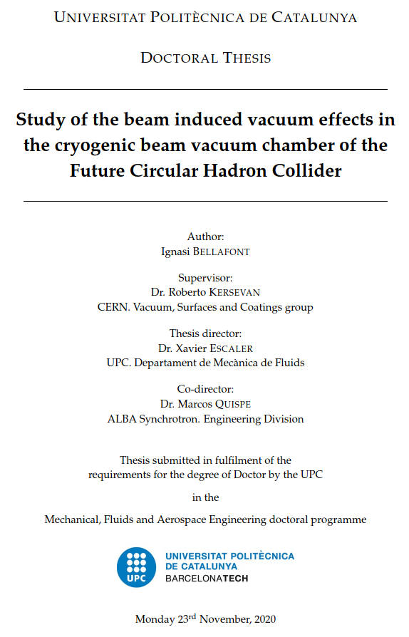
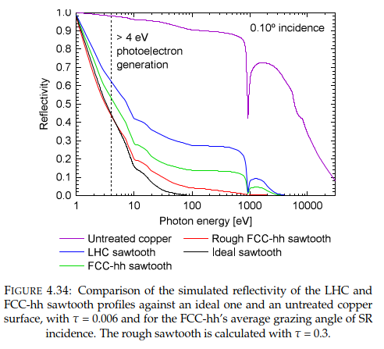
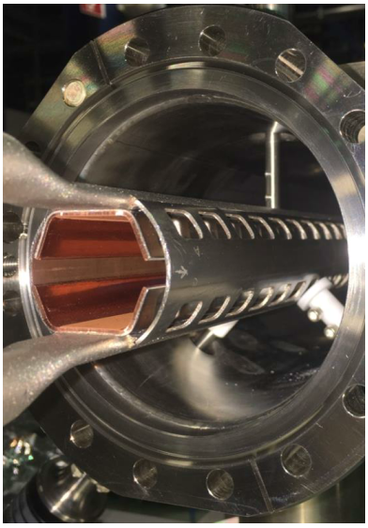
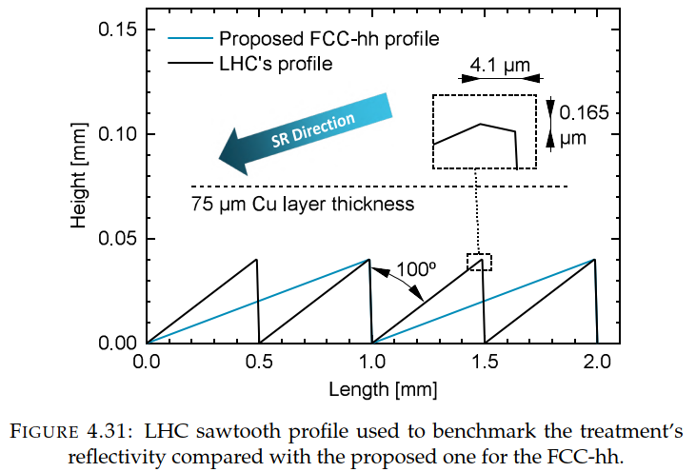
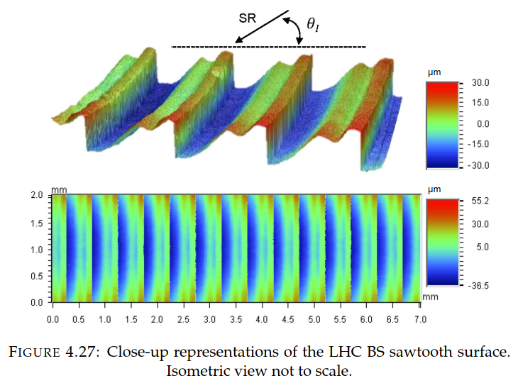
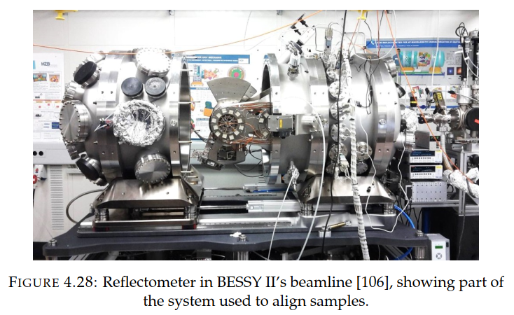
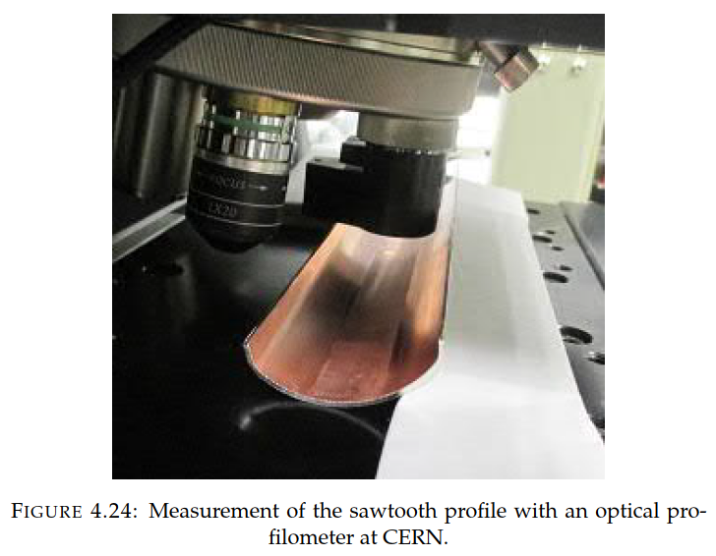
Sawtooth Profiles
Source: PhD thesis of I. Bellafont, CERN/Univ. Politècnica de Catalunya, Barcelona, 2020
FCC-hh BS with sawtooth profile installed at the BESTEX beamline, KARA ring, KIT
R. Kersevan, FCC-ee Vacuum System and Pressure Forecast, FCCIS WP2 Workshop

Slide 9
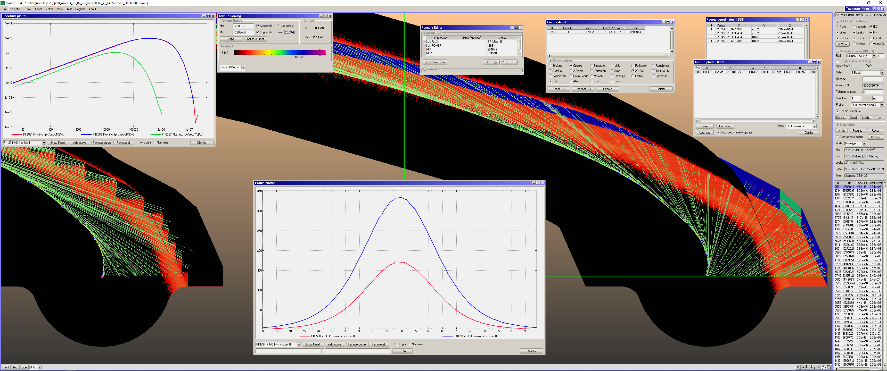
Ray-Tracing (SYNRAD+)
Vertical SR power density (inset bell shaped) on external vertical wall, in case no localized absorbers are implemented
Blue line: vertical profile over +/- 0.5 mm strip, length of 670 cm (quad QD3.468); peak value ~ 380 W/cm²
R. Kersevan, FCC-ee Vacuum System and Pressure Forecast, FCCIS WP2 Workshop

Slide 10
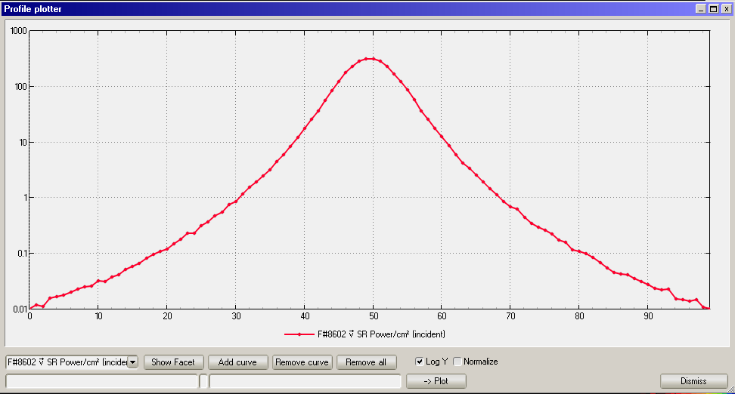
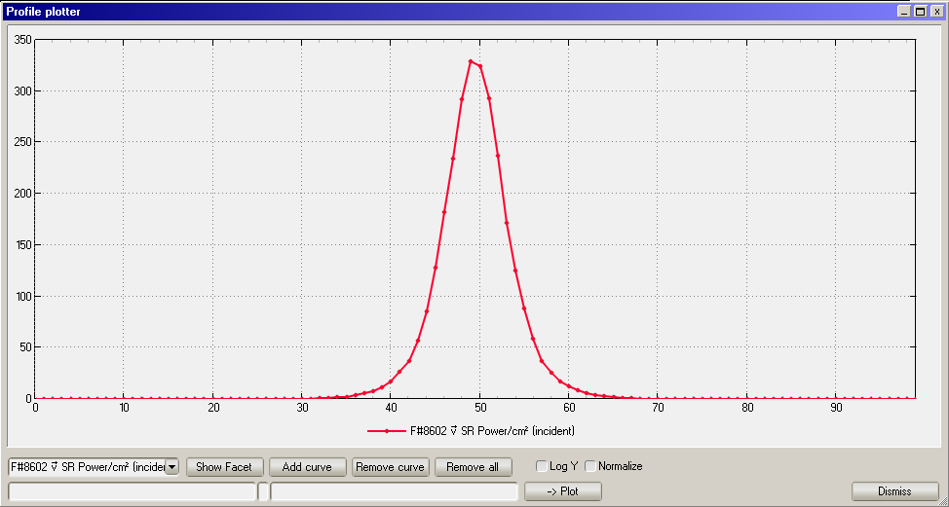
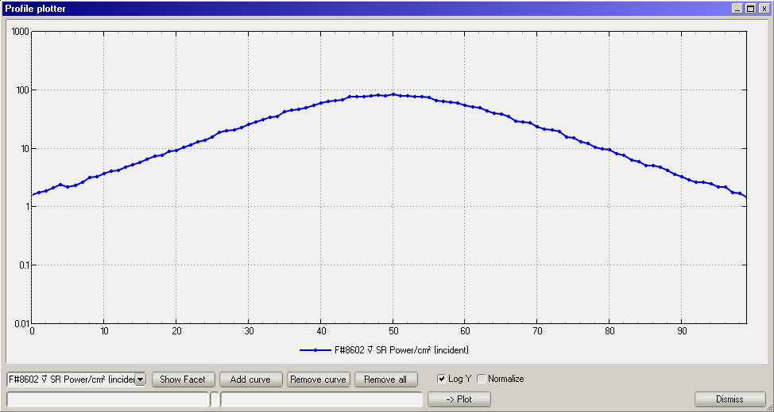
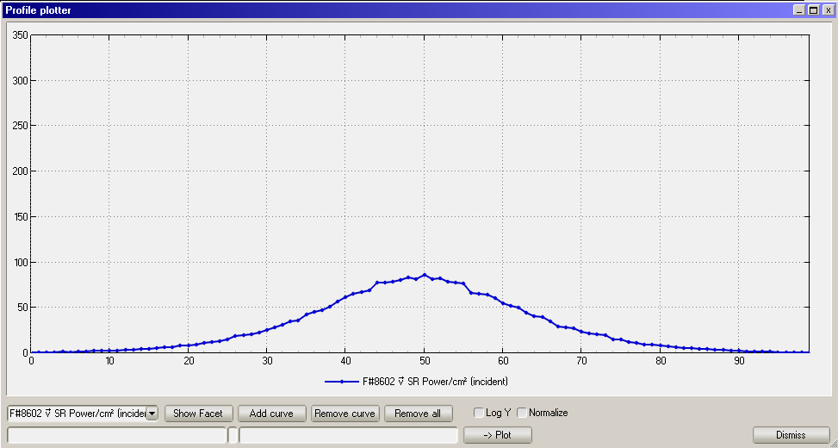
Vertical distribution of the SR power density, flat surface, +/- 1 mm height (horiz. Axis)
Top row: ttbar; Bottom row: Z-pole
R. Kersevan, FCC-ee Vacuum System and Pressure Forecast, FCCIS WP2 Workshop

Slide 11
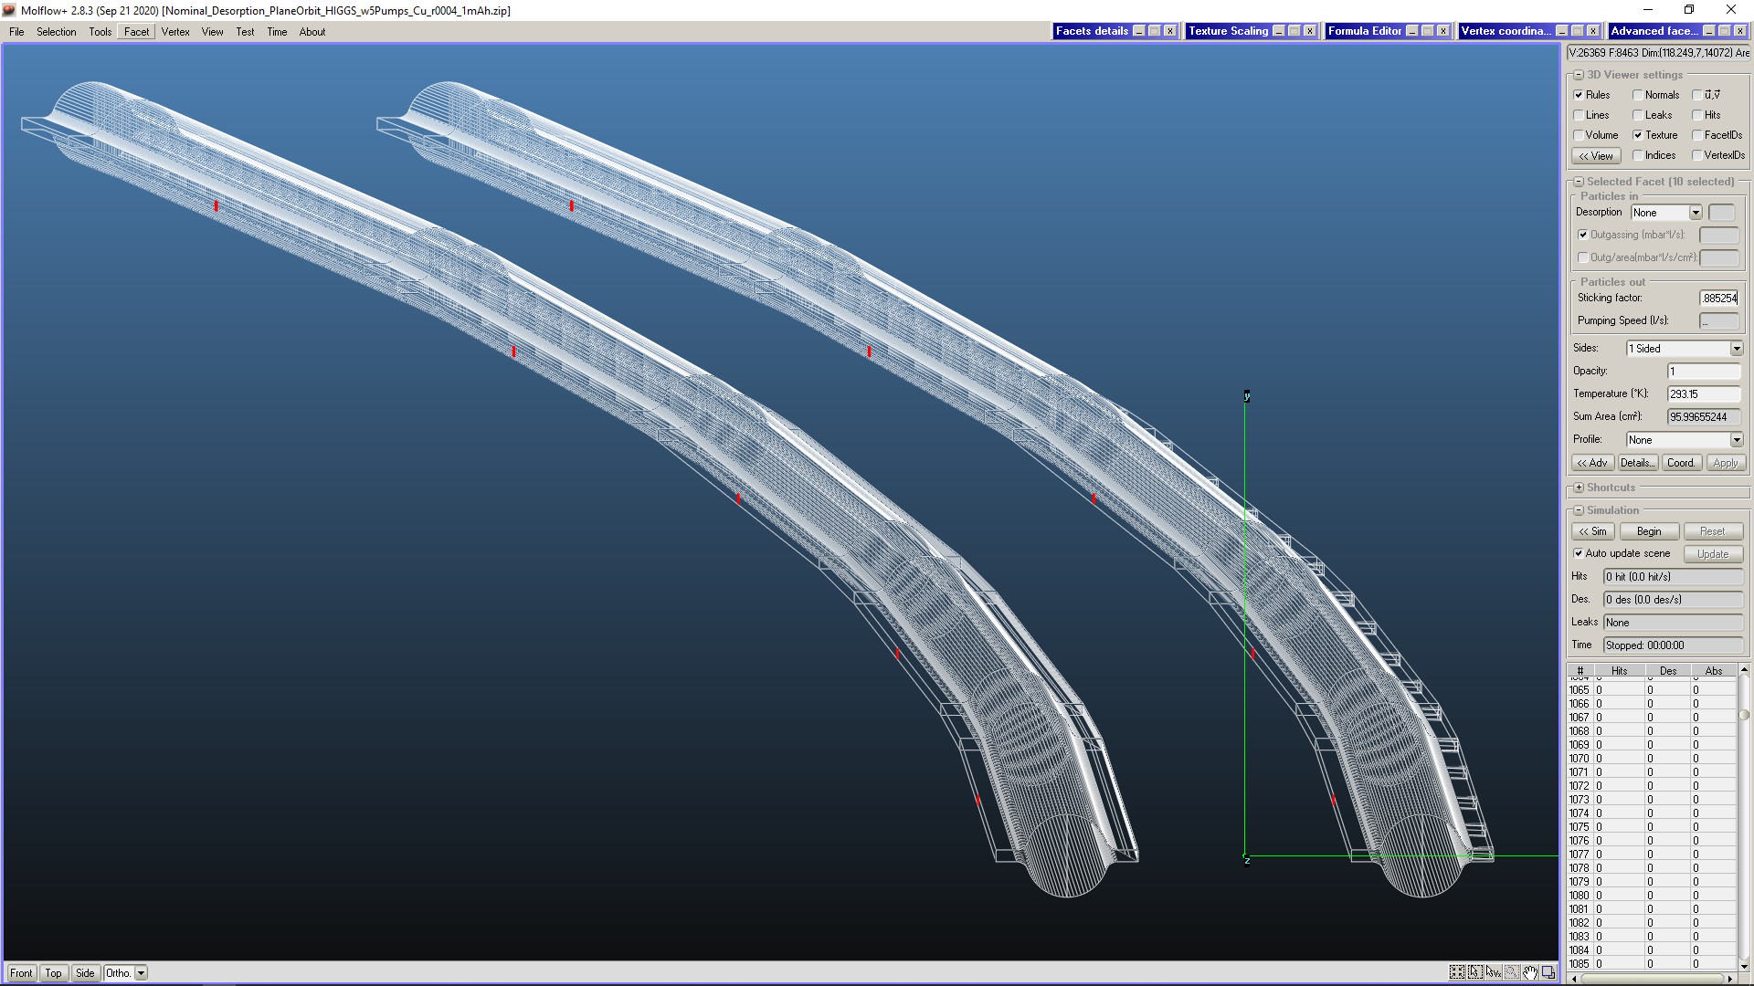
Modeling the FCC-ee Rings: Pressure Profiles
After running SYNRAD+ to trace the SR photon fans, we run Molflow+ choosing a total beam dose (A·hr) via a defined time interval at the nominal current
Since Molflow+ traces molecules, not photons like SYNRAD+, we need to define the position and size of the pumps
In this case we assume that B2 has a copper vacuum chamber, while B1 has a copper one with copper alloy (ZrCrCu) absorbers
5 pumps are placed in the middle of each dipole length, pumping on the inside of the ring (although B1 should have the pumps on the external wall, but the difference on the pressure is minimal)
The size of the 5 pumping slots on B2 is 12 cm length times 0.8 cm height, and an equivalent pumping speed of 100 l/s (CO) each_____________
5 more placed at same position along B1, but only the one in the middle is pumping (5 pumps/140 m would mean ~3000 pumps/ring)

Slide 12
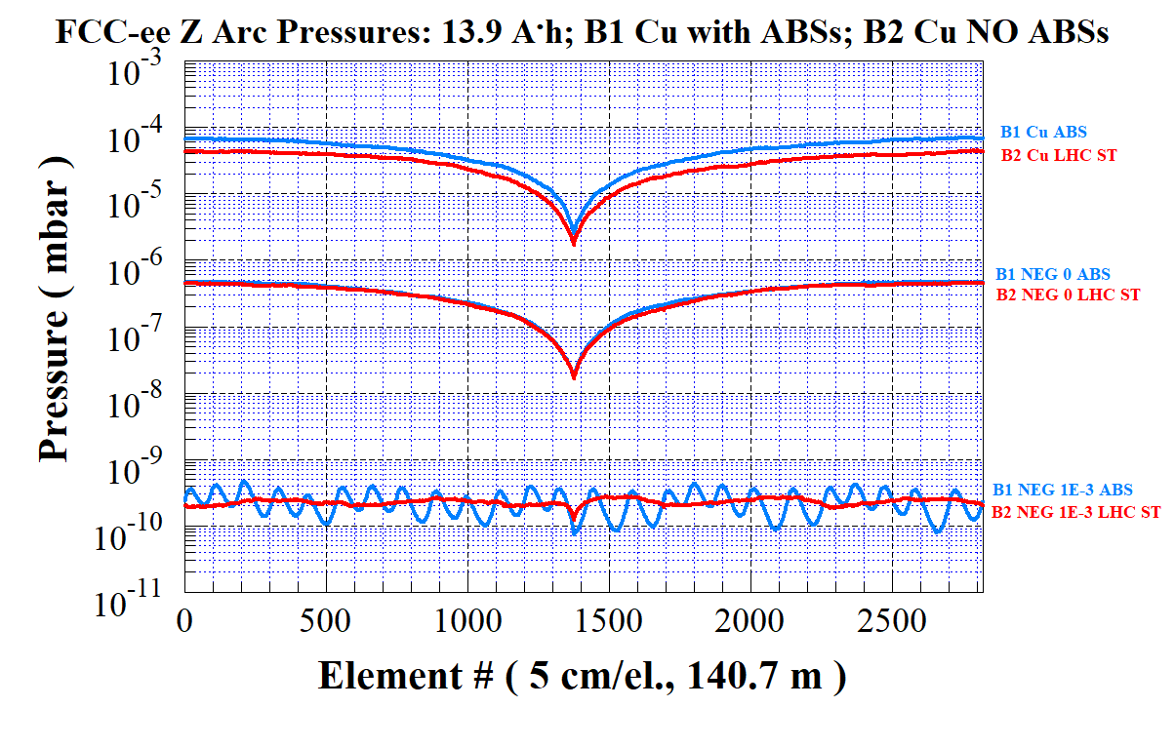
Modeling the FCC-ee Rings: Pressure Profiles
A few simulations of the pressure profiles on the same plot: bare copper (2 curves on top), then NEG-coated with saturated NEG (0 pumping speed, 2 curves in the middle), and case with NEG-coating with sticking coeff.=0.001 (bottom)
Average pressures span ~5 decades, for the same beam dose of 13.9 A·h
R. Kersevan, FCC-ee Vacuum System and Pressure Forecast, FCCIS WP2 Workshop

Slide 13
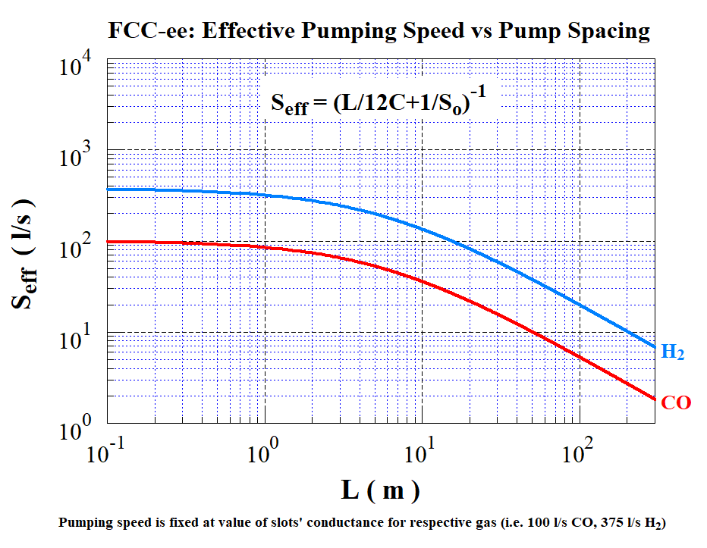
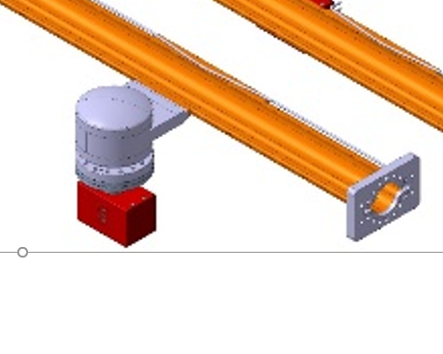
Scaling the Pumping Speeds
For a chamber with a specific conductance C (liter·m/s) and equally spaced pumps of pumping speed S₀, the effective pumping speed, e.g. useful to calculate the average pressure, is shown here below. A simple analytical formula, assuming that the outgassing profile is more or less evenly distributed along the chamber
C=46.5 (liter · m/s) (CO)
S₀=pumping slots’ conductance
R. Kersevan, FCC-ee Vacuum System and Pressure Forecast, FCCIS WP2 Workshop

Slide 14
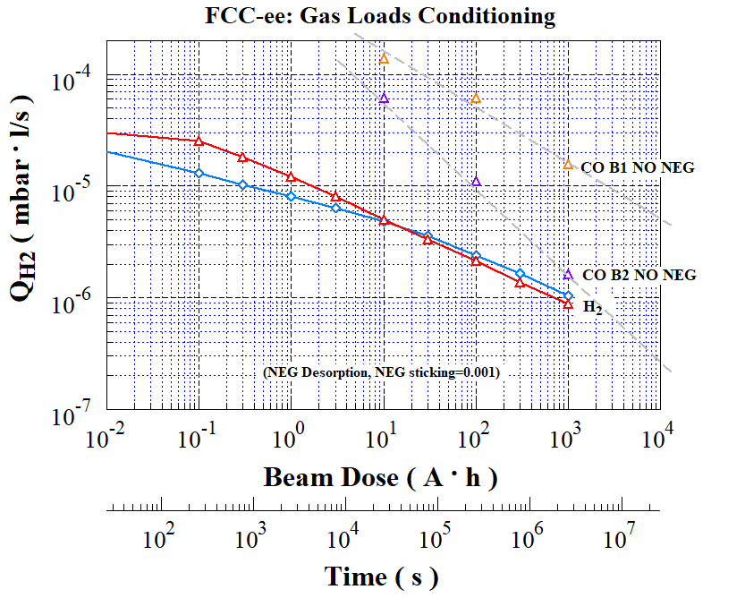
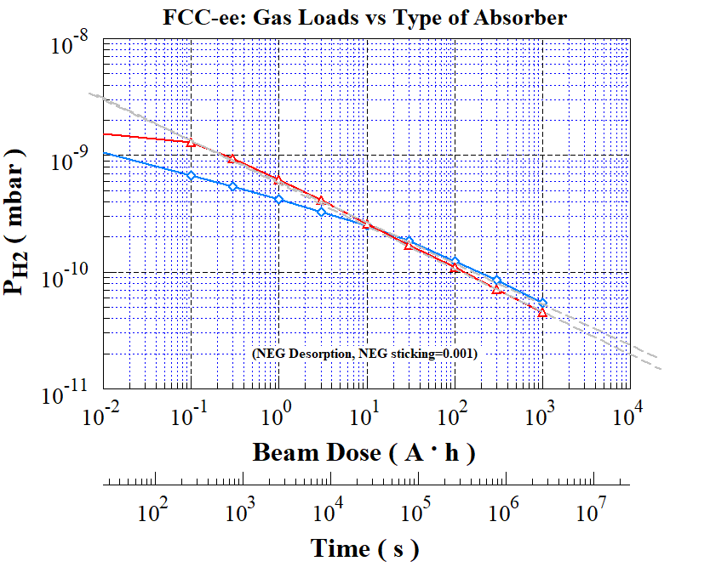
Gas Loads and Average Pressures
After running SYNRAD+ to trace the SR photon fans, we run Molflow+ for the most challenging case, the high-current Z-pole
1 Lumped pump is placed in the middle of the 3rd dipole of 5; The NEG-coating is assumed to be partly saturated, and having a residual sticking coefficient of 0.001 for H₂ (typical initial value is 0.008). We expect ~90% H₂ fraction.
The isolated markers on the Q_{H2} plot refer to a comparison analysis for CO given off by a Cu wall (no NEG-coating): initially the outgassing is much higher than that of H₂ but around ~2000 Ah of integrated beam dose it reaches values comparable to the H₂ case with NEG-coating. This is true only for the “LHC sawtooth-like” distributed absorber.
R. Kersevan, FCC-ee Vacuum System and Pressure Forecast, FCCIS WP2 Workshop

Slide 15
Work Underway
The mechanical engineering section of the Vacuum group at CERN has started designing the first components of the collider rings, aiming at producing testable prototypes
A cross-section of the chamber being tried first is shown here
Flanges based on shape-memory alloy rings in place of the usual Conflat flanges with screws and bolts are being designed
An alternative design to the baseline one for the RF contact fingers (SUPERKEK-B “comb-type”) is being studied too, implementing a scheme similar to that used for the inner-triplets in HL-LHC
The optimal length of the chambers (and dipole magnets as well) has been determined to be ~ 12 m, i.e. splitting in two the arc dipoles: this length is deemed suitable for carrying out the NEG-coating in a horizontal position, implementing the same concept developed for the in-situ a-C coating for LHC stand-alone magnets
Other types of coatings (a-C for reducing the SEY, in case the NEG’s SEY were too high), and surface finish (e.g. laser- or mechanical enhancement of the surface roughness) are also being considere
We plan to keep on using the BESTEX beamline at KARA ring (KIT) in order to test vacuum components under SR irradiation (still need to test several BS for FCC-hh, covid pandemic has basically stopped the program in March 2020)
Work/analysis as started on the SR fan distribution of the various polarization wigglers, since they generate copious amounts of SR; in LEP, they have been a source of trouble many times, generating hot spots and related vacuum leaks.
R. Kersevan, FCC-ee Vacuum System and Pressure Forecast, FCCIS WP2 Workshop

Slide 16
Comments, Questions, and Conclusions
The design of some components of the vacuum system of the storge rings is underway, despite limited human resources within the vacuum group mechanical engineering section
A new fellow will start on Feb 1st, 2022, as responsible person for the BESTEX beamline at KARA/KIT
We continue our collaboration with the FLUKA team (see next talk) on the design of the chambers and absorbers, and the integration in the tunnel
Work should start as soon as possible also on the full-energy booster: we lack information about the lattice and geometry of the magnets: the only known (to me) parameter is a 50 mm ID (OD?) of a circular vacuum chamber; such a cross-section has a specific conductance of 15.4 liter·m/s, i.e 1/3 of that of the storage ring (~46 liter·m/s), meaning that if NEG-coating will not be allowed or feasible, reaching a sufficiently low pressure will be rather difficult (for the Z-pole the boostere accelerates a large beam! hence lots of SR-induced desorption). In addition, possibly anti-bend orbits (see B. Dalena’s talk), tricky.
It seems evident that NEG-coating is mandatory if we are to reach the nominal beam parameters (full stored current) within the 2-year period envisaged in the experimental program schedule
The new concept for the longitudinal absorber implementing a “LHC-type” sawtooth (ST) geometry is worth investigating from the point of view of its fabrication and thermal behavior as well. If and when a prototype will be ready, we should be able to test it at KARA/KIT, although the SR power density will not be at the same level as in the FCC-ee
The ST absorber needs also to be characterized by the FLUKA team (although it should follow the case of the no-lumped absorbers case which is already under study)
Next item we need to study together with FLUKA team is the generation of bremsstrahlung (very high-energy gamma rays, up to the beam energy). Questions: is it negligible or is it a limiting factor? What’s the highest molecular density and gas composition we can tolerate in terms of bremsstrahlung losses? Highly atomic number Z dependent (~Z²). This may be relevant for the MDI region too.
R. Kersevan, FCC-ee Vacuum System and Pressure Forecast, FCCIS WP2 Workshop

Slide 17
