Slide 1
Synchrotron radiation (SR) studies for the FCC-ee arc with FLUKA
Barbara Humann (SY-STI-BMI)
Supervisor: Francesco Cerutti
FCCIS WP2 Workshop 2021 (09/12/2021)
Acknowledgments to J. Bauche, M. Benedikt, R. Garcia-Alia, G. Lerner, R. Losito, R. Kersevan & F. Valchkova

Slide 2
Agenda
Simulation setup - reminder
Synchrotron radiation: spectrum
Dose levels in the tunnel
Si-1MeV neutron equivalent fluence
Conclusion & Outlook

Slide 3
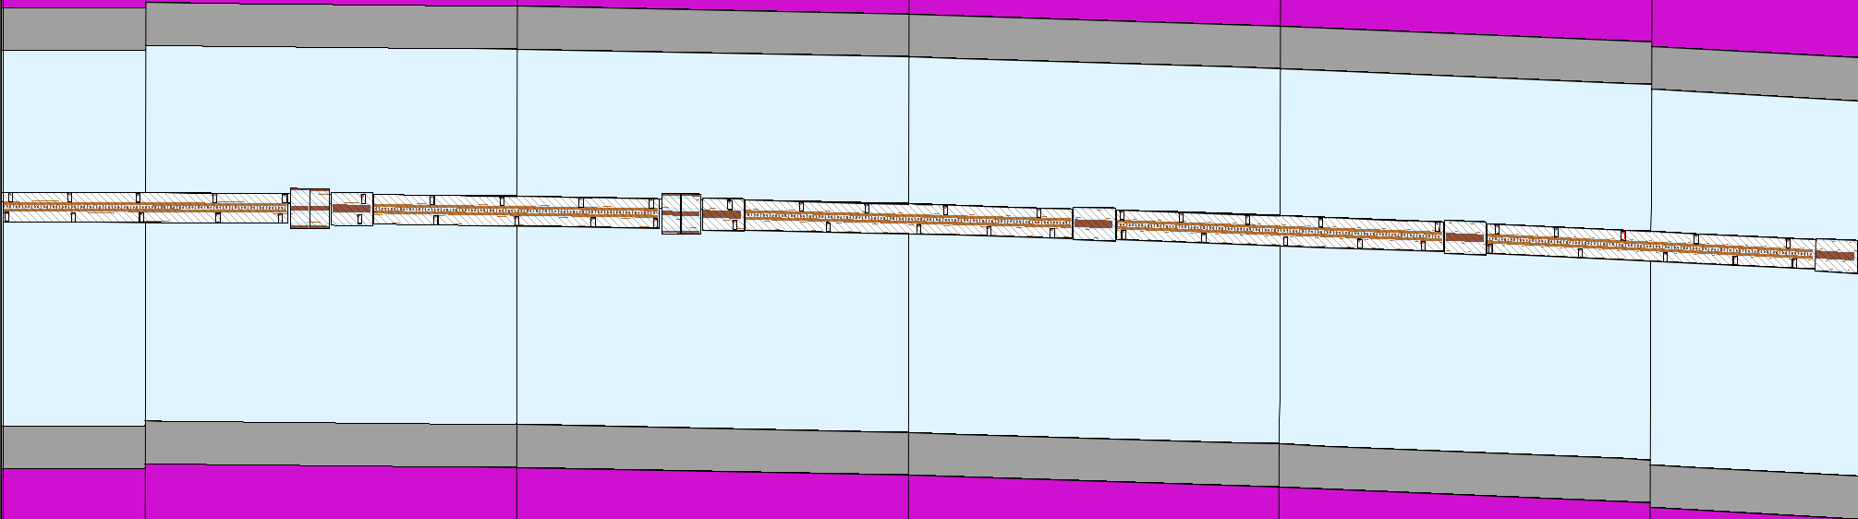
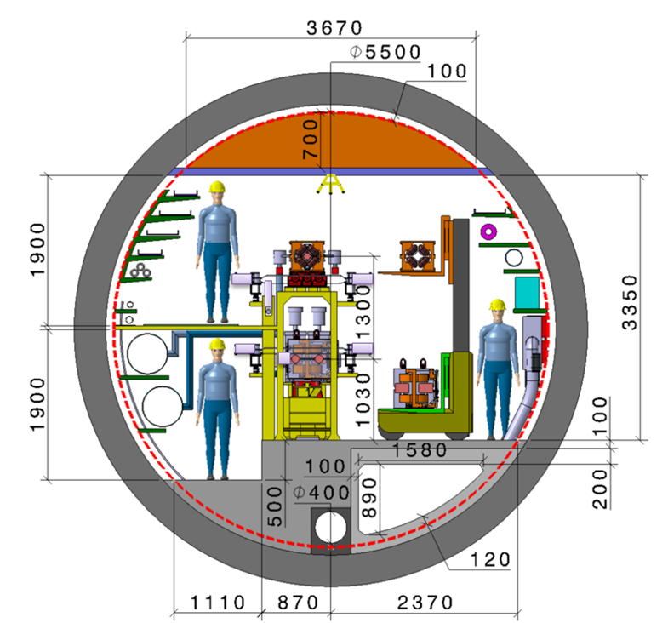
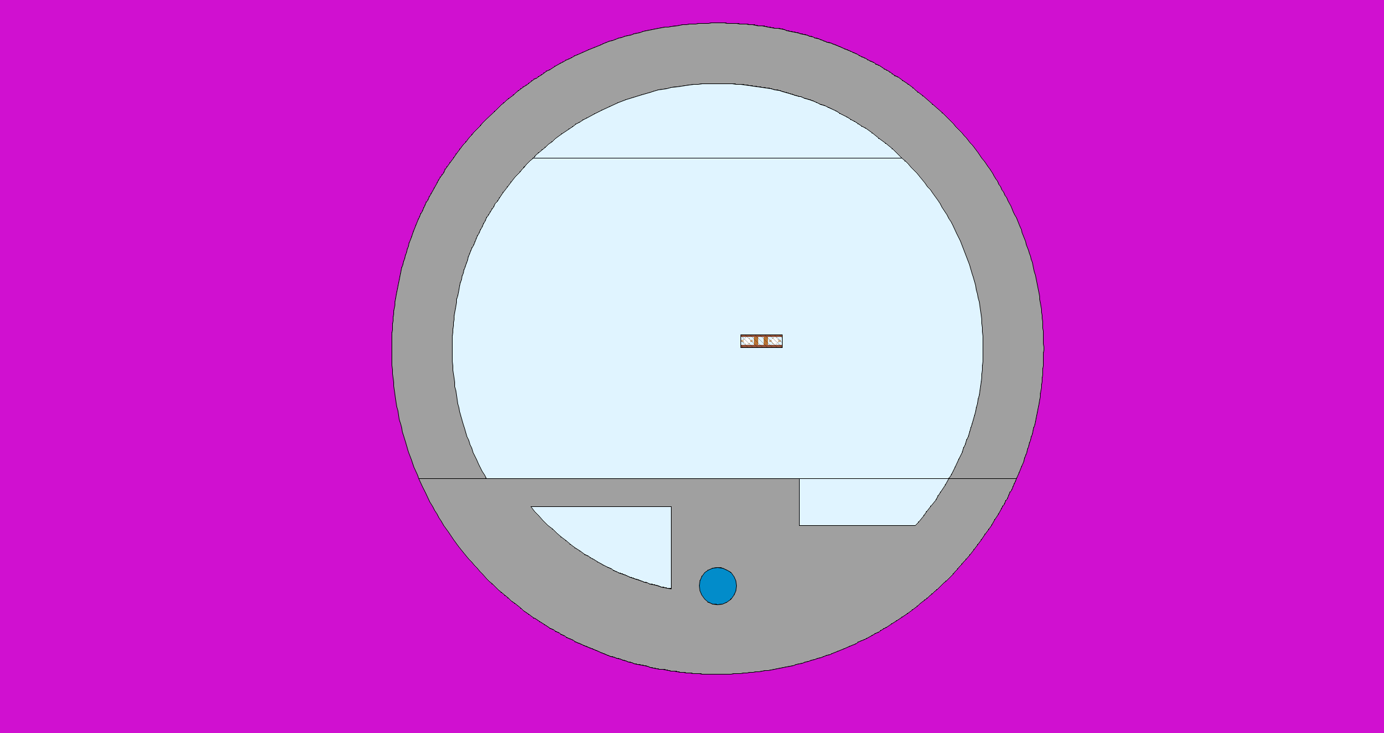
Simulation Setup
182.5GeV (ttbar): most challenging case for energy deposition studies
Representative arc cell (140m) → periodic re-insertion of the particles
  5 dipoles, 5 quadrupoles, 4 sextupoles
SR source (NEW!): e-, e+ in all magnets
→ direct approach
Different layouts performed:
  Absorbers: Tungsten (Inermet180) vs. copper (CuCrZr)
  Continuous shielding (comparable to LEP design): tungsten, 1cm around winglet
 | Tungsten | Copper
+ | Better absorption properties (higher Z and density) | Easier to manufacture, better behavior in vacuum
- | Brittle, harder to manufacture, cost | Less good energy absorption properties
Tunnel layout by F. Valchkova-Georgieva (IOWG, 16.10.2019)

Slide 4
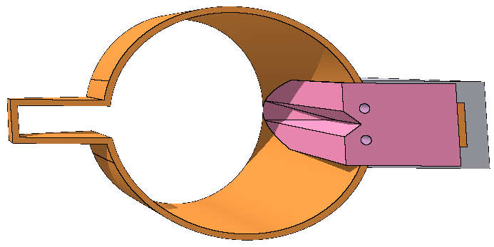

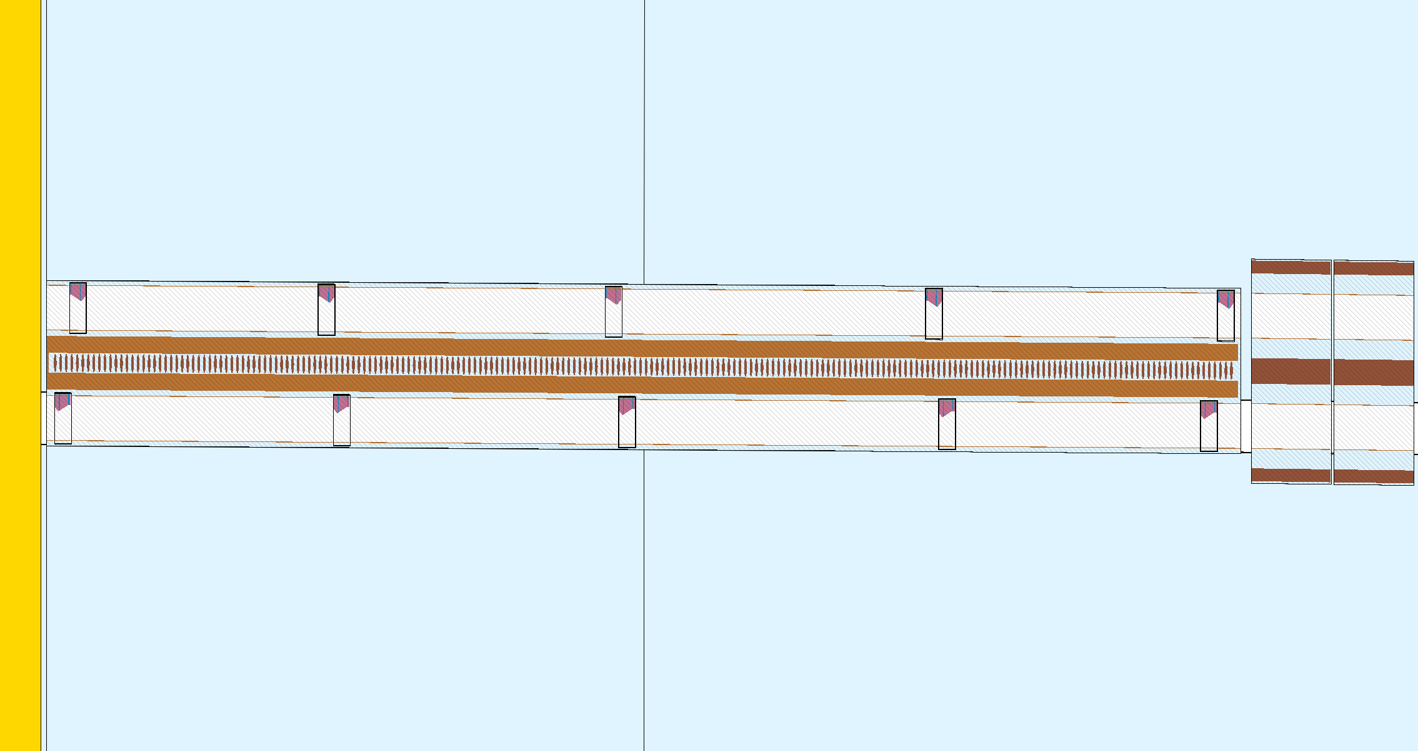
Model comparison: absorber vs continuous shielding
Absorbers (ABS):
CuCrZr or Inermet180
Length: 30cm
5-6m distance
Angled surfaces for even power distribution
Water cooled
25 ABS in each beam (MBs, MQs) (Design and initial placement by R. Kersevan)
Continuous shielding:
Equivalent to LEP layout
Continuous shielding around VC in MBs
  Space restrictions due to yoke and coils → no shielding in MQs and MSs.
Intermet180
Shielding thickness:
  Top/bottom: 1cm
  Sides: 1.3cm
x
z

Slide 5
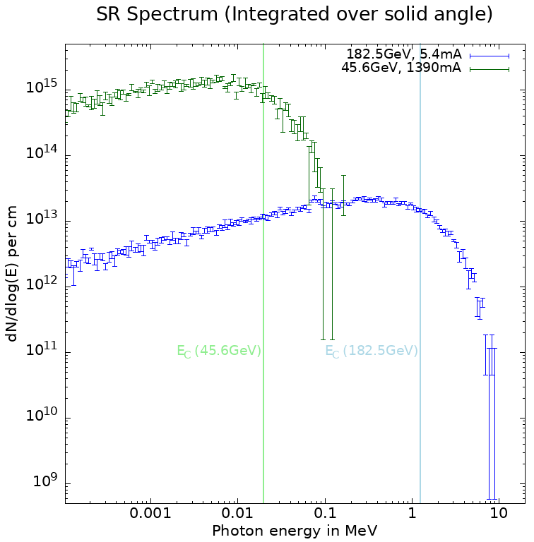
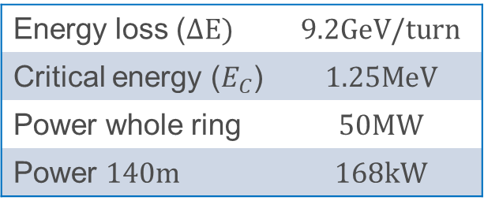
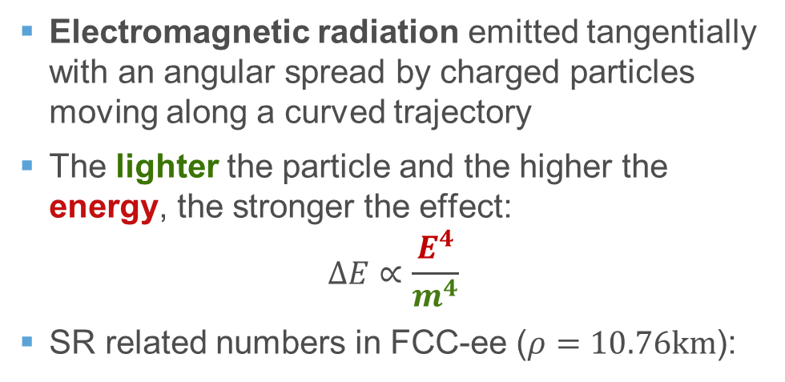
Source term – Synchrotron Radiation
SR Spectrum of primary electrons:
Electromagnetic radiation emitted tangentially with an angular spread by charged particles moving along a curved trajectory
The lighter the particle and the higher the energy, the stronger the effect:
$$ΔE∝\frac{E^{4}}{m^{4}}$$
SR related numbers in FCC-ee ($ρ=10.76km$):
-2
Energy loss ($ΔE)$ | $9.2GeV/turn$
Critical energy ($E_{C}$) | $$1.25MeV$$
Power whole ring | $$50MW$$
Power $140m$ | $$168kW$$
ttbar-mode is most relevant for energy deposition studies

Slide 6
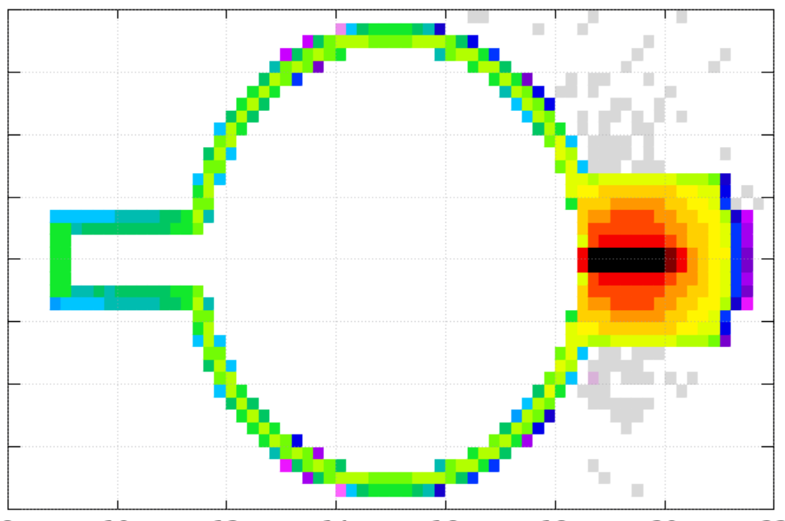
Power deposition comparison: Tungsten vs Copper vs Continuous
Power | Tungsten |  | Copper |  | Continuous
Dipoles* | 7.8kW | 4.7% | 23.4kW | 14% | 3.5kW | 2%
Quads | 0.9kW | 0.5% | 2.6kW | 1.6% | 17.4kW | 10.4%
Sexts | 0.05kW | 0.03% | 0.09kW | 0.06% | 7.1kW | 4.3%
ABS, Shield/VC | 155kW | 92.3% | 131kW | 78% | 135kW | 81%
Tunnel | 4.1kW | 2.4% | 9.5kW | 7% | 3.5kW | 2.1%
Total | 168kW |  | 168kW |  | 167kW
* Without VC and shielding
Peak heat load on ABS (hottest spot on the absorber)
In the (unrealistic) adiabatic assumption:
Tungsten: 280K/s
Copper: 100K/s
Continuous: 10K/s
Normalisation:
Current: 5.4mA
Energy: 182.5GeV
Runtime: 10⁷s

Slide 7
Power distribution on the absorbers and MBs
Power comparison different ABS:
Power distribution on MB: ABS (Copper) vs continuous
Highly impacted VC
Power on ABS | Tungsten | Copper
Absorber | 97% | 94%
Cooling | 0.4% | 1%
BP | 2.6% | 4%
Percentage calculated from one representative absorber
Power on MB | Tungsten (1.7kW) | Copper (5.3kW)
Yoke | 64% | 72%
Coil | 24% | 21%
BP | 12% | 7%
Comp. | Material
Yoke | Iron
Coils | Copper
VCR/VCL* | Copper
Shield | Inerm180
ABS (Copper)
`
Continuous
Absorber (CuCrZr, 30cm): ~2.6kW
(W/m not meaningful)
Percentage calculated from one representative MB
* VC…Vacuum Chamber (right/left)

Slide 8
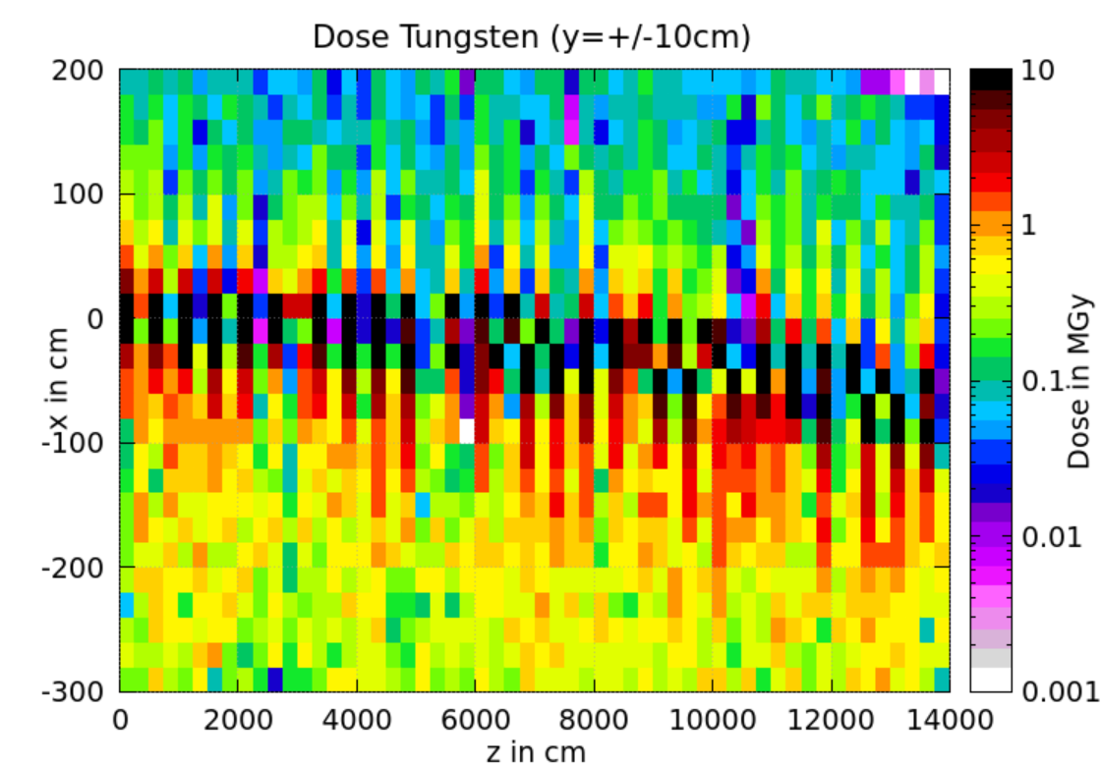
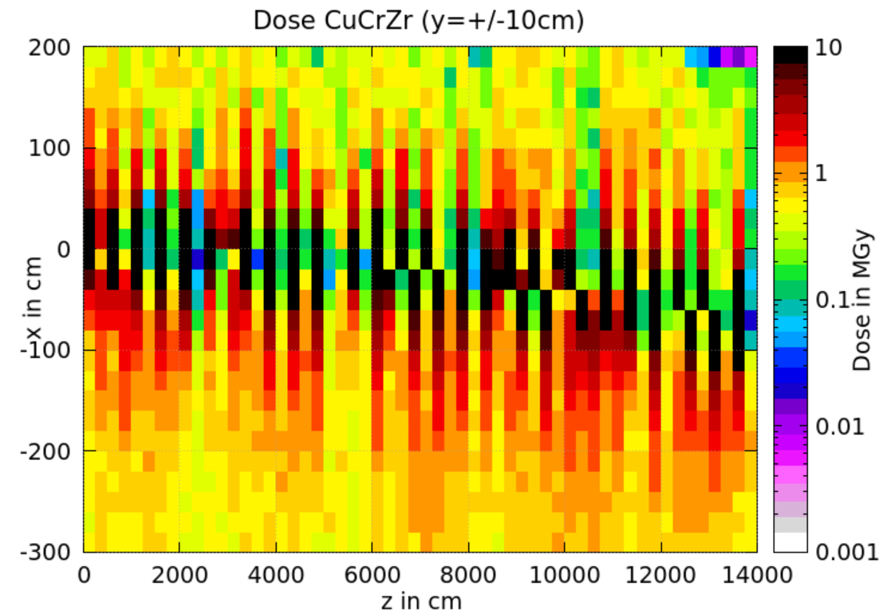
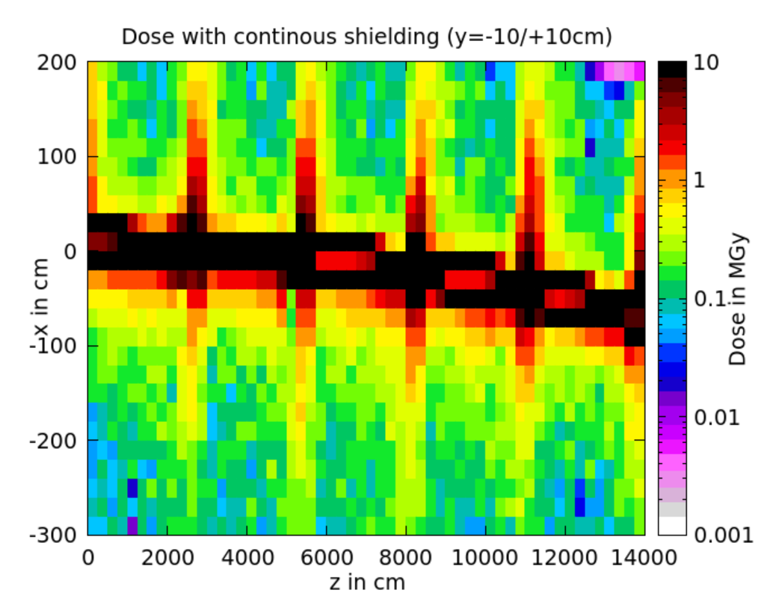
Dose in the tunnel environment – y centre
Higher dose internally due to backscattering of particles on ABS
One order of magnitude higher dose than for tungsten (especially externally)
Higher dose internally
Peaks due to missing shielding in MQs
Externally higher dose values
On average lowest dose
 | Tungsten | Copper | Cont.
Middle, ext. | 100kGy | 600kGy | 200kGy/1.2MGy
Middle, int. | 500kGy | 1MGy | 200kGy
HL-LHC arcs reference value: 1.4Gy (!)
TUNGSTEN
COPPER
CONTINUOUS
(https://edms.cern.ch/ui/file/2302154/1.0/HLLHC_Specification_Document_v1.0.pdf)

Slide 9
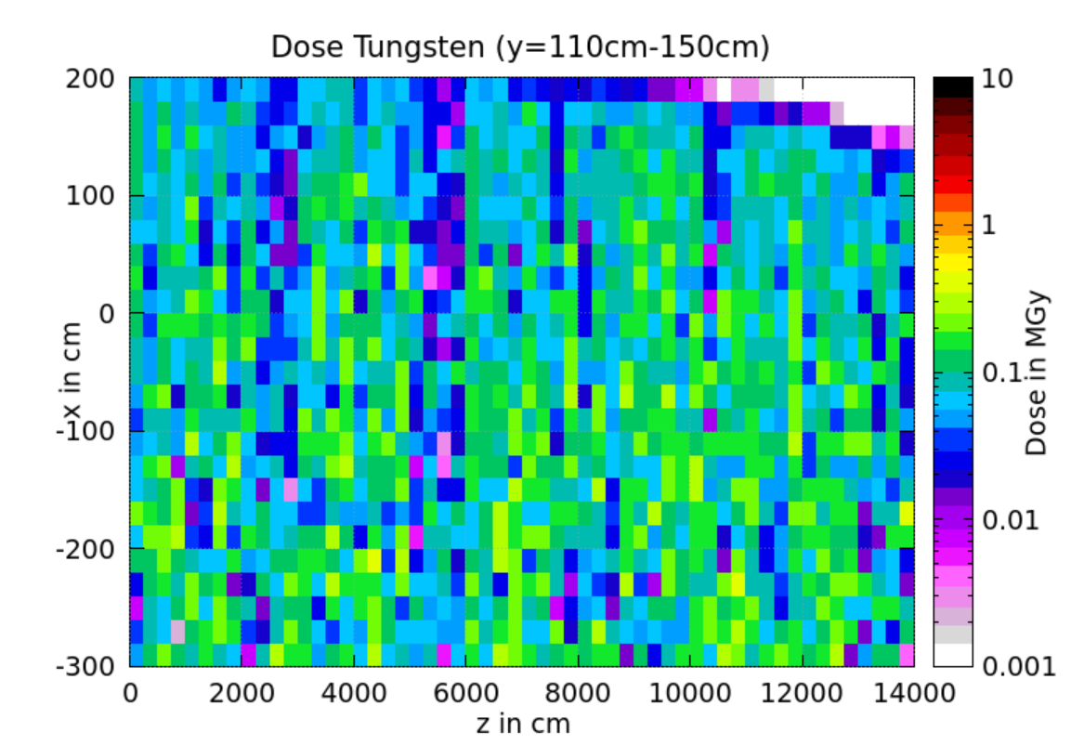
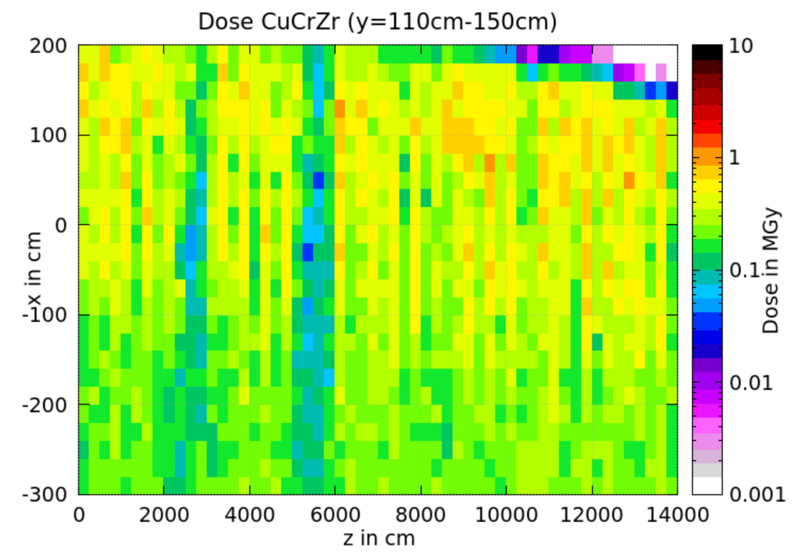
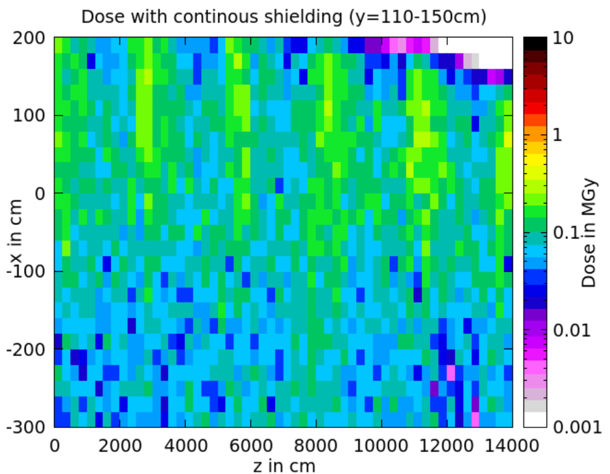
Dose in the tunnel environment – y above
TUNGSTEN
COPPER
CONTINUOUS
COPPER
 | Tungsten | Copper | Cont.
Top, Cent. | 100kGy | 300kGy | 120kGy
Lowest obtained dose levels
Homogeneously distributed
Less effective ABS lead to higher dose
Lower dose level at z~5500cm due to absorber placed in MQ
Areas of higher dose due to MQs without shielding
HL-LHC arcs reference value: 1.4Gy
(https://edms.cern.ch/ui/file/2302154/1.0/HLLHC_Specification_Document_v1.0.pdf)
Booster on top of collider
Shielding options for R2E are under study

Slide 10
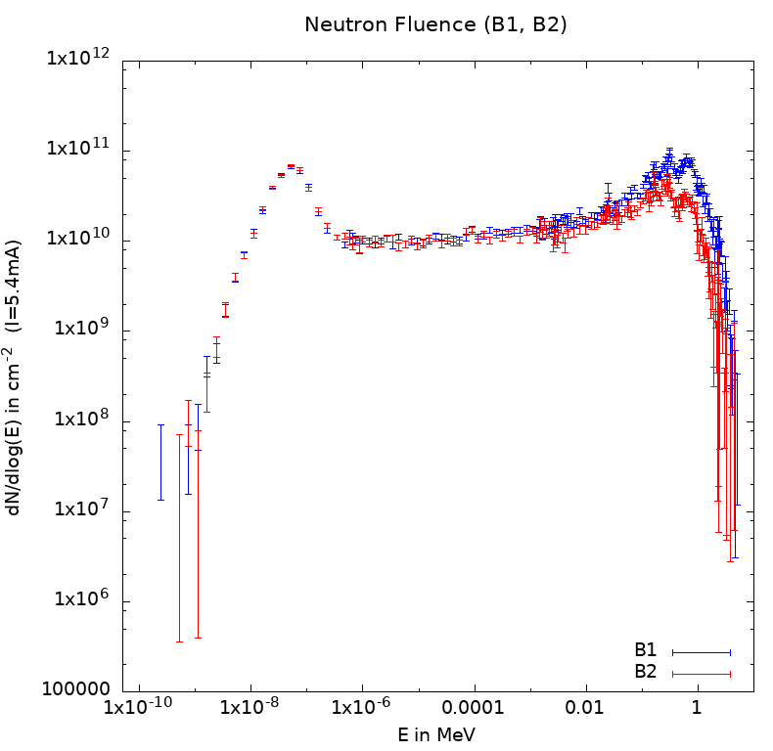
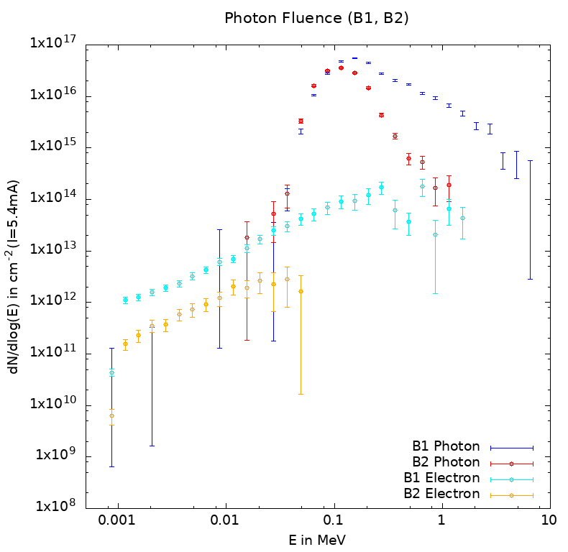
Fluence in the tunnel – ABS (Copper) layout
Electromagnetic particles fluence:
B1: higher fluence obtained due to scoring at the outside of the tunnel
B2: particles absorbed in magnets
Thermal neutrons (0.025eV)
Electron & Photon Fluence (B1, B2)
-2
y
Neutron fluence:
Similar results for B1 and B2
Magnets are “transparent” for neutrons
x
Scoring area

Slide 11
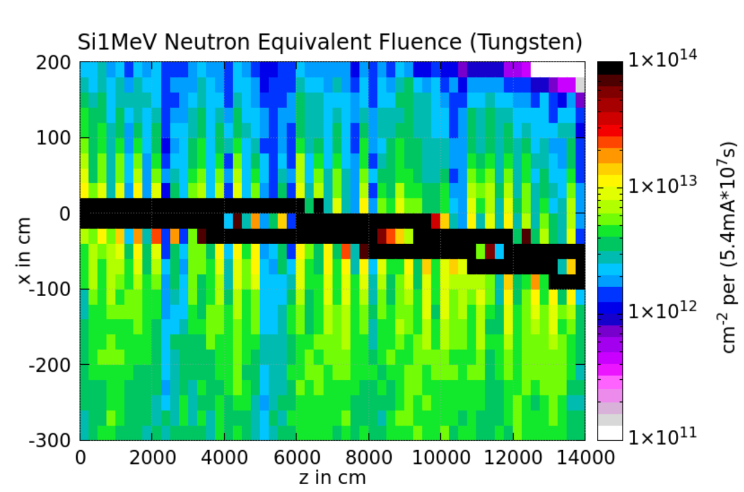
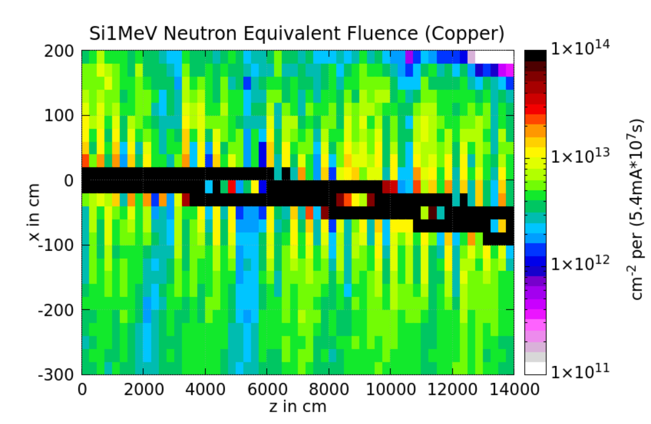
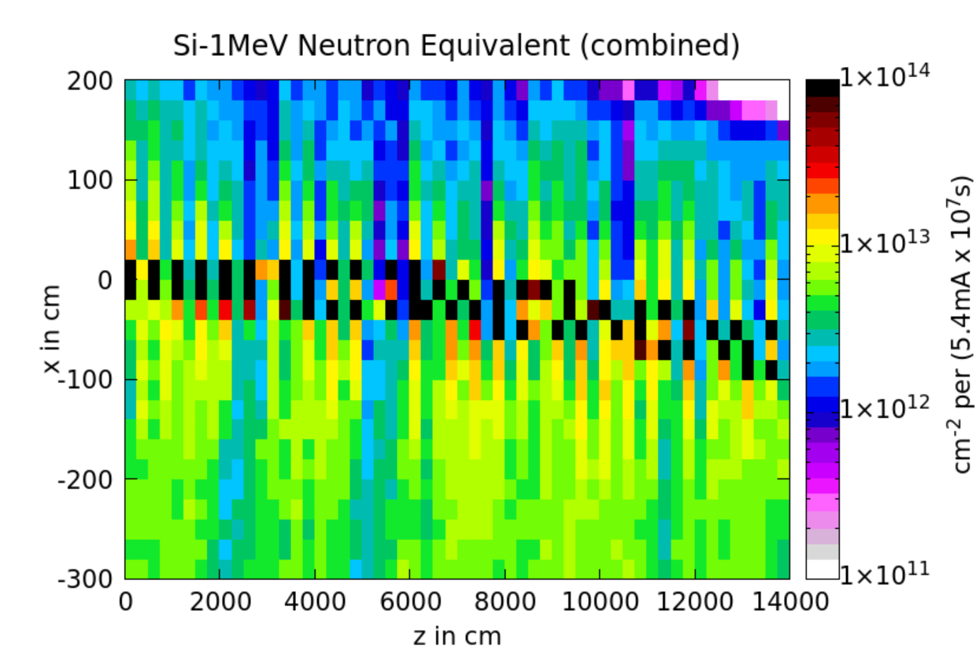
R2E: Si-1MeV neutron equivalent fluence
ABS Tungsten
ABS Copper
Continuous
Similar levels for all case, different contribution levels on the level of neutrons and em particles
  Tungsten: high Z leads to lower production threshold for neutrons
  Copper: higher production threshold for neutrons, but stronger impact from em particles
  → Total levels are similar
HL-LHC arcs reference: 1.6x10¹⁰cm⁻²

Slide 12
Summary
Heat load:
  Tungsten absorbers have best absorption properties, but cost and manufacturing properties are disadvantageous;
  VC highly impacted in case of continuous shielding
Peak heat load on the absorbers:
  2.5x higher for tungsten absorber → cooling feasible, outgassing?
Radiation to electronics:
  Highest dose levels for the copper absorbers in the tunnel environment
  Lower dose levels on top of accelerator are favorable for booster placement
  Si-1MeV eq. fluence similar for all three cases but different levels of contributions from neutrons and em. particles
  Si-1MeV neutron equiv. fluence ~2 orders of magnitude higher than in HL-LHC, but bigger differences are obtained in dose levels (kGy instead of Gy → 5 orders of magnitude!)

Slide 13
Outlook
Radiation studies for possible shielding in the tunnel for R2E
  Test different materials (lead, concrete) & thicknesses (1cm, 3cm, 10cm)
Investigate lower beam energies to assess if they comply with radiation safe environment in the tunnel (<1Gy/year)
Gas bremsstrahlung simulation
  Lowest energy (Z pole → higher current)
  Constant beam-gas profile → find critical residual gas density
Other Fluka/FCCee related ongoing activities: Heat load
studies for the positron target
Shielding
Space for electronics

Slide 14
Any questions?

Slide 15
Backup slides

Slide 16
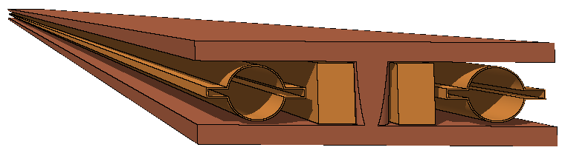
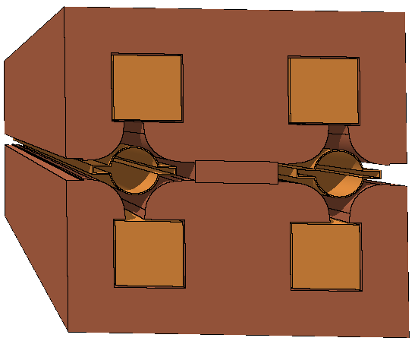
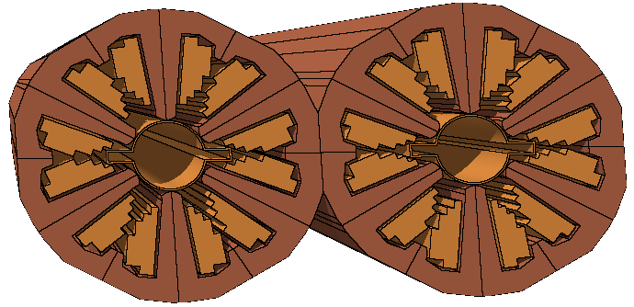
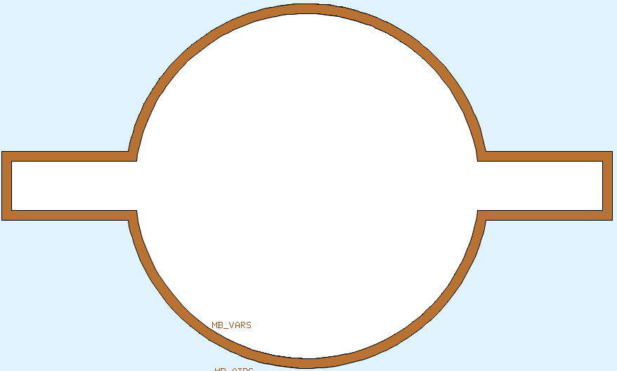
Magnets
General: 30cm beam separation
Dipoles (MB):
Long: 24.64m (l_{mag}) (Simulations were performed before 24m long model was abandoned)
Short: 21.44m (l_{mag})
56.6mT at 182.5GeV
Quadrupole (MQ):
2.9m (l_{mag})
3.2m (l_{mech})
Maximum gradient: 10.0T/m
Vacuum chamber (VC):
Copper
2mm
Winglets
Sextupole (MS):
1.4m (l_{mag})
No prototypes and technical drawings so far (ending of coils,…)
12cm
7cm
Magnets designed from scratch in Fluka. Technical drawings received from J. Bauche

Slide 17
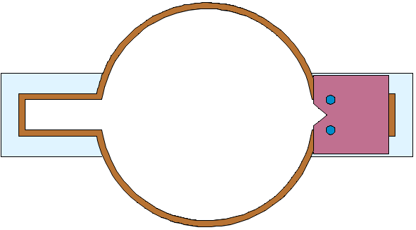
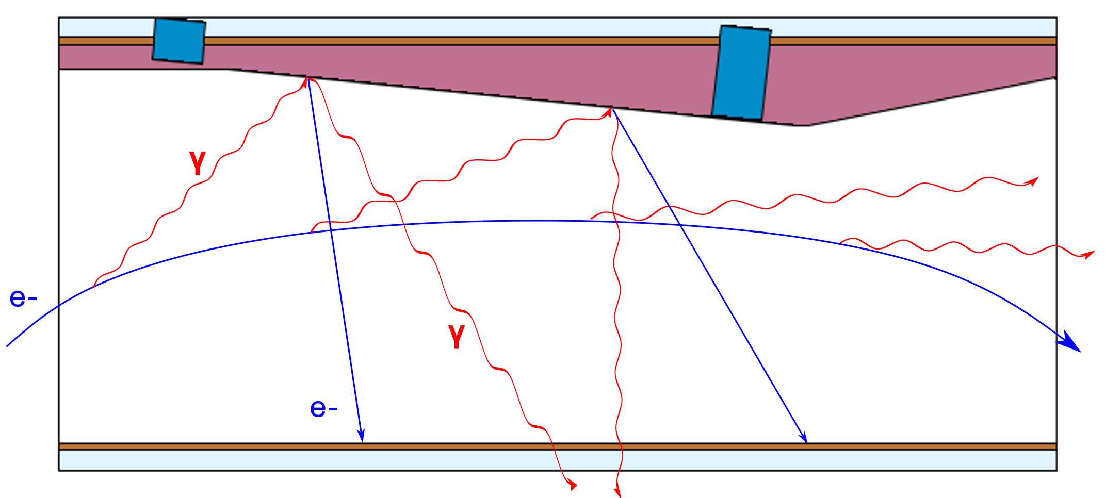
Absorber working & reflection
y
x
External beam: reflected particle → magnet yoke
x
z
Internal beam: reflected particle → tunnel
Compton scattering: photon collides with electron and is scattered into a different direction, dominant in the MeV range

