Slide 1

FCC WP2 Workshop 2021 Summary II
Ilya Agapov, DESY
Frank Zimmermann, CERN
Tor Raubenheimer SLAC
Michael Hofer, CERN
Friday, 2 July 2021

Slide 2
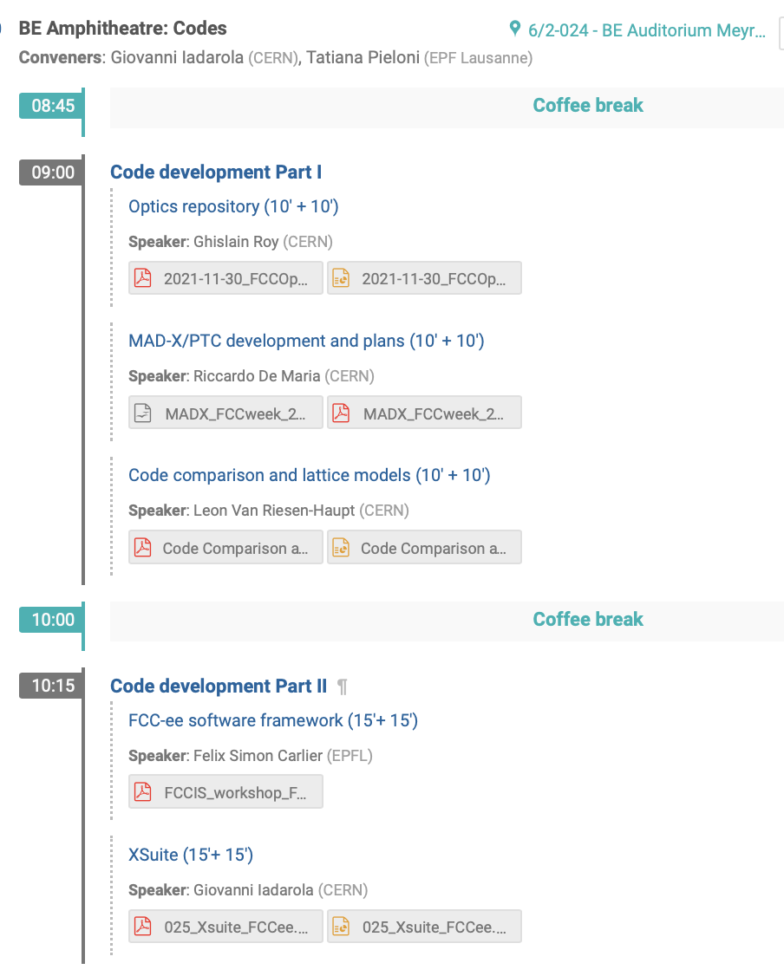
Tue Nov 30th

Slide 3

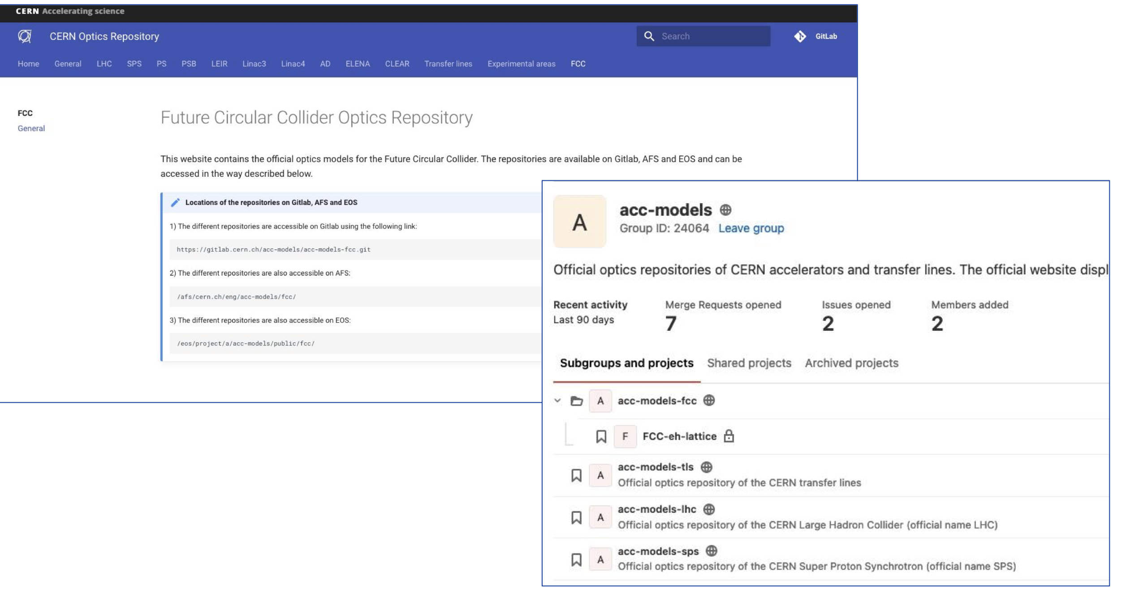
Optics Repository
Ghislain Roy

Slide 4
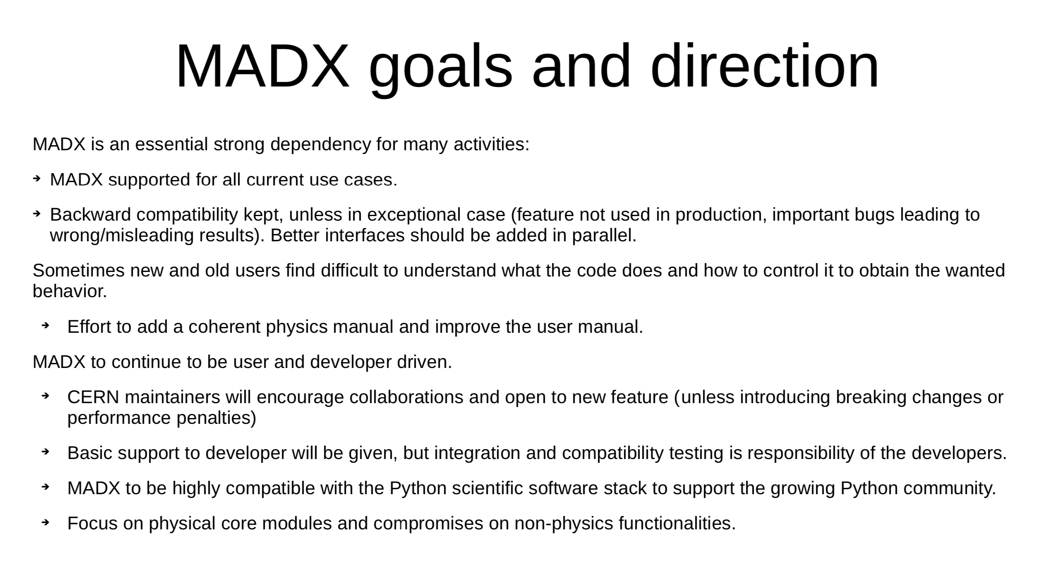
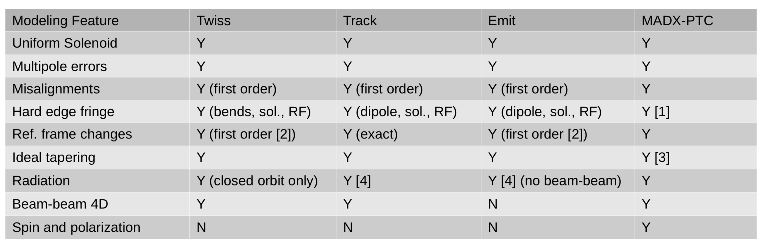
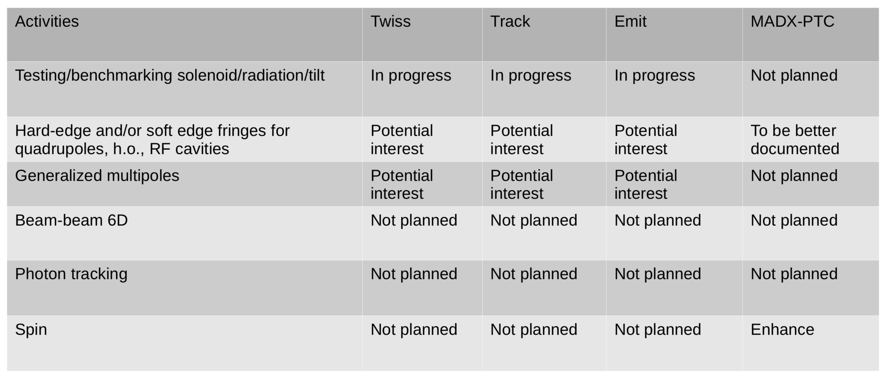
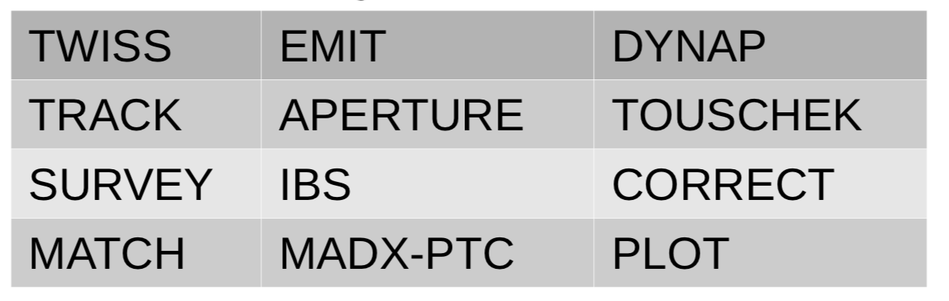
MAD-X/PTC
Riccardo de Maria

Slide 5
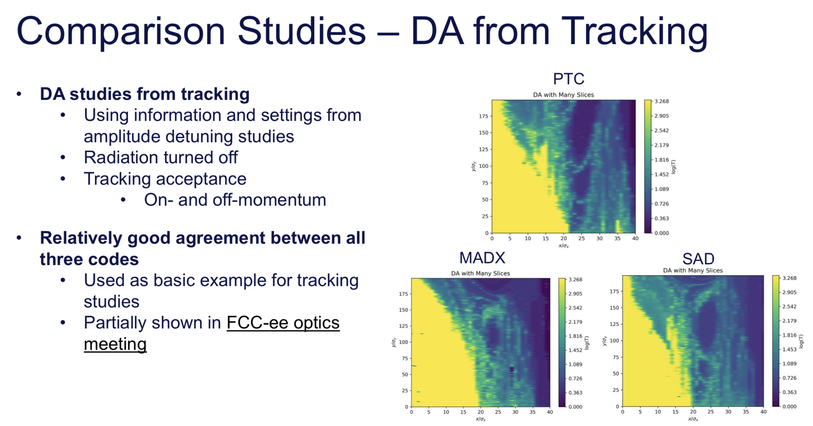
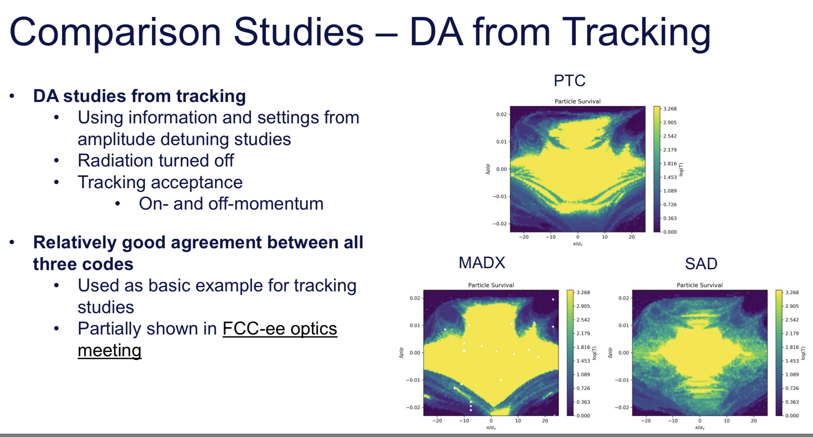
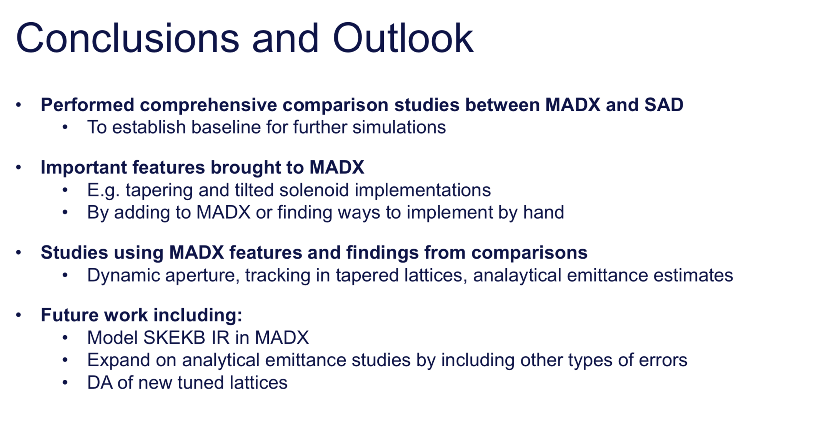
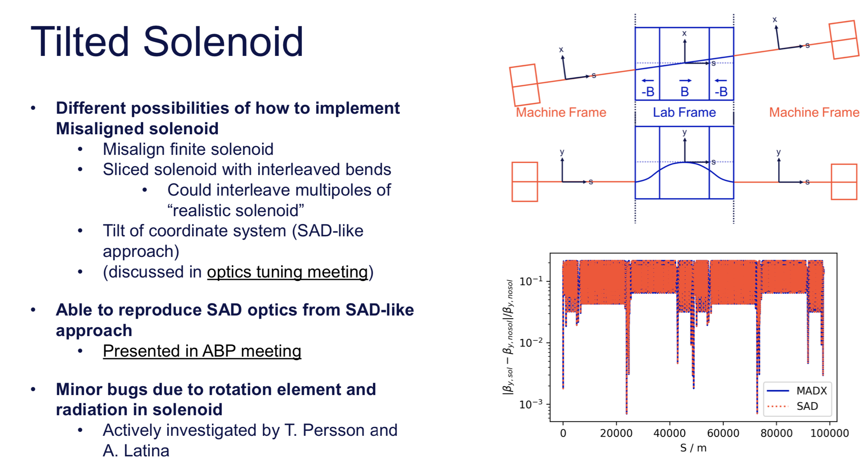
MAD-X/PTC
Leon van Riesen-Haupt

Slide 6

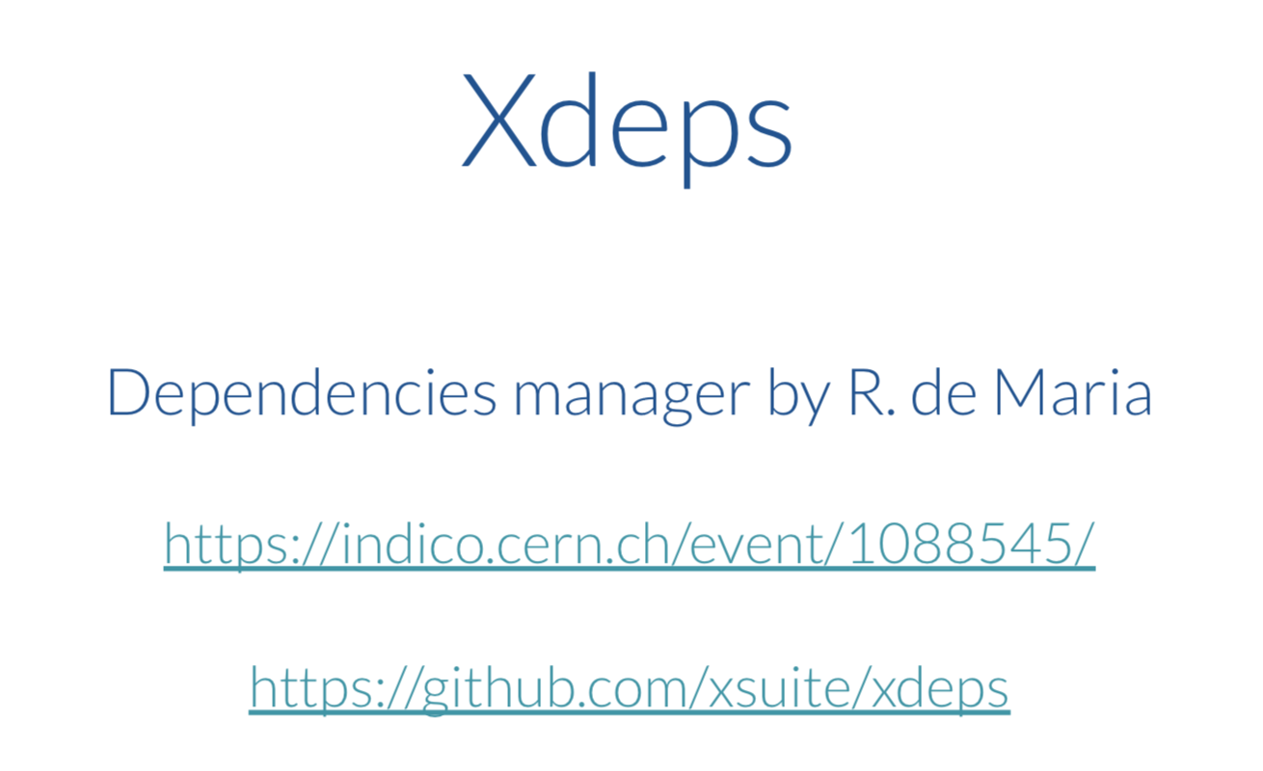

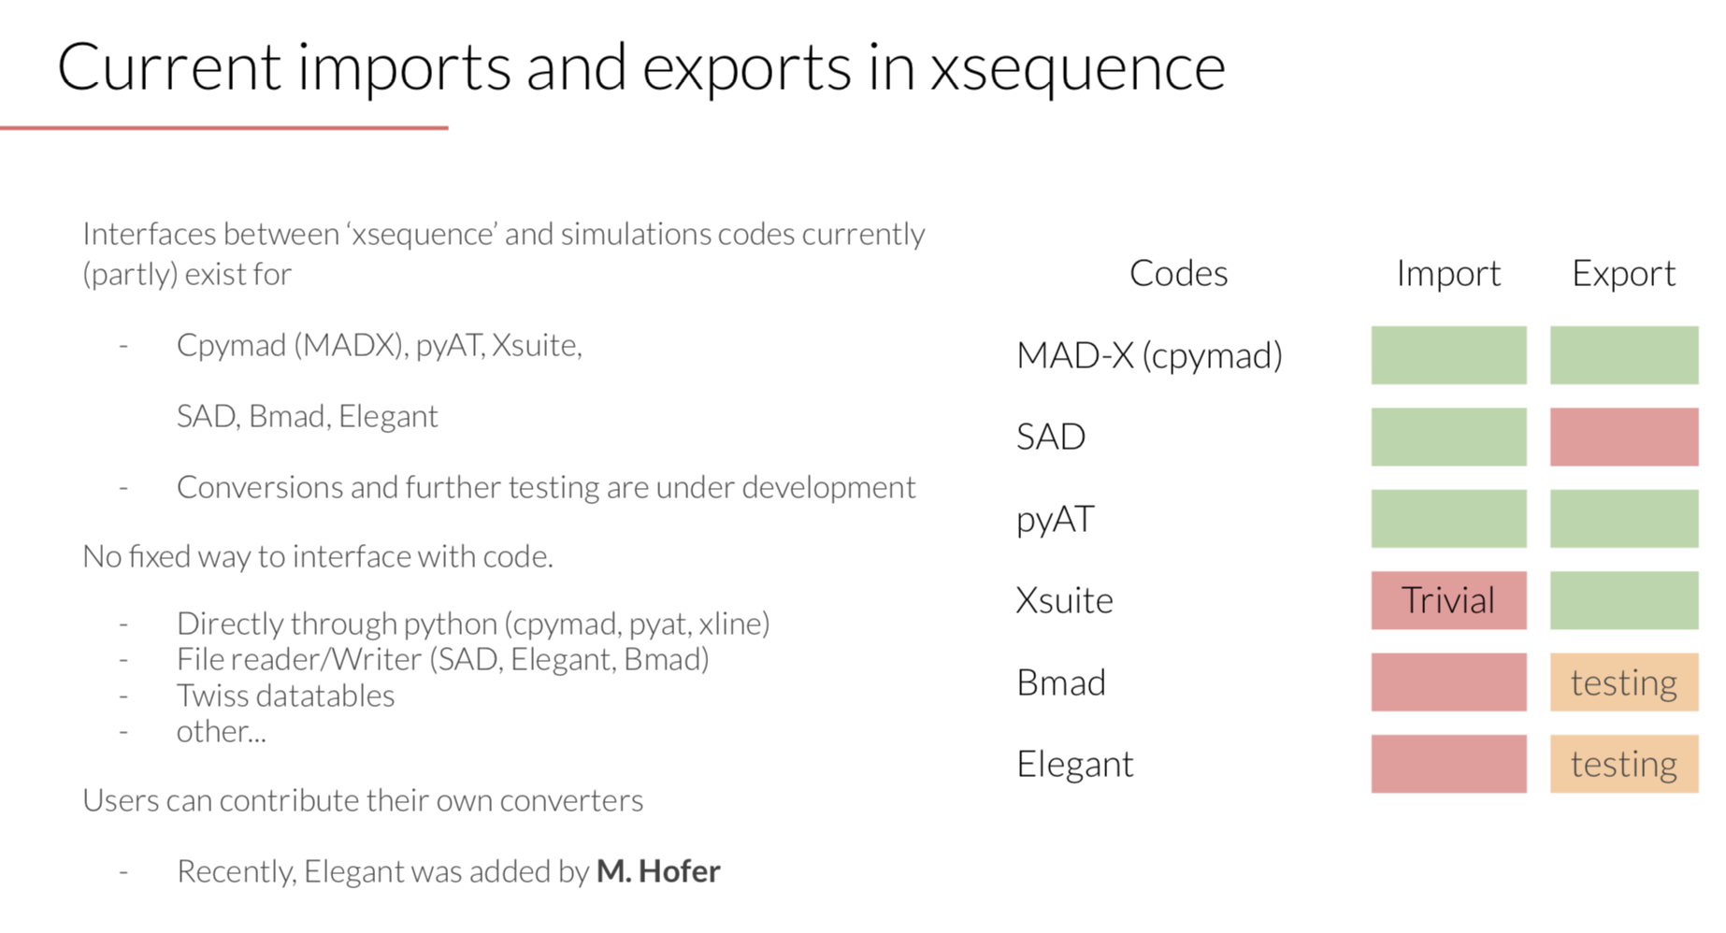
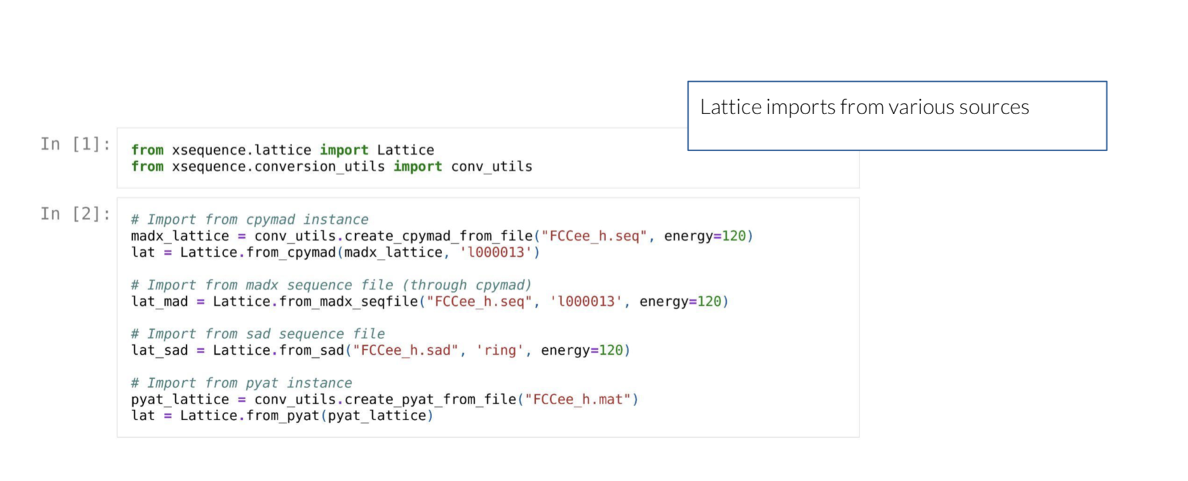
FCC-ee software framework
Felix Carlier

Slide 7
FCC-ee software framework
Felix Carlier

Slide 8
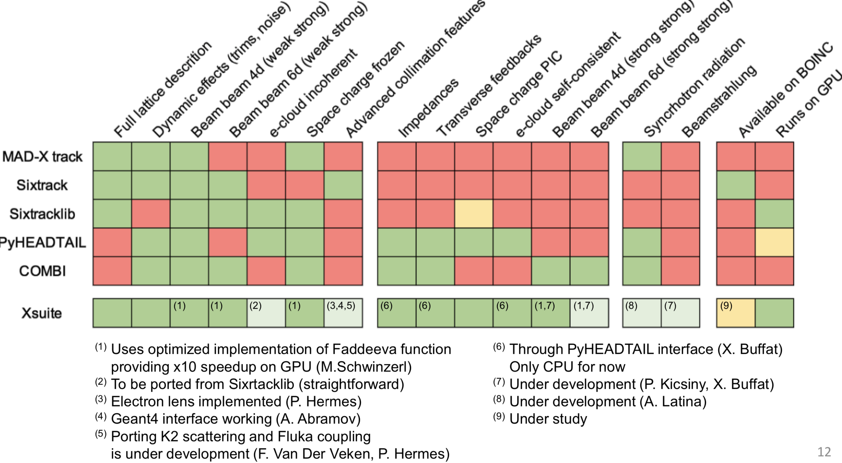
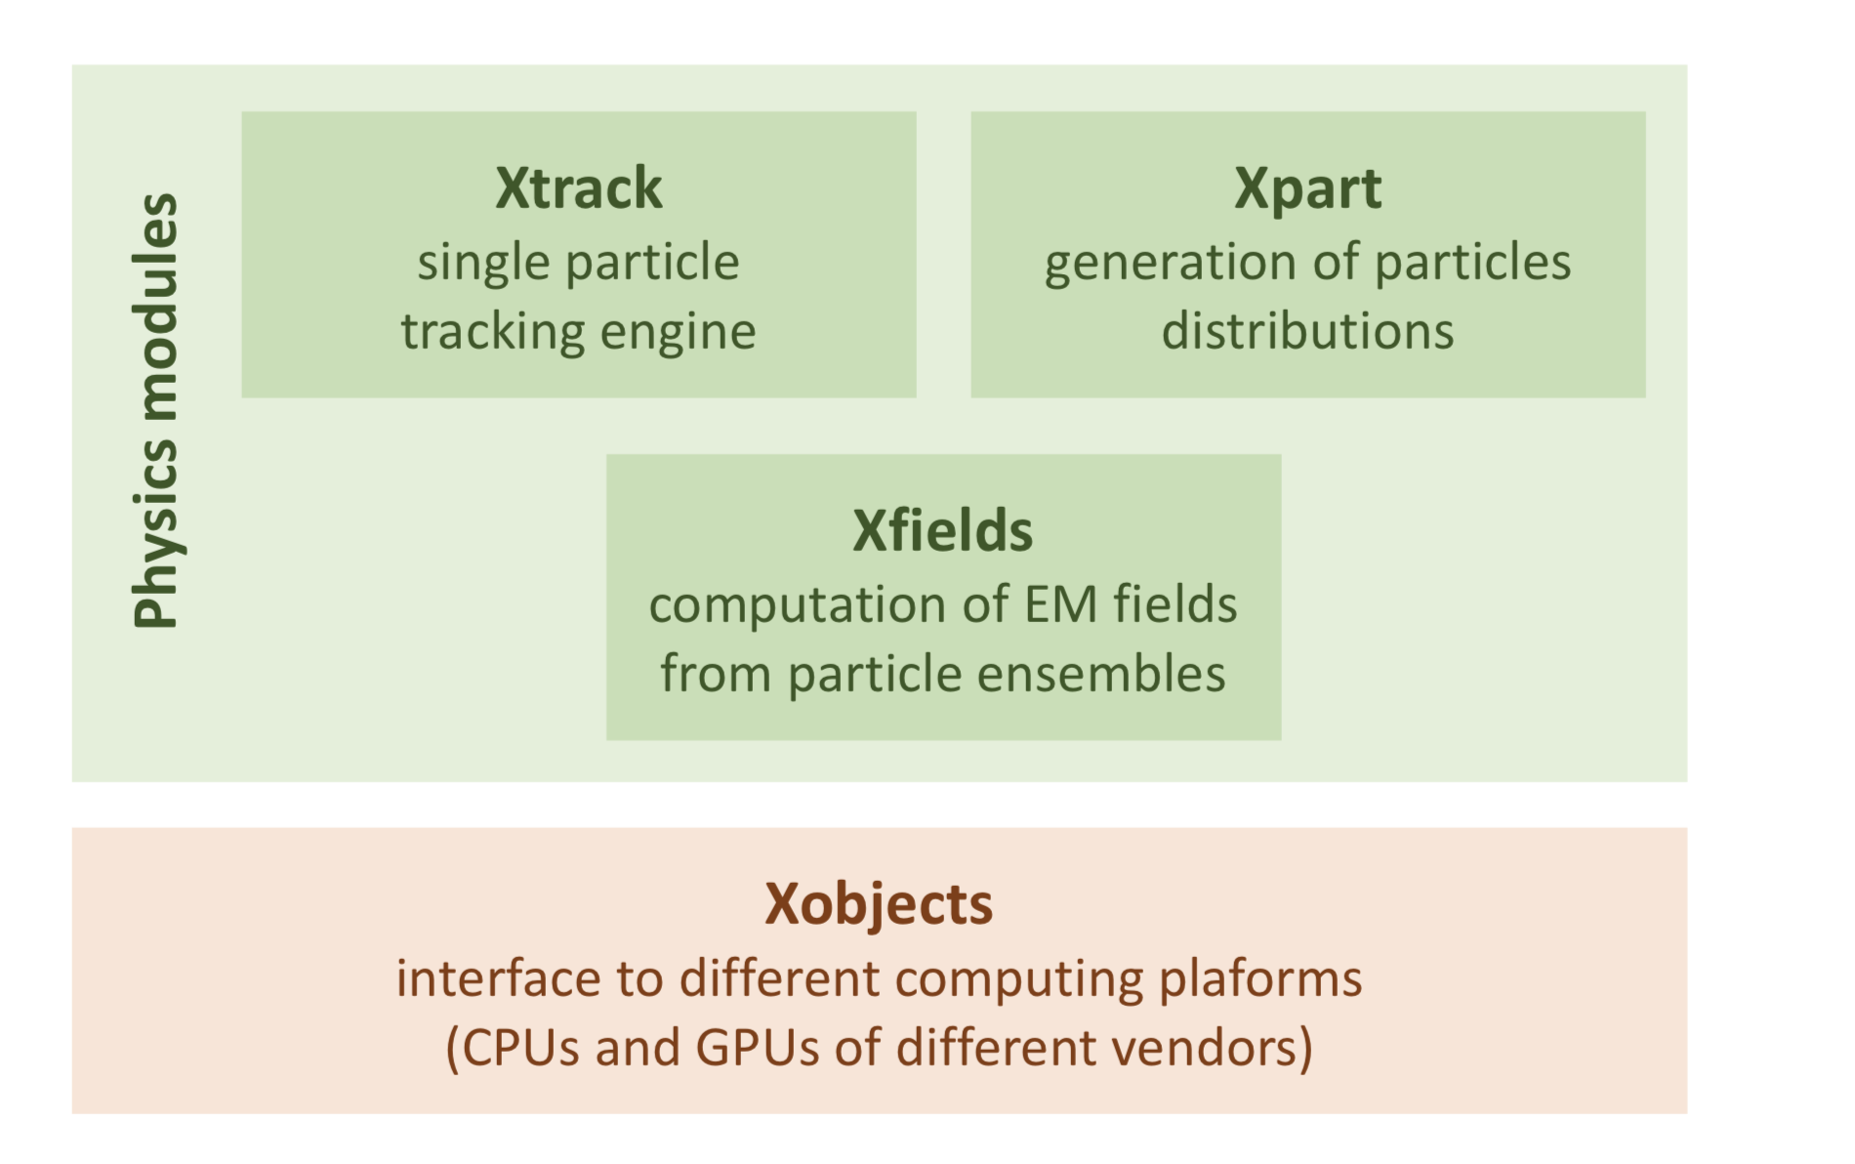
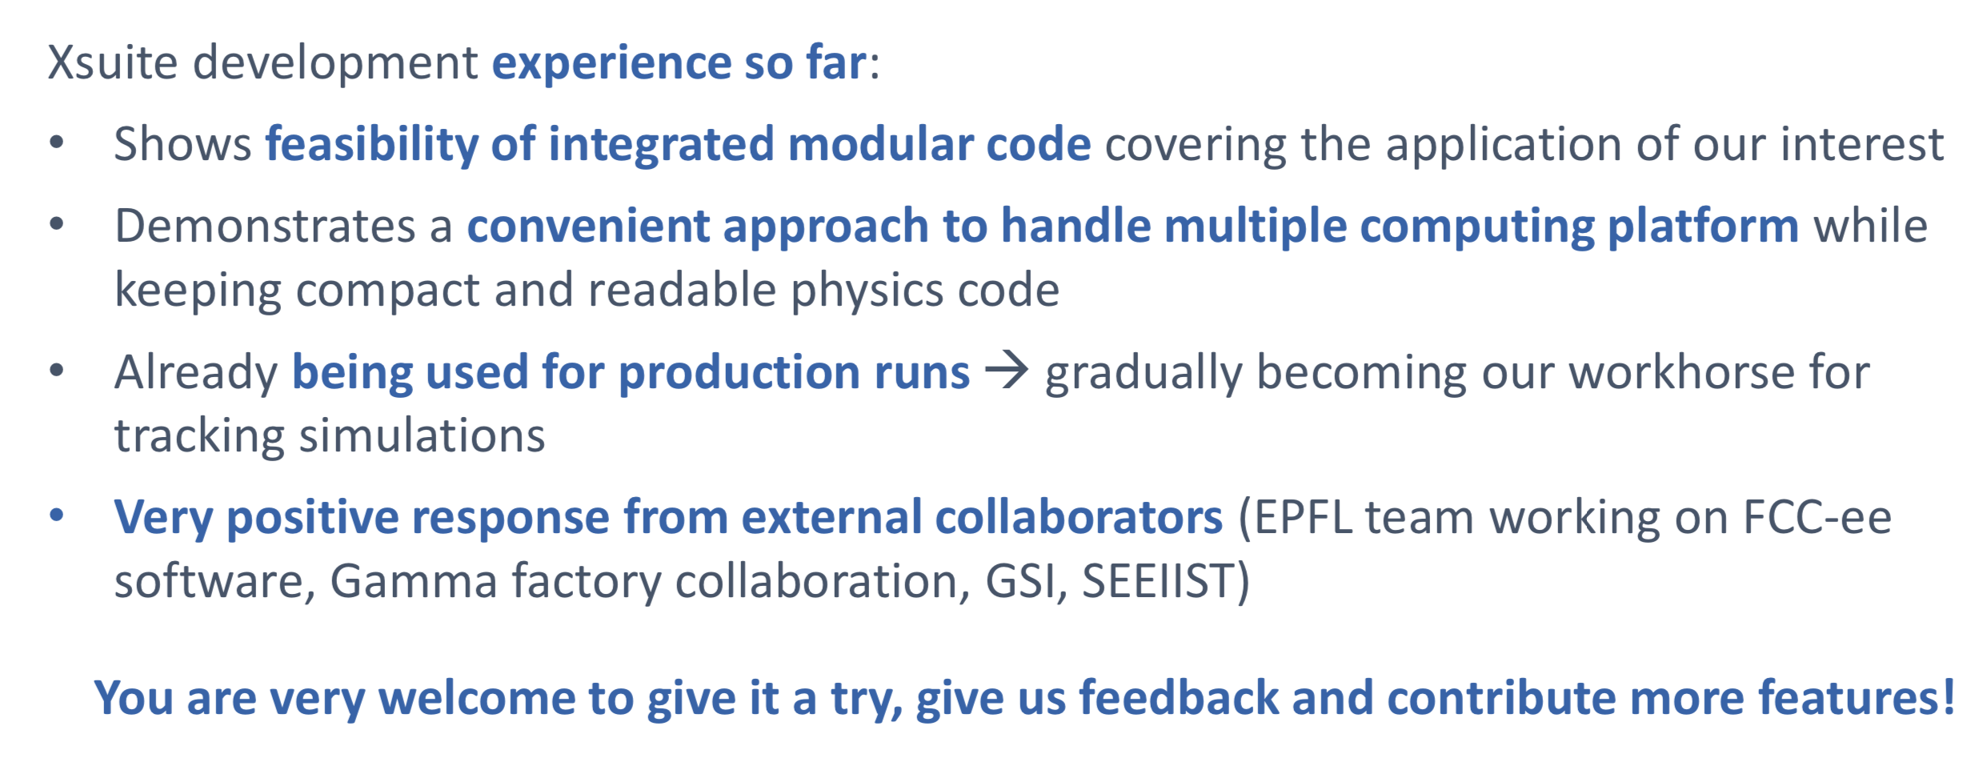
FCC-ee software framework
Giovanni Iadarola

Slide 9
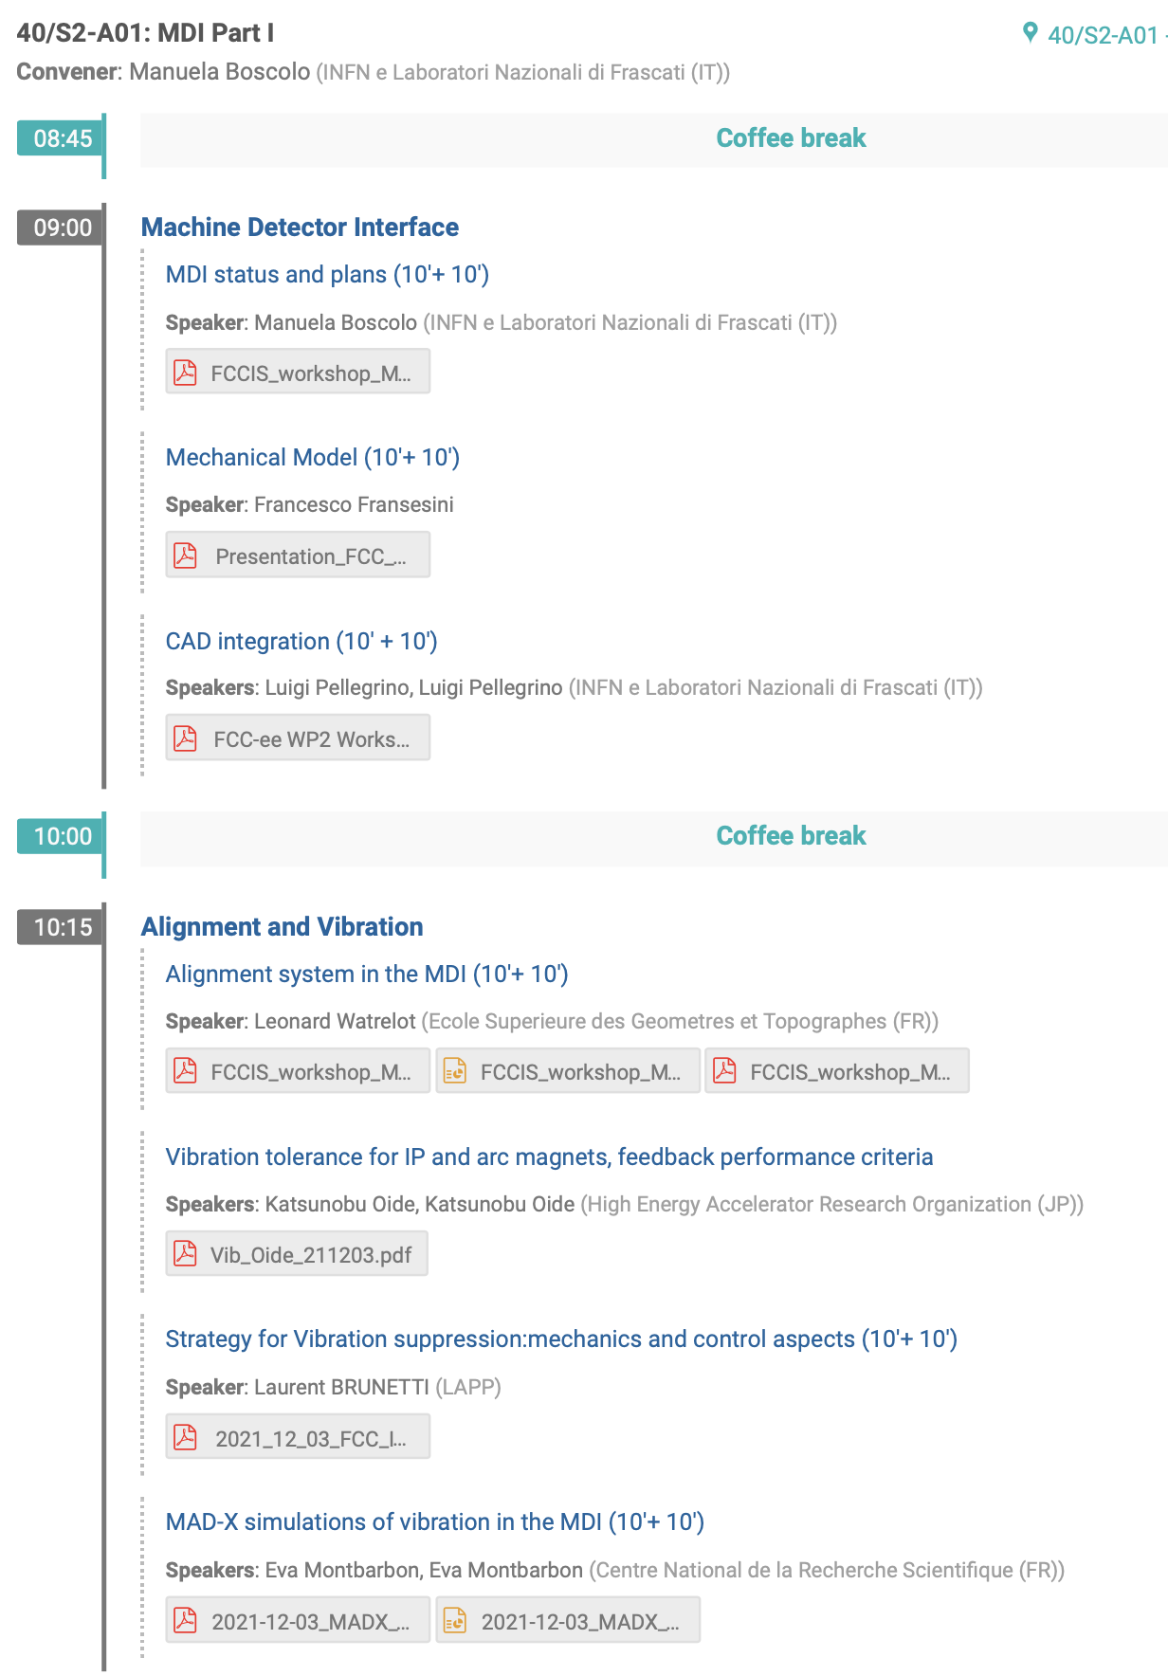
Friday Dec 4th

Slide 10
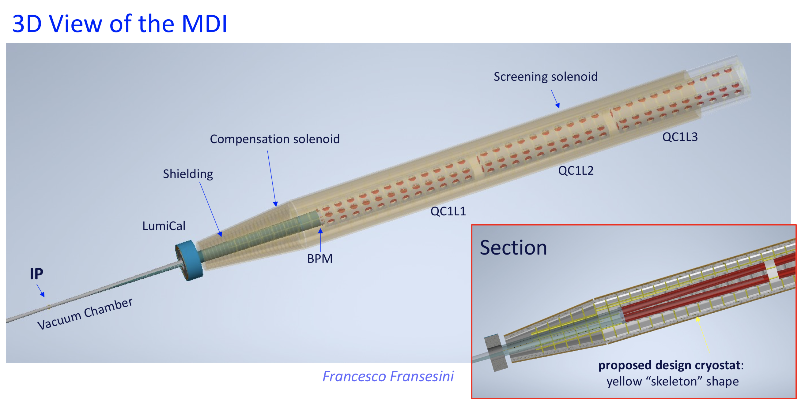
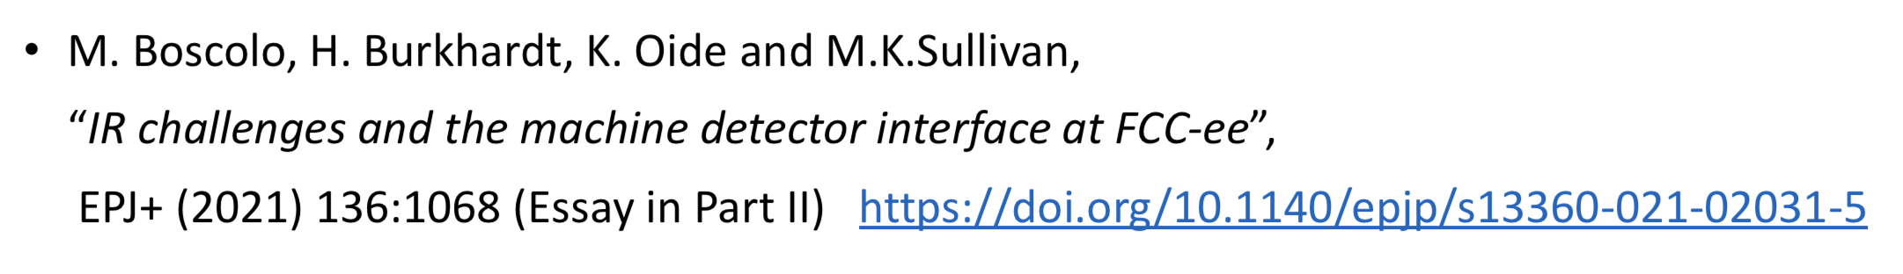
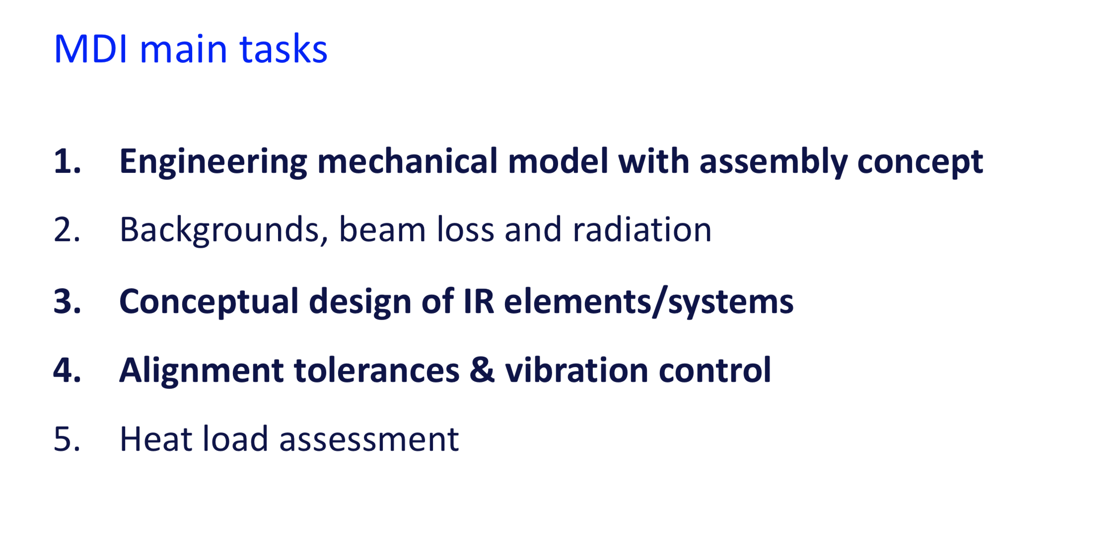
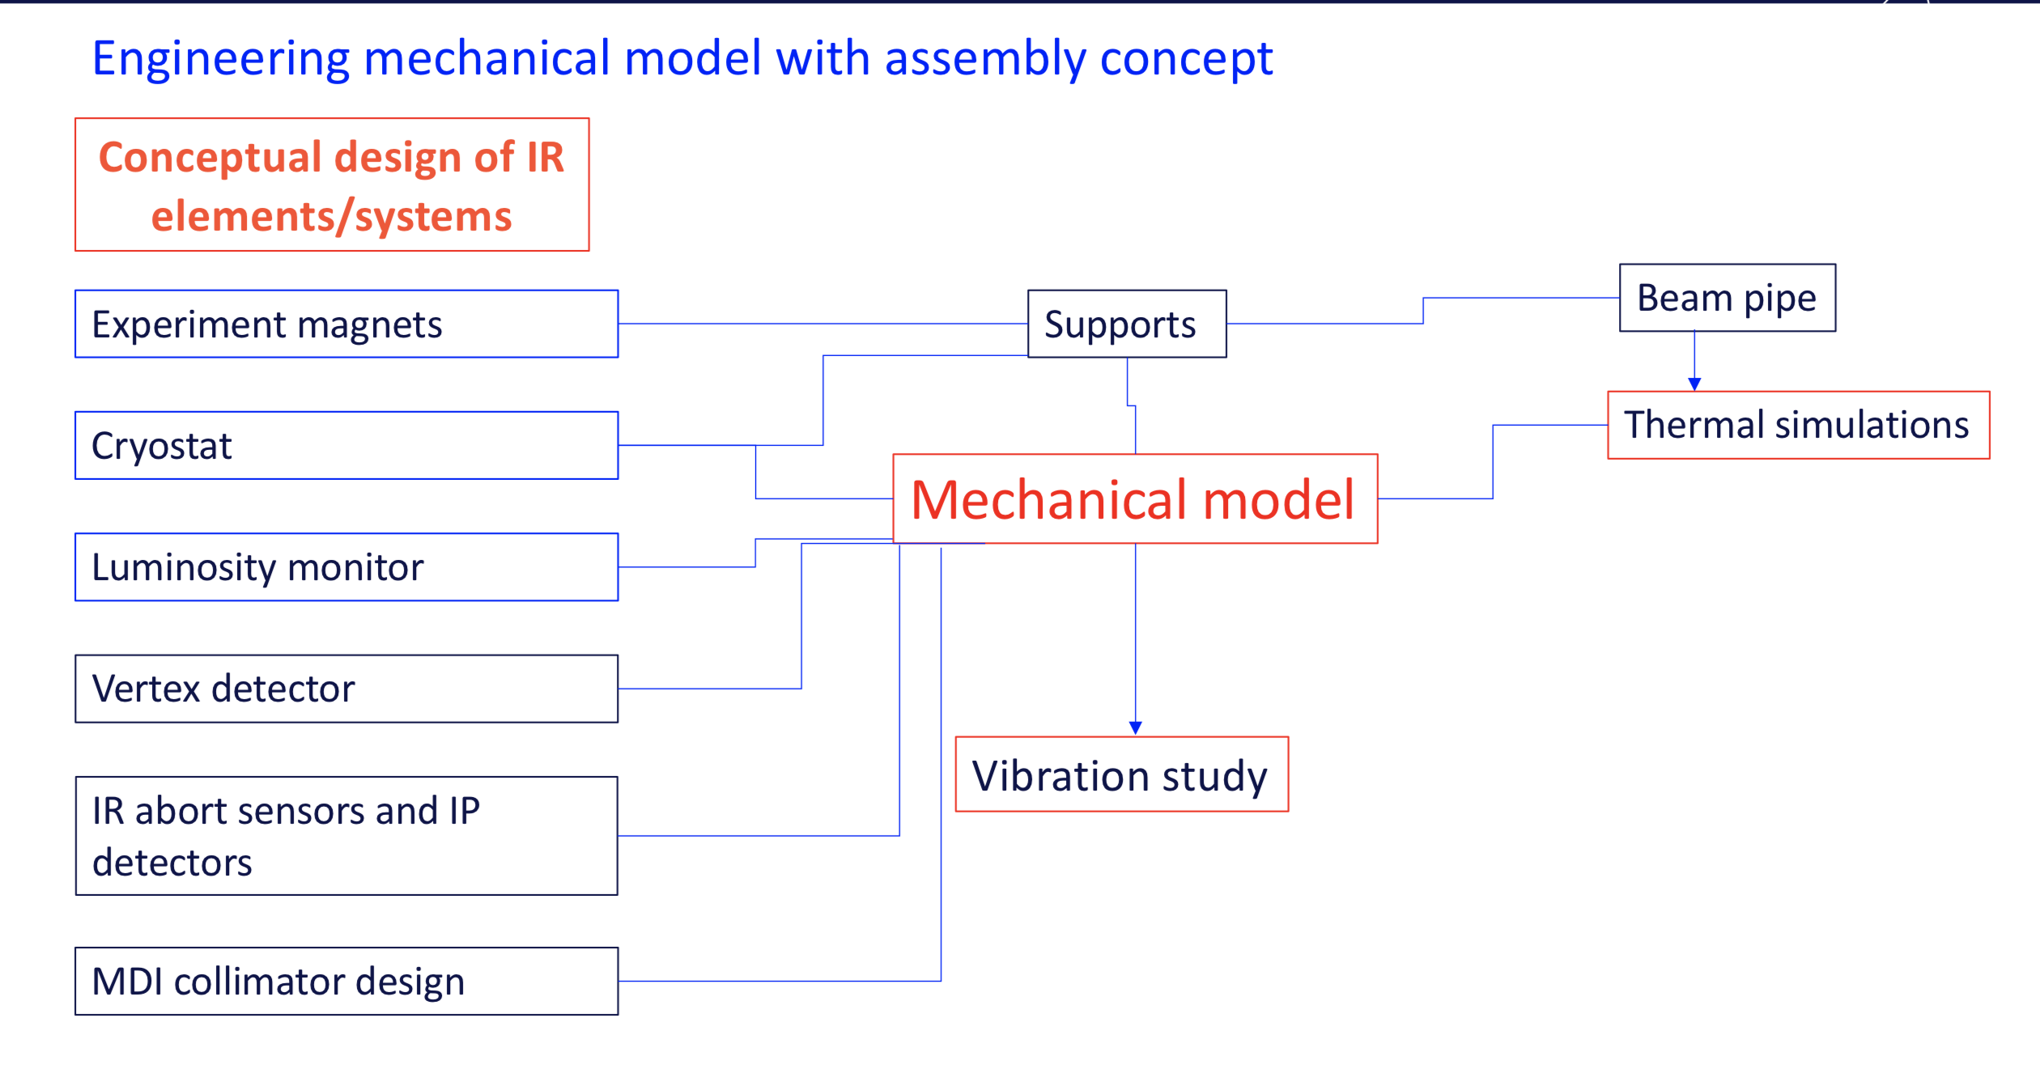
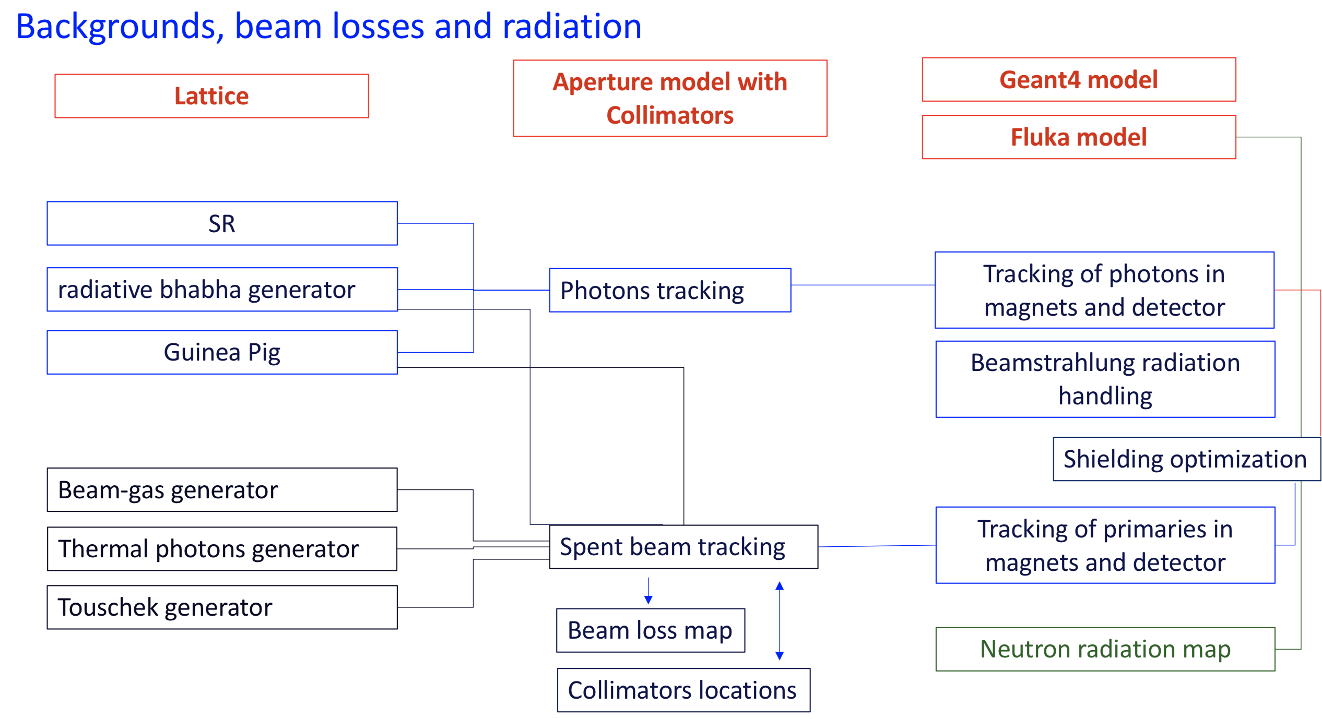
MDI Status and plans
Manuela Boscolo

Slide 11
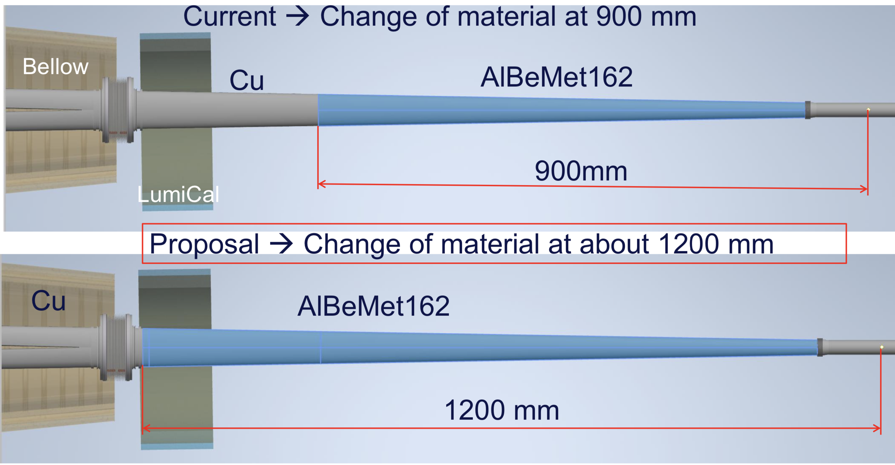
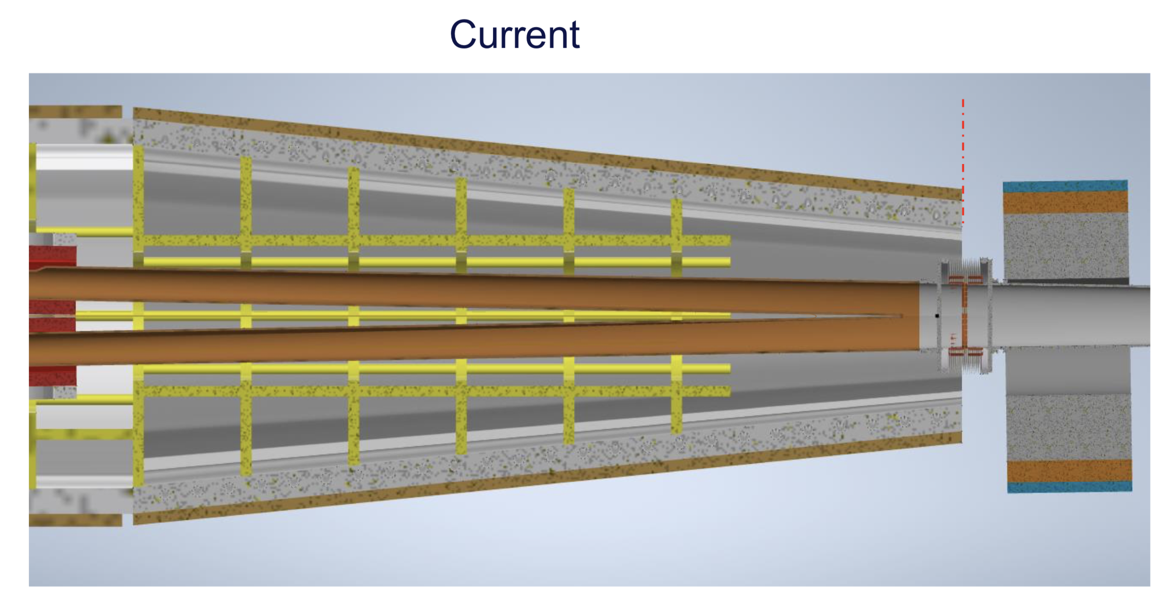
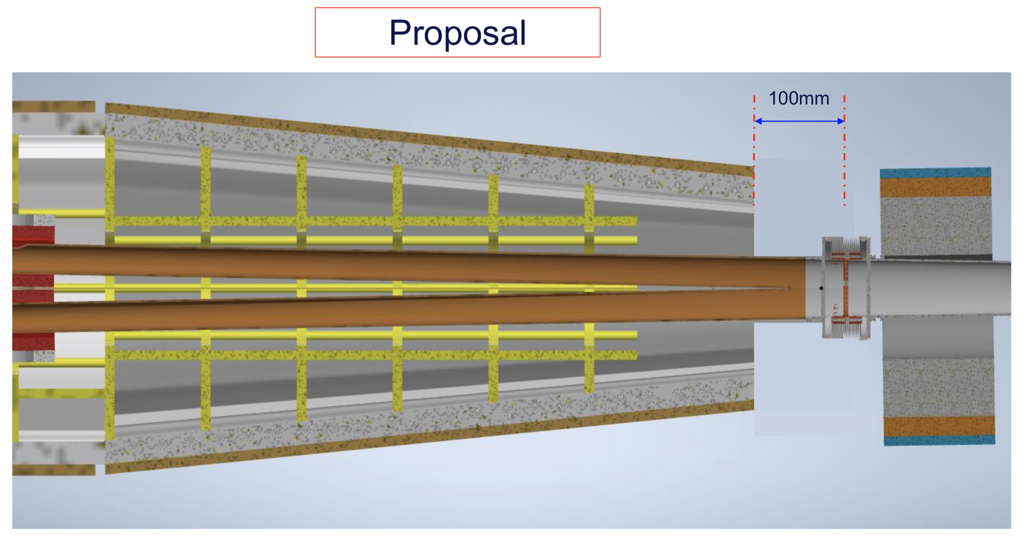
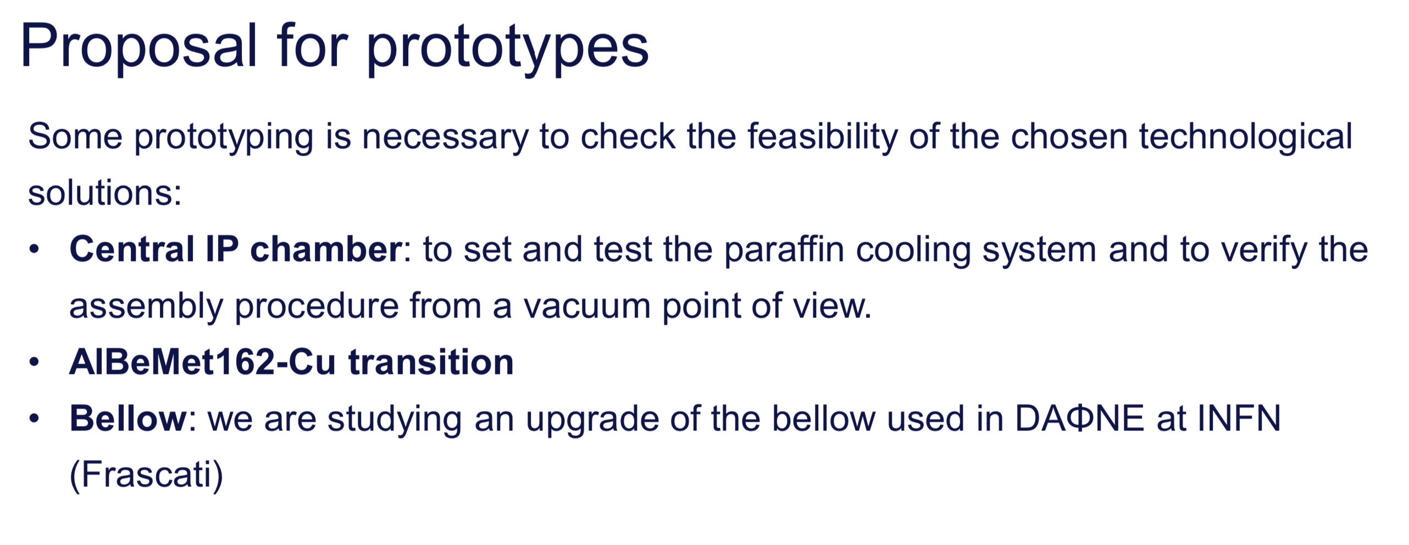
Mechanical Model
Francesco Fransesini

Slide 12
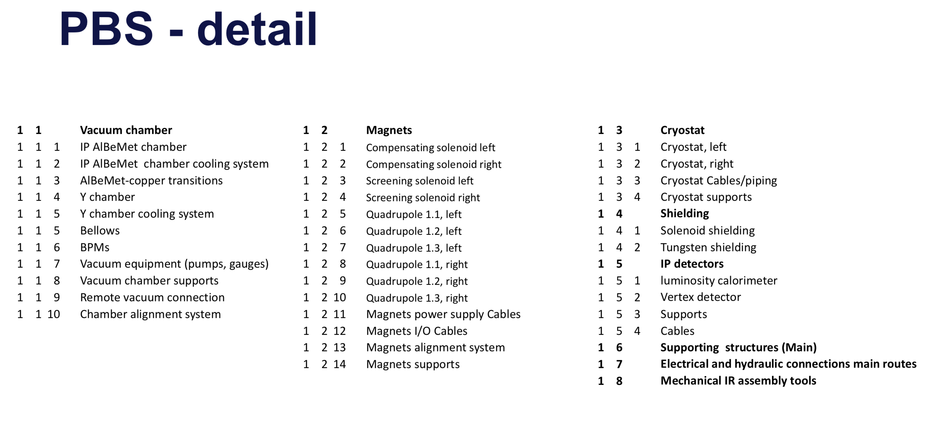
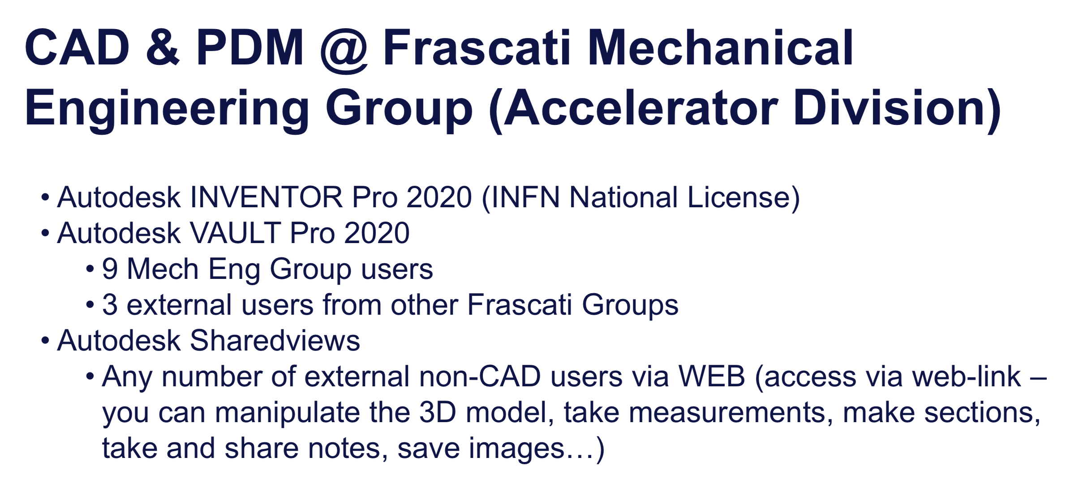
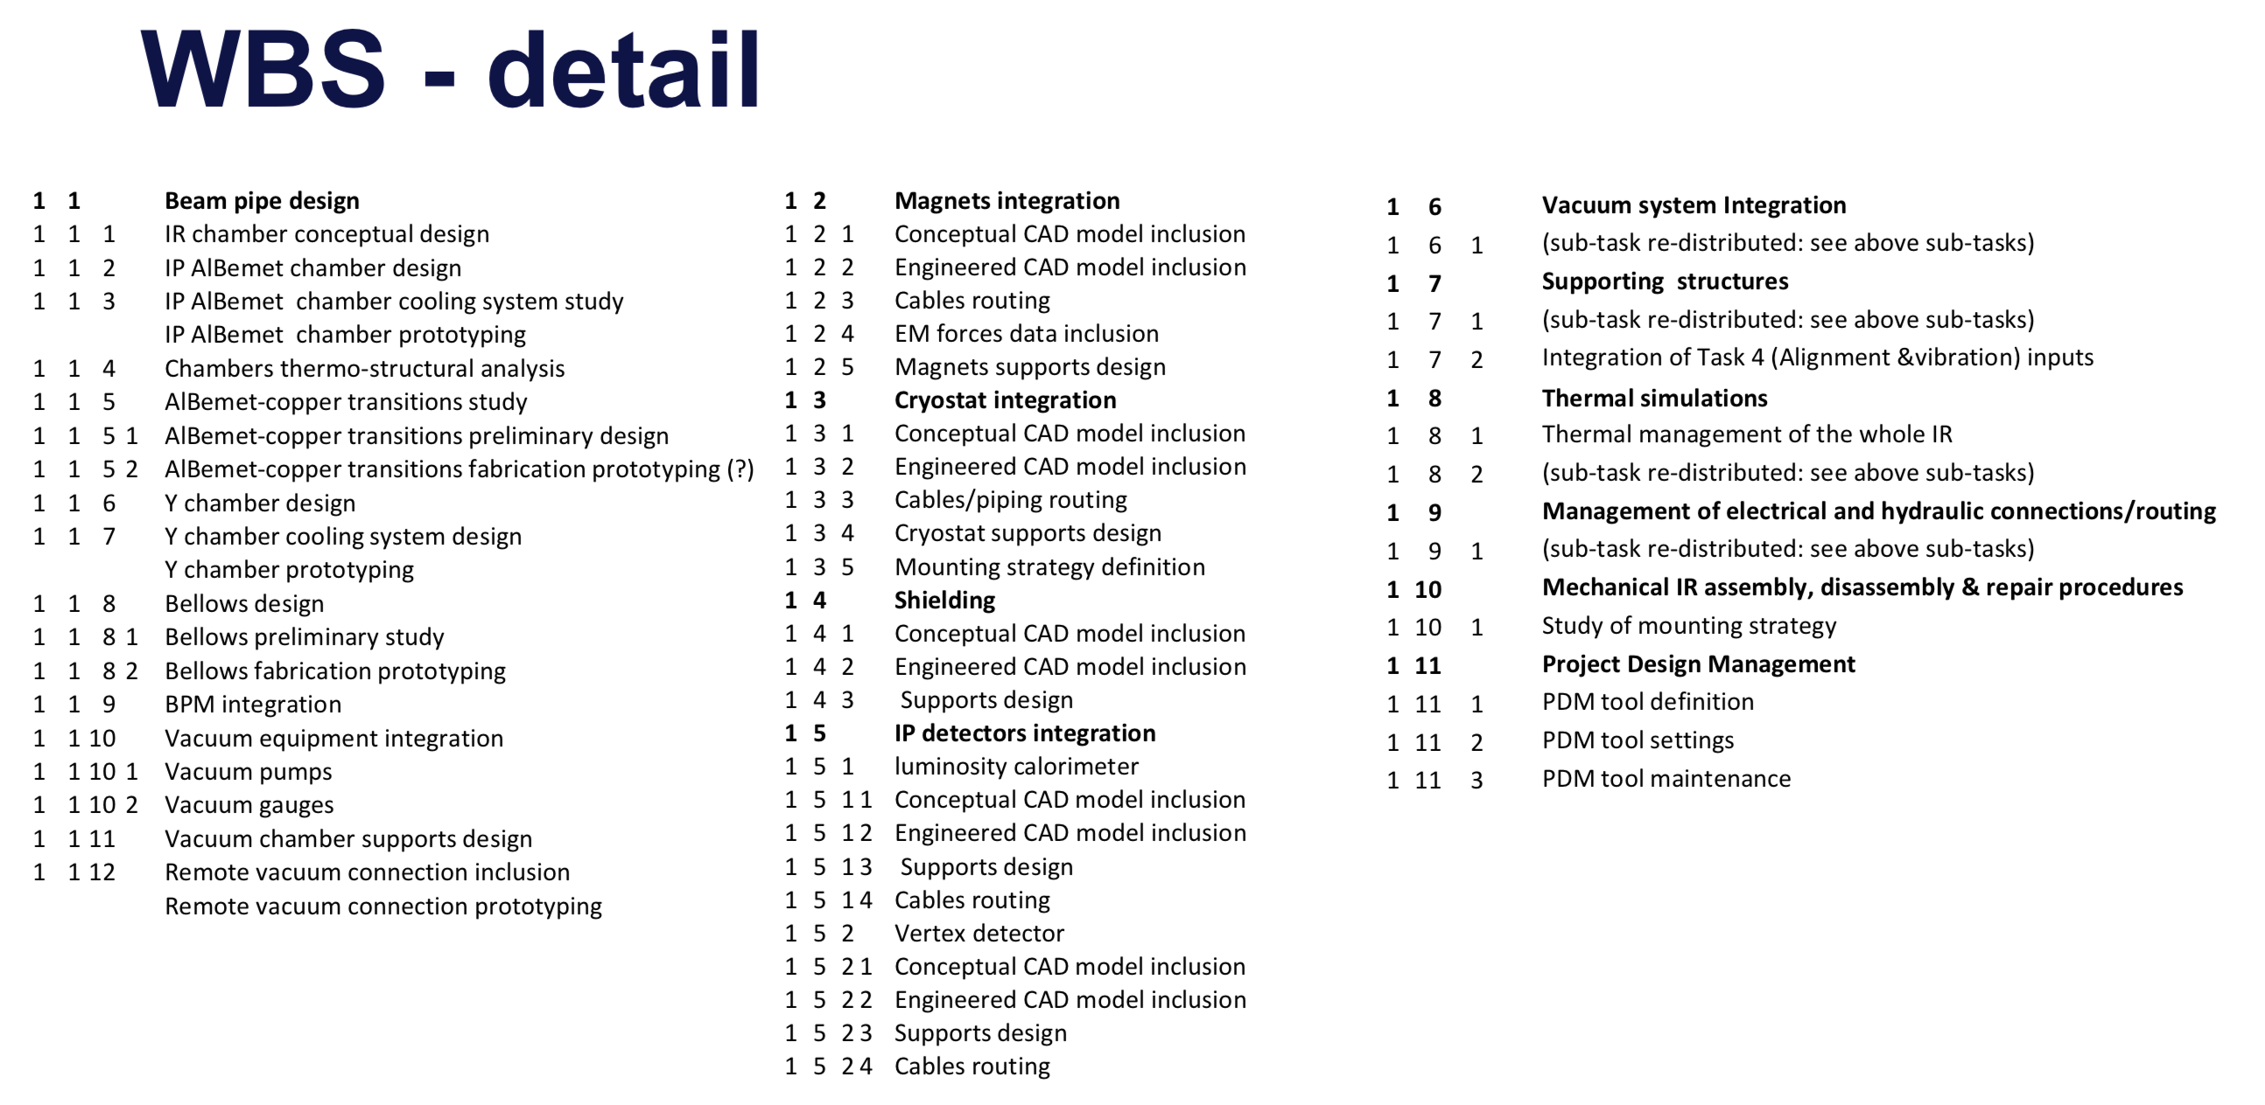
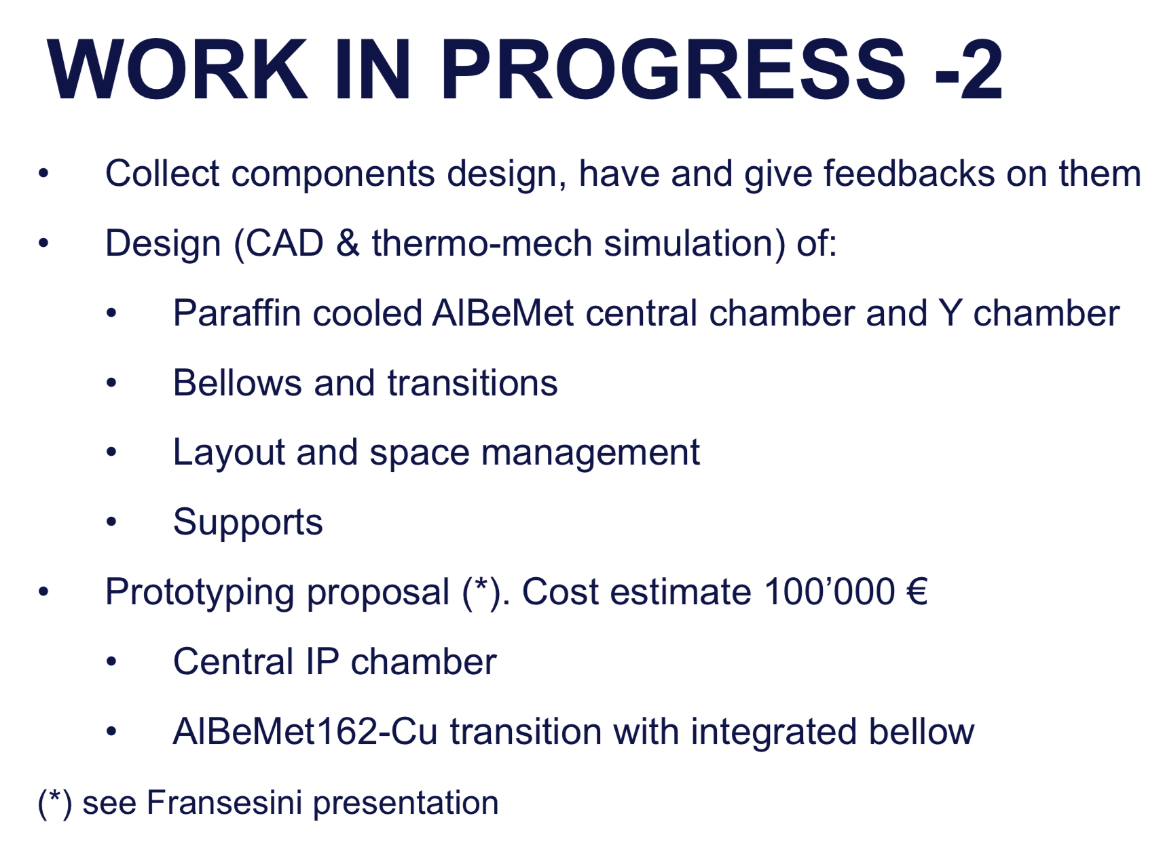
CAD integration
Luigi Pellegrino

Slide 13
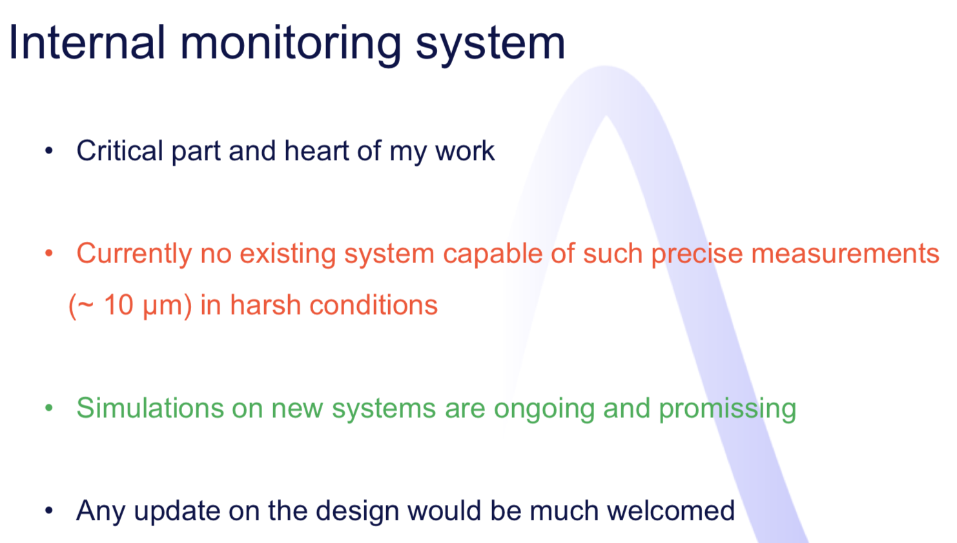
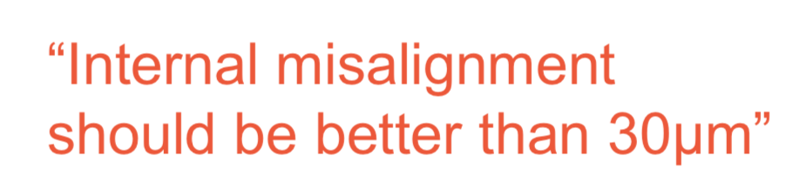
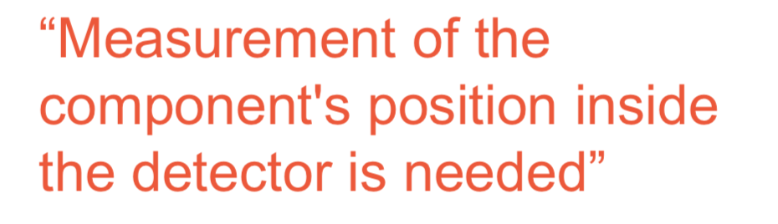
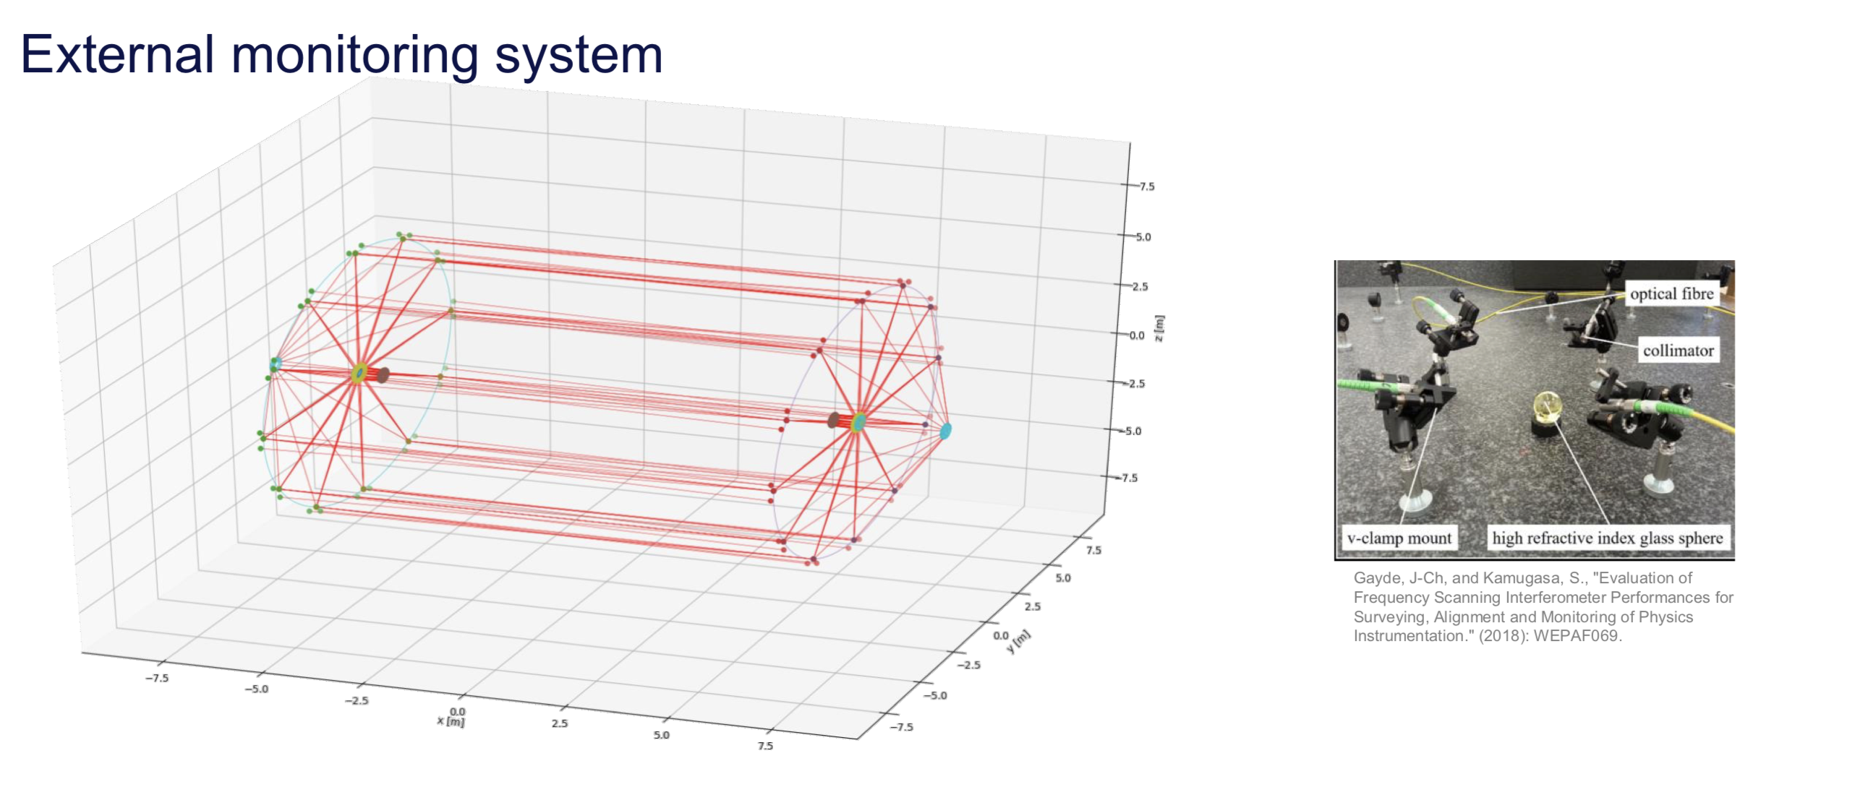
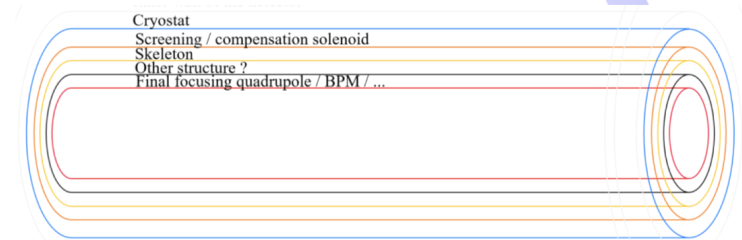
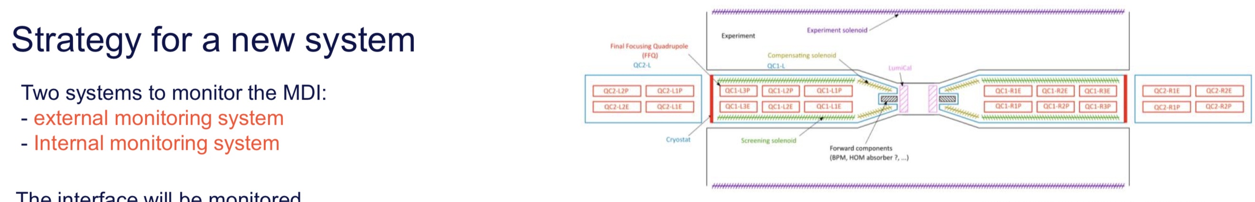
MDI Alignment
Leonard Watrelot

Slide 14
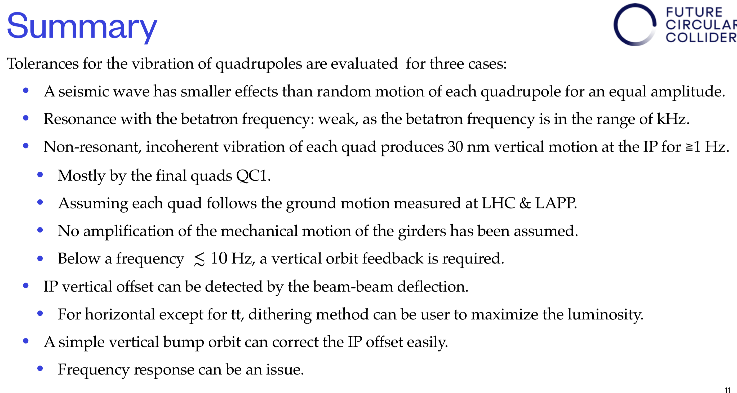
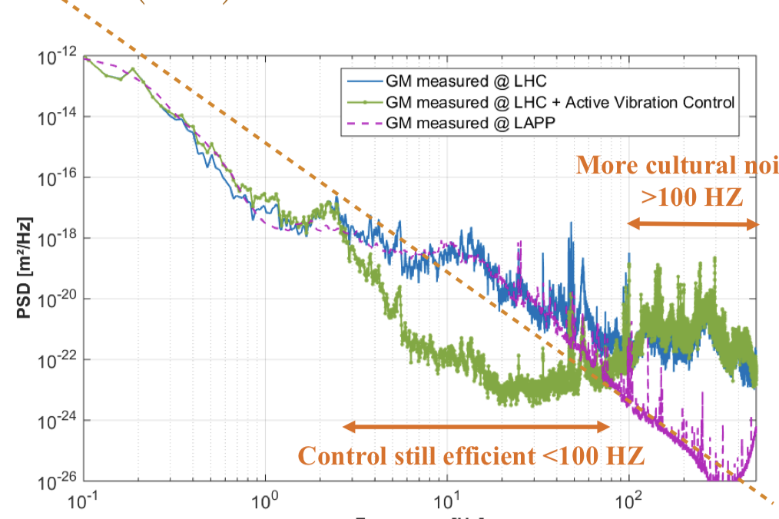
Vibration Tolerances
Katsunobu Oide

Slide 15
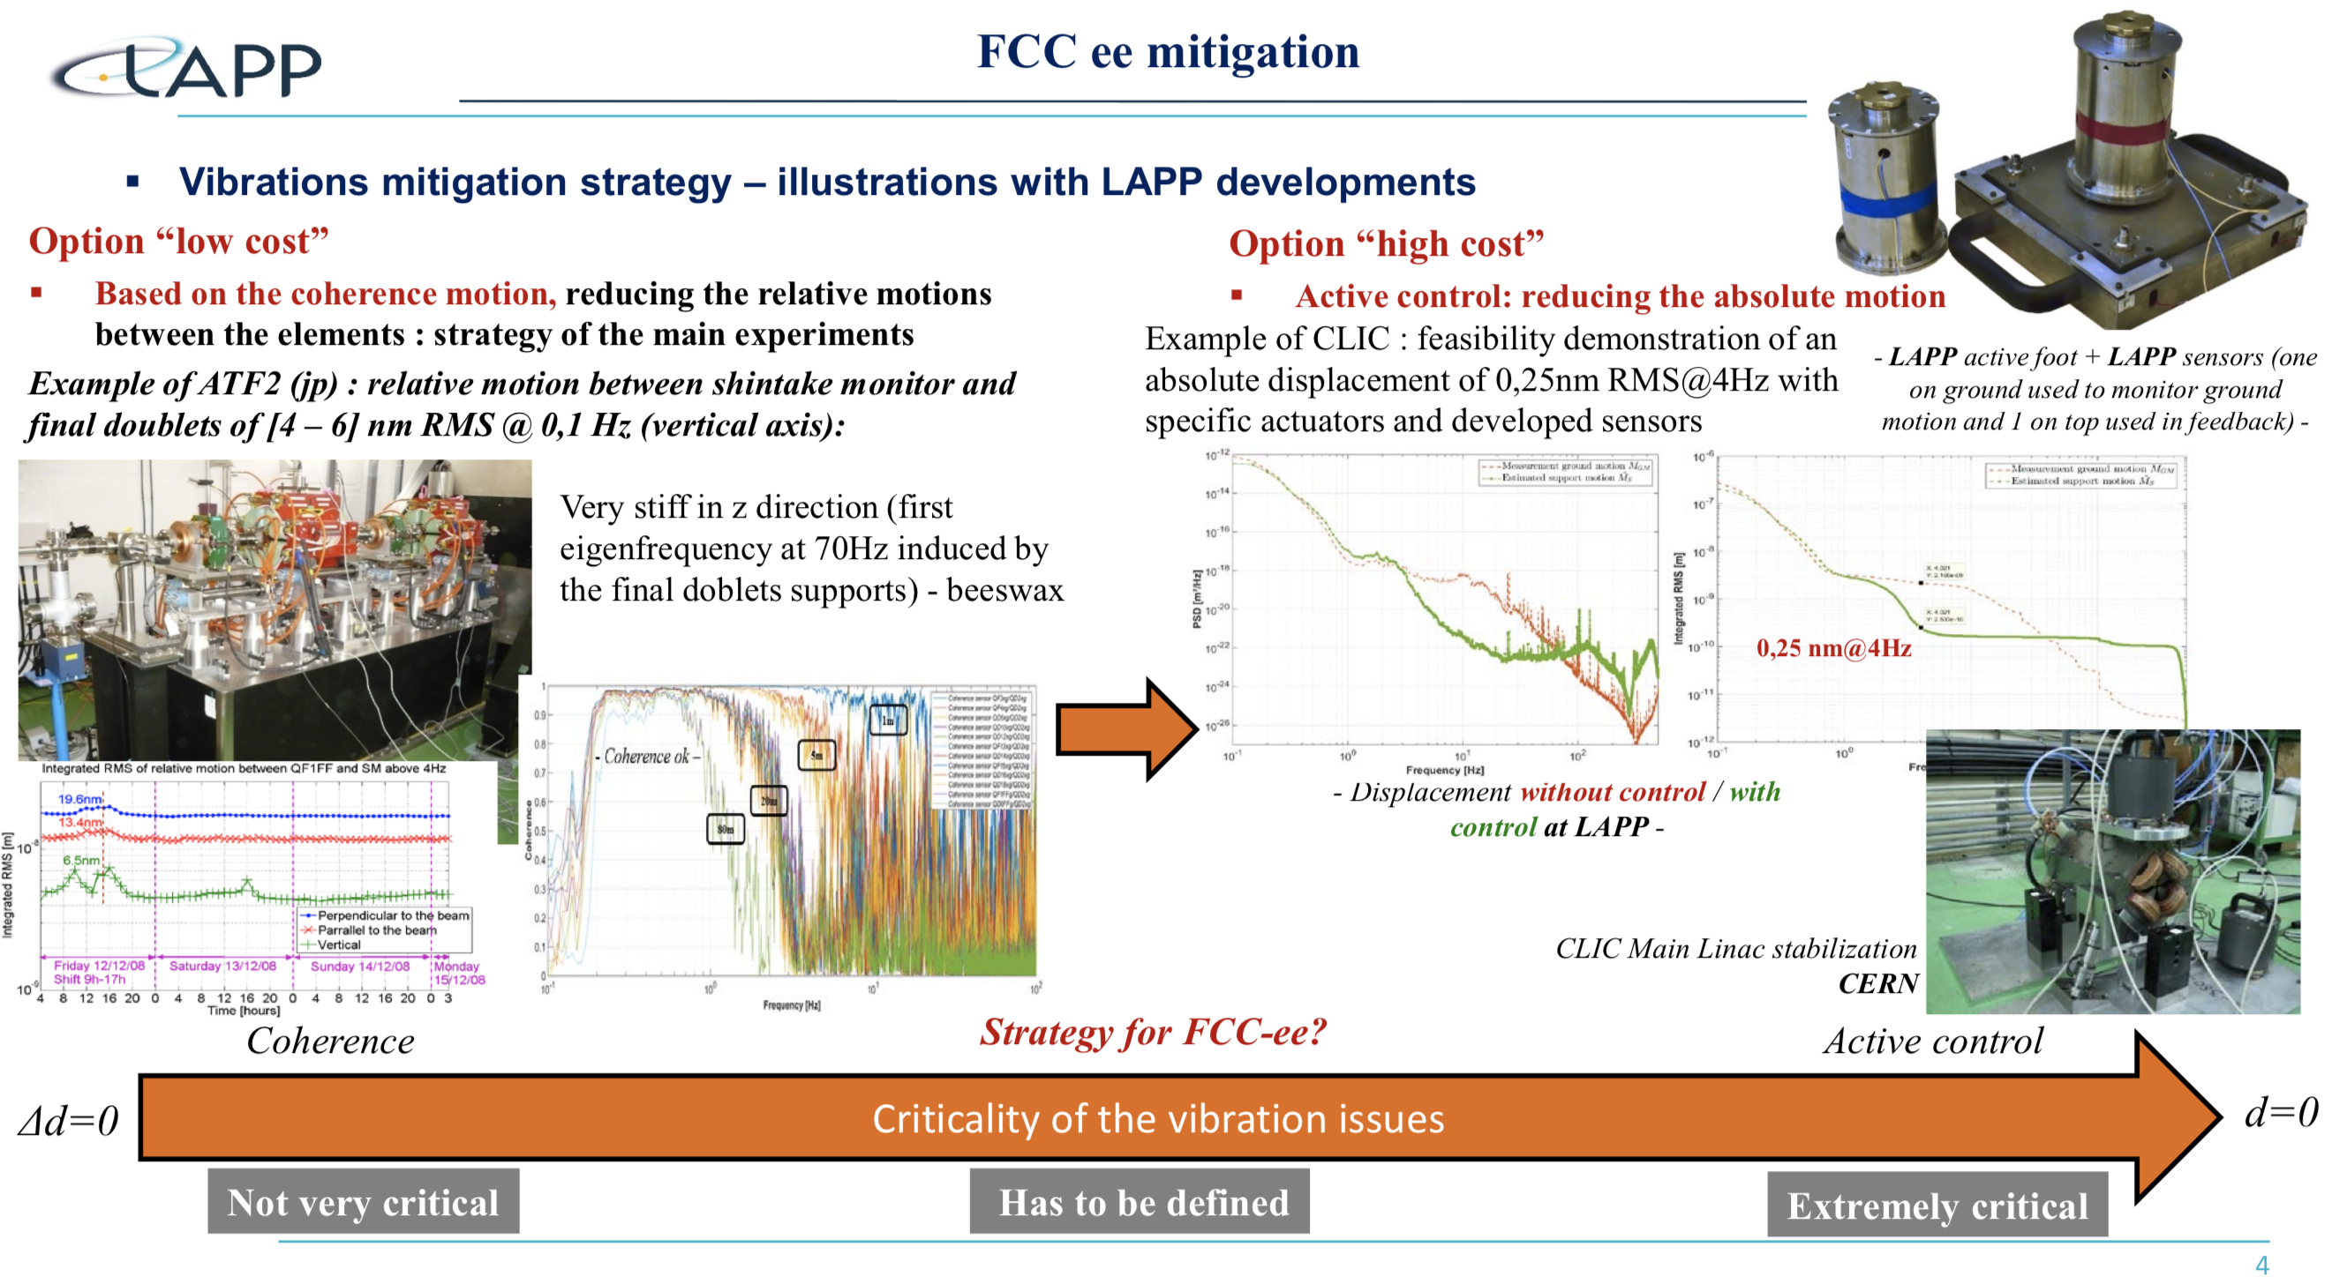
Vibration Mitigation Strategies
Laurent Brunetti

Slide 16
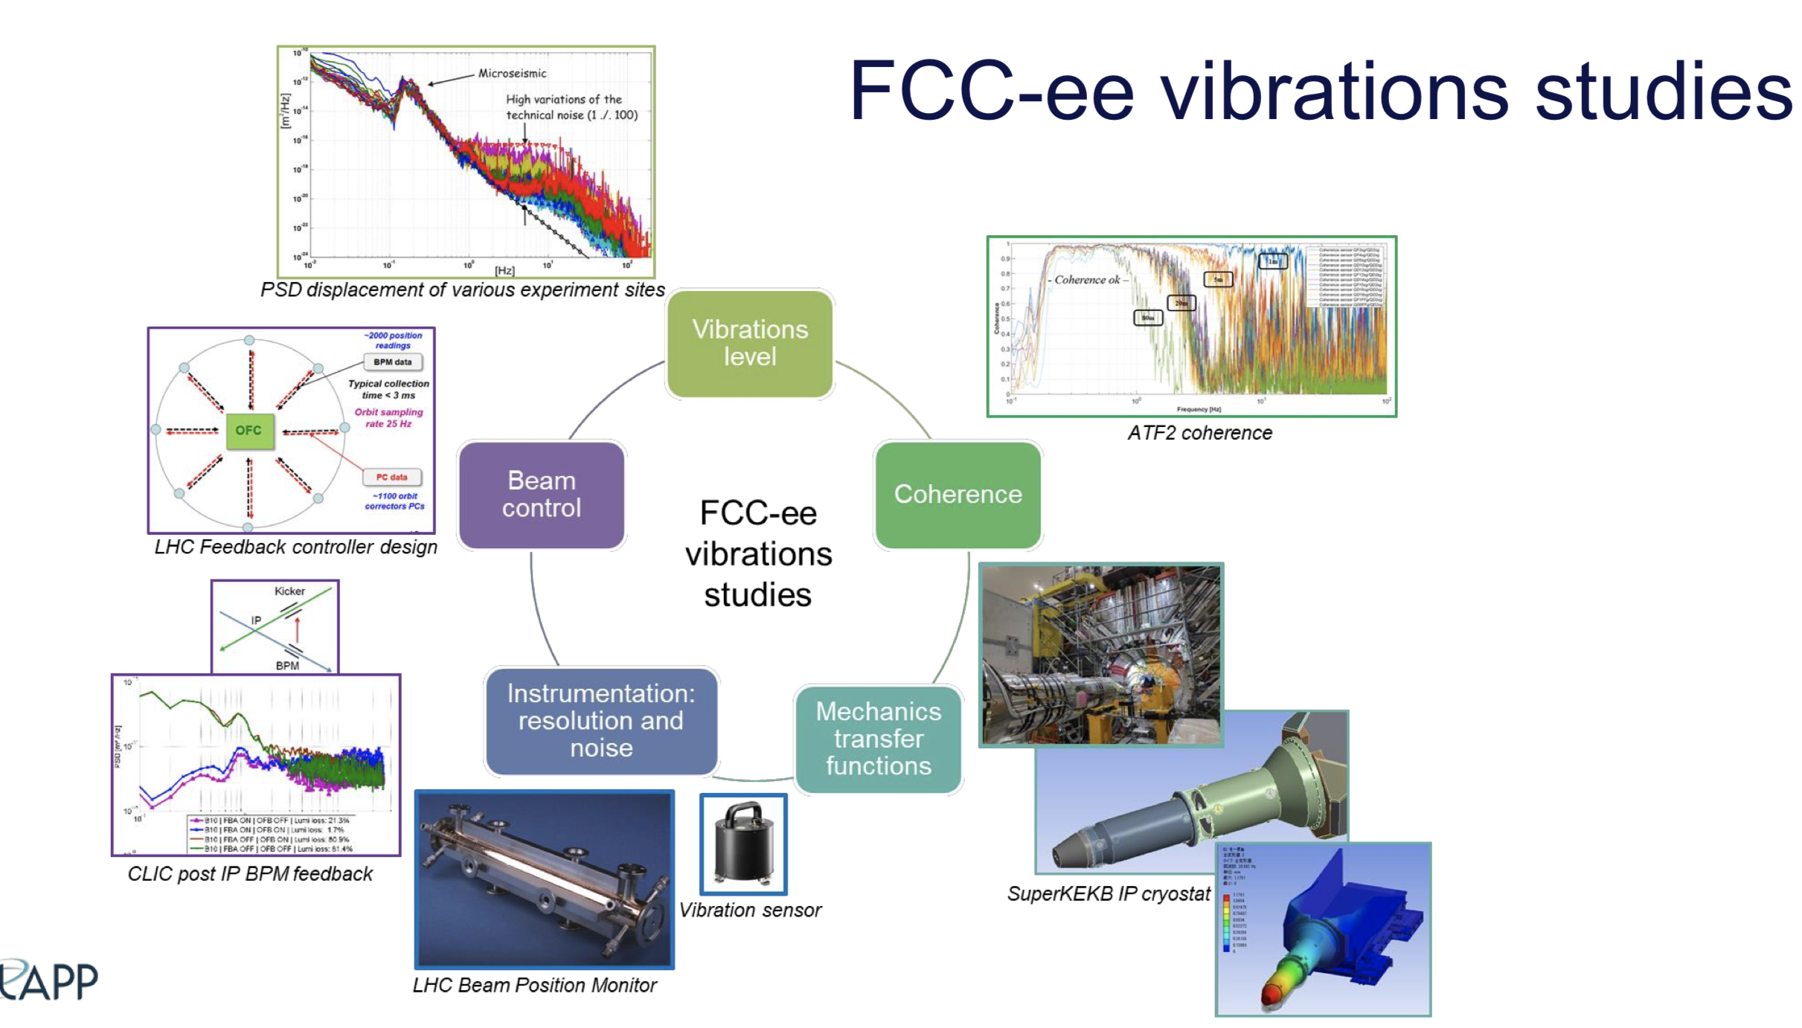
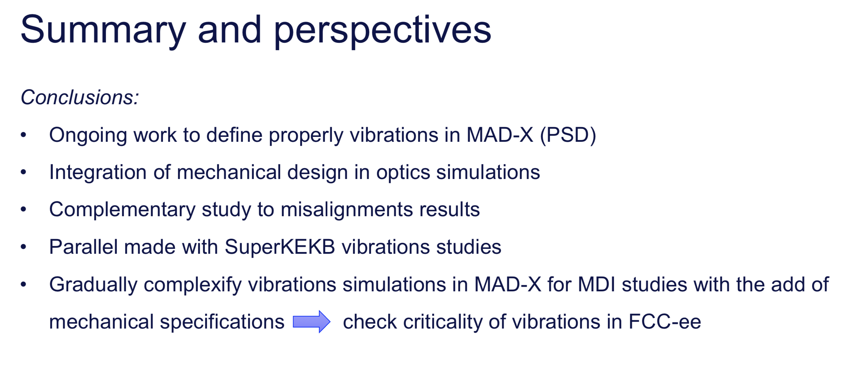
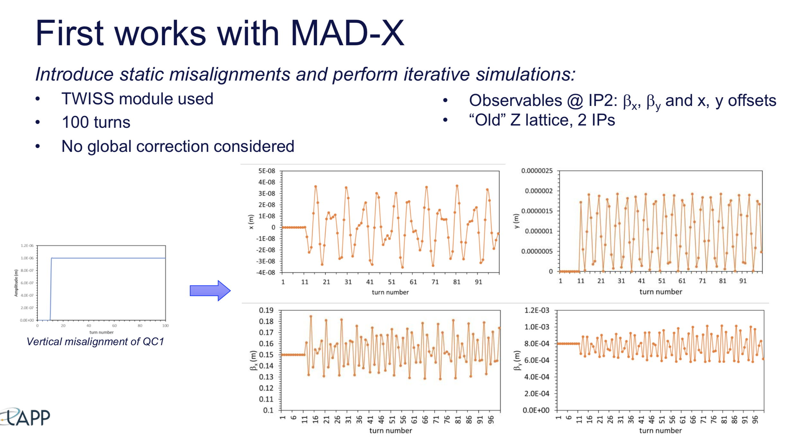
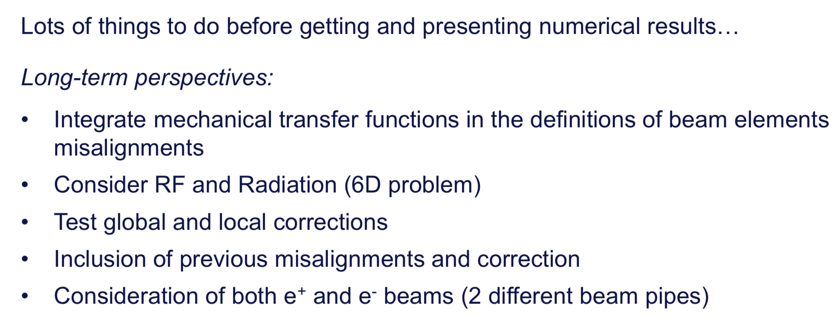
Madx simulations of MDI Vibrations
Eva Montbaron

Slide 17
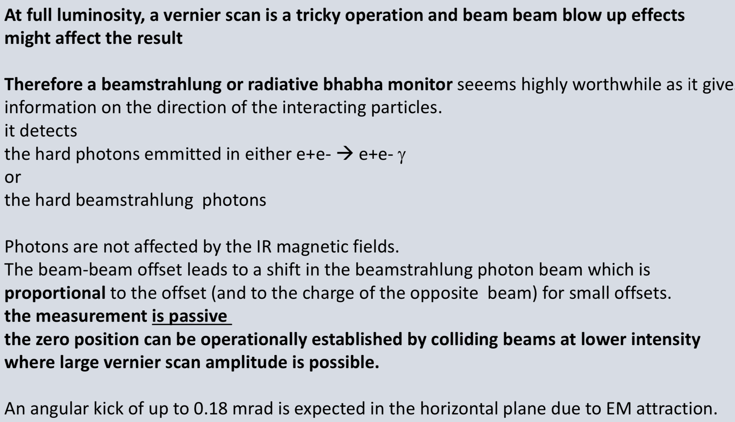
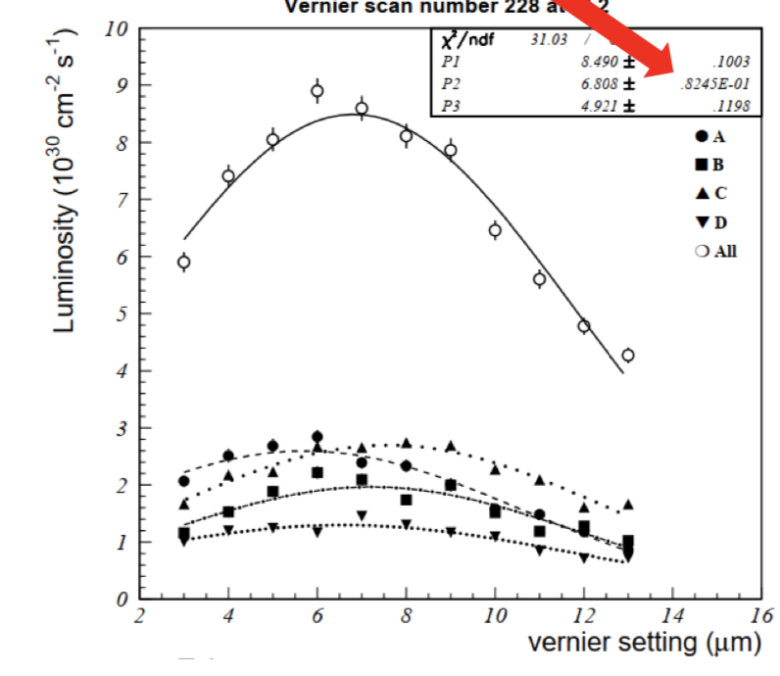
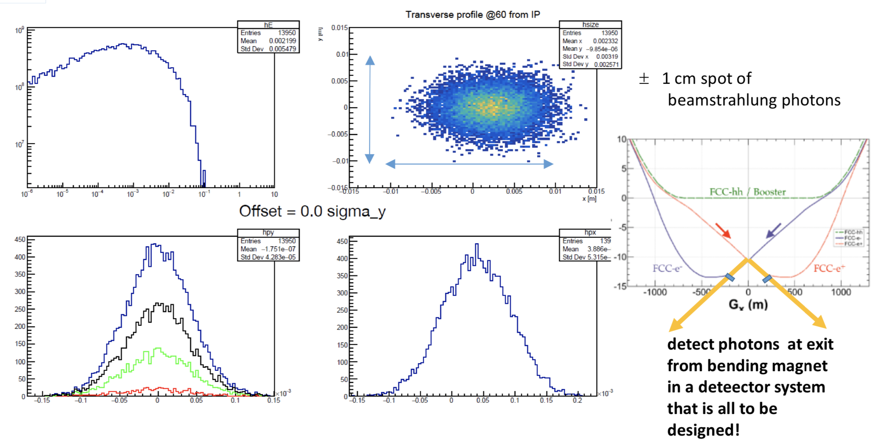
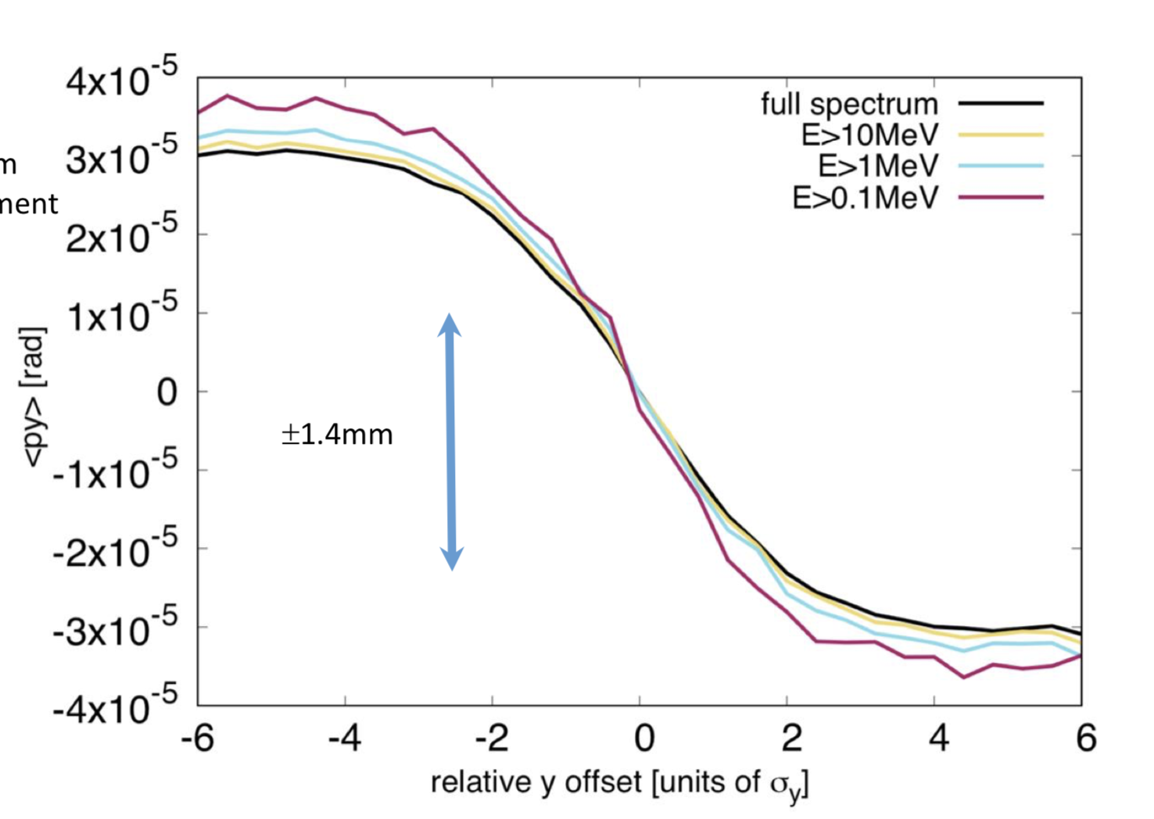
Beamstrahlung monitor
Alain Blondel
???

Slide 18
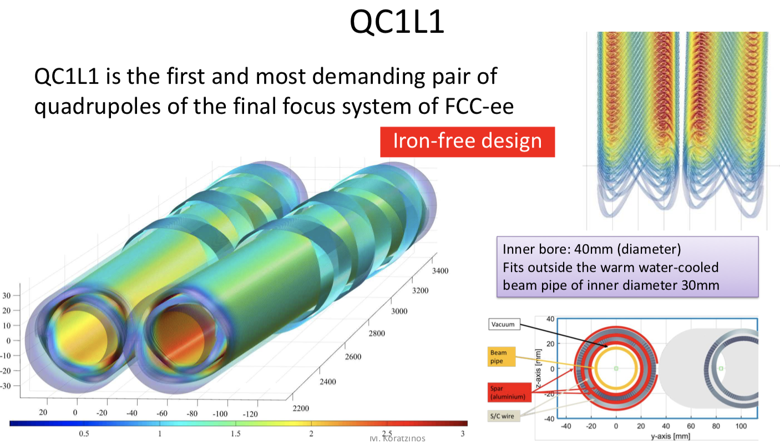
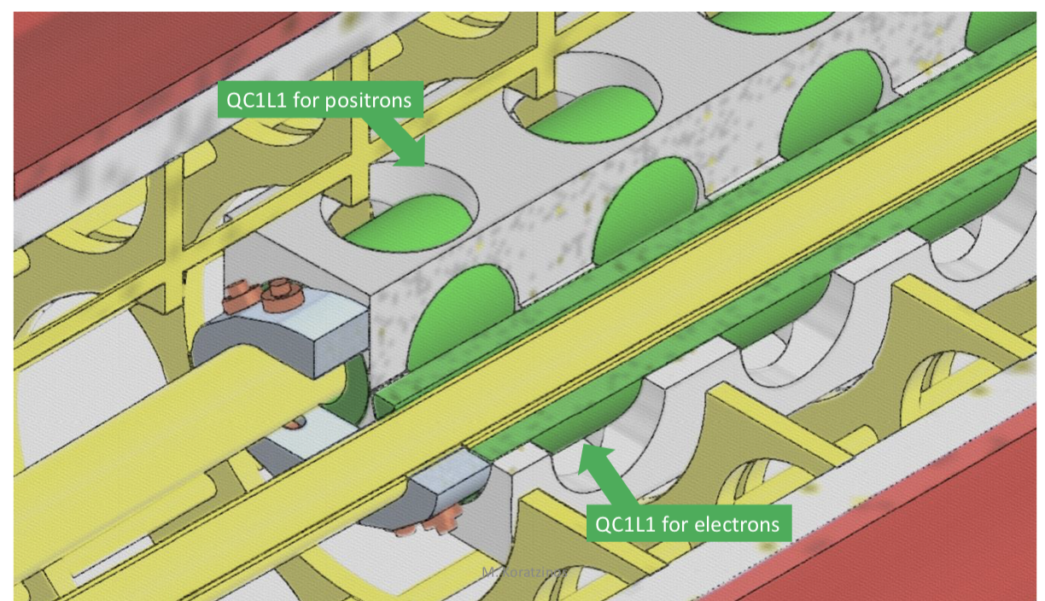
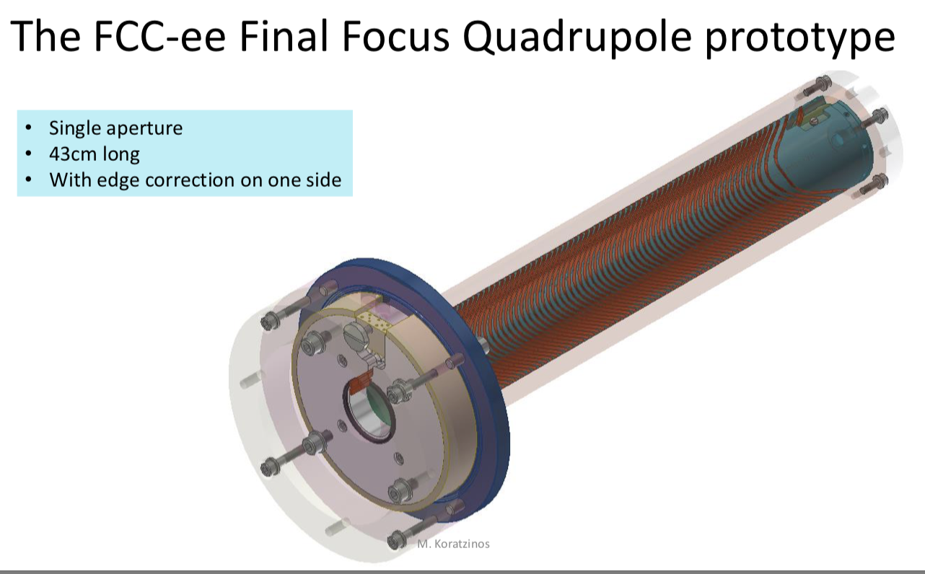


CCT Magnet Design
M Koranzinos

Slide 19

Monday Dec 6th

Slide 20





PETRA IV Beam stabilization
Ilya Agapov
PETRA IV facility design ongoing
Lattice in place (20 pm emittance)
Bootstrapping simulations performed
Ground vibration and long-term tunnel drifts measured
Transportation tests ongoing

Slide 21




Optics correction at ESRF-EBS
Simone Liuzzo
EBS-successfully commissioned
Design parameters reached
Software tools tested on EBS simulator
Use of sextupole/octupols/skew quad lifetime optimization
First results of FCC commissioning-like simulations

Slide 22



Optics measurements at SuperKEKB
Jaqueline Keintzel
SuperKEKB has many similarities to FCC-ee
Design parameters not yet reached
Understanding optics measurements and correction issues (e.g. closed-orbit vs TbT methods) and commissioning and operation issues important for FCC-ee

Slide 23





LHC Optics correction
Tobias Persson
Overview of commissioning strategies and optics correction progress in the LHC
Optics measurements with AC dipole
Improved precision by going to N-BPM method
Included K-modulation for beta*
Correcting with crossing
Demonstrated nonlinear (skew octupole) correction

Slide 24

Tuesday Dec 7th

Slide 25





Pre-Booster
Ozgur Etisken

Slide 26





High Energy Booster
Barbara Dalena
Next steps:

Slide 27





Injection and Extraction
Rebecca Ramjiawan
Eddy-current septum parameters
NLK

Slide 28









Dump System
Alexander Krainer

Slide 29

Wednesday Dec 8th

Slide 30







Overview of impedance
Mauro Migliorati

Slide 31





Impedance model and TMCI threshold
Emanuela Carideo
Impedance Database” on gitlab
Vlasov solver used to predict TMCI for different parameters
Further investigations into TMCI planned

Slide 32





Impedance of VC including bellows
Chiara Antuono

Slide 33





Resistive wall impedance
Ali Rajabi
| Technical Advisory Committee Meeting September 2021 | PETRA IV WP 2.01 – Accelerators and Storage Ring

Slide 34




Electron cloud (dipoles)
Fatih Yaman
| Technical Advisory Committee Meeting September 2021 | PETRA IV WP 2.01 – Accelerators and Storage Ring

Slide 35




Electron cloud (quadrupoles)
Karla Cantun
Updated parameters
| Technical Advisory Committee Meeting September 2021 | PETRA IV WP 2.01 – Accelerators and Storage Ring
| Technical Advisory Committee Meeting September 2021 | PETRA IV WP 2.01 – Accelerators and Storage Ring

Slide 36

Thursday Dec 9th

Slide 37






Vacuum system and pressure forecast
Roberto Kersevan
Prototypes will be made and tested at KARA
12 length m feasible for NEG coating
Tunnel layout and integration
Ray-tracing (140m length modeled)
Sawtooth profile -- power density issues seen, further investigations
Work on booster should start
| Technical Advisory Committee Meeting September 2021 | PETRA IV WP 2.01 – Accelerators and Storage Ring
| Technical Advisory Committee Meeting September 2021 | PETRA IV WP 2.01 – Accelerators and Storage Ring
| Technical Advisory Committee Meeting September 2021 | PETRA IV WP 2.01 – Accelerators and Storage Ring

Slide 38







Absorbers
Barbara Humann
| Technical Advisory Committee Meeting September 2021 | PETRA IV WP 2.01 – Accelerators and Storage Ring
| Technical Advisory Committee Meeting September 2021 | PETRA IV WP 2.01 – Accelerators and Storage Ring
| Technical Advisory Committee Meeting September 2021 | PETRA IV WP 2.01 – Accelerators and Storage Ring
| Technical Advisory Committee Meeting September 2021 | PETRA IV WP 2.01 – Accelerators and Storage Ring

Slide 39



Energy calibration, polarization
Alain Blondel
| Technical Advisory Committee Meeting September 2021 | PETRA IV WP 2.01 – Accelerators and Storage Ring
| Technical Advisory Committee Meeting September 2021 | PETRA IV WP 2.01 – Accelerators and Storage Ring
| Technical Advisory Committee Meeting September 2021 | PETRA IV WP 2.01 – Accelerators and Storage Ring
| Technical Advisory Committee Meeting September 2021 | PETRA IV WP 2.01 – Accelerators and Storage Ring

Slide 40
The End
Congratulations to everyone for fantastic progress!

