Slide 1
Injection and extraction in the collider
Rebecca Ramjiawan (SY-ABT-BTP, CERN)
With thanks to Y. Dutheil, W. Bartmann, J. Borburgh, M. Hofer, P. Hunchak, M. Aiba, A. Krainer, A. Lechner
FCCIS WP2 Workshop 2021
Tuesday 7th December 2021

Slide 2
Outline
Injection into the collider ring
Conventional injection vs. Multipole Kicker Injection (MKI)
On-axis and off-axis injection
Kicker and septa technology considerations
Extraction from the collider ring
Extraction from the collider and transfer to the beam dump
The extraction line should defocus the beam enough to not damage the spoiler and achieve sufficient separation between the beam dump and the collider ring

Slide 3
Top-up injection strategies
At highest energies, the beam lifetime is less than one hour requiring top-up injection to achieve high integrated luminosity

Slide 4
Off-axis vs. on-axis injection
Liouville’s theorem: Under conservative forces, the density of the particles in phase-space stays constant [1] $$∴$$you cannot inject into this phase-space.
Instead, injected beams are separated in betatron or synchrotron phase-space, and merge via synchrotron radiation damping.
Off-axis: separation in betatron phase-space - injected with a transverse offset.
On-axis: separation in longitudinal phase-space - injected with longitudinal offset onto off-momentum closed orbit. This requires there to be dispersion at the septum for separation of beams in energy.
Booster placement: the options of side-by-side or stacked placement will be studied in terms of how this affects injection. In either case, injection should be horizontal because of the larger horizontal aperture.
[1] H. Wiedemann, Particle Accelerator Physics I—Basic Principles and Linear Beam Dynamics (1993).

Slide 5
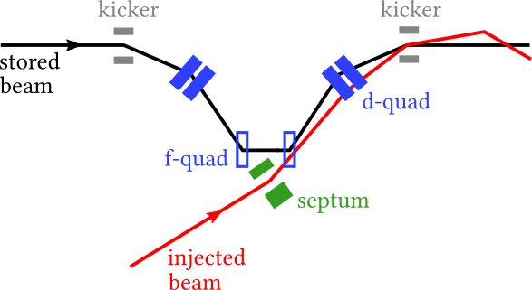
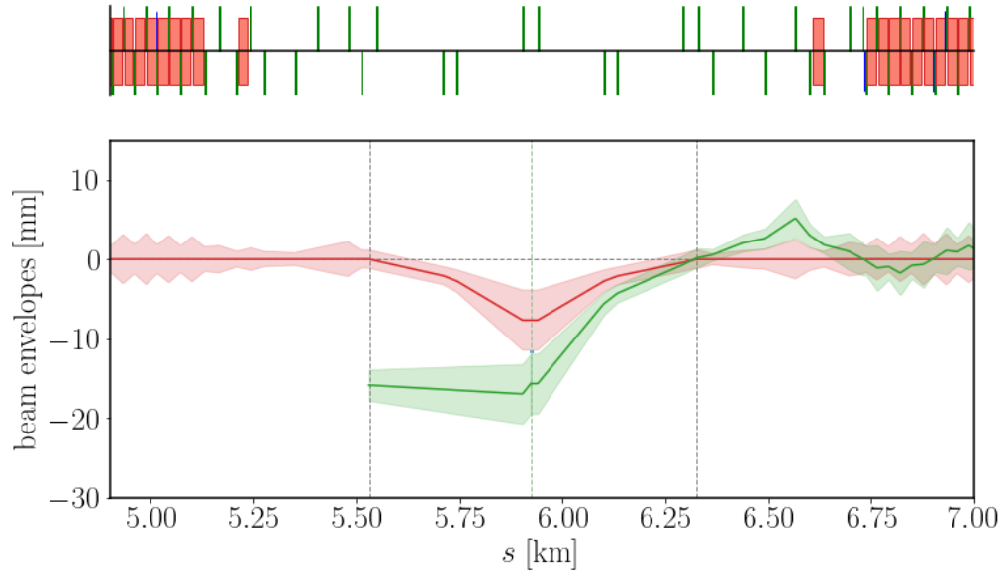
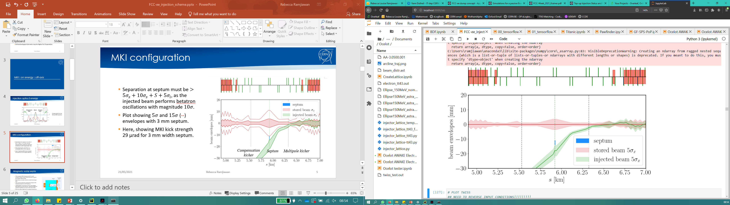
Conventional injection
Uses a dynamic orbit bump (dipole kickers) to bring the beam into the high-field region of the septum.
Requires a thin septum ($$∼200 μm$$) such as an electrostatic wire septum.
Machine protection: consider failure of the kicker and consequent impact on the wire septum, also consider beam deposition if the orbit bump is not correctly closed.
Kicker: feasible with current technology.
Septum: consider the rate of sparking in this atmosphere.
Kicker
Septum
Kicker

Slide 6
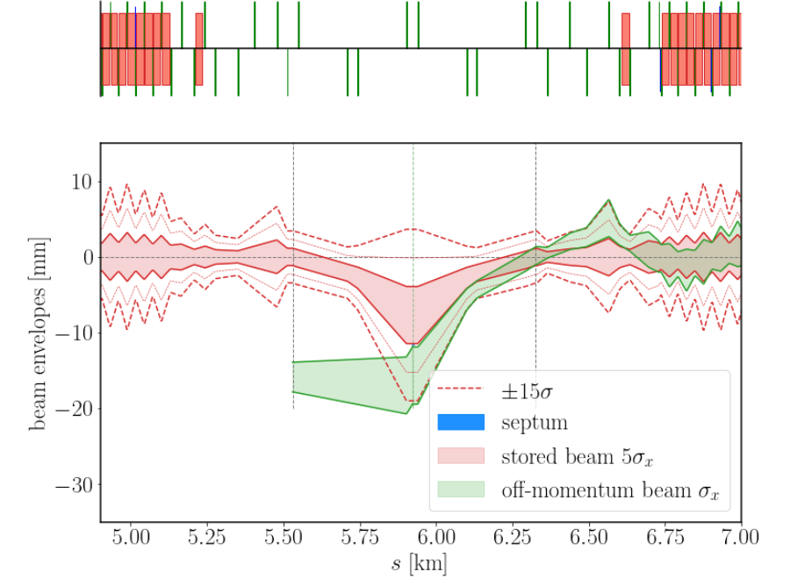
Conventional injection (off-axis)
Separation between the two beams at the septum of $$>5σ_{i}+S+5σ_{s}$$, and bump amplitude of $$10σ_{i}+S$$.
$$200 μm$$ septum-width means the beam-beam separation is $$∴10.3σ,$$as $$σ_{x}$$= 0.75 mm.
Kicker deflection: 12.5 µrad.
Septum deflection: 65 µrad, achievable with two 3 m modules with $$E=2\frac{MV}{m}$$.
Bump amplitude: 7.6 mm. Injected beam offset at septum: 15.7 mm.
Kicker
Septum
Kicker

Slide 7
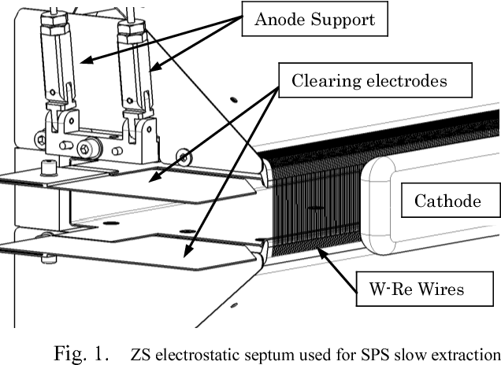
Electrostatic septum
Electrostatic septum with wires under tension separating the high-field and field-free regions. High-field between the wires and cathode.
Such a thin septum requires a dedicated positioning system for alignment.
“J. Borburgh (SY-ABT-SE) will start R&D in 2022 to look into the effect of X-rays on electrostatic septa sparking rates as a function of voltage
[2]
How often will it spark? Quantify SR hitting septum wires and the e-cloud around septum. Ions produced by ionising residual gas can cause breakdown as in the SPS ZS septa.
How damaging would sparking be? Damage to HV components, equipment and vacuum.
What to do in case of sparking? SPS has spark detection system [3].
How to minimise sparking? Lower voltage, ion trap, improve vacuum levels.

Slide 8
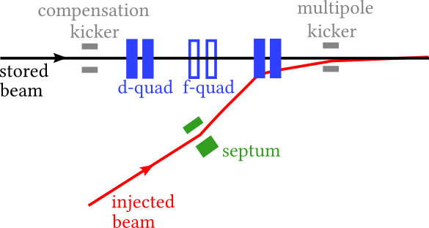
Multipole kicker injection
Multipole kicker has, ideally, zero field for the stored beam and constant field for the injected beam (i.e. step-function).
Compensation kicker to compensate the perturbation to the stored beam distribution.
Septum: a thicker magnetic eddy septum (blade e.g. 3 mm) or electrostatic septum.
Kicker: the order of disturbance goes with the order of the multipole kicker used. Here, we consider octupole fields.
Compensation kicker
Septum
Multipole kicker

Slide 9
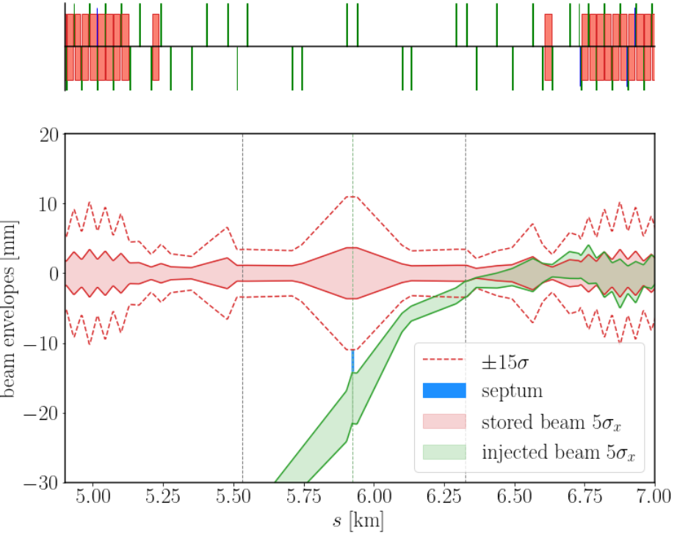
MKI (off-axis)
Separation of beams at septum $$>5σ_{s}+10σ_{s}+S+5σ_{i},$$to account for betatron oscillations of injected beam.
Tracking studies of the disturbance to the stored and injected beams to be presented by P. Hunchak (following talk).
MKI deflection: 29 µrad.
Septum deflection: 100 µrad; septum thickness: 3 mm.
Machine protection: absorbers for failure of kicker or septum. Less risk for stored beam than conventional injection.
Compensation kicker
Septum
Multipole kicker

Slide 10
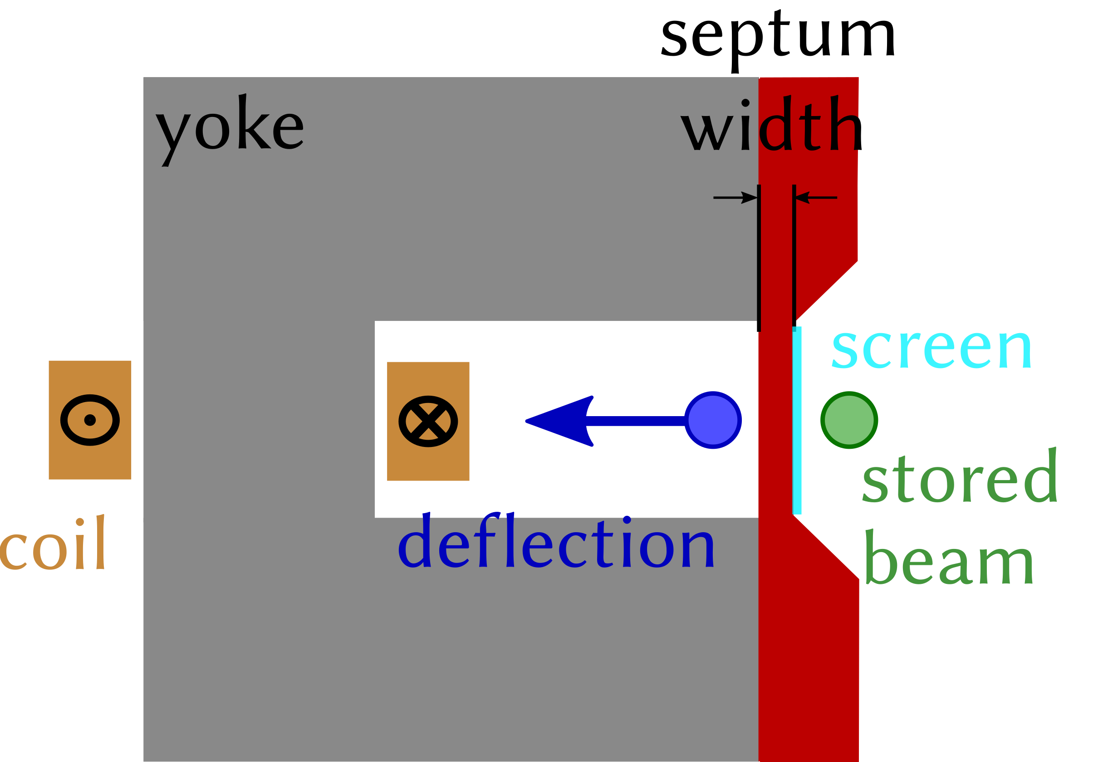
Magnetic eddy septa
If the magnetic field changes inside of a solid conductor, eddy currents will be induced to oppose the magnetic field change. These septa use the eddy currents to shield the leakage field.
Eddy current magnitude depends on the frequency of change of the magnetic field.
Leakage fields can be down to 0.01%, this may require mu-metal shielding.
The coil is typically single-turn, to minimise inductance.
eddy current septum
stored beam
septum thickness
$$θ$$
injected beam
deflecting field region

Slide 11
Magnetic eddy septum
Preliminary still under study
Parameter | Value
Deflection | 100 $$μrad$$
Field (Z, $$\overline{tt}$$) | 0.015/0.061 T
Max. current | 3 kA
Septum thickness | 3 mm
Gap height | 6 cm
Leakage field, do we need mu-metal shielding?
Gap width and deflecting field region required.
Powering: half-sine, full-sine. Pulse frequency, duration.
Is edge-cooling required?
Consider mechanical and thermal stresses.
Deflection angle: $$100 μrad$$
Magnetic field B: 0.061 T ($$t\overline{t}$$)
Max. current: 3 kA
$$θ_{B}\left[rad\right]≈\frac{0.2998×l\left[m\right]}{p\left[\frac{GeV}{c}\right]}B[T]$$
$$B[T]≈\frac{μ_{0}\left[\frac{H}{m}\right]NI[A]}{d[m]}$$
Design process
Septum thickness: 3 mm
Skin depth δ: 0.03 mm
Pulse frequency: $$f$$
$$δ≈0.1×d$$
δ∝1/f

Slide 12
Extraction from the collider ring

Slide 13
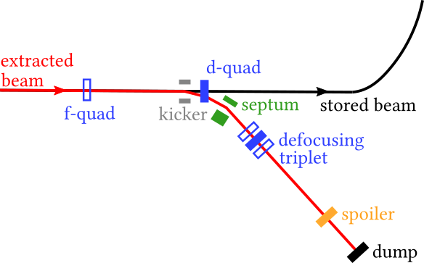
Extraction from the collider
Potential extraction configuration for the end of LSS
    Extraction with kicker and septum separated, ideally, with a defocusing quadrupole.
    At Z-pole, 20.6 MJ of stored energy/beam.
    Beam-dump-to-collider separation of 5-10 m for sufficient protection from radiation.
    Beam is defocused with the triplet, propagates for 100s of metres and passes through a spoiler to further dilute the beam.
    Alternatives considered: horizontal vs. vertical extraction, septum-less extraction, among other configurations.

Slide 14
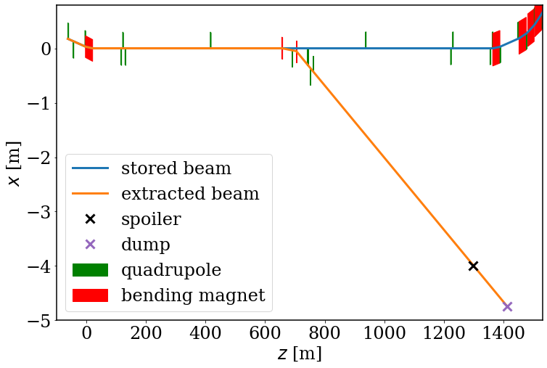
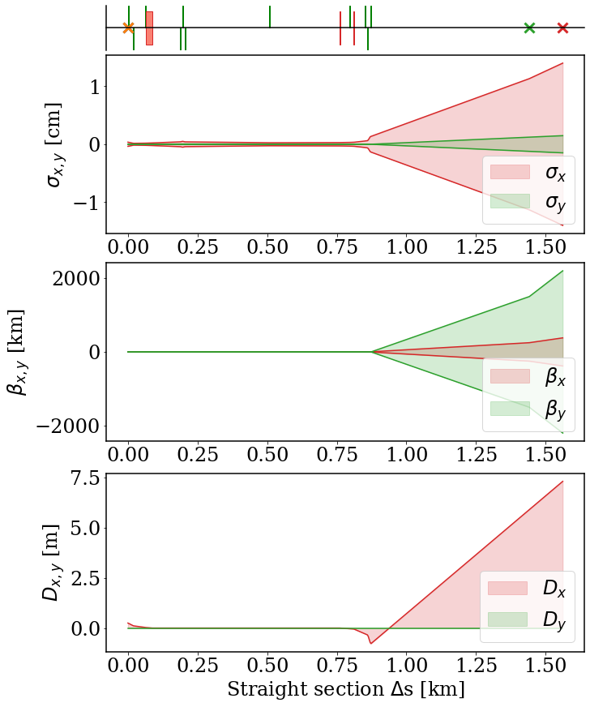
Horizontal extraction (Z-pole)
collider ring
Horizontal kicker and septum.
At spoiler $$σ_{x,y}= 11.3×1.2 mm$$.
Kicker deflection 1 mrad, septum deflection 5 mrad. Beam-beam separation at septum 5 cm.
kicker
septum
d-quad
triplet
kicker
spoiler
700 m
spoiler
dump

Slide 15
Kicker and septum
Kicker rise time 3 μs (within abort gap) and flat-top (to cover entire ring ~300 μs).
Kicker and septum parameters below are achievable with current technology (taking CDR beam params).
Machine protection
Without the defocusing triplet, the beam would damage the spoiler, $${1σ}_{x,y}=5 mm×0.03 mm$$.
As is the case for the LHC, we could implement current-change monitors to detect variations of order 10⁻³ in the triplet to trigger a beam dump.
For a $$±$$2% change in any of the quadrupoles in the triplet, the beam size could reduce to $$10.7×1.1 mm$$.
Magnet | Length [m] | Field | 1σ (x/y) [mm]
Kicker | 3 | 0.05 T | 0.29/0.023
Septum (DC) | 3 | 0.25 T | 0.35/0.023
Q1 | 3 | 4.2 Tm⁻¹ | 0.50/0.024
Q2 | 3 | -3.3 Tm⁻¹ | 0.14/0.038
Q3 | 3 | 4.2 Tm⁻¹ | 11.1/1.2
Preliminary still under study

Slide 16
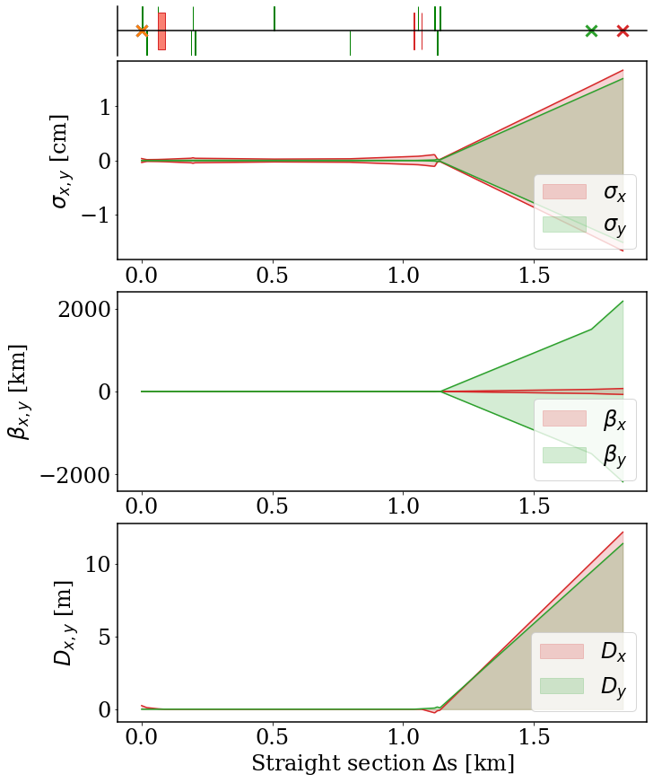
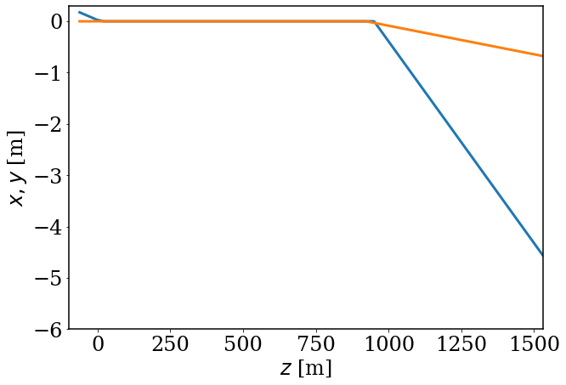
Vertical-kicker extraction
Kicker to extract vertically, septum to deflect horizontally.
Offers more flexibility for the placement of extraction, in terms of the availability of defocusing quadrupoles.
Vertical dispersion, from the kicker, also helps with increasing the vertical beam size at the spoiler.
x, y

Slide 17
Conclusions
Injection
We will consider four strategies for top-up injection, with studies so far focusing on off-axis injection. We will study conventional and multipole kicker injection, with both off-axis and on-axis injection.
SY-ABT will offer expertise for kicker and septum technologies.
Also, to be considered is how the booster-collider placement impacts the injection.
Extraction
Designs for the extraction line and extraction devices are progressing, in collaboration with A. Krainer for the beam requirements at the spoiler/dump.
We have shown a kicker-septum configuration for extracting the beam, with a defocusing triplet to blow up the beam before the spoiler. This satisfies the beam size requirements at the spoiler and requirements on the separation between the beam dump and collider ring.

Slide 18
Thank you for listening

Slide 19
Frequency of magnetic field change
The higher the magnetic field change rate is, the thinner the septum need be.
Typically powered by half or full sine wave current
Frequency of magnetic field change dependent on the septum thickness.
Skin depth for eddy currents typically between 10%-20% of the septum width [1],
𝛿=1𝜋𝑓𝜇0𝜇𝑟𝜎∝1𝑓
Where f is the magnetic field frequency [Hz], $$μ_{0,r}$$ are the vacuum [H/m] and relative permeabilities and σ is the material conductivity [S/m] [2].
Determine desired pulse frequency and duration.
E.g LINAC4 copper septum blade: 9 kHz; this corresponds to a skin-depth of ~0.7 mm

Slide 20
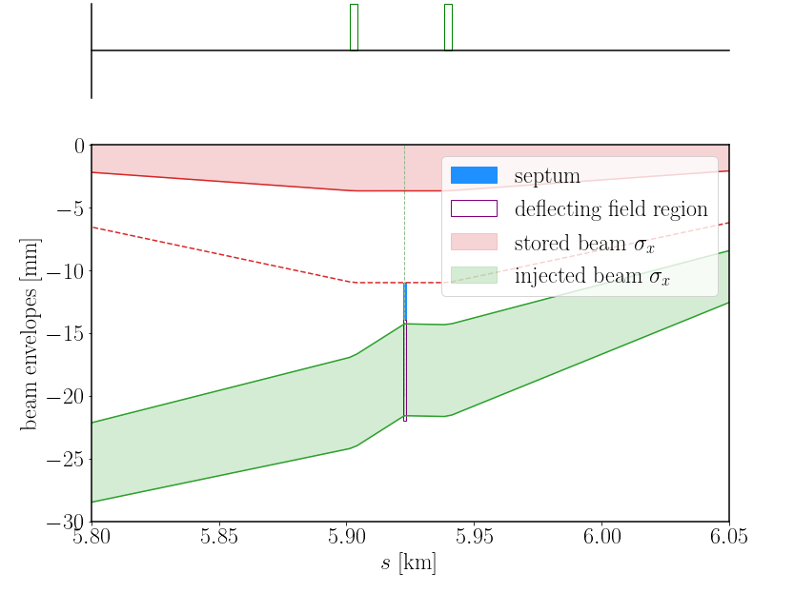
Gap width & deflecting field region
Must include beam envelopes and start and end of septum and beam trajectory from bending.
stored beam
$$t$$
$$θ$$
injected beam
$$w$$
deflecting field region
$$l$$
$$θ=$$ deflecting angle
$$w=$$ gap width
$$t=$$septum thickness
$$l=$$ septum length
> 8 mm
Gap width 10-30 mm is common for Eddy Septa.
[CAS 2018]

Slide 21
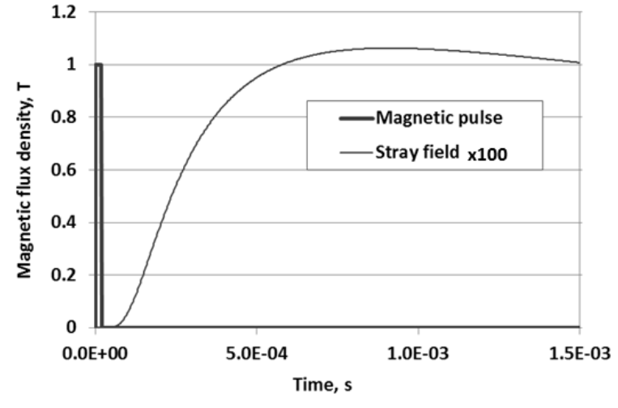
Leakage field
Example stray field time structure
Primarily low-frequency components that leak through. Need to study frequency components of the main field.
Maximum leakage field has delay, several times magnetic pulse length [4].
$$t_{delay}=\frac{1}{2}d_{s}^{2}σμ$$
𝐵max=𝐵022𝜏𝑑𝑠𝜎𝜇𝜆𝑐𝜋𝑒
$$d_{s}$$ = septum thickness, σ=conductivity, µ=permeability, $$B_{0}$$= amplitude of main field, $$τ$$=width of pulse, $$λ_{c}$$=characteristic length of stray field delay.
$$B_{max}$$
$$t_{delay}$$

Slide 22
Higher order considerations
Need to determine if there are any key parameters likely to be show-stoppers.
Pulsed power supply needs.
Additional magnetic shielding, e.g mu metal?, study saturation of the material. Shield thickness in addition to septum thickness.
Pole geometry to be designed to optimise field homogeneity.
Beam impedance.
Vacuum level.
Edge cooling may be needed.
Septum mechanical and thermal stress - pressure on the coil in the aperture.

Slide 23
Wire septa
$$θ_{E}\left[rad\right]≈\frac{E\left[V/m\right]l_{eff}\left[m\right]}{{10}^{9}βp\left[\frac{GeV}{c}\right]}→\frac{E\left[V/m\right]l_{eff}\left[m\right]}{{182.5×10}^{9}}$$
In the CDR, wire septum deflection over two modules, each of length 3 m:
  65$$\left[μrad\right]≈\frac{E\left[\frac{MV}{m}\right](2∗3)\left[m\right]}{{10}^{9}β×182.5\left[\frac{GeV}{c}\right]}$$, so that $$E=2\frac{MV}{m}$$
Comment on kicker from [Aiba, et al., 2018. NIM A, 880, pp.98-106.]:
  The required bump height is 6.6 mm achieved with a deflection angle of 21𝜇rad. The corresponding integrated field of the kicker is then ∼0.012 Tm for 175GeV beam, which is feasible using conventional kicker technology (for example, magnetic length of 0.4 m and field of 0.03 T).

