Slide 1
Injection Tracking Studies in the FCC-ee Collider ring
Dec. 7th, 2021 – 2021 FCCIS WP2 Workshop
Patrick Hunchak
M. Aiba, W. Bartmann, M. Boland, Y. Dutheil, M. Hofer, P. Hunchak, R. Ramjiawan, F. Zimmermann and others.

Slide 2

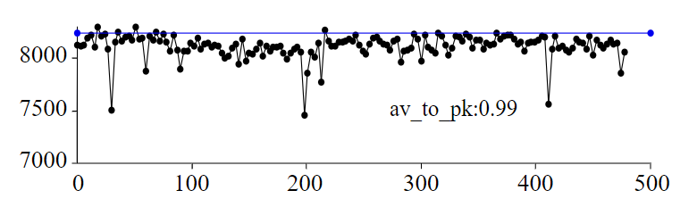
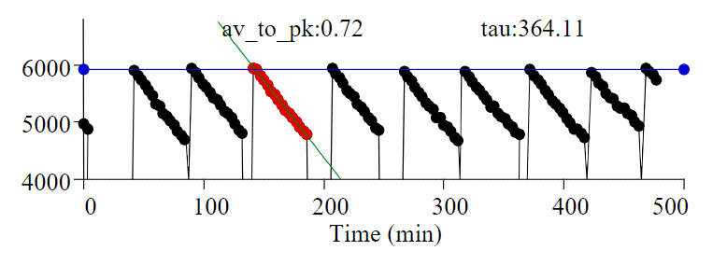
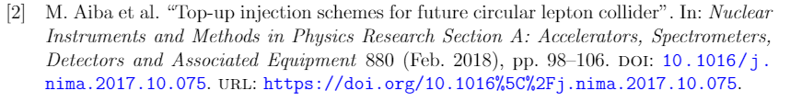
Top-up Injection for FCC-ee
Top-up injection is necessary to maximize the integrated luminosity of the collider.
Regular injection from the full-energy booster to maintain the beam current in the collider ring.
Proven at many other accelerators.
Four viable modes have been identified for FCC-ee in the past, we now look into follow-up studies of these approaches.
Wienands, U. “Lepton Collider Operation with Constant Currents”. Proceedings of the 2005 Particle Accelerator Conference. doi:10.1109/pac.2005.1590385

Slide 3
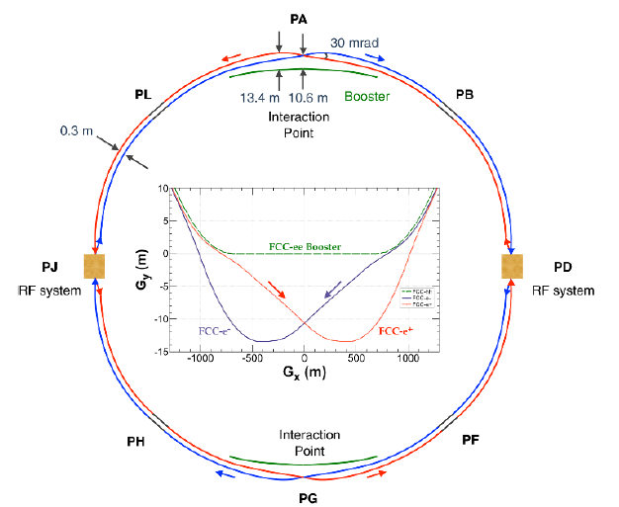
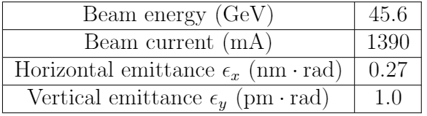


The FCC-ee Ring
Injection at Point PB
Four operation modes ( Z, WW, ZH, & $t\overline{t}$ ) ranging in beam energy from 45.6 to 182.5 GeV.
Z-mode examined first for machine protection aspect (high stored beam energy).
Z-mode operation Parameters
Layout has been updated. Shorter Circumference, longer injection straight.

Slide 4
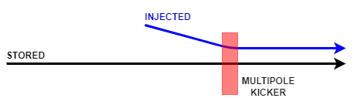
Injection Options
Multipole Kicker Injection (MKI)
Off-axis injected beam
Kicker has minimal on-axis field (stored beam)
Kicker has significant off-axis field (injected beam)
Conventional Orbit Bump Injection
Dipole kickers create a one turn orbit bump
Reducing the effective amplitude of off-axis injected beam
Bump is closed quickly to avoid septum on subsequent turns.
Both modes also work off-momentum, with dispersion allowing on-axis injection.
For all cases we’ve chosen to look into the horizontal plane.

Slide 5
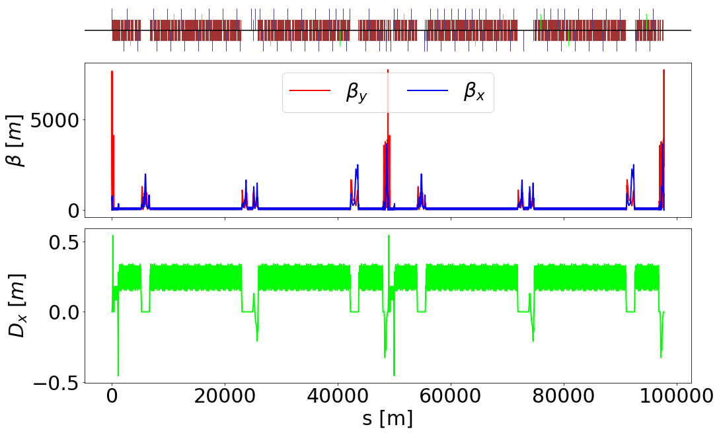
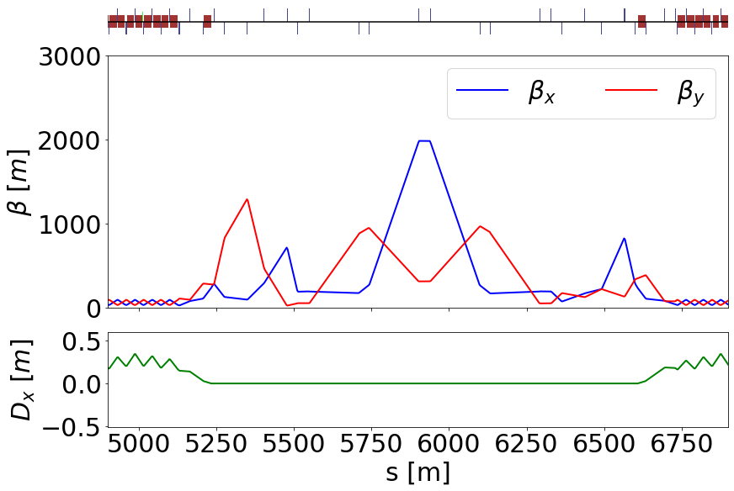
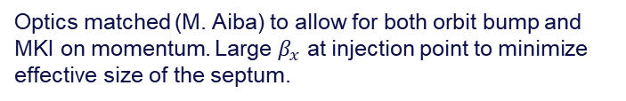
Machine Parameters
Z Optics Full Machine
PB Injection Section
Optics matched (M. Aiba) to allow for both orbit bump and MKI on momentum. Large $β_{x}$ at injection point to minimize effective size of the septum.

Slide 6
Multipole Kicker Injection
On-momentum

Slide 7
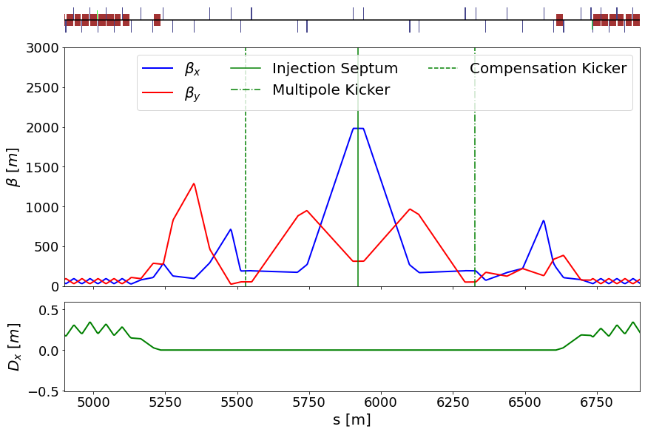
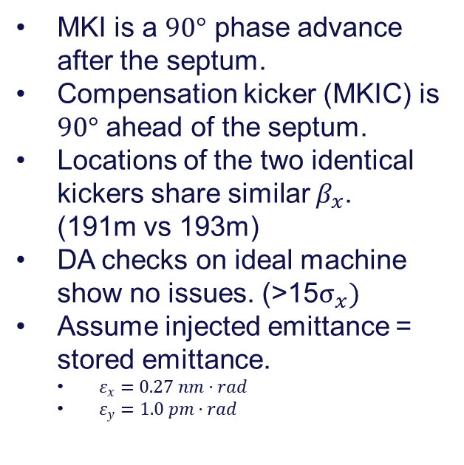
Placement of Injection Magnets
MKI is a $90°$ phase advance after the septum.
Compensation kicker (MKIC) is $90°$ ahead of the septum.
Locations of the two identical kickers share similar $β_{x}$. (191m vs 193m)
DA checks on ideal machine show no issues. (>15$σ_{x})$
Assume injected emittance = stored emittance.
  $ε_{x}=0.27 nm·rad$
  $ε_{y}=1.0 pm·rad$

Slide 8
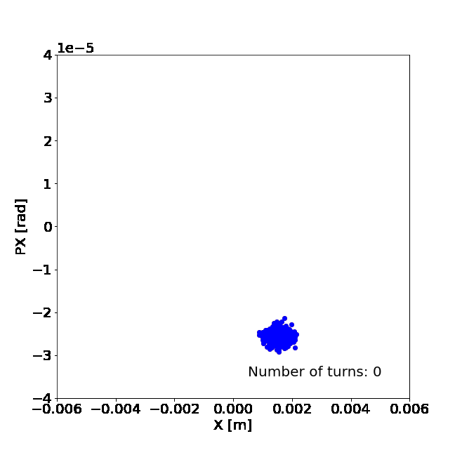
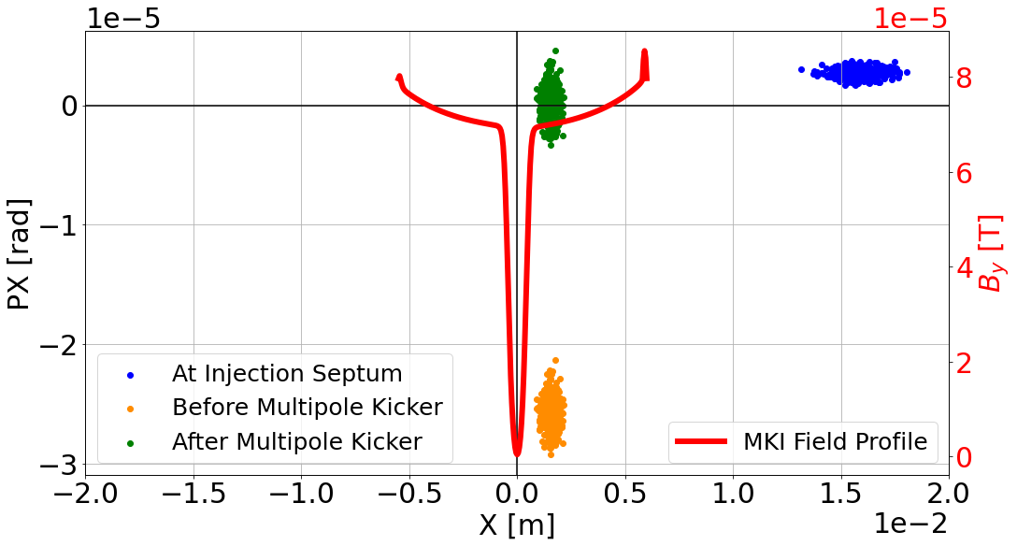
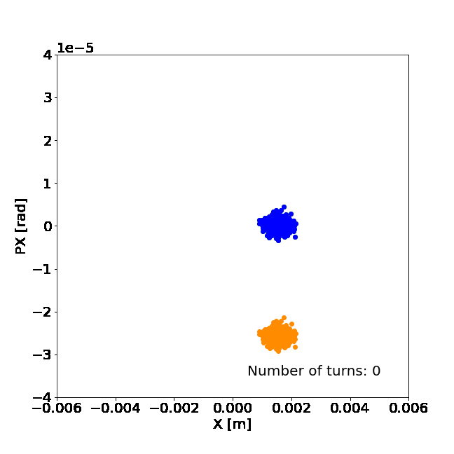
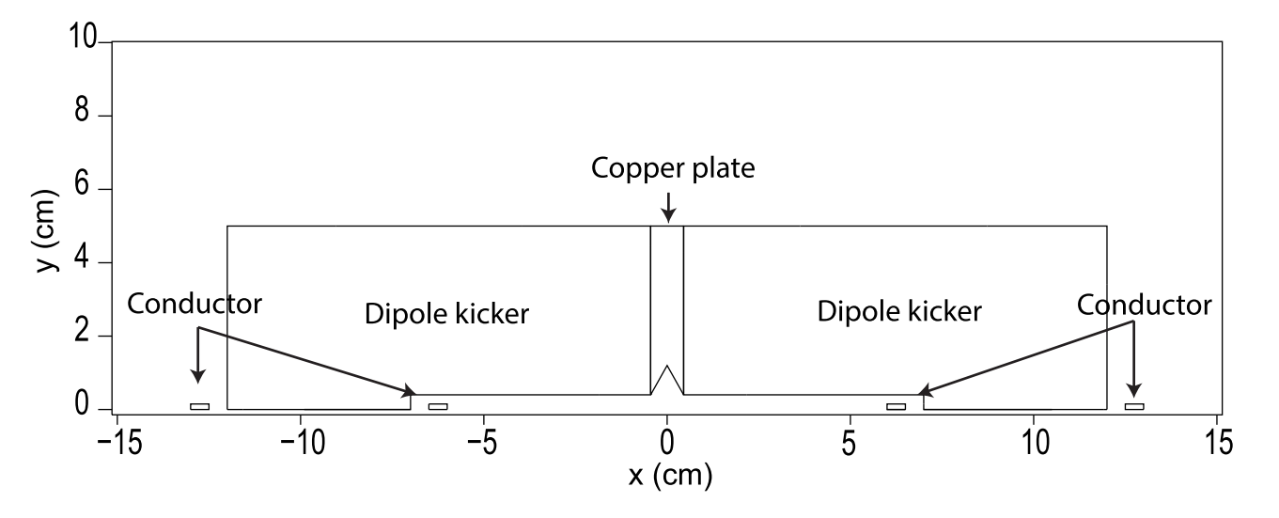
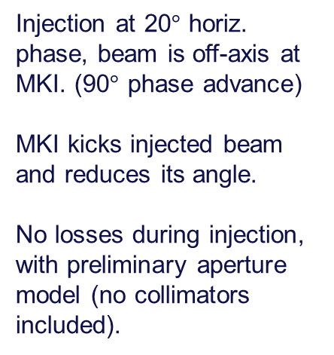
Simulating Injection
Injection at 20$°$ horiz. phase, beam is off-axis at MKI. (90$°$ phase advance)
MKI kicks injected beam and reduces its angle.
No losses during injection, with preliminary aperture model (no collimators included).
MKI Design

Slide 9
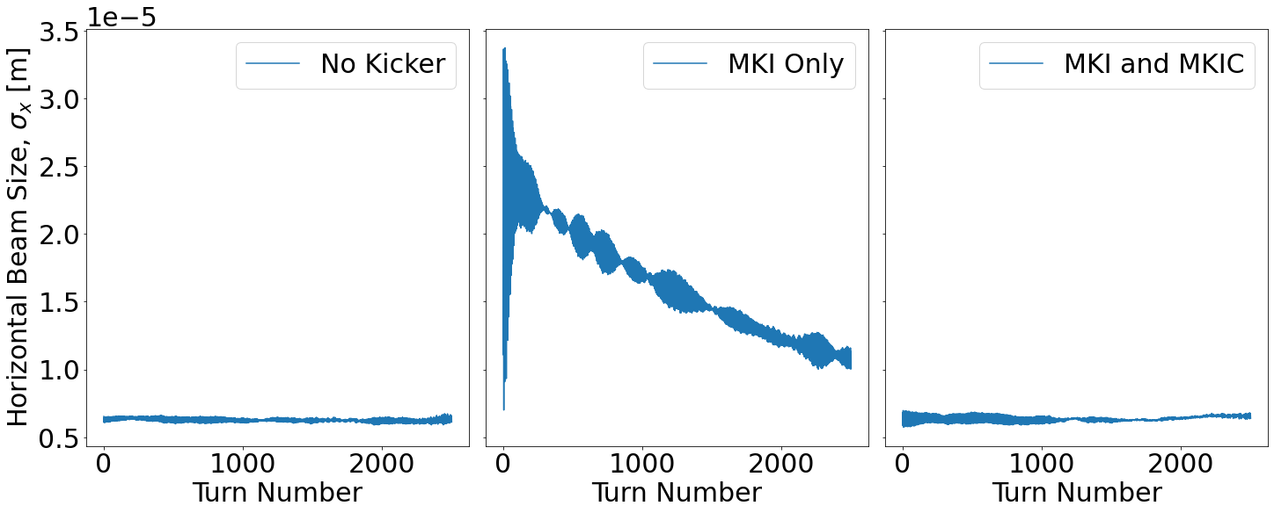
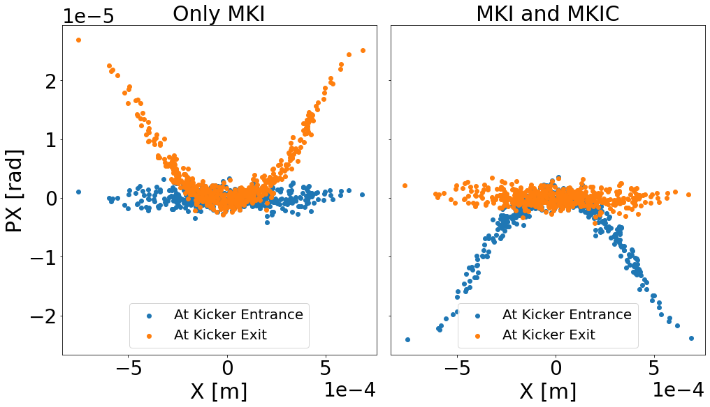
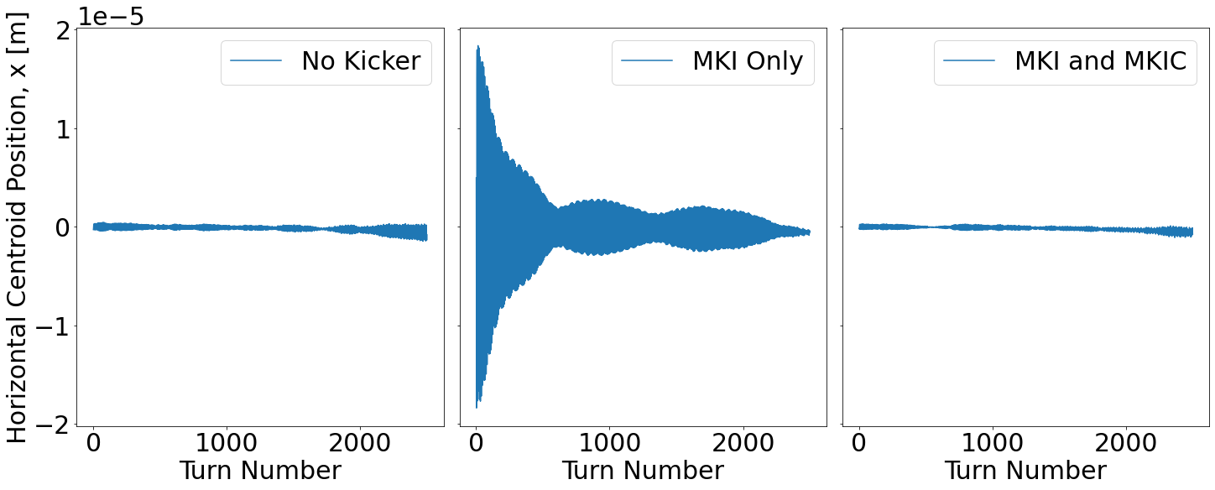
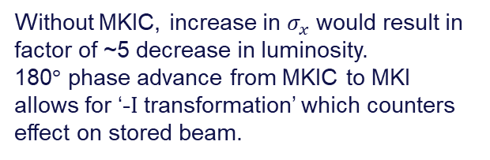
Injection Effect on Stored Beam at Interaction Point
Stored beam at IP
Without MKIC, increase in $σ_{x}$ would result in factor of ~5 decrease in luminosity.
180$°$ phase advance from MKIC to MKI allows for ‘-I transformation’ which counters effect on stored beam.
Stored beam at MKI location

Slide 10
Injection Effect on Stored Beam at Interaction Point
Stored beam at IP
Without MKIC, increase in $σ_{x}$ would result in factor of ~5 decrease in luminosity.
180$°$ phase advance from MKIC to MKI allows for ‘-I transformation’ which counters effect on stored beam.
Stored beam at MKI location

Slide 11
Conventional Orbit Bump
On-momentum

Slide 12
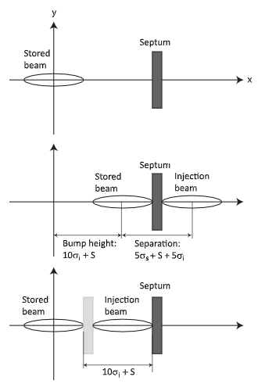
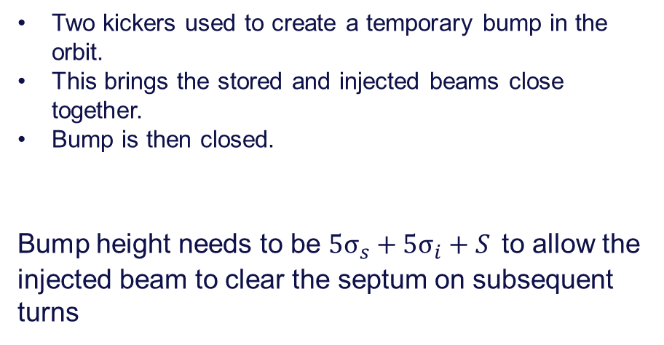
Conventional Orbit Bump
Two kickers used to create a temporary bump in the orbit.
This brings the stored and injected beams close together.
Bump is then closed.
Bump height needs to be ${5σ}_{s}+5σ_{i}+S$ to allow the injected beam to clear the septum on subsequent turns

Slide 13
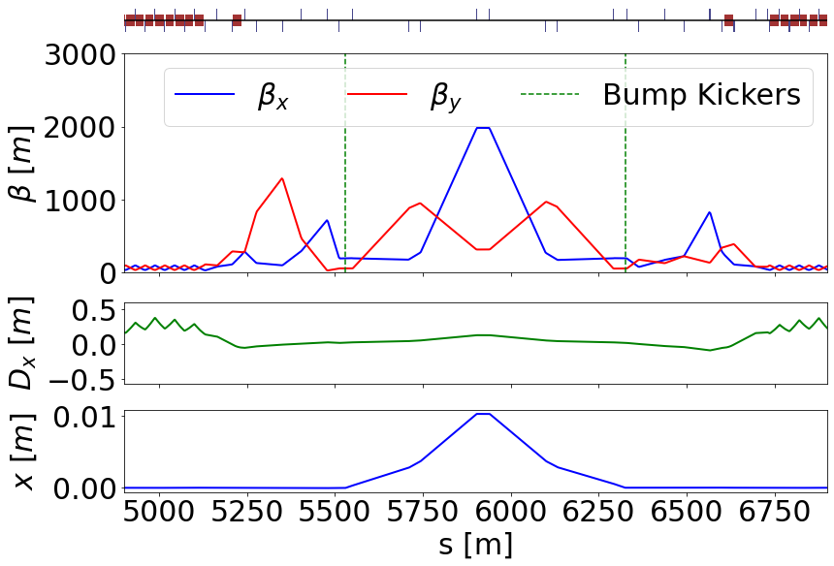
Injection Straight Optics - Bump Kickers Active
In both cases (MKI/Bump), the next step is error studies to see what closed orbit distortions we get and what injection efficiencies are achieved.

Slide 14
Optics Compatible with
Off-Momentum Injection

Slide 15
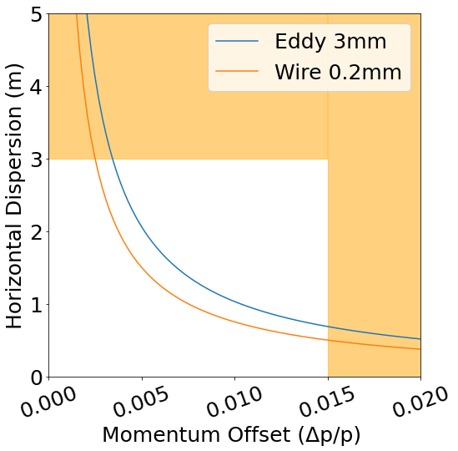
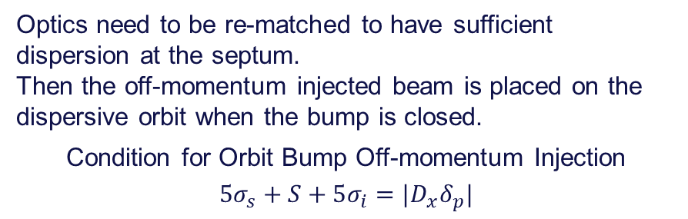
Matching Constraints
Optics need to be re-matched to have sufficient dispersion at the septum.
Then the off-momentum injected beam is placed on the dispersive orbit when the bump is closed.
Condition for Orbit Bump Off-momentum Injection
$$5σ_{s}+S+5σ_{i}=|D_{x}δ_{p}|$$

Slide 16
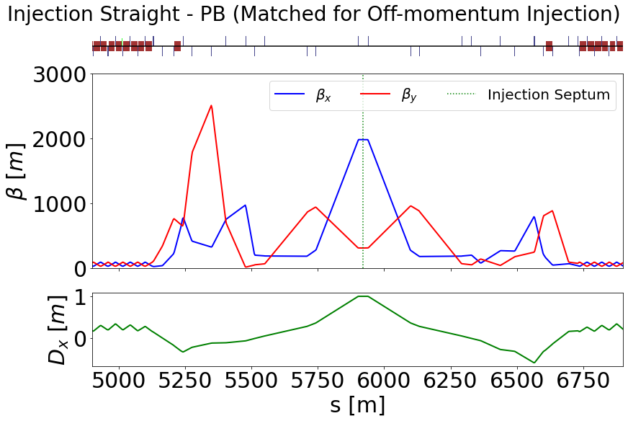
Key Matching Constraints
Dispersion at
septum = 1m
Phase advance over straight is maintained
Off-momentum DA under investigation.
Then follow up with studies using misalignments.

Slide 17
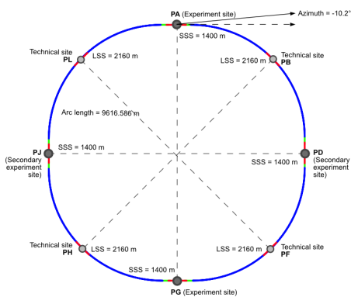
Outlook
Studied top-up injection approaches for Z operation mode
To be studied to determine injection efficiency:
  Injection with misalignments and corrections
  Other operation modes
  Beam-beam effects
Studies performed on old 2 IP lattice
  New layout with longer straight sections
  Complication arises in 4 IP
    Beam crossing
    Possibly combined with extraction
J. Gutleber - 144th FCC-ee Optics Design Meeting & 15th FCCIS WP2.2 Meeting
Injection
~1 km
2.1 km

Slide 18




Dec. 7th, 2021 – 2021 FCCIS WP2 Workshop
Patrick Hunchak
18
Thank you
for your attention
Gitlab Repository of Project Work:
https://gitlab.cern.ch/phunchak/fccee-injection-studies

Slide 19
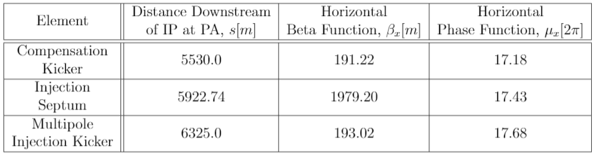
Placement of kickers
FCCee_z_216_nosol_1.seq

Slide 20
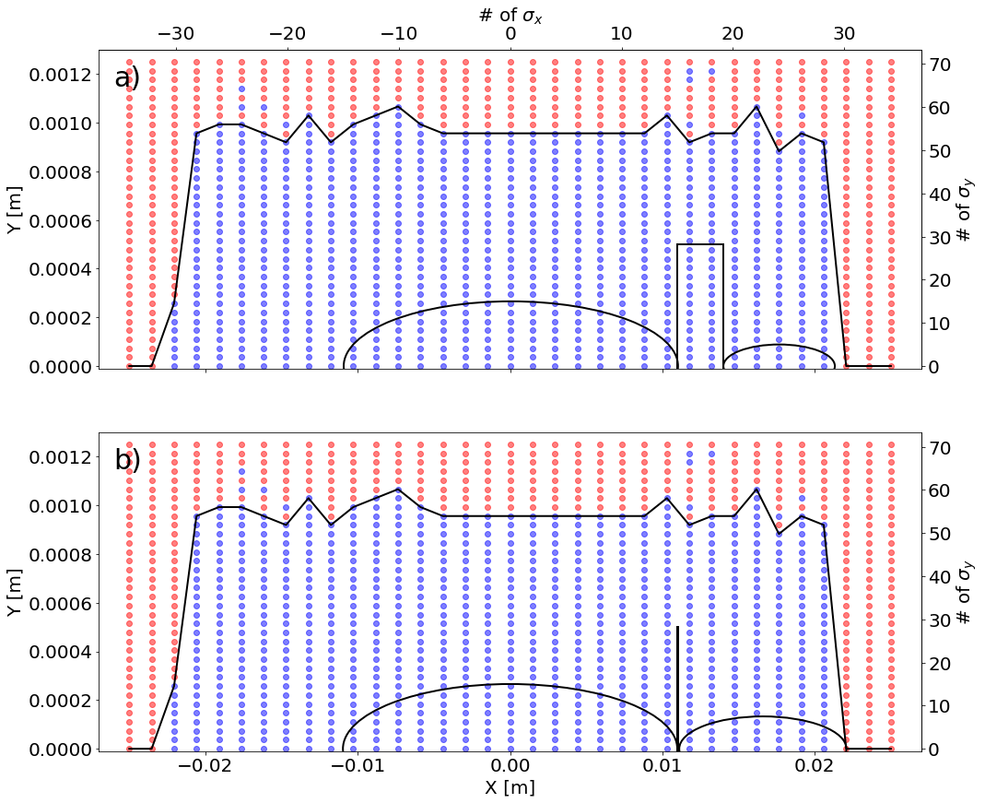
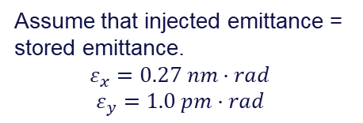
Dynamic Aperture
Assume that injected emittance = stored emittance.
$$ε_{x}=0.27 nm·rad$$
$$ε_{y}=1.0 pm·rad$$
3 mm eddy current septum
0.1 mm electro-static wire septum
The thinner septum reduces dynamic aperture req. but not previously used.*
Our simulations show plenty of DA for either septum.
* M. Aiba “Top-up Injection Status and Next Steps” FCC Week 2021 https://indico.cern.ch/event/995850/contributions/4419415/attachments/2271652/3858072/FCC-ee_Injection_aiba.pdf

Slide 21
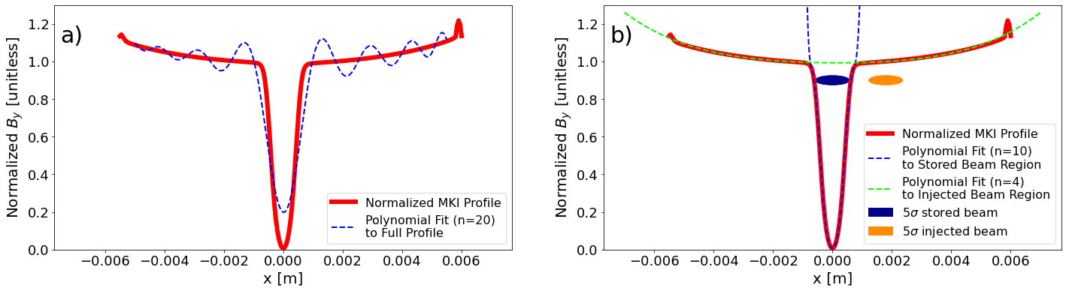
Modelling the Multipole Kicker
MKI has zero on-axis field to minimize disturbance of stored beam, large off-axis field to kick the injected beam.
MAD-X does not currently support arbitrary field elements.
Maximum of 20th order polynomial not a good fit.
Split into two fits, for interaction with stored/injected beam.

Slide 22
Colors
Backgrounds
Background Blue
Background Purple
Background Yellow
Background Grey
Use for Layout
Radiant Blue
Flash
Energy
Green
Red
Deep
Blue

Slide 23
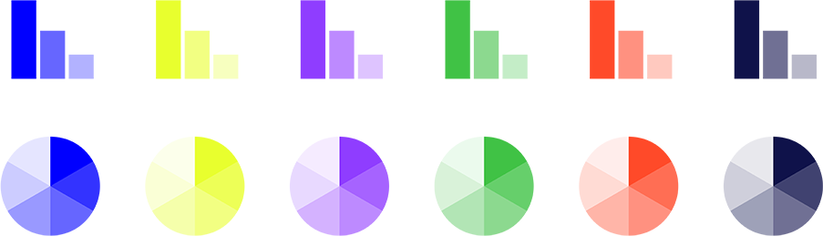
Graphical Elements
Badges
This information is a badge because it is important!
This information is a badge because it is important!
Separation lines 1.5 pt
Arrows
Use blue badges on light backgrounds
Infographics
This information is a badge because it is important!
This information is a badge because it is important!
Use light badges on dark backgrounds

