Slide 1


Slide 2

the FCC-ee Beam DumpING System
Alexander Krainer
Contributors:
Marco Calviani, Antonio Perillo-Marcone, Anton Lechner, Wolfgang Bartmann, Yann Dutheil, Rebecca Ramjiawan
 | FCCIS – The Future Circular Collider Innovation Study. This INFRADEV Research and Innovation Action project receives funding from the European Union’s H2020 Framework Programme under grant agreement no. 951754.

Slide 3
Table of contents
Recap of the proposed semi-passive beam dumping system
The HiRadMat experiment HRMT56-HED
Current Status
Next steps and open questions

Slide 4
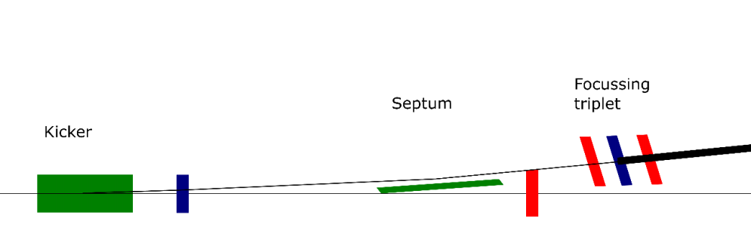
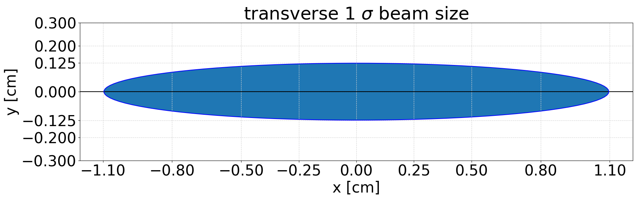
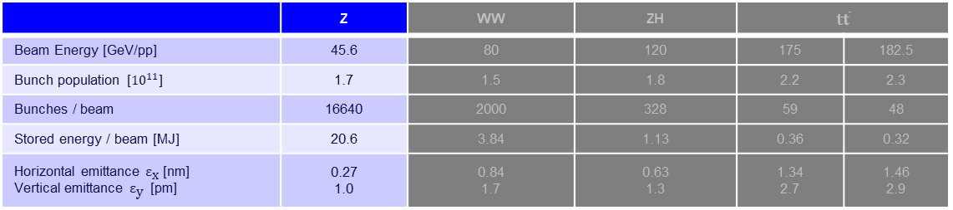
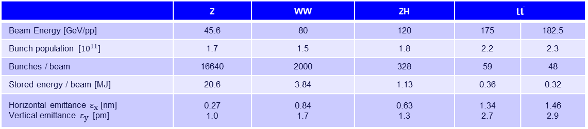
Challenges concerning the FCC-ee beam
 | Z | WW | ZH | t$\overline{t}$
Beam Energy [GeV/pp] | 45.6 | 80 | 120 | 175 | 182.5
Bunch population [${10}^{11}$] | 1.7 | 1.5 | 1.8 | 2.2 | 2.3
Bunches / beam | 16640 | 2000 | 328 | 59 | 48
Stored energy / beam [MJ] | 20.6 | 3.84 | 1.13 | 0.36 | 0.32
Horizontal emittance ${\text{ε}}_{\text{x}}$ [nm] Vertical emittance ${\text{ε}}_{\text{y}}$ [pm] | 0.27 1.0 | 0.84 1.7 | 0.63 1.3 | 1.34 2.7 | 1.46 2.9
Z, New Layout (4 IPs)
45
2.76
8800
17.5
0.71 1.42
LEP | SuperKEKB
50 | 7
8.3 | 0.653
18 | 2500
0.12 | 0.18
 | 4.6 11.5
 | Z | WW | ZH | t$\overline{t}$
Beam Energy [GeV/pp] | 45.6 | 80 | 120 | 175 | 182.5
Bunch population [${10}^{11}$] | 1.7 | 1.5 | 1.8 | 2.2 | 2.3
Bunches / beam | 16640 | 2000 | 328 | 59 | 48
Stored energy / beam [MJ] | 20.6 | 3.84 | 1.13 | 0.36 | 0.32
Horizontal emittance ${\text{ε}}_{\text{x}}$ [nm] Vertical emittance ${\text{ε}}_{\text{y}}$ [pm] | 0.27 1.0 | 0.84 1.7 | 0.63 1.3 | 1.34 2.7 | 1.46 2.9
Defocusing
triplet

Slide 5
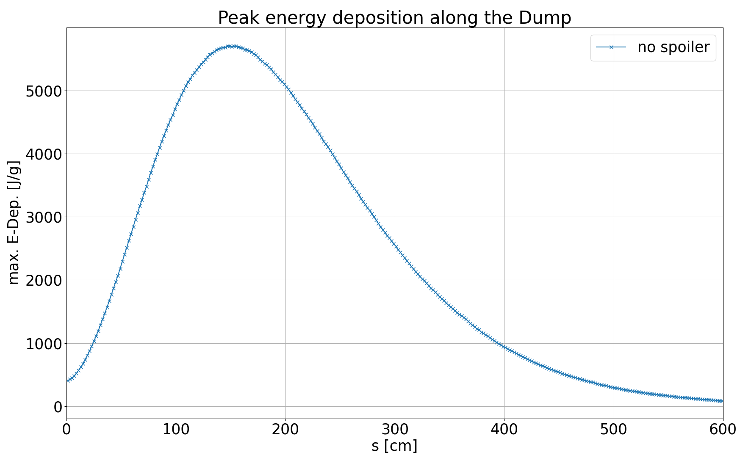
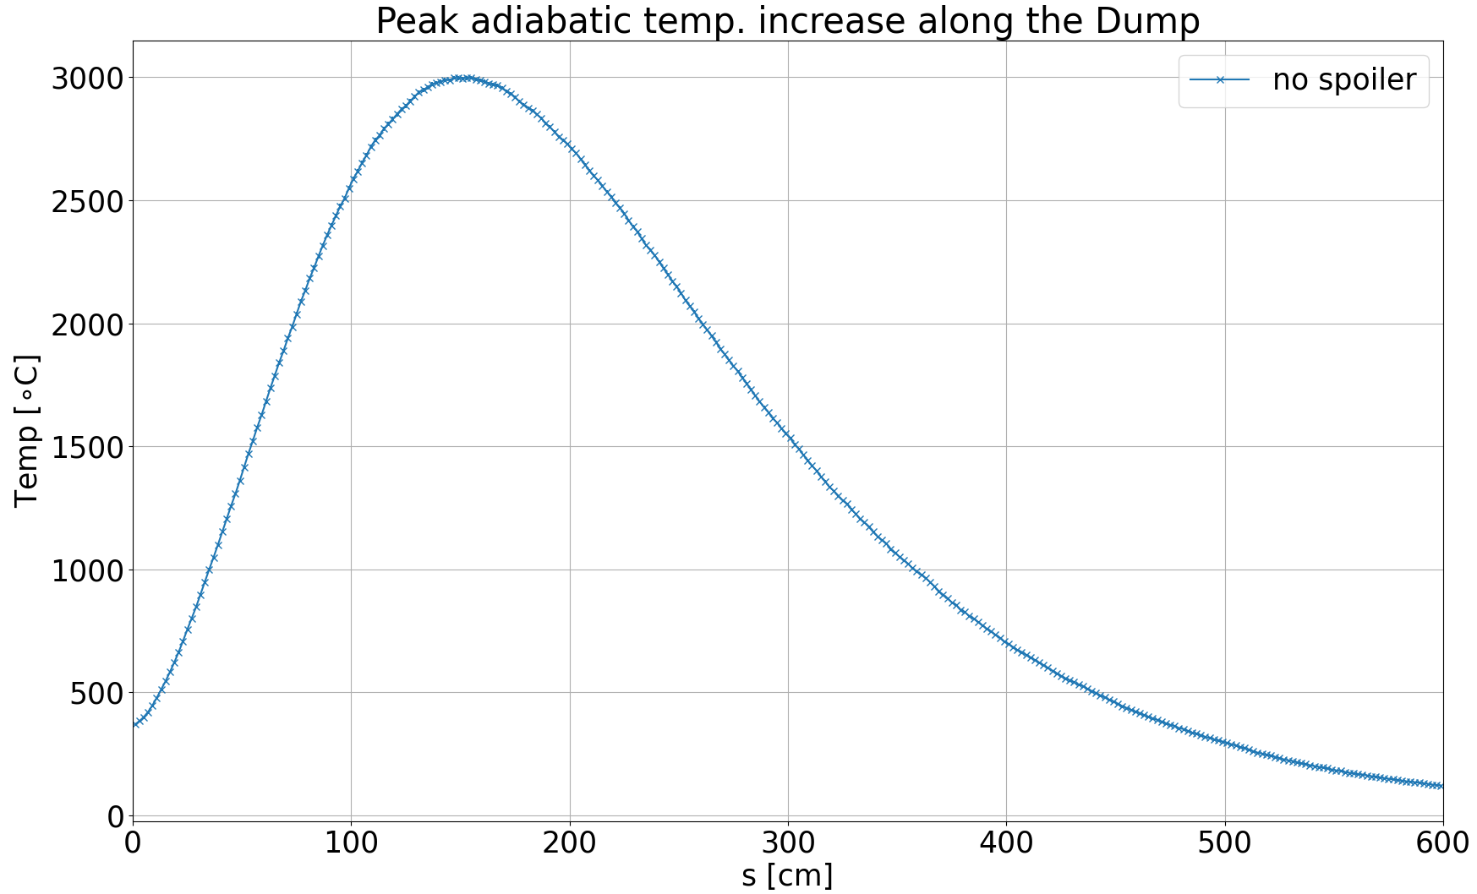
Peak Energy Deposition, with triplet, no dilution
assuming a 6 m long 1.0 g/cm³ graphite block

Slide 6
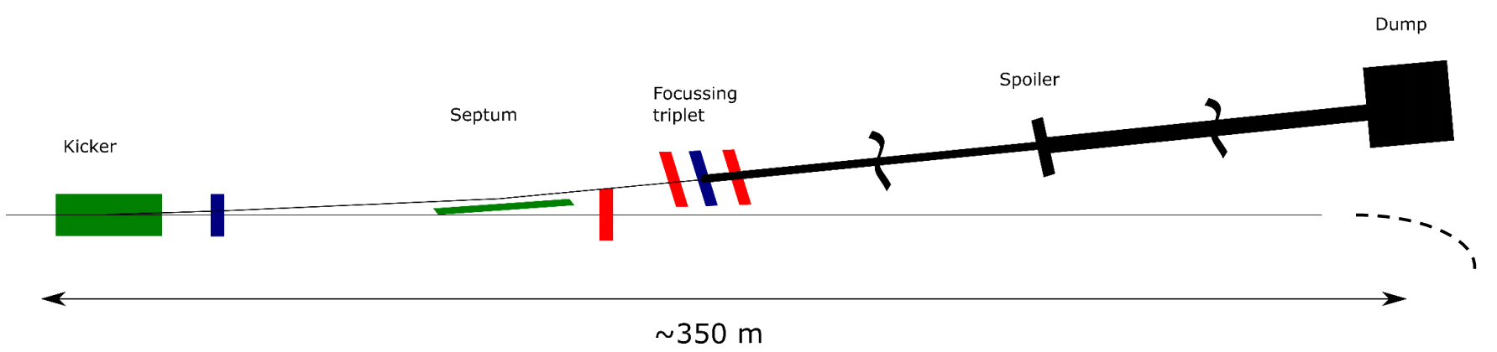
Passive Beam Diluter Concept
Dilution of the beam by multiple coulomb scattering and Bremsstrahlung energy losses
Bremsstrahlung-induced shower build-up contributes to the energy deposition in the Spoiler.
Defocusing
triplet
~350 – 700 m

Slide 7
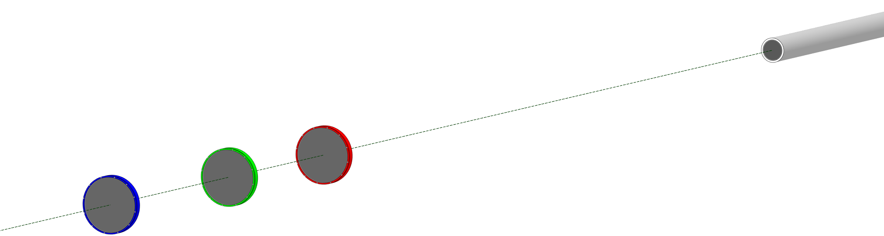
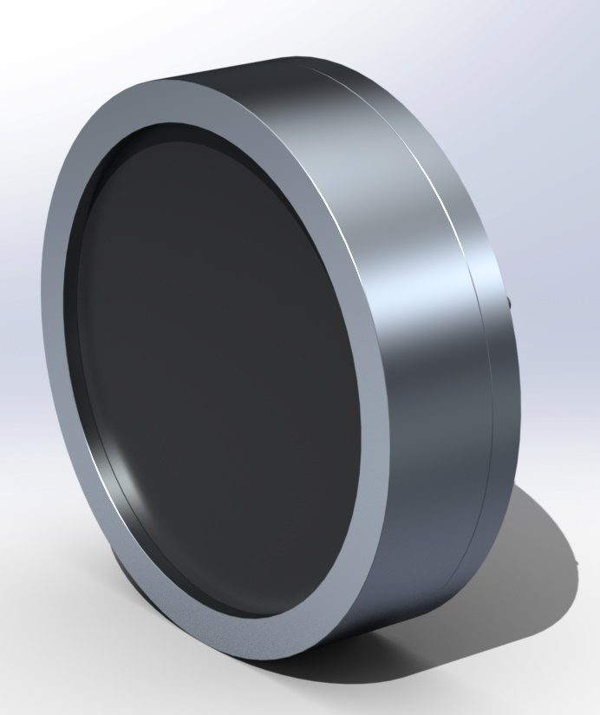
A semi-passive beam dumping system
Multiple spoilers to decrease the peak load
3.0 m
5.5 m
70 m
High density (1.7-1.8 g/cm³) graphite
3 cm thick
30 cm diameter
    Corresponding to ~15 σ horizontally
Aluminium support

Slide 8
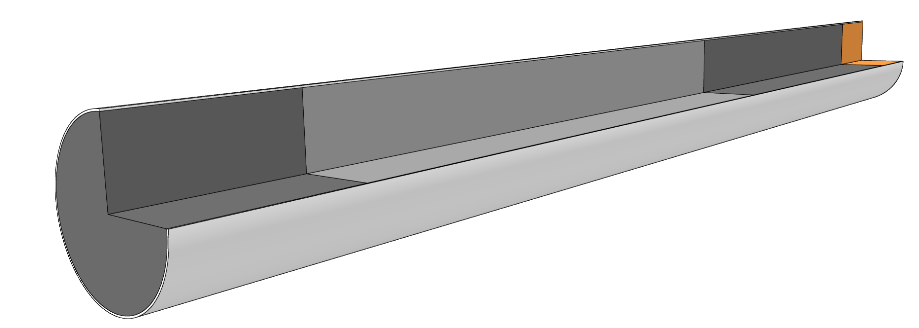
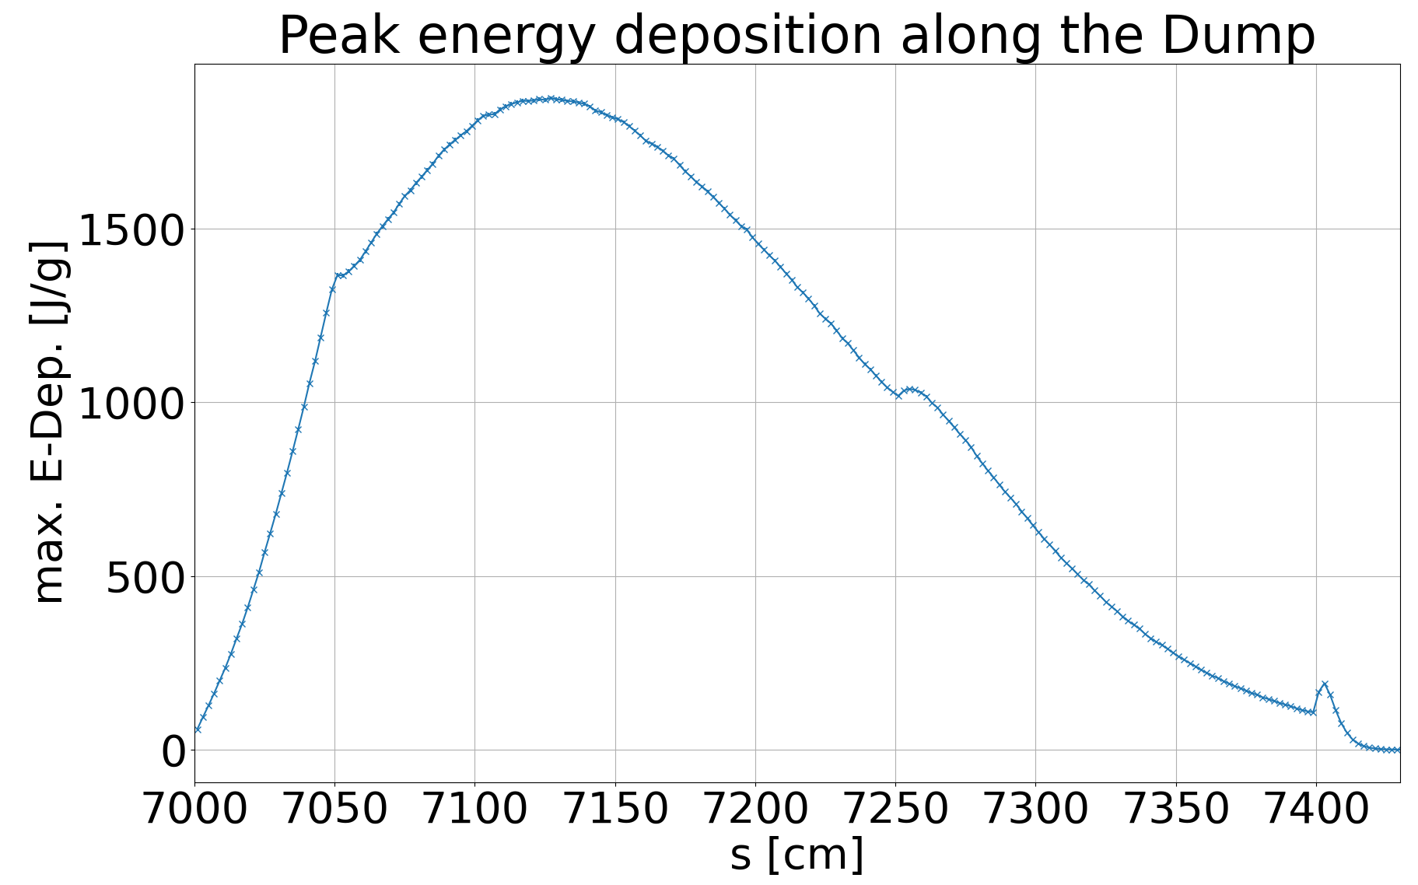
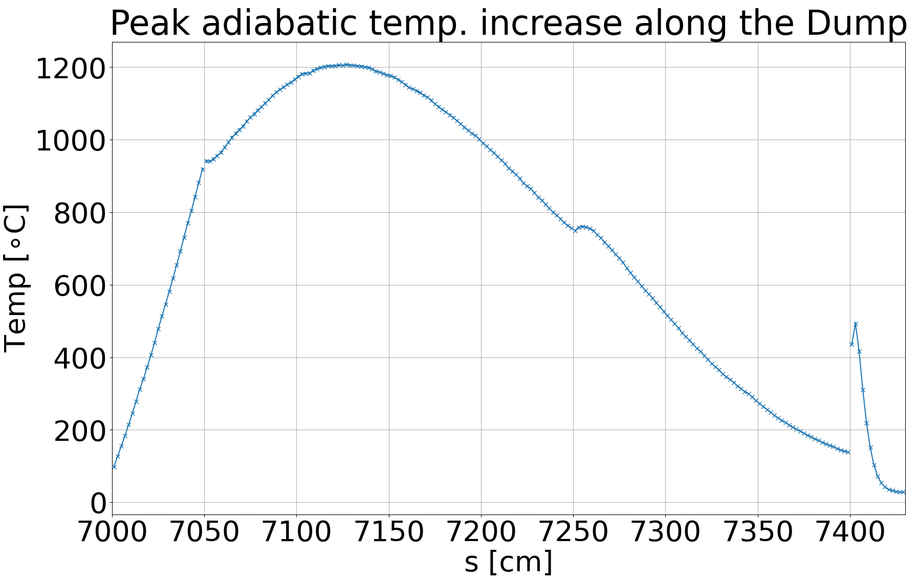
The FCC-ee Beam Dump Core
Similar approach as the current LHC Dump
Multiple sections with different densities for the Dump core
Design and material choice to be optimized
following the findings of the HiRadMat High Energy Dumps Experiment
High density absorber
Low density
Graphite (1.1 g/cm3)
High density
Graphite (1.8 g/cm3)
High density
Graphite (1.8 g/cm3)
with triplet and 3 spoilers

Slide 9
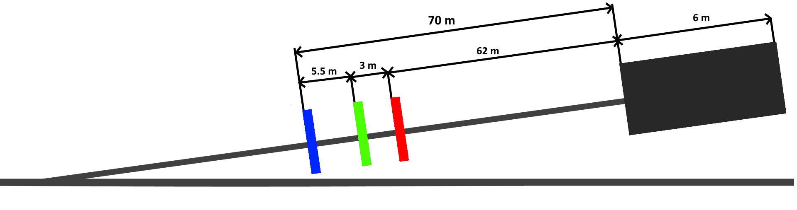
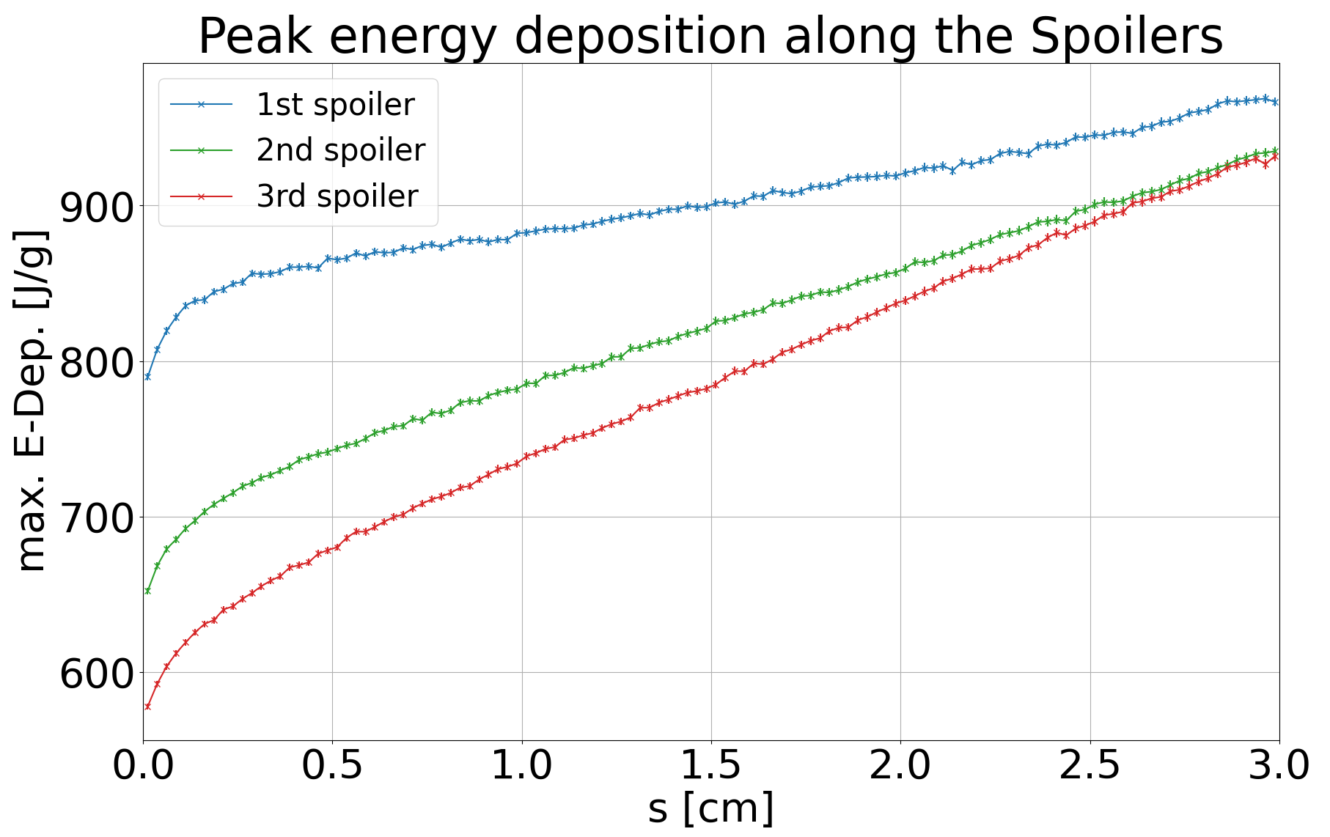
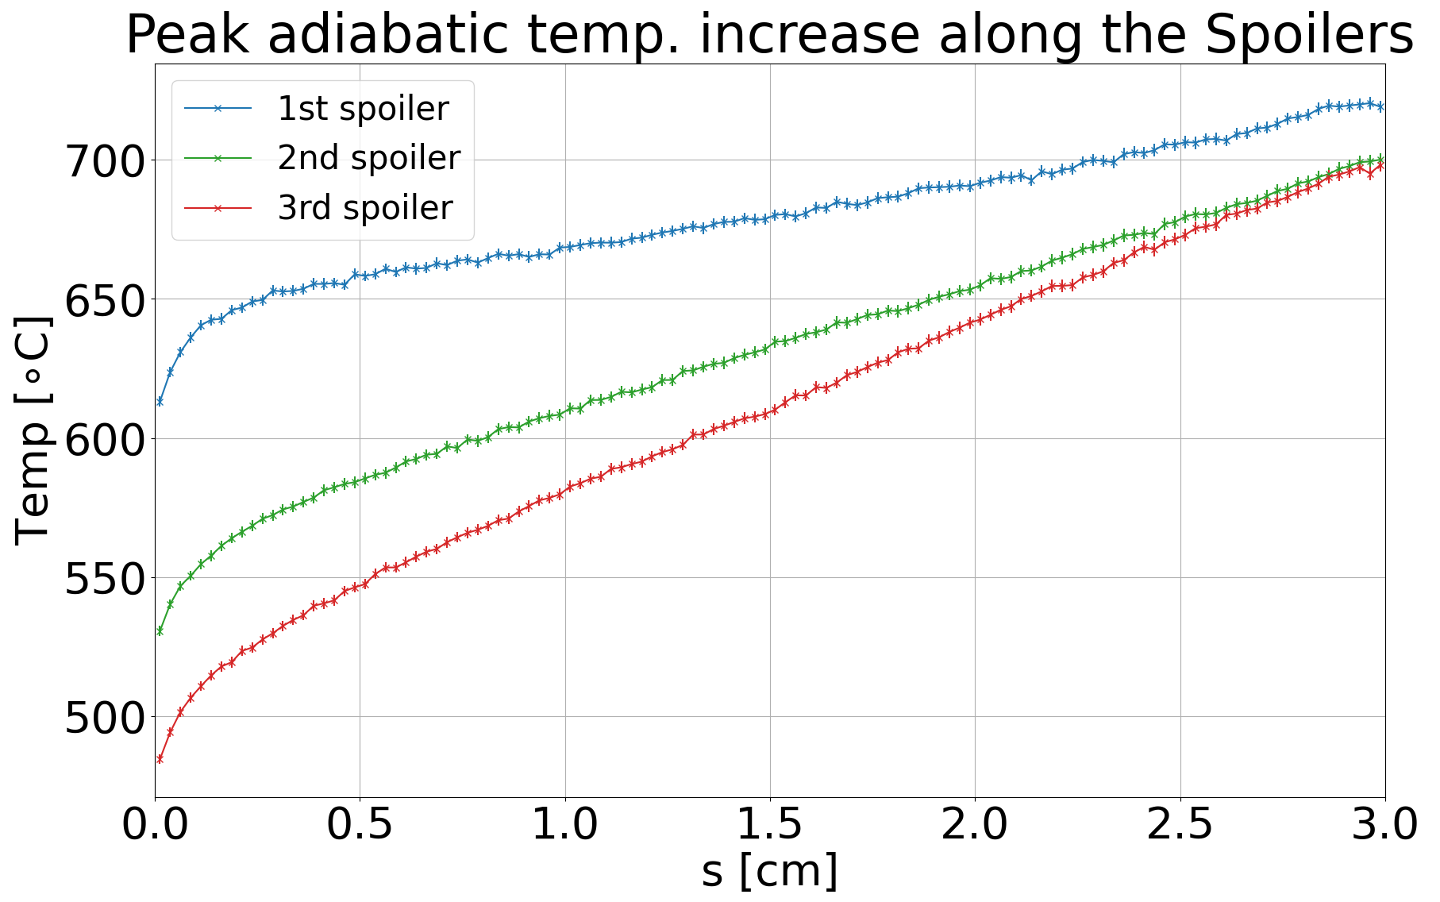
Peak energy deposition on the Spoiler
Spoiler spacing to reach similar peak energy deposition

Slide 10
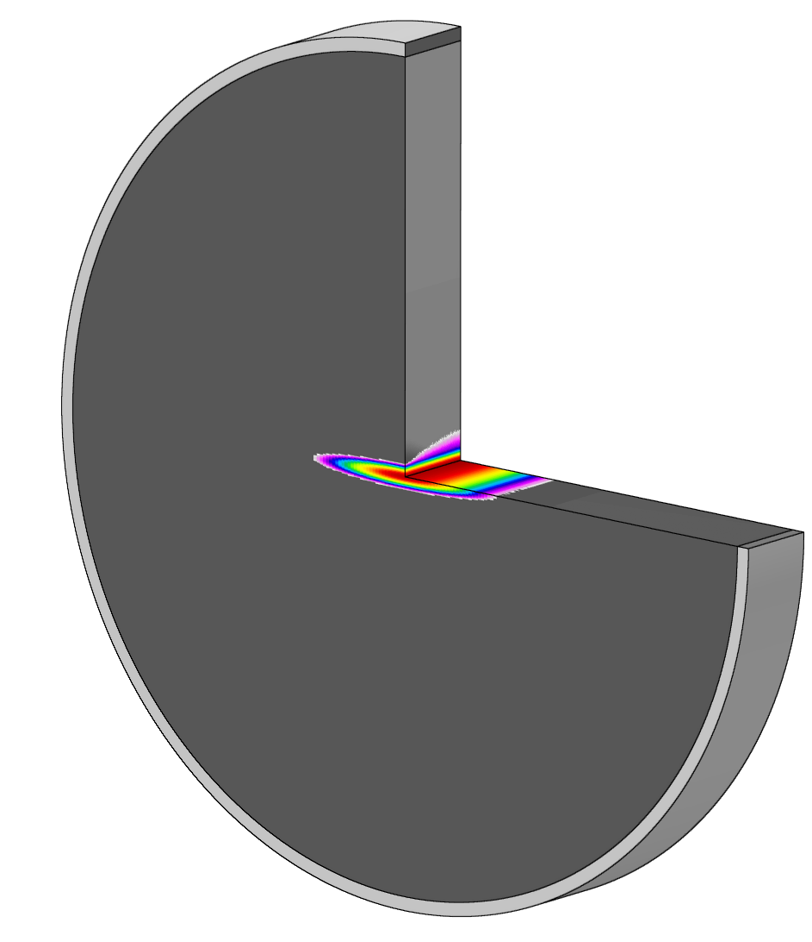
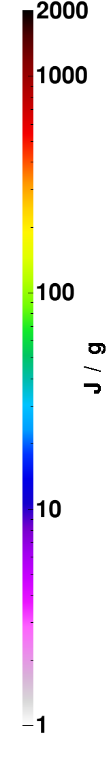
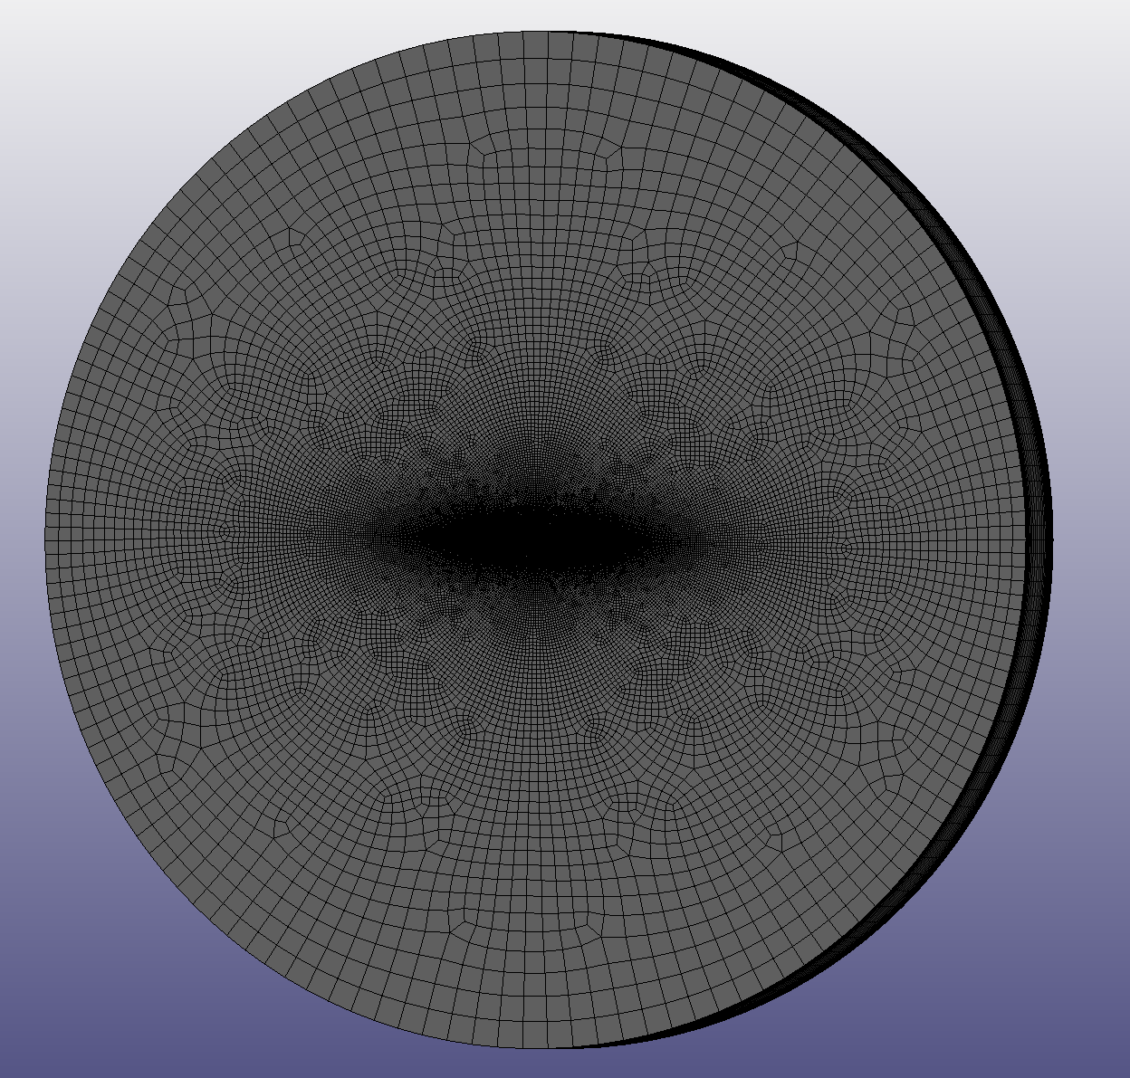
Thermomechanical simulations
Energy deposition from FLUKA
Finite Element Analysis
LS-Dyna tight-coupled thermomechanical simulations
Detailed material model with all relevant properties

Slide 11

Thermomechanical simulations
The Christensen Failure Criterion
For brittle materials, the von-Mises stress is not a good indicator for material failure.
Here the Christensen criterion is a much better representation for likelihood of material failure.
(The Theory of Materials Failure, Richard M. Christensen)
$$\left(\frac{1}{T}−\frac{1}{C}\right)\left(σ_{1}+σ_{2}+σ_{3}\right)+\frac{1}{2TC}\left[{\left(σ_{1}−σ_{2}\right)}^{2}+{\left(σ_{2}−σ_{3}\right)}^{2}+{\left(σ_{3}−σ_{1}\right)}^{2}\right]≤1$$
$σ_{i}<T$
For SGL R7550, isotropic graphite
(conservative estimate)
C = 120 MPa
T = 40 MPa
Where C is the maximum compressive strength
and T is the maximum tensile strength
Values > 1 show material failure

Slide 12
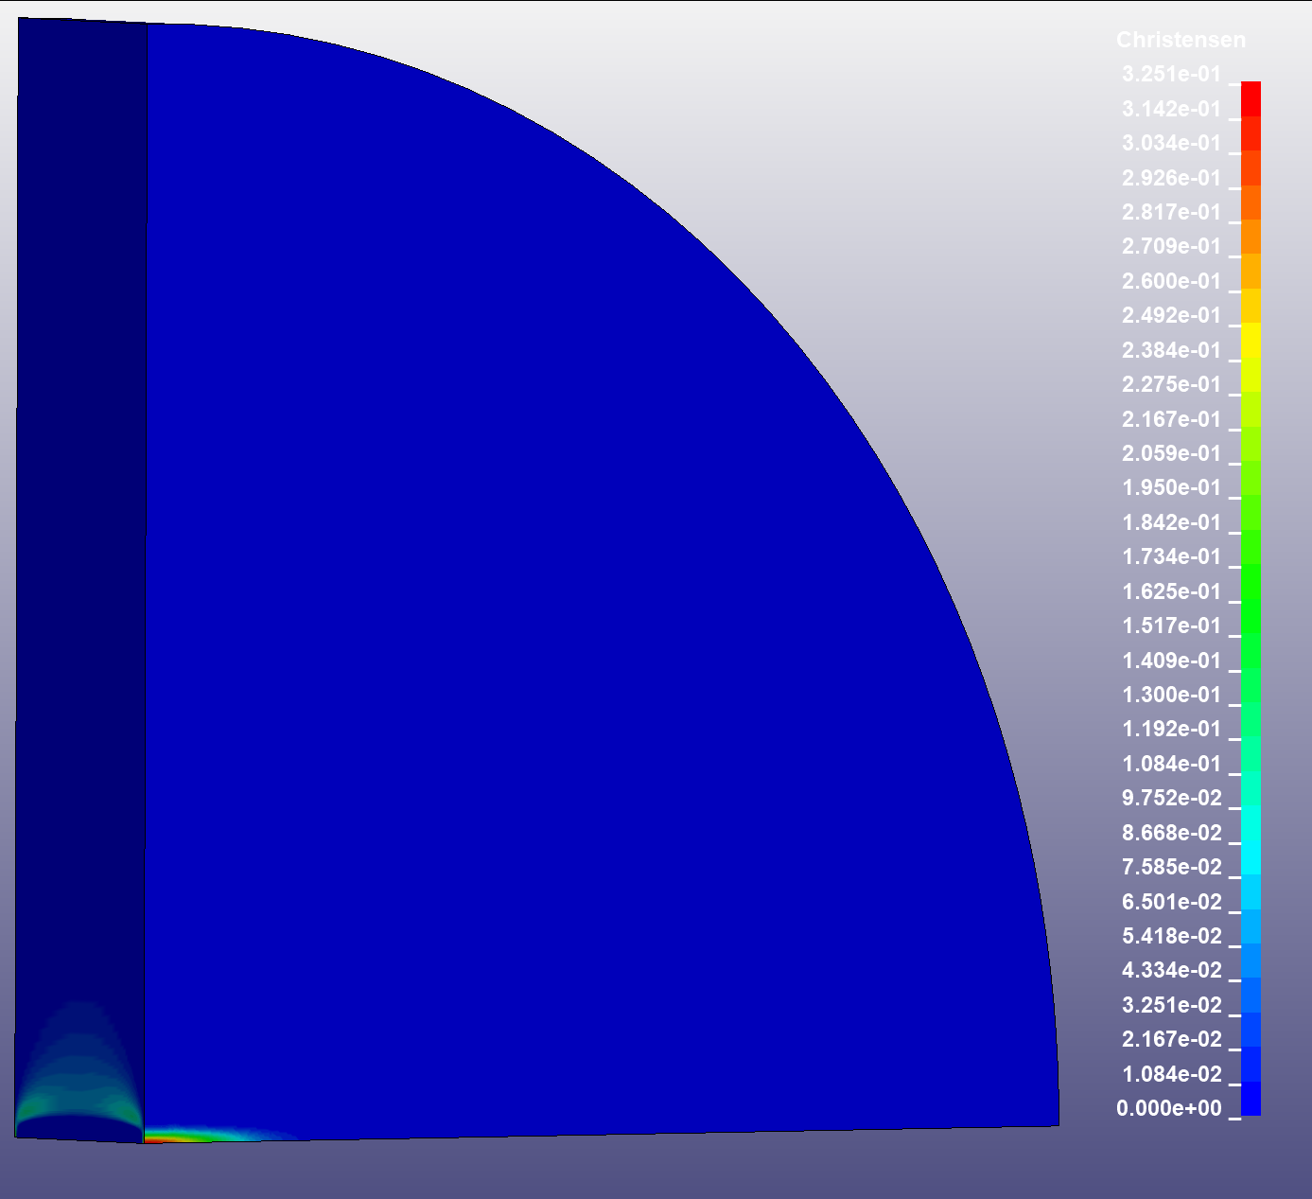
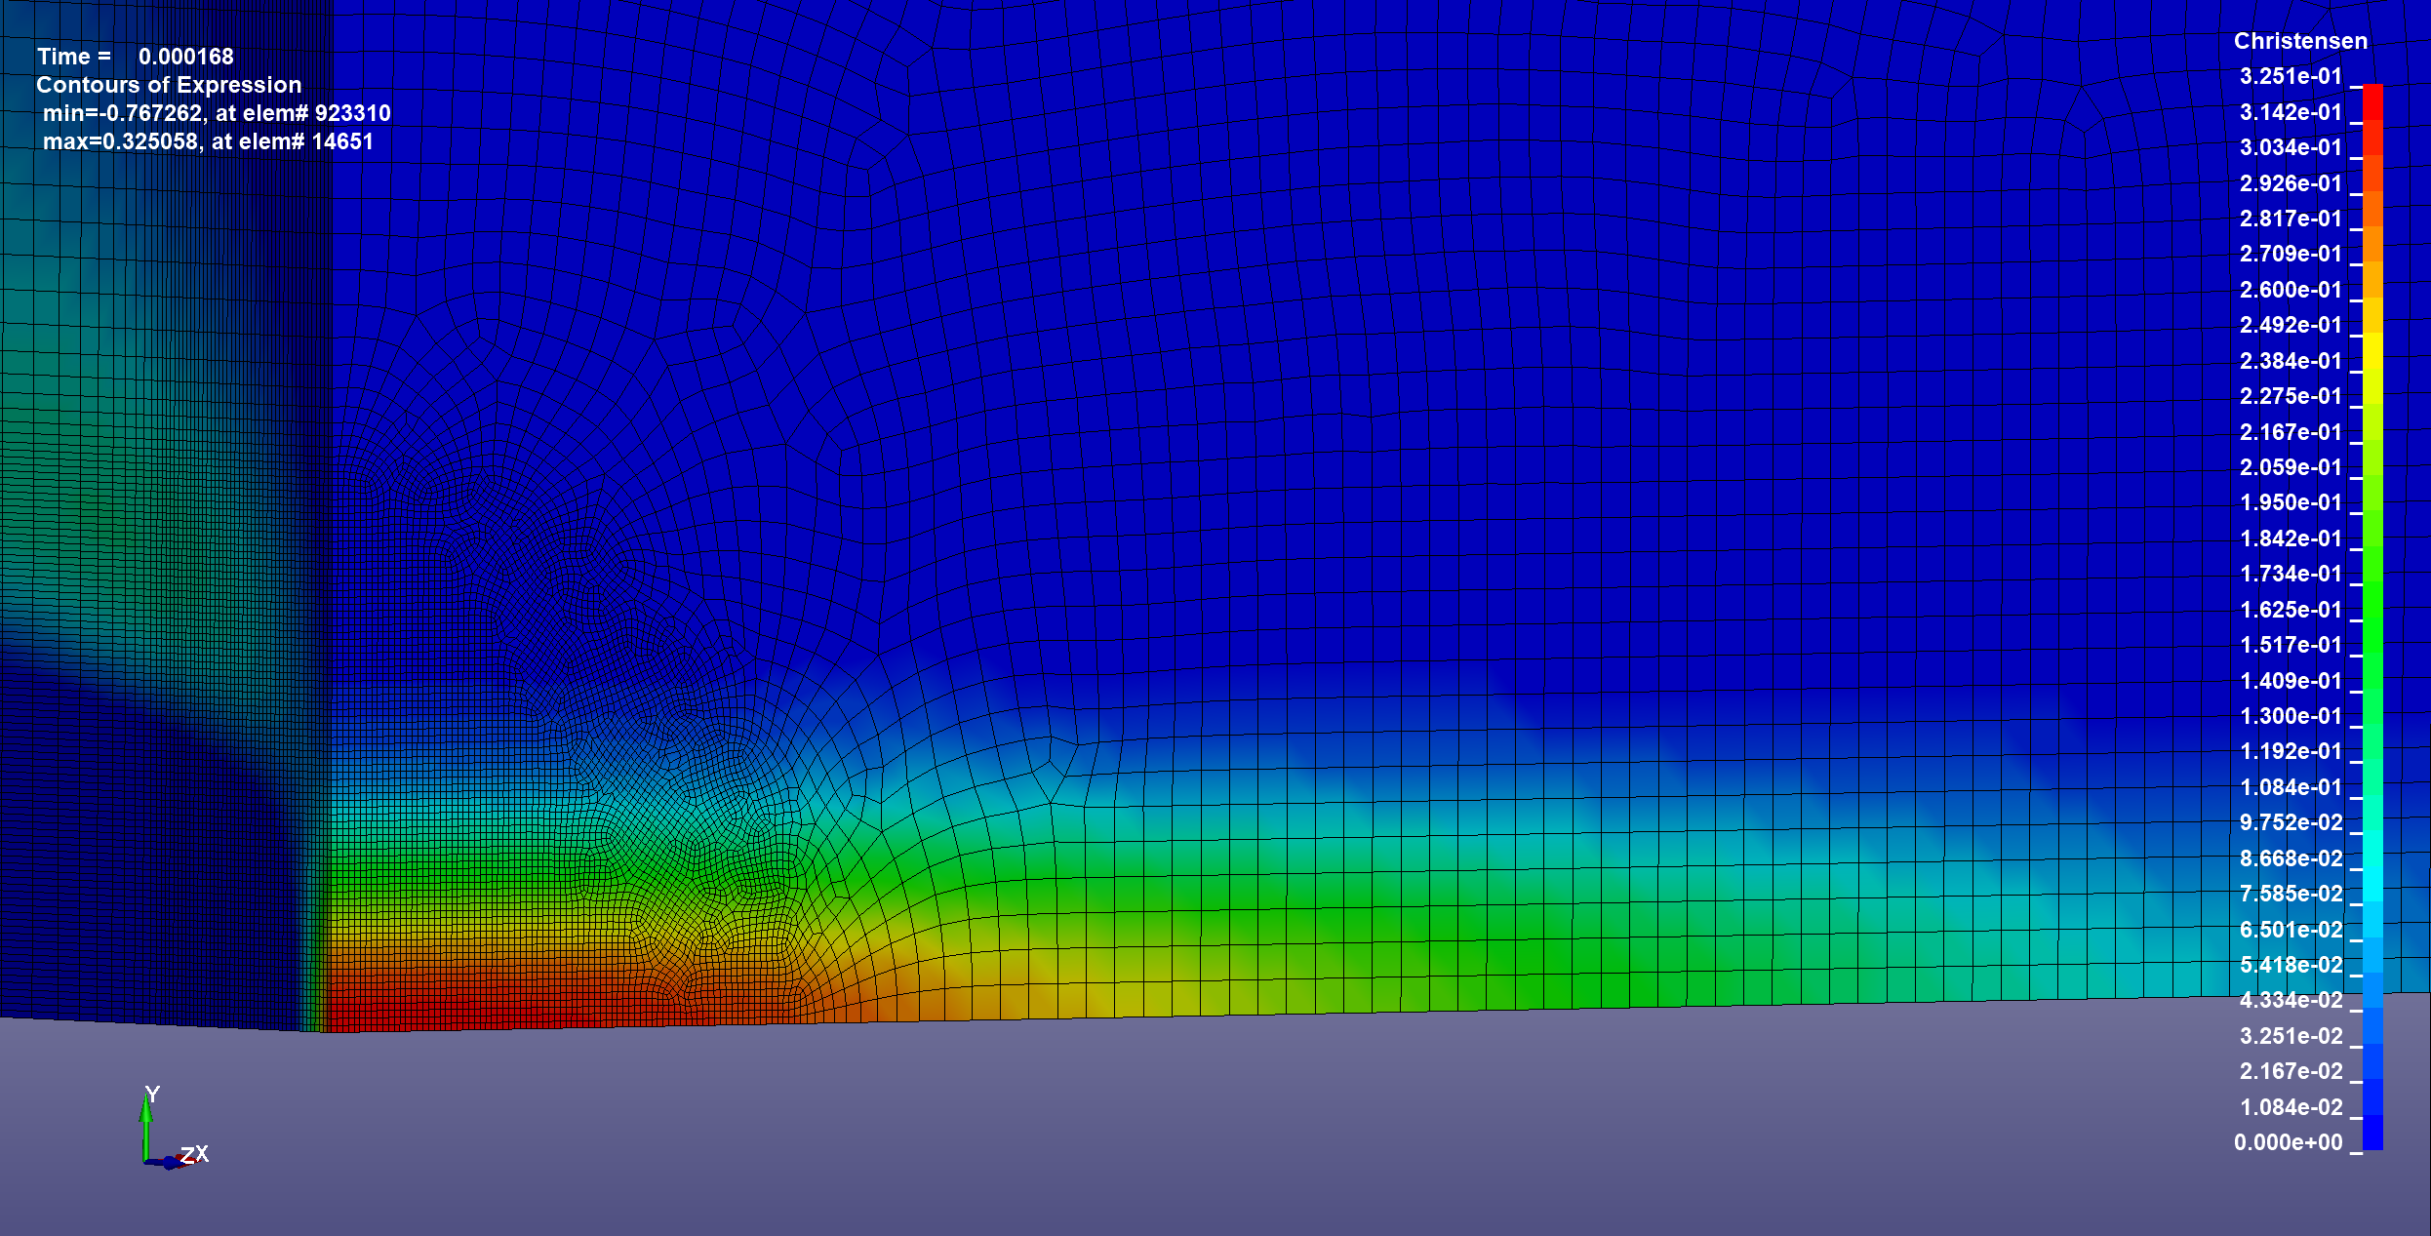
Thermomechanical simulations
Christensen Failure Criterion in LS-Dyna
max value:
0.33
Beam

Slide 13
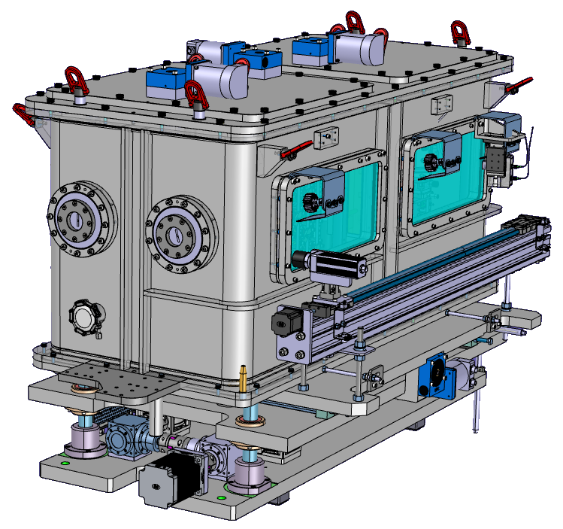
HiRadMat HRMT56-HED
High Energy Dumps experiment
Finished 1st week of November 2021
Multiple targets for testing:
    Sigraflex material of the existing LHC Dump
    Material candidates for the HL-LHC Dump
    Materials for the TCDQ and TCDS for the HL-LHC upgrade
    Material test for the FCC-ee Spoiler
In total 35 different targets
Key experiment for insights into high energy impacts on graphite materials.

Slide 14
HRMT56 FCC-ee Spoiler setup
Experimental verification of the validity of the simulations.
  Especially important since testing with an FCC-ee style beam is not possible.
HiRadMat beam parameters were chosen to reproduce the mechanical stresses expected from an impact with the FCC-ee beam.
  A proton beam of σ = 2.2 mm x 0.25 mm was used for the experiment.
  450 GeV, 288 bunches, ~1.2e11 protons/bunch
To increase the deposited energy in the target, a pre-target material is used to create shower build-up.
This material needs higher density than the target as well as a high melting point to survive the beam impact.
  Titanium – Carbide (TiC) and Titanium-Diboride (TiB2) proved to be the best options

Slide 15
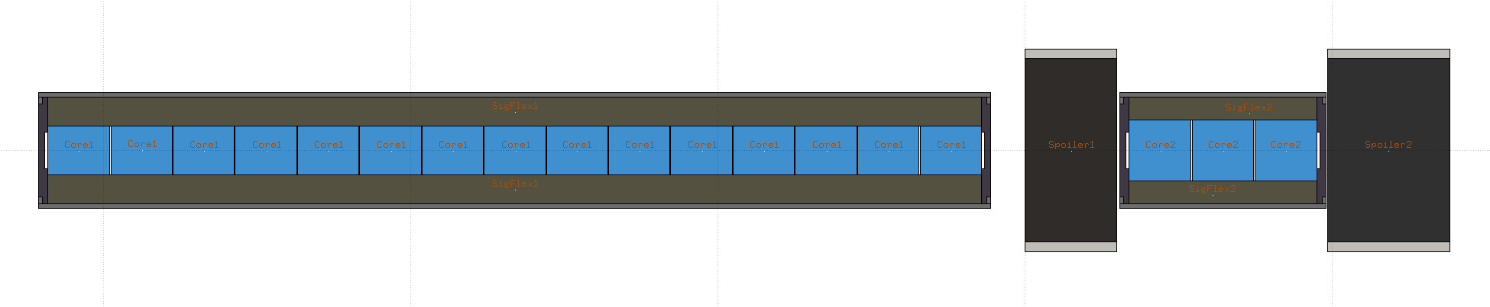
HRMT56 FCC-ee Spoiler setup
3 cm
4 cm
30 cm
6 cm
TiC
SGL R7550
isostatic graphite
Arianne Group S332
3D carbon/carbon

Slide 16
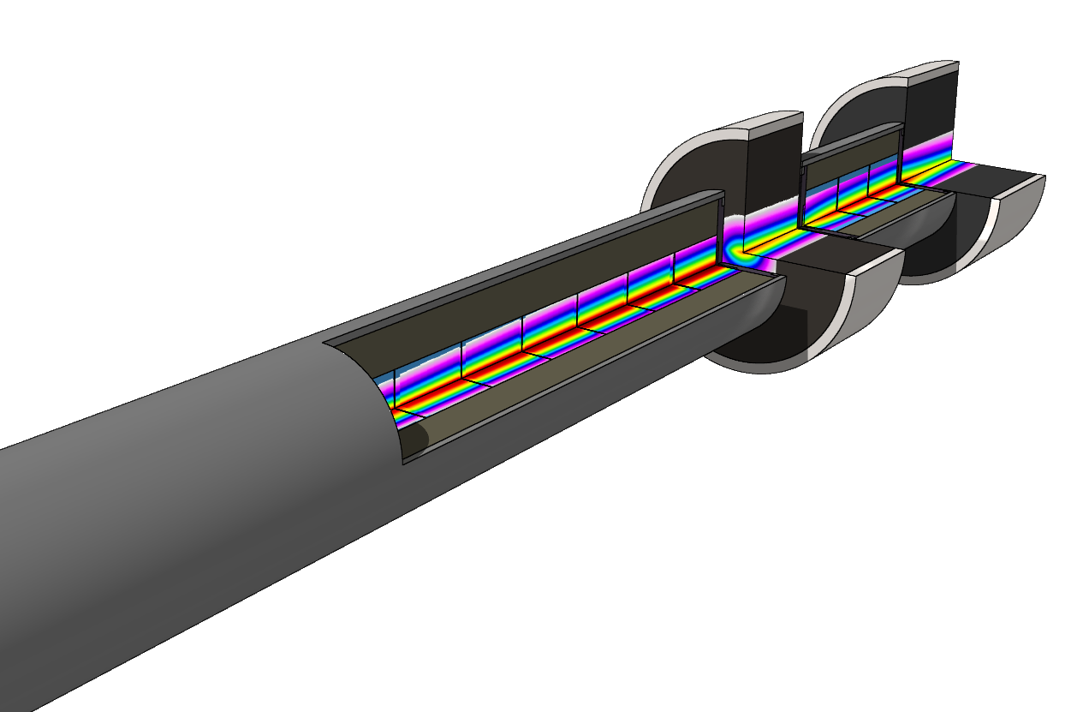
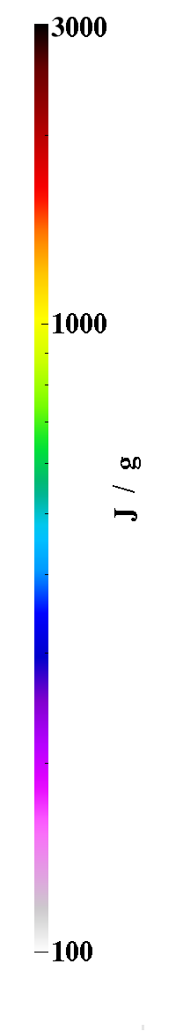
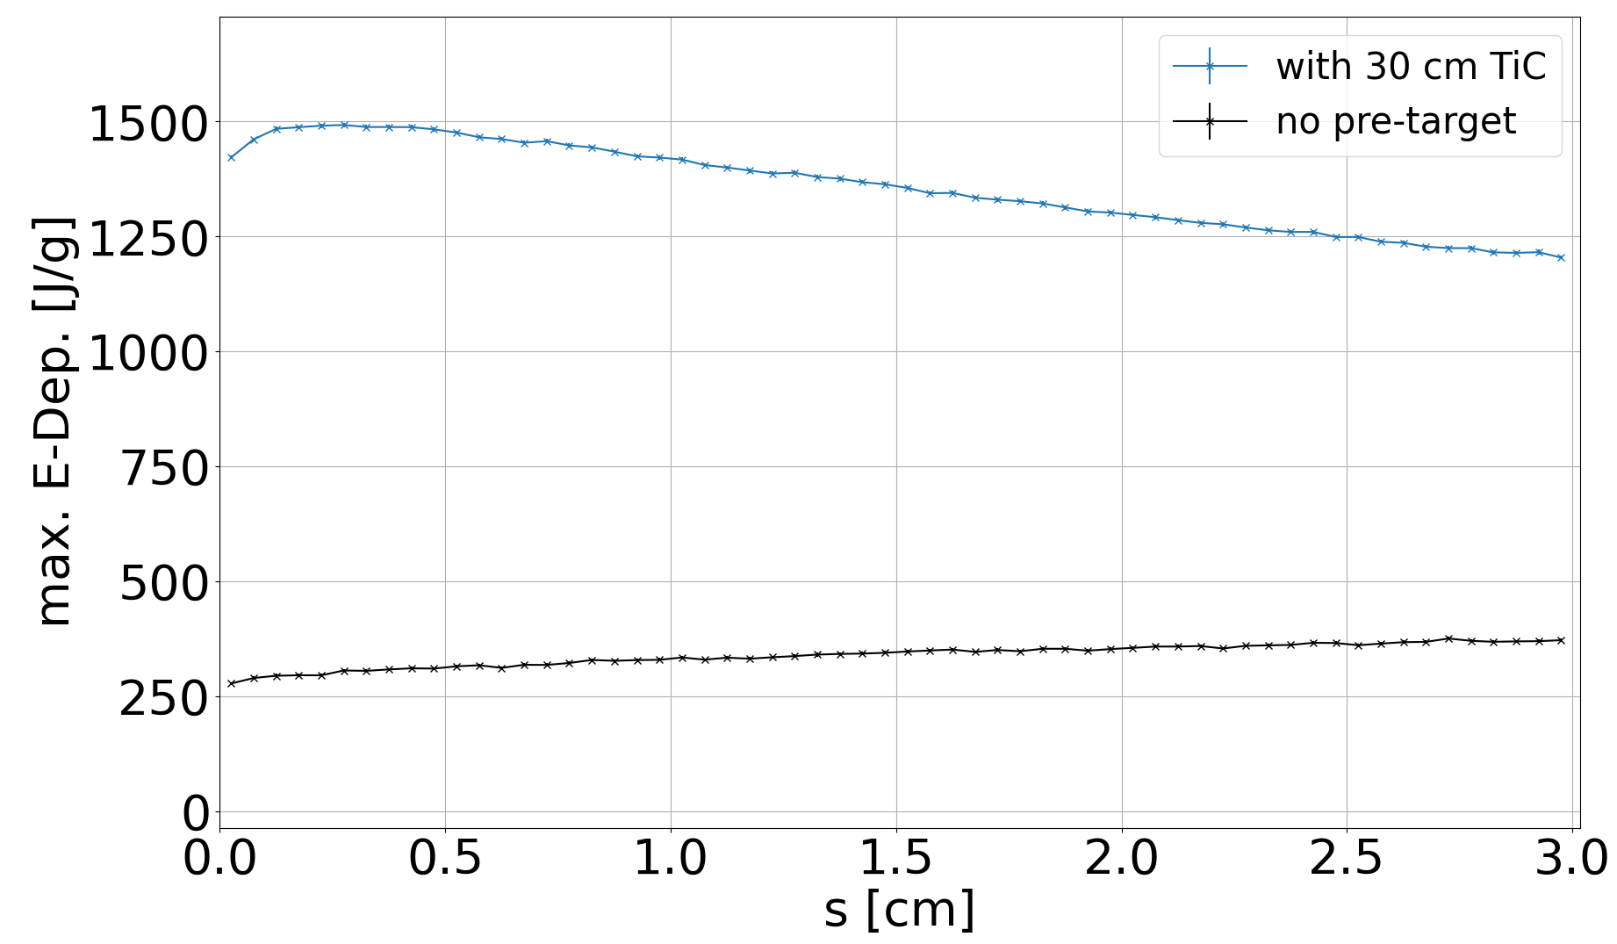
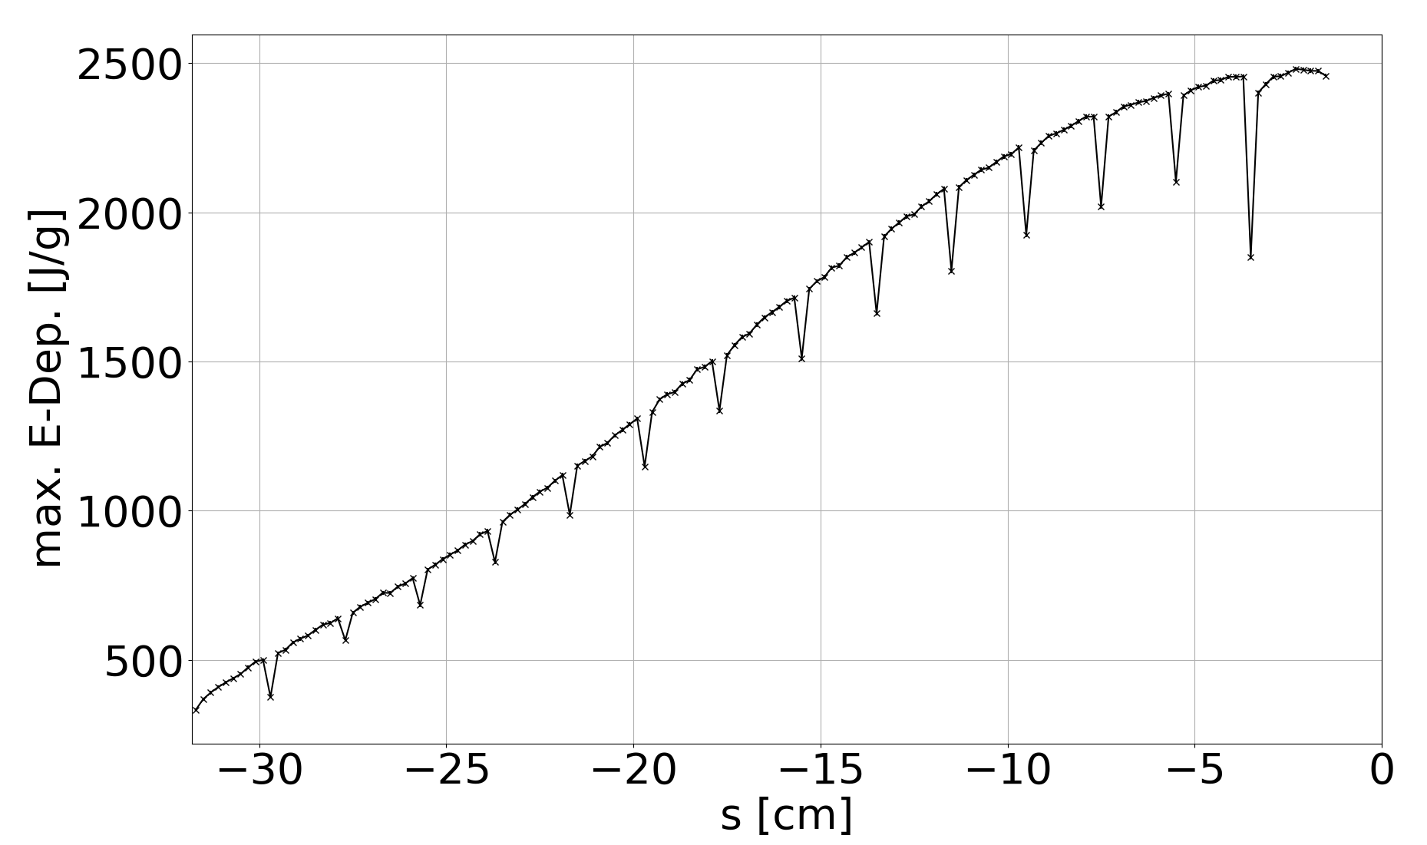
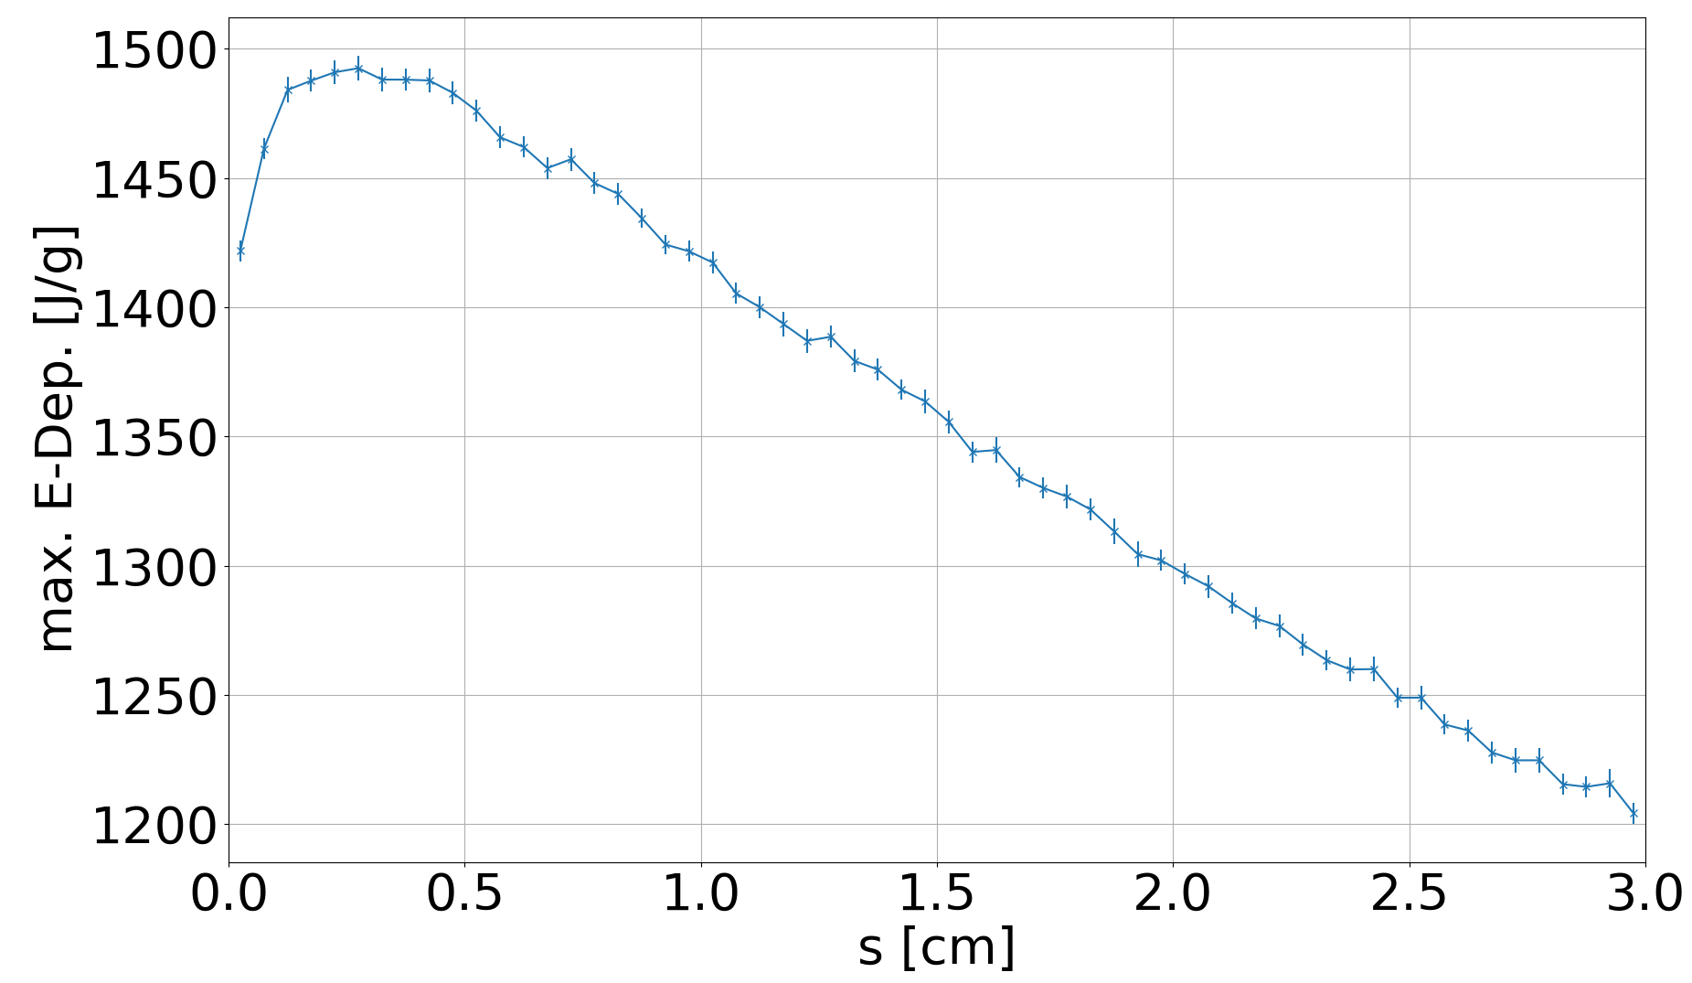
HRMT56 FCC-ee Spoiler setup
Notes:
Temp TiC: ~2600 C

Slide 17
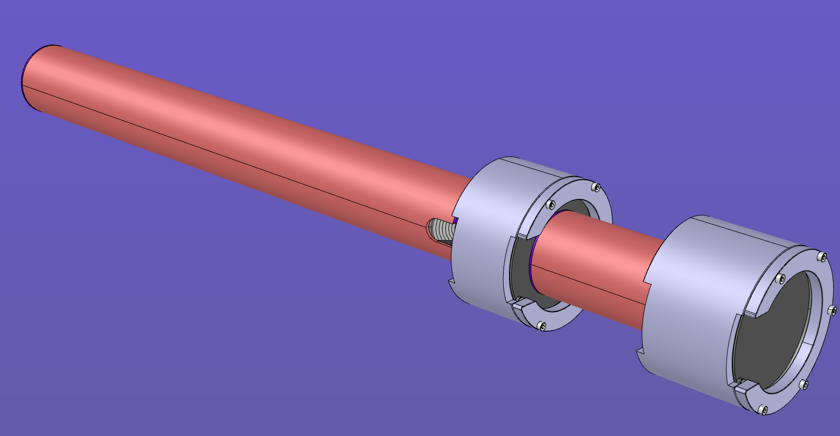
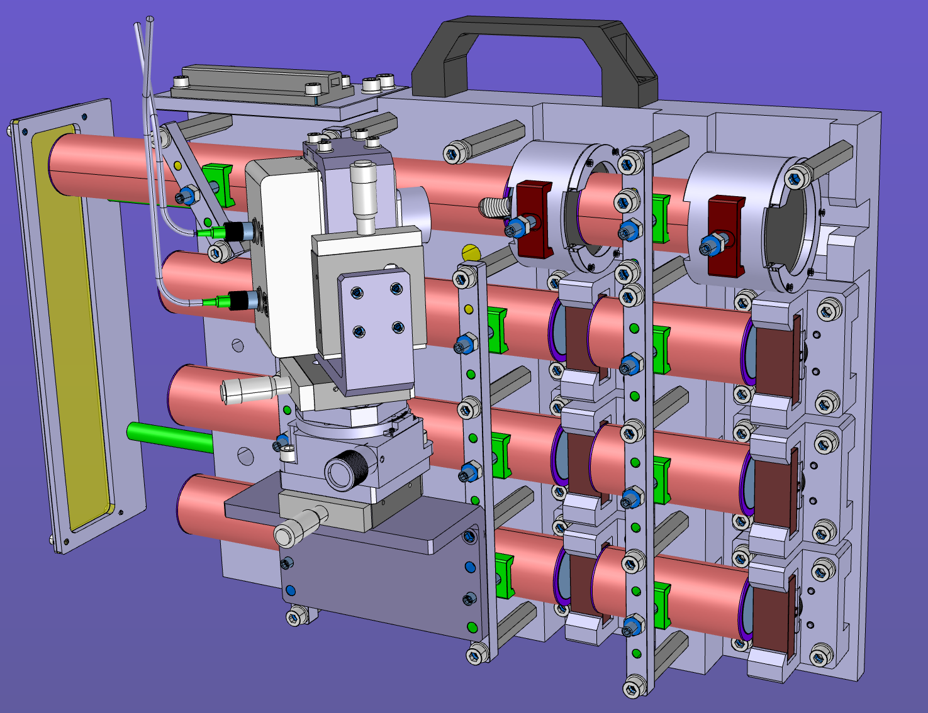
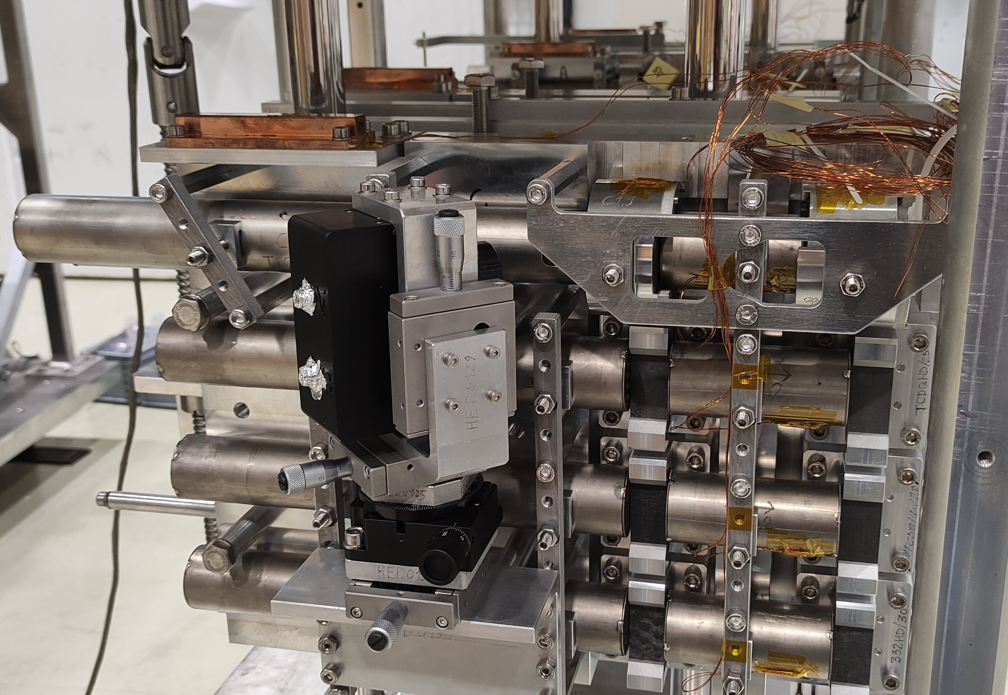
HiRadMat HRMT-56
FCC target 2
Carbon/Carbon
FCC target 1
iso. graphite

Slide 18
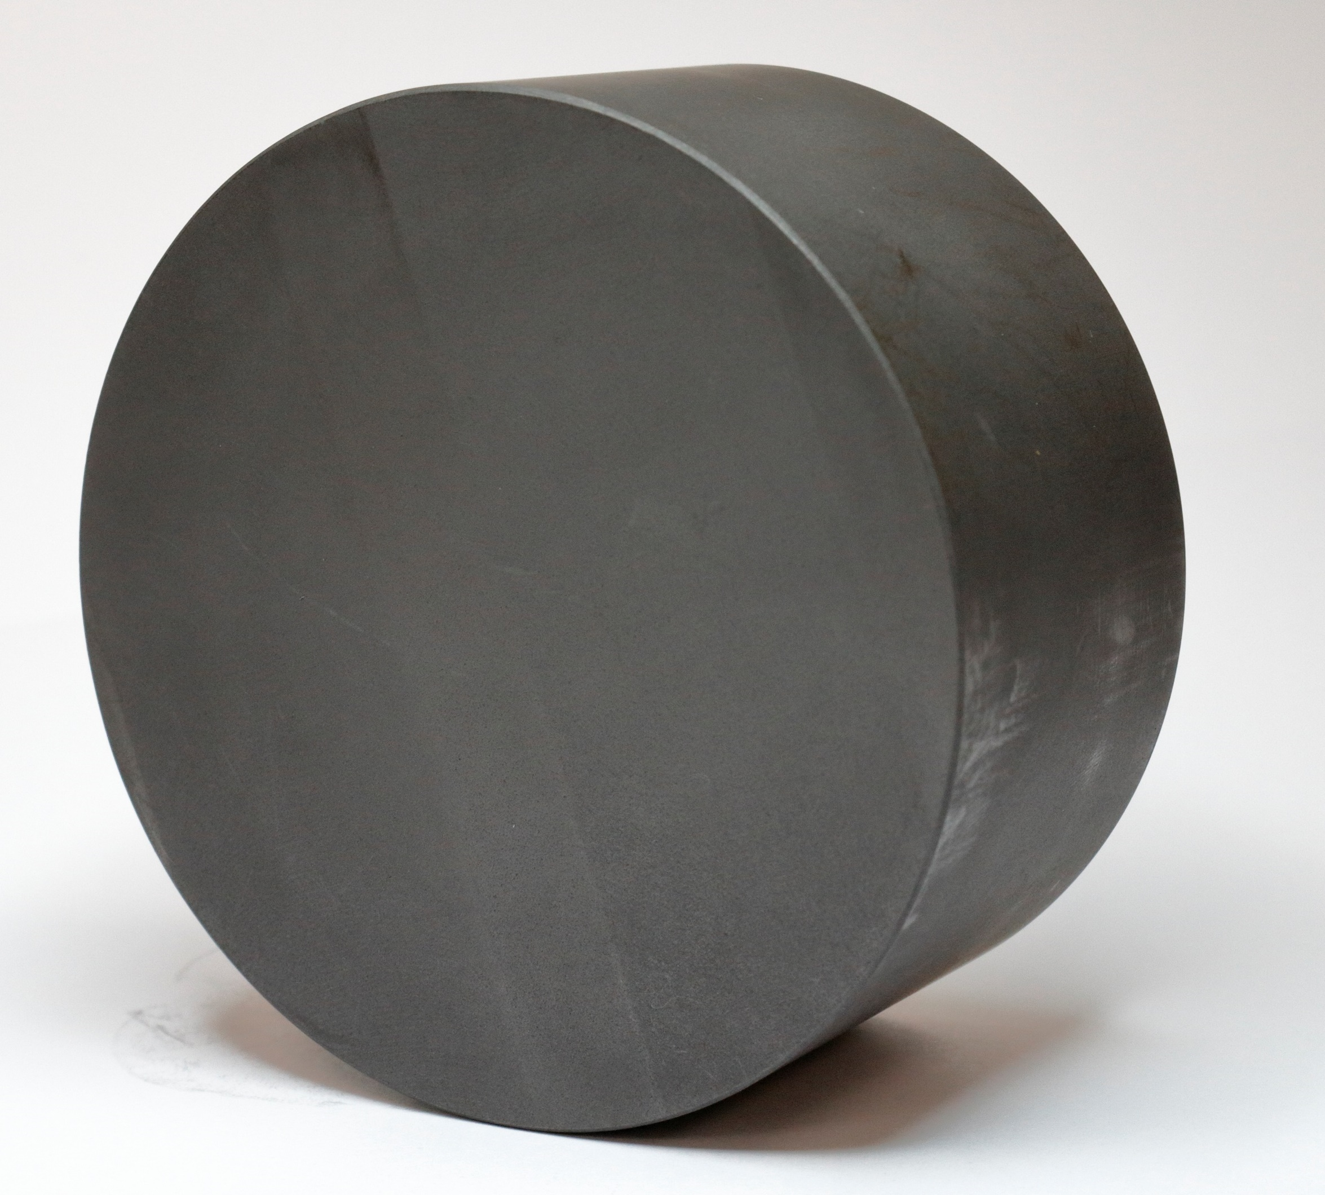
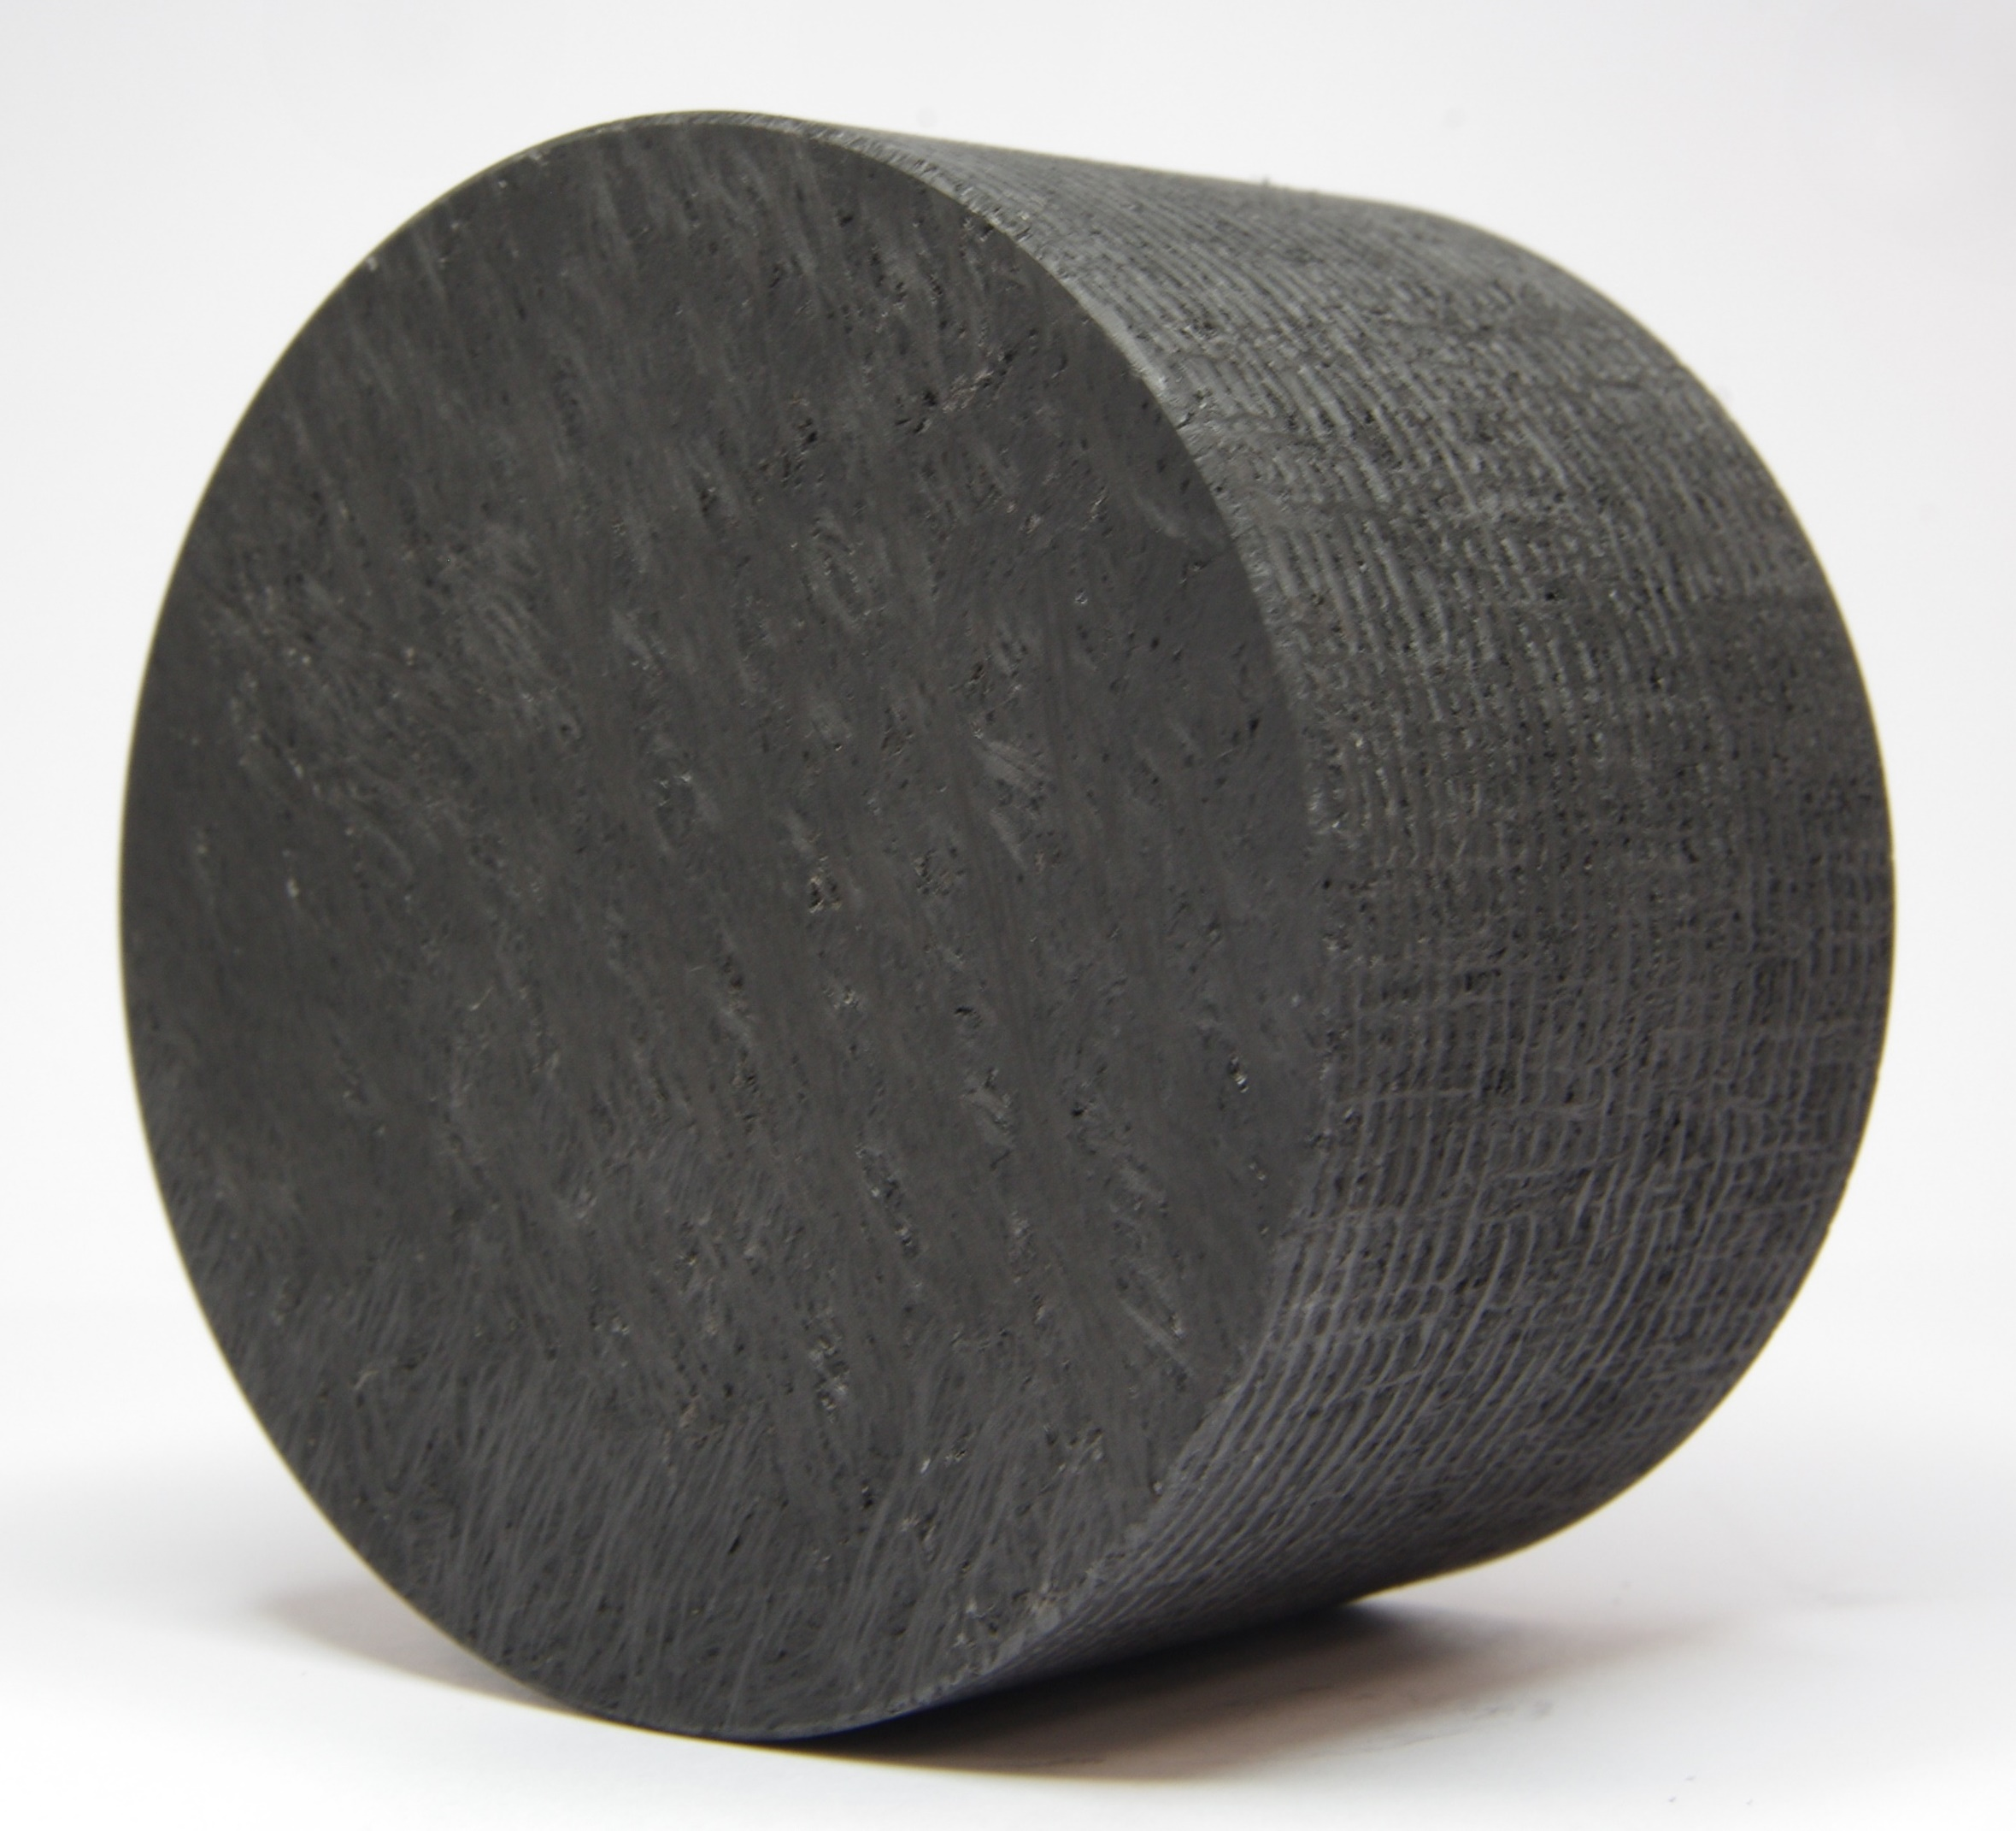
FCC-ee Spoiler material candidates
Requirements
  Low Z material
  High melting point
  High specific heat
    Over a wide temperature range
  Mechanical strength
Carbon/Carbon
Composites
(AG S332)
Isotropic Graphite
(SGL R7550)

Slide 19
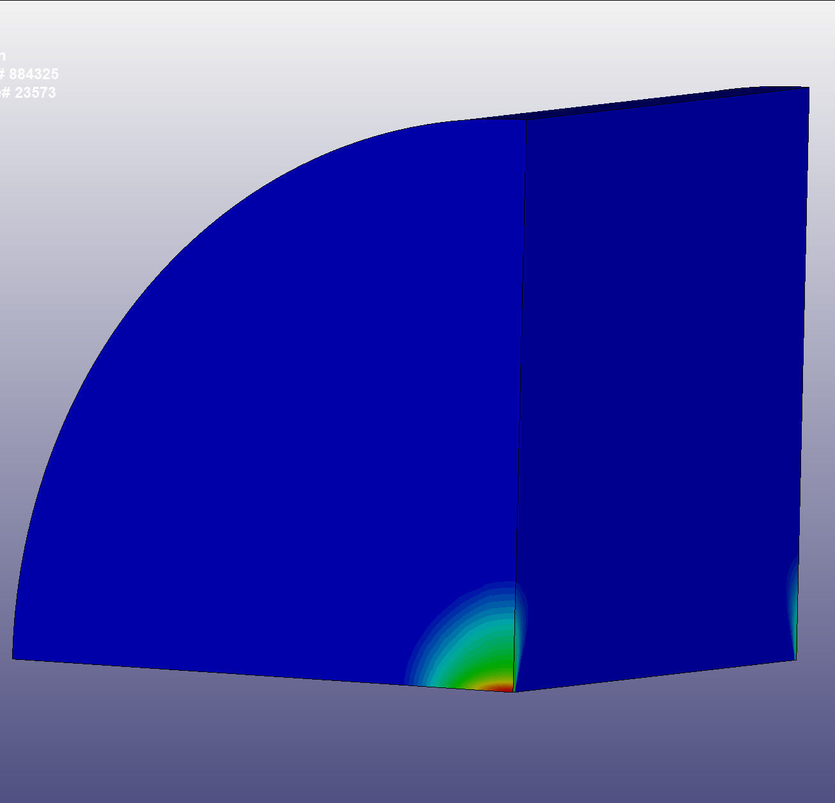
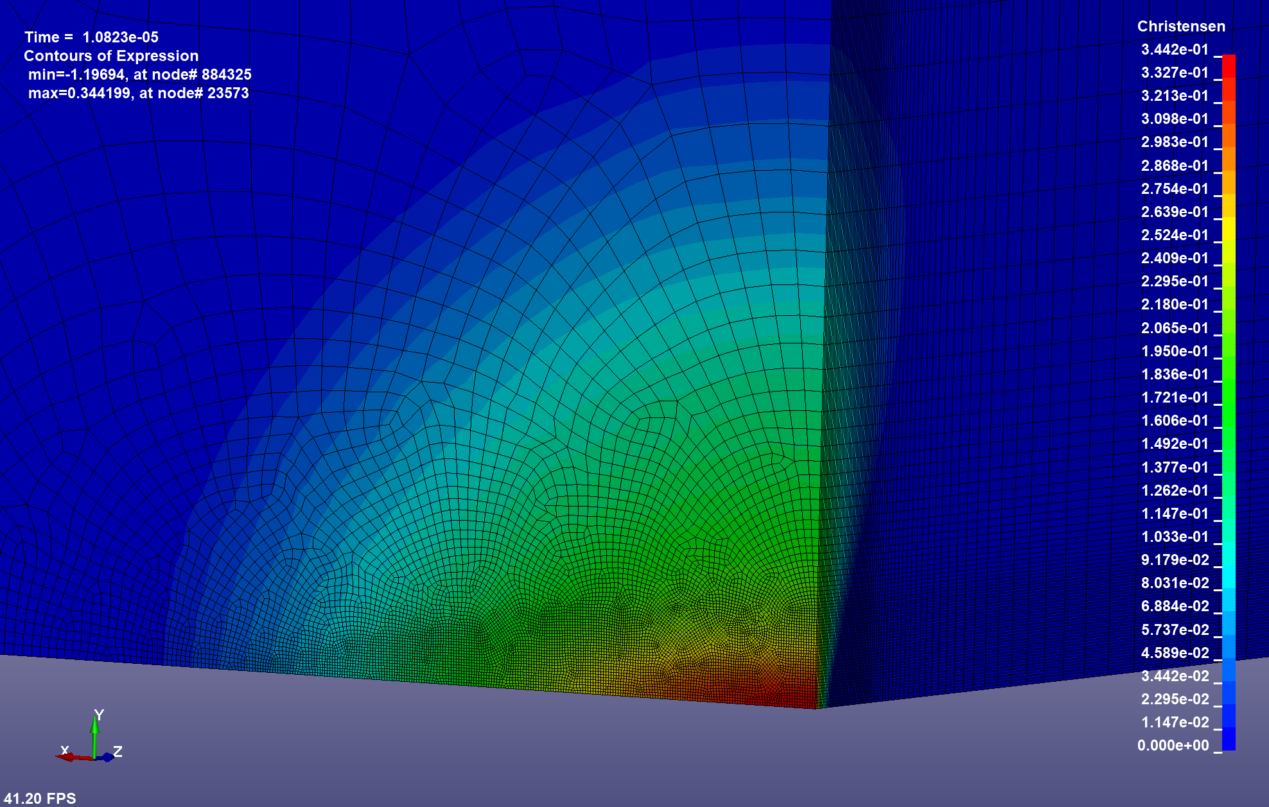
HRMT56 / LS-Dyna simulation
max value:
0.34
Similar to the FCC-ee Spoiler simulation
Beam

Slide 20
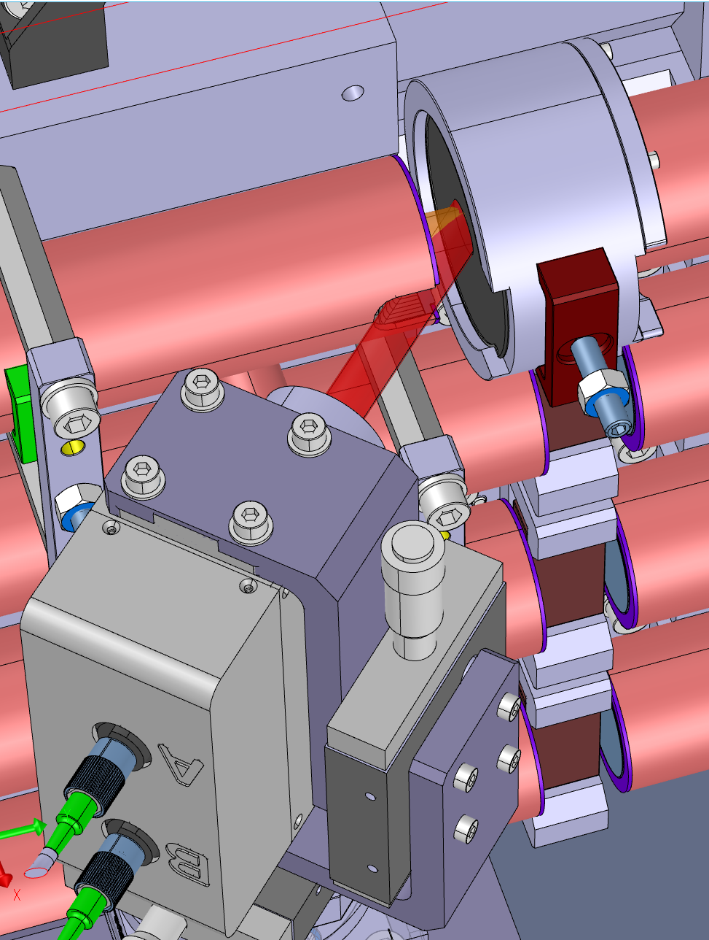
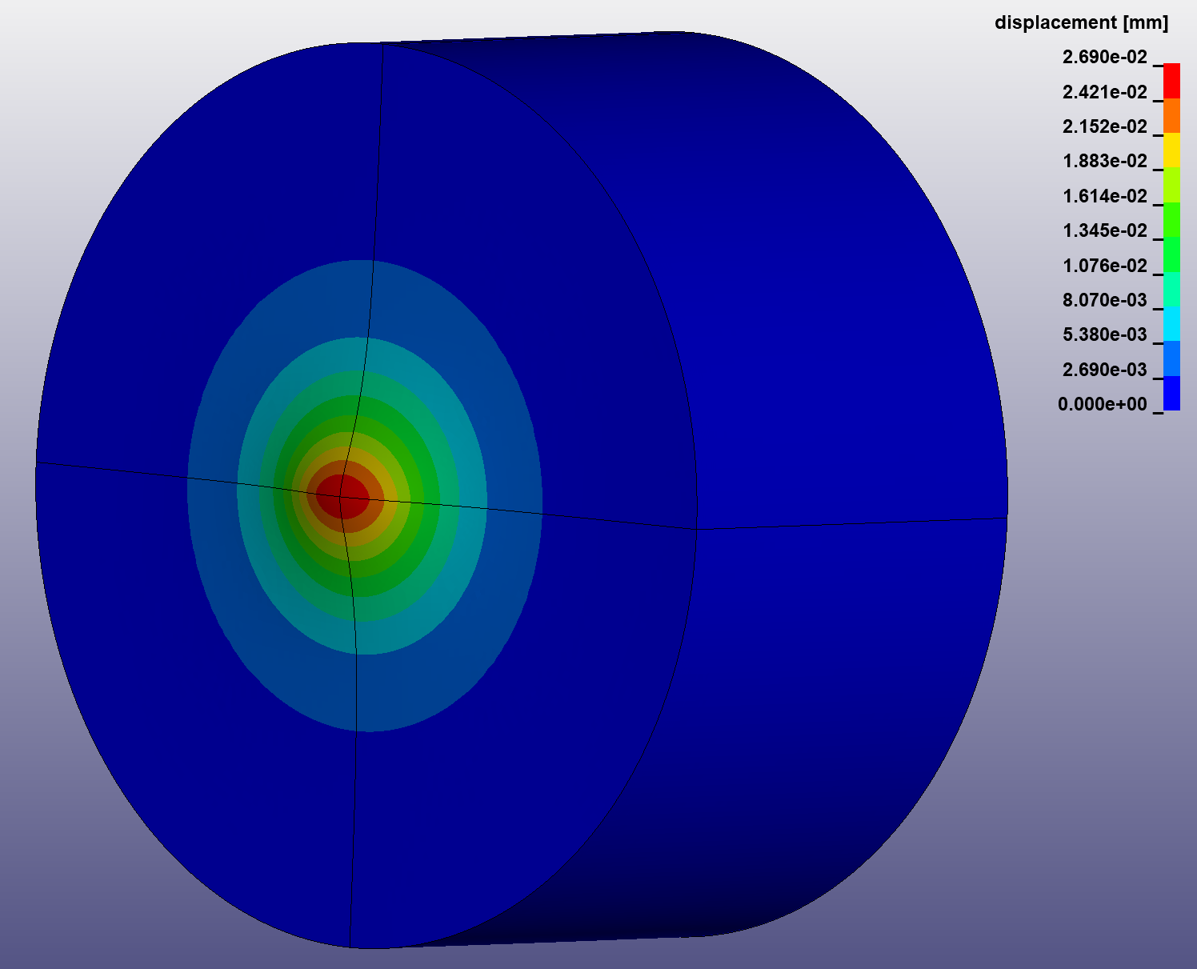
Instrumentation for the FCC target
Out of plane displacement is correlated to strain
Laser Doppler Vibrometer for live surface velocity measurement
Surface displacement and velocity are simulated and can be directly compared
Gives good indication if material model and simulations are correct
Post irradiation examination to verify material survival
(i.e. micro tomograpy, raman spectroscopy, etc.)

Slide 21
Current Status
Dump beamline ~70 m from Spoilers to Beam Dump.
Overall extraction line length depends mainly on
requirements for separation from the main ring.
Extraction does not need a dedicated external tunnel.
Location for extraction placement needs to be defined.
Access requirements and shielding requirements
(i.e. sensitive electronics nearby).

Slide 22
Next steps and open questions
Post irradiation examination of HRMT56-HED
  Optimize spoiler design
  Optimize dump absorber design
Specify location in the lattice
Evaluate radiation field around spoilers and dump
What about injection/extraction protection?
  Booster beam abort system?
  Extraction protection like in the LHC?

Slide 23
Thank you for your attention.

Slide 24
BACKUP

Slide 25
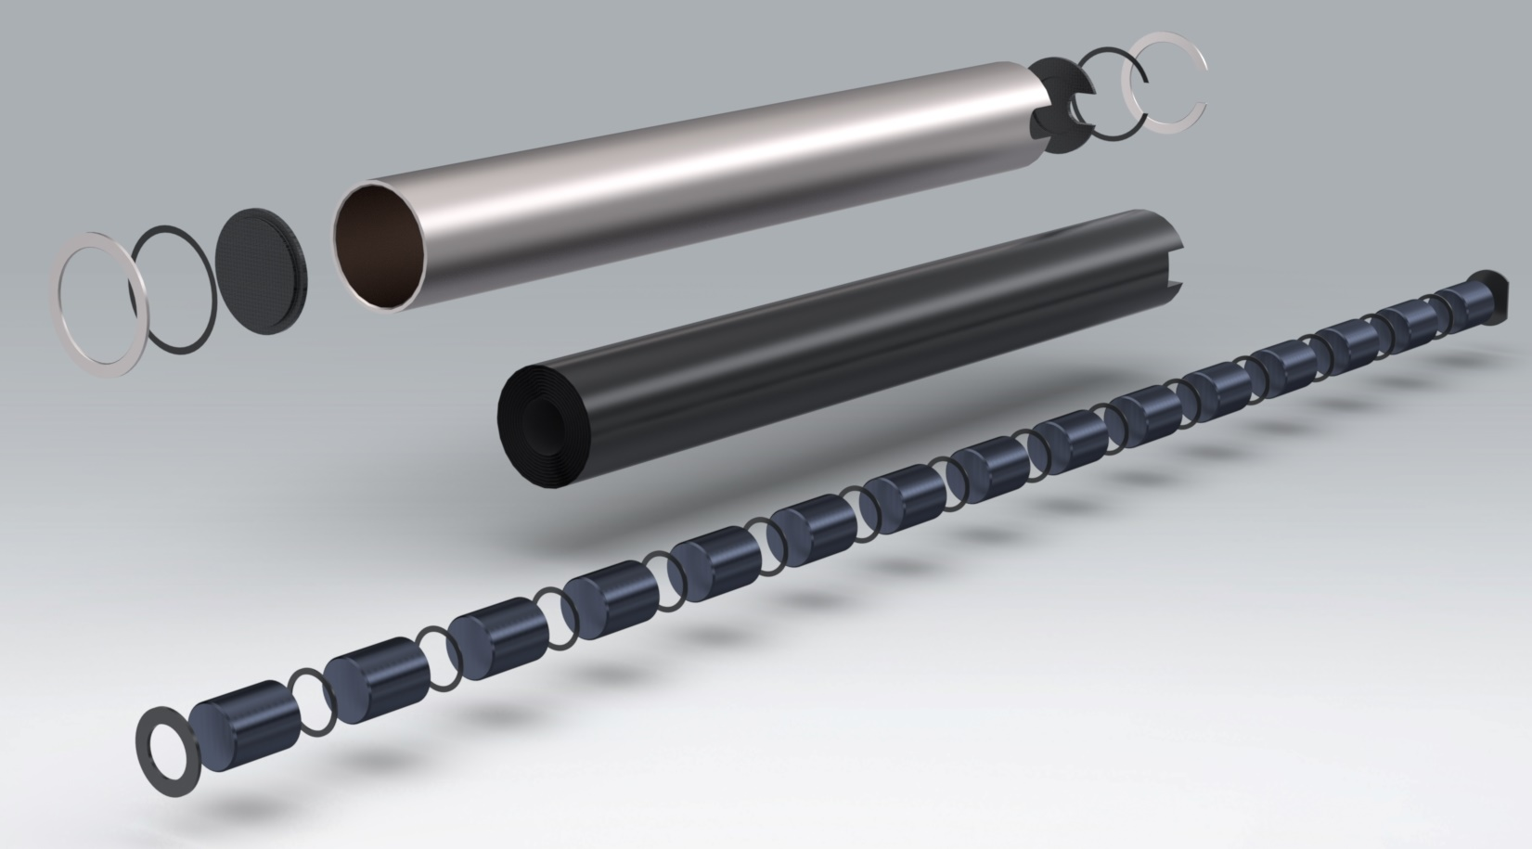
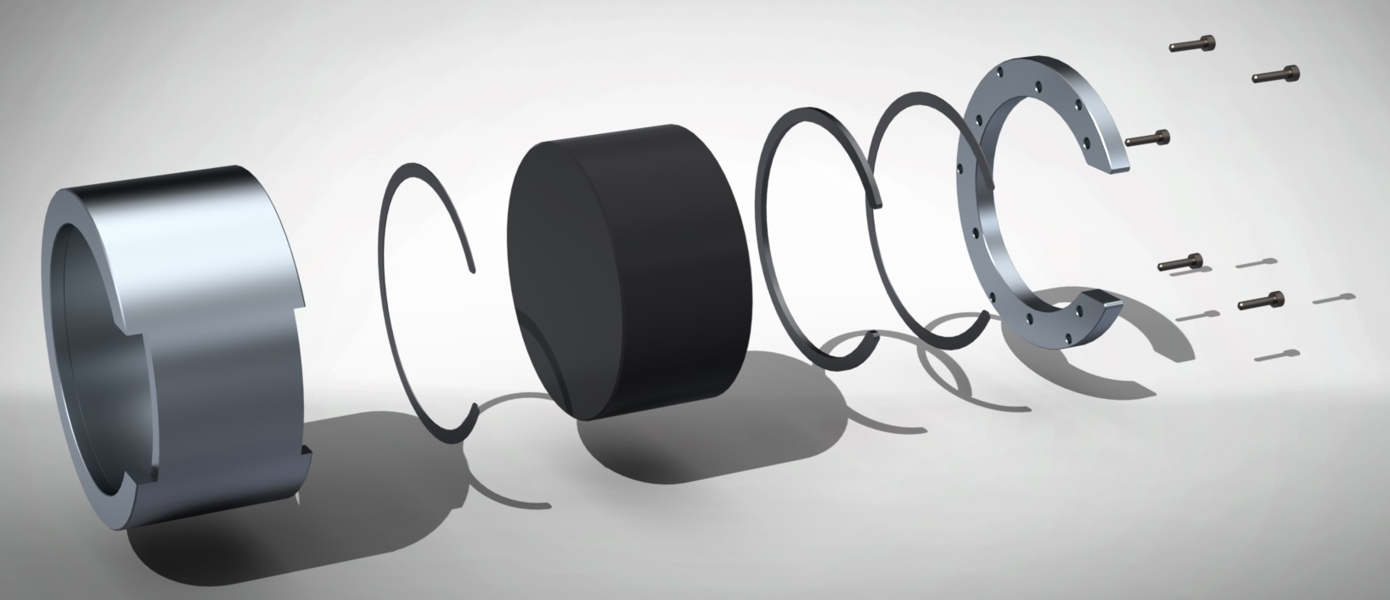
HRMT56 FCC targets
Pre-Target
Titanium-Carbide (TiC)
Density of ~4.84 g/cm³
Melting point of ~3100 °C
FCC target 1
iso. graphite
Targets
Scaled Model of the FCC-ee Spoiler design
Isotropic Graphite and Carbon/Carbon are tested
FCC target 2
Carbon/Carbon

Slide 26
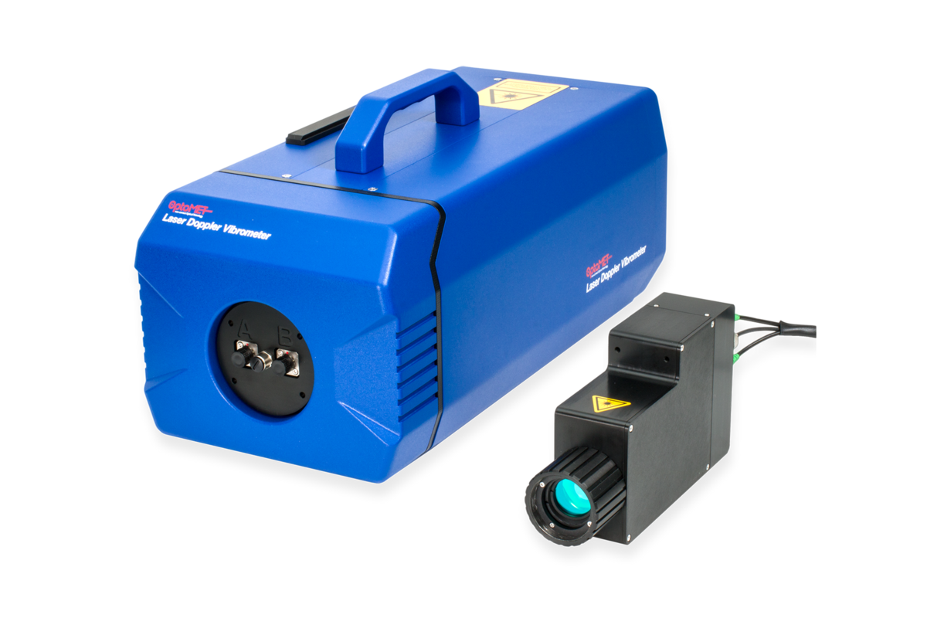
Instrumentation for HRMT56
To verify that the simulations correctly reproduce the thermal expansion and resulting stresses on the surface of the target, special instrumentation is needed.
Strain gauges do not have a good enough resolution and cannot be placed directly in the beam trajectory.
To measure this during and after the beam impact directly at the impact spot is possible by using a Laser Doppler Vibrometer (LDV).
The LDV can measure with a time resolution of 0.4 us (2.5 MHz) and a displacement resolution of less than 1 nm.
Target
Beam
45°
LDV

Slide 27
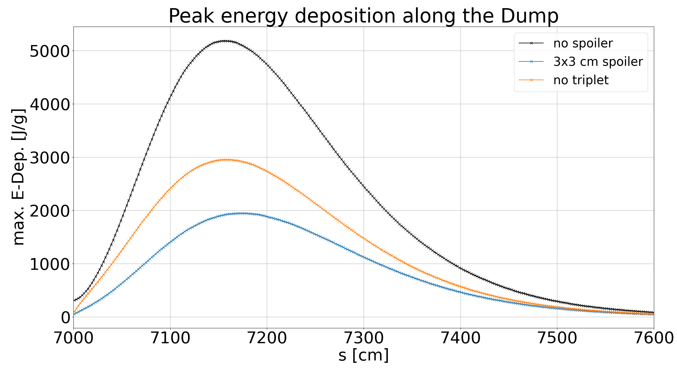
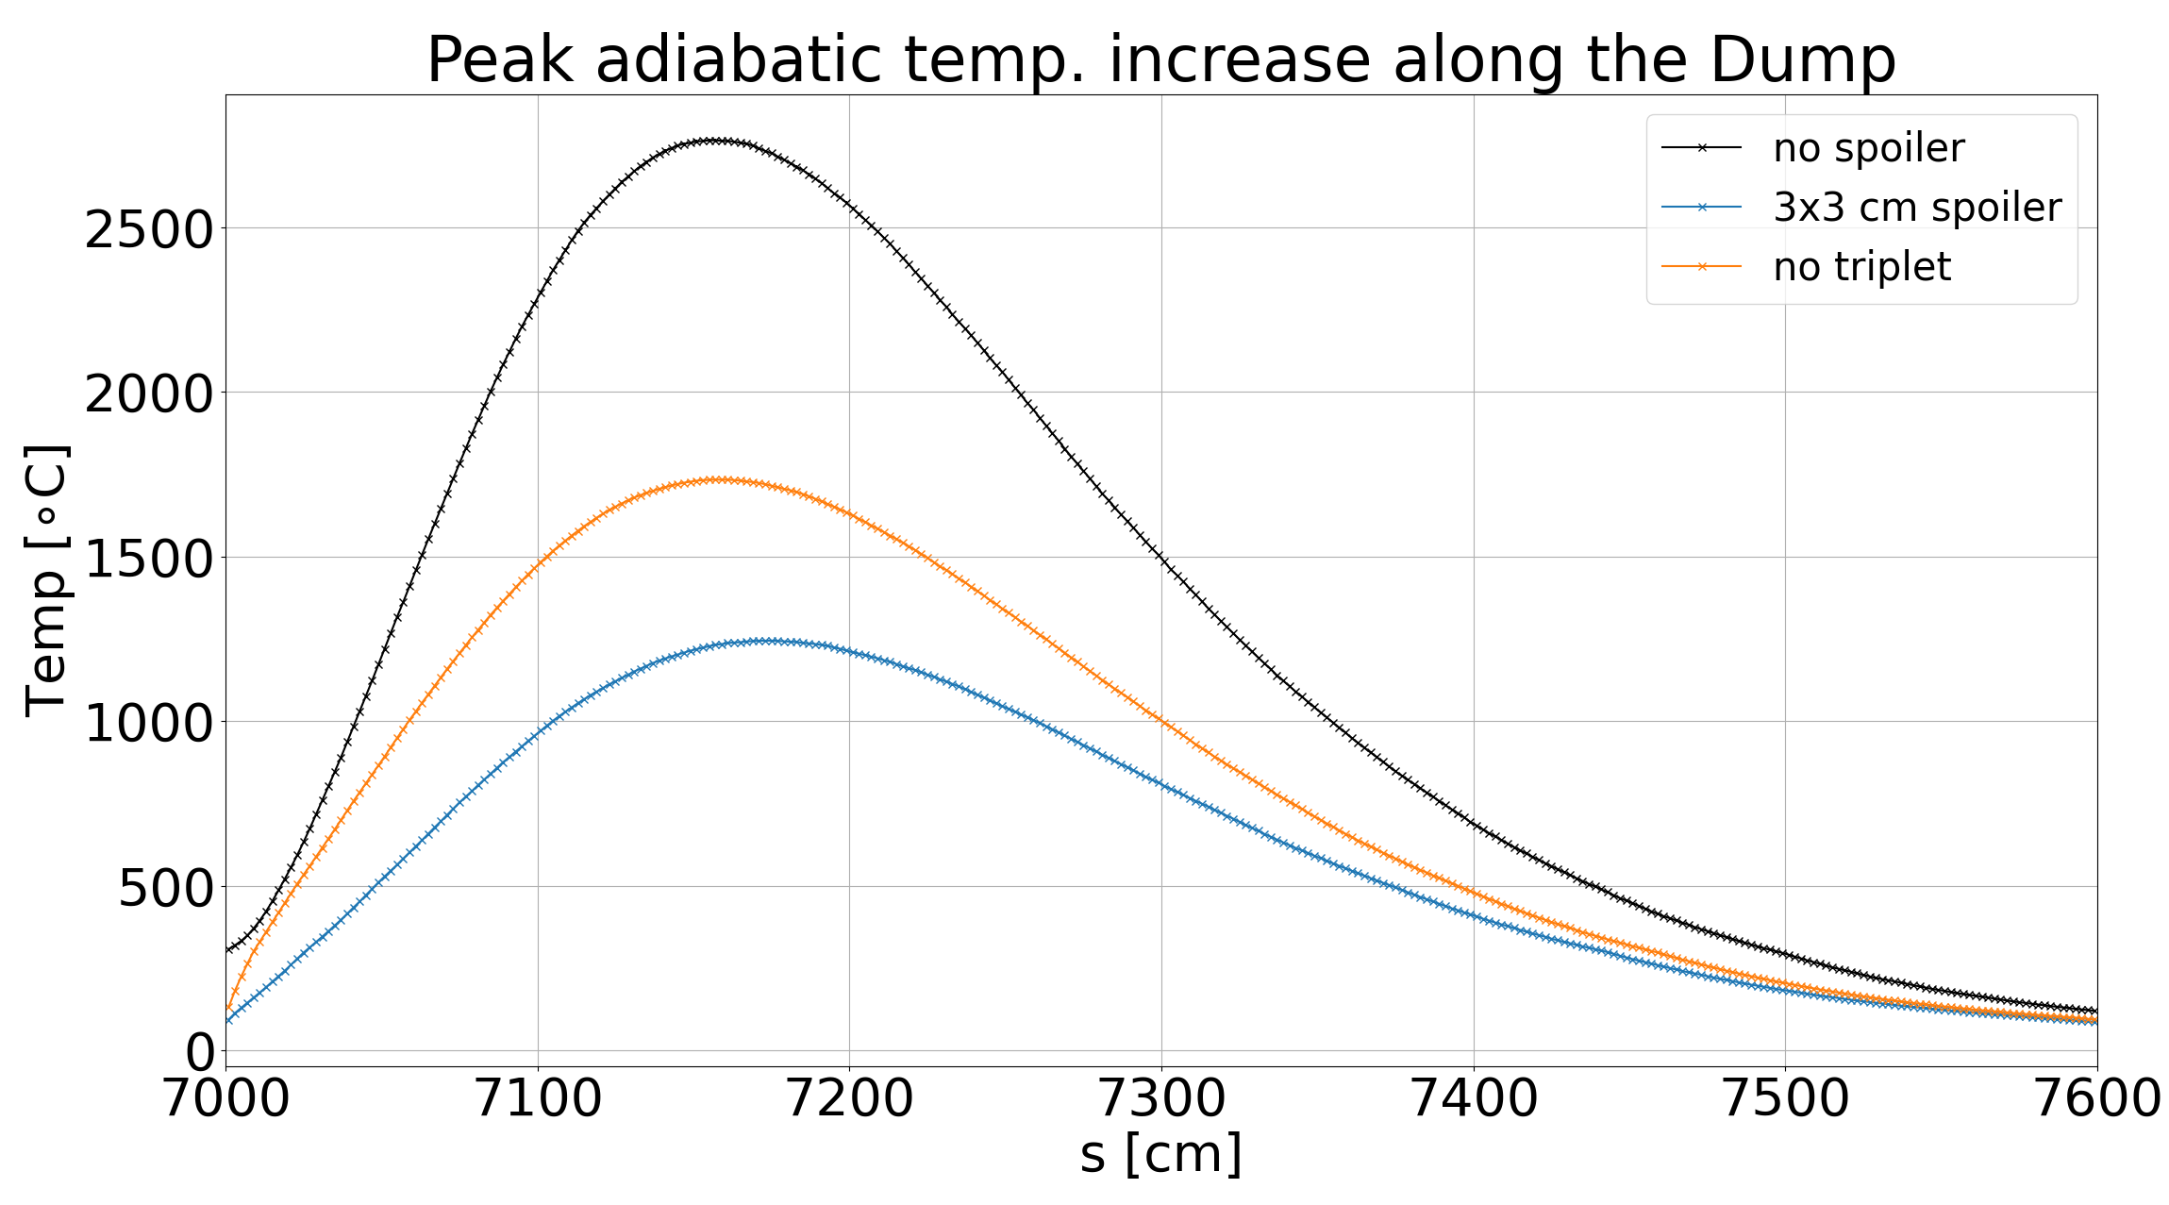
No triplet, passive protection by the Spoiler
Spoilers get destroyed
Dump should survive
Hydrodynamic tunneling not considered
Defocusing
triplet

