Slide 1
Introduction to machine learning
Harrison B. Prosper
Florida State University
ML4SCI 2021 Hackathon
8 – 22 Nov 2021

Slide 2
Outline
Introduction
Decision Trees
Deep Neural Networks
The Future of Machine Learning

Slide 3
Introduction

Slide 4
What is Machine Learning?
The use of computer-based algorithms for constructing useful models of data.
Machine learning algorithms fall into several broad categories including:
Supervised Learning
Semi-supervised Learning
Unsupervised Learning
Reinforcement Learning
Generative Learning

Slide 5
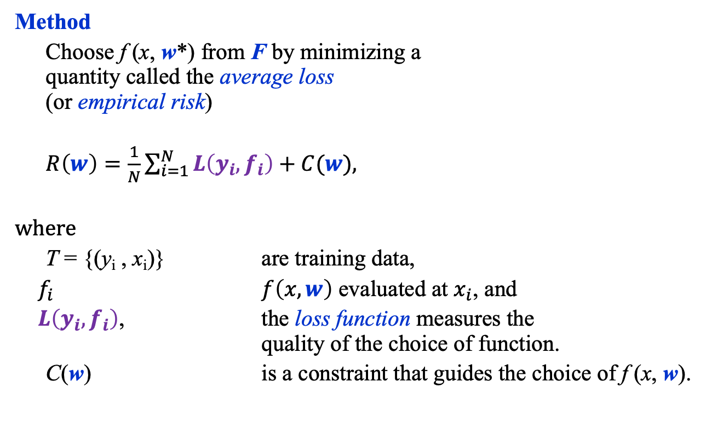
Machine Learning
F = Function class
Method
Choose f (x, w*) from F by minimizing a
quantity called the average loss
(or empirical risk)
$R\left(w\right)=\frac{1}{N}\sum_{i=1}^{N}{L\left(y_{i}, f_{i}\right)+C(w),}$
where
T = {(y_{i} , x_{i})} are training data,
$f_{i}$ $f\left(x,w\right)$ evaluated at $x_{i}$, and
$L\left(y_{i}, f_{i}\right)$, the loss function measures the quality of the choice of function.
C(w) is a constraint that guides the choice of f (x, w).

Slide 6

Minimizing the Average Loss
The average loss function defines a “landscape” in the space of functions, or, equivalently, the space of parameters.
The goal is to find the lowest point in that landscape by moving in the direction of the negative gradient:
$$w_{i}←w_{i}−ρ\frac{∂R(w)}{∂w_{i}}$$
Most minimization algorithms are variations on this theme.
Stochastic Gradient Descent (SGD) uses
random subsets (batches) of the training
data to provide noisy estimates of
the gradient.

Slide 7
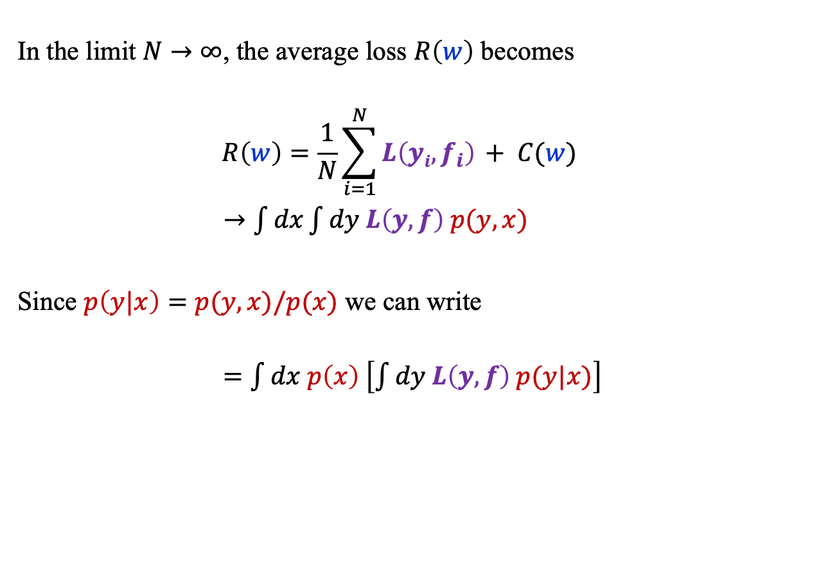
Minimizing the Average Loss
In the limit $N→∞$, the average loss $R\left(w\right)$ becomes
$$R\left(w\right)=\frac{1}{N}\sum_{i=1}^{N}{L\left(yi, f_{i}\right) + C(w)}$$
$→\int{dx\int{dy L\left(y,f\right) p(y,x)}}$
Since $p\left(y|x\right)=p(y,x)/p(x)$ we can write
$=\int{dx p\left(x\right) \left[\int{dy L\left(y, f\right) p(y|x)}\right]}$

Slide 8
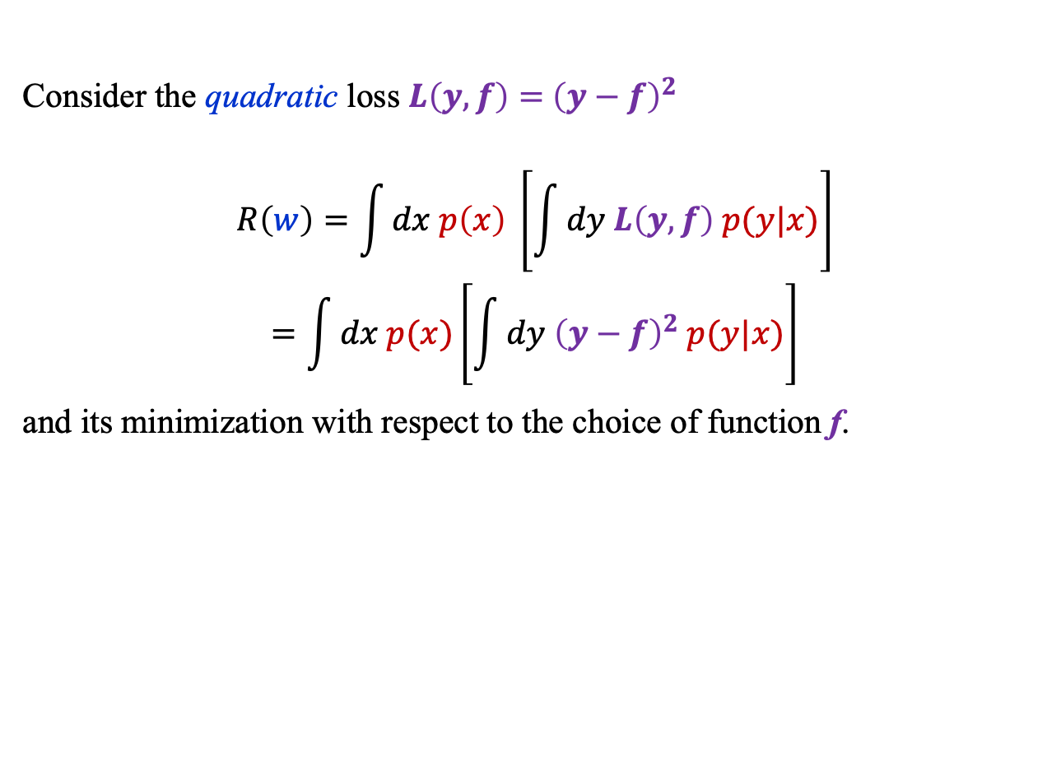
Minimizing the Average Loss
Consider the quadratic loss $L\left(y, f\right)={ \left(y−f\right)}^{2}$
$$R\left(w\right)=\int{dx p\left(x\right) \left[\int{dy L\left(y, f\right) p(y|x)}\right]}$$
$$=\int{dx p(x)\left[\int{dy{ \left(y−f\right)}^{2} p(y|x)}\right]}$$
and its minimization with respect to the choice of function f.

Slide 9
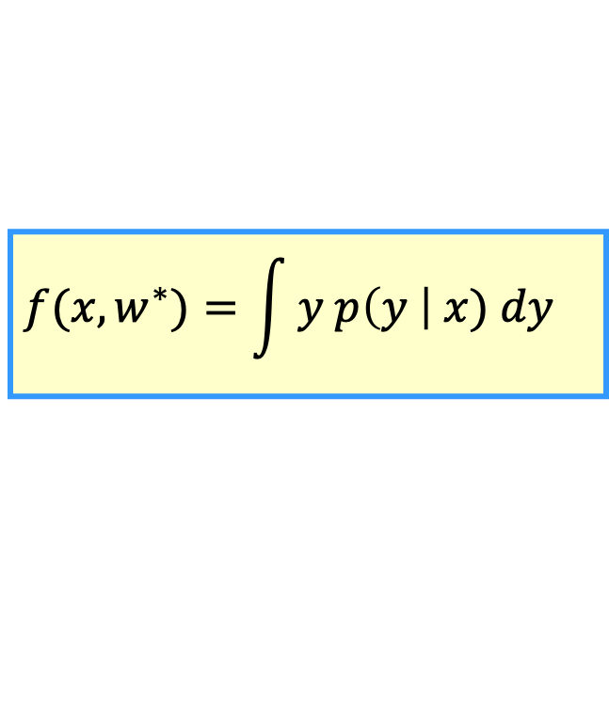
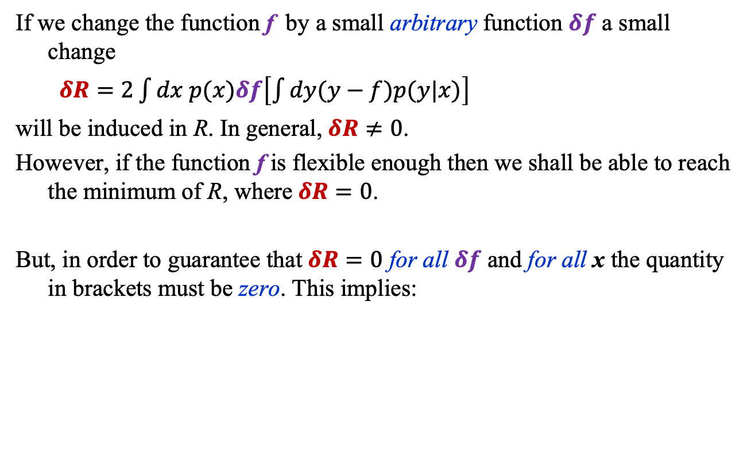
Minimizing the Average Loss
If we change the function f by a small arbitrary function $δf$ a small change
$δR=2\int{dx p(x)δf\left[\int{dy(y−f)p(y|x)}\right]}$
will be induced in R. In general, $δR≠0$.
However, if the function f is flexible enough then we shall be able to reach the minimum of R, where$δR=0$.
But, in order to guarantee that $δR=0$ for all $δf$ and for all x the quantity in brackets must be zero. This implies:
$$f(x, w^{∗})=\int{y p\left(y \right| x) dy}$$

Slide 10
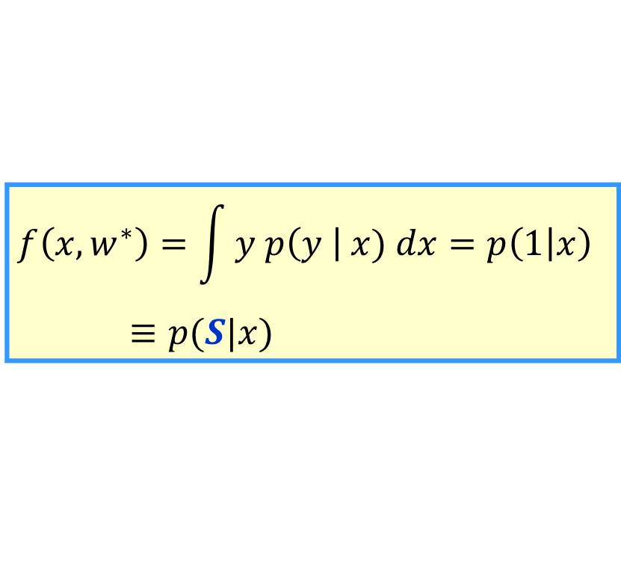
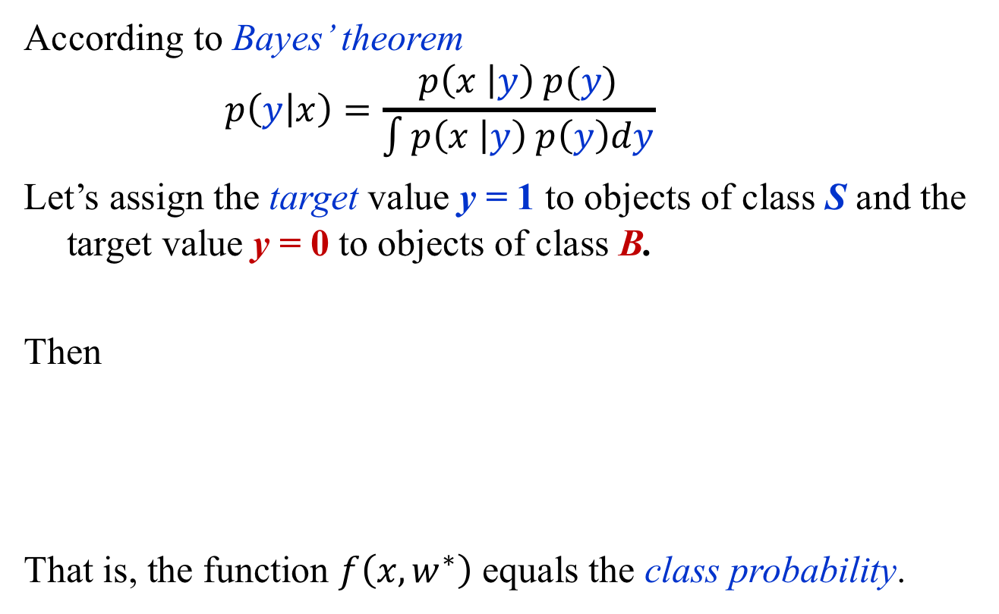
Classification
According to Bayes’ theorem
    $$p\left(y | x\right)=\frac{p\left(x | y\right) p(y)}{\int{p\left(x | y\right) p\left(y\right)dy}}$$
Let’s assign the target value y = 1 to objects of class S and the target value y = 0 to objects of class B.
Then
That is, the function $f\left(x,w^{∗}\right)$ equals the class probability.
$$f\left(x, w^{∗}\right)=\int{y p\left(y \right| x) dx}=p\left(1 | x\right)$$
$≡p(S|x)$

Slide 11
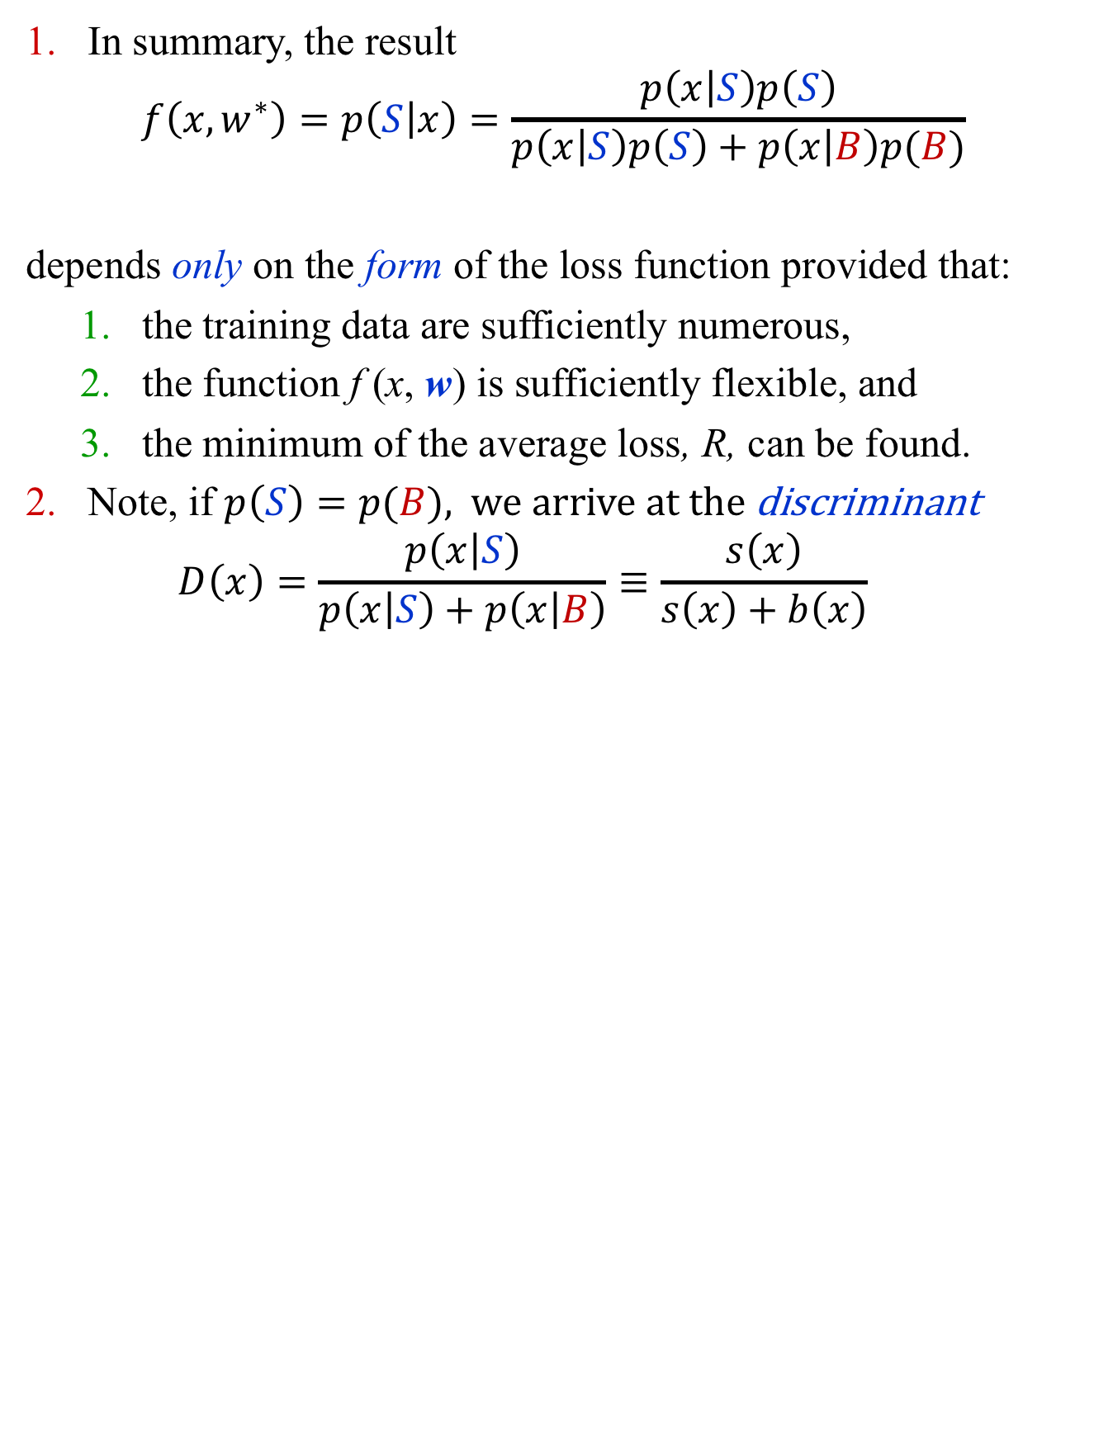
Classification
In summary, the result
$$f\left(x,w^{∗}\right)=p\left(S | x\right)=\frac{p\left(x | S\right)p\left(S\right)}{p\left(x | S\right)p\left(S\right)+p\left(x | B\right)p(B)}$$
depends only on the form of the loss function provided that:
  the training data are sufficiently numerous,
  the function f (x, w) is sufficiently flexible, and
  the minimum of the average loss, R, can be found.
Note, if $p\left(S\right)=p(B)$, we arrive at the discriminant
  $$D\left(x\right)=\frac{p\left(x | S\right)}{p\left(x | S\right)+p\left(x | B\right)}≡\frac{s\left(x\right)}{s\left(x\right)+b\left(x\right)}$$

Slide 12

decision trees
$$pp→H→ZZ→4l$$

Slide 13


$$pp→H→ZZ→4l$$
y
x
z
$$p_{T},η, φ η=−\ln{\tan{\frac{θ}{2}}}$$

Slide 14
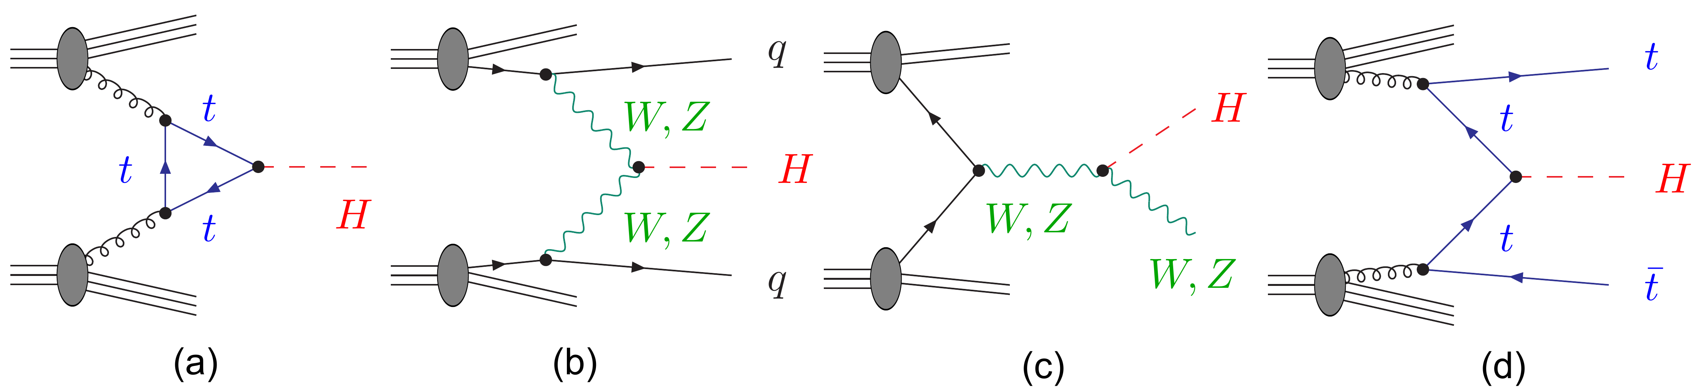

Higgs Boson Production
Process $σ × BR (fb)$
Gluon gluon fusion (ggF) 12.18
Vector boson fusion (VBF) 1.044
Associated production (VH) 1.047
Top anti-top fusion (ttH) 0.393
Before event selection, background ~ 1700 times larger!
http://www.scholarpedia.org/article/The_Higgs_Boson_discovery

Slide 15
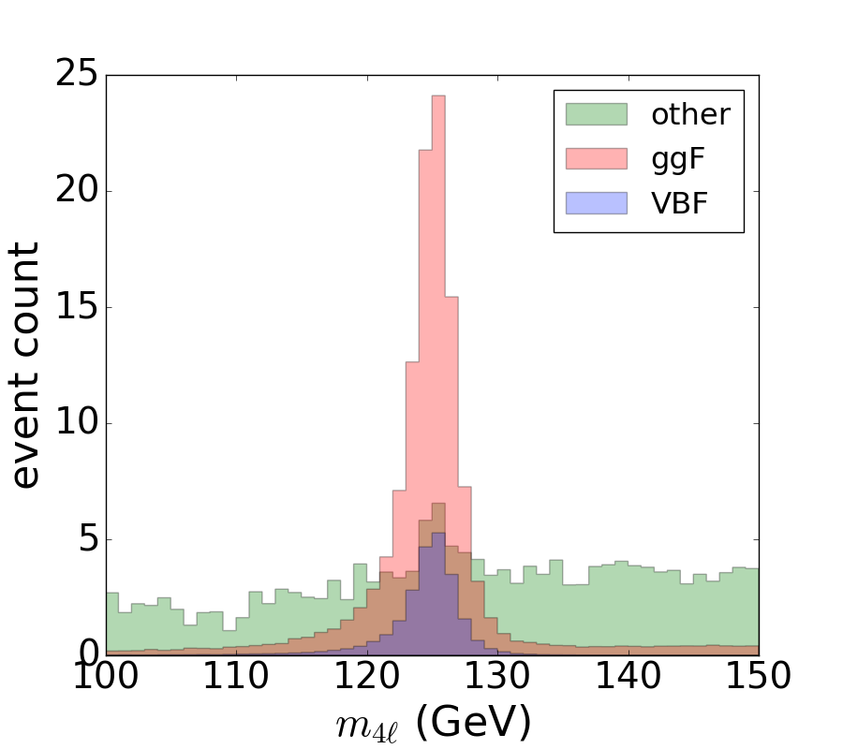
VBF vs. ggF Higgs Boson Production
The Higgs boson mass is an excellent discriminant between Higgs boson events and
many other classes
of events.
But clearly it is not
good for separating
VBF events from
ggF events. For that
we need other
observables.

Slide 16
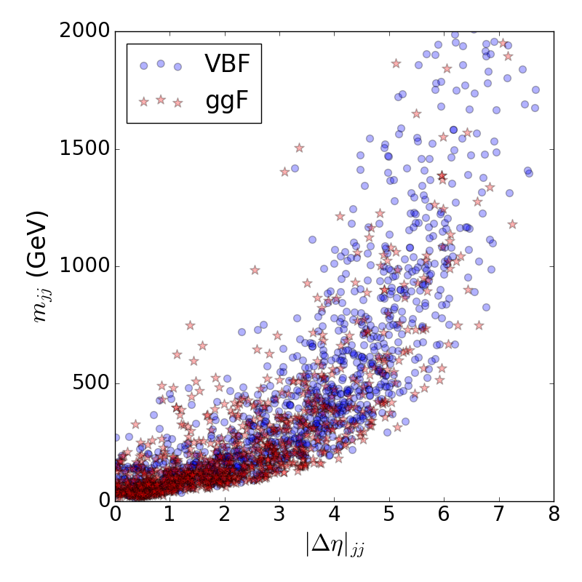
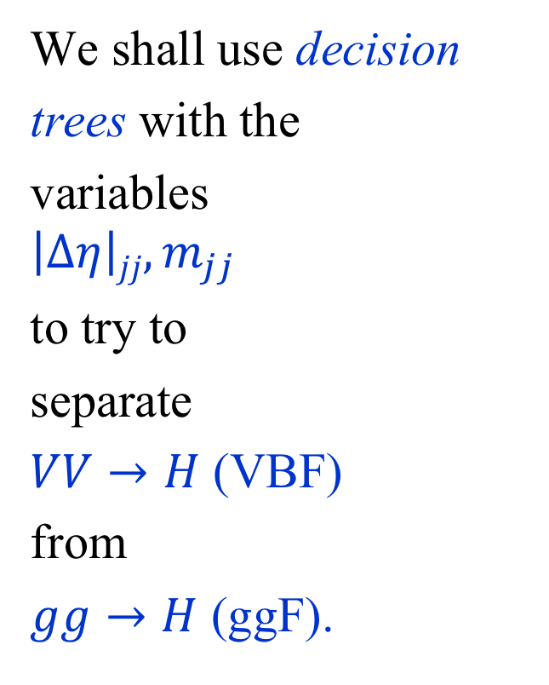
We shall use decision
trees with the
variables
$$\left|∆η\right|jj, m_{jj}$$
to try to
separate
$VV→H$ (VBF)
from
$gg→H$ (ggF).

Slide 17
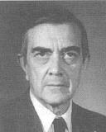
Decision Trees
A decision tree (DT) is a set of if then else statements that form a tree-like structure.
Algorithm: recursively partition the space into regions of diminishing impurity.
A common impurity measure is the Gini Index:
p (1 – p), where p is the purity
p = S / (S + B)
p = 0 or 1: maximum purity
p = 0.5: maximum impurity
(Corrado Gini, 1884-1965)

Slide 18
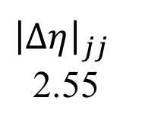

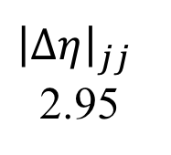
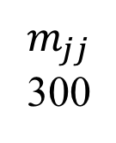
Decision Trees
For each variable,
find the partition
(“cut”) that gives
the greatest decrease in
impurity.
Choose the best partition among all partitions
and split the data
along that
partition into two
subsets.
Repeat 1. and 2. for each subset of data.
VBF
0.63
ggF
0.35
VBF
0.81
ggF
0.42
${\left|∆η\right|}_{jj}$
2.55
${\left|∆η\right|}_{jj}$
2.95
<
<
$m_{jj}$
577
ggF
0.34
<
$$m_{jj}$$
300
<

Slide 19
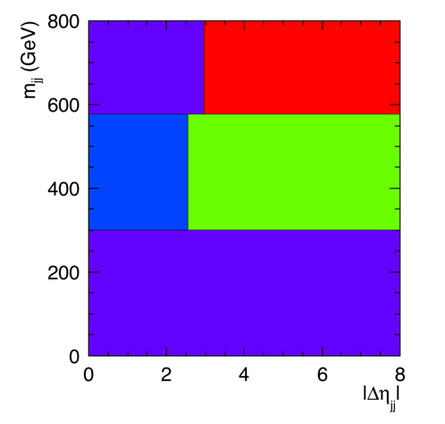
Decision Trees
Geometrically, a
decision tree is just a
d-dimensional
histogram in which the
bins are created
recursively.
ggF
0.42
VBF
0.63
ggF
0.35
VBF
0.81
${\left|∆η\right|}_{jj}$
2.55
${\left|∆η\right|}_{jj}$
2.95
<
<
$m_{jj}$
577
ggF
0.34
<
$$m_{jj}$$
300
<

Slide 20
Decision Trees
Unfortunately, decision trees are unstable!

Slide 21
Boosted decision trees

Slide 22
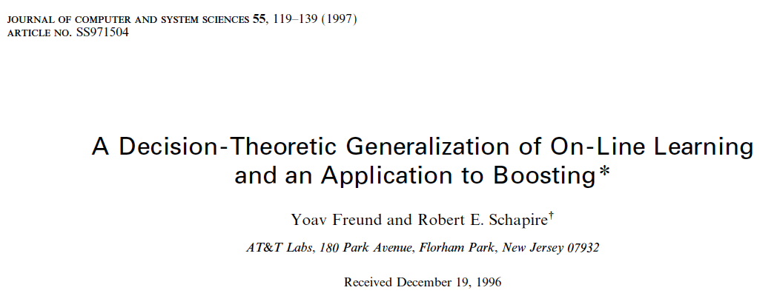
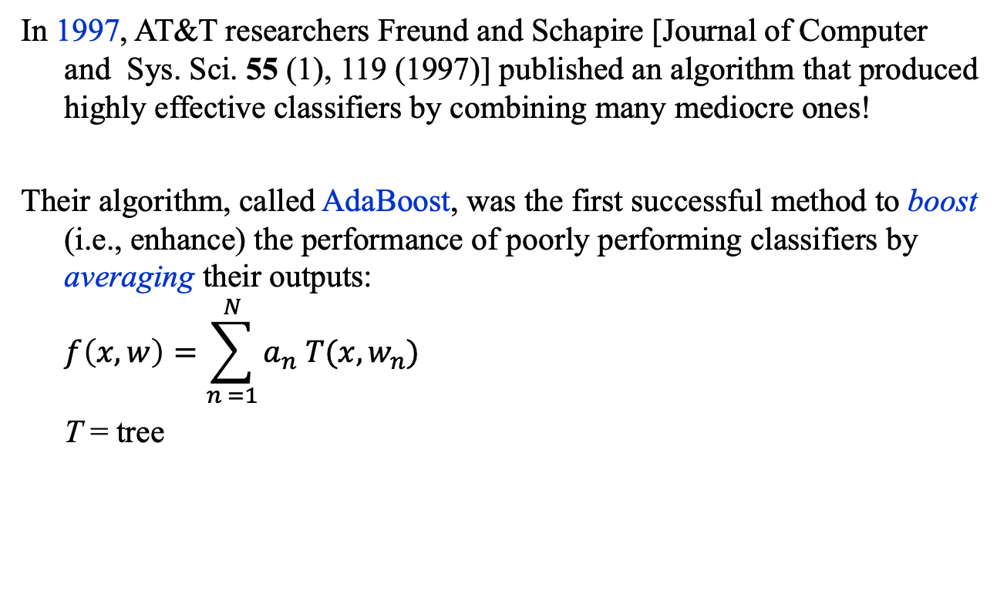
Boosted Decision Trees: AdaBoost
In 1997, AT&T researchers Freund and Schapire [Journal of Computer and Sys. Sci. 55 (1), 119 (1997)] published an algorithm that produced highly effective classifiers by combining many mediocre ones!
Their algorithm, called AdaBoost, was the first successful method to boost (i.e., enhance) the performance of poorly performing classifiers by averaging their outputs:
$$f\left(x, w\right)=\sum_{n =1}^{N}{a_{n} T(x, w_{n})}$$
T = tree

Slide 23
Averaging Methods
The most popular methods (used mostly with decision trees) are:
  Bagging: each tree is trained on a bootstrap* sample drawn from the training set
  Random Forest: bagging with randomized trees
  Boosting: each tree trained on a different reweighting of the training set
*A bootstrap sample is a sample of size N drawn, with replacement, from another of the same size. Duplicates can occur and are allowed.

Slide 24
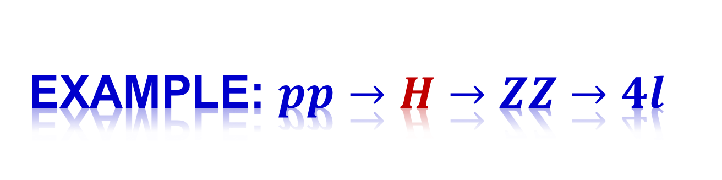
Example: $pp→H→ZZ→4l$

Slide 25
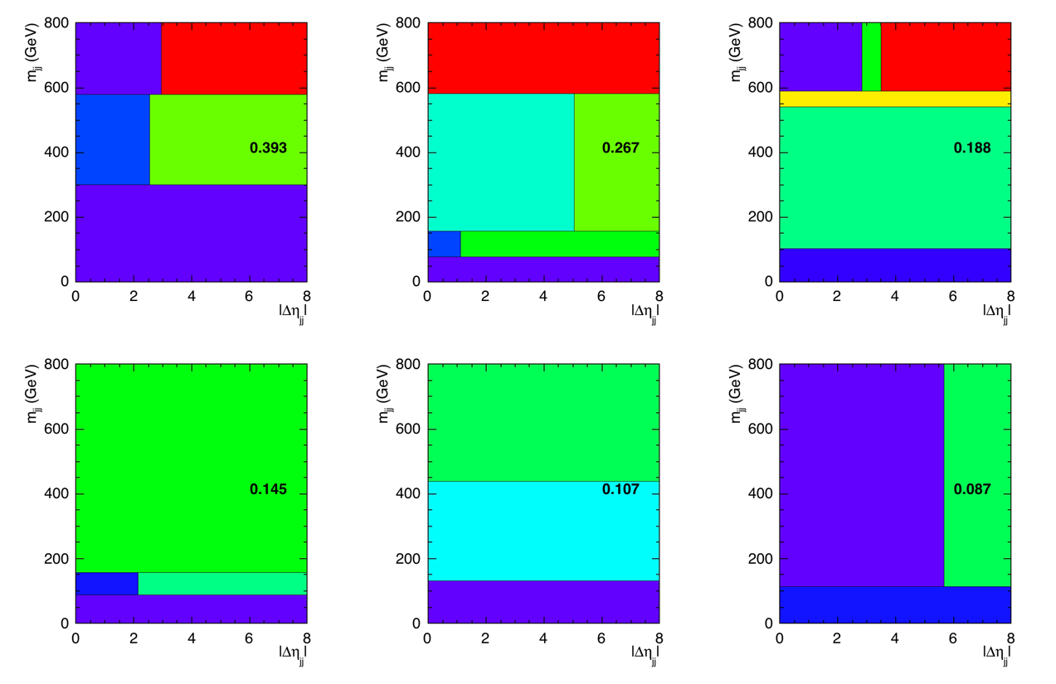
VBF vs. ggF: First 6 Decision Trees

Slide 26
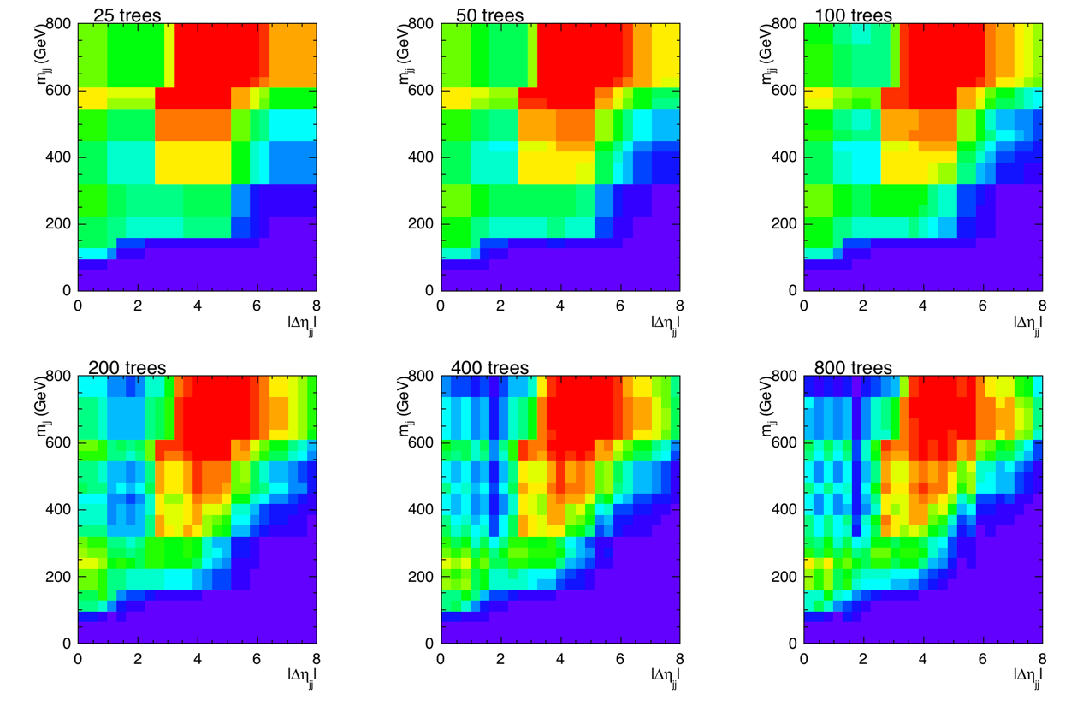
VBF vs. ggF: <Decision Trees>

Slide 27
neural networks

Slide 28
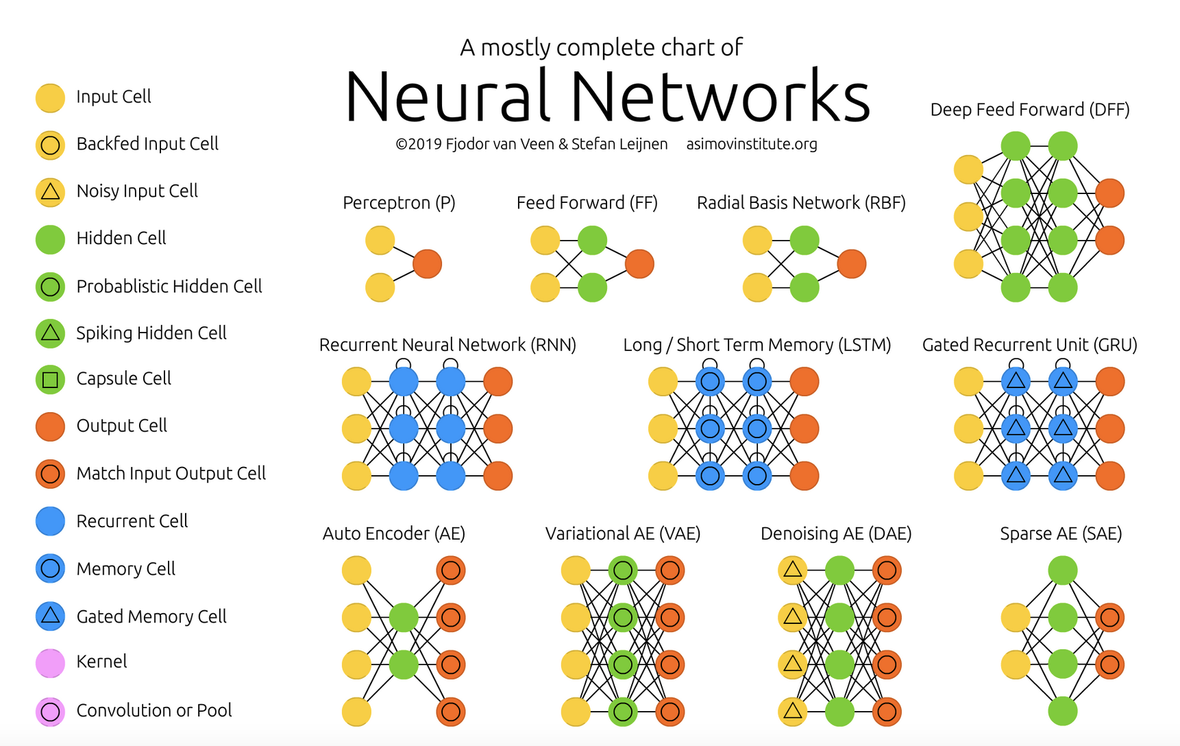
https://www.asimovinstitute.org/neural-network-zoo/

Slide 29
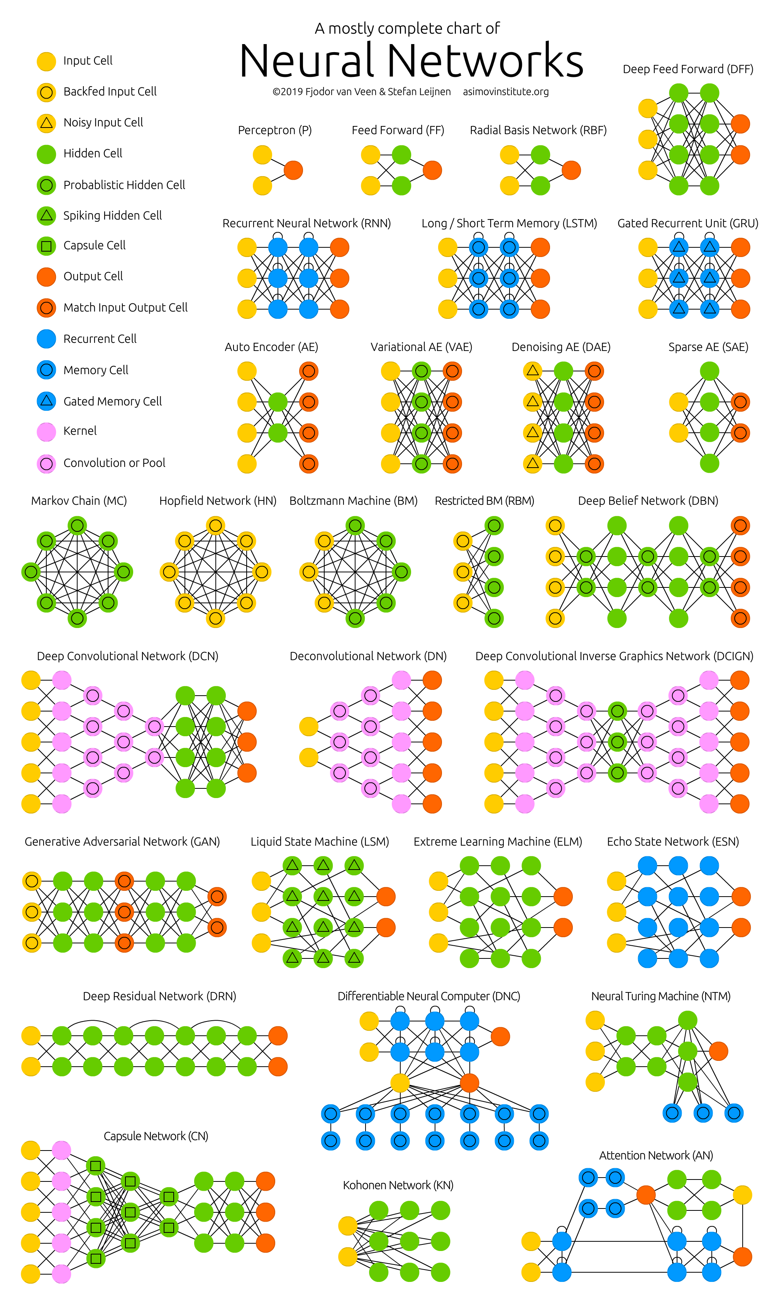
The NN Zoo
https://www.asimovinstitute.org/neural-network-zoo/

Slide 30
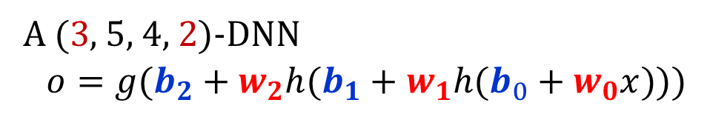
Neural Networks
input layer layer 0 layer 1 layer 2
A (3, 5, 4, 2)-DNN
$$o=g(b_{2}+w_{2}h(b_{1}+w_{1}h(b_{0}+w_{0}x)))$$
h(z) = ReLU(z) [= max(0, z)], tanh(z)
g(z) = Identity(z), logistic(z) = 1/[1 + exp(-z)]

Slide 31
Deep Neural Networks
In 2006, Hinton, Osindero, and Teh¹ (U. of Toronto ) succeeded in training a deep neural network for the first time using a very clever training algorithm.
But, in 2010, Cirȩsan et al.² showed that extreme cleverness was not needed! Just a lot of computing power!
The authors succeeded in training a DNN with architecture (784, 2500, 2000, 1500, 1000, 500, 10) to classify the hand-written digits in the MNIST database.
1 Hinton, G. E., Osindero, S. and Teh, Y., A fast learning algorithm
for deep belief nets, Neural Computation 18, 1527-1554.
2 Cirȩsan DC, Meier U, Gambardella LM, Schmidhuber J. , Deep, big,
simple neural nets for handwritten digit recognition. Neural Comput. 2010 Dec;
22 (12): 3207-20. http://yann.lecun.com/exdb/mnist/

Slide 32
Deep Neural Networks
The database comprises 60,000 28×28 = 784-pixel images for training and validation, and 10,000 for testing.
The error rate of their (784, 2500, 2000, 1500, 1000, 500, 10) DNN was 35 images out of 10,000.
The misclassified images are shown on the next slide.
2 Cirȩsan DC, Meier U, Gambardella LM, Schmidhuber J. , Deep, big,
simple neural nets for handwritten digit recognition. Neural Comput. 2010 Dec;
22 (12): 3207-20. http://yann.lecun.com/exdb/mnist/

Slide 33
(784, 2500, 2000, 1500, 1000, 500, 10)
Upper right: correct answer; lower left answer of highest DNN output;
lower right answer of next highest DNN output.

Slide 34
HBP

Slide 35
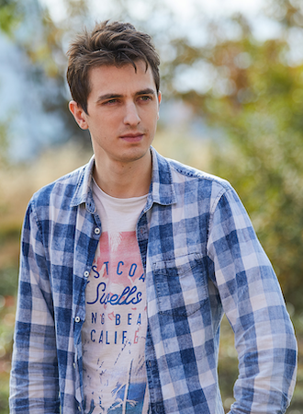
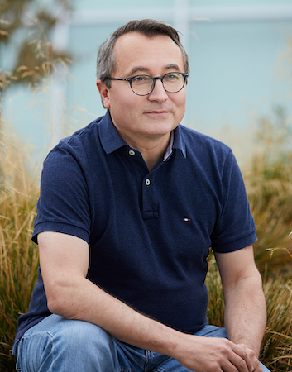
Symbolic Mathematics
In December 2019, Guillaume Lample and François Charton* at Facebook AI Research, Paris, made the startling claim: “We achieve results that outperform commercial Computer Algebra Systems such as Matlab or Mathematica.”
G. Lample and F. Charton, Deep Learning for Symbolic Mathematics, arXiv: 1912.01412v1.
Lample
Charton

Slide 36
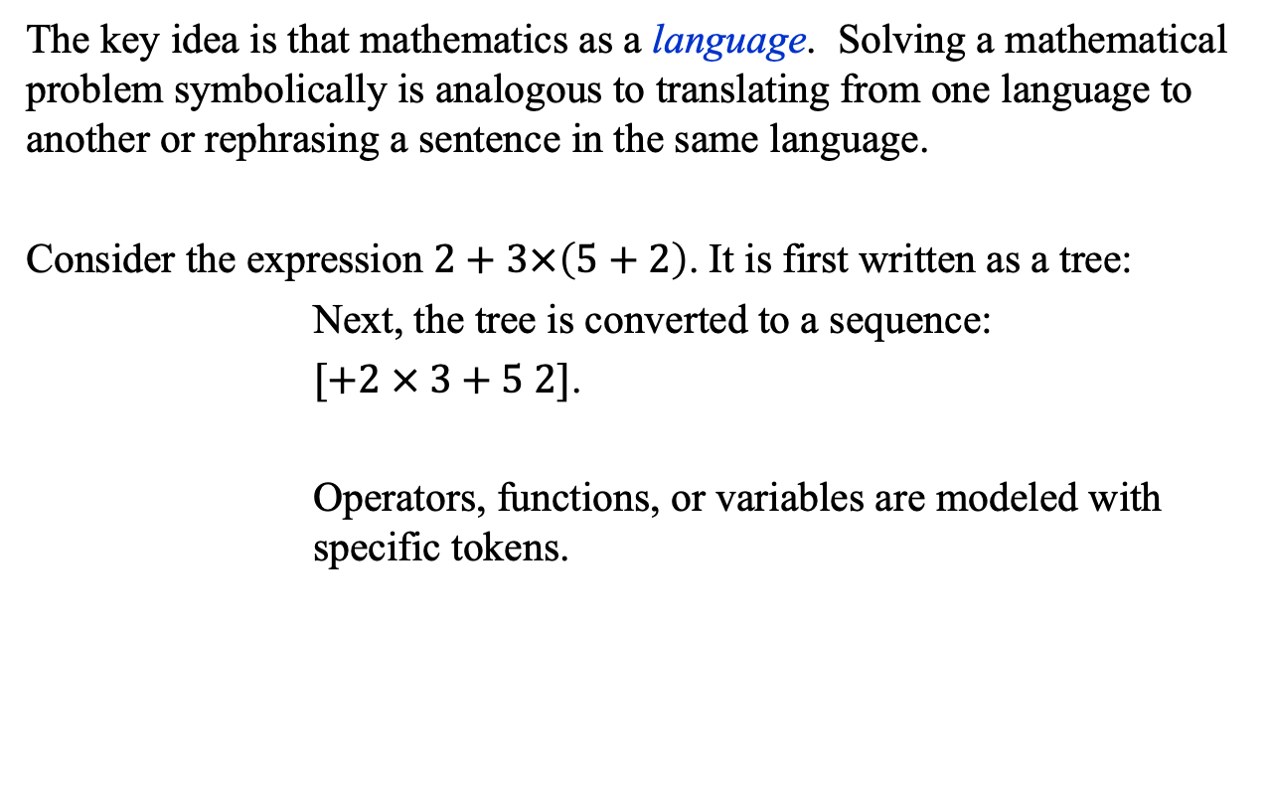
Symbolic Mathematics
The key idea is that mathematics as a language. Solving a mathematical problem symbolically is analogous to translating from one language to another or rephrasing a sentence in the same language.
Consider the expression $2+3×\left(5+2\right)$. It is first written as a tree:
Next, the tree is converted to a sequence:
$[+2 × 3+5 2]$.
Operators, functions, or variables are modeled with specific tokens.

Slide 37
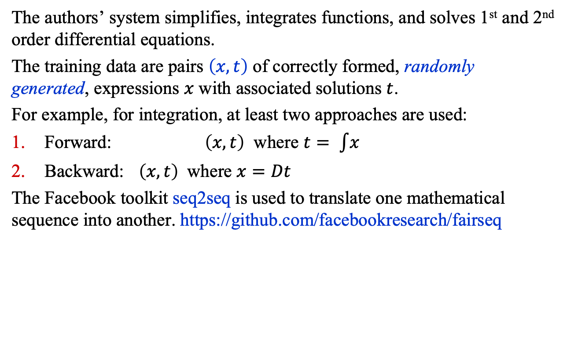
Symbolic Mathematics
The authors’ system simplifies, integrates functions, and solves 1st and 2nd order differential equations.
The training data are pairs $\left(x, t\right)$ of correctly formed, randomly generated, expressions $x$ with associated solutions $t$.
For example, for integration, at least two approaches are used:
Forward: $\left(x, t\right)$ where $t= \int{x}$
Backward: $\left(x, t\right)$ where $x=Dt$
The Facebook toolkit seq2seq is used to translate one mathematical sequence into another. https://github.com/facebookresearch/fairseq

Slide 38
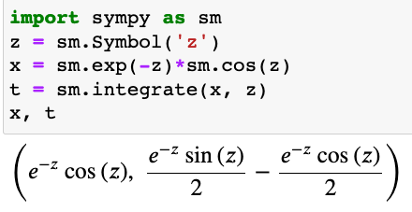
Symbolic Mathematics
…and here is something truly wonderful…
The authors trained their model using the subset of randomly generated functions that sympy can integrate, e.g.,
..and found that the model was able to integrate functions that sympy could not!

Slide 39
The future of machine learning

Slide 40
The Future of Machine Learning
In Particle Physics
  The standard approach to classification and regression problems is to use physical insight to arrive at suitable variables and functions.
  However, in recent work, machine learning has matched or outperformed the work of expert physicists.
In Society
  The most far-reaching application of machine learning is artificial intelligence (AI), a technological development that could transform our societies more profoundly than did the Industrial Revolution.

Slide 41
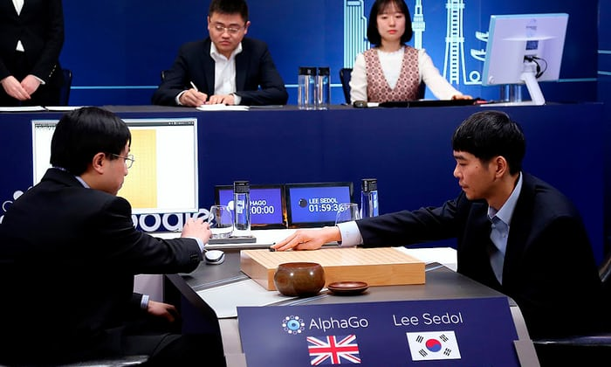
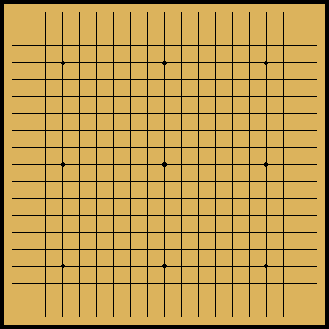
AlphaGo 4, Homo sapiens 1
2016 – Google’s AlphaGo program beats Go champion Lee Sodol.
Photograph: Yonhap/Reuters

Slide 42
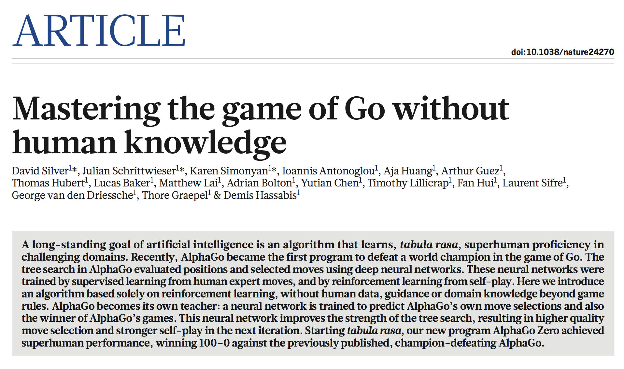
356 | NATURE | VOL 550 | 19 OCTOBER 2017

Slide 43
AlphaZero
arXiv:1712.01815v1
“Starting from random play, and given no domain knowledge
except the game rules, AlphaZero achieved within 24 hours a
superhuman level of play in the games of chess and shogi (Japanese
chess) as well as Go, and convincingly defeated a world-champion
program in each case.”

Slide 44
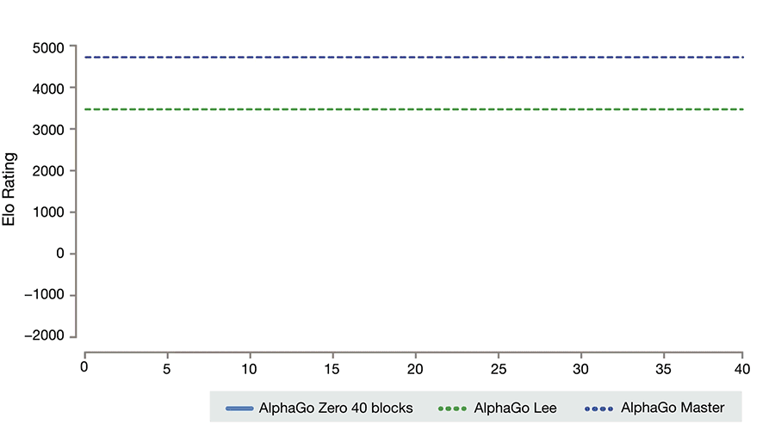
https://deepmind.com/blog/alphago-zero-learning-scratch/

Slide 45
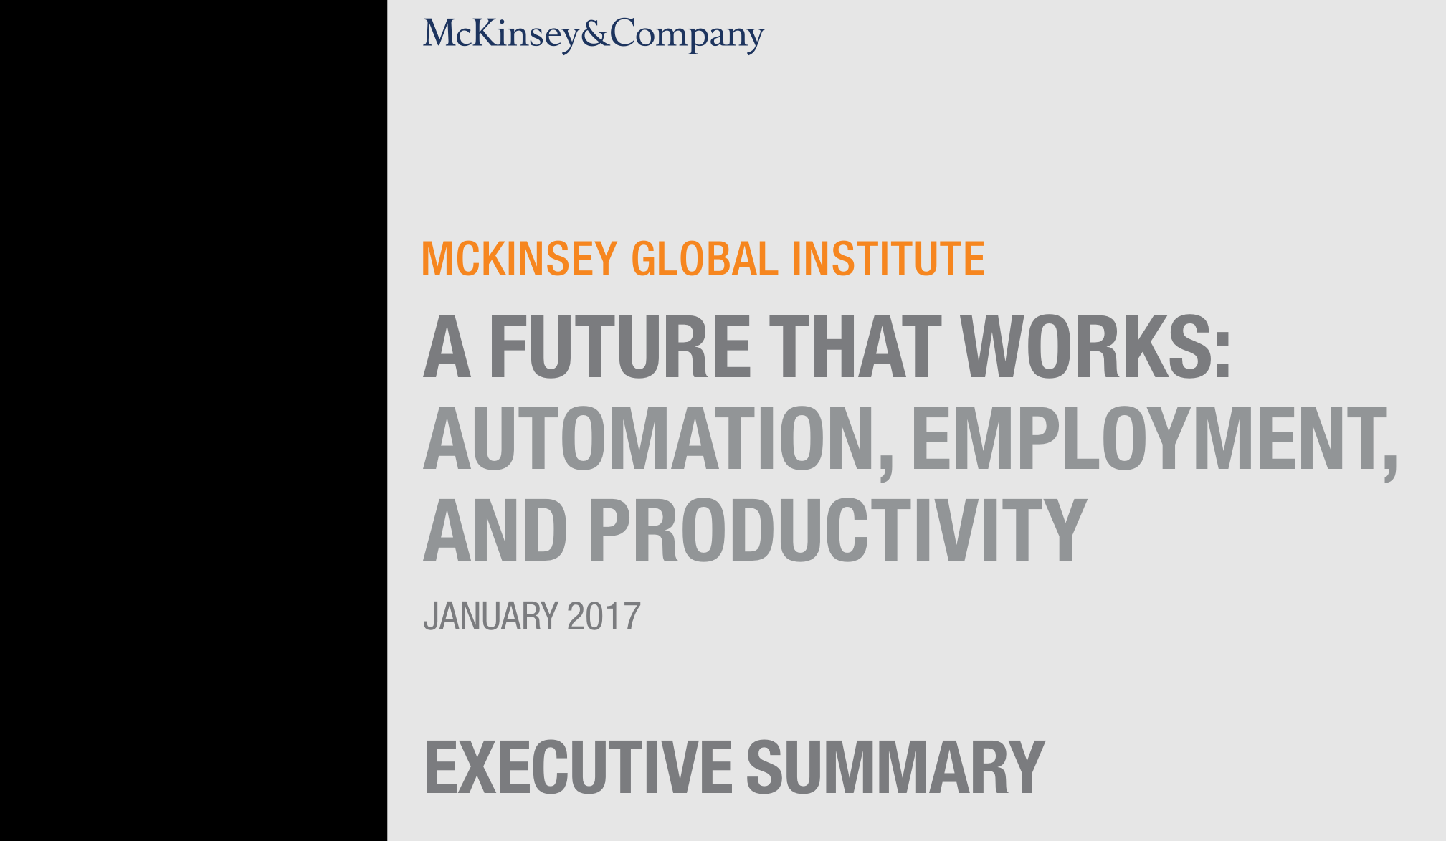

Slide 46
“Almost half the activities people are paid almost $16 trillion in wages to do in the global economy have the potential to be automated by adapting currently demonstrated technology, according to our analysis of more than 2,000 work activities across 800 occupations.”
McKinsey & Company,
A FUTURE THAT WORKS: AUTOMATION, EMPLOYMENT, AND PRODUCTIVITY
Executive Summary January 2017

Slide 47
The Future of Machine Learning
By 2050, the following AI systems might be in routine use:
personal predictive medical systems
personal tutors
autonomous house servants
autonomous vehicles that can drive safely in Delhi!
The potential of machine learning and AI is vast and exciting.
But some have argued (e.g, Henry Kissinger, Bill Gates, Elon Musk) that the dangers are also vast: autonomous drone soldiers, AI-enhanced computer viruses…
Your lives may well come to depend on AI systems…

Slide 48


Slide 49

Thank You!
“Doubt is not a pleasant condition, but certainty
is an absurd one”
Voltaire

Slide 50
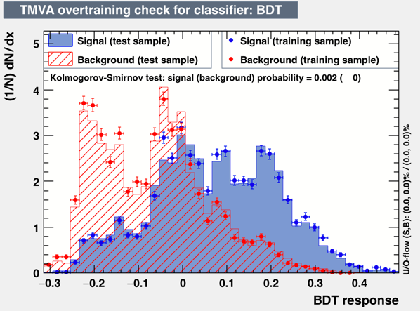
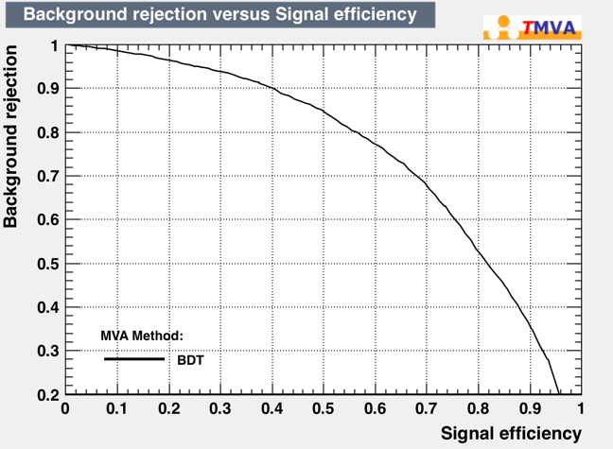
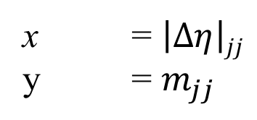
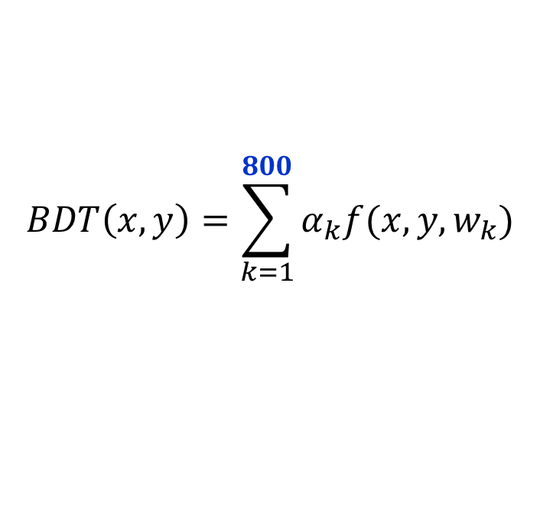
VBF vs. ggF: Results
x = $\left|∆η\right|jj$
y = $m_{jj}$
$$BDT\left(x, y\right)=\sum_{k=1}^{800}{α_{k}f(x, y, w_{k})}$$
Fraction of ggF events rejected
for a given fraction of VBF
events accepted.

Slide 51
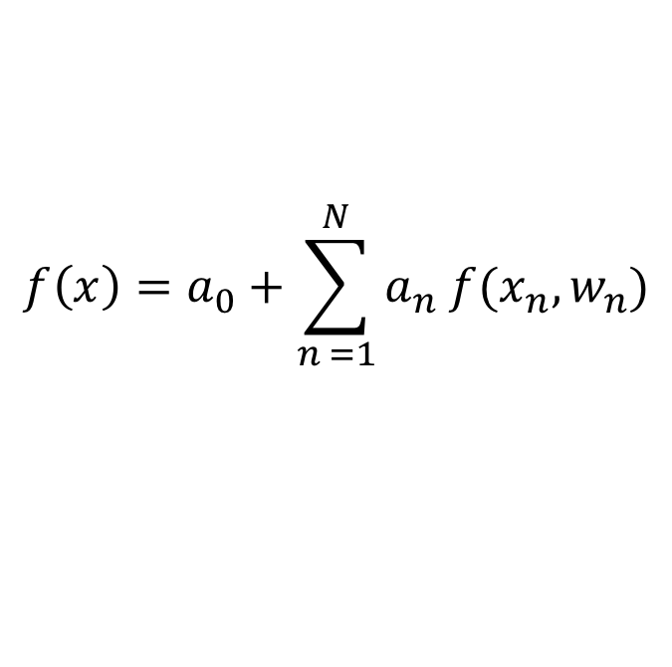
Ensemble Methods
Suppose you have an ensemble of classifiers f (x, w_{k}), which, individually, perform only marginally better than random guessing. Such classifiers are called weak learners.
It is possible to build highly effective classifiers by averaging their outputs:
$$f\left(x\right)=a_{0}+\sum_{n =1}^{N}{a_{n} f(x_{n}, w_{n})}$$
Jerome Friedman & Bogdan Popescu (2008)

Slide 52
Adaptive Boosting
The AdaBoost algorithm of Freund and Schapire uses decision trees f (x, w) with weights w assigned to each object to be classified, and each assigned a target value of either y = +1, or –1, e.g., +1 for signal, –1 for background.
The value assigned to each leaf of f (x, w) is also ±1.
Consequently, for object n, associated with values (y_{n}, x_{n})
f (x_{n}, w) y_{n} > 0 for a correct classification f (x_{n}, w) y_{n} < 0 for an incorrect classification
Y. Freund and R.E. Schapire. Journal of Computer and Sys. Sci. 55 (1), 119 (1997)

Slide 53
Adaptive Boosting
Initialize weights w in training set (e.g., setting each to 1/N)
for k = 1 to K:
Create a decision tree f (x, w) using the current weights.
Compute its error rate ε on the weighted training set.
Compute α = ln (1– ε) / ε and store as α _{k} = α
Update each weight w_{n} in the training set as follows:
w_{n} = w_{n} exp[–α _{k} f (x_{n}, w) y_{n}] /A, where A is a normalization constant such that ∑w_{n} = 1. Since
f (x_{n}, w) y_{n} < 0 for an incorrect classification, the weight of misclassified objects is increased.
At the end, compute the average f (x) = ∑ α_{k} f (x, w_{k})
Y. Freund and R.E. Schapire. Journal of Computer and Sys. Sci. 55 (1), 119 (1997)

Slide 54
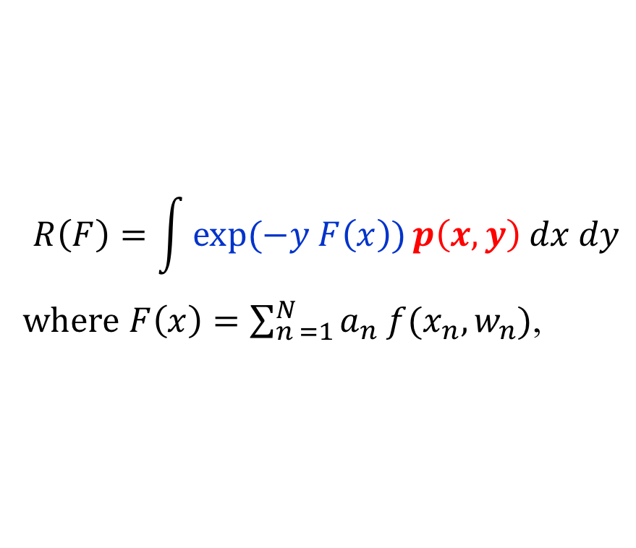
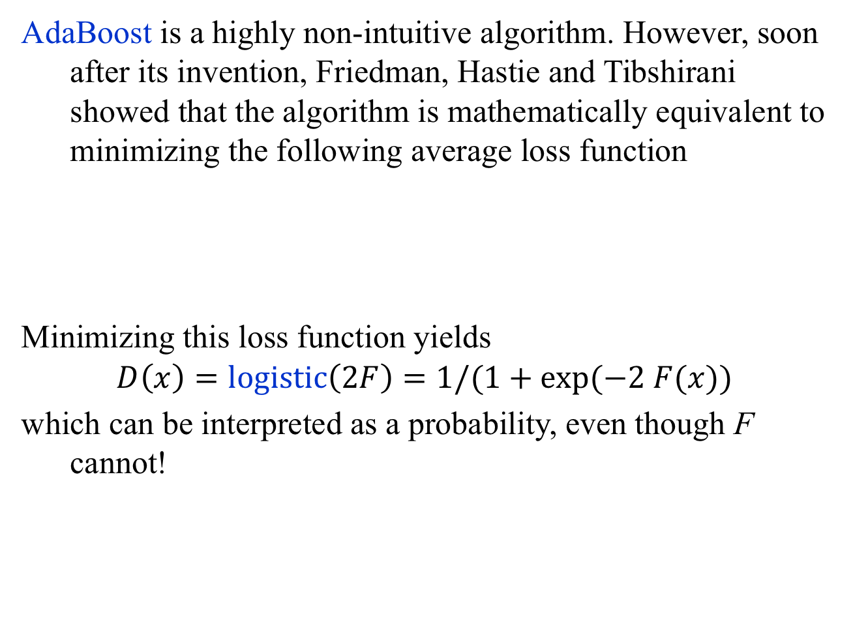
Adaptive Boosting
AdaBoost is a highly non-intuitive algorithm. However, soon after its invention, Friedman, Hastie and Tibshirani showed that the algorithm is mathematically equivalent to minimizing the following average loss function
Minimizing this loss function yields
$$D\left(x\right)=logistic\left(2F\right)=1/(1+exp⁡(−2 F(x))$$
which can be interpreted as a probability, even though F cannot!
$$R\left(F\right)=\int{\exp{(−y F\left(x\right))}p\left(x, y\right) dx dy}$$
$where$ $F\left(x\right)=\sum_{n =1}^{N}{a_{n} f(x_{n}, w_{n})}$,
J. Friedman, T. Hastie and R. Tibshirani, “Additive logistic regression: a statistical view of boosting,” The Annals of Statistics, 28(2), 377-386, (2000)

Slide 55
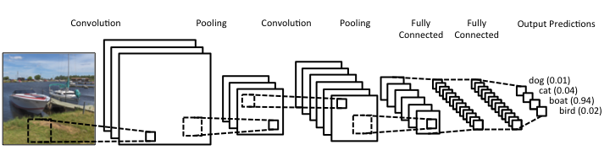
Convolutional Neural Networks
Many of the remarkable breakthroughs in tasks such as face recognition use a type of DNN called a convolutional neural network (CNN).
CNNs are functions that compress data and classify objects using their compressed representations using a fully connected NN. The compression dramatically reduces the dimensionality of the space to be searched.
Source: https://www.clarifai.com/technology

Slide 56
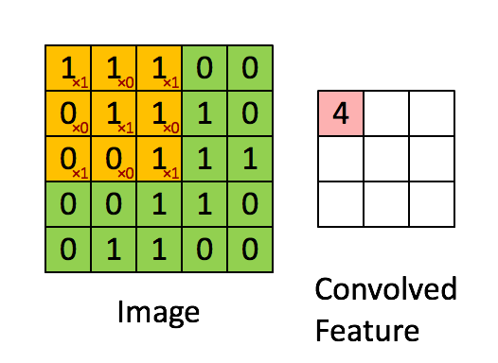
Convolutional Neural Networks
A CNN comprises three types of processing layers: 1. convolution, 2. pooling, and 3. classification.
Convolution layers
The input layer is “convolved” with one or more matrices using element-wise products that
are then summed. In this example,
since the sliding matrix fits 9
times, we compress the input from
a 5 x 5 to a to a 3 x 3 matrix.

Slide 57
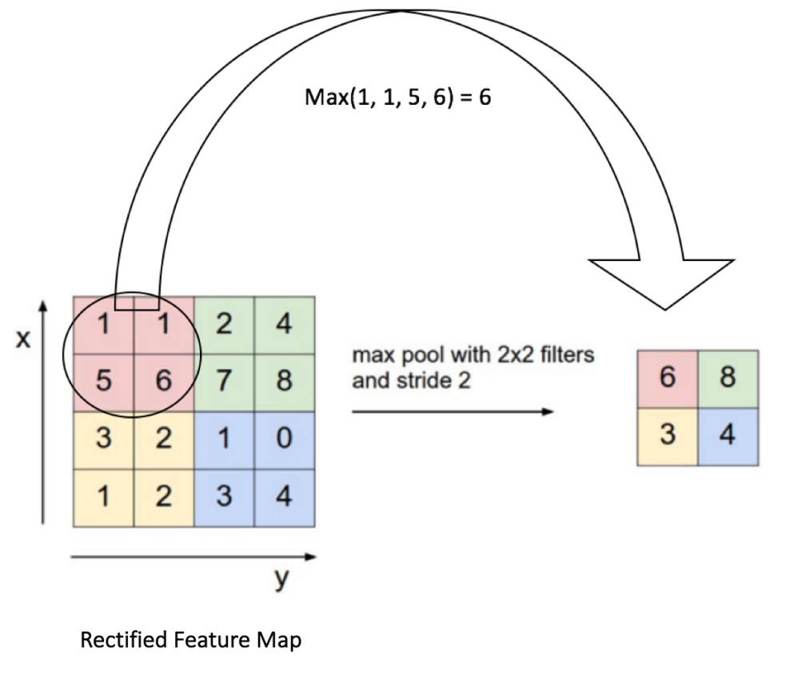
Convolutional Neural Networks
Pooling Layers
After convolution, and a pixel by pixel non-linear map (using, e.g., the function y = max(0, x) = ReLU(x)), a coarse-graining of the layer is performed
called max pooling in which the maximum
values within a series of small windows
are selected and become the output of
a pooling layer.

Slide 58
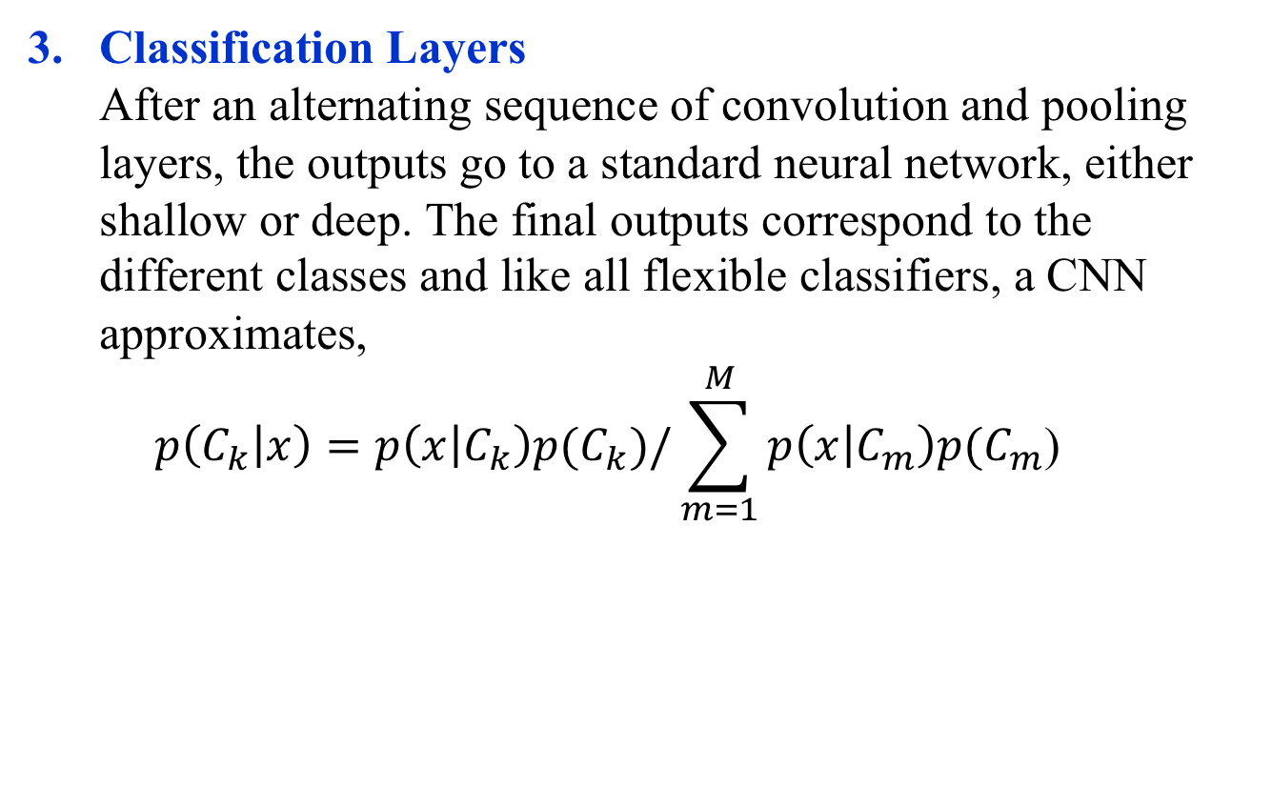
Convolutional Neural Networks
Classification Layers
After an alternating sequence of convolution and pooling layers, the outputs go to a standard neural network, either shallow or deep. The final outputs correspond to the different classes and like all flexible classifiers, a CNN approximates,
$p\left(C_{k} | x\right)=p\left(x | C_{k}\right)p(C_{k})/\sum_{m=1}^{M}{p\left(x | C_{m}\right)p(C_{m}\text{)}}$

Slide 59
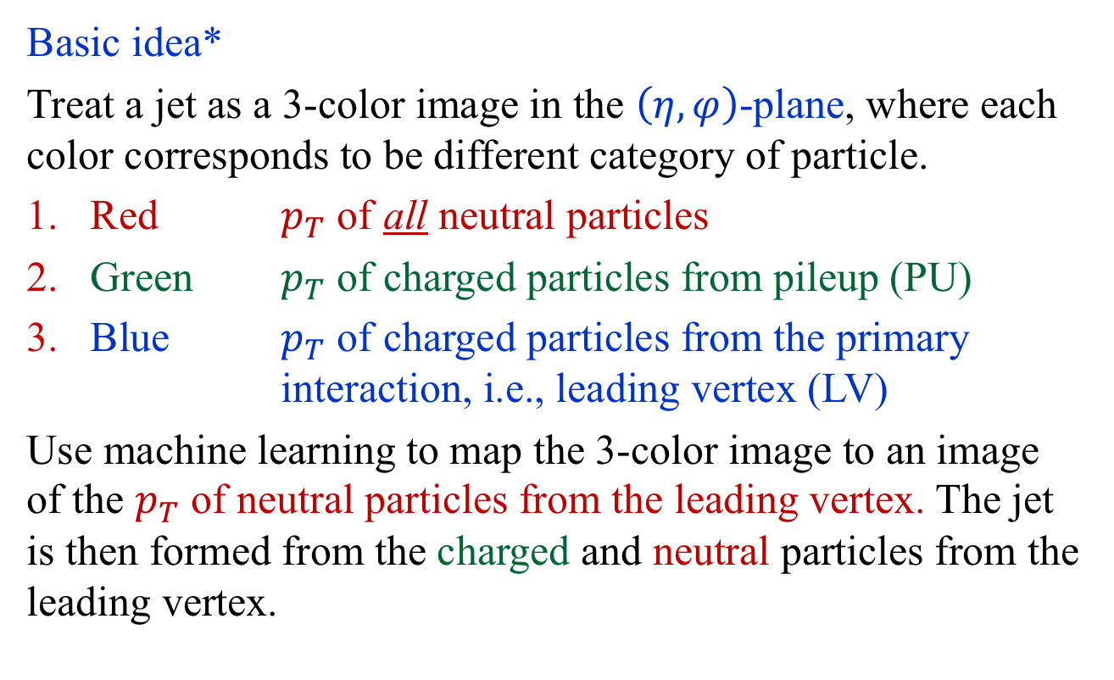
Pileup Mitigation Example: PUMML
Basic idea*
Treat a jet as a 3-color image in the $\left(η, φ\right)$-plane, where each color corresponds to be different category of particle.
Red $p_{T}$ of all neutral particles
Green $p_{T}$ of charged particles from pileup (PU)
Blue $p_{T}$ of charged particles from the primary interaction, i.e., leading vertex (LV)
Use machine learning to map the 3-color image to an image of the $p_{T}$ of neutral particles from the leading vertex. The jet is then formed from the charged and neutral particles from the leading vertex.
* Pileup Mitigation with Machine Learning (PUMML)
Metodiev, Komiske, Nachman, Schwarz, JHEP 12 (2017) 051, arXiv:1707.08600

Slide 60

Classification
The result
$$f\left(x\right)=p\left(S | x\right)=\frac{p\left(x | S\right)p\left(S\right)}{p\left(x | S\right)p\left(S\right)+p\left(x | B\right)p(B)}$$
was derived in 1990* in the context of neural networks.
But notice, our discussion so far made no mention of neural networks!
* Ruck et al., IEEE Trans. Neural Networks 4, 296-298 (1990); Wan, IEEE Trans. Neural Networks 4, 303-305 (1990);
Richard and Lippmann, Neural Computation. 3, 461-483 (1991)

