Slide 1



The FalconD Project
Future Accelerator post-LHC Cos-theta Optimised Nb₃Sn Dipole
Zoom October 14th 2021
INFN Team

Slide 2
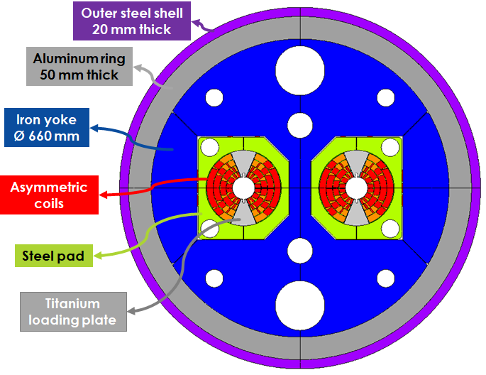
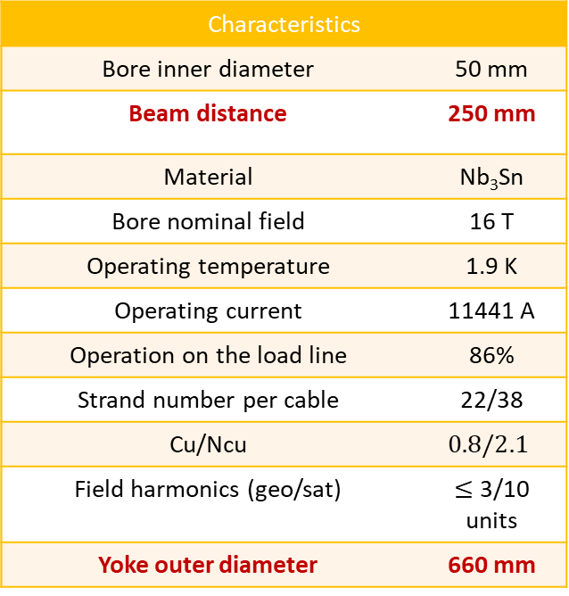
The starting point : EuroCirCol (H2020 project)
INFN has developed a twin 16 T cos-theta dipole design for FCC
Characteristics
Bore inner diameter | 50 mm
Beam distance | 250 mm
Material | Nb₃Sn
Bore nominal field | 16 T
Operating temperature | 1.9 K
Operating current | 11441 A
Operation on the load line | 86%
Strand number per cable | 22/38
Cu/Ncu | $$0.8/2.1$$
Field harmonics (geo/sat) | $≤$ 3/10 units
Yoke outer diameter | 660 mm

Slide 3
From EuroCirCol to short model development
Development in four years of a significant model in collaboration with industry
Single aperture, coil cross section comparable to EuroCirCol design, total length ∼2 m
Lay-out: initially similarly to EuroCirCol, i.e. a 4 layers cosine-theta dipole
The field had to be scaled according to the real conductor performances (in EuroCirCol J_{csup}= 1500 A/mm² @ 16 T, 4.2 K)
Start with the actual conductor characteristics
Plan the construction of a significant number of coils
Primary responsibility of INFN for design and construction
Strong contribution from CERN, in term of financial cash, materials, and know-how for Nb3Sn technology.

Slide 4
FalconD: the CERN-INFN agreement
Signed in October 2018
Addendum No. KE4102/FCC to FCC Memorandum of Understanding FCC-GOV-0004/17.10.2014
Collaboration on 16T –Nb3Sn Short Model Magnet Production in the framework of the FCC Study hosted by CERN
Five years program – (Deadline Sep. 2023) with a value 4300 k€
Cern contributes with 2750 k€ (1250 k€ materials&components+ 1500 k€ cash)
INFN contributes with 3050 k€ (+ the expenses of the oven)
Main prevision for expenses: Industrial Contract (2050 k€); INFN Engineering (1000 k€ for 12 MY)

Slide 5
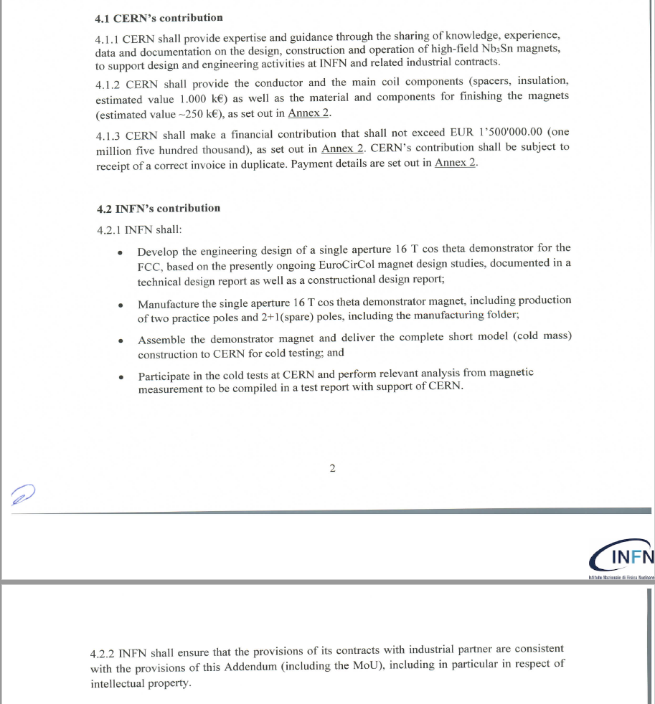

Slide 6
The consolidation of the short model program (FalconD project)
Considering difficulties in the construction of a 4-layers s.c. magnet, the limited experience of the team in Nb₃Sn technology and the involvement of the industry, the program then moved to the target of a field just over 11 T.
The magnet layout changed to a single aperture, 2 layers, cosine-theta, 1.5 m long dipole and nominal field 12 T at 1.9K .
The design choices allow to reach an ultimate field of about 14 T
Simplifying the structure as much as possible
Under these condition a two layers dipole is feasible (with a suitable large cable).
Considering the availability of CERN of Nb₃Sn wire ∅=1 mm, Cu/non-Cu =0.9, the choice of conductor went to a 40-strand Rutherford cable, which allow to have a reasonable margin (∼23% on load-line)
The reduction of n. of layers, allowed to plan the construction of a reasonably large number of coils (1 dummy coil, 1 practice pole + 4 real poles)

Slide 7
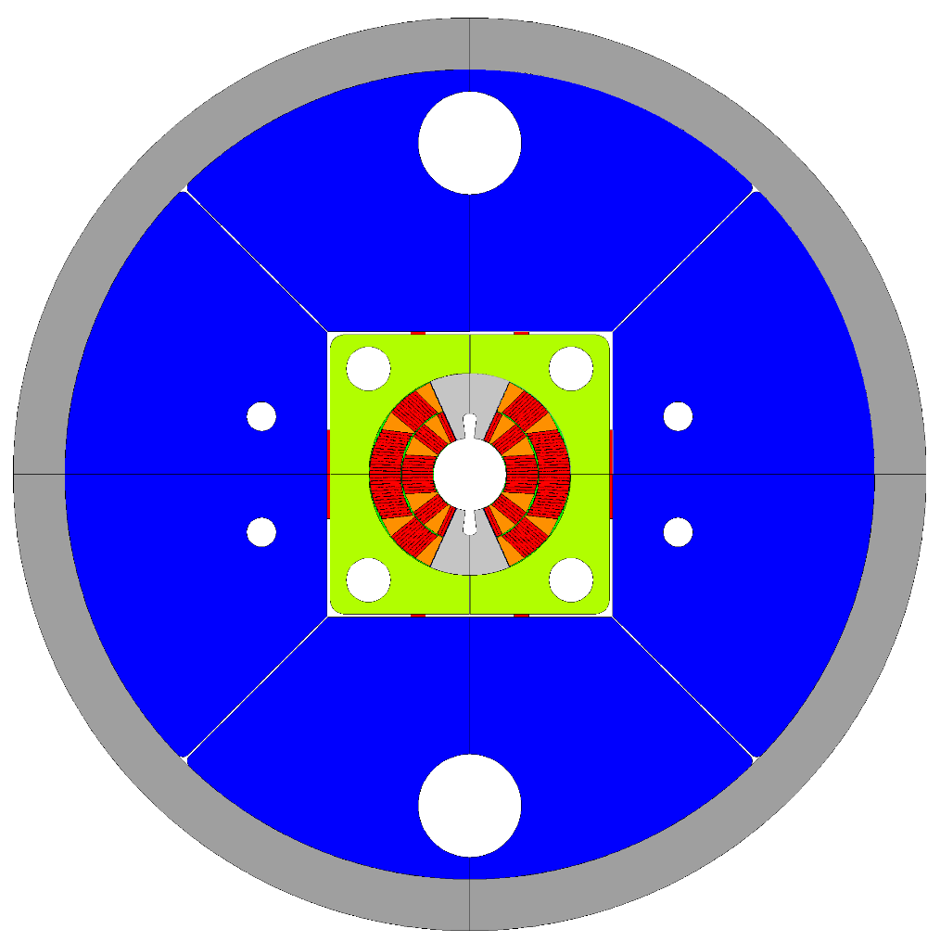
FalconD Dipole: Starting layout
Main characteristics :
2 layers ; 50 mm bore
Rutherford 40 strand Φ = 1 mm
Nominal magnetic field: 12 T
Ultimate magnetic field: 14 T
Short sample limit : 15.7 T
Mechanical structure: bladder & key
Stress in conductors <150 MPa in all conditions
Max dimension: 650 mm (LASA test)

Slide 8
The industrial contract awarded to ASG Superconductors in June 2020
The tender technical specification contained a series of target data, a possible lay-out and a list of construction activities to be carried out. Deadline 3 years.
From preliminary meetings it was agreed that ASG will focus on the construction of the coils. The contract aims to the construction of six coils to which two will be added following an integration of the contract itself (Our initial prevision was to cover the whole magnet construction)
As part of the development activities, INFN has purchased an oven for the heat treatment of the Nb₃Sn, initially intended to be installed in Milan-LASA, but later it was agreed to be temporarily installed in ASG Superconductors (given the risks of transporting reacted coils ).
The construction of the coils and a pre-assembly will be carried out in ASG Superconductors while the integration into the iron with the bladder & keys technique will be carried out at LASA, here a first cold test will also be carried out.

Slide 9
Construction activities in ASG
Construction drawings of the coils and of the mechanical structure excluding the flanges and in general the longitudinal pre-stress system.
Development and construction of the winding, curing, heat treatment (except the oven), impregnation and handling equipment
Preparation of the area to host the oven.
Construction of 6 coils including those materials not expressly specified later. Only the first one is dummy coil the others will involve the real cable. Pre-assembly of the coils
QA (except magnetic measurements) and as built documentation

Slide 10
INFN activities
Electromagnetic design ;
Coil end design ;
Mechanical design (2D and 3D) and constructive design of components not included in the ASG scope of work
Procurement of the oven ( 3 m long) and installation in ASG (temporary);
Integration of the coils into the mechanical structure and related tooling;
Field quality measurement ;
Magnet instrumentation and cold test

Slide 11
Materials and components provided by CERN
Insulated conductors ;
Ti poles and end spacers ( on the basis of ASG drawings) ;
Copper wedges (ASG drawings)
Quench heaters (INFN drawings )
Pads and iron yoke (ASG drawings )
Shell (INFN drawings)
Flanges and tie rods (ASG/INFN drawings )
Sensors
Bladders

Slide 12
Where we are: the TDR
Covid19 affected and delayed all the activities (1st milestone 2 years late partly due to this and partly because more than a year was needed to decide which model should be done (from 4 layers to 2 layers))

Slide 13
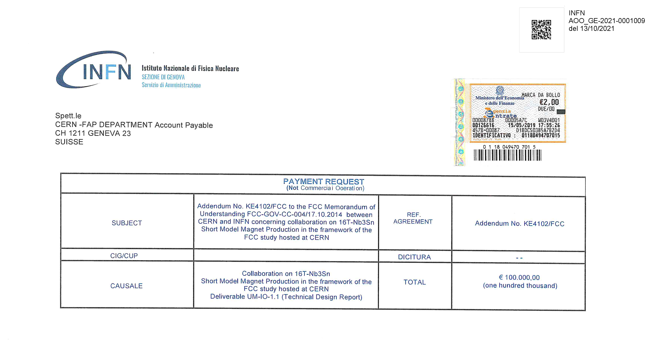
Where we are: the TDR
Following the suggestion by Germana during last meeting,
the invoice corresponding to the payment of deliverable UM-IO-1.1 has already been issued

Slide 14
Ongoing activities at ASG
Contract started on June 2020 – Activities started on July 2021
Constructive drawings of the coils
Constructive drawings of the tooling
Constructive drawings of mechanical structure and yoke
October 2021
Ongoing activities at INFN
Design activities aimed at the Technical Design Report
Procurement of the furnace (order signed Sept. 2020 -> delivery Jan 2022)
Procurement of minor equipment (B&K pumping system, mock-up, ..)
October 2021
The next step is the Constructional Design Report and the construction of the dummy coil (Dec-2021 -> Mar 2022)

Slide 15
Organization
S.Farinon INFN Coordination
7 FTE
INFN Genova
S. Farinon (Local responsible)
R. Musenich
A.Pampaloni
F. Levi (PhD)
S. Burioli (PhD)
INFN Milano LASA
M.Sorbi (Local responsible)
M. Prioli
M. Statera
E. De Matteis
S. Mariotto (Post-D)
R. Valente (PhD)
F.Lackner/?
H.Felice
ASG Superconductors
A.Verardo (Project Manager)
N.Valle
S.Ottazzi

Slide 16
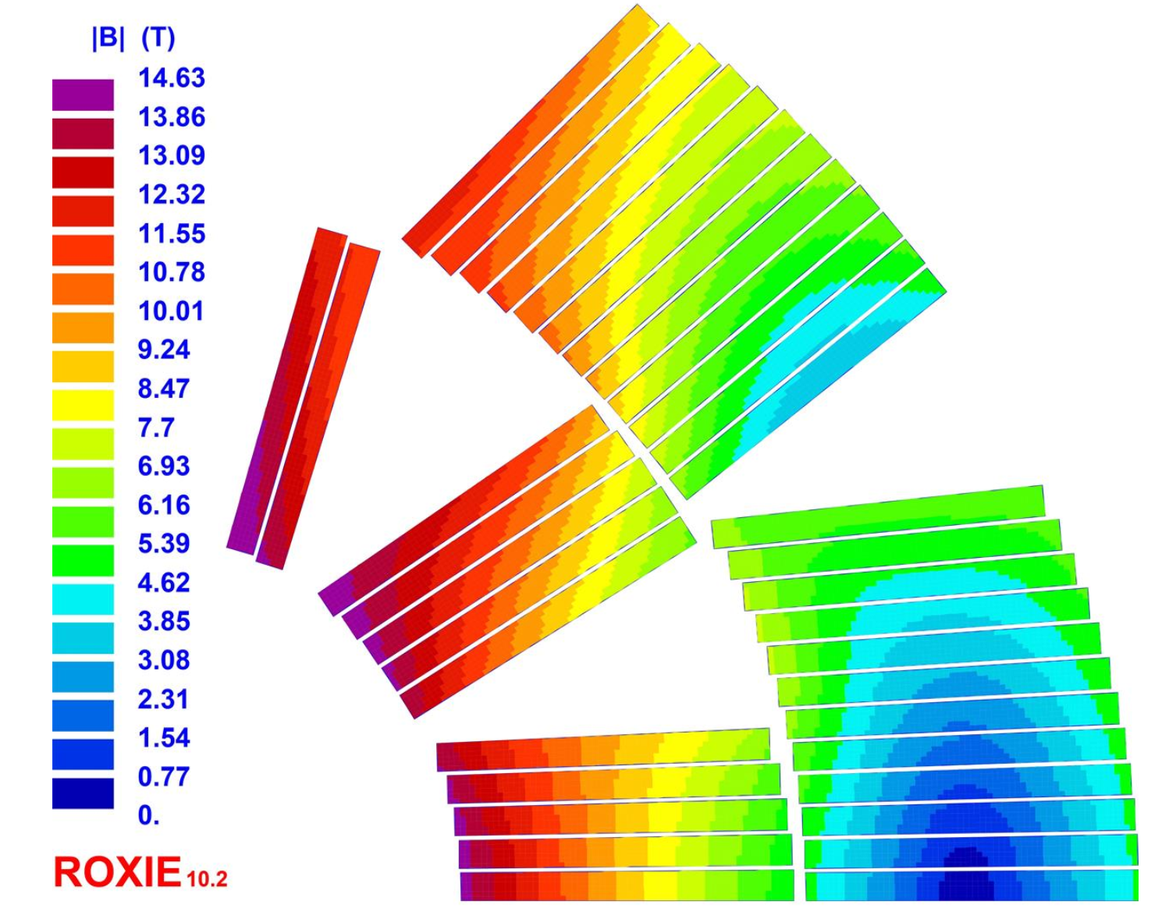
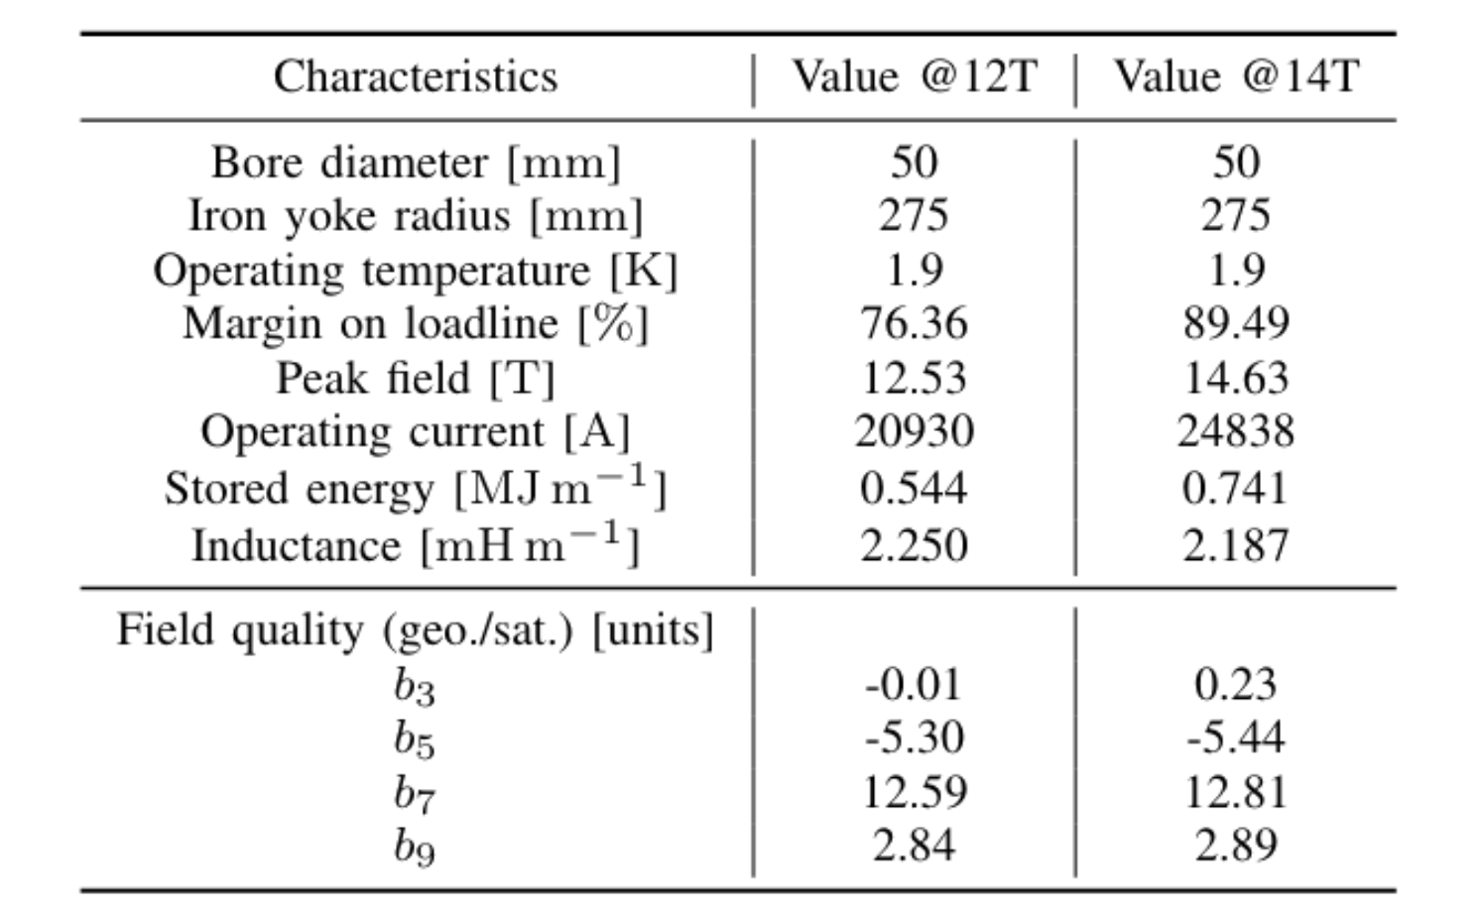
2D Magnet Design
Courtesy of R.Valente (INFN Mi-LASA)

Slide 17
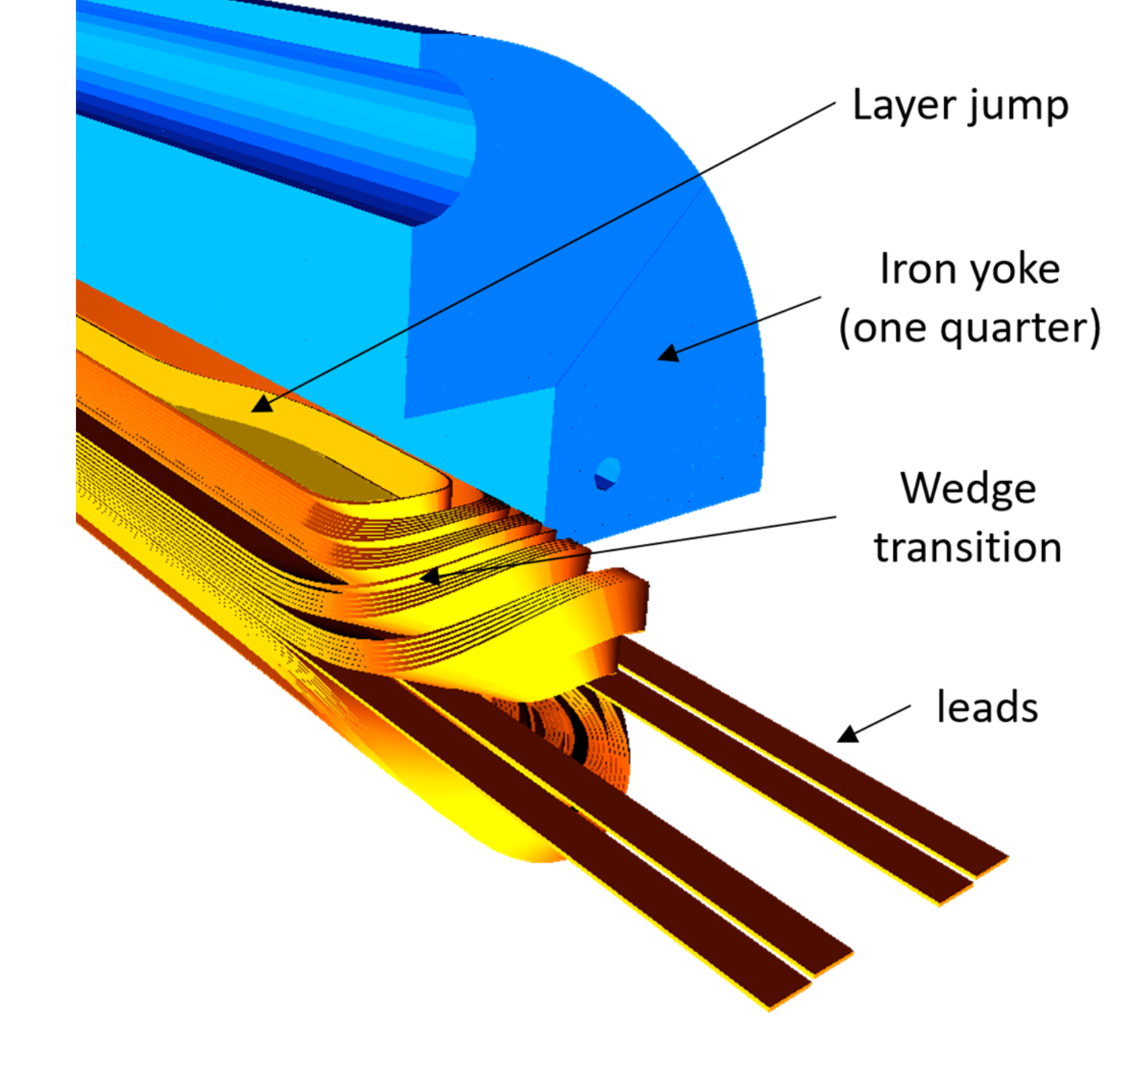
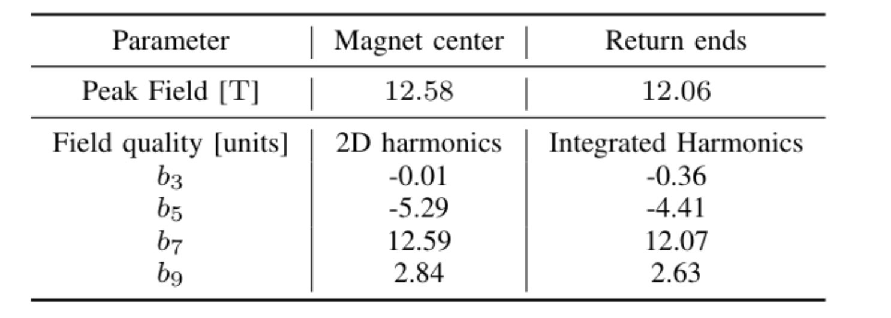
3D Magnet Design
Courtesy of R.Valente (INFN Mi-LASA)

Slide 18
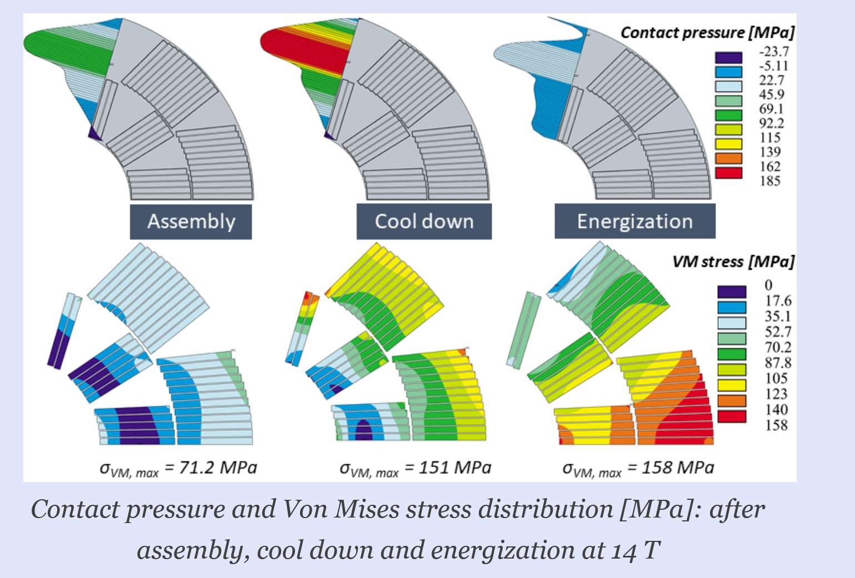
2D Mechanical Design
Courtesy A.Pampaloni INFN Genova

Slide 19
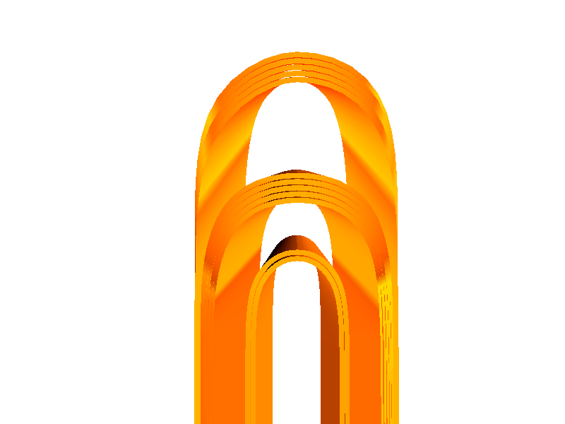
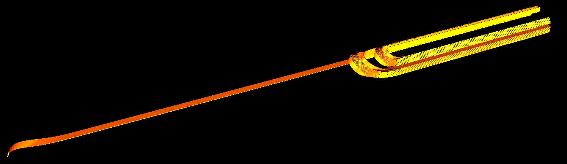
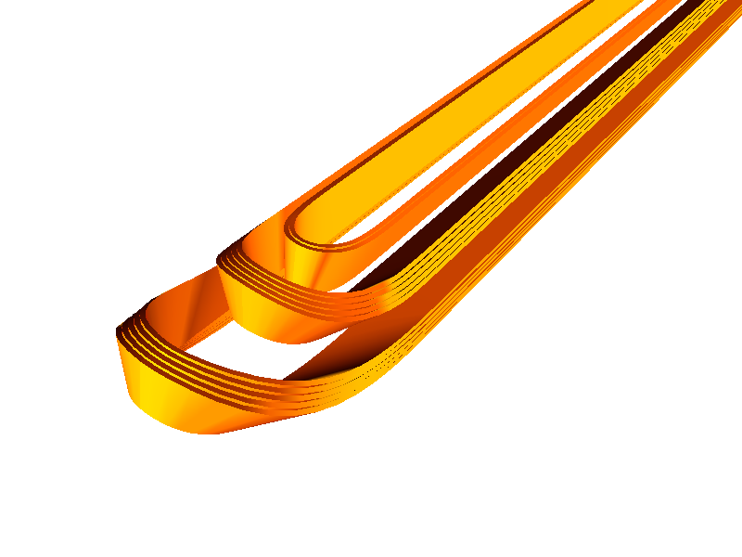
Open steps: new end spacers
As a result of the winding test performed at CERN, R.Valente is designing new end-spacers which should better follow the natural curves of the conductor
As soon as the design is ready, we could perform a second winding test at CERN
Old design

Slide 20
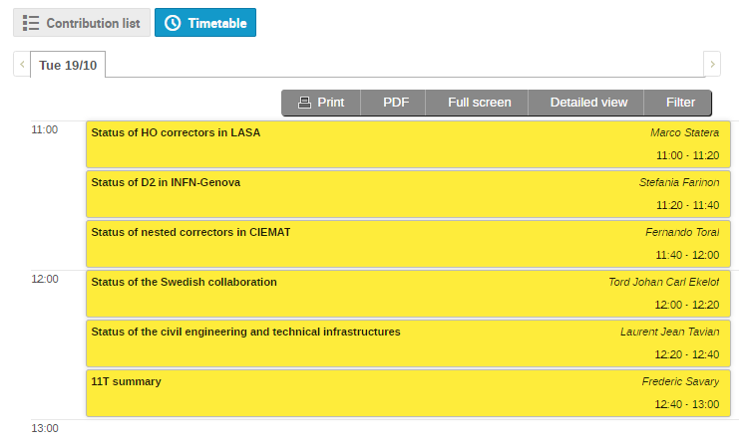
Open steps: new features following 11 T findings
F.Savary should present at the next HL annual meeting a comprehensive overview of the problems faced with 11 T magnets (and possible solutions, hopefully)
we have already agreed that we will address the major issues by implementing new features in our design

Slide 21
Open steps: INFN/ASG training on Nb3Sn
one of the pillars of the FalconD project has been from the beginning to involve industry by relying on CERN's support for all design and engineering activities
it is fundamental for us that rather quickly we find a way to realize this collaboration
INFN/ASG training should be done in parallel to eventual refinements of the design

