Slide 1
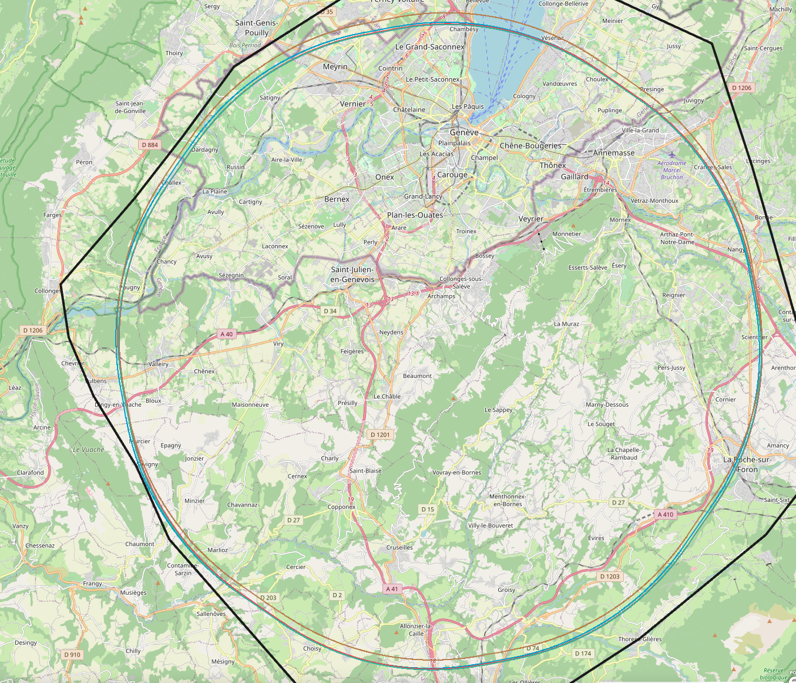
FCC feasibility study -- NEWS

Slide 2
The FCC-IS study is now on its way
FCC Technical and Financial Feasibility Study (FS) addresses the high level recommendation of the 2020 European Strategy
Plans for the study were informed to the CERN council in June 2021 and further reports given in September 2021.
Main deliverables and timeline of the FCC feasibility study
http://cds.cern.ch/record/2774007/files/English.pdf
Organisational structure of the FCC feasibility study
http://cds.cern.ch/record/2774006/files/English.pdf
FCC-IS Financial study focuses on first stage of the project (Tunnel and FCC-ee) ~10 BCHF
(indications also on full FCC financial study)
FCC PED objectives cover both the FCC-ee and FCC-hh (with proper emphasis associated with time scale)
First discussions between host states for contributions to the infrastructure are taking place
Significant efforts being made to broaden the collaboration further

Slide 3
FCC-IS organization chart

Slide 4
Coordination Group Meeting (CGM)
Proposed membership (Preliminary)
Main topics
General study organization, overall planning, strategy
Global parameters and design goals
Overall work programme management and follow-up
Collaboration aspects
Outreach and communication
Etc.
1 meeting / month
Study management:
Michael Benedikt
Frank Zimmermann
Mike Lamont
Pillar coordinators:
Patrick Janot
Gavin Salaam
Tor Raubenheimer
Klaus Hanke
Timothy Watson
Paul Collier
Specific advisors
Alain Blondel
Johannes Gutleber
Oliver Bruning
Katsunobu Oide
Roberto Losito
Volker Mertens
Jorg Wenninger
Julie Hadre
Michelangelo Mangano
Max Klein
Jonathan R. Ellis
Florian Sonnemann
Friedemann Eder
Panagiotis Charitos
Emmanuel Tsesmelis
M. Benedikt

Slide 5
Technical Coordination Meeting (TCM)
Proposed membership (Preliminary)
Main topics
Assure coherent technical design of accelerators, technical infrastructure, civil engineering integrated with territorial and environmental constraints.
Technical parameter management
Interfaces between Accel., TI, CE&HS pillars
2 meetings per month
Study management:
Michael Benedikt
Frank Zimmermann
Mike Lamont
Pillar coordinators:
Patrick Janot or Gavin Salam
Tor Raubenheimer
Klaus Hanke
Timothy Watson
Paul Collier
Specific advisors
Alain Blondel
Johannes Gutleber
Oliver Bruning
Katsunobu Oide
Roberto Losito
Volker Mertens
Jorg Wenninger
Julie Hadre
John Osborne
Massimo Giovannozzi
Manuela Boscolo
Olivier Brunner
Antoine Chance
Paolo Craievich
Ilya Agapov
M. Benedikt

Slide 6
FCC FC meeting structure
CGM and TCM for overall study coordination
Individual meetings at pillar level as deemed appropriate by pillar coordinators
M. Benedikt

Slide 7
recent contacts: Canada, Estonia, Slovenia

Slide 8
FCC-IS PED Organization -- work in progress

Slide 9
for both:
-- Physics Programme
-- Physics Performance
nominating conveners for
EW, Higgs, QCD, H.Flavours, top, BSM

Slide 10
we have presently received the interim report of the ECFA accelerator road map.
Noted that FCC-ee (in particular) appears very little so far
-- prepared a 4-page document to be added stressing the extent of required R&D for FCC-ee
-- and some comments to adapt the introduction and conclusions accordingly

Slide 11

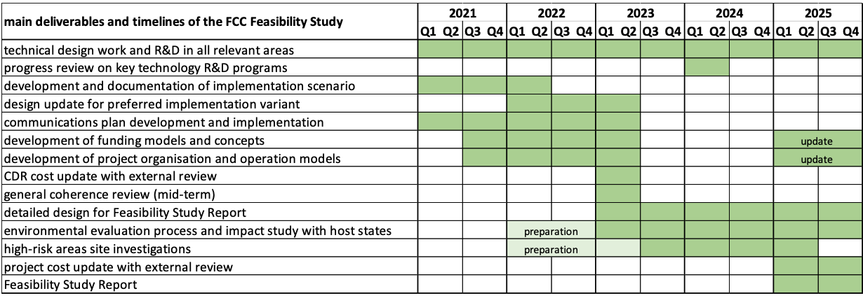
FCC FS timeline and main deliverables
Pre-decision on placement of the ring (geology, surface areas, etc.): mid-2022
High-risk area site investigations for selected placement: mid-2023 to mid-2025
Design update for preferred placement scenario: mid-2023
General coherence review across all work packages: mid-2023 (FS mid-term review)
Cost reviews with external expert review committee: 2023 and 2025
Feasibility Study Report

Slide 13
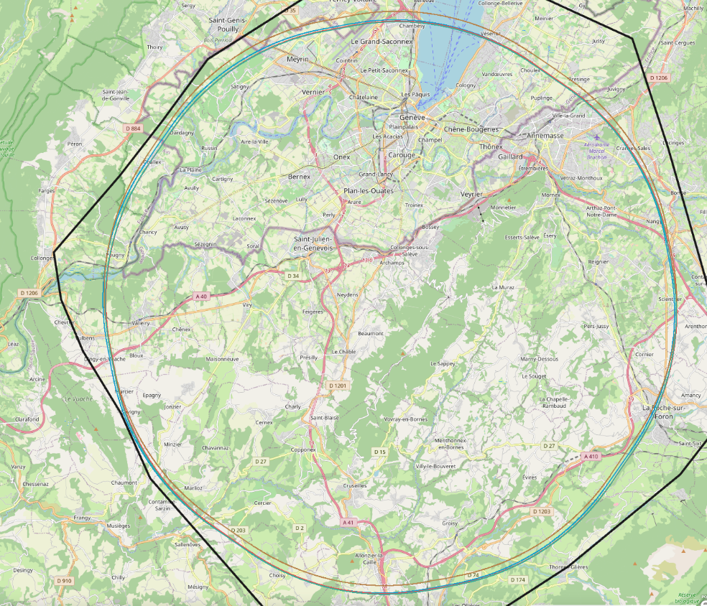
New FCC Layout
RF
RF
RF
-- Study has converged on 1 baseline layout (and 2 fallback solutions)
-- total circumference of 91.173km (was 97km in CDR)→ cost savings. Will lead to luminosity smaller by 10% (or more SR MW)
-- Consistent with 4IP. Optimization of 4IP parameters under study for realistic machines – stay tuned !
-- Placement of RF stations also under study. PL and PH proposed
– point has been made that for Z and WW a single RF point is better wrt ECM calibration

Slide 14
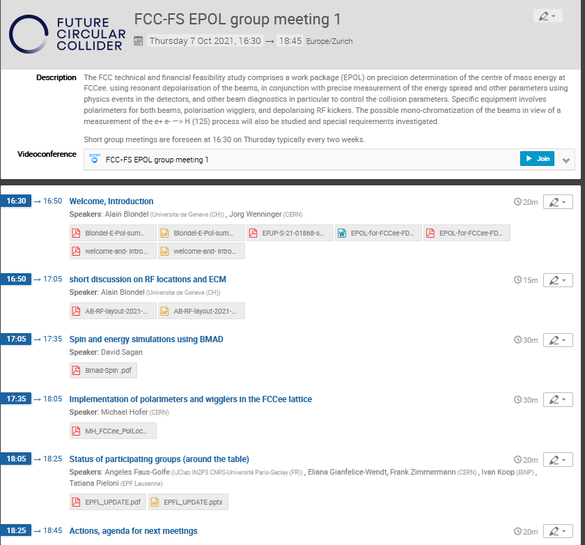
Highlights:
-- 27 participants
-- notes taken by Mike K.
-- issue with RF locations explained w.i.p.
-- BMAD is a good prototype of a code with
spin and orbit and collisions simulated
together in real machine with energy losses
and depolarization kicker (good news... CPU?)
-- present layout of wigglers
-- in the Dxy=0 point in bends near the IPs
-- expect monochromatization scheme
thereabout (maybe issue)
-- present layout of polarimeter
-- does not allow for γ-e collision before the
dipole – must be modified.
-- finally: good prospect for collaboration
-- CERN, BINP, EPFL, IJClab (Orsay)
-- USA: Cornell, BNL (for EIC)
-- Germany (KIT) etc.. w.i.p.
more coming, next meeting 18 November
https://indico.cern.ch/event/1080577/

Slide 15
PED Events of Interest
Snowmass 21 https://indico.fnal.gov/category/1098/
regular meetings of interest in the Energy Frontier, Rare processes and precision Frontier
We can use higher FCC people attendance (please let us know!)
Linear collider workshop 26-29 Oct. https://agenda.linearcollider.org/event/9211/
• CEPC international Workshop, 8-12 Nov. China https://indico.ihep.ac.cn/event/14938/
• ECFA “topical workshop” on Generators for “Future H/Ewk/top factories”, 9-10 Nov. see next slides
At CERN, with physical rooms https://indico.cern.ch/event/1078675/ Register by Nov 3
. ECFA Plenary Meeting: 18-19 November (Patrick invited to present the FCC-ee in Plenary session)
• Next FCC France workshop (Annecy): 30 Nov – 2 Dec
LAPP Annecy https://indico.in2p3.fr/event/22887/
• FCC Physics, Experiments & Detectors workshop in Liverpool 7-11 Feb 2022
https://indico.cern.ch/event/1066234/ see next slides
• FCC Week 2022, Paris, 30/5-3/6 2022 (note the date)

Slide 16
Juan Alcaraz Maestre

Slide 17
https://indico.cern.ch/event/1078675/

Slide 18
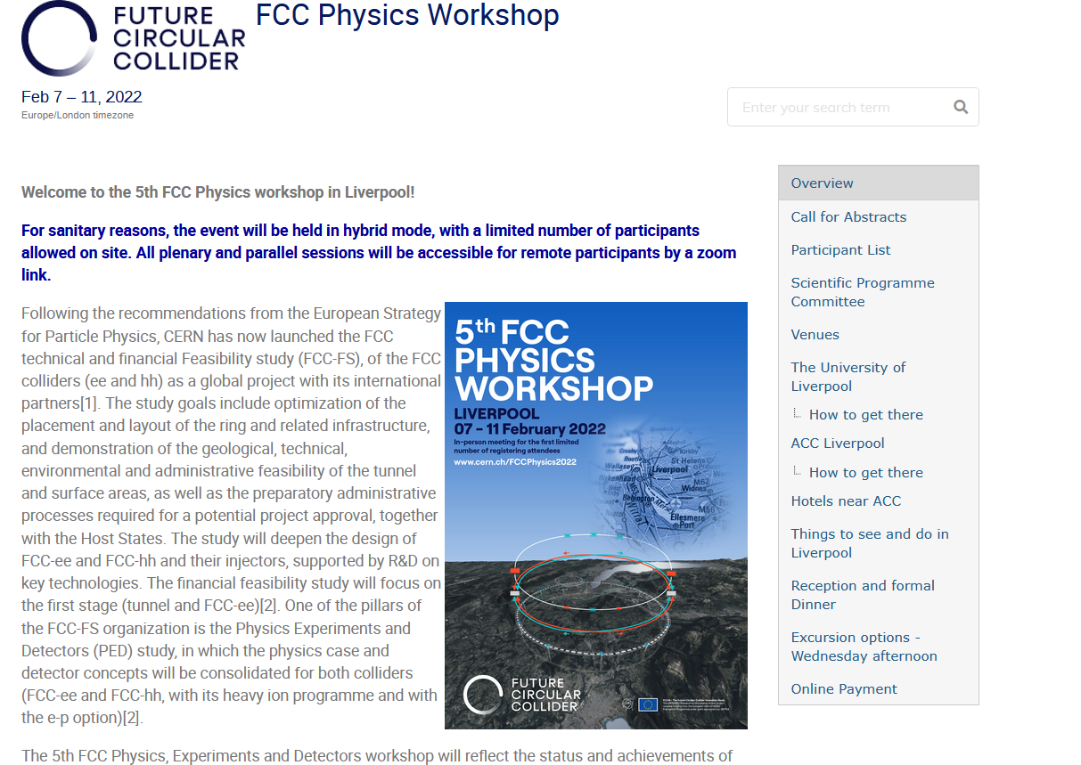
https://indico.cern.ch/event/1066234/

Slide 19
Important points for the 5th Physics workshop
The workshop registration will soon open
-- number of in-person participants is limited to ~150 (first come -- first served)
-- registration fee is 300£
(It was found that leaving this number open in COVID times would lead to huge climb of costs)
-- all sessions will be broadcast in zoom, and all slides on indico but of course not:
the poster session, collaboration dinner, excursion and private discussions, coffees/tea breaks etc.
Preliminary workshop agenda follows.
-- There will be parallel sessions corresponding to the PED main work-packages
-- There will be a poster session
3. Abstract submission:
-- single abstract for parallel/poster session.
-- submitter or one of the authors must be in person at the meeting to present it.
-- it is highly desirable that parallel session presentations also have a poster so that everyone can benefit from it.

Slide 20
time | title | speaker | duration /status
9:00-10:30 | session chair
9:00 | Welcome to Liverpool University
9:15 | Welcome and CERN vision
9:35 | FCC feasibility study, High Field Magnet R&D
10:10 | ECFA and the FCC
10:30 | coffee break
time | title | speaker | duration /status
10:45-12:30 | session chair
10:45 | PED study introduction and goals of meeting
11:05 | Plans for MDI WG [15+5]
11:25 | Plans for EPOL
11:55 | Plans for Software [15+5]
12:15 | reserve, discussion

Slide 21
time | title | speaker | duration /status
14:00-16:00 | session chair | TBD
14:00 | -- recap of the FCC-ee physics potential and open questions (20+5) | TBD | 20
14:20 | -- recap of the FCC-hh physics potential and open questions (20+5) | TBD | 20
14:40 | -- recap of the FCC-ep physics potential and open questions (10+5) | TBD | 10+5
14:55 | Plans for Physics Programme WP [15+5] | TBD | 15+5
15:15 | Plans for Physics Performance WP [15+5] | TBD | 15+5
15:35 | Plans for Detectors Concepts WP [15+5] | TBD | 15+5
16:00 | coffee break
time | title | speaker | duration /status
16:30-18:00 | session chair | TBD
16:30 | Software talk | TBD | 15+5
17:00 | Physics keynote 1 | TBD | 25+5
17:30 | Physics keynote 2 | TBD | 25+5
18:00

Slide 22
 | Monday 7 Feb | Tuesday 8 Feb | Wednesday 9 Feb | Thursday 10 Feb | Friday 11 Feb
morning | plenary | Physics Performance Detector concepts// 3. Physics programme 1 4. Physics programme 2 | 1. Detector concepts 2. Software 3. Machine detector interface (MDI) 4. Physics Programme 4 | plenary | plenary (ending 1pm)
afternoon | plenary | 14:00-15:30 1. Physics Performance 2. Detector concepts 3. Beam Energy calibration (EPOL) 4. Physics programme 3 16:00-18:00 1+2 Joint Performance and detectors: “joint tutorial on “Benchmarks to Detector requirements, software, case studies” 3. Beam Energy calibration (EPOL) 4. Physics programme 3 | excursion | plenary | UK meeting
evening | drinks & posters |  | workshop dinner
All plenary and parallel sessions to offer remote connection. Public lecture TBD

Slide 23
 | Monday 7 Feb | Tuesday 8 Feb | Wednesday 9 Feb | Thursday 10 Feb | Friday 11 Feb
morning | plenary | parallel 1 parallel 2 parallel 3 parallel 4 (up to 4 //) | parallel 1 parallel 2 parallel 3 parallel 4 (up to 4 //) | plenary (up to 6 presentations) Software Physics Presentations | plenary (ending 1pm Summary talks from parallel sessions Overall summary & outlook
afternoon | plenary | parallel 1 parallel 2 parallel 3 parallel 4 (up to 4 //) | excursion | plenary (up to 8 presentations) Special physics, EPOL, MDI detector concepts
evening | drinks & posters |  | workshop dinner | 18:30 The FCC global collaboration and international forum (TBC)
All plenary and parallel sessions to offer remote connection. Public lecture TBD

Slide 24
It is really exciting to see our dream become reality!

