Slide 1
OMC activities during the beam test
T. Persson on behalf of the
OMC-team

Slide 2
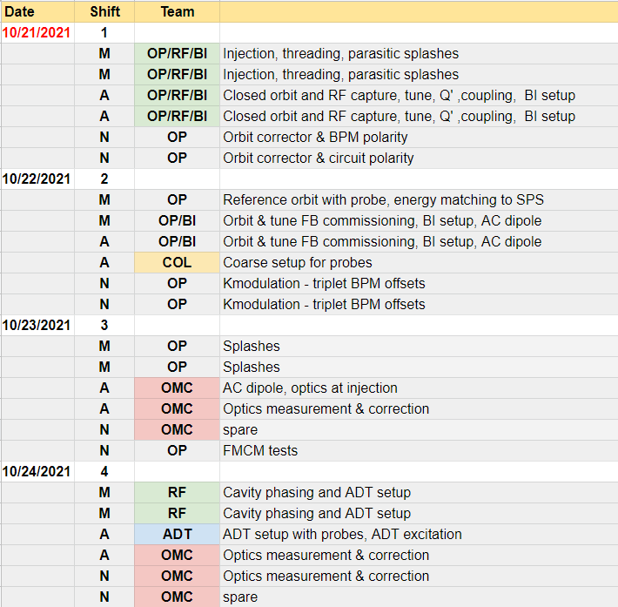
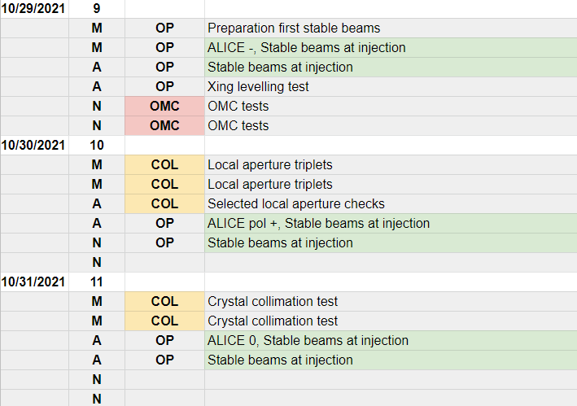
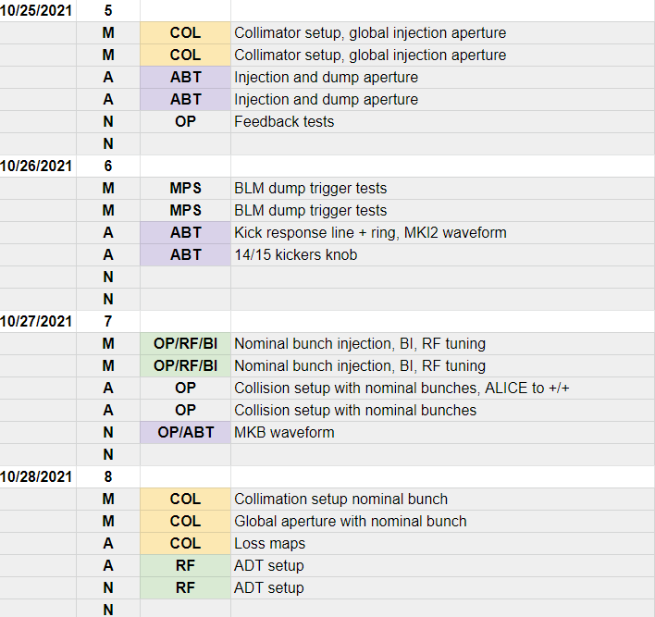
Do the essential checks of equipment and software
Note that the dates are likely to shift. Already starting day could potentially be 2 days ahead of schedule!!

Slide 3
Essential
The first thing is to excite with the AC-dipole and record with the BPMs
  In 2015 there were some issues with the phasing of the BPMs
  New multiturn and changes to the AC-dipole potential source of issues
    Could be 5 min but could also be days
  ADT-AC dipole
  K-modulation
  MKQ, MKA (without changing setting in the tunnel)
Important checks at injection
  3D-excitation

Slide 4
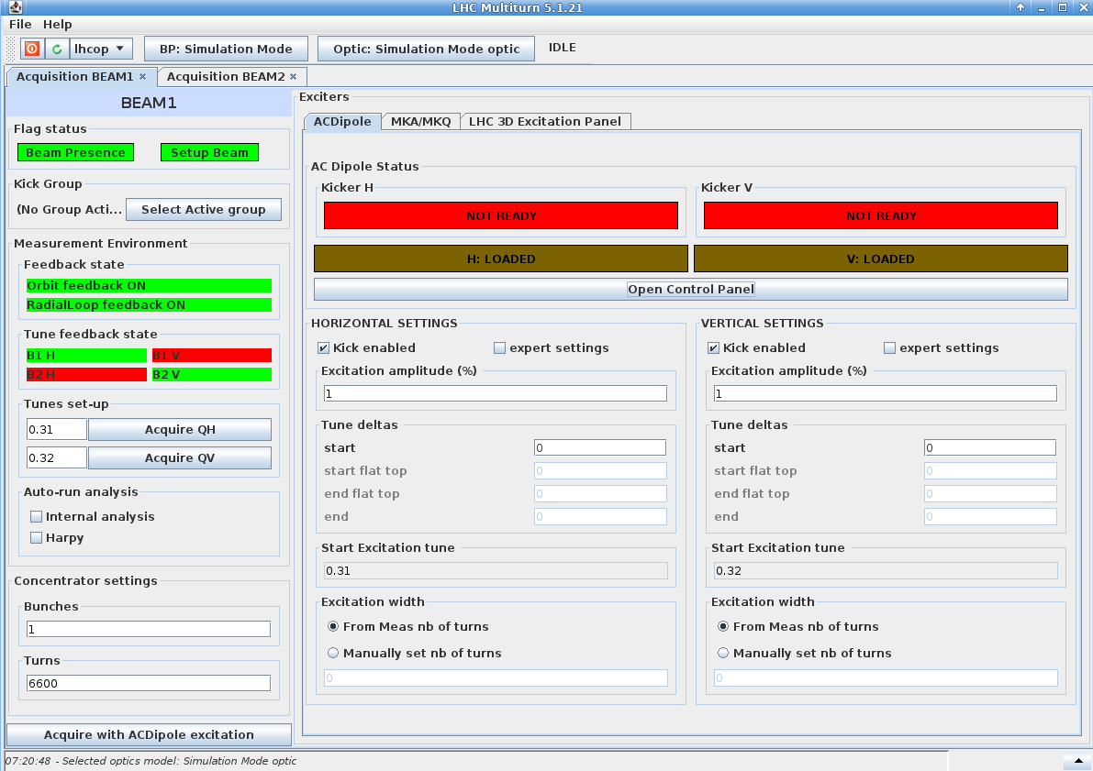
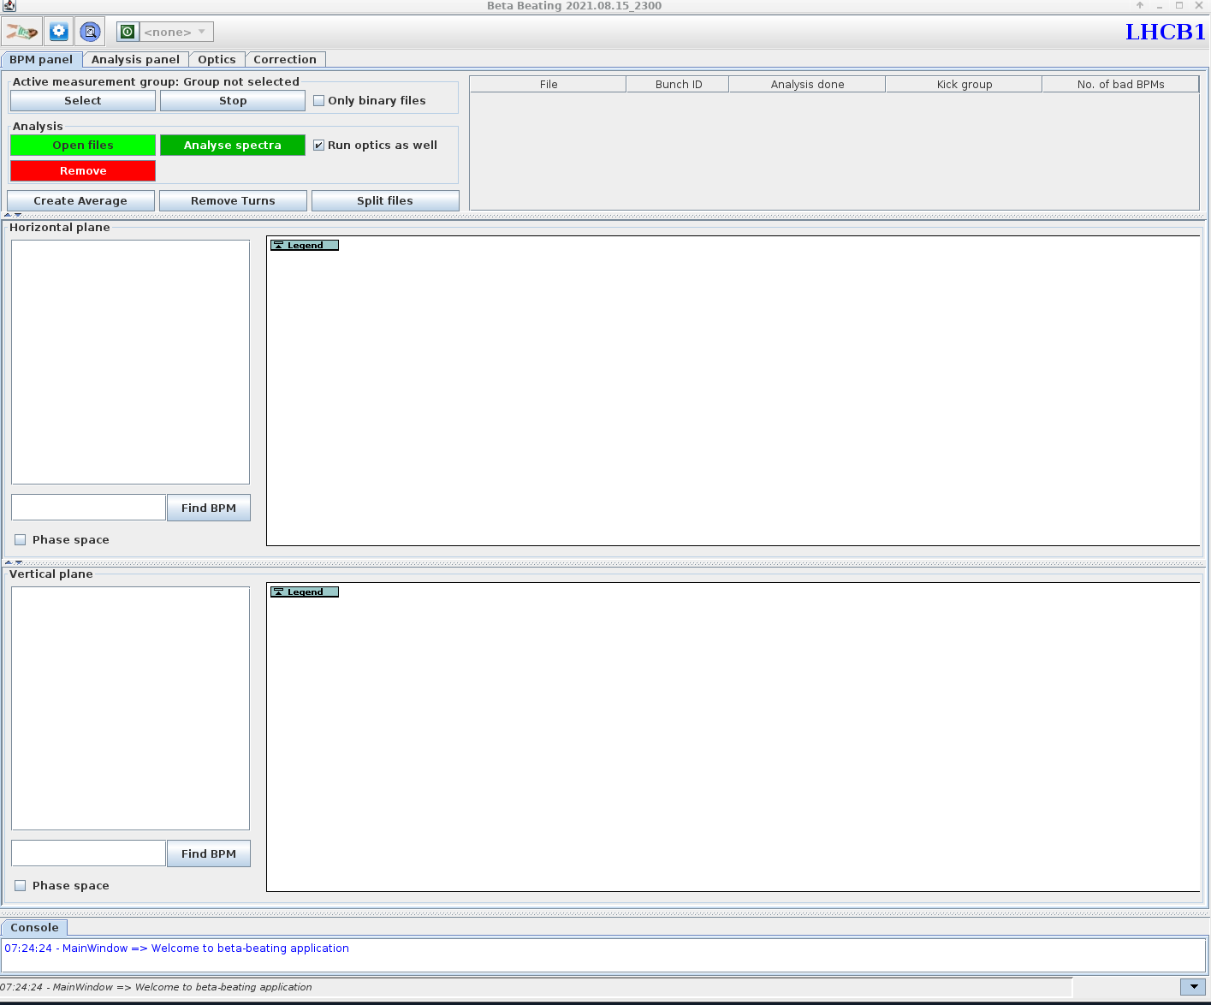
New software and functionalities
New multiturn application
  Made by LHC-OP
New functionalities added to the AC-dipole
New OMC-GUI
The code to analyse the data is also re-written (OMC3)
Status: The kicker has been pulsed so looks promising

Slide 5
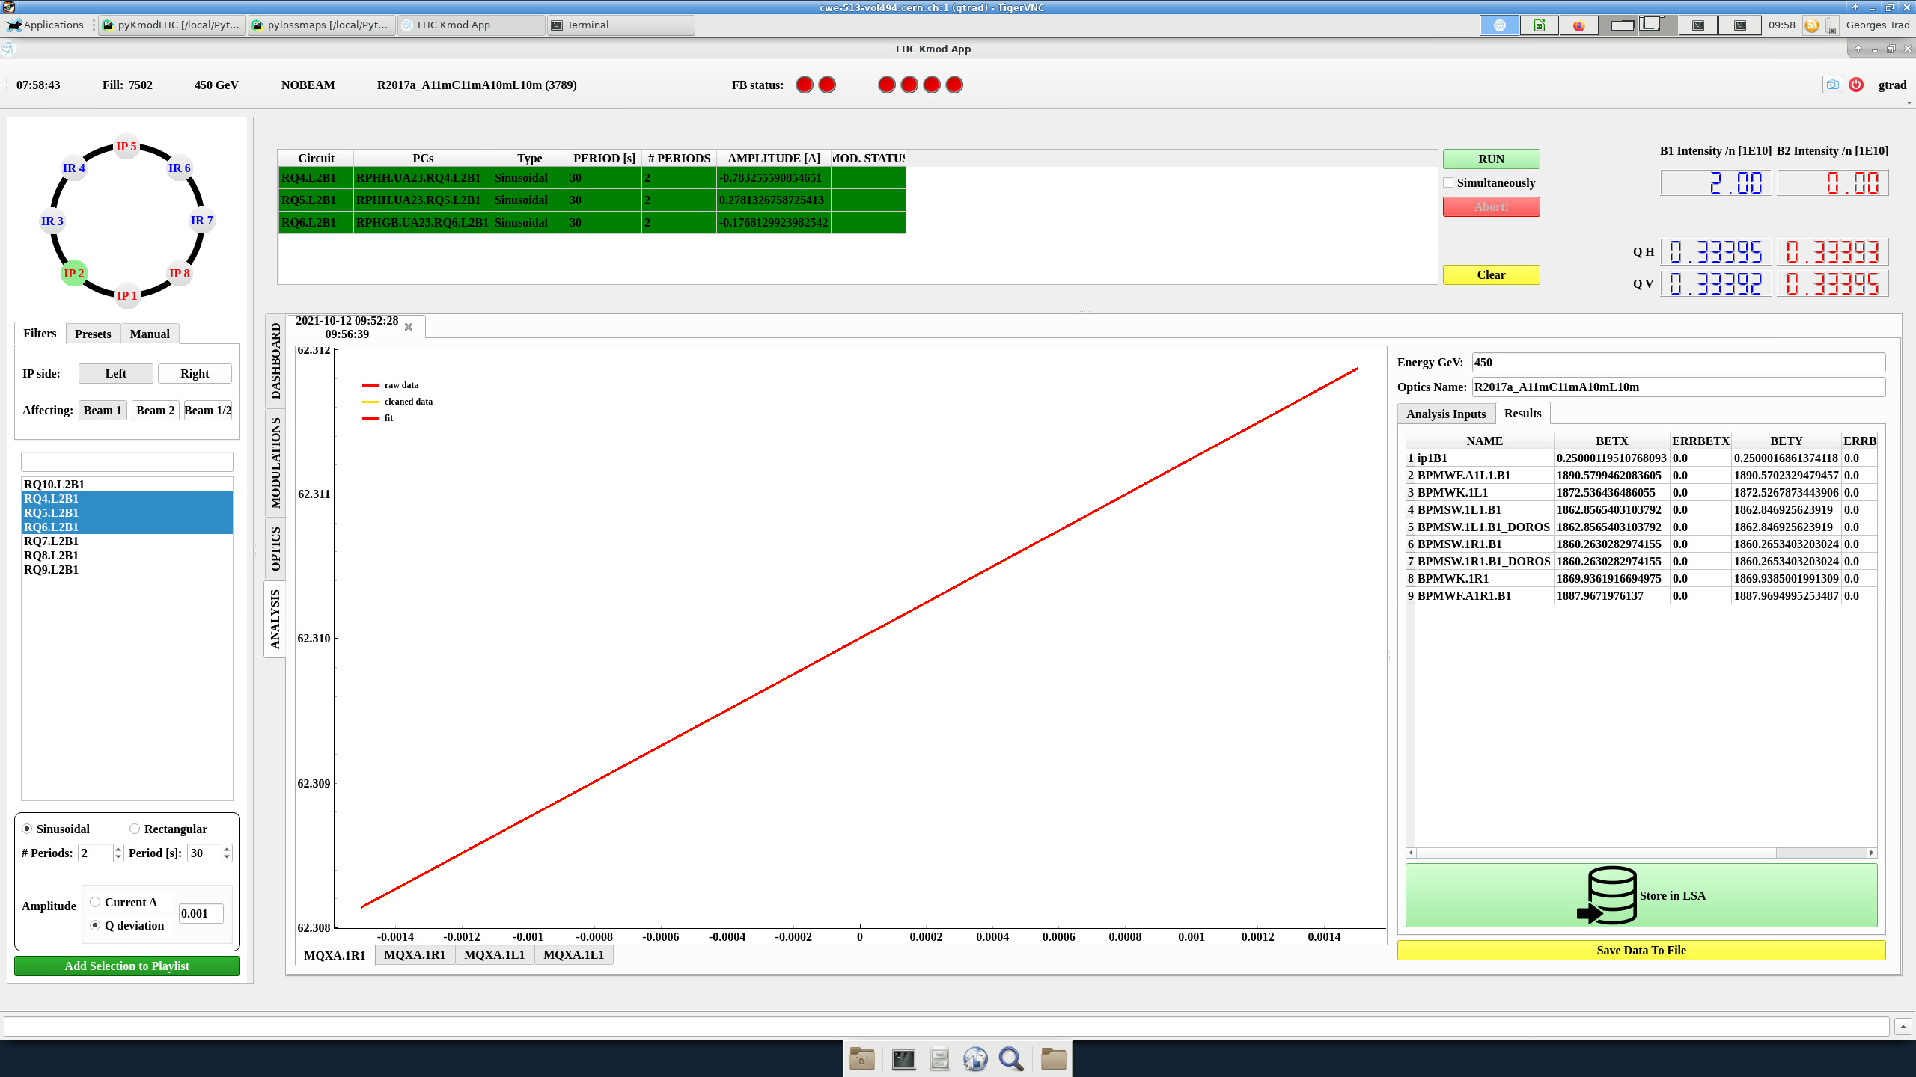
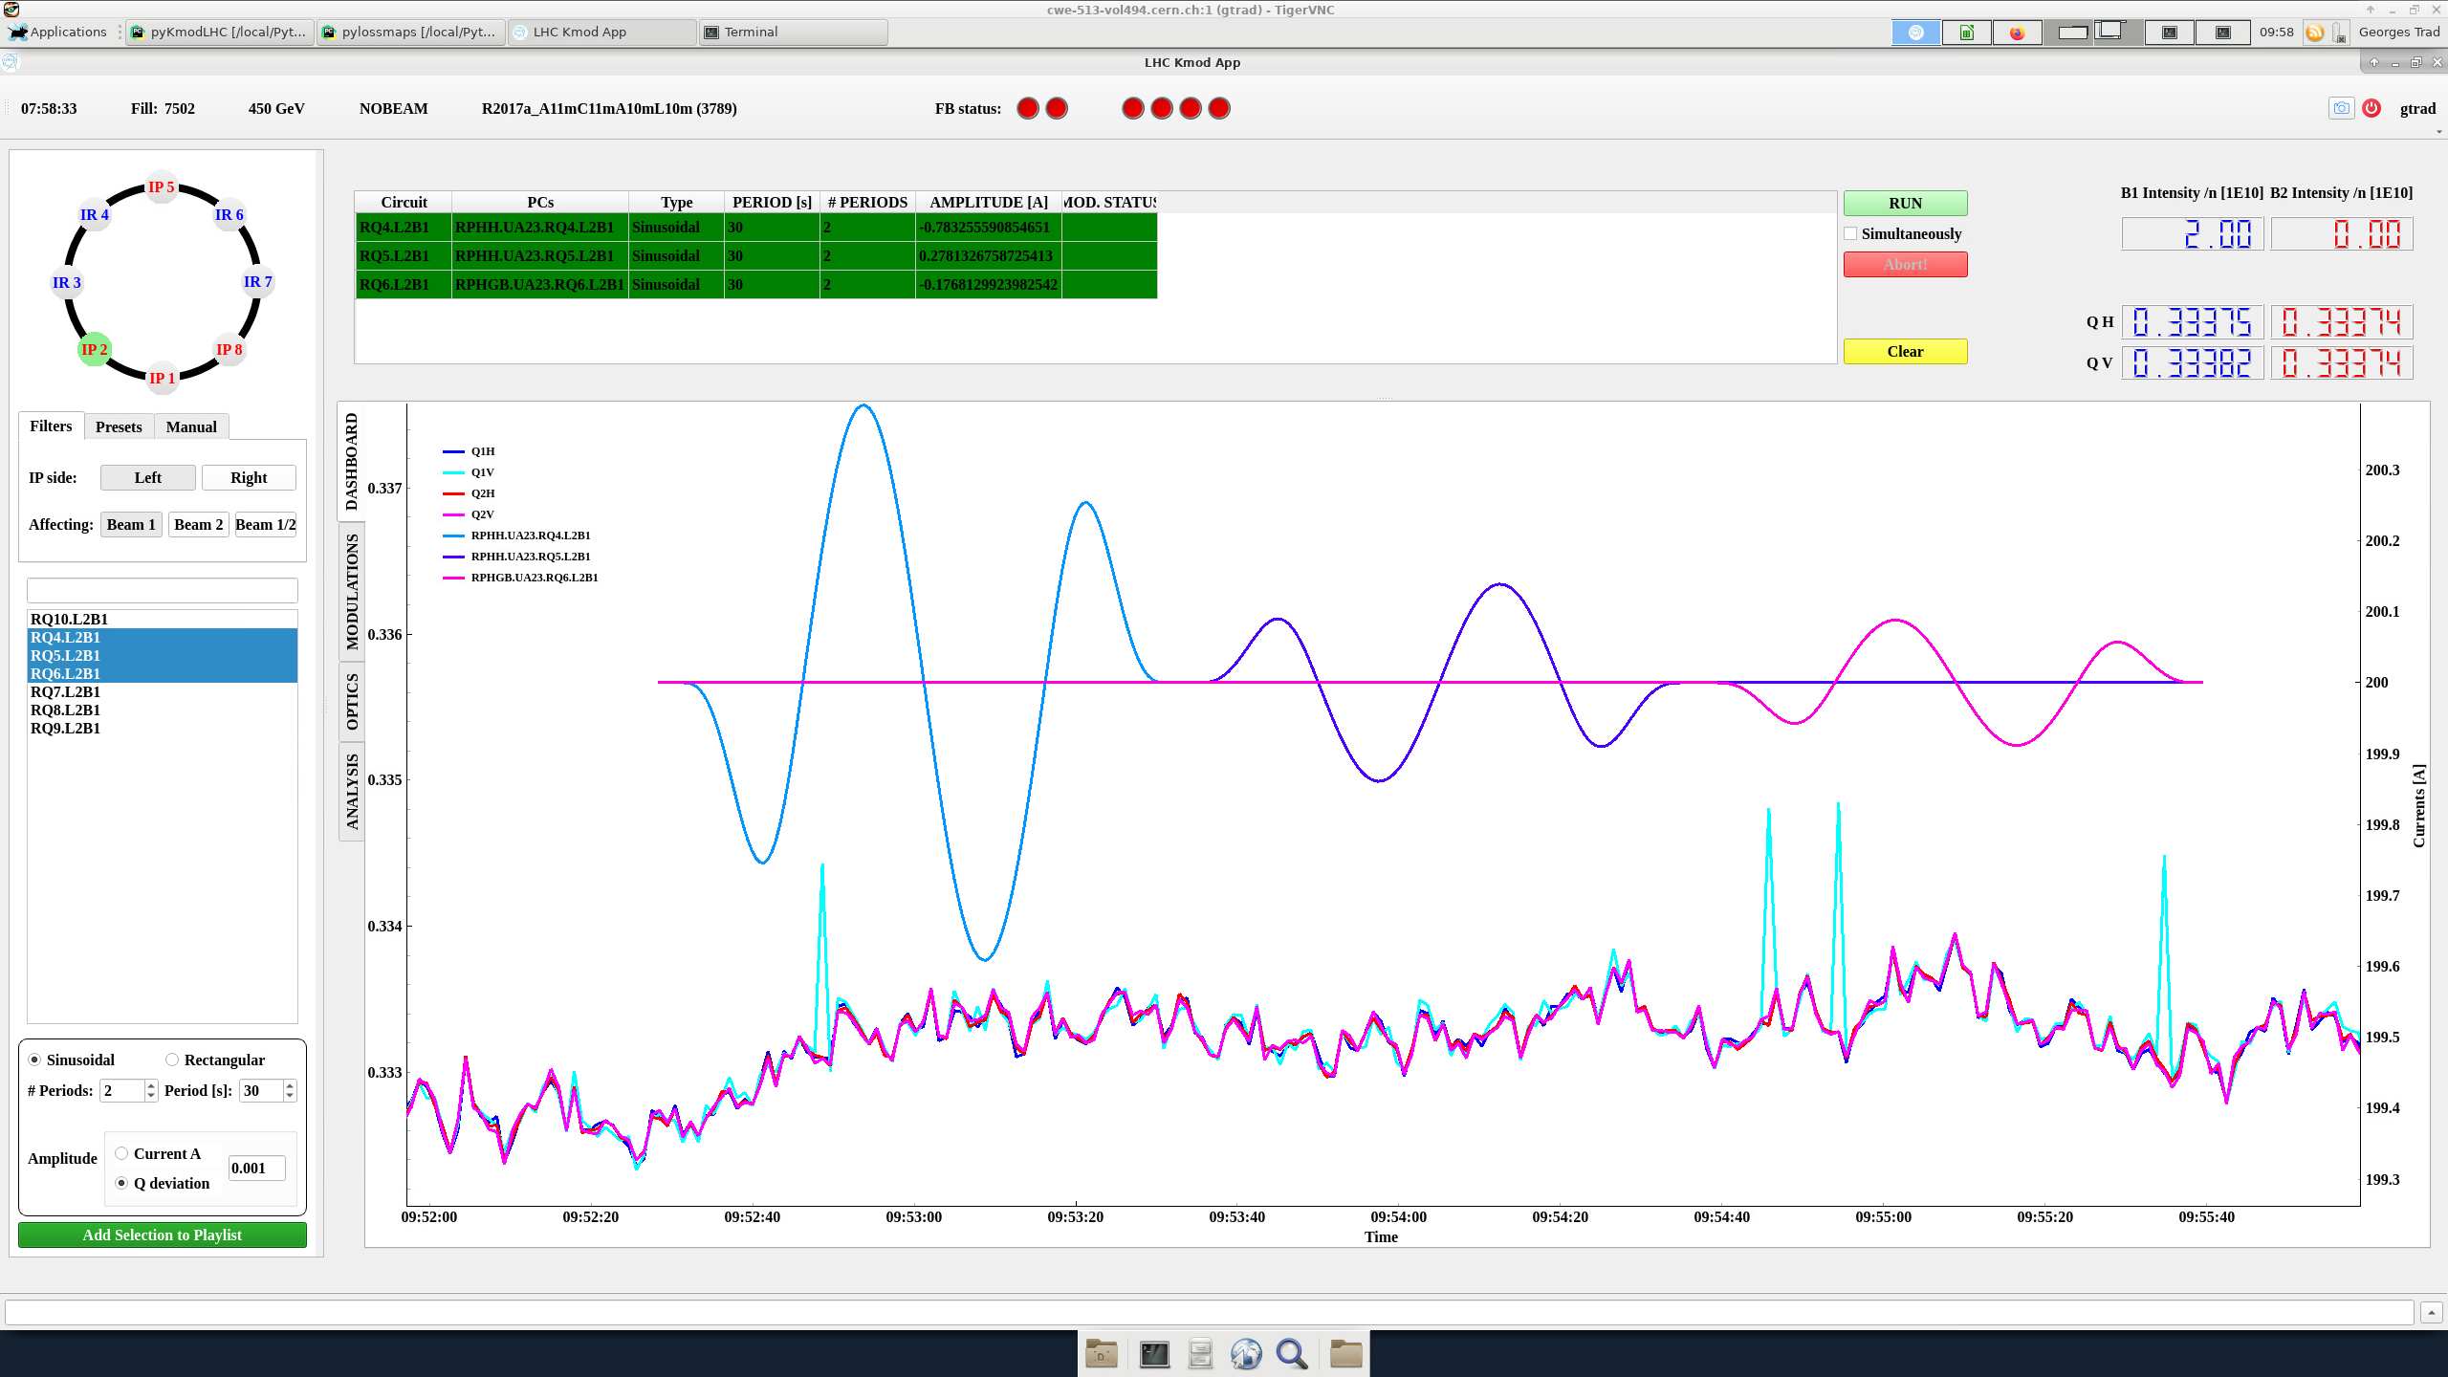
K-modulation
New GUI developed in Python by Georges Trad in close collaboration with Michael Hofer to interface our analysis
Enables the modulation of more magnets including Q2, Q3 and even an entire arc!
Status: Has been tested to drive magnets

Slide 6
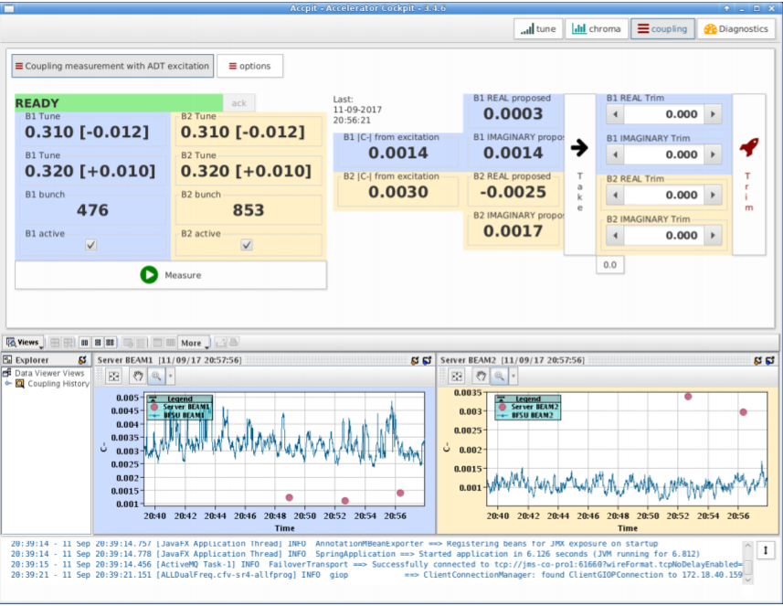
ADT AC - dipole
New protocol to transfer the data
Using the new code base (OMC3) and different compensation method for the driven motion.
A. Calia, et al “Online coupling measurements and correction throughout the LHC cycle”
Status: Has been deployed and tested with fake data. The ADT class is not yet tested.

Slide 7
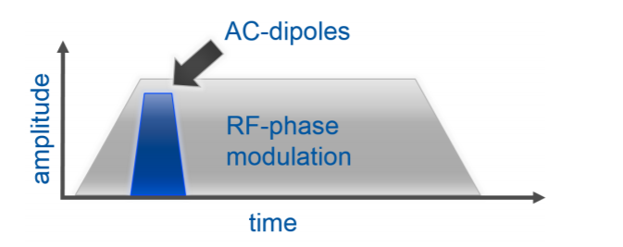
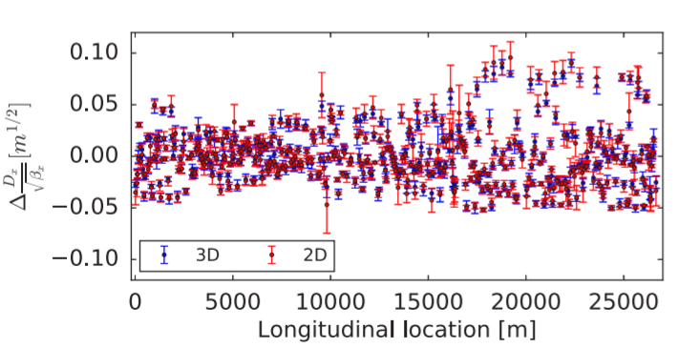
3D – kicks
The RF phase is modulated at the same time as the AC dipole excites the beam
  Can enable measurement of dispersion and chromatic functions during the ramp
  This is implemented in the Multiturn application
L. Malina
Status: Is implemented but still needs to be tested

Slide 8
Close collaboration with OP
The new applications are developed and maintained mainly by LHC OP
  When it comes to access hardware devices, RBAC etc, this is much more efficient since they have more experience in these area.
  We still need to collaborate closely since we are the expert on what to expect for many of the applications.
  A very fruitful collaboration!
A personal reflection is that the OMC-OP Workshop was very beneficial to increase our understanding of the common challenges
  In the next slide I will mention one of them

Slide 9
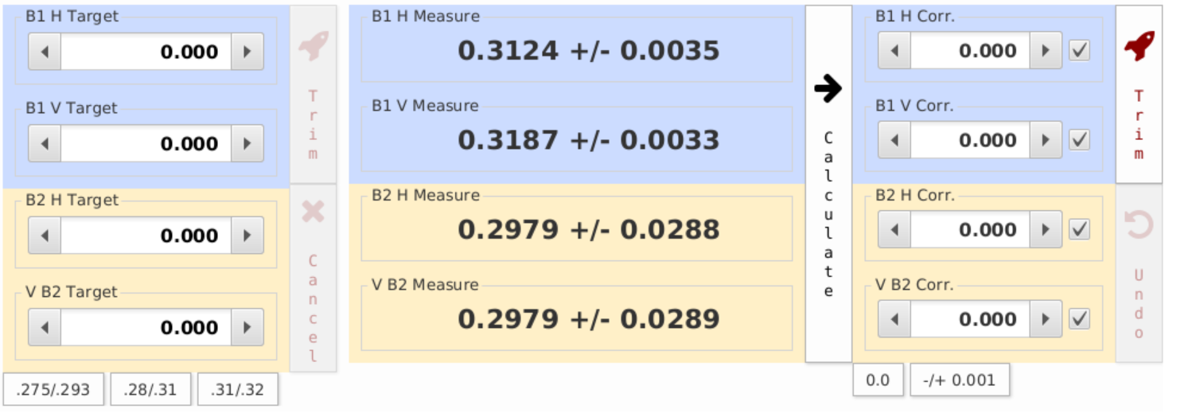
Target and Correction
One of the difficulties with re-create the state of the machine at a given time has been that it is not known from the logging why a setting was change.
  E.g., The tune knob is changed in LSA: Was this a change of working point or was this simply a correction of the tune back to the nominal?
  In the OMC-OP workshop different possibilities were discussed but, in the end, the main was to use the two different properties in LSA: Target and Correction.
    E.g., Target when you want to change the working point and correction when you want to correct the tune back to nominal
    This is now adopted in the accelerator cockpit application and the idea is to use this principle throughout the run

Slide 10
Back to the beam test

Slide 11
Do the essential checks of equipment and software
Calculate the corrections: Local coupling and global beta-beat

Slide 12
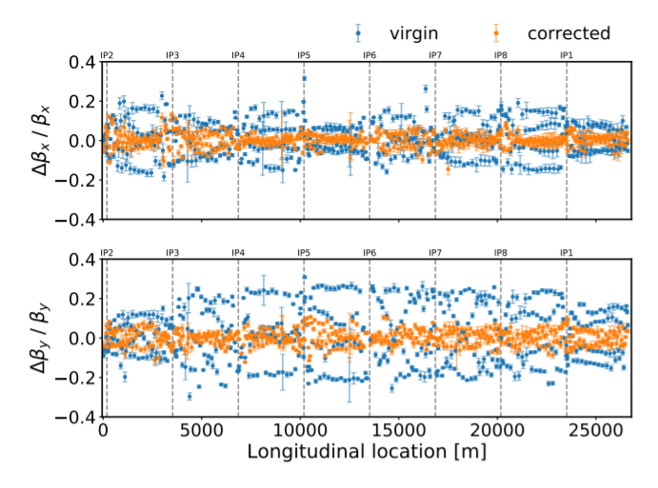
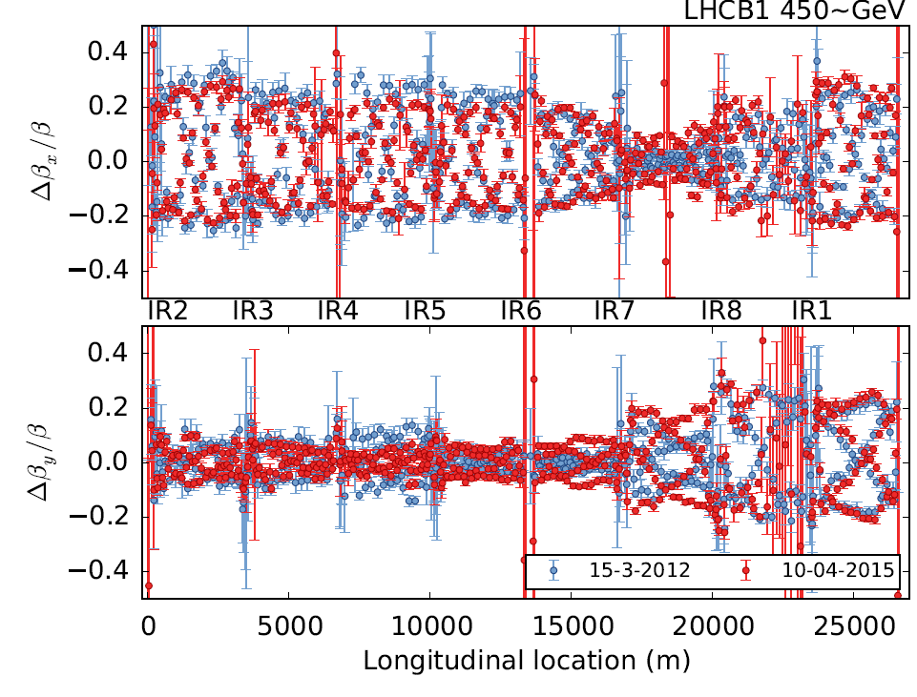
β-beating at injection
Virgin machine (non ATS)
ATS
The β-beat at injection has stayed relatively similar between Run 1 and Run 2
If we measure and correct during beam test we can most probably use the same corrections in 2022

Slide 13
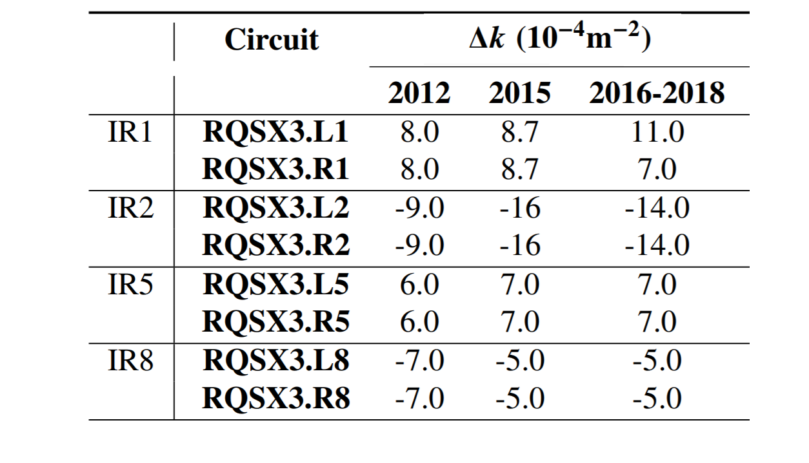
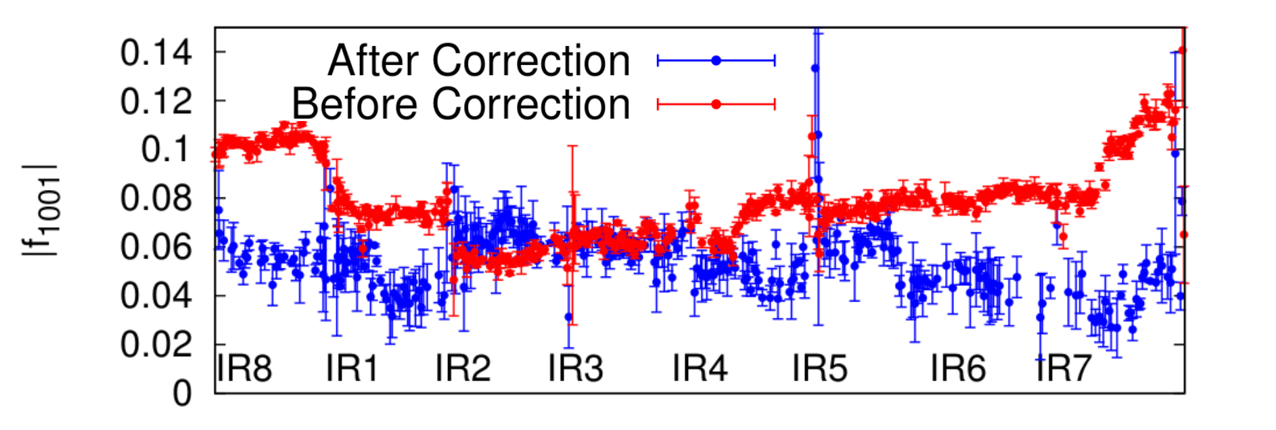
Local coupling
The local coupling corrections did not change so much from end Run 1 to Run 2
  Two data points are not much statistics! Rotations might have changed this time..
  A rough correction at injection can be made
Before local correction and arc-by-arc corrections (when needed) are applied the BBQ coupling measurement is less reliable
Before and after local coupling correction. Note that the global knobs also have been readjusted.
β*=2 m

Slide 14
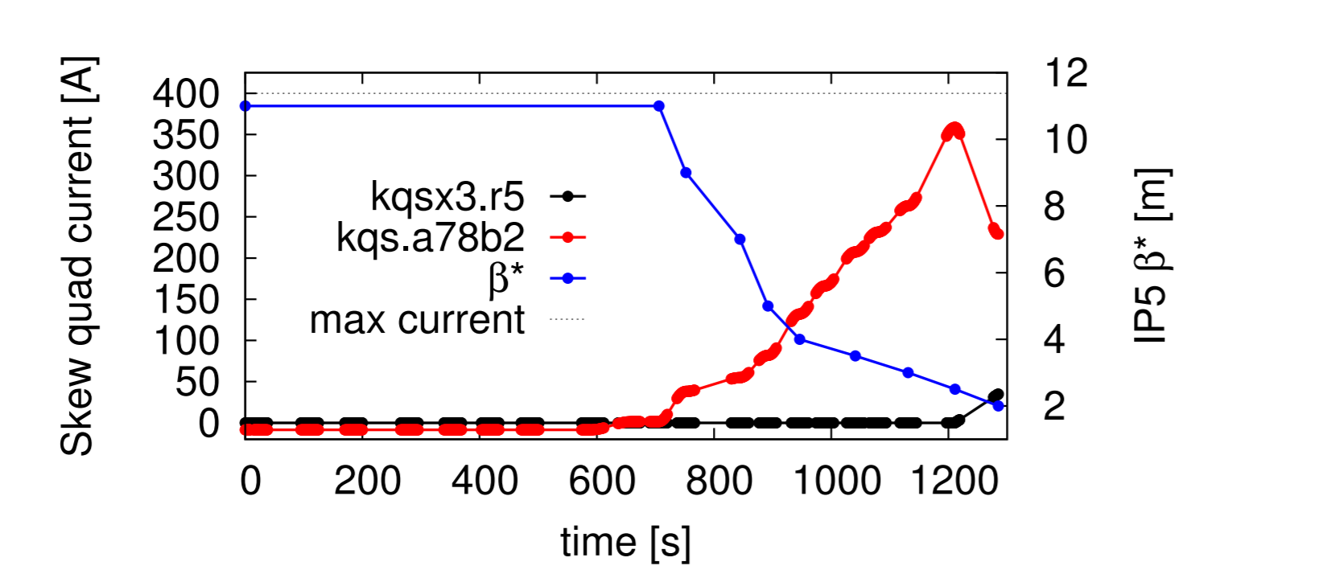
If we don’t correct the local coupling
In 2010 (3.5 TeV) the strength of the arc skew quadrupoles were almost maxed out before the local coupling corrections were implemented
  Local corrections needed for the first ramp and squeeze
β * = 2 m
Beam 1 Delta knob|C-| | 0.046
Beam 2 Delta knob|C-| | 0.022
Glenn Vanbavinckhove

Slide 15
How do we prepare for this?

Slide 16
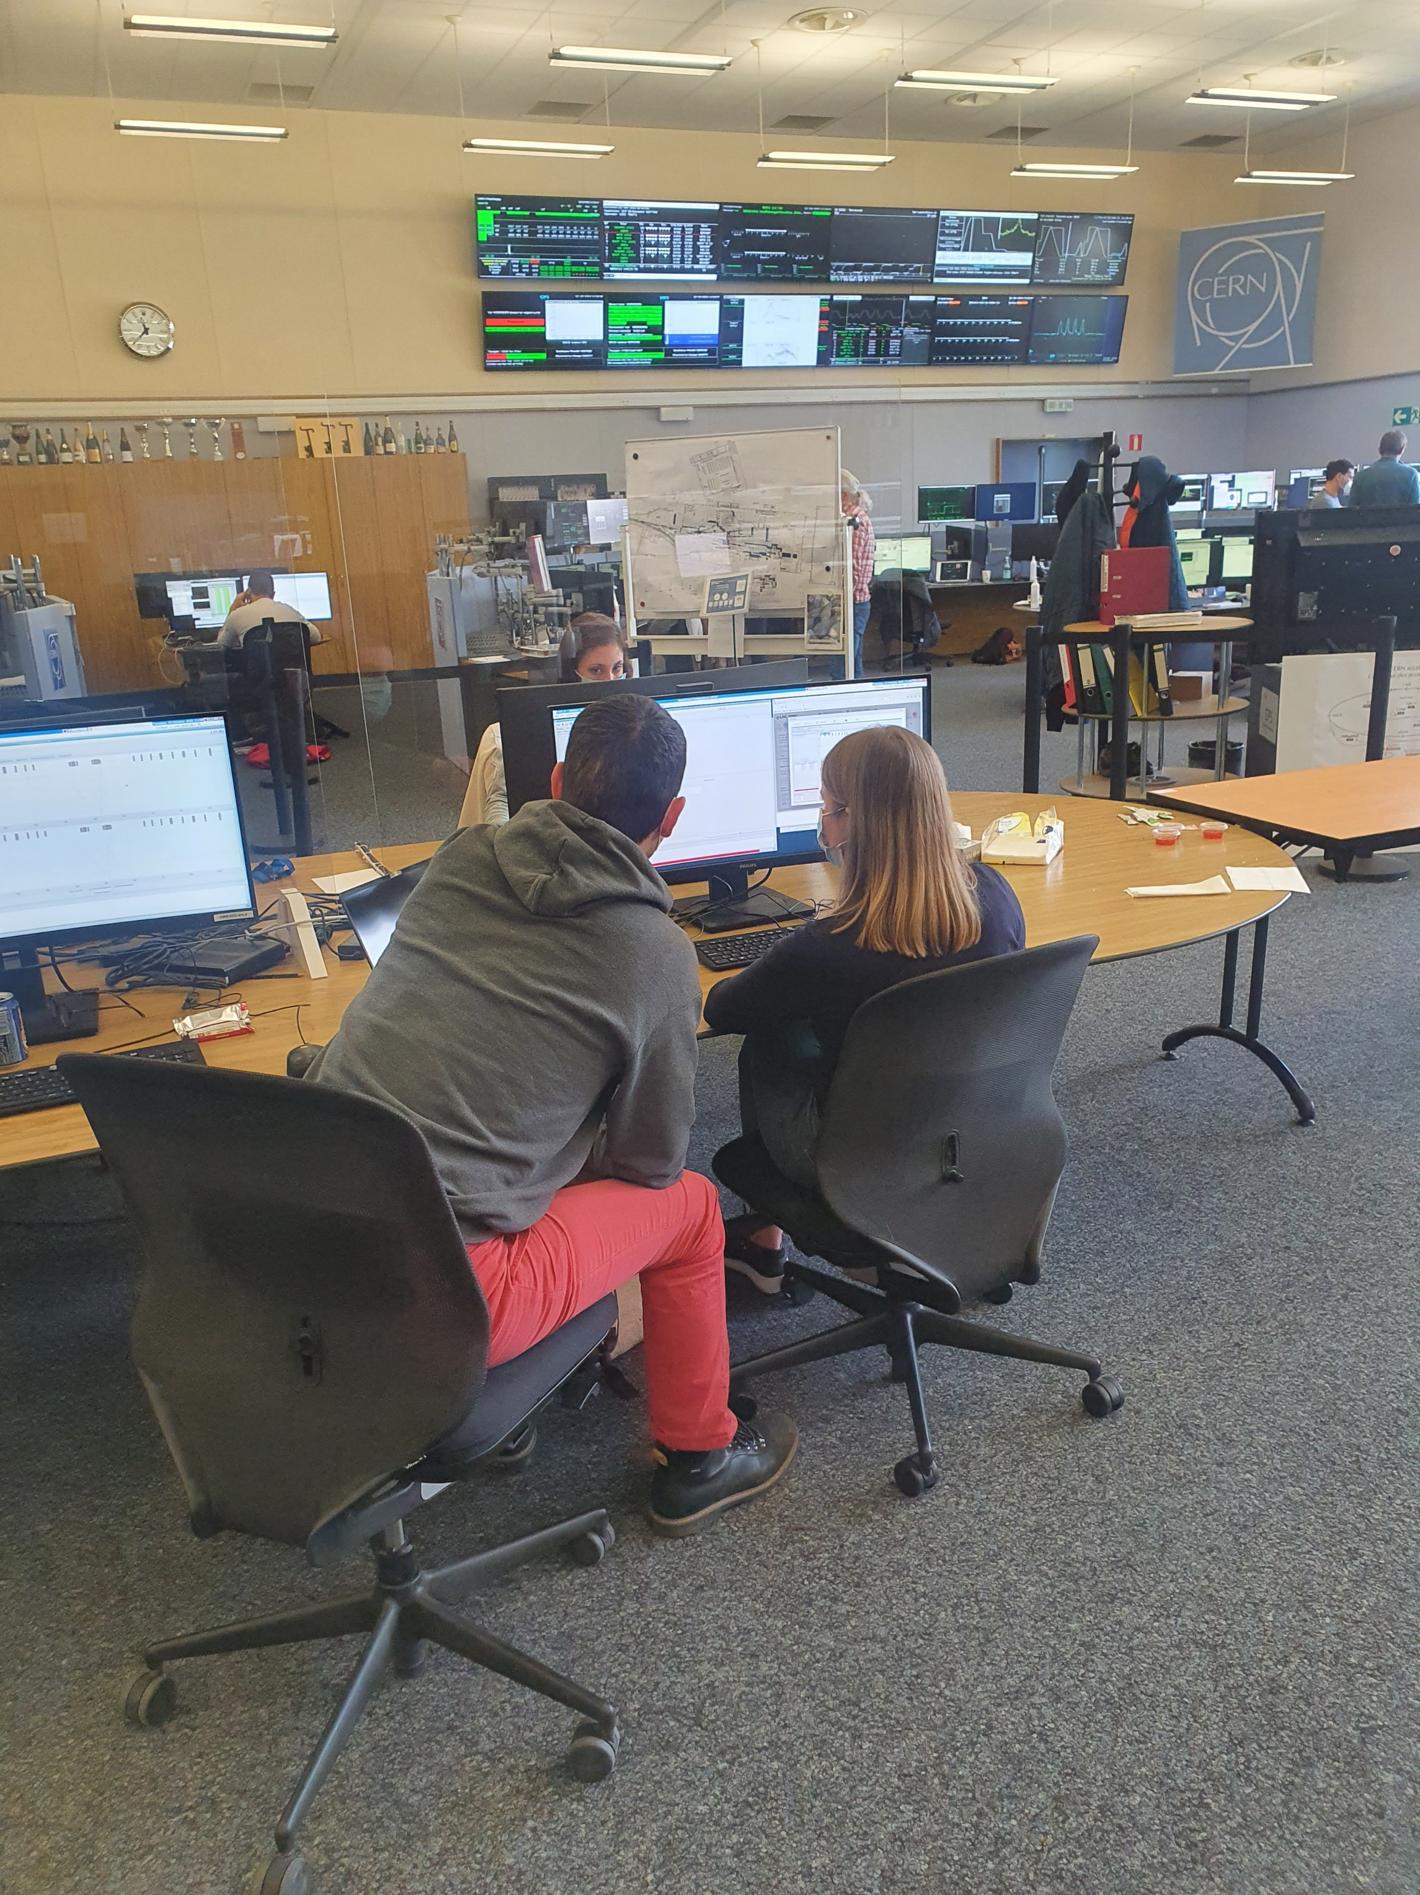
Testing in the CCC
Two purposes:
  Finding issues and bugs
  Train new people and remind the rest of us how to use the applications and calculate the corrections
We already had one session but split into 3 different time slots.
  We are now in the middle of a second iteration.

Slide 17
Beta-beat.src and OMC3
Beta-beat.src was used extensively used in Run 1 and Run 2 so well tested
OMC3 more flexible but still needs so more testing and still missing some functionalities
  Will use the beam test to continue testing the OMC while using the beta-beat.src as the reference

Slide 18
Do the essential checks of equipment and software
Calculate the corrections: local coupling and global beta-beat
MCS, Q’’ and potentially a re-validation of the corrections if needed

Slide 19
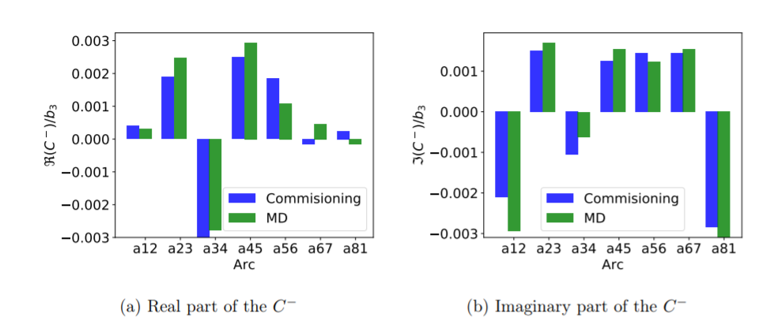
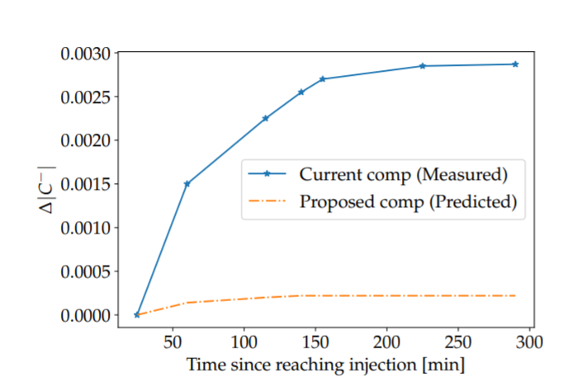
Counteract the coupling drift at injection
We change the setting of each of the MCS arc-by-arc
  Measure the change to C-
  Stayed constant between 6 months in Run 2.
Based on this measurement we could potentially have an uneven dynamic b3-compensation
T. Persson

Slide 20
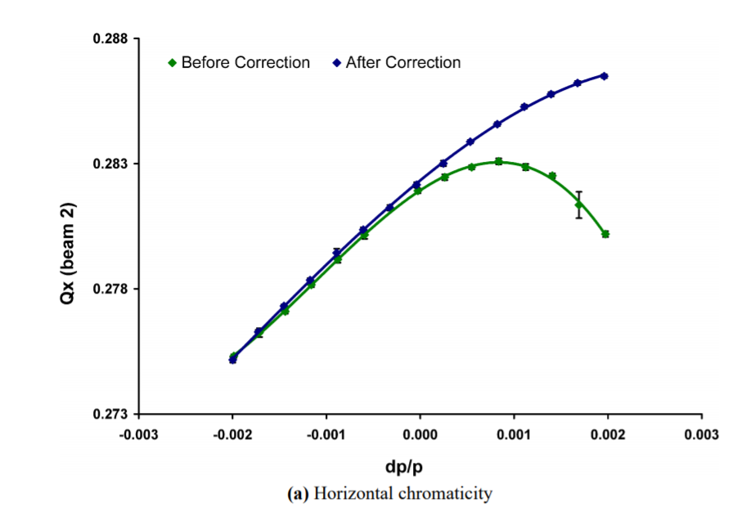
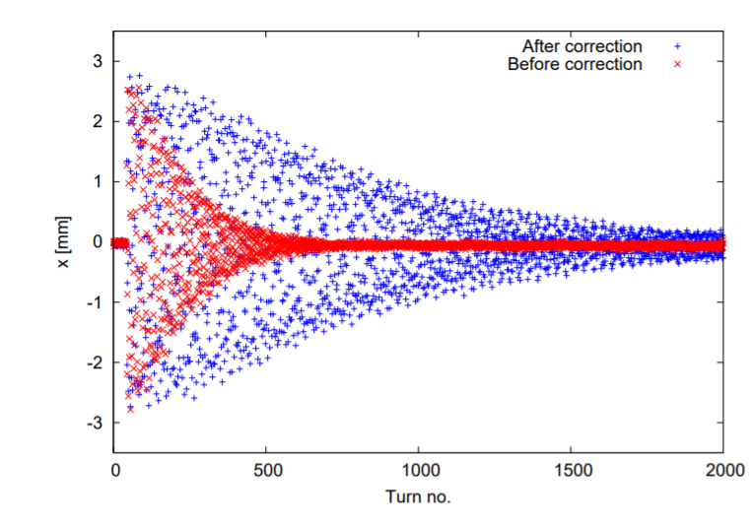
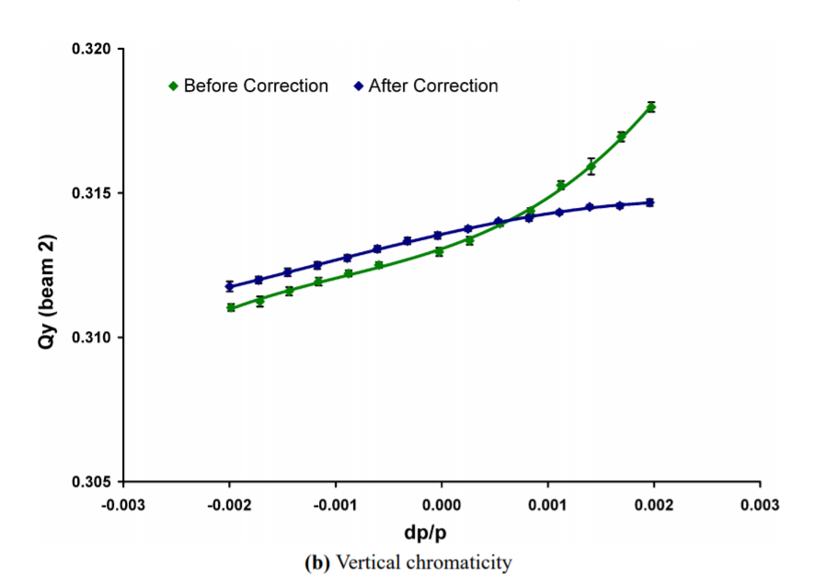
Measuring Q’’ and Q’’’
Interesting to compare to previous years
  Help to constrain a beam-based corrections
E. Maclean

Slide 21
Exotic K-modulation
K-modulation sector-by-sector (4h)
  Will give an independent measurement of the average beta-function
  Also try the functionality to trim the Q2 for example

Slide 22
Potentially the 60 deg phase advance (4 people needed + collimation experts )
Do the essential checks of equipment and software
Calculate the corrections: local coupling and global beta-beat
MCS, Q’’ and potentially a re-validation of the corrections if needed

Slide 23
60 deg phase advance optics
Try the 60 deg phase advance optics (8h)
  Designed for a higher energy LHC (replace every third dipole to 11 T) but would also probe the errors differently and would help to constrain the corrections further
  Significant different so will also help understand orbit errors
  Could bring insight into BPM calibration errors as well

Slide 24
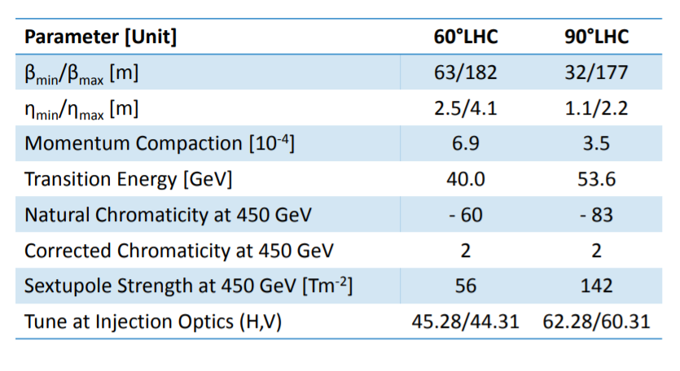
60 deg phase advance optics
Would be a different optics with different settings
  Help identifying underlying alignment and magnetic errors
  In particular the momentum compaction factor is different
J. Keintzel

Slide 25
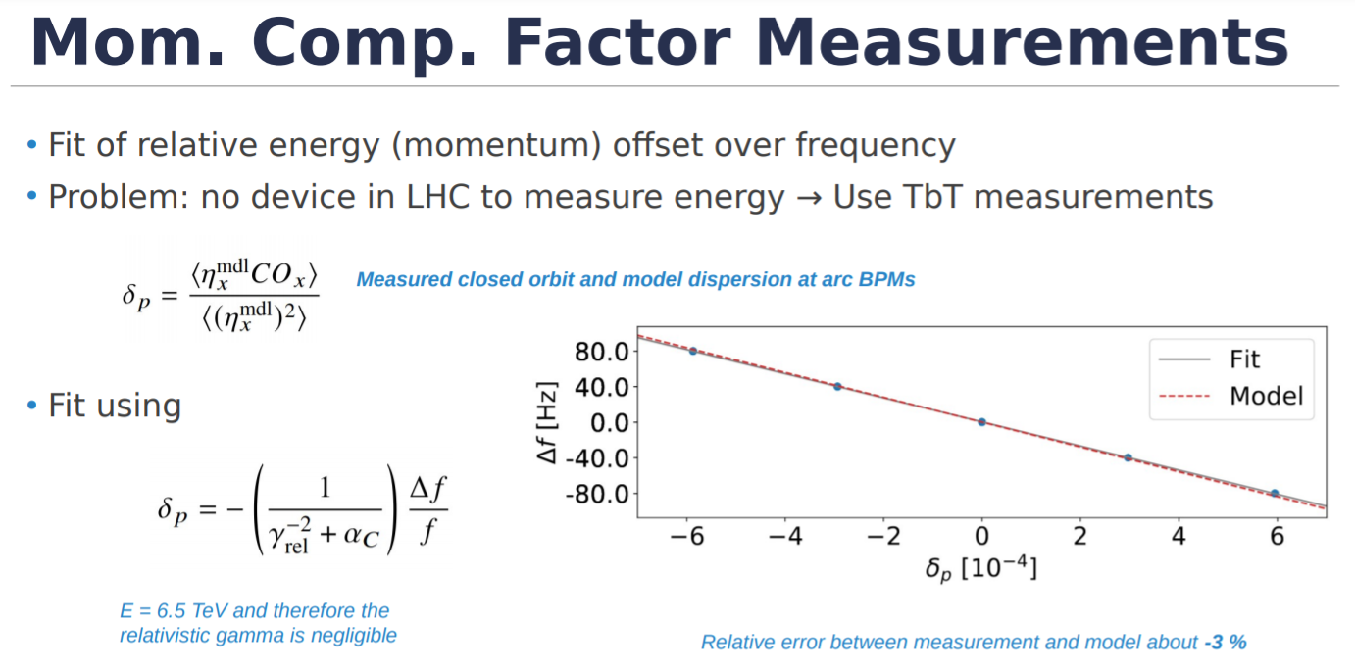
J. Keintzel

Slide 26
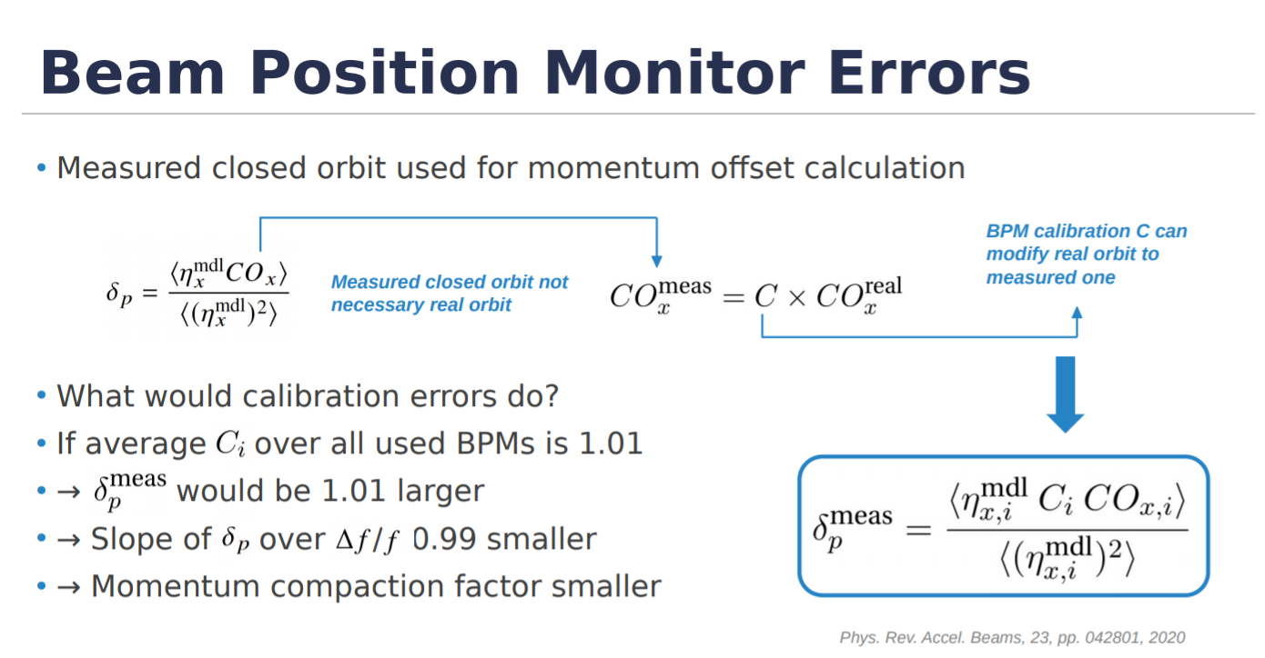
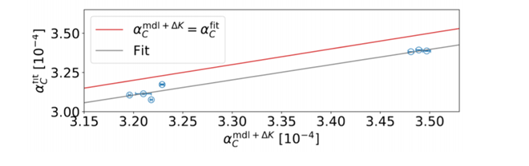
Takeaway: Around 3% error tentatively attributed to the arc BPMs -> IR BPM calibration from ballistic optics are also off because the method uses the arc BPMs
J. Keintzel

Slide 27
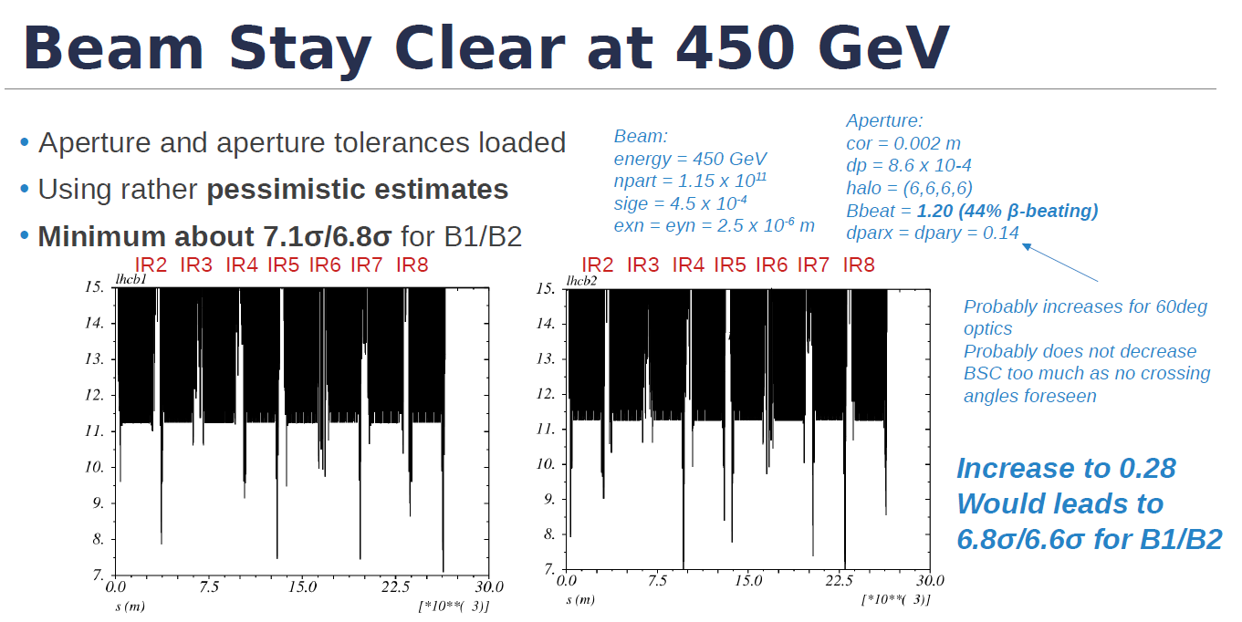
At the moment we are only interested in a single pilot bunch

Slide 28
Potentially the 60 deg phase advance (4 people needed + collimation experts)
Do the essential checks of equipment and software
If there is interest, we could also try the aperture measurements with the AC-dipole
-> Amplitude detuning for free
MCS, Q’’ and potentially a re-validation of the corrections if needed

Slide 29

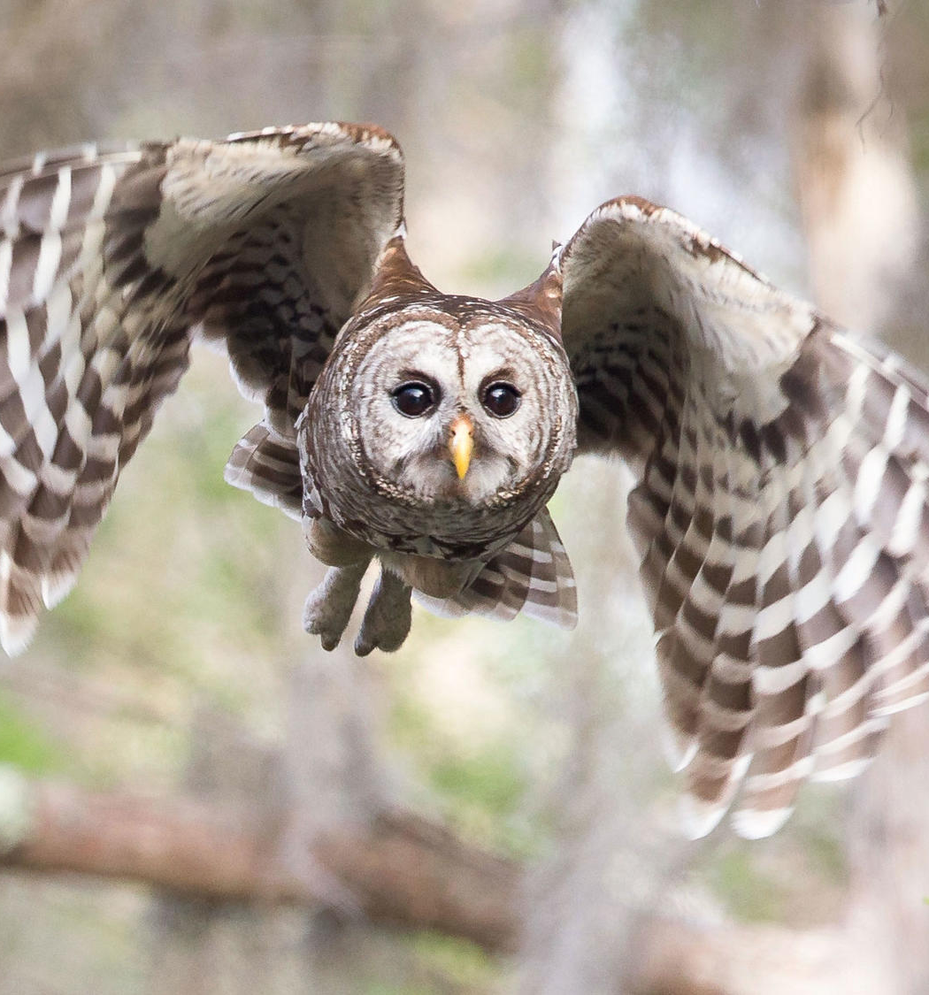
Conclusion
An extensive program ahead of us!
A lot of modifications have been done during the shutdown
  The beam test provides a great opportunity to test modifications to system and software
  Challenging also in the view of our own detraining (not only magnets can detrain)
The outcome will also depend on the availability of the machines and experts
  If everything goes well, we could still hope to test the 60 deg phase advance but we need your help for that!

Slide 30
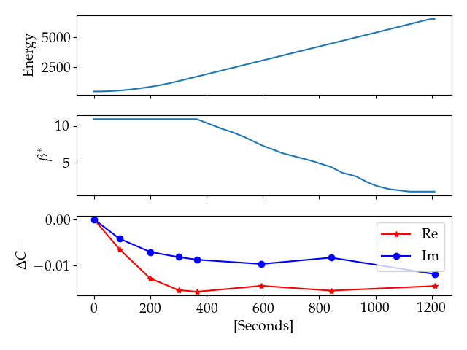
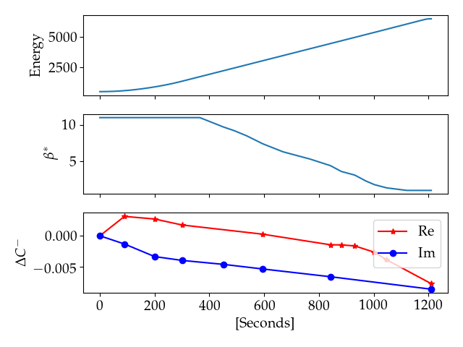
How did the coupling knobs change along the ramp and squeeze in 2018?
Most of the change is in the beginning of the ramp before the squeeze
-> Effect is coming from the arcs
  |C-| change up to 0.02
  Small changes in the later part even with the squeeze
    -> The local coupling corrections worked well
Beam 1
Beam 2

Slide 31
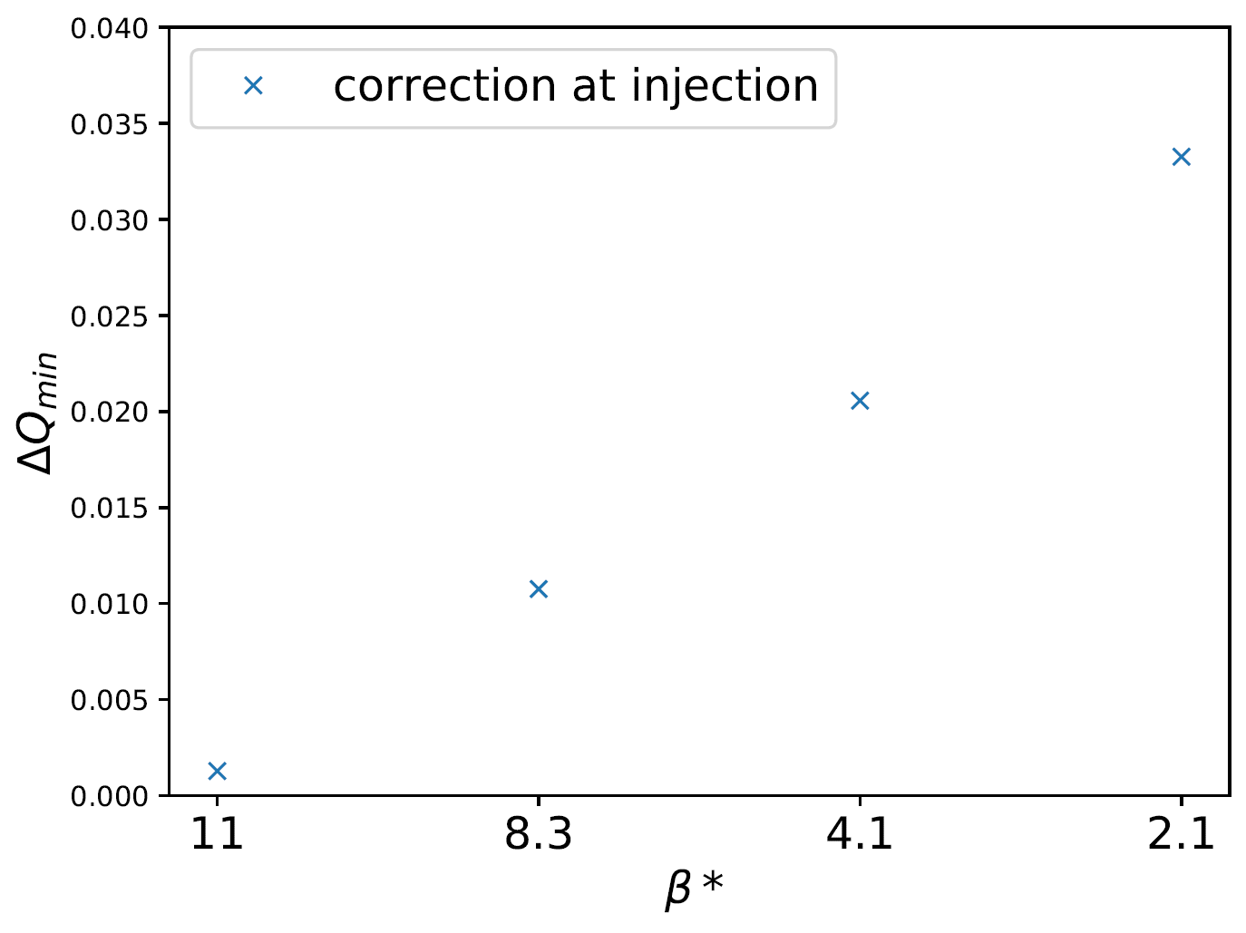
Without local coupling corrections
No measurements of the coupling as a function of β* in Run 2 but can use the local coupling corrections to estimate the situation
  Correct with knobs to |C-| = 0.001 at injection
  After squeezing to 7m we would have expected a |C-| ~0.01
E.J. Hoydalsvik

