Slide 1
SPL cryomodule specification:
Goals of the meeting
V.Parma, TE-MSC

Slide 2
Goal of today’s meeting
Identify and address still outstanding cryomodule design specification issues
Address the specific requirements related to the test program of the short cryomodule at CERN (for ex. : windows for in-situ intervention, need for diagnostics instrumentation, etc.).
Converge towards a technical specification to allow the continuation of the engineering of the short cryomodule, or identify road-maps to settle outstanding issues.
Chairperson: Vittorio Parma (CERN, TE/MSC)
Scientific secretary: Arnaud Vande Craen (CERN, TE-MSC)

Slide 3
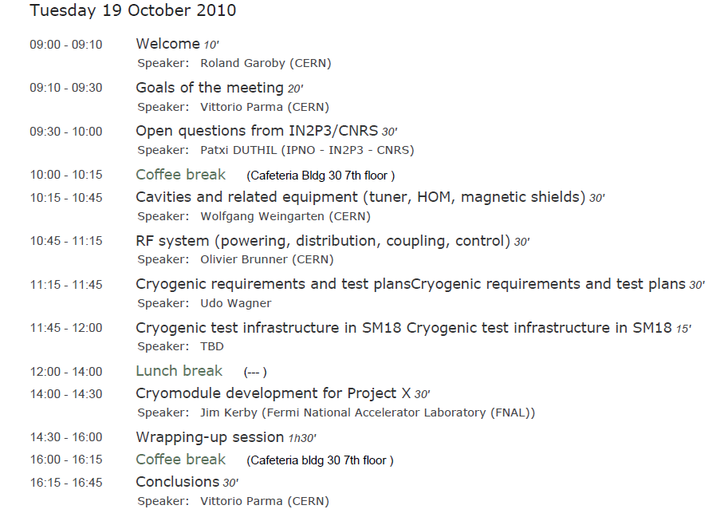
Agenda

Slide 4
Background information

Slide 5
Short cryo-module: Goal & Motivation
Goal:
Design and construct a ½-lenght cryo-module for 4 β=1 cavities (as close as possible to a machine-type cryomodule)
Motivation:
Test-bench for RF testing on a multi-cavity assembly driven by a single or multiple RF source(s)
Enable RF testing of cavities in horizontal position, housed in machine-type configuration (helium tanks with tuners, and powered by machine-type RF couplers)
Validate by testing critical components like RF couplers, tuners, HOM couplers in their real operating environment

Slide 6
Cryostat-related goals:
Learning of the critical assembly phases:
  From clean room assembly of cavities to a cryomodule
  Alignment/assembly in the cryostat;
Proof of concept of “2-in-1” RF coupler/cavity supporting:
  Fully integrated RF coupler: assembly constraints
  Active cooling effect on cavity alignment
Operation issues:
  Cool-down/warm-up transients
  Thermo-mechanics and alignment, vibrations
  Heat loads

Slide 7
Instrumentation: cryostat-specific needs
Alignment: Wire Position Monitor (WPM) type system
  On-line monitoring movements and vibrations of the Cold Mass (CM) during cool down and steady state operation
  Requires WPM supports of helium vessel
  Routing of coax cables through cryostat (4 per measurement point)
Calorimetric precision measurements (LHeII T drift) for static (and dynamic) Heat Loads
  T gauges in helium bath (1 per cavity)
  25 W electrical heaters in helium bath (1 per cavity)
Temperature mapping: T gauges (in insulation vacuum)
  RF coupler double-walled tube
  Tuner mechanical parts (normally badly thermalised, slow transients)
  Thermal shielding temperature mapping
  …

Slide 8
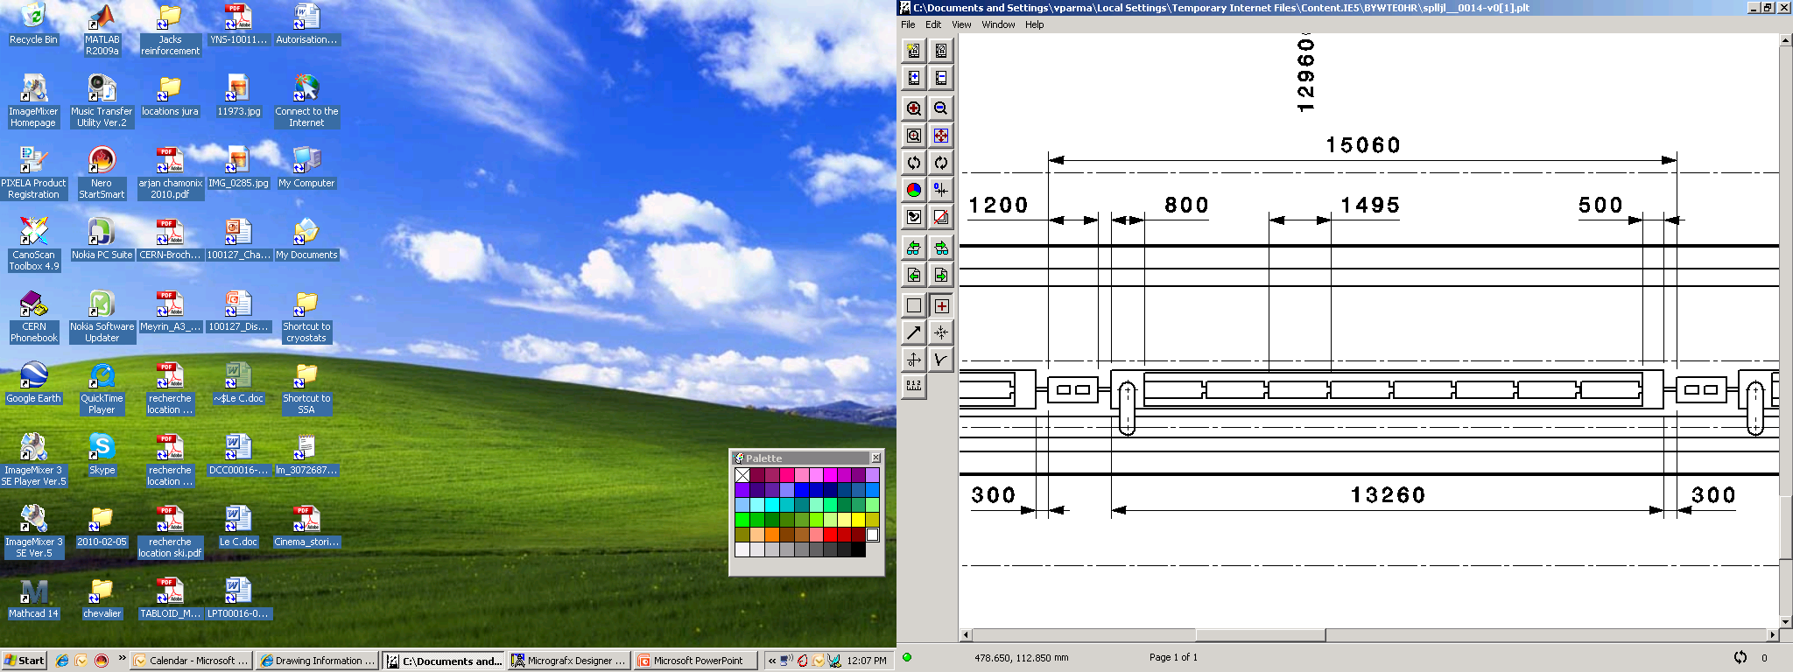
β=1 cryo-module in SPL layout

Slide 9
Moving from 8 to a 4-cavity design
Cryo-module Design Strategy:
Cryo design for an 8-cavity machine cryomodule:
  Cryogenics (p,T, heat loads, mass flows...)
  Inner cryo lines for a fully segmented machine layout:
    Individual cryo feeding, He vapours pumping, cryo control
      Pipe IDs, pressure drops, T margins,
      Control equipment (valves and instrumentation)
  Design for 1.7% tunnel slope (test 0%-2%)
Design for Manufacture for a small-to-medium number of cryomodule (typically ~50 units)
  Mechanical design, construction and assembly
  Alignment goals for machine-type cryomodules

Slide 10
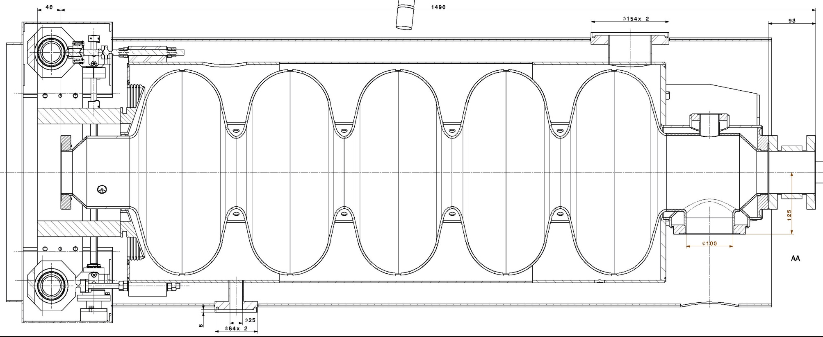
“Dressed” Cavity (CERN mods to CEA’s design)
Pumping port
HOM port
RF coupler port
Tuner
Cavity (Nb)
He vessel (Ti)
Magnetic shielding (cryoperm™)
Cool-down line port
Includes specific features for cryo-module integration (inter-cavity supports, cryogenic feeds, magnetic shielding …)
Th.Renaglia, EN-MME

Slide 11
Cavity Supporting System: alignment
Transversal position specification
BUDGET OF TOLERANCE
Step | Sub-step | Tolerances (3σ) | Total envelopes
Cryo-module assembly | Cavity and He vessel assembly | ± 0.1 mm | Positioning of the cavity w.r.t. beam axis ± 0.5 mm
 | Supporting system assembly | ± 0.2 mm
 | Vacuum vessel construction | ± 0.2 mm
Transport and handling (± 0.5 g any direction) | N.A. | ± 0.1 mm | Stability of the cavity w.r.t. beam axis ± 0.3 mm
Testing/operation | Vacuum pumping | ± 0.2 mm
 | Cool-down
 | RF tests
 | Warm-up
 | Thermal cycles
Construction precision
Long-term stability

Slide 12
Heat Loads (per β=1 cavity)
Operating condition | Value (nominal/”ultimate”)
cryo duty cycle | 4.11%/8.22%
quality factor | 10/5 x 10⁹
accelerating field | 25 MV/m
Source of Heat Load | Heat Load @ 2K (nominal/”ultimate”)
dynamic heat load per cavity | 5.1/20.4 W
static losses | <1 W (tbc)
power coupler loss at 2 K | <0.2/<0.2 W
HOM loss in cavity at 2 K | <1/<3 W
HOM coupler loss at 2 K (per coupl.) | <0.2/<0.2 W
beam loss | 1 W
Total @ 2 K | 8.5/25.8 W

Slide 13
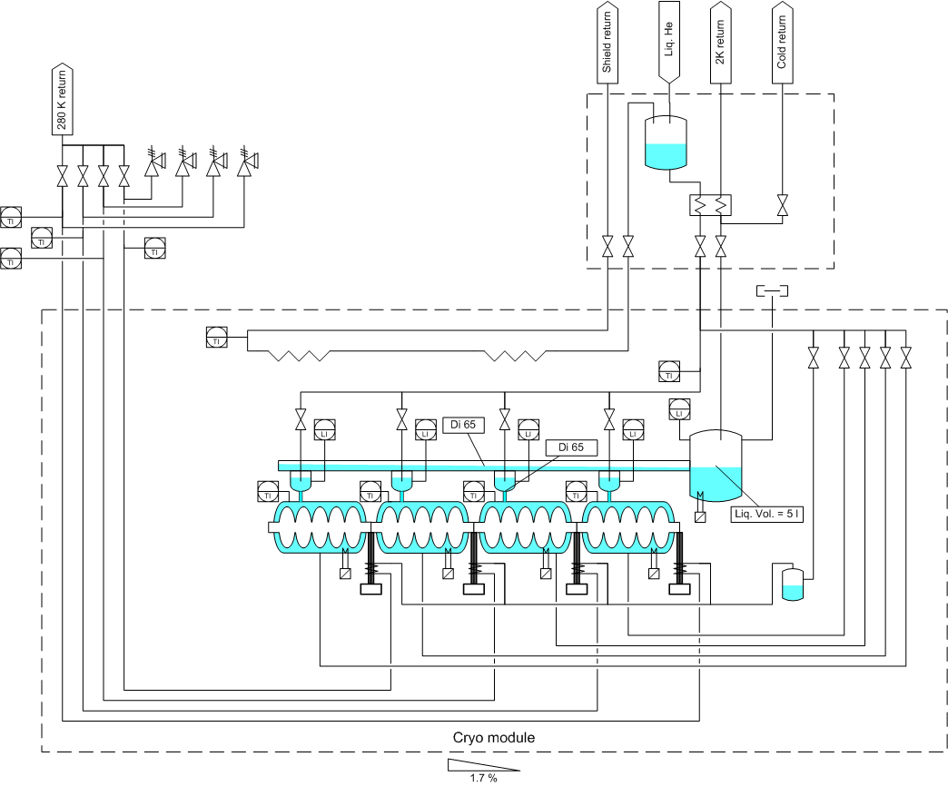
Cryogenic scheme (latest version)
E’
C
E
XB
C3
X
Y
C1
L
C2
U.Wagner, TE-CRG

Slide 14
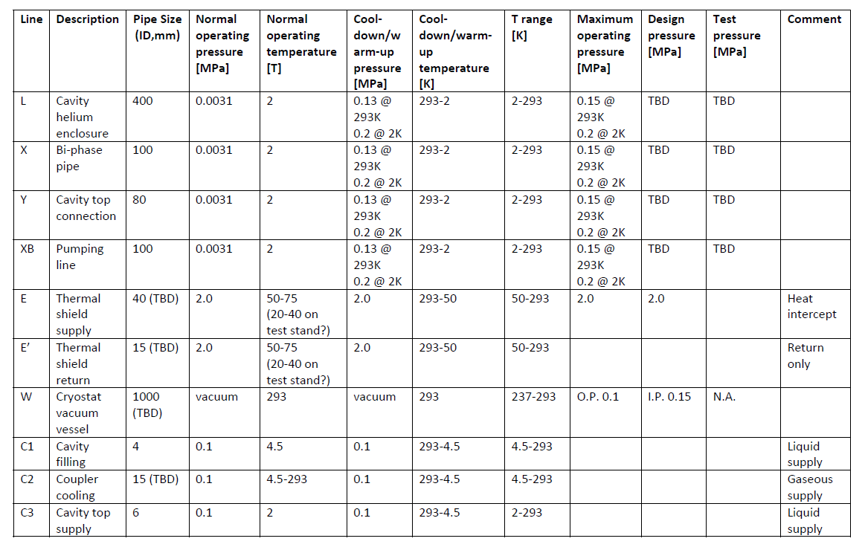
Pipe sizes and T, p operating conditions

Slide 15
Short cryomodule: layout sketch
Connection to cryo distribution line
End
Module
Cryo fill line (Y), top left
Technical Service
Module
Phase sep.
CW transition
Cavity additional support
RF coupler, bottom left side
1.7% Slope (adjustable 0-2%)
A.Vande Craen (MSC-CI)

