Slide 1
SPL short cryo-module
Cryogenic requirements and test plans
Udo Wagner
TE-CRG

Slide 2
What is unknown
Cool down:
  Do we need one CD valve for each cavity?
Operation:
  Is one supply for a string of 4/8 cavities sufficient?
  How will the distribution react on:
    Single cavity quench
    Start / Stop of RF power
  Will the “inversed” coupler cooling work

Slide 3
Envisaged tests
Cool down
  Using the CD valves (this should work)
  Using only the fill valves (uncertain if this works)
Operation
  Level control with one fill valve per cavity
  Level control with one fill valve per string
  Compensation of load variations by heaters
  Reaction of single cavity quench
  Cooling control of couplers

Slide 4
Static heat load measurements
Static heat loads are estimated at the range of 5% of dynamic loads
Do we really care for precise measurements of the static cryostat losses at this stage?
  If yes, instrumentation has to be adapted.
Nota: the thermal shield will operate temperatures not representative for an eventual SPL project.

Slide 5
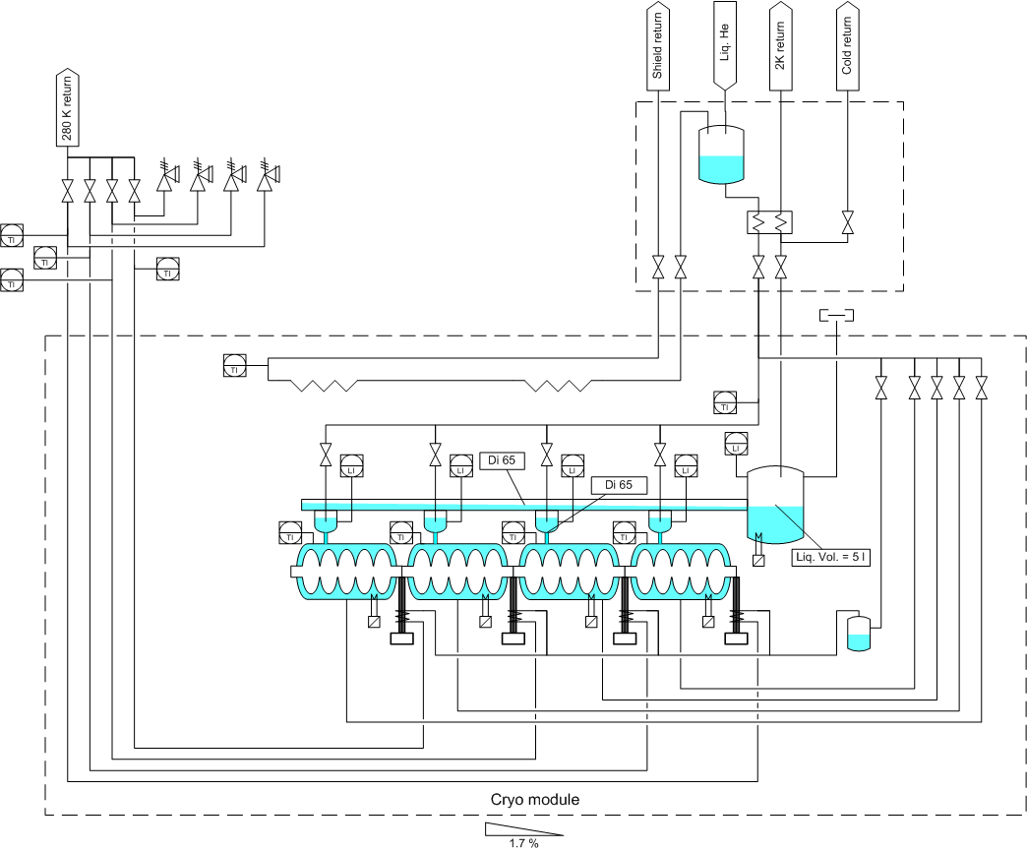
“Latest” SPL cryo-module PFD
Equipment needed or not?

