Slide 1
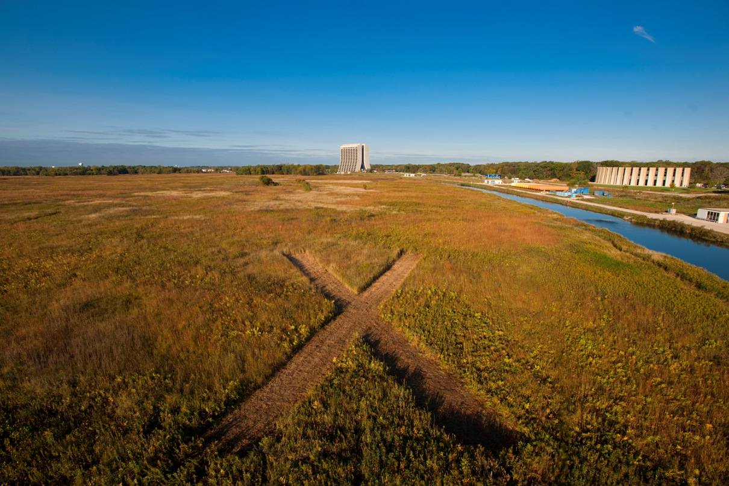
Project X Cryomodule Status
Jim Kerby
(w/ thanks to the Project X team)
SPL Meeting
CERN
19 October 2010

Slide 2
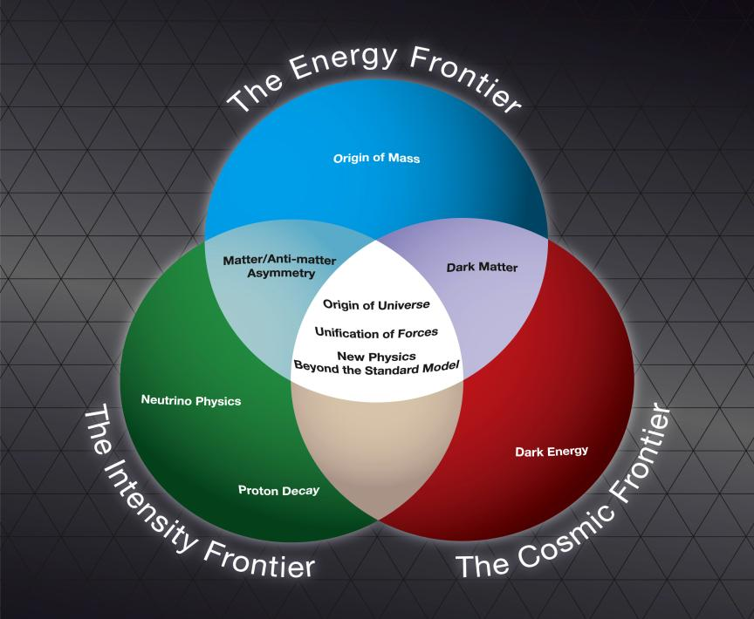
Fermilab Long Range Plan
Fermilab is the sole remaining U.S. laboratory providing facilities in support of accelerator-based Elementary Particle Physics
The Fermilab strategy is to
mount a world-leading program
at the intensity frontier, while
using this program as a bridge
to an energy frontier facility
beyond LHC in the longer term.

Slide 3
Evolution of the Fermilab Accelerator Complex
A multi-MW Proton Source, Project X, is the linchpin of Fermilab’s strategy for future development of the accelerator complex.
Project X provides long term flexibility for achieving leadership on the intensity and energy frontiers
  Intensity Frontier:
  NuMI→ NOνA→ LBNE/mu2e→ Project X → Rare Processes → NuFact
    Continuously evolving world leading program in neutrino and rare processes physics; opportunities for applications outside EPP
  Energy Frontier:
  Tevatron → ILC or Muon Collider
    Technology alignment
    Fermilab as host site for ILC or Muon Collider
CERN 19 Oct 2010-J. Kerby

Slide 4
Reference Design
3 GeV CW linac provides greatly enhanced rare process program
  ~3 MW; flexible provision for beam requirements supporting multiple users
Preferred option for 3-8 GeV acceleration: 1.3 GHz pulsed linac
Reference Design Report in final edit
Project X website: http://projectx.fnal.gov/
To RR/MI 2 MW neutrinos
3-8 GeV Pulsed Linac
Kaons
H⁻
CW RFQ, Chopper
3 GeV CW Linac
1 mA av beam current
Pulsed dipole
3 GeV RF Splitter
Muons
Other

Slide 5
Project X Performance Goals
Linac
Requirement | Description | Value
L1 | Delivered Beam Energy, maximum | 3 GeV (kinetic)
L2 | Delivered Beam Power at 3 GeV | 3 MW
L3 | Average Beam Current (averaged over >1 μsec) | 1 mA
L4 | Maximum Beam Current (sustained for <1 μsec) | 10 mA
L5 | The 3 GeV linac must be capable of delivering correctly formatted beam to a pulsed linac, for acceleration to 8 GeV
L6 | Charge delivered to pulsed linac | 26 mA-msec in < 0.75 sec
L7 | Maximum Bunch Intensity | 1.9 x 10 ⁸
L8 | Minimum Bunch Spacing | 3.1 nsec (1/325 MHz)
L9 | Bunch Length | <50 psec (full-width half max)
L10 | Bunch Pattern | Programmable
L11 | RF Duty Factor | 100% (CW)
L12 | RF Frequency | 325 MHz and harmonics thereof
L13 | 3 GeV Beam Split | Three-way
3-8 GeV Pulsed Linac
Requirement | Description | Value
P1 | Maximum beam Energy 8 GeV
P2 | The 3-8 GeV pulsed linac must be capable of delivering correctly formatted beam for injection into the Recycler Ring (or Main Injector).
P3 | Charge to fill Main Injector/cycle | 26 mA-msec in <0.75 sec
P4 | Maximum beam power delivered to 8 GeV | 300 kW

Slide 6
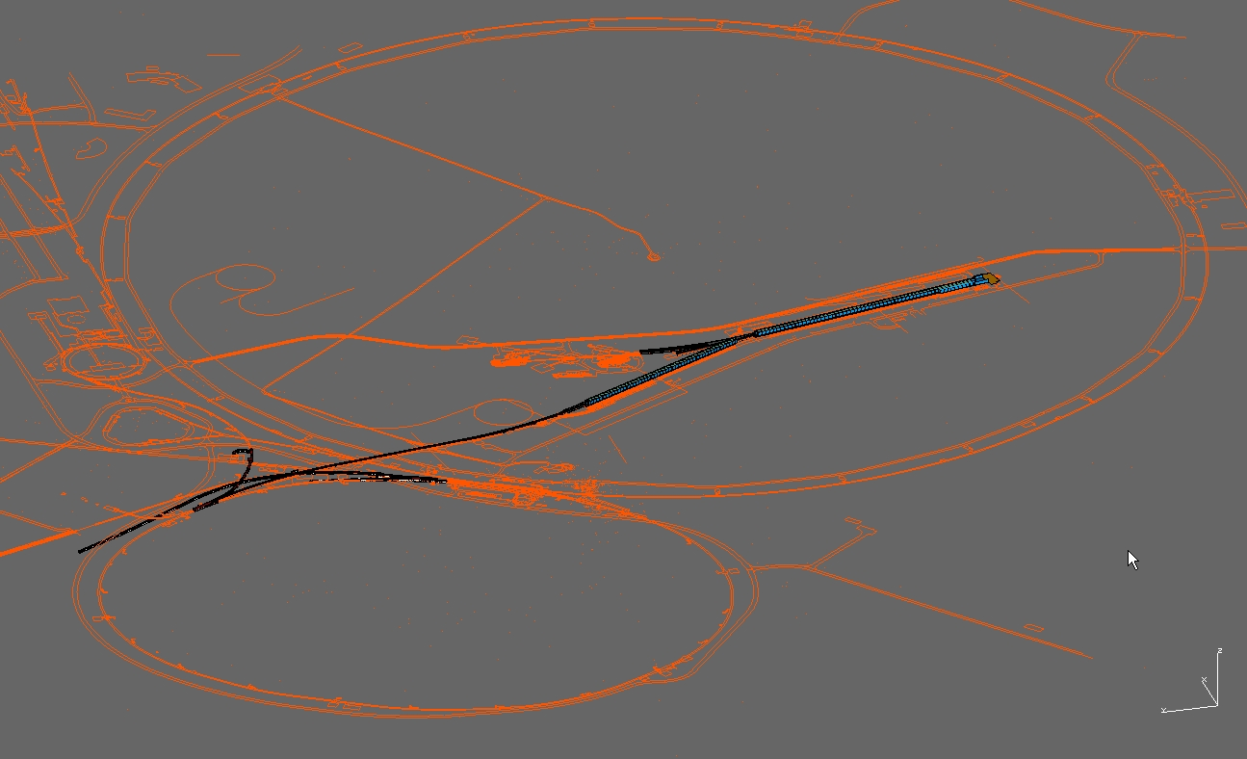
Layout

Slide 7
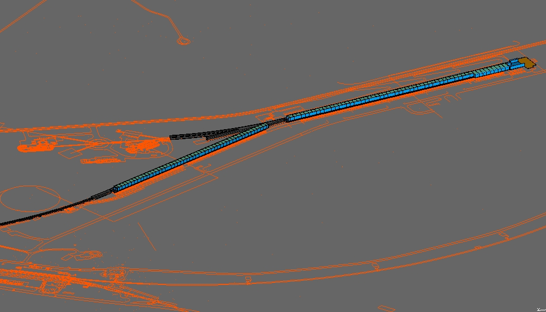
Layout
325 MHz
650 MHz
1300 MHz
3 GeV cw linac
3 - 8 GeV pulsed linac

Slide 8
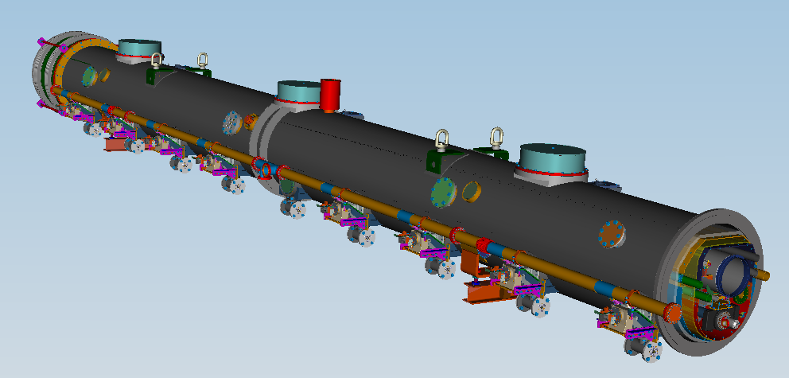
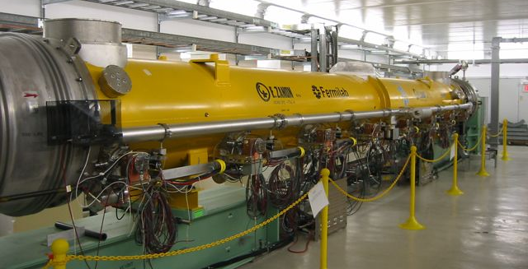
3-8 GeV Pulsed Linac
~4% duty factor, 200 1300MHz cavities operating at 25 MV/m
25 ILC-type (Type IV) Cryomodules
Existing design, CM1 cooldown next week, CM2-6 following (in addition to XFEL pre-production / production expereince)
Technical R&D into injection into Main Injector at lower energies

Slide 9
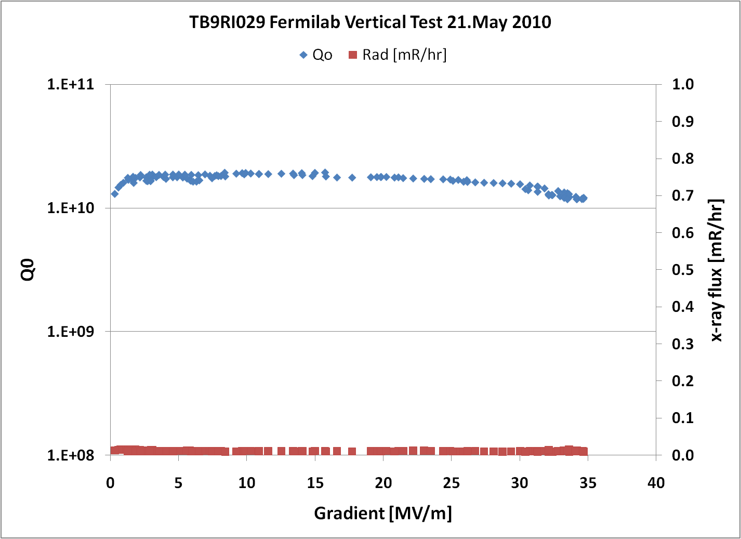
Recent VTS Results
FNAL vertical test result 21.May 2010:
34.6 MV/m maximum gradient with Q0=1.2E10 (quench)
No field emission measured above background
TB9RI029 is first FNAL/ANL-processed production-style cavity to reach ~35 MV/m
Bulk-EP was at RI
[AES003 after a long history was also light-EP’d recently at FNAL/ANL and
reached 32.2 MV/m (some FE);
TB9RI024, also with FNAL/ANL light-EP, reached 33.9 MV/m; some FE]

Slide 10
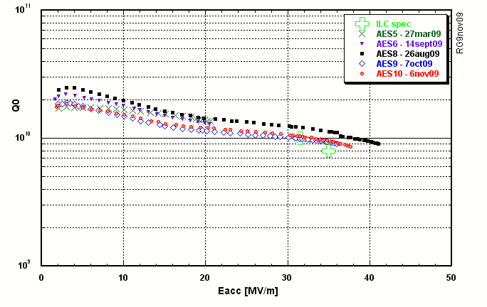
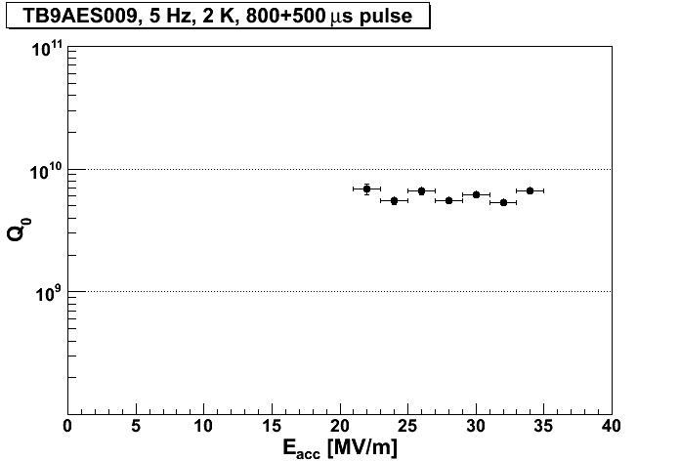
Recent HTS Results
JLab vertical test data 7.Oct 2009:
TB9AES009 maximum gradient
36.0 MV/m with Q0=9.1E9 (quench)
FNAL HTS data April/May 2010:
TB9AES009 maximum gradient
35 MV/m with Q0=6.6E9 (quench)

Slide 11
3GeV cw Linac
Technology Map
SSR0
SSR1
SSR2
β=0.6
β=0.9
ILC
325 MHz
2.5-160 MeV
650 MHz 0.16-2 GeV
1.3 GHz 2-3 GeV
Section | Freq | Energy (MeV) | Cav/Mag/CM | Type
SSR0 (β_{G}=0.11) | 325 | 2.5-10 | 26 /26/1 | SSR, solenoid
SSR1 (β_{G}=0.22) | 325 | 10-32 | 18 /18/ 2 | SSR, solenoid
SSR2 (β_{G}=0.4) | 325 | 32-160 | 44 /24/4 | SSR, solenoid
LB 650 (β_{G}=0.61) | 650 | 160-520 | 42 /21/7 | 5-cell elliptical, doublet
HB 650 (β_{G}=0.9) | 650 | 520-2000 | 96 /12 /12 | 5-cell elliptical, doublet
ILC 1.3 (β_{G}=1.0) | 1300 | 2000-3000 | 64 /8 /8 | 9-cell elliptical, quad

Slide 12
3GeV cw Linac
Technology Map
SSR0
SSR1
SSR2
β=0.6
β=0.9
325 MHz
2.5-160 MeV
650 MHz 0.16-3 GeV
Section | Freq | Energy (MeV) | Cav/mag/CM | Type
SSR0 (β_{G}=0.11) | 325 | 2.5-10 | 26 /26/1? | SSR, solenoid
SSR1 (β_{G}=0.22) | 325 | 10-32 | 18 /18/ 2 | SSR, solenoid
SSR2 (β_{G}=0.4) | 325 | 32-160 | 44 /24/4 | SSR, solenoid
LB 650 (β_{G}=0.61) | 650 | 160-487 | 36 /24/4? | 5-cell elliptical, doublet
HB 650 (β_{G}=0.9) | 650 | 487-3000 | 160 /38 /20 | 5-cell elliptical, doublet

Slide 13
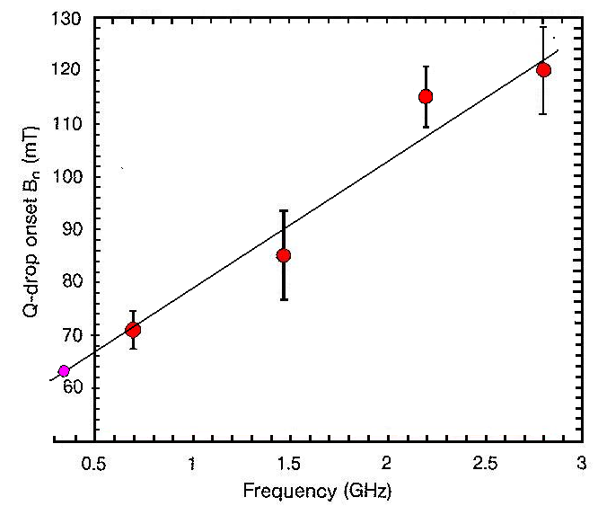
Choice of Cavity Parameters
Identify maximum achievable surface (magnetic field) on basis of observed Q-slope “knee”
Select cavity shape to maximize
gradient (subject to physical
constraints)
Establish Q goal based on
realistic extrapolation from
current performance
  Goal: <25 W/cavity
Optimize within (G, Q, T) space
(Initial) Performance Goals
  Freq (MHz) B_{pk}(mT) G (MV/m) Q @T (K)
  325 60 15 1.4E10 2
  650 72 16 1.7E10 2
  1300 72 15 1.5E10 2
HF Q-slope onset vs. Frequency (JLAB)

Slide 14
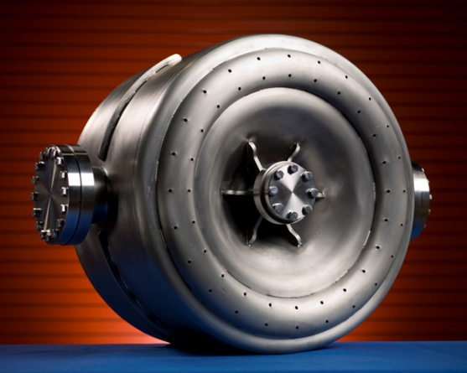
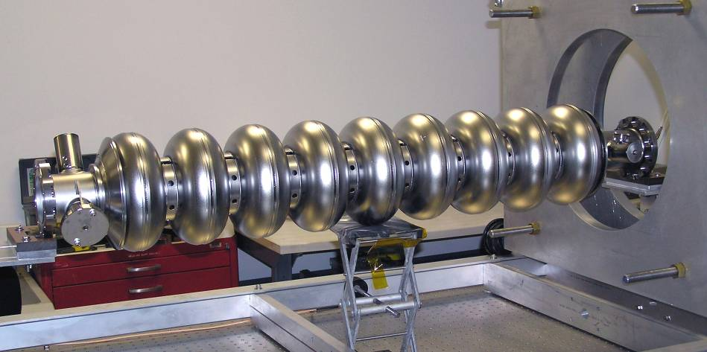
SRF Technology Development
Single Spoke Resonators (325 MHz)
Roark, Zanon, IUAC…
60 mT
Elliptical Cavities
(650 and 1300 MHz)
AES, RI, Jlab, Cornell, Niowave-Roark, RRCAT, Pavac….

Slide 15
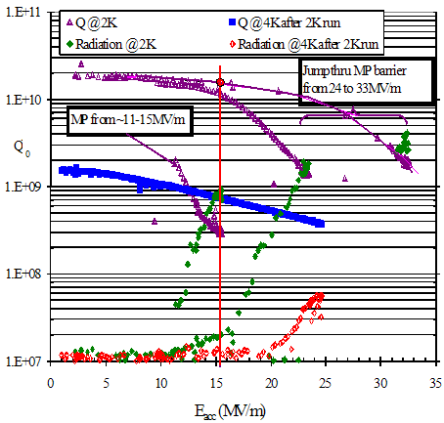
SSR1 Test Results
Roark and Zanon SSR have been tested successfully
Two in process at IUAC
10 more ordered from Roark
SSR0, SSR2 designs following
Ultimately a prototype SSR1 Cryostat will be assembled

Slide 16

325 Cryomodule
1 CM of SSR0, 18 – 26 cavities
Vent pipes every 6 - 8 cavities, 40+ mm thermal contraction, assembly
2 CM of SSR1, Minimize of the inter-cryostate drift space
L_{CM} =7.2m
4 CM of SSR2, Provide drift space by missing cavity
L_{CM} =9.6 m
From Nikolay Solyak
Project-X, CW Linac (ICD-2+)
Lattice Design, 16 Mar 2010

Slide 17
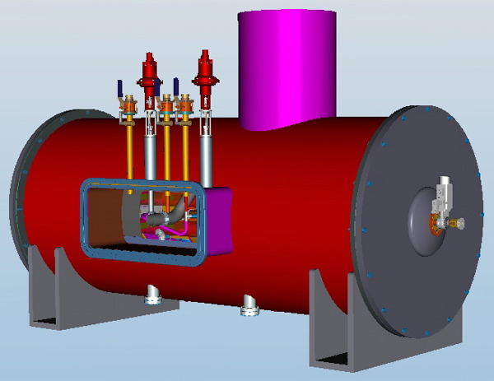
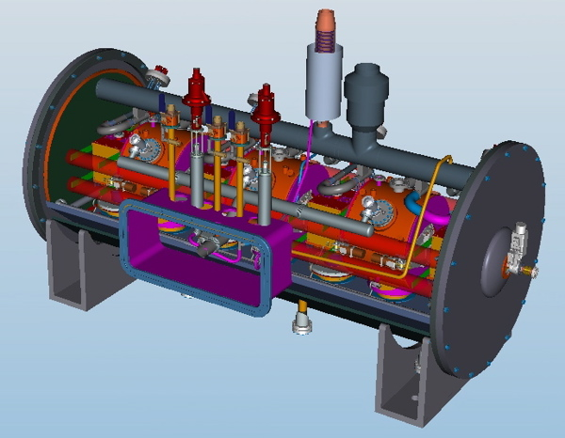
325 Prototype Cryomodule
Prototype design being developed to test 3 SSR1 and 4 solenoid magnets

Slide 18
650 Low and High Beta Optics
13808
11763

Slide 19
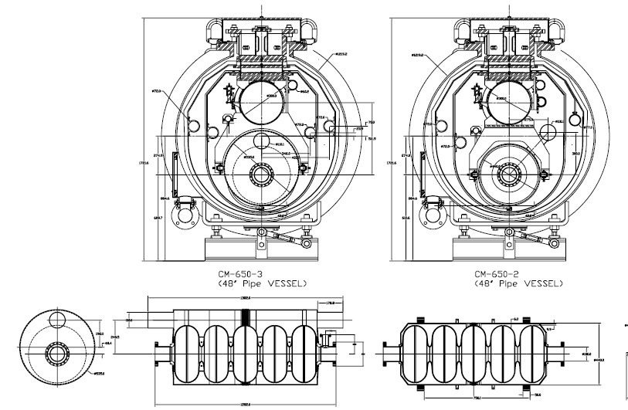
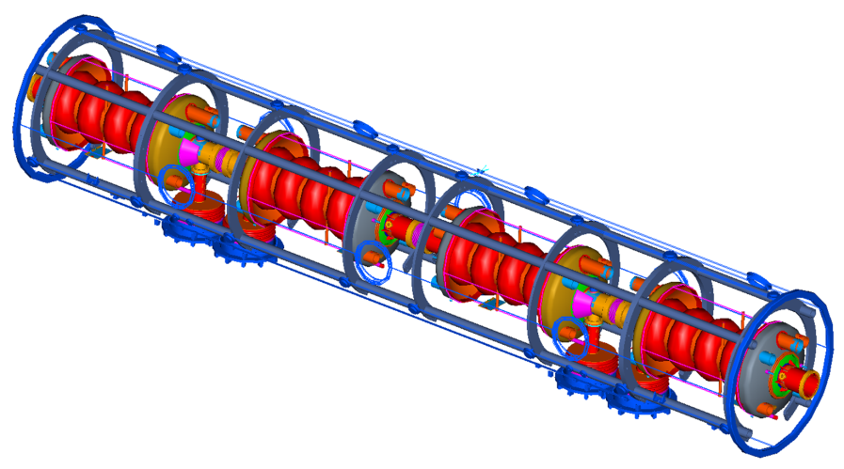
650 MHz Cryomodules
Individually segmented, each with ~250W to 2K
Design options range from “Spaceframe” to “TESLA” derivatives
Discussion on the effect of vapor and liquid volumes fractions and flow rates on pressure regulation

Slide 20
650 MHz Status
The optics design of the 2-3 GeV portion of the Project X CW Linac is under review.
The dynamic heat load per cavity, and per cryomodule, has individually segmented cryomodules under serious consideration for the CW linac
Initial alignment tolerances are 0.5mm rms, with a 1mm limit. The use of multiple correction elements and BPMs is motivating the numbers
650 Beta = 0.9 optics are more settled than Beta = 0.61 optics on a ‘cryomodule’ basis
Warm and cold magnet options are under consideration.
Inclusion of heat exchangers and cryogenic bayonets in the interconnect or directly from the vacuum vessel in discussion

Slide 21
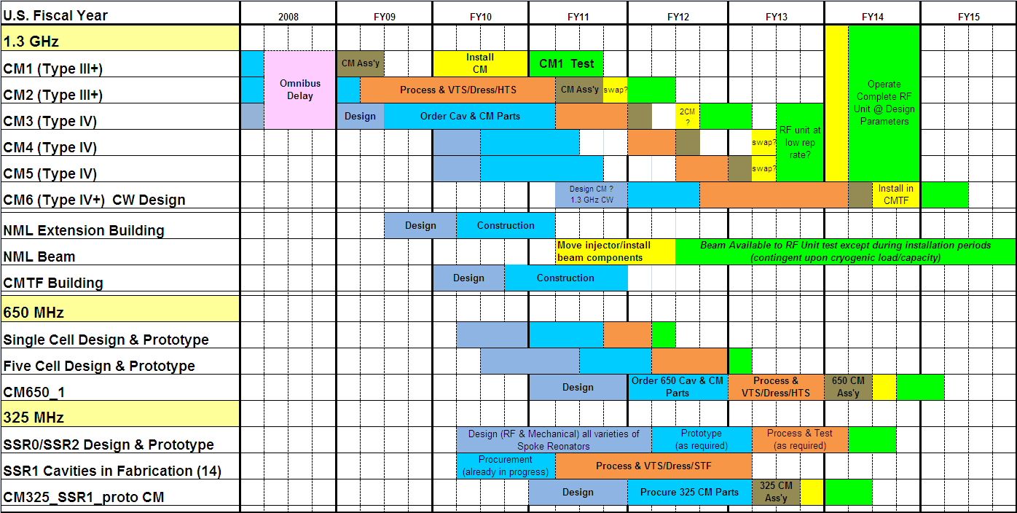
SRF Plan

Slide 22
Summary
Project X is central to Fermilab’s strategy for development of the accelerator complex over the coming decade
  World leading programs in neutrinos and rare processes
  Aligned with ILC and Muon Accelerators technology development;
  Potential applications beyond elementary particle physics
The machine design is converging, though iterations of the optics are underway (and expected) at this conceptual stage
At a minimum with respect to SPL cryogenics, alignment, and component thermal performance all appear to be areas of useful cross-calibration if not collaboration
  Fermilab Director and CERN DG signed a letter of intent on future cooperation last friday

