Slide 1
SM 18 infrastructure focused on SPL cavity tests
V. Benda, O. Pirotte, B. Vullierme

Slide 2
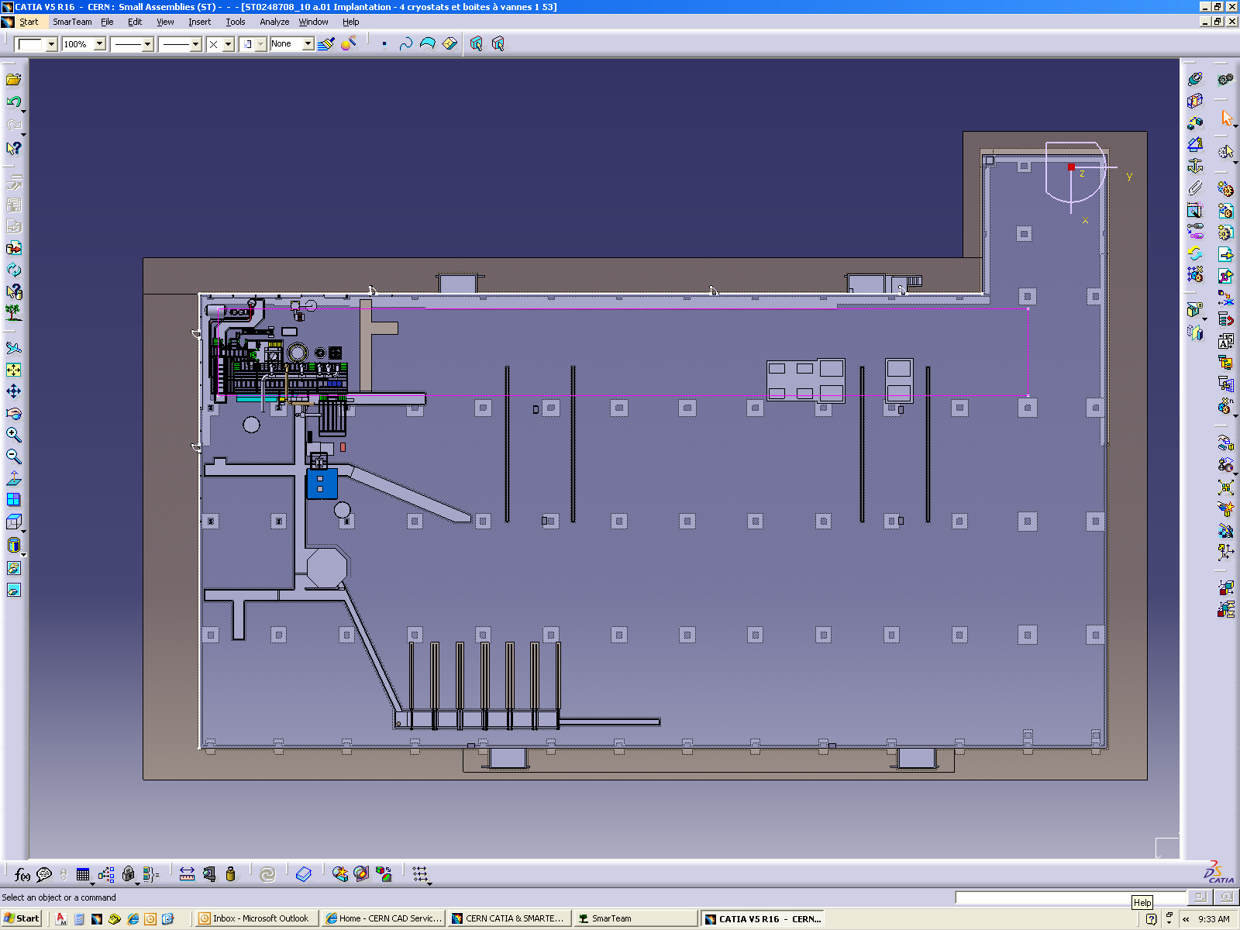
SM 18 layout, current status
Bloc 4 + FCM + SC Link
GReC
Magnet test benches CFBs
6 kW Linde
RF cavity

Slide 3
SM 18 cryogenic simplified flow scheme
1.9 K pumping
Compressors
CFB 10x
Dryer
full flow
WPU 1
CCU 2 & heater 1
String 3
HP
LP
Bloc4, Fresca 2,
CL test
Precooler
/adsorber
WPU 2
CCU 3 & heater 5
SC link
/FCM
Shield
6 kW
cold box
Cavity
4x v & 2 x h
SC helium
LHe
Heater
LHe
25 000 l LHe
dewar

Slide 4
Main inputs of SM 18 cryogenic infrastructure
The 6 kW Linde cold box
  Capacity: 25 g/s (700 l/h) of LHe
The 1.8 K pumping capacity
  2 warm pumping units (WPU), each one of a following pumping speed:
    6 g/s @ 10 mbar
    12 g/s @ 20 mbar
    18 g/s @ 30 mbar
  To each pumping unit is dedicated one very low pressure heater of 32 kW (20g/s)
  The cold compressor (CCU) & one WPU in series: 18 g/s @10 mbar
  One WPU is dedicated to CFBs and Bloc 4 including CCU if necessary
  Second WPU will be dedicated to cavity tests
  Both WPUs can work in parallel
New clients
  Bloc 4, FCM, SC Link: LHe & pumping capacity
  Cavity: Pumping capacity will required one WPU

Slide 5
Individual tests compatible with SM18 test capacity… L. Tavian
6 kW cryoplant
WPU + CCU
2 WPU

Slide 6
… but not all together ! → Coordination and … L. Tavian

Slide 7
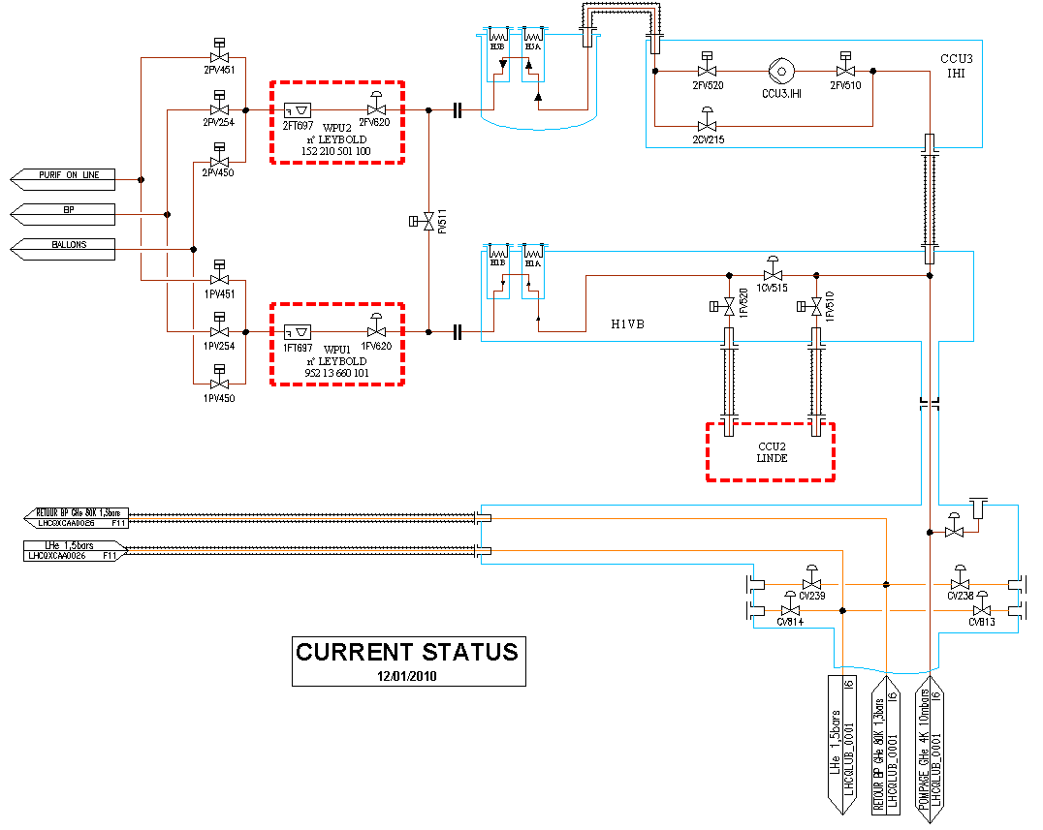
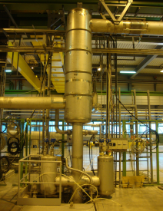
LHe distribution & 1.9 K pumping, current status

Slide 8
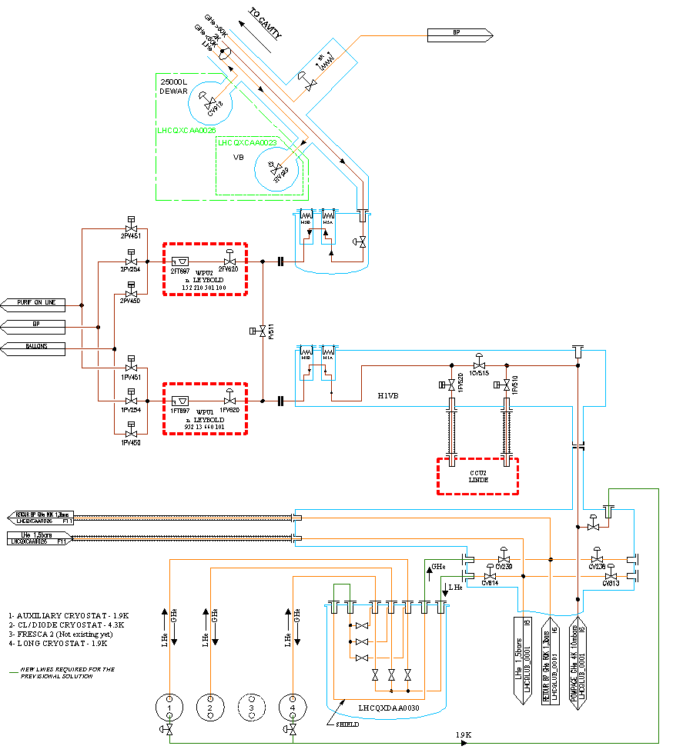
SM 18 upgrade, new cavity pumping line and Bloc 4 distribution simplified scheme

Slide 9
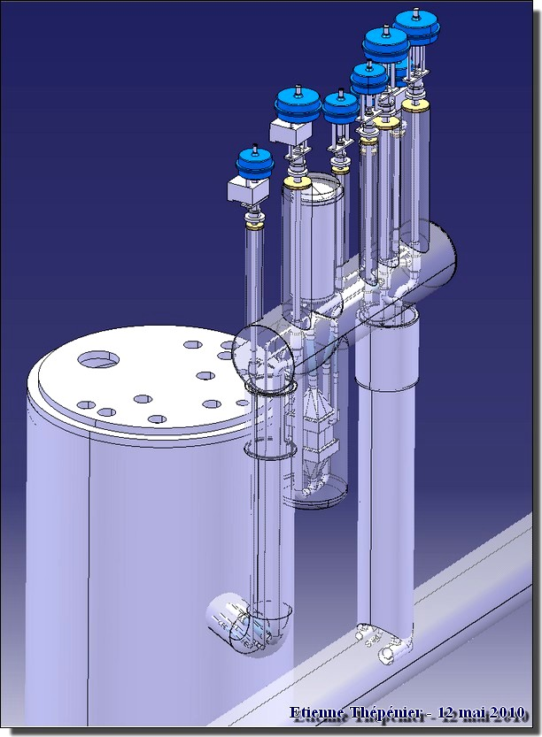
2 K RF service module

Slide 10
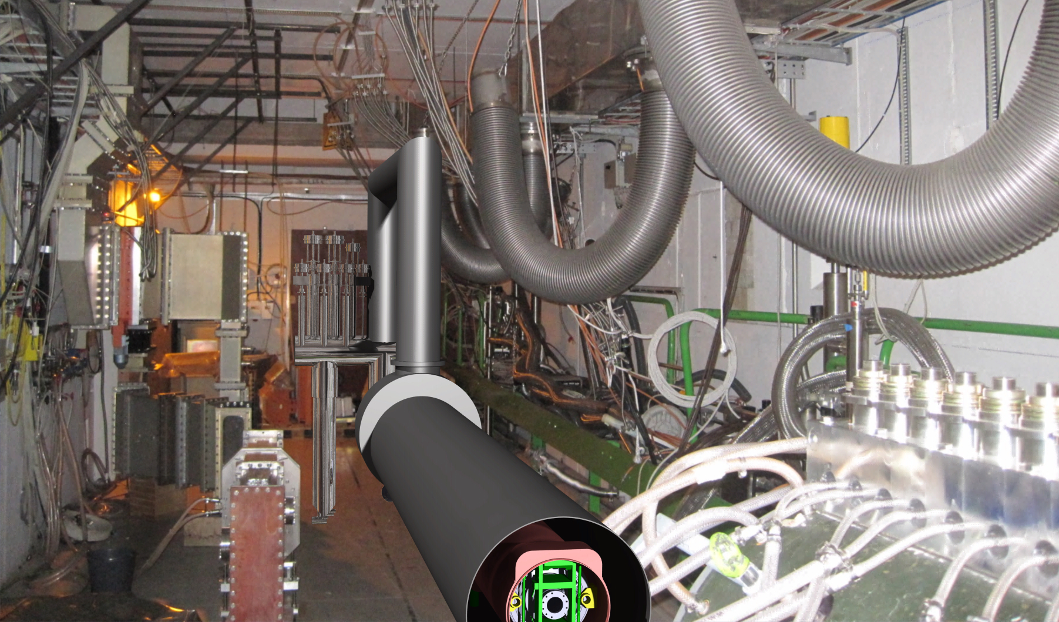
Cryo module in the bunker – simulation
Service module
Jumper
Interface of a cryo module
To be defined!
Cryo module

Slide 11
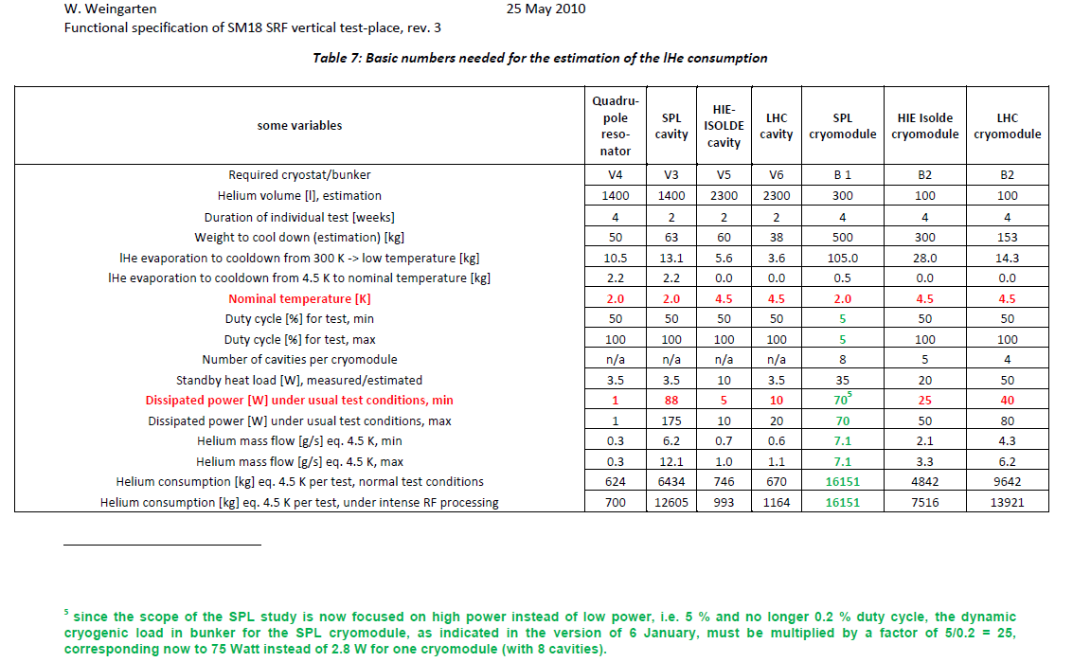
Clarification of the required cryogenic power @ 2 K
Operating condition | Value (nominal/”ultimate”)
cryo duty cycle | 4.11%/8.22%
quality factor | 10/5 x 10⁹
accelerating field | 25 MV/m
Source of Heat Load | Heat Load @ 2K (nominal/”ultimate”)
dynamic heat load per cavity | 5.1/20.4 W
static losses | <1 W (tbc)
power coupler loss at 2 K | <0.2/<0.2 W
HOM loss in cavity at 2 K | <1/<3 W
HOM coupler loss at 2 K (per coupl.) | <0.2/<0.2 W
beam loss | 1 W
Total @ 2 K | 8.5/25.8 W
Ultimate heat load @ 2 K for 8 cavities is:
8 x 25.8 = 208 W
What is the maximum required cryogenic power @ 2 K for a module of 8 cavities: 208 W or 75W?
SPL cavity and SPL module cannot be tested simultaneously.

Slide 12
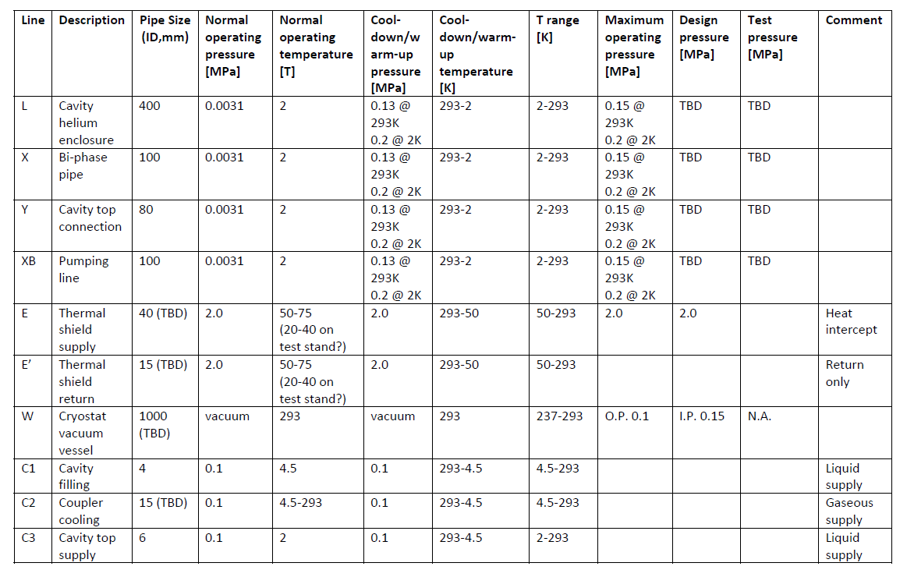
Some questions
1)Cryo module interface to be defined (welded sleeve, 4 x flexibles), as well as allocated volume in the bunker for Cryo equipment.
2)Required cryogenic power @ 2 K to be clarified.
3)Is there any limit of dT during cool down/warm up?
4)Required speed of warm up; procedure?
5) What is a heat inleak to the thermal shield.
6) Point A in the table ??
7) Point B: Safety valve adjustment?
8) Point C: Available temperature of GHe is 5 K.
9) Point D: Available pressure is 0.13 MPa.
A
B
D
C

