Slide 1
WP4 - NA3 - Innovation, technology transfer, industry relation
Manuela cirilli (CERN)
Cino Matacotta (infn)
Martina bauer, tobias engert (GSI)

Slide 2
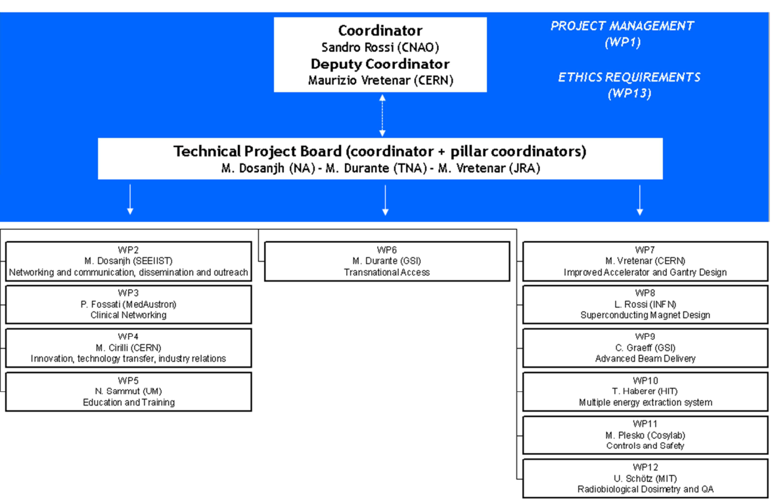
Work Packages Organization
Notes:
All WP4 partners have dedicated Technology Transfer offices with the necessary experience to support the work plan and to achieve these objectives. Tight links with the HITRIplus JRA work-packages (WP7-WP12) will ensure an effective internal communication about the technologies being developed.

Slide 3
The industrial landscape today
Proton therapy:
Many turnkey solutions available from a variety of vendors (e.g. IBA, Optivus Proton Therapy, Inc., Mevion Medical Systems, Varian Medical Systems, ProTom International, Hitachi, Ltd., Mitsubishi Corporation, ProNova Solutions LLC, Sumitomo Heavy Industries, Ltd…)
Single room & multi room options
Market size in 2020: USD 1,350.8 million
Leader is European (IBA)
Ion therapy:
4 bespoke centres in Europe
Turnkey heavy ion therapy accelerators can be bought from Japanese companies
European industry absent from this market

Slide 4
WP4: devise and implement a ROADMAP for the INDUSTRIALISATION of the HITRIplus TECHNOLOGIES
Foto di Sven Lachmann da Pixabay

Slide 5
Objectives
Identify the most promising technical developments (in terms of tech transfer) in HITRIplus
Devise and implement the most adequate technology transfer routes
  Taking into account Intellectual Property matters, and exploring both traditional approaches (e.g. patents) and less conventional ones, such as open-access licensing schemes (e.g. CERN Open Hardware Licence)
Proactively promote the selected technology innovations to gather industrial interest and feedback
Build an innovation ecosystem by establishing relationships with relevant industrial actors in order to successfully industrialise the HITRIplus technologies and by liaising with entrepreneurship programmes

Slide 6
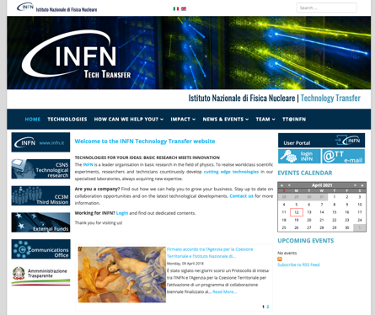
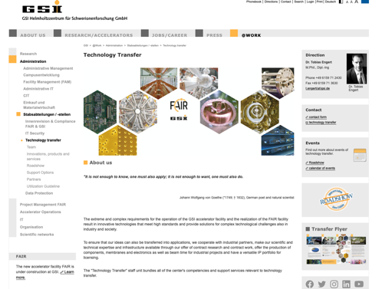
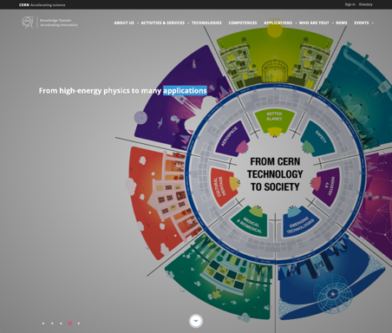
WP4: 3 partners with dedicated and experienced Tech Transfer groups

Slide 7
Three main tasks to achieve the objectives
Task 4.1: Technology overview/assessment (CERN, GSI, INFN)
Task 4.2: Technology promotion (GSI, CERN, INFN)
Task 4.3: Technology matching (INFN, CERN, GSI)
HITRIplus Technology Overview committee:
WP4 members + WP7-12 leaders

Slide 8
Task 4.1: Technology overview/assessment
“Inventory” of the innovations developed in HITRIplus
Advice on IP matters, including patentability
Evaluate optimal tech transfer routes
Identify key industrial players
Provide recommendations

Slide 9
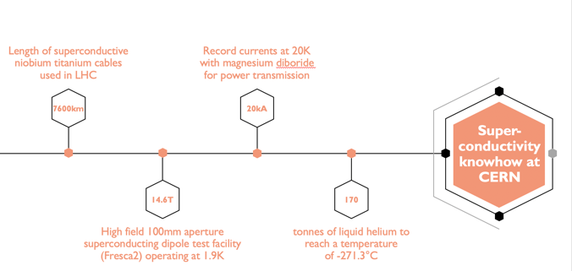
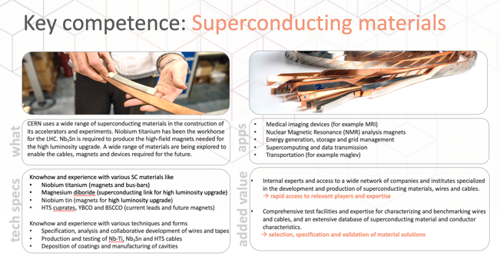
Task 4.2: Technology promotion
Develop “value propositions”
Ensure tech promotion

Slide 10
Task 4.3: Technology matching
Follow-up of the industrial contacts
Technology matching event “HITRIplus meets industry”, including b2b meetings (in person or virtual)

Slide 11
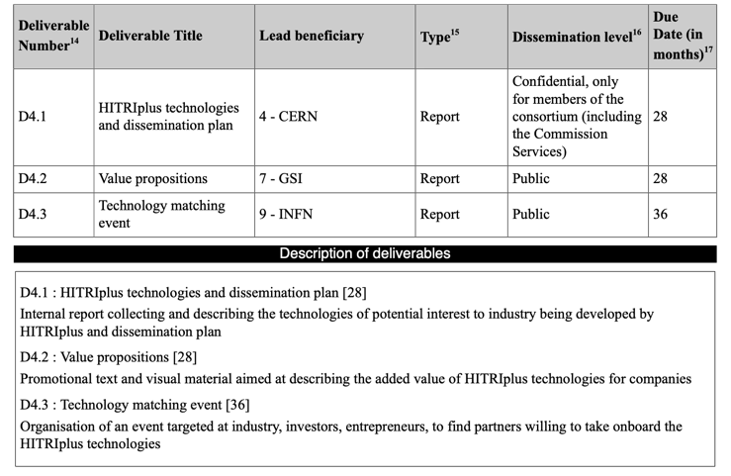
Deliverables

Slide 12
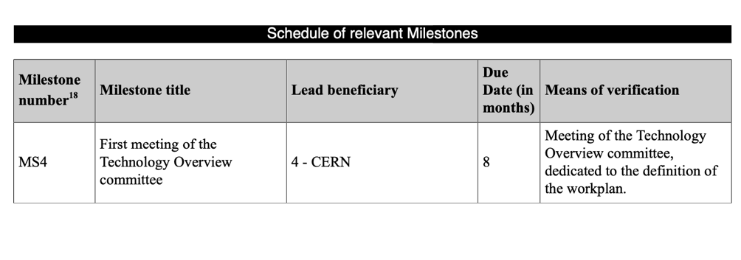
Milestones

Slide 13
Technology Overview Committee (TOC)
Notes:
All WP4 partners have dedicated Technology Transfer offices with the necessary experience to support the work plan and to achieve these objectives. Tight links with the HITRIplus JRA work-packages (WP7-WP12) will ensure an effective internal communication about the technologies being developed.

Slide 14
TOC Organization
WP4 members + WP7-12 leaders
  M. Cirilli, R. Ferreira & S. Muhr
  M. Vretenar (CERN)
  L. Rossi (INFN)
  C. Graeff (GSI)
  T. Haberer (HIT)
  T. Petaros (Cosylab)
  U. Schötz (MIT)
The committee meets 2x a year and exchanges regularly

