Slide 1
Introduction to the GM group and its challenges
Hélène Mainaud Durand
28/11/2021

Slide 2
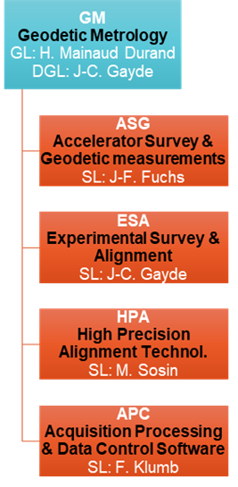
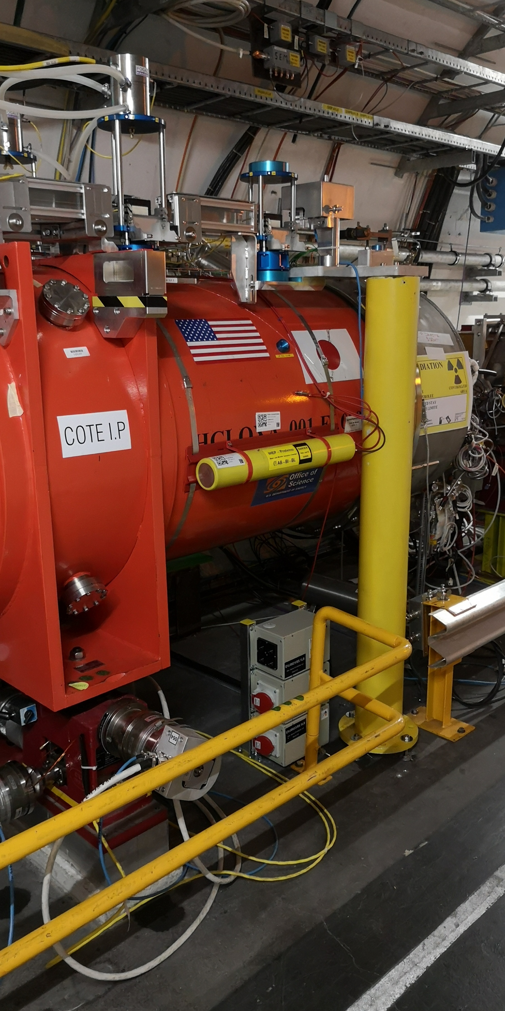
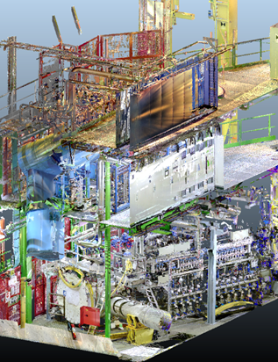



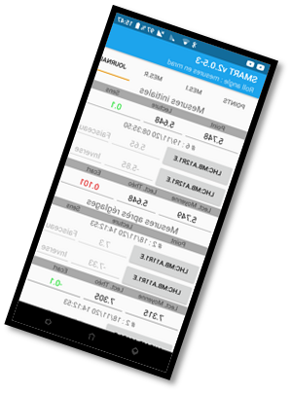
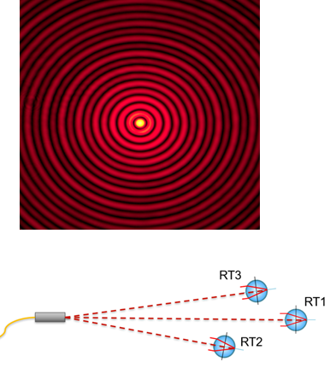
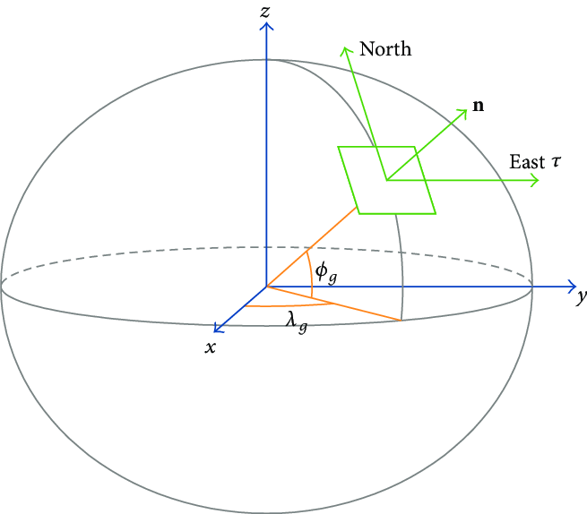

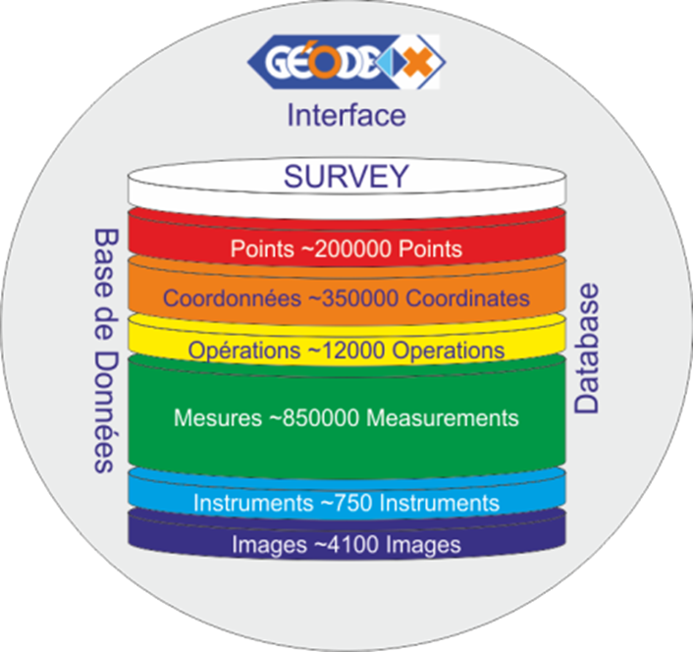

Présentation du groupe GM – Geodetic Metrology
The GM group provides metrology and alignment for components installed in the accelerators, their beam transfer lines and physics experiments throughout the CERN.
  ̴ 60 km beam lines
  ̴ 7500 componants
  20 experiments
  Thousands of sub-detectors
Geodetic aspects
R&D
Permanent monitoring
3D geo-referenced scans
Database and software

Slide 3
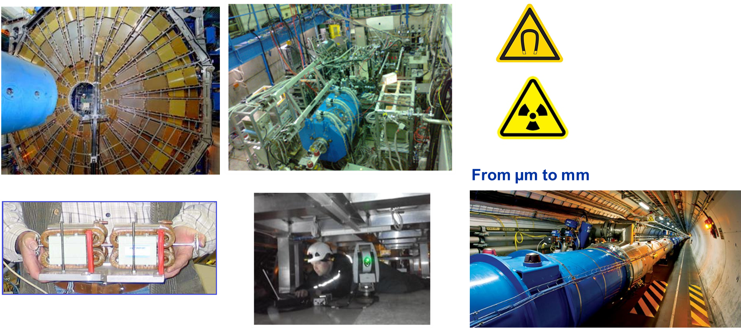
Daily challenges
Scale
Size of components
Congested area
Difficult configuration:
Narrow and straight
Underground
Environment
Meas. uncertainties

Slide 4
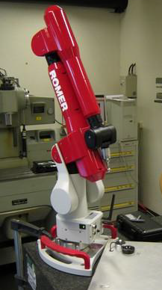
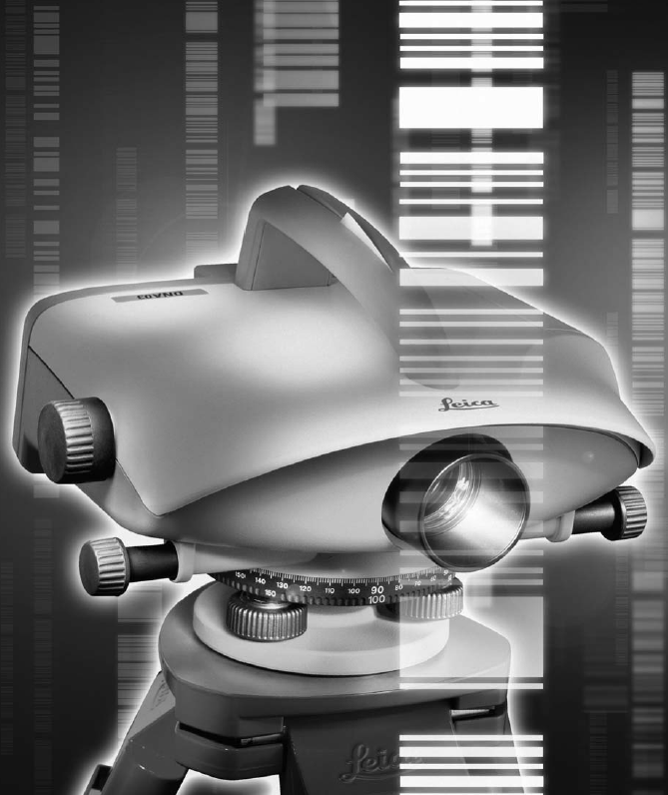

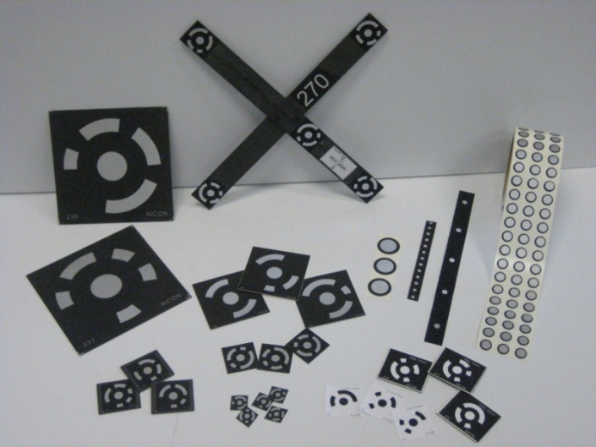

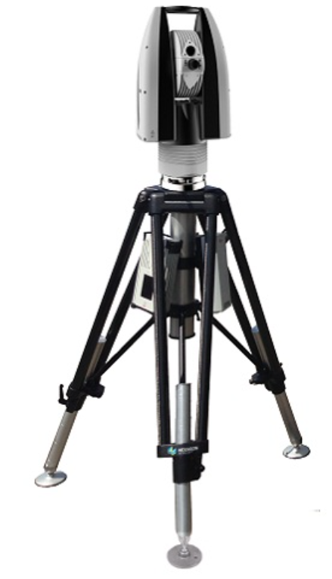

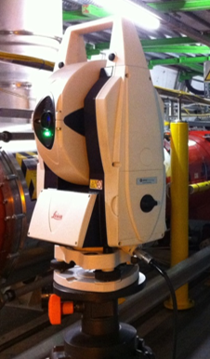
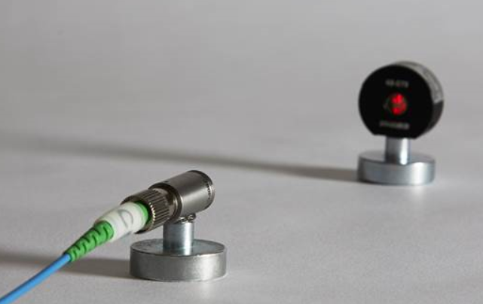
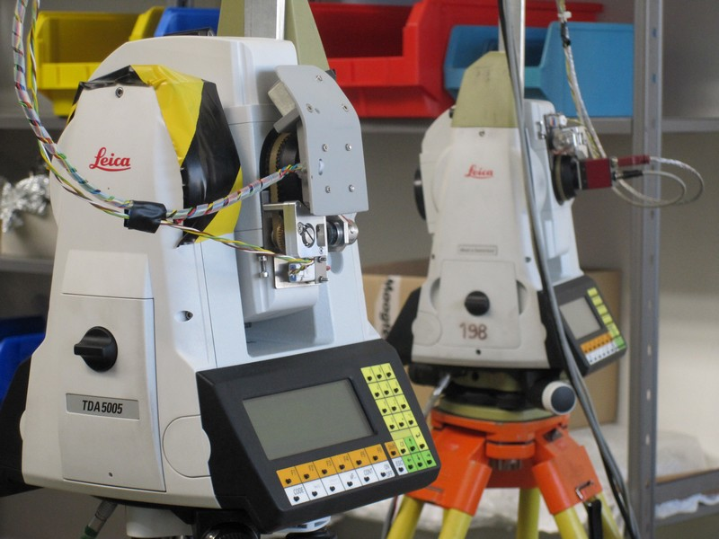
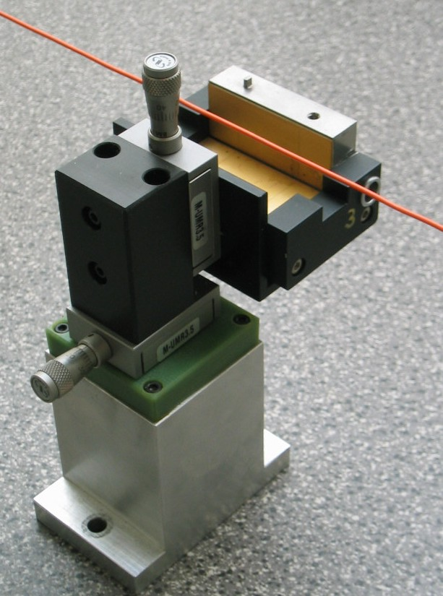
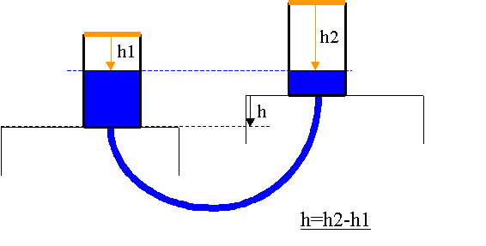
GM – Geodetic Metrology
-- more information -
Portable CMM
Software & database
Optical & digital levels
Development of adjustment solutions
Photogrammetry
Laser trackers & total stations
GM
TOOLBOX
Expertise & consultancy
R&D systems
Laser scanners
Alignment sensors
Knowledge transfer

Slide 5
GM – Geodetic Metrology
-- Futurs challenges --
Time line
Explain our GM requirements to other groups
Develop & strengthen collaborations on Geodetic Metrology
Finalize LS2 the best as possible & conclude (REX) for LS3
Prepare instruments, methods & associated analyses for LS3
Make HL-LHC Full Remote Alignment System (FRAS)
a success
Develop the potential of the Structured Laser Beam (SLB)
Consolidate GM software & dB
Develop «train-based» alignment solutions
Develop alignment solutions for the next colliders

Slide 6
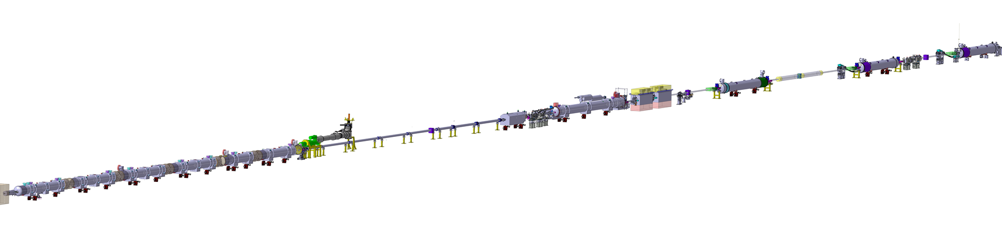
New alignment systems for the LHC upgrade
High Luminosity LHC
  Major upgrade program for LHC
  1.2 km of beamline will be exchanged
  Provide same alignment precision as for LHC over longer distances
High Luminosity LHC (~200 m)
Alignment strategy
  Remote alignment system installed along 200 m on each side of the experiment
  Continuous position determination systems
  Additional measurement systems will be put in place: longitudinal measurements, permanent measurements inside the cryostats
Challenges
  Operation and maintenance in highly radioactive areas
  Manufacturing, calibration and exploitation of more than 700 sensors in total
  Remote alignment of components in a range of ±2 mm with micrometric precision

Slide 7
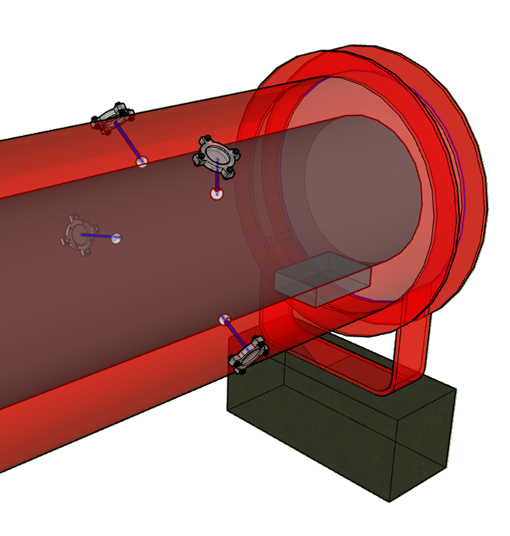
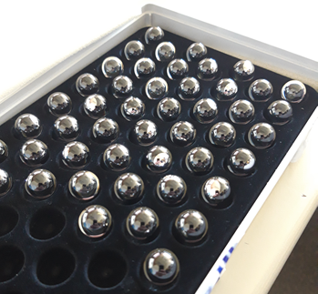
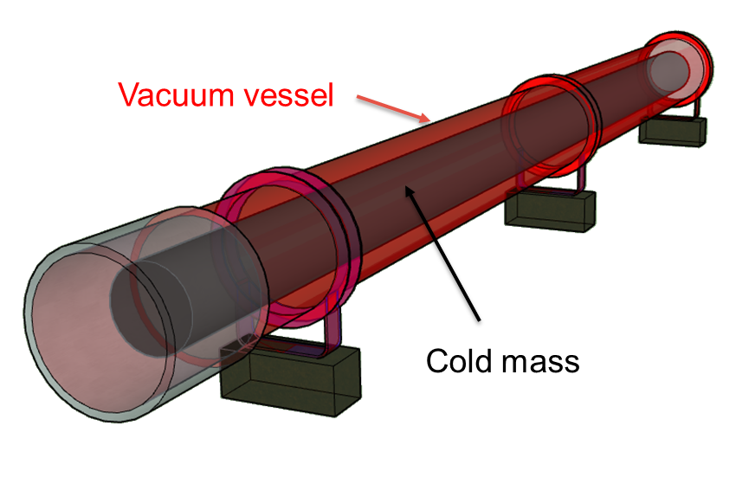
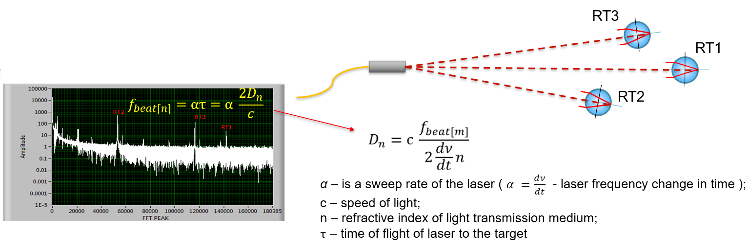
New alignment systems for the HL-LHC
Internal position monitoring
Absolute distance measurement between ferrule and glass spheres
Environment :
Temperature : 1.9 K (Cryogenics conditions)
Vacuum : 10⁻⁶ mBar
Radiation : 1 MGy
Continuous monitoring of the cold mass position w.r.t. vacuum vessel within an accuracy of 0.1 mm

Slide 8
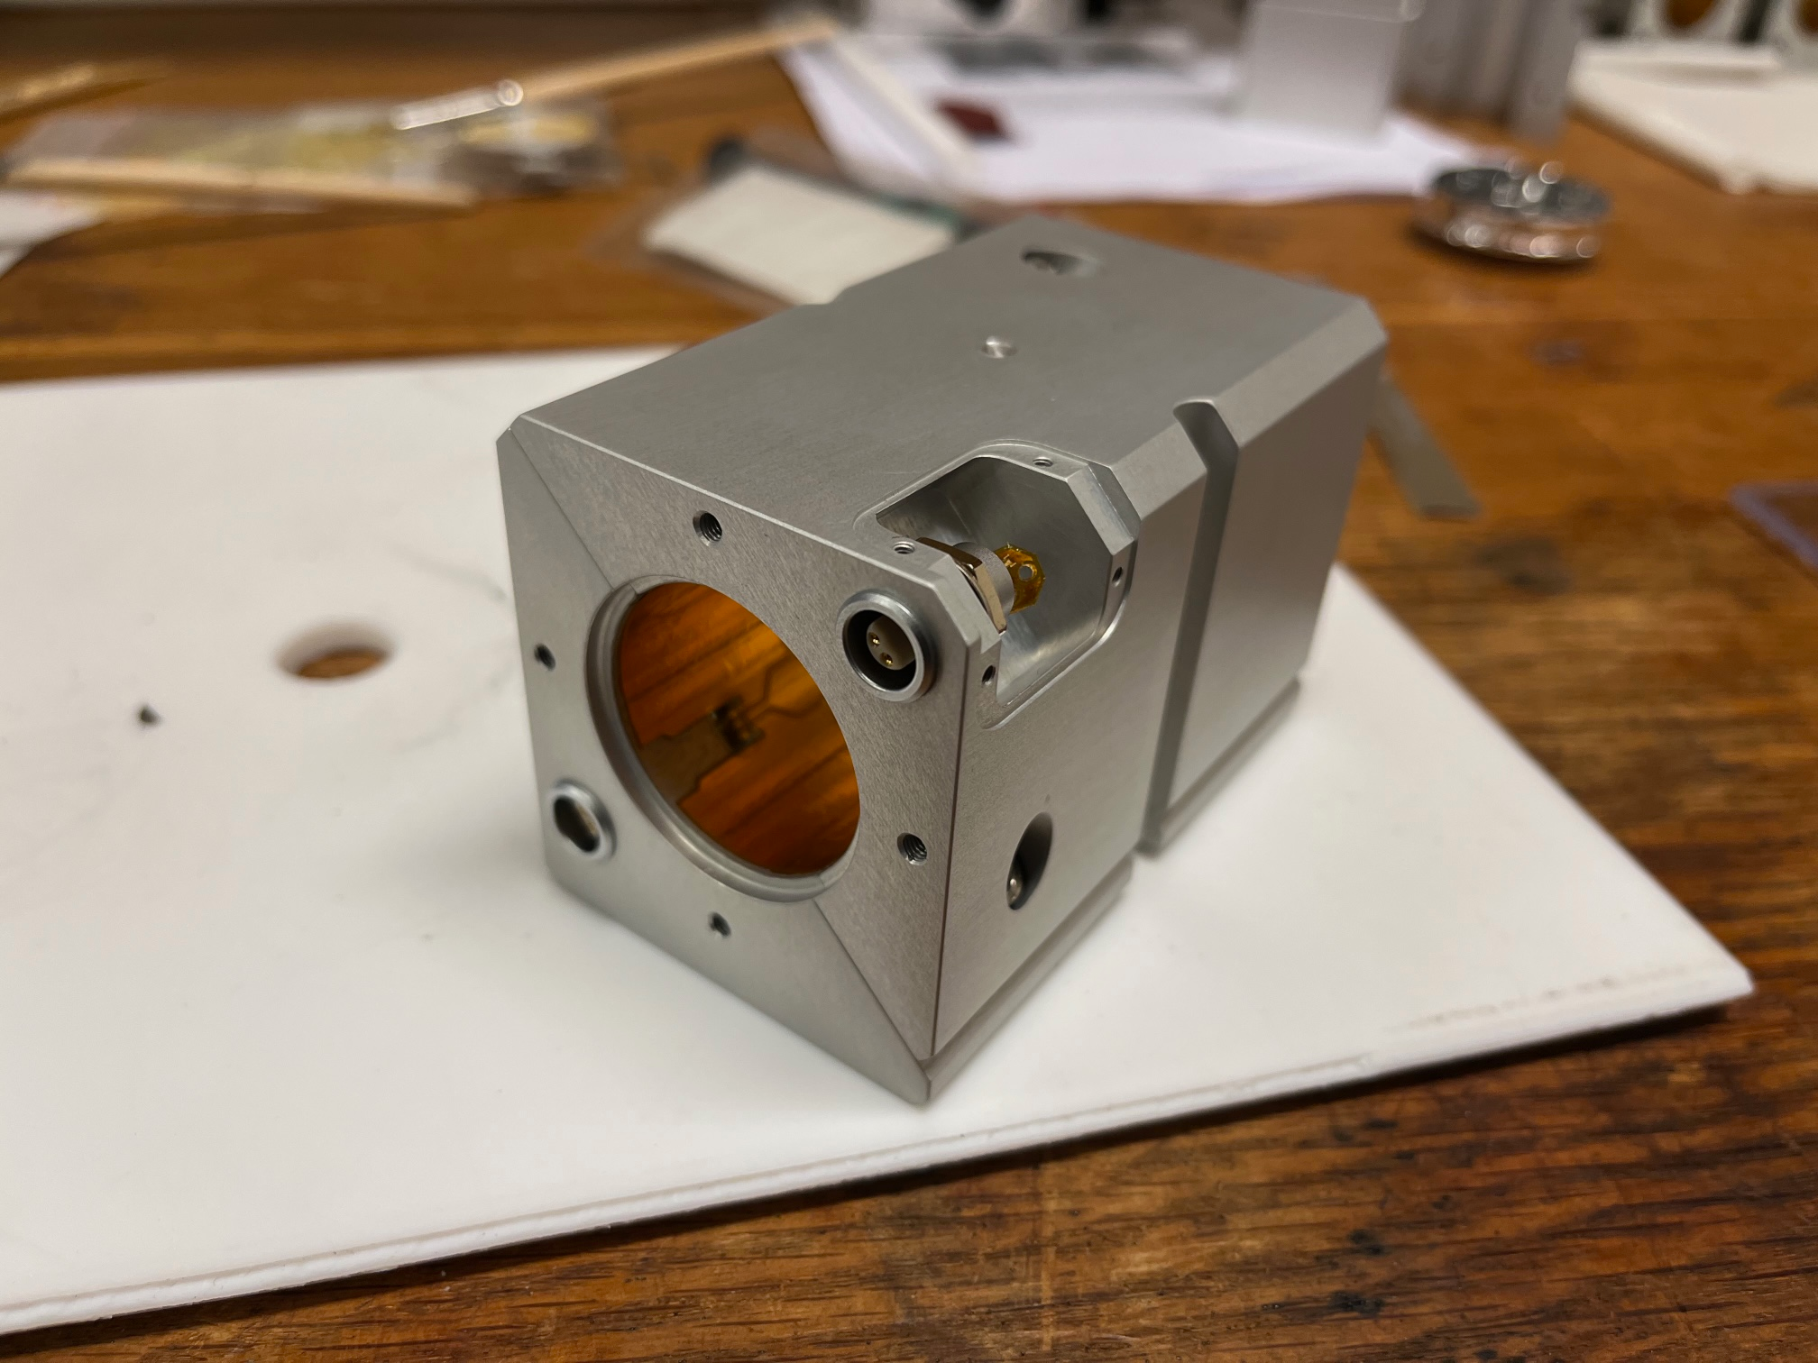
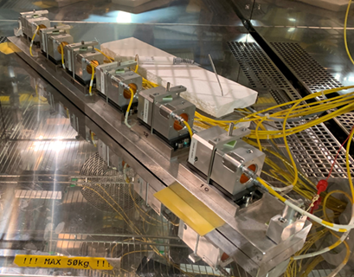
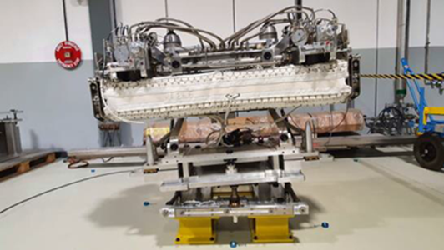
New alignment systems for HL-LHC
Development of solutions to determine the continuous position of the components, combined with solutions to remotely re-adjust the components at their nominal position:
In-house alignment (Wire Positioning Sensors (WPS), Hydrostatic Levelling Sensors (HLS), inclinometers)
Motorization of the jacks supporting the heavy components, development of a Universal Adjustment Platform for the lighter ones (and its associated motorization)
In collaboration with 2 other groups from BE: development of all the acquisition systems, control/command systems and softare.

Slide 9
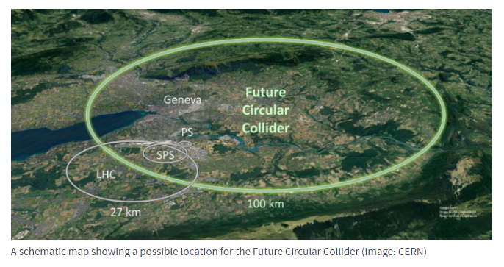
Future challenges
A few challenges from the Geodetic Metrology point of view:
Geodetic aspects:
  FCC 10 times larger than LHC
  Reference frames and infrastructure go back to LEP (80s)
  The installation of components will start before the final completion of the whole tunnel ring
  Very important to setup ASAP adapted geodetic reference systems: coordinate reference systems, coordinate reference frames and their corresponding software tools, technical documentation and control baselines.
Alignment aspects:
  Thousands of components to fiducialise, alignment, at tighter tolerances than in the LHC:
    To propose affordable and sustainable solutions (less cables, less space, very robust).
    Automated solutions to determine the position of components and to adjust them.
Future Circular Collider (FCC) WEBSITE
Circumference of ̴ 100 km, depth of ̴ 400 m
At the stage of the feasibility study and intensified R&D
2 stages: FCC-ee -- > FCC-hh over 50 years

Slide 10
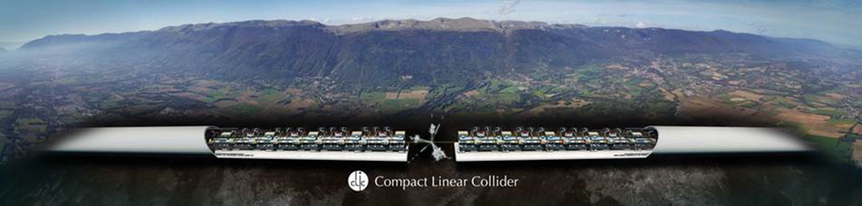
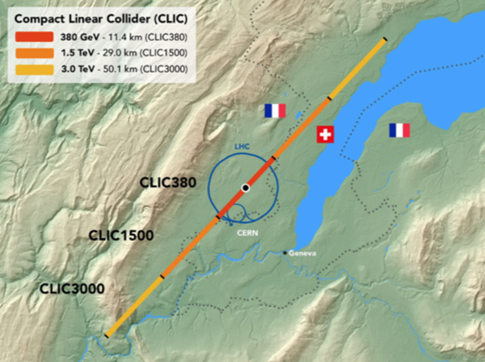
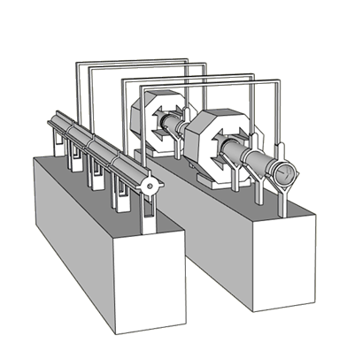
Future challenges
WEBSITE
Compact LInear Collider (CLIC).
For a 3 TeV configuration: 20 000 modules.
Considering the number of components to be aligned, ground motion and tight tolerances of alignment (micron level) – > active pre-alignment
Active pre-alignment means:
  Continuous determination of the position of all components using alignment sensors
  Remote adjustment (when the position is above thresholds) using actuators.
Different methods already developed:
  To pre-align the components on a girder
  To align the girders over hundreds of meters within a micrometric accuracy.
  See interesting links here: LINK1, LINK2, PACMAN

Slide 11
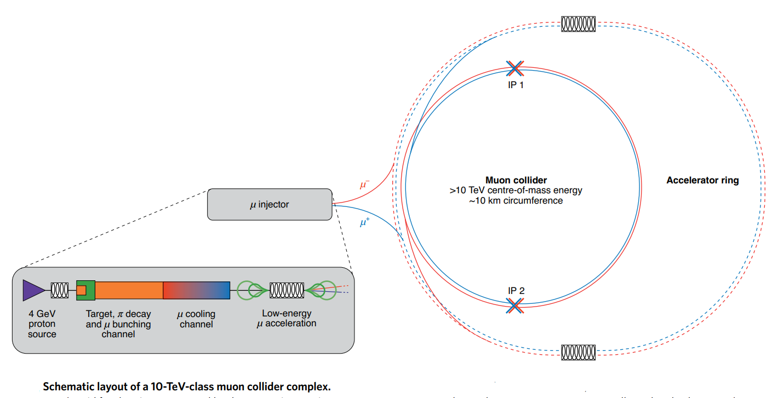
Future challenges
Muon Collider. WEBSITE
New study at CERN at a conceptual design stage.
Offer great potential for high energy physics (muon accelerated without limitation from synchrotron radiation)
Could fit in the LHC tunnel for example
Challenges: from the short muon lifetime (2.2 µs!) to the difficulty of producing large numbers of muons in bunches with small emittance

