Slide 1
SPS summary – weeks 40-41
G. Papotti, F. M. Velotti
for the SPS team

Slide 2
summary of the past 7 days
SFTPRO rather stable with a few problems
  intermittent spike at the start of spill, 100 Hz, symmetry changing quite often
  investigations ongoing
AWAKE run started yesterday after dedicated MD
LHCPILOT and LHCINDIVs to downstream TED in TI8
successful work on LHCION1 and LHCION2
dedicated MD in coast for crab cavities
main reasons for downtime
  injectors, esp. PSB
  3 access system trips (BA80, BA2, TCC8)
  issue on BEND.043 in NA, not completely clear
  (less RF trips thanks to the lower intensity on the SFTPRO)

Slide 3
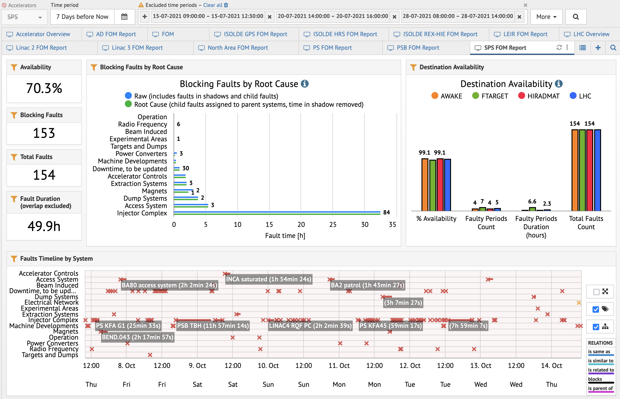

Slide 4
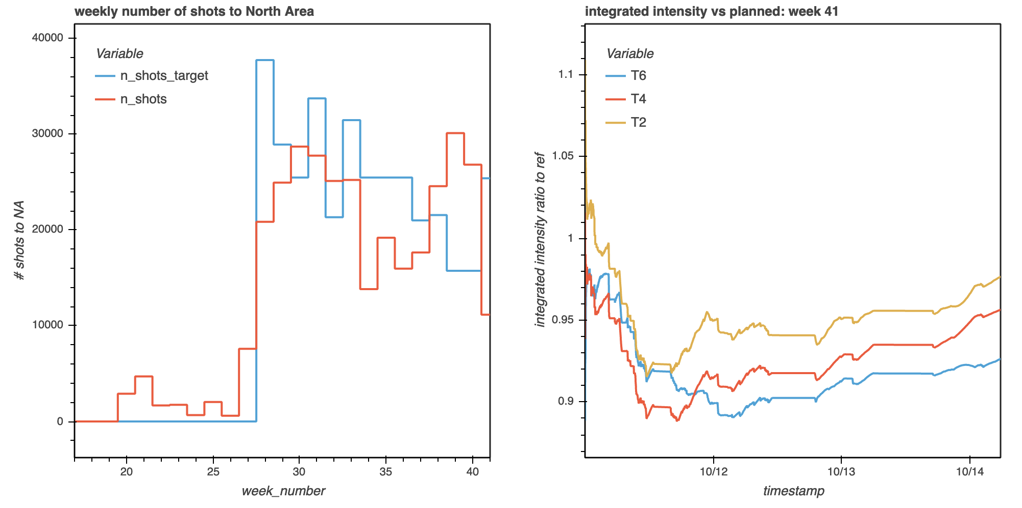
bpt.cern.ch

Slide 5
upcoming
w41
  SFTPRO + AWAKE
  agreed for LHCPILOT in prep of LHC Beam Test
    lower priority than SFTPRO and AWAKE (only 1x in supercyle, and only if physics is stable)
    Friday 18h-20h, Sunday 13h-16h
w42
  SFTPRO + AWAKE + LHCPILOT/INDIV

