Slide 1
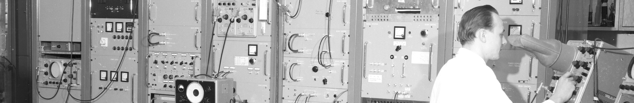
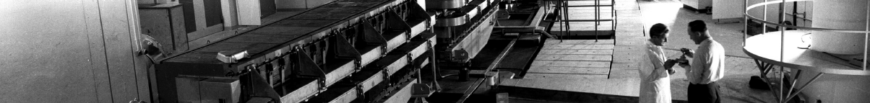
PS Report W40-41
Many thanks
to the PS operations and coordination team as well as all equipment experts and support teams!

Slide 2
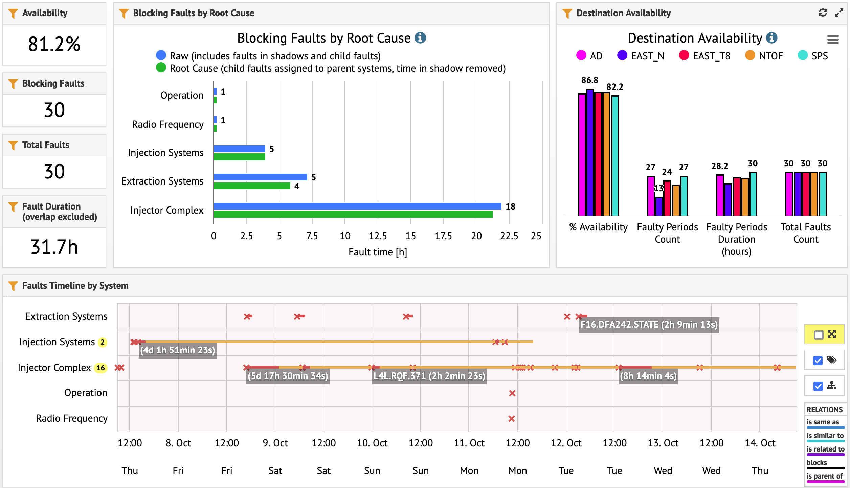
Accelerator Fault Tracking (AFT)
PSB BHZ15L1 R2 trim

Slide 3
Main Issues
Injection kicker KFA45
  Repeated trips since Wednesday due to 1 faulty module
  Maximum voltage of KFA45 in this situation limited to 240 kV, while several beams were using up to 280 kV (in particular AD and TOF) → injection settings modified to compensate for missing kick strength
  Several interventions since Thursday; module 1 back in operation since Tuesday morning
Extraction kicker BFA09 (affecting MTE beam to SPS)
  Tripped Friday evening and again on Saturday morning
  Required both times the intervention of the SY-ABT specialist (resistor exchange; 2h downtime).
PSB issue with Ring 2 trim coil (open circuit) of main extraction bend
  PSB magnet intervention on Friday evening (BHZ15L1) → shunt R2 trim coil
  MTE and TOF beams were strongly affected, but nightshift crew corrected the position and angle at extraction on ring 2 and recovered operational beams
  Additional access Tuesday at 13h showed that R2 magnet shim has moved outside aperture → fixed back in place to avoid potential damage to vacuum chamber → 2 x 8h downtime

Slide 4
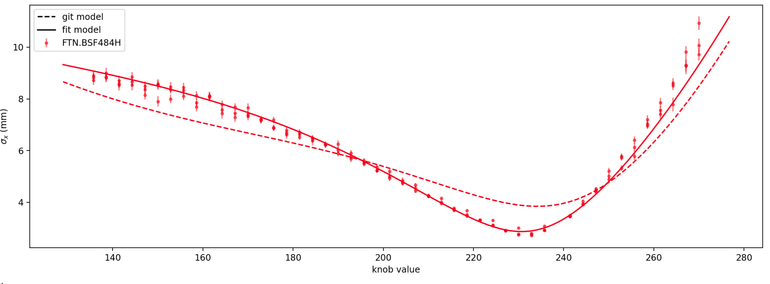
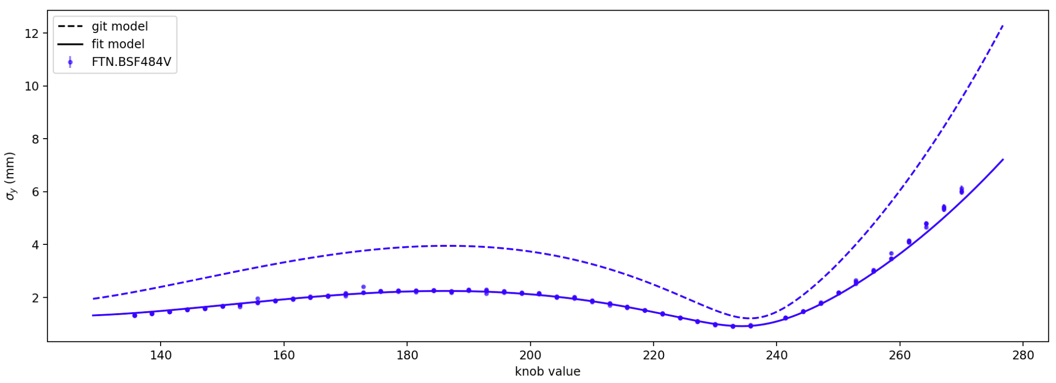
N_TOF – FTN MD
  New quad scan performed and measurements of initial conditions in ring
  Allowed to compute both dispersion and transverse Twiss parameters
  Close to simulated optics
  Finish 2nd part of MD next Tuesday morning
    Plug in new optics and check predicted beam size
    Important dependence on PS machine settings like working point etc. → would be nice to perform a sensitivity scan with different ring settings

Slide 5
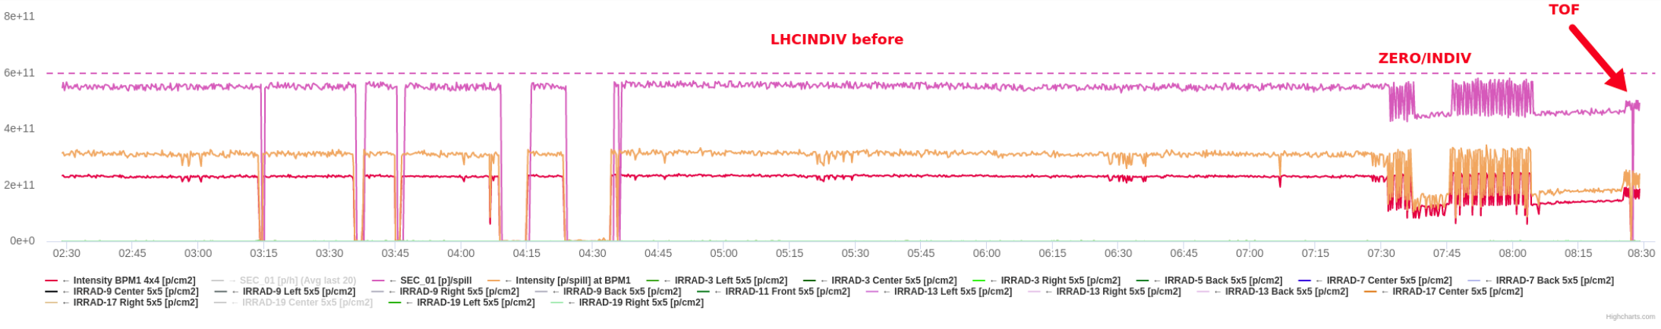
EAST
  Intensity delivered to secondary areas dependent on supercycle composition
    Need to investigate underlying reason and try to correct
  Asked for new EAST_DUMP destination in MTG
    Will allow to reconfigure F61.BHZ01 as multi-ppm by destination

Slide 6
Status of operational beams
MD planning for this week (link)
Fixed target beams | Status | Comment
SFTPRO (MTE 5 turn extraction) | Operational | Up to ~2 ∙ 10¹³ p/p delivered to SPS
AD | Operational | 1.55 ∙ 10¹³ p
TOF | Operational | Delivered at 8.5 ∙ 10¹² p/b with pre-LS2 optics
EAST | Operational / Setup | Extraction up to 60e10 p/p to EAST dump, T8 (slow and fast), T9 and T10/11 Started setup of fast extracted ions to EAST dump
LHC-type beams | Status | Comment
LHCPROBE, LHCINDIV | Operational
LHC25 (72b) | Operational | Polished up to 1.3 ∙ 10¹¹ ppb; set up up to > 2.6 ∙ 10¹¹ p/b ε_{h} / ε_{v} (FT) ≈ 1.2 / 1.1 mm mrad (for 1.3 ∙ 10¹¹ p/b)
LHC25 (12 to 48b) | Operational | 2 BP cycle; settings synchronized with LHC25 high intensity variant
LHC25 BCMS (48b) | Operational | Available up to 1.6 ∙ 10¹¹ p/b (3 BP cycle)
AWAKE | Operational | 3 ∙ 10¹¹ p/b
Ion beams | Status | Comment
EARLY | Setup | ~1.5 ∙ 10¹⁰ p/p, fine-tuning
NOMINAL | Operational | 8 ∙ 10¹⁰ p/p accelerated, fine-tuning

Slide 7

PS Coordinator for week 40 – Bettina Mikulec
PS Supervisor for week 41 – Alexander Huschauer
Questions and Comments
8:45 Daily Zoom meeting during beam commissioning
Web address: https://cern.zoom.us/j/9372114100?pwd=L29BcmlHUENCdFBRSytXYVcrM1B4Zz09
Meeting ID : 937 211 4100
Passcode: 525463

