Slide 2

Michal Simon
XrdCl Erasure Coding
15/10/2021
Michal Simon

Slide 3
Highlights
We use state of the art Intel ISAL Reed-Solomon implementation
The erasure coding plug-in can be load on demand
  The server can send a special redirect response that will trigger the client to load the EC plug-in
  The server configures the number of data and parity chunks, block size, etc.
  The server needs to provide a placement group with locations that can accommodate data/parity stripes
ZIP is used for bundling data chunks together
  Each chunk is a separate file within a ZIP archive
  The file header contains information like the crc32, size, etc.
To calculate the checksums we use either Intel ISAL crc32 implementation or h/w assisted crc32c
15/10/2021
Michal Simon
3

Slide 4
Writing
Client buffers the data until it has a full block
The block is divided into chunks
The chunks are erasure coded
All chunks (data/parity) are checksumed
15/10/2021
Michal Simon
4

Slide 5
Writing
Each stripe is stored in a ZIP archive, each chunk is a separate file within the archive
Header: crc32, size, etc.
FileName.0.0
Block: 0, Stripe: 0
Header: crc32, size, etc.
FileName.1.0
Block: 1, Stripe: 0
Header: crc32, size, etc.
FileName.2.0
Block: 2, Stripe: 0
Central Directory
Header: crc32, size, offset, name
Header: crc32, size, offset, name
Header: crc32, size, offset, name
15/10/2021
Michal Simon
5

Slide 6
Writing
If the placement group has more locations than the number of data and parity stripes (> n + m) we choose locations randomly for each block (uniform distribution)
4+2 with 8 locations:
Allows to recover errors on write at spare locations
Data
Parity
Parity
Data
Data
Data
Parity
Data
Parity
Data
Data
Data
Data
Data
Data
Parity
Parity
Data
15/10/2021
Michal Simon
6

Slide 7
Use Case: Alice O2
2000 sources, each generating a new 2GB file (Time Frame) every 40s
  Every 20ms 2GB file written
  Aggregate throughput of 100GB/s
  40s hard deadline to transfer the file
Transfer data directly from Alice P2 to EOS in CERN CC
15/10/2021
Michal Simon
7

Slide 8
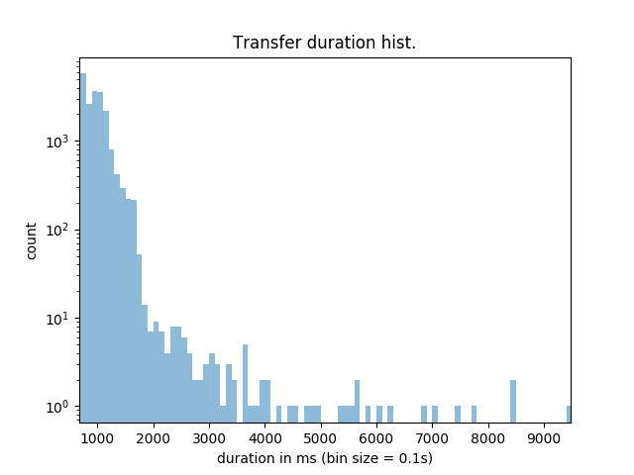
Use Case: Alice O2
~10% of the target production load, ~10% of the cluster capacity
10+2 layout,
10GB/s of aggregate throughput (200 streams),
1 hour run, 6 data servers
Avg duration: 974 msec
Avg transfer rate: 2.15GB/s
Transfer rate stdev: 0.418
Transfer duration stdev: 290
15/10/2021
Michal Simon
8

Slide 9
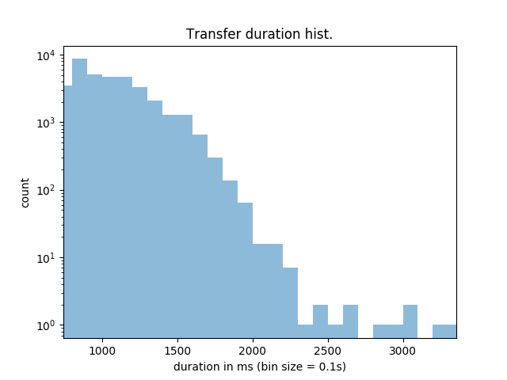
Use Case: Alice O2
~20% of the target production load, ~10% of the cluster capacity
10+2 layout,
20GB/s of aggregate throughput (400 streams),
1 hour run, 6 data servers
Avg duration: 1063 msec
Avg transfer rate: 1.97GB/s
Transfer rate stdev: 0.400
Transfer duration stdev: 244
15/10/2021
Michal Simon
8

Slide 10
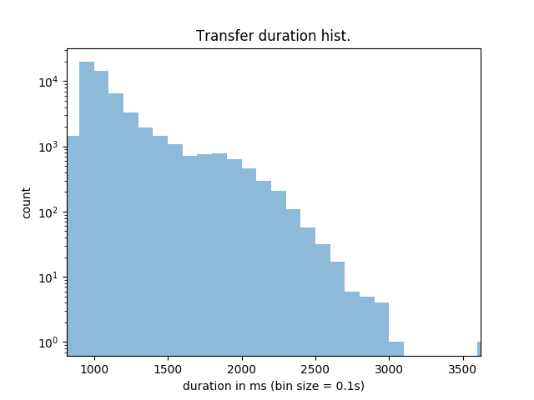
Use Case: Alice O2
~30% of the target production load, ~10% of the cluster capacity
10+2 layout,
30GB/s of aggregate throughput (600 streams),
1 hour run, 6 data servers
Avg duration: 1127msec
Avg transfer rate: 1.84GB/s
Transfer rate stdev: 0.317
Transfer duration stdev: 272
15/10/2021
Michal Simon
10

Slide 11
Reading
Again, the server on open request tells the client to load the EC plugin
  Static configuration: number of data and parity chunks, block size, etc.
  The server needs to provide a placement group: this can be obtained through standard locate request (as all stripes use the same file name)
On open client reads/parses the CD of each stripe
  Afterwards each chunk locations is known
15/10/2021
Michal Simon
12

Slide 12
Reading
There is no need to reconstruct a block for every read
  Unless the client needs to do error correction
  While streaming the data user can benefit from full performance boost due to striping
In order to verify the checksum the client at minimum needs to read a whole chunk
  Reads are translated into respective chunks
  Chunks are cached until user is accessing data within same block
offset
length
offset
length
Data
Data
Data
Data
Data
15/10/2021
Michal Simon
11

Slide 13
Final word
Limitations
  It is meant for write once, read many use case
  Updates are not supported
    When we introduce range cloning this will change
  Sparse files are not supported
Server will need a dedicated plug-in so it can generate the special redirect response that triggers EC plug-in
  Otherwise it is compatible with vanilla XRootD
Data reallocation: stripes and chunks are location independent
  It is possible to copy data chunk by chunk with ZIP append
15/10/2021
Michal Simon
11

