Slide 1

R. Guida on behalf of the CERN Gas Systems Team (EP-DT-FS)
EP-DT
Detector Technologies
The gas systems for
the CERN Gamma Irradiation Facility
GIF++ users meeting , November 16, 2021

Slide 2

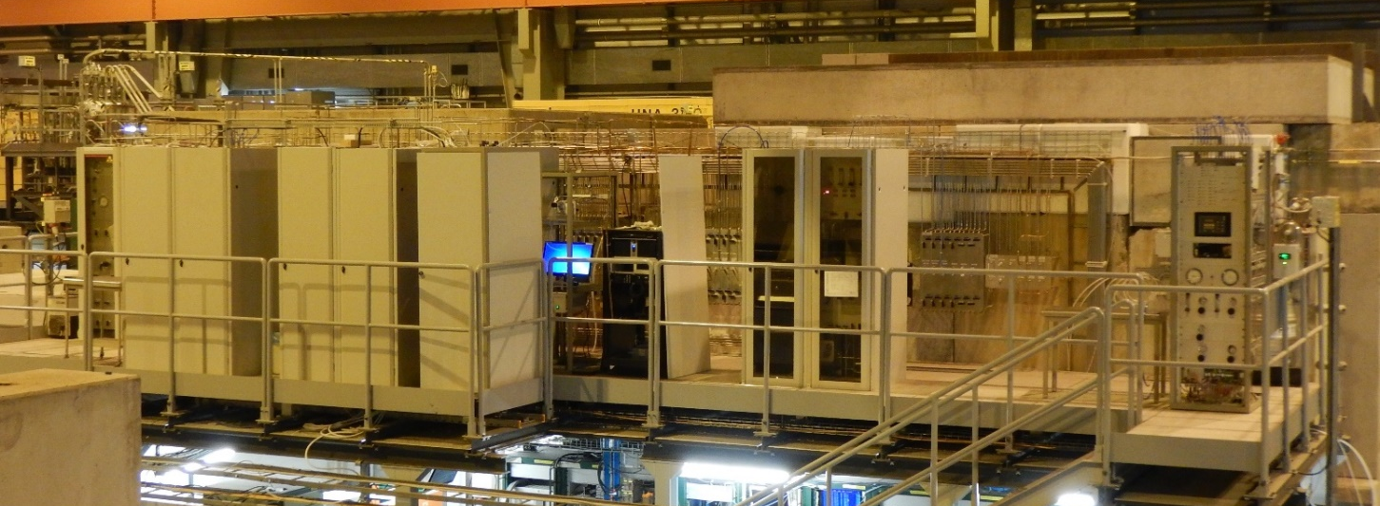
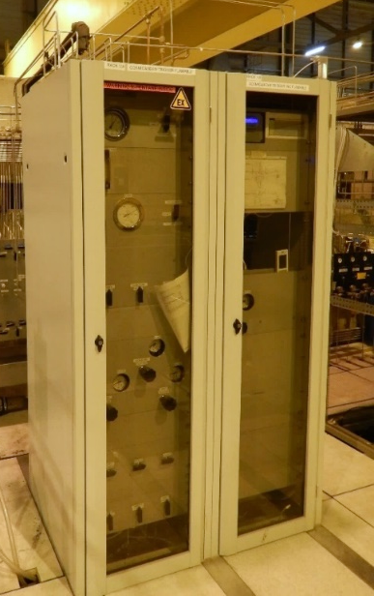
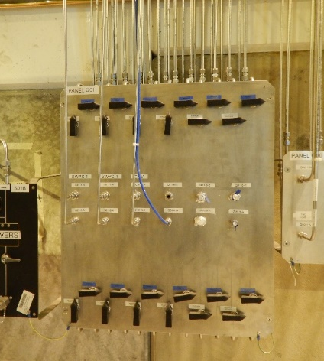
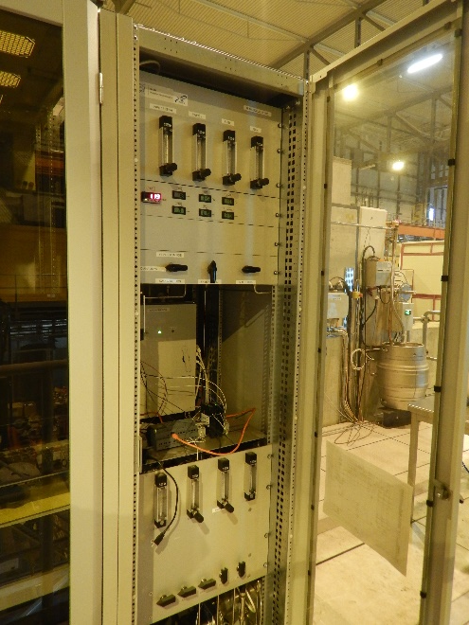
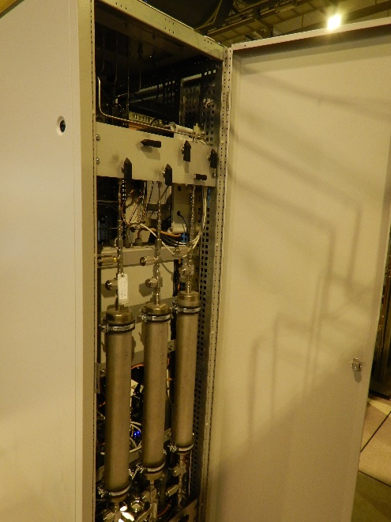
Gas modules at GIF++
Mixture distribution
Gas purification cartridges
Monitoring of pressure, O2/H2O, temperature, atmospheric pressure
Additional software controlled pressure regulation for very low flow regimes
Gas mixing unit

Slide 3
Gas modules at GIF++
The gas systems infrastructure is a key element for successful R&D programs at GIF++
New mixing units and gas recirculation modules developed and build
For GIF++, Gas team built and it is contacted for maintenance/operation of:
  7 gas mixer modules
  3 gas recirculation systems (for flow < 50 l/h)
  1 gas recirculation system (for flow < 200 l/h still to be commissioned)
  3 gas humidification modules
  1 gas chromatograph
  2 infrared analysers
  10 O2 and H2O analysers
  1 exhaust module
  21 gas distribution panels
  regeneration of gas cleaning agents (about 10 cartridges)
  pipe work
  special gas requests (for example nC5H12, HFO, calibration bottles)
  development of interlock signals related to specific gas system conditions

Slide 4
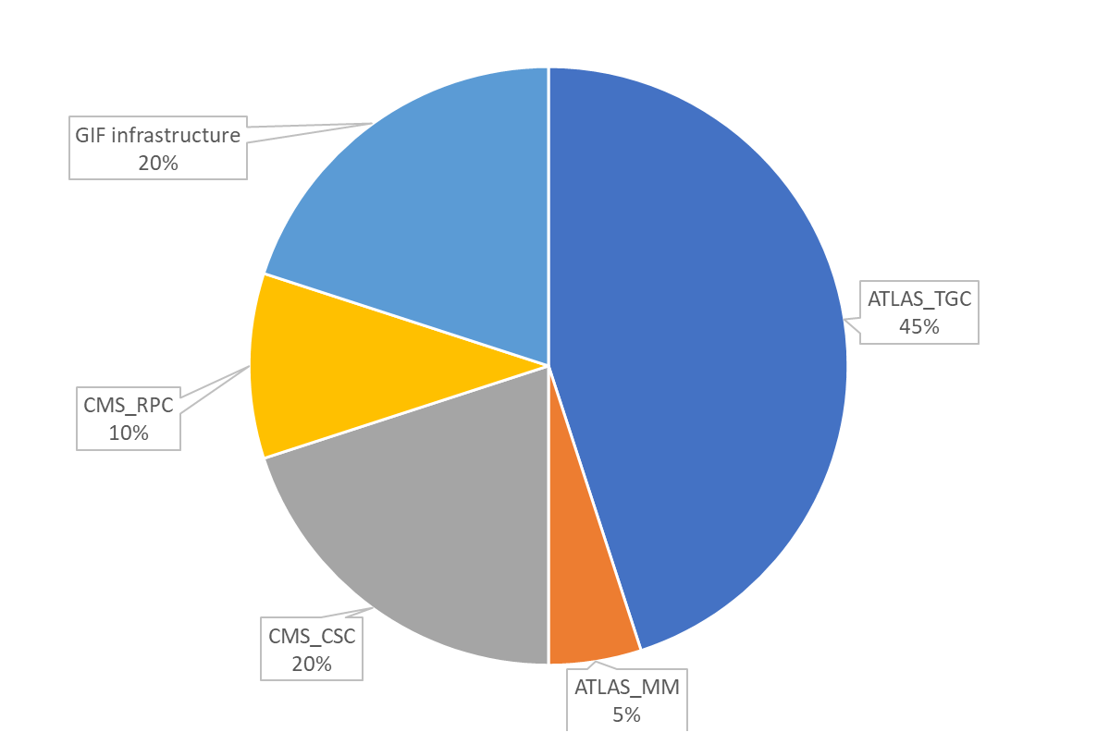
Summary
About 20 interventions over the year
Probably some others not documented
Numbers of interventions

Slide 5
Conclusions
In conclusion:
The GIF++ Gas systems infrastructure is comparable to a medium size experiment.
Frequent changes related to the normal R&D activities are particularly demanding.
Gas Team has limited resources.
Pending: modification & renewal of TGC mixer to facilitate filling with nC5H12
We need to monitor and measure the GIF++ need →
for this reason we request to use the elog (tab GasSystemSupport)
GIF++ elog:
From 2014 to December 2020: implementation and maintenance done by Gas team
December 2020/January 2021: hand over to GIF team

Slide 6
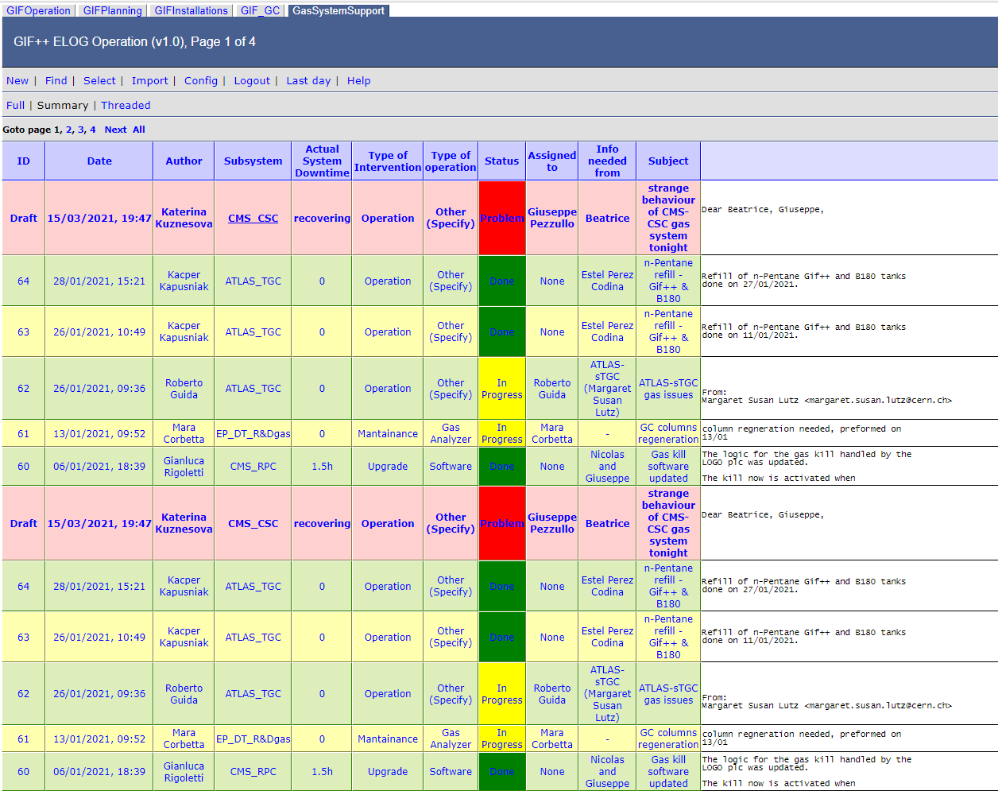
Conclusions
For new needs please check with GIF++ responsible and use dedicated elog page to request any intervention (http://eloggifpp.cern.ch/GasSystemSupport/ )
I realized yesterday that some elogs went lost (was it when there a problem with elog? )
We are trying to track back from emails.

