Slide 1
ATLAS RPCs@ GIF++
Annual User meeting
G. Aielli for the ATLAS RPCs
University and INFN Roma Tor Vergata

Slide 2
ATLAS BIS78 Module 0 in 2021
BIS78 chambers represent a new generation of RPC with respect to the ones installed in ATLAS
The BIS78 module 0 has been installed at the GIF++ in summer
It is a triplet detector with 2D readout, strip pitch 26 mm
Total 318 channels
Gas gap 1; mm electrodes 1.2 mm surface 180 x 110 cm^2
FE electronics includes preamp + discriminator chip with LVDS output
  IHP BiCMOS SiGe technology 1000 e- noise
  Operated with an equivalent threshold between 6 and 2 pC/count of total charge for MIPS at > 95% efficiency
Fully readout with the BIS78 vertical slice made of a set of HPTDC connected to a FPGA capable of self trigger on track, triggerless and external trigger modes

Slide 3
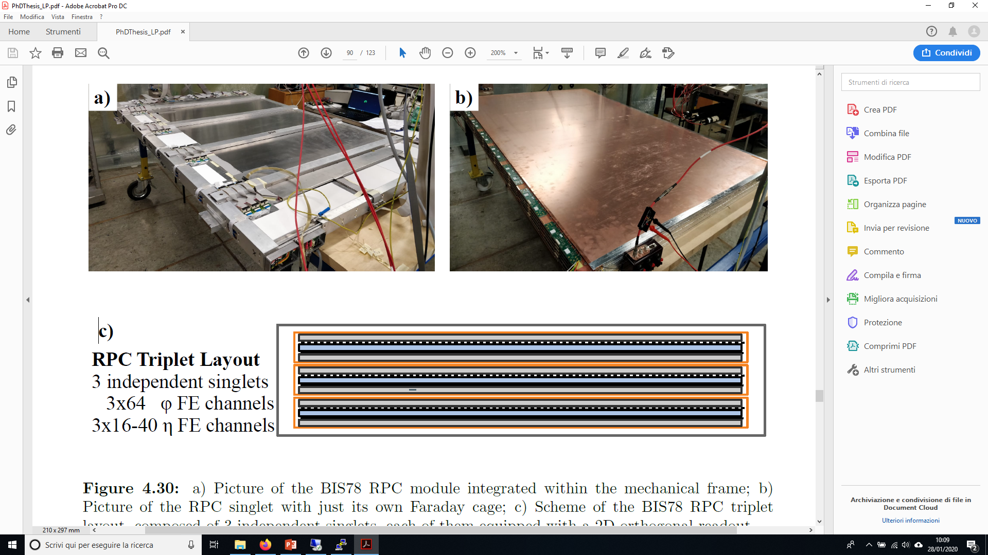
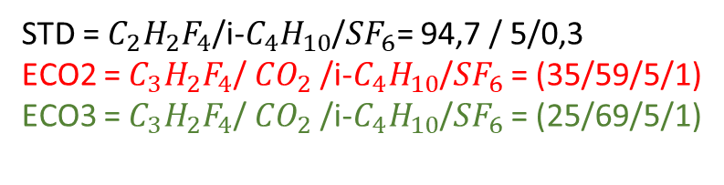
Test Setup
Two test beam sessions
  September focused on performance measurement for the chamber and for the readout system, in presence of HL-LHC radiation background
  October focused on performance comparison between the standard gas mixture and various eco-compatible alternatives (ECO2 and ECO3). This last test is performed with the support of the ECO-Gas collaboration
Detector features
  This chamber is a vide area 3 layers 3D+time tracker
  Can self trigger on CRs with a wide solid angle
  A good intrument to study both system performance and detector physics
STD = $C_{2}H_{2}F_{4}$/i-$C_{4}H_{10}$/${SF}_{6}$= 94,7 / 5/0,3
ECO2 = $C_{3}H_{2}F_{4}$/ ${CO}_{2}$ /i-$C_{4}H_{10}$/${SF}_{6}$ = (35/59/5/1)
ECO3 = $C_{3}H_{2}F_{4}$/ ${CO}_{2}$ /i-$C_{4}H_{10}$/${SF}_{6}$ = (25/69/5/1)

Slide 4
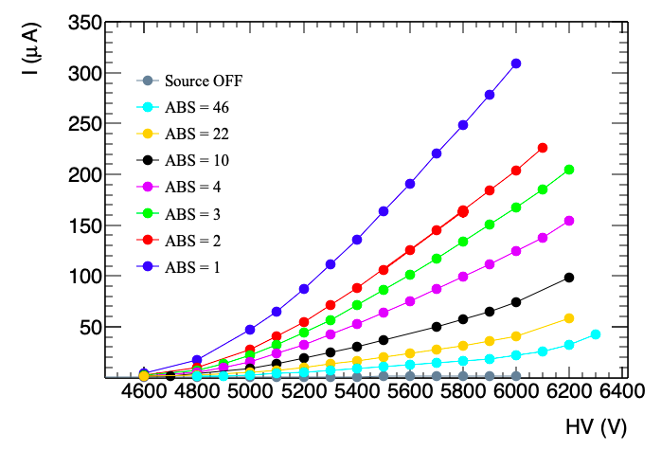
Scope of the test
Current vs. HV for different source intensities
Test performed
Trigger and DAQ working at high rate
RPC performance vs. radiation background
RPC Performance vs. Front-end threshold
Measurement of the average charge per count for gamma and MIPS vs. HV and FE threshold
f) Timing performance through internal ToF
  Time resolution as a function of HV, FE threshold and gas mixture
  Estimate of the drift velocity for different gases
Efficiency of 1 mm gas gap for different gas mixtures

Slide 5
ATLAS RPC Plans for 2022

Slide 6
Ageing test program
Period: end 2021 + 2022 + 2023
Detectors to be tested:
  BIS78 mod. 0
  small size ATLAS like doublet
  Phase-2 real size prototypes
Test mode: performance vs. Integrated charge
Performance measured periodically with CRs and muon beam
Longevity target with standard mixture:
  Legacy RPCs → 30 pc/count @ 150 Hz/cm^2 x 15 HL-LHC years → 700 mC/cm^2
  New gen. RPCs → 5 pc/count @ 300 Hz/cm^2 x 15 HL-LHC years → 225 mC/cm^2
Longevity target with eco-gas mixture:
  The average charge per count is higher with HFO but is very much mis dependent
  charge/count of different mixtures must be measured in advance
  The charge/count is specific of a given detector layout so targets may vary alot
Goal of the test:
Assessment of legacy ATLAS detectors (2 mm gas gaps) longevity with eco-gas mixtures using minimal amount of HFO to determine the maximum safely operable w.p.
Assessment of new generation RPC (advanced FE + 1 mm gas gap) longevity with
  standard mixture
  Eco-friendly mixture (ensuring full efficiency operation) may need higher HFO fractions or additions of R134A)
Eco gas Mixtures for legacy and new generation RPC are likely not the same
Additional flexibility in the gas system will be needed to test different detectors at the same time
We will need to operate the new gen. RPCs at 2 pc/count to gain a further margin with higher fractions of HFO → detector integration challenge

Slide 7
Characterization of the ATLAS detectors ageing properties with different gases
The ATLAS standard gas mixture has been characterized several years ago by measuring the fluoride concentration as a function of
  Working point
  Radiation background
  Lenght of exposition time window
It was also studied for relative variation of the main components
The results are still applicable to the new generation RPCs
What is missing is the equivalent characterization for a HFO based gas mixtures used with legacy and new gen. RPCs.
We are planning to setup such a measurement set in collaboration with the CERN gas group
Time schedule would be after the RUN3 start for man power conflicts...

Slide 8
Charachterization of recirculation systems
Not an ATLAS specific activity
Done with joint funds of ATLAS and CMS technical coordination and in collaboration with CERN gas group
A dedicated recycling gas system will be installed in 2022
Some history
The ability of present recycing systems to purify RPC mixtures has been measured several years ago at the old GIF facility
The result was given in terms of the fraction of fresh gas needed over the recirculated volume and empirical values among 5% and 10% have been estabilshed
The result is certainly significant but is system dependent under several aspects
The main limit is that in this formulation the result would negatively depend on the recycling speed while it should be independent on it
PROPOSAL of a new measurement to find the limits of recycling systems
Relevant to reduce the gas waste
The limits on the fresh gas needs should depend on
  Necessity to dilute the the polluting radicals not filtered by the filter system which are proportional to the total operating current
  Necessity to dilute air intake proportional to time, and system tightness.
The system will use an irrdiated ATLAS RPC set to provide an empirical assessment the gas quality, as a function of recycling parameters by watching both current and charge distribution maps obtained with photon hits and CRs
CERN gas group will perform gas analysis to provide a quantitative gas quality assessment

Slide 9
ATLAS Phase-2 project gas gap validation test
ATLAS Inner Barrell chamber production expected to start in the 1° quarter of 2022
Total production is about 1000 gas gaps lasting more than 2 years
Tested in batches of 24 each irradiated vertically on special trolleys (similar to the ones used for BIS78) → about 40 test cycles
Need HV, gas and current readout, position flexible in the downstream area
Cycle duration wed to wed
In 2022 we expect 30% to 40% of production

