Slide 1


ELECTRONICS
COMMUNITY FORUM
E. GOUSIOU, S. UZNANSKI | 04.11.2021

Slide 2
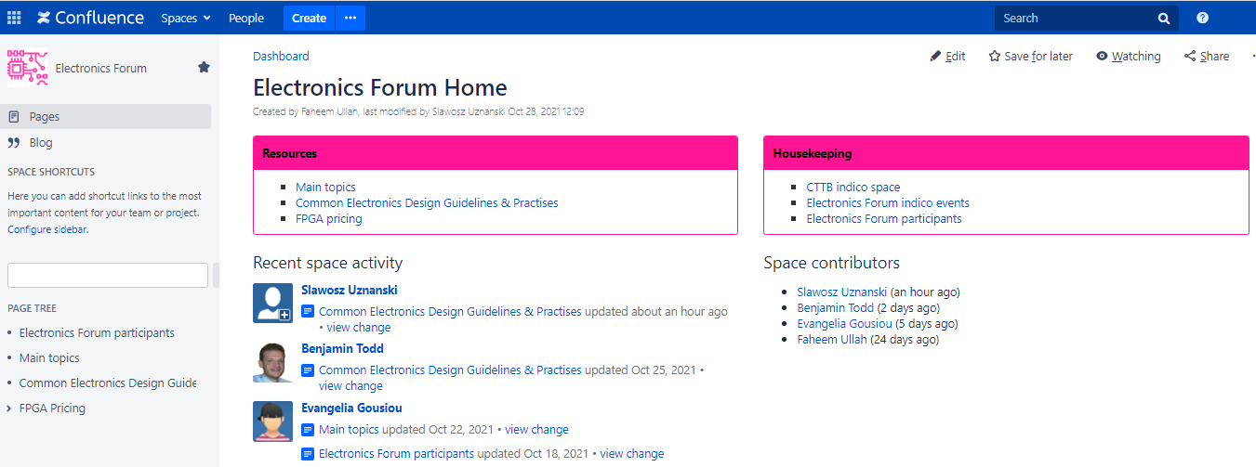
How we are communicating?
Sources:
eGroup
mattermost
indico
wiki
Kick-off meeting:
50-60 participants
~40 topics of interest
Voting & selection of topics
Contacts:
Electronics.forum.conveners@cern.ch
Slawosz.Uznanski@cern.ch
Evangelia.Gousiou@cern.ch

Slide 3
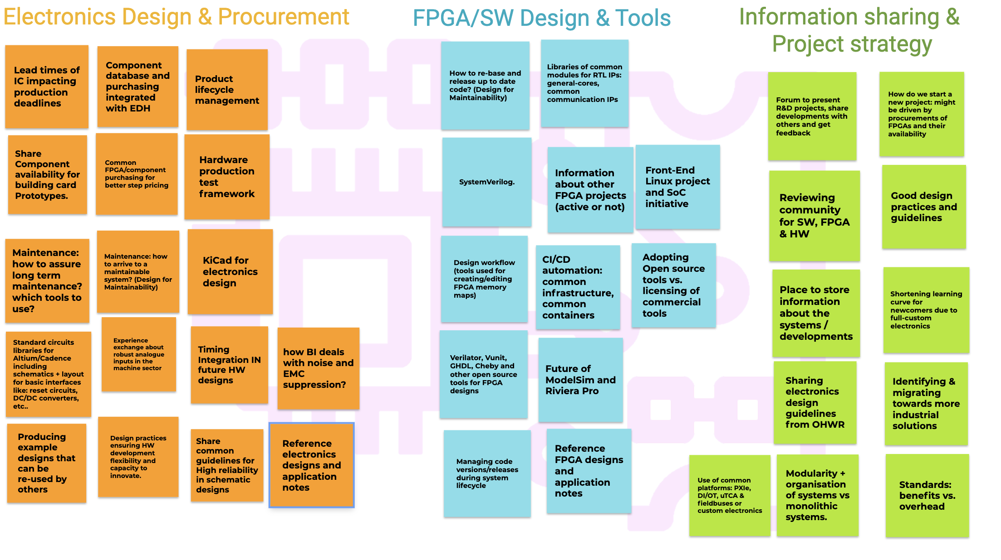
TOPIC SELECTION
  More info: wiki
Topic selection:
~40 topics of interest
3 main topic categories
Voting & selection done

Slide 4
RANKING OF TOPICS

Slide 5
NEXT MEETINGS
  More info: wiki
Electronics Forum meetings & joint meetings with RASWG:
Meeting #1: 2021-11-04: Common electronics design guidelines/practices
EF-RASWG #1: 2021-11-18: Electronics production
Meeting #2: 2021-12-03: CI/CD for FPGA/SW
EF-RASWG #2: 2021-12-09 TBC: Formal Verification
Meeting #3: 2022-01-13: Migrating towards more industrial and common solutions. Fieldbuses at CERN.
Meeting #4: 2021-02-03: Reviewing Community & Check lists: 1. HW, 2. FPGA.
EF-RASWG #3: 2022-02-17 TBC: Reliable Electronics Guidelines
Meeting #5: 2021-03-03: Fieldbuses at CERN (TBC).
Feedback form CTTB:
Centralised electronic components procurement and storage for ATS

Slide 6
TODAY’S DISCUSSION

