Slide 1
Electronics-Forum discussion #1
EDA Designs Search Tool
R. Berberat, W. Billereau

Slide 2
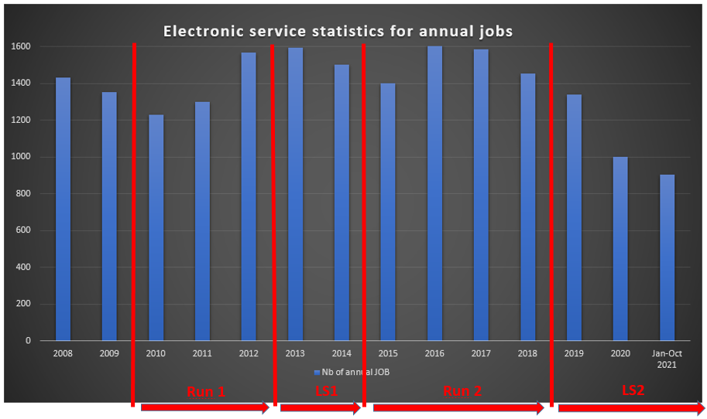
Introduction to the service and why we developed a tool
BE-CEM-EPR propose a service providing CERN-wide support in the domain of Printed Circuit Boards (PCB) and Electronic Module Assembly.
The main activities of the service are:
Altium & Cadence CERN Libraries; creation and maintenance
Layout design for electronic boards and crates
Manufacturing of bare PCB at CERN or by subcontracting
Mechanical parts production in collaboration with EN-MME
Assembly and integration of electronic modules, internally
or by subcontracting
A team of 18 members coming from the Industry:
7 technicians for the design of standard and special PCB layouts
2 technicians specialized in CAD libraries
2 engineers specialized in production processes, dedicated to
design reviews, subcontractor validation and follow-up
2 technicians specialized in PCB assembly and special repair
2 technical assistants for ordering components and assembly
1 ADMIN student
2 TTE

Slide 3
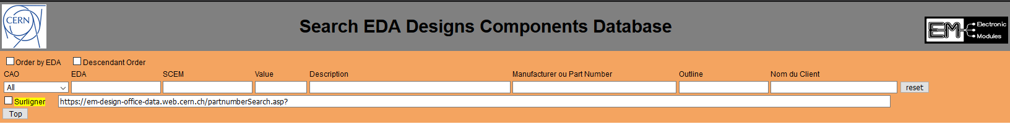
Introduction to the service and why we developed a tool
The Search EDA Designs Components Database tool was developed by our Design Office in order to allow the Electronics Service Team to know if a specific part number is used on an EDA project. This in order to:
Ease the procurement of components
Help for the design and the routing of electronic boards.
The tool may be used here: https://em-design-office-data.web.cern.ch/partnumberSearch.asp
It was not developed to be shared with other users but due to its success, we decided to add it on our Twiki page to give the chance to everyone to use it when needed: https://twiki.cern.ch/twiki/bin/view/ElectronicModules/WebHome
This tool is specifically designed to search the full list of EDA projects managed by our design office.
All other CERN projects that are not referenced with an EDA number are not included in the search.
When using the tool, please click the reset button before searching and between 2 search actions, to guarantee the correct result.

Slide 4
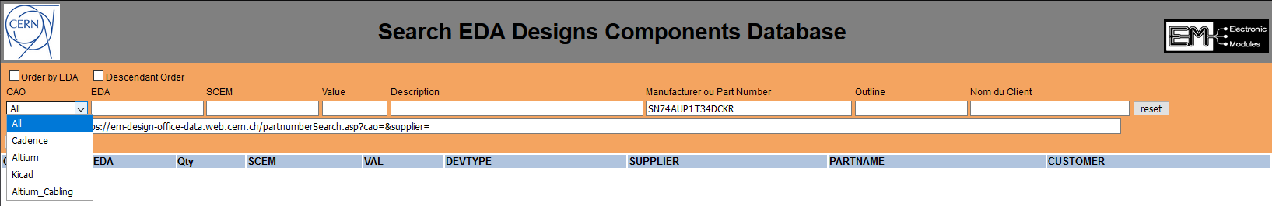
How to use the tool
This selection MENU allow you to select the CAD Software if you are interested in a specific tool.
→ My Advice is to always consider all CAD Software.
If you are interested in a schematic or a part of layout, software package is not important.

Slide 5
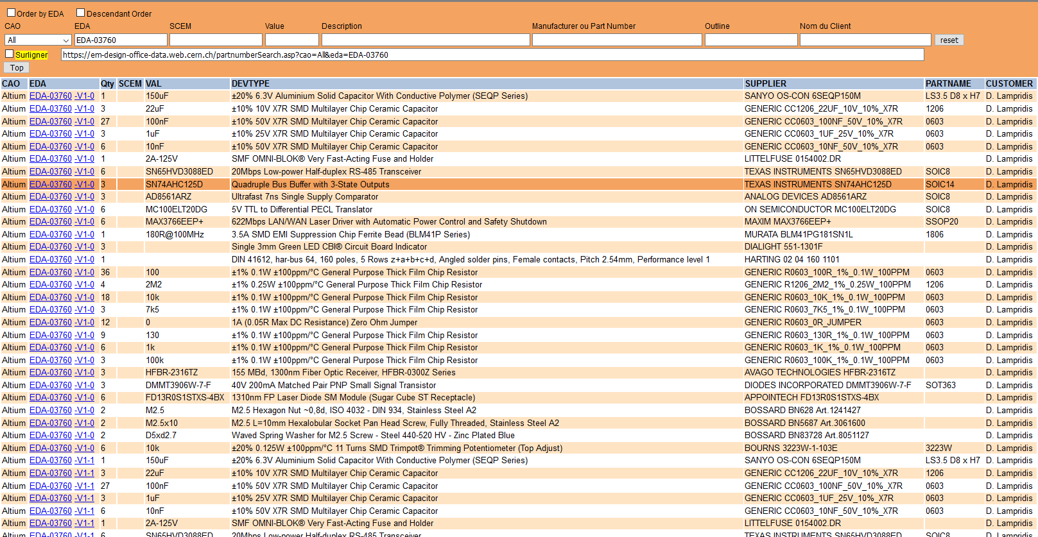
How to use the tool with EDA reference
If you know the EDA reference of the project, you should use it here with or without Version and Execution. This will sort the complete BOM of each PCB, starting with V1-0, then V1-1, etc

Slide 6
How to use the tool with SCEM number
If you know the SCEM number of a component you are looking for and you want to know if it was used on an EDA design, the tool will sort the EDA projects using this article, giving the quantity of units used on this design.

Slide 7
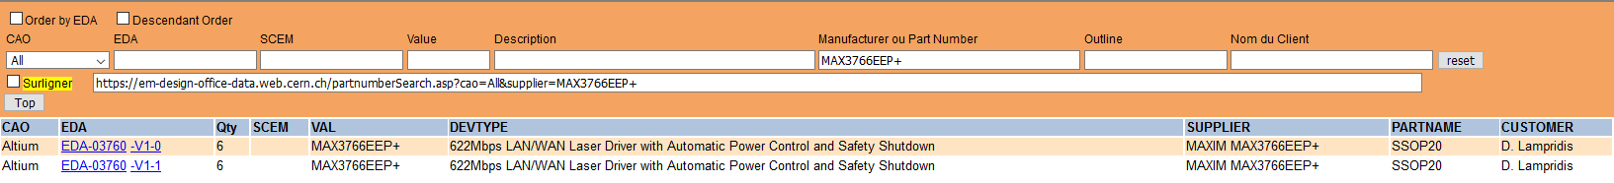
How to use the tool with a part number
If you want to know if a specific component is used on an EDA project, you may search with the reference of the component. The tool will sort the EDA projects where this component is used. The more precise you are in the article part number, the more precise will be the result of your search.
At the same time, if you are looking for a sample as you need to make a rework of your board and you can’t wait to order the part, the tool gives you the name of the owner of each EDA project. If you are lucky, they will maybe have some units in stock.
Note that this is also interesting in the case of Part Life Notification announced by manufacturers or official distributors.
When the Electronics Service receives a Part Life Notification, the Altium & Cadence libraries are updated with a Not Recommended status for these components.

Slide 8
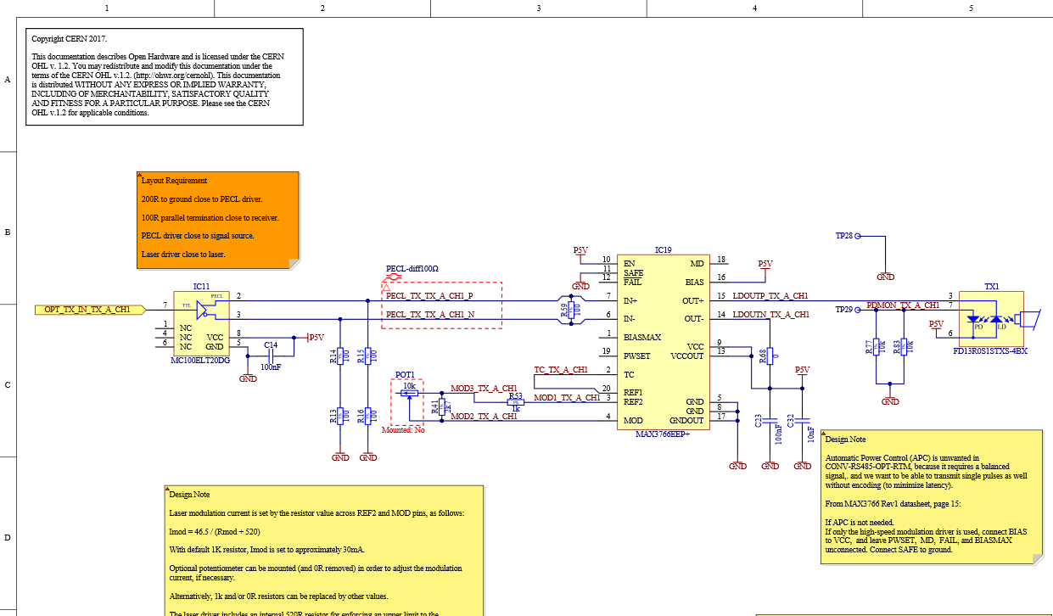
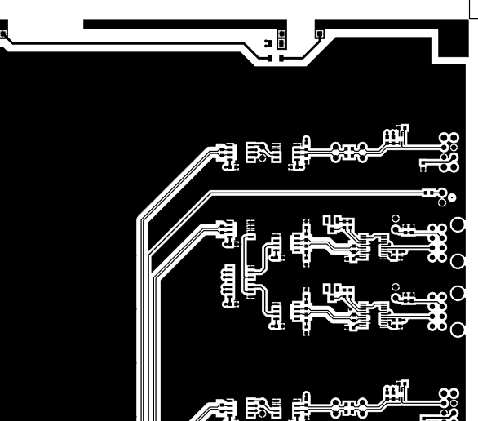
Advantages of the tool
When you know the EDA project using the part number our are interested in, you can then access EDMS and see the schematic prepared by the developer
And also how the layout was done

Slide 9
Limits of the tool
Please be aware when you are using the tool:
In the Electronics Service, we are not in charge of the development of electronic boards. We manage PCB layout, but have no input on the schematic.
Important point: if a mistake was made in the schematic, we will not know and you may reproduce the error on your board. I recommend that you always look at the latest version of the EDA project.
This is true also for the PCB layout: sometimes the Design Office receives strong instructions from a final user about designing the layout according to the specific needs of the final electronic board. You should always check the datasheet and the recommended design to check if the design you can find on an EDA project is acceptable for your application.
The name of the owner of the project may refer to someone who has left CERN for any reason (retirement, end of contract, …). You will have to find whom to contact for information if the owner is not at CERN anymore.
As already mentioned, only projects having an EDA reference are listed by the Search EDA Designs Components Database tool.

Slide 10
Questions?

Slide 11
Thank you for your attention!

