Slide 1
THE GISELA PROJECT Long-term sustainability & VRC Support
Bernard M. Marechal
CETA-CIEMAT (Spain) and UFRJ (Brazil)
8th Concertation meeting, 4th - 5th November 2010
CERN (Geneva - Switzerland)

Slide 2
GISELA references
FP7 INFRA-2010-2 call - Topic INFRA-2010-1.2.3: Virtual Research Communities
Start date: 01/09/2010 - Duration: 24 months
Project type: CP-CSA Grant agreement Nº: 261487
Project Coordinator: Bernard M. Marechal
CETA-CIEMAT (Spain) & UFRJ (Brazil)
email: marechal at if.ufrj.br
2
Notes:
2

Slide 3
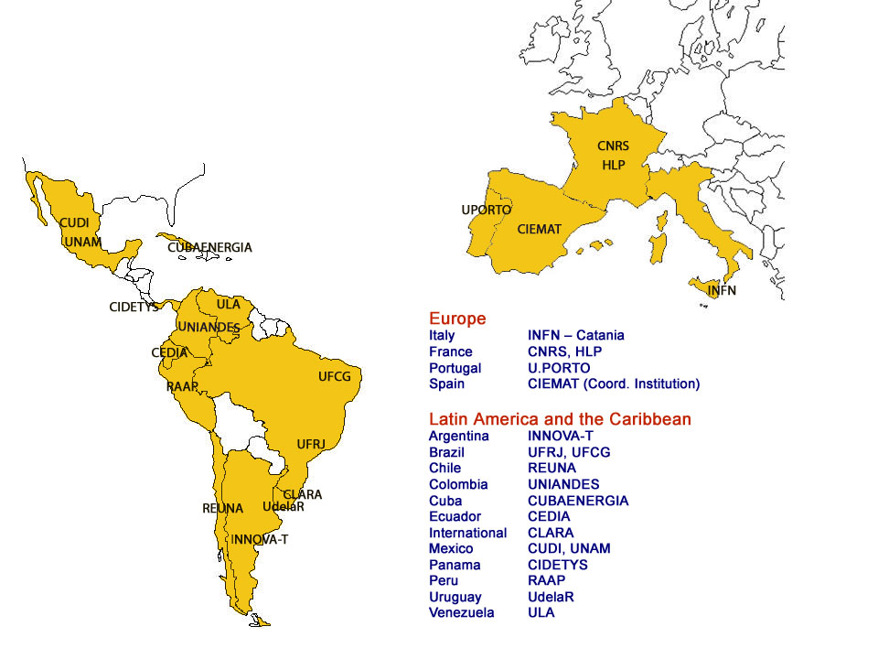
GISELA Countries & Partners
15 Countries (11 in Latin America)
19 Partners (14 in Latin America)
Negotiation with Bolivia & Paraguay for possible collaboration
3
Notes:
3

Slide 4
Objectives and Work plan
Objective1: Ensure the long- term sustainability of the e-Infrastructure in the Latin American continent
Objective 2: Provide full support to the Virtual Research Communities spanning Latin America and Europe, using the e-Infrastructure.
Work plan:
Implement a sustainability model rooted on National Grid Initiatives (NGI), in association with CLARA, Latin American NRENs and collaborating with EGI.
Provide the communities with the suited e-Infrastructure and Application-related Services required to improve the effectiveness of their research. This will address both:
  The current EELA-2 User Communities whose research investigations are carried out at the Institution level or in small collaborations.
  The larger Virtual Research Communities as Life & Earth Sciences, HEP
4
Notes:
4

Slide 5
Long-term sustainability: Genesis
A concern since EELA-2 !
  Sustainability model defined in EELA-2: http://documents.eu-eela.org/record/1119/files/
  Adaptation of the EGI model to the Latin American context
  3-layer model: Local (Institution), National (Country) and Regional (Latin America & The Caribbean)
  Main idea: Get CLARA and Latin American NRENS involved in supporting Research e-Infrastructures on the long-term
  1-year negotiation with CLARA : model modified, adapted and finally adopted during the preparation of the GISELA Proposal
  Responsibilities:
    Local: Resource Centre Institutions
    National: JRU, NGI or Equivalent Domestic Grid Structure (EDGS)
    Regional: IGALC - Iniciativa de Grid de America Latina – Caribe: www.igalc.org

Slide 6
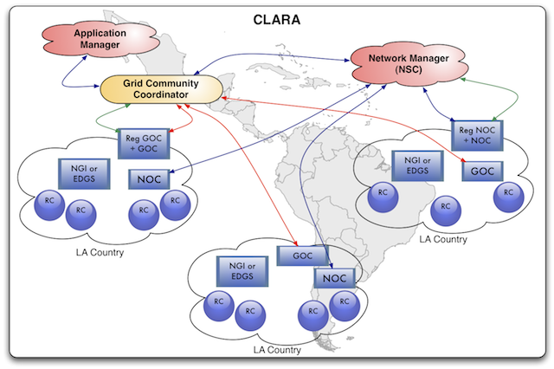
Long-term sustainability: Model
The CLARA-GISELA model as defined in the GISELA DoW:
  http://documents.gisela-grid.eu/record/32?ln=en

Slide 7
Long-term sustainability: Roadmap
GISELA / IGALC shall provide and support basic (CORE) operation services. It will develop inter-operation agreement with EGI, GÉANT2, CLARA, the NRENs and the NGIs (or EDGS), in Europe and Latin America
GISELA shall refine, with the CLARA Transition Team, the final model of sustainability for the e-Infrastructure best adapted to the CLARA and LA NRENs environment
CLARA shall identify the NREN(s) that will be in charge of the Operation and Support of the e-Infrastructure, applying a business plan
Over the course of GISELA, Grid knowledge and expertise shall be handed over to CLARA and the selected NRENs, via the Transition Team
By the end of GISELA, CLARA and Latin American NRENs, NGIs or EDGS shall take over the operation of the e-Infrastructure and the support of the VRCs

Slide 8
VRC Support: Genesis
One of the major concerns of EELA and EELA-2 was to constantly interact with User Communities to:
  Disseminate Grid technology, provide training & technical support
  Get back full support from User Communities on strategic and political issues
Instruments
  Tutorials, Grid schools, “Gridification” weeks, User Forum, Workshops, Conferences, etc.
  In 2009, EELA-2 (www.eu-eela.eu) collaborated to the realisation of the e-Infrastructure Survey of the eResearch 2020 Project (www.eResearch2020.eu). Its purpose was to “investigate the utilisation of e-Infrastructures in Virtual Research Communities and to propose strategies to policy makers and the e-Infrastructure community to enhance the uptake and use of these technologies”

Slide 9
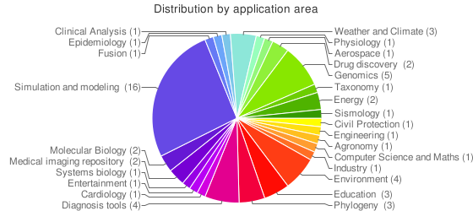
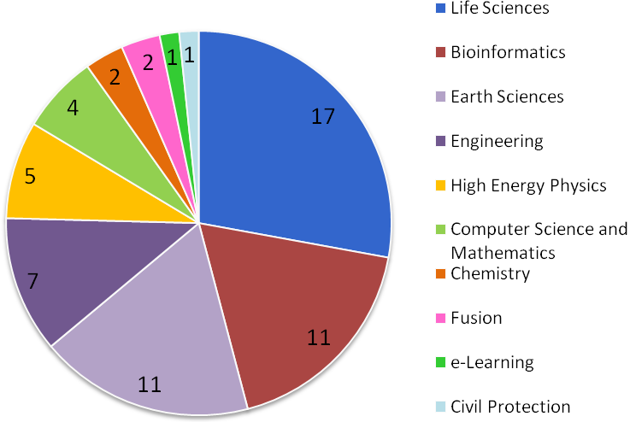
VRCs Support: Initial situation
VRC situation in EELA-2:
  EELA-2 ended up supporting 61 Applications from 78 Institutions
  EELA-2 User Communities were typically 1-2 Institution group(s), largely located in Latin America, alone or collaborating with a few Institutions. Their use of the Infrastructure was to learn Grid technology to evaluate its potential for their future research.
  A few large VRCs from HEP (Auger, LHCb, ALICE, CMS, ATLAS) were also supported
9

Slide 10
VRCs Support: Strategy
From the DOW
  “WP3 (User Communities Support) will interact with new VRCs to evaluate the technical requirements and impact of their Applications and to support their deployment. WP6 (Infrastructure and Applications-oriented Services) will contribute to the dissemination and use of the services it developed in EELA-2
  WP6 will interact with the VRCs to collaborate to the identification, development and deployment of integrated services (e.g. gateways)”
Will to adopt precise strategies on the short term
  Bottom up strategy
    Get asap a few VRCs running production as intensively as possible on GISELA
    Aim at saturating the e-Infrastructure
  Top down approach
    Contact VRCs by all means
    Collaborate with EGI, CHAIN and other regional initiatives
    Refine our VRC approach
10

Slide 11
VRCs Support: Status
Identification of VRCs to include
  Selected EELA-2 User communities
  User Communities recruited by CLARA
  More large VRCs from Earth, Life Sciences, HEP
  Other possible VRCs from national initiatives, e.g. centres/poles of excellence
  Industry partners, as from contacts taken through Chambers of Commerce (e.g. San Luis Potosi - Mexico)
Not clear: collaboration with ESFRI projects!
Enrolling large VRCs, e.g.
  e-NMR / WeNMR: UFRJ (Brazil) group coming on board
  Weather Research and Forecasting (WRF) for mass production
Progress with EGI and related projects
  Active participation at the "Regional Initiatives" session of the EGI Technical Forum (Amsterdam - 14th to 17th September 2010)
  Proposal to organise a Workshop "Regional e-Infrastructures meet VRCs” to take place at the CHAIN KoM (Roma, December 2010)

Slide 12
VRCs Support: Basic duties
Ensure the proper access of GISELA users to the e-Infrastructure resources
Support Application developers and users over the whole process from deploying an Application up to running it in production
Organise the training best adapted to each VRC
Support the use of the e-Infrastructure and Application-related Services already developed in EELA-2 and helps the users in the validation of these services in the context of their Application
Participate in the development of new services requested by the VRCs and helps in the test and validation of these services for user’s Applications
12

Slide 13
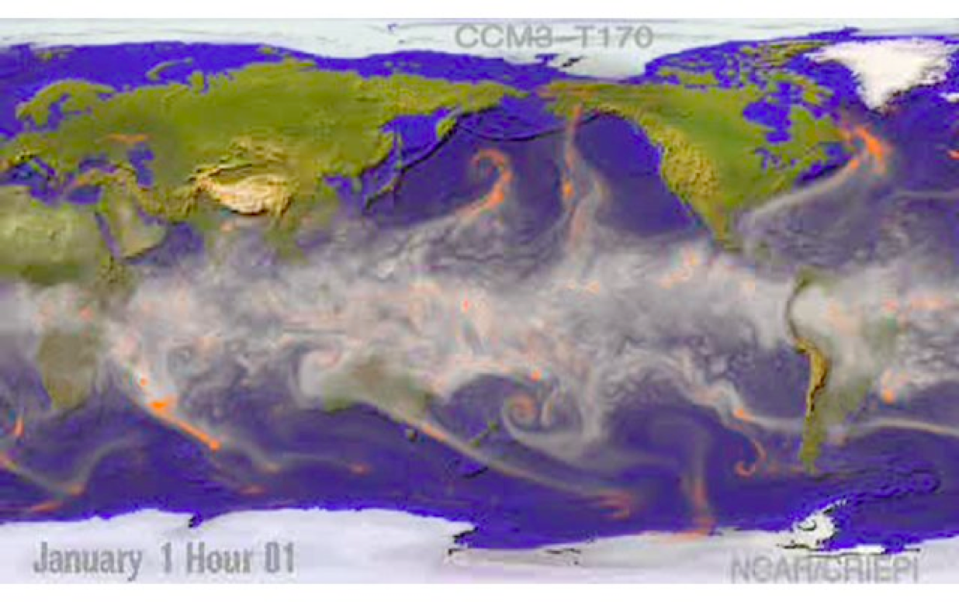
Application example 1/2
Weather predictions (UNICAN – Spain)
http://applications.eu-eela.eu/application_details.php?l=20&ID=65
The Weather Research and Forecasting (WRF) Model (www.wrf-model.org) is a popular model used both operational forecasting and atmospheric research. It is well adapted to a broad spectrum of applications across scales ranging from kilometers to thousands of kilometers.
13

Slide 14
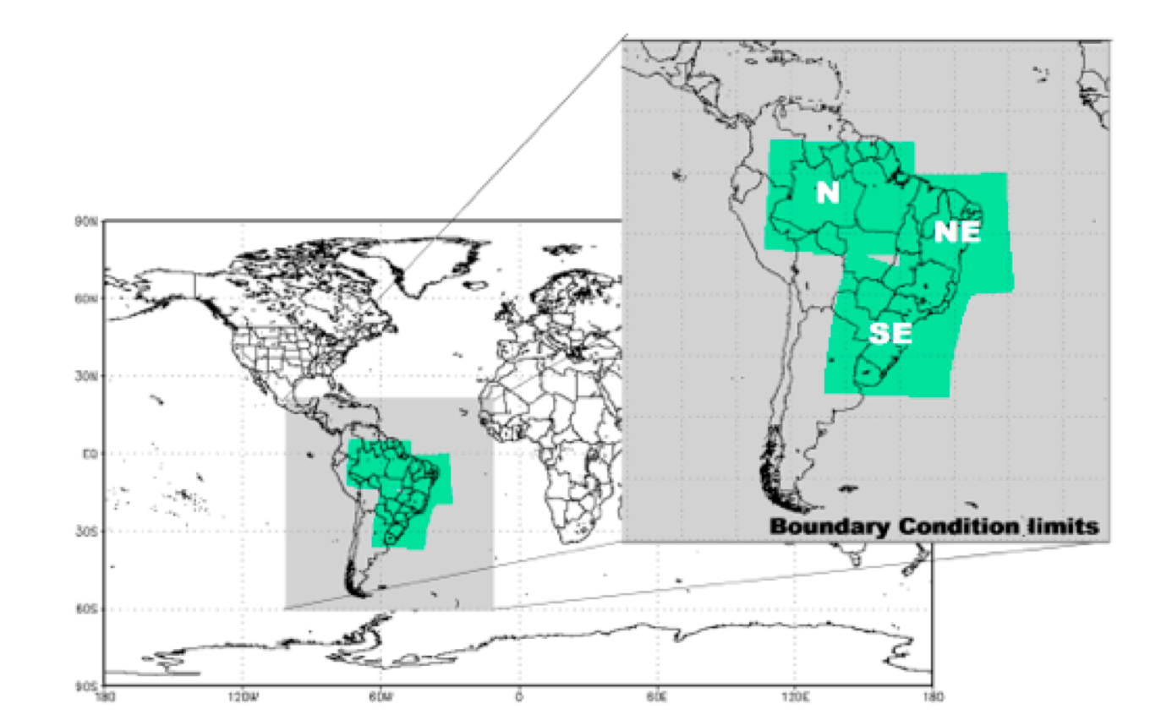
Application example 2/2
Water resources management (UFCG – Brazil)
The SegHidro platform (http://seghidro.lsd.ufcg.edu.br/) cares of the water resource management in Brazil, in particular in the Northeast, a semi-arid region, where irregular rainfall distribution causes many problems to the population. It uses the BRAMS simulation model developed by INPE (Brazil's National Institute for Space Research) to provide weather forecast and climate prediction over a given area and period of time. As climatology simulations normally require a high computational effort due to the large amount of data that must be processed, they are conveniently run on Grid infrastructures.
BRAMS is routinely used - on either the GISELA infrastructure that runs gLite or on the opportunistic part that runs OurGrid - to process the regional climatology of the 3 areas shown. It provides workflows such as (i) weather and seasonal climate forecasting; (ii) reservoir planning and operation; (iii) rainwater harvesting risk analysis; (iv) integrated surface and groundwater management; (v) operation of water distribution networks; (vi) agricultural planning; (vii) flood forecasting; (viii) soil conservation planning; (ix) and regional impact of climate change.
14

