Slide 1
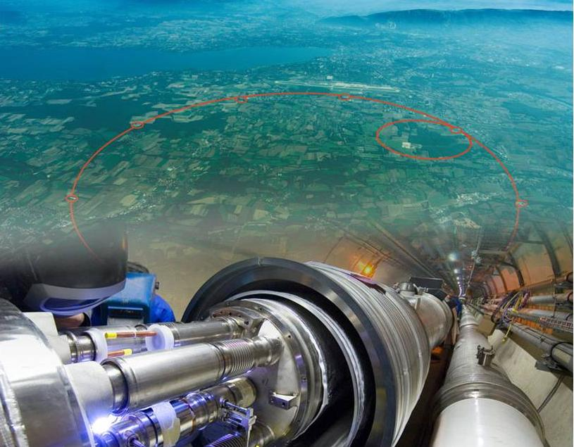
Welcome to CERN
8th Concertation meeting
CERN, Globe of Science and Innovation
Sergio Bertolucci
Director for Research and Computing
4 November 2010

Slide 2
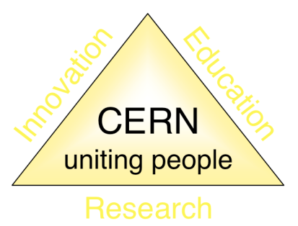
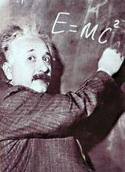




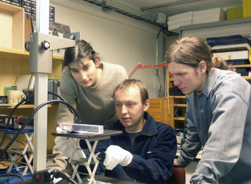
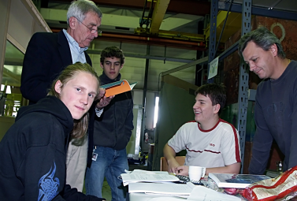
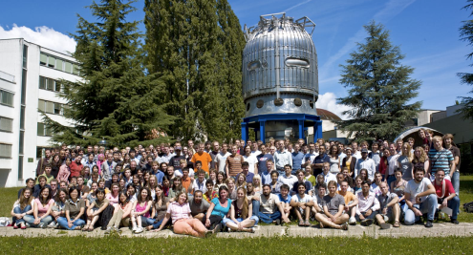
The Mission of CERN
Push back the frontiers of knowledge
E.g. the secrets of the Big Bang …what was matter like within the first moments of the Universe’s existence?
Develop new technologies for accelerators and detectors
Information technology - the Web and the GRID
Medicine - diagnosis and therapy
Train scientists and engineers of tomorrow
Unite people from different countries and cultures
Notes:
2

Slide 3
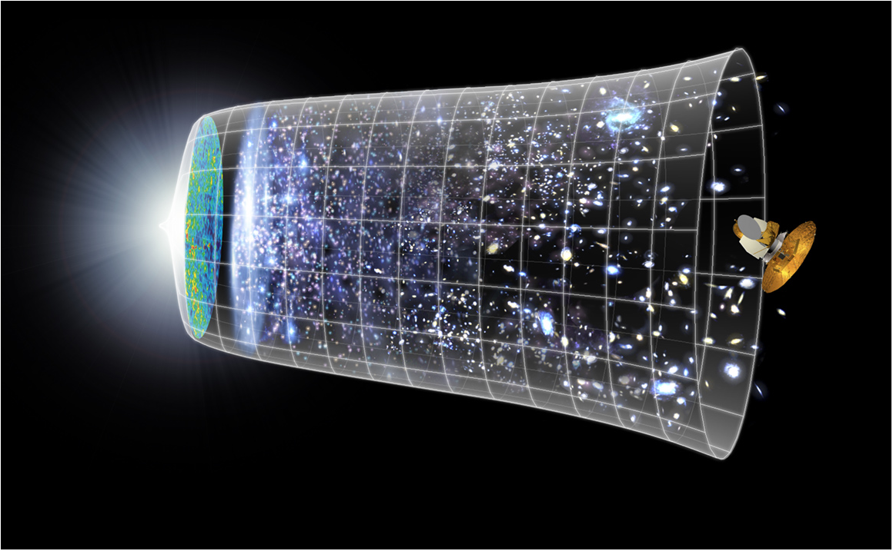
Evolution of the Universe
Big Bang
LHC
10⁻¹⁰s
13.7 Billion Years
Today
10²⁸ cm or 100 000 000 000 000 000 000 000 km
Canada and CERN / October 2009
3

Slide 4
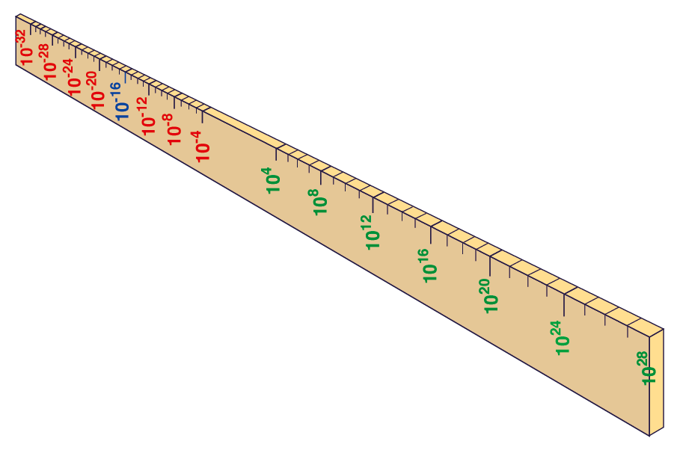
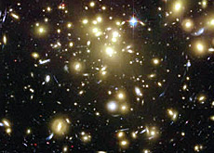


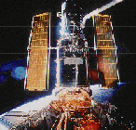
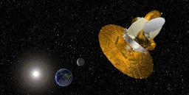
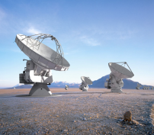
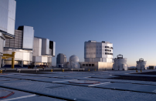
Big Bang
Proton
Atom
Radius of Earth
Earth to Sun
Radius of Galaxies
Universe
LHC
Super-Microscope
cm
Study physics laws of first moments after Big Bang
increasing Symbiosis between Particle Physics,
Astrophysics and Cosmology
Hubble
WMAP
ALMA
VLT
Notes:
4
60 Grössenordnungen

Slide 5
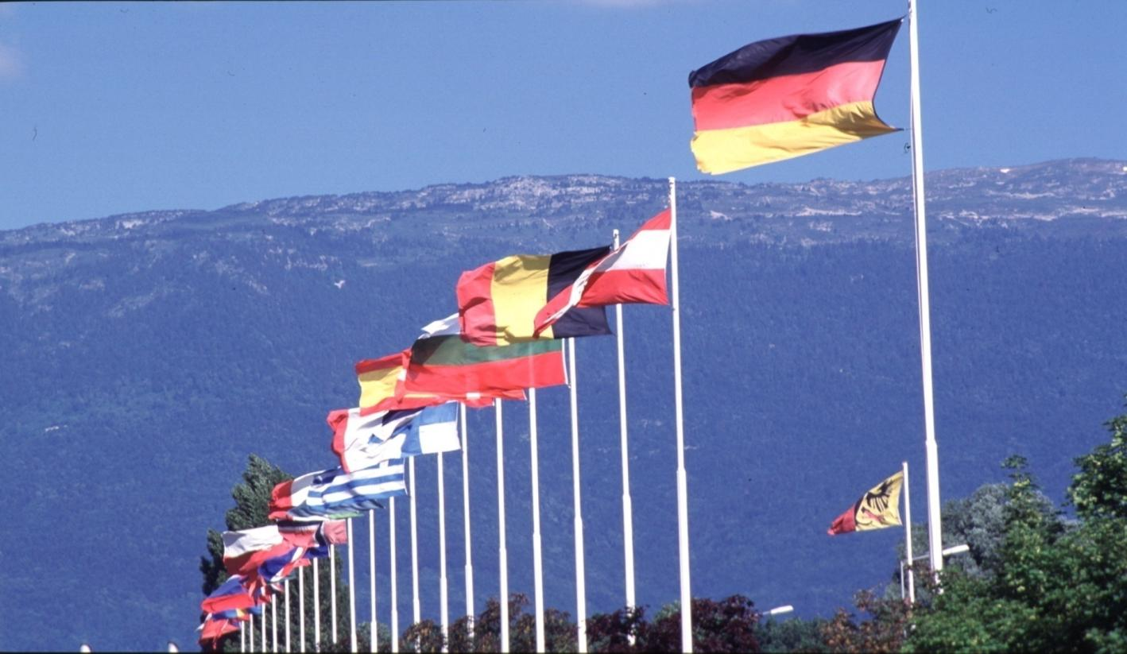
CERN Governance
Twenty Member States:
Austria Belgium Bulgaria Czech Republic
Denmark Finland France Germany
Greece Hungary Italy Netherlands
Norway Poland Portugal Slovak Republic
Spain Sweden Switzerland United Kingdom
Plus eight Observers: European Commission, India, Israel, Japan, Russian Federation, Turkey, UNESCO and USA
Annual Budget: ~1000 MCHF
Personnel: 2250 Staff, 700 Fellows and Associates, >10’000 Users

Slide 6
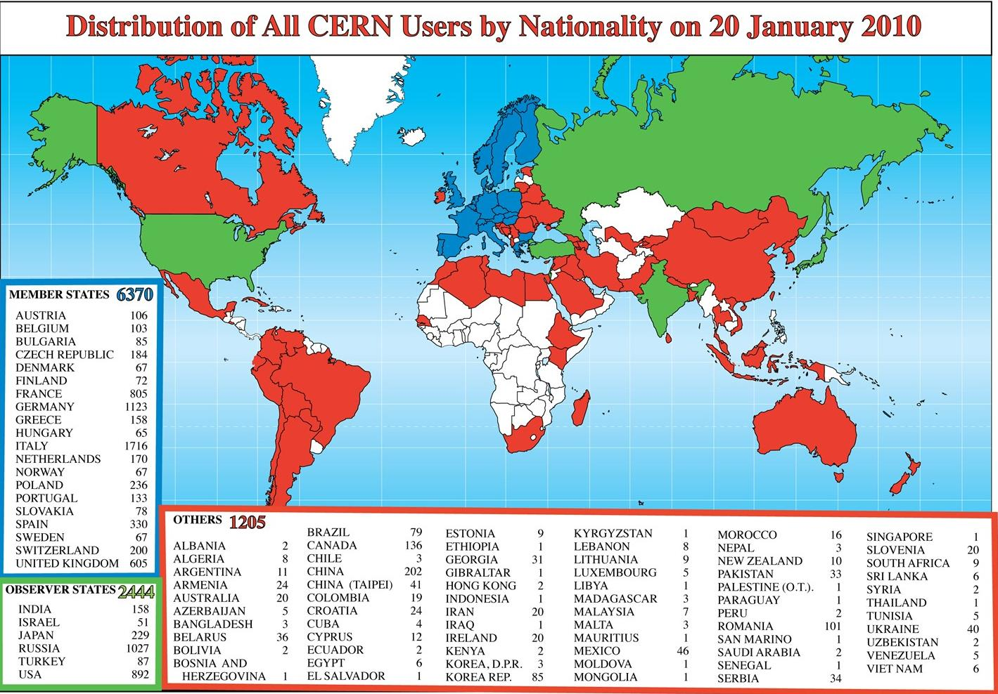

Slide 7
CERN’s tools
The world’s most powerful accelerator: LHC
  A 27 km long tunnel filled with high-tech instruments
  Equipped with thousands of superconducting magnets
  Accelerates particles to energies never obtained before
  Produces particle collisions creating microscopic “big bangs”
Very large sophisticated detectors
  Four experiments each the size of a cathedral
  Hundred million measurement channels each
  Data acquisition systems treating Petabytes per second
Top level computing to distribute and analyse the data
  A Computing Grid linking ~140 computer centres around the globe
  Sufficient computing power, storage and networking to handle 15 Petabytes per year, making them available to thousands of physicists for analysis

Slide 8


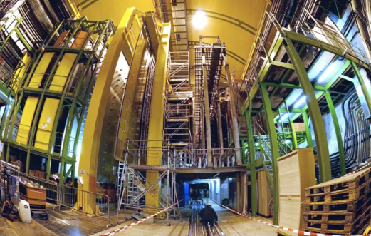
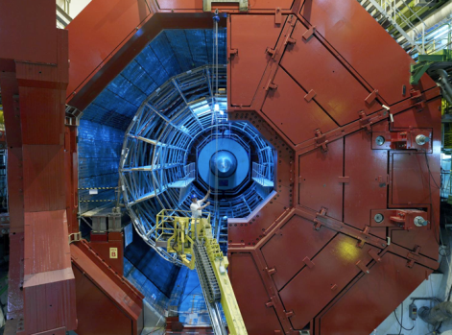


Enter a New Era in Fundamental Science
Start-up of the Large Hadron Collider (LHC), one of the largest and truly global scientific projects ever, is the most exciting turning point in particle physics.
CMS
LHCb
Exploration of a new energy frontier
Proton-proton collisions at E_{CM} = 7 TeV
ALICE
LHC ring:
27 km circumference
ATLAS
Notes:
8

Slide 9
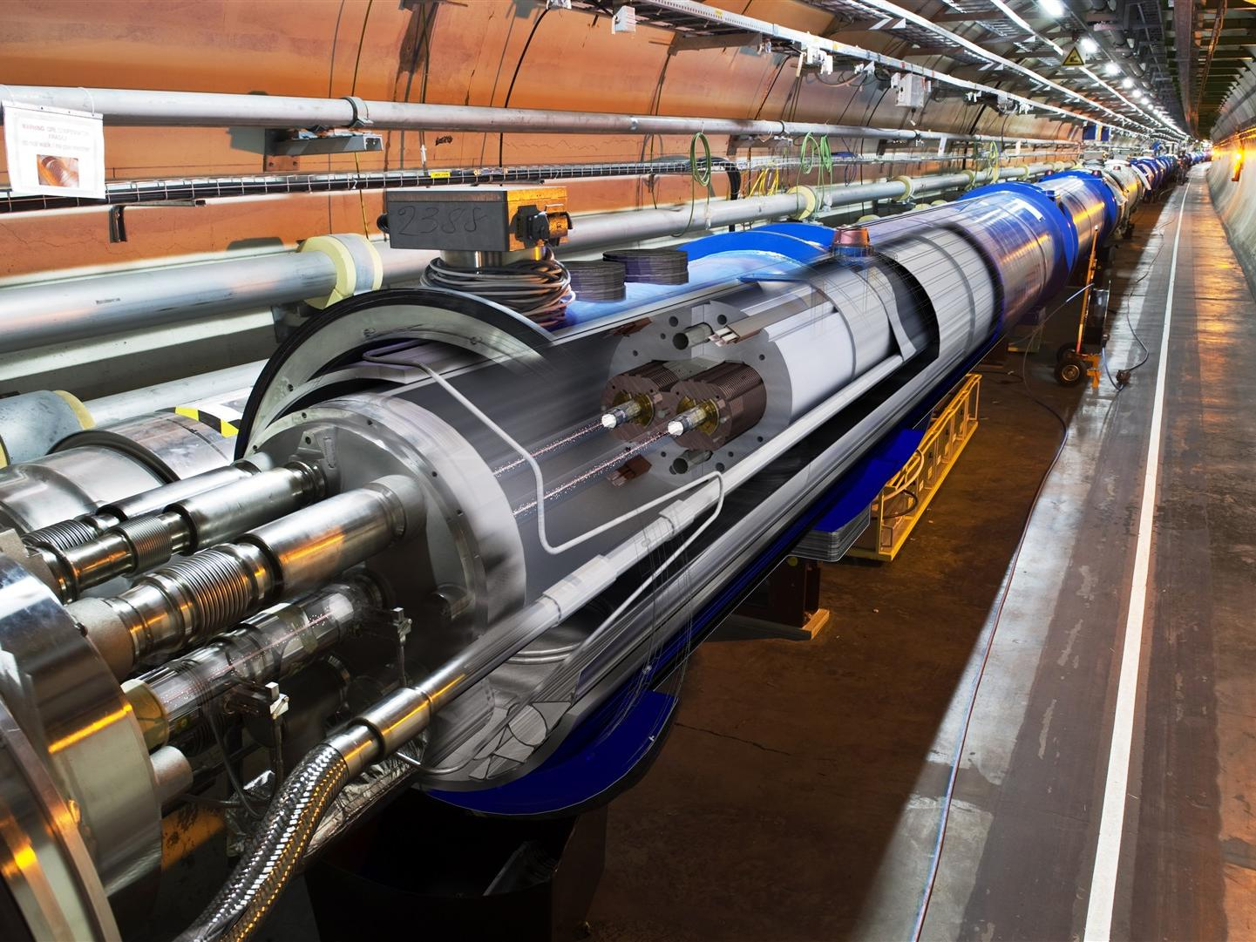
Inside the Large Hadron Collider

Slide 10
An impressive start
LHC commissioning proceeding at an unprecedented pace
Experiments showed their readiness in the exploitation of the 7 TeV data…
…ready to follow with more complex triggers the increase of luminosity.
Analyses proceeding very rapidly in all experiments and results being submitted for publication within days
Brilliant performances of the WLCG a key factor in the spectacular startup.

Slide 11
The Computing Challenge
Search for extremely rare events – a needle in huge hay stack
Very high initial data rates – up to 1 Petabyte per second
Massive data reduction directly at the detectors
After filtering, still 1-2 GB/second leading to over 15 PB/year, to be stored, distributed and analyzed
Users are distributed all over the Globe
Many institutes/universities/teams contribute with compute power and disk storage, but all do their own way

Slide 12
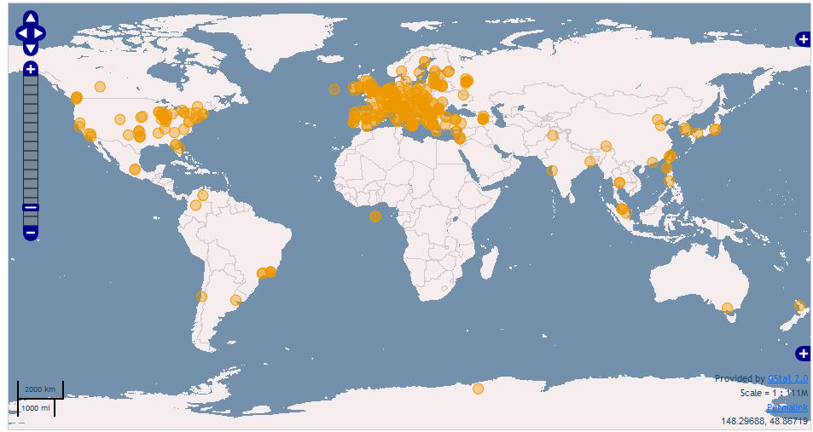
Worldwide resources
Today >140 sites
~250k CPU cores
~100 PB disk

Slide 13
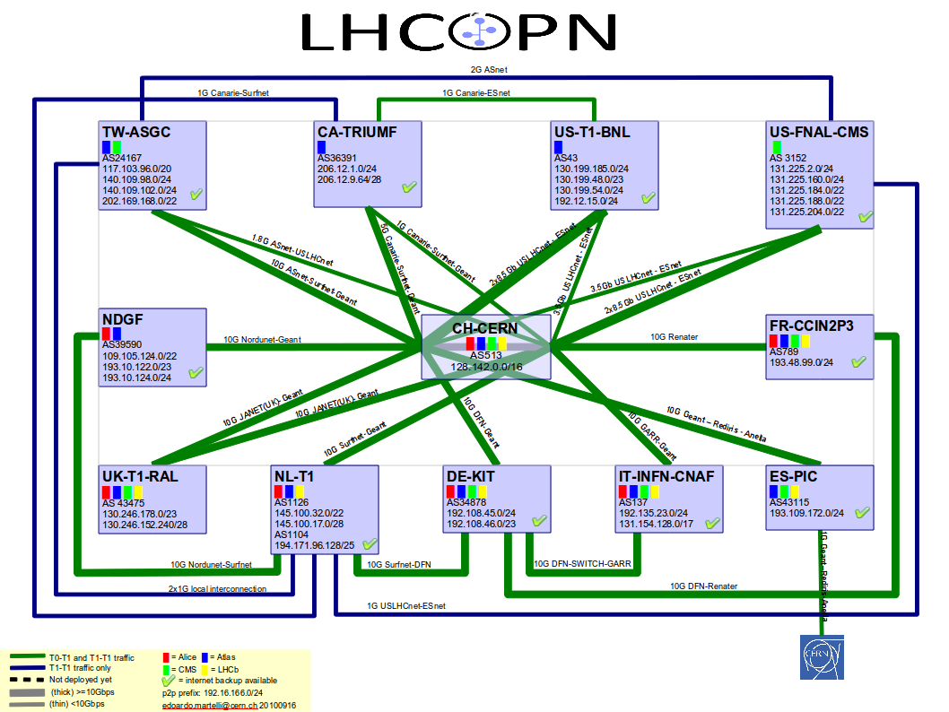
Notes:
CERN makes use of high-speed networks to link together the resources around the Globe. CERN has worked with Europe’s NRENs and international partners to ensure the LHC data can distributed to the Tier-1 centres with back-up links to ensure high reliability. CERN is a Point of Presence (PoP) for GEANT and provides network access to the a number of international organisation in Geneva as well as hosting a number of Commercial Internet service providers at its Internet Exchange Point (CIXP)

Slide 14
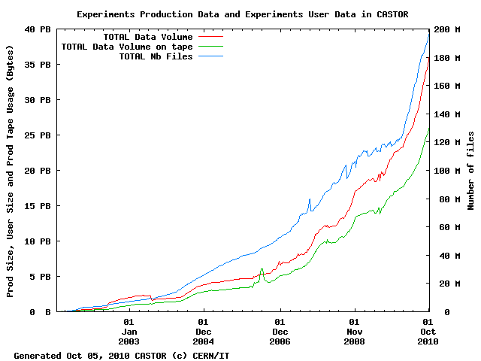
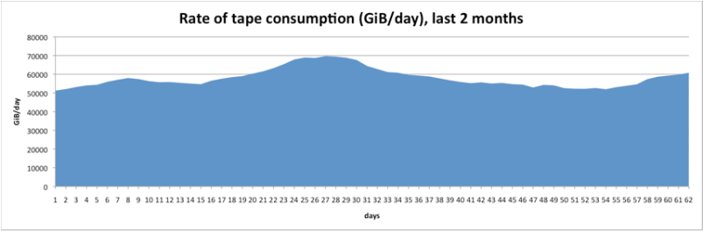
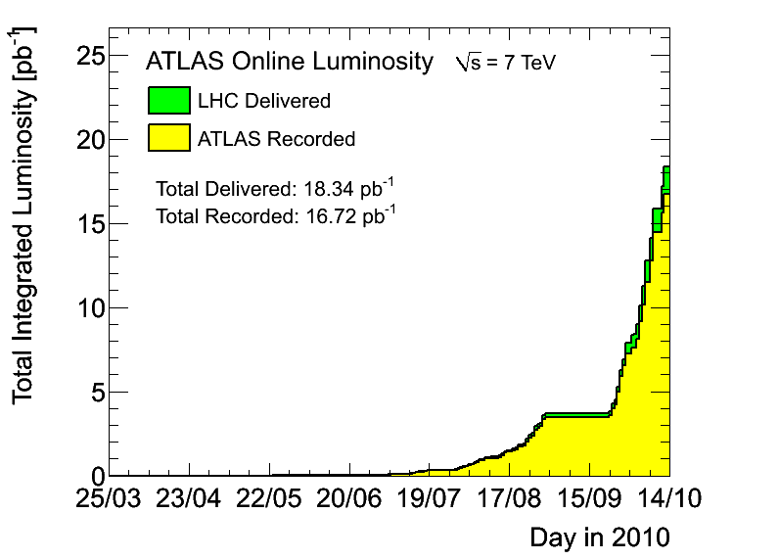
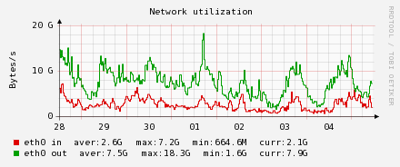
6 months of LHC data
Data written to tape (Gbytes/day)
Stored ~ 5 PB this year
Writing up to 70 TB / day to tape
(~ 70 tapes per day)
Disk Servers (Gbytes/s)
Tier 0 storage:
Accepts data at average of 2.6 GB/s; peaks > 7 GB/s
Serves data at average of 7 GB/s; peaks > 18 GB/s
CERN Tier 0 moves ~ 1 PB data per day

Slide 15
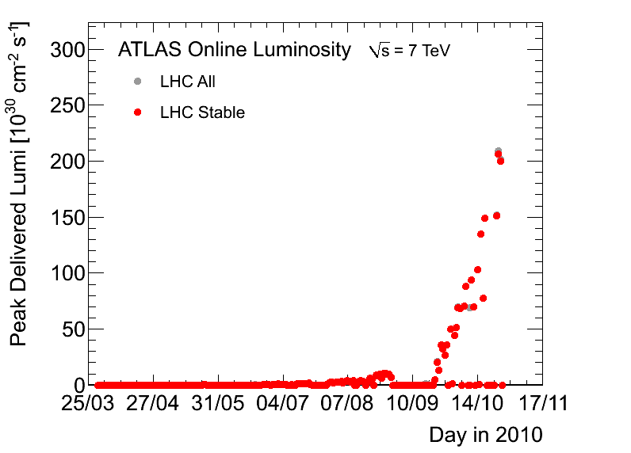
LHC progress
2010 goal

Slide 16
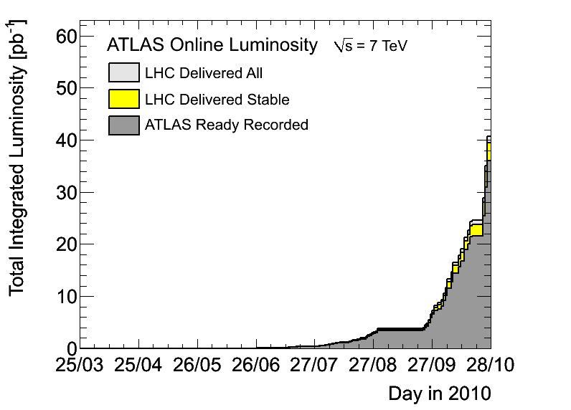
LHC progress

Slide 17
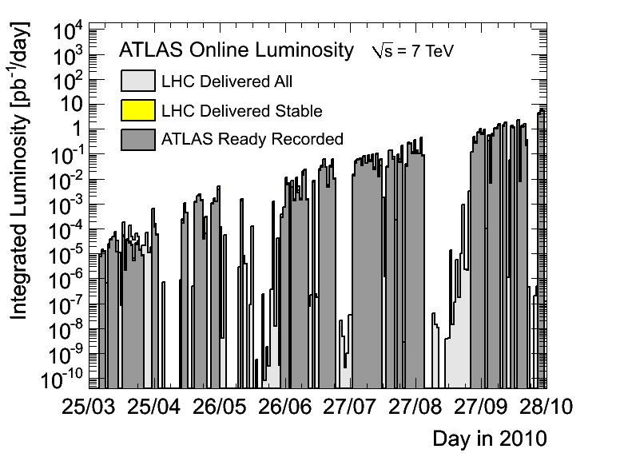
LHC progress

Slide 18
LHC Experiments

Slide 19
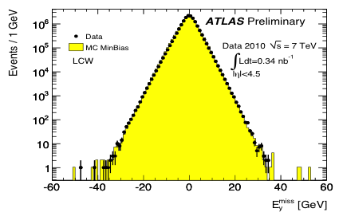
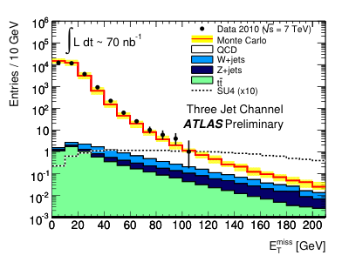
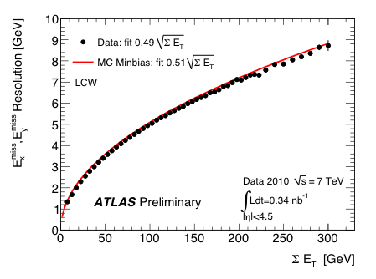
Missing transverse energy
Sensitive to calorimeter performance
(noise, coherent noise, dead cells,
mis-calibrations, cracks, etc.), and
non-collision backgrounds
Fundamental for searches (Higgs, SUSY, ..)
Calibrated E_{T}^{miss} from
minimum-bias events
Measured over ~ full calorimeter coverage
(360⁰ in φ, |η| < 4.5, ~ 200k cells)
E_{T}^{miss} spectrum from SUSY searches:
events with ≥ 3 high-p_{T} jets, p_{T} (j1) > 70 GeV
Calibrated
SUSYx10
(m~400 GeV)

Slide 20
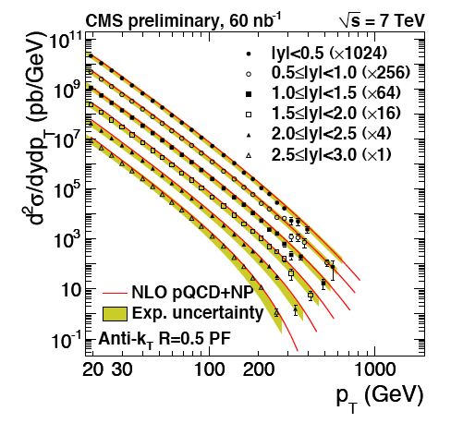
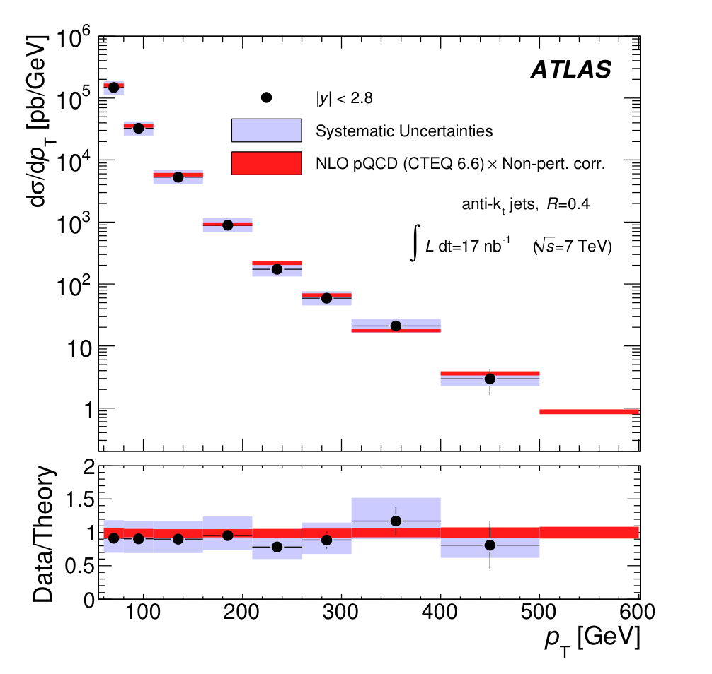
Inclusive jet cross-section
NLOJET++
Good agreement data-NLO QCD over > 5 orders of magnitude
within ~ 40% experimental uncertainty (dominated by jet energy scale)

Slide 21
dN_{ch}/dη versus √(s)
dN_{ch}/dη versus √s
Relative increase in dN_{ch}/dη
Inelastic N_{ch} ≥ 1 in |η|<1
ALICE
CMS
NonSingleDiffractive
all Inelastic
Good news for the Heavy Ion program:
More charged particles will create
a denser and hotter system !
fits ~ s^{0.1}
Results:
- dN_{ch}/dη well described by power law (√s)^{0.2}
increase with energy significantly stronger in data than MC’s
Alice & CMS agree to within 1 σ (< 3%)

Slide 22
MC Scoreboard
MC/TUNE | D6T | Perugia0 |  | CSC |  | PHOJET
dN_{ch}/dη | -20% | -17% |  | +3% |  | -2%
N_{ch} | N_{ch}>10 | N_{ch}>5 |  |  | N_{ch}>15 | N_{ch}>10
p_{t} |  |  |  |  | p_{t}>1GeV |  | p_{t}>1GeV
<p_{t}>
MC << data
MC >> data
MC ≈ data
0.9 TeV
Stay tuned !
η | -24% |  | -21% |  | -2% | -8%
N_{ch} |  | N_{ch}>10 |  | N_{ch}>5 | N_{ch} >20 | N_{ch}>15
2.36 TeV
η | -27% | -24% | -4% | -17%
N_{ch} |  |  | N_{ch} >30
7 TeV
Conclusion:
none of the tested MC’s (adjusted at lower energy) does really well
tuning one or two results is easy, getting everything right will require more effort
(and may, with some luck, actually teach us something on soft QCD rather than only turning knobs)
22

Slide 23
Entering uncharted territories…

Slide 24
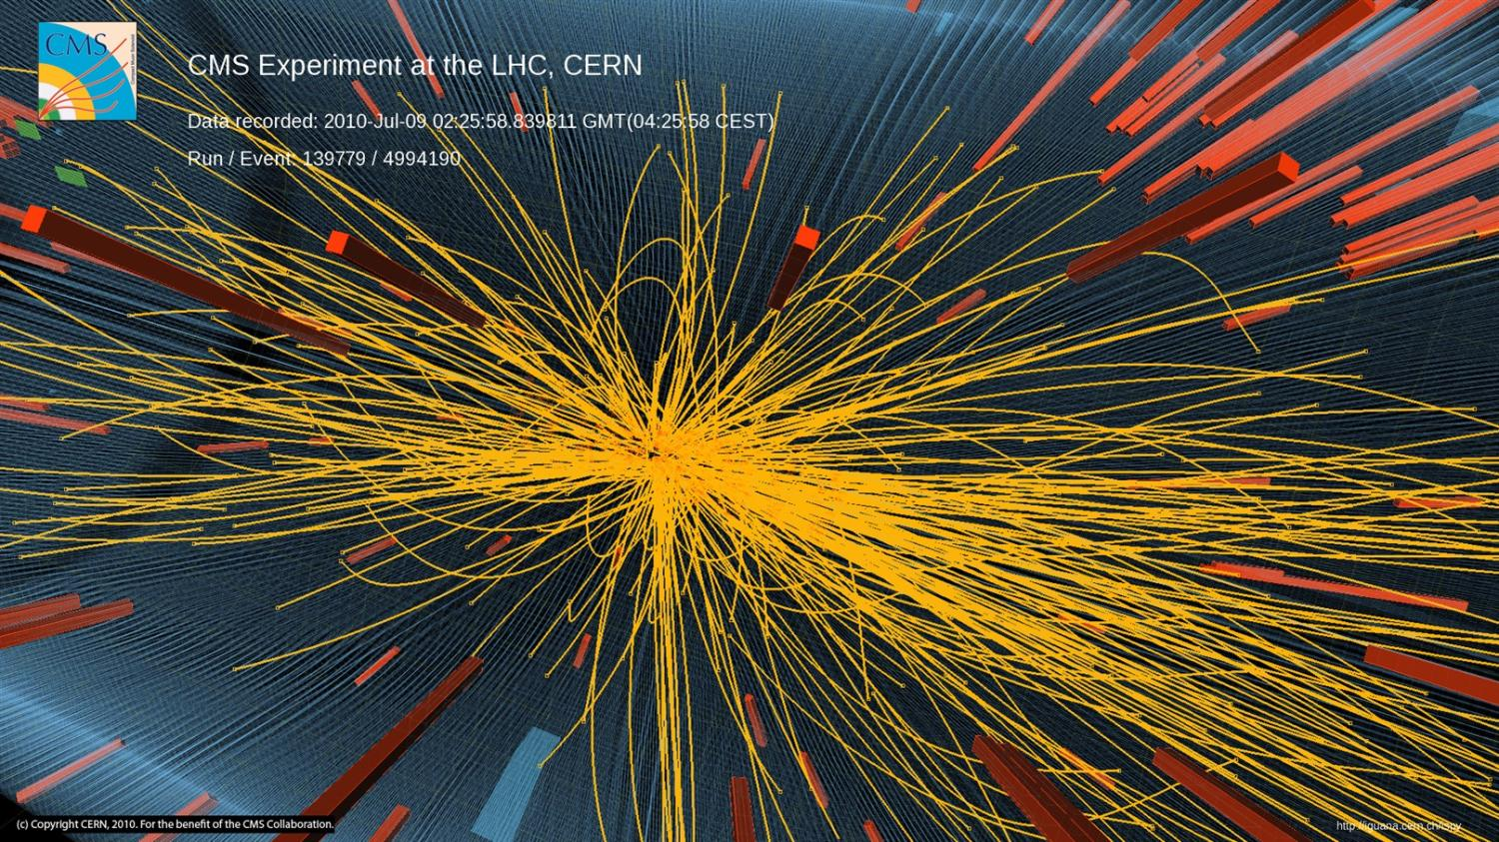
First signs of new phenomena?

Slide 25
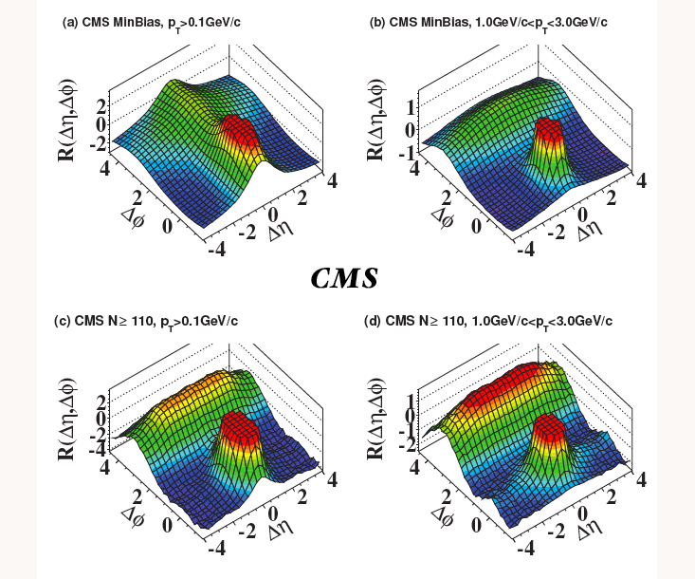
“The ridge” in CMS

Slide 26
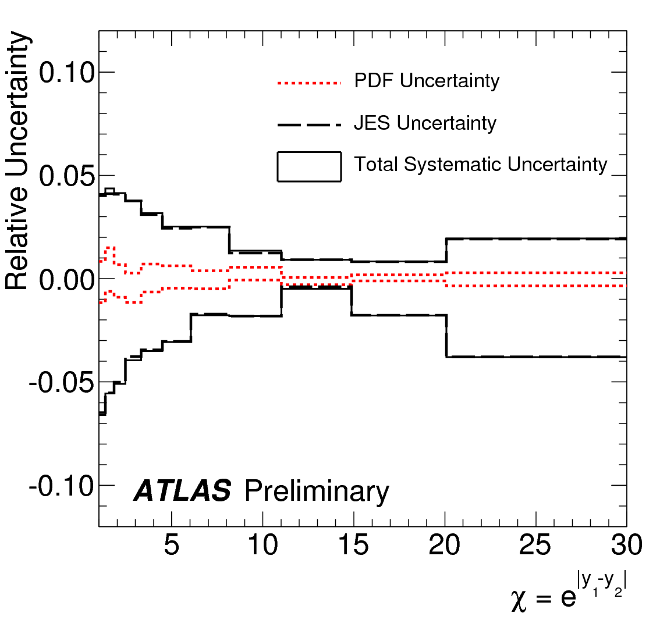
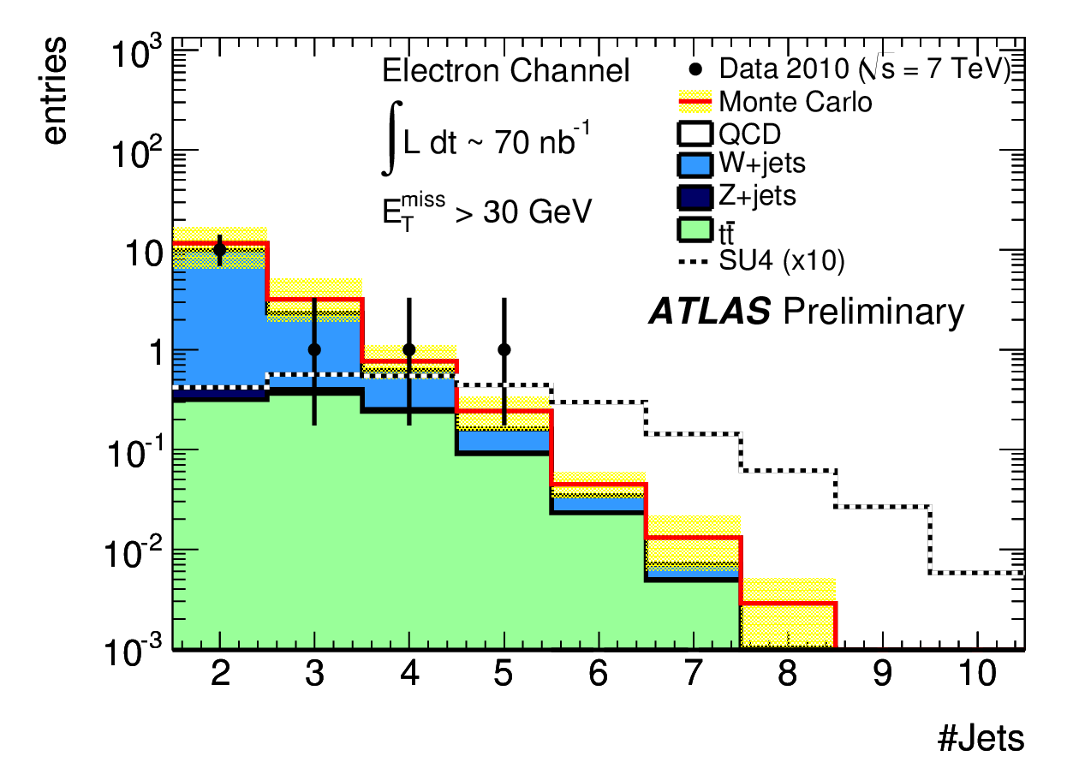
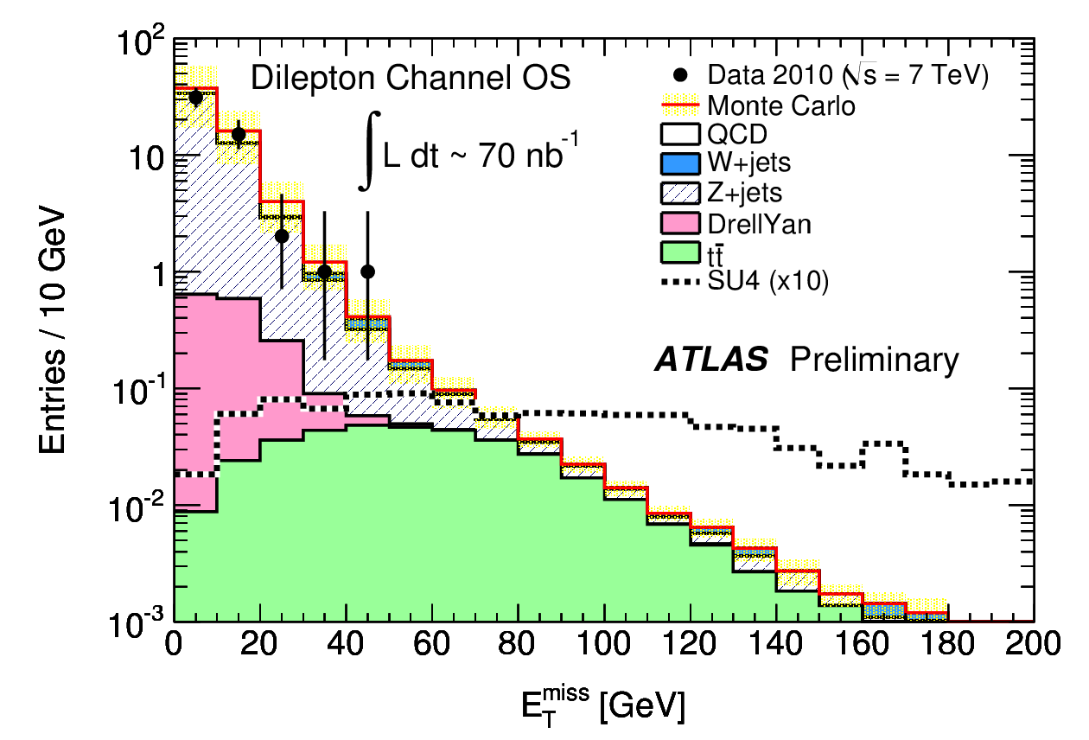
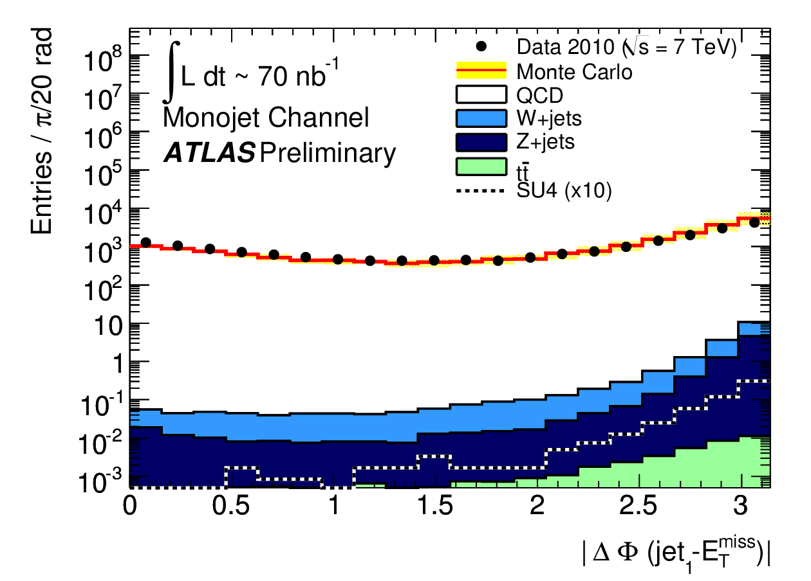
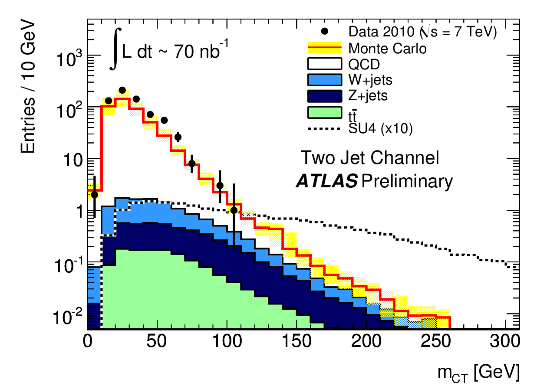
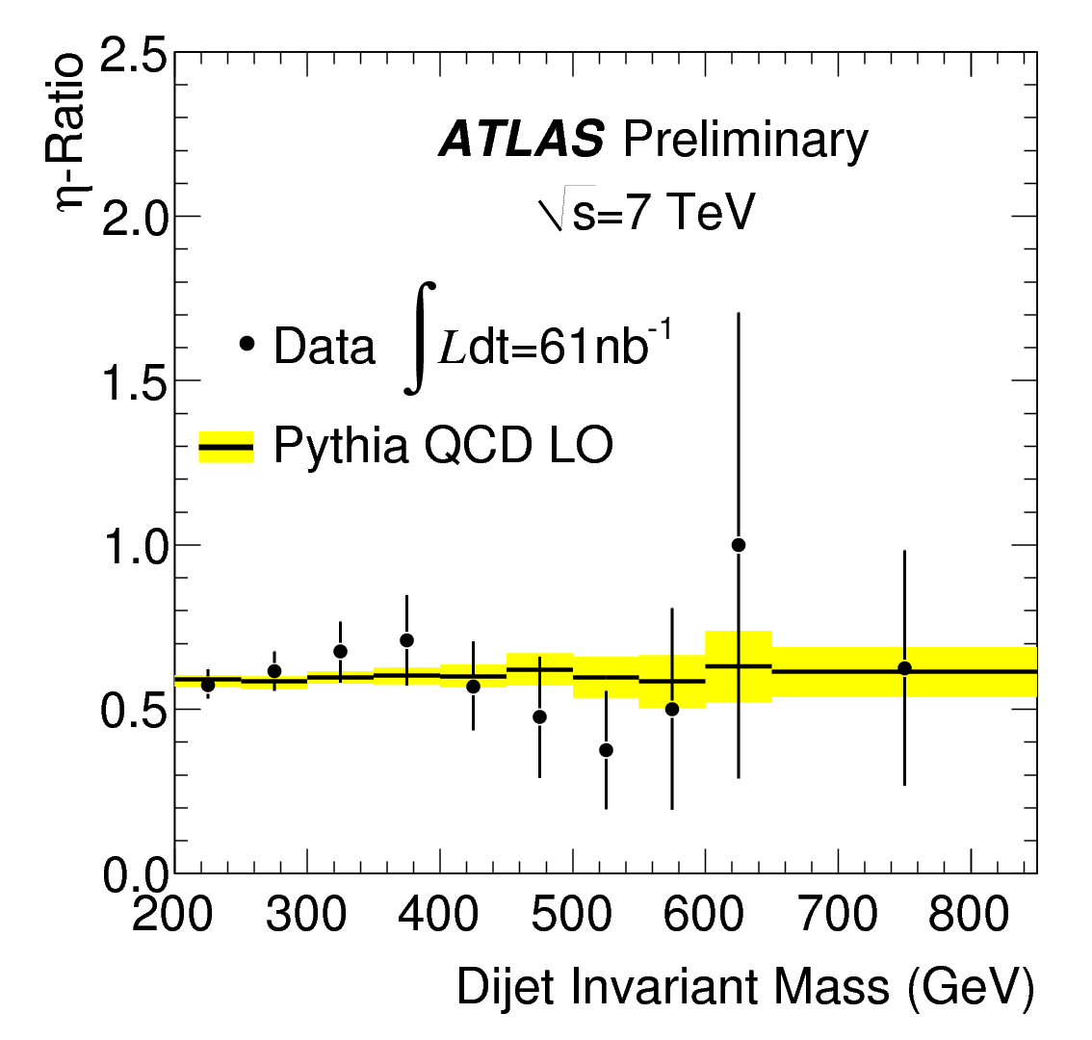
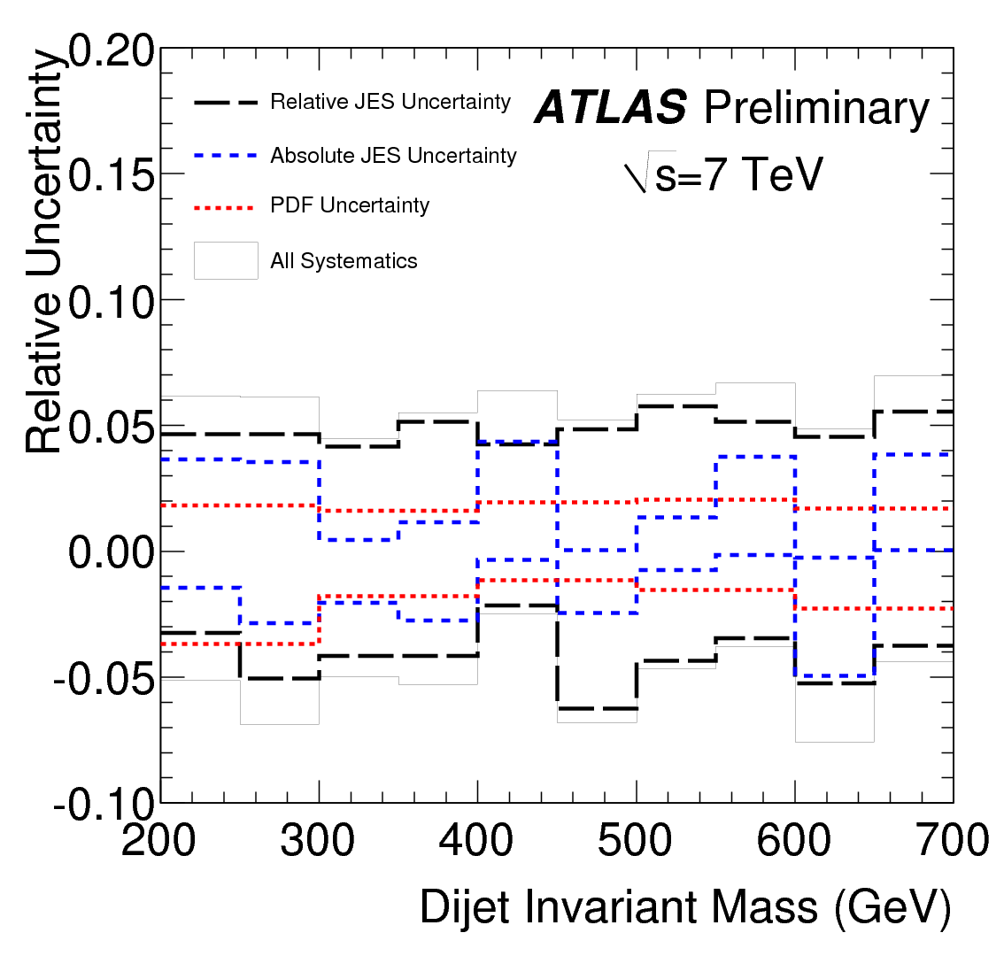
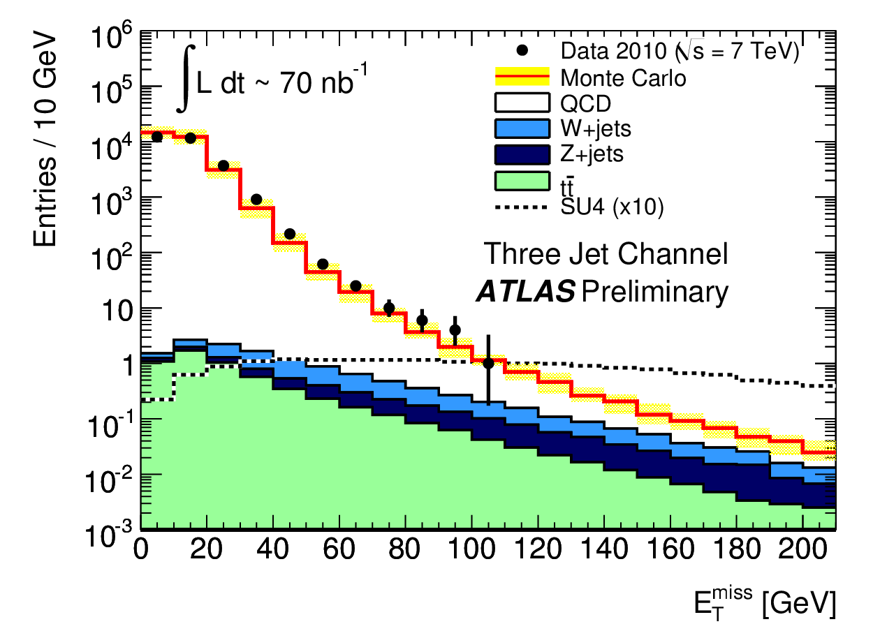
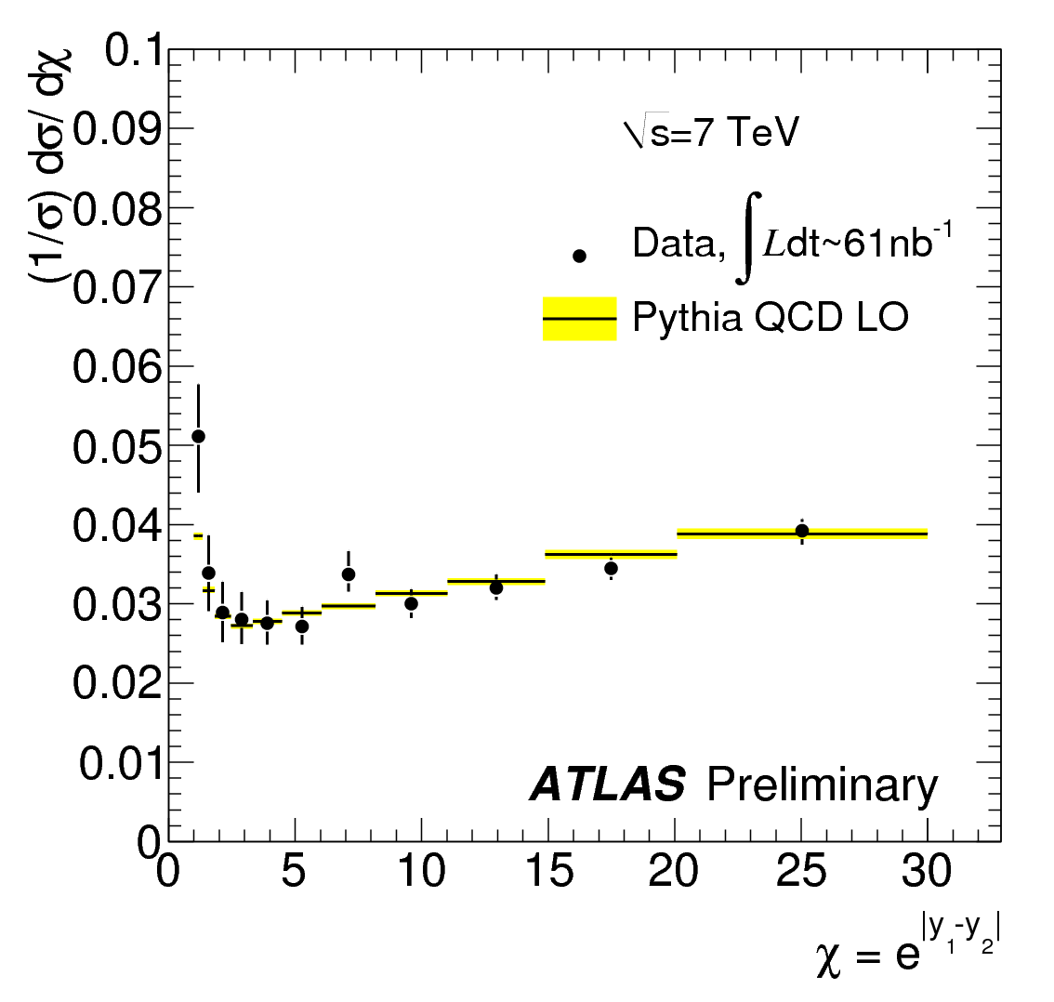
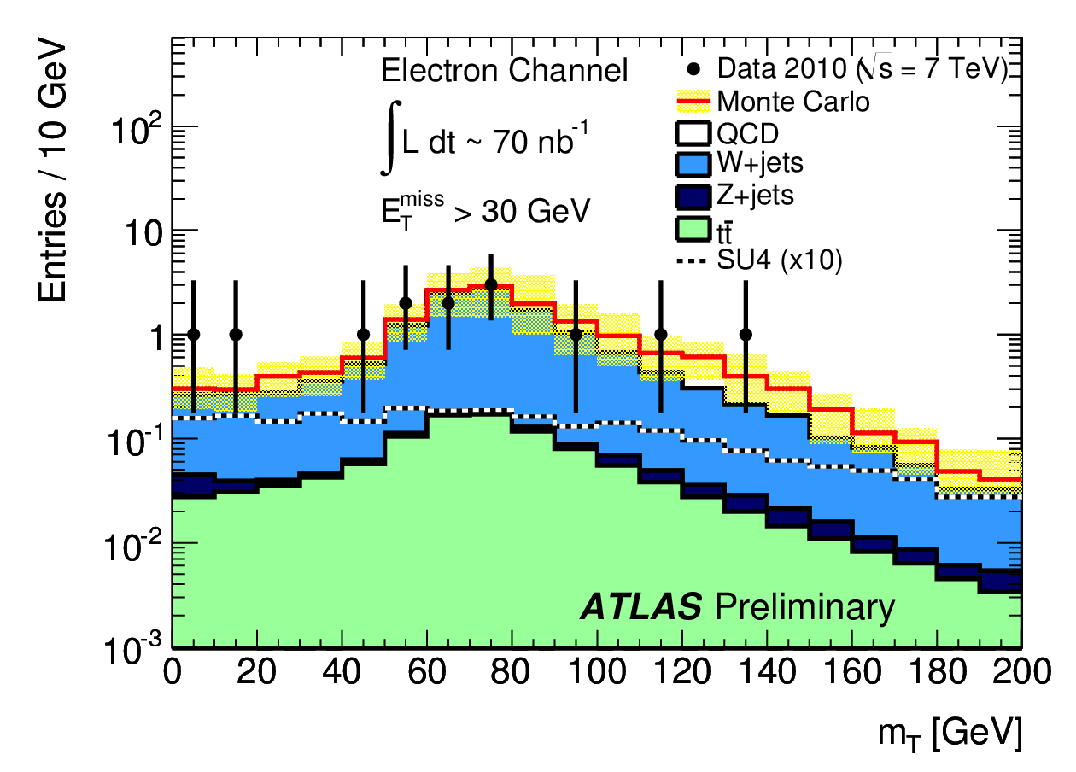
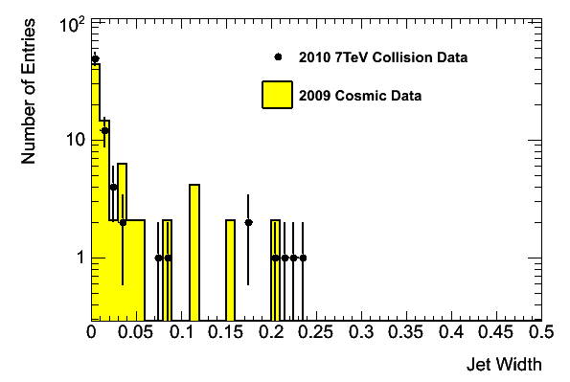
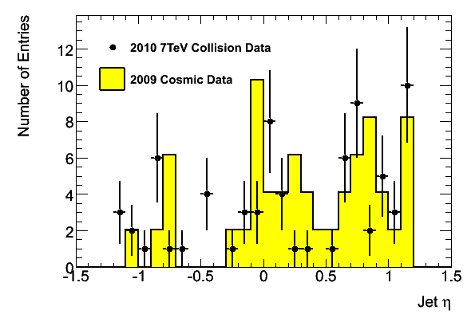
First searches for New Physics
Present goals:
understand backgrounds by comparing MC to data for key search-sensitive
distributions (→ complementary studies to Standard Model analyses)
started to set competitive limits with Tevatron → two results shown here
be prepared for discoveries when enough data available
Typically:
few pb⁻¹: start to compete with Tevatron sensitivity
O (100 pb⁻¹ ): discovery (5σ) potential (just) beyond Tevatron limits
~ 1 fb⁻¹: discovery potential extends into new territory, e.g.
W’ up to m~ 2 TeV
SUSY up to m (squarks, gluinos) ~ 750 GeV
Backgrounds to gluino R-hadrons
decaying in the calorimeters
out-of-time of collisions

Slide 27
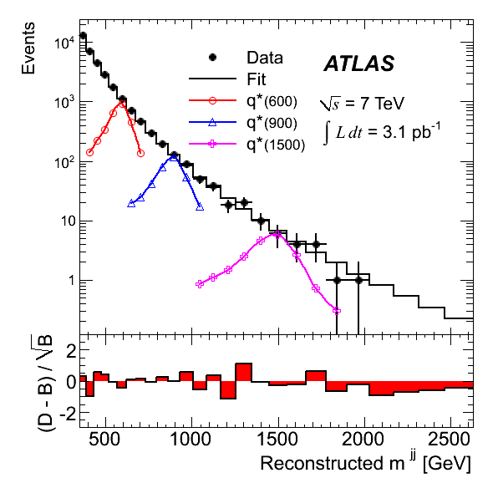
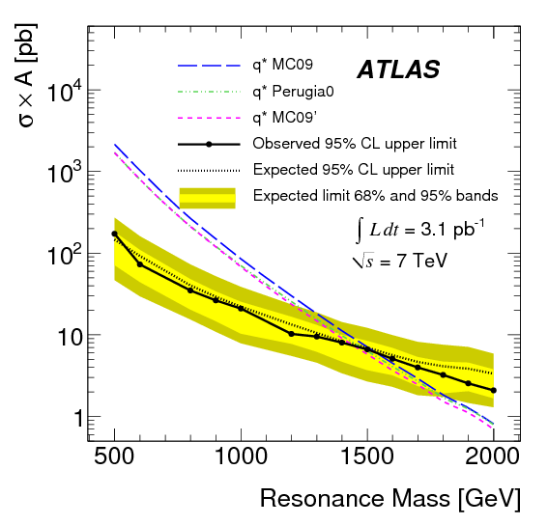
Searches for excited quarks: q*→ jj
Latest published limit: CDF (1 fb⁻¹):
260 < M (q*) < 870 GeV
Look for di-jet resonance in the measured M(jj) distribution
→ spectrum compatible with a smooth monotonic function → no bumps
August 2010: with 315 nb⁻¹ : 0.4 < M (q*) < 1.26 TeV excluded at 95% C.L.
→ beyond the Tevatron for the first time
→ accepted for publication in Phys. Rev. Lett.
Today: with 3.1 pb^{-1:} limit extended to ~ 1.5 TeV
ATLAS
internal
ATLAS
internal
1.53 TeV
p_{T} (j₁, j₂) > 150, 30 GeV, |η|<2.5, |η₁-η₂|<1.3, m_{jj}> 350 GeV
Experimental systematic uncertainties (luminosity, jet E-scale, background fit, …) included
Impact of theoretical uncertainties (PDF, scale): < 100 GeV

Slide 28
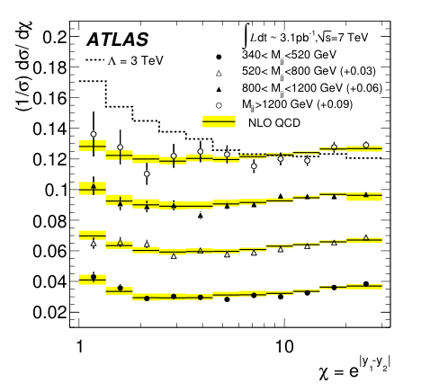
Searches for quark contact interactions
Full data sample: ~ 3.1 pb⁻¹
Look for deviations from QCD in dijet angular distributions
ϑ* = polar angle of the dijet system
QCD: χ distribution ~ flat (t-channel g-exchange dominates)
Contact interactions (characterized by a scale Λ) or new massive physics:
excess at low χ for large M(jj)
ATLAS internal
p_{T} (j₁, j₂) > 60, 30 GeV, |y₁+y₂|<1.5, M(jj) >340 GeV
Jet E-scale and PDF uncertainties included
Λ > 3.43 TeV at 95% C.L.
Expected limit: Λ > 3.49 TeV
Latest published limit:
D0 (0.7 fb⁻¹): 2.84 TeV

Slide 29
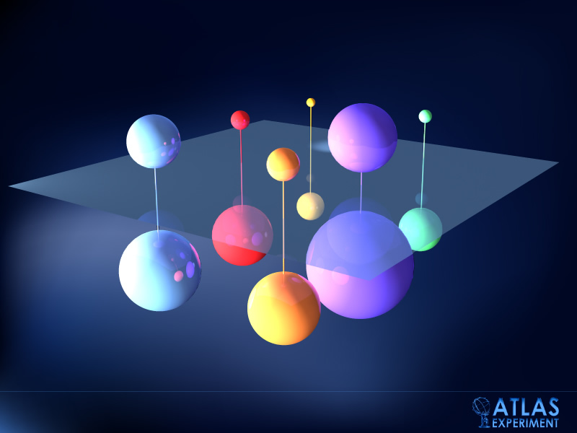
Supersimmetry

Slide 30

Search for Supersymmetry
Expected 95% C.L.
exclusions from
≥ 3 jets + E_{T}^{miss} searches
(50% background
uncertainty included)
Tevatron exclusion
reach: ~ 450 GeV
LHC discovery reach for , 1 experiment
M (TeV) 1 fb⁻¹ 2 fb⁻¹ 5 fb⁻¹
√s=7 TeV 0.7 0.8 1
√s=8 TeV 0.8 0.9 1.1

Slide 31


Expected Higgs mass coverage (GeV)
ATLAS and CMS internal and very preliminary
Luminosity Comments ATLAS+CMS ATLAS+CMS ATLAS+CMS
per expt and √s 95% CL exclusion 3σ evidence 5σ discovery
1 fb⁻¹ 7 TeV 2011 123-550 GeV 130-450 GeV 152-174 GeV
1 fb⁻¹ 8 TeV 2011 (?) 120-570 127-500 150-176
2.5 fb⁻¹ 7 TeV 2011 “aggressive” 114-600 123-530 138-220
5 fb⁻¹ 7 TeV 2012 (if run) 114-600 114-600 124-510
5 fb⁻¹ 14 TeV 2013 ≥ 115
30 fb⁻¹ 14 TeV ~2014 H→ bb at 4-5 σ ?
ATLAS internal

Slide 32

Ions and Quark-Gluon Plasma

Slide 33



Heavy Ions: Flow at LHC
one of the first and most anticipated answers from LHC
  2nd RHIC paper: Aug 24, 22k MB events, flow surprise ( v₂)
    Hydrodynamics: modest rise (Depending on EoS, viscosity, speed of sound)
    experimental trend & scaling predicts large increase of flow
LHC ?
BNL Press release, April 18, 2005:
Data = ideal Hydro
"Perfect" Liquid
New state of matter more remarkable than predicted –
raising many new questions
LHC will either
confirm the RHIC interpretation
(and measure parameters of the QGP EoS)
OR
……………………..

Slide 34
The LHC Computing grid today
Distributed computing for LHC is a reality and enables physics output in a very short time
Experience with real data and real users suggests areas for improvement
  The infrastructure will evolve with the underlying technology and commercial offerings

Slide 35

Grids & HEP: Common history
CERN and the HEP community have been involved with grids from the beginning
Recognised as a key technology for implementing the LHC computing model
HEP work with EDG/EGEE in Europe, iVDGL/Grid3/OSG etc. in US has been of clear mutual benefit
  Infrastructure development driven by HEP needs
  Robustness needed by
  WLCG is benefitting other
  communities
  Transfer of technology from
  HEP
    Ganga, AMGA, etc used by
    many communities now

Slide 36
Large scale = long times
LHC, the experiments, & computing have taken ~20 years to build and commission
They will run for at least 20 years
We must be able to rely on long term infrastructures
  Global networking
  Strong and stable NGIs (or their evolution)
    That should be eventually self-sustaining
  Long term sustainability - must come out of the current short term project funding cycles

Slide 37
LHC is not alone
HEP has been a leader in needing and building global collaborations in order to achieve its goals
It is no longer unique – many other sciences now have similar needs
  Life sciences, astrophysics, ESFRI projects
  Anticipate huge data volumes
  Need global collaborations
There are important lessons from our experiences,
  HEP was able to do this because it has a long history of global collaboration; missing from many other sciences
We must also collaborate on common solutions where possible

Slide 38
Long times require constant progress
… on technology follow-up
… on paradigm changes
… on organization
… on inclusion of wider communities
… on expansion to wider sectors of the society
In short:
MORE BRAINWARE

Slide 39
Thank you!

