Slide 1

Implementing & measuring the FP7 OA pilots
8th e-Infrastructure Concertation Meeting
CERN, Geneva
4-5 Nov, 2010
Natalia Manola
Department of Informatics & Telecommunications
University of Athens, Greece

Slide 2
Outline
Open Access – initiatives & impact
OpenAIRE
  Overview
  Services
Impact assessment
  Open Access pilot
  Repositories infrastructure
  FP7 Research publications
Infrastructure measurements/metrics

Slide 3
Open Access initiatives
Open Access mandates internationally
  27 funder mandates
  22 institutional mandates
EC Open Access initiatives – Aug 2008
  FP7 pilot within seven scientific areas
  ERC OA guidelines
Source: EC Open Access Pilot publication

Slide 4
Open Access impact
Researchers: disseminate research results as widely and effectively as possible to guarantee maximum exploitation and impact.
Funders: observe increased impact of (the EU's) investment in research and development and to avoid wasting time and valuable resources on duplicative research.
SMEs: benefit from improved access to the latest research developments to speed up commercialisation and innovation.

Slide 5
OpenAIRE fact sheet
Started Dec 1, 2009
Coordination
  University of Athens
  Göttingen State and University Library
  CNR-ISTI
5 technical partners
  Digital libraries, e-Infrastructure experts
6 libraries/library ITs
  Active on OA - European & international level
27 national organizations
  National research infrastructures on scholarly publications
5 scientific communities

Slide 6



Researchers
Funders
Orphan
FP7 Project Information
OA repositories
Links OA repositories with FP7 projects
Provides repository for “orphan” researchers
Calculates document statistics on OA deposition

Slide 7
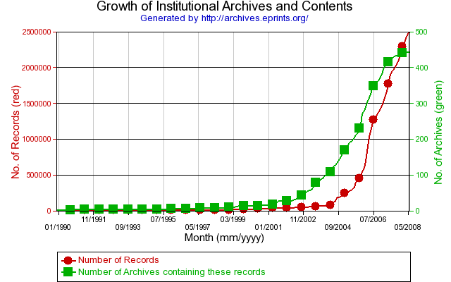
OpenAIRE participatory design
Building on existing repository infrastructure - DRIVER projects
Institutional repositories and deposited publications - growing over time
Cost of maintaining a central repository
  Institutional: 29K – 240K €
  ArXiv: 285K → 355K €
Source: JISC report

Slide 8
OpenAIRE implements the OA pilot
Services to researchers to
  Deposit (FP7 funded) publications
  Refer published (FP7) OA/non-OA publications
  Access FP7 publications
  Ask questions: Helpdesk
Organizational support with toolkits (howto’s) to
  Researchers
  Institutional managers
  National Organizations
  Repository Managers (Guidelines)

Slide 9
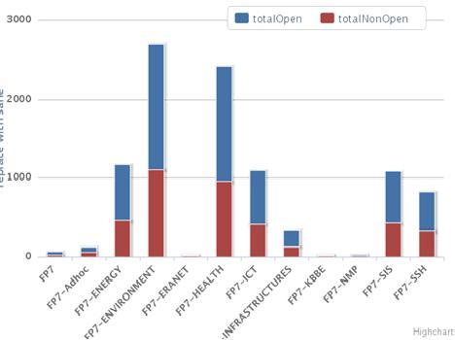
OpenAIRE measures the OA pilot
Document statistics for OA deposition
  % rate of OA deposition
  Research output of EC funding per
    FP7 programmes/projects
    FP7 scientific area
    Countries/institutions
    Flavors of Open Access
    ….

Slide 10
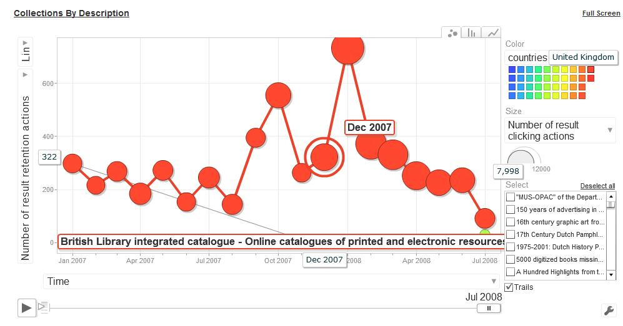
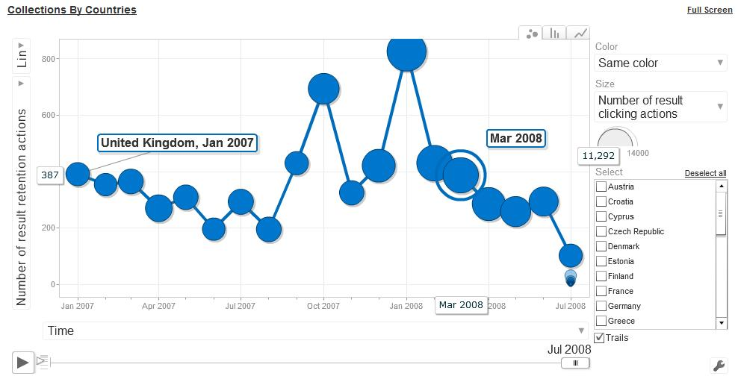
Repository Managers
Funders
Orphan
Researchers
view
download
rate
OA repositories
OpenAIRE measures research impact:
Harvests usage data from institutional repositories
Processes usage data to generate usage statistics

Slide 11
Measuring research impact of FP7 publications
Usage statistics on FP7 OA publications
Calculate research impact per
  Publication
  Programme/Project
  Scientific area
  Institution/Repository
  Country
  …

Slide 12
Impact Measurement - Metrics
# of national infrastructures on board
# of repositories that become compliant
  IRs of large research organizations
  Thematic vs. Institutional repositories
# of new repositories
# of identified (harvested) FP7 publications
# of depositions in the Orphan (OA & non-OA)
# of identified FP7 publications
  non OpenAIRE compliant repositories
  publishers

Slide 13
Some actual numbers
27 National infrastructures
Compliant repositories
  30 (Univ. of Minho Dspace addon)
  50-60 by the end of the year
125 identified (harvested) FP7 publications
  HAL independent project started in April 2009
0 publications in the “orphan”– not public yet
0 identified FP7 publications – not public yet
  Projected for OA pilot (20% of FP7) – 15K publications

Slide 14
Research impact - Metrics
Bibliometrics & webometrics
Set of usage metrics for publication impact
  Frequency-based metrics
  Time-based metrics
  Trend behaviour metrics
Metrics calculated wrt.
  FP7 programmes, projects, scientific areas
  Repositories, countries, institutions

Slide 15
OpenAIRE status
OpenAIRE is set to provide production quality 24x7 services
Helpdesk waiting to reply to your questions @ www.openaire.eu
Services and infrastructure go public in December
Important for all project coordinators to attend the OpenAIRE training session

