Slide 1


Implementing & measuring OA pilot
8th e-Infrastructure Concertation Meeting
CERN, Geneva
4-5 Nov, 2010
Natalia Manola
Department of Informatics & Telecommunications
University of Athens, Greece

Slide 2
OpenAIRE - factsheet
Programme: FP7 – Research Infrastructures
Starting date: December 1, 2009
Duration: 36 months
Budget: 4.1 Million
38 partners covering all European member-states
OpenAIRE services to be launched in Dec 2010

Slide 3
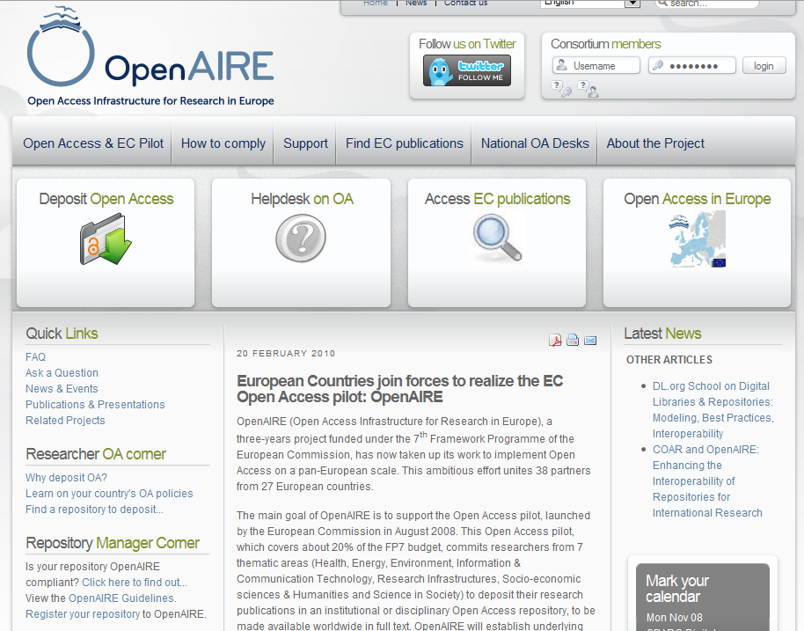
www.openaire.eu

Slide 4



OpenAIRE overview
Funders
Researchers
Orphan
FP7 Project Information
OA repositories
Links OA repositories with FP7 projects
Provides repository for “orphan” researchers
Calculates document statistics on OA deposition

Slide 5

Based on the network of OA repository infrastructure built during the DRIVER projects

Slide 6
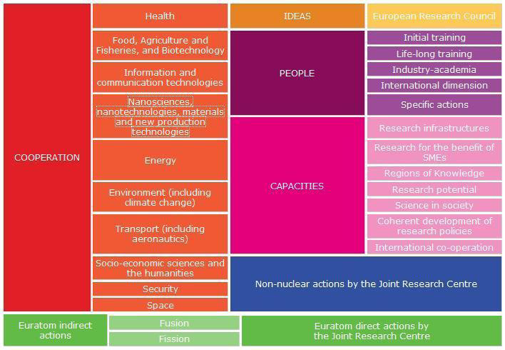
Close collaboration with the EC providing FP7 project information

Slide 7
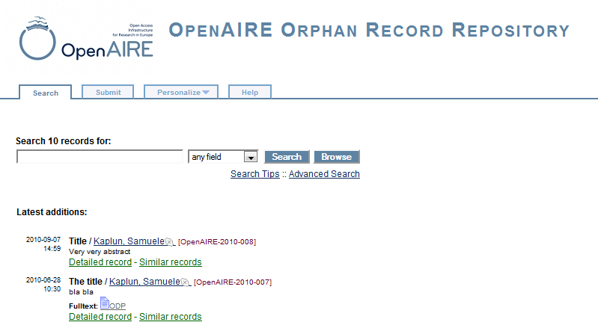
Provide repository for “orphan” researchers - no institutional or thematic repository
of reference
CERN- powered by Invenio

Slide 8
4-step deposition
Find your repository
Identify your project(s)
Upload publication(s)
Fill in metadata

Slide 9


Deposition in OA repositories
Researchers
Deposit only once policy!
Orphan
Repository
PUMA
HAL
CERN CDS
…
…
…
IR Repository
IR Repository
IR Repository
OpenAIRE compliant repository: maintains FP7 project information

Slide 10
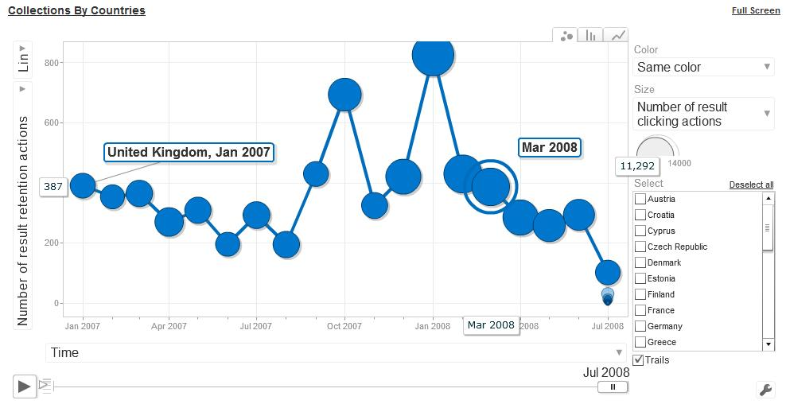
Research impact
Repository Managers
Funders
Orphan
Researchers
view
download
rate
OA repositories
OpenAIRE measures research impact:
Harvests usage data from institutional repositories
Processes usage data to generate usage statistics

Slide 11
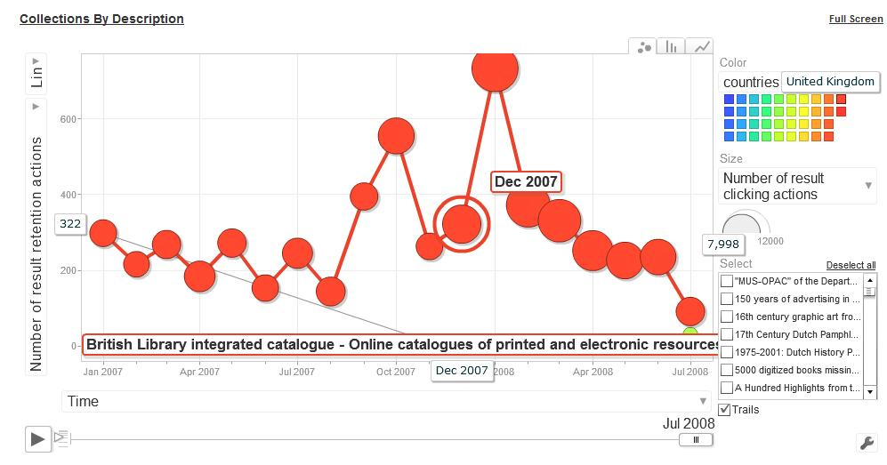
Usage statistics - example

