Slide 1
Design office meeting
2021-10-19
Raphael Vuillermet
2021/10/19

Slide 2
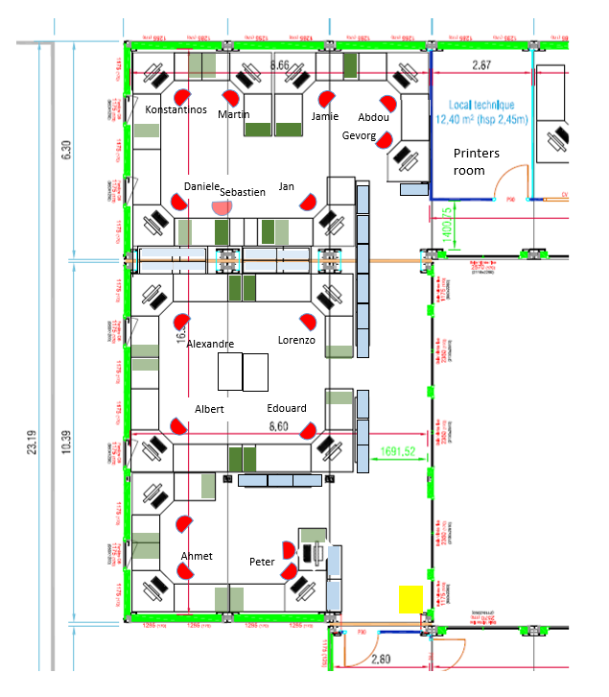
This year several new colleagues in the ATLAS design office
  Albert Davletov -> Muon access for BI project
  Daniele Benvenuti -> design of CO2 support frame and false floor reinforcement in USA15-CV
  Jan Brajer -> Integration of the CO2 system, (USA15-CV, ULX, Toroid)
  Martin Smetana -> integration of PP2 area
  Ahmet Renklioglu -> working on the BIR & BIM layout definition
  Abdou Seck -> working on SR1 the CO2 system with Martin Doubek
  Welcome to all of you

Slide 3
Reminder
Importance of well organizing and documenting the CAD database
  For easy and fast retrieval (whoever is looking for information)
  For future activities
  For future colleagues (ATLAS, CERN, Institutes)
  For the continuity of the projects (overall several years especially when upgrade time is coming)
  For future migration (PLM or CAD)
We should keep in mind that :
    ATLAS will be operating at least until 2035 and most probably longer …
    ATLAS decommissioning will take place much later … but punctually become earlier (SW) !
Leaving well structured model and project is part of our job

Slide 4
General information
The closing of the ATLAS detector is schedule for the end of January 2022.
  No access in the toroid and UX15 until the end of 2022.
  All information ( photo, scan, measurements, situations,…) shall be taken before to allow a smooth and productive work during the run.
  I invite you to make the point on each of your project and anticipate this closure
Work organization
  Edouard is in charge of the PC support activities
  Edouard is the CAD Local correspondent of the office
  Lorenzo agrees to be centralized the order for economa

