Slide 1



Design Office CAD Meeting
Tips & Tricks
E.Demeure
19/10/2021

Slide 2

CATIA Tips & Tricks – How to solve problems
“Listen to CATIA” by reading what it exactly needs – Bottom left of the screen
Visit CAD Support website (link available on the dashboard)
Use F1 key to open CATIA local help
Ask colleagues ☺
In case of emergency, call CAD Support at 160660
Don’t get stuck !

Slide 3

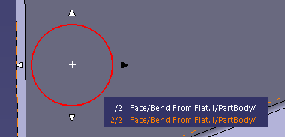
CATIA Tips & Tricks – Part & Product
F2 = Hide/show elements
  Exploring hidden space can be useful (“swap visible space” button)
  When studying on some big models, swapping the visible space twice helps a lot and make CATIA more fluid
F3 = Hide/show the tree
  You can also modify its size by using CTRL + mouse wheel up/down (the size/position of the tree is saved with the part)
  You can also move it by grabbing it by the vertical white lines (when the pointer shows the hand)
Compass tricks
  Right click on the compass -> Edit -> To modify translation & rotations increments when moving a part
  When pressing SHIFT key, you can move a part according to the constrains it has
Select a hidden face
  ALT + left click (or just arrow up/down) allows you to select a hidden face behind your pointer

Slide 4
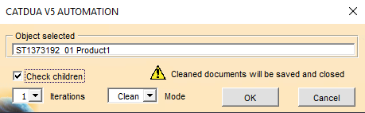
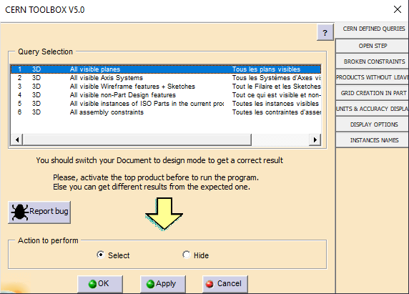
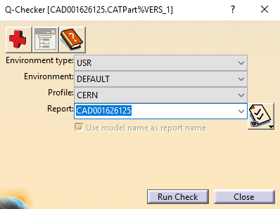
CATIA Tips & Tricks – Part & Product
Model update
  SmarTeam menu -> Collaboration -> Global update
Dimensions in sketches
  Lock the dimensions positioning with CTRL key
  Avoid the default locking with SHIFT key
CERN specific tools
  CATDUAV5
  Q-Checker
  Toolbox
  Tracepart

Slide 5
CATIA Tips & Tricks – Part & Product
3D Previews
  Very fast to open
  Limited interaction with the model
  It can be copy/paste in an assembly but cannot be save
Design mode
  Useful on small assemblies to move from CGR to real file
Capture
  Better image quality than windows print screen

Slide 6


CATIA Tips & Tricks – Drawing
Dimensions
  You can copy/paste dimensions from one view to another, CATIA will keep the link
  Press CTRL key before positioning the dimension to catch the yellow dots to change the anchor of the dimension
Hide/show the frames of the views
  Click this button to hide/show the frames to have a better overview of the drawing
  When frames are shown, double-click on it to activate the view (mandatory to attach text notes properly, or to make a specific child view etc…)
Axis
  Press CTRL key when grabbing the white dot of an axis to extend only one side
Bill of material
  CATIA cannot make an automatic link between bubbles numbers and the bill of material
Coordinates table
  You can show the coordinates of some points regarding the axis system of the part/product. Be careful, this is not associative !
Surface color
  It is possible to change the default pattern inside a surface

Slide 7
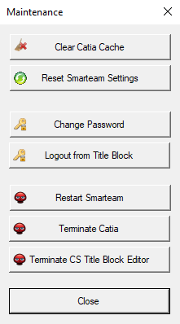

SmarTeam Tips & Tricks
Basic rules = Check in + Put team + Work in USER project
  Team by default = last team used
“Overwrite” instead of “Keep” if no need
Clear CATIA cache + Clean Work

Slide 8

About ARAS
To be deployed in 2022
Interface is on internet browser – Accessible from everywhere
1st phase : user tests → done
2nd phase : pilot projects started Q3 2021
Not very different than SmarTeam ; it uses different terminology

