Slide 2
PicoTDC update and plans
PicoTDC Users Meeting 09.11.2021
David Porret – CERN – EP-ESE-ME

Slide 3
Status : new package development
Mid 2020 contract awarded to the packaging company
Fall 2020 packaging design (device power dissipation, SI simulations, layout iterations …)
January 2021 final design approval
Winter 2021 purchase of test contactors for production test
October 2021:
  prototyping batch received (target quantity 1337 – received 1312 )
  start of test and characterization with the new package
First tests showed that the new package matches the design (no open or short), all functionalities are working.
Complete performances tests are in still progress but so far it is comparable or better to what has been measured before.
A picoTDC part has been added to the CERN Altium Library (based on the draft version distributed by me to some of you).

Slide 4
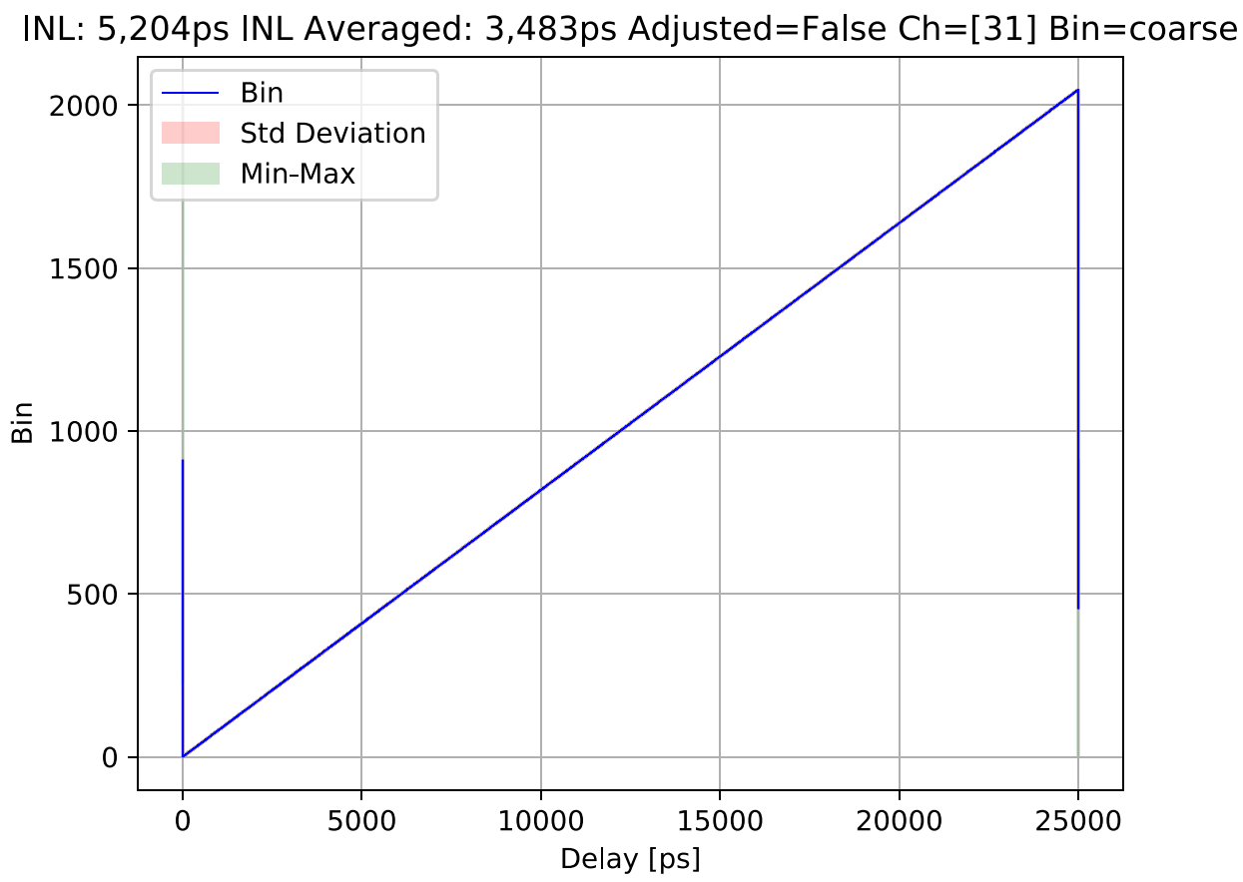
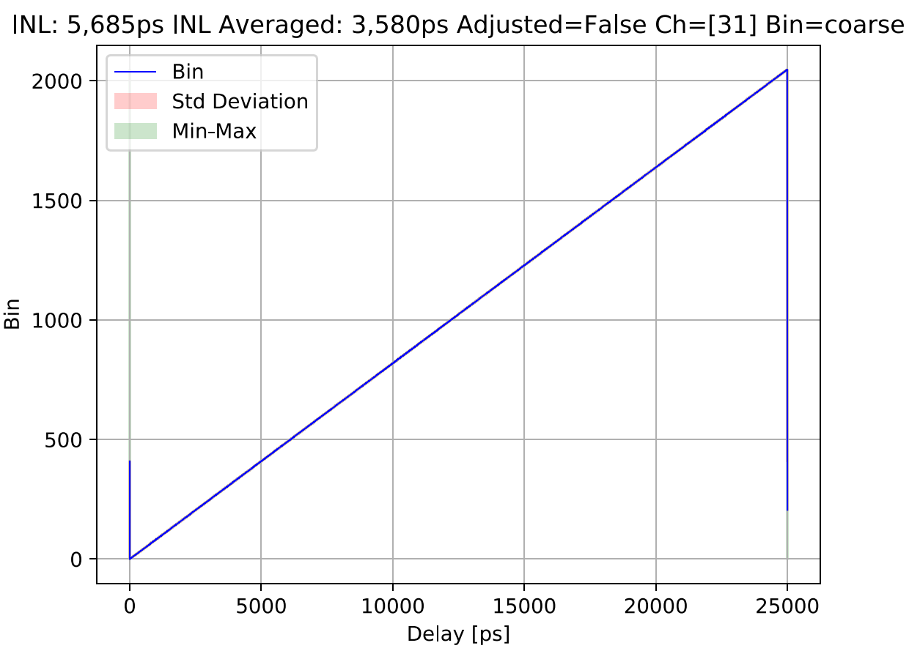
Package comparison
Generic
New

Slide 5
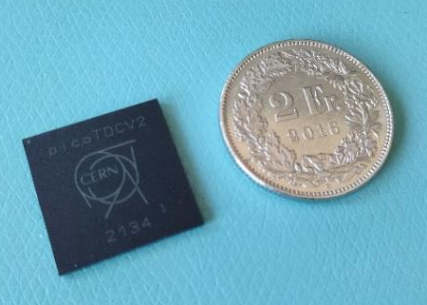
Package details
BGA 21x21 mm
1.7 mm height
1 mm ball pitch

Slide 6
Plans: production test
All packaged devices have to be individually tested.
Testing based on mixed functional / performance tests.
The test is running on a dedicated test system (actually waiting for the assembled board to finish software development).
Production test plan at CERN for 2022-Q1
Partially / Fully tested samples can be supplied for your prototypes from now.

Slide 7
Plans : new demo board
Re-shuffling of the actual board (EDA-04186-V1):
  fit the new package (direct mounting or test socket)
  bugs correction
  same form factor
  modified firmware (new pin mapping on FMC)
Prototype validated
Will be pushed to CERN design office for production (small add-ons can be still discussed).

Slide 8
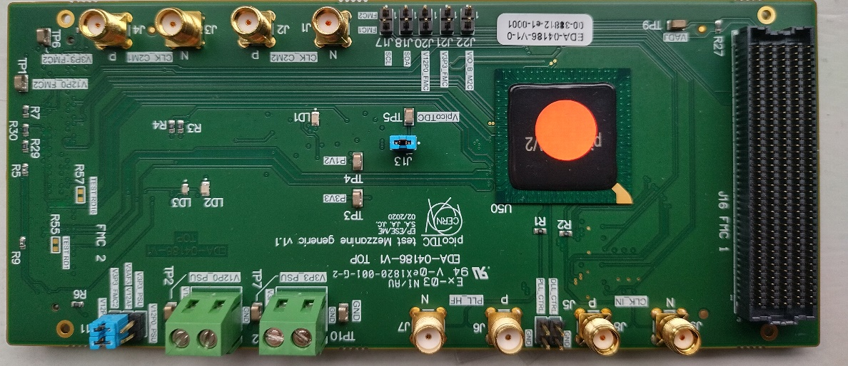
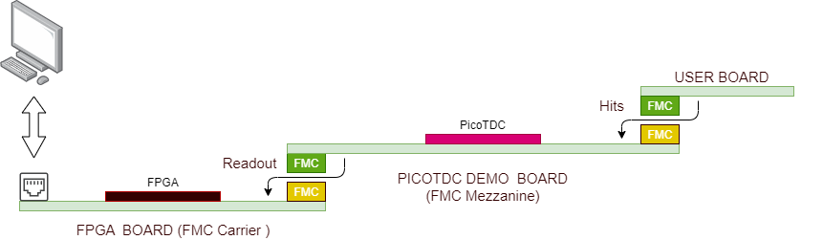
New demo board - Overview

Slide 9
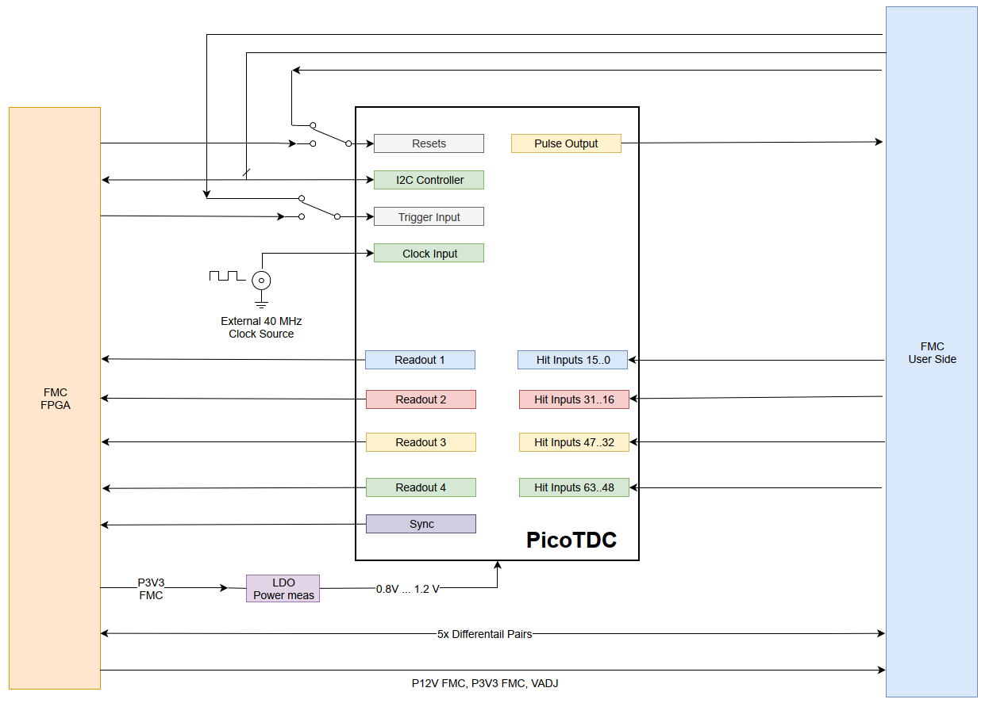
New demo board - Diagram

Slide 10
FMC Carrier board requirements
  1 FMC header for control and readout
  With at least La bus (34 pairs), Ha bus required just for the 4th readout port.
  FPGA banks with 1.2V support (i.e. Xilinx 7 series).
  Adjustable VADJ voltage down to 1.2V

Slide 11
«probably» compatible FPGA boards
Non exhaustive
Type | Vendor | FPGA | FMC | Price (USD) | PicoTDC Readout
VC707 (*) | Xilinx | Virtex-7 | 1x HPC 1x LPC | 4300 | 1-2-3-4
ZCU104 | Xilinx | Zynq UltraScale+ | 1x LPC | 1300 | 1-2-3
Genesys Zu | Digilent | Zynq UltraSscale | 1x LPC | 1150 | 1-2-3
Nexys Video(**) | Digilent | Artix-7 | 1x LPC | 480 | 1-2-3
Genesys2 (**) | Digilent | Kintex-7 | 1x HPC | 1000 | 1-2-3-4
* Used by PicoTDC project
** La Bus not on HP Bank – pseudo differential only

