Slide 1
Coil 101 cross section analysis and feedback for 2nd generation coils
Susana Izquierdo Bermudez
Images from Ana Teresa Perez Fontenla (CERN EN-MME)

Slide 2
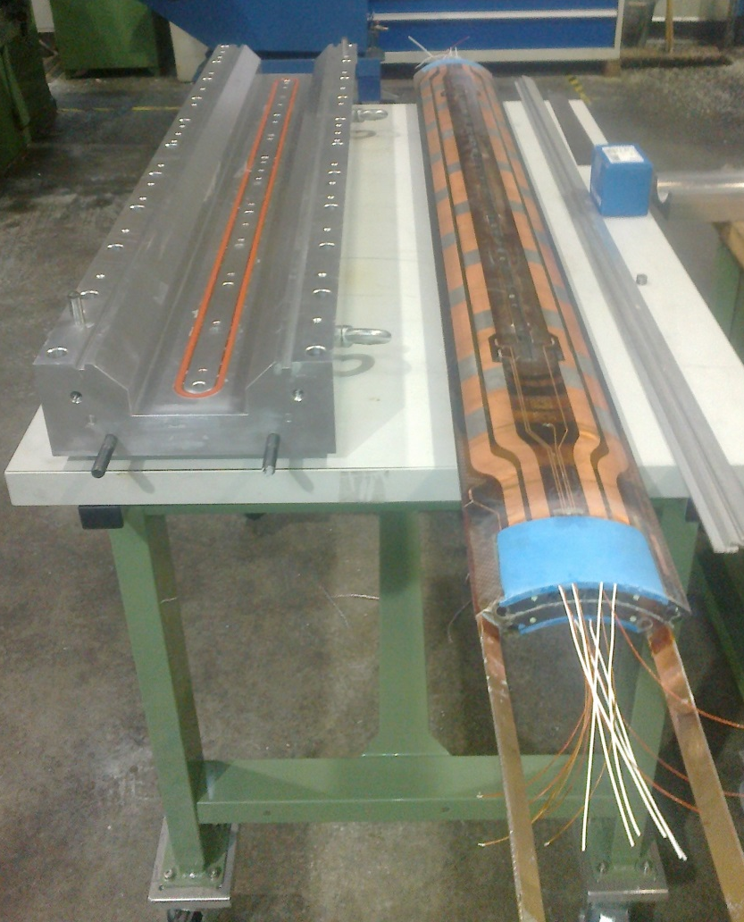
Coil 101: Overview
CERN practice coil
Conductor: Low grade Nb3Sn. RRP 132/169
Reacted three times to optimize oven parameters:
  First full heat treatment
  2nd heat treatment done with short plateaus
  3rd heat treatment done only with first plateau
Longitudinal contraction after winding (release of the winding tension) . Δl_{W} = 1.5 mm
Longitudinal contraction after heat treatment: Δl_{HT} = 0.4 mm

Slide 3
Cable dimensions
 |  | Cable before reaction | Cable after reaction (2.0 % growth in width, 4.5 % growth in thickness) | Δ
Bare width | mm | 18.150 | 18.513 | 0.363
Bare thickness in | mm | 1.438 | 1.505 | 0.067
Bare thickness out | mm | 1.612 | 1.682 | 0.070
Bare mid-thickness | mm | 1.525 | 1.594 | 0.069
Keystone angle |  | 0.550 | 0.550 | 0.000
According to the studied cross section:
4.5 % growth in thickness seems to be a good assumption
2.0 % in width seems to overestimate the growth in width

Slide 4
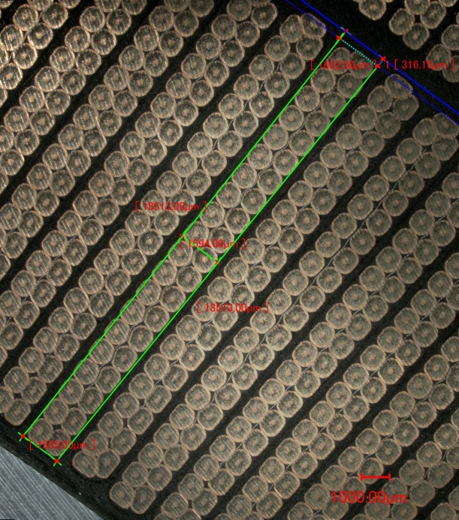
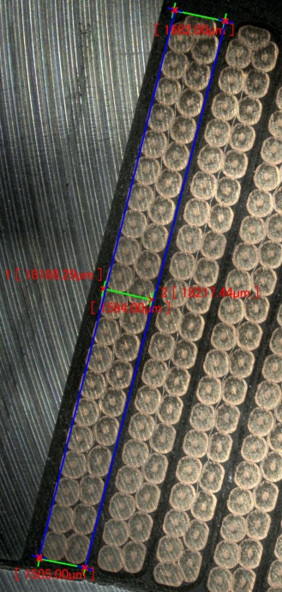
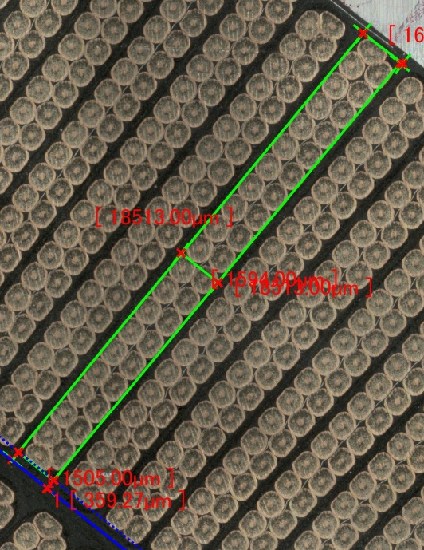
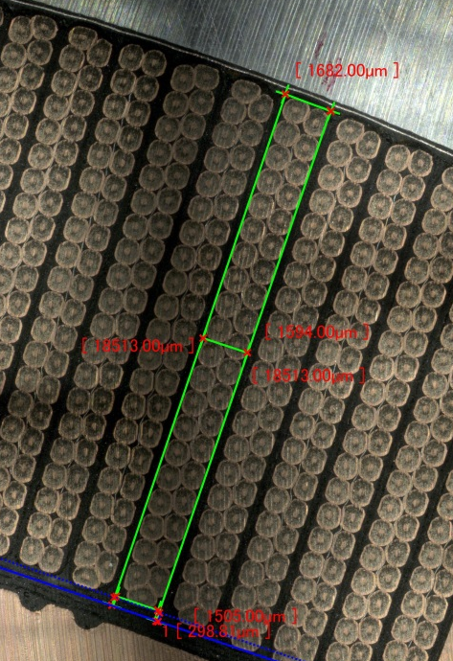
Cable growth - width
Turn 9
Turn 22
Turn 30
Turn 44
 |  | Turn 9 | Turn 22 | Turn 30 | Turn 44
Expected growth | % | 2
Expected growth | µm | 363
Measured growth | % | 0.26 | 0.28 | 0.02 | 0.35
Measured growth | µ | 47 | 50 | 4 | 64

Slide 5
Cable dimensions for the 2nd iteration
Based on this analysis, our suggestion for the second iteration cable is:
1st ITERATION CABLE |  | Cable before reaction | Cable after reaction (2.0 % growth in width, 4.5 % growth in thickness) | Δ
Bare width | mm | 18.150 | 18.513 | 0.363
Bare thickness in | mm | 1.438 | 1.505 | 0.067
Bare thickness out | mm | 1.612 | 1.682 | 0.070
Bare mid-thickness | mm | 1.525 | 1.594 | 0.069
Keystone angle |  | 0.550 | 0.550 | 0.000
2nd ITERATION CABLE |  | Cable before reaction | Cable after reaction (1.17 % growth in width, 4.5 % growth in thickness) | Δ
Bare width | mm | 18.150 | 18.363 | 0.213
Bare thickness in | mm | 1.462 | 1.530 | 0.068
Bare thickness out | mm | 1.588 | 1.658 | 0.069
Bare mid-thickness | mm | 1.525 | 1.594 | 0.069
Keystone angle |  | 0.400 | 0.400 | 0.000
Consequence: 150 µm to be compensated radially in the tooling.

Slide 6
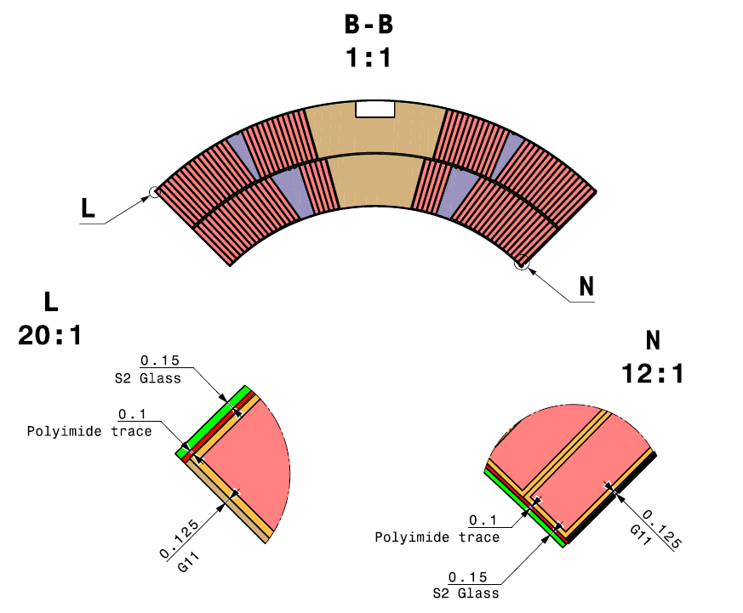
Radial compensation
We can compensate for the differences in cable width, keeping the same tooling and coil inner/outer diameters:
Outer radius:
150 µm S2 Glass →
2 x 150 = 300 µm S2 Glass
Inter layer:
500 µm S2 Glass
→ 650 µm S2 Glass

Slide 7
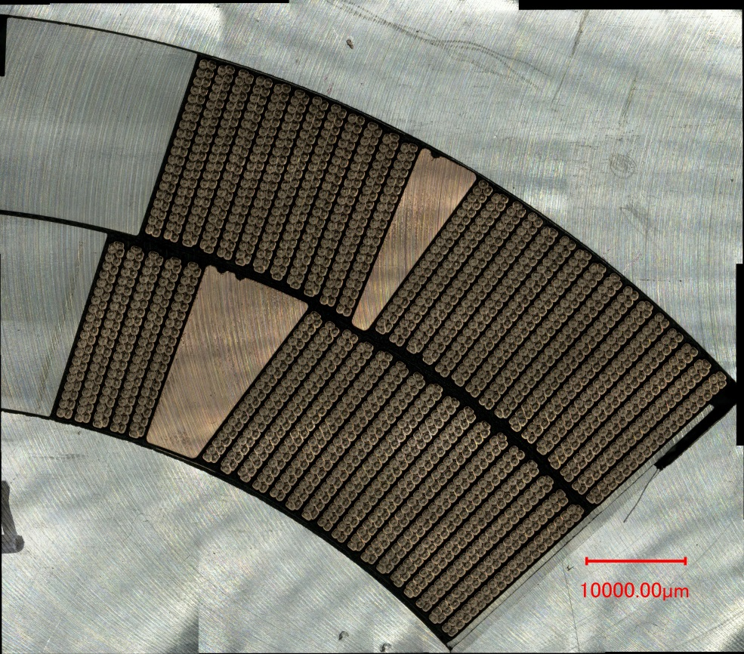
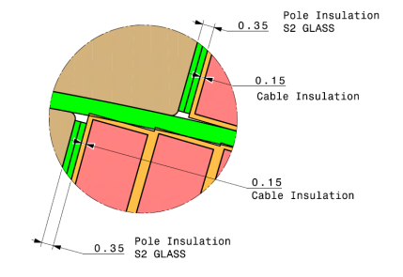
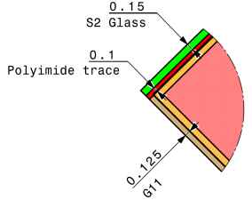
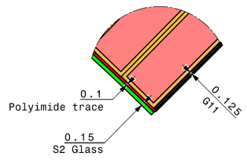
Coil insulation
3
# |  | Nominal (µm) | Measured (µm) | Δ (µm)
1 | IL IR pole | 250 | 200 | -50
2 | IL OL pole | 500 | 460 | -40
3 | OL OR pole | 250 | 250 | 0
4 | IL PT | 500 | 445 | -55
5 | OL PT | 500 | 480 | -20
6 | MP IL | 275 | 290 | 15
7 | MP OL | 275 | 260 | -15
8 | IL IR MP | 400 | 900 | 500
9 | IL OL MP | 800 | 930 | 130
10 | OL OR MP | 400 | 350-590
5
2
A
4
B
10
1
9
7
6
8
C
A
B
C

Slide 8
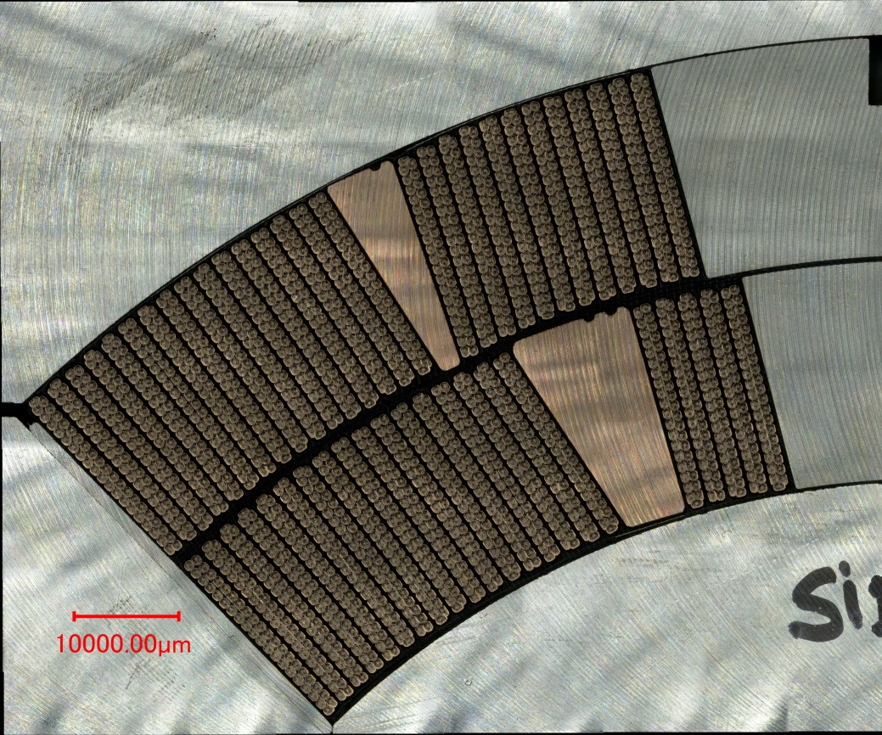
Coil – Some observations
We have about 600 µm of “free radial space”, that seems to be taken by the inter-layer insulation in the pole, and by the inner radius in the mid-plane.

Slide 9
Roxie non-insulated conductors

Slide 10
Block 1

Slide 11
Block 2

Slide 12
Block 3

Slide 13
Block 4

Slide 15
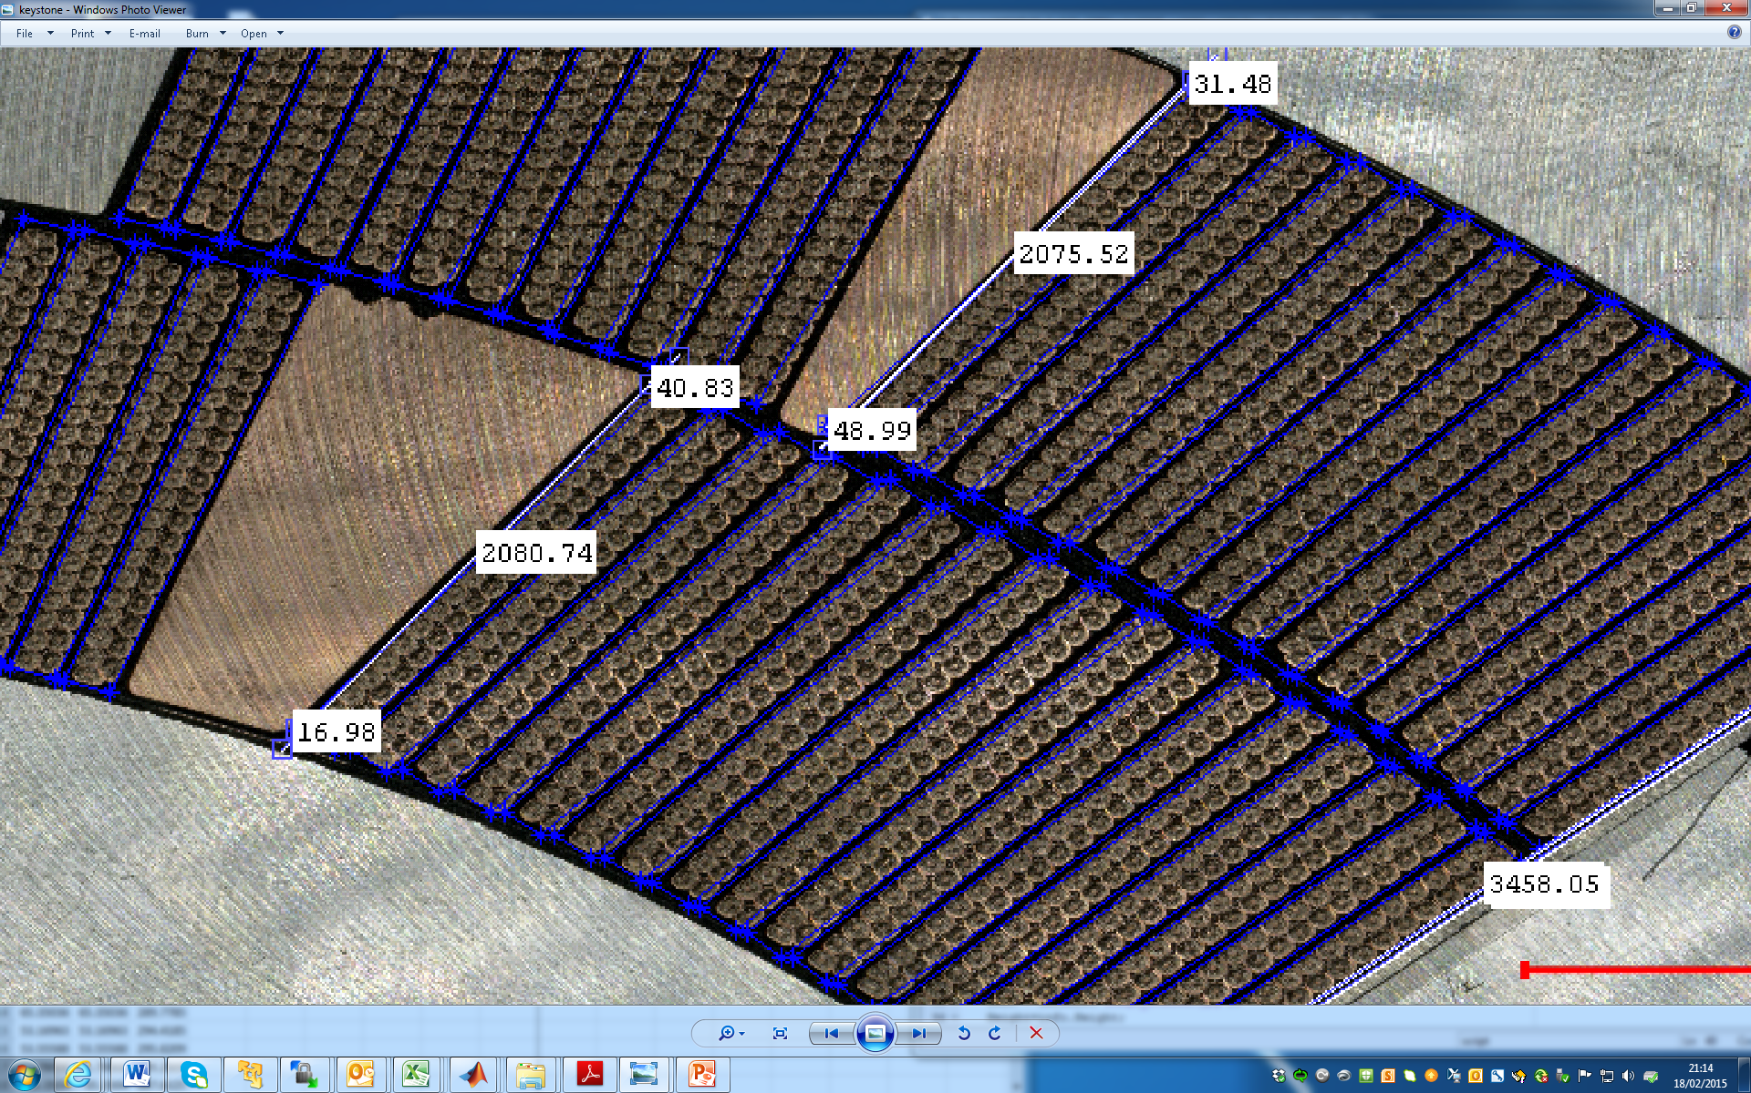
Keystone angle
Keystone evaluation
Inner layer, bock 1
(17 conductors):
  -170 µm thin edge
  (-10 µm/cond.)
  +410 µm thick edge
  (+25 µm/cond.)
Outer layer, bock 3
(16 conductors):
  -490 µm thin edge
  (-30 µm/cond.)
  +320 µm thick edge
  (+20 µm/cond.)

Slide 16
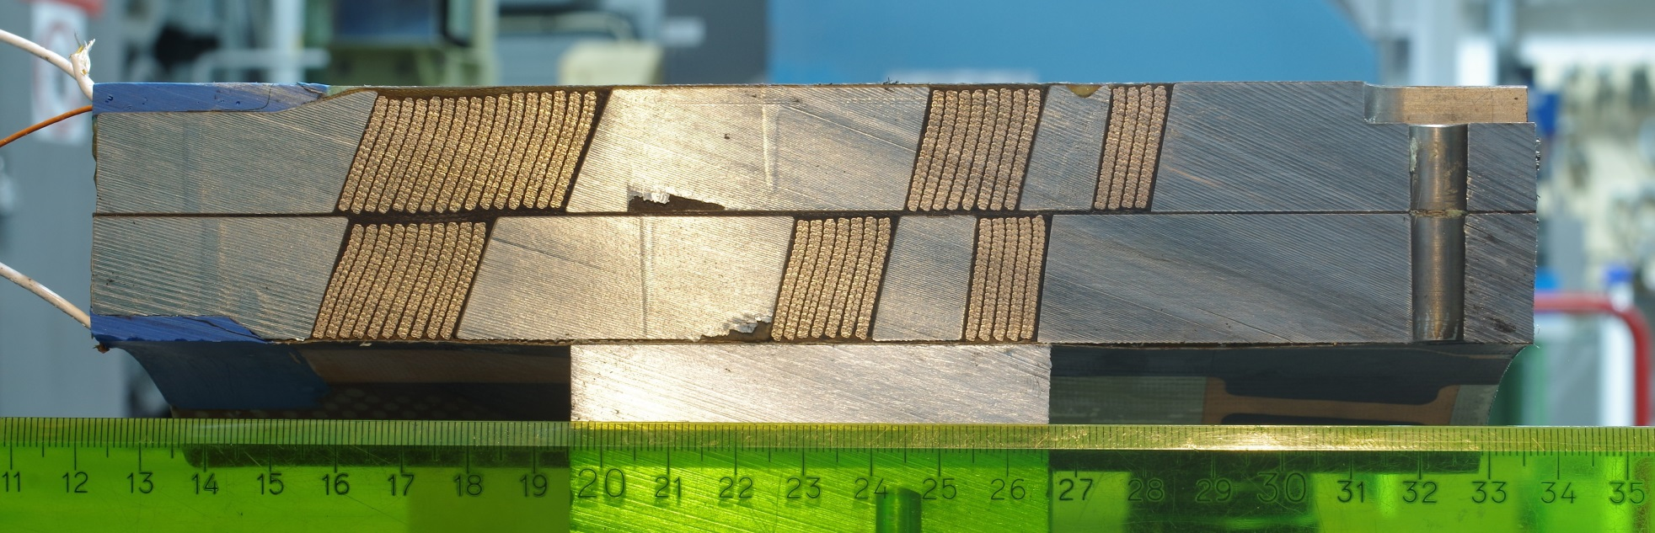
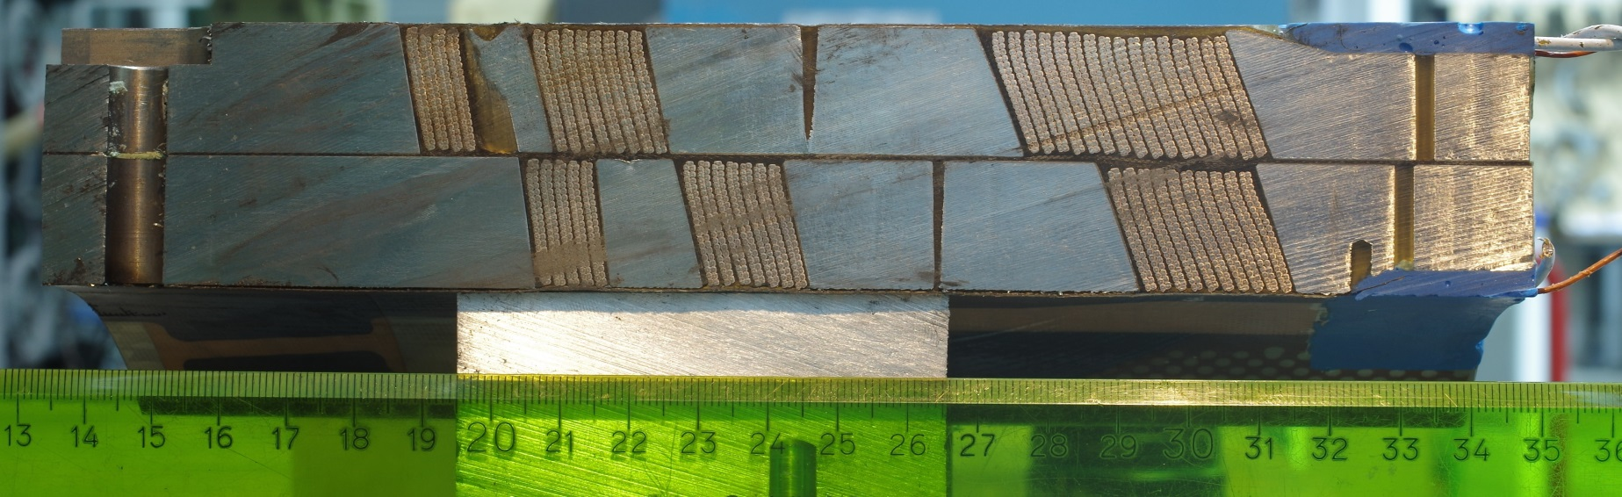
Ends: Return

Slide 17
Return end: Comparison CERN-ROXIE

Slide 18
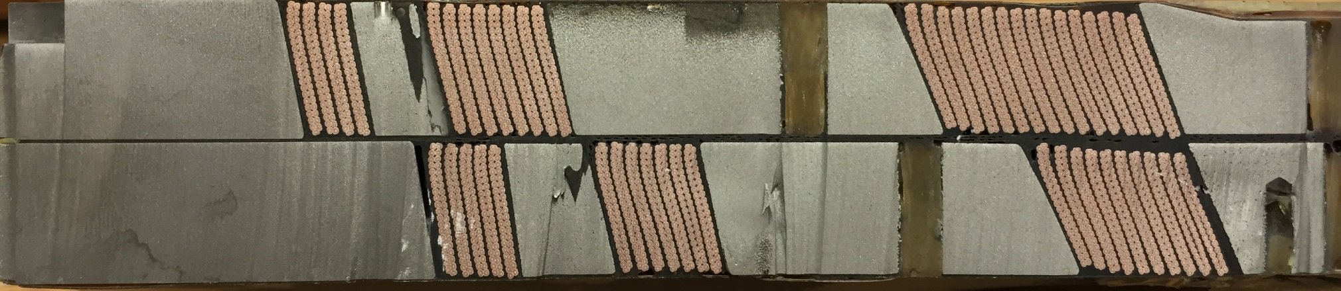
Return end: Comparison CERN-LARP
CERN
CERN
LARP

Slide 19
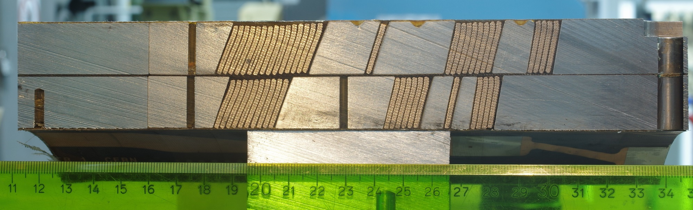
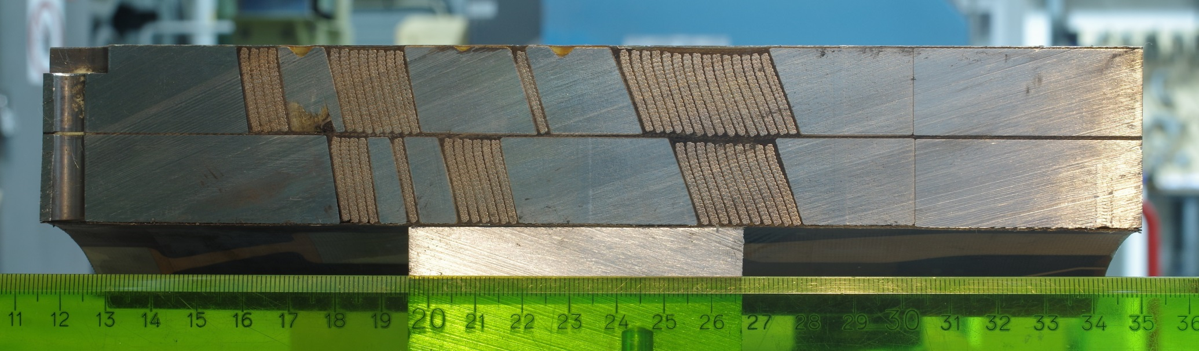
Ends: Lead

Slide 20
Lead End

Slide 21
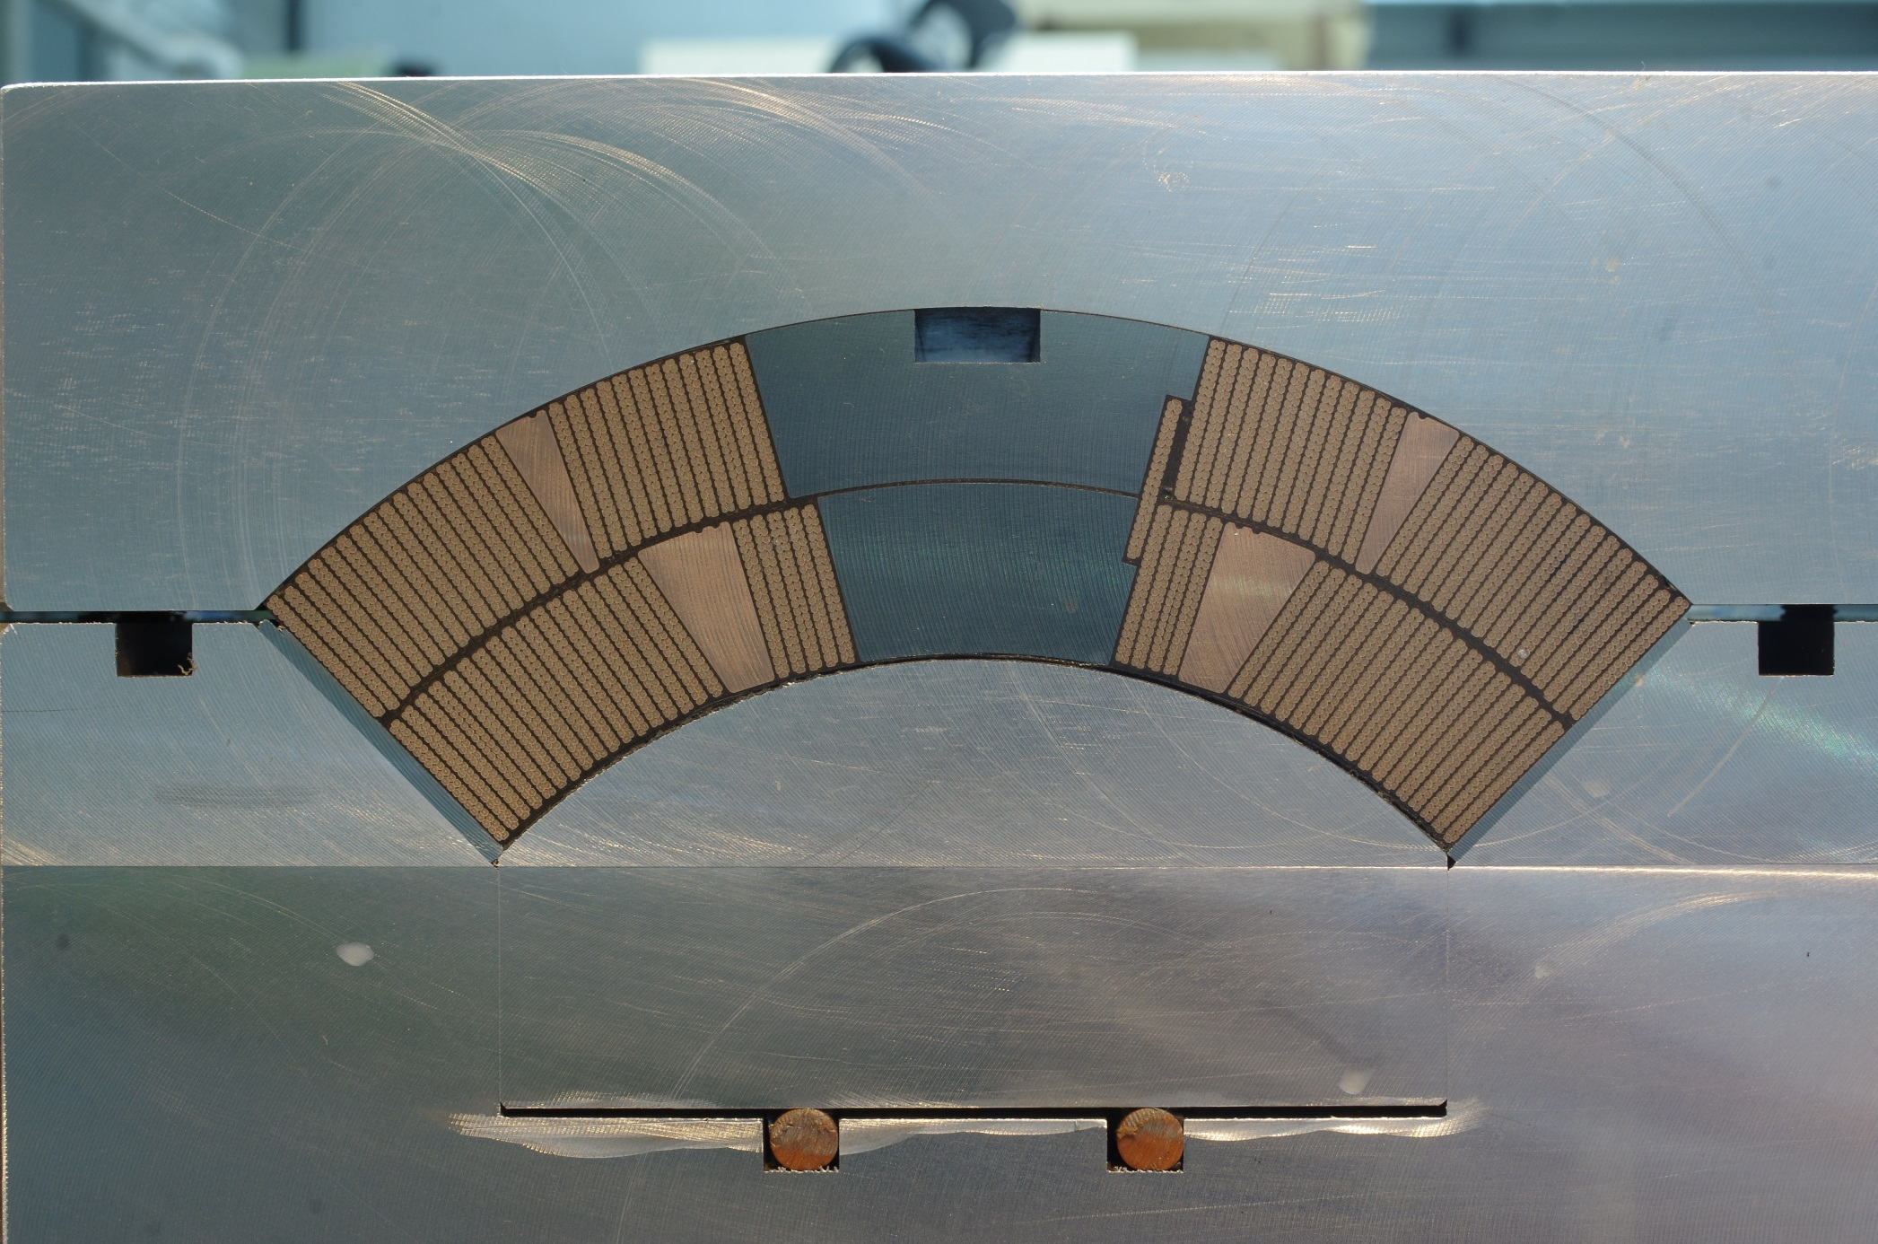
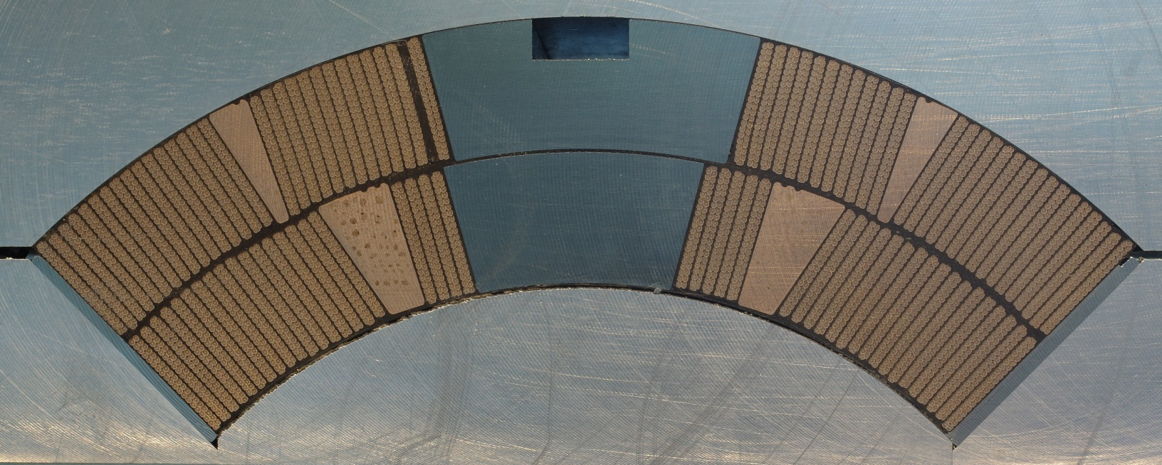
Layer jump

Slide 22
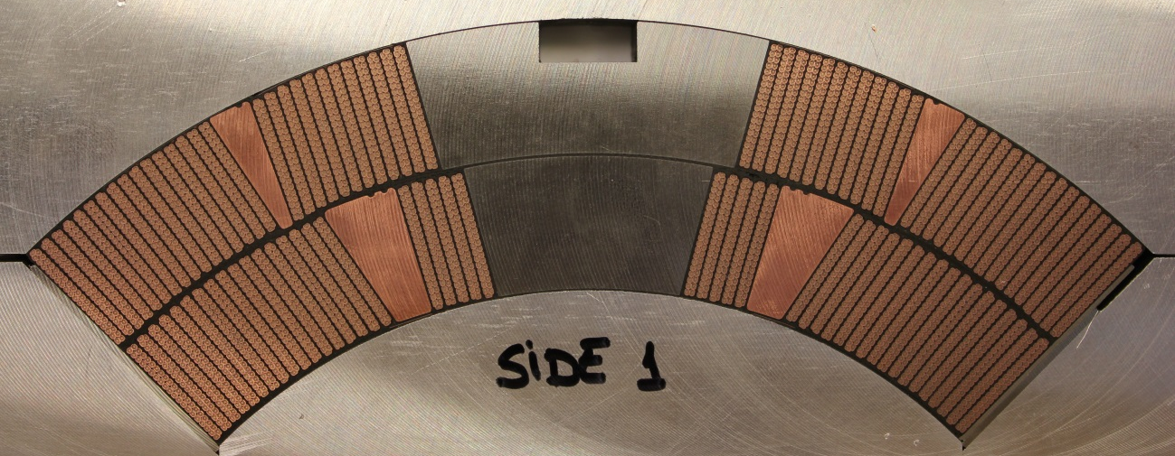
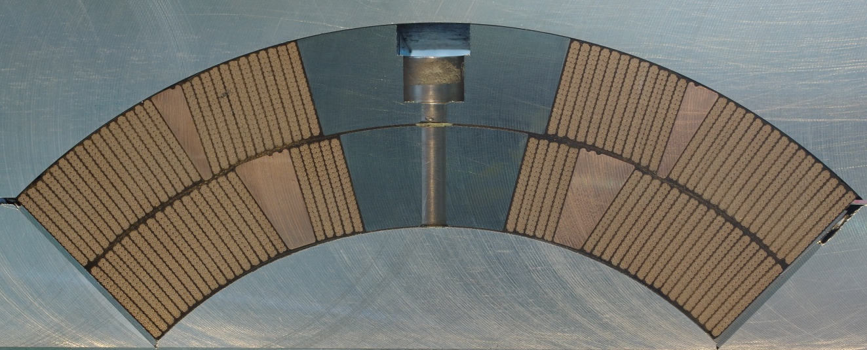
Additional studies…
For the moment, we only looked at one coil cross section:
To have more statistics we will look at:
CERN: coil 101, different cross section
LARP coil

Slide 23
2nd Coil Cross Section Assumptions/Considerations/Guidelines
Cable
  Keystone 0.55→ 0.40
  Growth in width 2.00 % → 1.17 %
Cable insulation
  150 µm, with the possibility to go for 145 µm if needed
Coil insulation
  Inter layer thickness 500 µm → 650 µm
  Outer radius S2 glass 150 µm → 300 µm
Gradient = 130 T/m at 7 TeV
Field quality:
  b6 = 2 units at 6.5 TeV
  Possibility to add/remove 125 µm shim thickness from the mid-plane and pole for fine tuning field quality during production
    Pole insulation:
      OPTION 1: 2x175 µm → 4 x 125 µm (pole-turn insulation 375-500-625 µm)
      OPTION 2:2x175 µm → 3 x 125 µm (pole-turn insulation 250-375-500 µm)
    Mid-plane shim: 125 µm → 250 µm
  The thin edge of the outer layer wedge should not be smaller than the one for the first cross section
  Same concept for the layer jump.

Slide 24
Additional slides

Slide 25
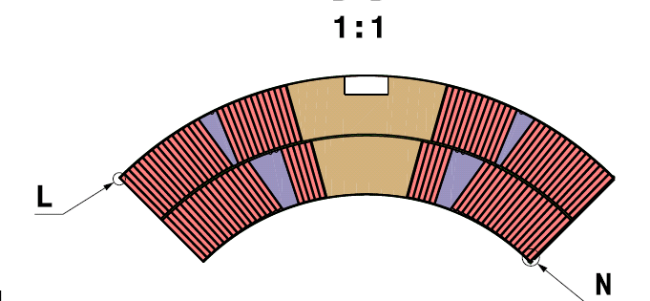
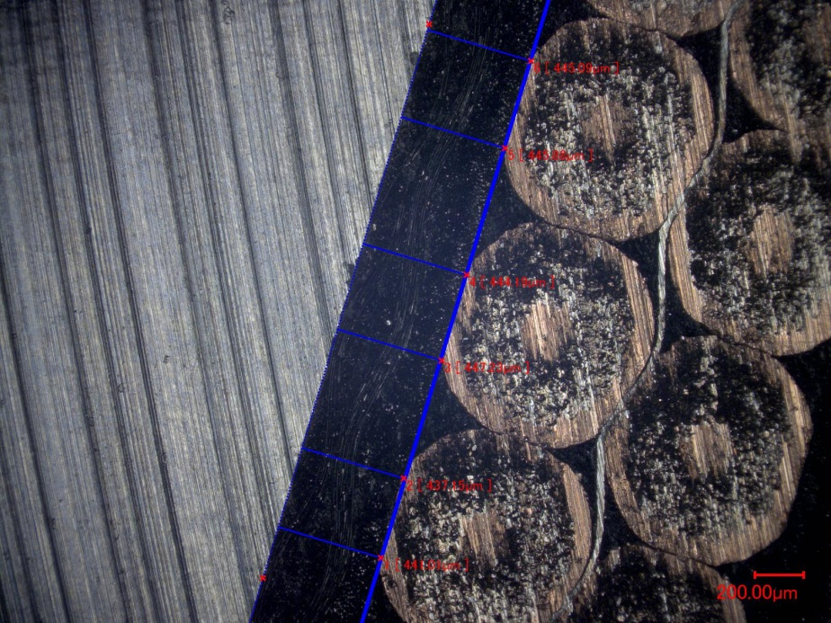
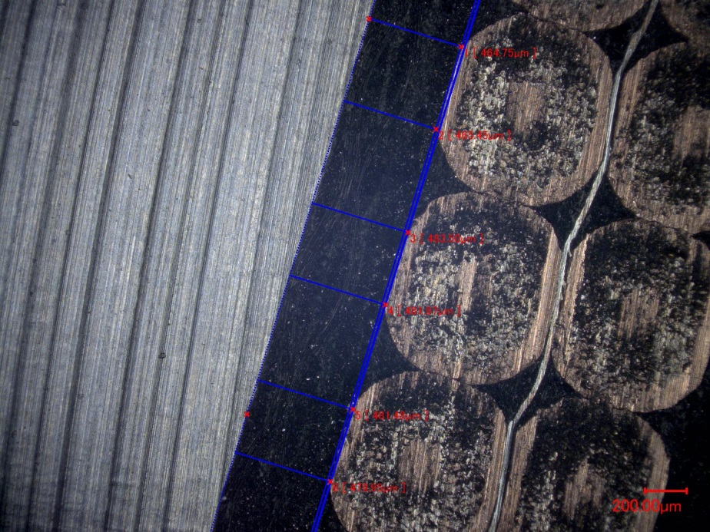
Inner layer, pole turn,
turn2pole
Outer layer, pole turn,
turn2pole

Slide 26
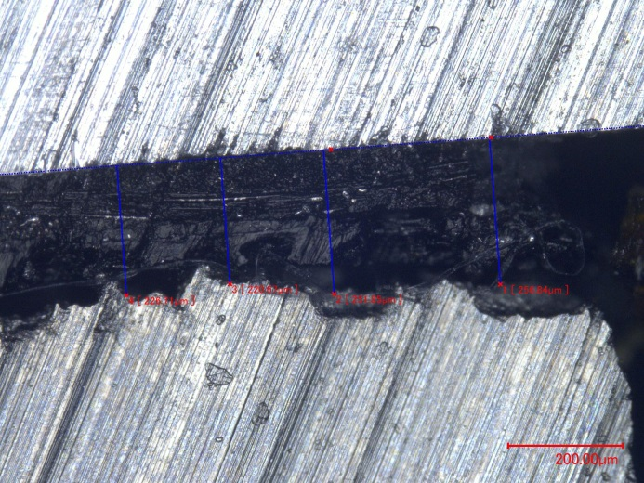
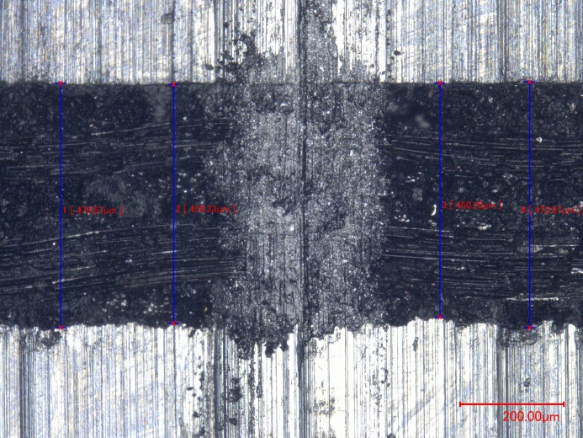
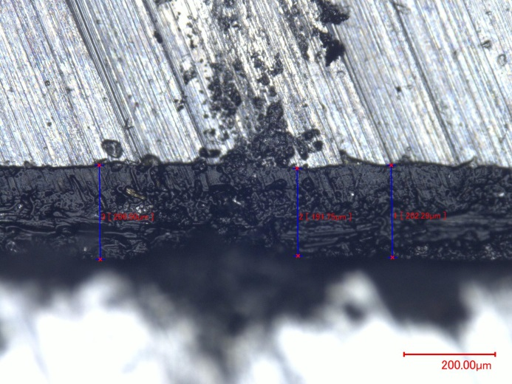

Slide 27
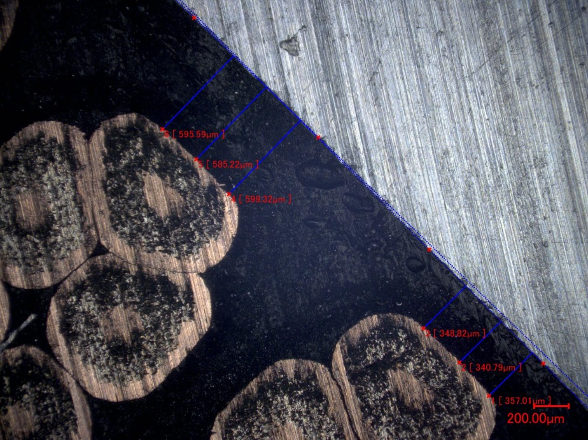
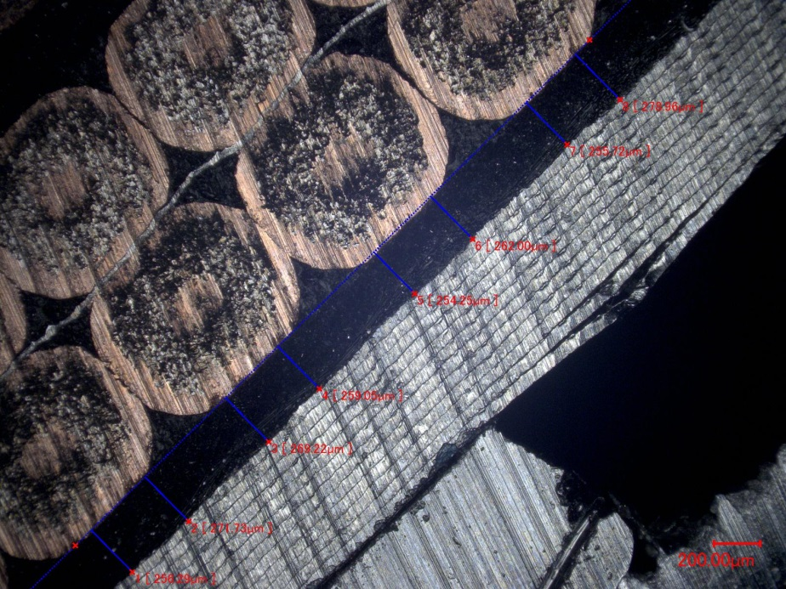
Outer layer,
pole turn,
Turn2outer D
Outer layer,
pole turn,
Turn 2 midplane

Slide 28
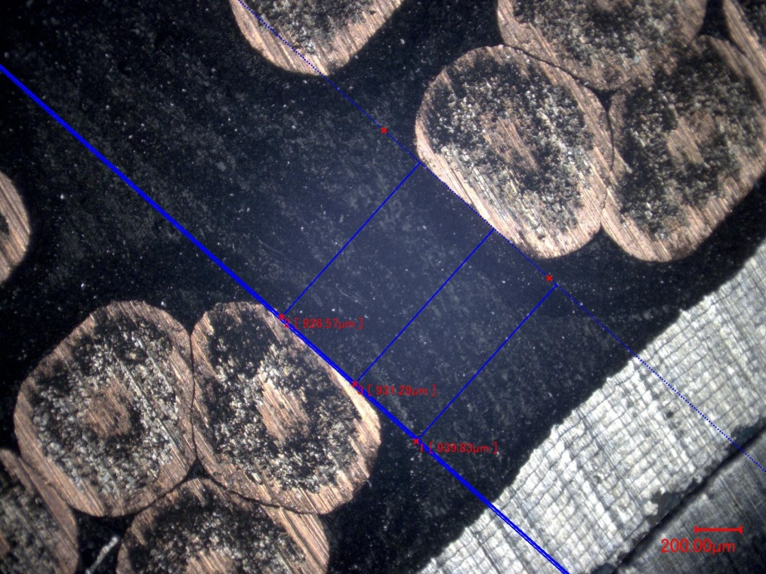
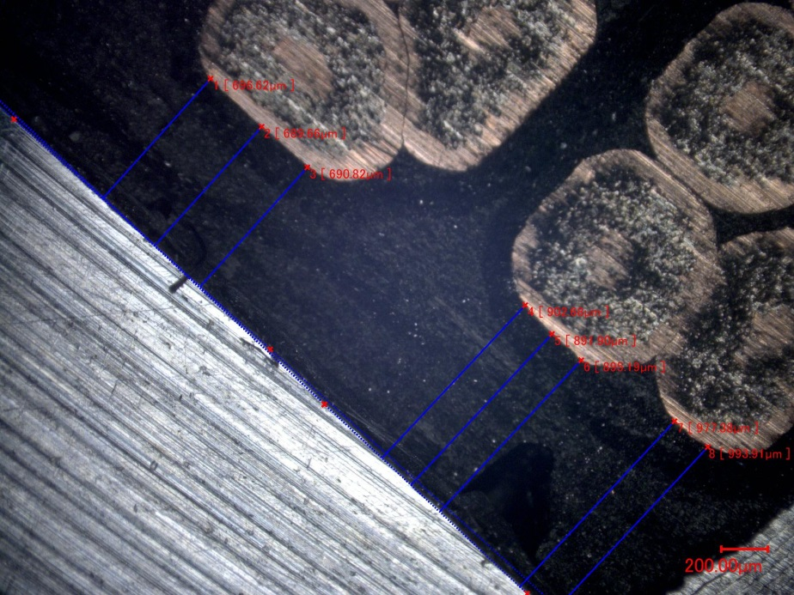
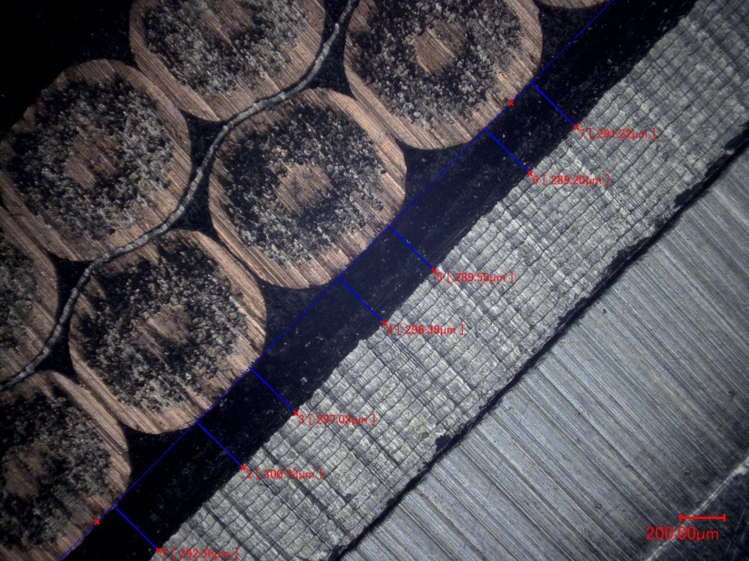

Slide 29
Left side of the cross section has also been studied, but we have a problem in the scale of the image that needs to be cross-checked
Mid-plane alignment
Pole alignment

Slide 30
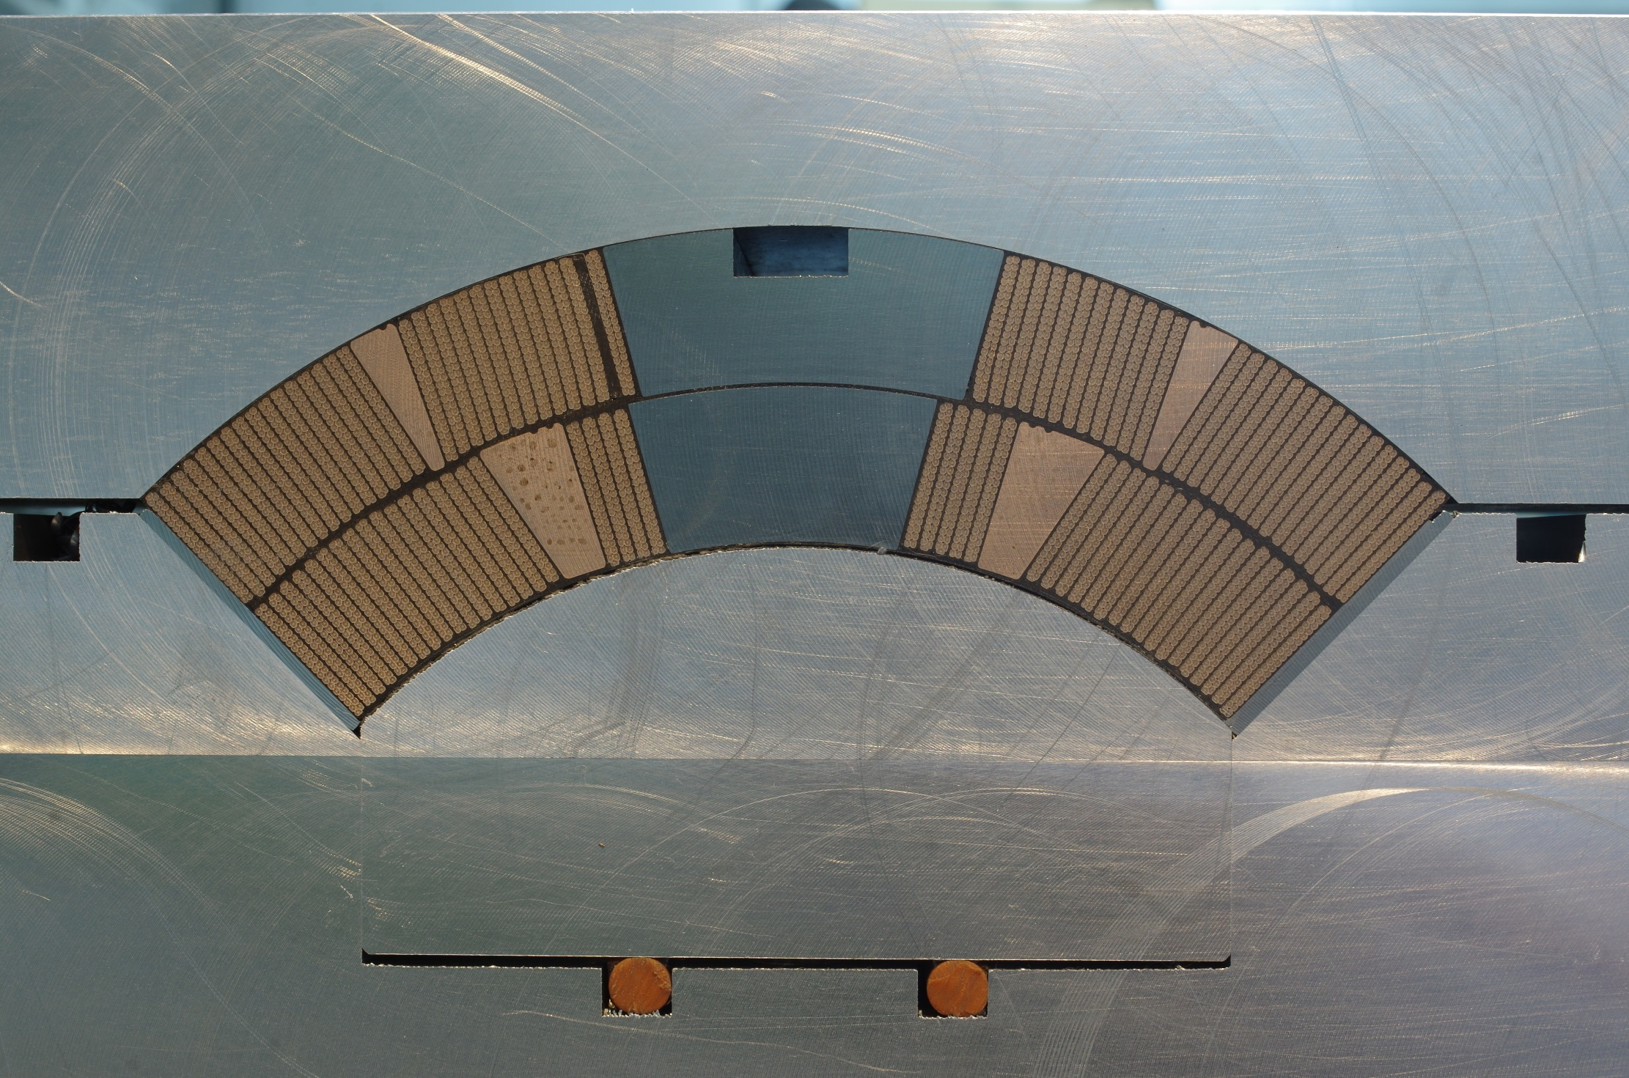

Slide 32
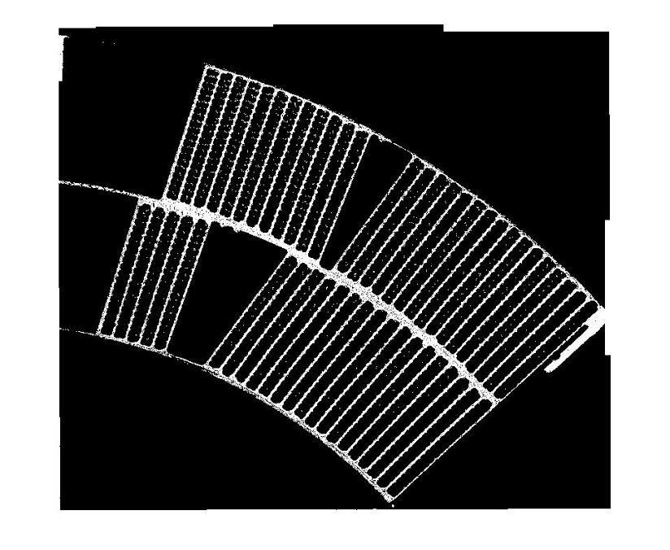
Characterization of insulation thickness layers on-going

Slide 33
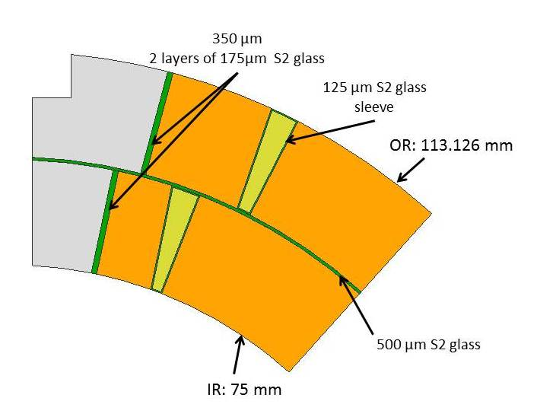
Insulation layers
Wedge:
  S2 ??TEX-??? Sleeve 0.125 mm thickness
Coil Inter-Layer:
  2 x S2 66TEX-933
  (250 mm width, 0.250 mm thickness)
Splice box Inter-Layer:
  3? x S2 33TEX–493 (is it supposed to be better for impregnation if it is not reacted?)
  (250 mm width, 0.250 mm thickness)
Pole:
  2 x S2 33TEX–493 → 66TEX-933?
  (19 mm width, 0.175 mm thickness)
  4 or 5 x S2 33TEX–493 → 66TEX-933?
  (19 mm width, 0.100 mm thickness)
  4 x S2 33TEX–493 → 66TEX-933?
  (19 mm width, 0.125 mm thickness)
Interface spacers-conductor:
  1 x S2 33TEX–493 → 66TEX-933?
  (19→25 mm width, 0.175 mm thickness)
Additional orders
Can we change?
To be cross-checked
933 → Thermally stable inorganic sizing
493 → Sizing compatible with epoxies or polyesters (slightly darker after reaction)

Slide 34
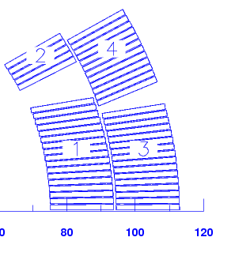
Coil shimming
Flexibility to add/remove ~ 100 µm shim with no impact on coil compaction
How to do it?
Mid-plane:
  1st Generation: 0.125 mm G11 in the mid-plane
  2nd Generation: 2x0.125 mm G11 in the mid-plane?
Pole: modify insulation layout around the pole
  1st Generation: 2 x 0.175 mm.
  2nd Generation: 3 x 0.125 mm?
    In case we remove one layer, we will have a pole insulation thickness of 0.250 mm. Is it enough?

